Slide 1
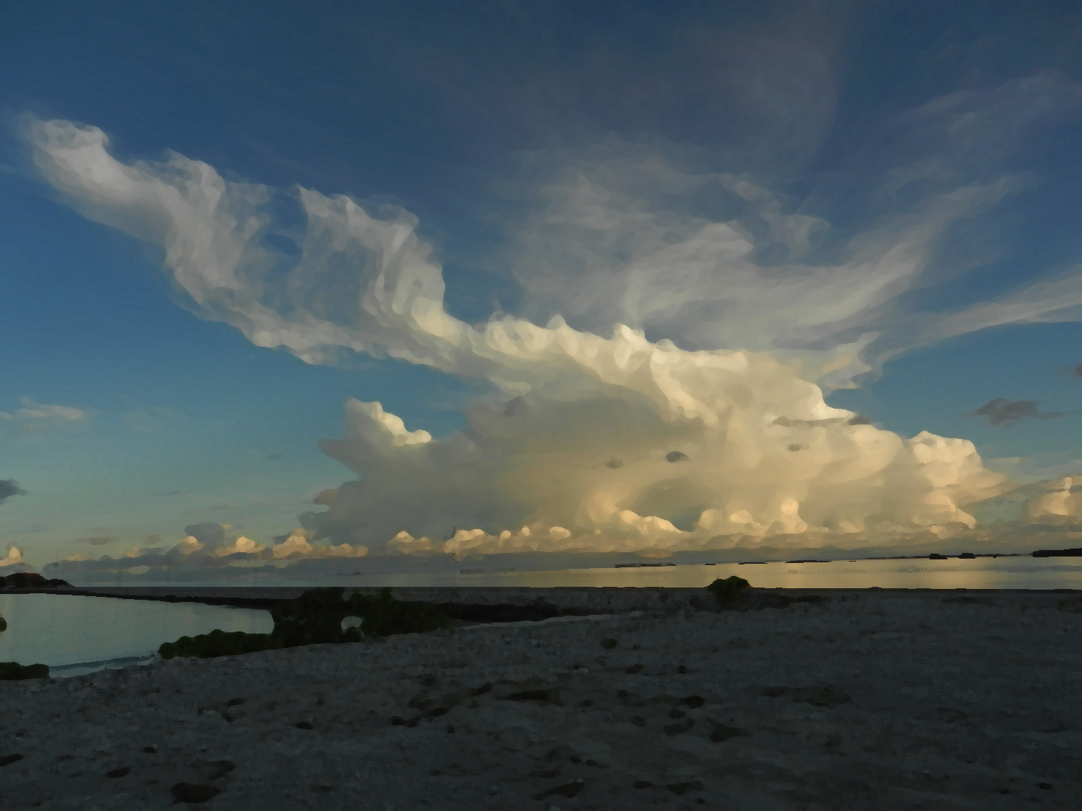
A Conceptual Model for the Hydrometeor Structure of Mesoscale Convective Systems during the MJO Active Stage
Hannah C. Barnes
Robert A. Houze, Jr.
University of Washington
31st Conference on Hurricanes and Tropical Meteorology
Town & Country Resort and Conference Center, San Diego, CA
2 April 2014
Funded by NSF –Grant AGS 1059611 and DOE Grant DE-SC0008452

Slide 2
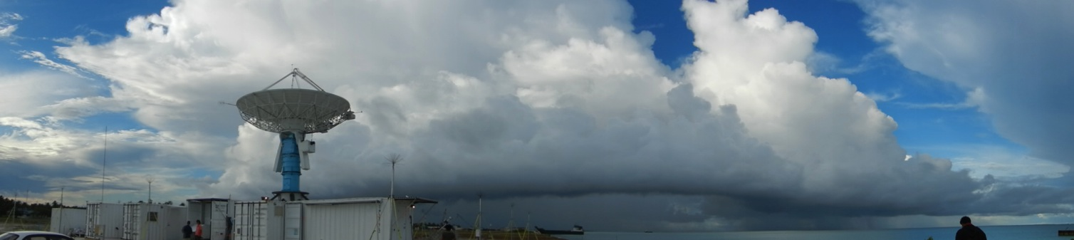
Objective
Characterize hydrometeor structure of MCSs
Composite with respect to kinematic structure
Notes:
Thus, the primary objective of this study is to characterize the hydrometeor structure of MCSs. This will done by compositing the location of different types of hydrometeors with respect to the airflow through the convective and stratiform portions of MCSs.

Slide 3
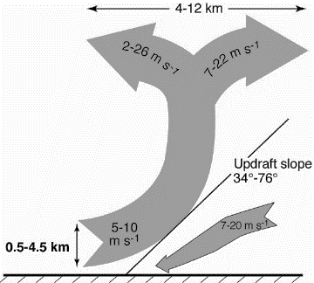
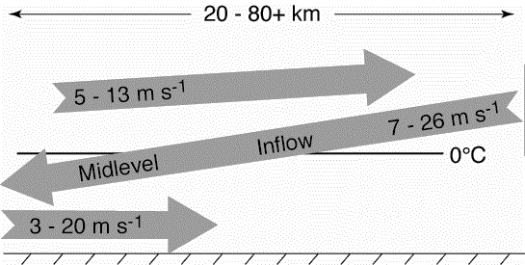
Kinematic Structure of Mesoscale Convective Systems (MCSs)
Moncrieff (1992): Layer airflow
Kingsmill and Houze (1999): 3D structure
Convective
Stratiform
Notes:
Brief introduction to MCS structure
Emphasize that TOGA COARE added to that picture by confirming that layered airflow structures described by Moncrieff (1992)
Convective regions characterized by steeply sloping convergent zones with a divergence signature aloft
Stratiform often characterized by mid-level inflow that starts below the anvil and slowly descends into the precipitating stratiform region. The mid-level inflow may or may not reach the surface.
DYNAMO is opportunity to add another layer of knowledge of the structure of MCS through microphysics

Slide 4
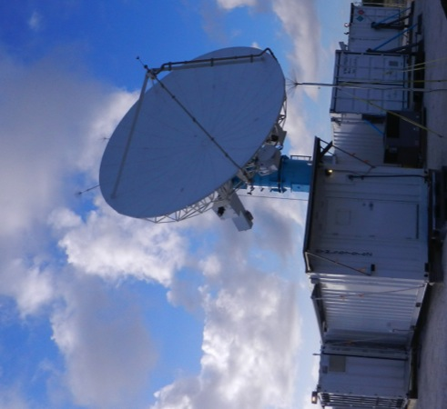
NCAR SPolKa Radar
Addu Atoll
Dual wavelength
Only using S-Band
Single Doppler
Dual-polarimetric
Particle Identification Algorithm (Vivekanandan et al., 1999)
RHI sector and within 100 km
Notes:
Briefly introduce SPolKa
Doppler capabilities allow us to identify the kinematic structures of Kingsmill and Houze (similar to TOGA COARE)
Dual-polarimetric capabilities new for DYNAMO and allow to identify different types of hydrometeors.
PID algorithm developed by Vivekanadan et al. 1999 was APPLIED to the SPolKa data
In two regions the SPolKa radar did a series of high resolution RHI scans, which enabled us to obtain a detailed vertical picture of the hydrometeor structure within MCSs

Slide 5
Case Selection
Convective: 24 Oct 2011
dBZ
V_{r} profile
SPolKa data during active phases
Subjectively identify cases
SPolKa radial velocity
Layer lifting
One per storm
25 Convective Cases
37 Stratiform Cases
Stratiform: 23 December 2011
dBZ
V_{r} profile
Notes:
Explain that focusing on the 11 top rain events during DYNAMO, which all occurred during the active phase.
Rain events selected on the 24 hr running mean time series. Consider 24 hours before and after the 11 maxima identified in that timeseries
Explain composite method
Explain basic process of selecting cases (the bottom figure highlights the region where I look for these features)
Subjective
Create map of hydrometeors in each case by hand
Enables to reduce noise and artifacts
Composite.
Done by scaling so that all cases have the same slope, height, and range.
The slope, height, and range used for compositing are the average values of all the events
____________EXTRA INFORMATION ____________
Number of events in each composite
Convective – 27
Mid-Level Inflow – 38
Trailing Stratiform – 7
Non-Trailing Stratiform – 29

Slide 6
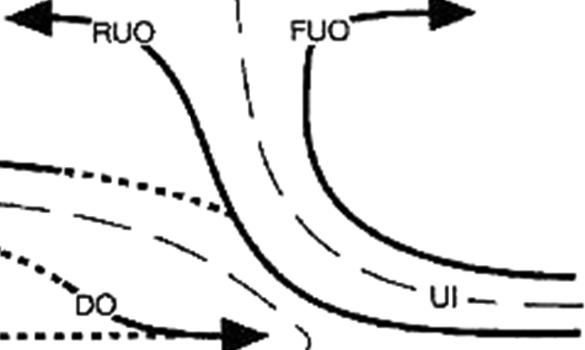
Compositing Methodology
1.) Map kinematics and hydrometeors using radial velocity and PID
2.) Composite around layer lifting model
Radar Data
Composite Structure
X Scale Factor
Z Scale Factor

Slide 7
Convective Updraft
Composites
Graupel
Rimed Aggregates
Heavy Rain
Moderate Rain
Light Rain
Wet Aggregates
Dry Aggregates
Small Ice Crystals
Horz. Oriented Ice
Notes:
Red line is the convergent updraft.
Colors shows how often that type of hydrometeor is located at a given location. The scales in each figure or different in order to show their distribution most clearly.
Top row shows the rain categories, the middle row shows the categories with graupel (there was no hail), and the bottom line shows the snow and ice categories.
Structure is systematic
Few features to emphasize
Heavy rain just downwind of updraft
Moderate rain within updraft core
Graupel just downwind updraft in a narrow vertical column
Dry aggregates extend from the melting level to the base of the divergence signature
Non-oriented ice surround dry aggregates

Slide 8
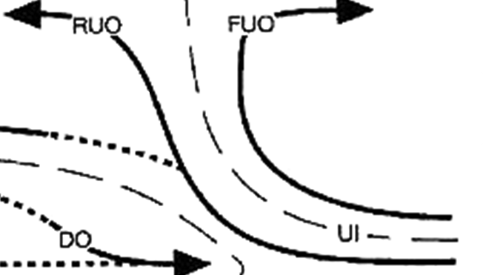
Hydrometeor Organization in Convective Updrafts
Small Ice Crystals
Dry Aggregates
Graupel/Rimed Aggregates
Light Rain
Heavy Rain
Wet Aggregates
Moderate Rain
Notes:
Based on those results we have developed this conceptual diagram for the hydrometeor structure of convective updrafts.

Slide 9
Stratiform
Stratiform with leading line
Stratiform without leading line
dBZ
dBZ
23 December 2011
18 November 2011

Slide 10
Stratiform with Leading Line
Composites
Graupel
Rimed Aggregates
Heavy Rain
Moderate Rain
Light Rain
Wet Aggregates
Dry Aggregates
Small Ice Crystals
Horz. Oriented Ice
Notes:
Red line shows mid-level inflow that was composited around. This composite mid-level inflow can be thought of starting on the right side of each figure under the anvil and ending on the left side of the figure with stratiform precipitation
Structure again is very systematic.
As move out towards the anvil the rain intensity systematically weakens.
Snow and ice are highly layered
Wet aggregates at the melting level, then dry aggregates and non-oriented ice respectively layered above
The wet aggregate layer becomes more fragmented near the anvil
Sometimes a thin layer of graupel was found within the upper portion of the wet aggregate layer.
Especially when brightband strong
Surprised to see but do not think this is an artifact
large aggregates and graupel have been found during MISMO which was another campaign in the central Indian ocean in 2006
Videosondes (rawinsondes outfitted with video camera
Released in stratiform regions, saw aggregates and graupel near and above the melting level
Now I am going to turn to the non-leading line MCSs and I want you watch very carefully as I change the slide since the hydrometeor structure is virtually the same.

Slide 11
Stratiform without Leading Line
Composites
Graupel
Rimed Aggregates
Heavy Rain
Moderate Rain
Light Rain
Wet Aggregates
Dry Aggregates
Small Ice Crystals
Horz. Oriented Ice
Notes:
- More cases in this composite so images not as fragmented but the overall hydrometeor structure is the virtually the same.

Slide 12
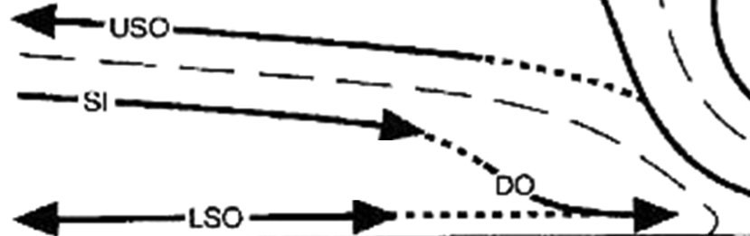
Hydrometeor Organization in Stratiform
Horizontally Oriented Ice
Small Ice Crystals
Dry Aggregates
0˚C
Light Rain
Heavy Rain
Graupel / Rimed Aggregates
Moderate Rain
Wet Aggregates
Notes:
Using these results we have created this conceptual diagram of the hydrometeor structure for regions characterized by a mid-level inflow.
Key features
Heavy rain from events when mid-level inflow reached surface, otherwise very rare
Rain intensity decrease with distance from center of storm
Snow and ice crystals are layered
Wet aggregate layer becomes fragmented as move towards anvil

Slide 13
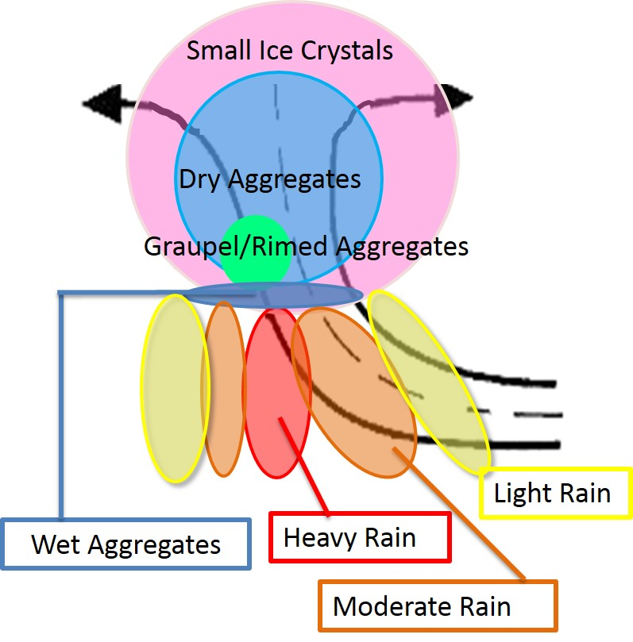
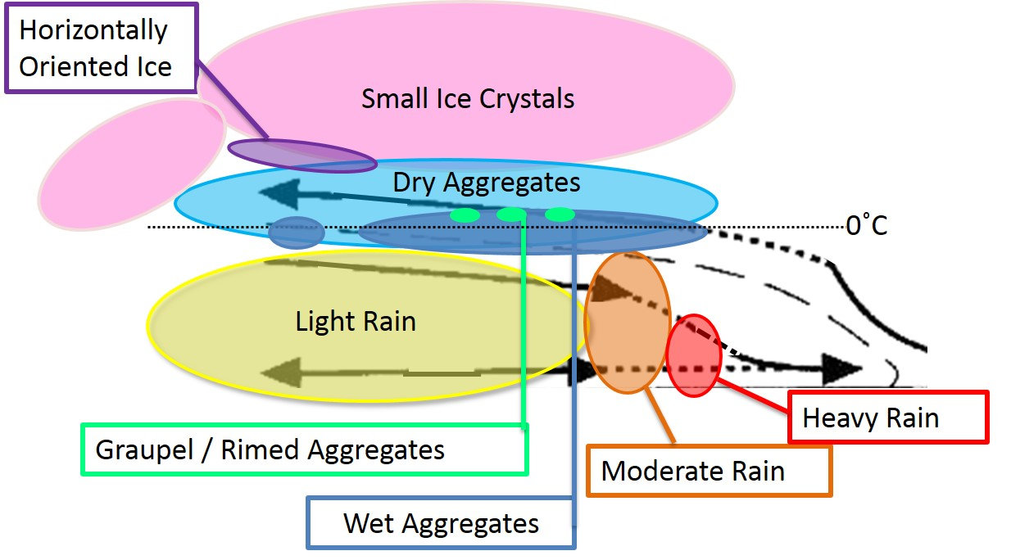
Conclusions
Convective
Stratiform
Hydrometeor organization consistent across MCS types
Heating similar with and without leading line
Interpretation of microphysical processes
Comparison of model output and radar observations
Notes:
The two previous conceptual diagrams are combined and summarized
Differences between convective updrafts and mid-level inflow
Graupel: narrow and vertical in convective updraft, but shallow and flat in mid-level inflow
More dry aggregates than non-oriented ice in convective updrafts but more non-oriented ice than dry aggregates in mid-level inflows
Two reasons why results are exciting
These hydrometeor structures are very robust. For example saw very little difference between leading line and embedded convection.
Suggests the structure of MCSs are not different because of differences in their hydrometeor structure
Emphasizes a need to further explore why MCSs take on different structures.
Can use to more directly compare model output with radar observations

Slide 14

Questions ?

Slide 15
Frequency of Occurrence
 | Convective Updraft Inflow | Stratiform with Leading Line | Stratiform without Leading Line
Graupel/Rimed Aggregates | 88% | 66% | 64%
Heavy Rain | 92% | 11% | 14%
Moderate Rain | 100% | 55% | 60%
Light Rain | 72% | 100% | 100%
Wet Aggregates | 92% | 100% | 100%
Dry Aggregates | 100% | 100% | 100%
Small Ice Crystals | 92% | 100% | 89%
Horizontally-Oriented Ice Crystals | 20% | 44% | 53%

Slide 16
Areal Coverage
 | Convective Updraft Inflow | Stratiform with Leading Line | Stratiform without Leading Line
Graupel/Rimed Aggregates | 2% | 0.3% | 0.5%
Heavy Rain | 12% | 4% | 1%
Moderate Rain | 16% | 5% | 6%
Light Rain | 13% | 28% | 31%
Wet Aggregates | 3% | 1% | 4%
Dry Aggregates | 22% | 12% | 18%
Small Ice Crystals | 12% | 26% | 18%
Horizontally-Oriented Ice Crystals | - | 2% | 2%

Slide 17
Distribution of Convective Polarimetric Variables
Reflectivity
Linear Differential Reflectivity
GA HR MR LR WA DA SI HI
GA HR MR LR WA DA SI HI
Correlation Coefficient
Differential Reflectivity
Differential Reflectivity
GA HR MR LR WA DA SI HI
GA HR MR LR WA DA SI HI
Specific Differential Phase
Temperature
GA HR MR LR WA DA SI HI
GA HR MR LR WA DA SI HI

Slide 18
Distribution of Mid-Level Polarimetric Variables
Reflectivity
Linear Differential Reflectivity
GA HR MR LR WA DA SI HI
GA HR MR LR WA DA SI HI
Differential Reflectivity
Correlation Coefficient
GA HR MR LR WA DA SI HI
GA HR MR LR WA DA SI HI
Temperature
Specific Differential Phase
GA HR MR LR WA DA SI HI
GA HR MR LR WA DA SI HI

Slide 19
Confidence of PID
Mid-Level Inflow with Leading Line
Convective Updraft
PID interest value
Likelihood of particle type
Highest interest value chosen
PID confidence
Difference of 1st and 2nd largest interest values
Larger difference = more confidence

Slide 20
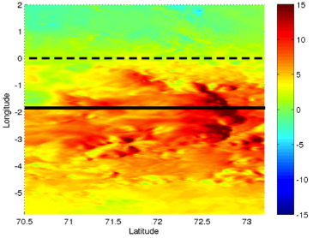
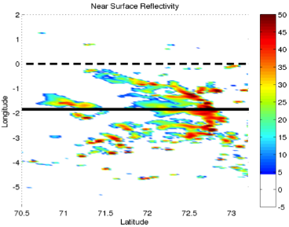
Mesoscale Modeling of Squall Line
Zonal Wind
WRF 3.4.1
Resolution: Outer – 9km, Inner – 3km
Cu Param: Outer – KF, Inner – None
MP Param: Both - Goddard
PBL Param: Both – UW
Forcing: ERAi
00 UTC 23 Dec – 00 UTC 25 Dec
Reflectivity

Slide 21
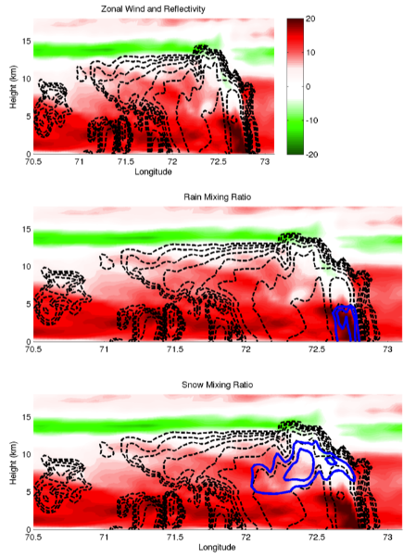
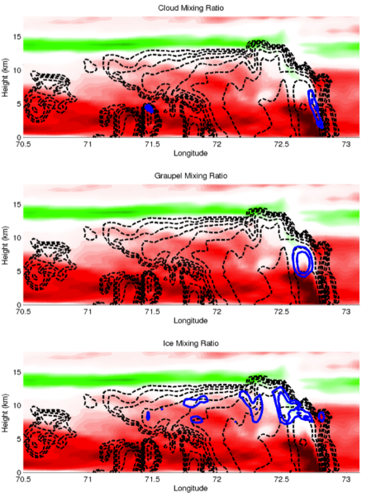
Distribution of Hydrometeor Mixing Ratio
Zonal Wind and Reflectivity
Cloud Mixing Ratio
Rain Mixing Ratio
Graupel Mixing Ratio
Snow Mixing Ratio
Ice Mixing Ratio

Slide 22
Convective Example Oct 24

Slide 23
Squall Example Nov 18

Slide 24
Differences in Graupel/Rimed Aggregates and Wet Aggregates in Mid-Level Inflow Cases
Graupel
Wet Aggregates Only

