Slide 1
Cloud structure and organization under suppressed conditions during DYNAMO/AMIE/CINDY2011
Angela Rowe and Robert Houze, Jr.
University of Washington
31st Conference on Hurricanes and Tropical Meteorology
San Diego, CA
1 April 2014

Slide 2
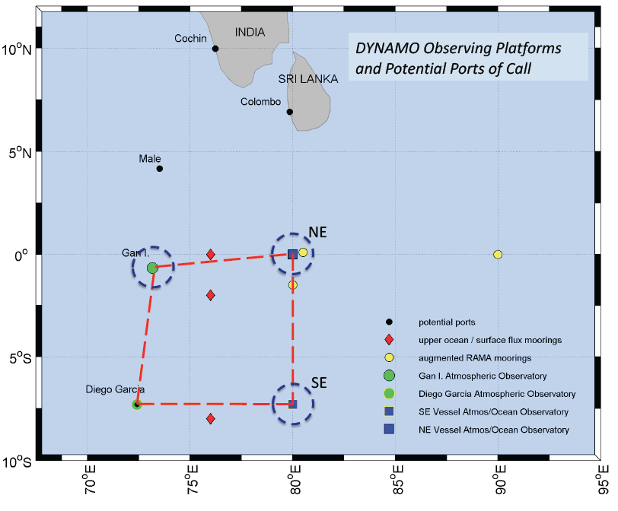
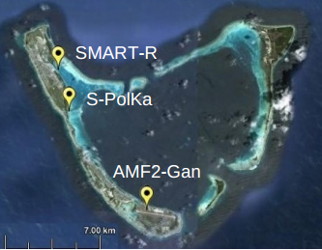
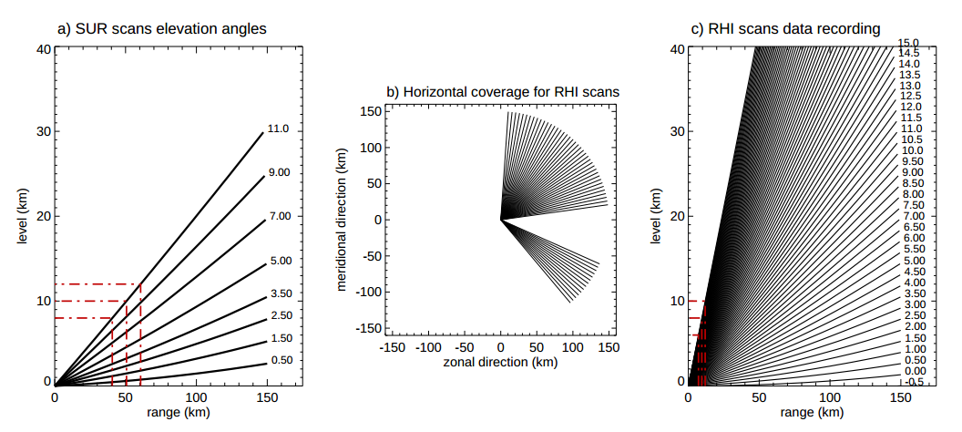
DYNAMO/AMIE/CINDY
Zuluaga and Houze (2013)

Slide 3
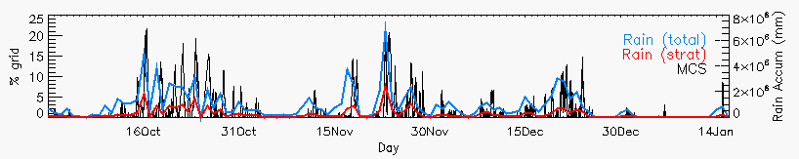
S-PolKa
Active periods: Increased rainfall/organization
Suppressed periods: Reduced rainfall, shallower convection, dry mid-levels
Objective: Describe the evolution of non-precipitating clouds to deeper convection during suppressed conditions

Slide 4
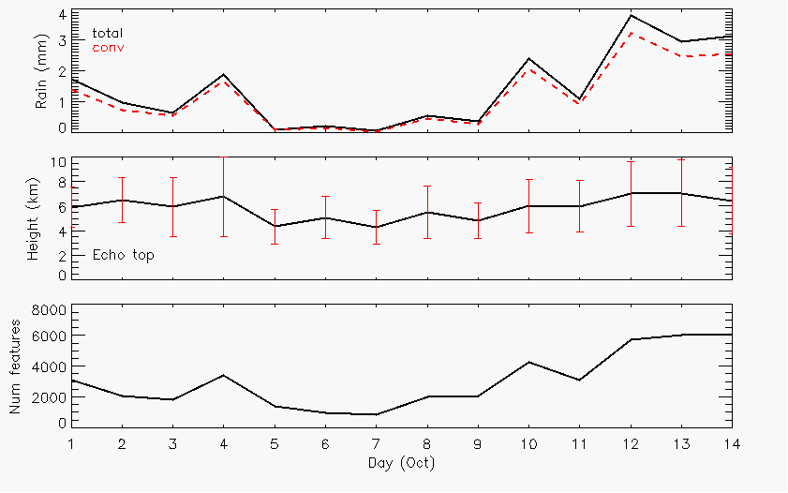
October
Rain
Echo-top heights
Number cells

Slide 5
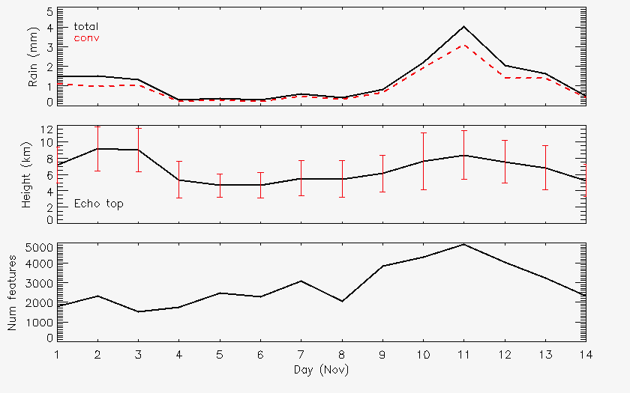
November
Rain
Rain
Echo-top heights
Echo-top heights
Number cells
Number cells

Slide 6
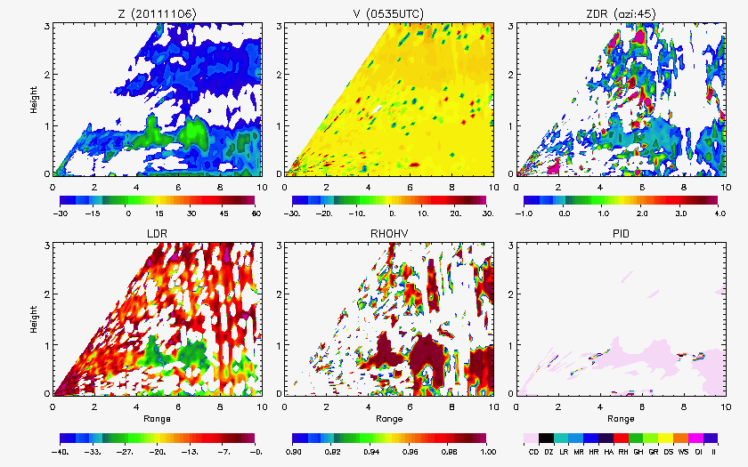
Non-precipitating echo
0-5 dBZ
No particular orientation
Homogeneous collection of scatterers
Cloud droplets

Slide 7
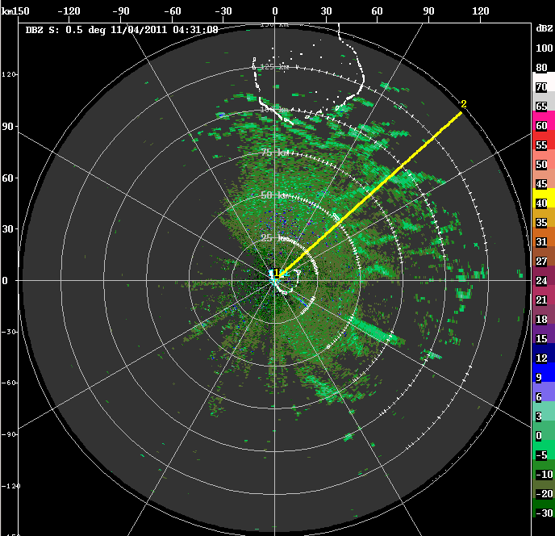
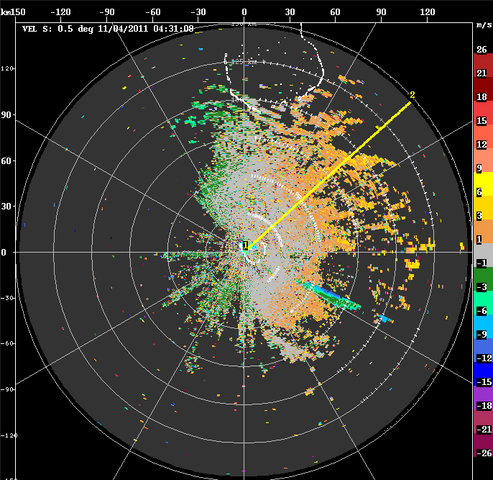
Cloud lines (6 Nov)
Z
V

Slide 8
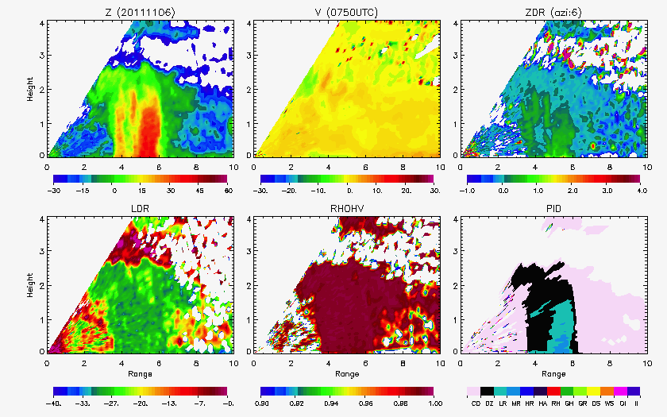
Shallow convection
3 km
Moderate rain

Slide 9
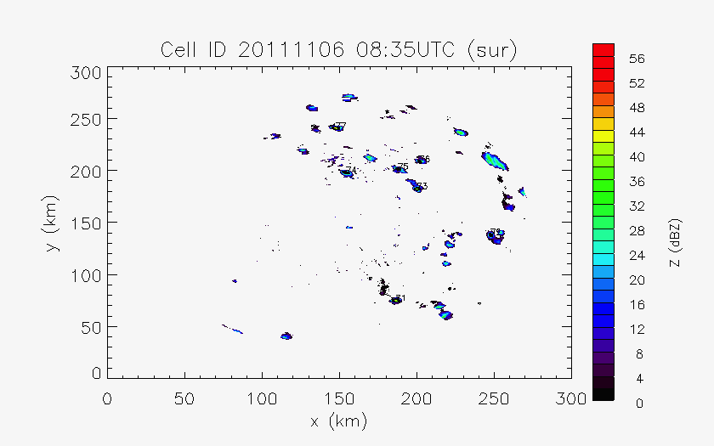
Cell tracking (> 35 dBZ)

Slide 10
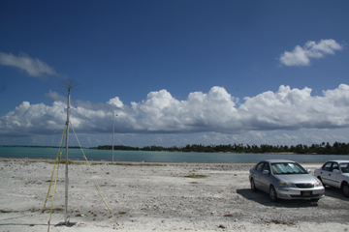
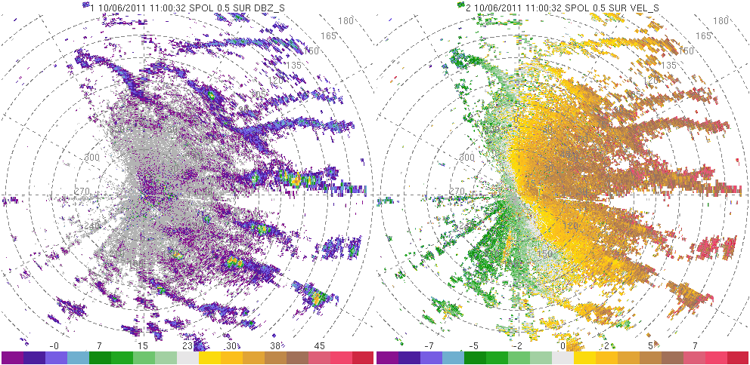
6 October
Photo: Bob Houze

Slide 11
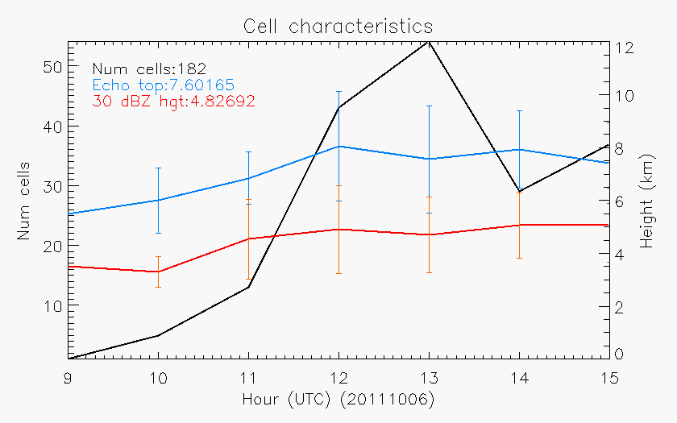
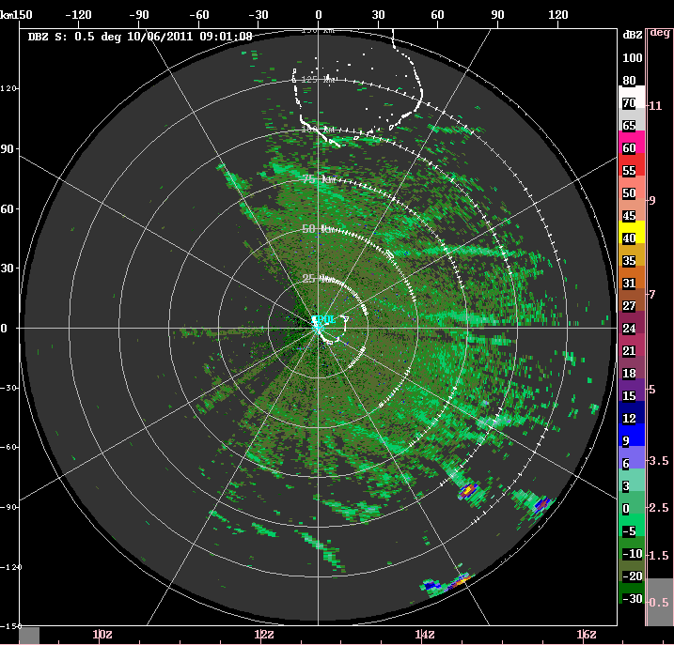
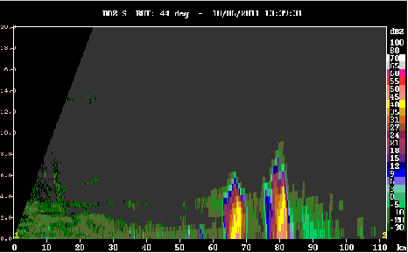
6 October
8 km

Slide 12
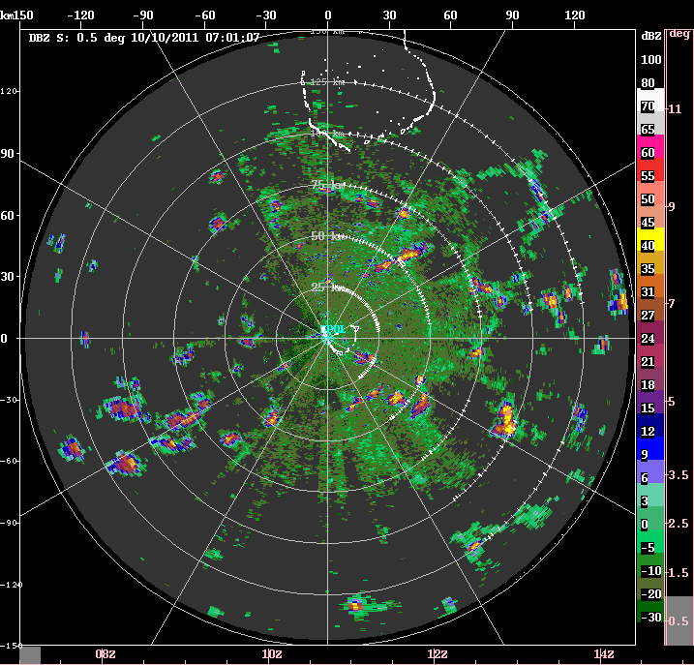
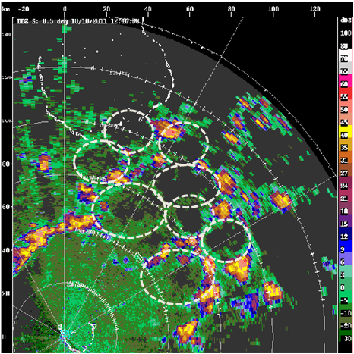
10 October
20-30 km diameters

Slide 13
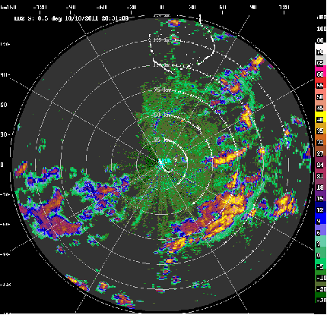
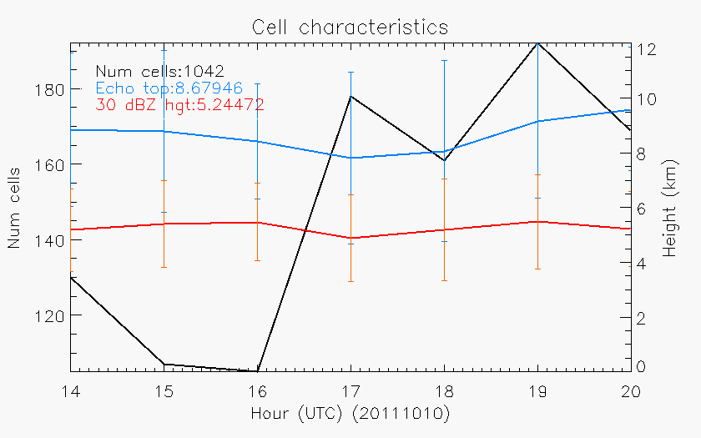
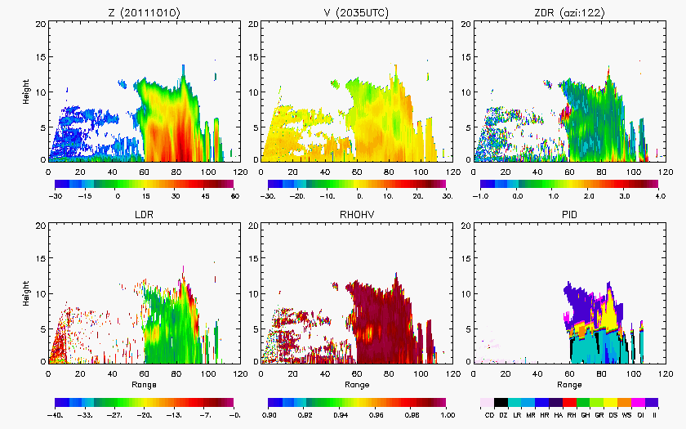
12 km

Slide 14
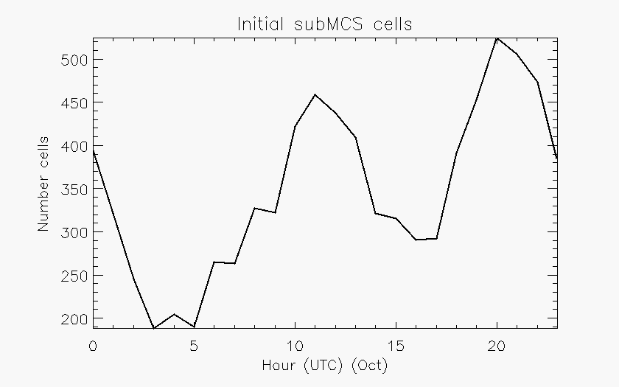
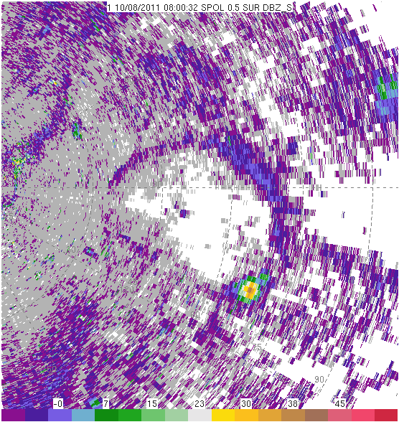
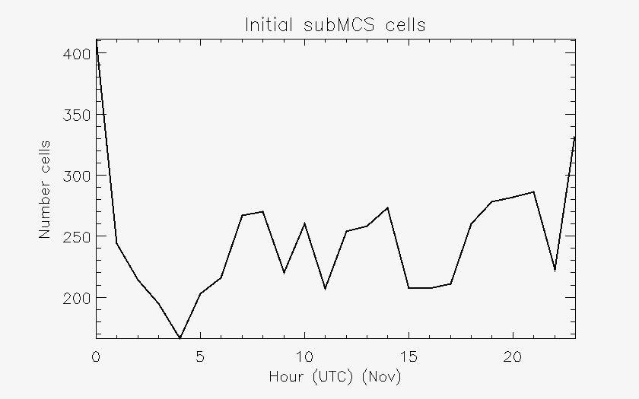
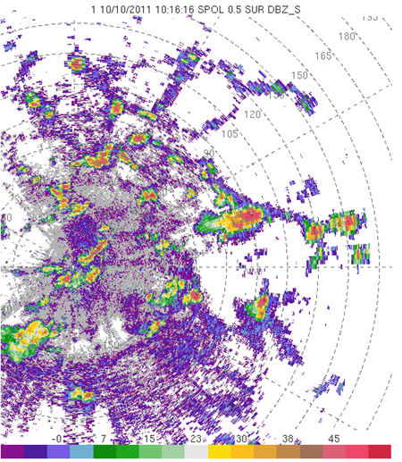

Slide 15
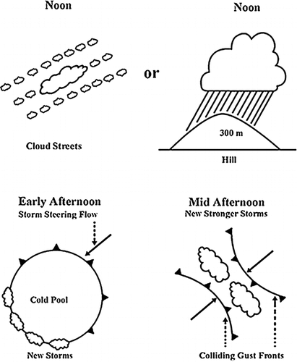
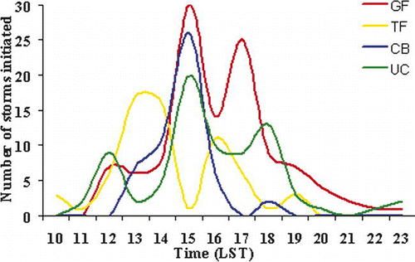
Lima and Wilson (2008)
Amazon (TRMM-LBA)

Slide 16
Summary
Convection forming along boundary layer features (rolls, cloud lines) in the morning
Non-precipitating clouds have distinct polarimetric signatures
Precipitating clouds produce cold pools late morning/afternoon
New initiation focused along gust front
More numerous and deeper convection when gust fronts collide
As near active period, increased rain, deeper echo, more cells, interacting cold pools

Slide 17
Ongoing work
Characterize periods and properties of cloud lines (environment, frequency, diurnal cycle, non-precipitating clouds)
Manually document cold pools (maximum diameter, parent convection characteristics)
Search for times when gust front moves over Gan ARM site and relate to radar data

Slide 18
Funded by NSF Grant #AGS-1059611 and DOE Grant #DE-SC0008452
Thank you!

