Slide 1
Shallow cloud structure and organization under suppressed conditions in AMIE/DYNAMO
Angela Rowe and Robert Houze, Jr.
University of Washington
ASR Science Team Meeting
Potomac, MD
13 March 2014

Slide 2
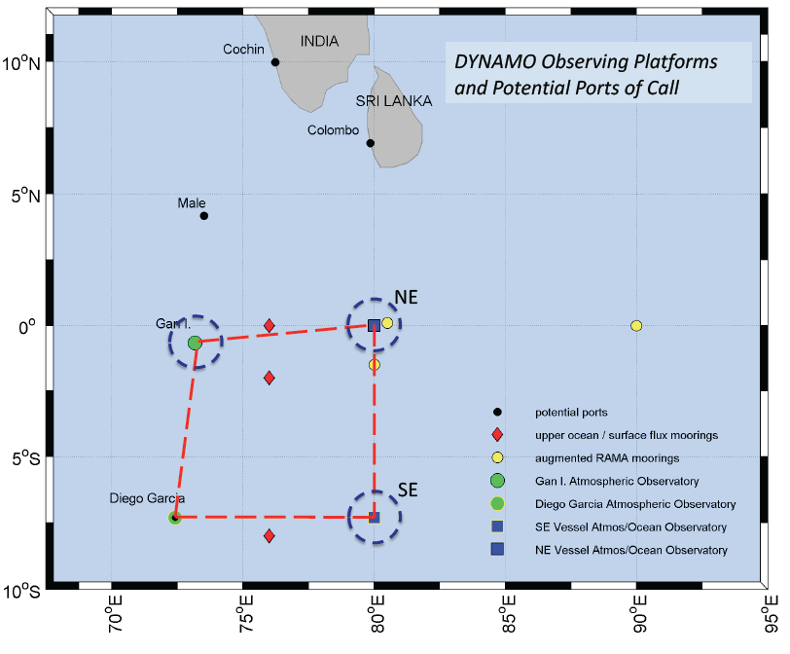
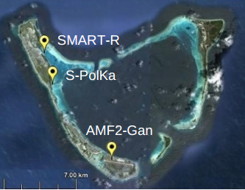
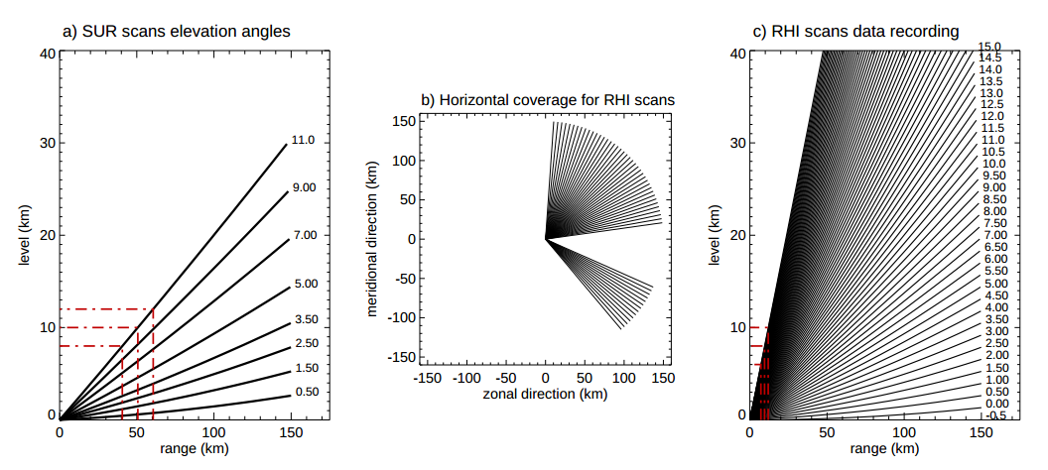
AMIE/DYNAMO
Zuluaga and Houze (2013)

Slide 3
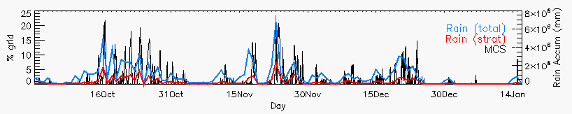
S-PolKa
Active periods: Increased rainfall/organization
Suppressed periods: Reduced rainfall, shallower convection, dry mid-levels

Slide 4
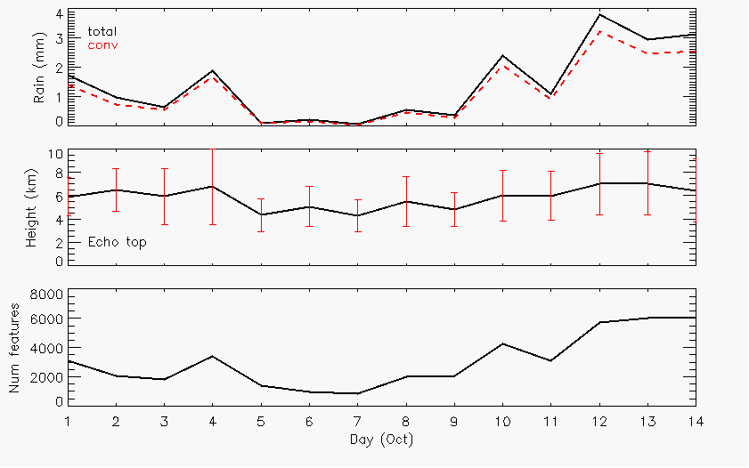
October
Rain
Echo-top heights
Number cells

Slide 5
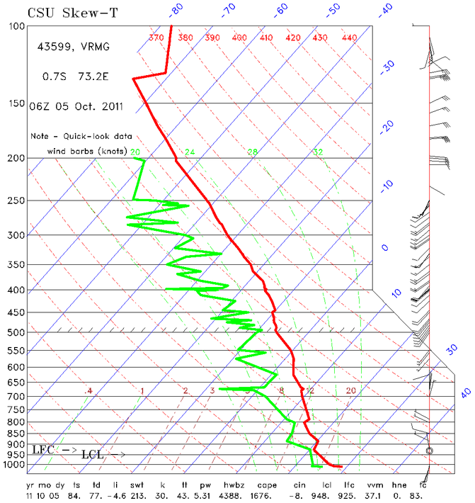
5 October

Slide 6
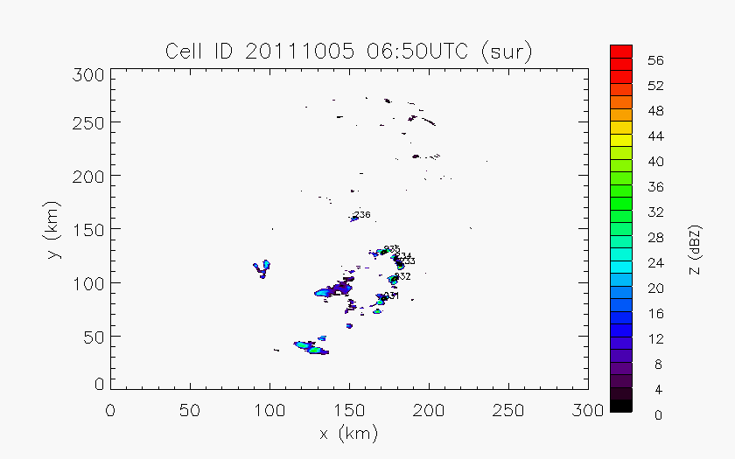
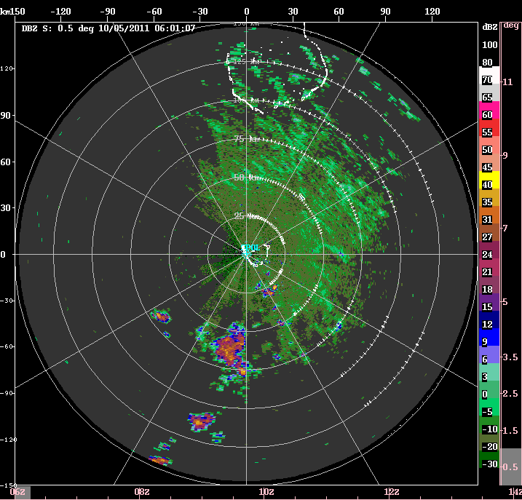
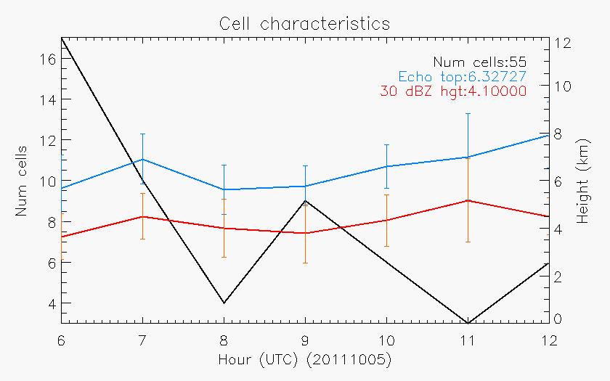
5 October
Echo tops
# cells

Slide 7
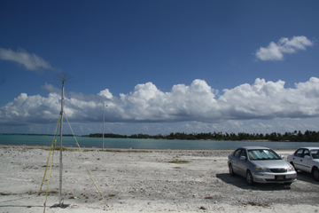
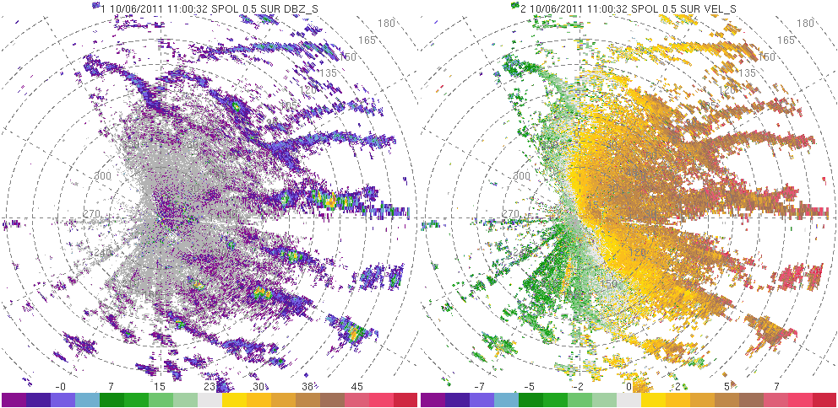
6 October
Photo: Bob Houze

Slide 8
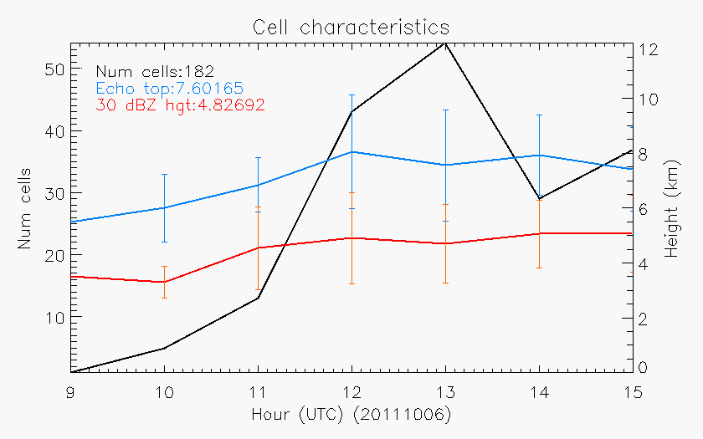
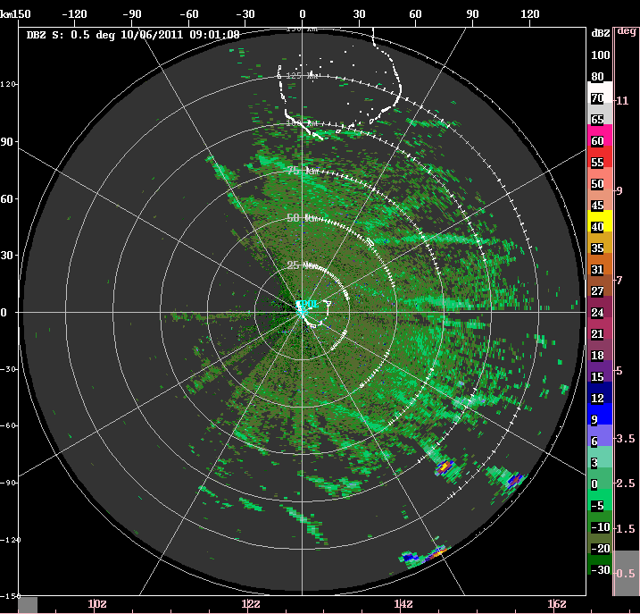
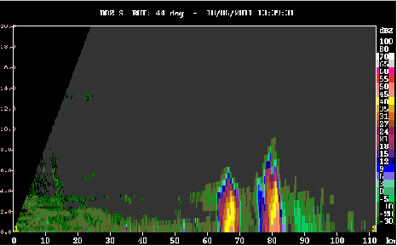
6 October

Slide 9
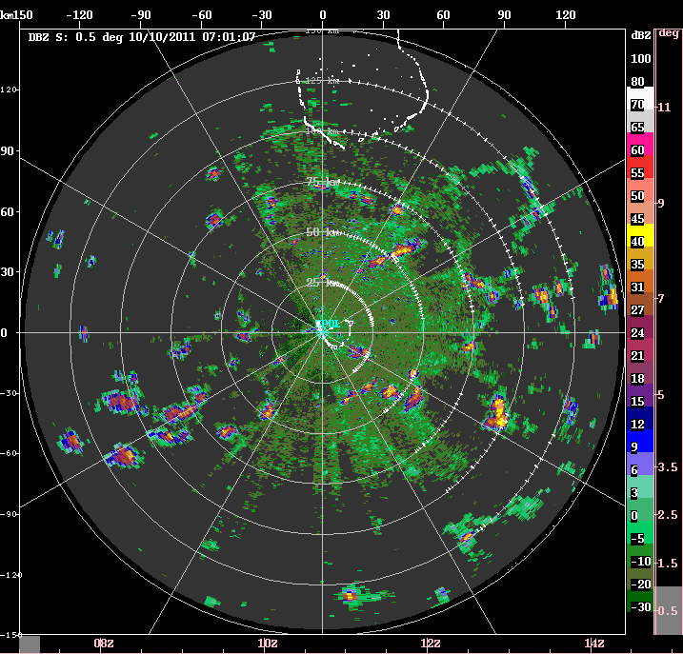
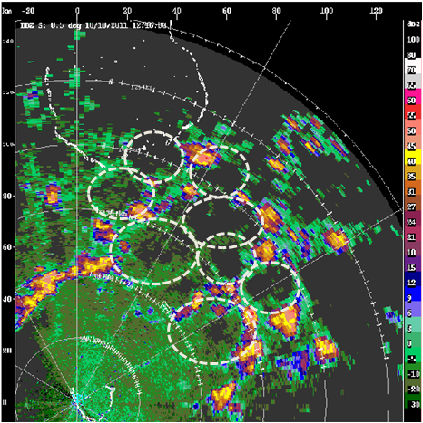
10 October
20-30 km diameters

Slide 10
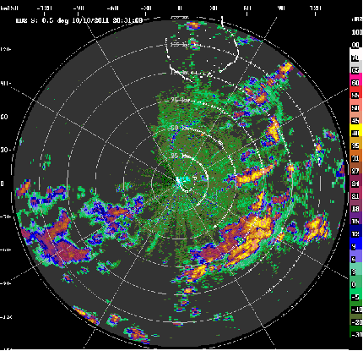
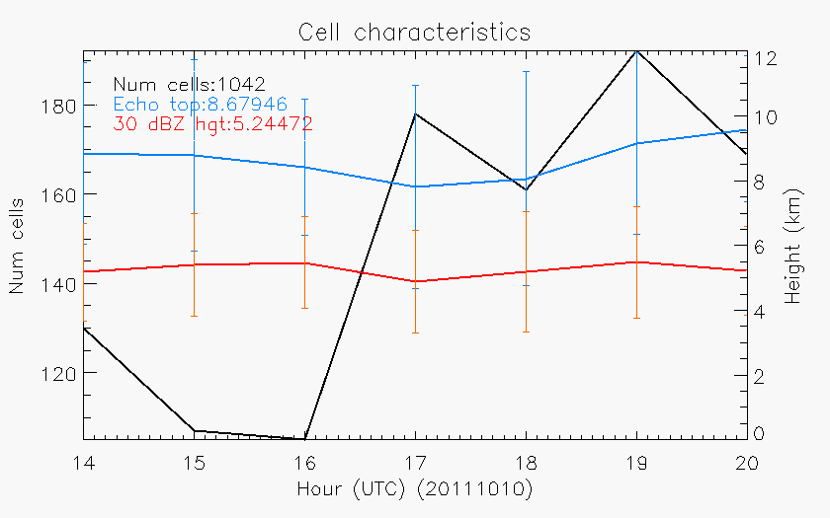
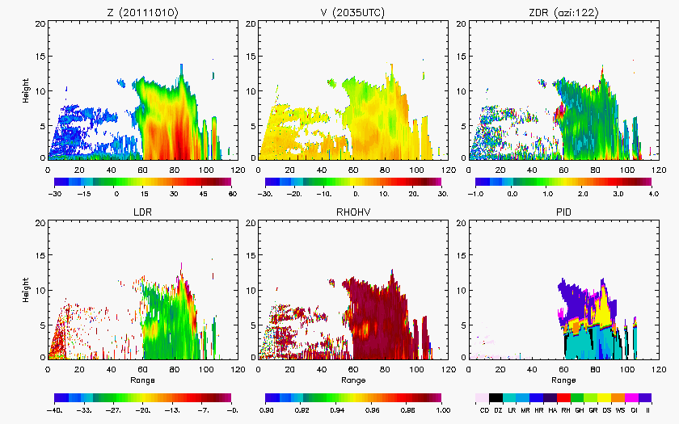

Slide 11
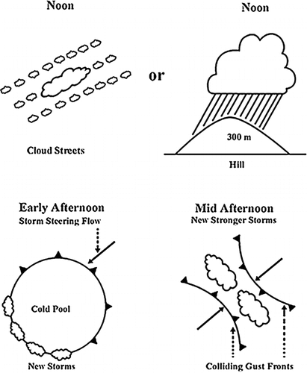
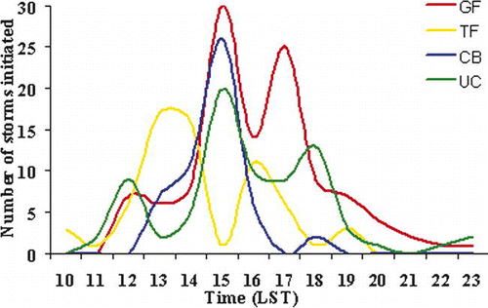
Lima and Wilson (2008)
Amazon (TRMM-LBA)

Slide 12
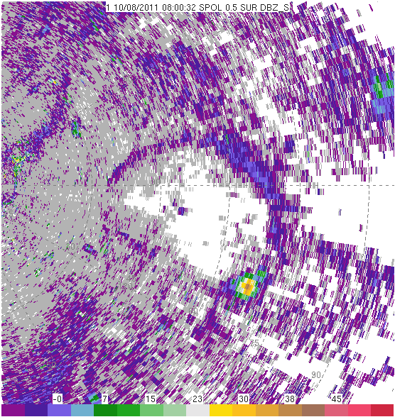
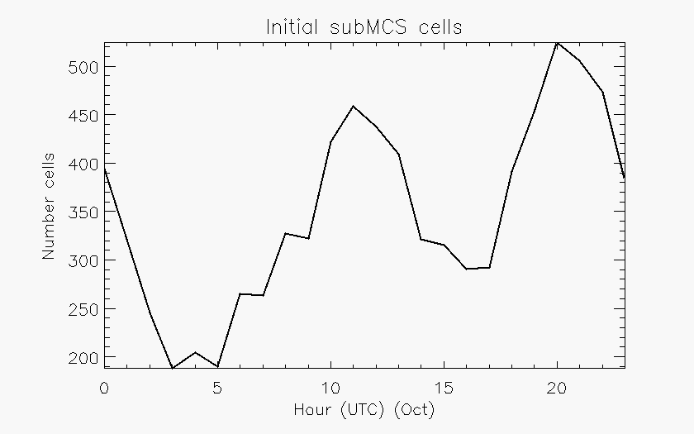
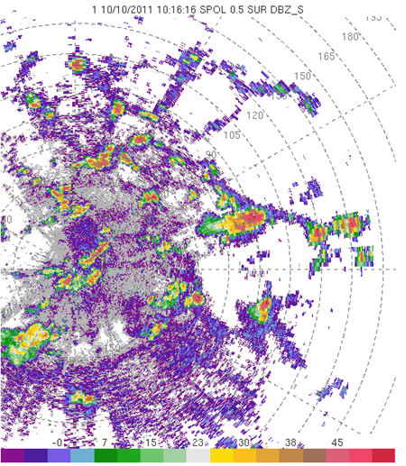

Slide 13
Summary
As near active period, increase rain, deeper echo, more cells
Convection forming along boundary layer features (rolls, cloud lines) produce cold pools during afternoon
New initiation focused along gust front
More numerous and deeper convection when gust fronts intersect
Same for November (December is odd…)

Slide 14
Next steps
Characterize periods and properties of cloud lines (environment, frequency, diurnal cycle, nonprecipitating clouds)
Manually document cold pools (maximum diameter, parent convection characteristics)
Continue to search for times when gust front moves over Gan ARM site and relate to radar data

Slide 15
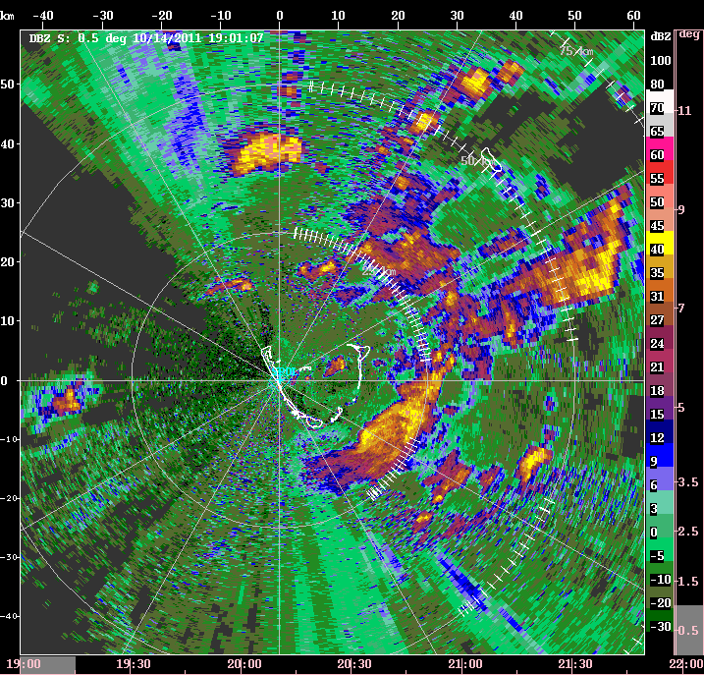

Slide 16
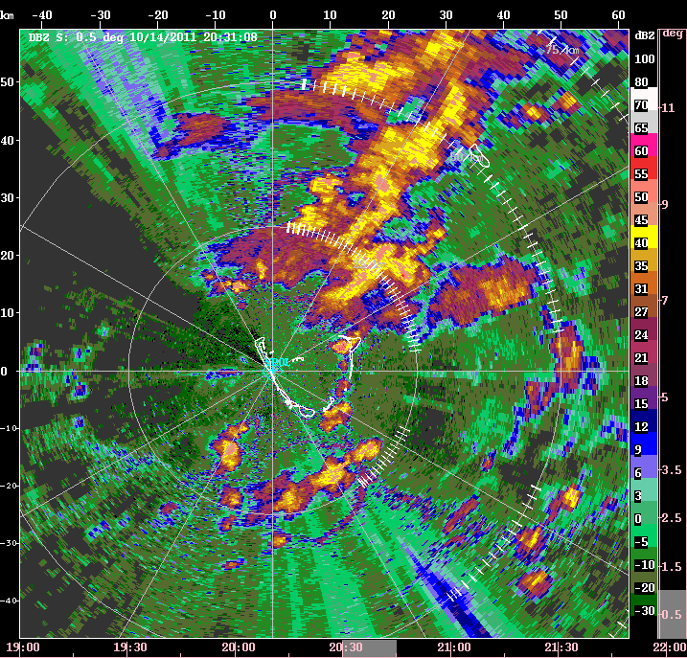

Slide 17
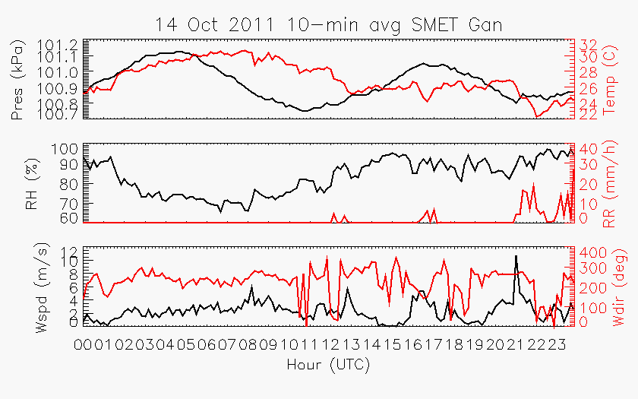

Slide 18
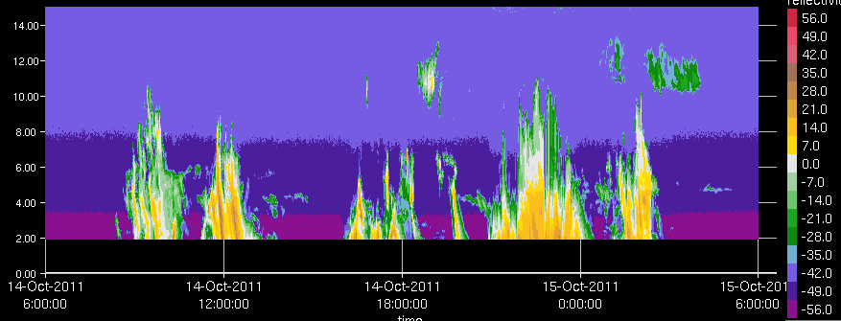
KAZR

Slide 19
Funded by NSF Grant #AGS-1059611 and DOE Grant #DE-SC0008452
Thank you!

