Slide 1
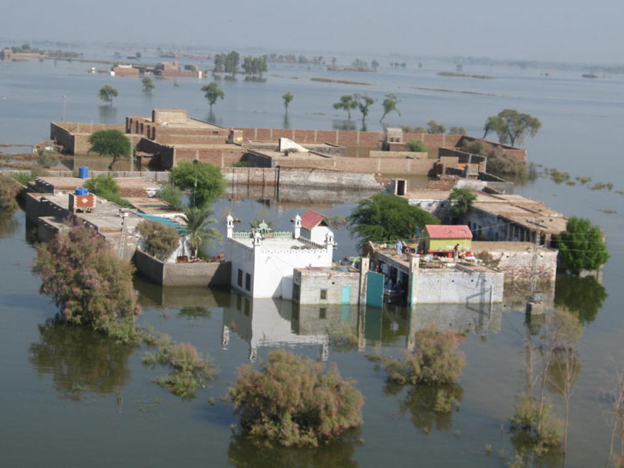
Four Years of Floods in Pakistan and India
R. A. Houze, Jr., FRMetS
with contributions from
K. Rasmussen, A. Hill, M. Zuluaga, and A. Kumar
Royal Meteorological Society, London, 19 February 2014

Slide 2
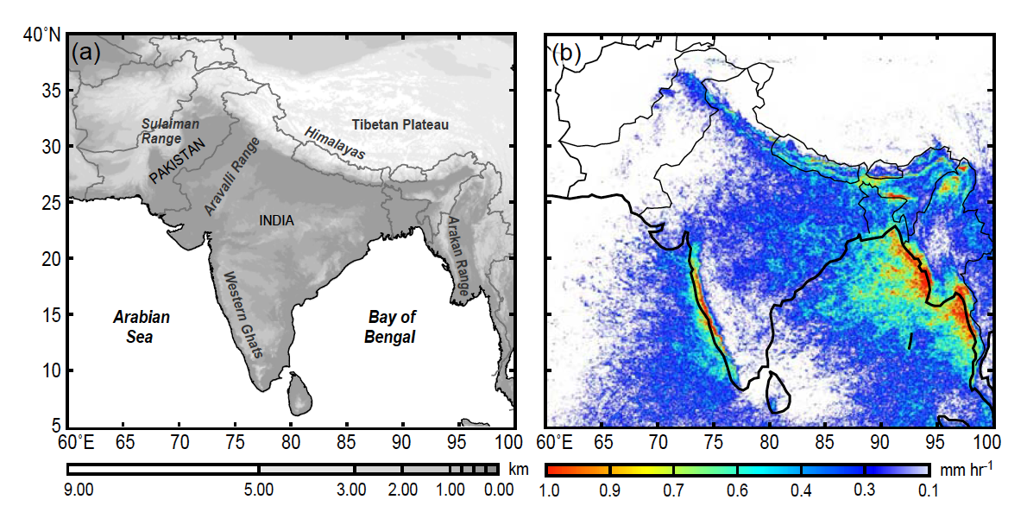
Monsoon Rainfall Climatology from TRMM satellite radar
X
Floods were in arid regions!
x
x

Slide 3
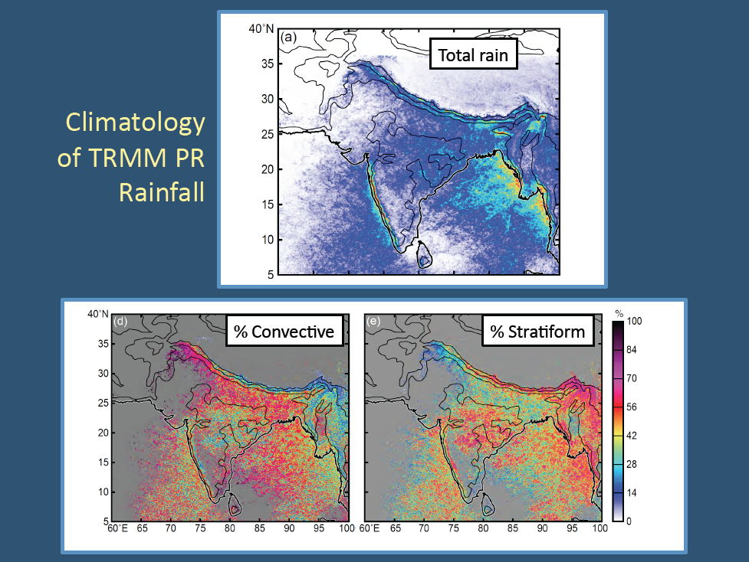
TRMM rainfall climatology subdivided
Stratiform is rare

Slide 4
Meteorological ingredients of floods: (Adapted from Doswell, Brooks, and Maddox, 1996)
Large upward transport of air
Substantial water vapor content
High precipitation efficiency of the cloud system
Large and long-lasting cloud system
Such conditions are often associated with cloud systems with large stratiform components
Frontal systems
Tropical cyclones
Persistent orographic uplift
Mesoscale convective systems

Slide 5
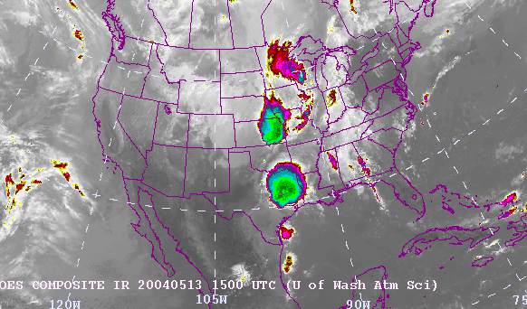
Mesoscale Convective Systems (MCSs)
Large areas of cold cloud top

Slide 6
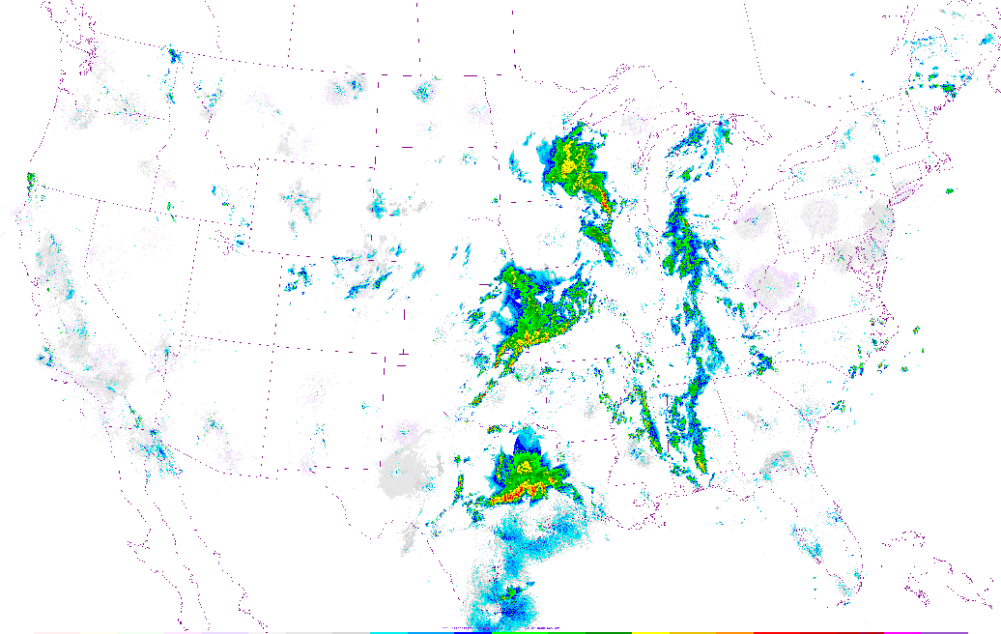
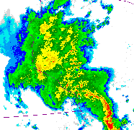
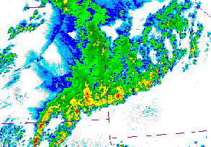
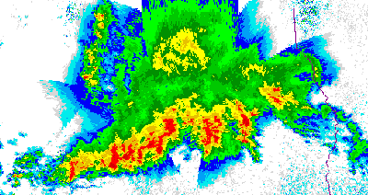
… and large rain areas
Broad region of “stratiform” precipitation
Wide zone of “convective” precipitation
1458GMT 13 May 2004

Slide 7
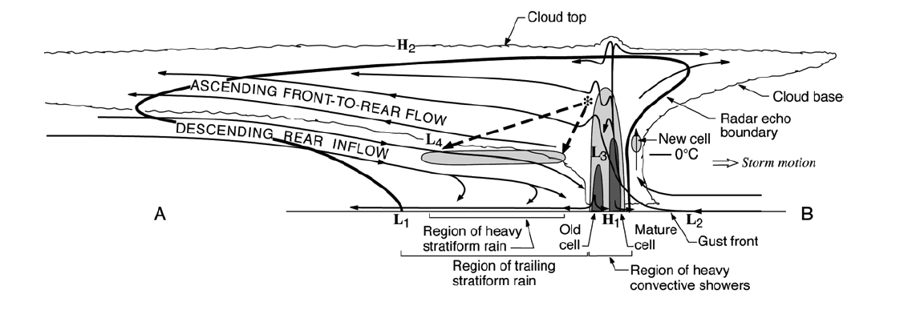
“Mesoscale Convective System"
Midlevel Jet
Stratiform
Convective
MIDLEVEL JET
Houze et al. 1989
Notes:
The basic components of an MCS can be simplified into 3 main features, which can be identified and MEASURED by satellite. The combination of these three properties can be used to identify an MCS if they satisfy certain criteria. Thus we can determine when and where MCSs occur around the globe. In addition we can determine how the properties of these three components vary from region to region. How big and wide is the cold top; how big and intense is the raining core; how thick are the anvils; and what are the characteristics of their internal structure. And how do these properties vary around the globe? One cannot holistically determine the properties of MCSs by identifying one of these properties alone. It’s important to see and evaluate all 3.

Slide 8
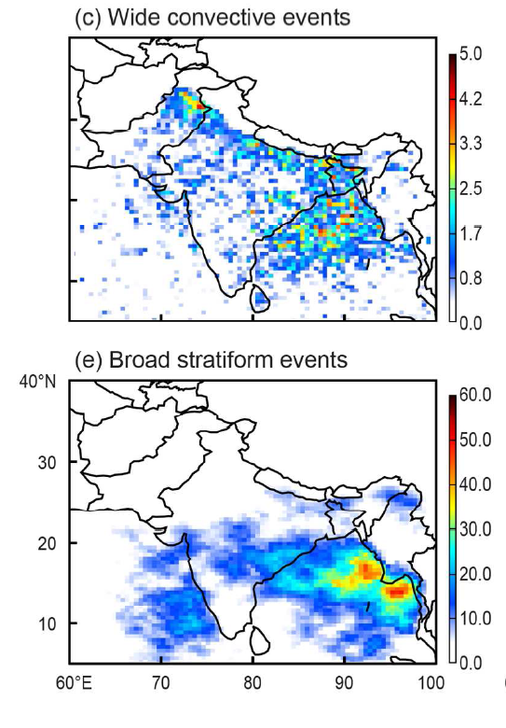
Wide convective echo frequency
x
x
15 years of TRMM satellite data
Broad stratiform echo frequency
x
x

Slide 9
Three South Asian flood scenarios:
Leh, India, 2010: Flash flood in complex terrain
Indus River Basin, Pakistan, 2010: Slow rising river downstream of terrain
Sindh, Pakistan, 2011 and 2012: Overflow of Indus without terrain influence

Slide 10
The Leh flash flood (India)

Slide 11
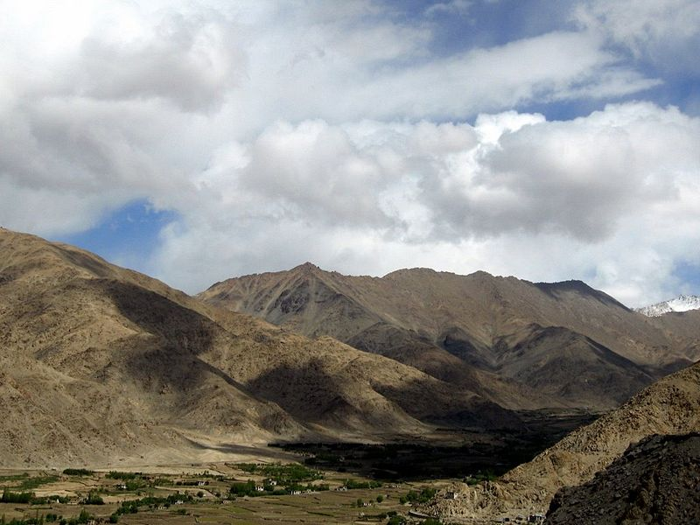

Leh, India
3500 m MSL
Near the Indus River

Slide 12
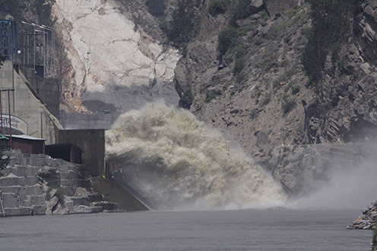
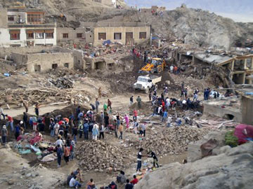
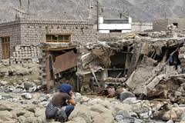
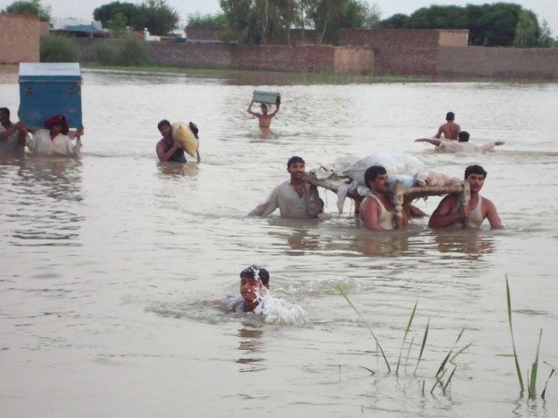

Slide 13
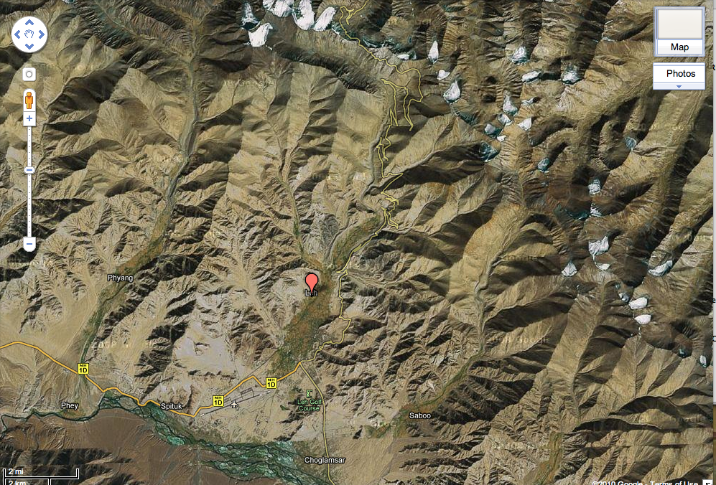
Tibetan Plateau
Steep slope
Leh City
Indus River

Slide 14
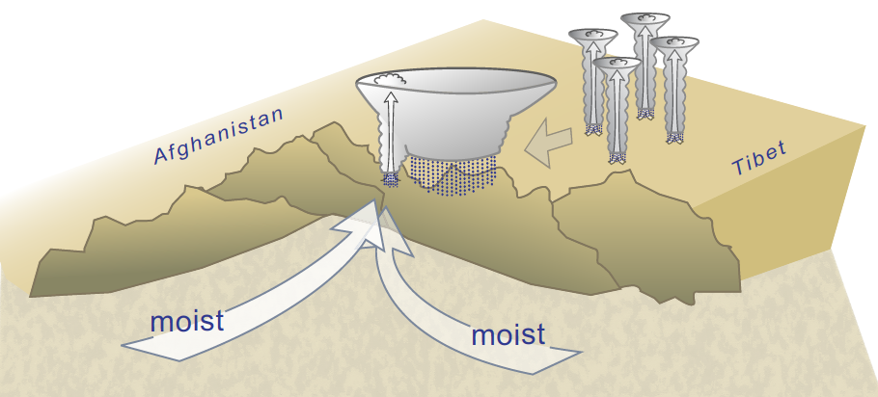
Afternoon convective cells grew upscale to form a mesoscale system that moved off the plateau and fed on low-level moisture
Rasmussen and Houze 2011

Slide 15
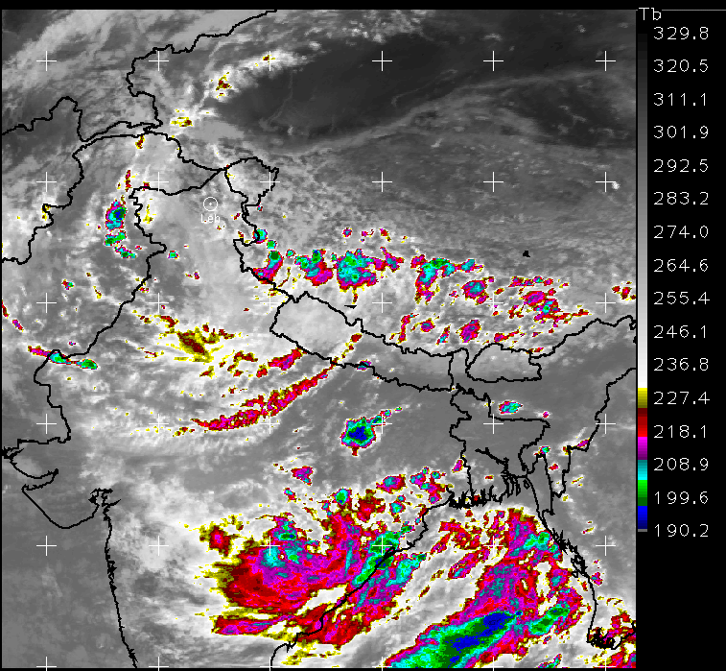
Leh Flood, 8 UTC 5 August 2010

Slide 16
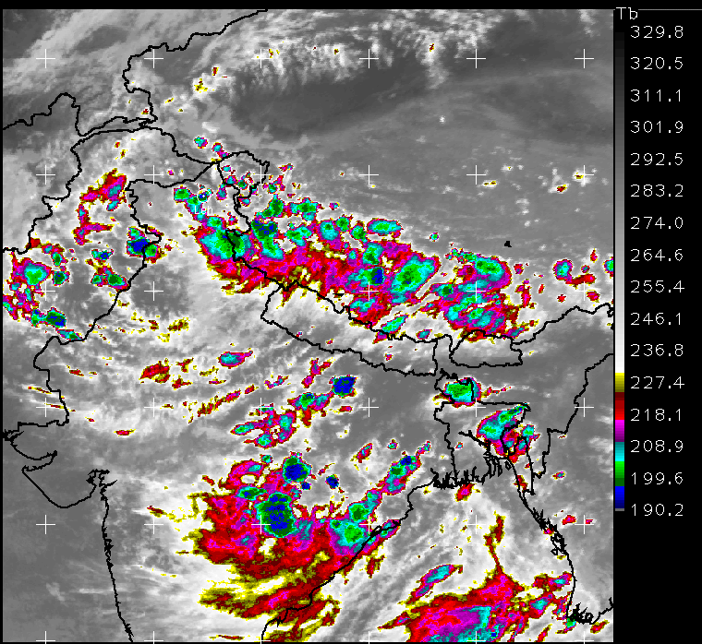
Leh Flood, 12 UTC 5 August 2010

Slide 17
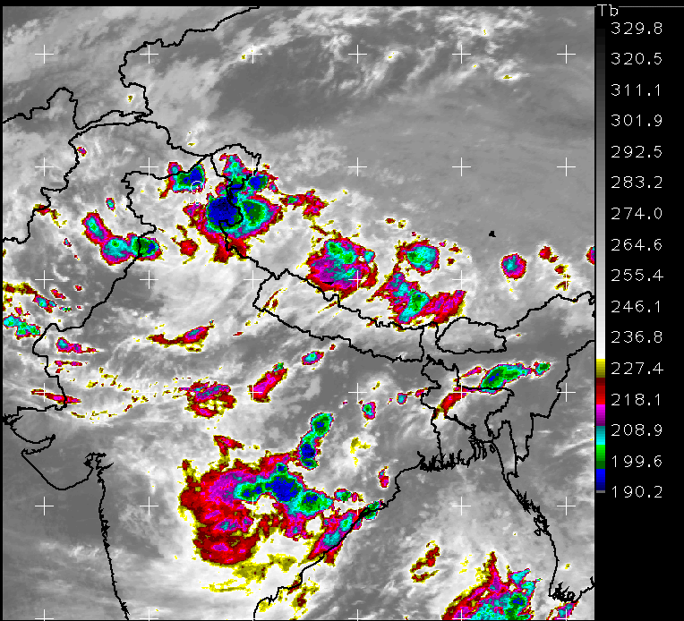
Leh Flood, 16 UTC 5 August 2010

Slide 18
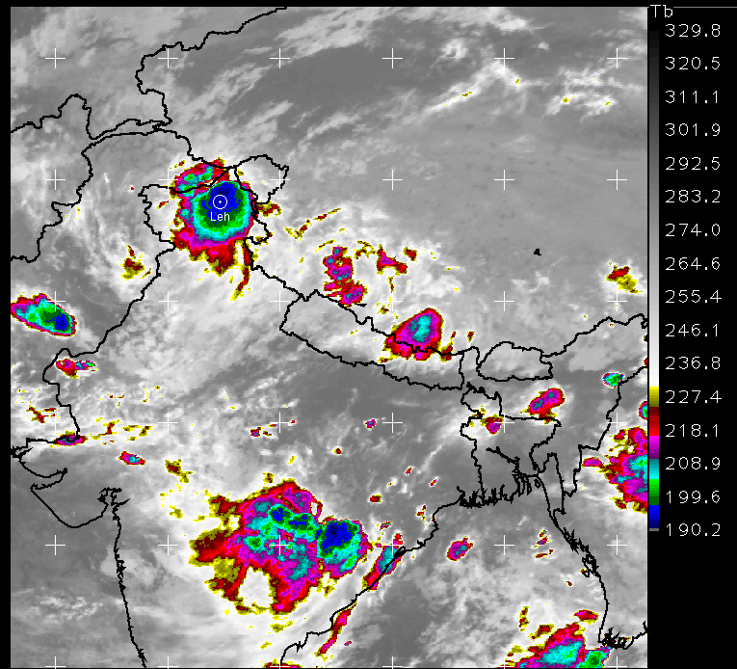
Leh Flood, 20 UTC 5 August 2010

Slide 19
The synoptic conditions during the Leh flood

Slide 20
4 August 2010
5 August 2010
H
Jet over Tibet
H
L
L
L
500 mb
500 mb
H
H
Deep moist flow
L
L
L
L
850 mb
850 mb

Slide 21
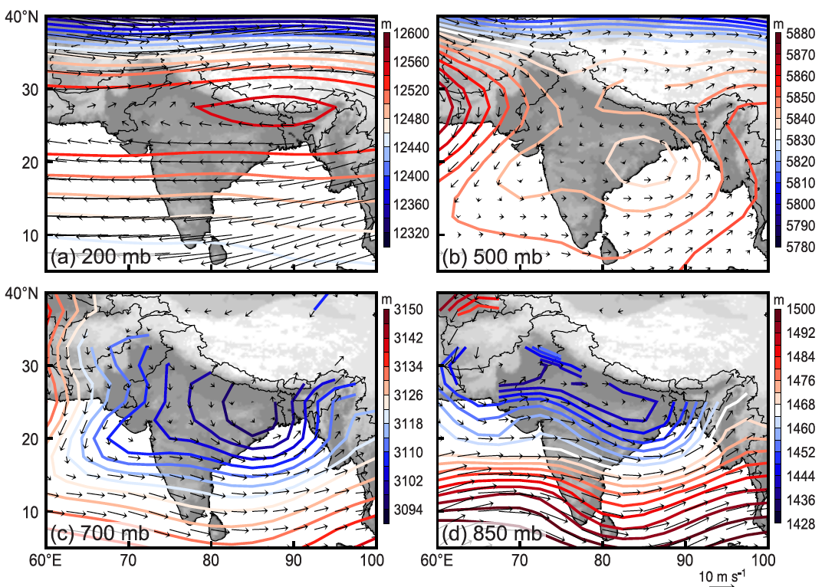
Synoptic climatology over South Asia during the monsoon
Dry

Slide 22
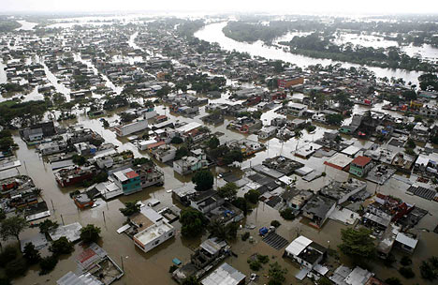
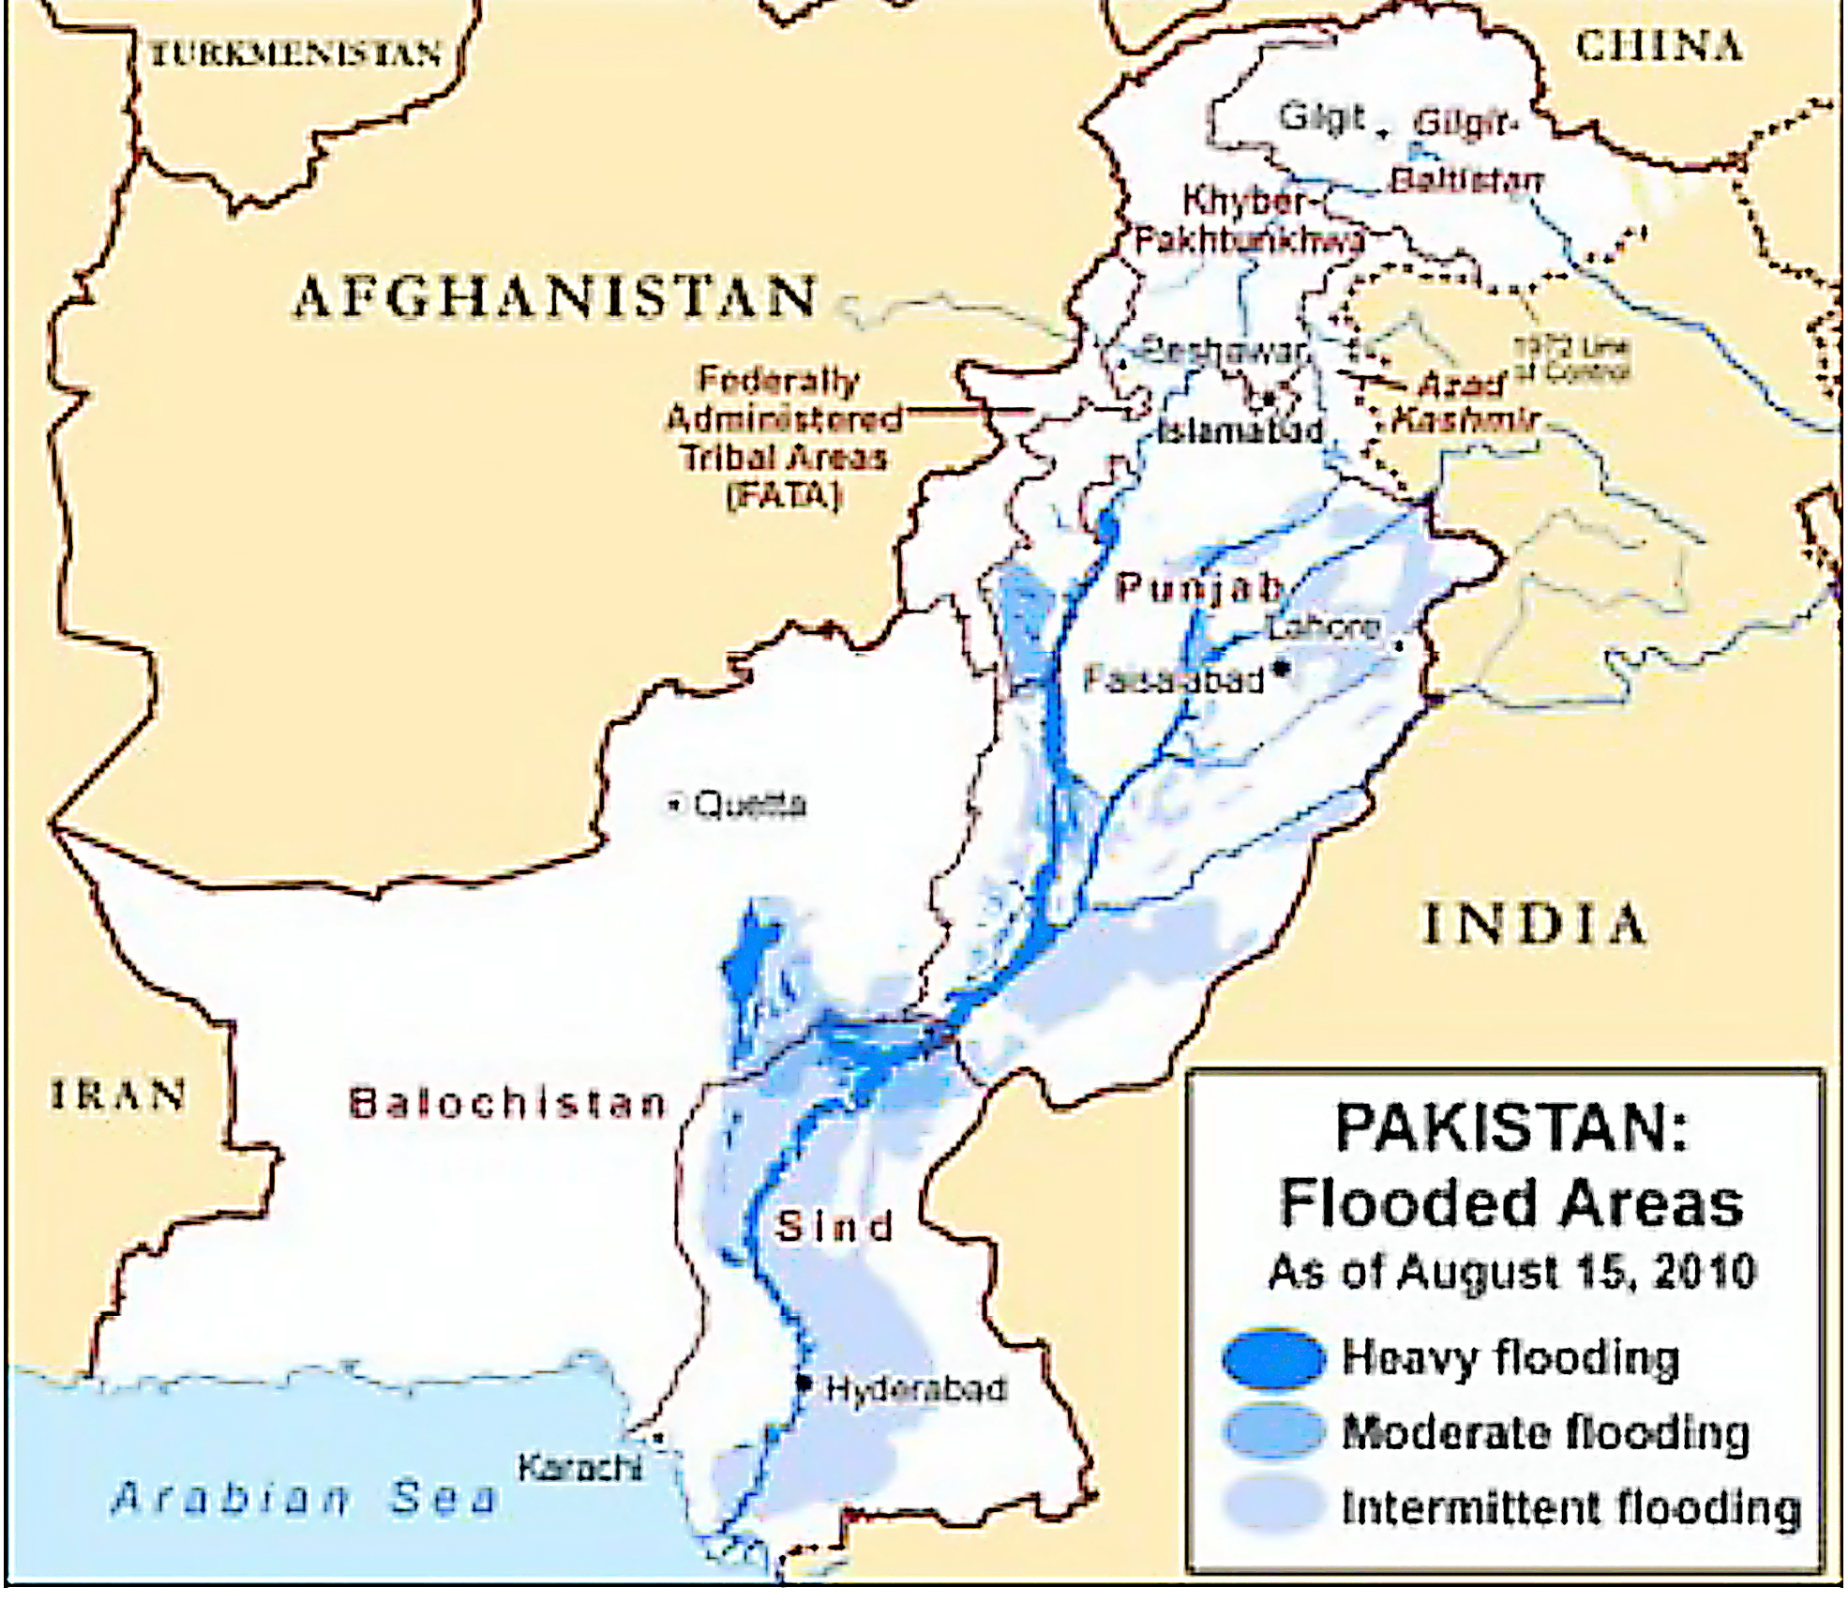
Leh 2010

Slide 23
Pakistan 2010
Pakistan 2010

Slide 24
Pakistan 2010
Pakistan 2010
"Almost 20 million people need shelter, food and emergency care. That is more than the entire population hit by the Indian Ocean tsunami, the Kashmir earthquake, Cyclone Nargis, and the earthquake in Haiti—combined.”
Secretary-General Ban Ki-moon
August 2010

Slide 25
Pakistan 2011 2012
Pakistan 2011, 2012

Slide 26
The synoptic situation during flood time periods was remarkably similar in all three years

Slide 27
Common factor:
no dry subsiding flow from the west—instead deep moist inflow from the east

Slide 28
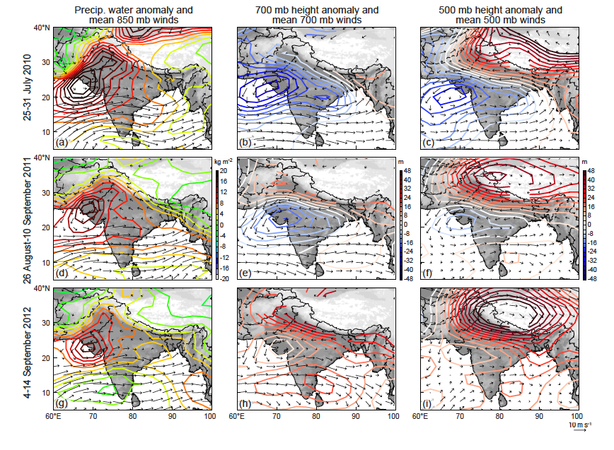
Synoptic conditions during 2010, 2011, 2012 flood periods
2010
Midlevel easterly jet
2011
2012

Slide 29
The precipitation events over India & Pakistan in 2010-12 were also very unusual!

Slide 30
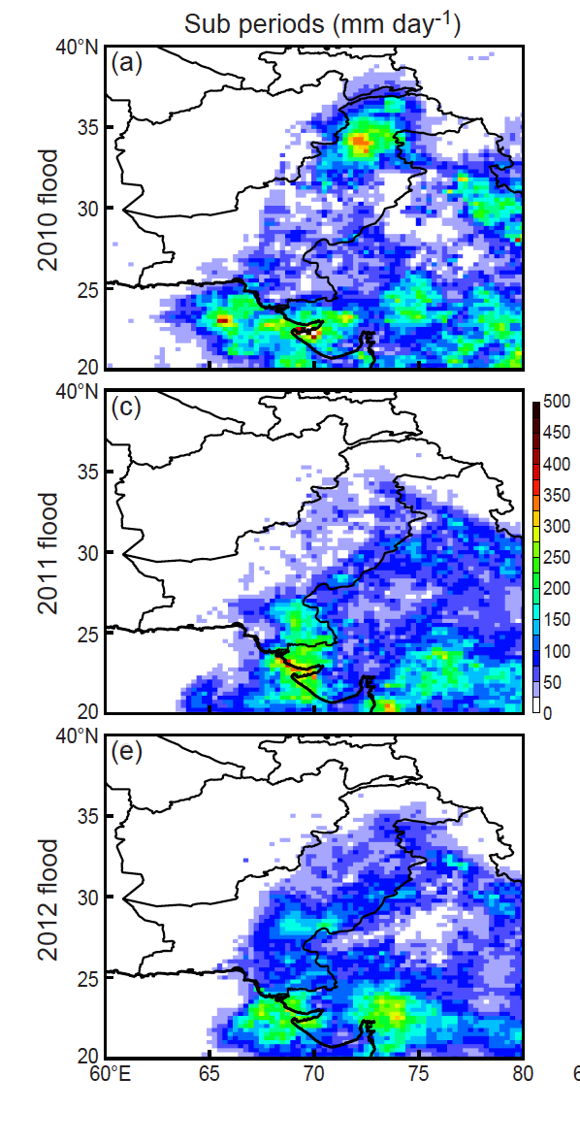
Regional
Climatology for Pakistan
2010
2011
2012

Slide 31
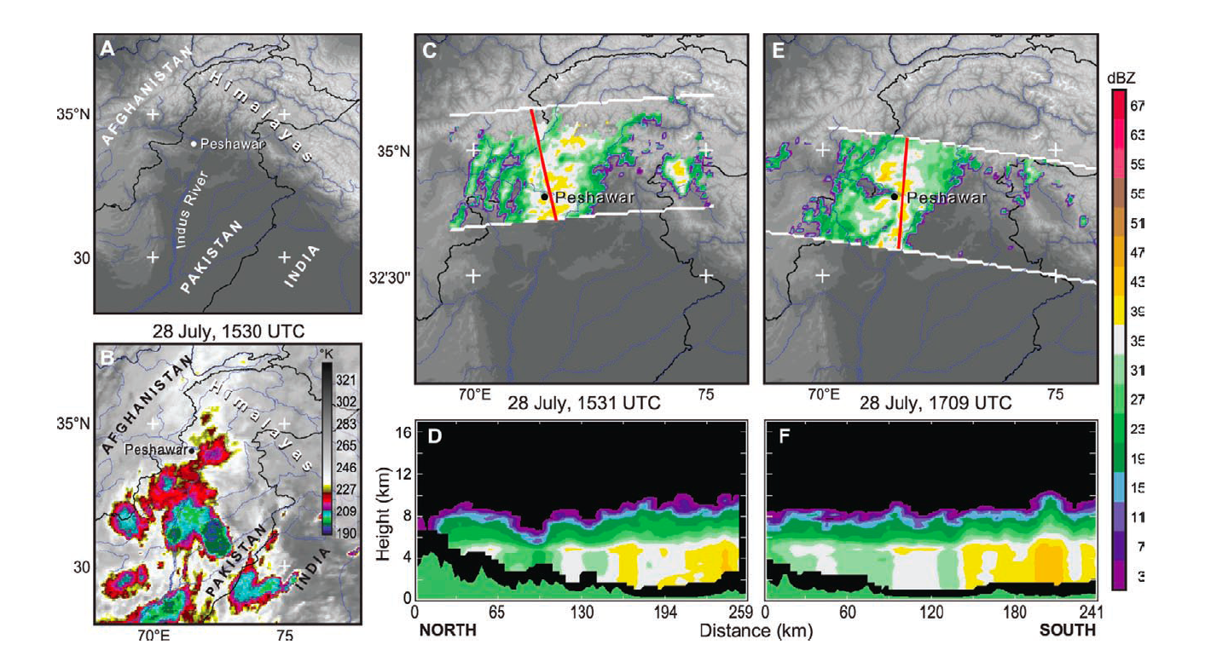
TRMM view of flood producing storms Northern Pakistan
2010
moisture
TRMM radar data
extensive stratiform

Slide 32
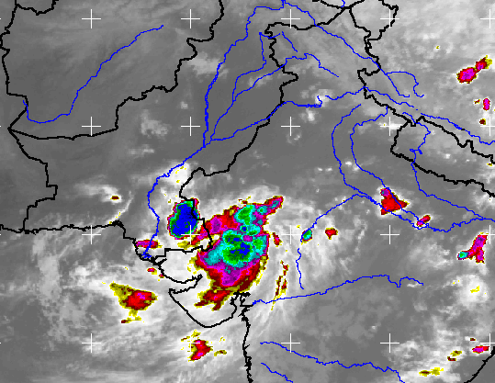
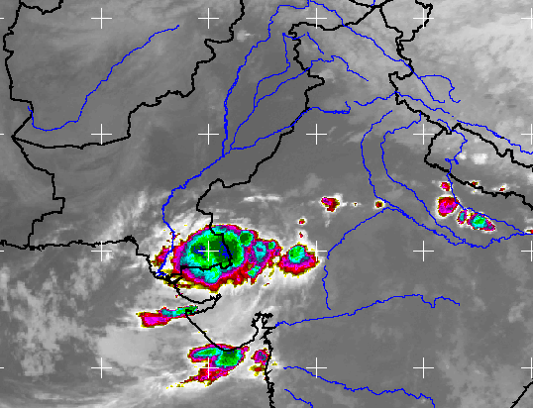
TRMM view of flood producing storms Southern Pakistan
2011

Slide 33
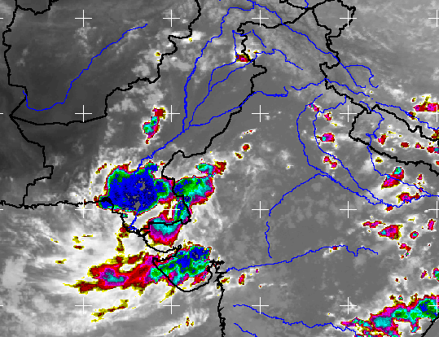
TRMM view of flood producing storms Southern Pakistan
2011

Slide 34
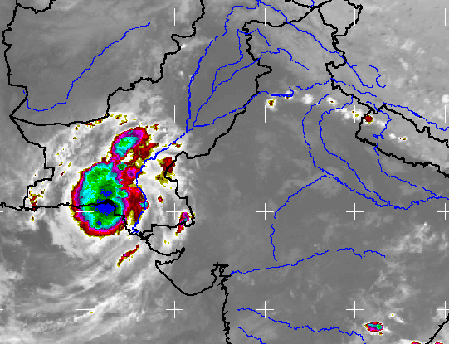
TRMM view of flood producing storms Southern Pakistan
2011

Slide 35
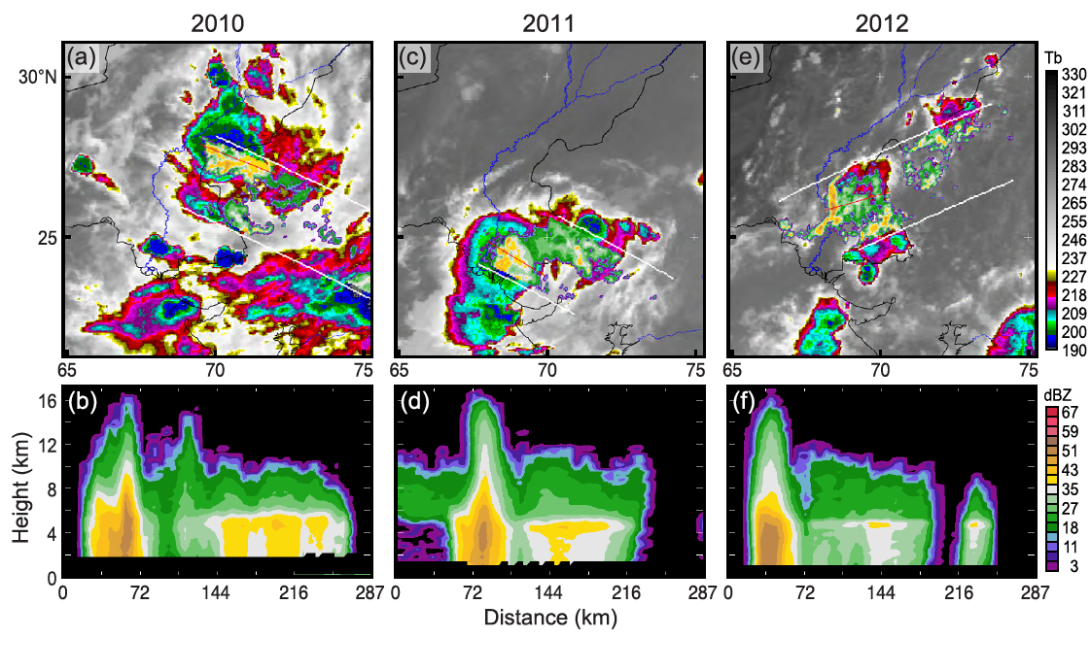
TRMM view of flood producing squall lines Southern Pakistan
All 3 years

Slide 36
India & Pakistan floods 2010-2012
Summary
The abnormalities
Much stratiform rain—rare for these arid regions
Deep moist flow from the east—normally dry from the west—due to midlevel cyclone over western India and ridge over the Tibetan Plateau
Midlevel jets easterly jets—organizing convection into mesoscale systems
The different flood scenarios
2010 Flash flood in high Himalayas—traveling mesoscale system from Tibet meeting the low-level moisture
2010, 11, 12 Slow rising river over the southern plains of Sind—traveling mesoscale systems organized by easterly jet
2010 catastrophic flood over Pakistan—combination of upslope in the Himalayas and traveling mesoscale systems from the east
Notes:
We now look briefly at how we combine 2 of these properties to first identify MCSs

Slide 37
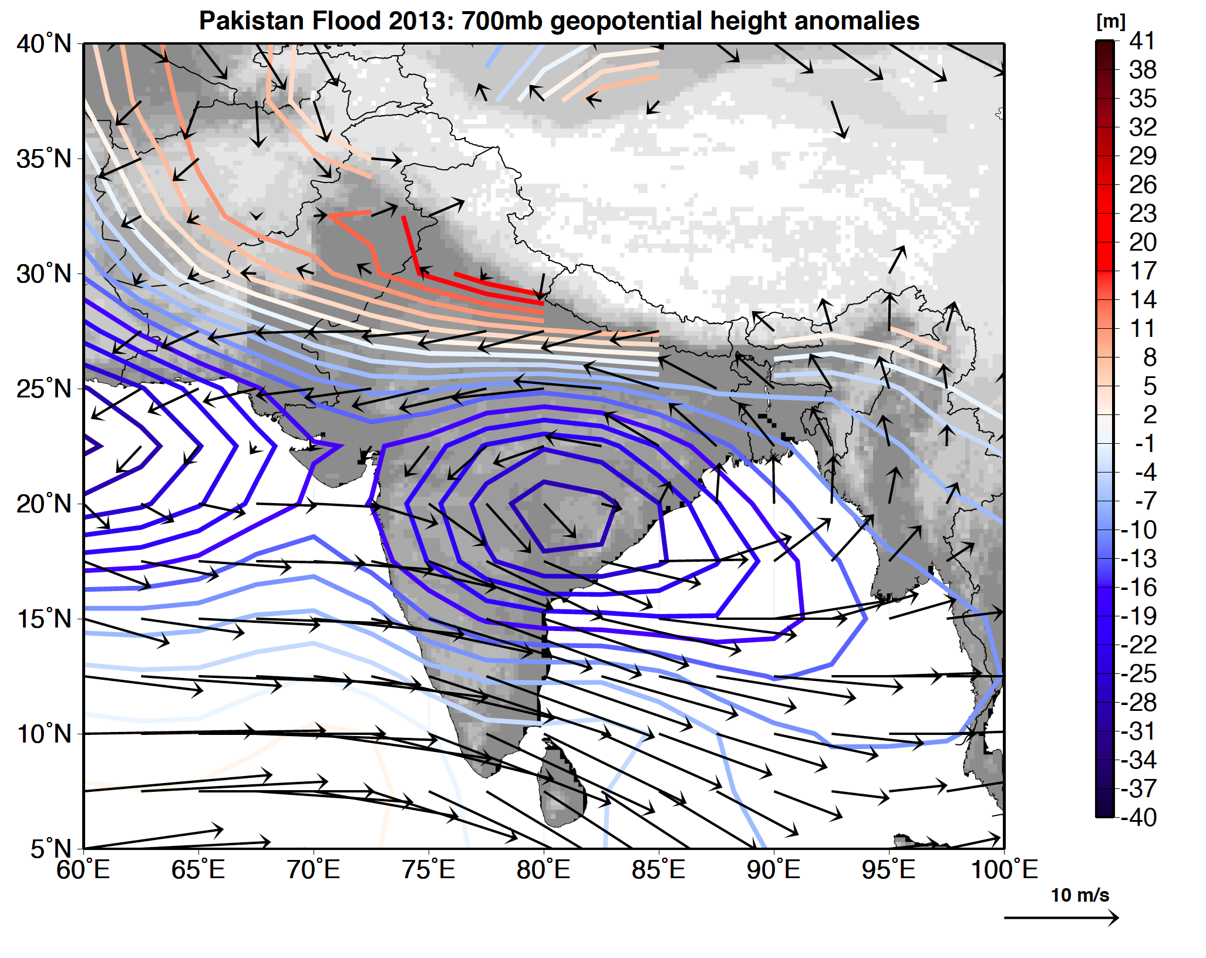
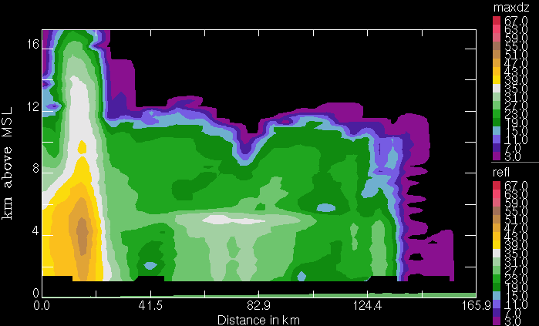
Epilogue
2013
x
Notes:
We now look briefly at how we combine 2 of these properties to first identify MCSs

Slide 38
End
This research was supported by
NASA grants NNX10AH70G & NNX13AG71G
NSF grant AGS-1144105

Slide 39
Southern Pakistan 2013
Notes:
We now look briefly at how we combine 2 of these properties to first identify MCSs

Slide 40
Karachi 2013

Slide 43
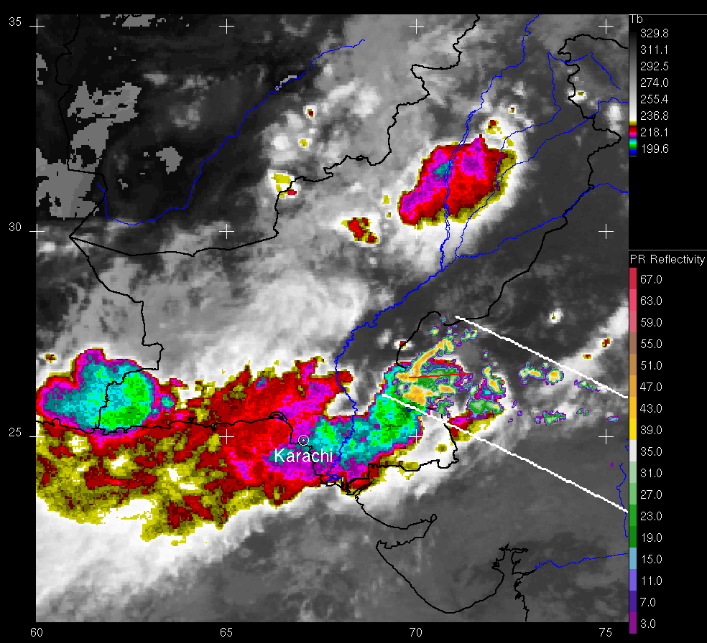
1200 GMT

Slide 44
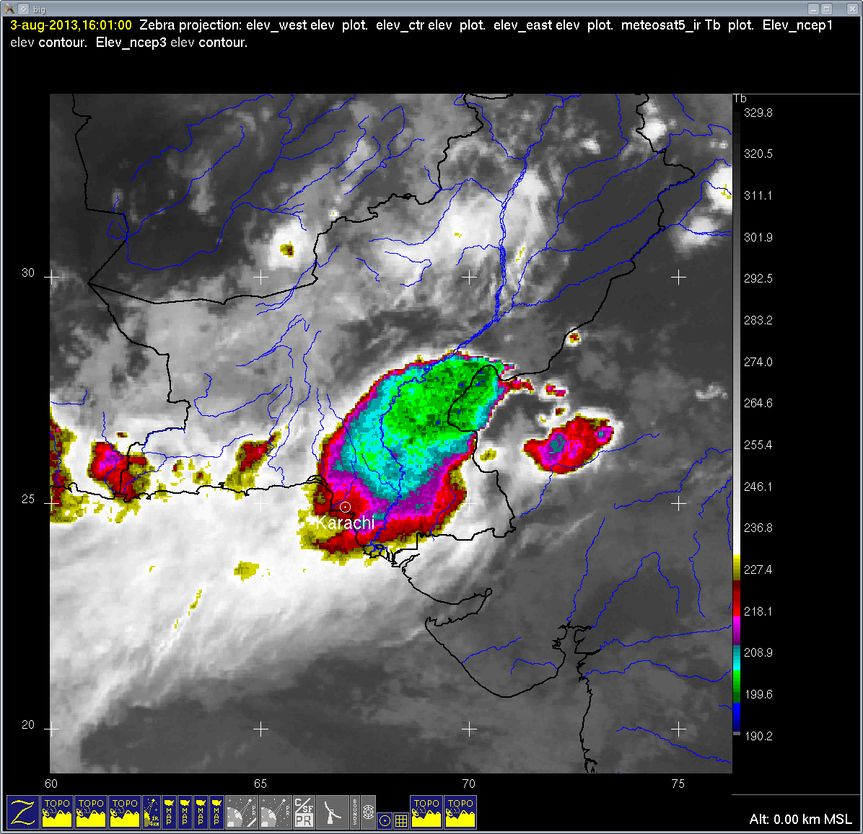
1600 GMT

Slide 45
Extra Slides
Notes:
We now look briefly at how we combine 2 of these properties to first identify MCSs

Slide 46
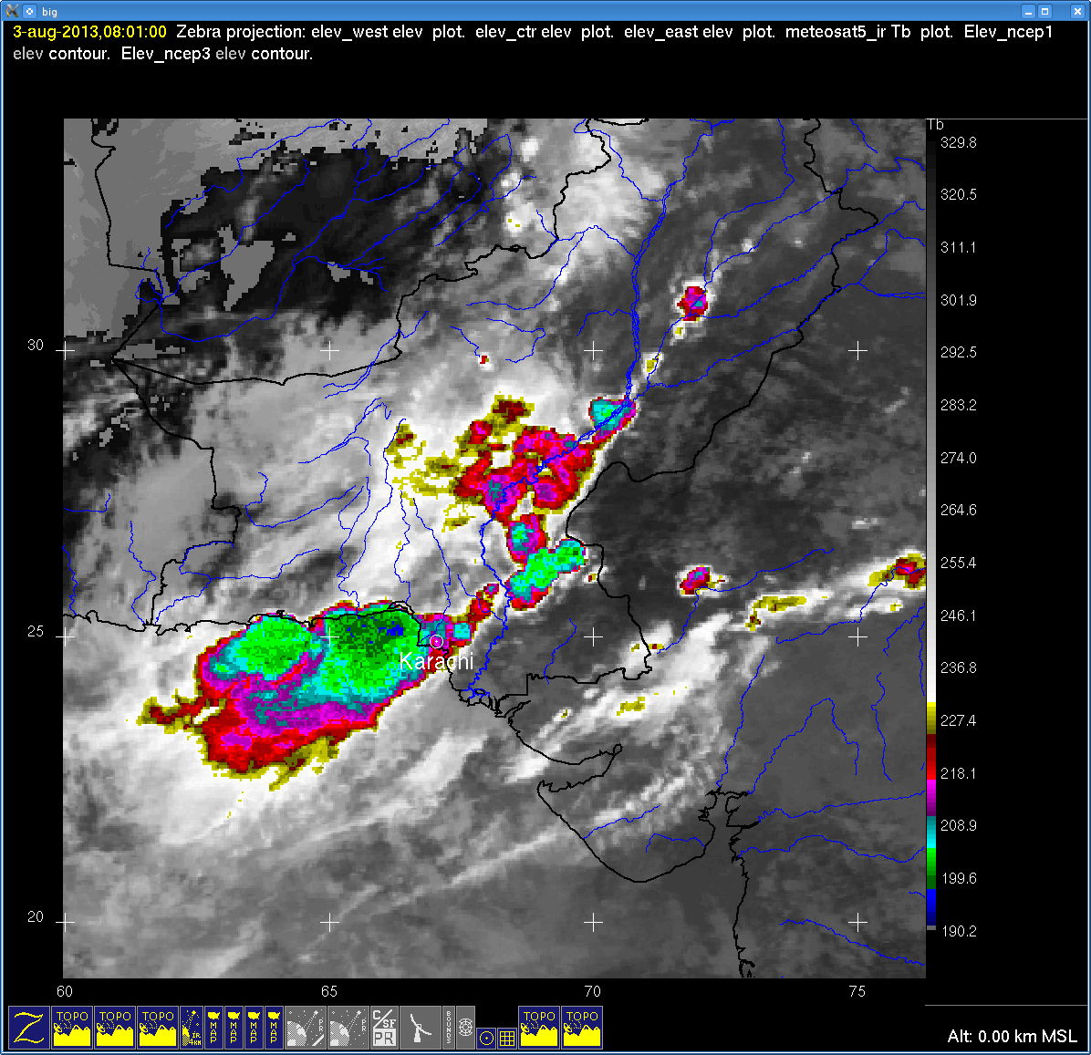

Slide 47
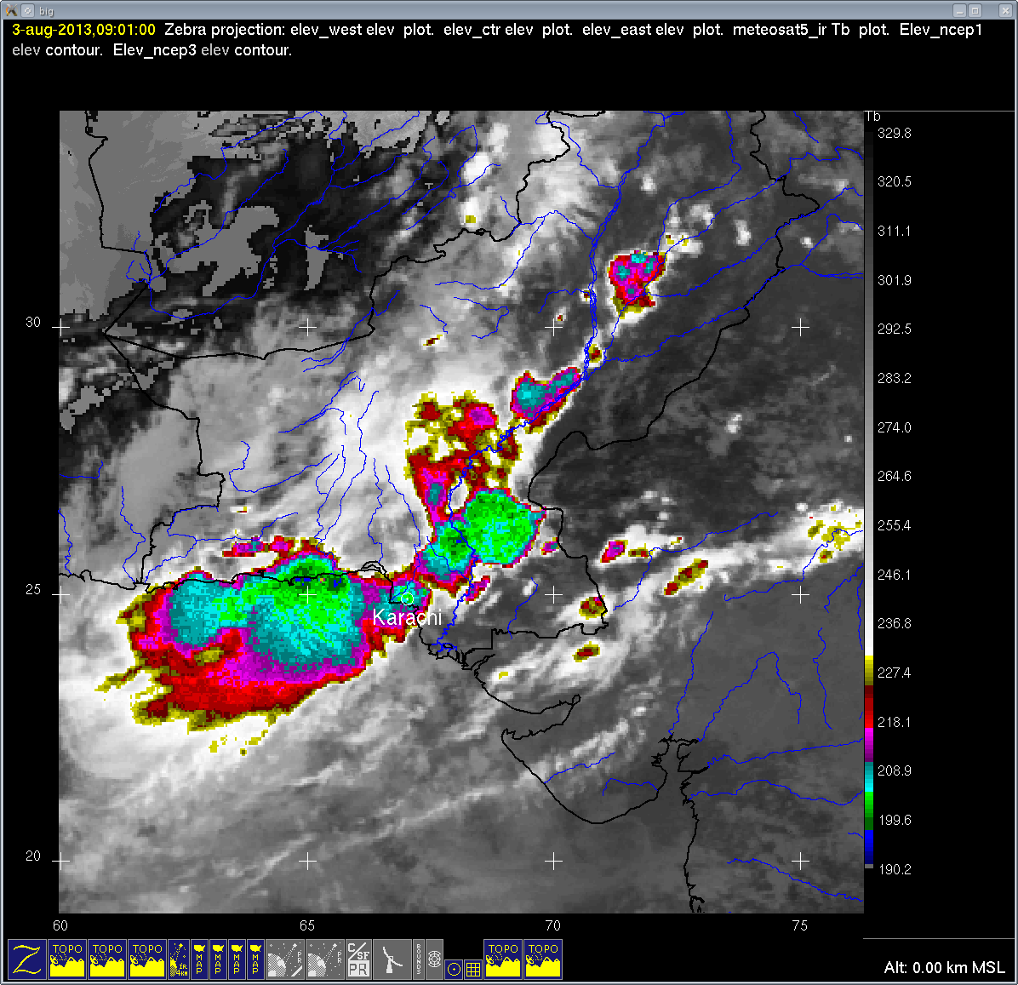

Slide 48
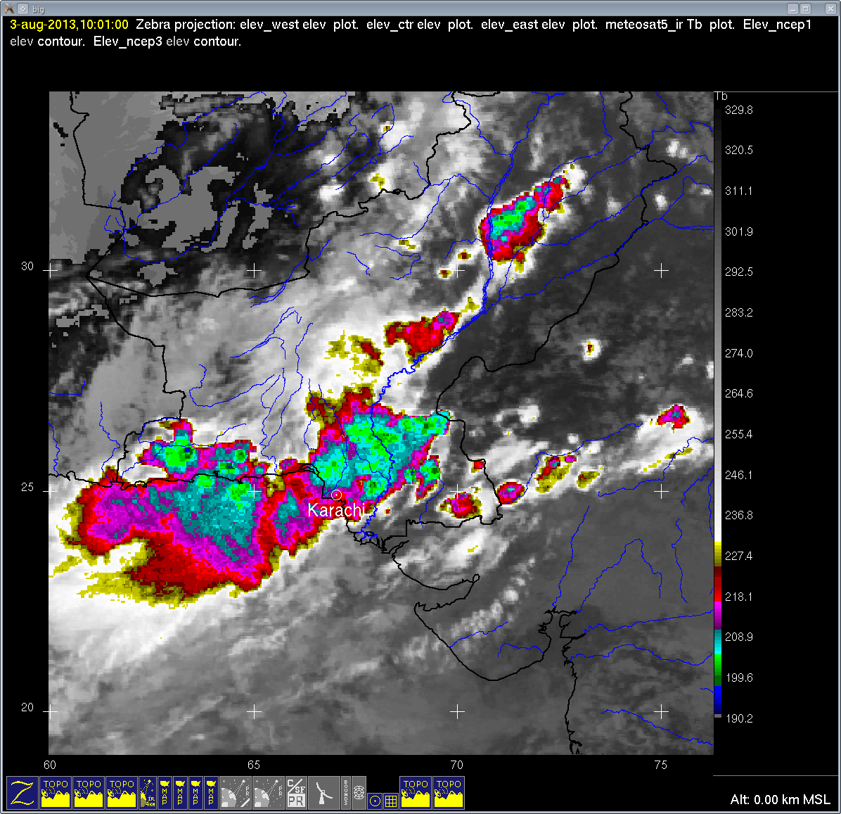

Slide 49
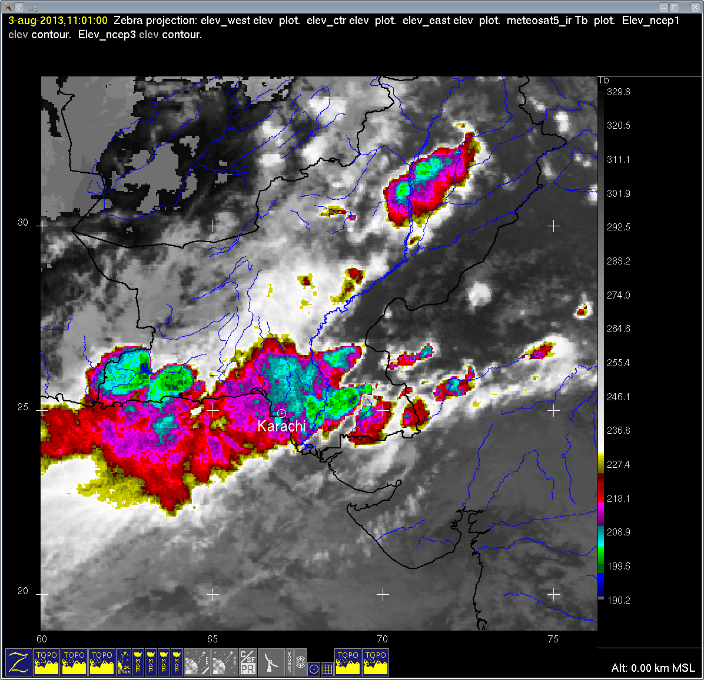

Slide 50
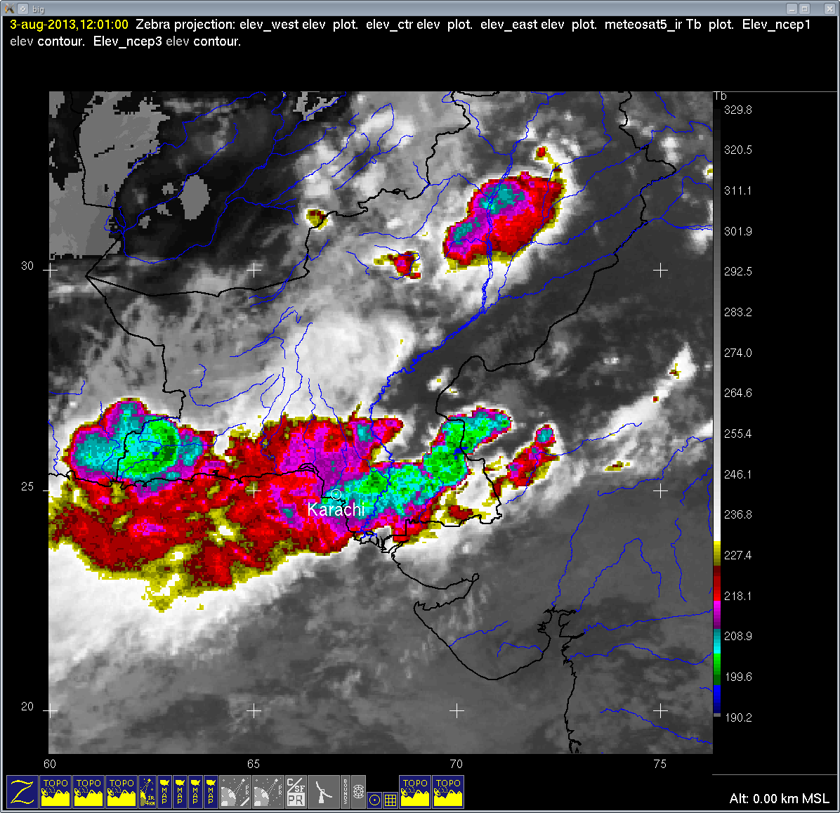

Slide 51
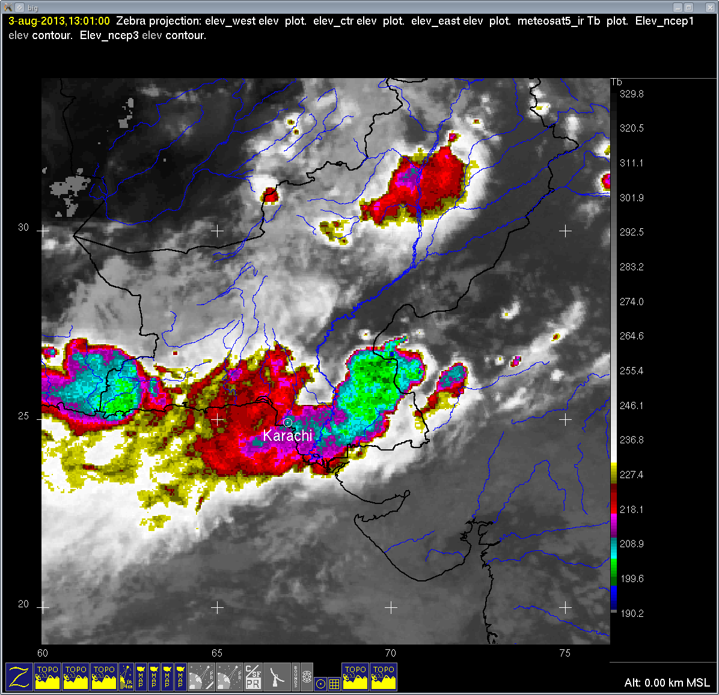

Slide 52
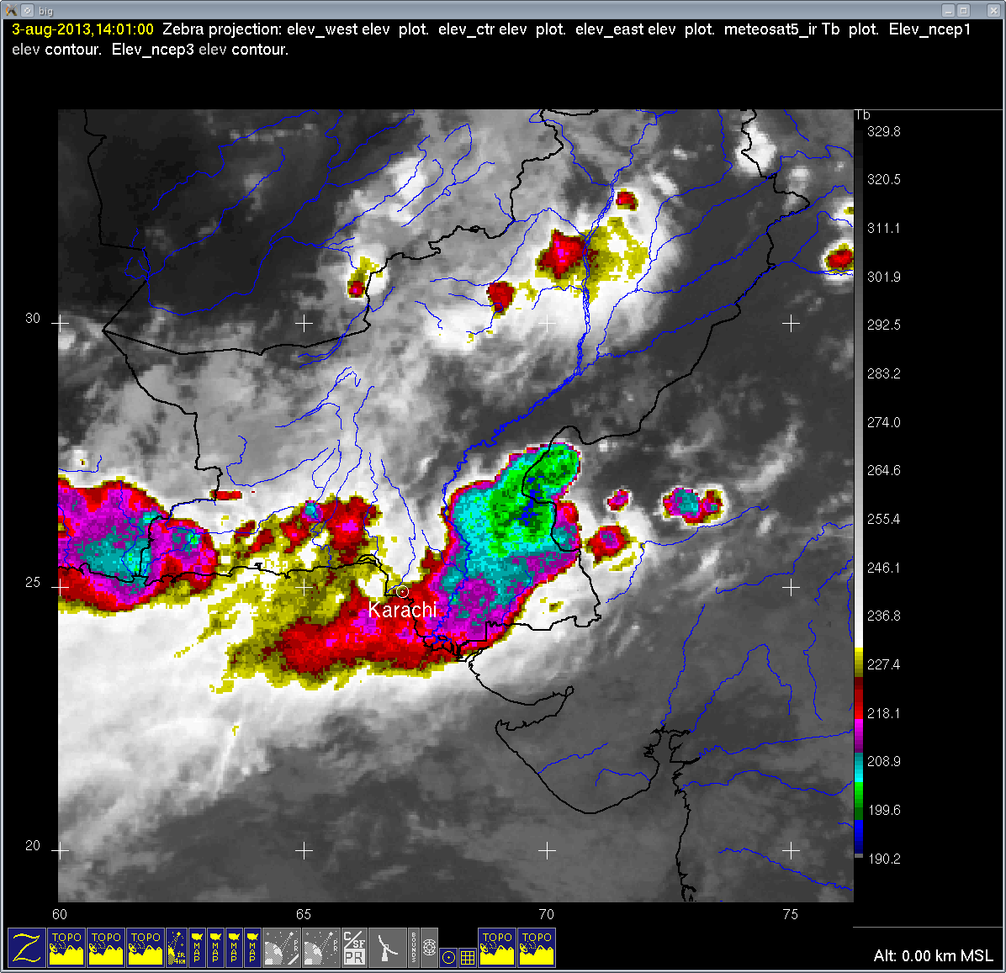

Slide 53
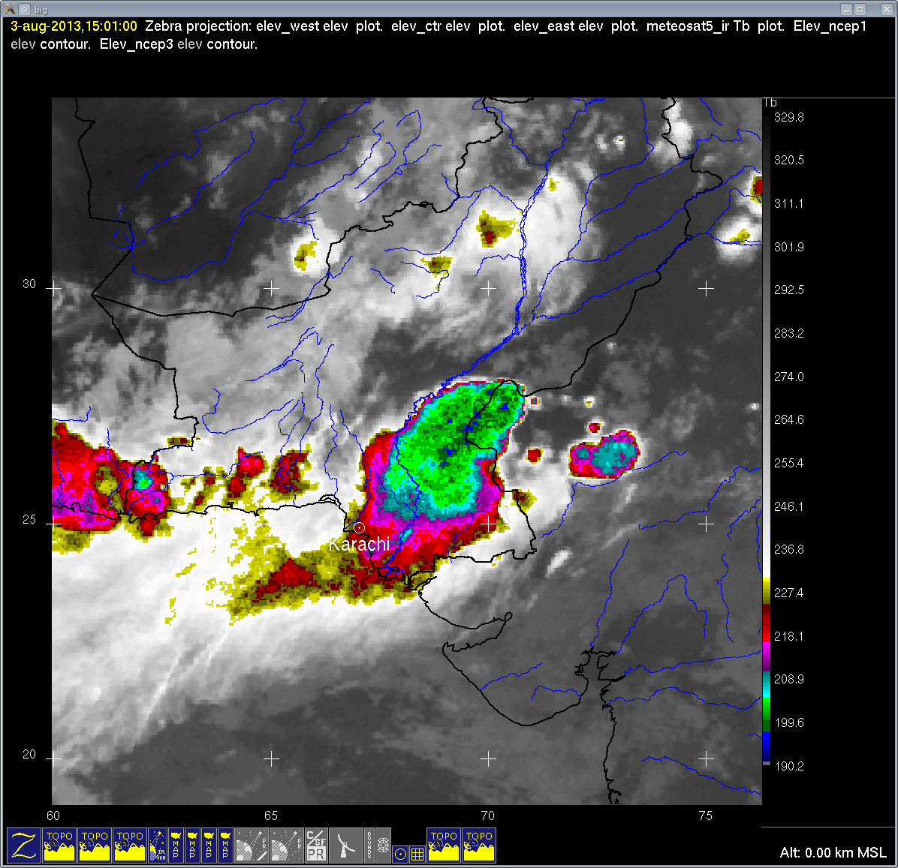

Slide 55
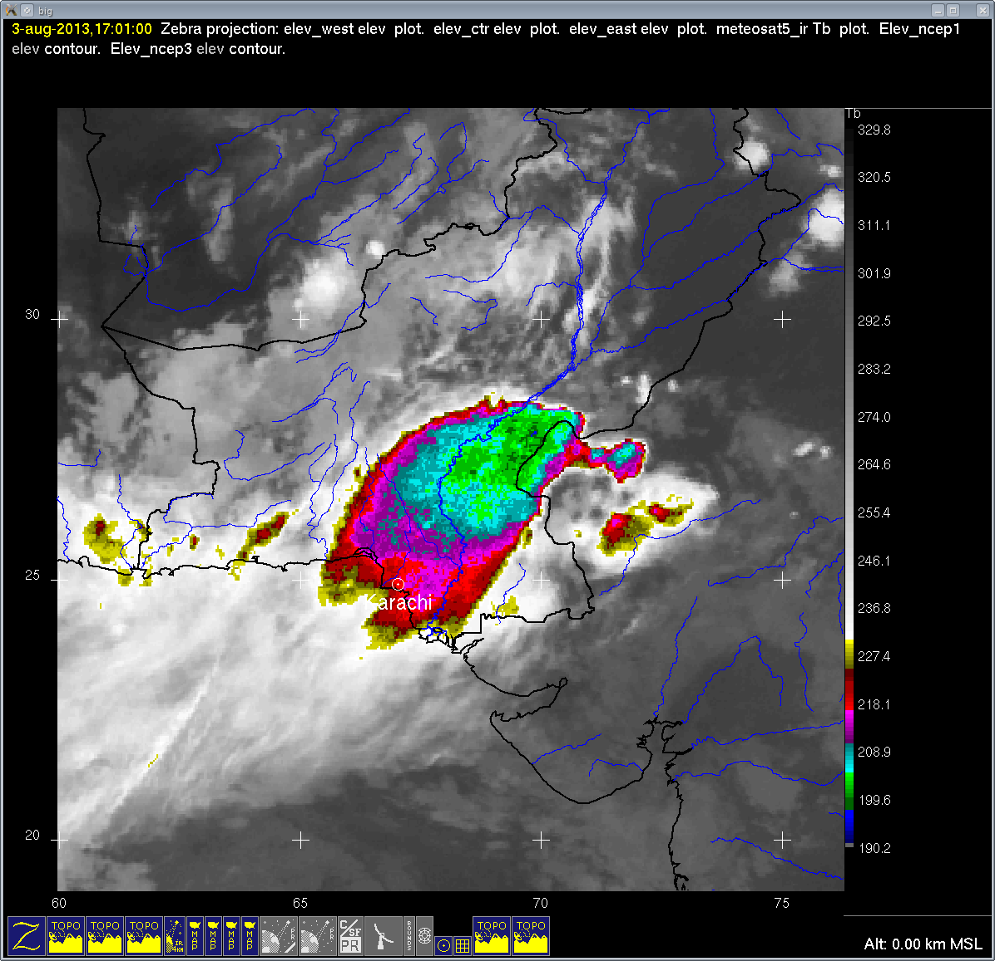

Slide 56
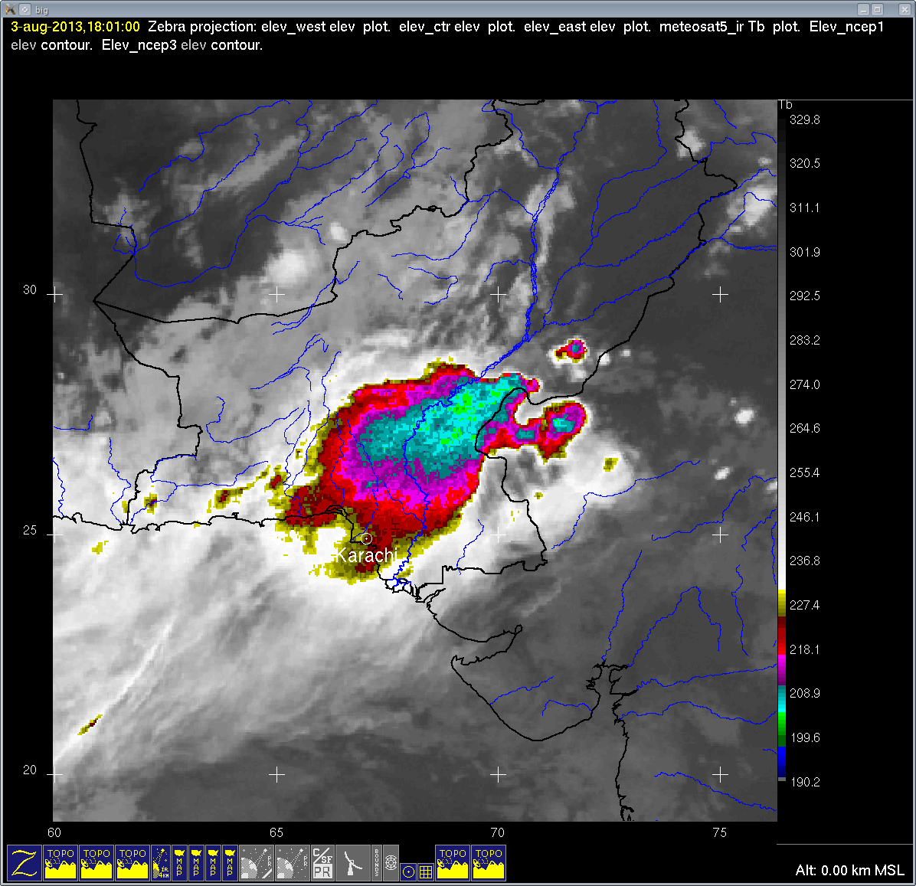

Slide 57
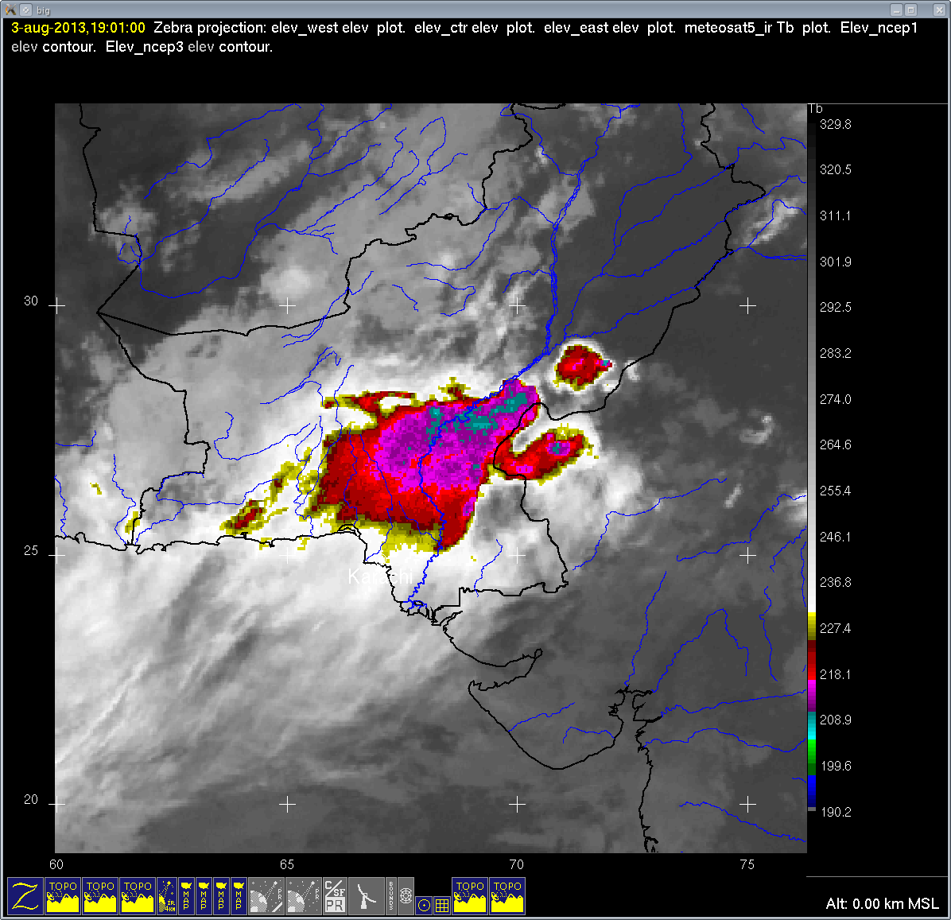

Slide 58
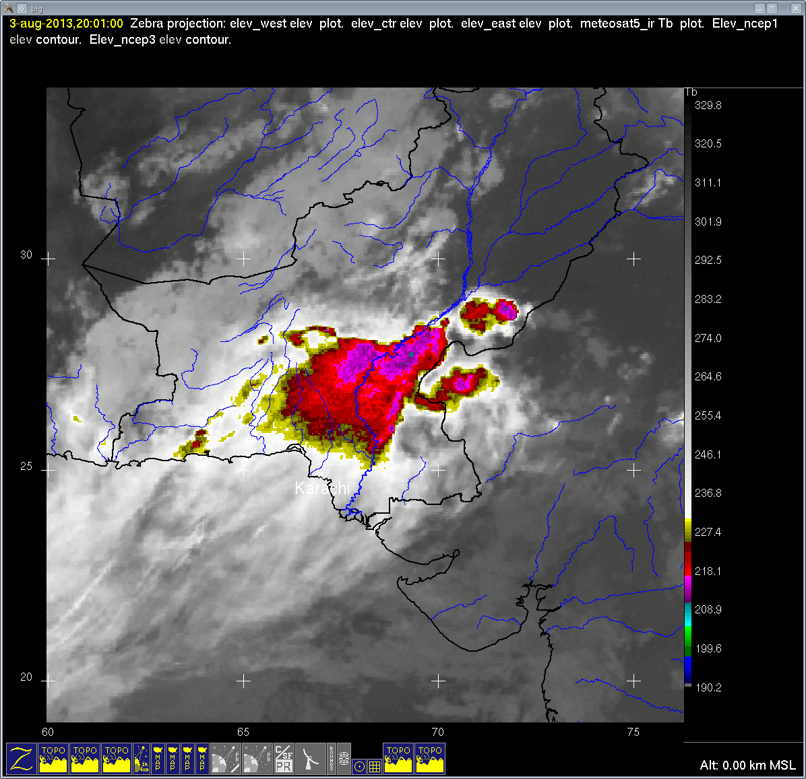

Slide 59
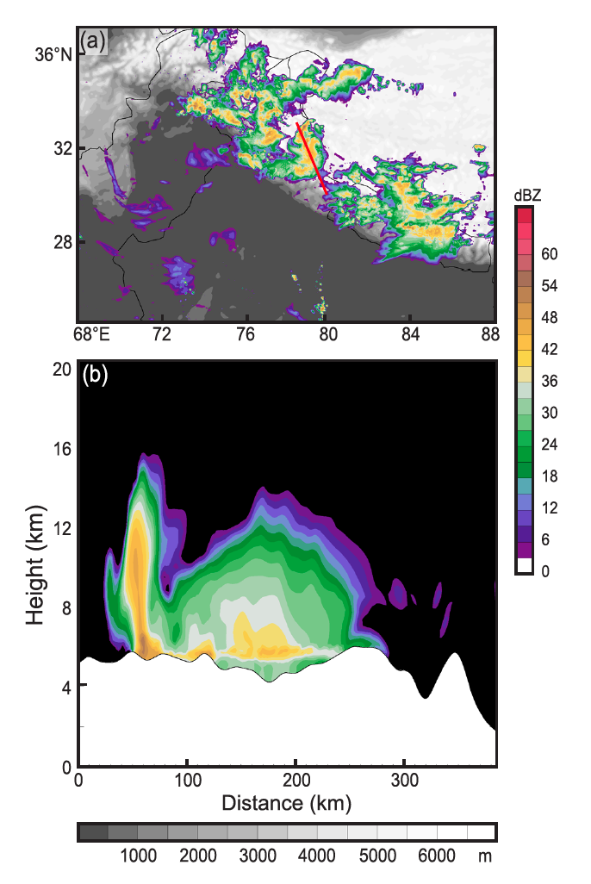
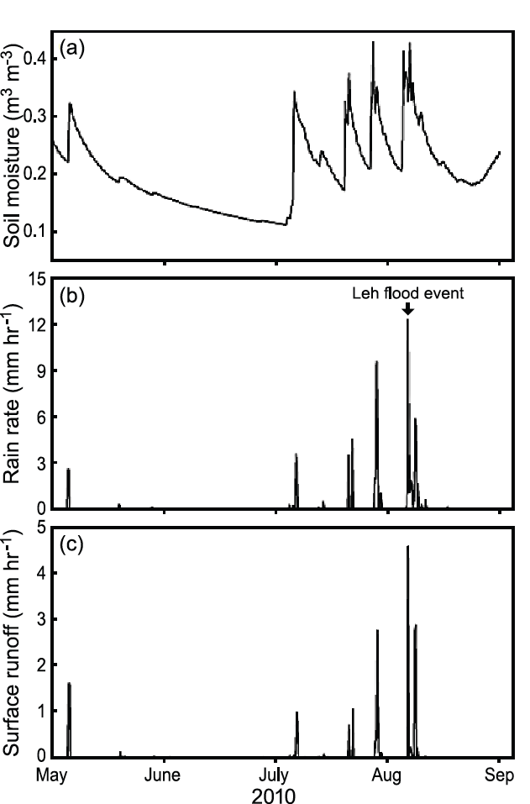
Leh Flood, WRF + GSFC LIS model
Soil moisture
Rain
Runoff

Slide 60


Slide 61


Slide 62

Synoptic conditions during 2010, 2011, 2012 flood periods
2010
2011
2012

Slide 63
Meteorological ingredients of floods: (Adapted from Doswell, Brooks, and Maddox, 1996)
Large upward transport of air
Substantial water vapor content
High precipitation efficiency of the cloud system
Large and long-lasting cloud system

