Slide 1
Microphysical characteristics of MCSs observed during the MJO over the Indian Ocean
Angela K. Rowe and Robert A. Houze, Jr
University of Washington
94th AMS Annual Meeting
Atlanta, GA
4 February 2014

Slide 2
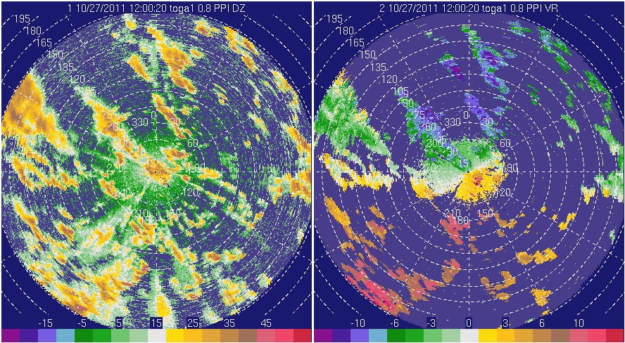
27-28 October 2011
Nearly 8” rain in 6 hours!

Slide 3
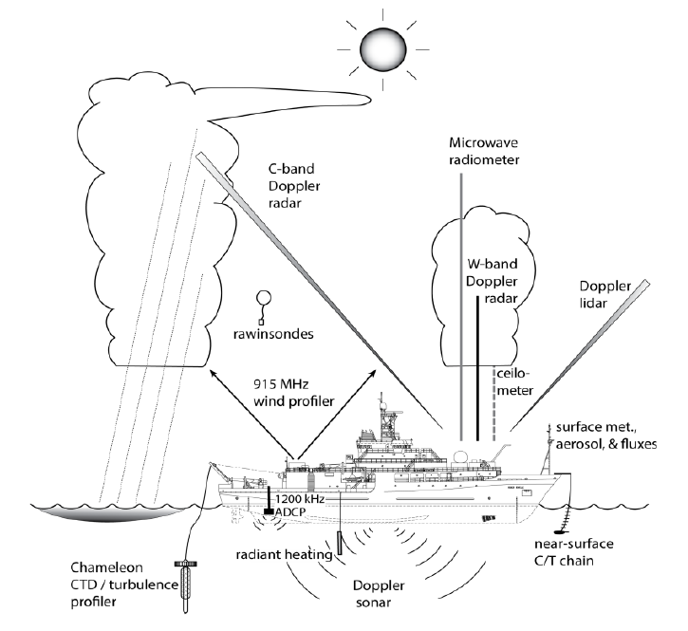
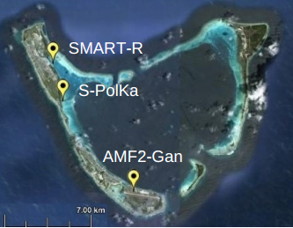
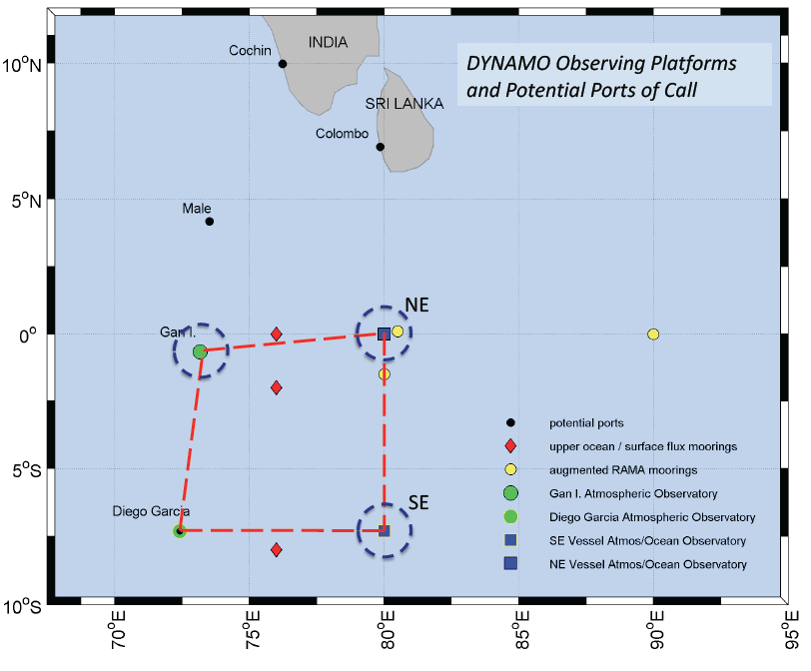
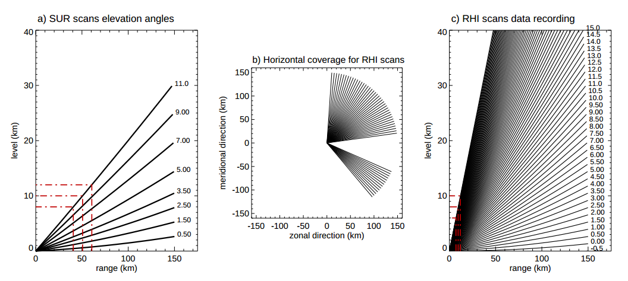
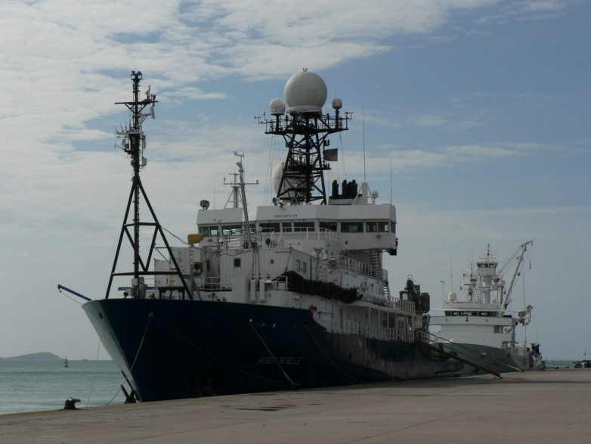
DYNAMO
Zuluaga and Houze (2013)

Slide 4
S-PolKa
Radar network: Observe convective population and transition from shallow to deep
Doppler: Airflow within the storm
  Momentum transport
Convective/stratiform
  Organization, latent heating
Dual-polarization
  Shape, size, water content, phase,…
  Particle identification, microphysical properties

Slide 5
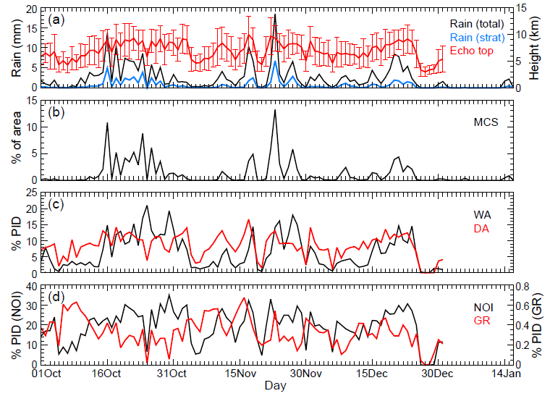
6
7
8
1
2
4
5
3
6
7
8
1
2
3
4
5
4
5
6

Slide 6
Objectives
How are hydrometeors vertically distributed in convective systems during active phases?
  Compared to suppressed?
Are the hydrometeor characteristics similar for each active MJO period?
What differences exist between the convective and stratiform components of these systems?

Slide 7
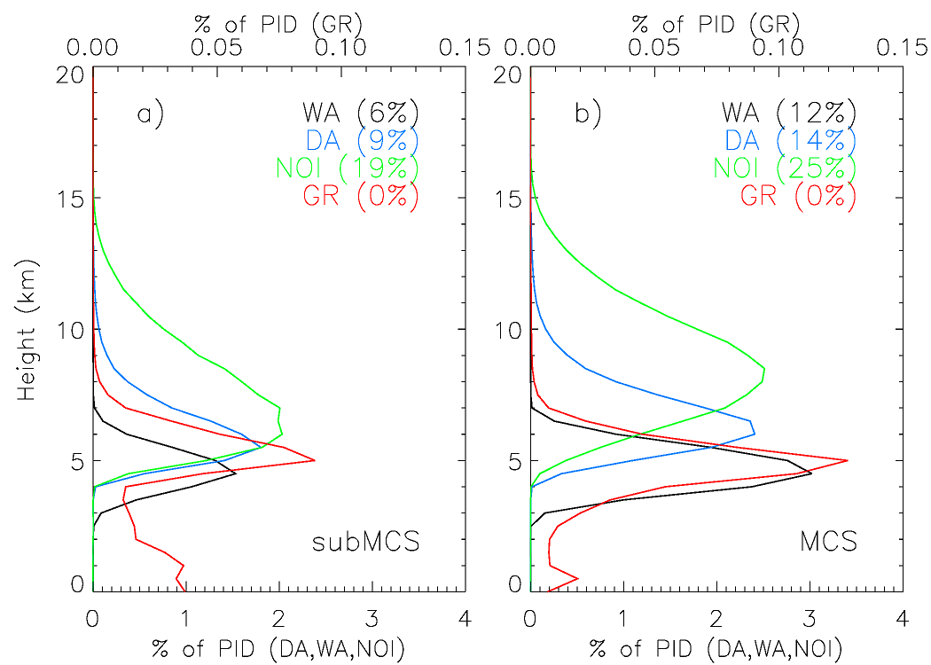
Vertical profiles
Ice crystals
Ice crystals
Dry Agg
Dry Agg
Graupel
Graupel
Wet Agg
Wet Agg

Slide 8
Hydrometeor profiles

Slide 9
What’s different about December?

Slide 10
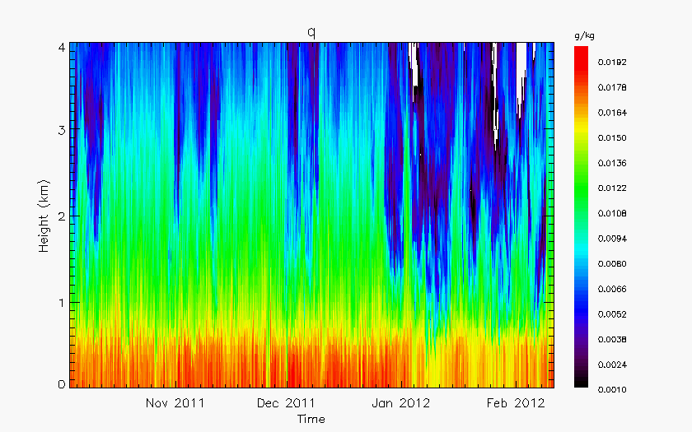
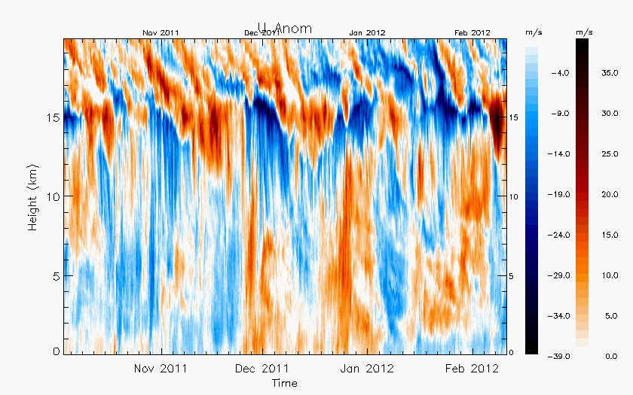
Sounding data
Zonal wind anomaly
Specific humidity

Slide 11
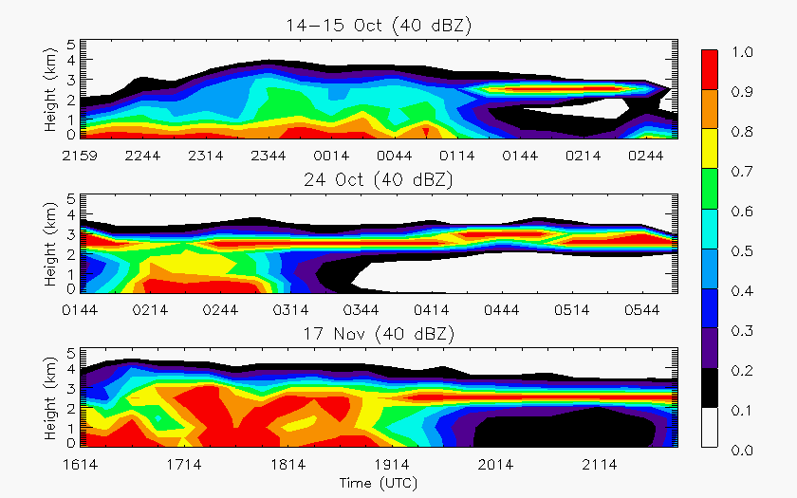
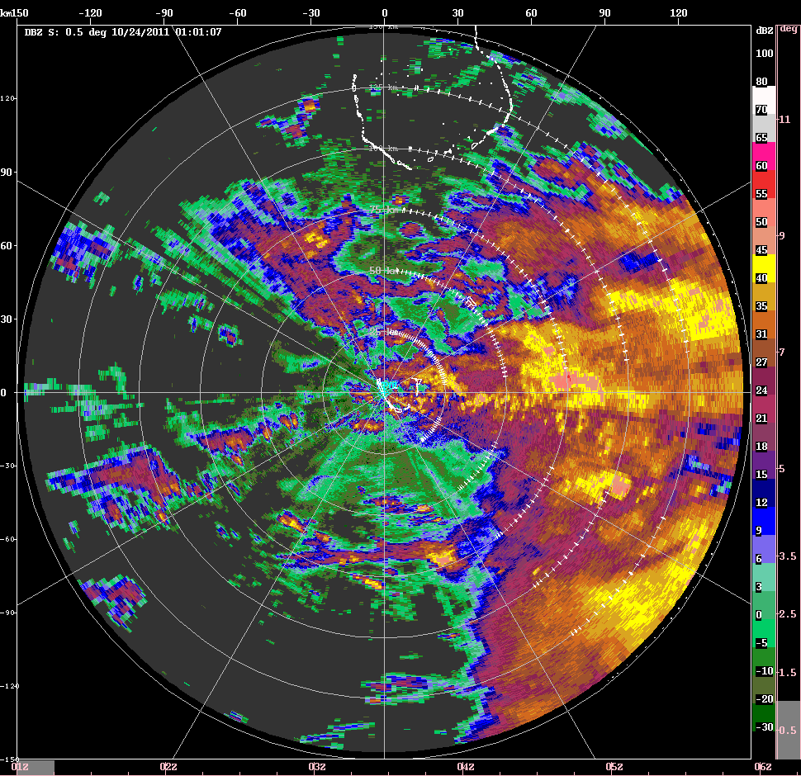
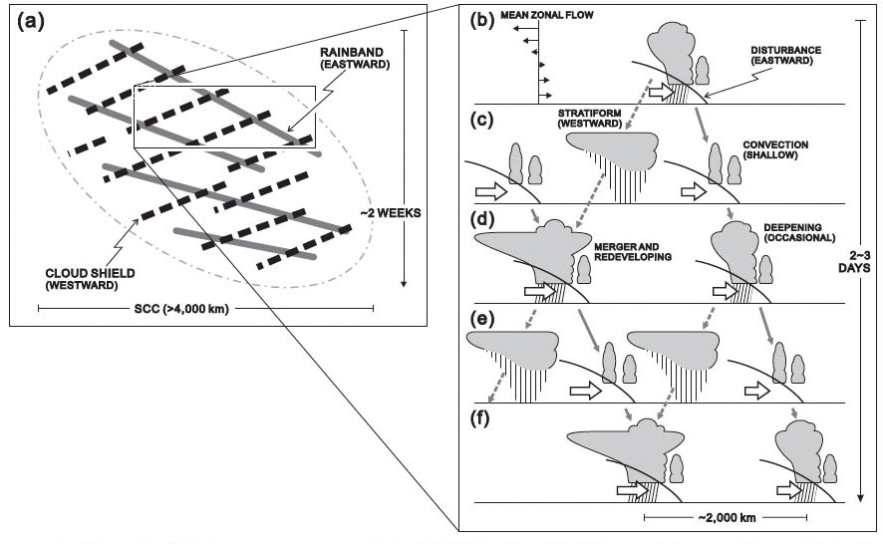
Oct, Nov
Yamada et al. (2010)
MISMO

Slide 12
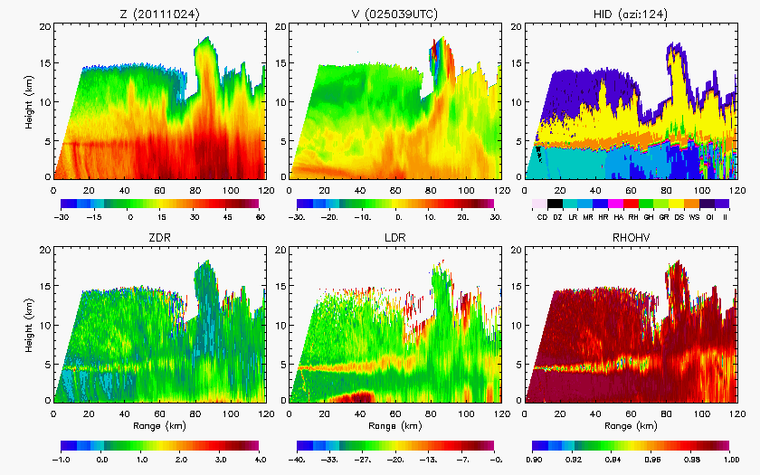
0250 UTC 24 Oct 2011

Slide 13
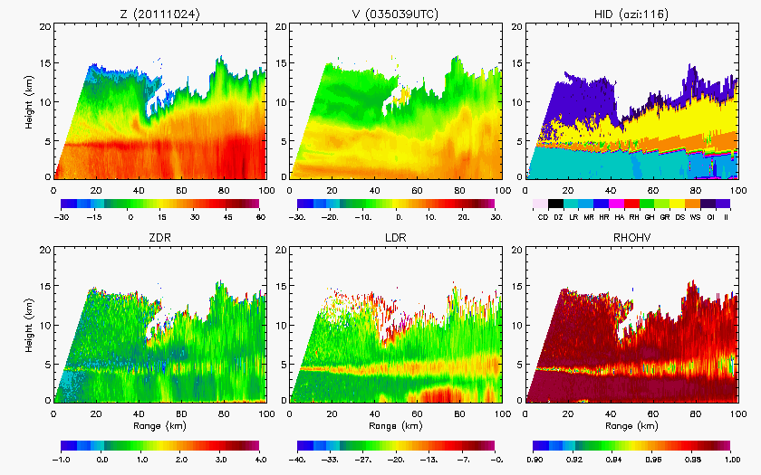
0350 UTC 24 Oct 2011

Slide 14
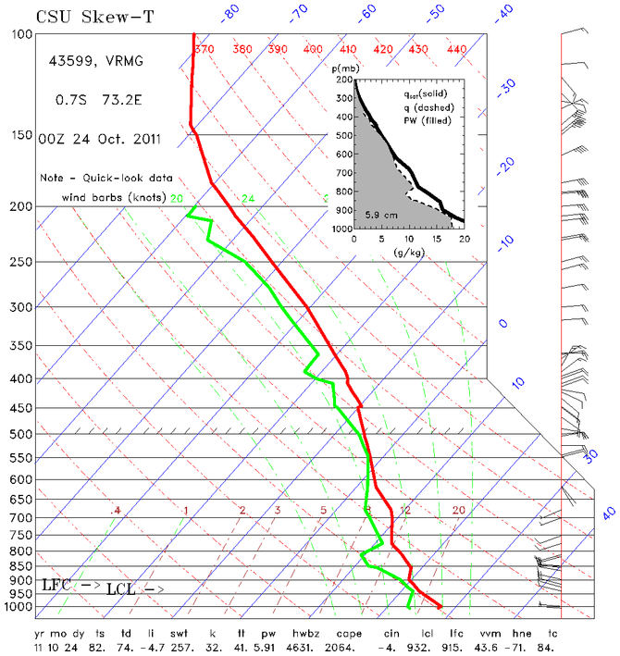
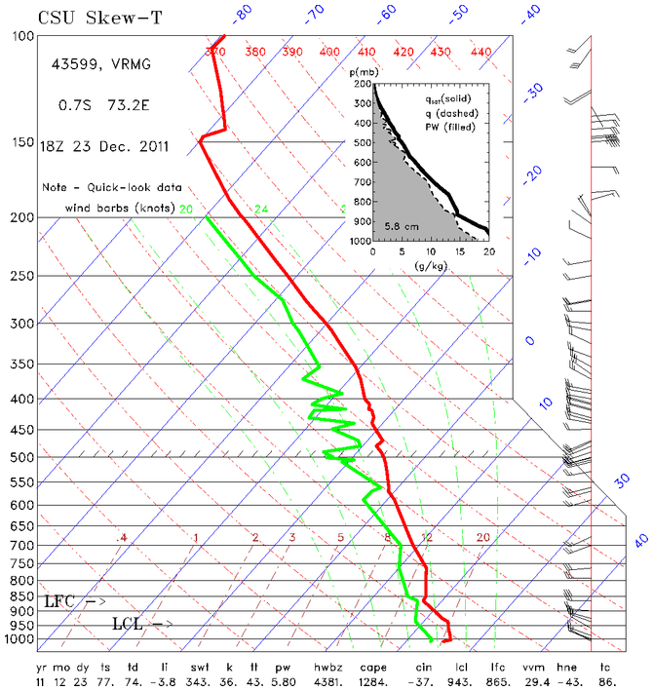
October
December

Slide 15
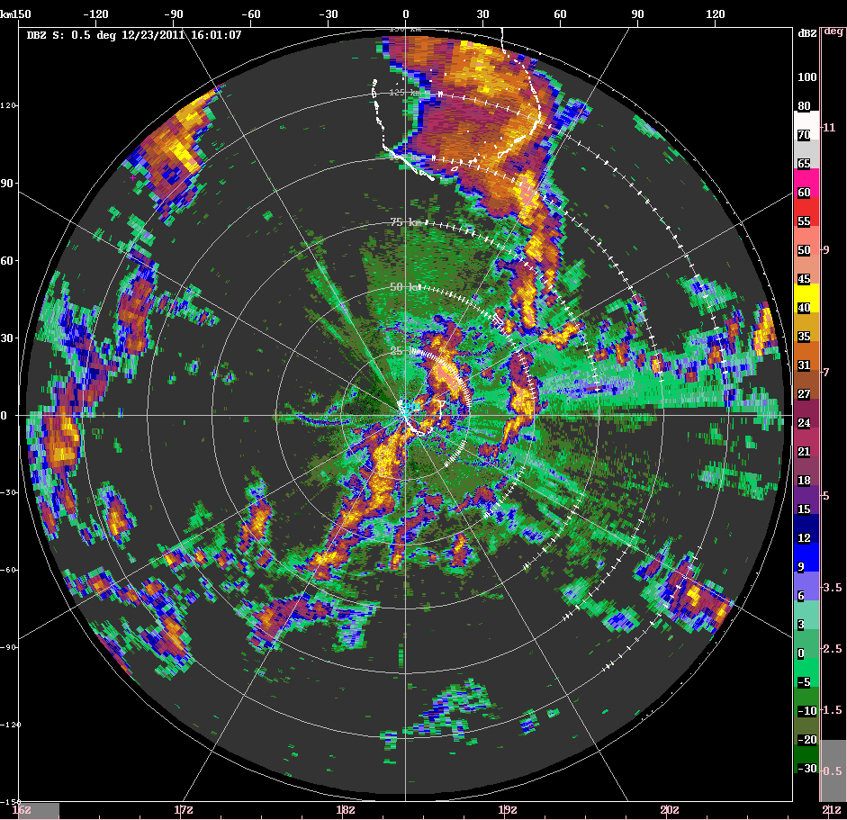
December

Slide 16
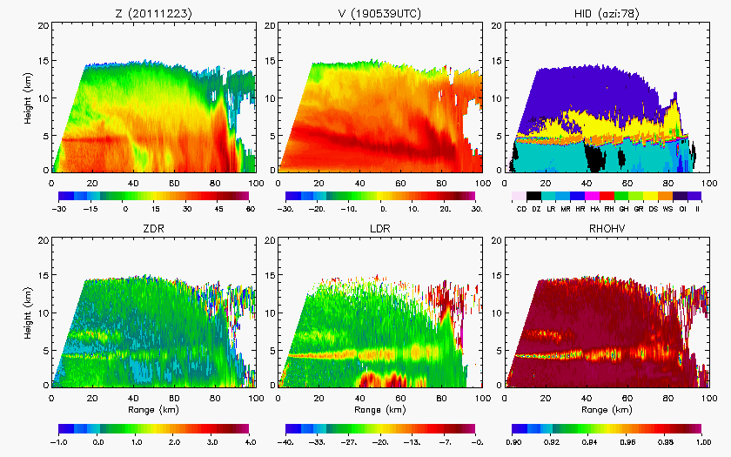
23 Dec 2011

Slide 17
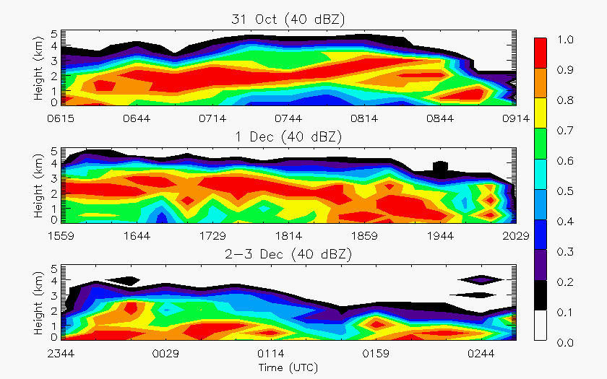
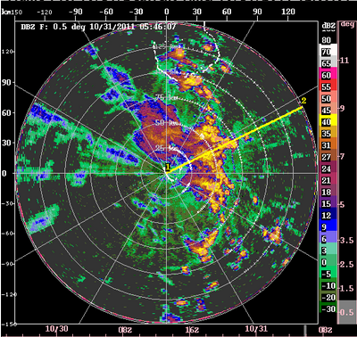
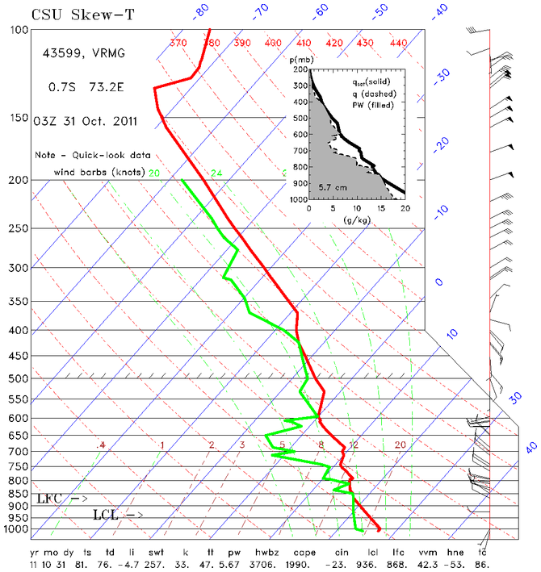
End of active phases

Slide 18
Take-home points
Similar hydrometeor profiles with enhanced wet aggregates during active periods and low overall occurrence of graupel
Individual MCSs show different characteristics for three groupings based on the environmental wind profile
  Increased westerlies generally resulted in shallower convection and less widespread stratiform as the active phases transitioned to more suppressed conditions
Fast-moving squall lines in Dec featured shallow convection and descending rear-inflow (similar to TOGA COARE)
  Oct/Nov active phase MCSs contained deep embedded convection in a weakly sheared environment with robust stratiform (similar to MISMO)

Slide 19
Thank you!
Funded by NSF Grant # AGS-1059611 and DOE Grant # DE-SC0008452

