Slide 1
Using the TRMM Precipitation Radar to Understand Floods in Pakistan and India
Robert A. Houze, Jr.
With contributions from:
K. Rasmussen, A. Hill, M. Zuluaga, and A. Kumar
AGU Annual Meeting, San Francisco, 12 December 2013
Notes:
We now look briefly at how we combine 2 of these properties to first identify MCSs

Slide 2
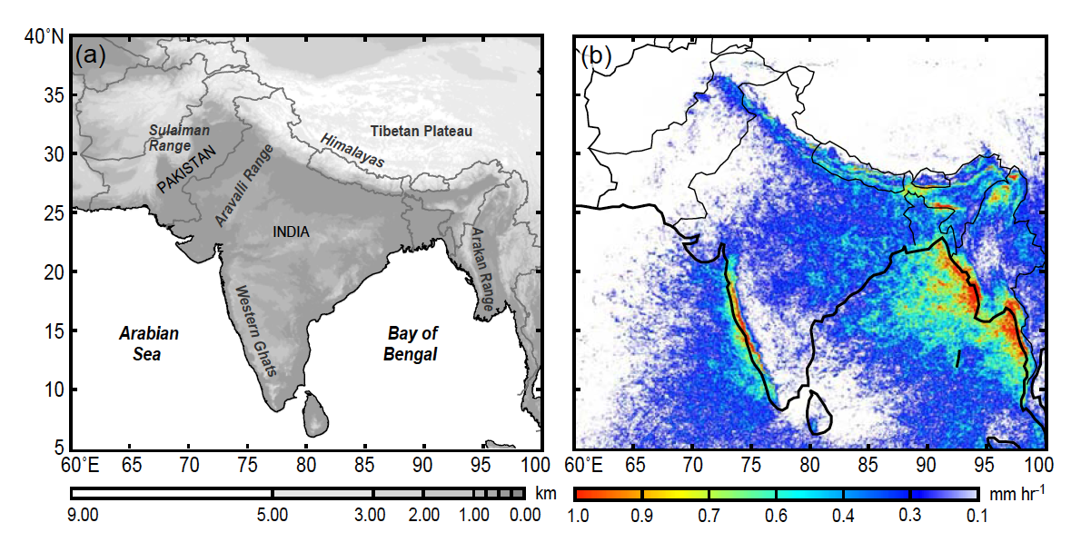
Monsoon Rainfall Climatology from TRMM

Slide 3
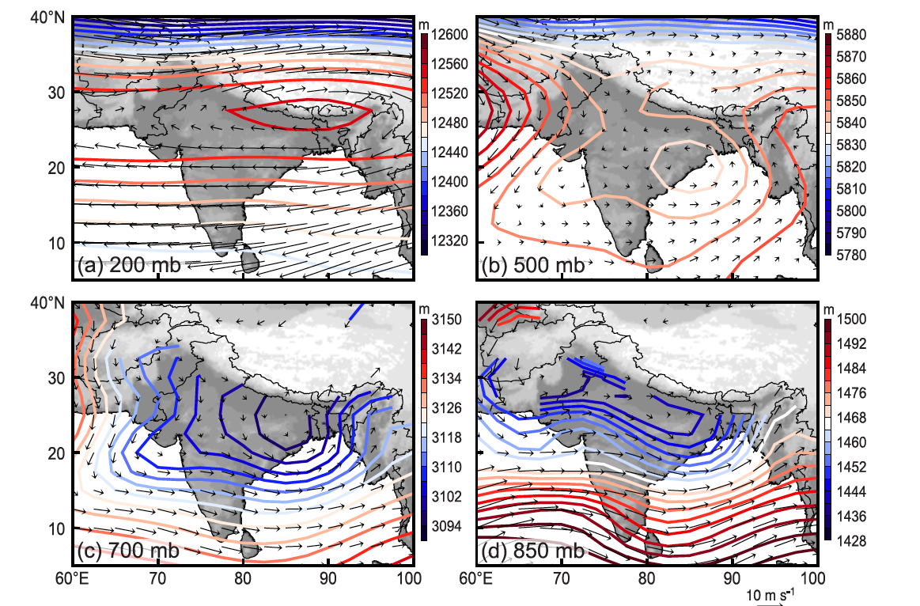
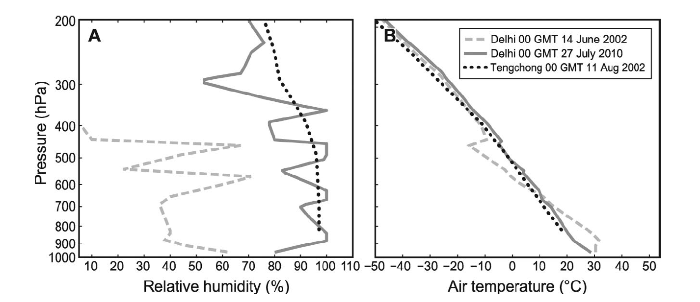
Synoptic climatology over South Asia in JJAS
RH
Temp

Slide 4
Compare to the flood periods in 2010, 2011 2012

Slide 5
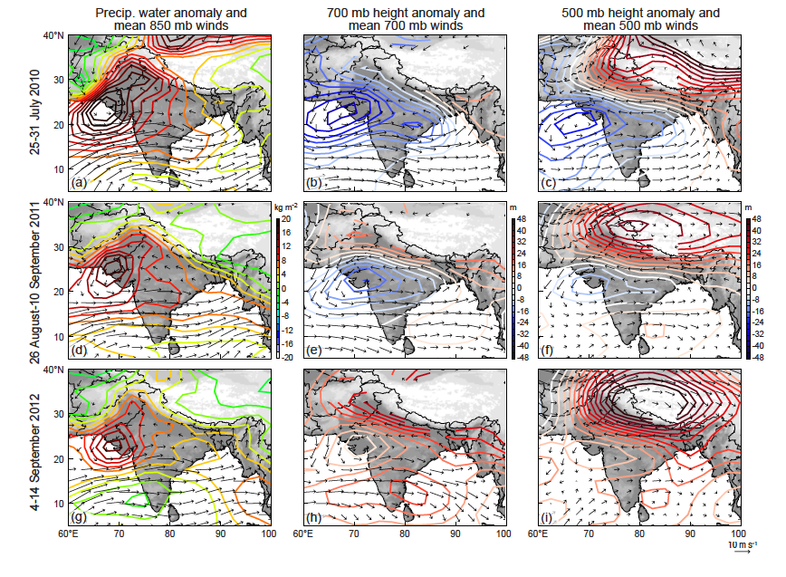
Synoptic conditions during flood periods
2010
2011
2011

Slide 6
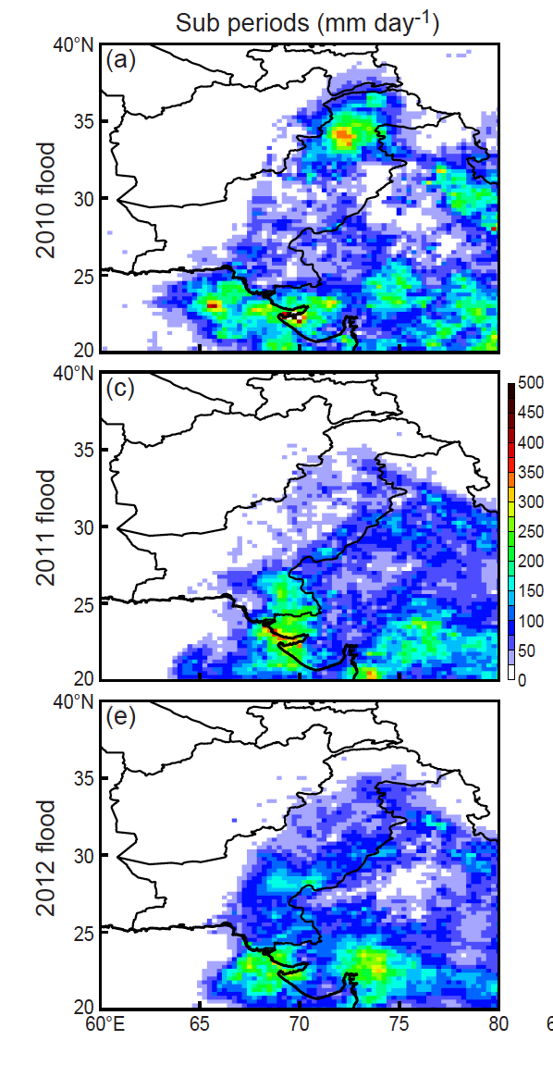
Regional
Climatology for Pakistan
2010
2011
2012

Slide 7
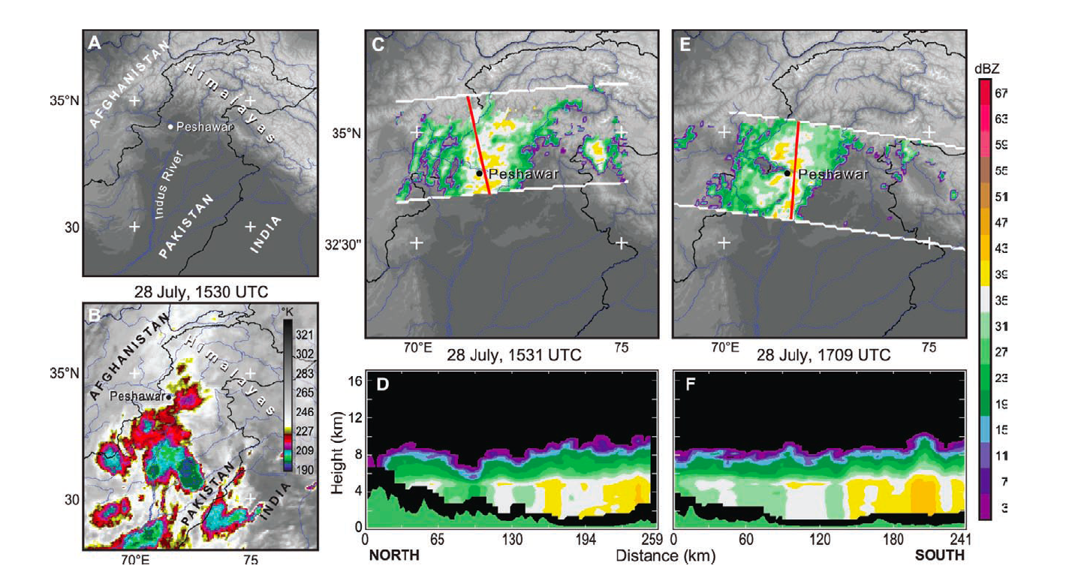
TRMM view of flood producing storms Northern Pakistan
2010

Slide 8
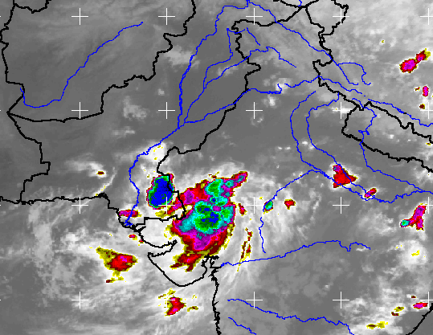
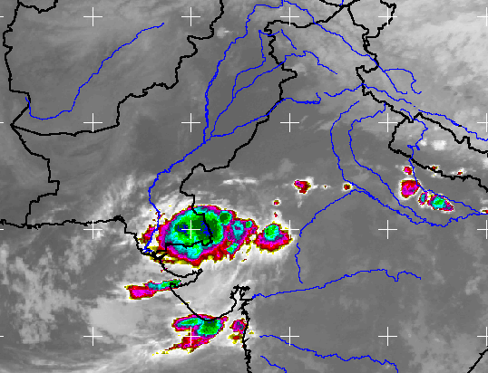
TRMM view of flood producing storms Southern Pakistan
2011

Slide 9
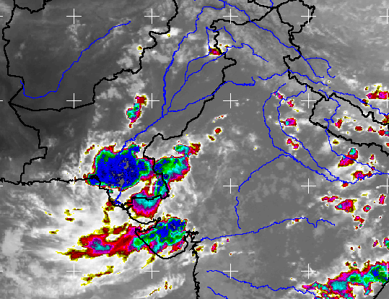
TRMM view of flood producing storms Southern Pakistan
2011

Slide 10
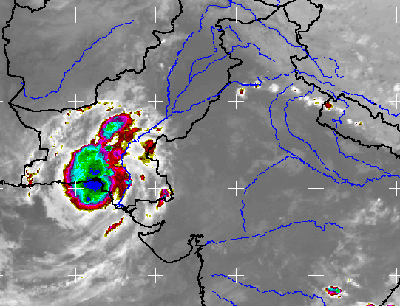
TRMM view of flood producing storms Southern Pakistan
2011

Slide 11
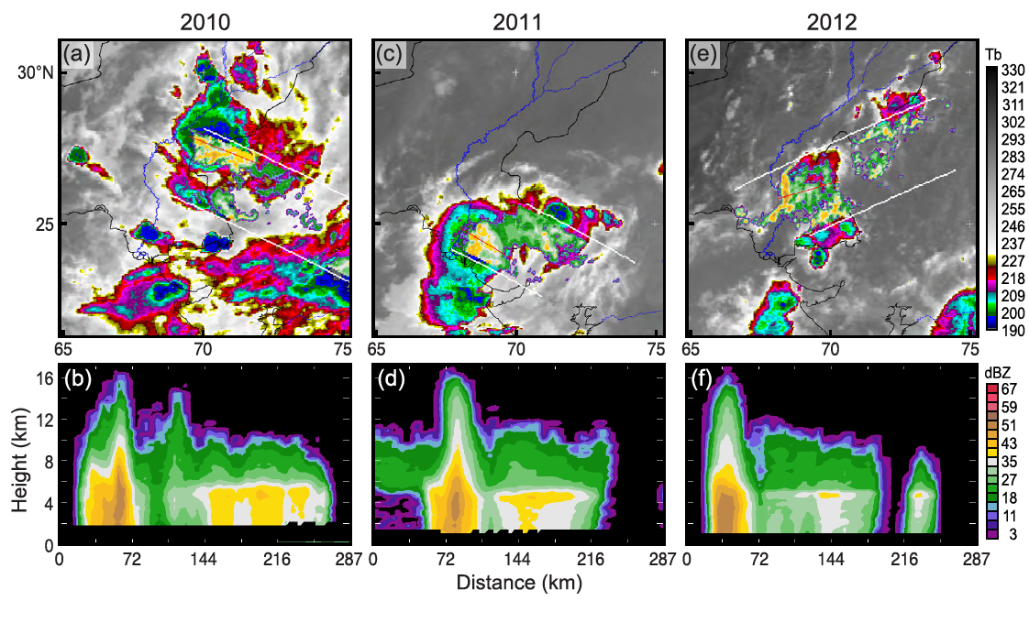
TRMM view of flood producing squall lines Southern Pakistan
All 3 years

Slide 12
The Leh flash flood (India)

Slide 13
Synoptic conditions during flood periods
2010
2011
2011

Slide 14
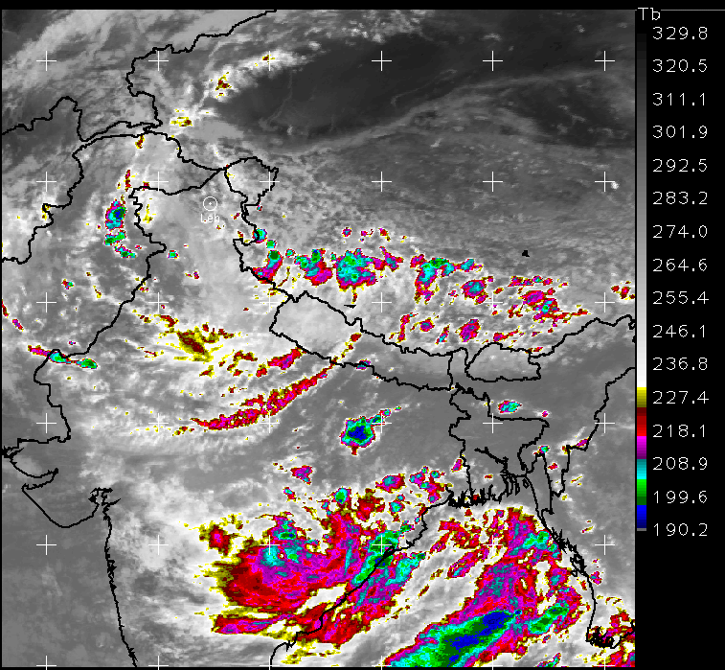
Leh Flood, 8 UTC 5 August 2010

Slide 15
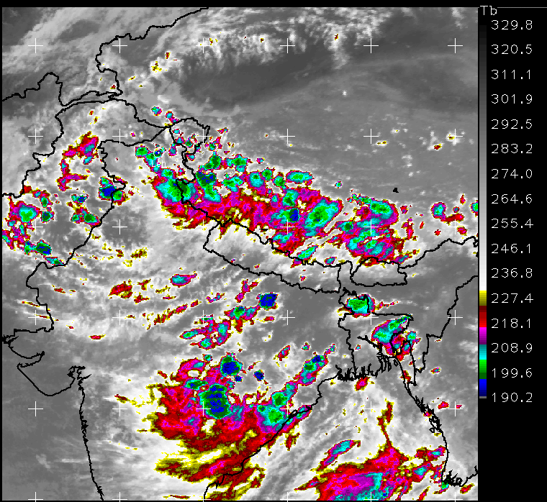
Leh Flood, 12 UTC 5 August 2010

Slide 16
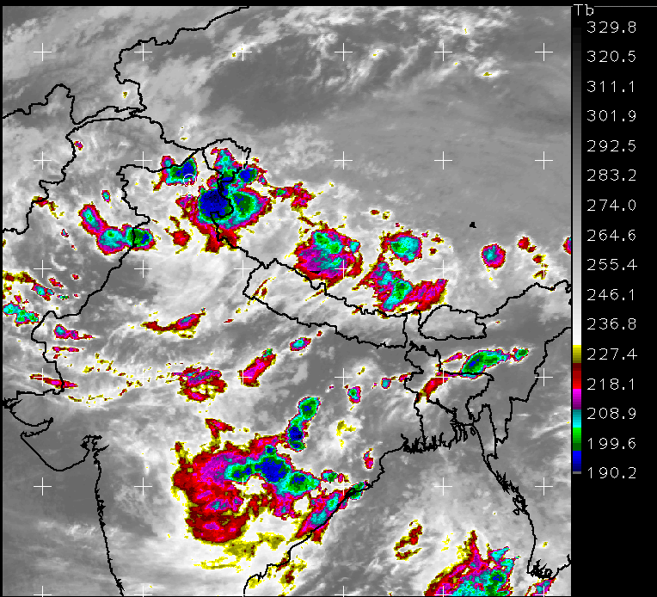
Leh Flood, 16 UTC 5 August 2010

Slide 17
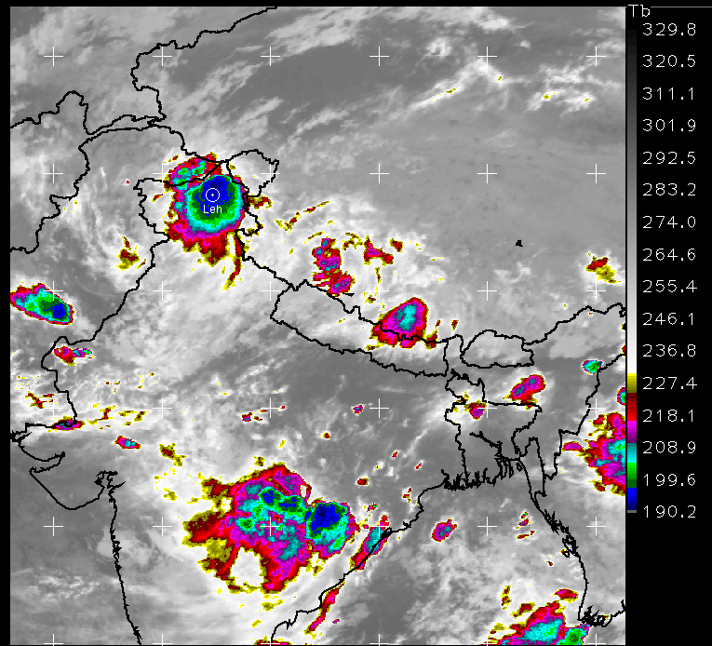
Leh Flood, 20 UTC 5 August 2010

Slide 18
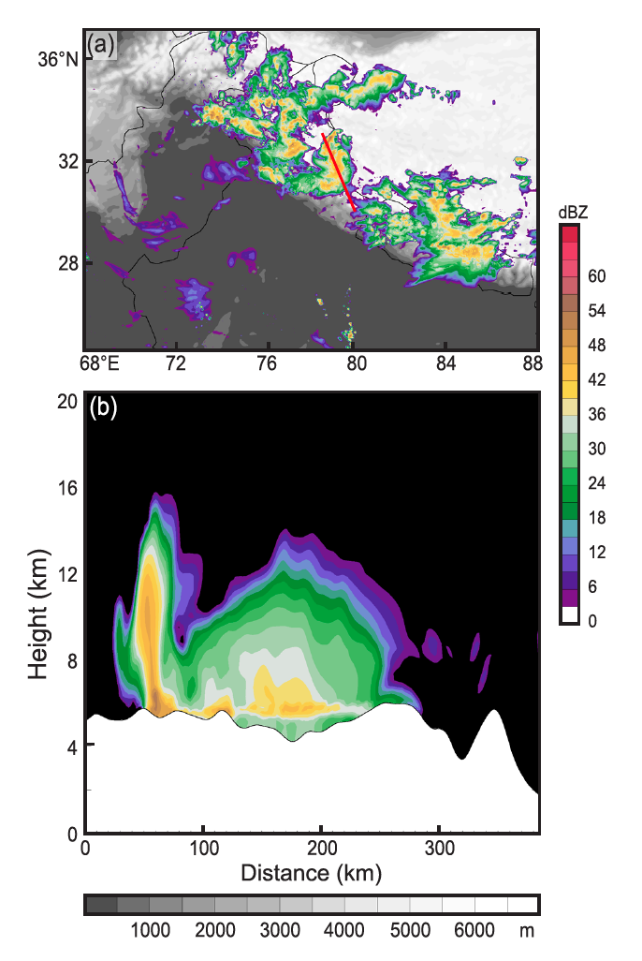
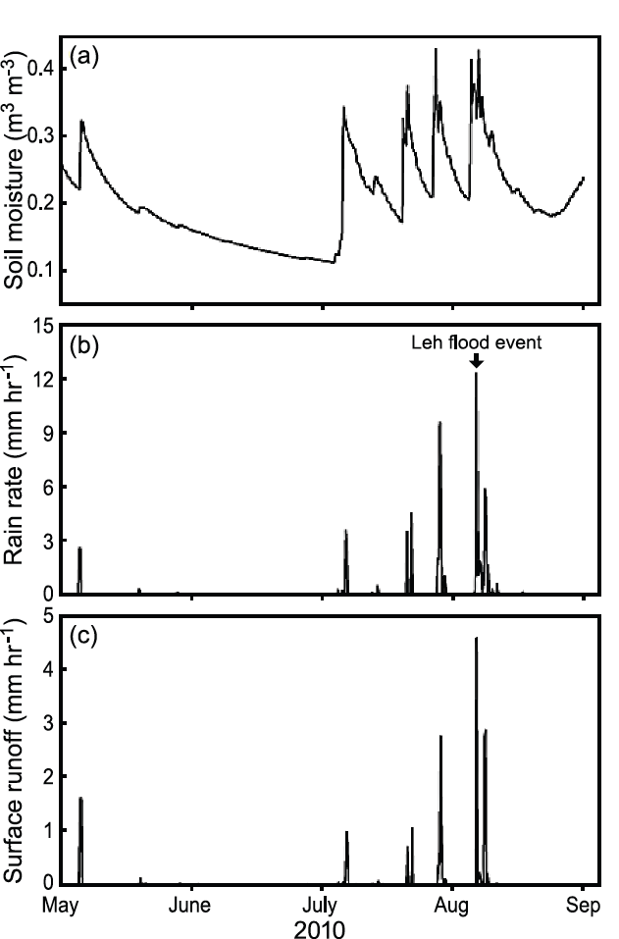
Leh Flood, WRF + GSFC LIS model
Soil moisture
Rain
Runoff

Slide 19
Conclusions
Floods in Pakistan were produced by mesoscale systems with broad stratiform regions—abnormal for the region
Flow from east provided deep moist conditions conducive to large mesoscale systems
Stationary systems locked to the terrain in the north produced large area flooding in 2010
Midlevel jets produced propagating systems that led to flooding in south Pakistan in all years, & the Leh flash flood in 2010
Notes:
We now look briefly at how we combine 2 of these properties to first identify MCSs

Slide 20
End
This research was supported by
NASA grant NNX13AG71G
NSF grant AGS-1144105

Slide 21
End
This research was supported by
NASA grant NNX13AG71G
NSF grant AGS-1144105

Slide 22
TRMM view of flood producing storms Southern Pakistan
2011

Slide 23
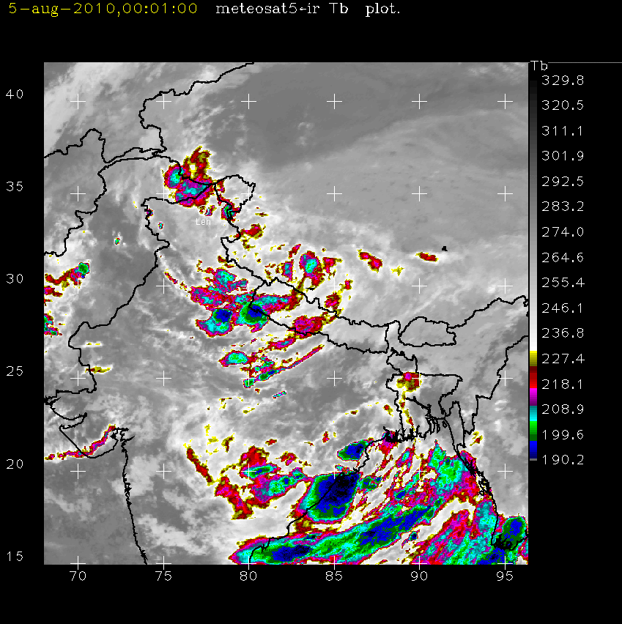
Leh Flood, 5 August 2010

