Slide 1


The use of multi-frequency radar measurements for investigating microphysical processes during DYNAMO/AMIE
Angela Rowe and Robert Houze, Jr.
University of Washington
ASR Fall Working Group Nov 2013
Microphysics Breakout
Rockville, MD
Funded by NSF Grant # AGS-1059611 and DOE Grant # DE-SC0008452

Slide 2
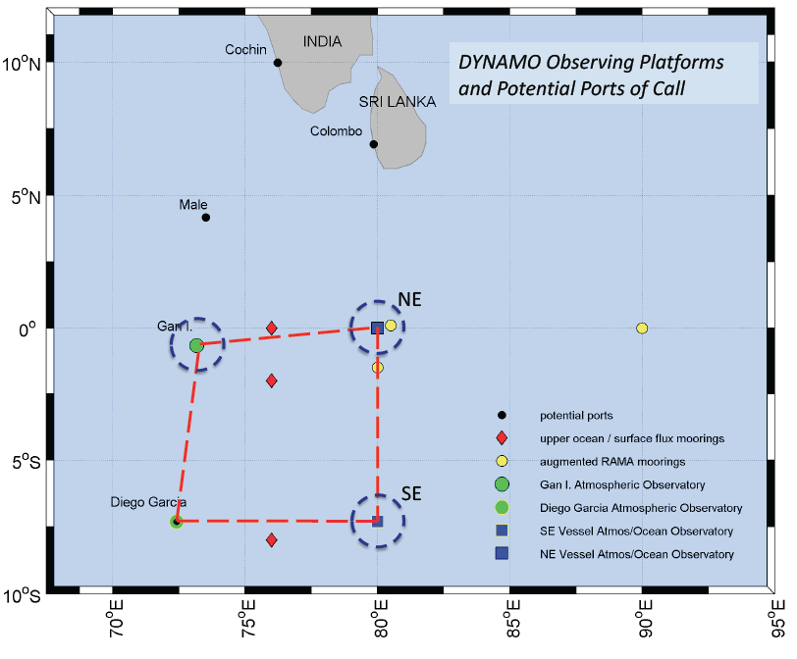
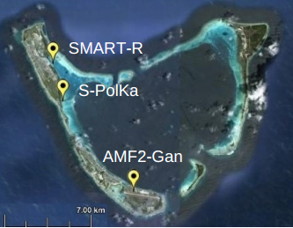
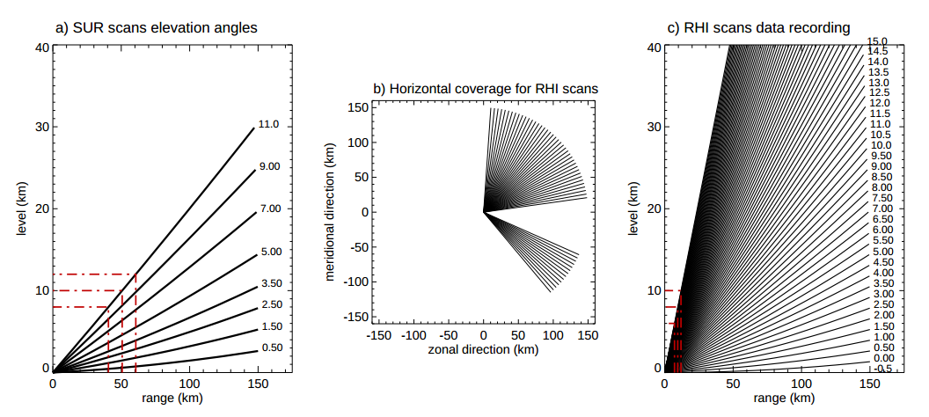
S-PolKa
Zuluaga and Houze (2013)

Slide 3
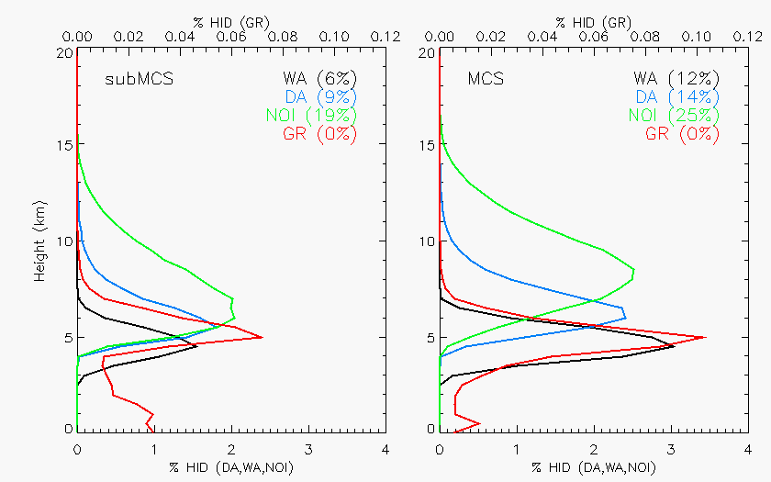
Hydrometeor profiles
Ice crystals
Ice crystals
Dry Agg
Dry Agg
Graupel/Rimed Agg
Graupel/Rimed Agg
Wet Agg
Wet Agg

Slide 4
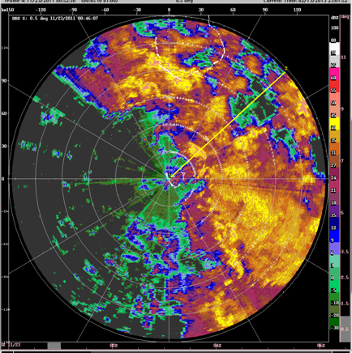
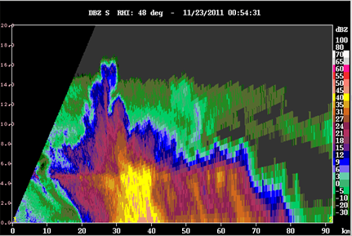
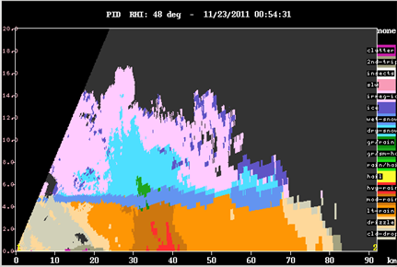
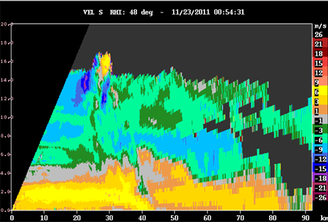
Z
Graupel
PID
V

Slide 5
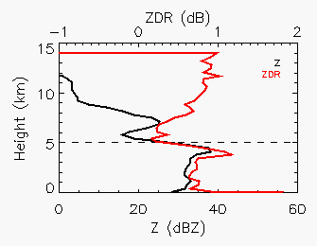
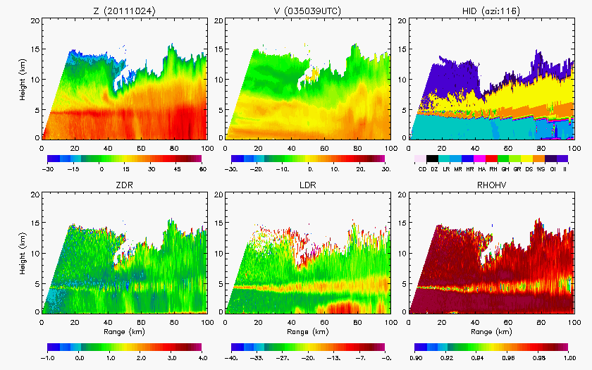
Stratiform

Slide 6
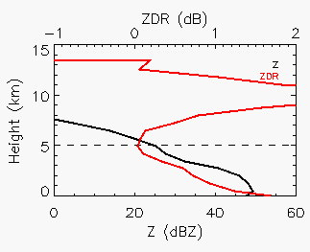
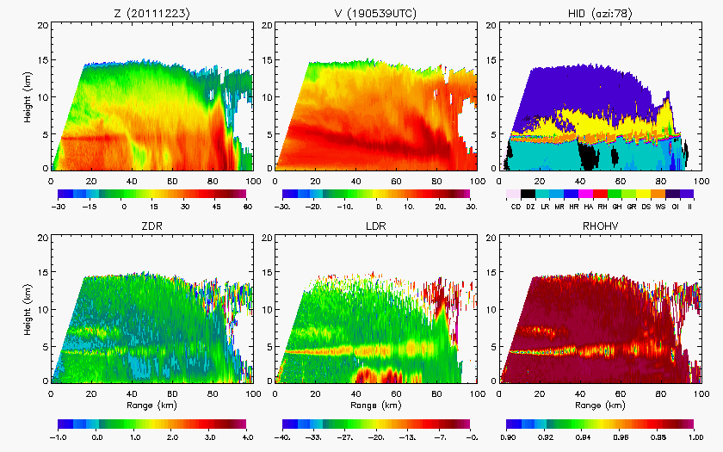
Squall line

Slide 7
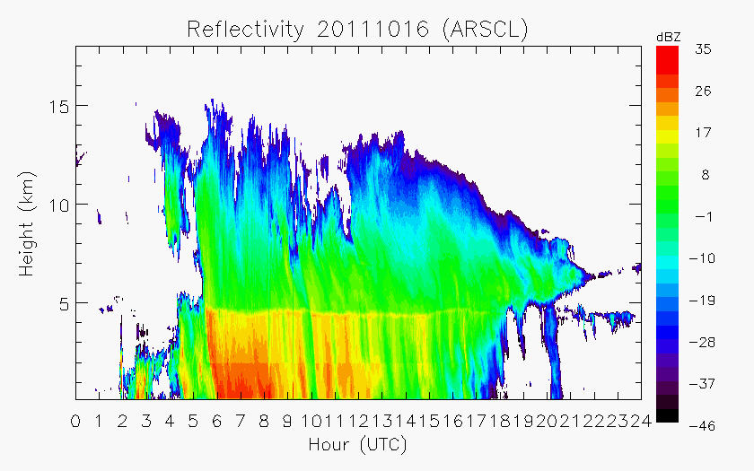
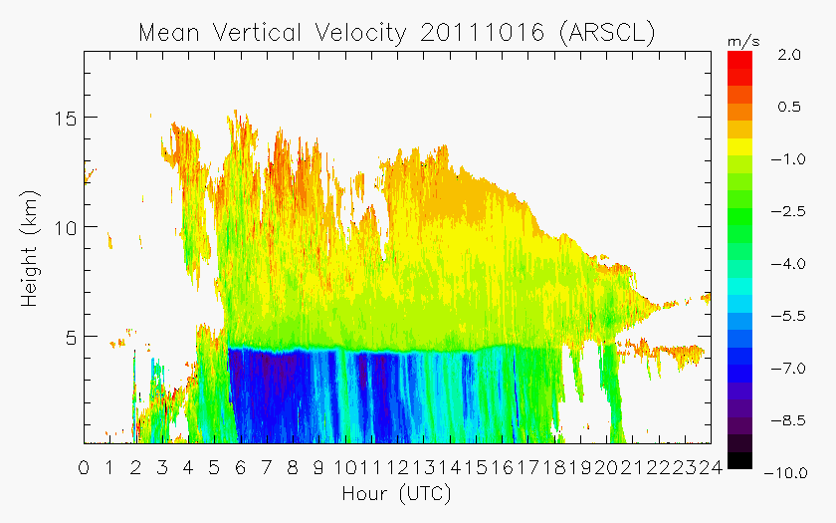
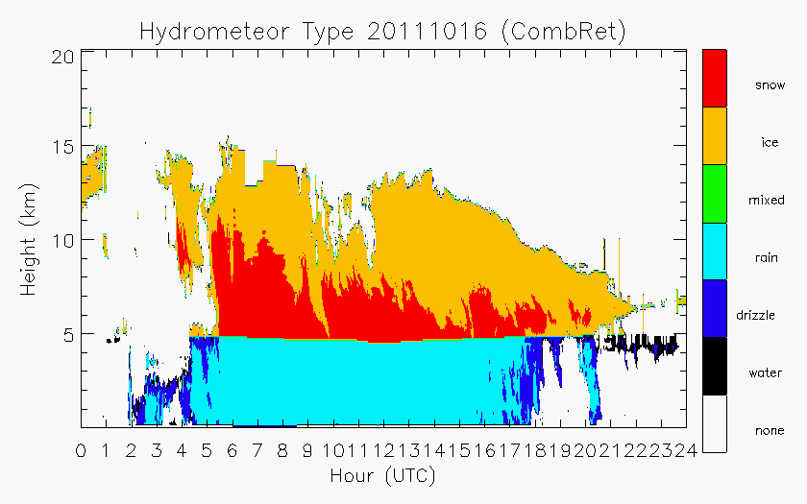
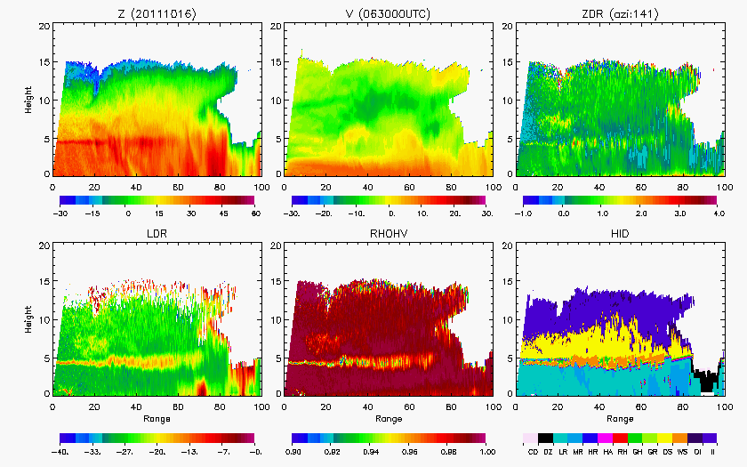
KAZR
KAZR
S-PolKa
KAZR within context of broader system
KAZR velocity providing additional kinematic information
Anvils

Slide 8
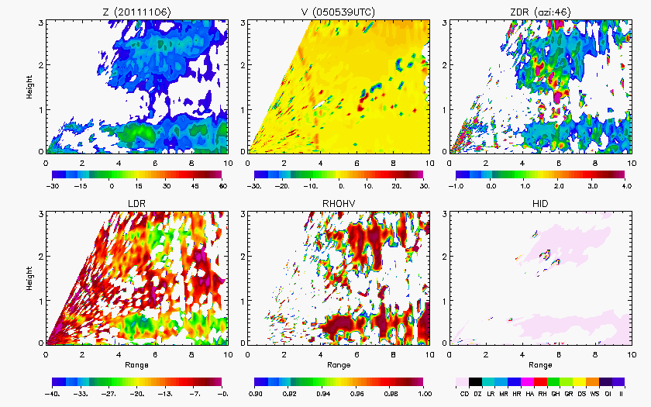
Initial echo
Dual-polarimetric variables!
S-PolKa

Slide 9
Multi-wavelength radar network
Full spectrum of clouds
Microphysical details
Early echo
Warm-rain processes
Melting, fall streaks, anvil, etc.
Comparisons
Attenuation correction
Strengths of different wavelengths for particle identification (Brenda Dolan – MC3E)
Regional (Darwin/Manus)
What can the modeling community do with this information?
Mean profiles of dominant hydrometeor type
Vertical profiles or RHI snapshots of dual-pol variables?

