Slide 1


Characteristics of Mesoscale Convective Systems during DYNAMO/AMIE
Angela Rowe and Robert Houze, Jr.
University of Washington
ASR Fall Working Groups
AMIE/MJO Breakout
November 2013
Rockville, MD

Slide 2
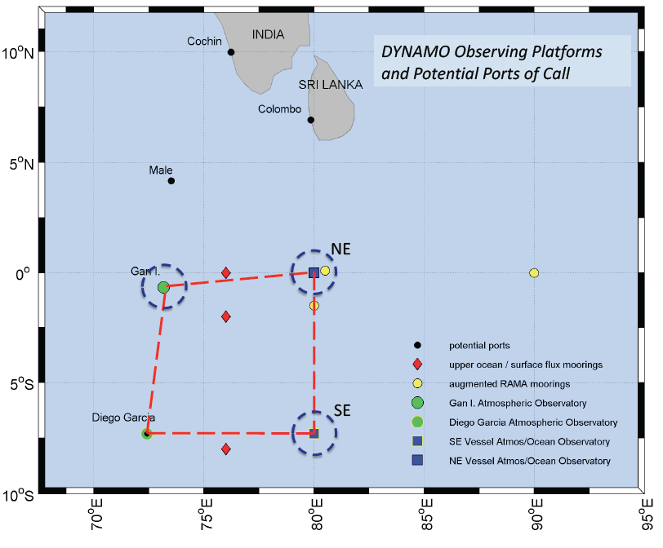
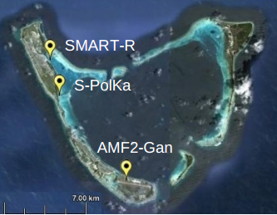
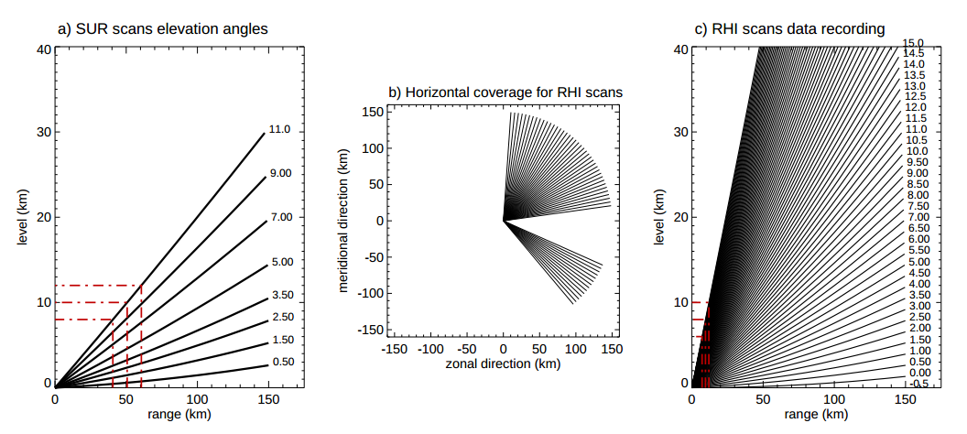
S-PolKa
Zuluaga and Houze (2013)

Slide 3
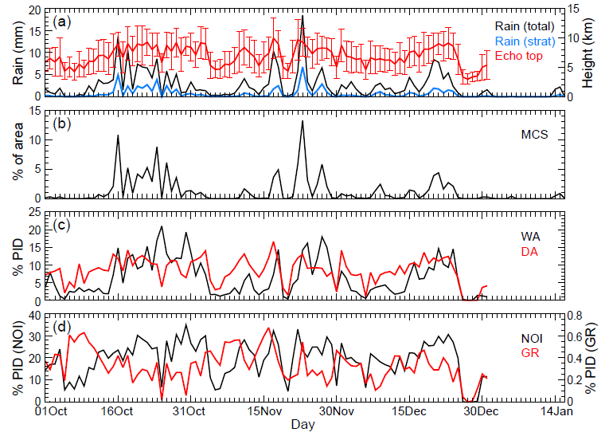
6
7
8
1
2
4
5
3
6
7
8
1
2
3
4
5
4
5
6

Slide 4
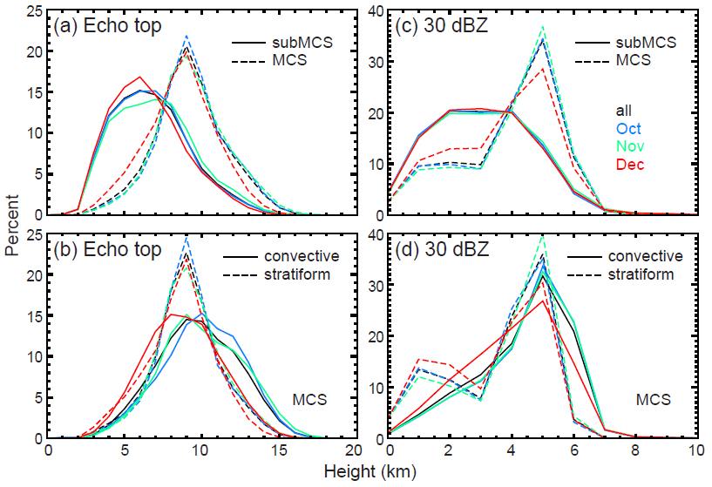
Echo distributions

Slide 5
Hydrometeor profiles

Slide 6
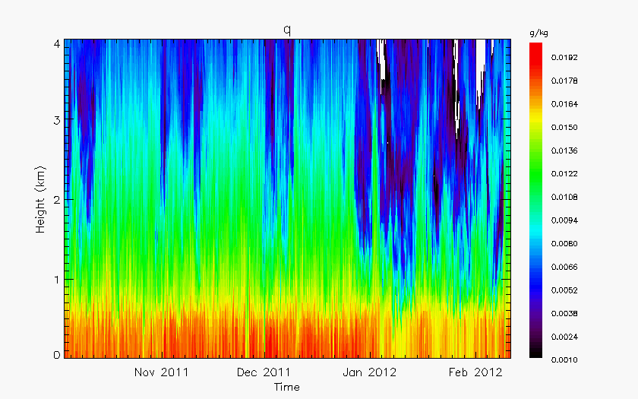
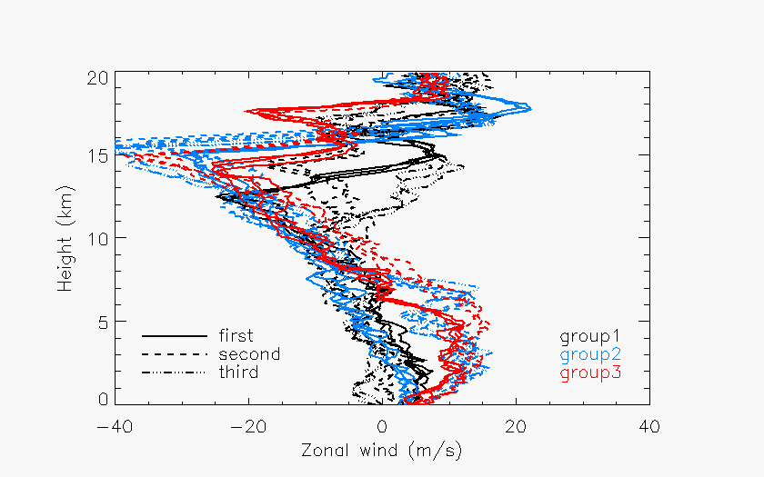
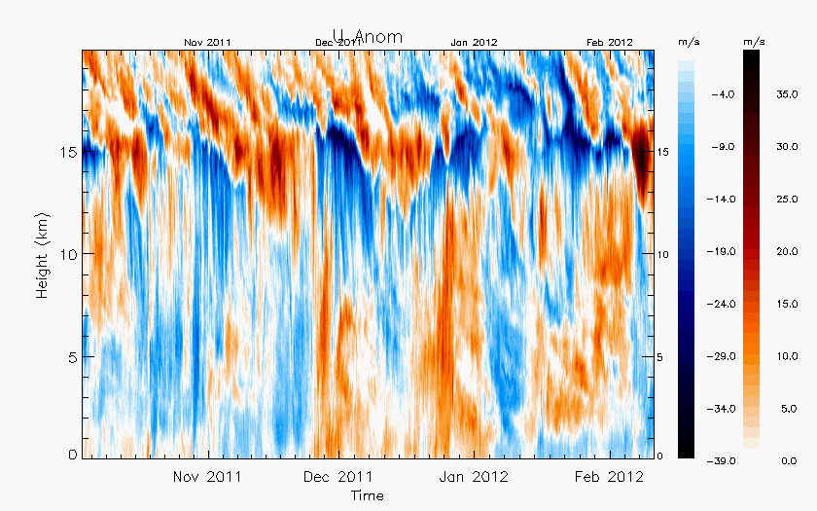
MCSs
Group1: embedded convection, easterlies over westerlies, conv/strat move in opposite directions (14-15 Oct, 24 Oct, 17 Nov)
Group 2: Increased westerlies at end of active phases, drier mid-levels, weaker stratiform, conv/strat move same direction (31 Oct, 1 Dec, 2-3 Dec)
Group 3: Deep, strong westerlies in Dec active phase, fast-moving squall-lines

Slide 7
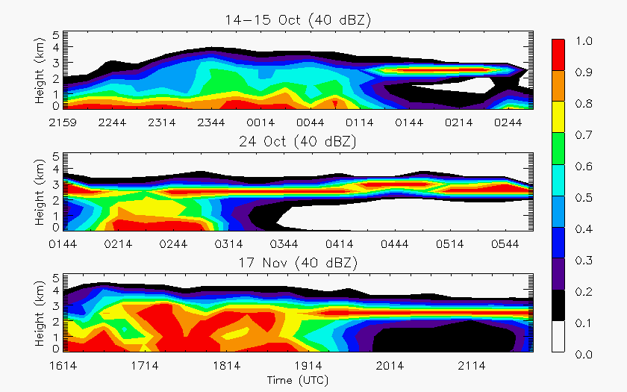
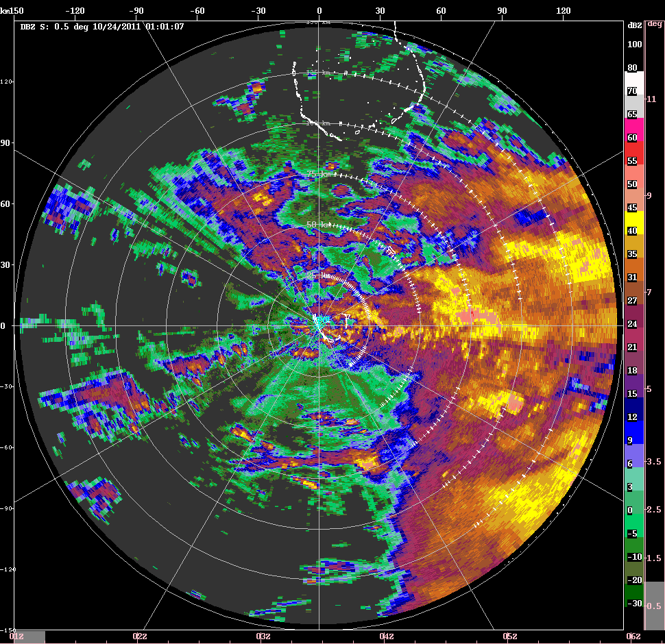
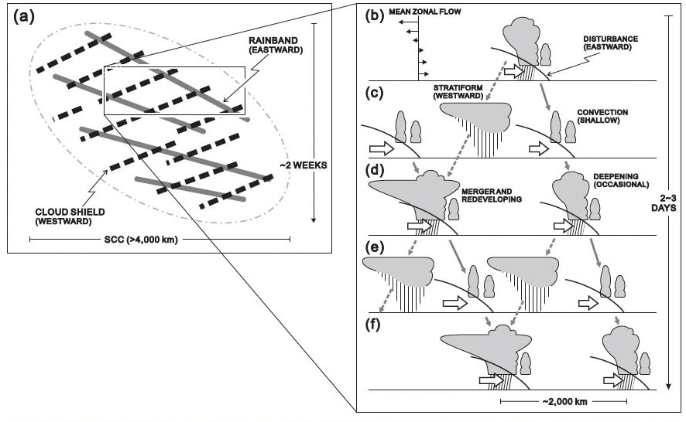
Group 1
Active phases of Oct, Nov
Yamada et al. (2010)
MISMO

Slide 8
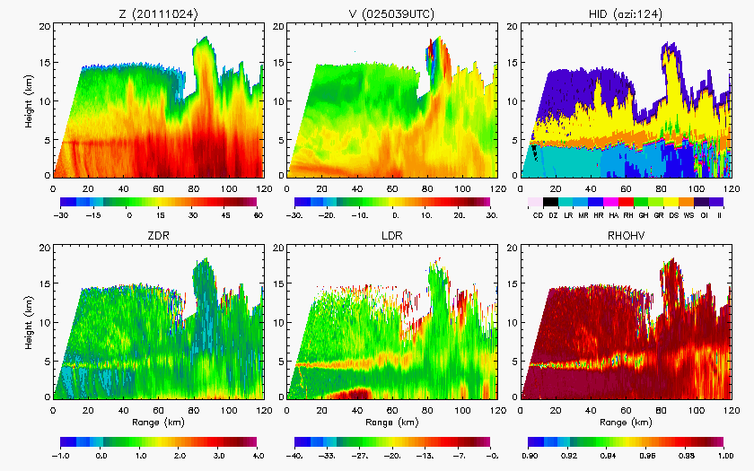
Group 1

Slide 9
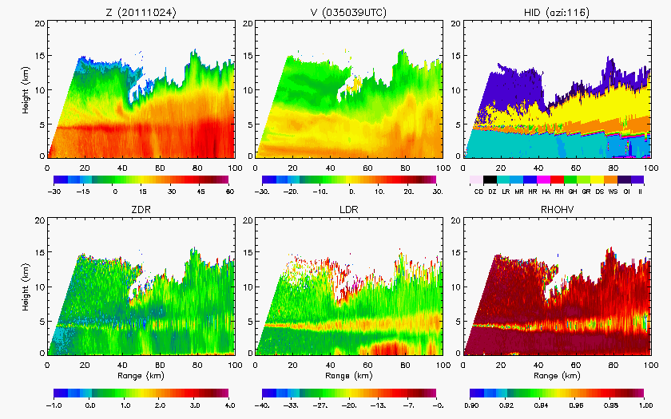
Group 1

Slide 10
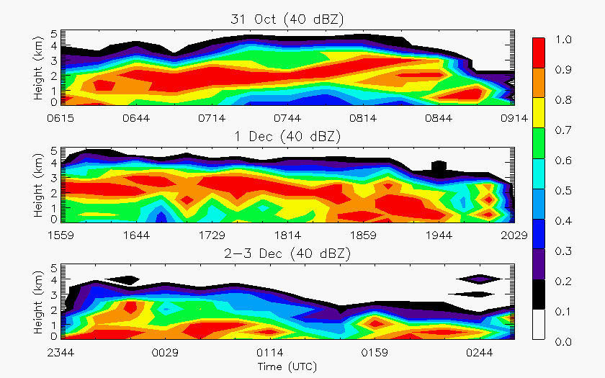
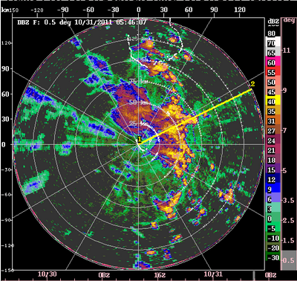
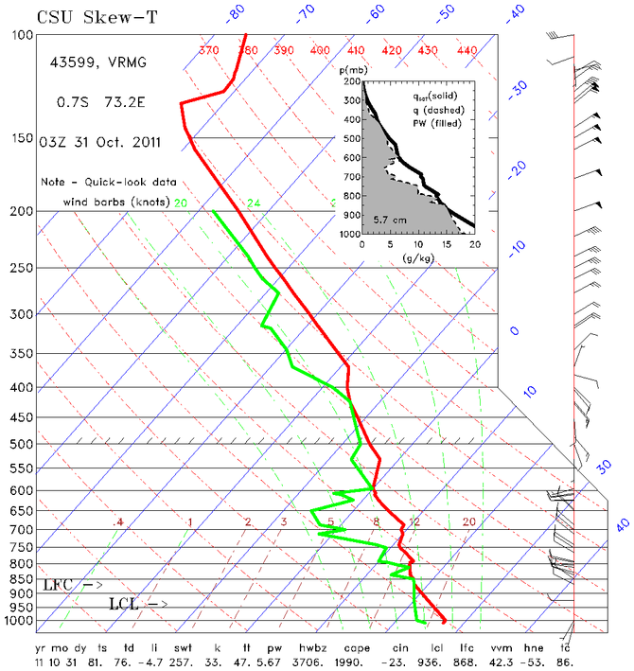
Group 2
End of active phases

Slide 11
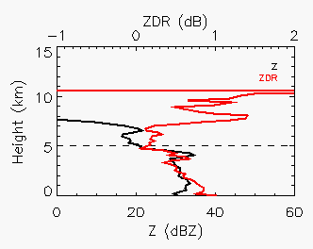
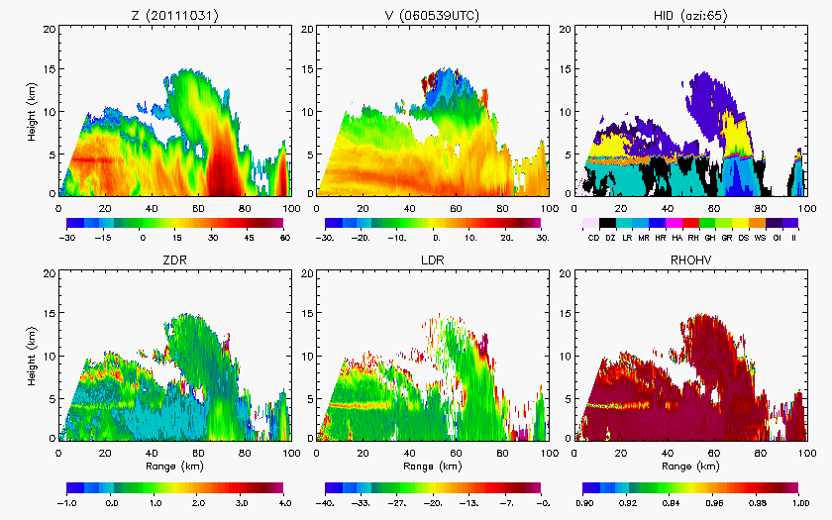
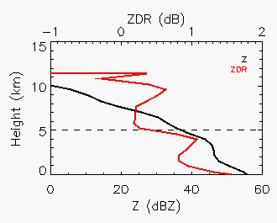
Group 2

Slide 12
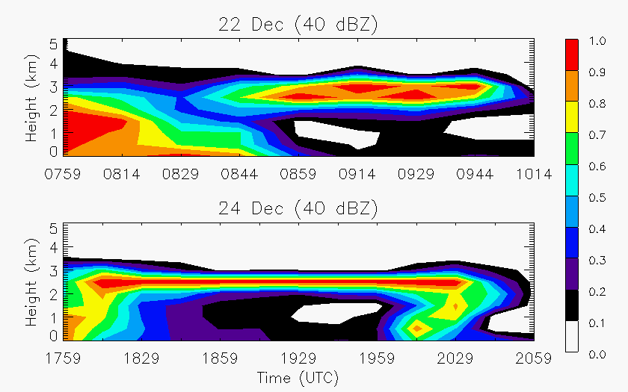
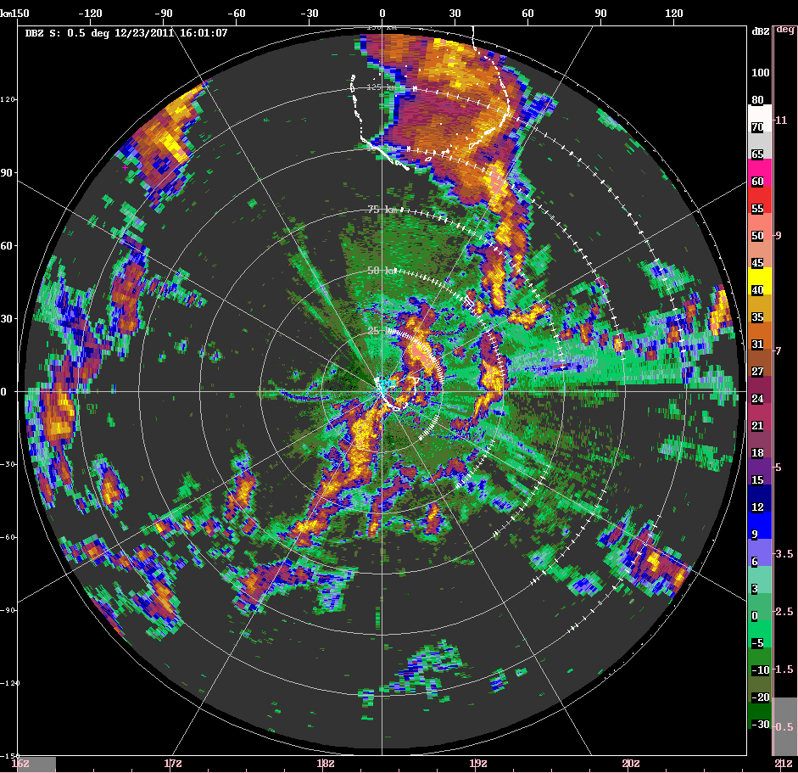
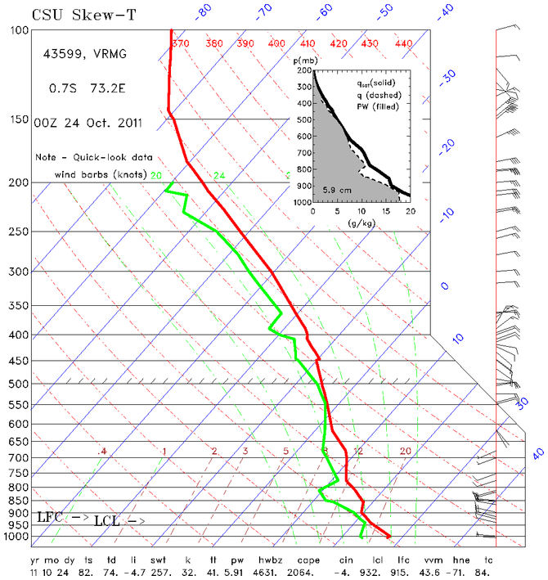
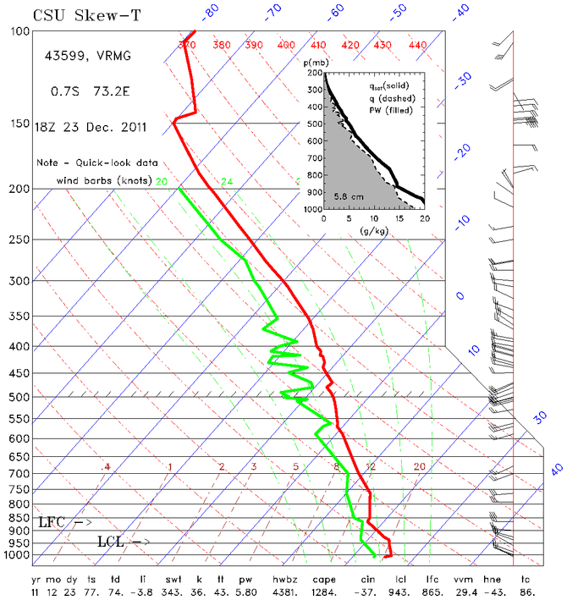
Group 3
Squall lines in Dec active phase
October
December

Slide 13
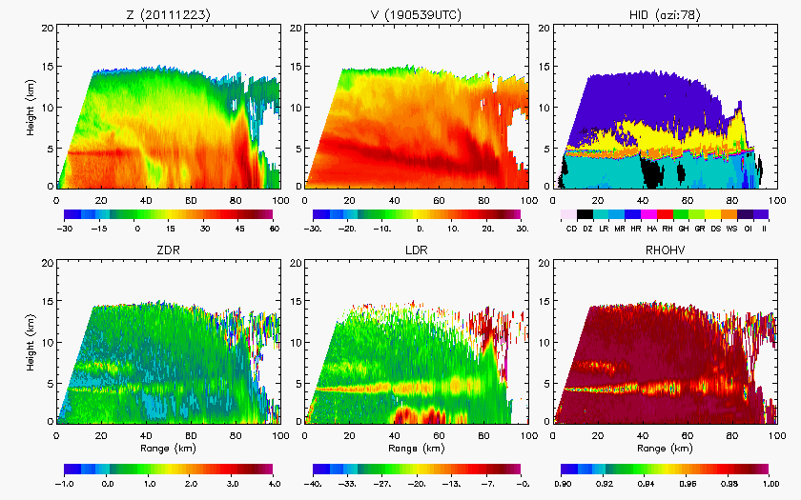
Group 3

Slide 14
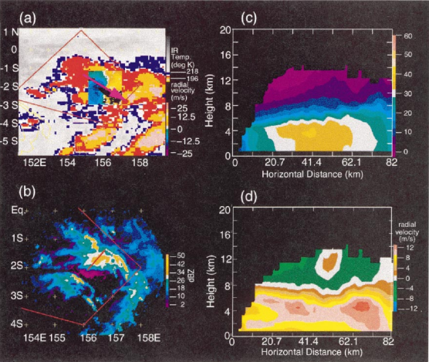
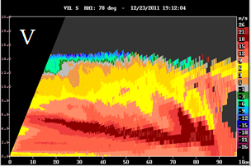
TOGA COARE
Transport of westerly momentum downward in strong westerly region (Houze et al. 2000)
Positive feedback
Houze et al. (2000)

Slide 15
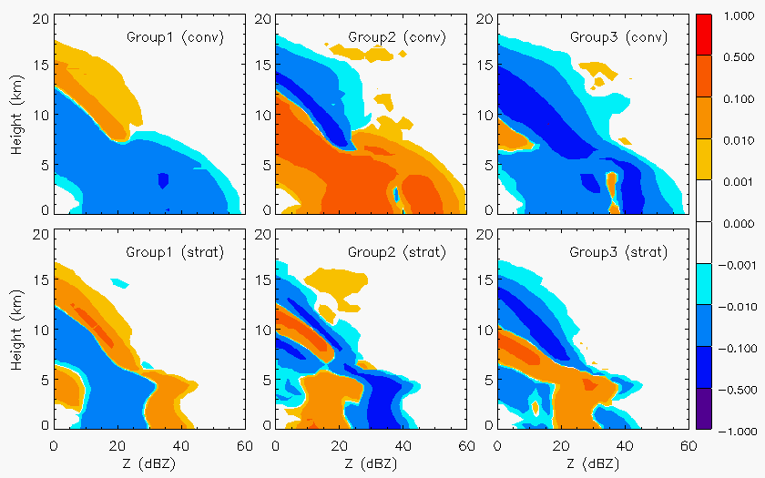
Group comparison

Slide 16
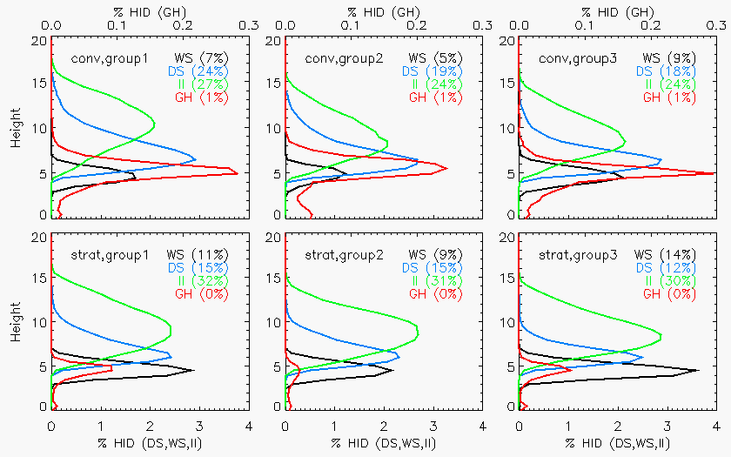
Group comparison

Slide 17
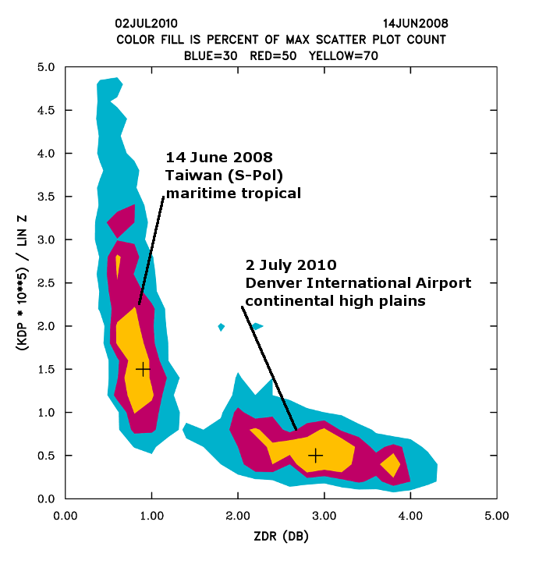
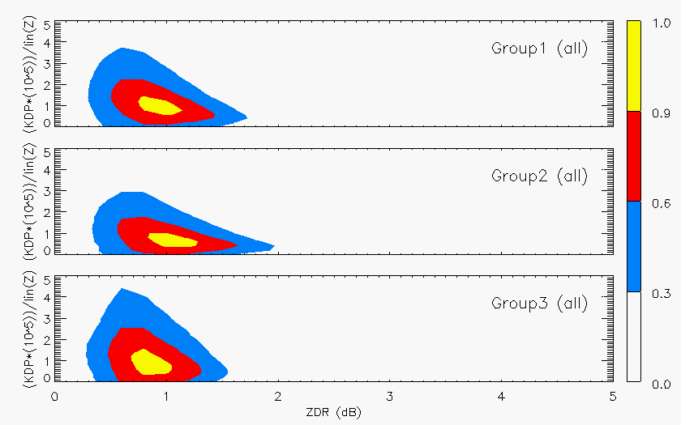
Group comparison
Kennedy et al. (2011)

Slide 18
Take-home points
Similar hydrometeor profiles with low relative occurrence of graupel and enhanced wet aggregation during active periods as deep convection transitions to stratiform echo
December active period characterized by shallower convection and less robust stratiform
Individual MCSs show different characteristics for three groupings based on the environmental wind profile
Increased westerlies generally resulted in shallower convection and less widespread stratiform as the active phases transitioned to more suppressed conditions
Fast-moving squall lines in Dec featured shallow convection and descending rear-inflow/ momentum transport (similar to TOGA COARE)
Oct/Nov active phase MCSs contained deep embedded convection in a weakly sheared environment with robust stratiform (similar to MISMO)

Slide 19
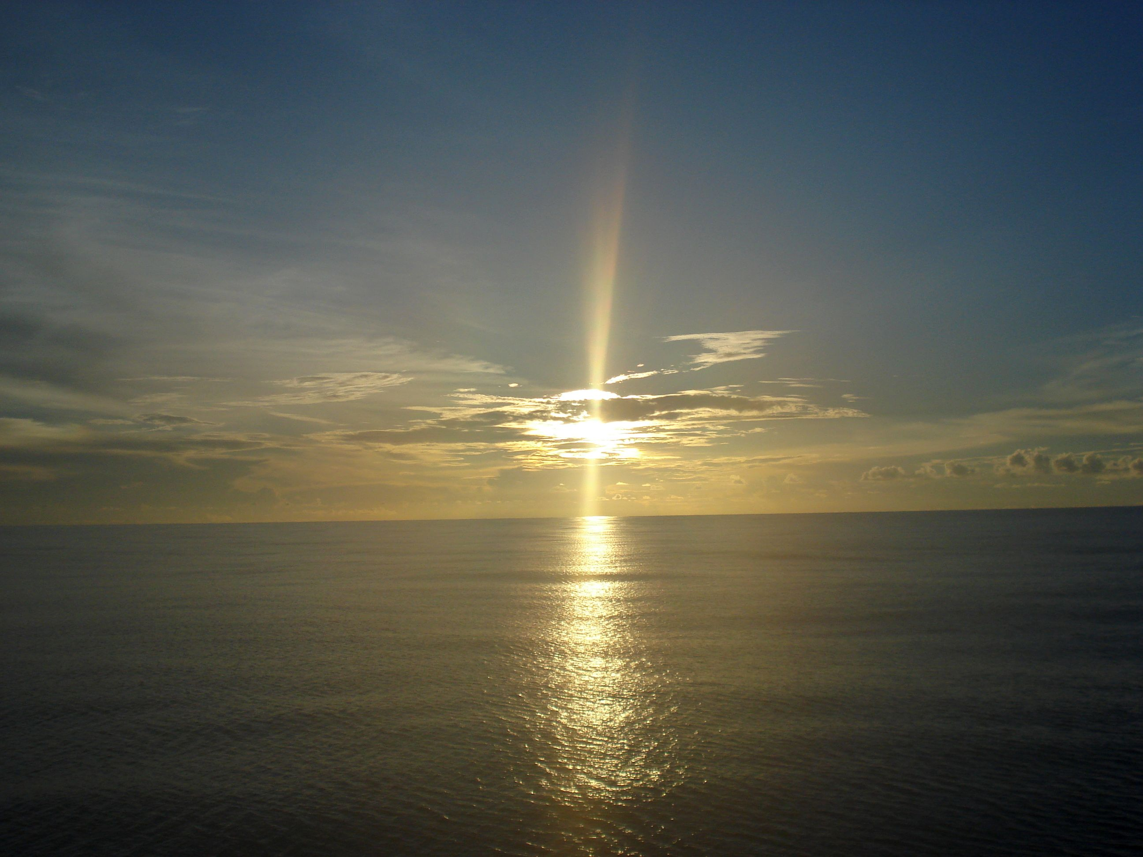
Thank you!
Funded by NSF Grant # AGS-1059611 and DOE Grant # DE-SC0008452

