Slide 1
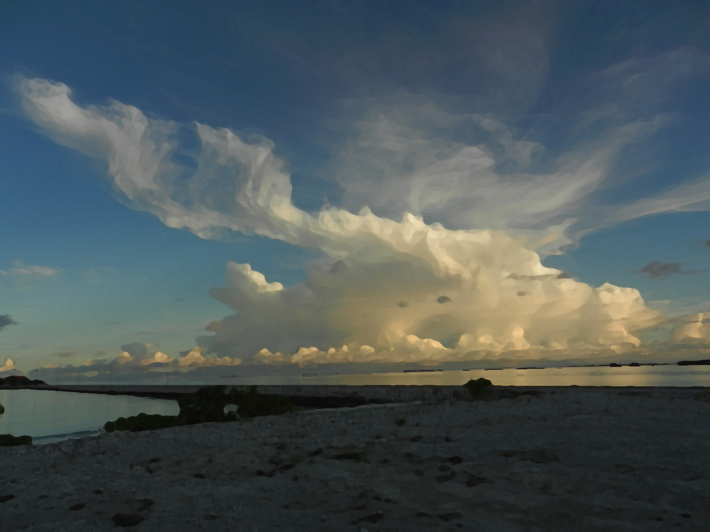
The Hydrometeor Structure of
Mesoscale Convective Systems During DYNAMO
Hannah C. Barnes
Robert A. Houze, Jr.
University of Washington
2013 Atmospheric System Research (ASR) Fall Working Group Meeting
Hilton Washington DC / Rockville Hotel & Executive Meeting Center
5 November 2013
Funded by NSF –Grant AGS 1059611

Slide 2
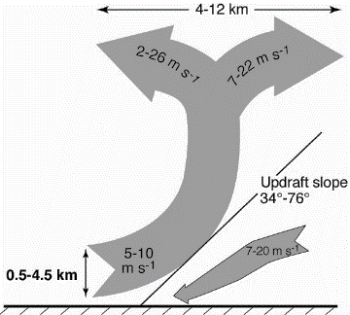
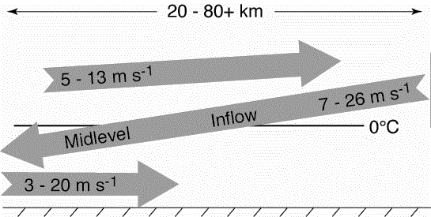
Conceptual Model of Mesoscale Convective Systems (MCSs)
TOGA COARE: 3D, layer airflow
Convective
Stratiform
Kingsmill and Houze (1999a)
Notes:
Brief introduction to MCS structure
Emphasize that TOGA COARE added to that picture by confirming that layered airflow structures described by Moncrieff (1992)
Convective regions characterized by steeply sloping convergent zones with a divergence signature aloft
Stratiform often characterized by mid-level inflow that starts below the anvil and slowly descends into the precipitating stratiform region. The mid-level inflow may or may not reach the surface.
DYNAMO is opportunity to add another layer of knowledge of the structure of MCS through microphysics

Slide 3
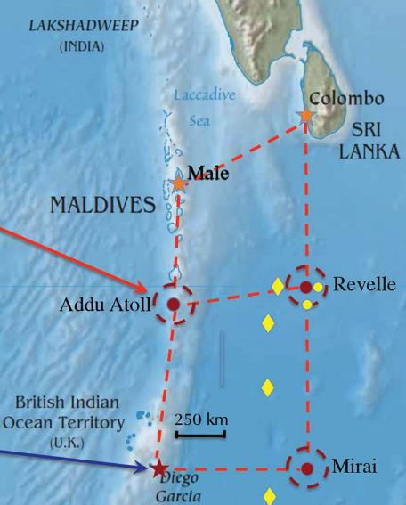
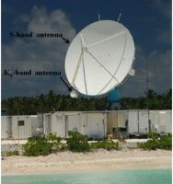
DYNAMO-AMIE-CINDY
SPolKa
Indian
Ocean
Addu Atoll, Maldives
Dual wavelength
  Only using S-Band
Doppler
Dual-polarimetric
  Particle Identification Algorithm (Vivekanandan et al., 1999)
RHI sectors
Notes:
Briefly introduce SPolKa
Doppler capabilities allow us to identify the kinematic structures of Kingsmill and Houze (similar to TOGA COARE)
Dual-polarimetric capabilities new for DYNAMO and allow to identify different types of hydrometeors.
PID algorithm developed by Vivekanadan et al. 1999 was APPLIED to the SPolKa data
In two regions the SPolKa radar did a series of high resolution RHI scans, which enabled us to obtain a detailed vertical picture of the hydrometeor structure within MCSs

Slide 4
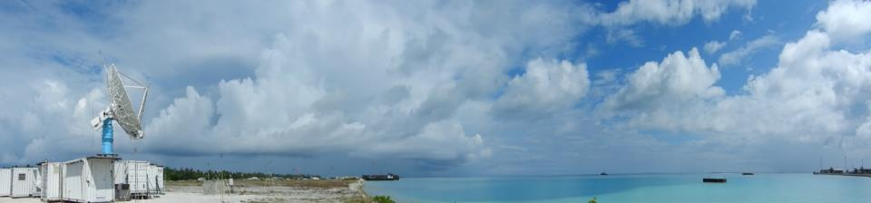
Objective
Characterize hydrometeor structure of MCSs
  Composite with respect to kinematic structure
Notes:
Thus, the primary objective of this study is to characterize the hydrometeor structure of MCSs. This will done by compositing the location of different types of hydrometeors with respect to the airflow through the convective and stratiform portions of MCSs.

Slide 5
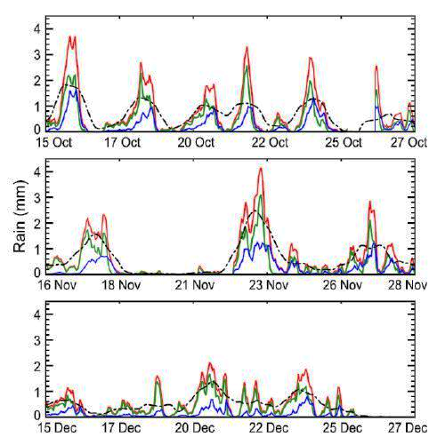
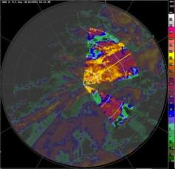
Methodology
Hourly Timeseries of Accumulated Rain
1
2
4
3
5
6
11 rain maximums during DYNAMO (Zuluaga and Houze, 2013)
Subjectively identify cases
  SPolKa radial velocity
  Layer lifting
  RHI sector and within 100 km
  One per storm
Manually map hydrometeor location using PID
Composite around layer lifting
8
9
7
10
11
Zuluaga and Houze (2013)
Notes:
Explain that focusing on the 11 top rain events during DYNAMO, which all occurred during the active phase.
Rain events selected on the 24 hr running mean time series. Consider 24 hours before and after the 11 maxima identified in that timeseries
Explain composite method
Explain basic process of selecting cases (the bottom figure highlights the region where I look for these features)
Subjective
Create map of hydrometeors in each case by hand
Enables to reduce noise and artifacts
Composite.
Done by scaling so that all cases have the same slope, height, and range.
The slope, height, and range used for compositing are the average values of all the events
____________EXTRA INFORMATION ____________
Number of events in each composite
Convective – 27
Mid-Level Inflow – 38
Trailing Stratiform – 7
Non-Trailing Stratiform – 29

Slide 6
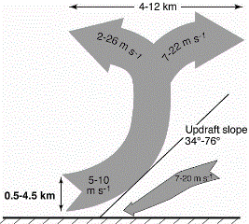
Convective Updraft
dBZ
V_{rad}
24 Oct 0250 UTC

Slide 7
Heavy Rain
Moderate Rain
Light Rain
Very Light Rain
Graupel / Rimed Aggregates
Graupel - Rain
Convective Updraft
Wet Aggregates
Dry Aggregates
Small Ice Crystals
Horz. Oriented Ice
Notes:
Red line is the convergent updraft.
Colors shows how often that type of hydrometeor is located at a given location. The scales in each figure or different in order to show their distribution most clearly.
Top row shows the rain categories, the middle row shows the categories with graupel (there was no hail), and the bottom line shows the snow and ice categories.
Structure is systematic
Few features to emphasize
Heavy rain just downwind of updraft
Moderate rain within updraft core
Graupel just downwind updraft in a narrow vertical column
Dry aggregates extend from the melting level to the base of the divergence signature
Non-oriented ice surround dry aggregates

Slide 8
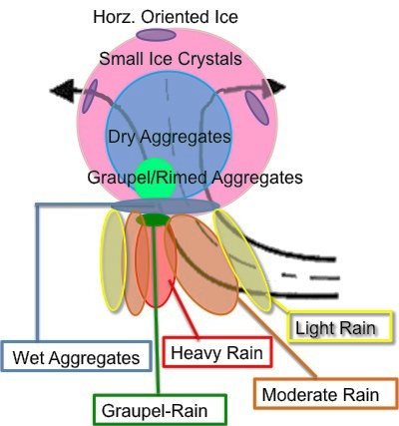
Conceptual Diagram of Convective Updrafts
Notes:
Based on those results we have developed this conceptual diagram for the hydrometeor structure of convective updrafts.

Slide 9
Distribution of Convective Polarimetric Variables
Reflectivity
Differential Reflectivity
G GR HR MR LR VLR WA DA SI HI
G GR HR MR LR VLR WA DA SI HI
Correlation Coefficient
Temperature
G GR HR MR LR VLR WA DA SI HI
G GR HR MR LR VLR WA DA SI HI
Notes:
Based on those results we have developed this conceptual diagram for the hydrometeor structure of convective updrafts.

Slide 10
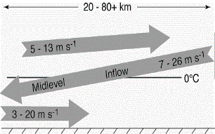
Mid-Level Inflow
dBZ
V_{rad}
23 Dec 1850 UTC
Notes:
Now turn to the stratiform regions in MCSs that have clear mid-level inflows

Slide 11
Heavy Rain
Moderate Rain
Light Rain
Very Light Rain
Graupel / Rimed Aggregates
Graupel - Rain
Leading Line – Trailing Stratiform
Wet Aggregates
Dry Aggregates
Small Ice Crystals
Horz. Oriented Ice
Notes:
Red line shows mid-level inflow that was composited around. This composite mid-level inflow can be thought of starting on the right side of each figure under the anvil and ending on the left side of the figure with stratiform precipitation
Structure again is very systematic.
As move out towards the anvil the rain intensity systematically weakens.
Snow and ice are highly layered
Wet aggregates at the melting level, then dry aggregates and non-oriented ice respectively layered above
The wet aggregate layer becomes more fragmented near the anvil
Sometimes a thin layer of graupel was found within the upper portion of the wet aggregate layer.
Especially when brightband strong
Surprised to see but do not think this is an artifact
large aggregates and graupel have been found during MISMO which was another campaign in the central Indian ocean in 2006
Videosondes (rawinsondes outfitted with video camera
Released in stratiform regions, saw aggregates and graupel near and above the melting level
Now I am going to turn to the non-leading line MCSs and I want you watch very carefully as I change the slide since the hydrometeor structure is virtually the same.

Slide 12
Distribution of Squall Polarimetric Variables
Reflectivity
Differential Reflectivity
G GR HR MR LR VLR WA DA SI HI
G GR HR MR LR VLR WA DA SI HI
Correlation Coefficient
Temperature
G GR HR MR LR VLR WA DA SI HI
G GR HR MR LR VLR WA DA SI HI

Slide 13
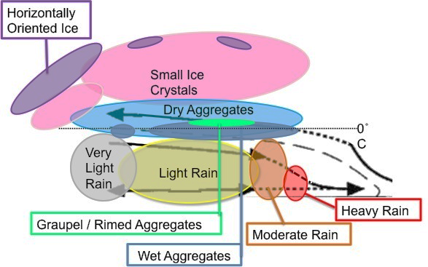
Conceptual Diagram of Mid-Level Inflow
Notes:
Using these results we have created this conceptual diagram of the hydrometeor structure for regions characterized by a mid-level inflow.
Key features
Heavy rain from events when mid-level inflow reached surface, otherwise very rare
Rain intensity decrease with distance from center of storm
Snow and ice crystals are layered
Wet aggregate layer becomes fragmented as move towards anvil

Slide 14
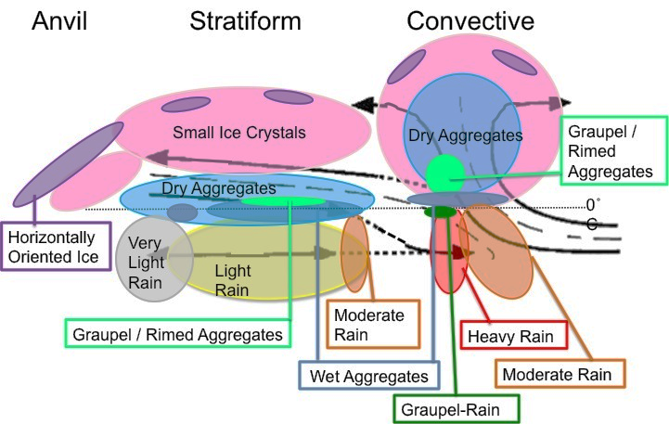
Conclusions
Comparison of model output and radar observations
Notes:
The two previous conceptual diagrams are combined and summarized
Differences between convective updrafts and mid-level inflow
Graupel: narrow and vertical in convective updraft, but shallow and flat in mid-level inflow
More dry aggregates than non-oriented ice in convective updrafts but more non-oriented ice than dry aggregates in mid-level inflows
Two reasons why results are exciting
These hydrometeor structures are very robust. For example saw very little difference between leading line and embedded convection.
Suggests the structure of MCSs are not different because of differences in their hydrometeor structure
Emphasizes a need to further explore why MCSs take on different structures.
Can use to more directly compare model output with radar observations

Slide 15
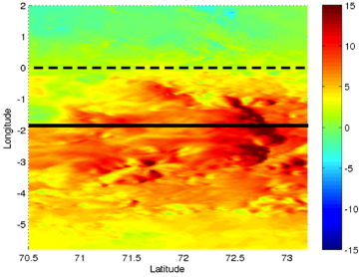
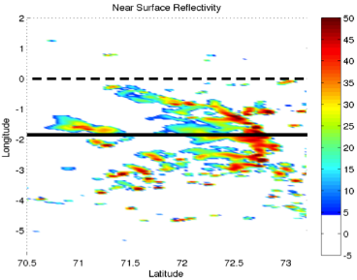
Mesoscale Modeling of Squall Line
Zonal Wind
WRF 3.4.1
Resolution: Outer – 9km, Inner – 3km
Cu Param: Outer – KF, Inner – None
MP Param: Both - Goddard
PBL Param: Both – UW
Forcing: ERAi
00 UTC 23 Dec – 00 UTC 25 Dec
Reflectivity

Slide 16
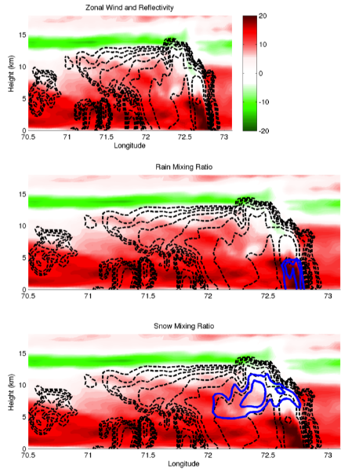
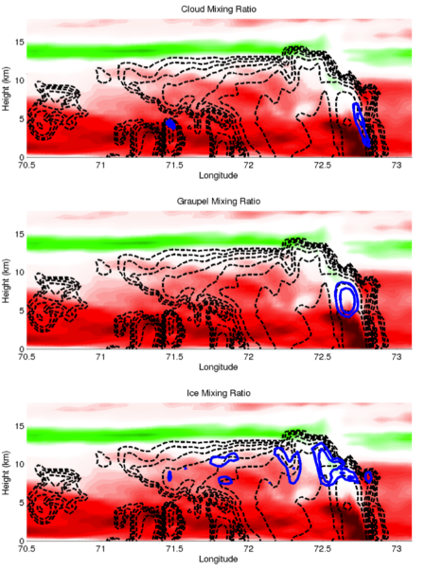
Distribution of Hydrometeor Mixing Ratio
Zonal Wind and Reflectivity
Cloud Mixing Ratio
Rain Mixing Ratio
Graupel Mixing Ratio
Snow Mixing Ratio
Ice Mixing Ratio

Slide 17
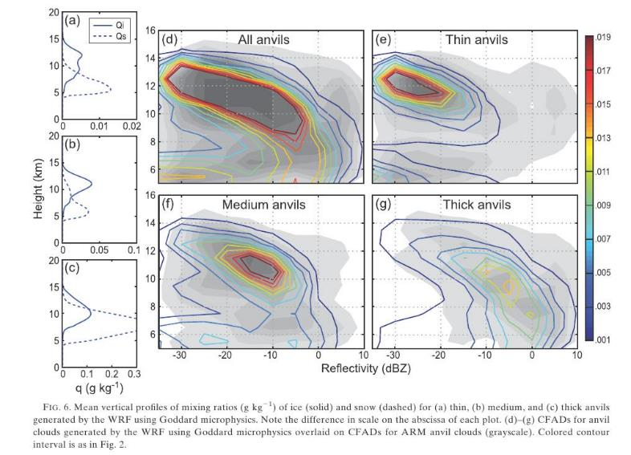
Model Representation of Anvils over Afirca
Powell et al., 2012
Notes:
Thick stratiform with weak rain, brightband clear
Aggregates and graupel near and above melting level

Slide 18

Questions ?

