Slide 1
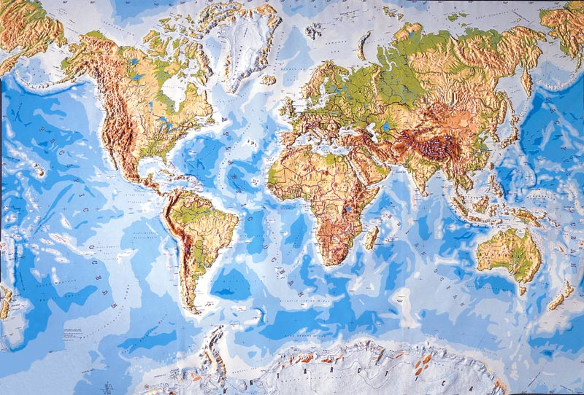
Global Variability of Intense Convection
Robert A. Houze, Jr.
University of Washington
With:
Kristen Rasmussen
Manuel Zuluaga
Jian Yuan
Ulrike Romatschke
Hannah Barnes
Katrina Virts
Stella Choi
Megan Chaplin
Alexandria Gingrey
Seminar, University of Colorado, Boulder, 24 October 2013

Slide 2
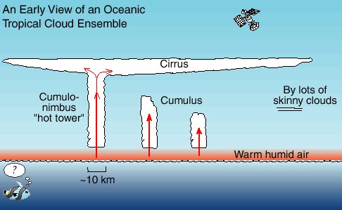
Prevailing view of tropical convection in the early 1970’s
Satellite view of the tropical cloud population

Slide 3
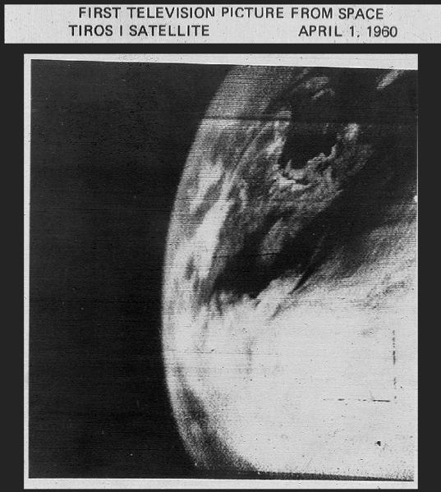

Slide 4
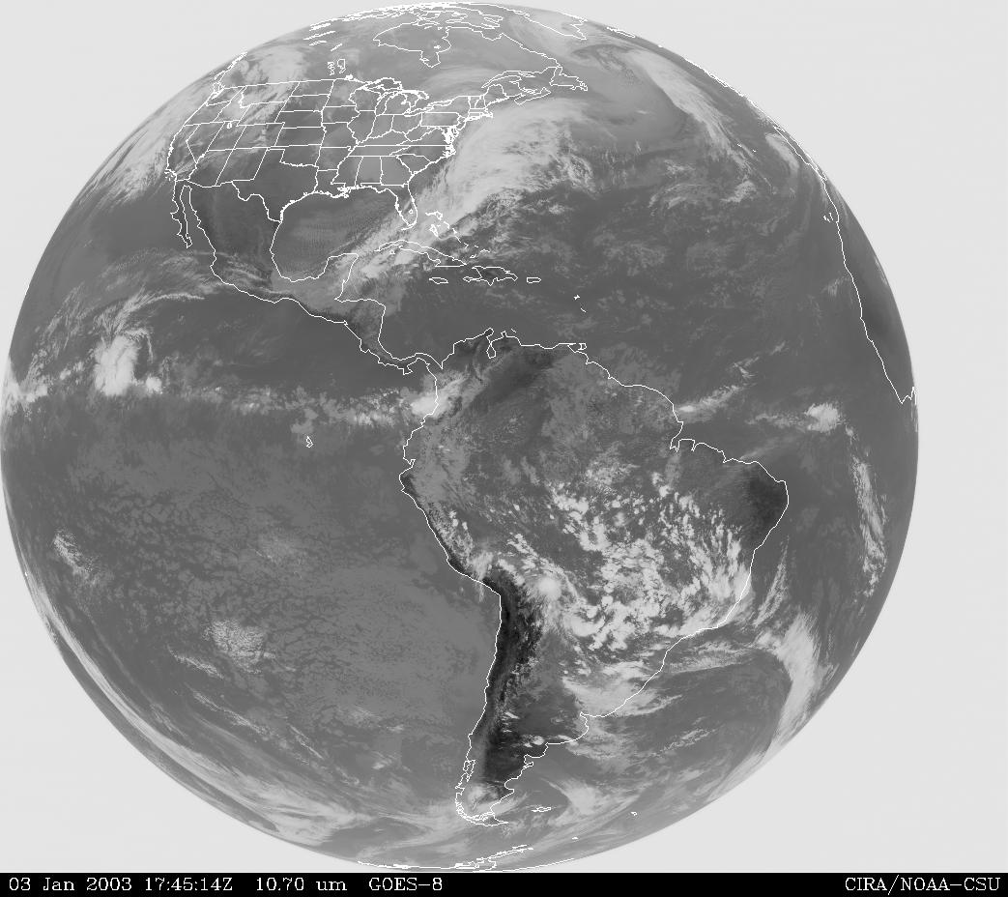
“No particular significance is attached to the interaction between the [mesoscale] and the other scales.”
…NAS Plan for U.S. Participation in GATE
1969
Convective clouds
have mesoscale
extent
Notes:
The IR pattern emphasizes the higher cloud tops, which largely determine the global precipitation (and hence latent heating) pattern.

Slide 5
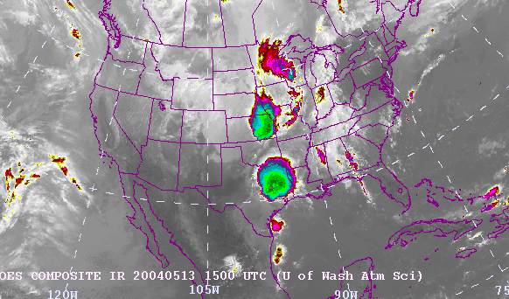
Mesoscale Convective Systems (MCSs)
Large areas
of cold top

Slide 6
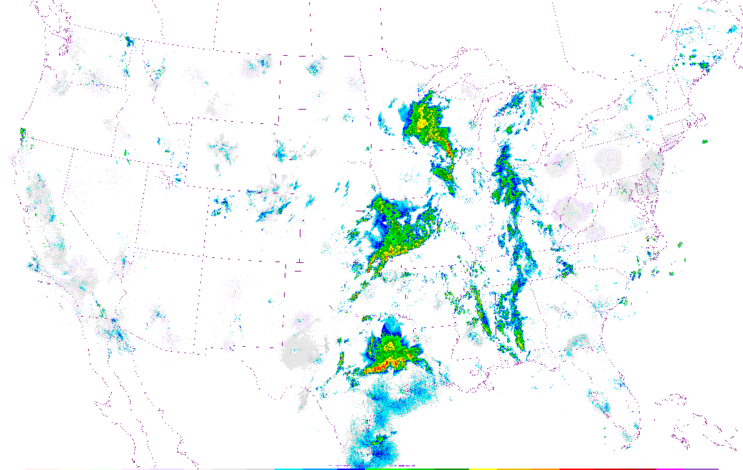
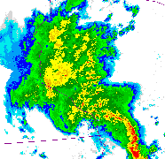
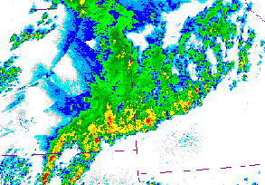
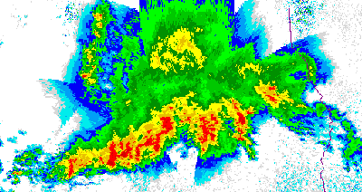
Radar echoes showing
the precipitation
in the 3 MCSs
Stratiform
Precipitation
Convective
Precipitation
1458GMT 13 May 2004

Slide 7
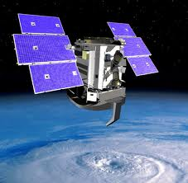
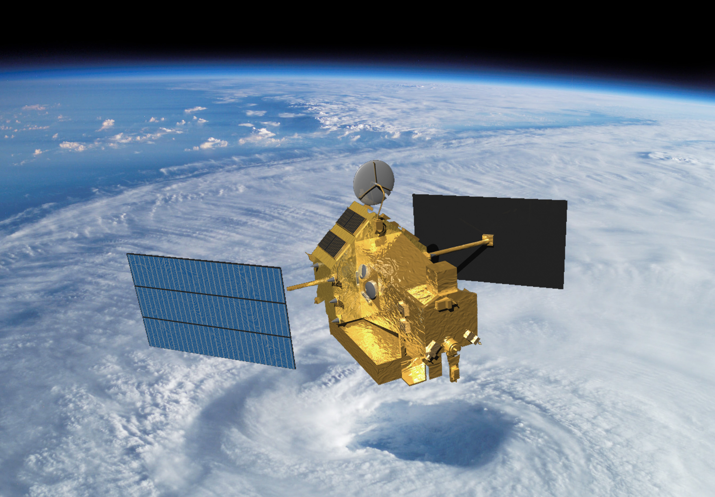
Radars in Space
CloudSat
2006-
(A-Train)
TRMM
1997-
Notes:
CloudSat: W-band, 94 GHz, 3 mm
TRMM: Ka-band, 13.8 GHz, 2.17 cm

Slide 8
  TRMM and CloudSat radars & other data have helped us map MCS occurrence globally
Notes:
Satellites provide the opportunity to determine how these properties vary over the globe and thus to determine their role in the climate system.

Slide 9
  A-Train
Notes:
CloudSat: W-band, 94 GHz, 3 mm
TRMM: Ka-band, 13.8 GHz, 2.17 cm

Slide 10
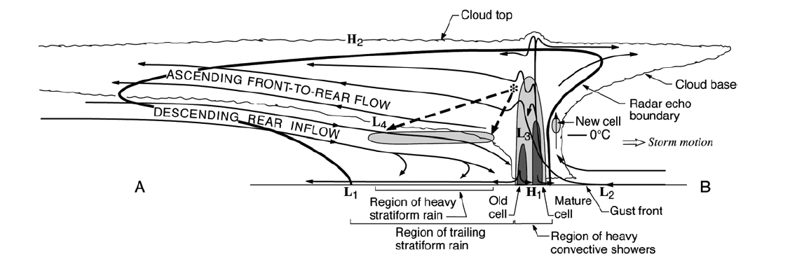
Details learned from field projects
Notes:
The basic components of an MCS can be simplified into 3 main features, which can be identified and MEASURED by satellite. The combination of these three properties can be used to identify an MCS if they satisfy certain criteria. Thus we can determine when and where MCSs occur around the globe. In addition we can determine how the properties of these three components vary from region to region. How big and wide is the cold top; how big and intense is the raining core; how thick are the anvils; and what are the characteristics of their internal structure. And how do these properties vary around the globe? One cannot holistically determine the properties of MCSs by identifying one of these properties alone. It’s important to see and evaluate all 3.

Slide 11
Basic components of an MCS
Cold top
Anvil
Anvil
Raining core
Houze et al. 1989
A-Train sees all of these elements
Notes:
The basic components of an MCS can be simplified into 3 main features, which can be identified and MEASURED by satellite. The combination of these three properties can be used to identify an MCS if they satisfy certain criteria. Thus we can determine when and where MCSs occur around the globe. In addition we can determine how the properties of these three components vary from region to region. How big and wide is the cold top; how big and intense is the raining core; how thick are the anvils; and what are the characteristics of their internal structure. And how do these properties vary around the globe? One cannot holistically determine the properties of MCSs by identifying one of these properties alone. It’s important to see and evaluate all 3.

Slide 12
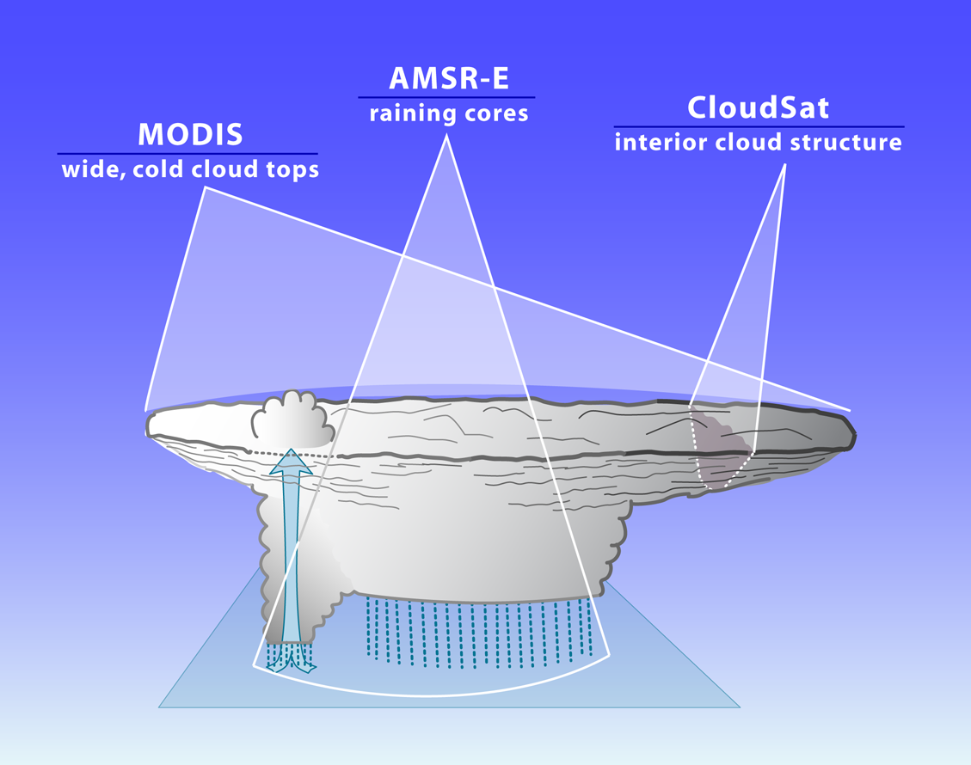
How A-Train sees the whole MCS
2
3
1
Notes:
A-Train offers the ability to see all 3 characteristics simultaneously. We take advantage of this ability.

Slide 13
  Combining cloud top and raining cores
Notes:
We now look briefly at how we combine 2 of these properties to first identify MCSs

Slide 14
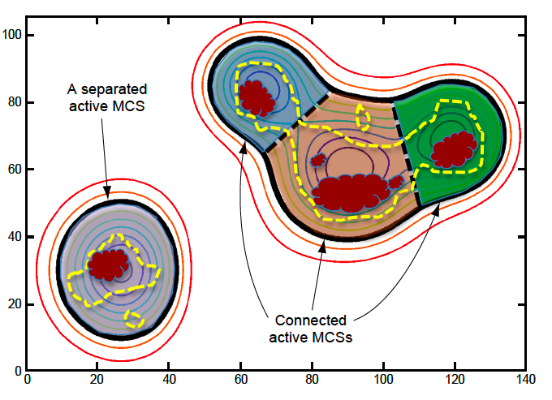
Identify High Cloud Systems (HCSs)
260K
HeavyRain
Closed
contour
Rain
Separated
HCS
“Separated” active HCS
“HCS”
“Connected” active HCS

Slide 15
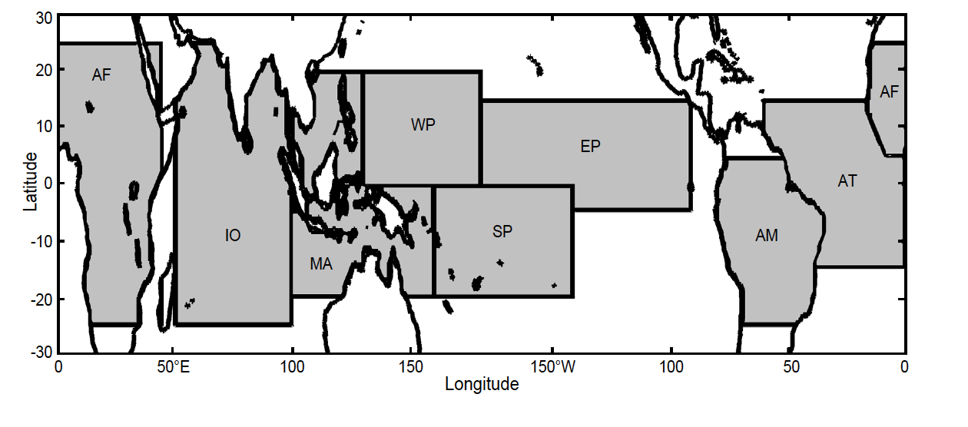
Which HCSs are MCSs?
Yuan and Houze 2010

Slide 16
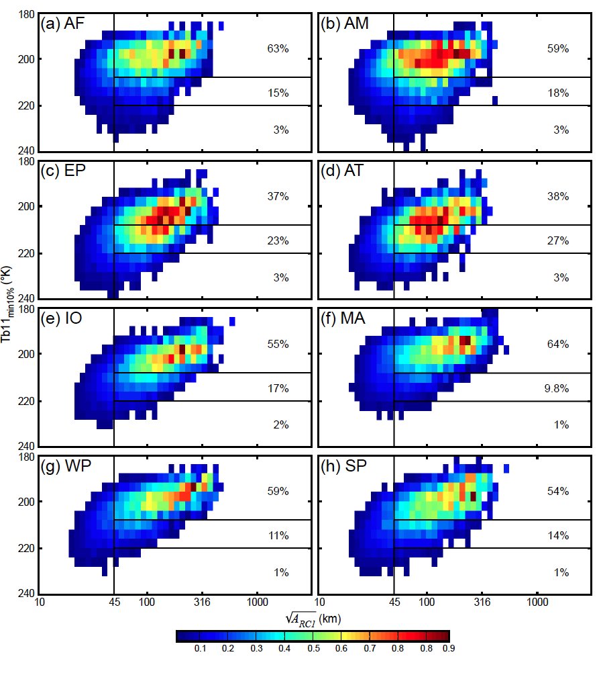
PDF of rain amount as a function of raining core properties
Min TB11 over raining core
220
°K
Using these values for “MCS” criteria
→56% all tropical rain
2000 km²
Size of raining core
Yuan and Houze 2010
Notes:
Must have one dominant core
with intense cells, and
accounting for >70% rain area

Slide 17
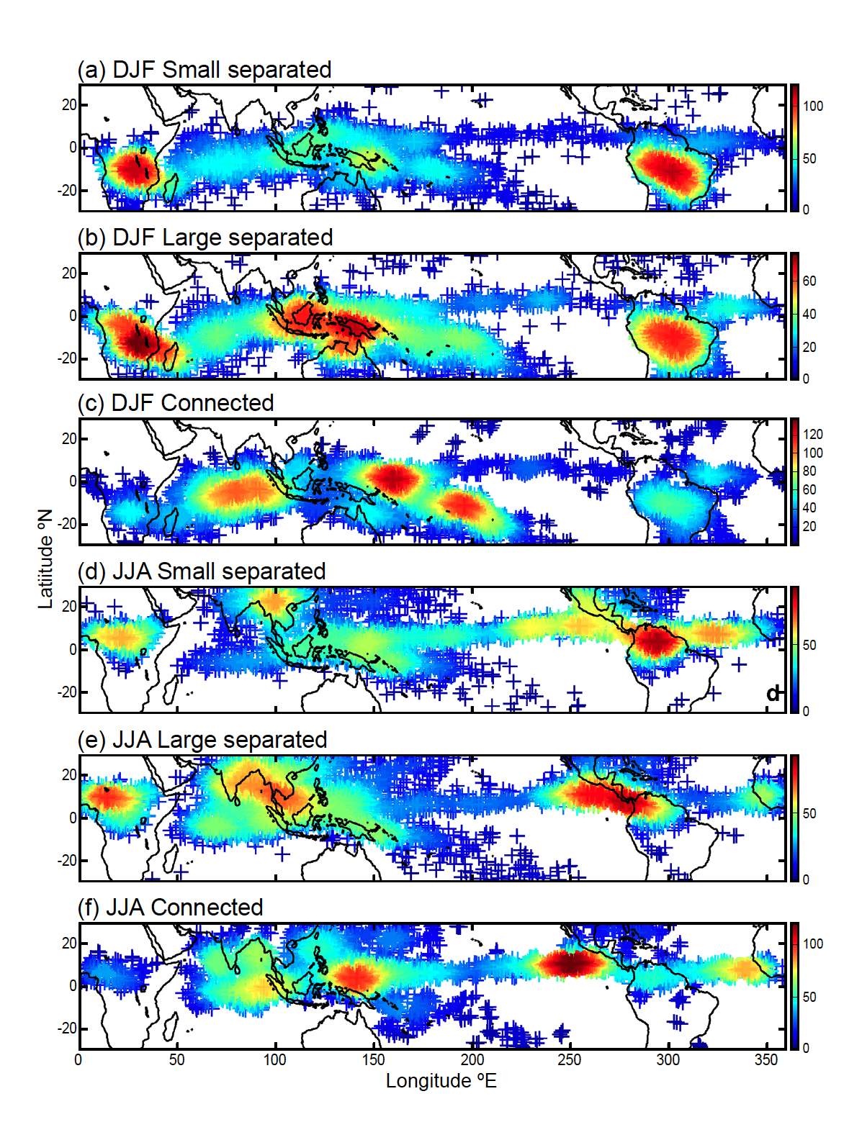
MCSs Over the Whole Tropics (DJF)
Smallest 25% (<12,000 km²)
Largest 25% (>40,000 km²)
“Superclusters”
Yuan and Houze 2010
Yuan and Houze 2010
Notes:
Size of MCS is size of cold cloud top. To qualify as MCS, must have large cold cloud top, large rain area, and some heavy rain. This figure shows spatial distribution of active MCSs. Color of each point shows the number of active MCSs found within a circular area with radius of five degrees centered on that point. (a) Small separated MCSs (<12,000km2; i.e., the smallest 25%) in DJF, (b) large separated MCS (>40,000km2; i.e., the largest 25%) in DJF, (c) connected MCS in DJF, (d)-(f) same as (a)-(c) except for JJA.

Slide 18
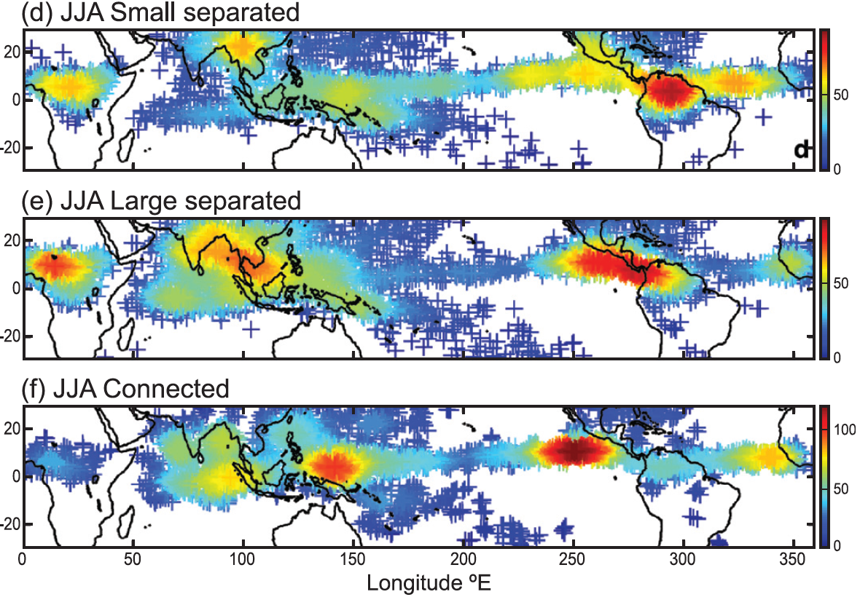
JJA MCSs Over the Whole Tropics
Smallest 25% (<12,000 km²)
Largest 25% (>40,000 km²)
“Superclusters”
Yuan and Houze 2010
Yuan and Houze 2010
Notes:
Size of MCS is size of cold cloud top. To qualify as MCS, must have large cold cloud top, large rain area, and some heavy rain. This figure shows spatial distribution of active MCSs. Color of each point shows the number of active MCSs found within a circular area with radius of five degrees centered on that point. (a) Small separated MCSs (<12,000km2; i.e., the smallest 25%) in DJF, (b) large separated MCS (>40,000km2; i.e., the largest 25%) in DJF, (c) connected MCS in DJF, (d)-(f) same as (a)-(c) except for JJA.

Slide 19
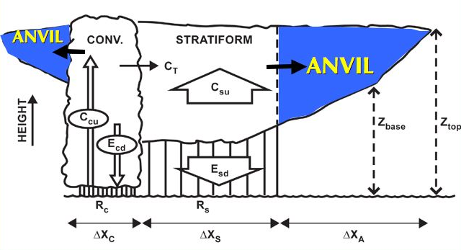
The Anvil Problem
Mesoscale Convective System
Need to understand how anvil is related to the raining region
Extensively studied

Slide 20
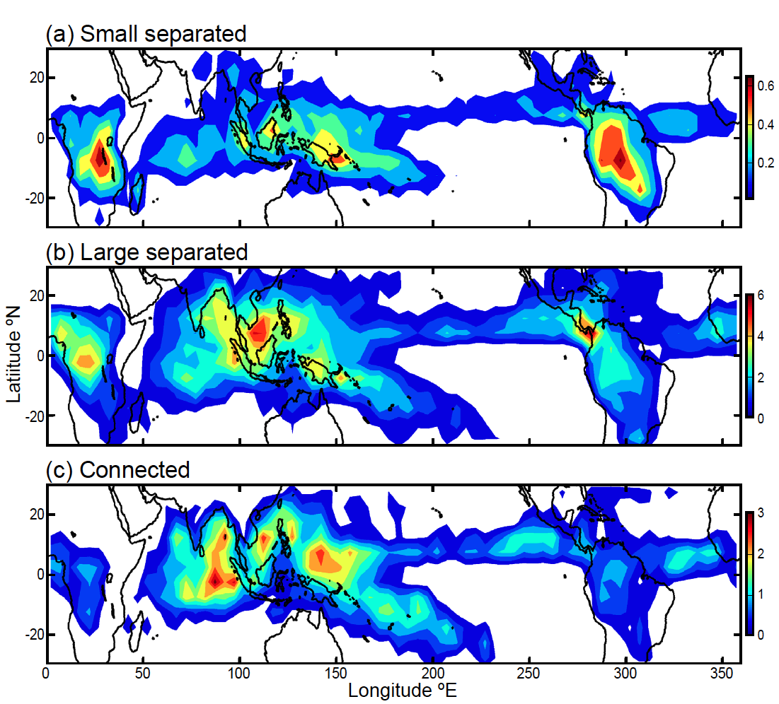
Frequency of MCS anvils over tropics
Yuan and Houze 2010

Slide 21
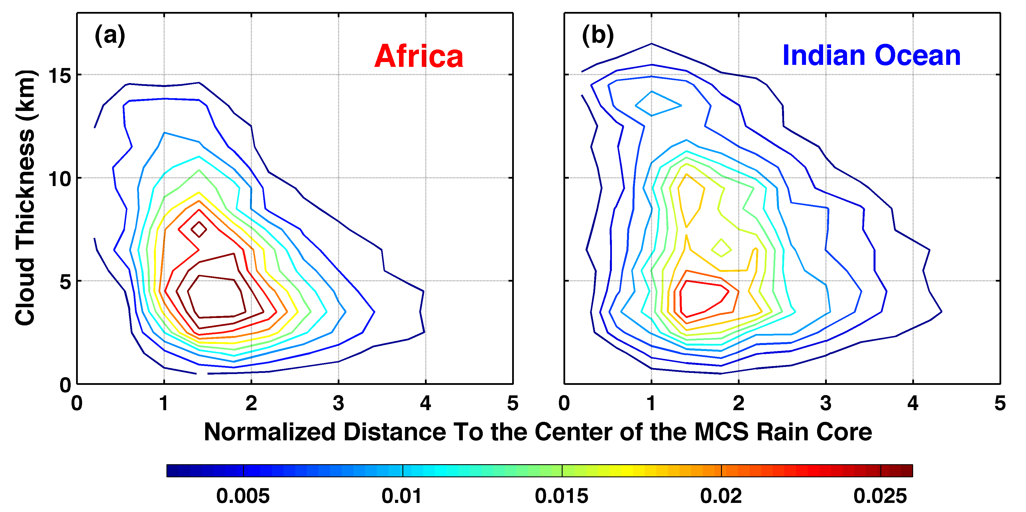
Statistics of anvil width & thickness seen by CloudSat
Africa
Indian Ocean
Yuan and Houze 2010
Notes:
Normalized by dimension of the MCS rain area

Slide 22
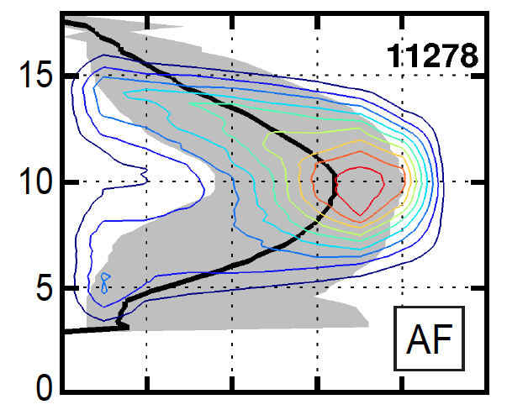
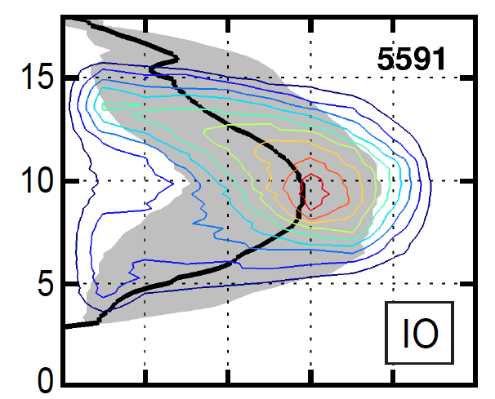

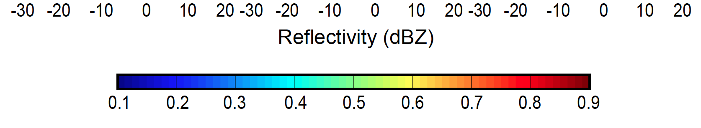
Internal structure of MCS anvils
Africa
Indian Ocean
Yuan, Houze, and Heymsfield 2011
Notes:
Black curves are medians

Slide 23
  TRMM
Notes:
We now look briefly at how we combine 2 of these properties to first identify MCSs
CloudSat: W-band, 94 GHz, 3 mm
TRMM: Ka-band, 13.8 GHz, 2.17 cm

Slide 24
Basic components
Cold top
Stratiform
Convective
Anvil
Anvil
Raining core
Houze et al. 1989
TRMM separates the convective and stratiform echoes
Notes:
The basic components of an MCS can be simplified into 3 main features, which can be identified and MEASURED by satellite. The combination of these three properties can be used to identify an MCS if they satisfy certain criteria. Thus we can determine when and where MCSs occur around the globe. In addition we can determine how the properties of these three components vary from region to region. How big and wide is the cold top; how big and intense is the raining core; how thick are the anvils; and what are the characteristics of their internal structure. And how do these properties vary around the globe? One cannot holistically determine the properties of MCSs by identifying one of these properties alone. It’s important to see and evaluate all 3.

Slide 25
Use TRMM to find the most extreme convective & stratiform elements
Identify each contiguous 3D echo object
seen on radar
Convective component
Stratiform component
Extreme characteristic
Contiguous 3D volume of
convective echo > 40 dBZ
Extreme characteristic
Contiguous stratiform echo
with horizontal area > 50 000 km²
“Broad stratiform region”
Top height > 10 km
“Deep convective core”
Horizontal area > 1 000 km²
“Wide convective core”

Slide 26
  Continents
Notes:
We now look briefly at how we combine 2 of these properties to first identify MCSs

Slide 27
  Topographic vs Synoptic Controls on Extreme MCSs
Notes:
We now look briefly at how we combine 2 of these properties to first identify MCSs

Slide 28
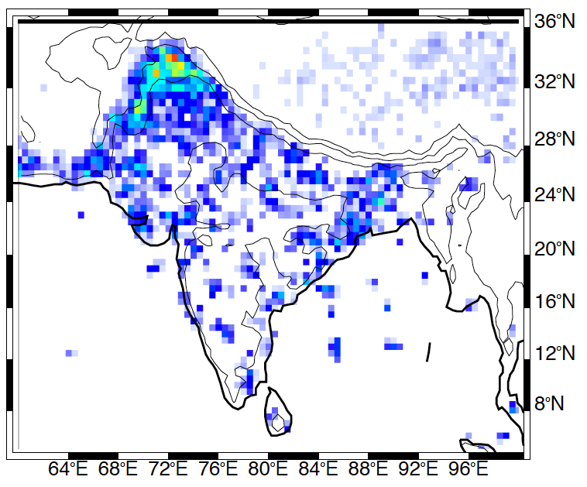
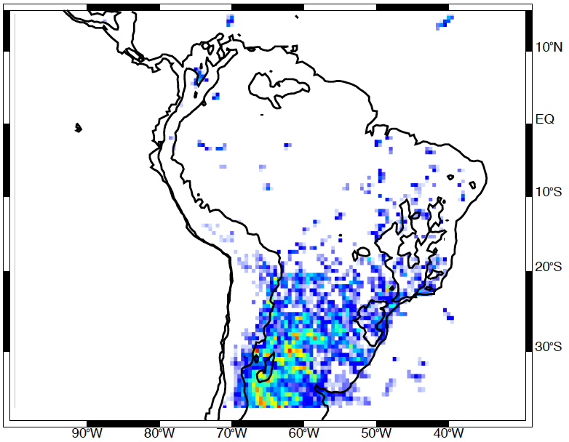
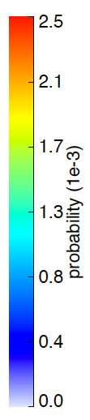
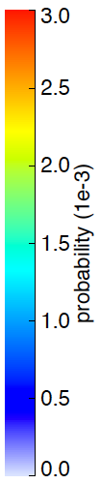
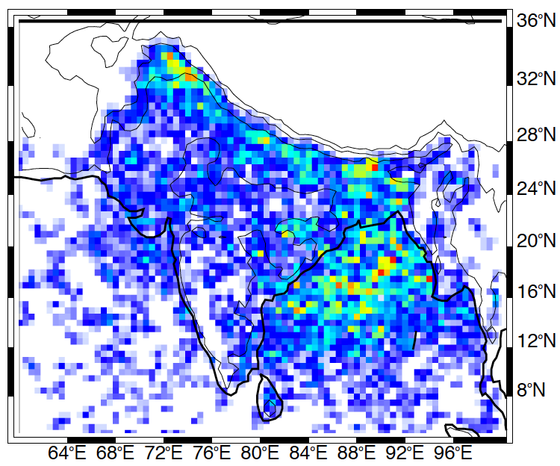
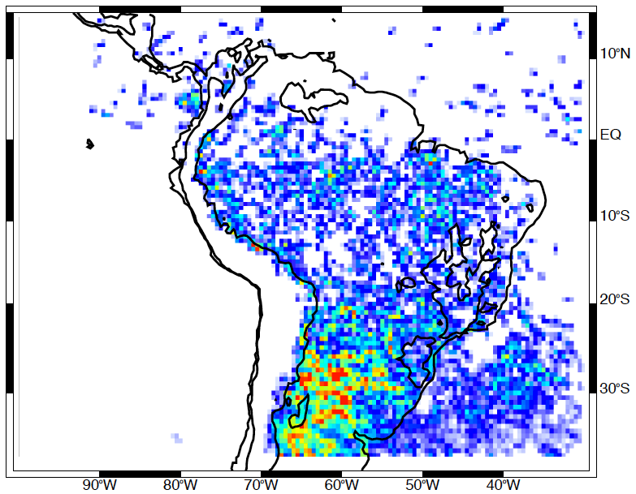
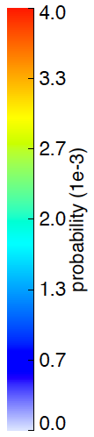
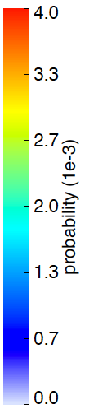
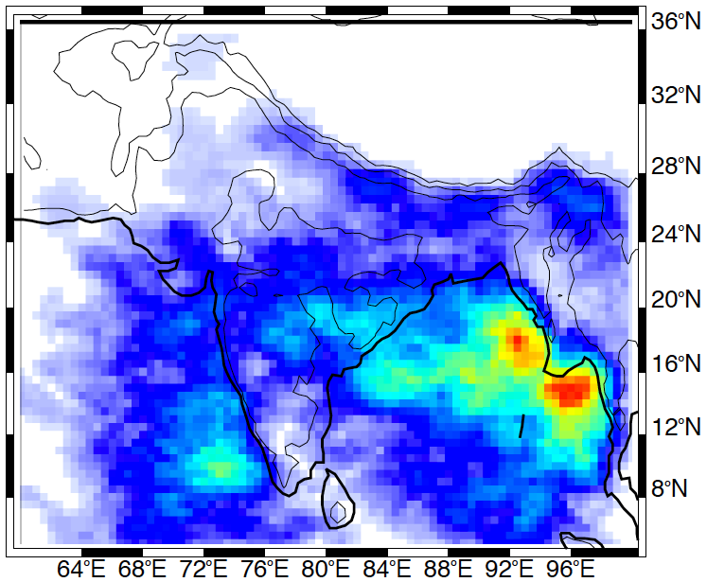
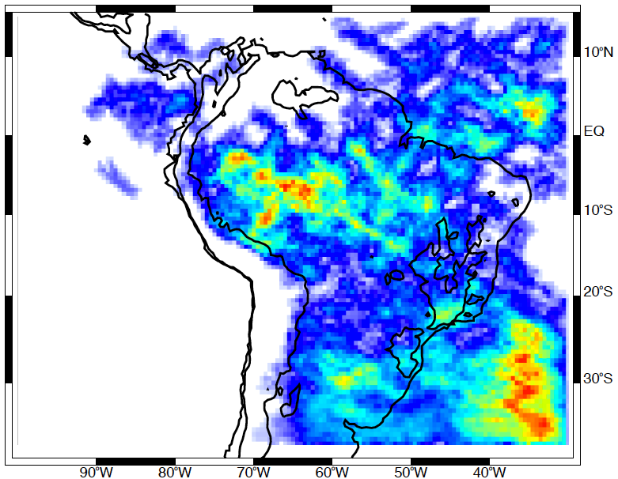
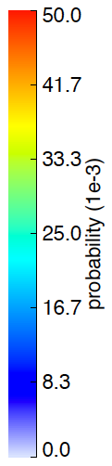
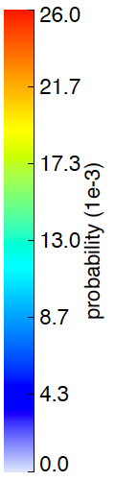
  South Asia
  &
  South
  America
JJAS
DJF
Deep Convective Cores
Wide Convective Cores
Broad
Stratiform
Regions
Notes:
1998-2012

Slide 29
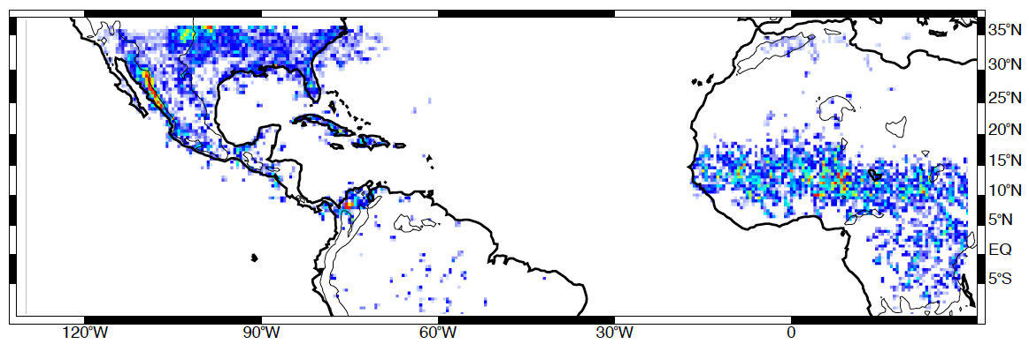
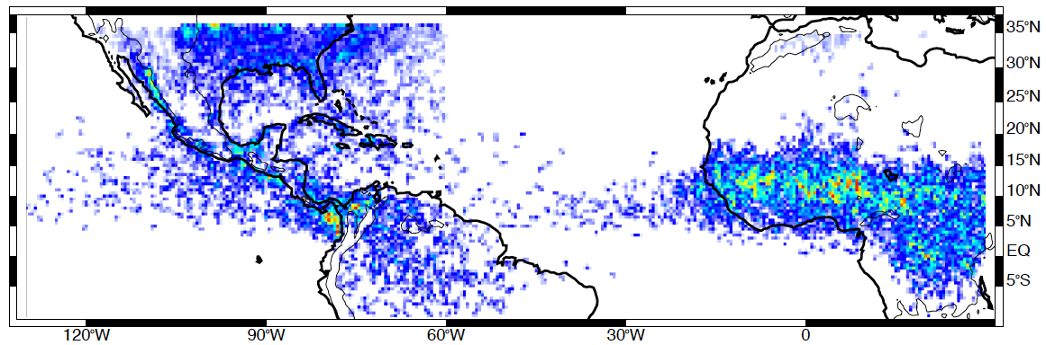
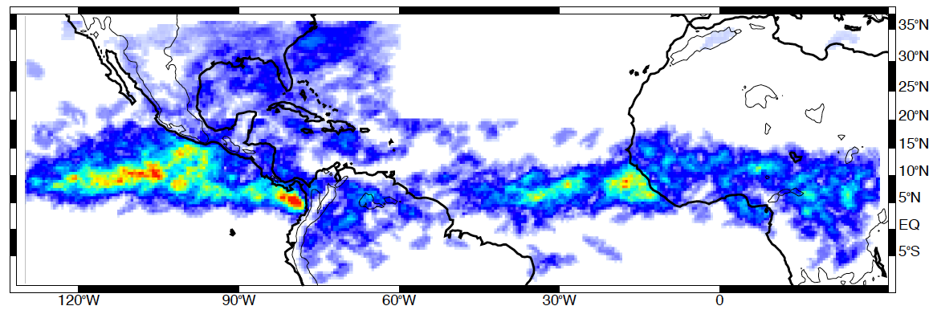
  Americas and Africa
JJA
Deep Convective Cores
Wide Convective Cores
Broad
Stratiform
Regions

Slide 30
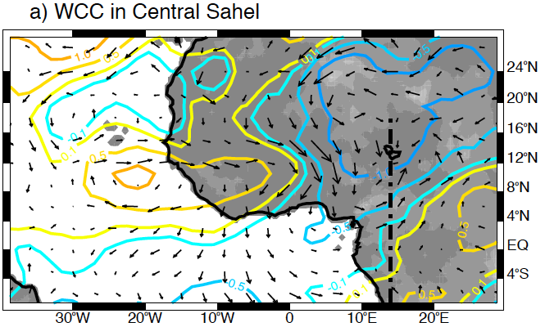
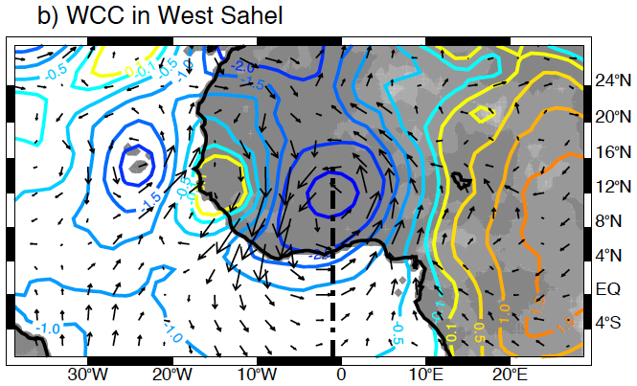
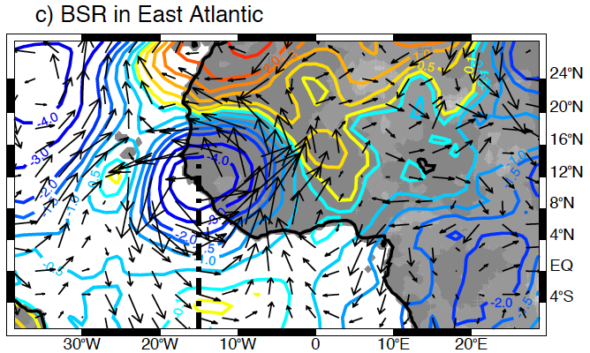
Tropical Africa
Composite 700 hPa geopotential height and wind vector anomalies
700 hPa geopotential height (m)
Notes:
Composites of ERA-interim geopotential height and horizontal wind anomalies at 700 hPa for the closest hour when (a) WCC where observed in Central Sahel, (b) WCC were observed in West Sahel, and (c) BSR were observed in the East Atlantic Ocean region. The black dash line in each composite represents the approximate location of the AEW trough

Slide 31
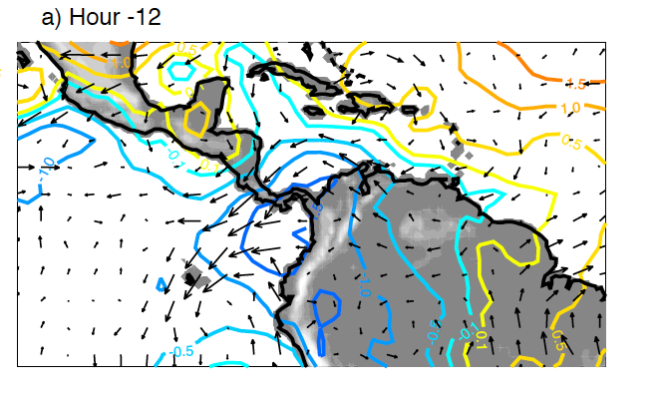
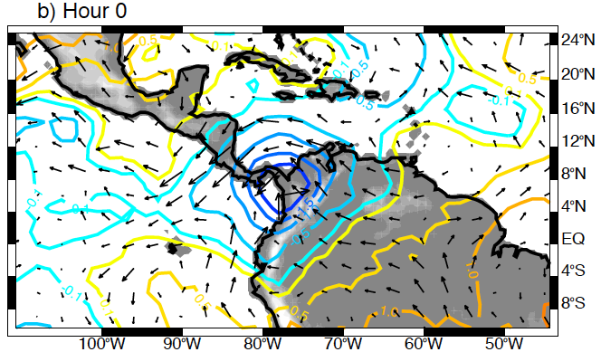
Tropical Africa
Composite 700 hPa geopotential height and wind vector anomalies
WCCs in Tropical America
700 hPa geopotential height (m)
700 hPa geopotential height (m)
Notes:
Composites of ERA-interim geopotential height and horizontal wind anomalies at 700 hPa for (a) -12 h and (b) 0 h from the time when WCC where observed in the Colombia-Panama Bight

Slide 32
  How much rain is produced by the extreme MCSs?
Notes:
We now look briefly at how we combine 2 of these properties to first identify MCSs

Slide 33
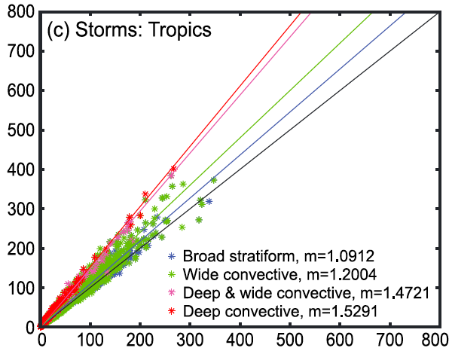
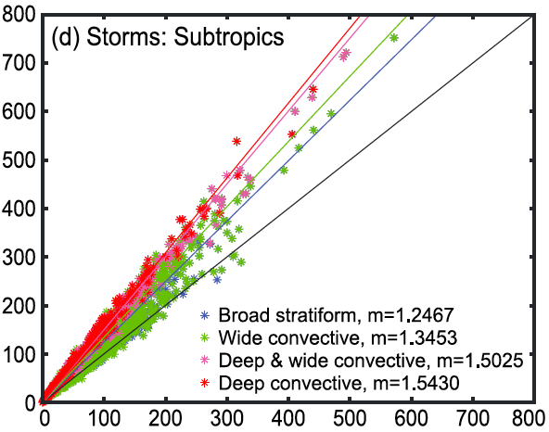
Rainfall estimation from TRMM
Our aim is understanding the rainfall from extreme convective storms globally
TRMM PR rainfall algorithm underestimates precipitation from deep convection over land (Iguchi et al. 2009)
Need to mitigate this bias
Use a traditional Z-R
Finding: bias is greater for storms with deeper echo tops and with significant mixed phase hydrometeors (Rasmussen et al. 2013)
South American storms
Rasmussen, Choi, Zuluaga, and Houze 2013
Notes:
In both tropics and subtropics the TRMM PR rain underestimation is consistent with respect to storm type--systematic
Important to include heavy precipitation from extreme storms in the total climatology that are underestimated in the standard TRMM near-surface rain climatology
TRMM algorithm assumes snow particles only
Not assuming different DSDs from pixel to pixel based on the snow model
Same reflectivity at same altitude in both types of calculations
7 Z-R’s, used conservative one
Trying to mitigate the problem

Slide 34
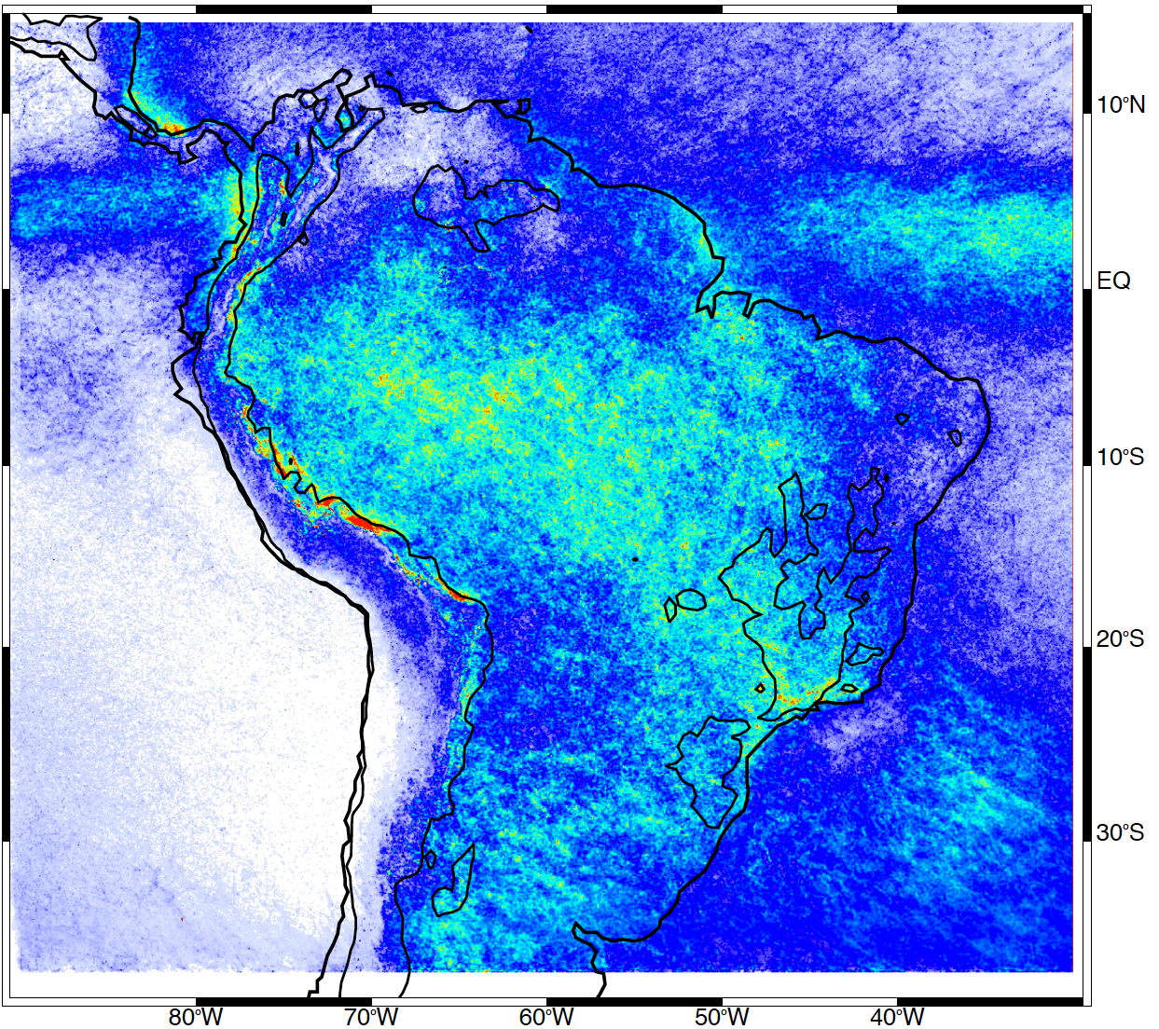
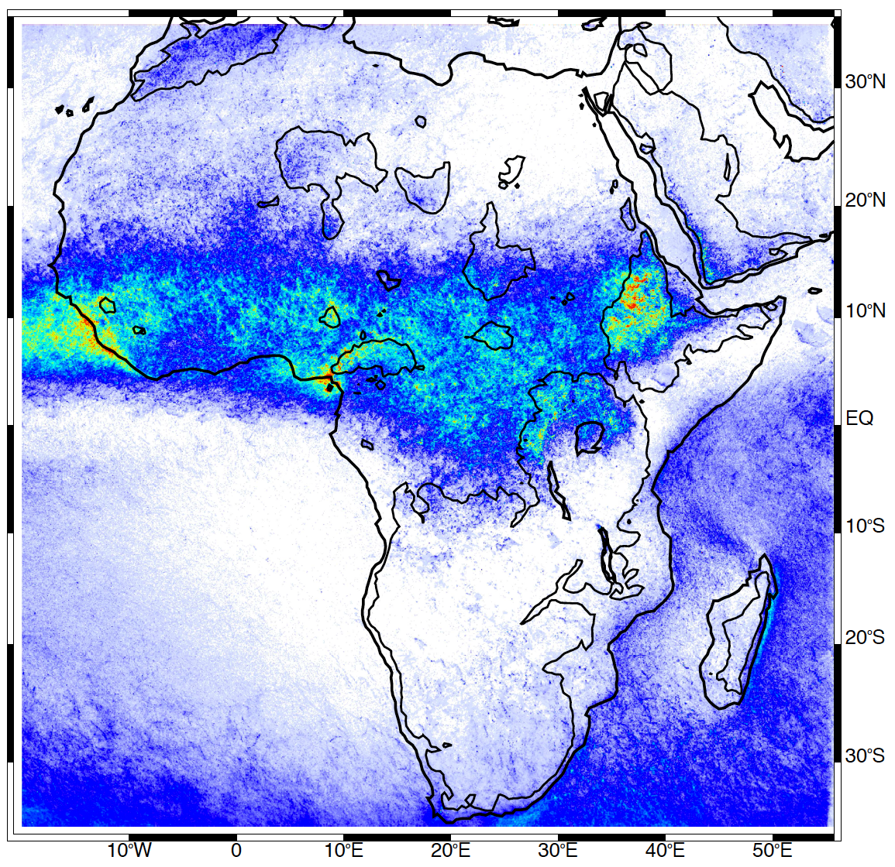
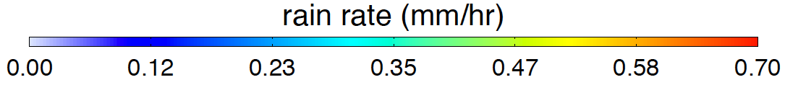
TRMM PR rainfall climatology
DJF
JJA

Slide 35
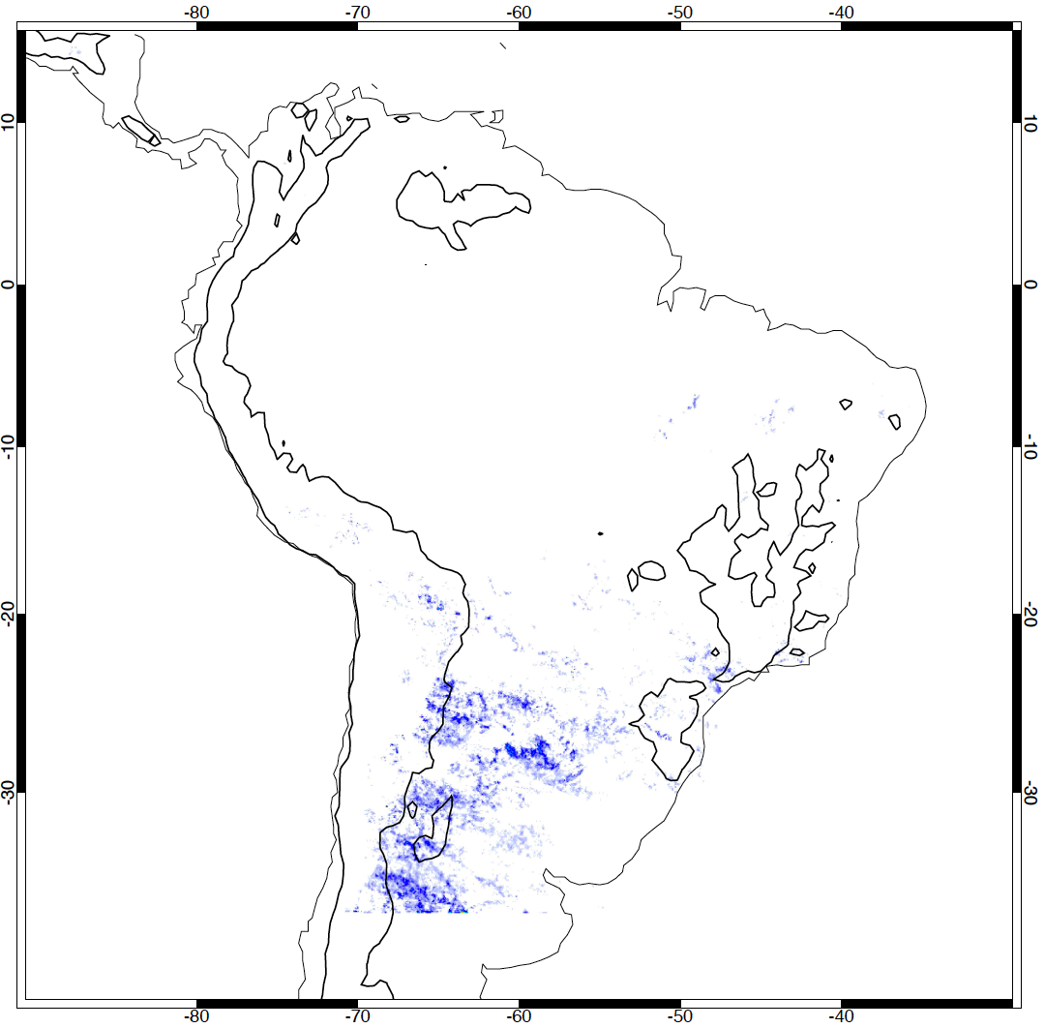




DJF rainfall climatology
Rainfall contribution by storm type
DCC
DWCC
Contribution of convective categories to the total warm season rainfall: ~ 60%
Including BSR precipitation, all extreme echo types contribute ~ 95% of the total warm season rainfall
WCC
BSR
~43% of total rainfall

Slide 36





JJA rainfall climatology
Rainfall contribution by storm type
DCC
DWCC
Contribution of convective categories to the total warm season rainfall: ~ 47%
Including BSR, ~ 58% of the total warm season rainfall
WCC
BSR
~36% of total rainfall
Notes:
AEJ is a topographically induced feature. It in turn modulates the extreme convection. Indirect topographic effect.

Slide 37
  Oceans
Notes:
We now look briefly at how we combine 2 of these properties to first identify MCSs

Slide 38
TRMM Radar Observations of the MJO over the Indian Ocean
Active Phase
Suppressed Phase
Deep Convective Cores
Broad Stratiform Rain Areas
Phase 7

Slide 39

Indian Ocean MCSs Contribution to Rainfall by phase of the Madden-Julian Oscillation
Active
Suppressed
Connected MCSs
Separated MCSs
Other high cloud systems
Yuan and Houze 2012

Slide 40


Composite MCS Lightning in the MJO
Separated
ACTIVE
Separated
SUPPRESSED
Notes:
Size of MCS is size of cold cloud top. To qualify as MCS, must have large cold cloud top, large rain area, and some heavy rain. This figure shows spatial distribution of active MCSs. Color of each point shows the number of active MCSs found within a circular area with radius of five degrees centered on that point. (a) Small separated MCSs (<12,000km2; i.e., the smallest 25%) in DJF, (b) large separated MCS (>40,000km2; i.e., the largest 25%) in DJF, (c) connected MCS in DJF, (d)-(f) same as (a)-(c) except for JJA.

Slide 41
Conclusions
A-Train data
  Identifies MCSs globally
  Show anvils of MCSs
  TRMM & A-Train together
  Deep convection takes on various forms
  Forms of convection controlled by
    Mountain ranges in Asia and South America
    Easterly waves over Africa
    MJO over ocean
  Warm season precipitation over Africa and S. America
  Amazon precipitation affected by smaller non-extreme MCSs
  Extreme MCSs dominate eq. Africa and subtrop. S. America
Notes:
Cause & Effect theme:
Precipitation
Warm season rain dominated by storms with wide convective regions (MCSs) in both Africa and South America
Amazonian precipitation not affected by storms with extreme convective or stratiform features (tropical oceanic)
Equatorial Africa precipitation dominated by MCSs controlled by AEWs
Subtropical South America dominated by MCSs controlled by topography

Slide 42

The future?
GPM
CloudSat → EarthCare
TRMM
Next generation:
  Radars need to be in the same orbit!
This research was supported by
NASA grants NNX13AG71G, NNX10AH70G, NNX11AL65H, NNX10AM28G,
DE-SC0008452, and NSF grant AGS1144105
Notes:
Comment on GPM and the ability go to higher latitudes in the future—frontal systems, etc.

Slide 43
  End

Slide 44
  End

Slide 45
  End

Slide 46
  These storms are
  Mesoscale Convective Systems
  “MCSs”

Slide 47








Severe weather impacts
in South America
Flooding
Hail
damage
Tornadoes

Slide 48

TRMM observations of extreme storms in S. America
Local media reported tornadoes, hail, flooding, and power outages during both storms
Height (km)

Slide 49
Rainfall contribution by storm type
(entire rainy season—10 months)
TRMM echo type | Tropics (%) | Subtropics (%)
Broad stratiform | 9.69 | 30.47
Deep conv. | 0.68 | 1.62
Deep/wide conv. | 1.29 | 17.67
Wide conv. | 15.79 | 33.70
Total | 27.45 | 83.46

Slide 50


Geopotential height and wind vector anomalies
Tropical America
a) -12 h
Diurnal sea-breeze favoring convergence for the closest hour when DCC were observed
b) 0 h
850 hPa geopotential height (m)
Notes:
Composites of ERA-interim geopotential height and horizontal wind anomalies at 850 hPa for (a) -12 h, and (b) 0 h of the time where DCC were observed in the northern Andes mountain region

Slide 51

Internal structure of MCS anvils
Indian Ocean Anvils
CVCV
CVCV

Slide 52
Cold top
Anvil
Anvil
Raining core
MODIS/AMSR-E
→identifies cold top
→locates the raining core
→remainder is anvil

Slide 53


Slide 54


Geopotential height and wind vector anomalies
Tropical East Pacific
a) Day -2
Easterly moving disturbance (SE-NW) with maximum cross-equatorial flow for the day when BSR were observed
b) Day 0
850 hPa geopotential height (m)
Notes:
Composites of ERA-interim geopotential height and horizontal wind anomalies at 850 hPa for (a) -2, and (b) 0 days of the time where BSR were observed in the Tropical East Pacific region.

Slide 55


Geopotential height and wind vector anomalies
Western Sierra Madre
a) -12 h
Strong diurnal sea-breeze favoring convergence for the closest hour when DCC or WCC were observed
b) 0 h
850 hPa geopotential height (m)
Notes:
Composites of ERA-interim geopotential height and horizontal wind anomalies at 850 hPa for (a) -12 h, and (b) 0 h of the time where DCC were observed in the Western Sierra Madre region

Slide 56

TRMM Precipitation (Method 1)
TRMM PR near-surface rain rate algorithm (2A25 Product)
Negative biases of near-surface precipitation estimates from the TRMM algorithm in deep convective storms over land → partially attributed to errors in the drop size distribution (DSD) parameter ε (Iguchi et al. 2009)
Non-dimensional parameter ε used as a sliding term to adjust the vertical profile model ζ→ equivalent to estimating the DSD (Kozu et al. 2009)
When the storm top is high, ζ tends to be overestimated (mixed-phase attenuation parameters in ice regions; Iguchi et al. 2009)
PIA-path-integrated attenuation;
r_{b}-farthest range of rain echo;
q – dB conversion constant;
β – exponential parameter in k_{p}=αZ_{e}^{β} related to the precipitation attenuation; ζ – vertical profile model to approximate α and β

Slide 57

TRMM Precipitation (Method 2)
Derived from Romatschke and Houze (2011) → uses a more traditional Z-R relationship
Z is the radar reflectivity at each pixel between the surface and 2.5 km for each precipitation echo
Parameters a and b are constants that depend on the rain type (Convective, Stratiform, or Other) and were calibrated in Romatschke and Houze (2011) to match the climatological near-surface rain rate over subtropical land regions

Slide 58




TRMM Precipitation Data Processing
Full Storm
Convective/Stratiform
with LIS lightning
TRMM 2A25
near-sfc. rain
Wide Convective
Core
Precipitation from each TRMM PR overpass was calculated using both methods for the “full storm” and “core storm”

Slide 59

Contribution to total rain from intense storms
Precipitation bias study was necessary to facilitate this investigation
Assess the relative contribution of precipitation from the TRMM-identified core echoes to each separate storm in which the cores are embedded within
Assess the contribution of precipitation from intense storms to the climatological precipitation
Full Storm
Convective/
Stratiform
TRMM 2A25
near-sfc. rain
Wide Convective
Core

Slide 60
Rainfall estimation from TRMM
To mitigate this bias we employ a more traditional Z-R relationship to include the hydrological impacts of extreme storms on the climatological rainfall
  The method is described in Rasmussen et al. 2013, and uses conservative values for the Z-R equation
Assess the contribution of precipitation from intense storms to the climatological precipitation
Notes:
We are bypassing the standard method with a more traditional ZR relations
We came up with a method for computing the rainfall contribution from these systems
If someone ask about details of ZR method:
We used a conservative estimates compare to different ZR methodologies
The ZR method uses a similar vertical level and reflectivity values as the PR standard near-surface TRMM algorithm

Slide 61






  North America
Deep Convective Cores
Wide Convective Cores
Broad
Stratiform
Regions

Slide 62

North AUS Probability and rainfall climatologies
- Summer
JJA

Slide 63



  Rainfall contribution by storm type
Deep Convective Cores
Wide Convective Cores
Broad
Stratiform
Regions

Slide 64

Meso-America rain climatology
JJA

Slide 65



  Rainfall contribution by storm type in Meso-America
Deep Convective Cores
Wide Convective Cores
Broad
Stratiform
Regions

Slide 66
Composite MCS Lightning
Eq. Africa
Argentina
West Pacific
Eq. Atlantic
Connected
Separated
Determined from WWLLN
Notes:
Size of MCS is size of cold cloud top. To qualify as MCS, must have large cold cloud top, large rain area, and some heavy rain. This figure shows spatial distribution of active MCSs. Color of each point shows the number of active MCSs found within a circular area with radius of five degrees centered on that point. (a) Small separated MCSs (<12,000km2; i.e., the smallest 25%) in DJF, (b) large separated MCS (>40,000km2; i.e., the largest 25%) in DJF, (c) connected MCS in DJF, (d)-(f) same as (a)-(c) except for JJA.

Slide 67

Epic Floods in Pakistan
2010, 2011, 2012

Slide 68






TRMM PR showing storms producing the floods
2010
2011
2012
30N
Sindh
25N
65E
75E
65E
75E
65E
75E
16
Height (km)
8
0
0
287
0
232
0
241
Distance (km)

Slide 69
Radars in Space
CloudSat
2006-
(A-Train)
TRMM
1997-
Notes:
CloudSat: W-band, 94 GHz, 3 mm
TRMM: Ka-band, 13.8 GHz, 2.17 cm

