Slide 1

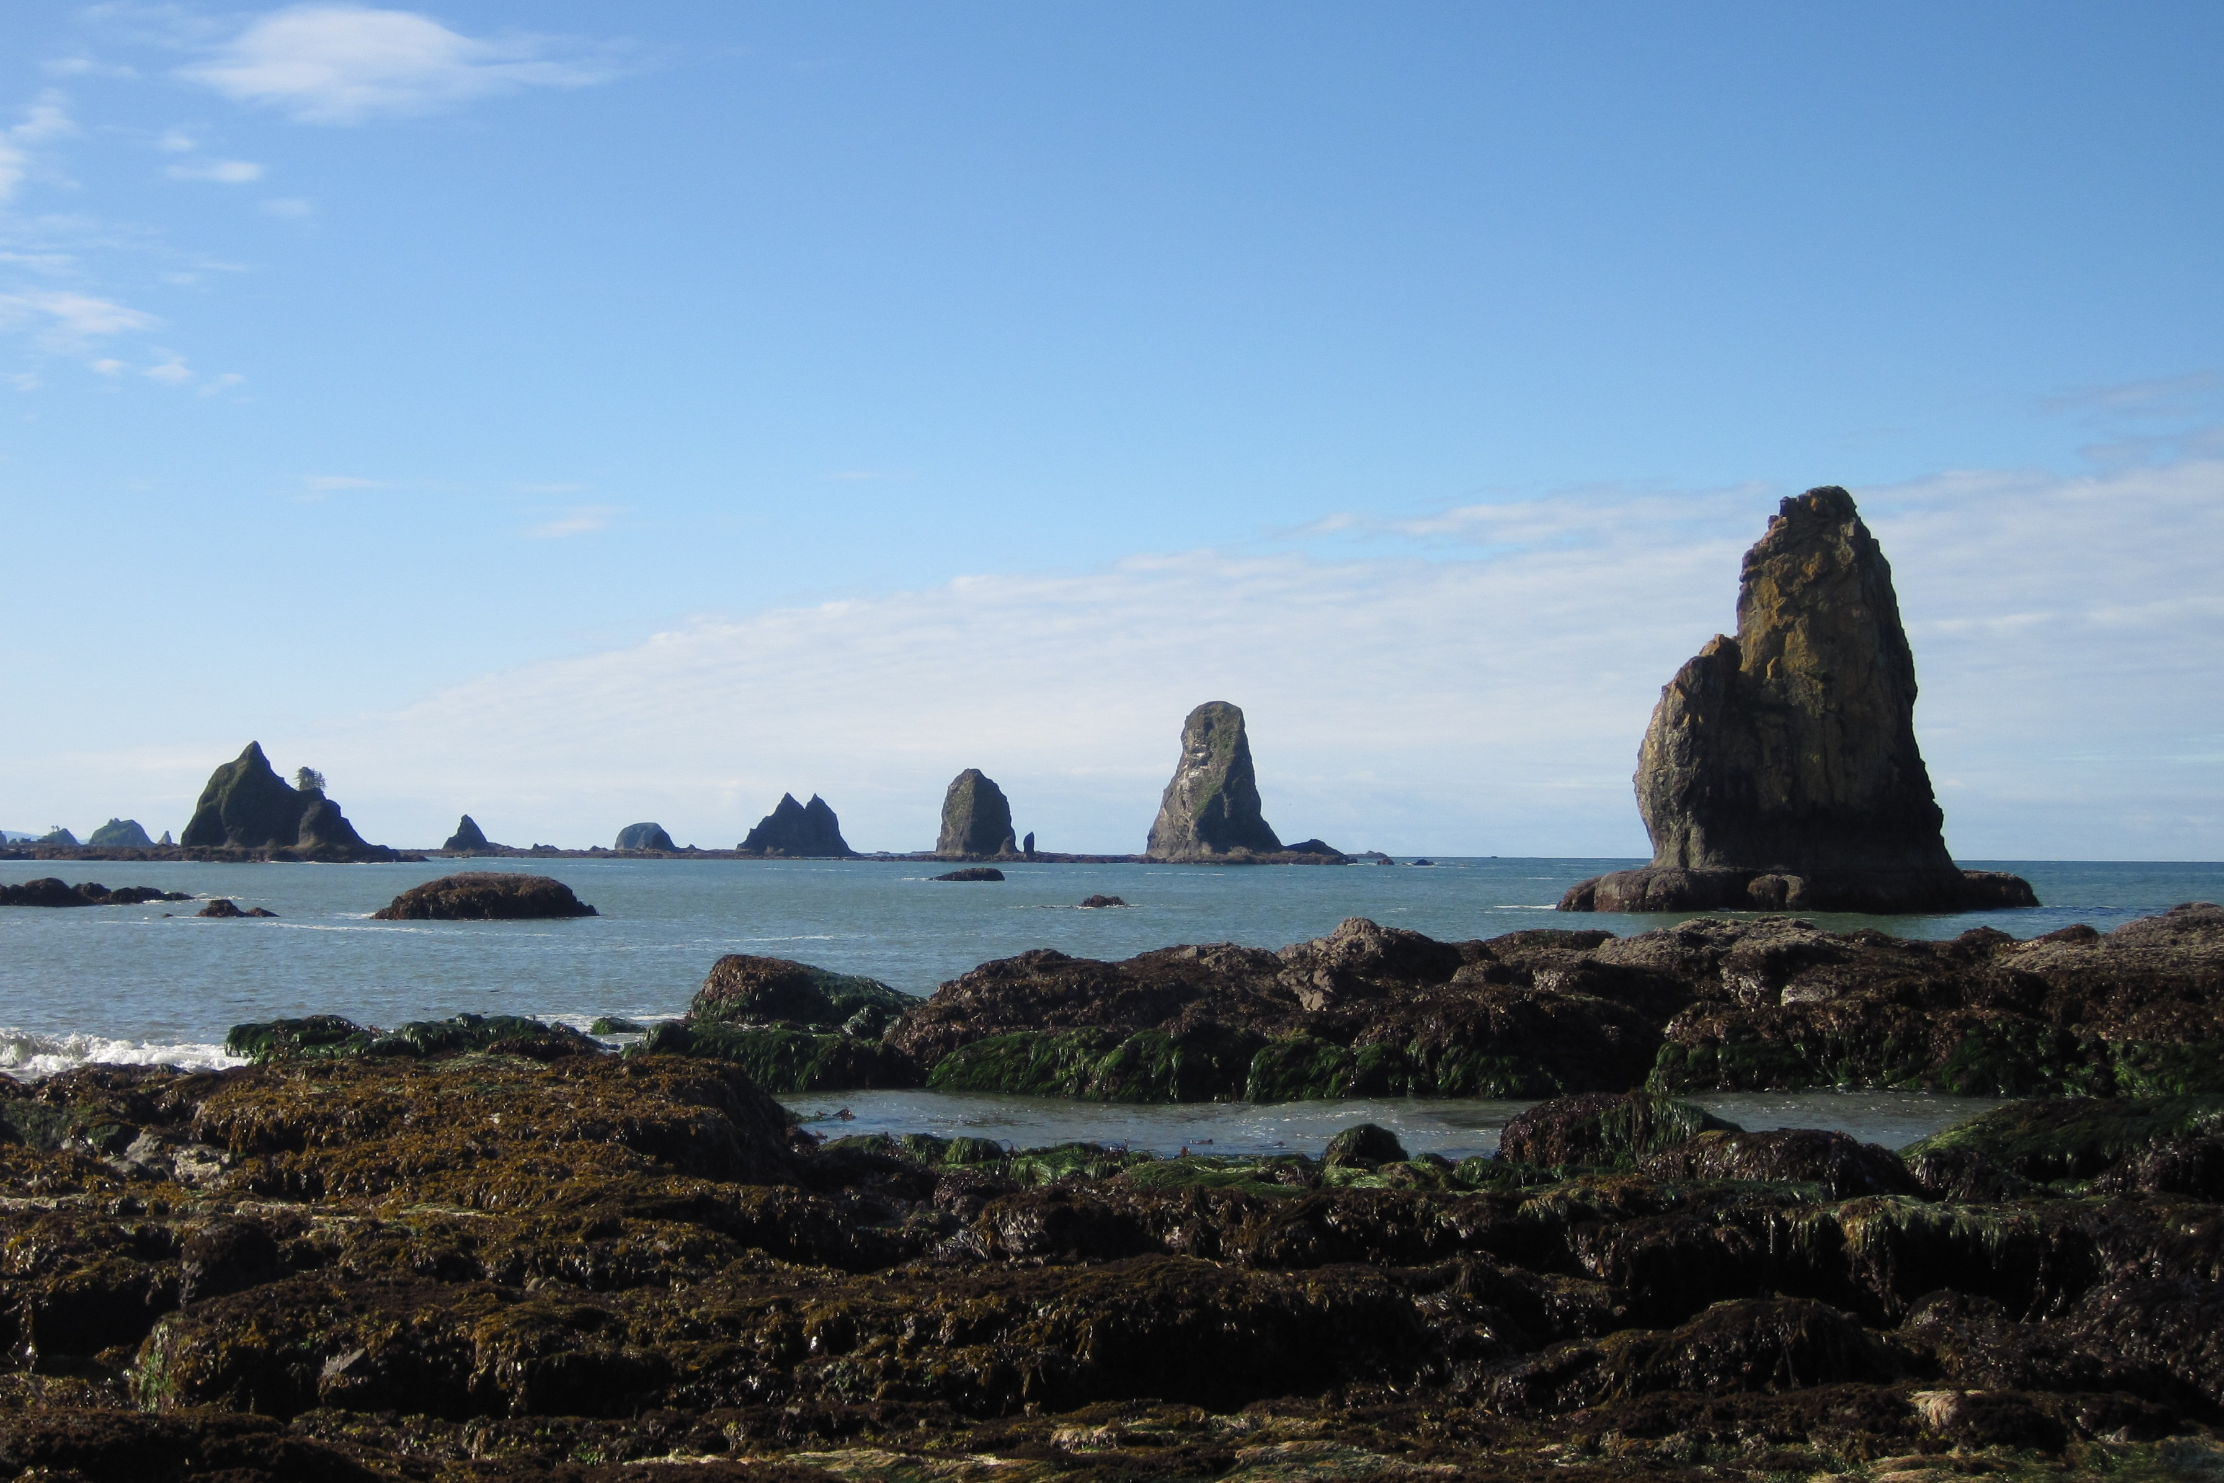
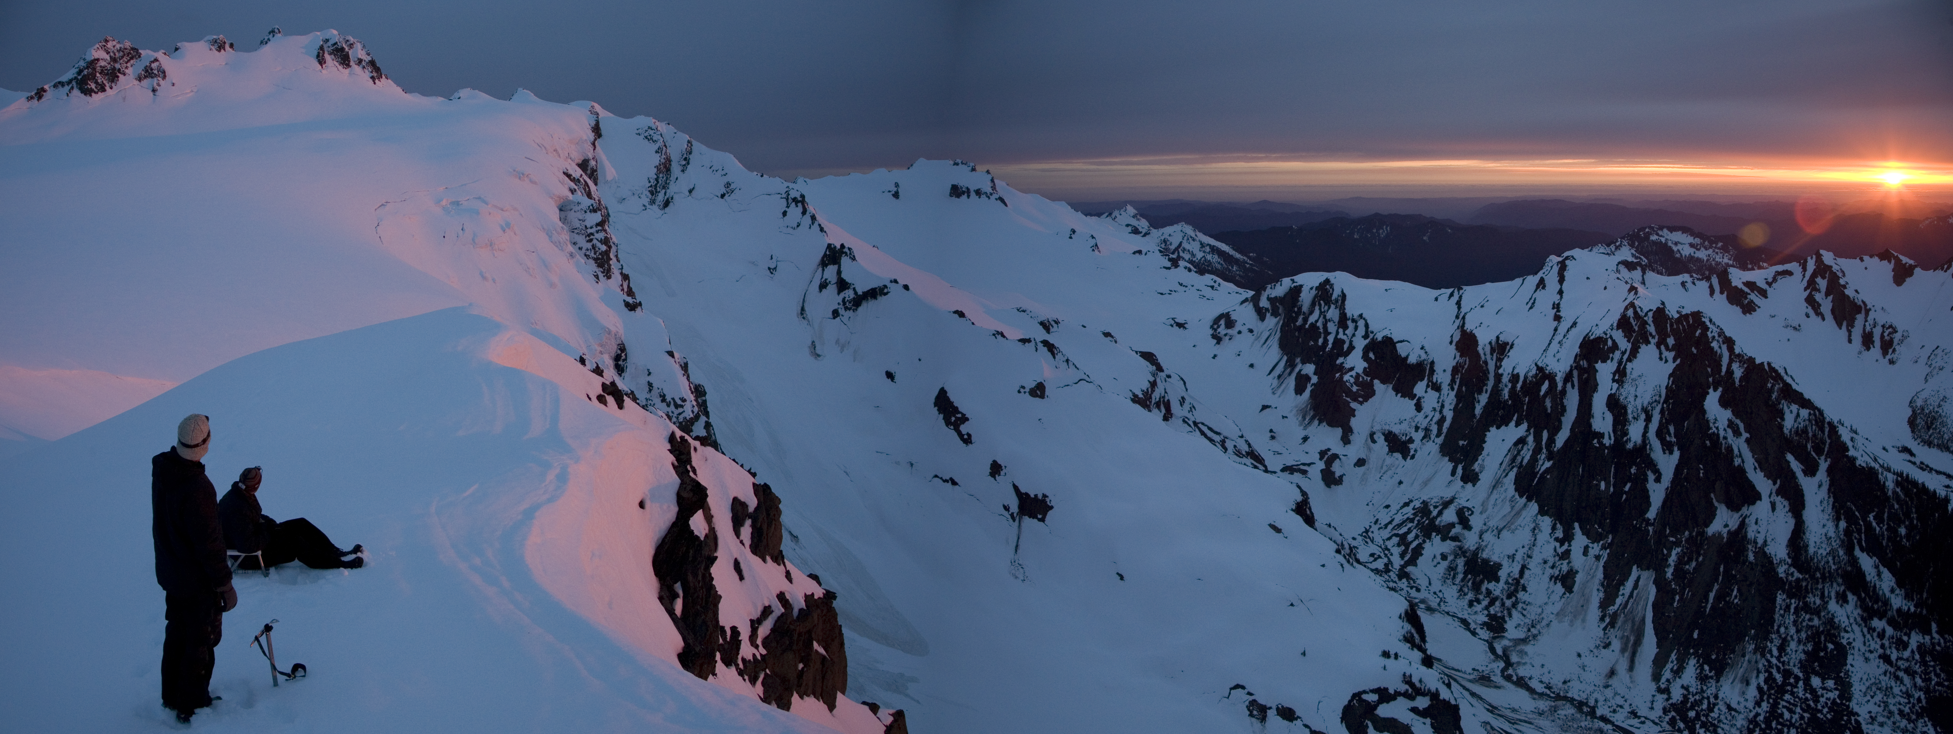
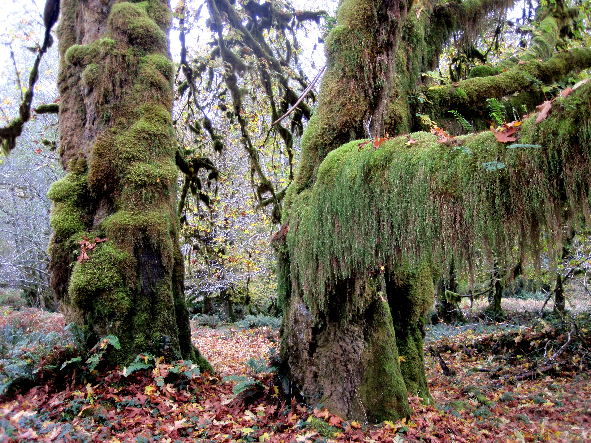
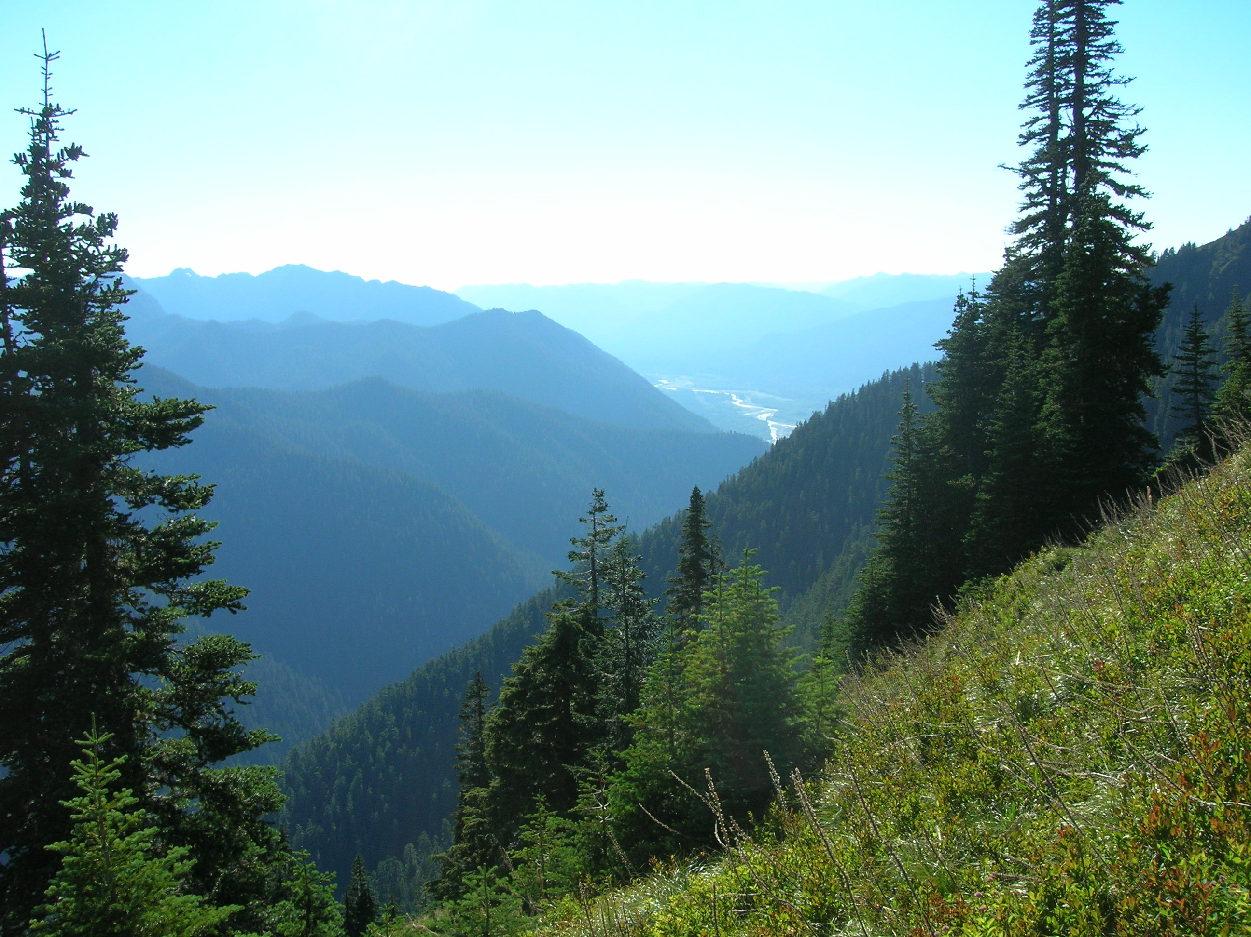
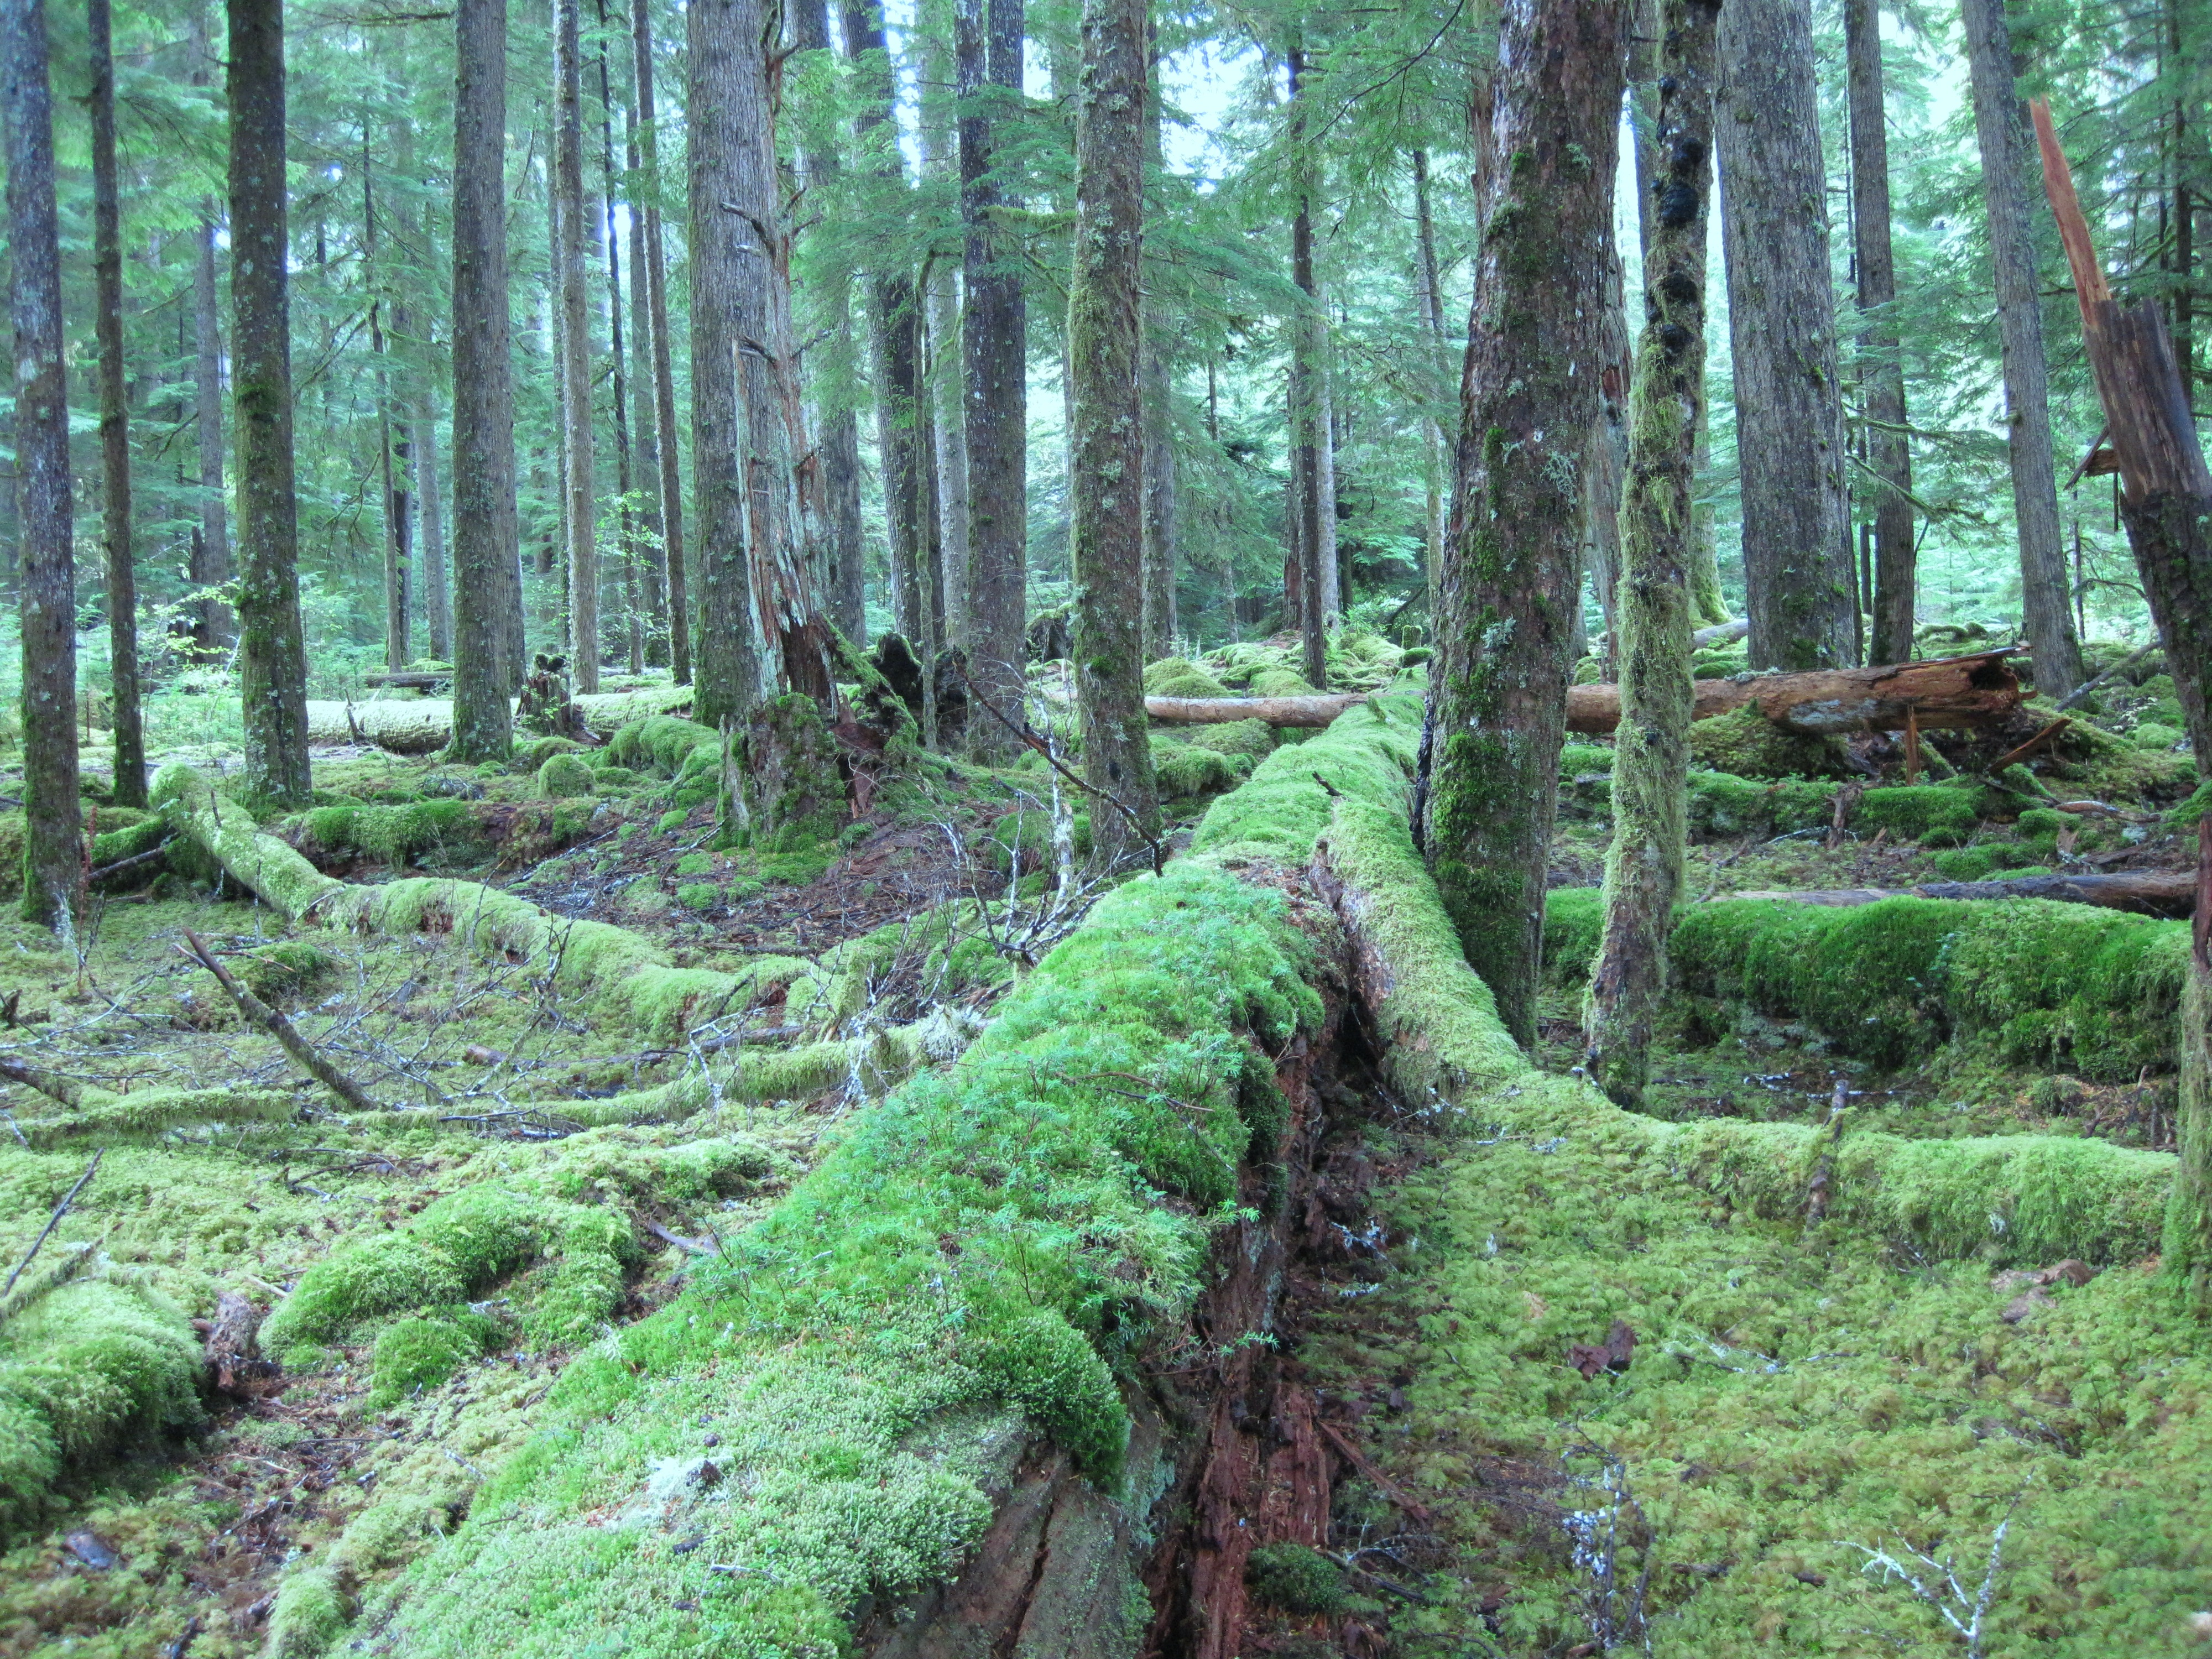
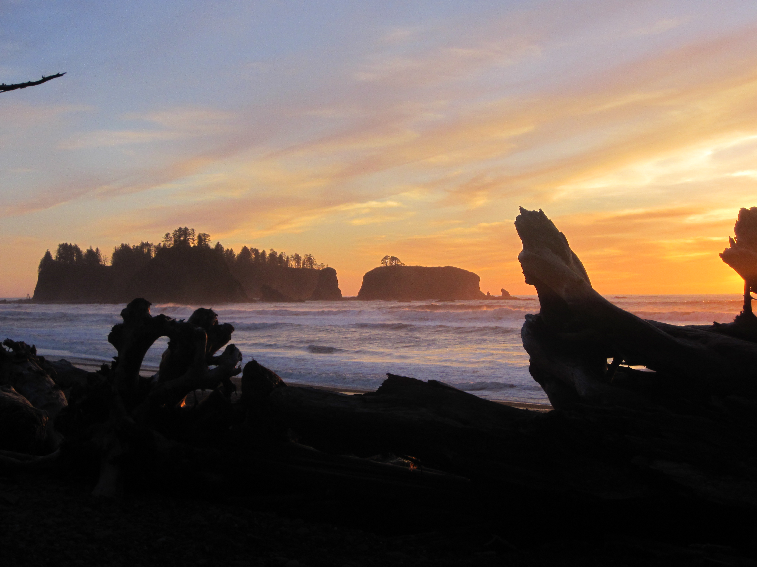
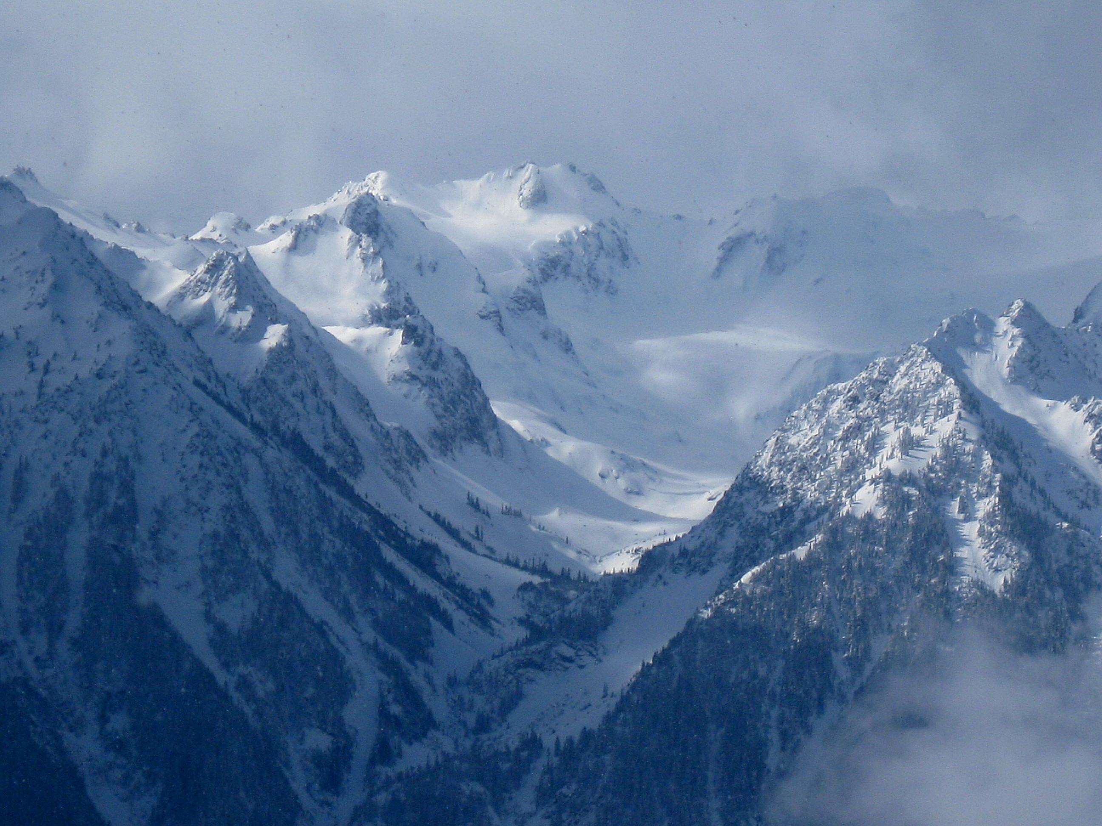
OLYMPEX: A Ground Validation Program on the Olympic Peninsula in the Pacific NW
Lynn McMurdie, Robert A. Houze, Jr., Cliff Mass
(Atmospheric Sciences, University of Washington)
Dennis Lettenmaier, Jessica Lundquist
(Civil Engineering, University of Washington)
Walter Petersen and Mathew Schwaller
(GSFC NASA)
27 September 2013 McGill University, Montreal, Canada

Slide 2
A future field program to validate a future satellite
In winter 2014 a new precipitation measuring satellite will be launched called the core satellite of the Global Precipitation Measurement (GPM) mission (next generation TRMM)
NASA is conducting several Ground Validation (GV) field campaigns to validate and develop the algorithms used by the instruments on the GPM
One of these field programs will be on the Olympic Peninsula during water year 2016. Most likely from Nov 2015 – Jan 2016

Slide 3
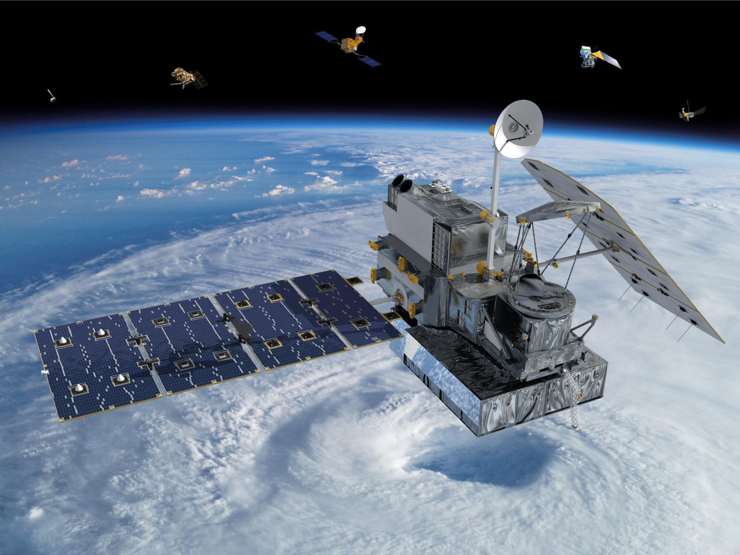
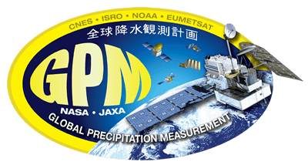

The GPM Satellite
GPM is a cooperative international science mission between NASA and the Japanese Space Agency, JAXA
The satellite is being assembled and tested at NASA Goddard and will be flown to JAXA in fall 2013 and launched from Japan.
Latest mission update: Sept. 2013 – GPM passed the vibration test and is in the final stage of testing at Goddard.
The satellite will be launched into orbit on an HII-A rocket and is scheduled for launch in early 2014.

Slide 4
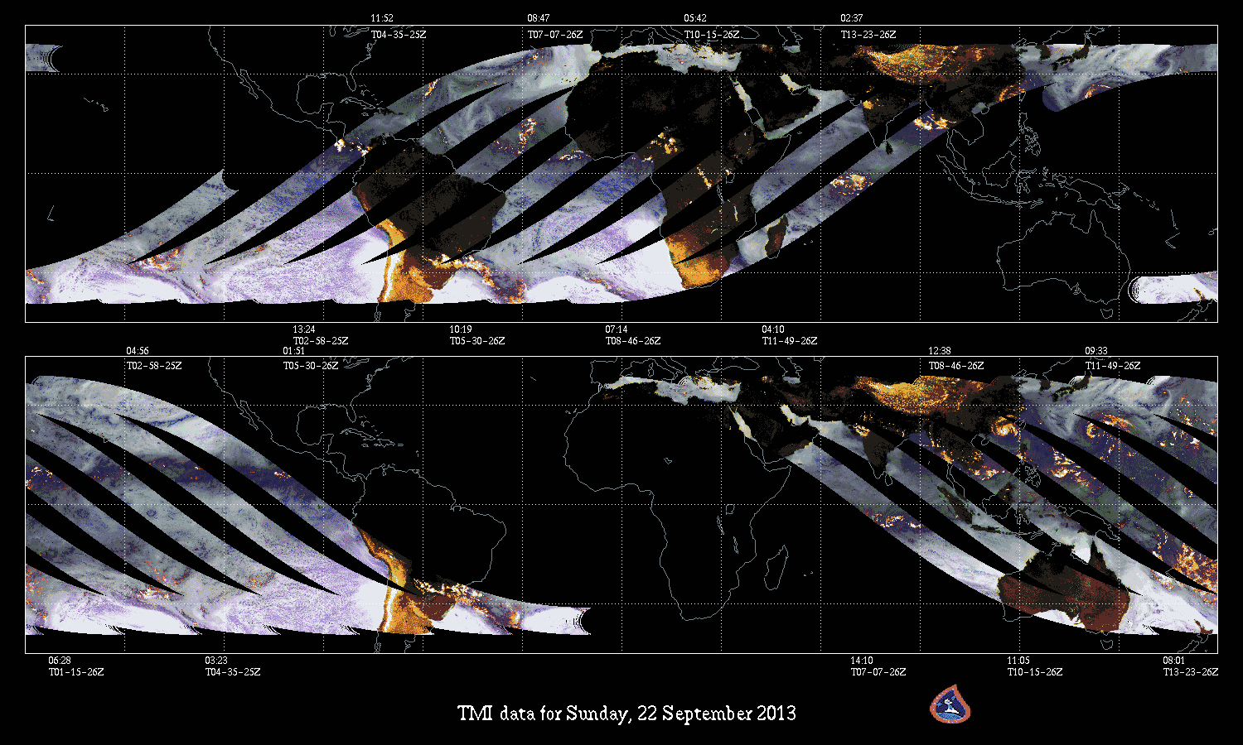
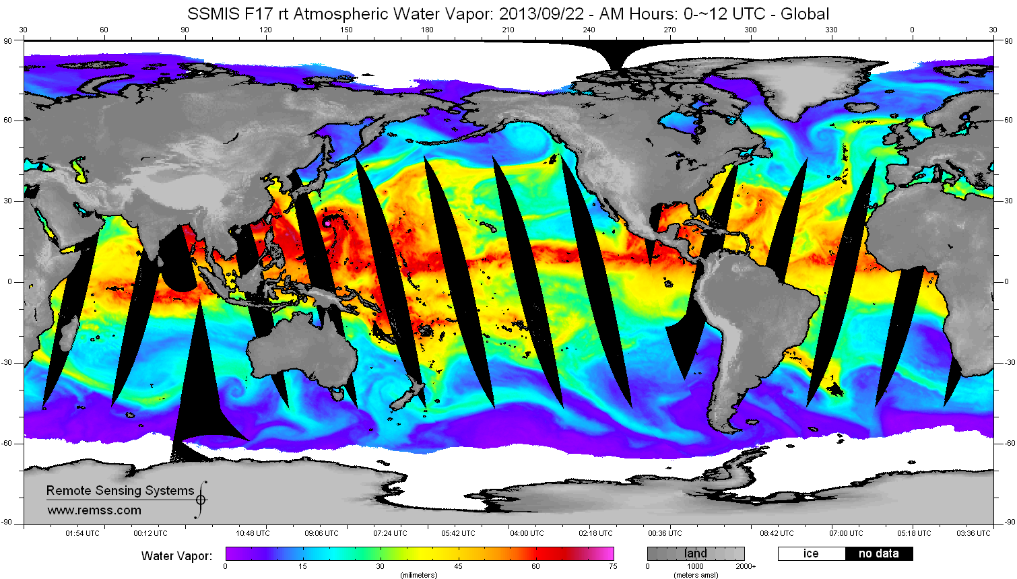
The GPM Satellite
F17 SSMI Water Vapor for 9/23/2013
TRMM orbits for 9/23/2013
GPM will be a polar orbiting satellite with an altitude of 407 km, a 65° orbit inclination, and a non sun-synchronous circular orbit dedicated to measuring precipitation from space.
This means it will sample the earth from the Antarctic circle to the Arctic circle and will sample a particular spot on the earth at different times of the day.
The GPM orbits will be farther poleward than TRMM but not as close to the poles as polar orbiters like the DMSP F17 (SSMI).

Slide 5
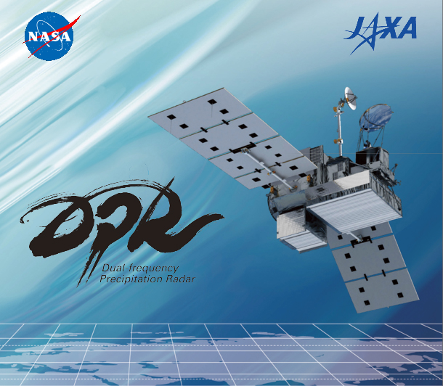
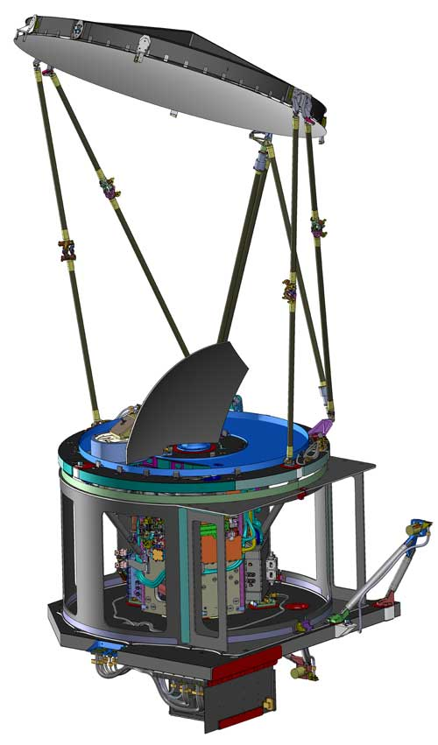
The GMI (and the) DPR Instruments
The GPM Microwave Imager
Passive microwave instrument with low frequencies to measure rain and high frequencies to measure snow
Will have a swath width of 904 km
Prior instruments did not have the very high frequencies that will be on the GMI
The Dual-Frequency Precipitation Radar (first time in space)
Will detect the 3-D distribution of precipitation
These frequencies will detect a range of precipitation regimes – tropical intense rain to midlatitude light rain and snow
Will have a swath width of 245 km (Ku band) and 120 km (Ka band)

Slide 6
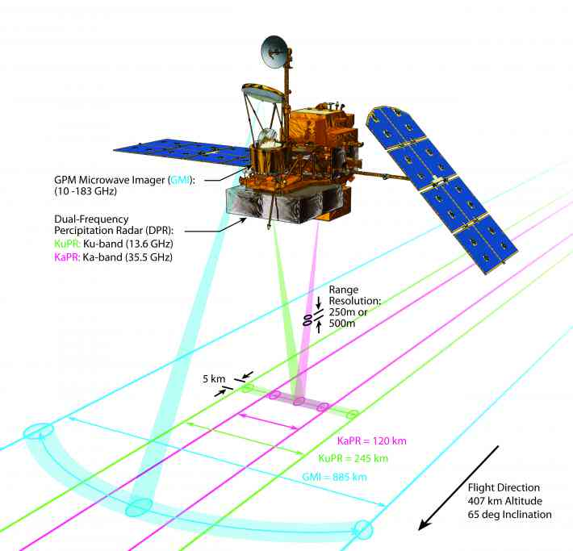
The GMI (and the) DPR Instruments
DPR Swath Widths Ka 120 km, Ku 245 km
GMI Swath Width ~ 885 km

Slide 7
GPM Mission Objectives
Measure rain and snow globally especially in areas lacking surface observations or ground-based radars.
Be able to detect solid and liquid precipitation over a wide range of intensities (0.2 mm hr⁻¹ to 110 mm hr⁻¹), a wide range of locations (ocean to complex terrain) and a wide range of regimes (light snowfall to intense tropical convection).
Apply remotely measured precipitation to a wide range of applications such as determining storm structures and observing flood and drought events.
Need Ground Validation Field Campaigns to Achieve these Objectives

Slide 8


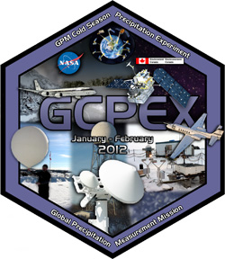

Past GV Campaigns for GPM
LPVEx: Light Precipitation Evaluation. Gulf of Finland. Sept-Oct. 2010. High latitude, low freezing level precipitation regime.
MC3E: Midlatitude Continental Convective Clouds Experiment. Central Oklahoma, April-June 2011.
GCPEX: GPM Cold-Season Precipitation Experiment in Ontario, Canada. Jan 15 – Feb 26, 2012.
Ifloods: Iowa Flood Studies. April – June 2013. Integrated Hydrologic Ground validation
HMT – SE: HydroMeteorological Testbed in the SouthEast. North Carolina, Summer 2014 – After Launch

Slide 9
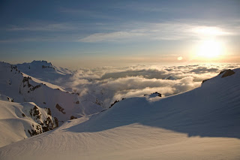
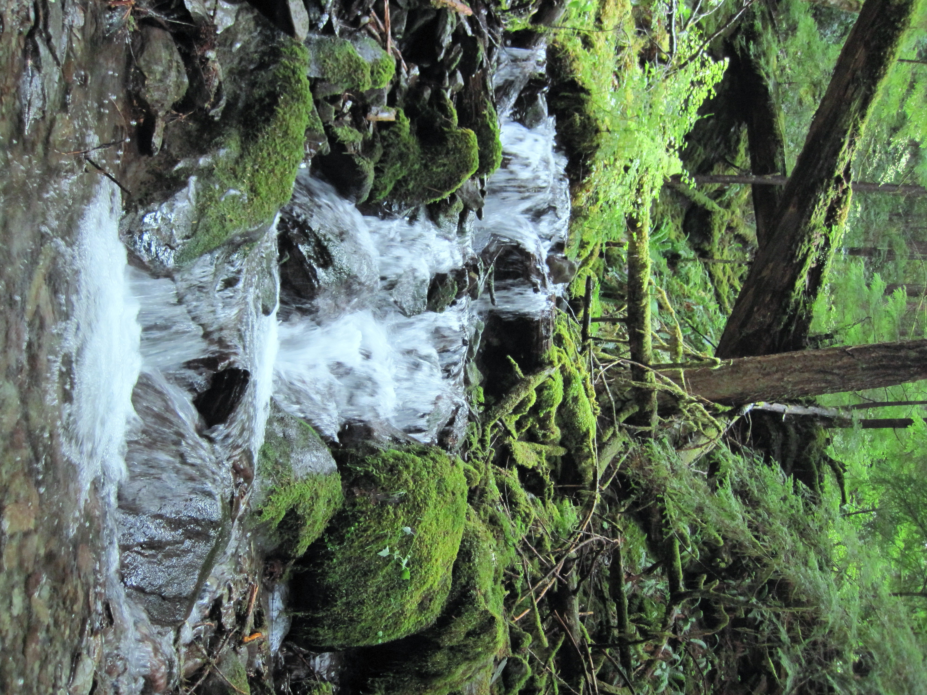
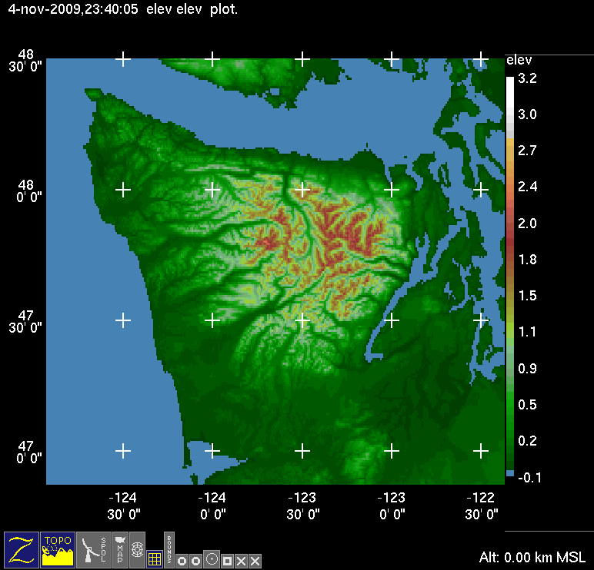
OLYMPEX is the all-in-one GV Campaign
Lots of Rain
Lots of Snow
Complex Terrain with transition from ocean to coast to land

Slide 10
OLYMPEX Objectives
Provide physical validation of the GMI and DPR precipitation (rain and snow) algorithms
Document precipitation mechanisms in midlatitude frontal systems and their modification by complex terrain
Test hydrological applications of the GPM data.
Merge numerical model and satellite observations to optimize precipitation estimates

Slide 11
What do we need to measure for OLYMPEX to achieve these Objectives?
Rain and snow at multiple sites from the coast, to the lowlands to mountain ridges.
Seasonal snowpack (in terms of snow water equivalent, or SWE) over the higher terrain
Upstream meteorological conditions over the Pacific Ocean.
Brightband variability
Microphysical properties of precipitation within all sectors of midlatitude storms and their variability in complex terrain
Emissivity of a variety of surfaces from ocean, to coast, to forest and snow-covered mountains.
River response and runoff.

Slide 12
The Olympic Peninsula
Situated on the NW corner of Washington Station
Olympic National Park covers the majority of the region’s high terrain and a portion of the coast
National Forest and National Wilderness areas and the Quinault Indian Reservation are cover part of the Peninsula
Focus on Quinault and Chehalis river basins

Slide 13
Climatology of Olympic Peninsula
Climatology of MSLP from Nov-Feb from NCEP Reanalysis grids 1979 – 2012
Annual average precipitation in inches from PRISM (Parameter-elevation Regressions Independent Slopes Model
Persistent moist onshore flow produces extraordinary annual precipitation totals – 2500 mm (100”) on the coast and more than 3250 mm (150”) in the interior

Slide 14
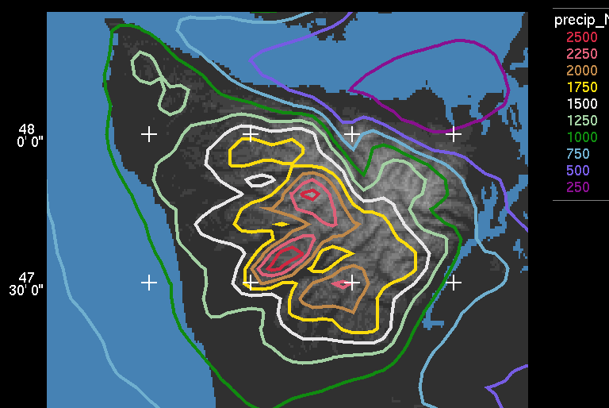
Climatology of Olympic Peninsula
Precipitation varies between ridges and valleys and exhibits enhancement on the mountain ridges.
Derived from a 5-year climatology of continuous mesoscale model results (MM5) and verified by precipitation gauges (Minder et al., 2008)

Slide 15
Climatology of Olympic Peninsula
Clearwater
Monthly Average Precipitation
Rainiest months: Nov, Dec, Jan. Range from 3.5” (90 mm) to 30” (750 mm) in Nov.
On any given day in Nov, Dec, Jan there is a 73% probability of receiving >0.01” rain and a 36% probability of receiving > 0.5” rain.

Slide 16
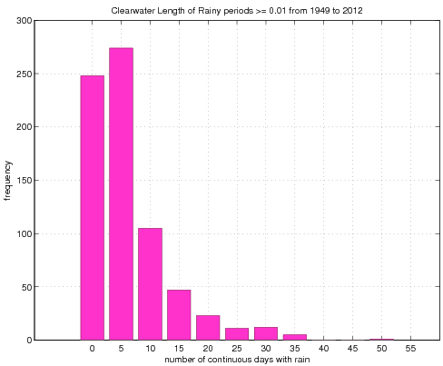
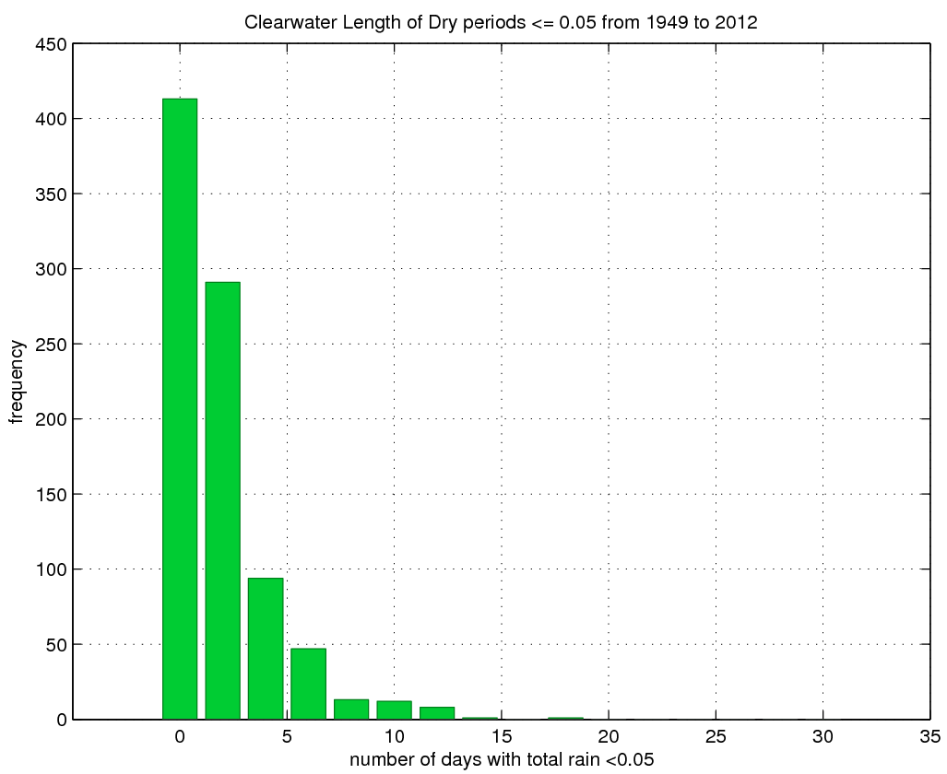
Climatology of Olympic Peninsula
Clear water Wet Spells Nov - Feb
Clearwater Dry Spells Nov - Feb
Longest period with continuous rain (daily precip >=0.01”) = 33 days – Jan 1953. Probability of 2 week period receiving >= 18” (450mm) = 2%
Longest ‘dry’ period with daily precip <=0.05”) = 18 days – Dec 1985. Probability of 2 week period of <= 0.05 (~1 mm) during Nov-Feb = 0.17%

Slide 17

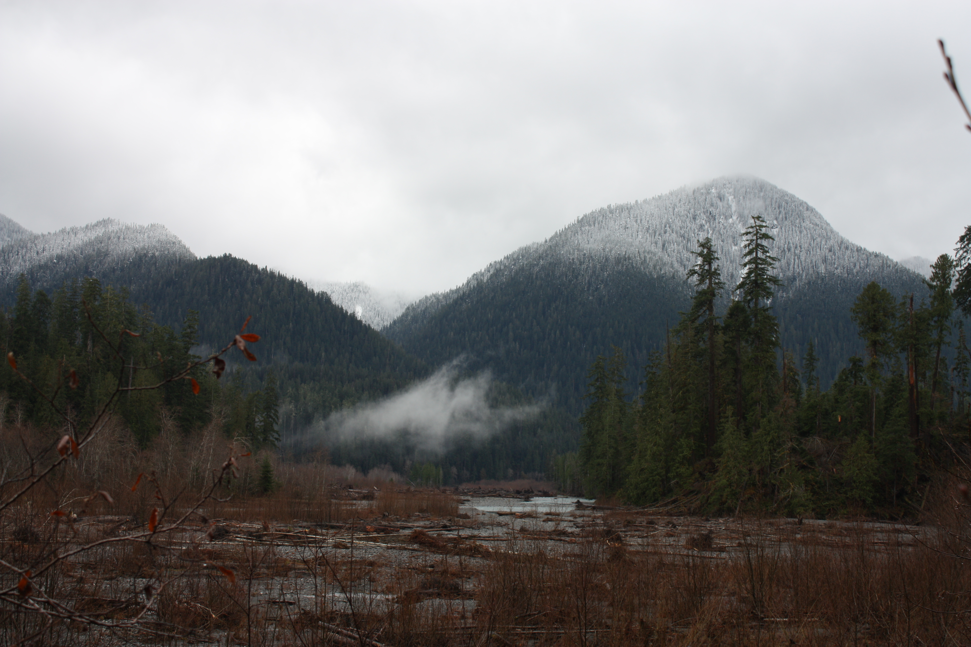
Climatology of Olympic Peninsula
KUIL
The mean 0°C level is low so that there is rain at low elevations and snow at high elevations
Distribution of Nov-Jan 0°C level for flow that is onshore and moist at low levels (KUIL sounding). Mean 0°C level during storms = 1.5 km See this full range in individual storms!
(plot provided by Justin Minder)
Mean 0°C level in winter during moist onshore flow = ~1.5 Km. Rain at lower elevations, snow at higher elevations. This varies a lot from storm to storm and within each storm. Melting layer bends downward towards sloping terrain (Medina and Houze 2005, Minder et al. 2011)

Slide 18
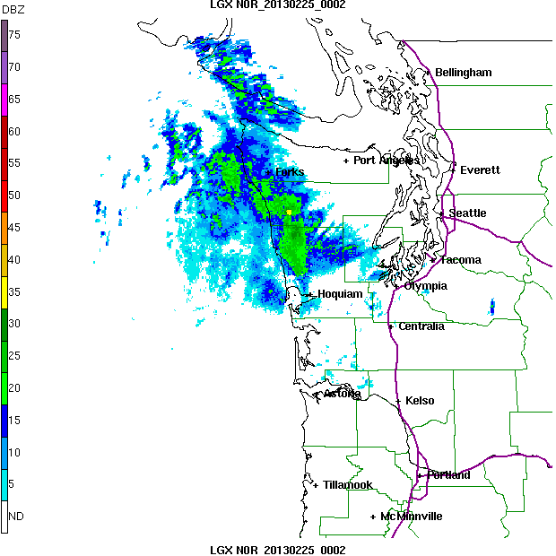
Typical Frontal Passage
(as seen by the coastal radar LGX)
SW side of Olympics gets rain well ahead of front
SW side gets rain during front
SW side gets post-frontal showers

Slide 19
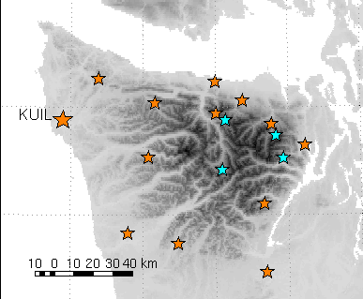
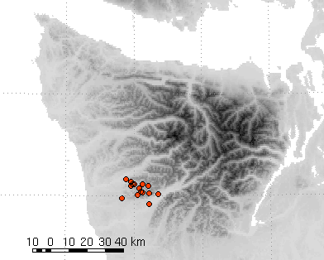
Rain Measurements
Detailed gauge network
SNOTEL
RAWS sites
CRN site
Gauges
Proposed
Existing – Surface-Based Direct Measurements of Precipitation amounts and rain-rates
  Surface ASOS, RAWS and Coop network
  Supplemental tipping-bucket style gauges along transect between Quinault and Queets River
Proposed – Additional direct precipitation measurements and microphysical properties
  Supplemental gauges in the Chehalis basin
  Ground-based microphysical instruments (Disdrometer, etc.)

Slide 20
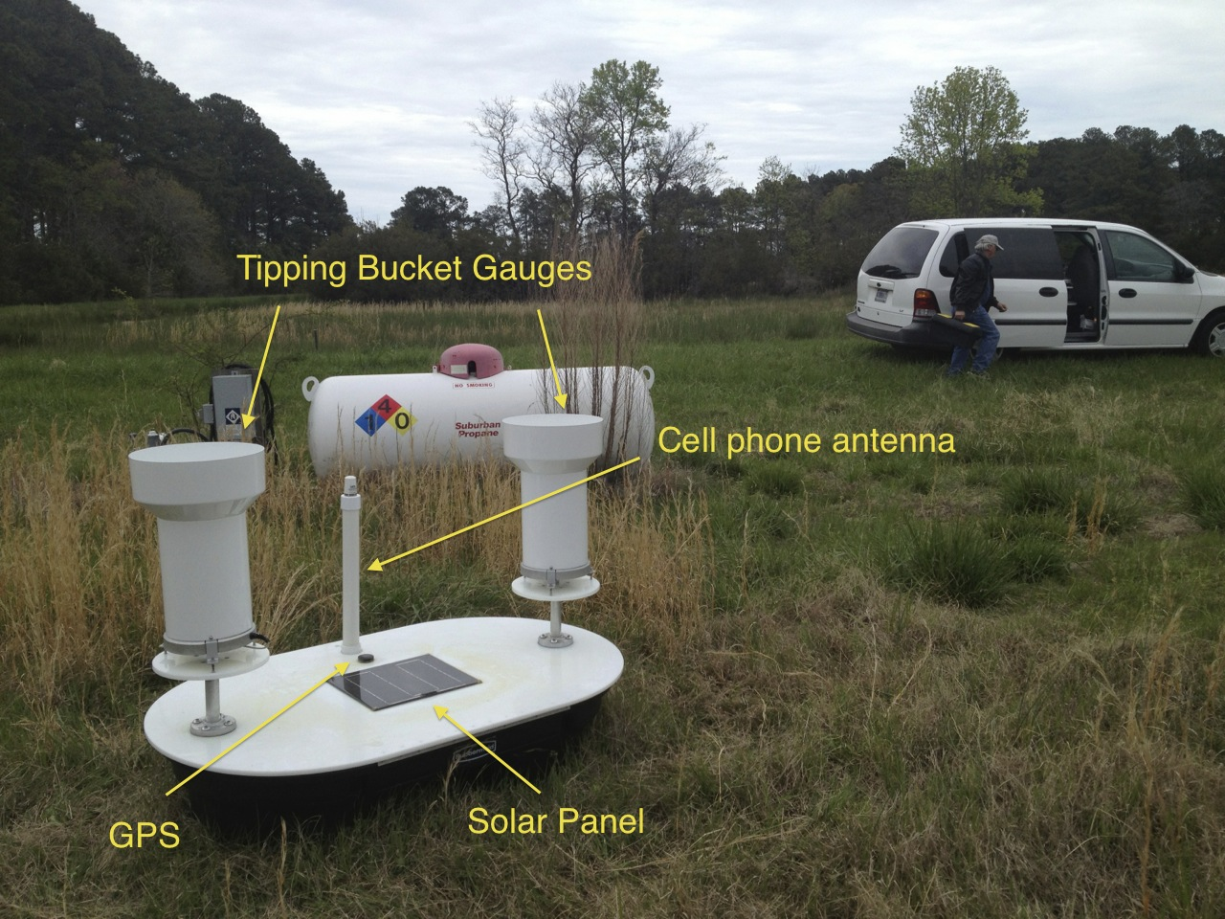

Rainfall: Dual-Rain Gauge Networks
Ground State: Soil Moisture and Temperature
Dual Rain Gauges
Soil probes placed at 5 – 10 cm depth

Slide 21
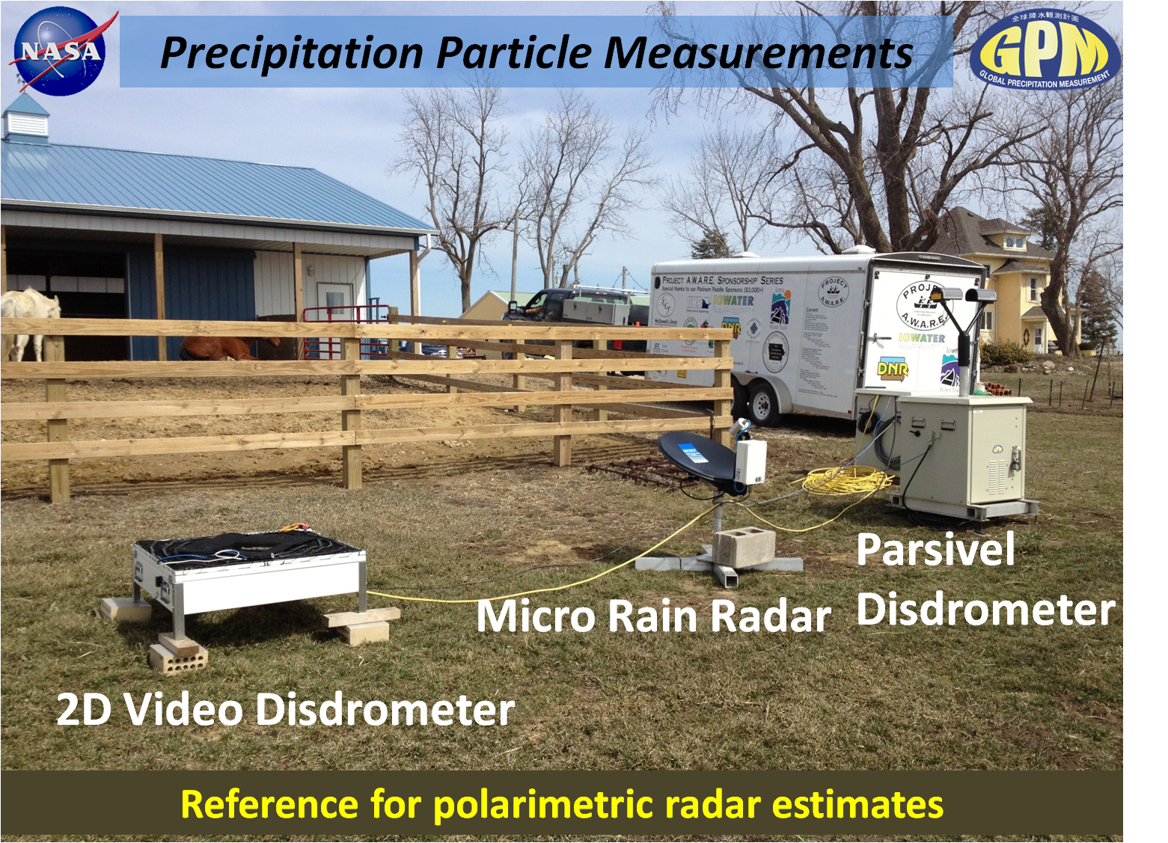

Slide 22
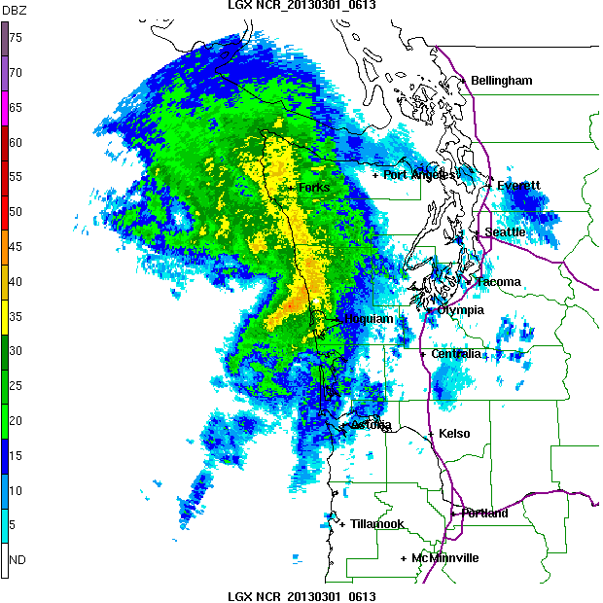
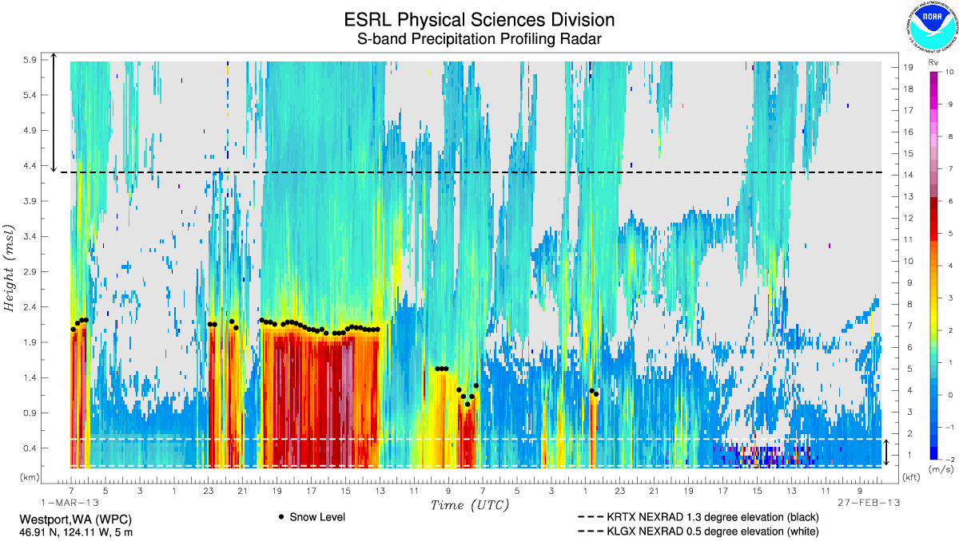
Ground-Based Radar – Existing
Atmospheric River Observatory
Langley Radar
WSR 88D Dual-Pol at Langley
Atmospheric River Observatory at Westport:
  915 MHz Wind Profiler
  Vertically-pointing S-Band precipitation profiling radar
  Global Positioning System to measure column integrated water vapor
  meteorological tower to measure near-surface conditions including falling precipitation
Npol Proposed
Langley
Westport

Slide 23
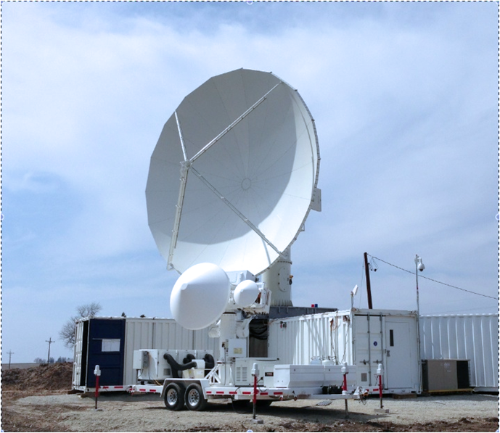
Ground-Based Radar – Committed
IFloodS, May-June 2013
NPOL and D3R near Traer, Iowa
NPOL
D3R
NASA NPOL Polarmetric Radar: S-Band with dual-polarization
NASA D3R: Dual-Frequency Ka-Ku band, Dual-Pol, Doppler Radar
Npol Proposed
Langley
Westport

Slide 24
Ground-Based Radar – Proposed
C-Band: Prof. S. Rutledge, deployed in Chehalis Basin
DOW: Doppler on Wheels – Profs. S. Yuter, B. Geerts and B. Colle, help sample in regions that may experience blockage for NPOL and WSR-88D
X- and W-Band: McGill, Environment Canada, More sensitive to lighter precipitation, fill in measurement gaps

Slide 25
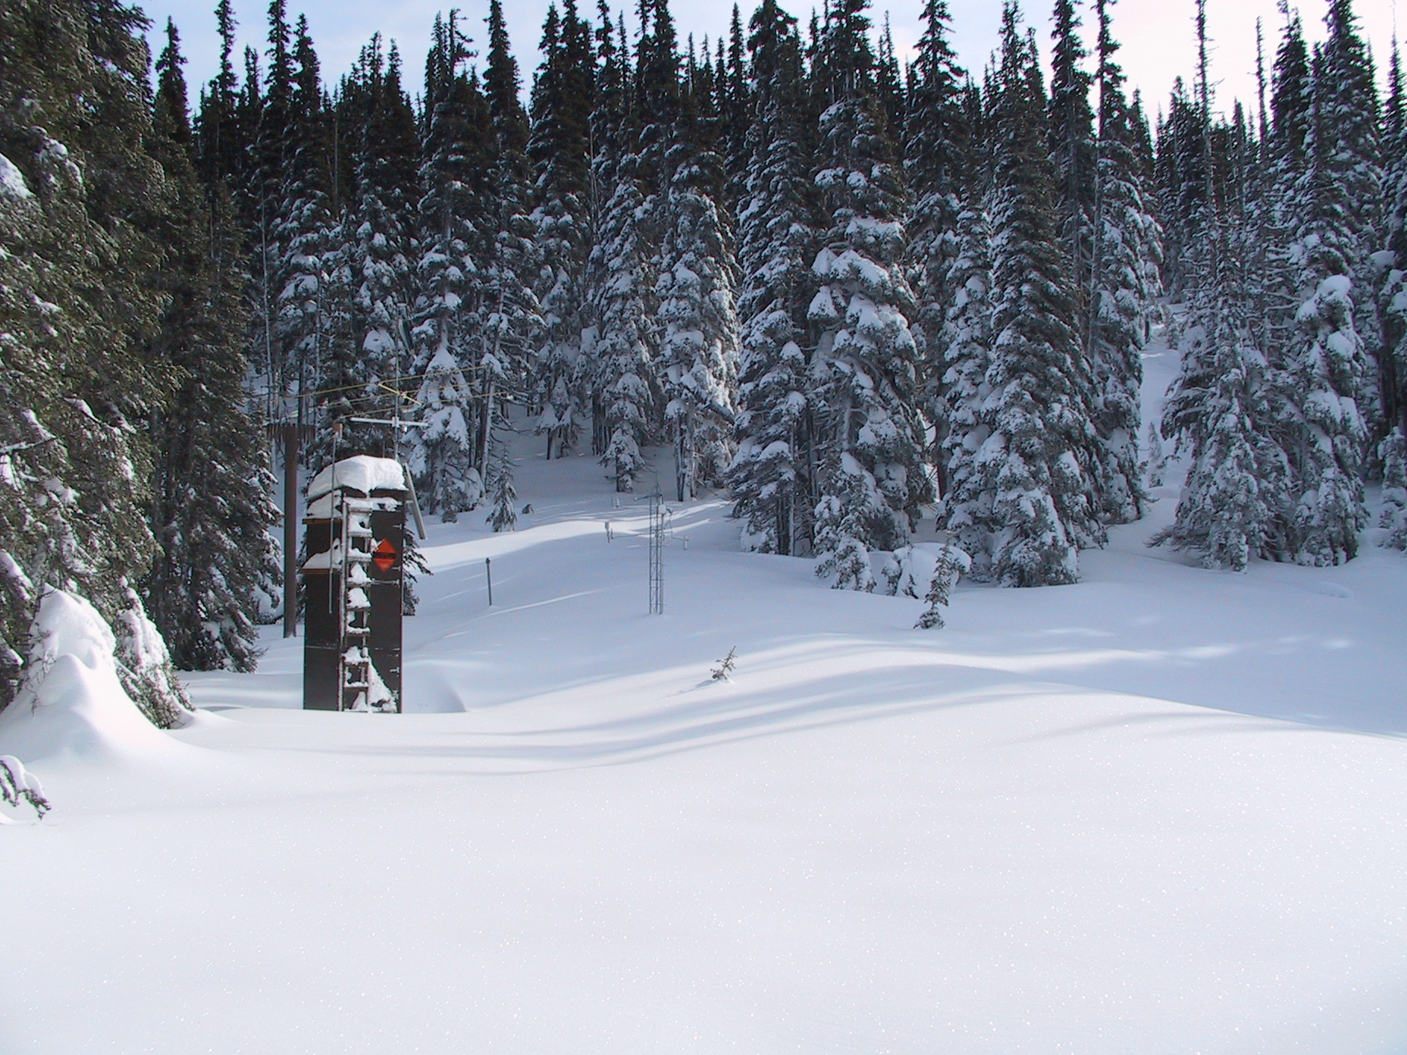
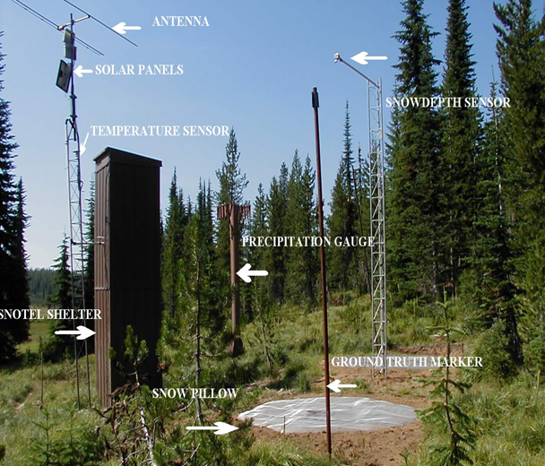
Snow Measurements – Existing (SNOTEL)
Waterhole SNOTEL 5010’
Buckinghorse SNOTEL 4870’
Waterhole SNOTEL

Slide 26
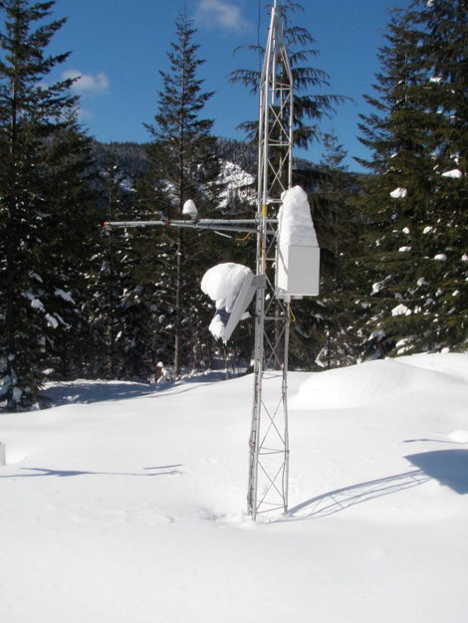
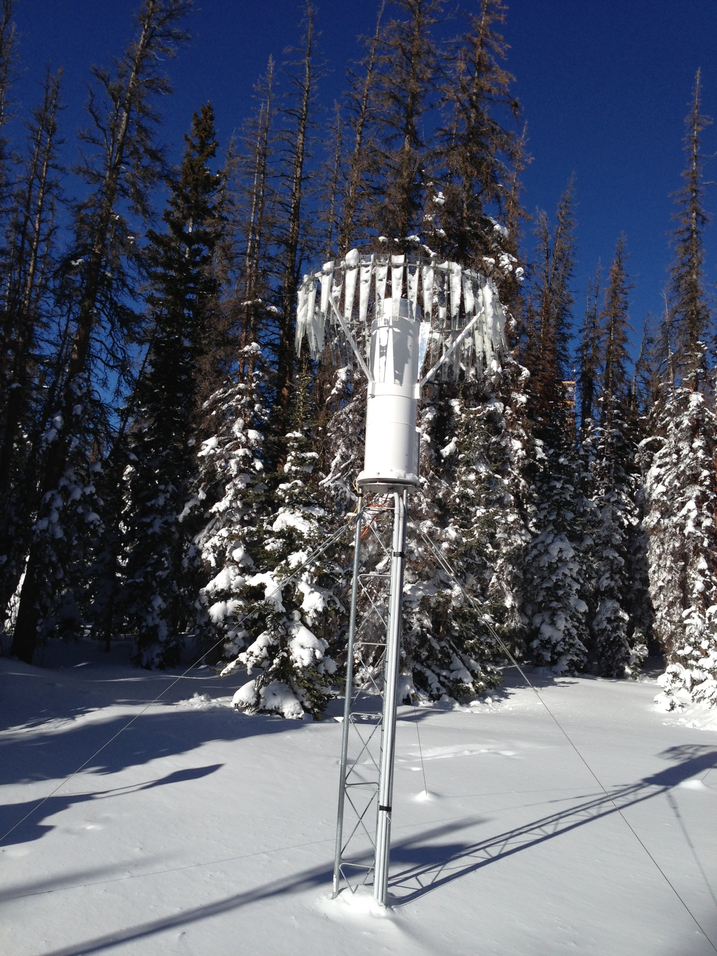
Snow Measurements
Sticky Snow
Hotplate
Proposed – microphysical measurements and SWE
  Video Disdrometers
  Hotplates, Pluvios
  Power issues, access for maintenance
  Best location – Hurricane Ridge??

Slide 27
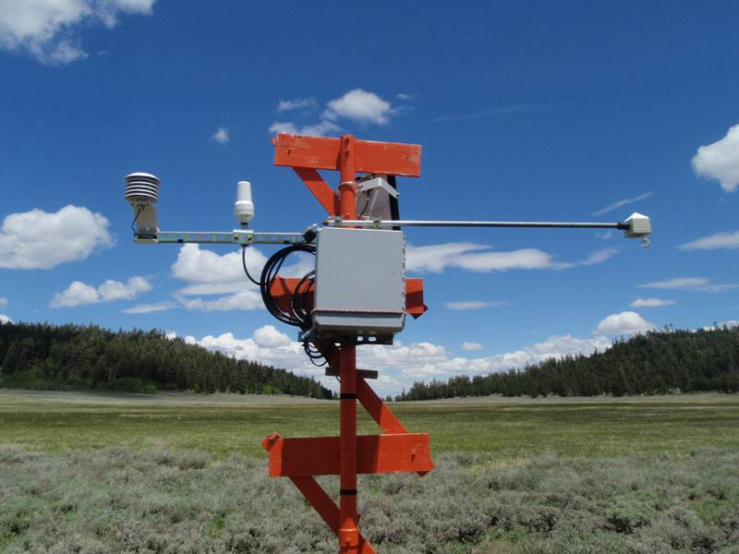
Snow Measurements
Proposed – snow pack measurements
  Helicopter Snow Surveys, time-lapse photography ….
  SNOLITE measures snow depth and temperature. Data transmitted weekly

Slide 28
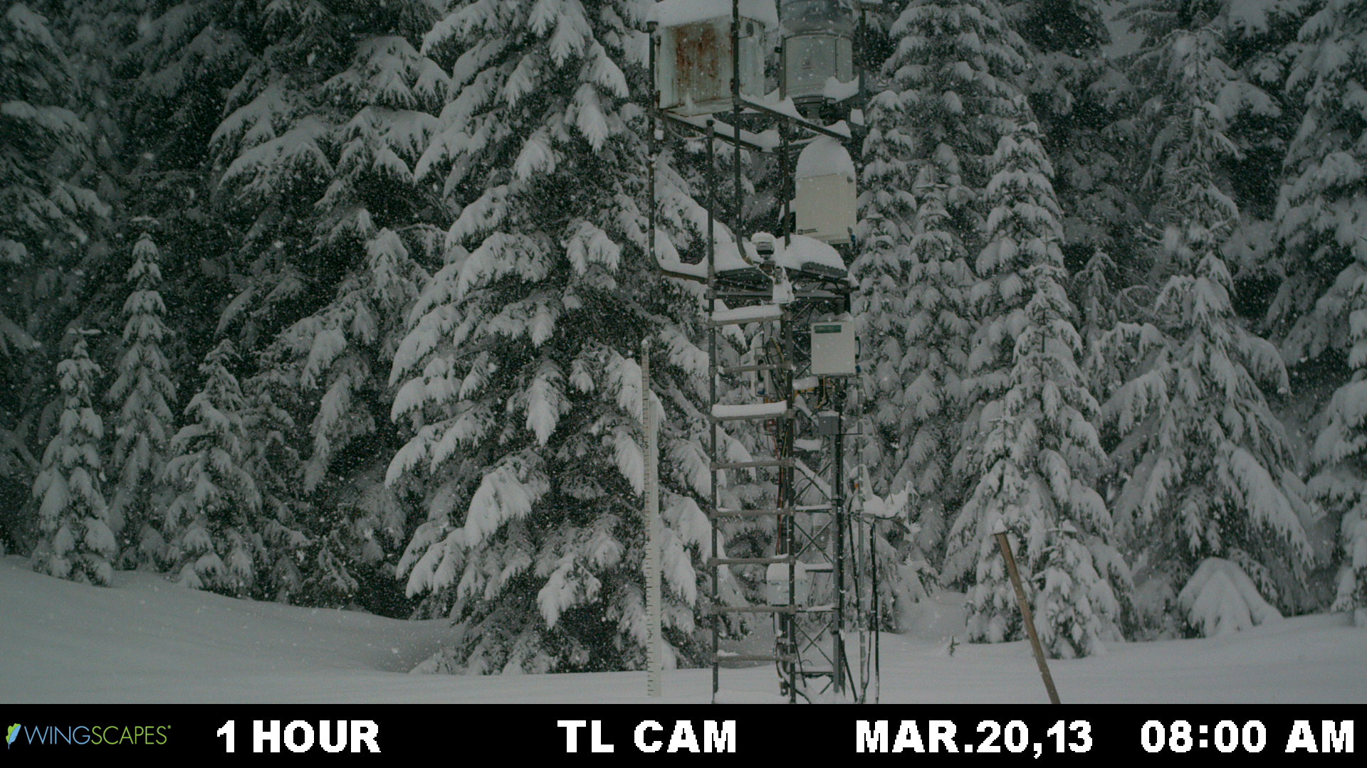

Slide 29
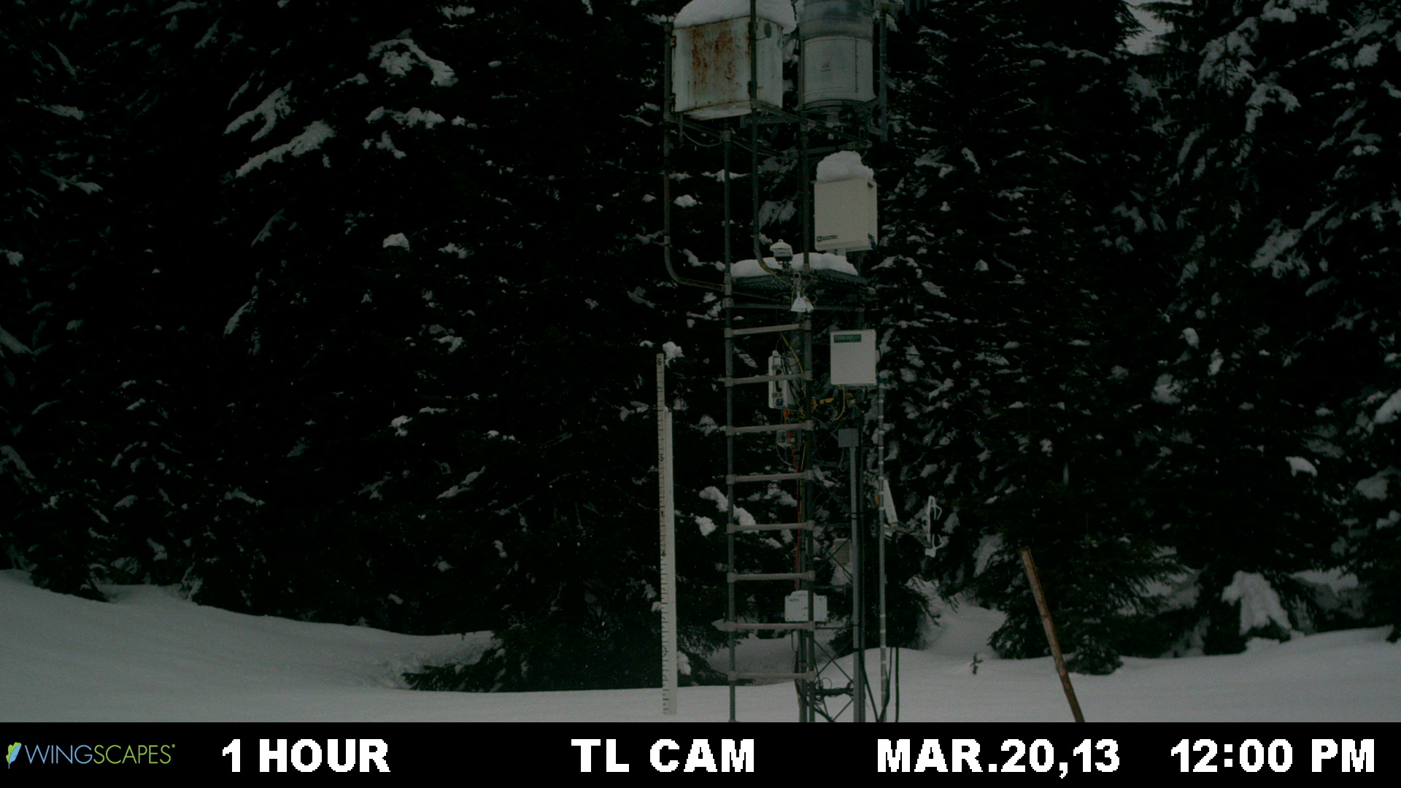

Slide 30
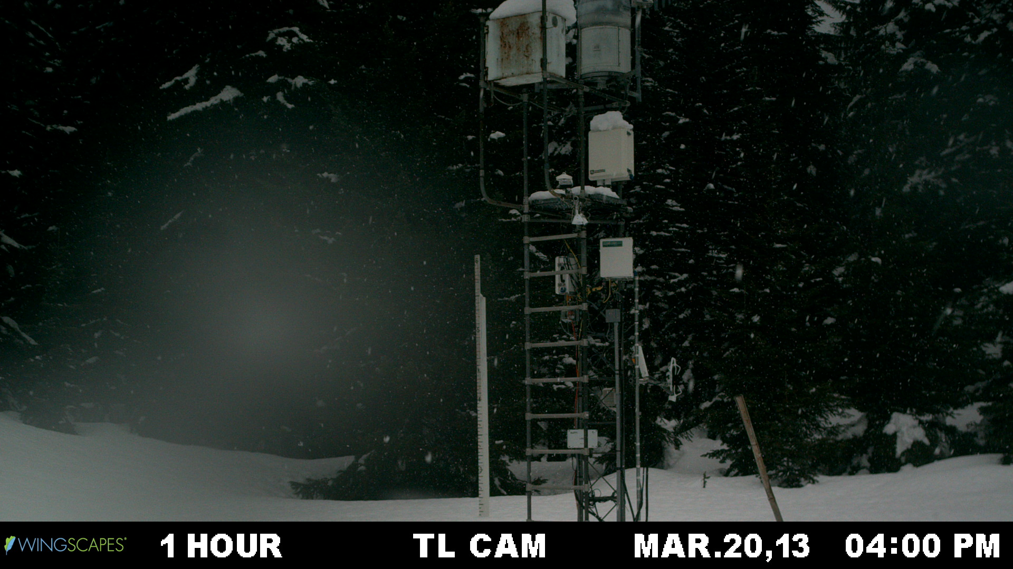

Slide 31
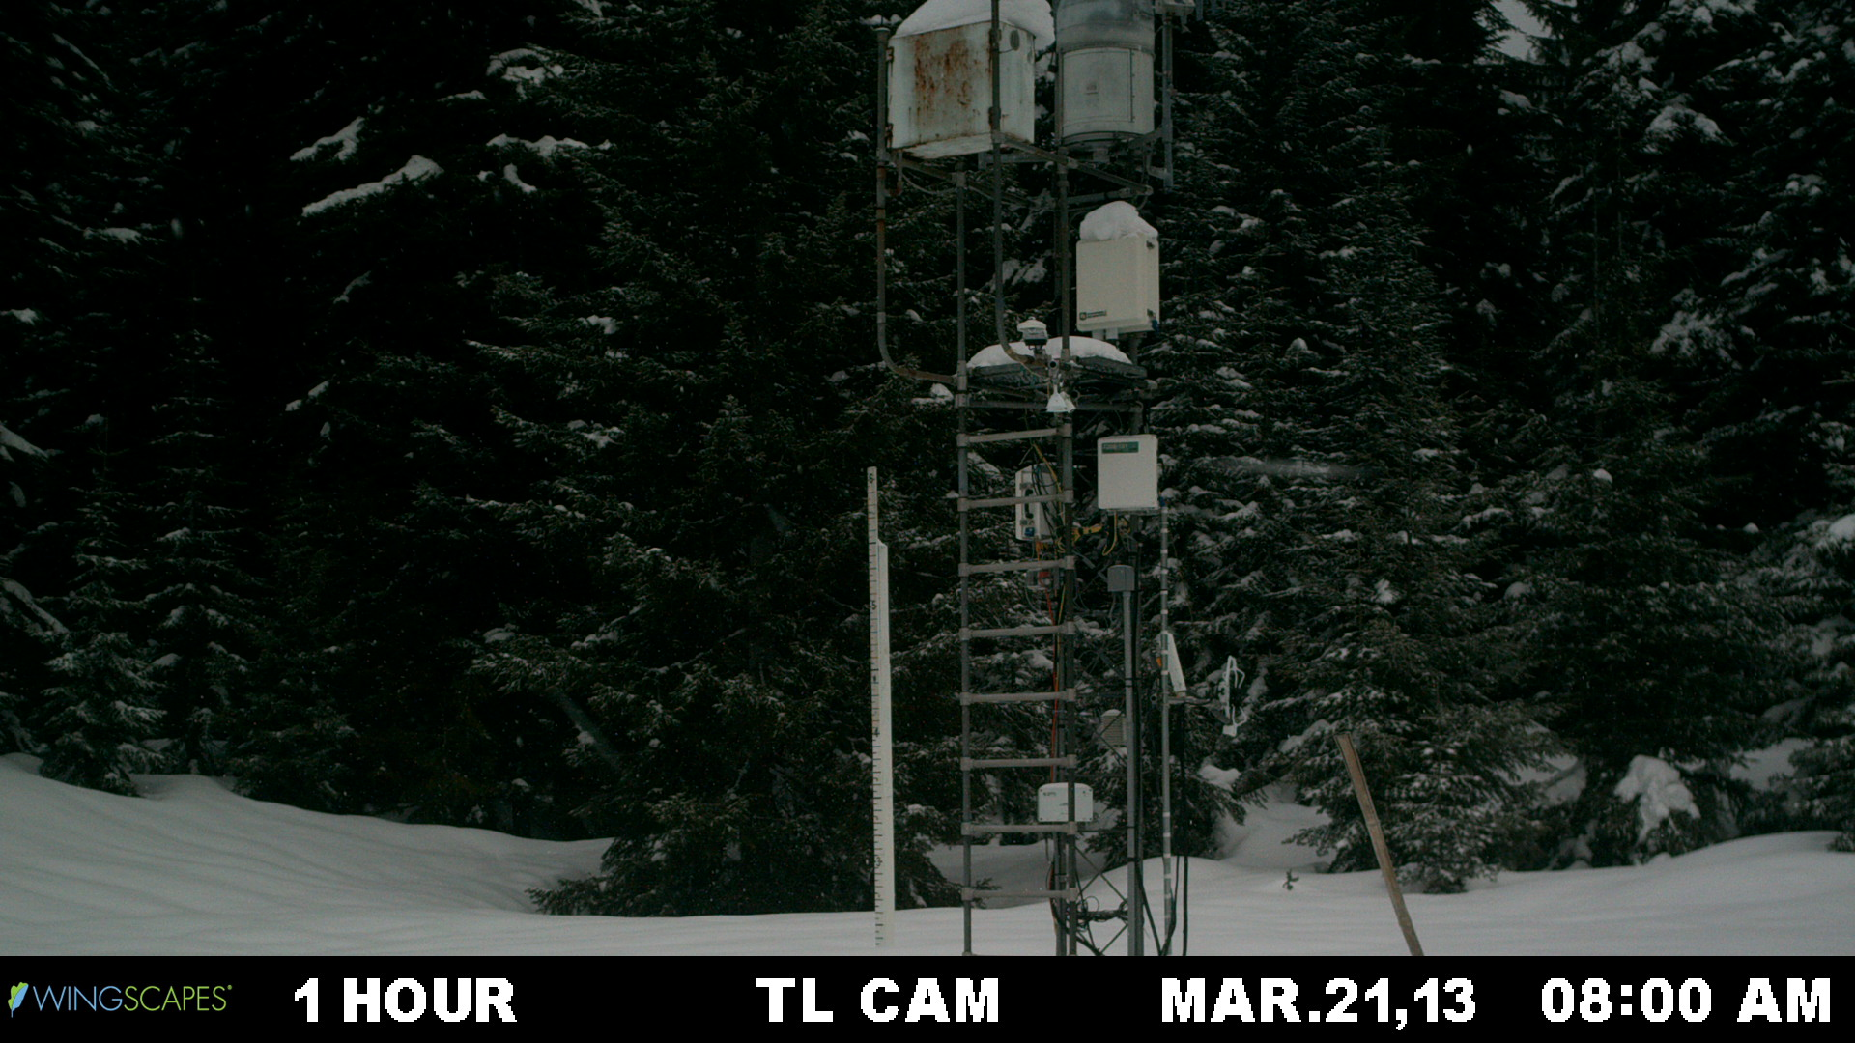

Slide 32
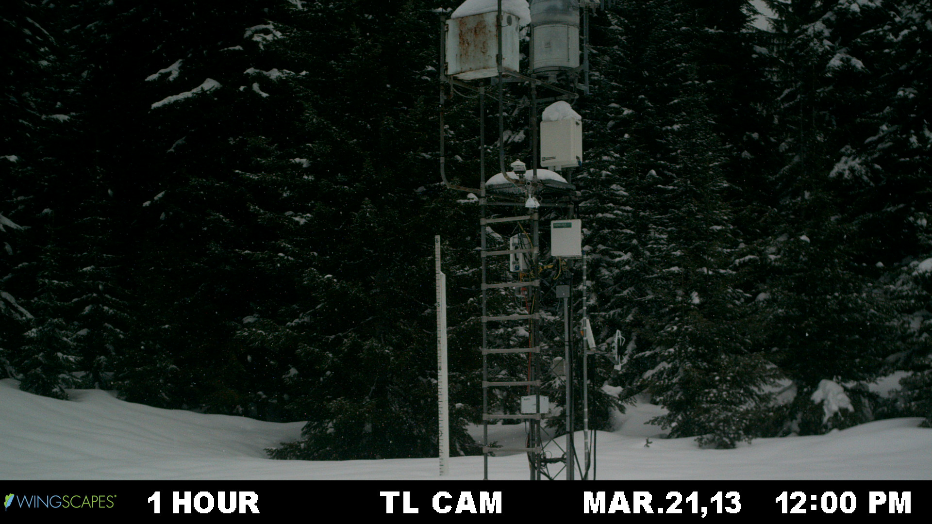

Slide 33
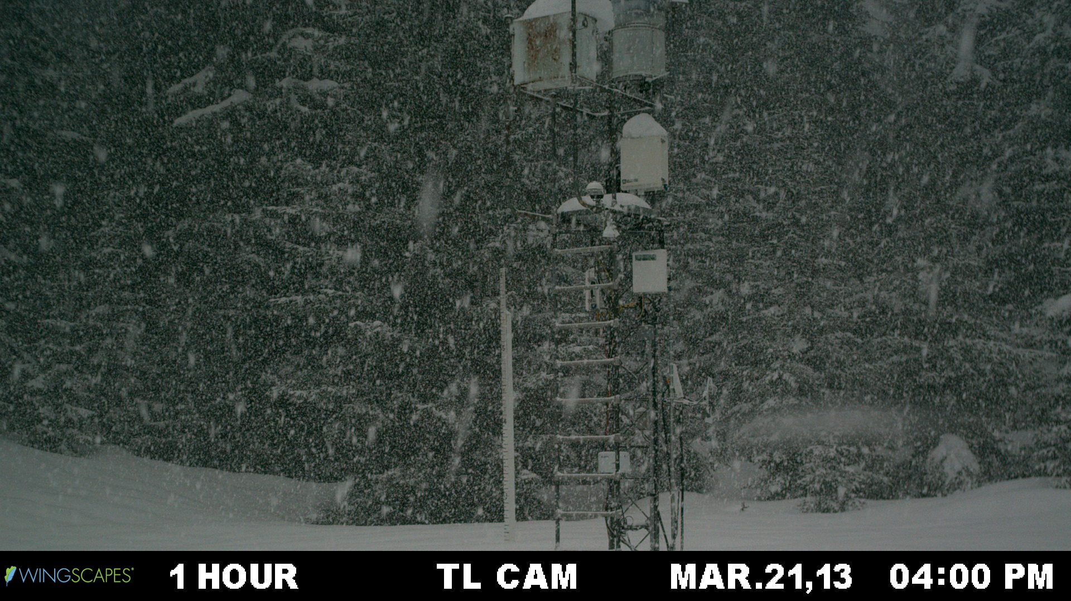

Slide 34
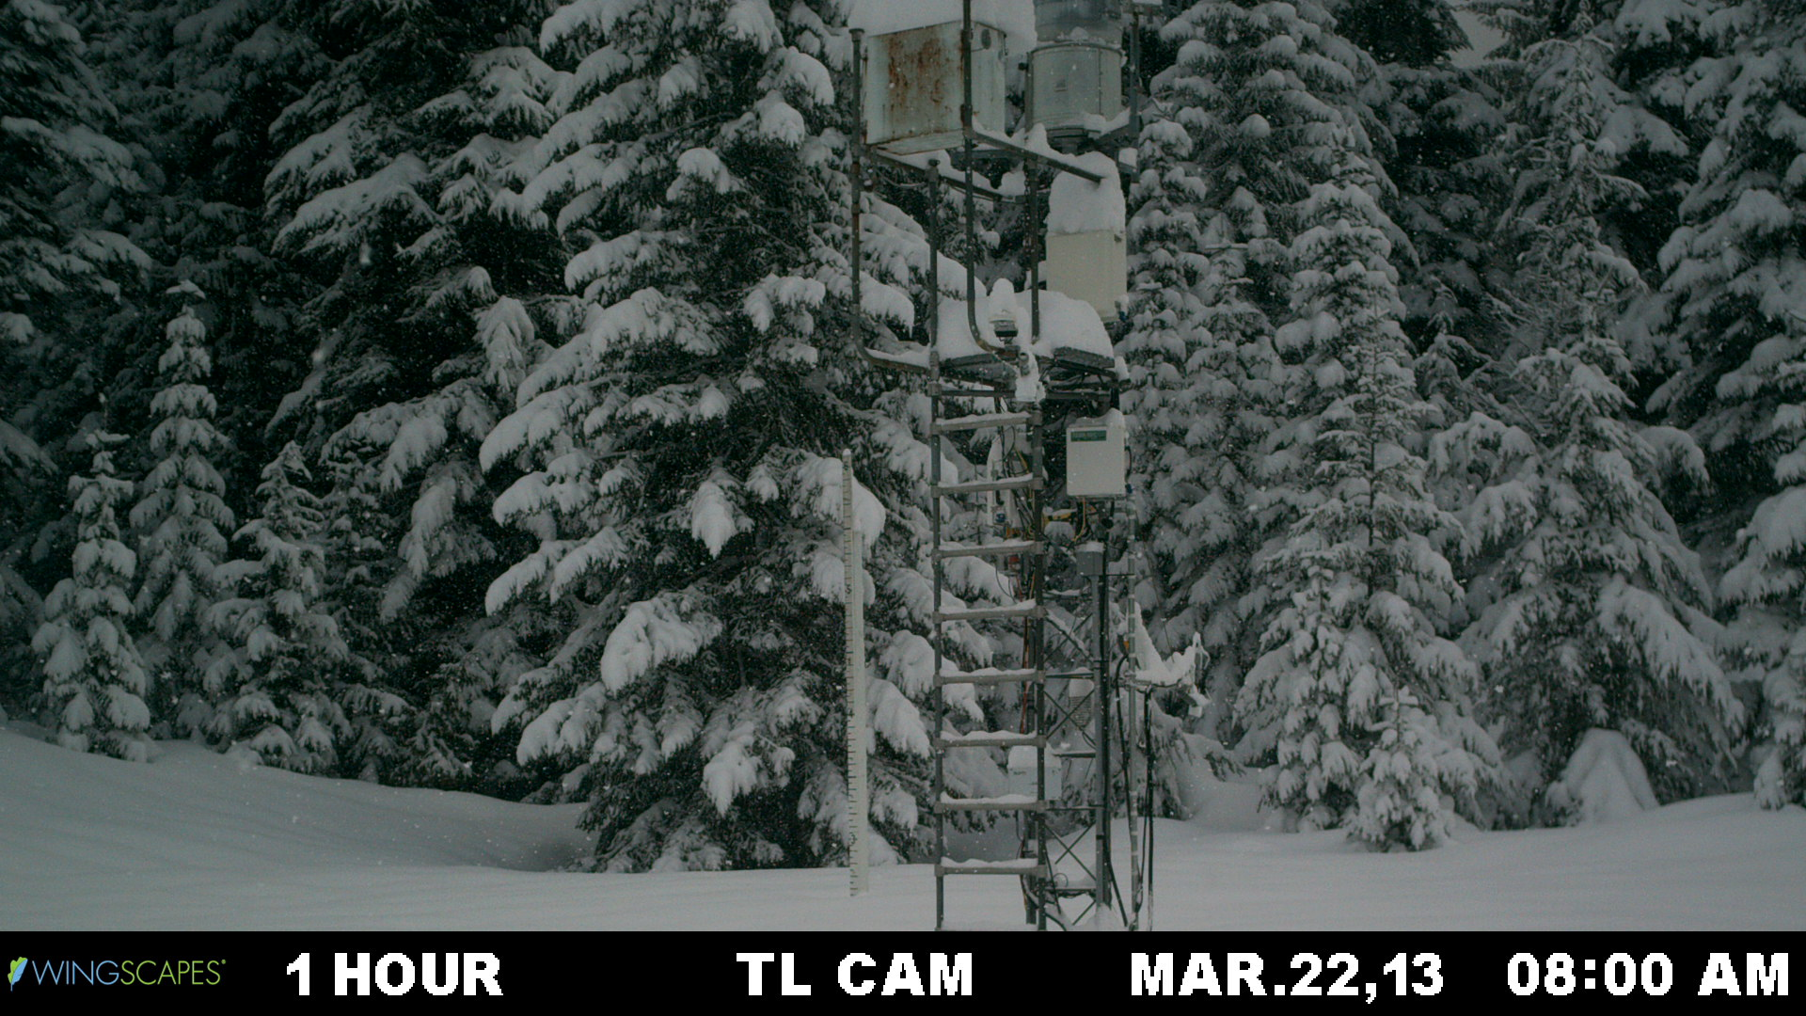

Slide 35
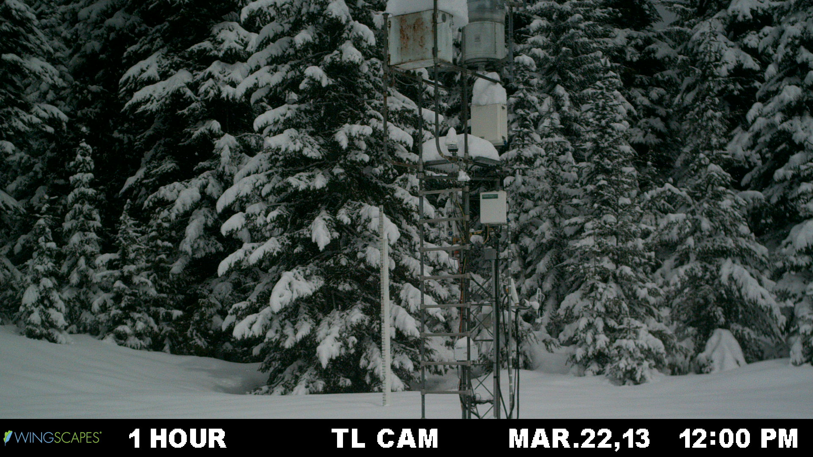

Slide 36
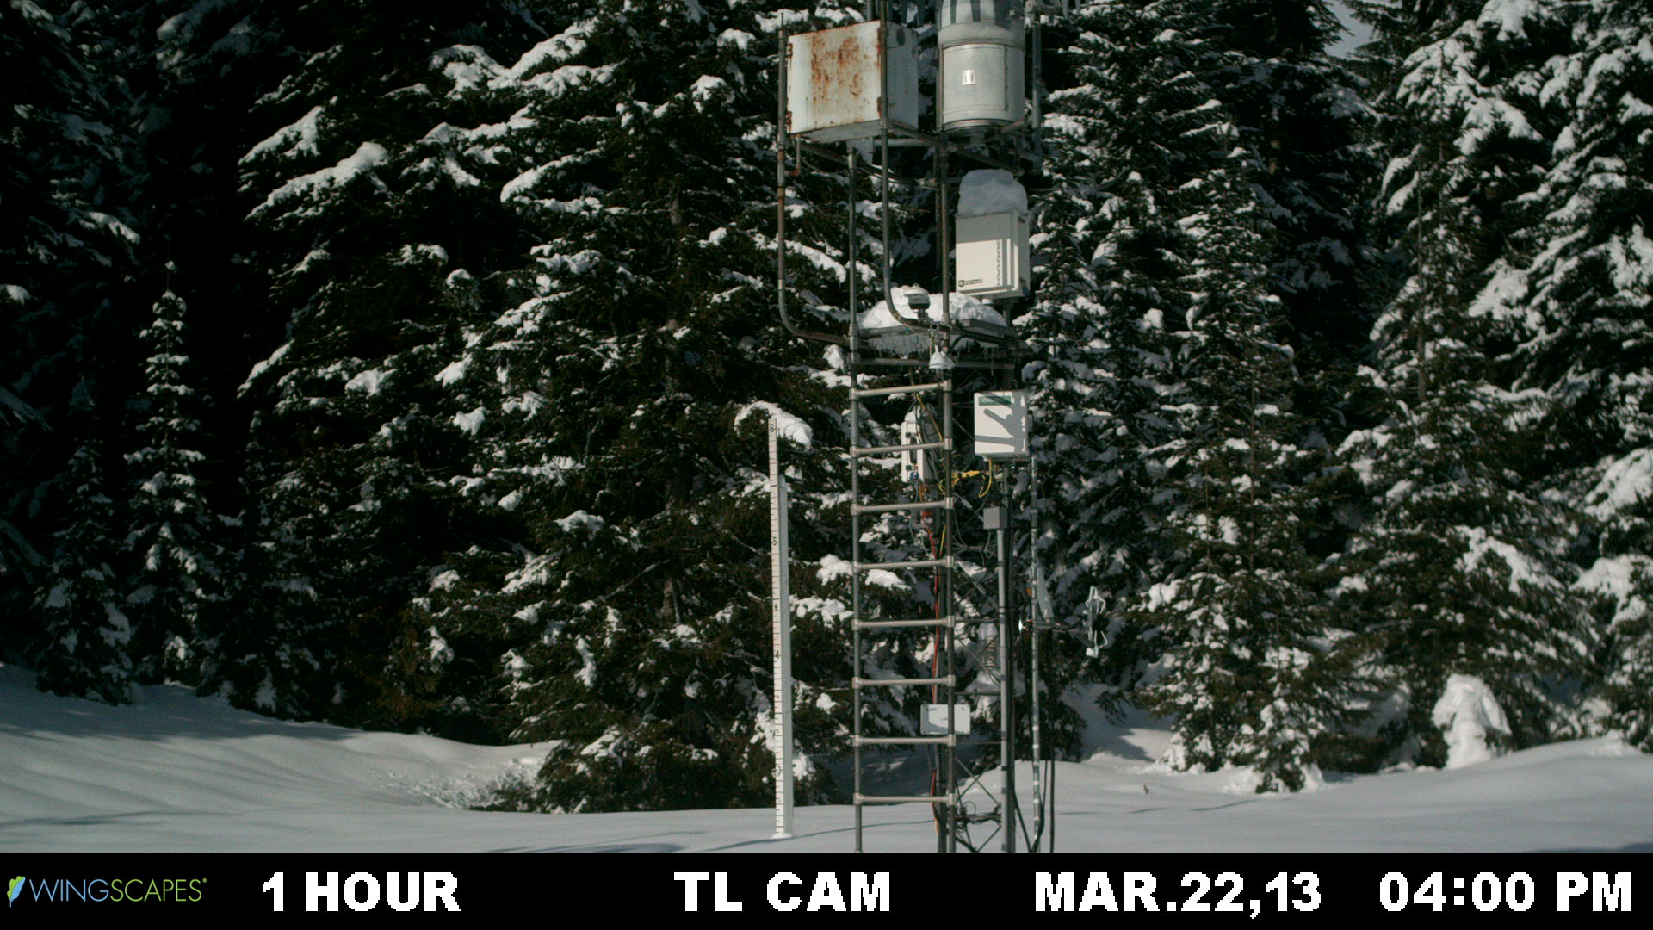

Slide 37
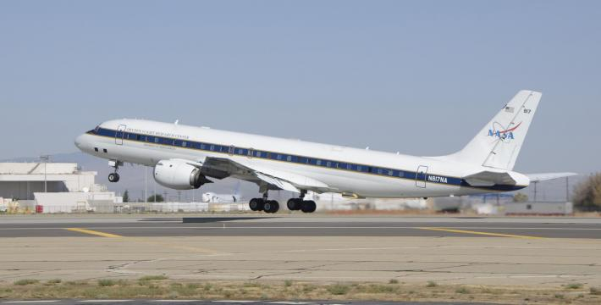
Aircraft
DC-8
Global Hawk
Committed
  NASA DC-8: Satellite Simulators (mini-GMI and mini-DPR), dropsondes, some microphysics
  North Dakota Citation: microphysics
Proposed (wish list)
  NASA ER-2: Upstream conditions, dropsondes, satellite simulators
  Wyoming King Air: microphysics, W-band radar
  Canadian NRC Convair: state-of-art microphysics
  NASA Global Hawk: Satellite simulators, dropsondes

Slide 38
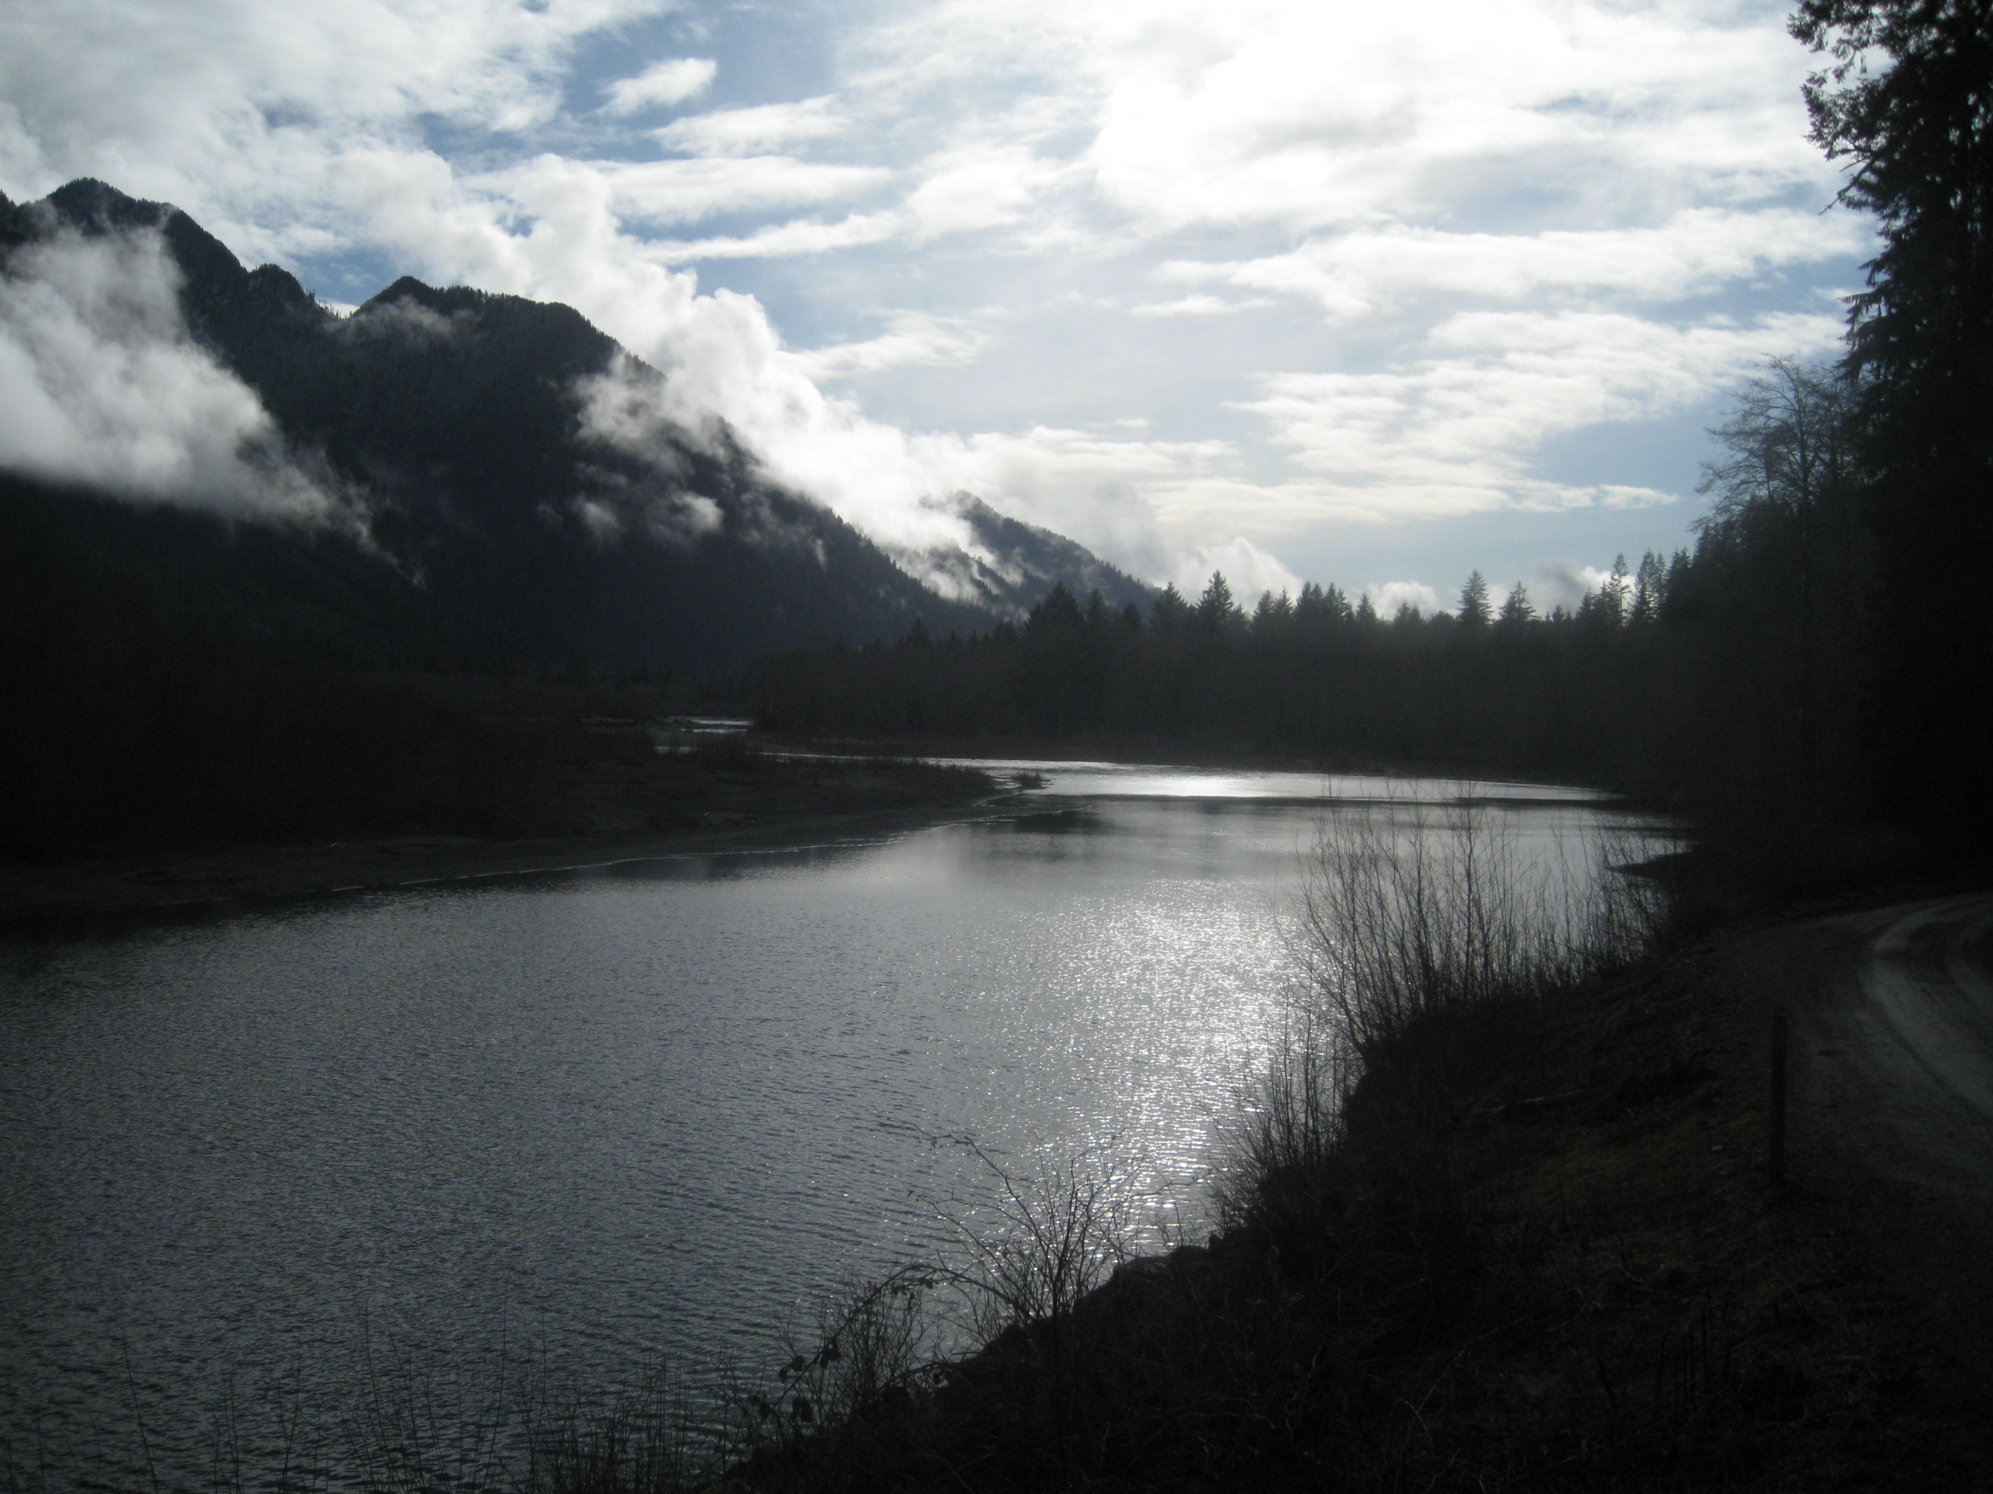
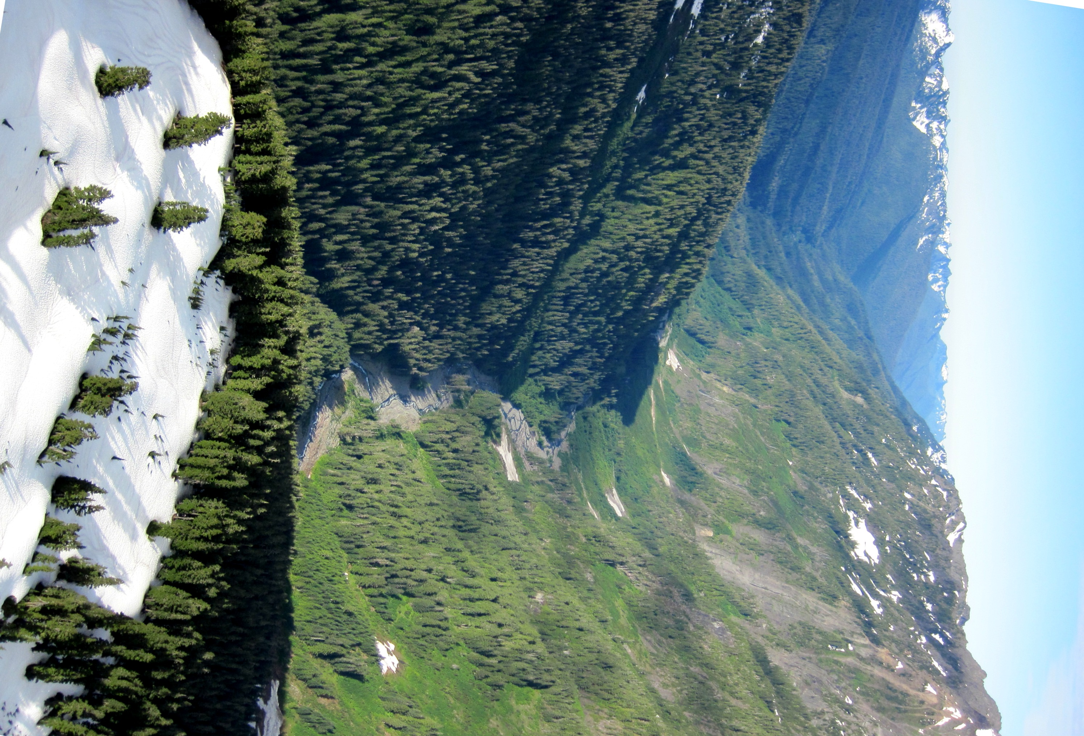
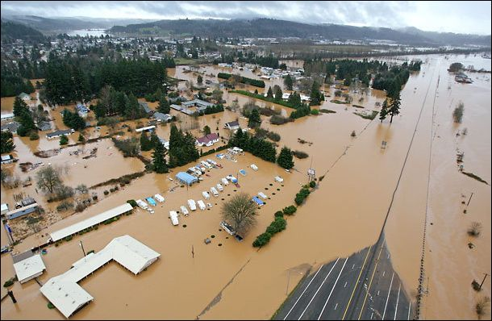
Hydrological Applications of GPM
One of the main goals of GPM is to provide precipitation estimates for input into hydrological applications such as forecasting flood events and water supply. OLYMPEX will focus on the Quinault and Chehalis basins
The Quinault has its’ headwaters in high elevation and drains the SW Olympics
Major flooding on the Chehalis, a low elevation basin which drains the SW Olympics and lower terrain to the SE
Notes:
Point out – another hydro apllication is to address the entire snowfield on top of Olympics – Water supply – circle around olympics to remind me – scale addressable by footprint of satellite

Slide 39
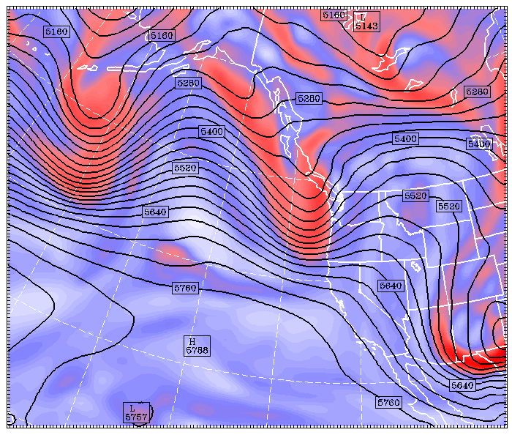
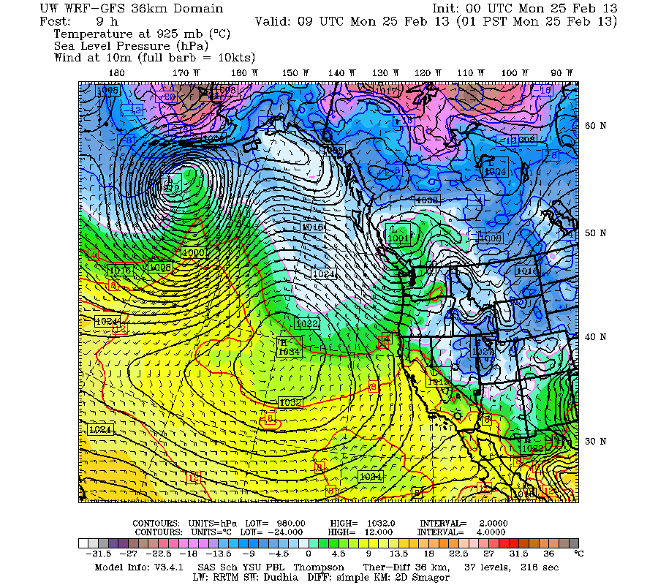
Modeling component of OLYMPEX
Mesoscale numerical model has been run real time for the Pacific Northwest for 15+ years.
Run for 2 forecast cyclones at several resolutions: see http://www.atmos.washington.edu/mm5rt.
The output will be crucial for operations support during the OLYMPEX field phase.
Higher resolution runs (4 km and 1.3km) will be used for precipitation processes in complex terrain, developing algorithm physics, and estimating snowpack accumulation where observations don’t exist.

Slide 40


Modeling component of OLYMPEX
1.3 km forecast of 3hr Precip valid 9 UTC 25 Feb 2013
36 km 9-h forecast of SLP + Temp and winds
36 km 9-h forecast of SLP + Temp and winds
1.3 km forecast of 3hr Precip valid 9 UTC 25 Feb 2013
IR Image + 500 heights + obs. for 00 UTC 25 Feb 2013
IR Image + 500 heights for 00 UTC 25 Feb 2013
Observations and forecasts for a typical land-falling cyclone affecting the Olympic Peninsula. Note the forecast of strong westerly winds along the Washington and Oregon coasts and the strong enhanced precipitation forecast for the western and southwestern slopes of the Olympics and the maximum precipitation along the windward slopes of the highest terrain

Slide 41
OLYMPEX Summary
Ground Validation (GV) Field Campaign on the Olympic Peninsula Nov 2015 – Jan 2016
Provide Physical Validation for rain and snow algorithms for the GPM GMI and DPR instruments
Document precipitation processes and structures in land-falling cyclones and their modification over complex terrain.
Test hydrologic applications (water supply, and flooding) of GPM
Will consist of ground-based measurements of rain and snow, aircraft and radar measurements
Challenges: Remote area, power issues, operations within designated wilderness areas.
Opportunities: In order to fulfill GPM’s mission objectives of measuring precipitation world-wide, over a wide range of intensities, and a broad range of regimes, a field program such as OLYMPEX is necessary
This work is supported by the National Aeronautics and Space Administration Grants NNX12AL54G and NNX13AG71G

