Slide 1

The Hydrometeor Structure of
Mesoscale Convective Systems During DYNAMO
Hannah C. Barnes
Robert A. Houze, Jr.
University of Washington
36th Conference on Radar Meteorology
Beaver Run Resort & Conference Center, Breckenridge, CO
17 September 2013
Funded by NSF –Grant AGS 1059611

Slide 2
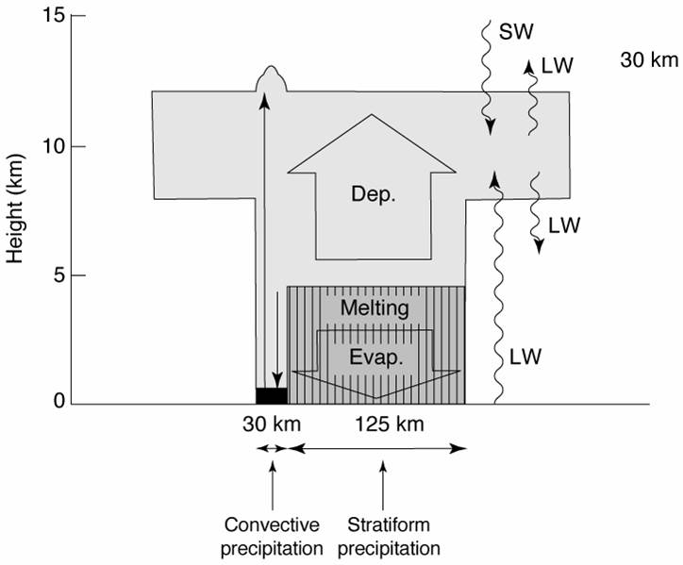
Conceptual Model of Mesoscale Convective Systems (MCSs)
GATE: Diabatic Heating
Houze (1982, 2004)
Notes:
Brief introduction to MCS structure
Briefly mention that GATE showed the structure of heating in MCSs

Slide 3
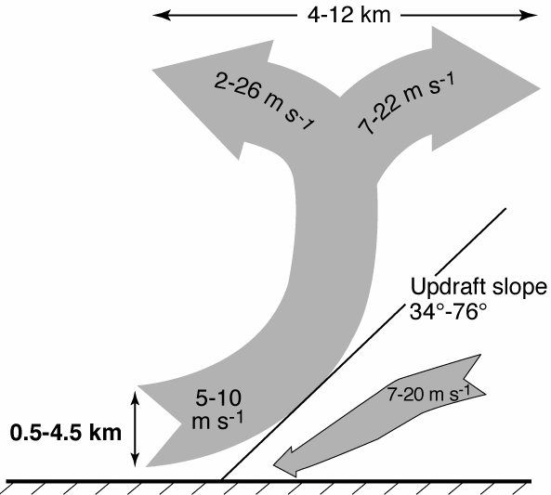
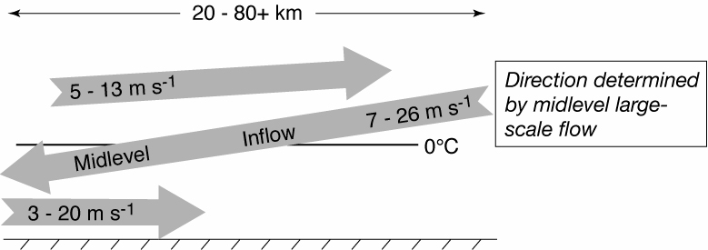
Conceptual Model of Mesoscale Convective Systems (MCSs)
TOGA COARE: 3D, layer airflow
Convective
Stratiform
Kingsmill and Houze (1999a)
Notes:
Brief introduction to MCS structure
Emphasize that TOGA COARE added to that picture by confirming that layered airflow structures described by Moncrieff (1992)
Convective regions characterized by steeply sloping convergent zones with a divergence signature aloft
Stratiform often characterized by mid-level inflow that starts below the anvil and slowly descends into the precipitating stratiform region. The mid-level inflow may or may not reach the surface.
DYNAMO is opportunity to add another layer of knowledge of the structure of MCS through microphysics

Slide 4
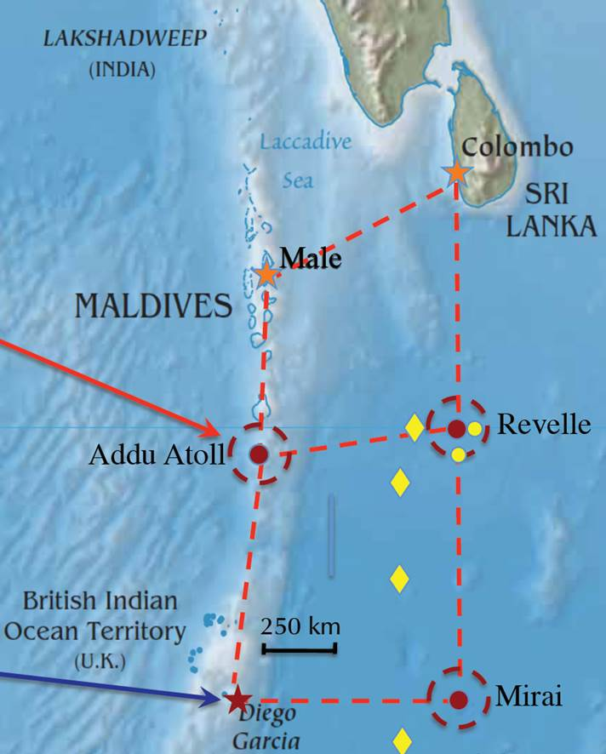
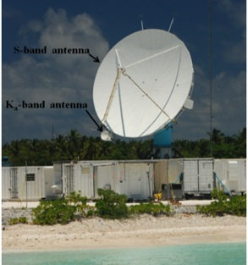
DYNAMO-AMIE-CINDY
SPolKa
Indian
Ocean
Addu Atoll, Maldives
Dual wavelength
  Only using S-Band
Doppler
Dual-polarimetric
  Particle Identification Algorithm (Vivekanandan et al., 1999)
RHI sectors
Notes:
Briefly introduce SPolKa
Doppler capabilities allow us to identify the kinematic structures of Kingsmill and Houze (similar to TOGA COARE)
Dual-polarimetric capabilities new for DYNAMO and allow to identify different types of hydrometeors.
PID algorithm developed by Vivekanadan et al. 1999 was APPLIED to the SPolKa data
In two regions the SPolKa radar did a series of high resolution RHI scans, which enabled us to obtain a detailed vertical picture of the hydrometeor structure within MCSs

Slide 5
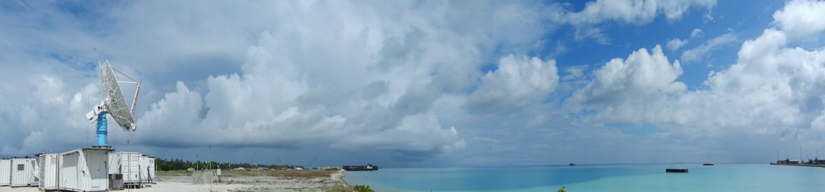
Objective
Characterize hydrometeor structure of MCSs
  Composite with respect to kinematic structure
Notes:
Thus, the primary objective of this study is to characterize the hydrometeor structure of MCSs. This will done by compositing the location of different types of hydrometeors with respect to the airflow through the convective and stratiform portions of MCSs.

Slide 6
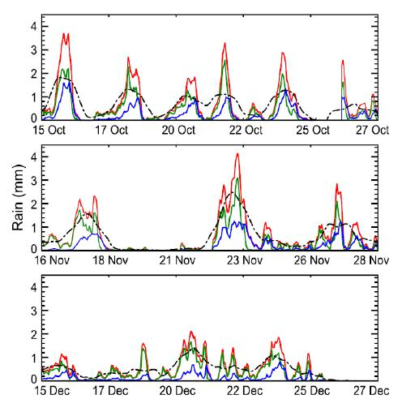
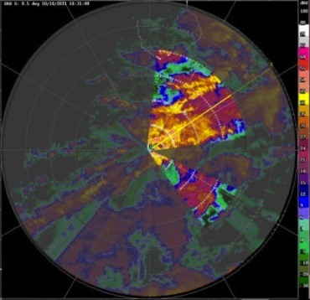
Methodology
Hourly Timeseries of Accumulated Rain
1
2
4
3
5
6
11 rain maximums during DYNAMO (Zuluaga and Houze, 2013)
Subjectively identify cases
  SPolKa radial velocity
  Layer lifting
  RHI sector and within 100 km
  One per storm
Manually map hydrometeor location using PID
Composite around layer lifting
8
9
7
10
11
Zuluaga and Houze (2013)
Notes:
Explain that focusing on the 11 top rain events during DYNAMO, which all occurred during the active phase.
Rain events selected on the 24 hr running mean time series. Consider 24 hours before and after the 11 maxima identified in that timeseries
Explain composite method
Explain basic process of selecting cases (the bottom figure highlights the region where I look for these features)
Subjective
Create map of hydrometeors in each case by hand
Enables to reduce noise and artifacts
Composite.
Done by scaling so that all cases have the same slope, height, and range.
The slope, height, and range used for compositing are the average values of all the events
____________EXTRA INFORMATION ____________
Number of events in each composite
Convective – 27
Mid-Level Inflow – 38
Trailing Stratiform – 7
Non-Trailing Stratiform – 29

Slide 7
Convective Updraft
dBZ
V_{rad}
24 Oct 0250 UTC

Slide 8
Heavy Rain
Moderate Rain
Light Rain
Very Light Rain
Graupel
Graupel - Rain
Convective Updraft
Wet Aggregates
Dry Aggregates
Non-oriented Ice
Horz. Oriented Ice
Notes:
Red line is the convergent updraft.
Colors shows how often that type of hydrometeor is located at a given location. The scales in each figure or different in order to show their distribution most clearly.
Top row shows the rain categories, the middle row shows the categories with graupel (there was no hail), and the bottom line shows the snow and ice categories.
Structure is systematic
Few features to emphasize
Heavy rain just downwind of updraft
Moderate rain within updraft core
Graupel just downwind updraft in a narrow vertical column
Dry aggregates extend from the melting level to the base of the divergence signature
Non-oriented ice surround dry aggregates

Slide 9
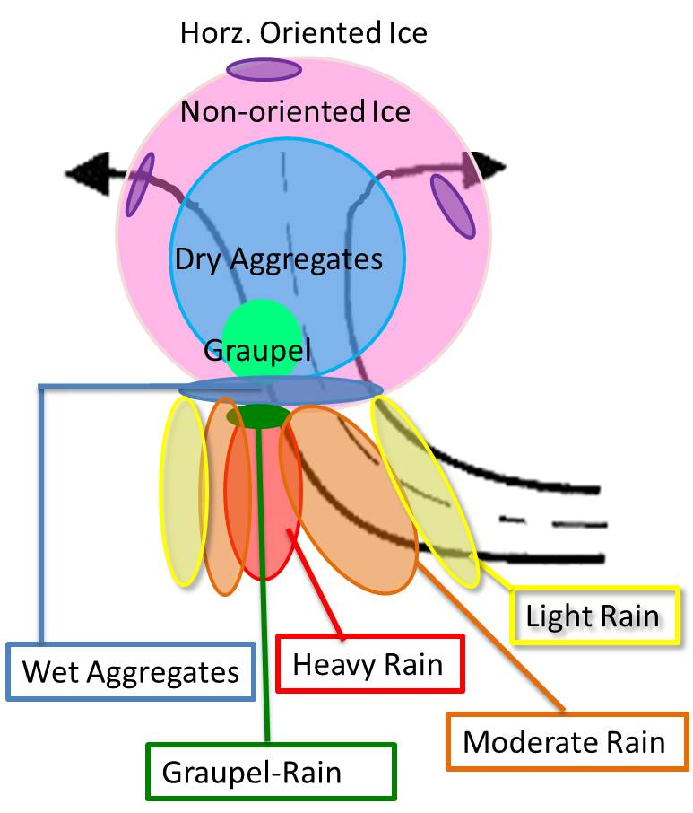
Conceptual Diagram of Convective Updrafts
Notes:
Based on those results we have developed this conceptual diagram for the hydrometeor structure of convective updrafts.

Slide 10
Mid-Level Inflow
dBZ
V_{rad}
23 Dec 1850 UTC
Notes:
Now turn to the stratiform regions in MCSs that have clear mid-level inflows

Slide 11
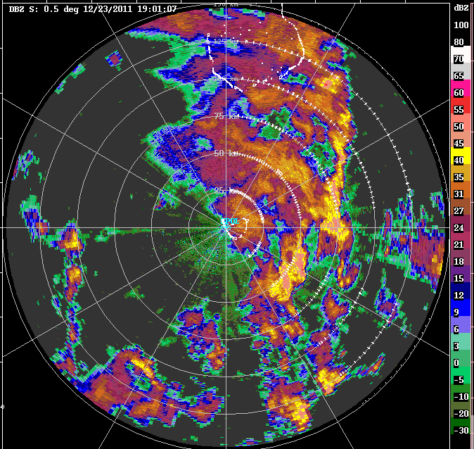
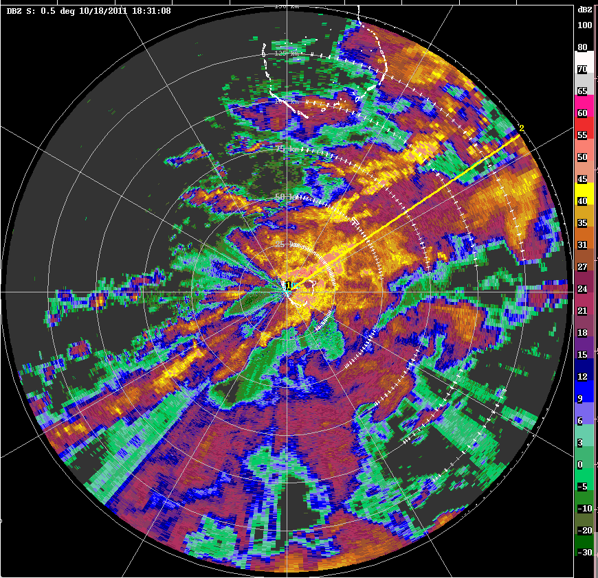
Types of Mesoscale Convective Systems
Leading Line – Trailing Stratiform
23 Dec 1850 UTC
Non-leading Convection
18 Oct 1835 UTC
Notes:
SPolKa observed two types of MCSs.
A few cases had the traditional leading-line trailing stratiform structure but most had a complex structure with convection embedded within large stratiform regions.
Rawinsondes suggest that these two types of MCSs occurred in different large-scale environments
The bottom figures show hodographs taken at within a few hours of the radar images
Warmer colors are at lower pressures
When leading line surface winds maximized near the surface and are westerly. Little directional shear
When convection embedded winds maximized aloft. Large amount of directional shear.
Since reflectivity and evolution of these two types of MCSs are so distinct we thought that microphysical structure of these storms differed. Thus, we made separate composites for each type of event.
_________ EXTRA INFORMATION ____________
How classify mid-level inflow types
Characteristics of LLTS
- Convection
- no stratiform ahead
- no convection embedded within stratiform
- directly connected to stratiform
- active when swath sampled
- continuous
- propagate coherently and continuously normal to the stratiform region
- sustained

Slide 12
Heavy Rain
Moderate Rain
Light Rain
Very Light Rain
Graupel
Graupel - Rain
Leading Line – Trailing Stratiform
Wet Aggregates
Dry Aggregates
Non-oriented Ice
Horz. Oriented Ice
Notes:
Red line shows mid-level inflow that was composited around. This composite mid-level inflow can be thought of starting on the right side of each figure under the anvil and ending on the left side of the figure with stratiform precipitation
Structure again is very systematic.
As move out towards the anvil the rain intensity systematically weakens.
Snow and ice are highly layered
Wet aggregates at the melting level, then dry aggregates and non-oriented ice respectively layered above
The wet aggregate layer becomes more fragmented near the anvil
Sometimes a thin layer of graupel was found within the upper portion of the wet aggregate layer.
Especially when brightband strong
Surprised to see but do not think this is an artifact
large aggregates and graupel have been found during MISMO which was another campaign in the central Indian ocean in 2006
Videosondes (rawinsondes outfitted with video camera
Released in stratiform regions, saw aggregates and graupel near and above the melting level
Now I am going to turn to the non-leading line MCSs and I want you watch very carefully as I change the slide since the hydrometeor structure is virtually the same.

Slide 13
Heavy Rain
Moderate Rain
Light Rain
Very Light Rain
Graupel
Graupel - Rain
Non-Leading Convection
Wet Aggregates
Dry Aggregates
Non-oriented Ice
Horz. Oriented Ice
Notes:
- More cases in this composite so images not as fragmented but the overall hydrometeor structure is the virtually the same.

Slide 14
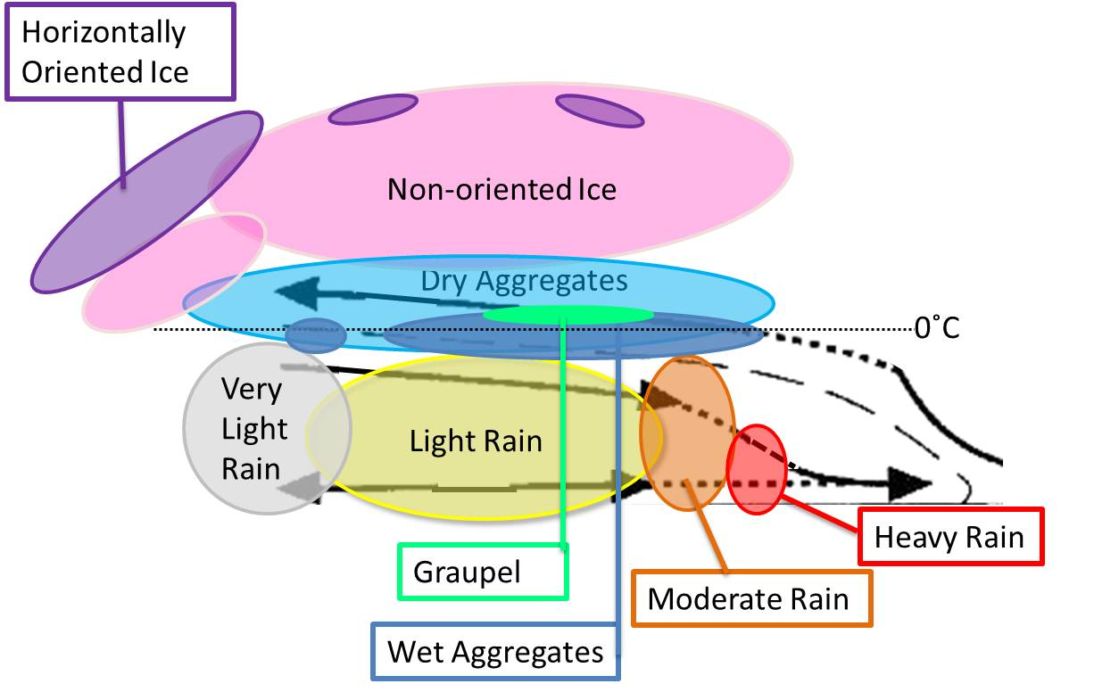
Conceptual Diagram of Mid-Level Inflow
Notes:
Using these results we have created this conceptual diagram of the hydrometeor structure for regions characterized by a mid-level inflow.
Key features
Heavy rain from events when mid-level inflow reached surface, otherwise very rare
Rain intensity decrease with distance from center of storm
Snow and ice crystals are layered
Wet aggregate layer becomes fragmented as move towards anvil

Slide 15
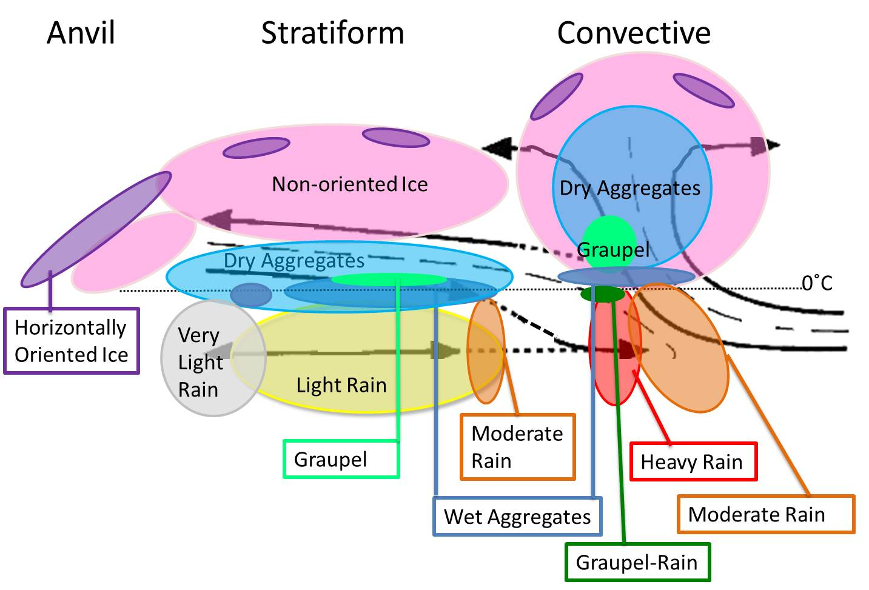
Conclusions
Hydrometeor organization consistent across MCS types
  Need research different MCS structures
Comparison of model output and radar observations
Notes:
The two previous conceptual diagrams are combined and summarized
Differences between convective updrafts and mid-level inflow
Graupel: narrow and vertical in convective updraft, but shallow and flat in mid-level inflow
More dry aggregates than non-oriented ice in convective updrafts but more non-oriented ice than dry aggregates in mid-level inflows
Two reasons why results are exciting
These hydrometeor structures are very robust. For example saw very little difference between leading line and embedded convection.
Suggests the structure of MCSs are not different because of differences in their hydrometeor structure
Emphasizes a need to further explore why MCSs take on different structures.
Can use to more directly compare model output with radar observations

Slide 16
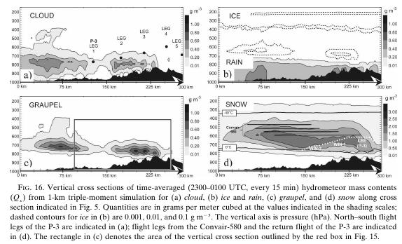
Milbrandt et al. (2008)
Notes:
Example of how can use results with computer models.
Milbrandt et al 2008
Modeled orographic event using triple moment microphysics scheme
Solid black shows orography
Mass content of different types of hydrometeors in contours and shading
Instead of showing orography could show airflow with through an MCS.
Then can compare the organize of the model to the radar results shown here.
If model can correctly represent structure of MCS can be more confident of momentum and moisture transport within the model

Slide 17

Questions ?

Slide 18
Extra Slides
Notes:
Now turn to the stratiform regions in MCSs that have clear mid-level inflows

Slide 19
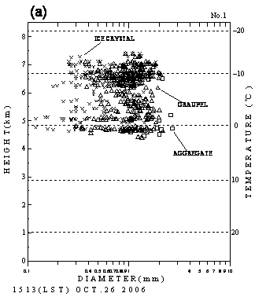
Videosonde Observations in Thick Stratiform during MISMO
Suzuki,
Notes:
Thick stratiform with weak rain, brightband clear
Aggregates and graupel near and above melting level

Slide 20
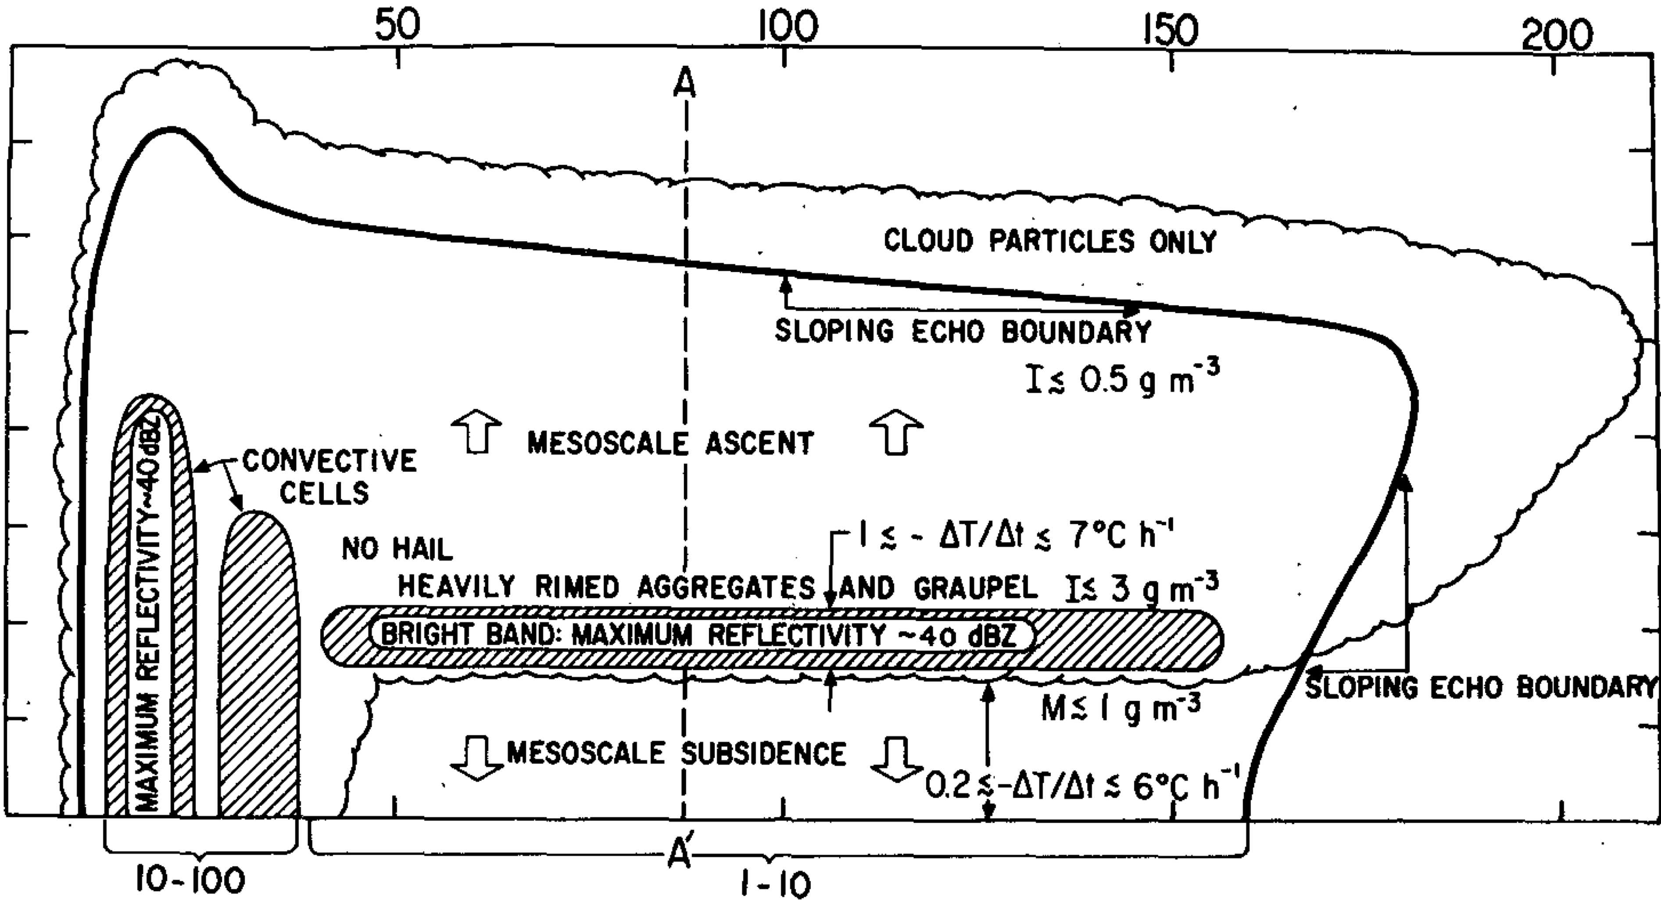
Theorized Hydrometeor Profile of MCS from GATE
Leary and Houze (1979b)

Slide 21
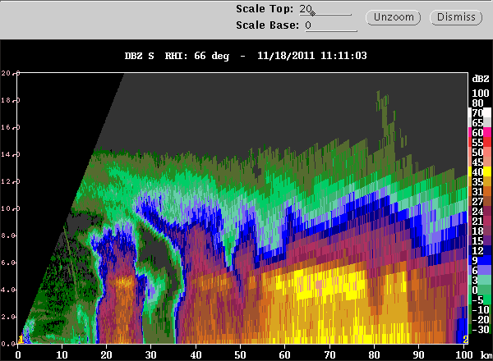
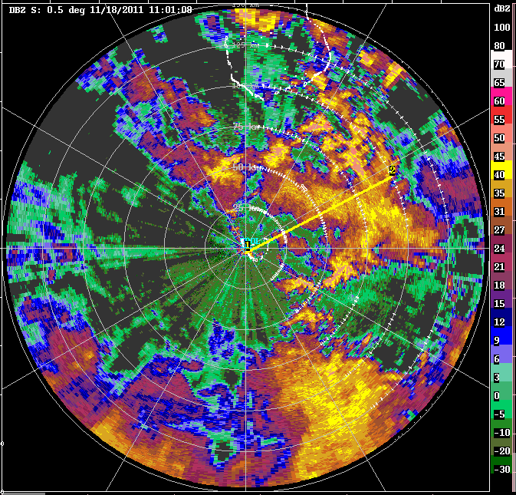
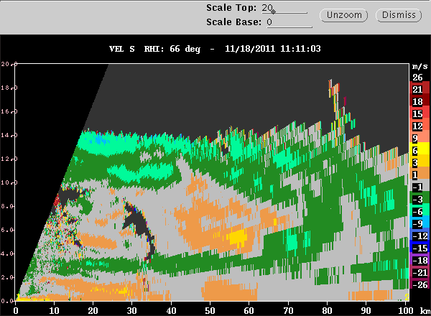
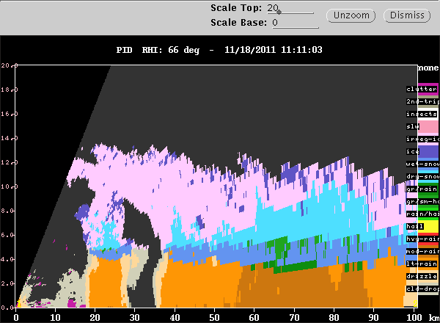
Strong Brightband
18 Nov 2011, 1101 UTC, 66 deg

Slide 22
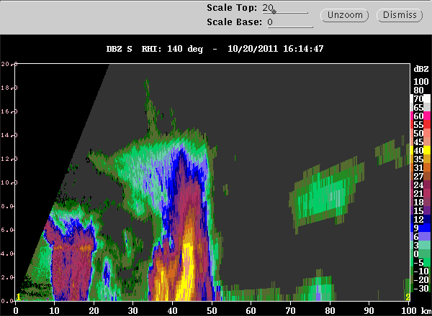
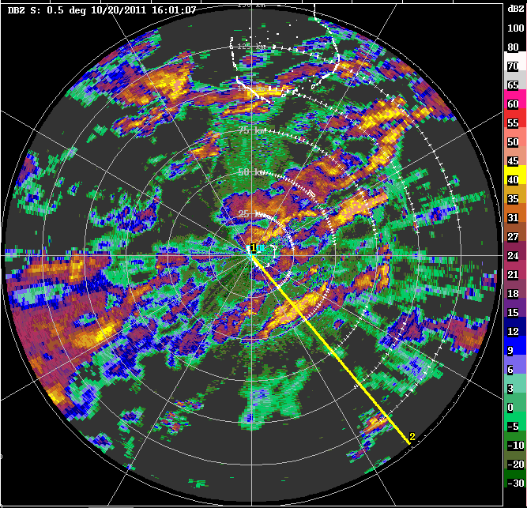
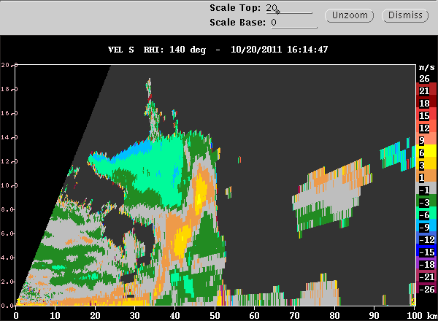
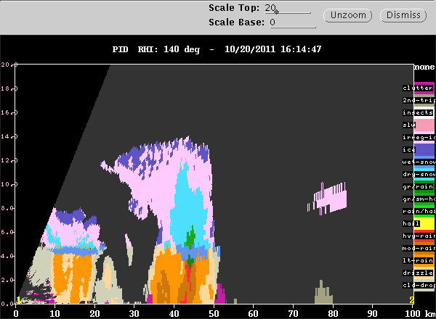
Convective Example
20 Oct 2011, 1605 UTC, 140deg

Slide 23
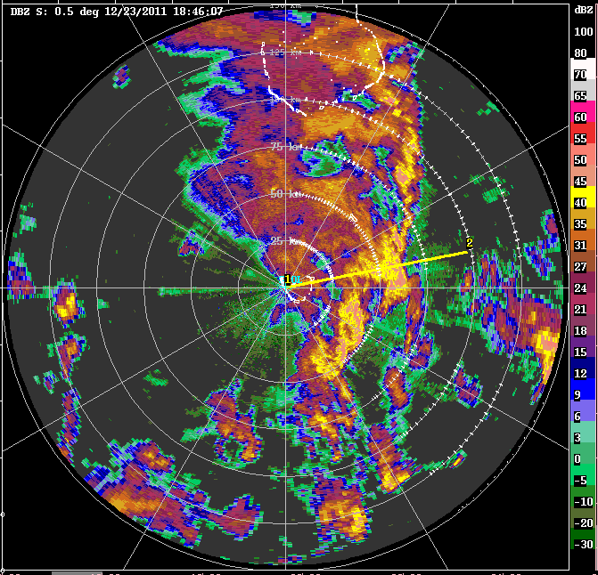
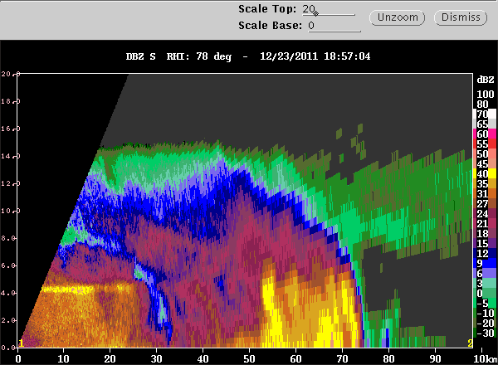
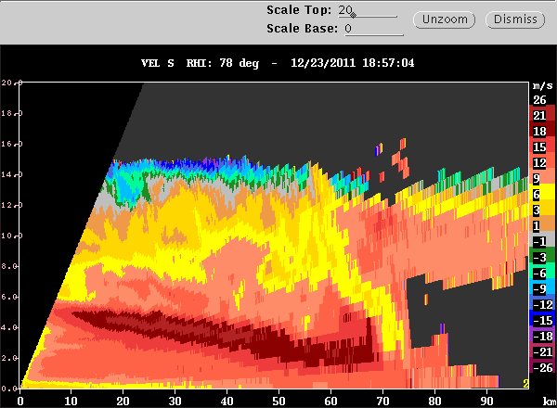
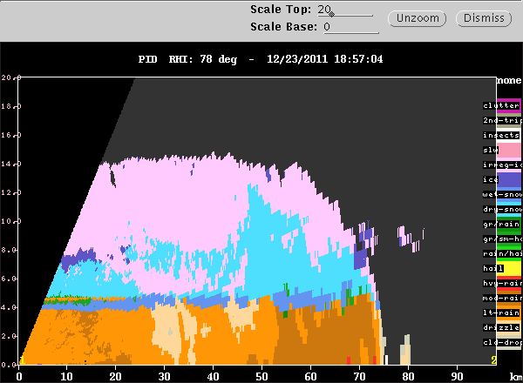
Leading Line Example
23 Dec 2011, 1850 UTC, 78deg

Slide 24
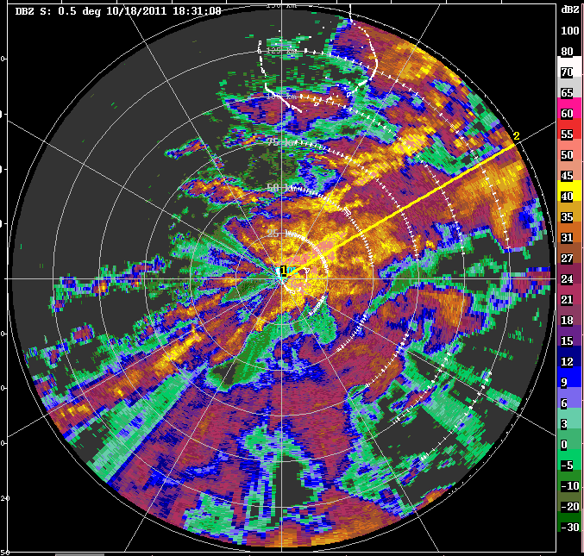
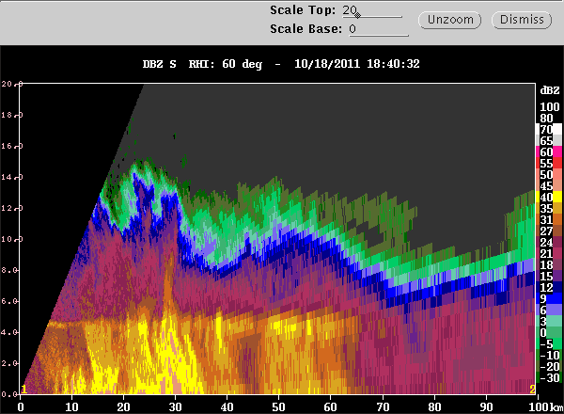
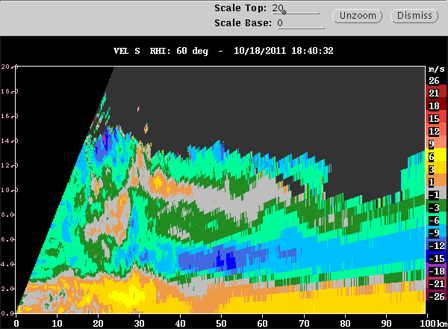
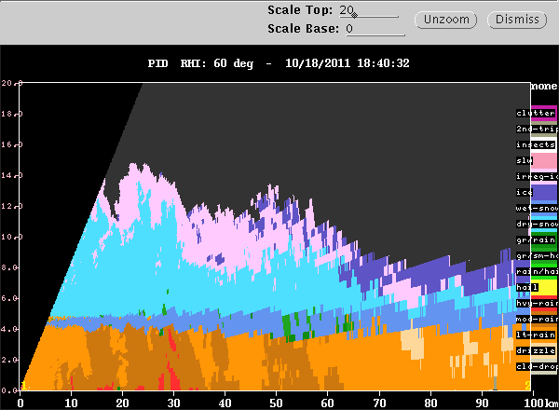
Non-Leading Convective Example
18 Oct 2011, 1835 UTC, 60deg

Slide 25
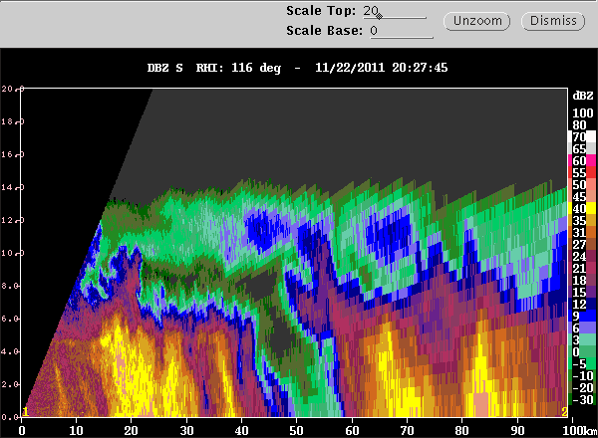
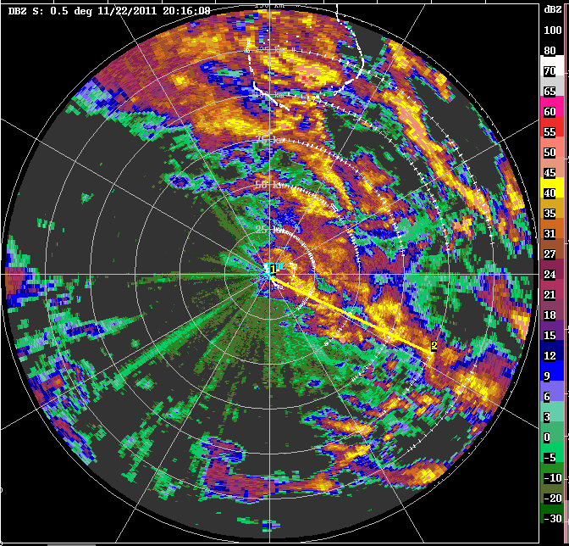
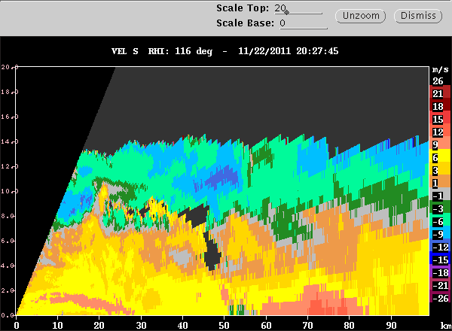
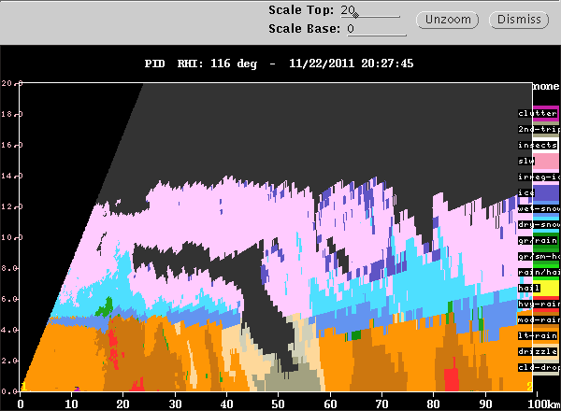
Mid-Level Inflow Surface Example
22 Nov 2011, 2020 UTC, 116deg

