Slide 1

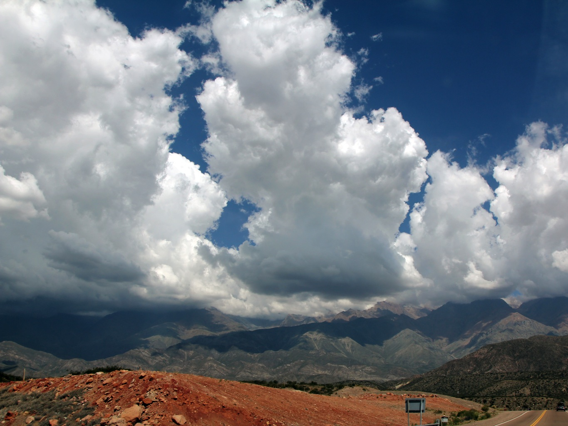
The mesoscale organization and dynamics of extreme convection in subtropical South America
Kristen Lani Rasmussen
Robert A. Houze, Jr., Anil Kumar
2013 Mesoscale Processes, Portland, OR
9 August 2013

Slide 2
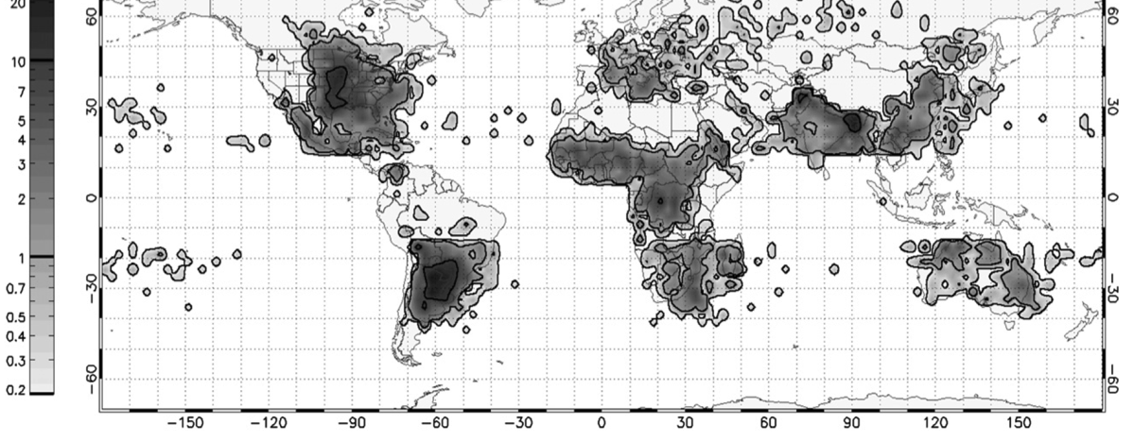
Most Intense Thunderstorms on Earth
Flash rate (#/min)
0-2.9
2.9-32.9
32.9-126.7
126.7-314.7
314.7-1389
Convective “hot spots” occur near major mountain ranges (Zipser et al. 2006)
AMSR-E Annual Severe Hail Climatology
Subtropical S. America → Highest frequency of
severe hailstorms (Cecil and Blankenship 2012)
Notes:
Get rid of top tier

Slide 3
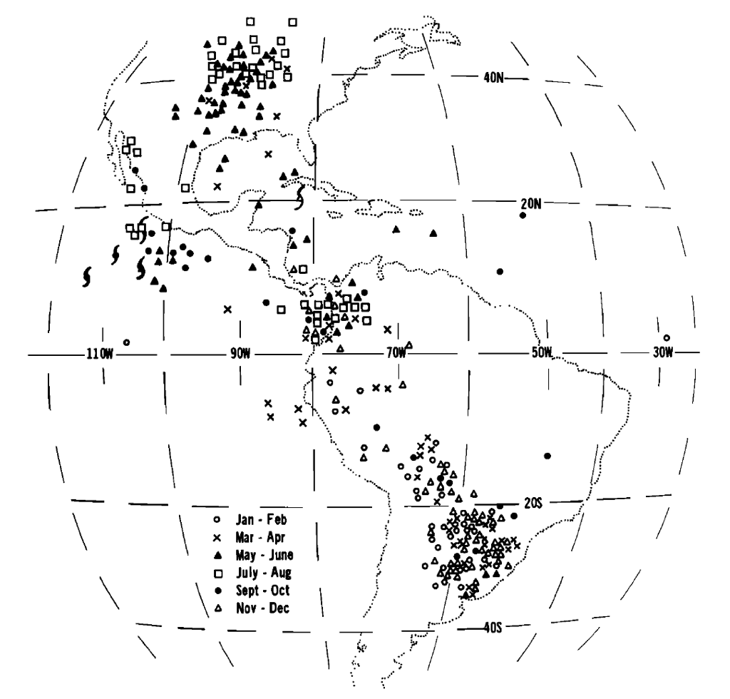
MCSs in the Americas
Over the past ~30 years, many studies have suggested a similarity between convective storm formation and organization in N. and S. America (Carlson et al. 1983, Velasco and Fritsch 1987, Laing and Fritsch 1997, Zipser et al. 2006, etc.)
Lack of available data prevented detailed investigations of storm structure and distribution until the TRMM satellite era!
Velasco and Fritsch (1987)

Slide 4
Severe Storms in the U.S.
Low-level moist air from the Gulf of Mexico
Mid-level dry air from the Mexican Plateau and the Rocky Mountains overrides moist air creating a “capping” inversion
Initiation mechanism is typically a dryline or an upper level trough
Carlson et al. (1983)

Slide 5
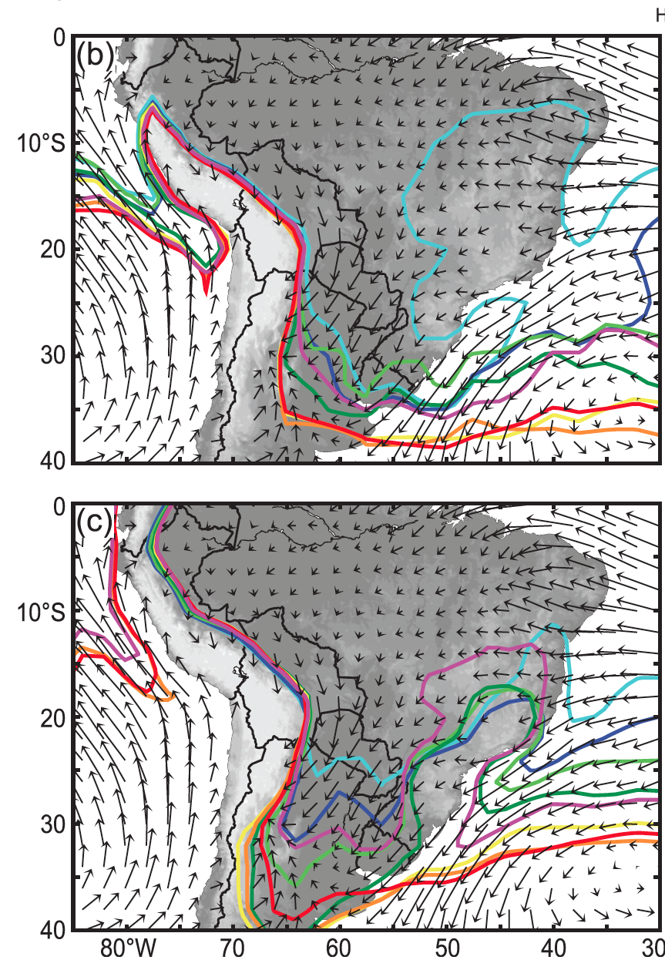

Seasonal temperature and moisture
Precipitable water
seasonal progression
→ 28 mm contour
Near-surface air temperature seasonal progression
→ 23°C contour

Slide 6
Capping and Initiation
700 mb omega
Moist air from the Amazon
Upper-level flow over the Andes; Dry, subsiding air

Slide 7
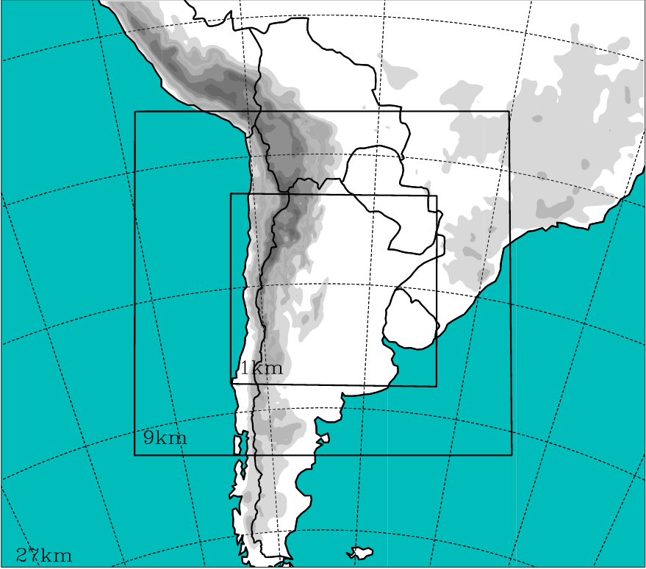
Data and Experiments
TRMM Precipitation Radar analysis:
September-April (1999-2012)
Product 2A23 - Rain Characteristics
Algorithm categorizes precipitation as stratiform, convective, or other
Product 2A25 - Rainfall Rate and Profile
3D reflectivity data from Precipitation Radar (PR)
WRF Experimental Setup:
Three nested domains, Microphysics sensitivity
tests
Topographic initiation & mesoscale organization
Remove small terrain features along E. Andes
Reduce the Andes height by 1/2
3 km
9 km
27 km

Slide 8
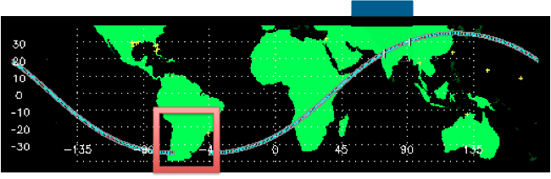
Radar Identification of Extreme Events
TRMM Precipitation Radar
Houze et al. (2007), Romatschke and Houze (2010), Rasmussen and Houze (2011), Houze et al. (2011), Zuluaga and Houze (2013), Rasmussen et al. (2013)

Slide 10
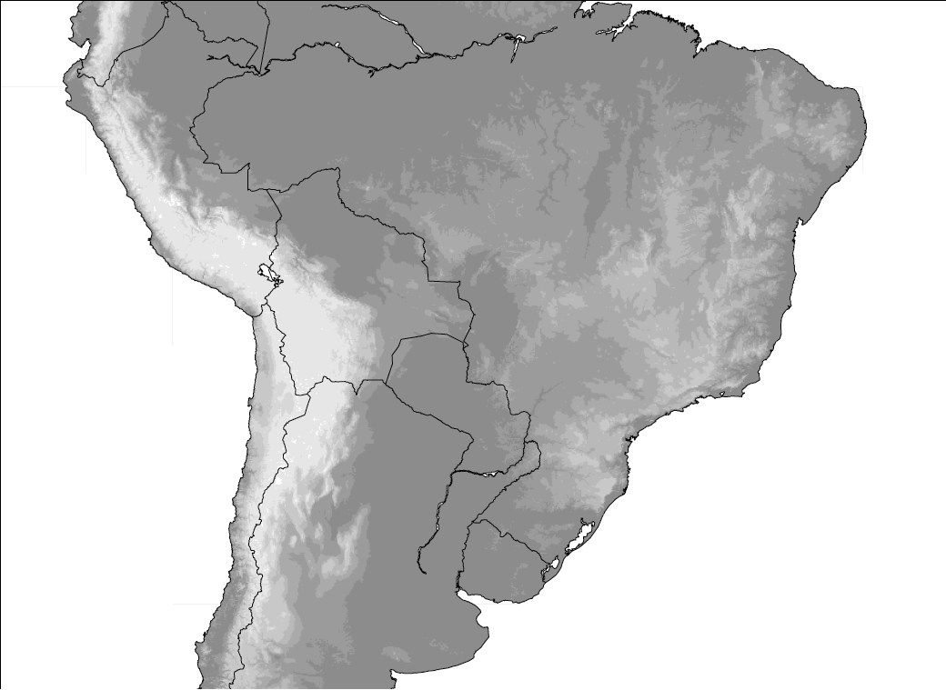
Hypothesis of Storm Life-Cycle
Broad
Stratiform
Regions
Wide
Convective
Cores
Deep
Convective
Cores
Romatschke and Houze (2010)
Suggested by Rasmussen and Houze (2011), Matsudo and Salio (2011)

Slide 11
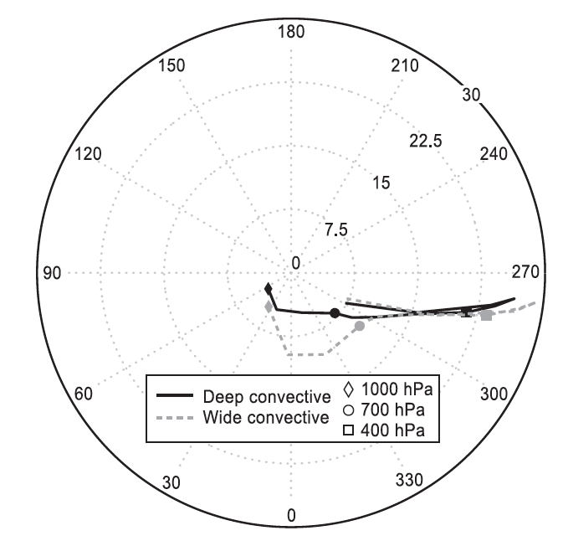
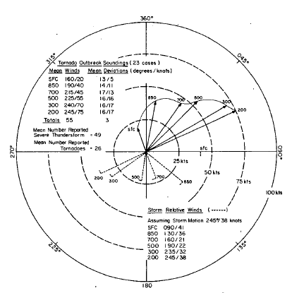
Top 50 Storms Composite Hodographs
South America (Top 50 WCCs)
U.S. (Tornado outbreak hodographs)
Rasmussen and Houze (2011)
Maddox (1986)

Slide 12
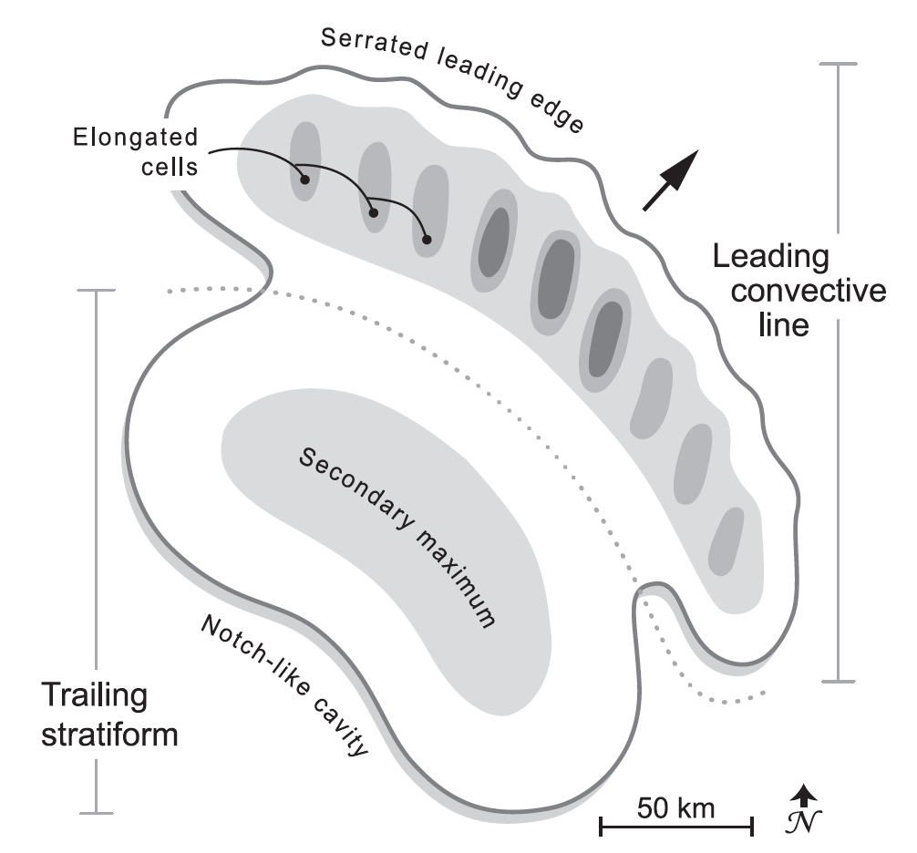
Oklahoma Archetype
Houze et al. (1990), modified by Rasmussen and Houze (2011)

Slide 13
Rating System for 10 Characteristics
1 or -1 points if the feature or threshold was unambiguously present or absent
0.5 or -0.5 points if characteristic was to some degree present or absent
Sum of points for all 10 characteristics is the “C” or “Classifiability score”

Slide 14
Examples of Mesoscale Organization

Slide 15
Mesoscale Organization
Degree of Organization | Range of Scores | South America | Oklahoma (Houze et al. 1990) | Switzerland (Schiesser et al. 1995)
Strongly Classifiable | C > 5 | 11 (20%) | 14 (22.2%) | 0 (0%)
Moderately Classifiable | 0 ≤ C ≥ 5 | 30 (54.5%) | 18 (28.6%) | 12 (21.4%)
Weakly Classifiable | C < 0 | 7 (12.7%) | 10 (15.9%) | 18 (32.1%)
All Classifiable Systems | All C | 48 (87.3%) | 42 (66.7%) | 30 (53.6%)
All Unclassifiable Systems | --- | 7 (12.7%) | 21 (33.3%) | 26 (46.4%)
Total Number of Storms Analyzed | --- | 55 | 63 | 56
Rasmussen et al. (2011)

Slide 16
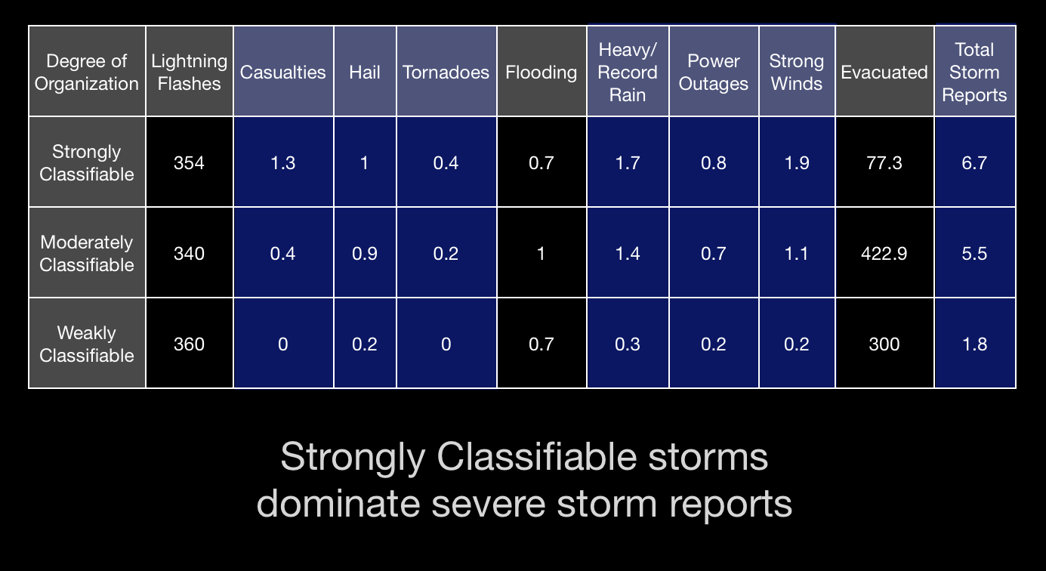
Average storm reports by mesoscale organization

Slide 17
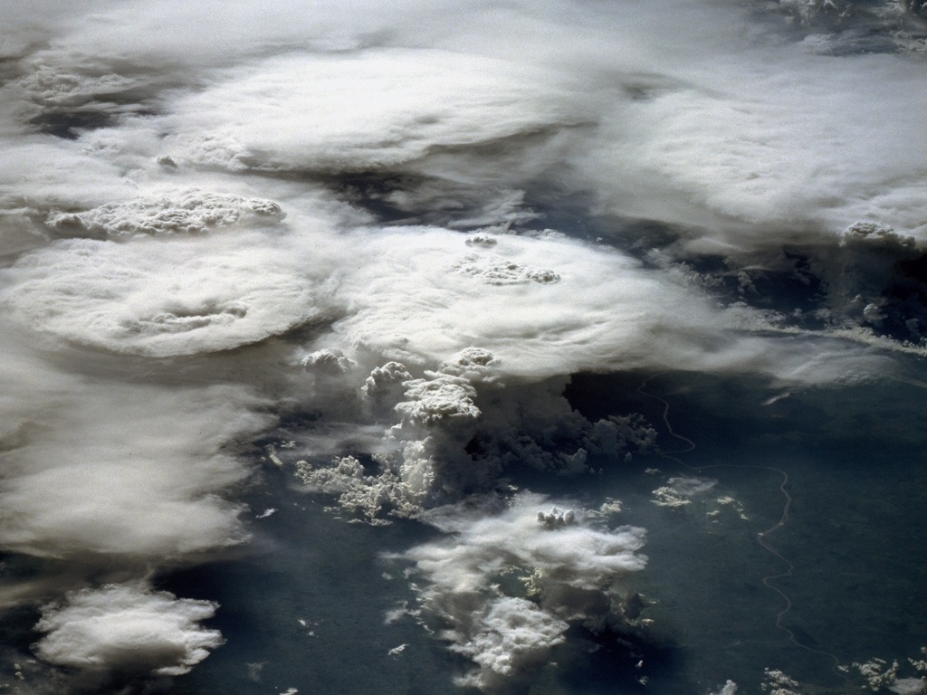
Work in Progress
WRF Simulations
17

Slide 18
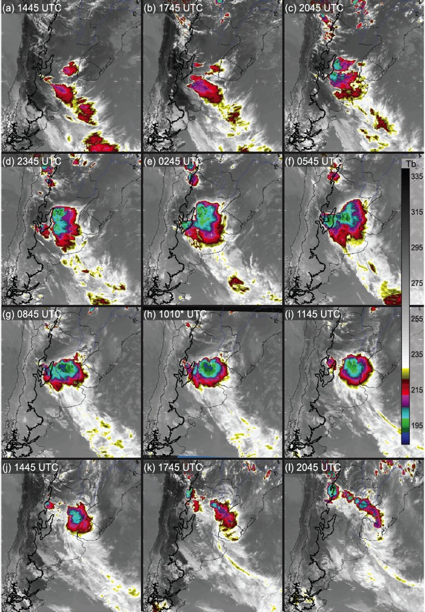
27 December 2003 GOES IR Loop
0.5 km topography outlined in black
Rasmussen and Houze (2011)

Slide 19
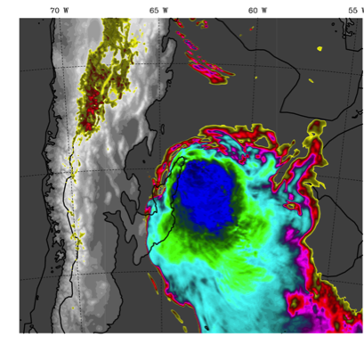
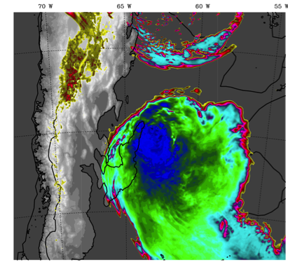
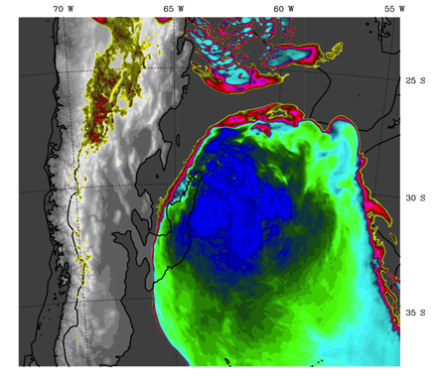
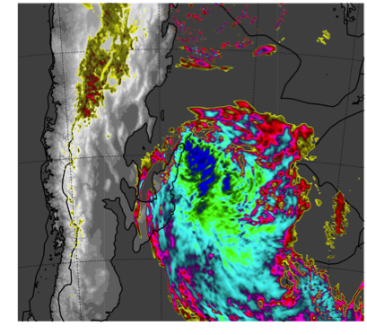
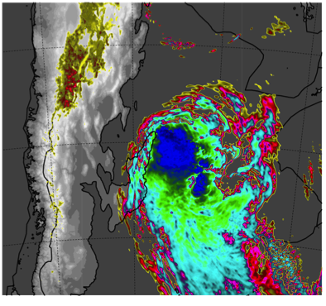
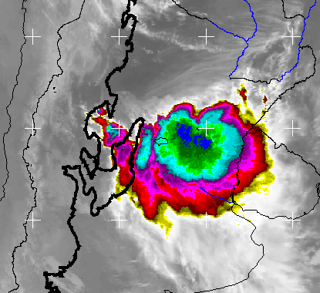
WRF OLR & GOES IR Comparisons
Thompson 10Z
Morrison 09Z
Milbrandt 10Z
WDM6 09Z
Goddard 09Z
GOES IR 10Z
Rasmussen et al. (2013, in prep)

Slide 20
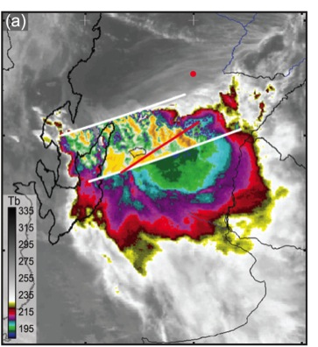
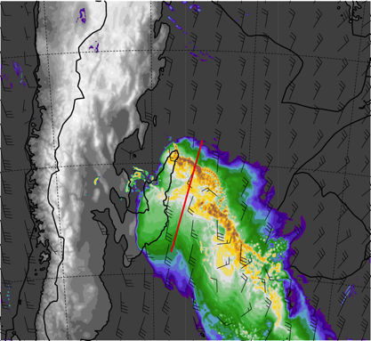
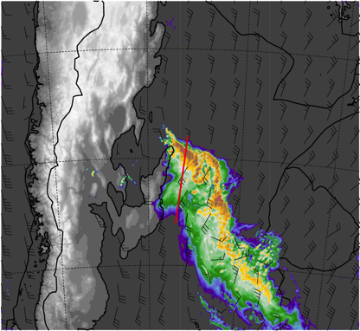
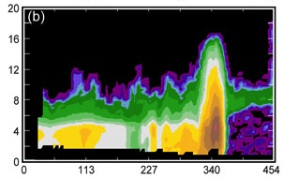
WRF Model & Data Comparisons
TRMM PR Data
GOES IR
WRF Simulation: Thompson Scheme
WRF Simulation: Goddard Scheme
TRMM PR Data
Hydrometeor mixing ratios
Thompson Scheme
Hydrometeor mixing ratios
Goddard Scheme
Snow
Ice
Graupel
Rain water (shaded)
Rain water (shaded)
Snow
Ice
Graupel
Rain water (shaded)
Rain water (shaded)
Height (km)
Distance (km)
Distance (km)
Distance (km)

Slide 21
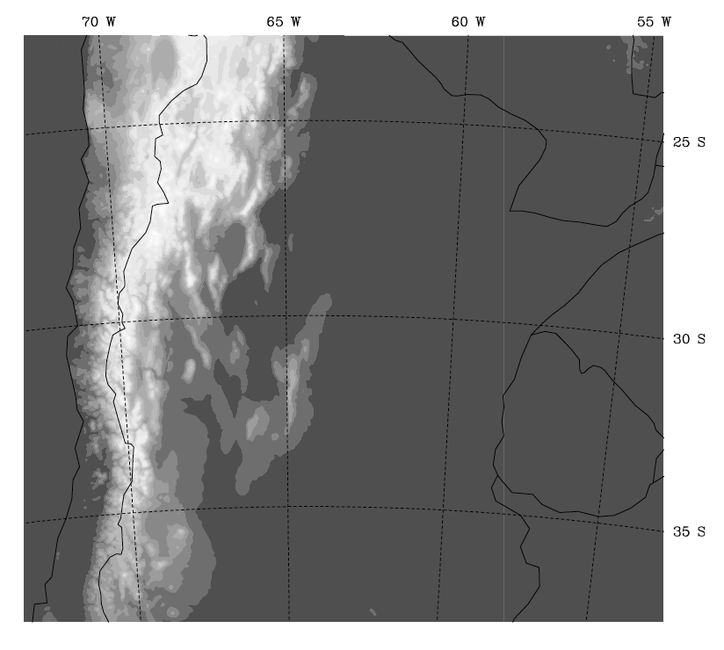
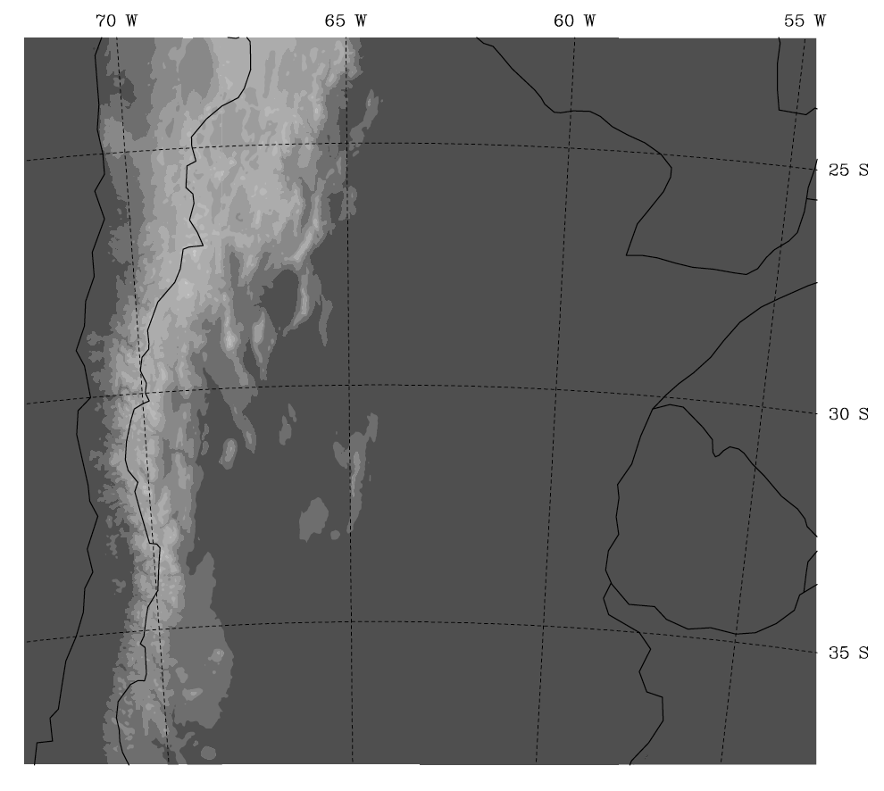
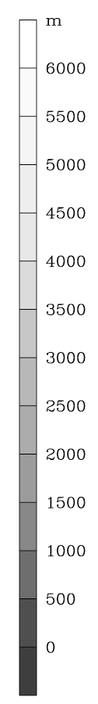
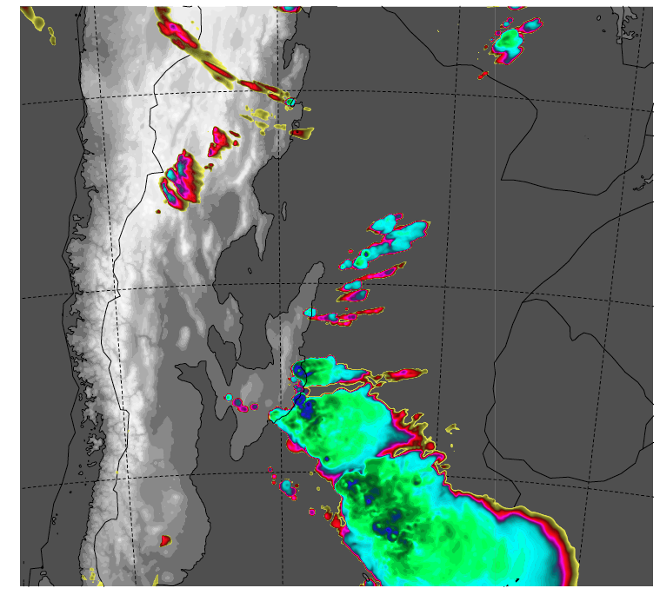
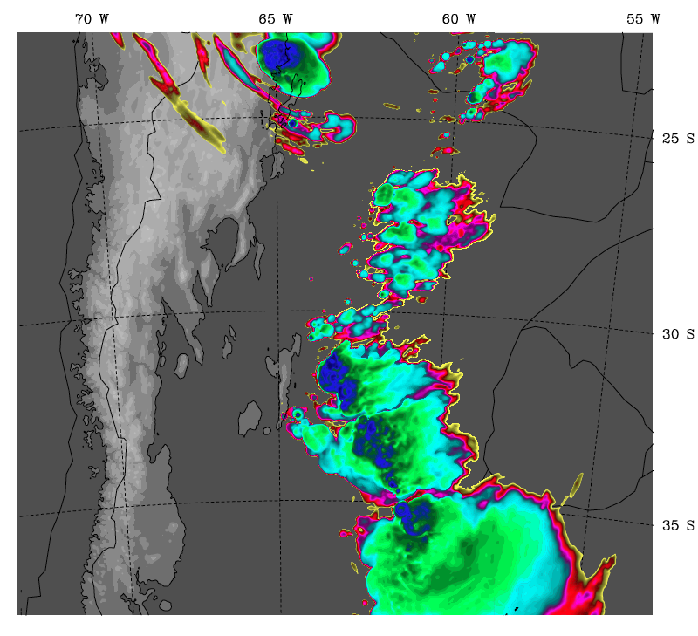
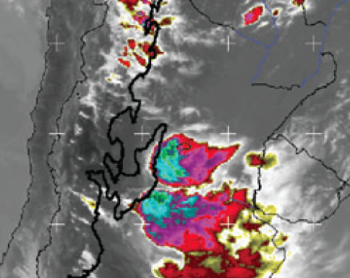
WRF Topography Experiments
Control
½ Andes
GOES IR
26 Dec 2003 2045 Z
26 Dec 2003 20 Z
26 Dec 2003 20 Z

Slide 22
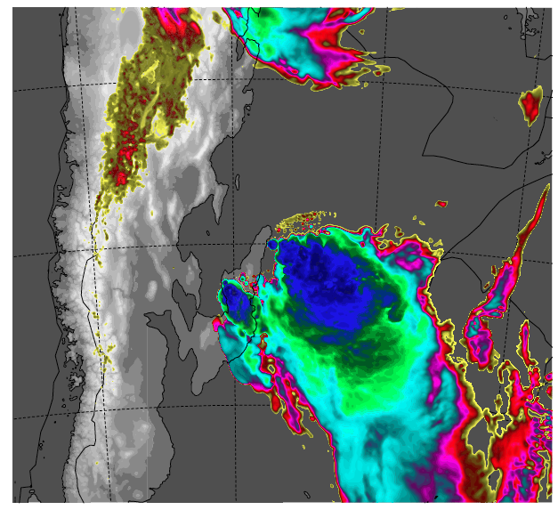
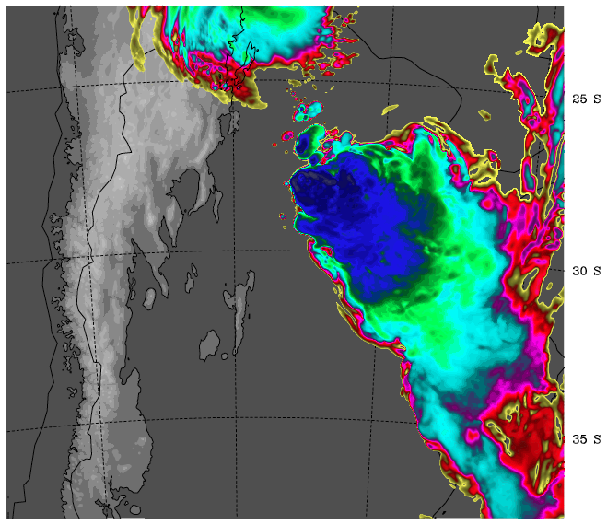
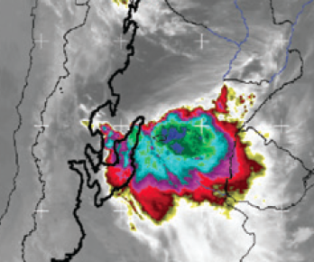
WRF Topography Experiments
Control
½ Andes
GOES IR
27 Dec 2003 845 Z
27 Dec 2003 8Z
27 Dec 2003 8Z

Slide 23
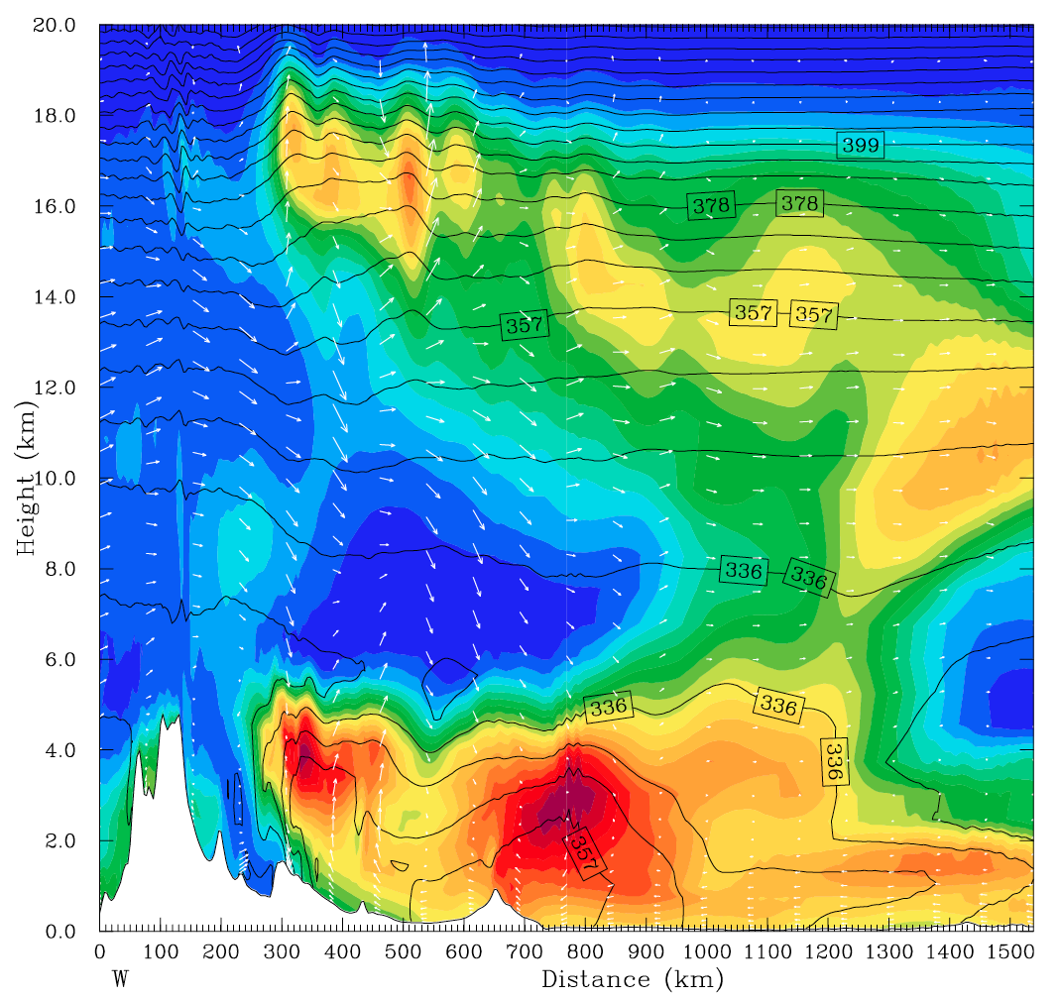
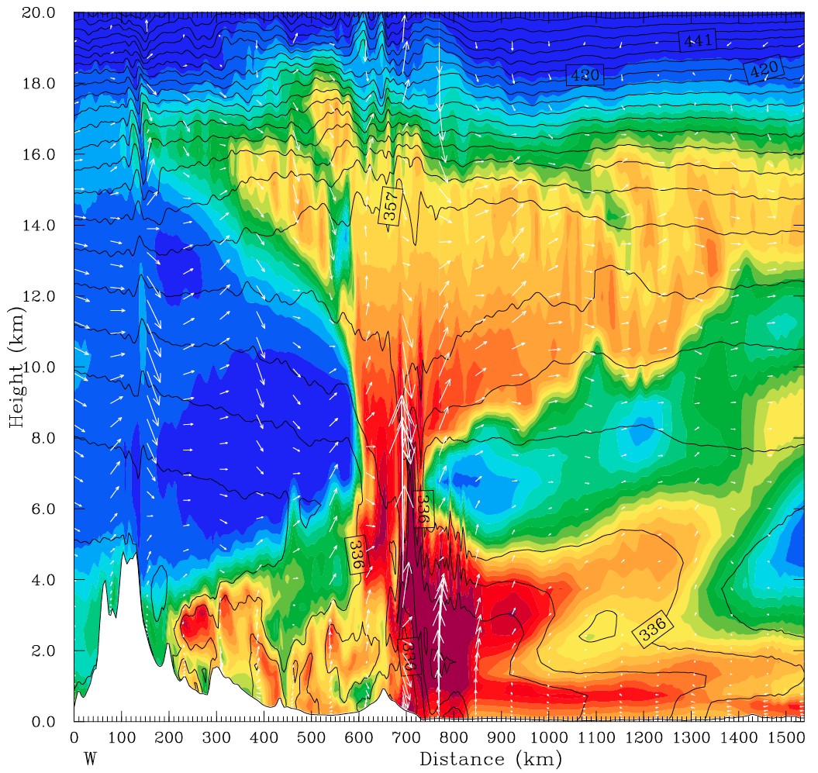

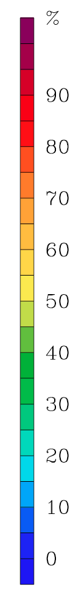
WRF simulation results (Control)
Dashed lines - equivalent potential temperature, shading - relative humidity
T = 2 hrs
Lee subsidence capping low-level
moist air
➔ Highly unstable!
T = 8 hrs
Convective initiation on
the eastern foothills of
the Sierras de Córdoba
Mountains
Air with high equivalent
potential temperatures
near the Andes foothills
Seems to confirm the hypothesis of lee subsidence and a capping inversion from Rasmussen and Houze (2011)

Slide 24
Conclusions
Deep convection initiates near the Sierras de Córdoba Mountains and Andes foothills, grows upscale into eastward propagating MCSs, and decays into stratiform regions
Storms with wide convective cores in S. America tend to be line-organized and are similar in organization to squall lines in Oklahoma
Thompson microphysics scheme realistically represents the leading-line/trailing stratiform structure

Slide 25
Conclusions
Foothills topography is important for both convective initiation and focusing subtropical South American deep convection
Lee subsidence and a capping inversion hypothesized in Rasmussen and Houze (2011) is evident in the WRF data
Future work: Deep convection in this region is also modulated by strong moisture convergence, diurnal effects, and mountain dynamics → role in mesoscale dynamics and organization

Slide 26
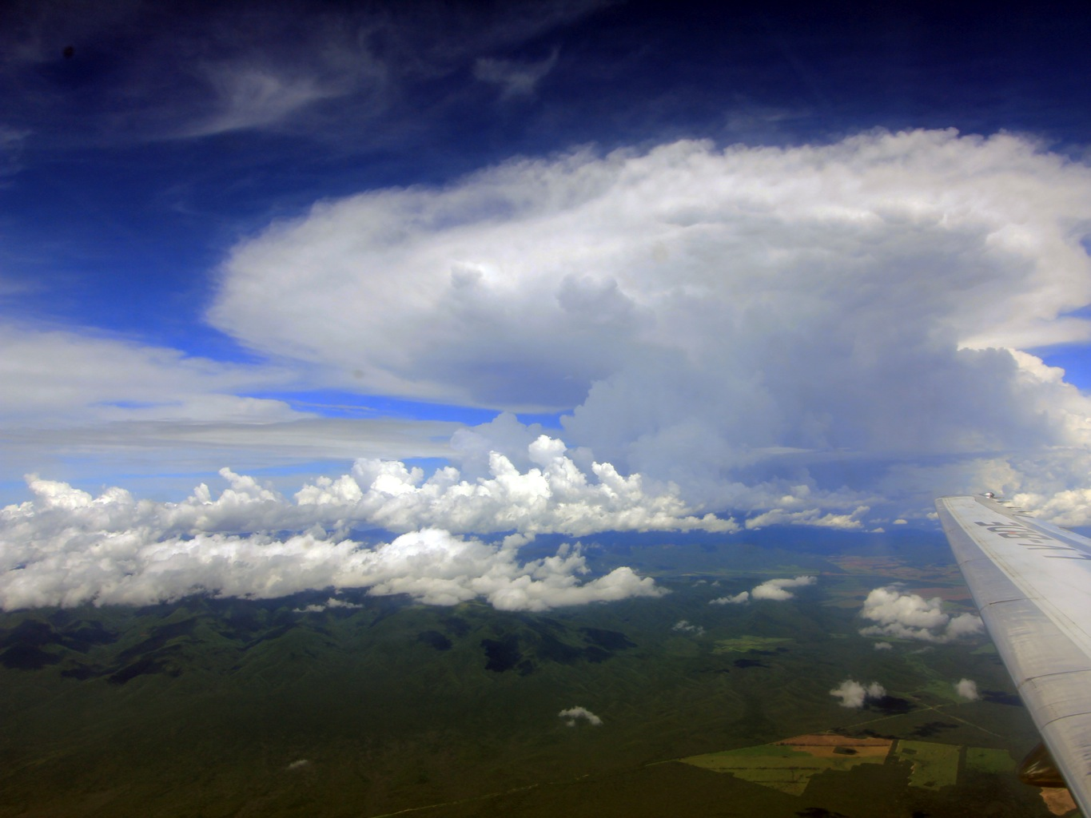
Questions?
This research was supported by:
NASA grant NNX13AG71G
NASA grant NNX10AH70G
NASA ESS Fellowship NNX11AL65H
NSF grant ATM-0820586
Notes:
Radar is 3D

