Slide 1

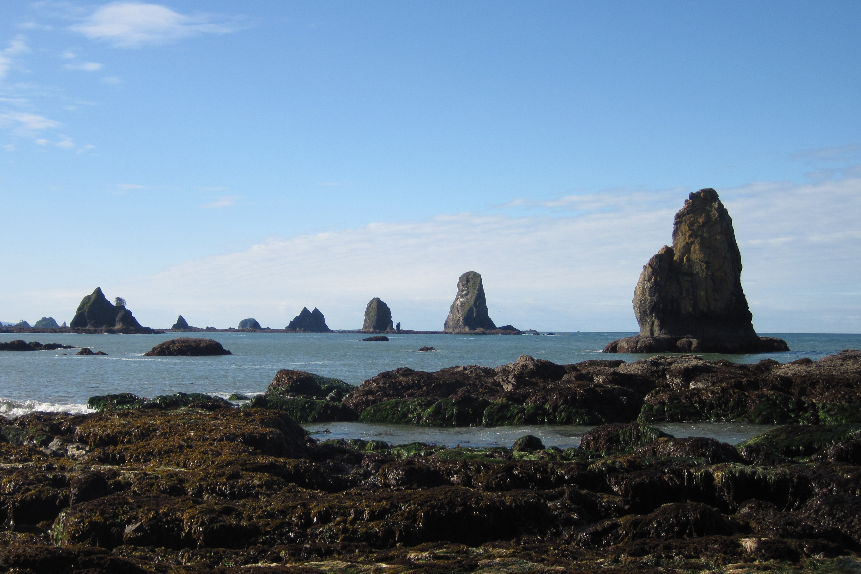
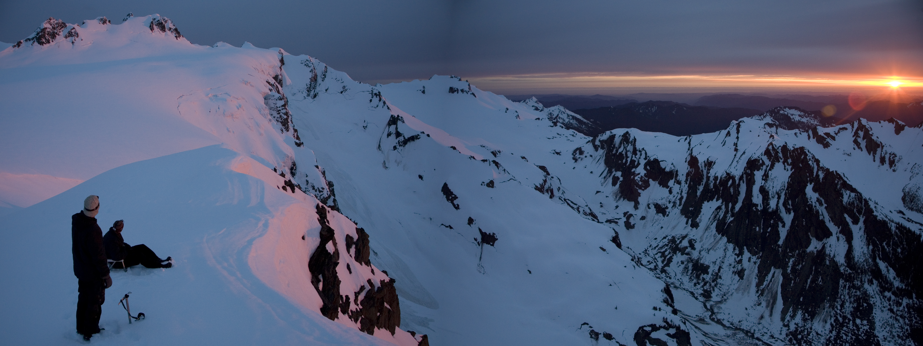
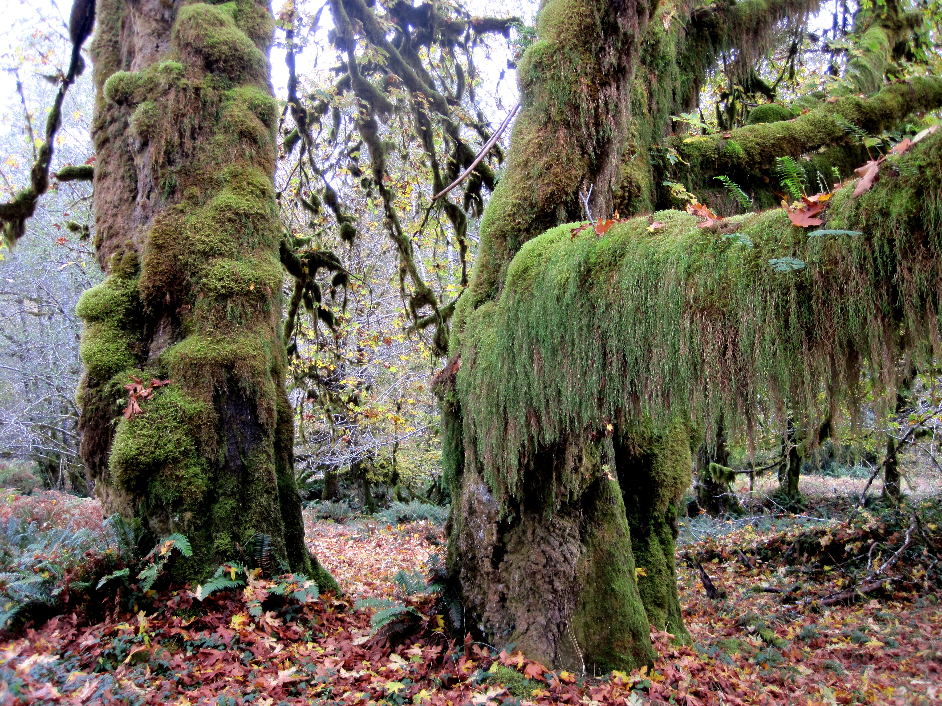
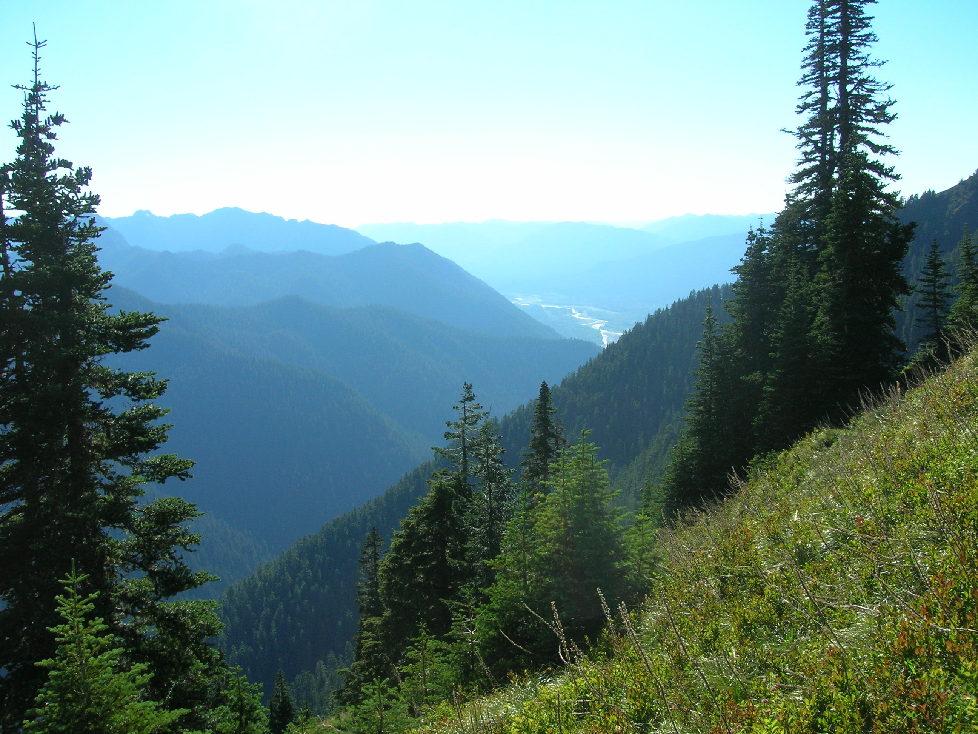
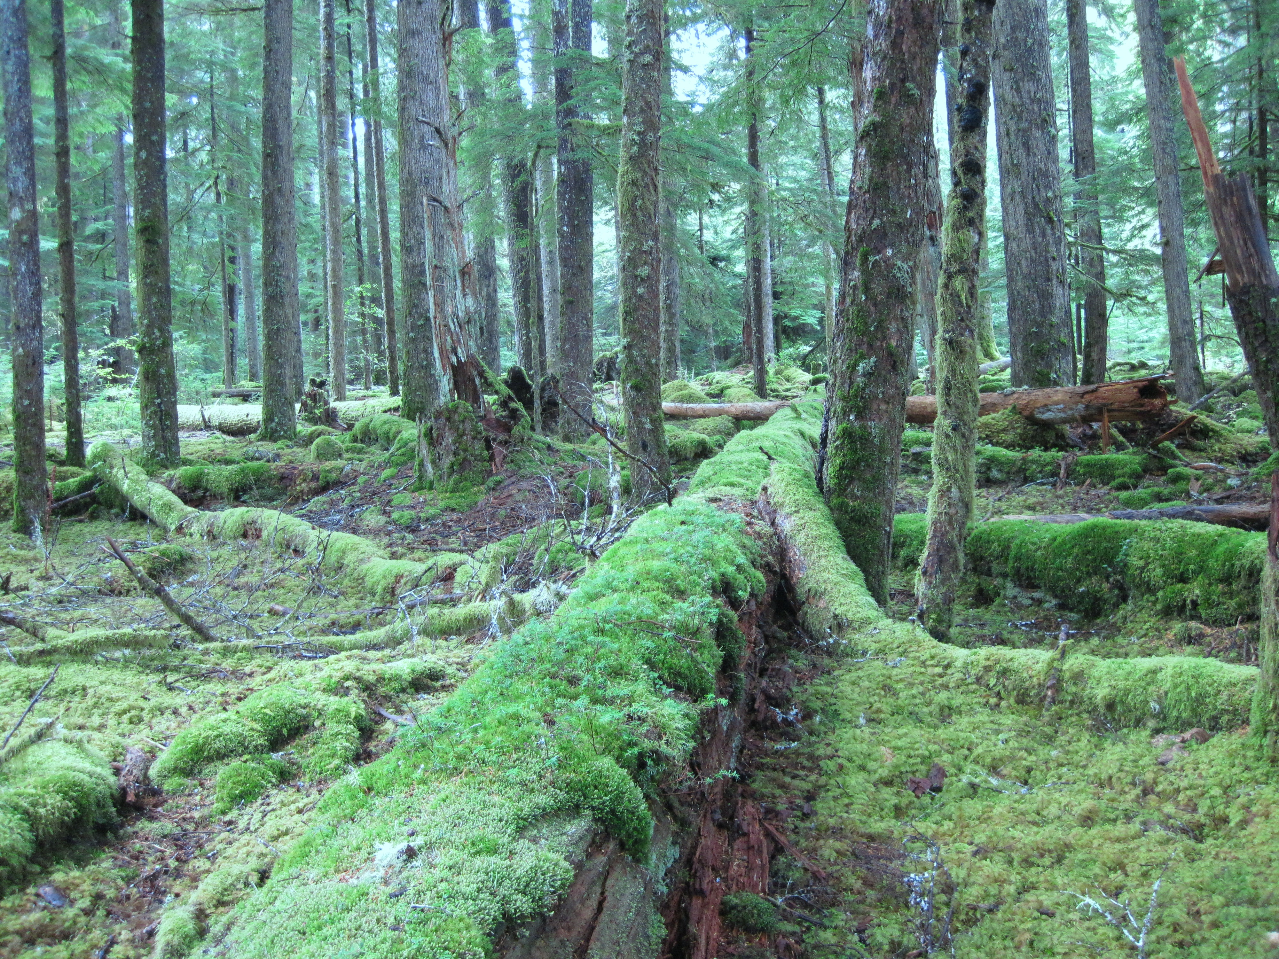
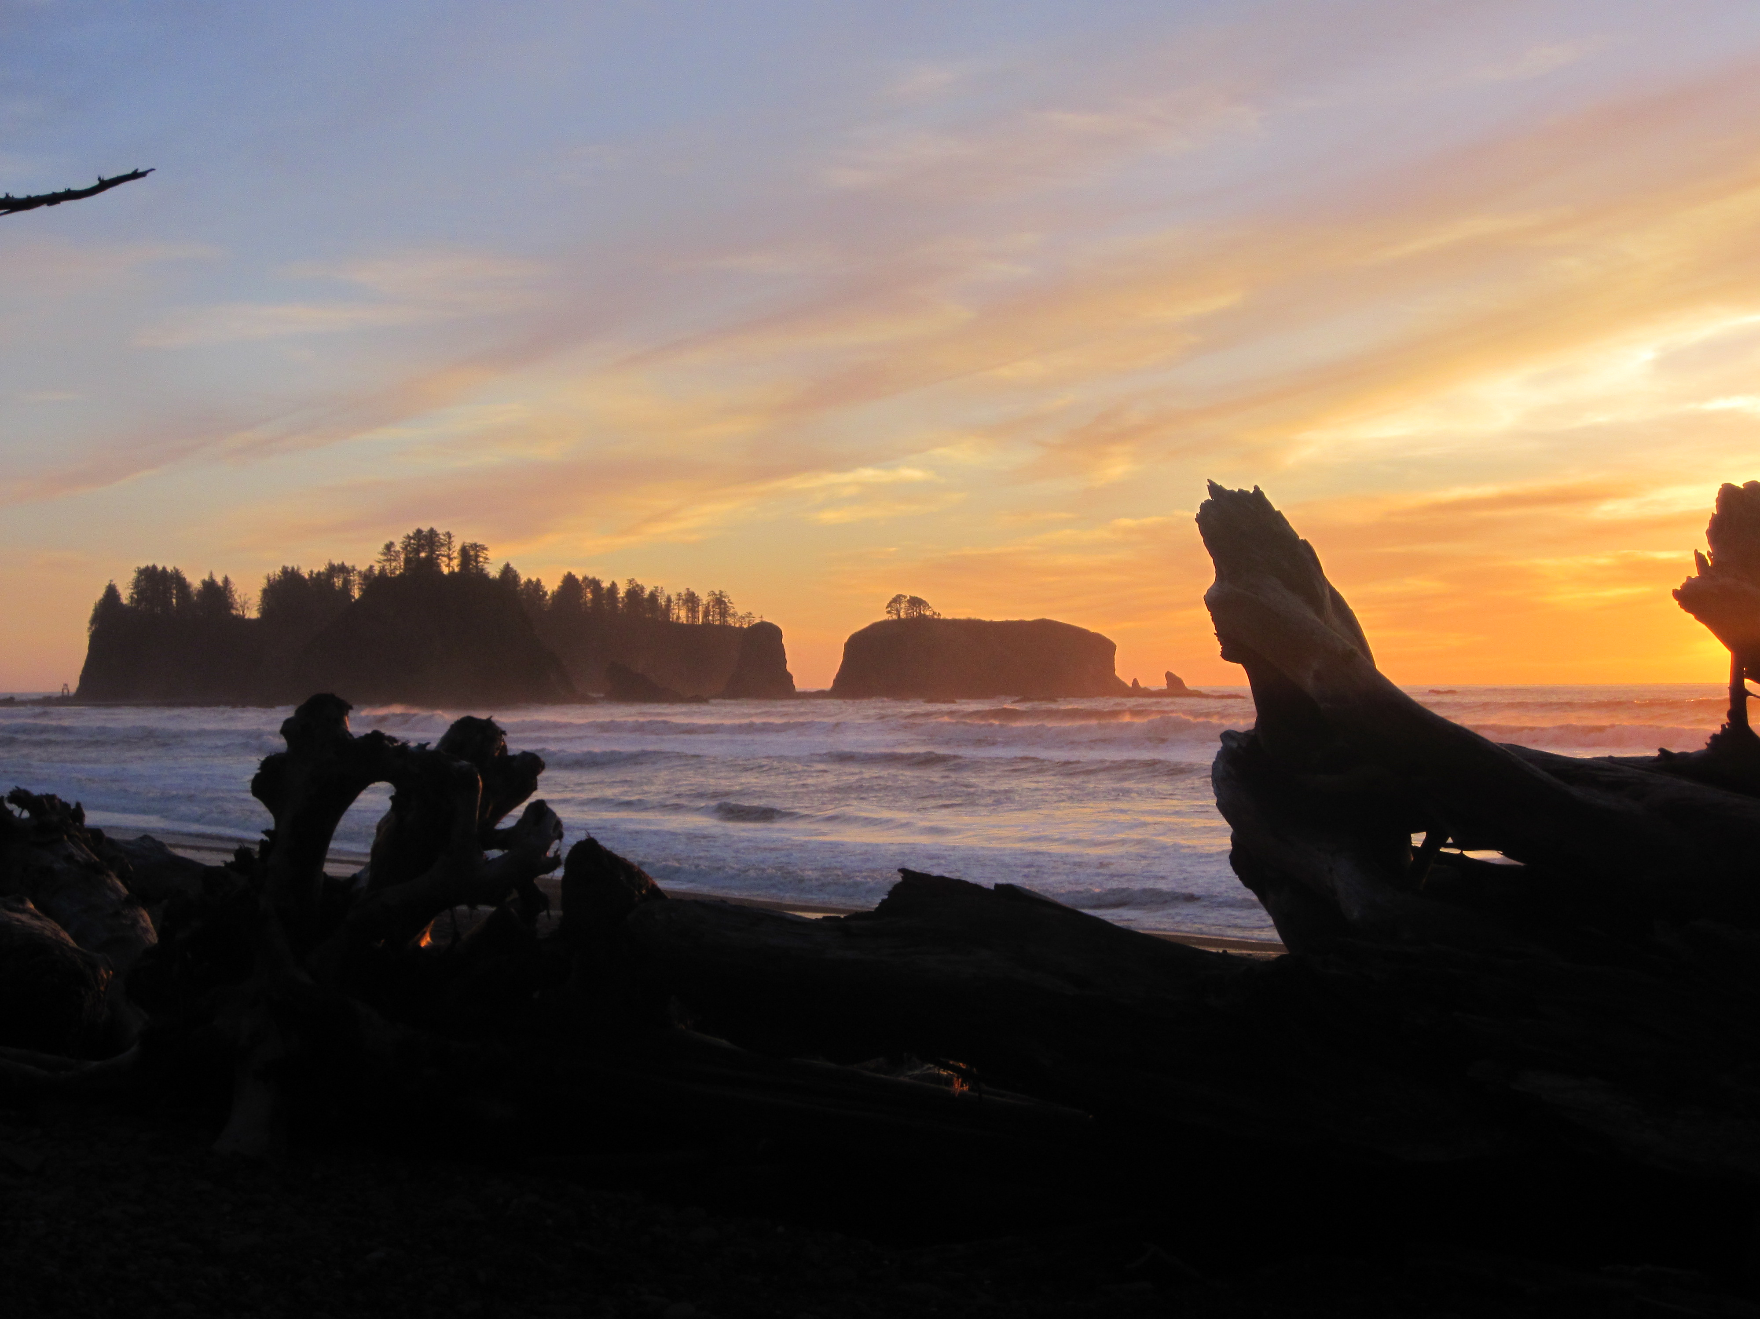
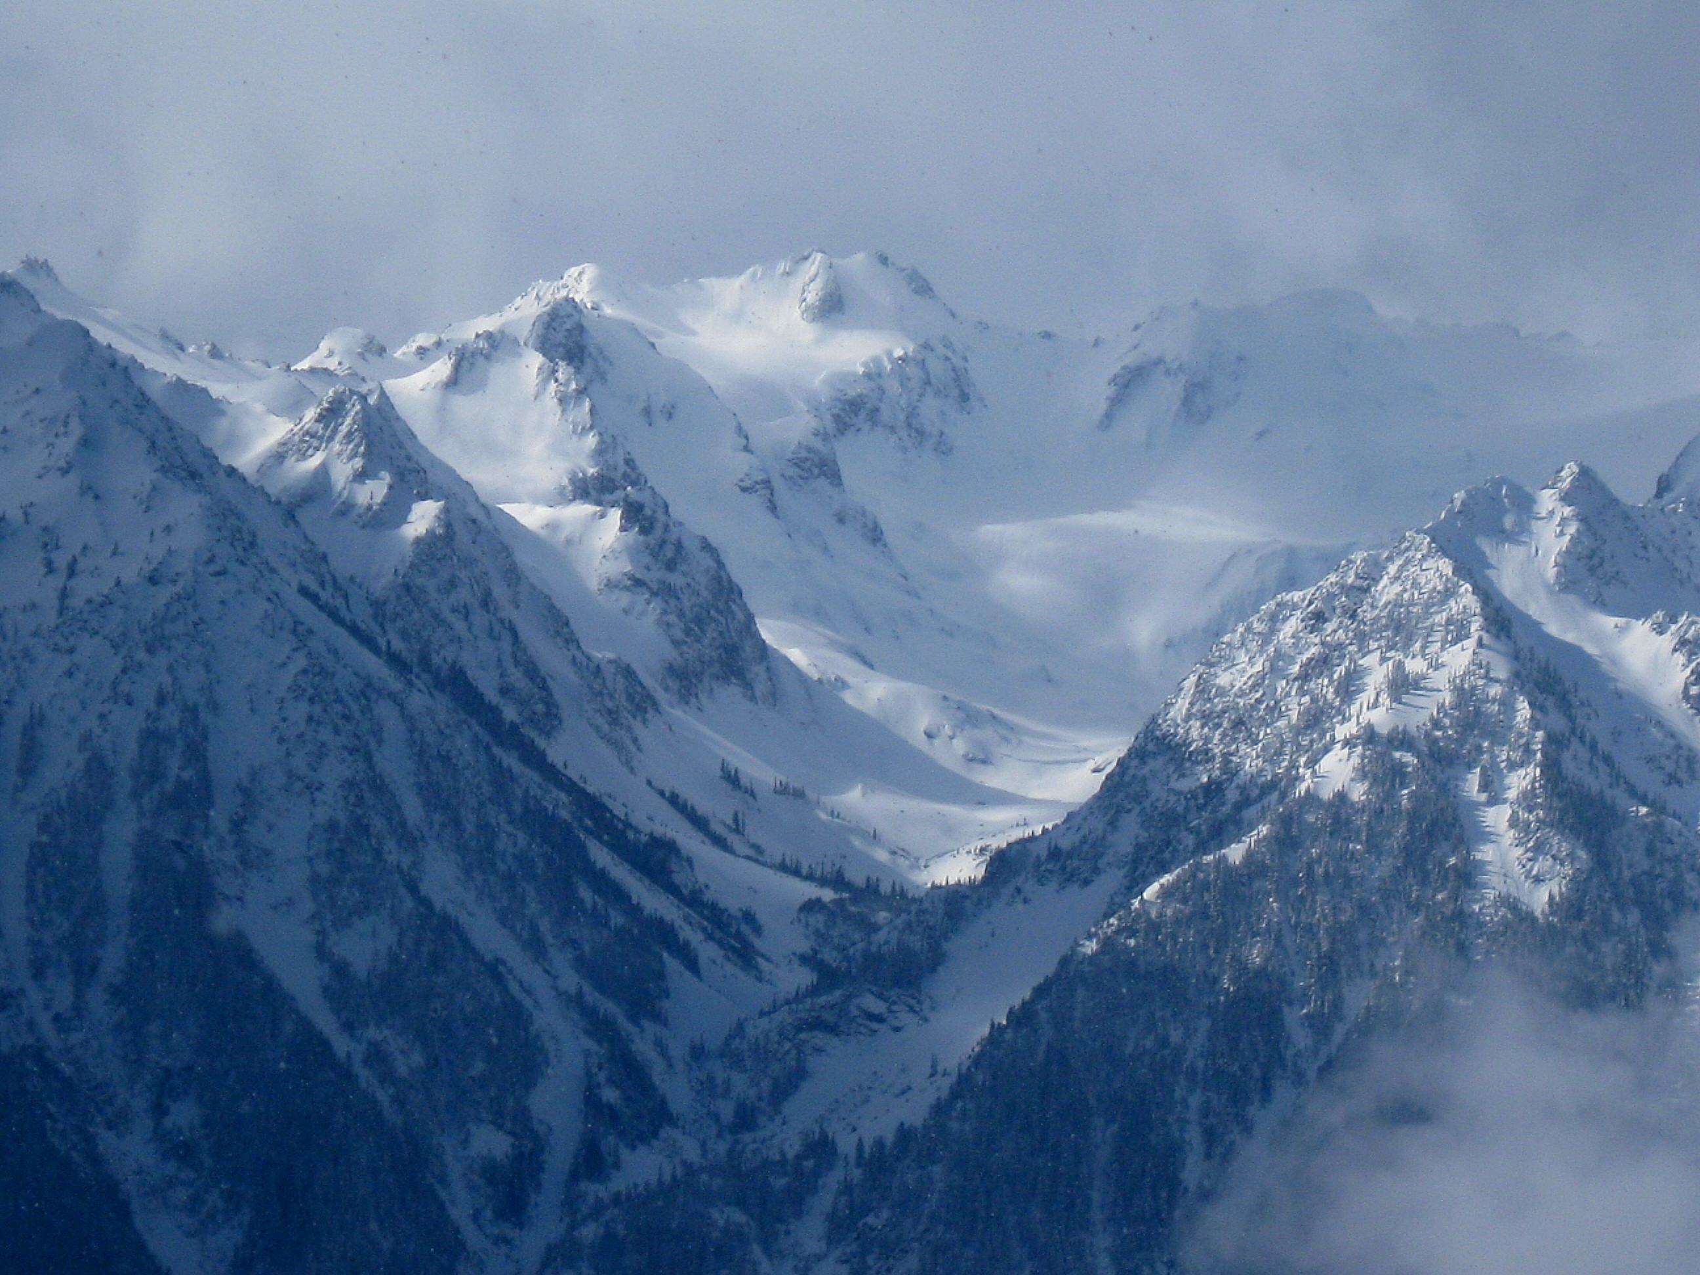
OLYMPEX: A Ground Validation Program on the Olympic Peninsula in the Pacific NW
Lynn McMurdie, Robert A. Houze, Jr., Cliff Mass
(Atmospheric Sciences, University of Washington)
Dennis Lettenmaier, Jessica Lundquist
(Civil Engineering, University of Washington)
Walter Petersen and Mathew Schwaller
(GSFC NASA)
Presented: 9 August 2013 AMS Mesoscale Conference, Portland, Oregon
Supported by: NASA grants NNX12AL54G and NNX13AG71G

Slide 2
A future field program to validate a future satellite
In winter 2014 a new precipitation measuring satellite will be launched called the core satellite of the Global Precipitation Measurement (GPM) mission (next generation TRMM)
NASA is conducting several Ground Validation (GV) field campaigns to validate and develop the algorithms used by the instruments on the GPM
One of these field programs will be on the Olympic Peninsula during water year 2016. Most likely from Nov 2015 – Jan 2016

Slide 3
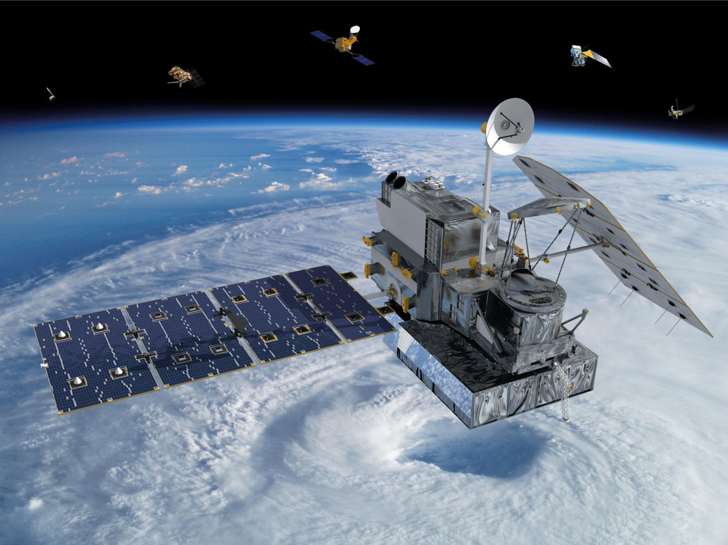
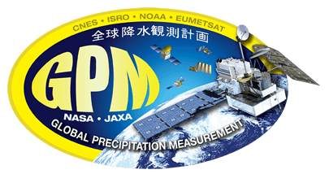

The GPM Satellite
A polar orbiting satellite with an altitude of 407 km, a 65° orbit inclination, and a non sun-synchronous circular orbit dedicated to measuring precipitation from space.
This means it will sample the earth from the Antarctic circle to the Arctic circle and will sample a particular spot on the earth at different times of the day.
Prior precipitation satellite TRMM only measured tropical regions

Slide 4
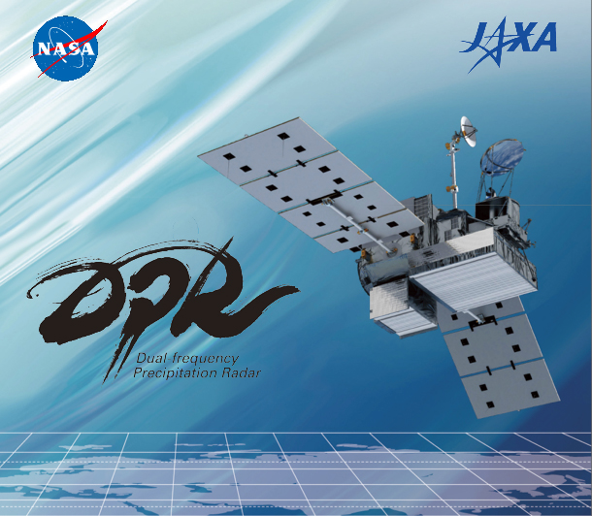
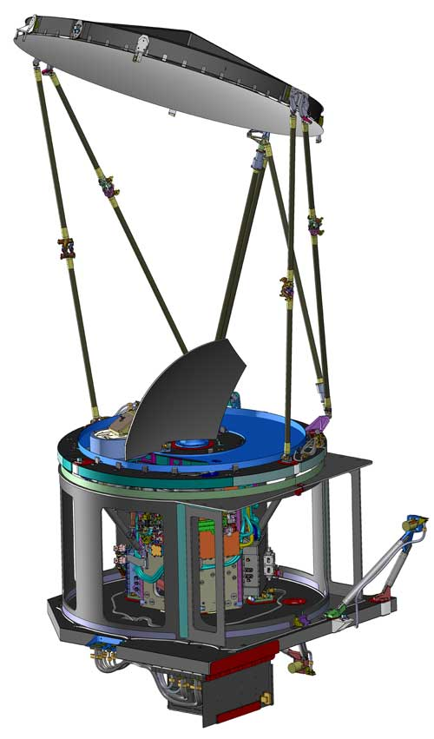
The GMI (and the) DPR Instruments
The GPM Microwave Imager
Passive microwave instrument with low frequencies to measure rain and high frequencies to measure snow
Will have a swath width of 904 km
Prior instruments did not have the very high frequencies that will be on the GMI
The Dual-Frequency Precipitation Radar (first time in space)
Will detect the 3-D distribution of precipitation
These frequencies will detect a range of precipitation regimes – tropical intense rain to midlatitude light rain and snow
Will have a swath width of 245 km (Ku band) and 120 km (Ka band)

Slide 5
GPM Mission Objectives
Measure rain and snow globally especially in areas lacking surface observations or ground-based radars.
Be able to detect solid and liquid precipitation over a wide range of intensities (0.2 mm hr⁻¹ to 110 mm hr⁻¹), a wide range of locations (ocean to complex terrain) and a wide range of regimes (light snowfall to intense tropical convection).
Apply remotely measured precipitation to a wide range of applications such as determining storm structures and observing flood and drought events.
Need Ground Validation Field Campaigns to Achieve these Objectives

Slide 6
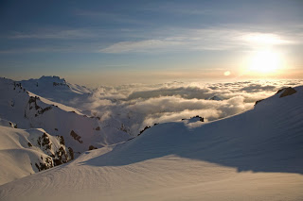
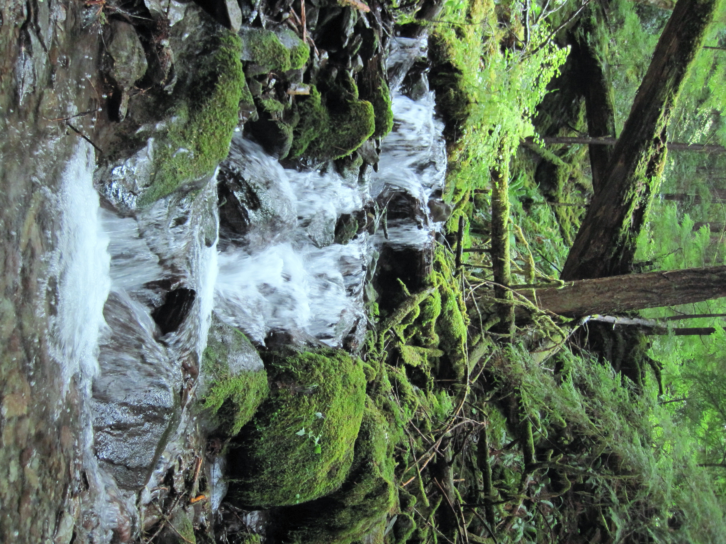
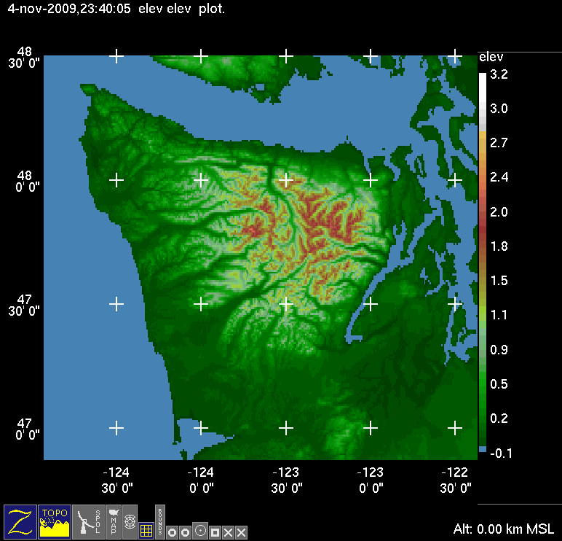
OLYMPEX is the all-in-one GV Campaign
Lots of Rain
Lots of Snow
Complex Terrain with transition from ocean to coast to land

Slide 7
OLYMPEX Objectives
Provide physical validation of the GMI and DPR precipitation (rain and snow) algorithms
Document precipitation mechanisms in midlatitude frontal systems and their modification by complex terrain
Test hydrological applications of the GPM data.
Merge numerical model and satellite observations to optimize precipitation estimates

Slide 8
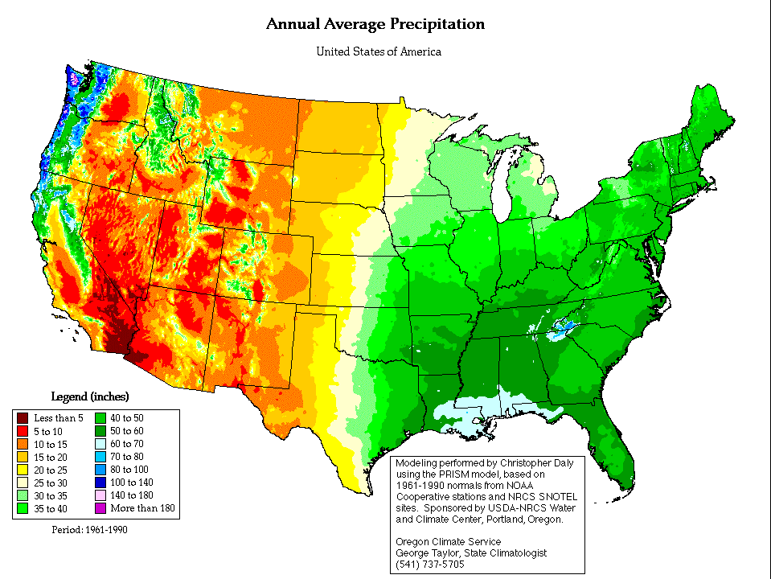
Climatology of Olympic Peninsula
Annual average precipitation (PRISM)
Extremely large precipitation accumulation produced as the moist Southwesterly flow impinges on coastal terrain

Slide 9
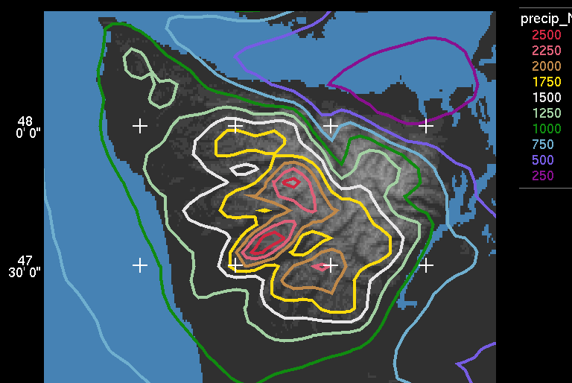
Climatology of Olympic Peninsula
Precipitation varies between ridges and valleys and exhibits enhancement on the mountain ridges.
Derived from a 5-year climatology of continuous mesoscale model results (MM5) and verified by precipitation gauges (Minder et al., 2008)

Slide 10
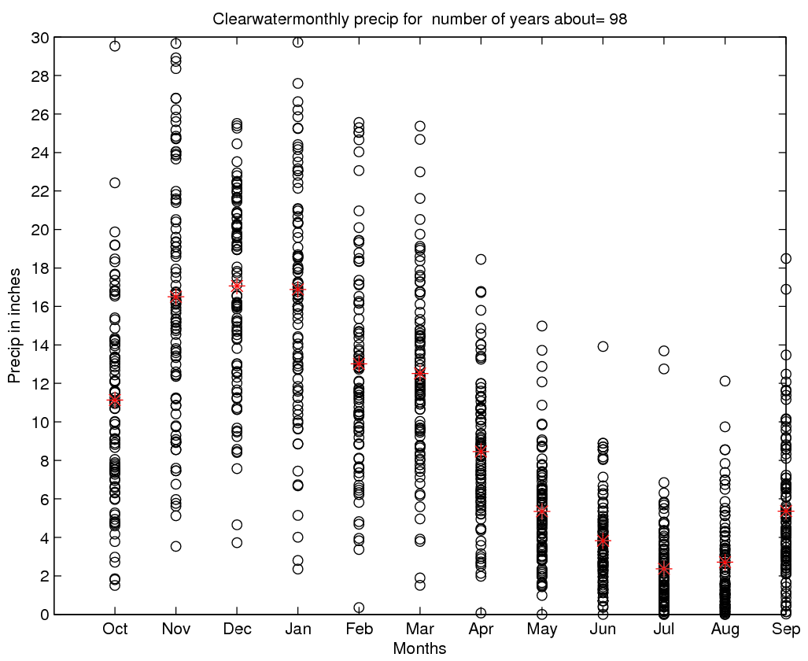
Climatology of Olympic Peninsula
Clearwater
Monthly Average Precipitation
Rainiest months: Nov, Dec, Jan. Range from 3.5” (90 mm) to 30” (750 mm) in Nov.
On any given day in Nov, Dec, Jan there is a 73% probability of receiving >0.01” precip and a 36% probability of receiving > 0.5” rain.

Slide 11
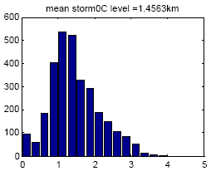

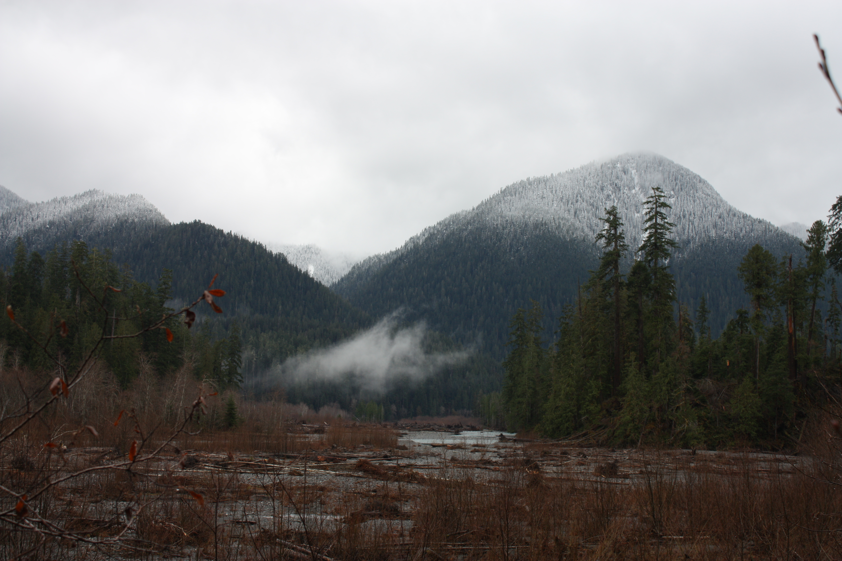
Climatology of Olympic Peninsula
KUIL
Frequency of occurrence
0°C level in km
The mean 0°C level is low so that there is rain at low elevations and snow at high elevations
Distribution of Nov-Jan 0°C level for flow that is onshore and moist at low levels (KUIL sounding). Mean 0°C level during storms = 1.5 km See this full range in individual storms!
(plot provided by Justin Minder)
Mean 0°C level in winter during moist onshore flow = ~1.5 Km. Rain at lower elevations, show at higher elevations. This varies a lot from storm to storm and within each storm.

Slide 12
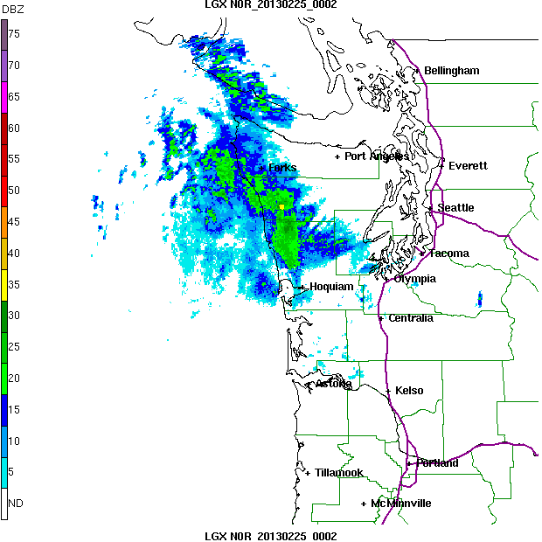
Typical Frontal Passage (as seen by the coastal radar LGX)
SW side of Olympics gets rain well ahead of front
SW side gets rain during front
SW side gets post-frontal showers

Slide 13
What do we need to measure for OLYMPEX?
Measure rain and snow precipitation at multiple sites from the coast, to the lowlands to mountain ridges.
Seasonal snowpack (in terms of snow water equivalent, or SWE) over the higher terrain
Upstream meteorological conditions over the Pacific Ocean.
Brightband variability
Microphysical properties within all sectors of midlatitude storms and their variability in complex terrain
Emissivity of a variety of surfaces from ocean, to coast, to forest and snow-covered mountains.
River response and runoff.

Slide 14
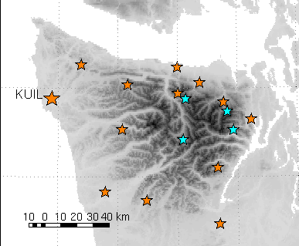
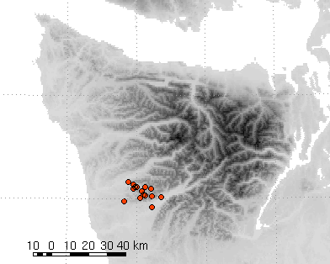
Rain Measurements
Detailed gauge network
SNOTEL
RAWS sites
COOP site
Gauges
Proposed
Existing
Surface ASOS, RAWS and Coop network
Supplemental tipping-bucket style gauges along transect between Quinault and Queets River
Proposed
Supplemental gauges in the Chehalis basin
Ground-based microphysical instruments (Disdrometer, etc.)

Slide 15
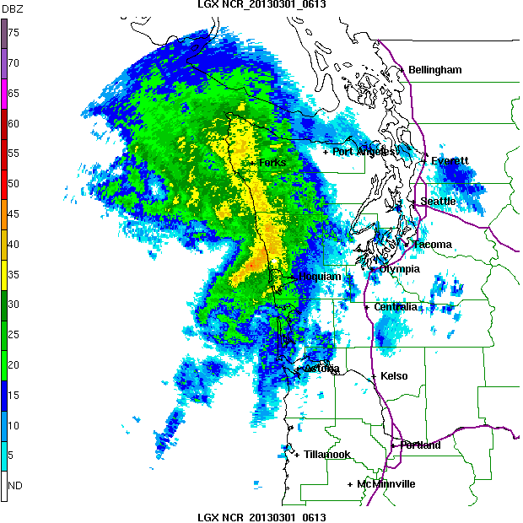
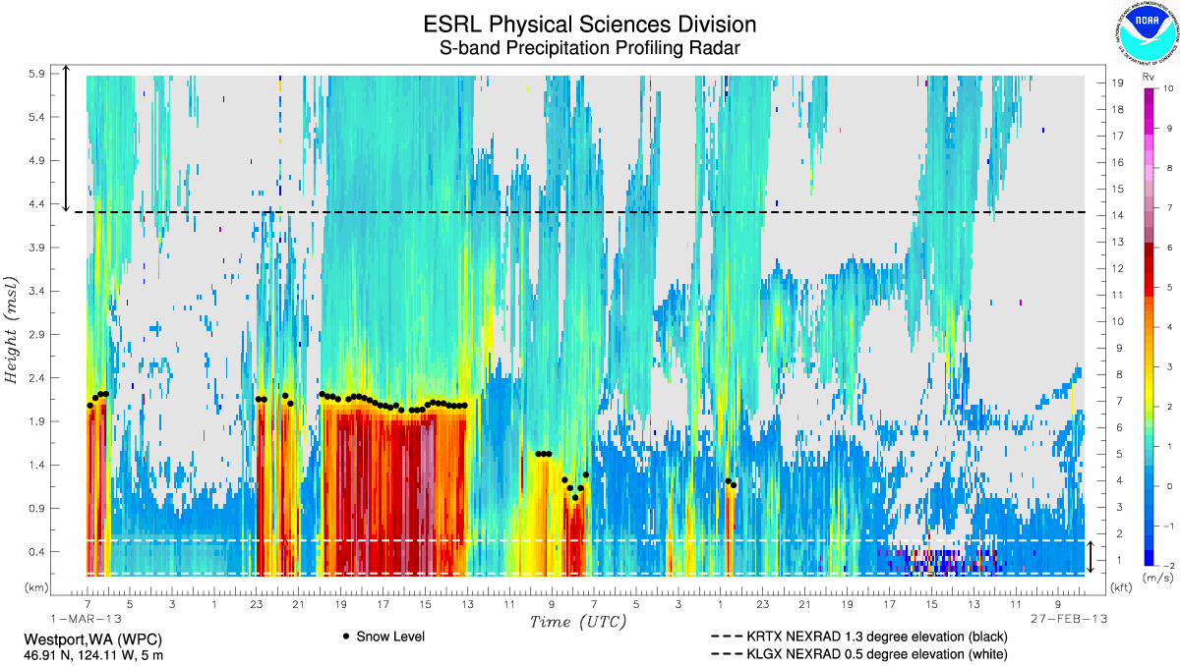
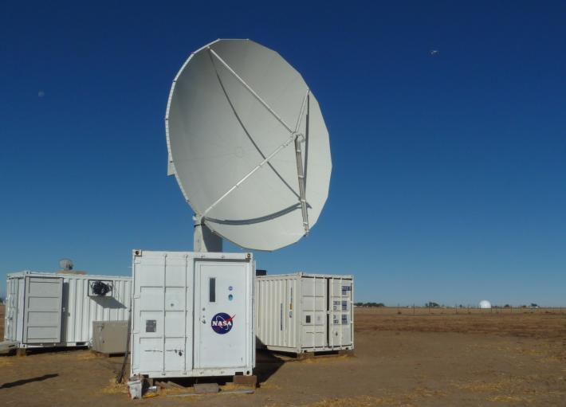
Ground-Based Radar
Atmospheric River Observatory
Npol
Langley Radar
Existing
WSR 88D Dual-Pol at Langley
Atmospheric River Observatory at Westport
Committed for OLYMPEX
NASA S-band NPOL and another NASA provided Radar?
Proposed
DOW (Yuter et al.)
X-band and W-band vertically pointing Radars (McGill)
C-band (? Rutledge)
Npol Proposed
Langley
Westport

Slide 16
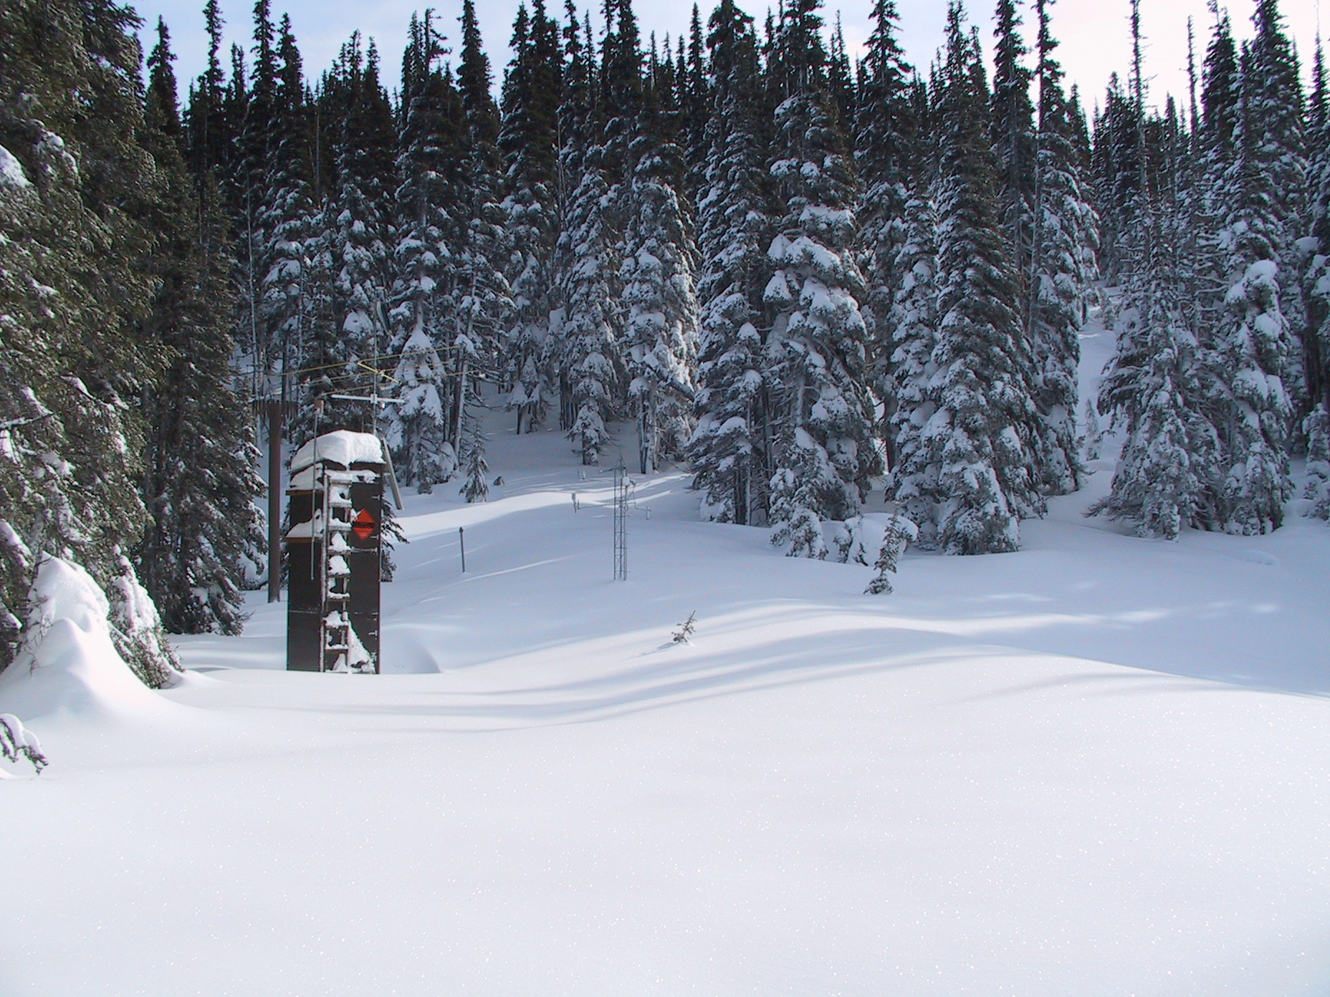
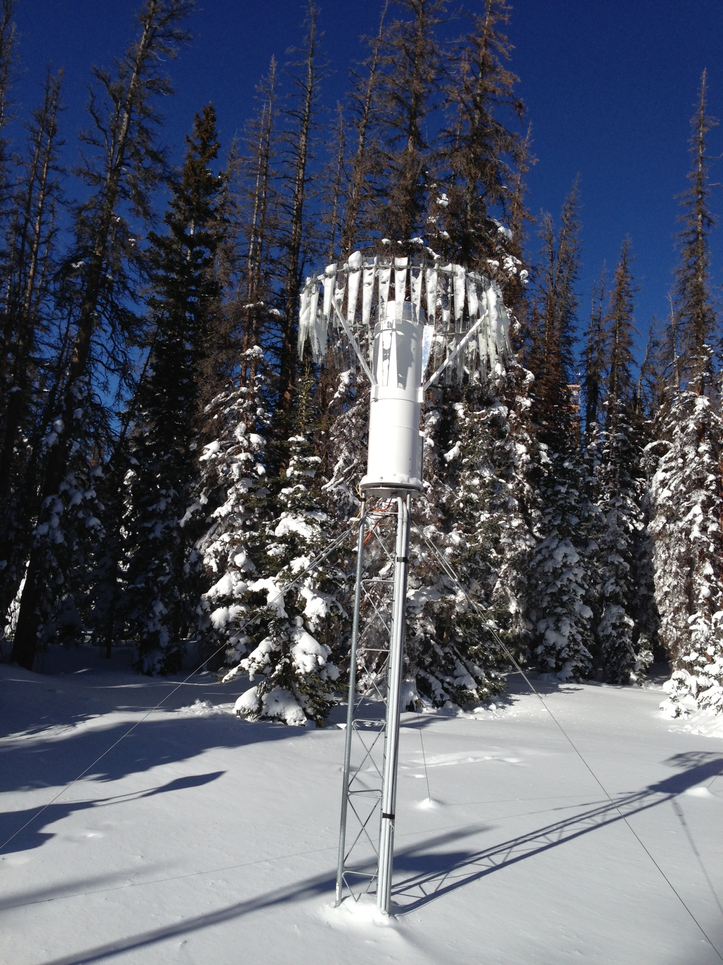
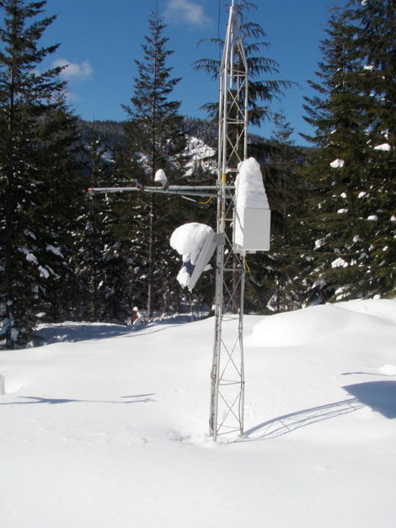
Snow Measurements
Hotplate
Existing
4 SNOTEL Sites – SWE, Precip, Depth, Temp
Buckinghorse 4870’, Waterhole 5010’, Dungeness 4010’, Mt. Crag 3960’
Proposed – snow pack measurements
Helicopter Snow Surveys, time-lapse photography
SNOLITE (cheaper, but no SWE or Precip)
Proposed – microphysical measurements and SWE
Video Disdrometers
Hotplates, Pluvios
Power issues, access for maintenance
Waterhole SNOTEL
Buckinghorse SNOTEL
Sticky Snow

Slide 17

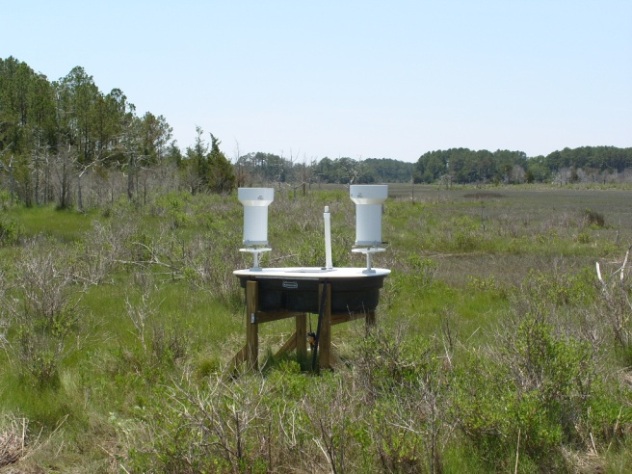
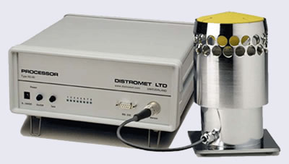

NASA GPM GV Instruments for OLYMPEX (Preliminary)
NASA GV OLYMPEX INSTRUMENTS
Radars: Rain mapping, 4-D precip structure, DSD, rates
NPOL S-band transportable, scanning dual-pol radar
D3R radar: Dual-frequency (KA-KU), dual-polarimetric, Doppler radar.
4 Metek Micro Rain Radars (K-band), vertically pointing
**TOGA C-band Radar (**possible)
Point-Network Disdrometer/Gauges: Precip character/reference
5 - 6 2D Video Disdrometers
16 -20 Parsivel-2 Disdrometer with MetOne 12” TB Rain Gauge
Up to 6 Joss Waldvogel (possible)
20 dual-gauge Met One TB rain gauges with soil T/Q
4 Pluvio2 Weighing Gauges
1-2 PVI-2 (snow video imager)
2 Hot Plates (possibly more; TBD)
Dual-Gauge Net
Precipitation Video Imager (PVI)
JW
From Walter Petersen

Slide 18
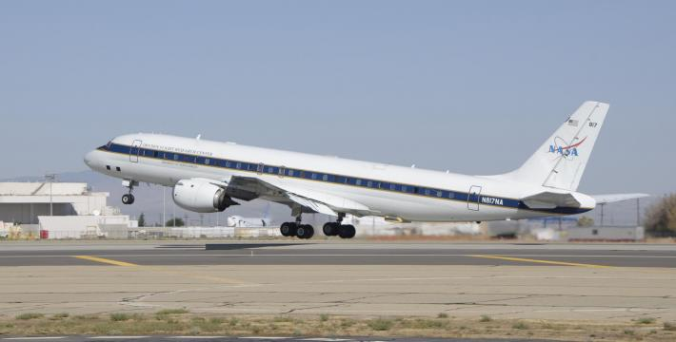
Aircraft
DC-8
Global Hawk
Committed
NASA DC-8: Satellite Simulators (mini-GMI and mini-DPR), dropsondes, some microphysics
North Dakota Citation: microphysics
Proposed (wish list)
NASA ER-2: Upstream conditions, dropsondes, satellite simulators
Wyoming King Air: microphysics, W-band radar
Canadian NRC Convair: state-of-art microphysics
NASA Global Hawk: Satellite simulators, dropsondes

Slide 19
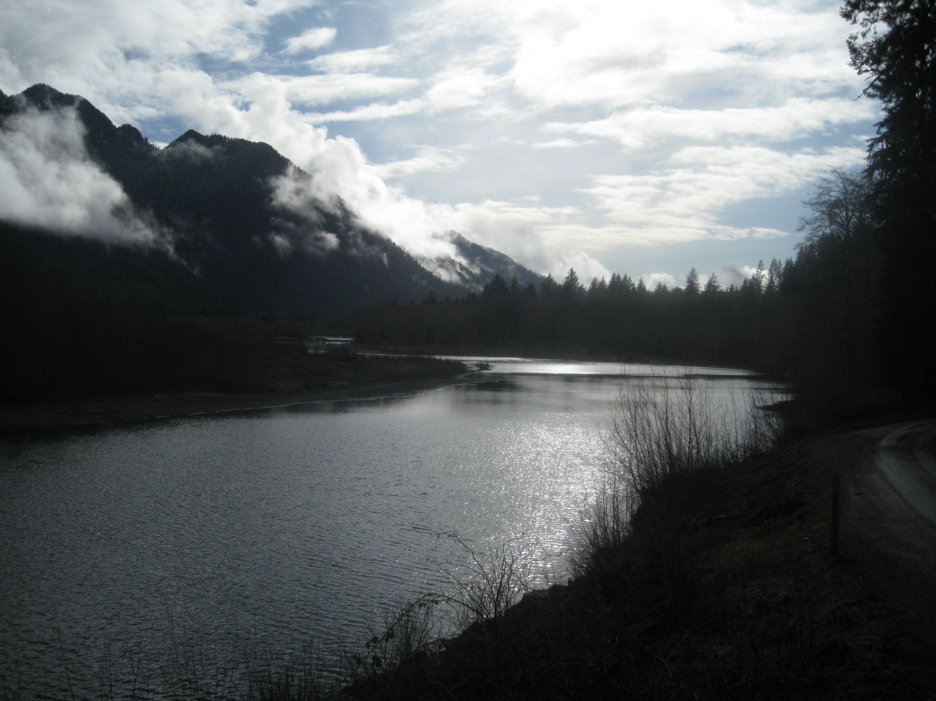
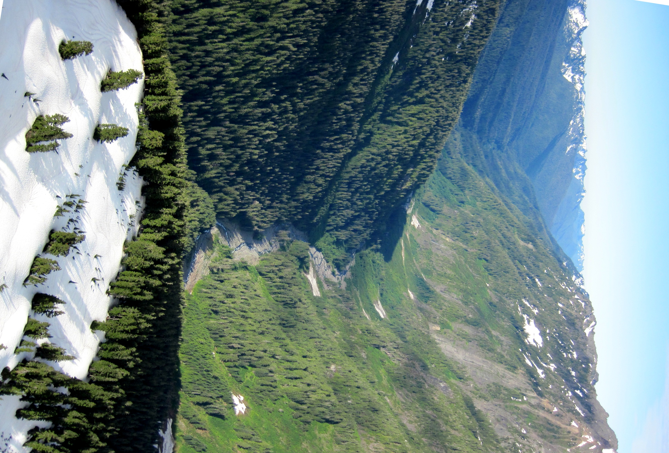
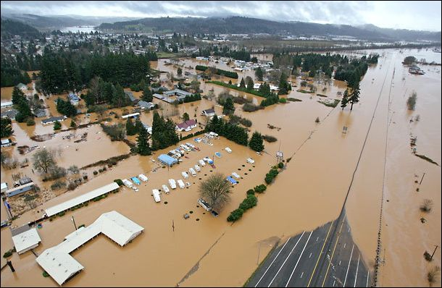
Hydrological Applications of GPM
One of the main goals of GPM is to provide precipitation estimates for input into hydrological applications such as forecasting flood events and water supply. OLYMPEX will focus on the Quinault and Chehalis basins
The Quinault has its’ headwaters in high elevation and drains the SW Olympics
Major flooding on the Chehalis, a low elevation basin which drains the SW Olympics and lower terrain to the SE
Notes:
Point out – another hydro apllication is to address the entire snowfield on top of Olympics – Water supply – circle around olympics to remind me – scale addressable by footprint of satellite

Slide 20
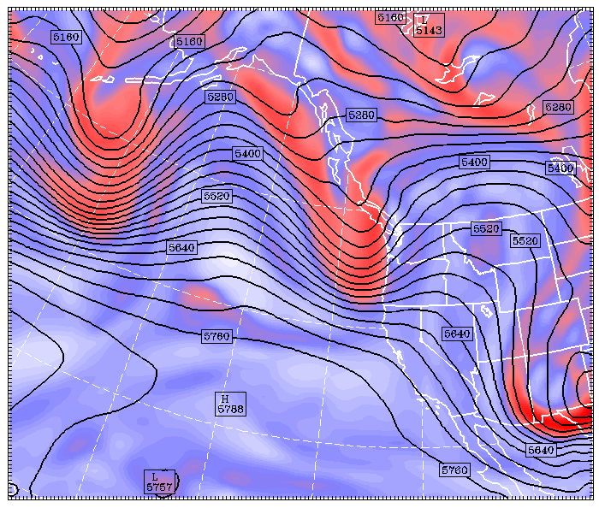
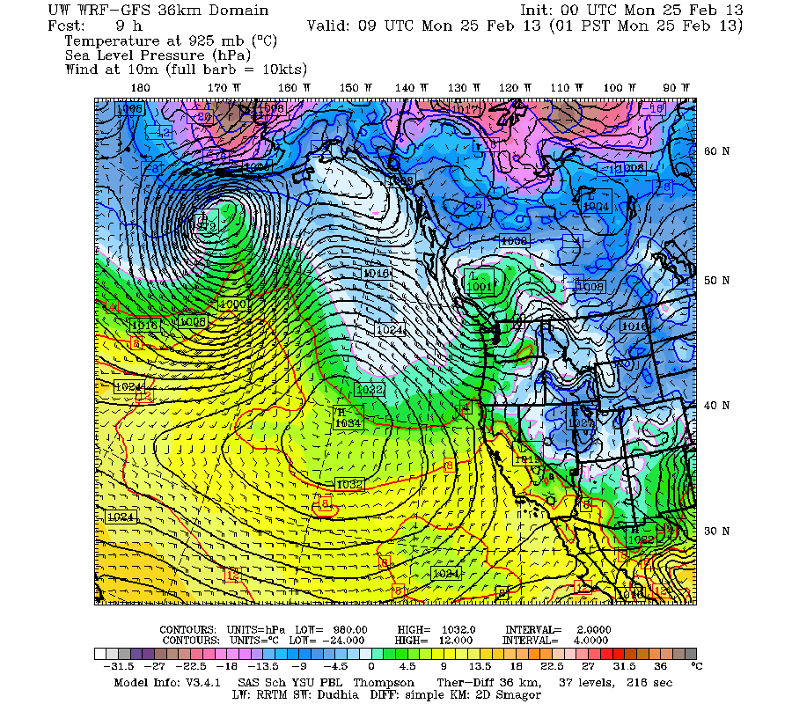
Modeling component of OLYMPEX
Mesoscale numerical model has been run real time for the Pacific Northwest for 15+ years.
Run for 2 forecast cyclones at several resolutions: see http://www.atmos.washington.edu/mm5rt.
The output will be crucial for operations support during the OLYMPEX field phase.
Higher resolution runs (4 km and 1.3km) will be used for precipitation processes in complex terrain, developing algorithm physics, and estimating snowpack accumulation where observations don’t exist.

Slide 21
OLYMPEX Summary
Ground Validation (GV) Field Campaign on the Olympic Peninsula Nov 2015 – Jan 2016
Provide Physical Validation for rain and snow algorithms for the GPM GMI and DPR instruments
Document precipitation processes and structures in land-falling cyclones and their modification over complex terrain.
Test hydrologic applications (water supply, and flooding) of GPM
Will consist of ground-based measurements of rain and snow, aircraft and radar measurements
Challenges: Remote area, power issues, operations within designated wilderness areas.
Opportunities: In order to fulfill GPM’s mission objectives of measuring precipitation world-wide, over a wide range of intensities, and a broad range of regimes, a field program such as OLYMPEX is necessary.

Slide 22


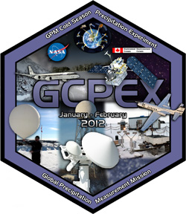

Past GV Campaigns for GPM
LPVEx: Light Precipitation Evaluation. Gulf of Finland. Sept-Oct. 2010. High latitude, low freezing level precipitation regime.
MC3E: Midlatitude Continental Convective Clouds Experiment. Central Oklahoma, April-June 2011.
GCPEX: GPM Cold-Season Precipitation Experiment in Ontario, Canada. Jan 15 – Feb 26, 2012.
Ifloods: Iowa Flood Studies. April – June 2013. Integrated Hydrologic Ground validation
HMT – SE: HydroMeteorological Testbed in the SouthEast. North Carolina, Summer 2014 – After Launch

Slide 23
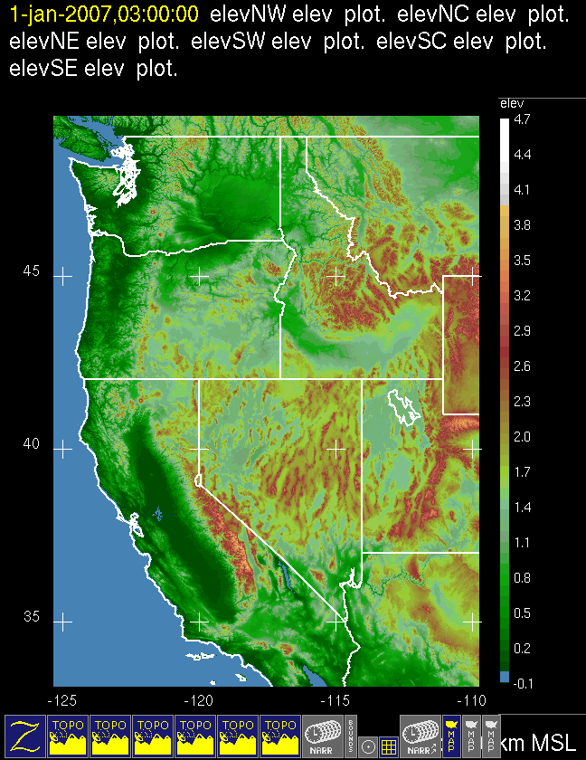
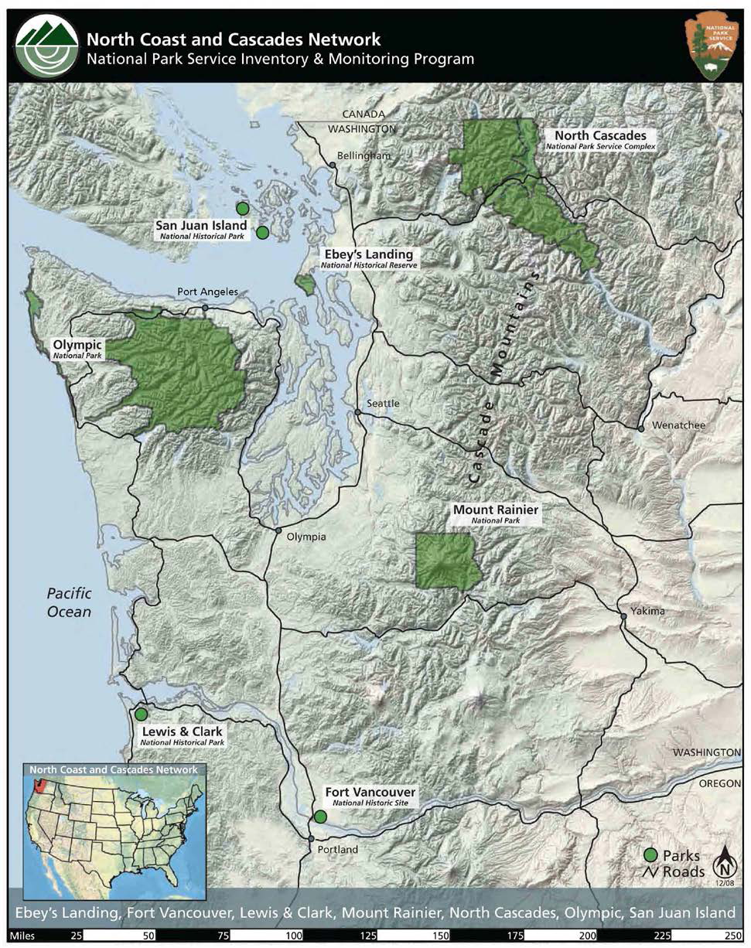
Where is the Olympic Peninsula???
Quillayute
Hurricane Ridge
Waterhole
Clearwater
Buckinghorse
The Quinault
The Upper Chehalis
Quinault Reservation
National Forest Service Wilderness Area

Slide 24
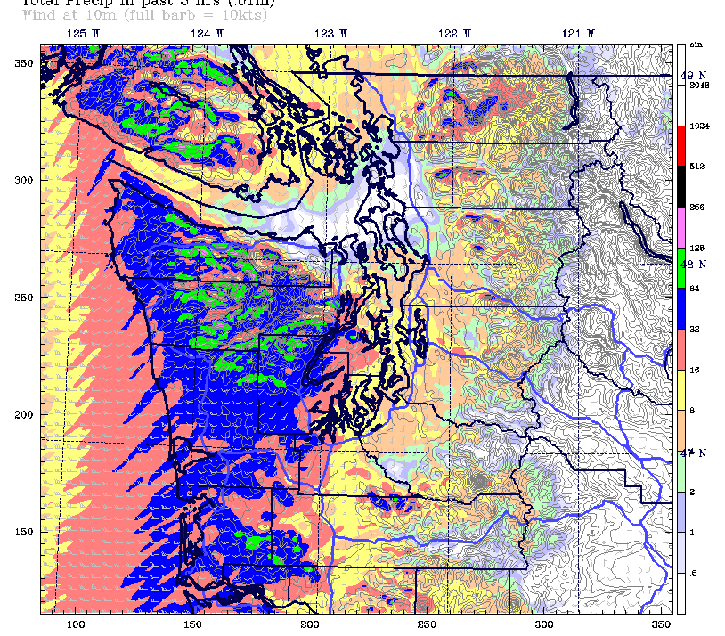
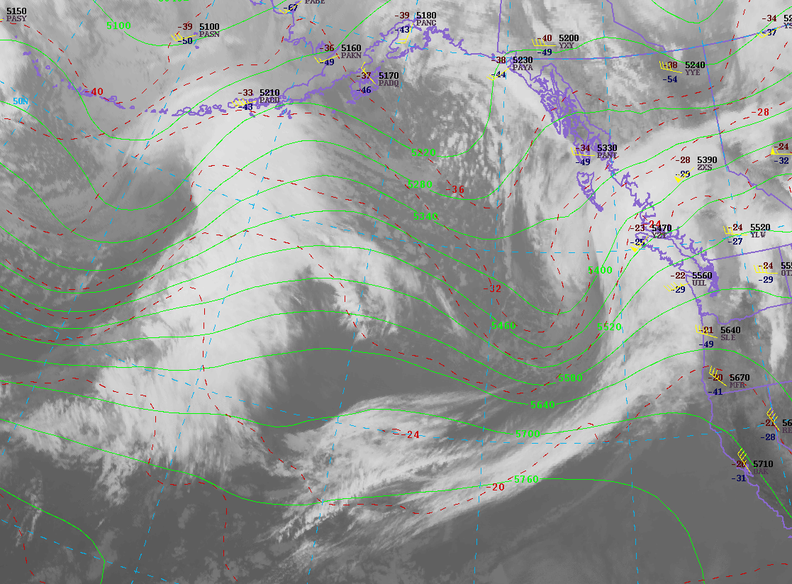
Modeling component of OLYMPEX
1.3 km forecast of 3hr Precip valid 9 UTC 25 Feb 2013
36 km 9-h forecast of SLP + Temp and winds
36 km 9-h forecast of SLP + Temp and winds
1.3 km forecast of 3hr Precip valid 9 UTC 25 Feb 2013
IR Image + 500 heights + obs. for 00 UTC 25 Feb 2013
IR Image + 500 heights for 00 UTC 25 Feb 2013
Observations and forecasts for a typical land-falling cyclone affecting the Olympic Peninsula. Note the forecast of strong westerly winds along the Washington and Oregon coasts and the strong enhanced precipitation forecast for the western and southwestern slopes of the Olympics and the maximum precipitation along the windward slopes of the highest terrain

