Slide 1

Observations of Convection in the MJO—TOGA COARE, TRMM, & DYNAMO
Robert Houze
University of Washington
(With Hannah Barnes, Manuel Zuluaga,
and Angela Rowe)
MJO Workshop, George Mason University, Fairfax, Virginia, 9 June 2013
Notes:
The midlevel inflow to the sf region is an imp part of the MCS circulation.

Slide 2
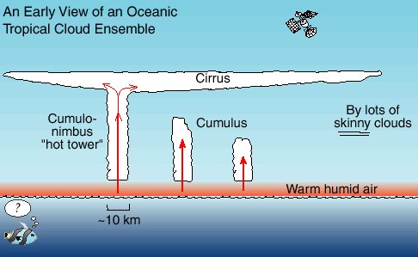
Prevailing view of tropical convection in the early 1970’s
Satellite view of the tropical cloud population

Slide 3
Post-GATE view of the tropical cloud population
Houze et al. (1980)

Slide 4
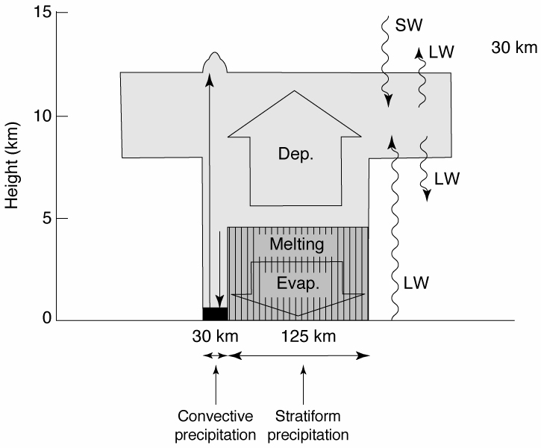
Heating and cooling processes in a mesoscale system
Houze 1982
Notes:
Top heavy

Slide 5
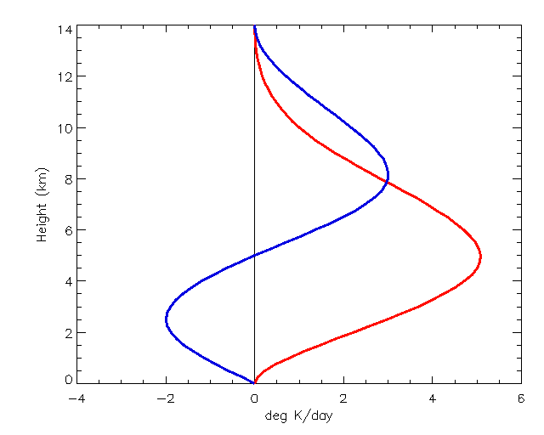
Mesoscale System Heating Profiles
Stratiform
Height (km)
Convective
Schumacher et al. 2004
Deg K/day
Notes:
The blue curve is applied to the stratiform fraction of the precipitation at the given pixel. Go to next slide.

Slide 6
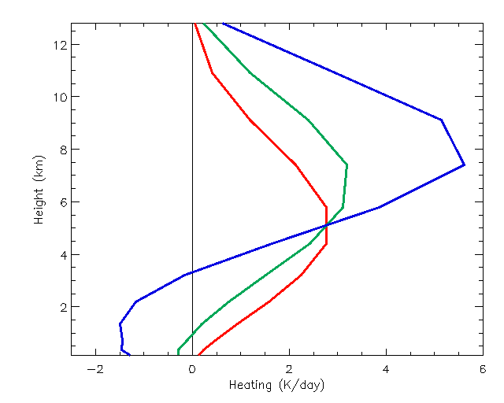
Mesoscale System Heating Profiles
70% stratiform
40% stratiform
Height (km)
0% stratiform
Deg K/day
Schumacher et al. 2004
Notes:
70% stratiform precipitation at a pixel yields the blue profile, which has a higher maximum than the 0% or 40 % stratiform profiles. Note also how the increased stratiform percentage yields a stronger vertical gradient of heating at upper levels and hence greater generation of potential vorticity. This shows how an increase in the stratiform rain fraction leads to a stronger circulation at upper levels.

Slide 7
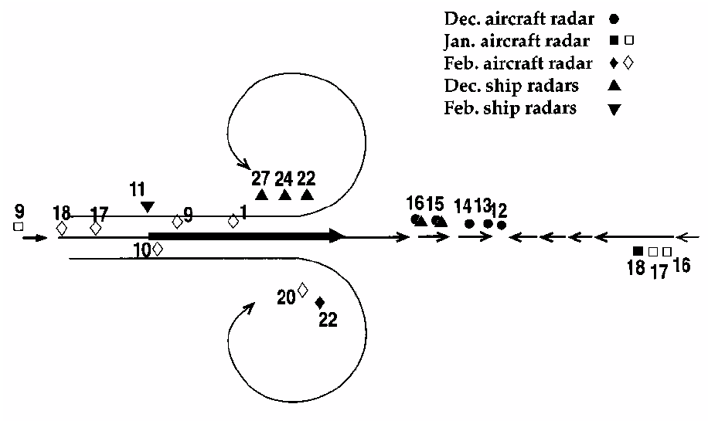
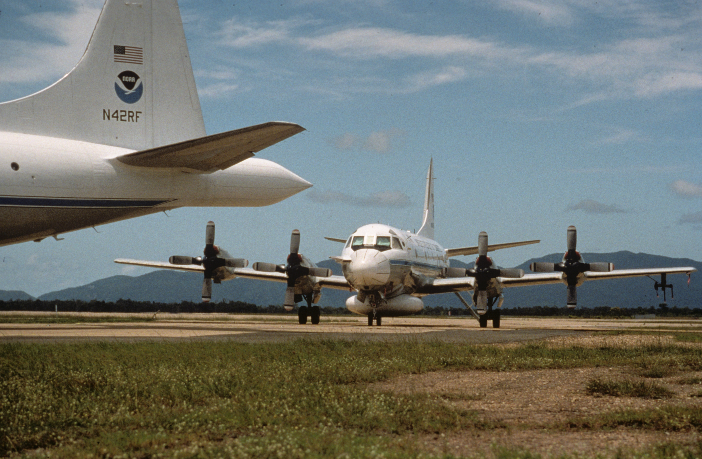
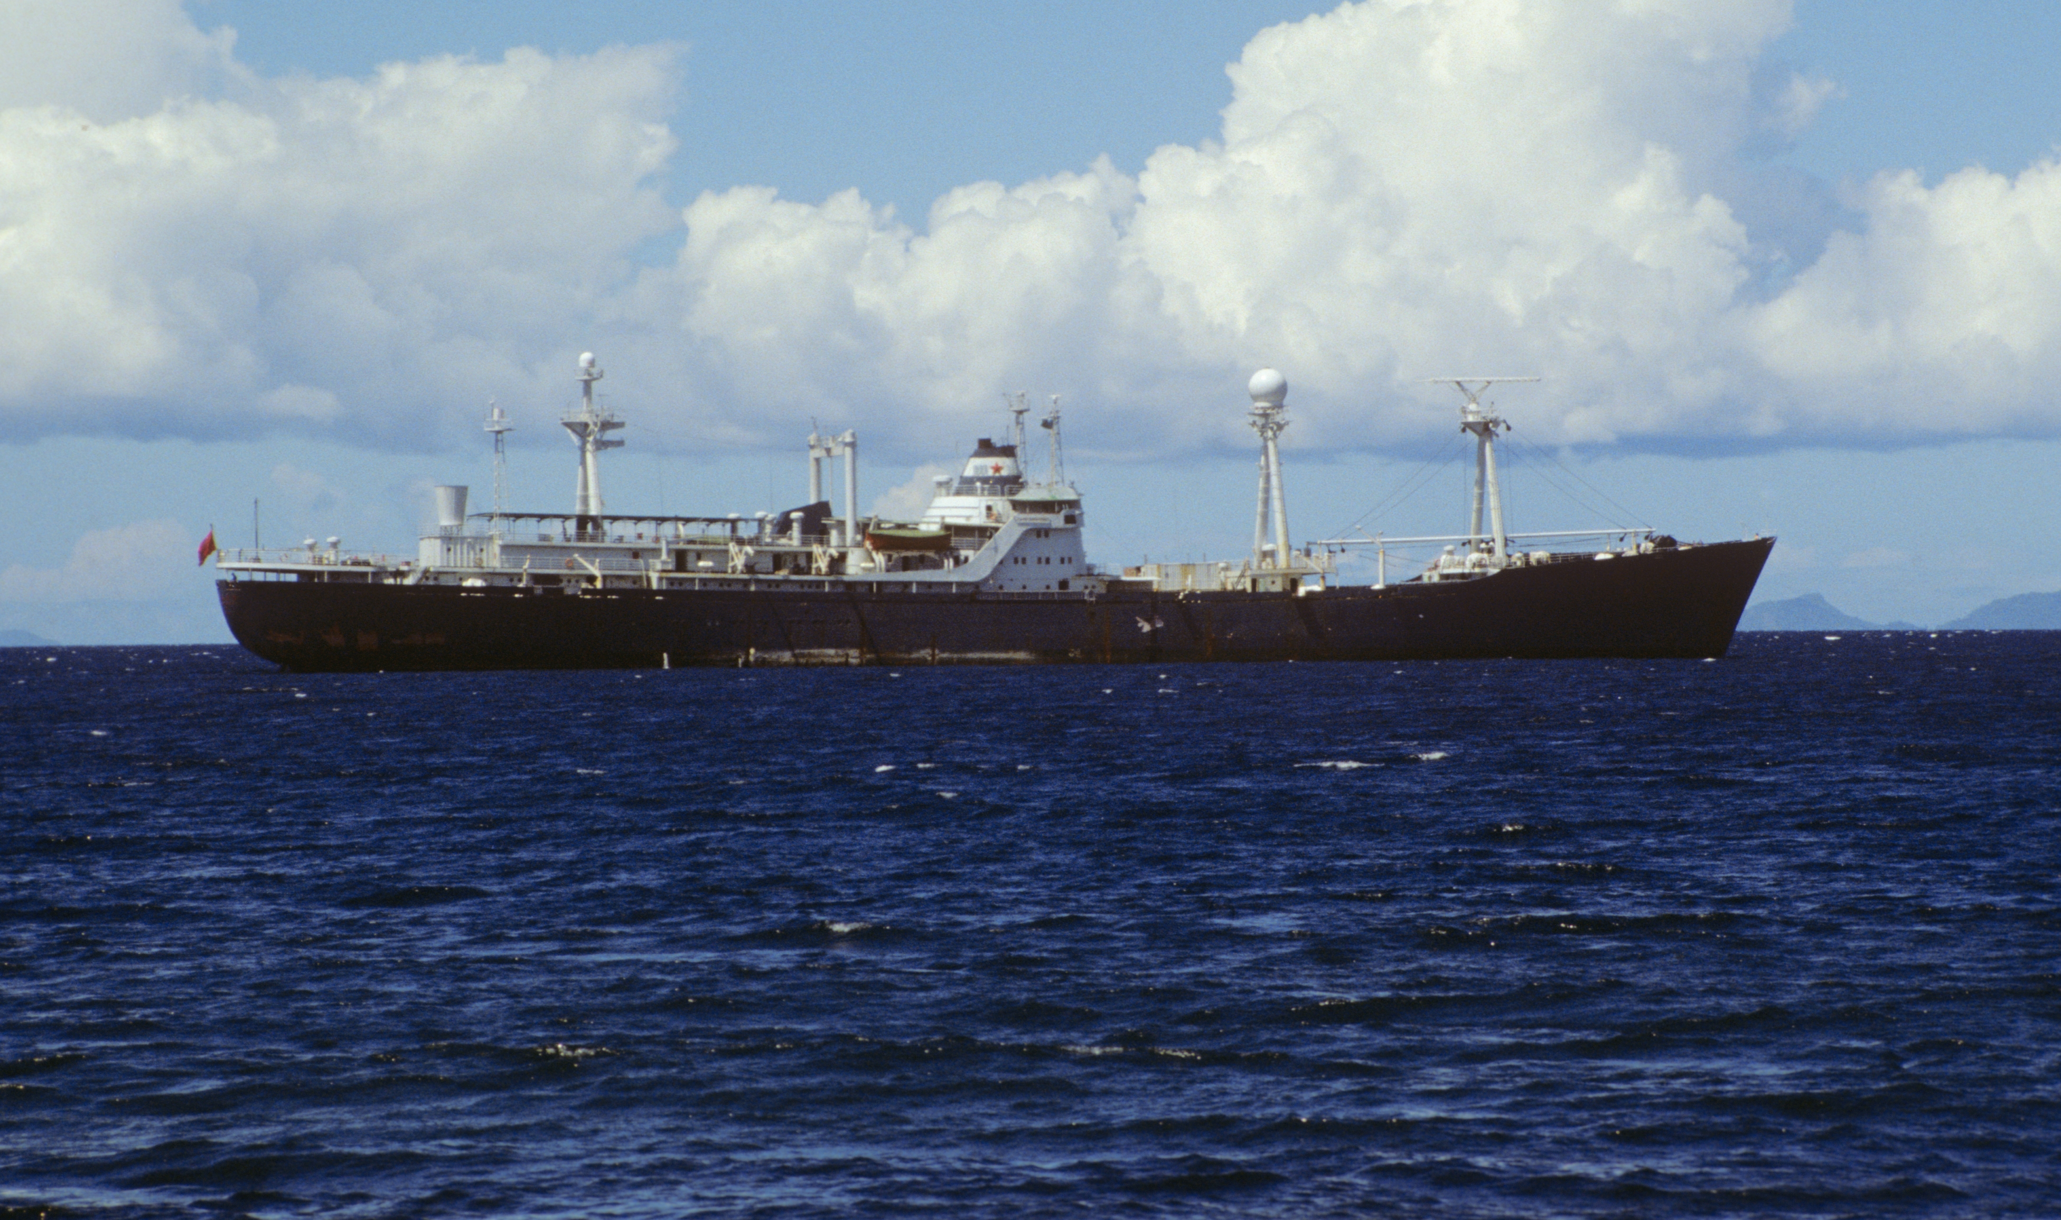
TOGA COARE → Doppler radar sampling relative to the MJO
Rossby
Gyres
Kelvin Wave
Convergence
Houze et al. (2000)

Slide 8
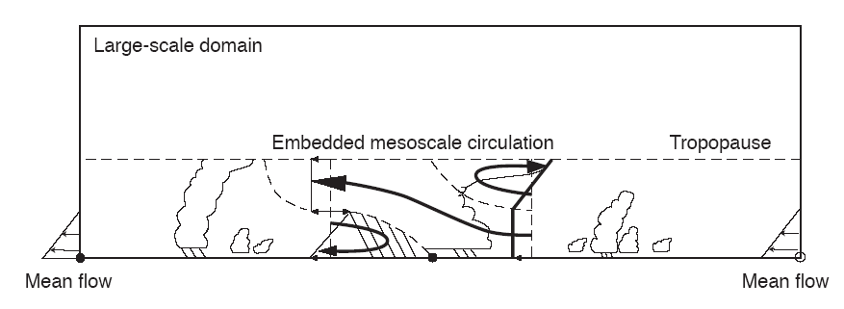
Verified Moncrieff’s Mesoscale Layer Model of Tropical Convection…
Moncrieff 92

Slide 9
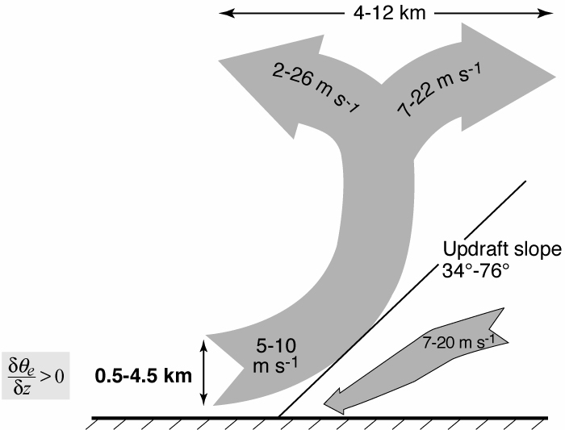
TOGA COARE Airborne Doppler Observations of MCSs…
25 convective region flights
<
Kingsmill & Houze 1999
Notes:
KH studied data from ___ flights around the conv regions of MCSs and found a deep layer of uplift. The layer lifting consisted of pot. Unstable air.

Slide 10
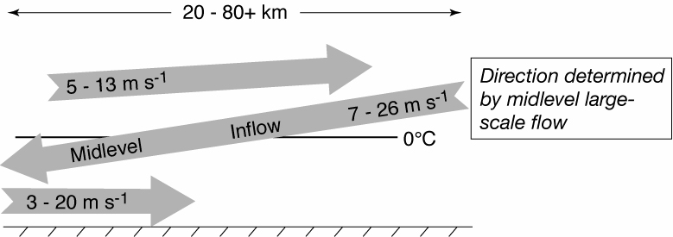
TOGA COARE Airborne Doppler Observations of MCSs…
25 stratiform region flights
Kingsmill & Houze 1999
Notes:
The midlevel inflow to the sf region is an imp part of the MCS circulation.

Slide 11
Now we can add the mesoscale circulation…
Midlevel inflow
Layer inflow
Houze 1982
Notes:
From the distributin of heating and cooling in the sf region we expect mid level convergence.

Slide 12
What’s the PDF of the members of the population?
Houze et al. (1980)

Slide 13
What’s the PDF of the members of the population?
Use 3D radar data to identify:
Shallow isolated echoes (3D convective echo with top < 5 km )
Deep convective cores (3D convective echo >30 dBZ, tops >8 km)
Wide convective cores (3D convective echo >30 dBZ, area >800 km²)
Broad stratiform area (stratiform echo > 50 000 km²)
Use 3D radar data to identify:
Shallow isolated echoes (3D convective echo with top < 5 km )
Deep convective cores (3D convective echo >30 dBZ, tops >8 km)
Wide convective cores (3D convective echo >30 dBZ, area >800 km²)
Broad stratiform area (stratiform echo > 50 000 km²⁾

Slide 14
TRMM says the PDF varies with phase of the MJO…
Isolated, Shallow Echoes
Deep Convective Cores
Broad Stratiform Regions
Active
Suppressed
Barnes and Houze 2013

Slide 15
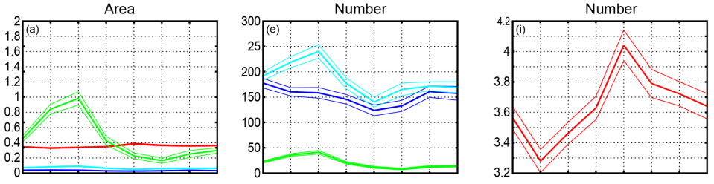
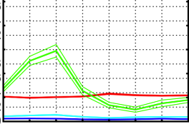
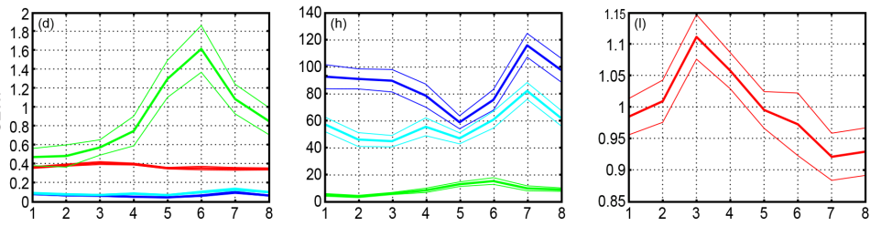
Indian Ocean
%
x10⁴
ISE
DCC
WCC
BSR
x10^4
WIndian
Active
250
MJO Phase
SE West Pacific
%
x10⁴
Area
Number
Number
Active
MJO Phase

Slide 16
DYNAMO is showing how various scales of motion affect the MJO cloud population

Slide 17
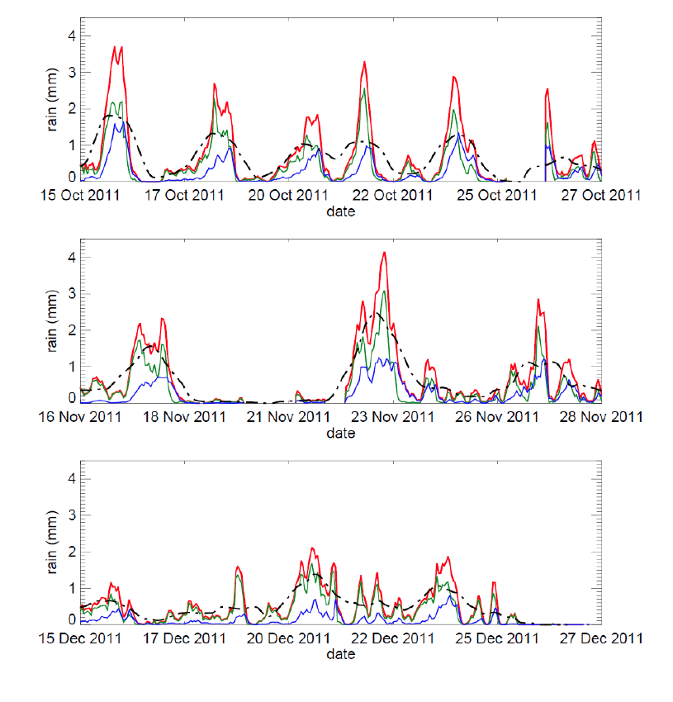
October Active Period
ACTIVE PERIODS ARE EPISODIC
Rain (mm)
November Active Period
Rain (mm)
Rainfall concentrated into 2-4 day episodes
December Active Period
Rain (mm)
Zuluaga and Houze 2013

Slide 18
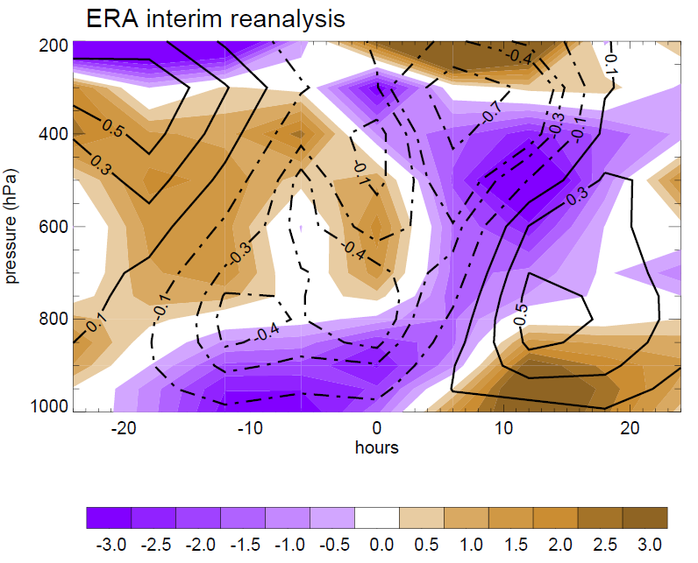
Composite large-scale divergence and vertical motion during 2-day rainfall episodes
Zuluaga and Houze 2013

Slide 19
Composite large-scale divergence and vertical motion during 2-day rainfall episodes
Gan soundings
ERA interim reanalysis
Zuluaga and Houze 2013

Slide 20
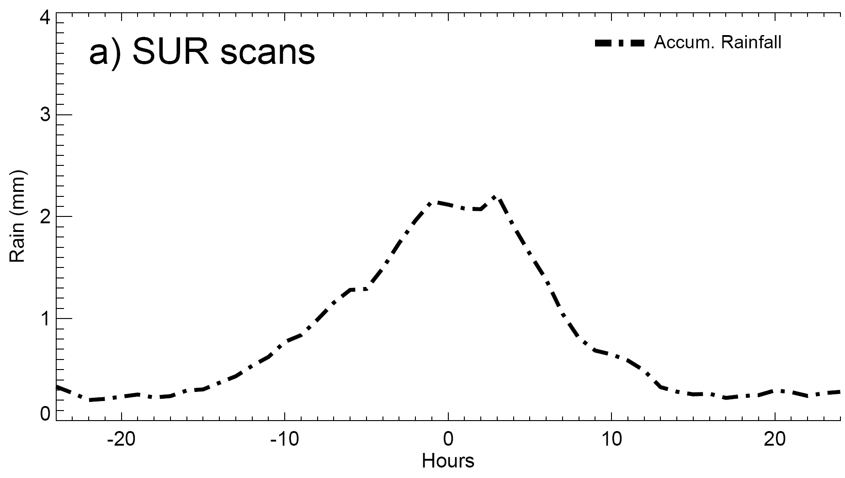
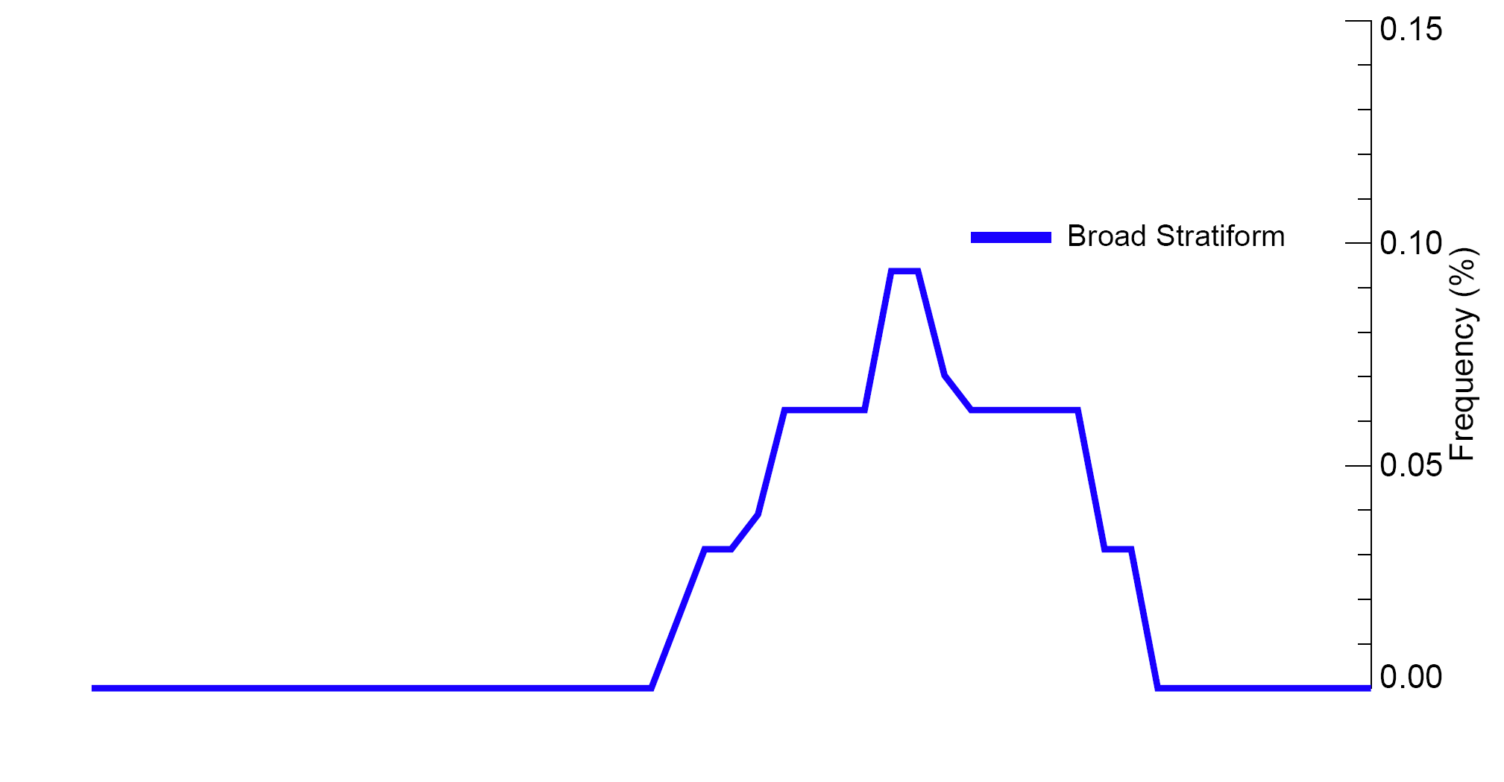
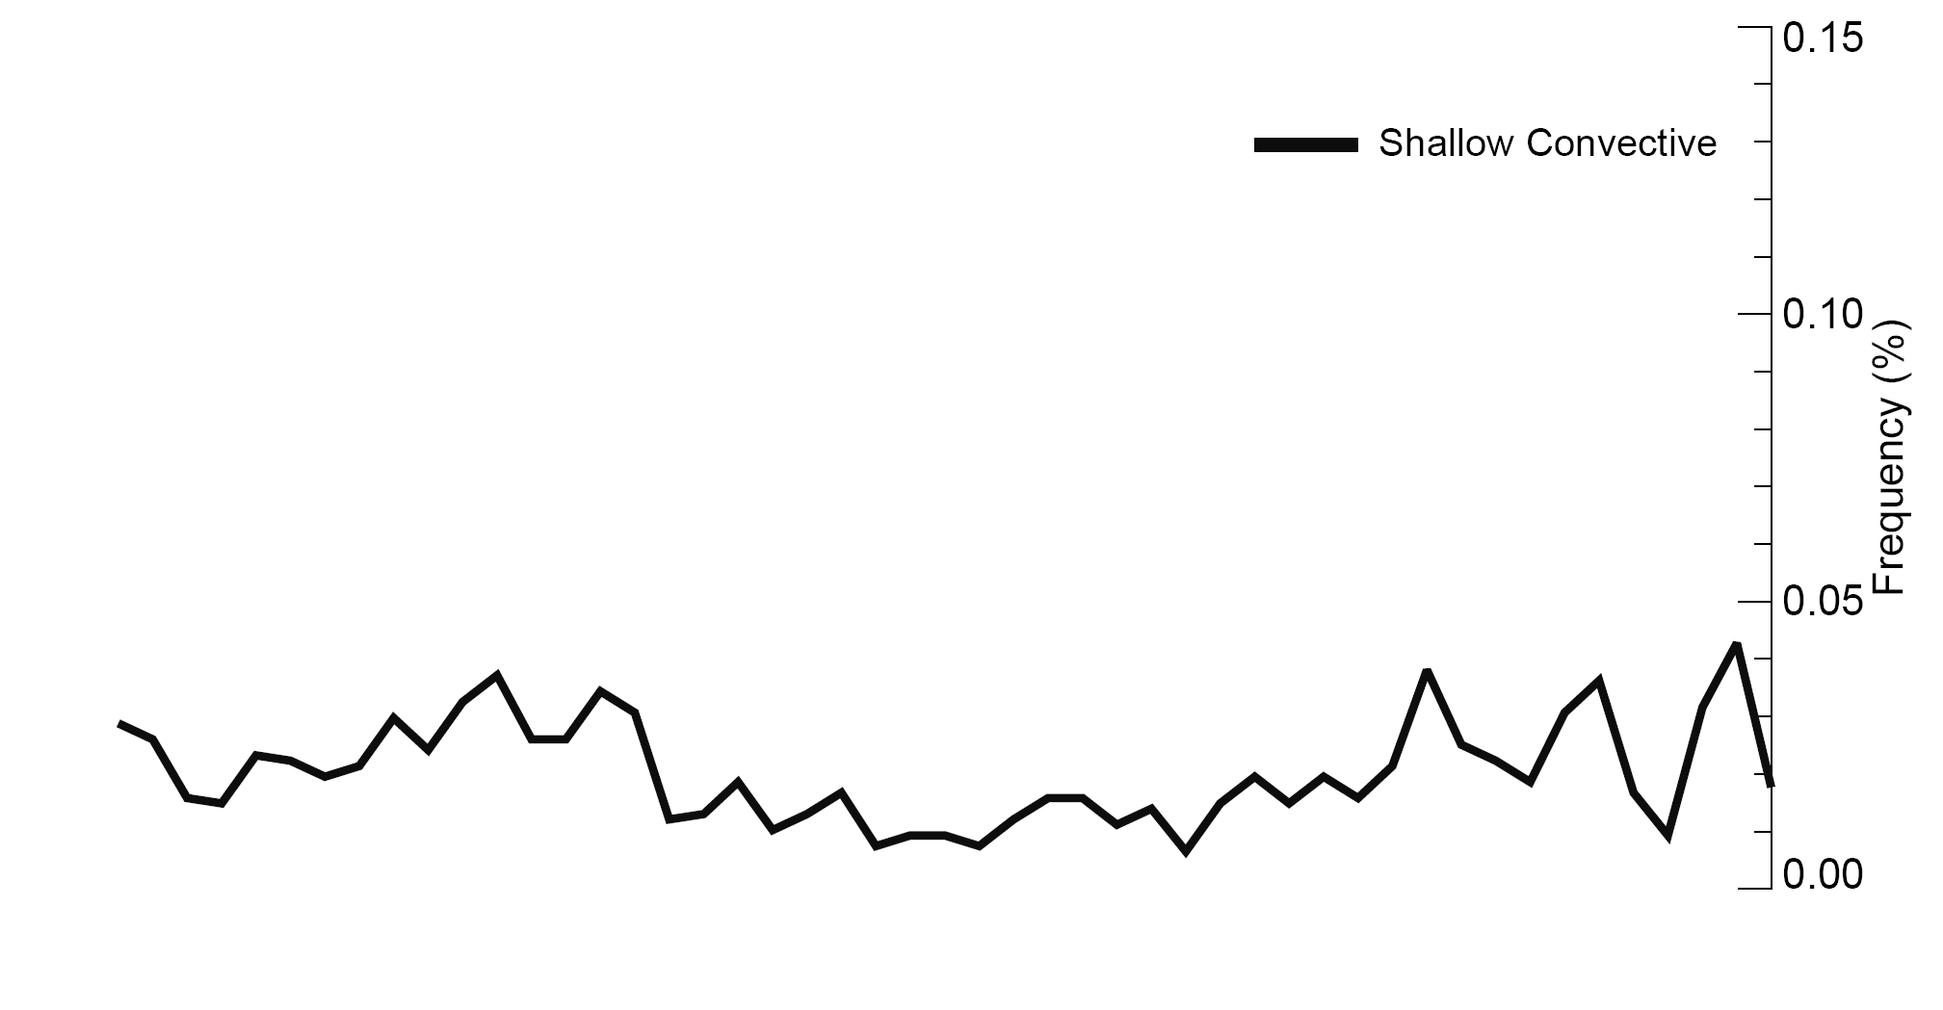
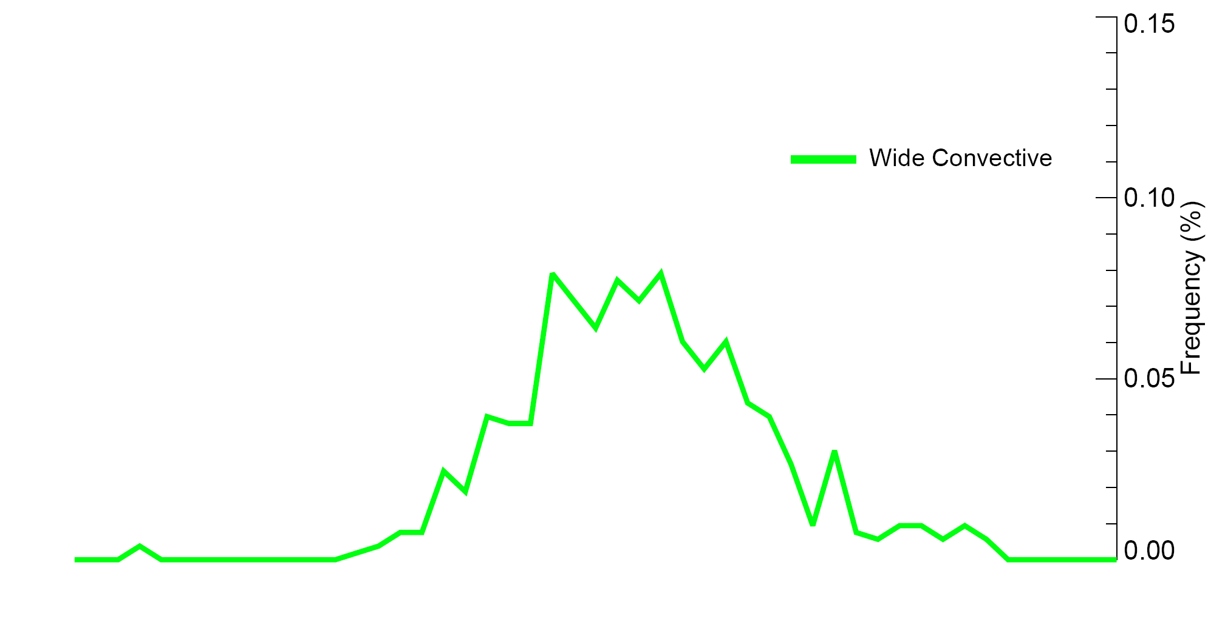
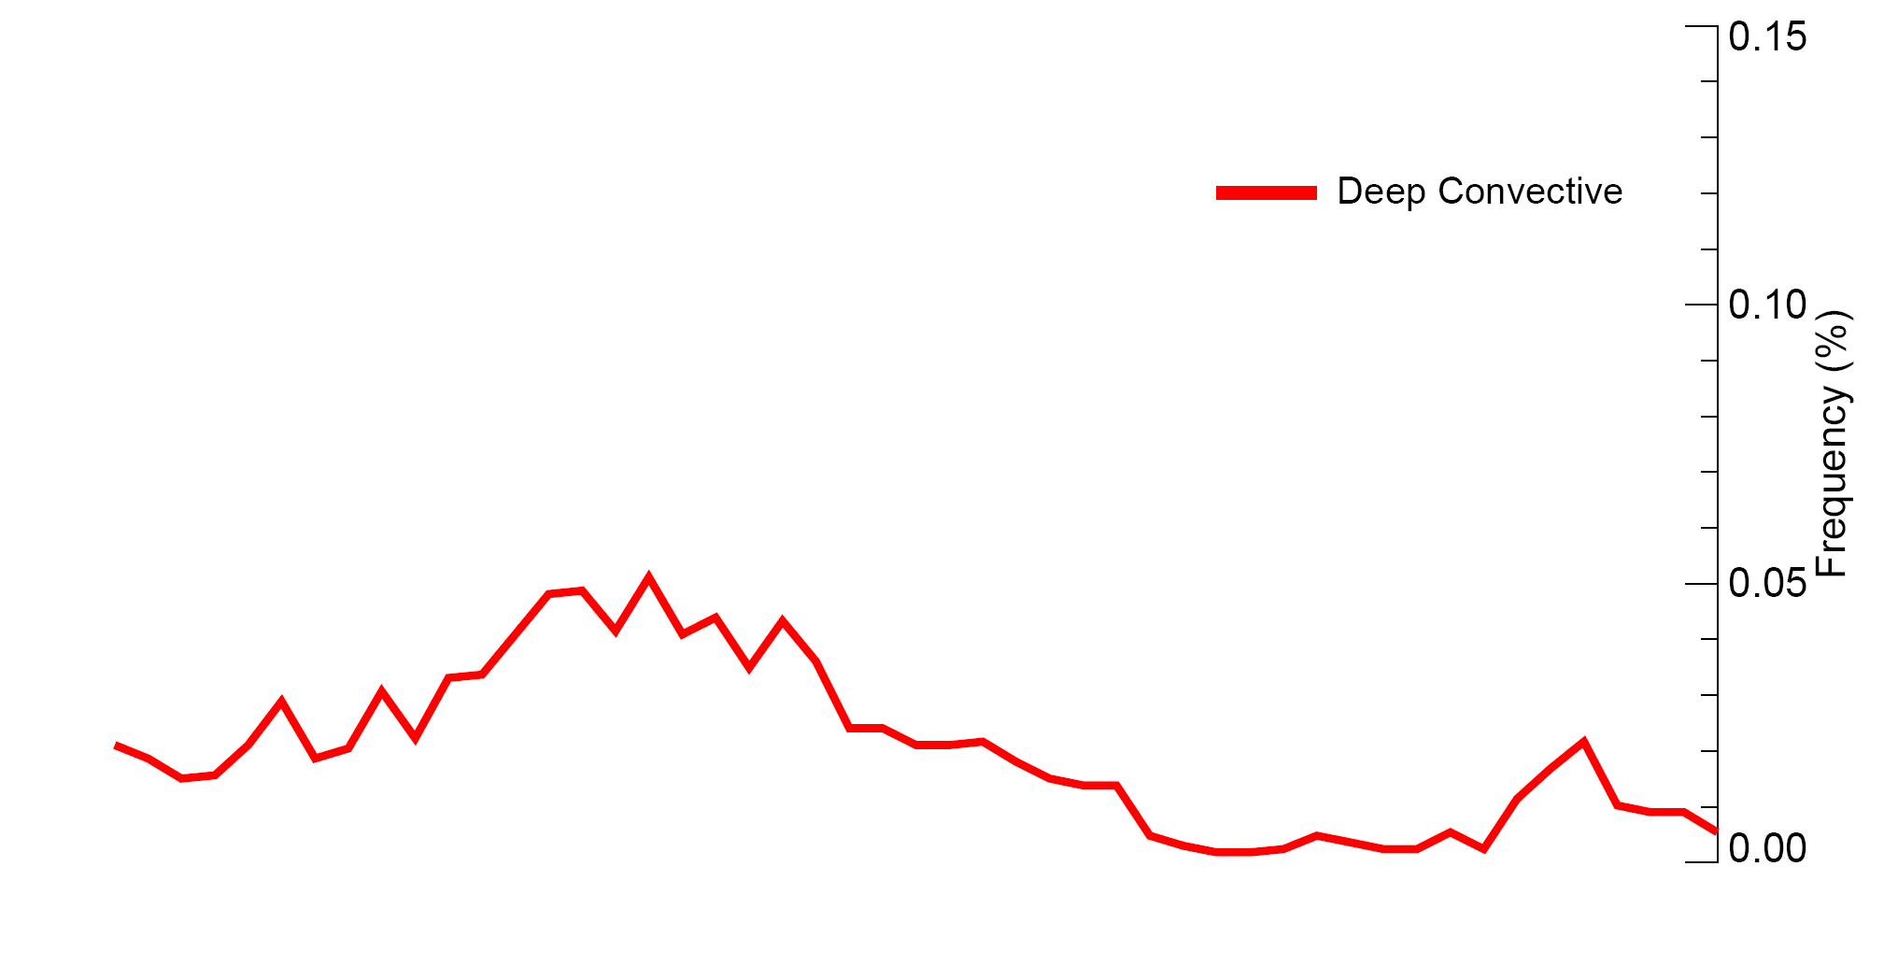
Variation of the DYNAMO radar echo population during a rain episode
Composite of all 2-day rainfall episodes
Zuluaga and Houze 2013

Slide 21
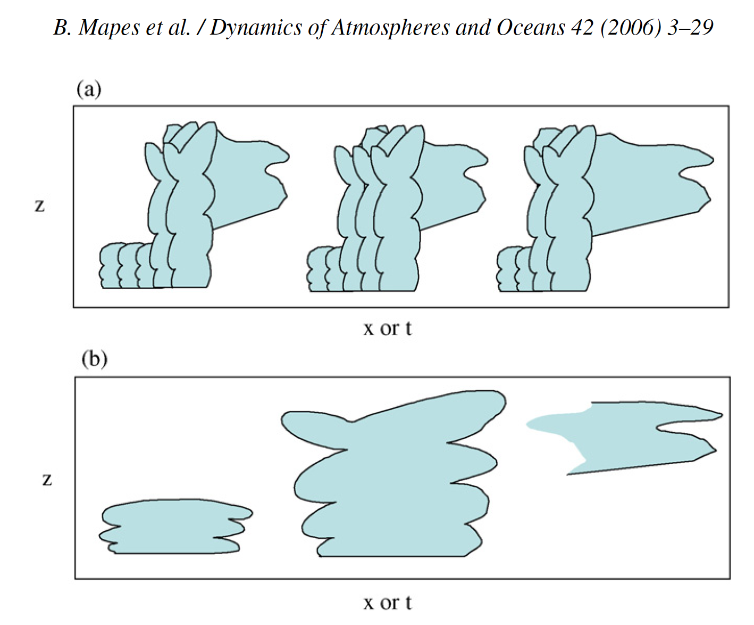
Stretched Building Block Hypothesis
Mapes et al. 2006
Cloud population at three different times
Large-scale wave structure at the same times

Slide 22
SUMMARY of TRMM results
Similarities of Indian Ocean and West Pacific regions→
Isolated shallow convection ever-present—max number in suppressed phases
Broad stratiform rain areas dominate area coverage variability—max in active to post active phases
Differences between IO and WP→
Deep and wide intense convection peaks with broad stratiform in IO but after broad stratiform in WP—maybe related to large-scale shear and humidity
Notes:
The midlevel inflow to the sf region is an imp part of the MCS circulation.

Slide 23
SUMMARY of DYNAMO results
Active periods are episodic→
Rain occurs in 2-4 day bursts—suppressed in between
Echo population (PDF) evolves→
Peaks of ISE, DCC, WCC, & BSR echoes occur in order
Cloud population evolution occurs over 2-4 day period of the rain episode (i.e. not on an MJO time scale)
Episodes have scale of waves on time scale of a few days→
Wave structure aligns with cloud population evolution
Suggestive of stretched building block behavior
Notes:
The midlevel inflow to the sf region is an imp part of the MCS circulation.

Slide 24
Mesoscale Dynamics & Microphysics

Slide 25
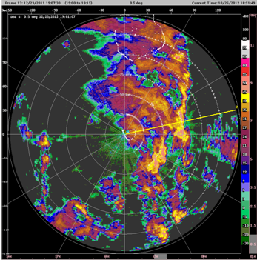
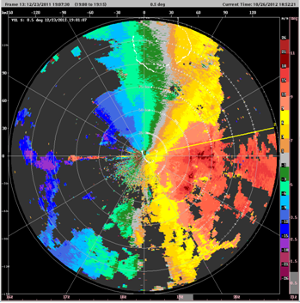
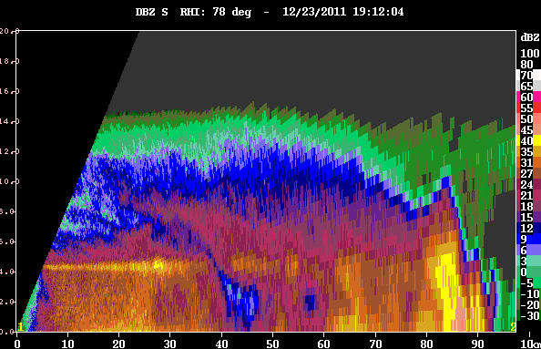
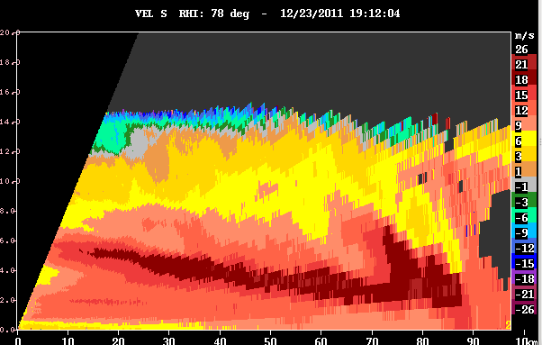
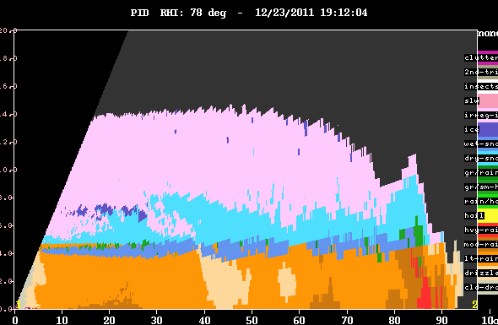
All mesoscale systems are not alike…
S-PolKa on 23 December 2011
Z
V
PID

Slide 26
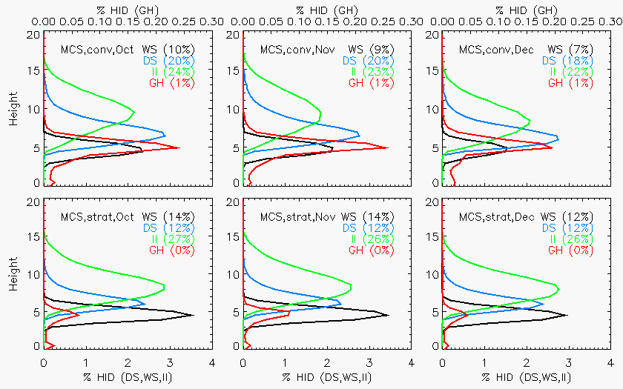
Microphysics are pretty constant…
October
November
December
Convective
Convective
Convective
Small ice
Dry snow
Melting snow
Graupel
Stratiform
Stratiform
Stratiform

Slide 27
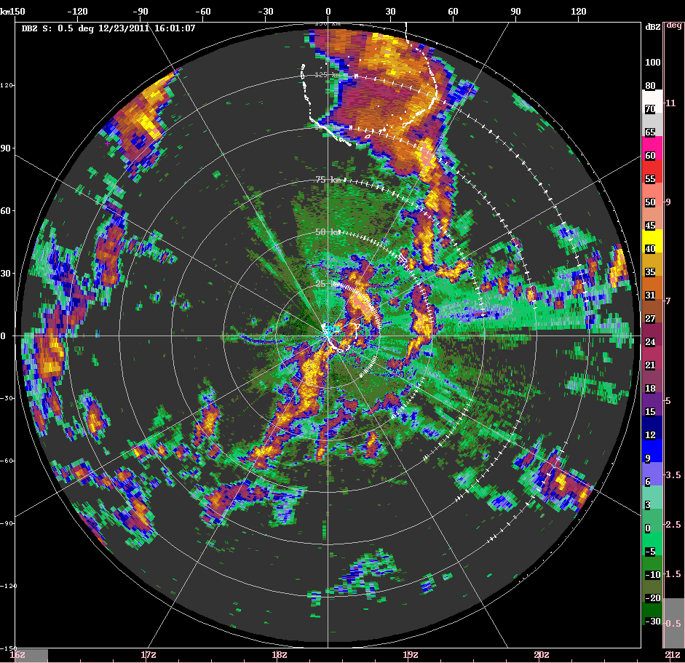
23 December 2011

Slide 28
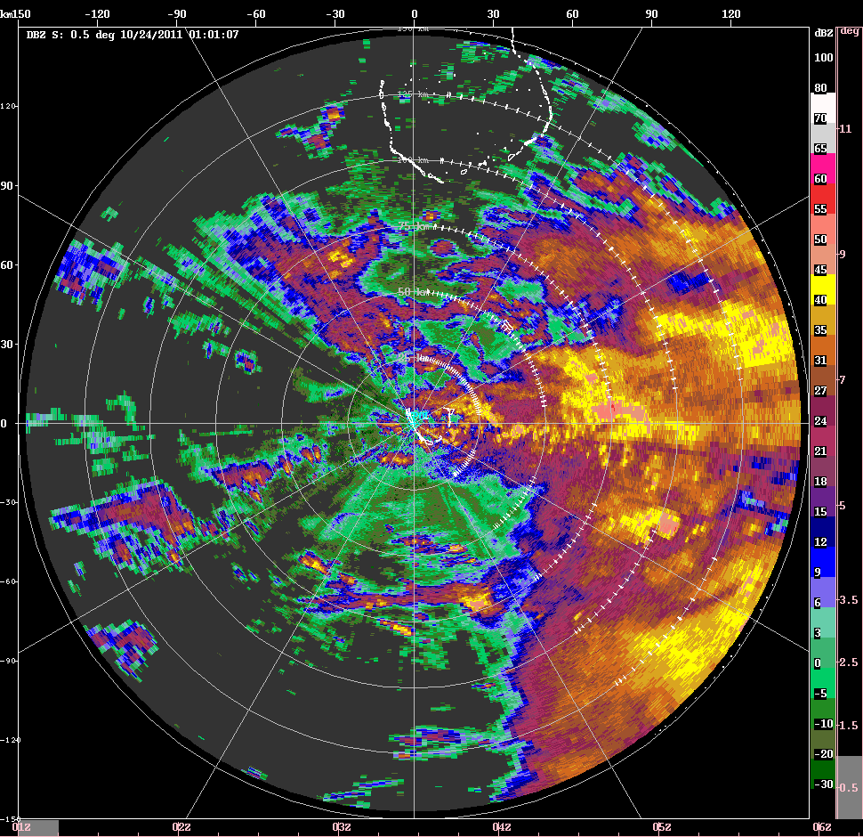
24 October 2011

Slide 29
End
This research was supported by
NASA grant NNX10AH70G
NSF grant AGS-1059611
DOE grant DE-SC0008452

