Slide 1

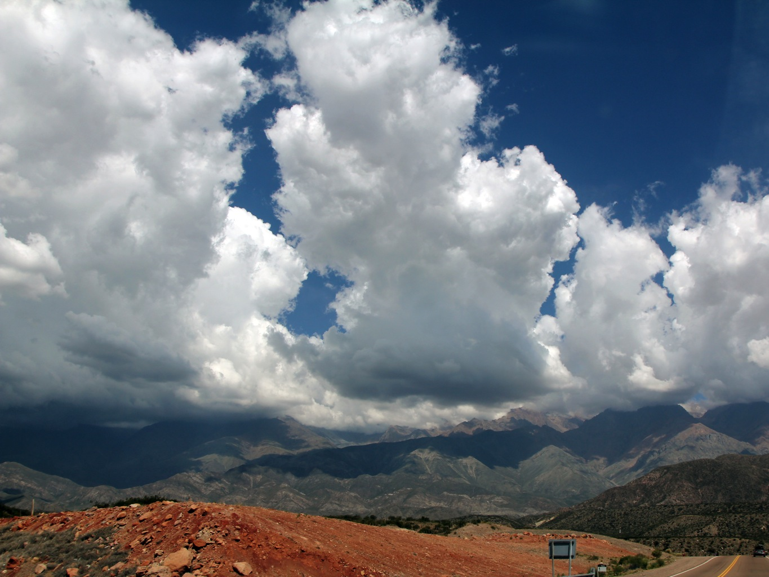
Orographic triggering and mesoscale organization of extreme storms in subtropical South America
Kristen Lani Rasmussen
Robert A. Houze, Jr.
ICAM 2013, Kranjska Gora, June 6th

Slide 2
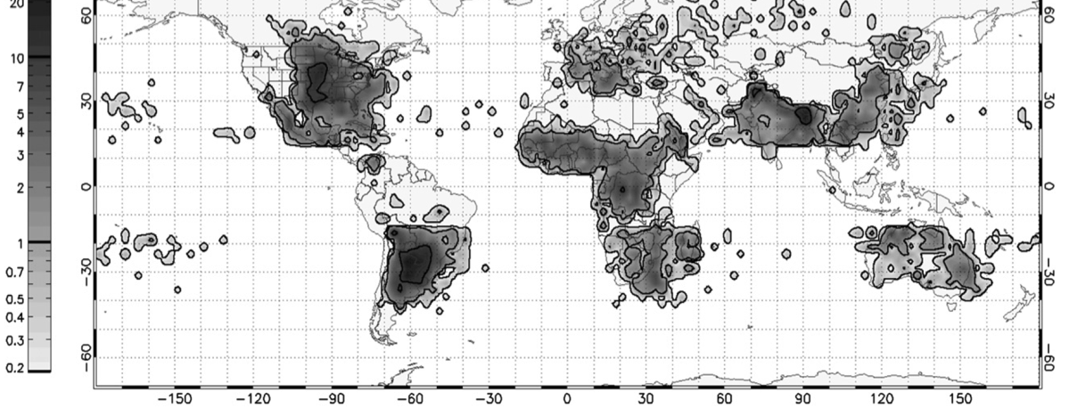
Most Intense Thunderstorms on Earth
Flash rate (#/min)
0-2.9
2.9-32.9
32.9-126.7
126.7-314.7
314.7-1389
Convective “hot spots” occur near major mountain ranges (Zipser et al. 2006)
AMSR-E Annual Severe Hail Climatology
Subtropical S. America → Highest frequency of
severe hailstorms (Cecil and Blankenship 2012)
Notes:
Get rid of top tier

Slide 3
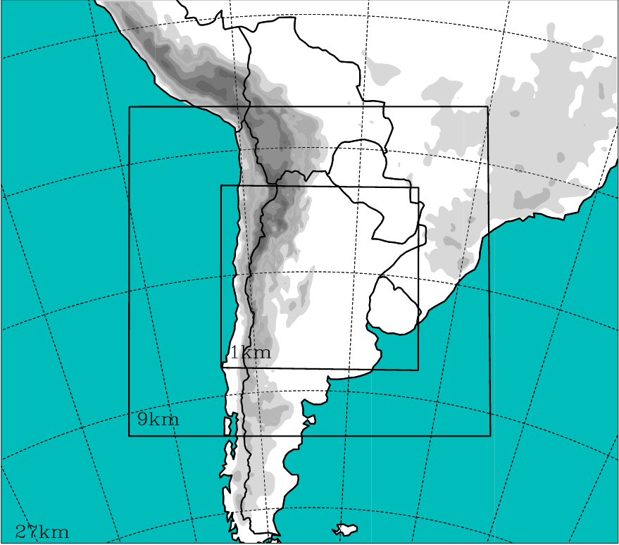
Data and Experiments
TRMM Precipitation Radar analysis:
September-April (1999-2012)
3D reflectivity data
WRF Experimental Setup:
WRF Exp. 1: Microphysics storm structure test
WDM6, GCE, Milbrandt, Morrison, and
Thompson schemes
WRF Exp. 2: Topographic triggering & mesoscale organization
Remove the Sierras de Cordoba Mountains
3 km
9 km
27 km

Slide 4
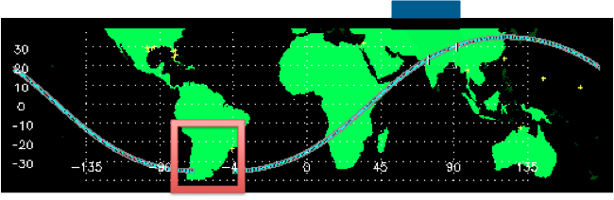
Radar Identification of Extreme Events
TRMM Precipitation Radar
Houze et al. (2007), Romatschke and Houze (2010), Rasmussen and Houze (2011), Houze et al. (2011), Zuluaga and Houze (2013), Barnes and Houze (2013)

Slide 6
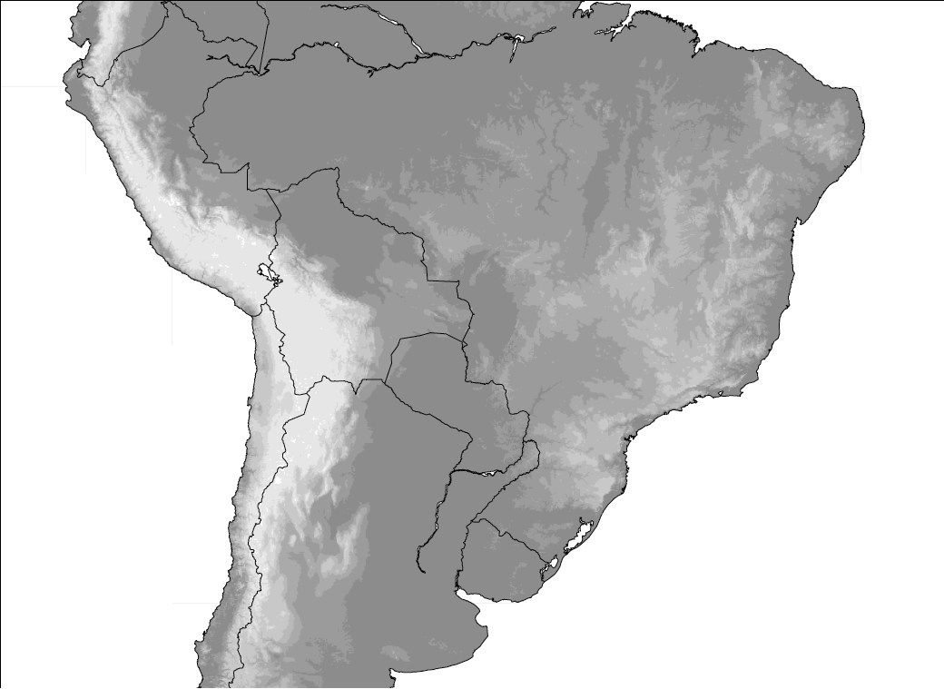
Hypothesis of Storm Life-Cycle
Broad
Stratiform
Regions
Wide
Convective
Cores
Deep
Convective
Cores
Romatschke and Houze (2010)
Suggested by Rasmussen and Houze (2011), Matsudo and Salio (2011)

Slide 7
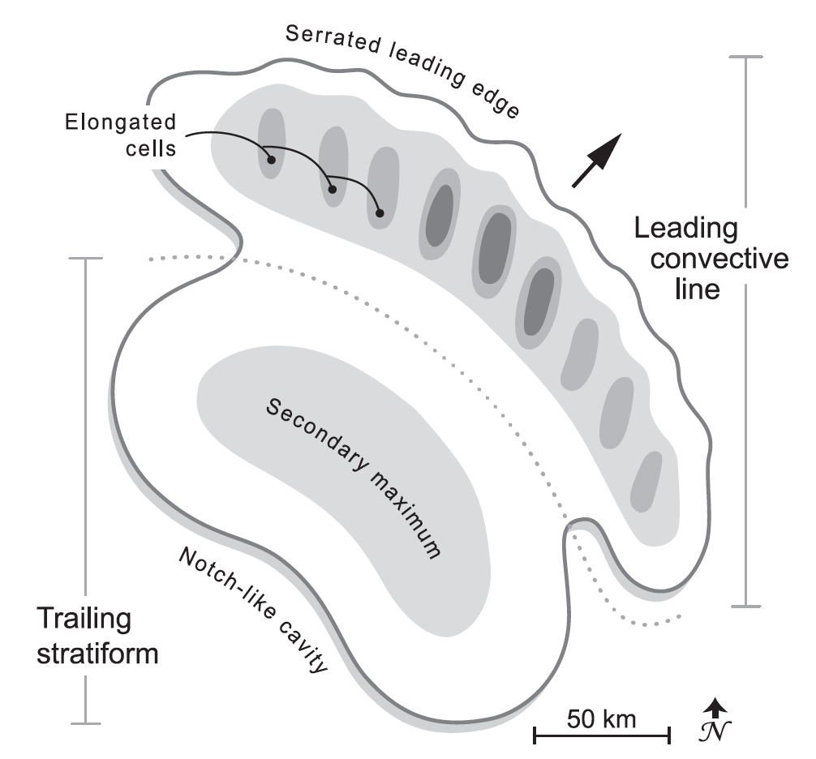
Oklahoma Archetype
Houze et al. (1990), modified by Rasmussen and Houze (2011)

Slide 8
Mesoscale Organization
Degree of Organization | Range of Scores | South America | Oklahoma (Houze et al. 1990) | Switzerland (Schiesser et al. 1995)
Strongly Classifiable | C > 5 | 11 (20%) | 14 (22.2%) | 0 (0%)
Moderately Classifiable | 0 ≤ C ≥ 5 | 30 (54.5%) | 18 (28.6%) | 12 (21.4%)
Weakly Classifiable | C < 0 | 7 (12.7%) | 10 (15.9%) | 18 (32.1%)
All Classifiable Systems | All C | 48 (87.3%) | 42 (66.7%) | 30 (53.6%)
All Unclassifiable Systems | --- | 7 (12.7%) | 21 (33.3%) | 26 (46.4%)
Total Number of Storms Analyzed | --- | 55 | 63 | 56

Slide 9
Capping and triggering
700 mb vertical motion
Composite climatology for days when a wide convective core was identified in subtropical South America
Subsidence on leeward side of Andes helps suppress convective outbreaks prior to reaching the Sierras de Cordoba Mountains
Moist air from the Amazon
Upper-level Flow over the Andes; Dry, subsiding air

Slide 10
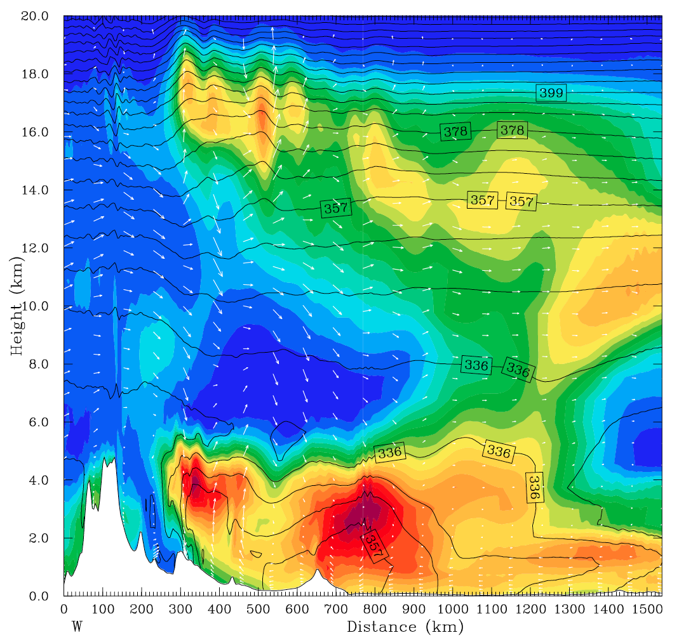
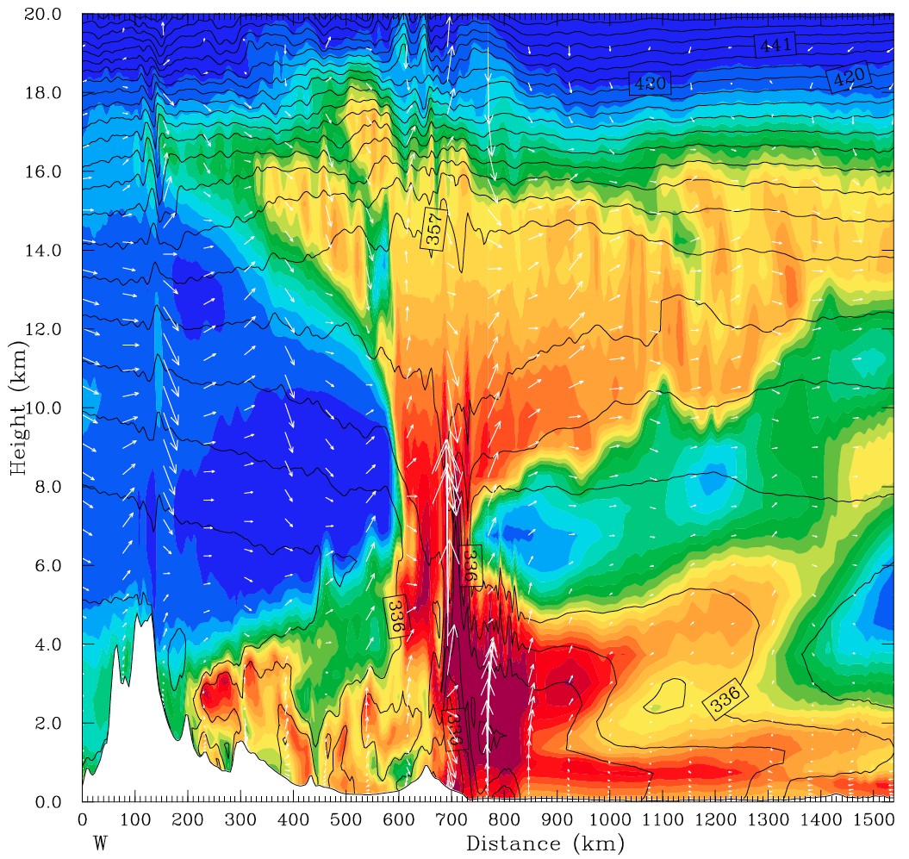

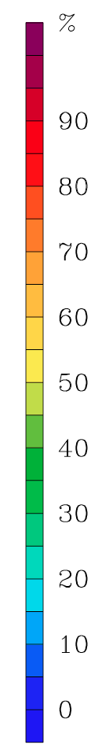
WRF simulation results
Dashed lines - equivalent potential temperature, shading - relative humidity
T = 2 hrs
Lee subsidence capping low-level
moist air
➔ Highly unstable!
T = 8 hrs
Convective initiation on
the eastern foothills of
the Sierras de Córdoba
Mountains
Air with high equivalent
potential temperatures
near the Andes foothills
Strong evidence confirming the hypothesis of lee subsidence and a capping inversion from Rasmussen and Houze (2011)

Slide 11
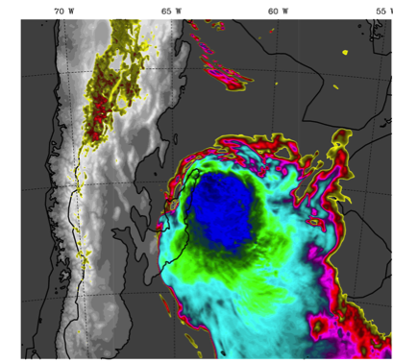
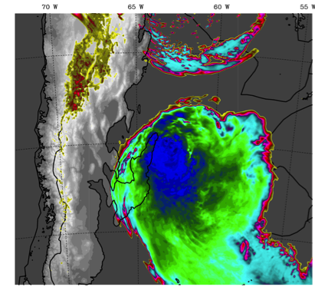
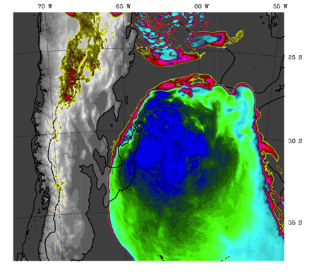
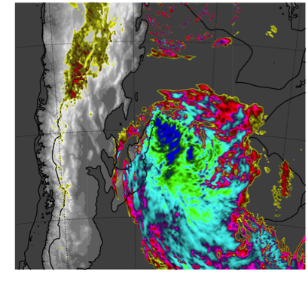
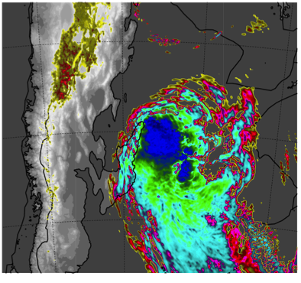
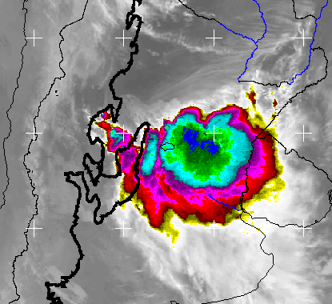
WRF OLR & GOES IR Comparisons
Thompson 10Z
Morrison 09Z
Milbrandt 10Z
WDM6 09Z
Goddard 09Z
GOES IR 10Z

Slide 12
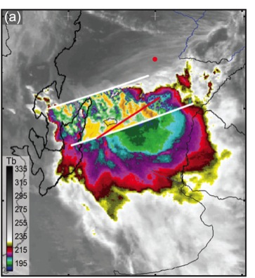
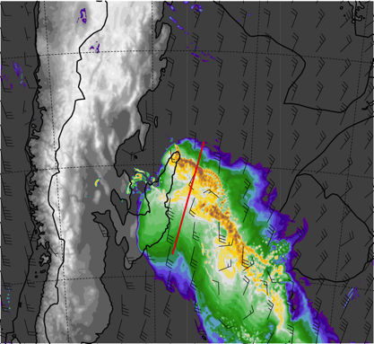
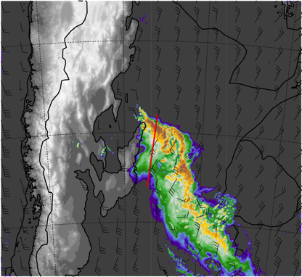
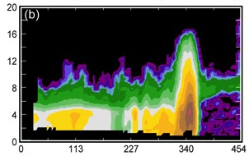
WRF Model & Data Comparisons
TRMM PR Data
GOES IR
WRF Simulation: Thompson Scheme
WRF Simulation: Goddard Scheme
TRMM PR Data
Hydrometeor mixing ratios
Thompson Scheme
Hydrometeor mixing ratios
Goddard Scheme
Snow
Ice
Graupel
Rain water (shaded)
Rain water (shaded)
Snow
Ice
Graupel
Rain water (shaded)
Rain water (shaded)
Height (km)
Distance (km)
Distance (km)
Distance (km)

Slide 13
WRF Hydrometeor Analysis
Microphysics scheme | Total accum. precip (mm) | Max rain rate (mm/hr) | Mean supercooled water (10⁻⁶ g/kg)
WDM6 | 3697349 | 116.27 | 0.60
GCE | 4051027 | 249.48 | 3.92
Milbrandt | 2867934 | 118.17 | 4.05
Morrison | 3942666 | 113.23 | 2.27
Thompson | 3934273 | 164.51 | 3.37

Slide 14
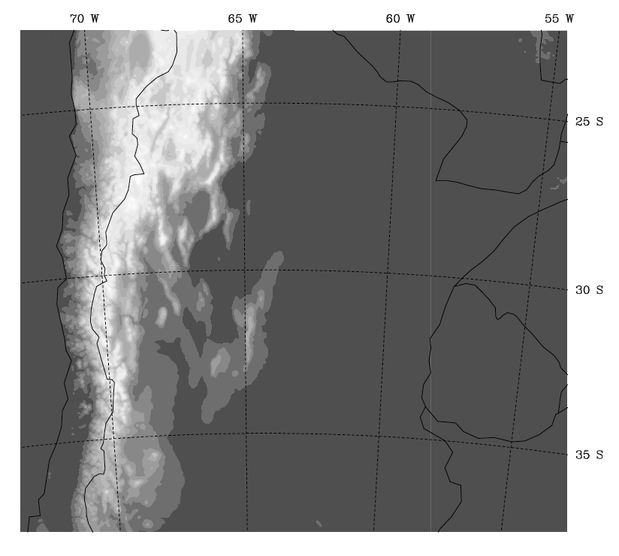
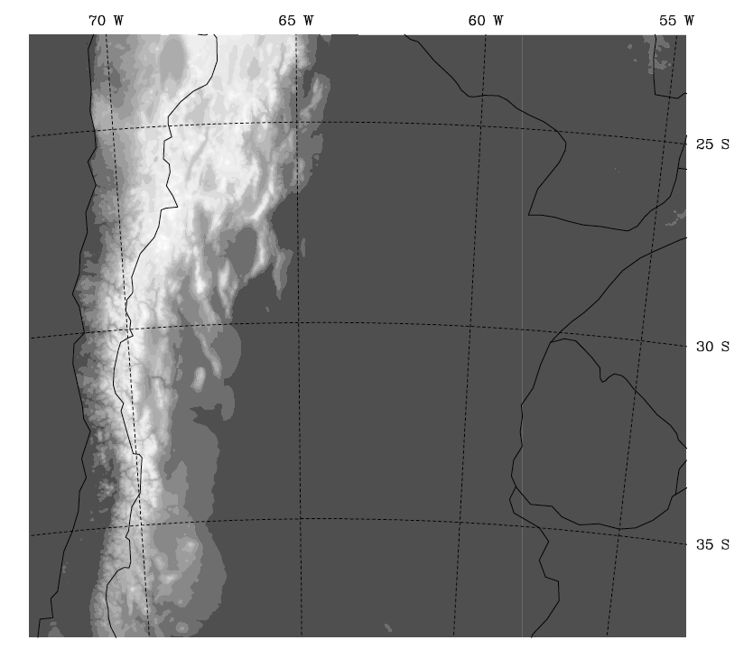
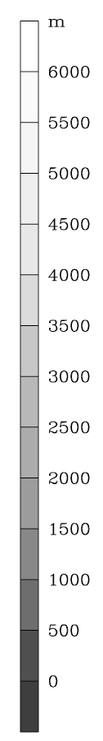
WRF Topography Experiment
Sierras de Cordoba
Mtns. removed
Control

Slide 15
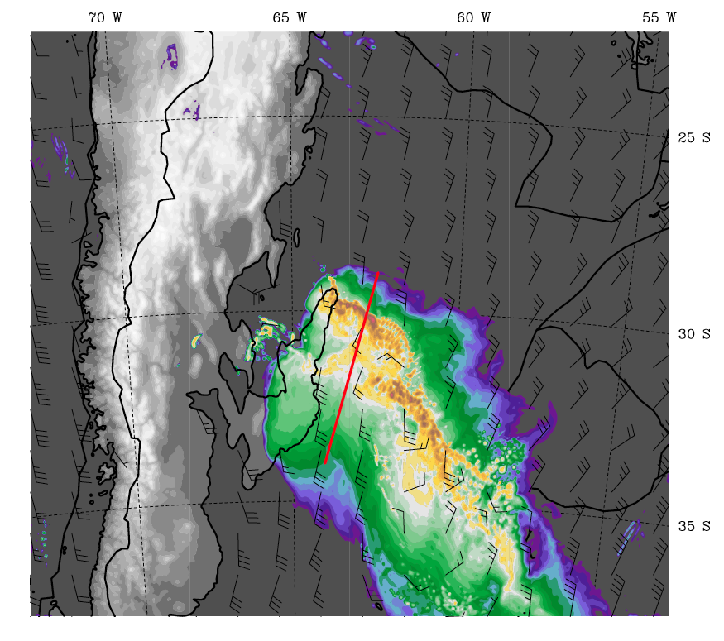
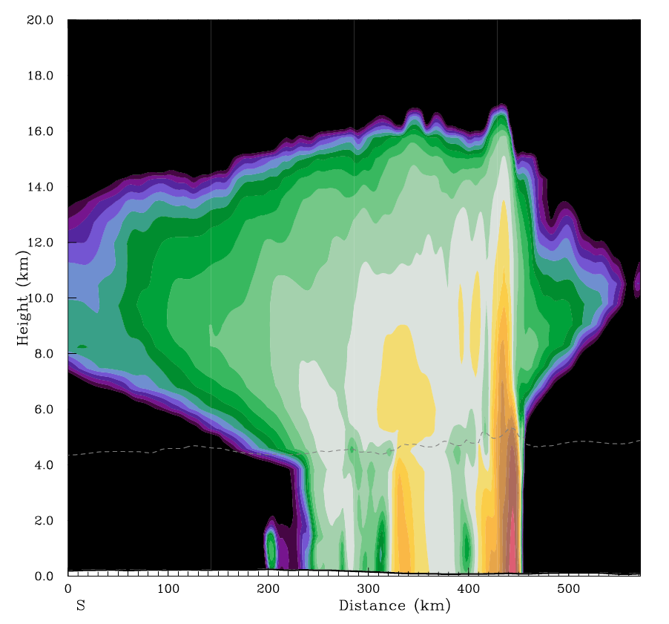
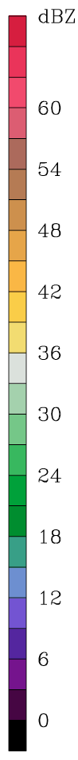
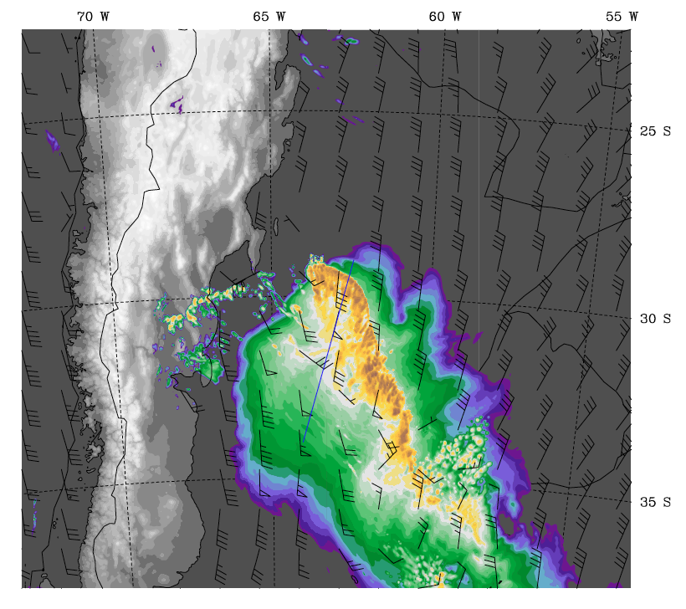
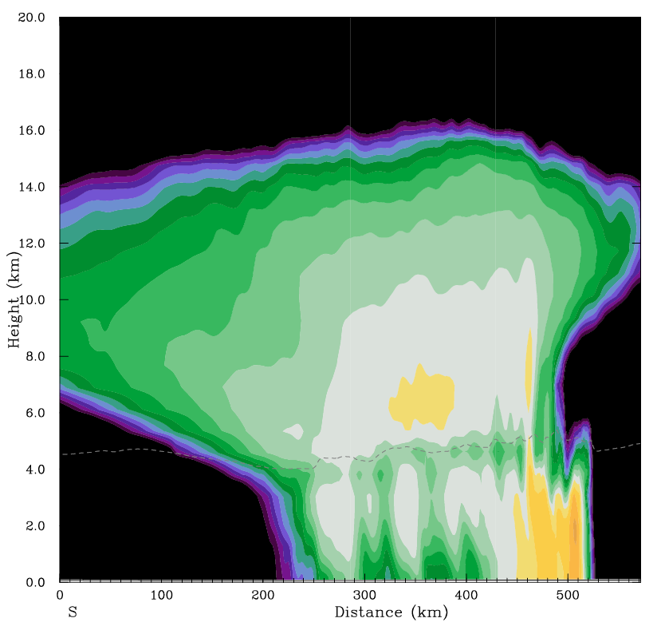

WRF Topography Experiment
Control
Weak trailing
stratiform region
Coherent leading
convective line
absent
Sierras de
Cordoba
removed

Slide 16
Conclusions
Deep convection triggers near the Sierras de Córdoba Mountains and Andes foothills, grows upscale into eastward propagating MCSs, and decays into stratiform regions
Storms with wide convective cores in S. America tend to be line-organized and are similar in organization to squall lines in Oklahoma
Thompson microphysics scheme realistically represents supercooled water and snow, leading to robust leading-line/trailing stratiform structure
Removing small topographic features weakens both convective and stratiform elements in the storm structure

Slide 17
Acknowledgments
This research was supported by NASA Grants NNX10AH70G and NNX11AL65H, and NSF Grant AGS-1144105,

Slide 18
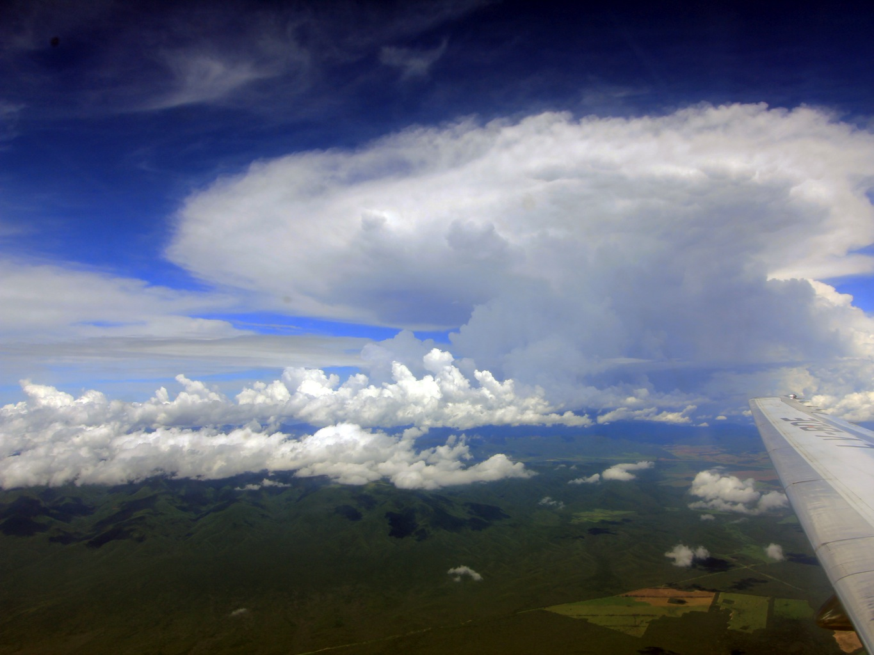
Questions?
Notes:
Radar is 3D

