Slide 1
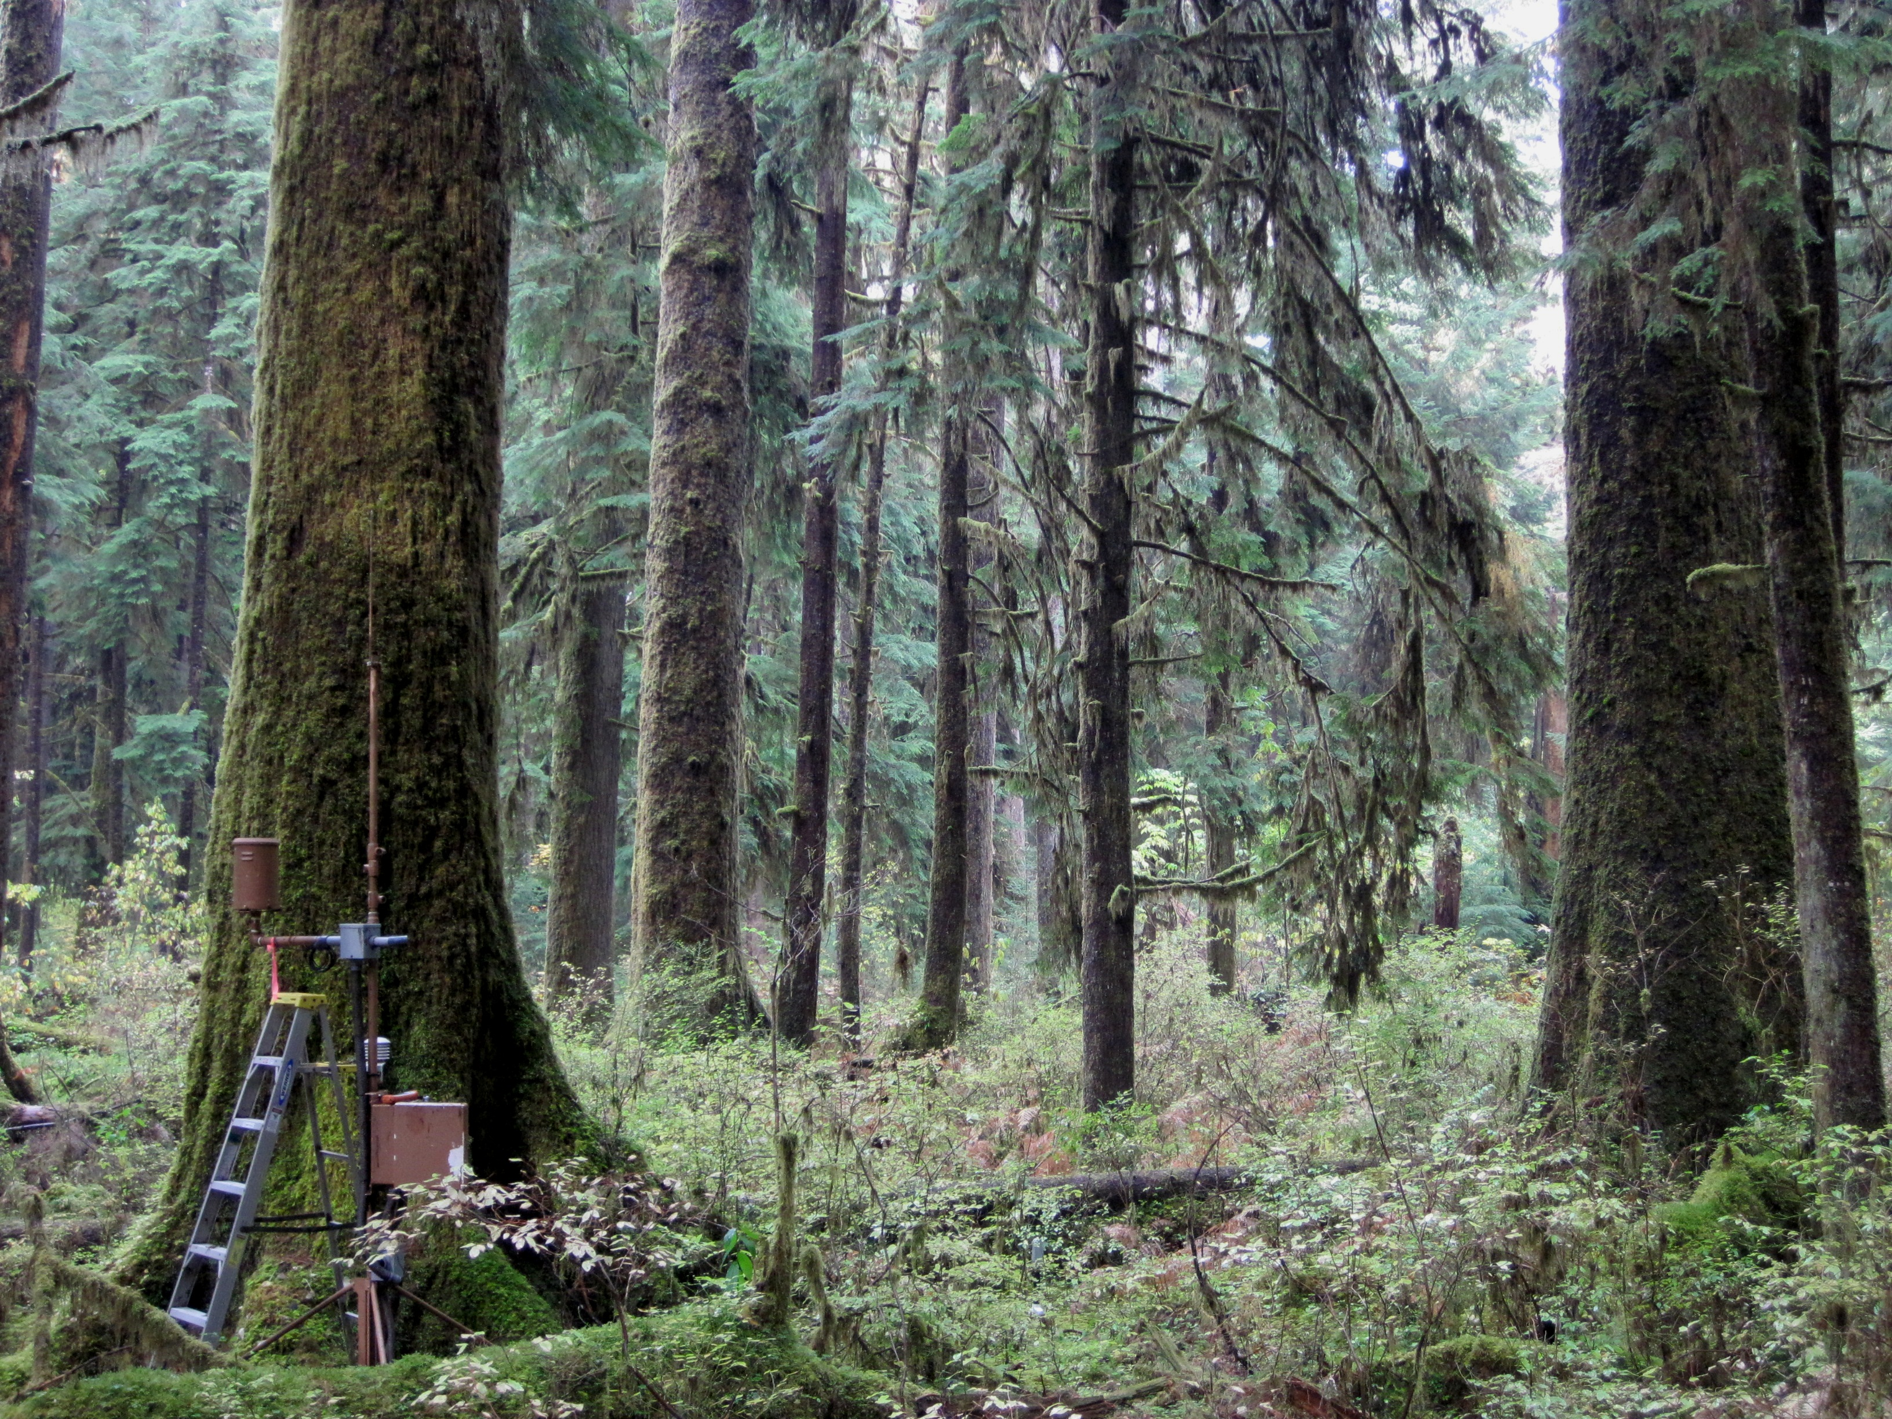
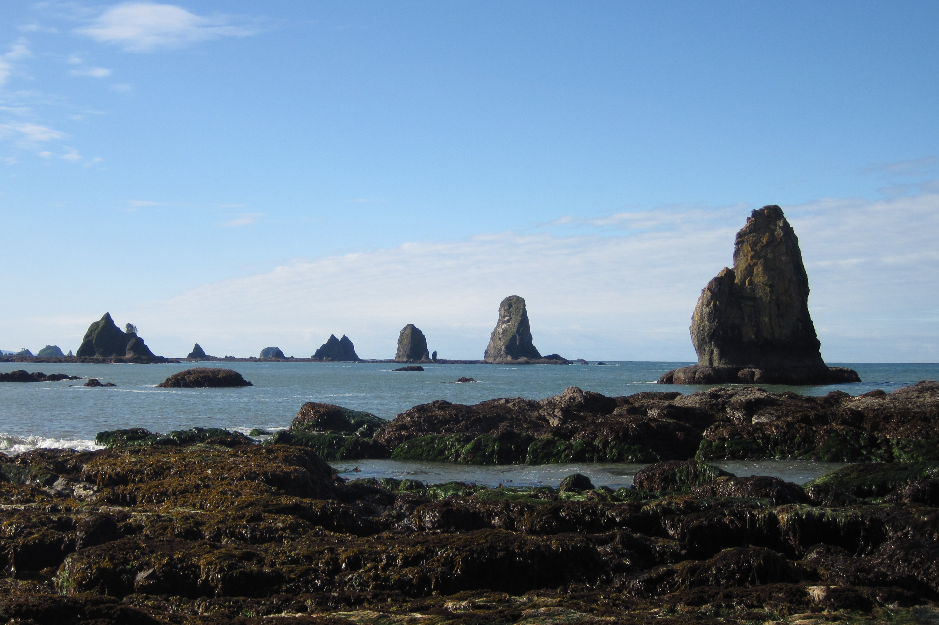
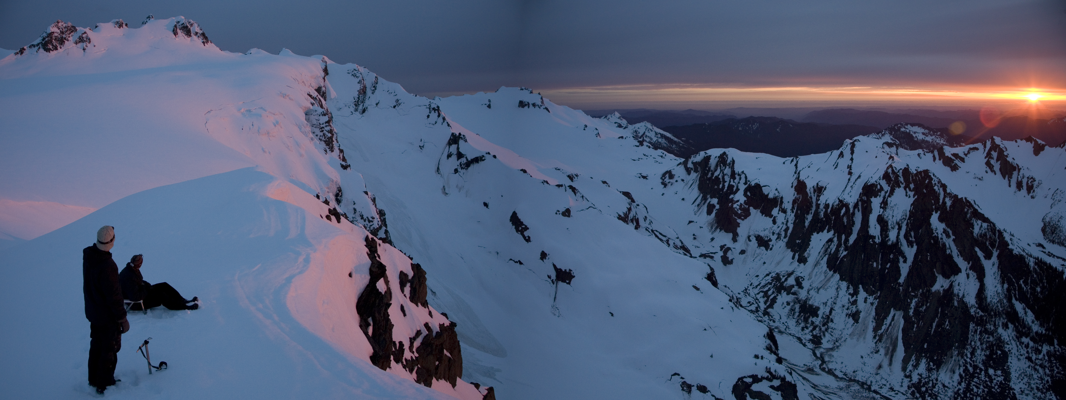
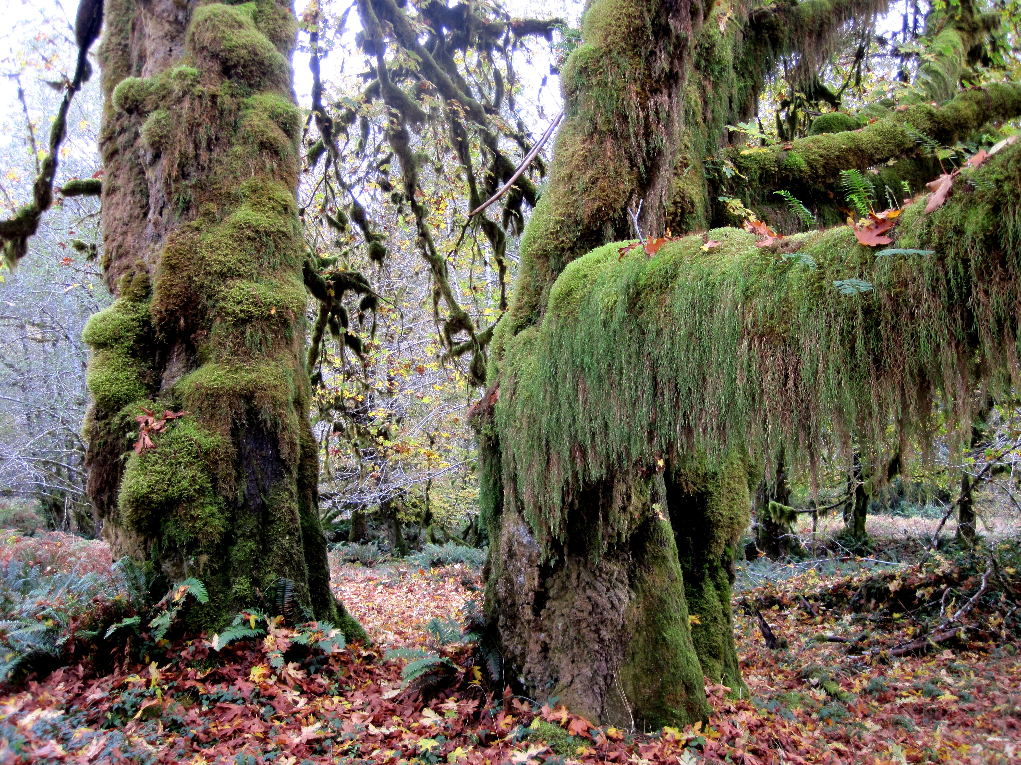
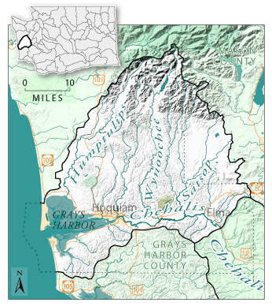
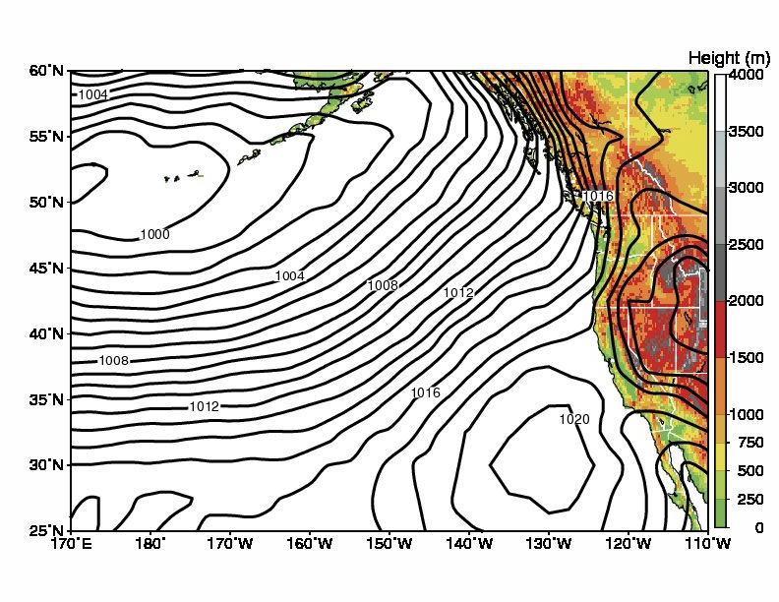
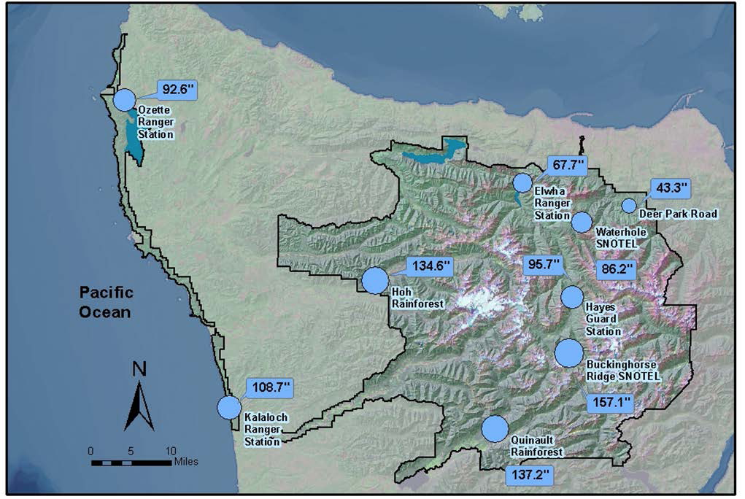
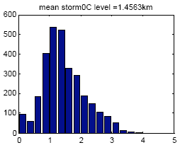
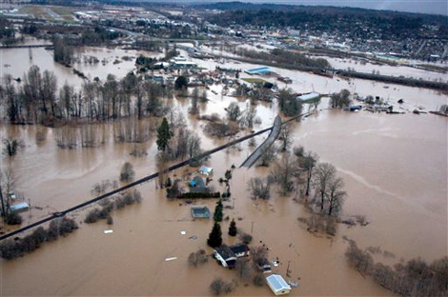
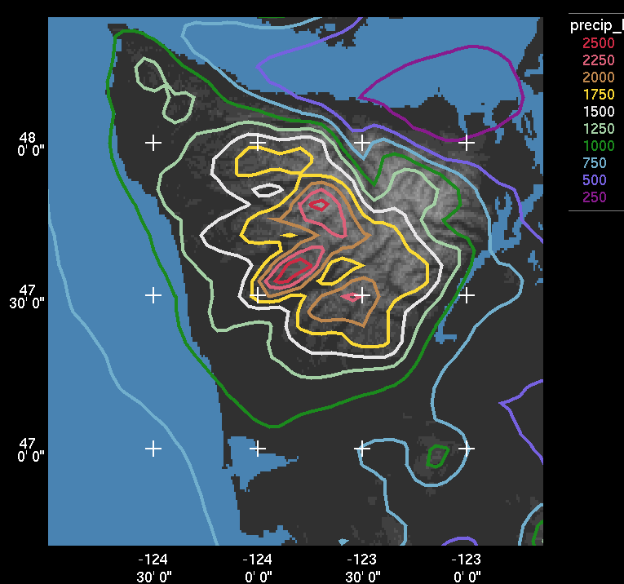
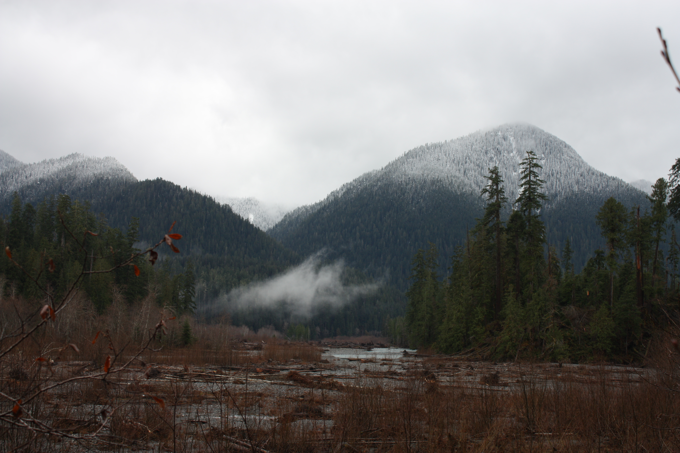
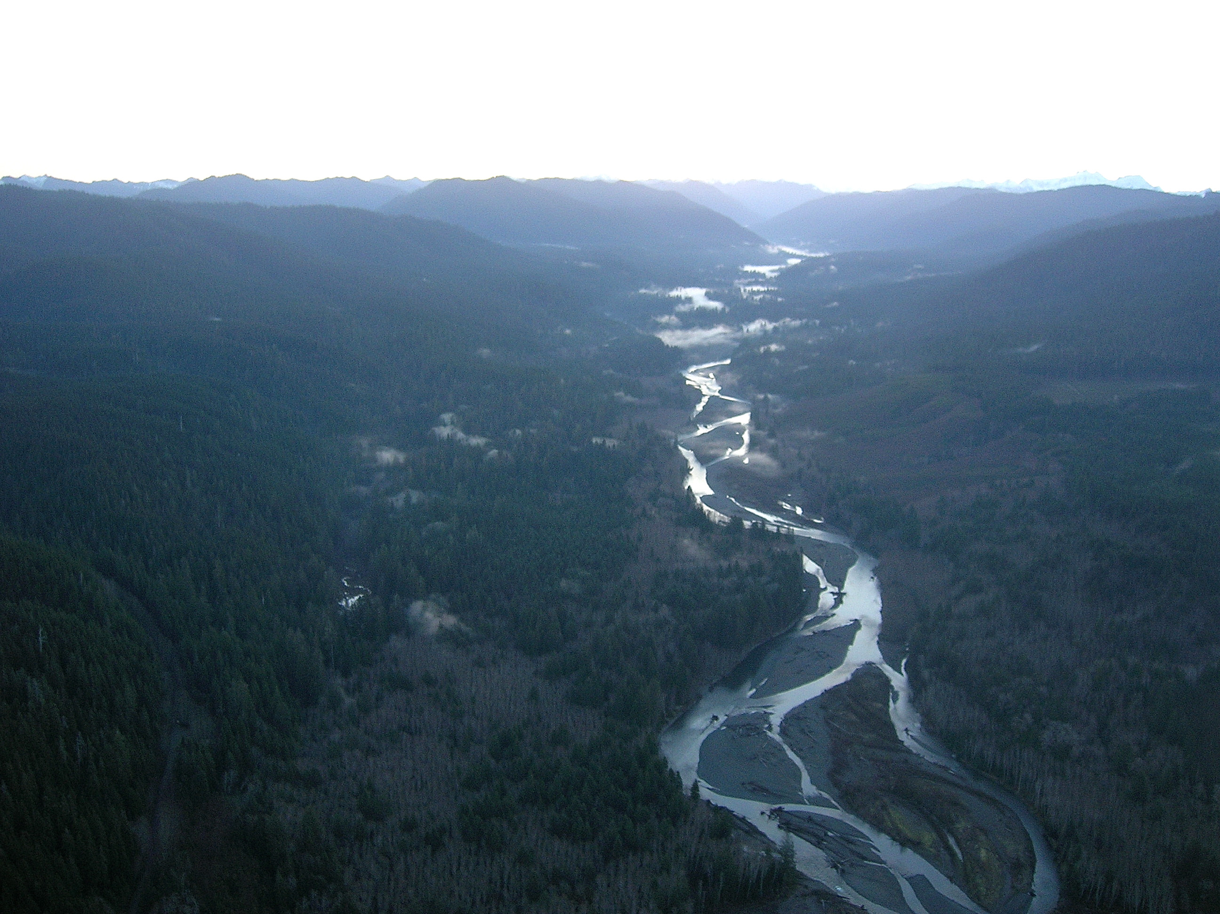
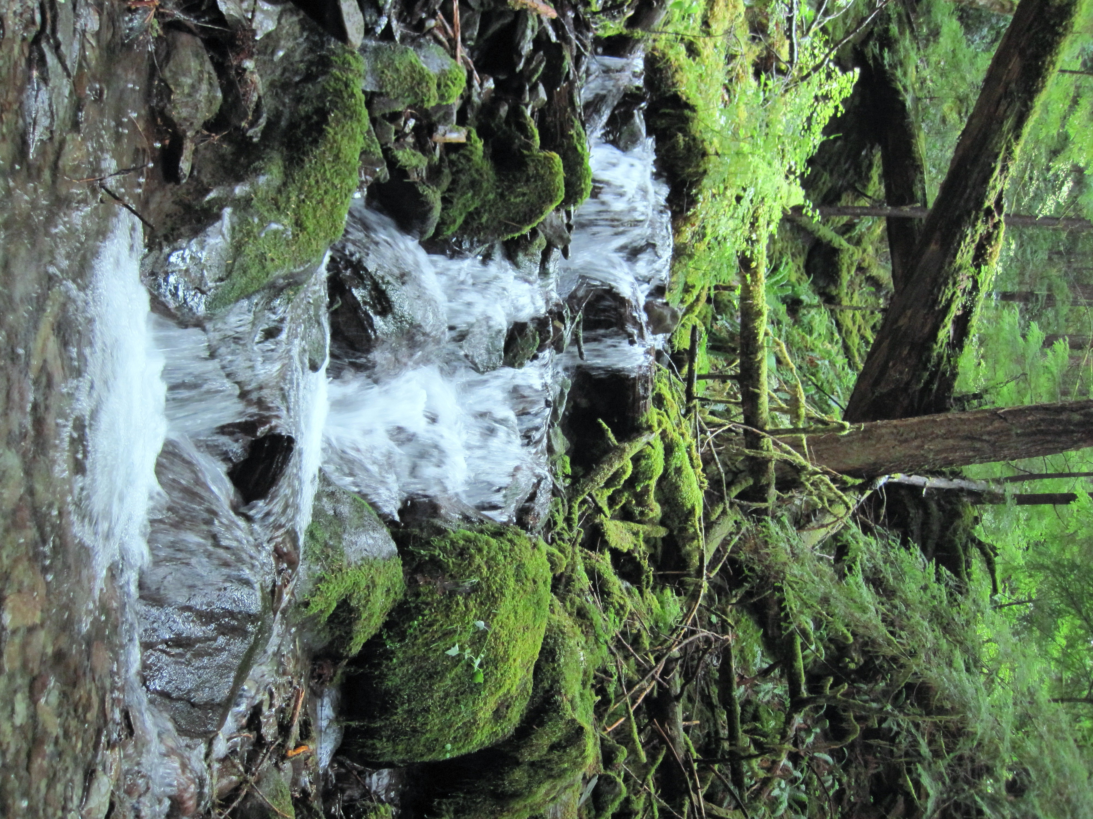
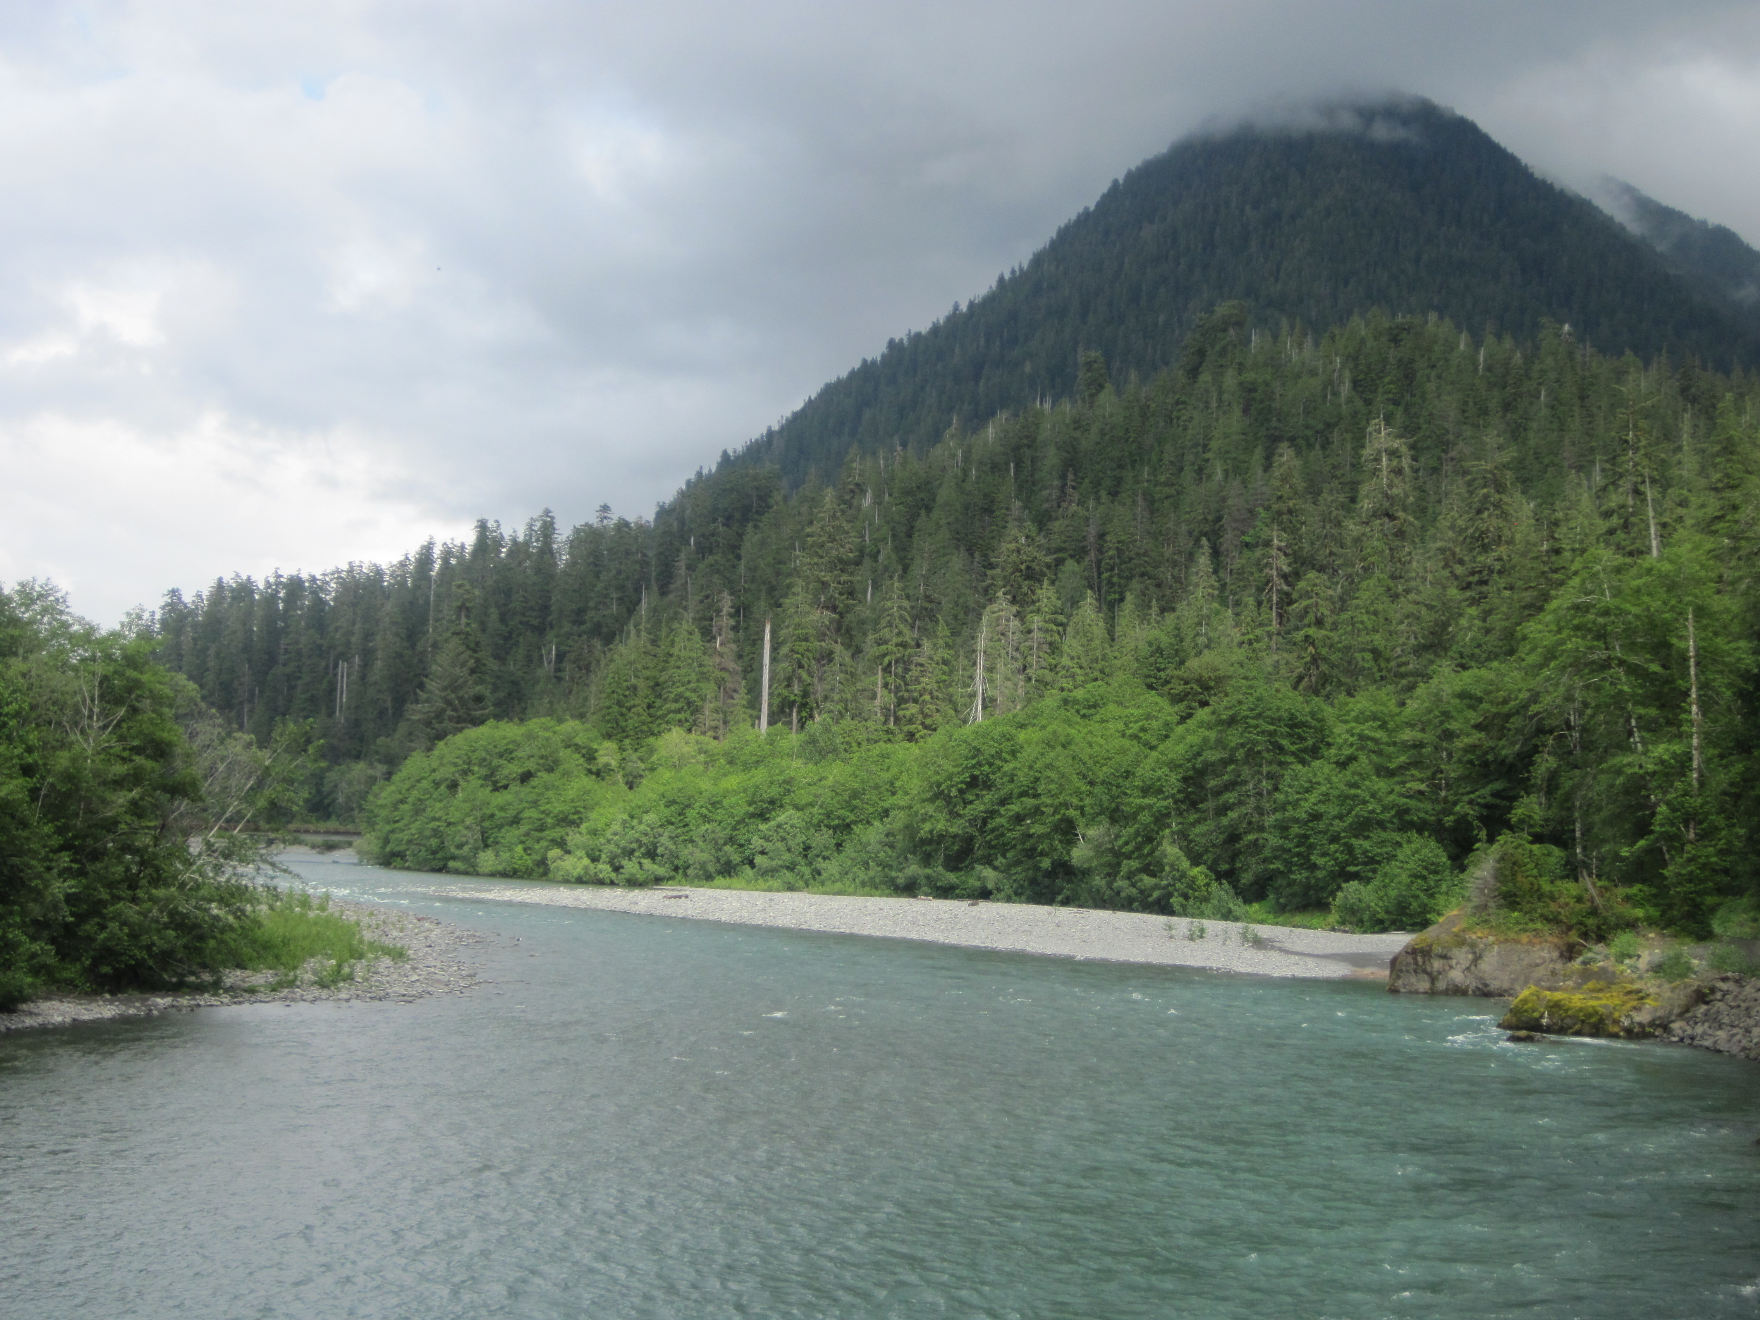
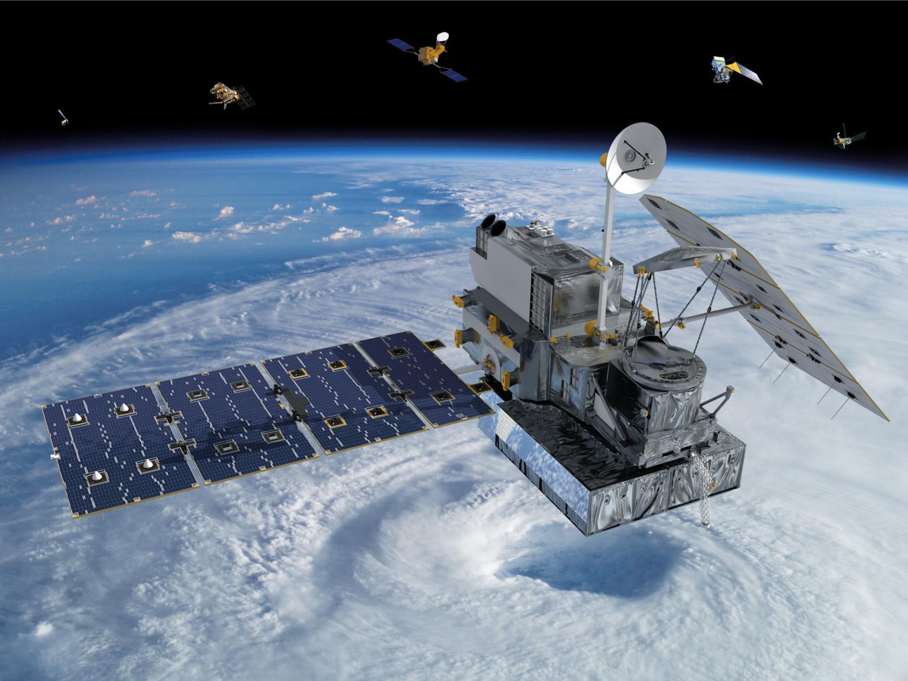
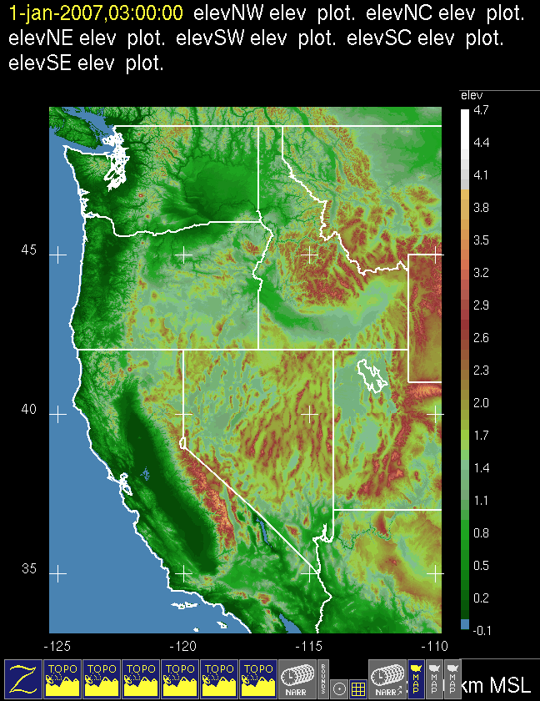
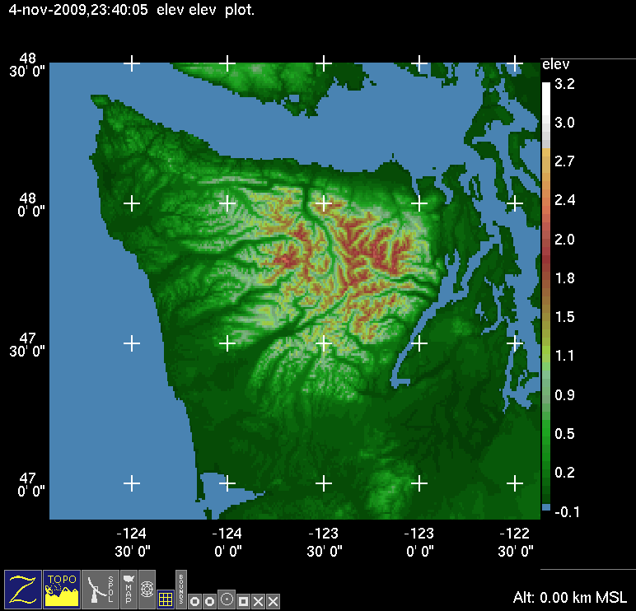
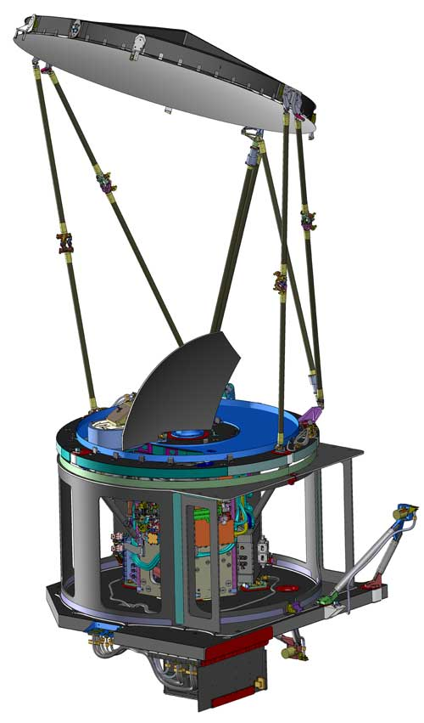
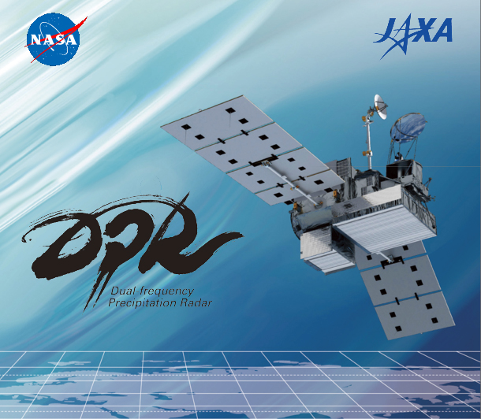
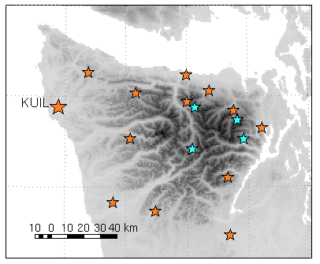
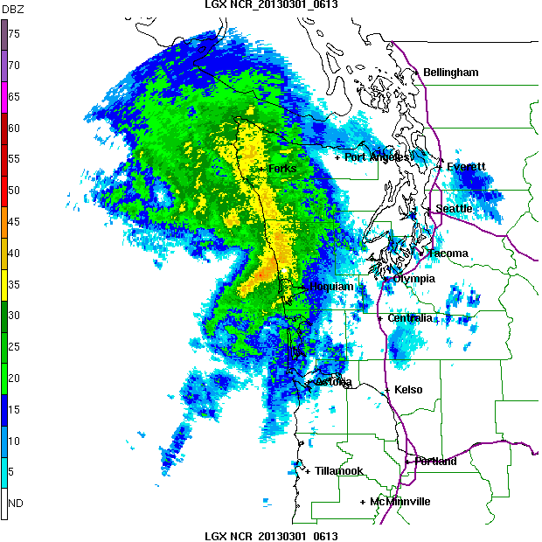
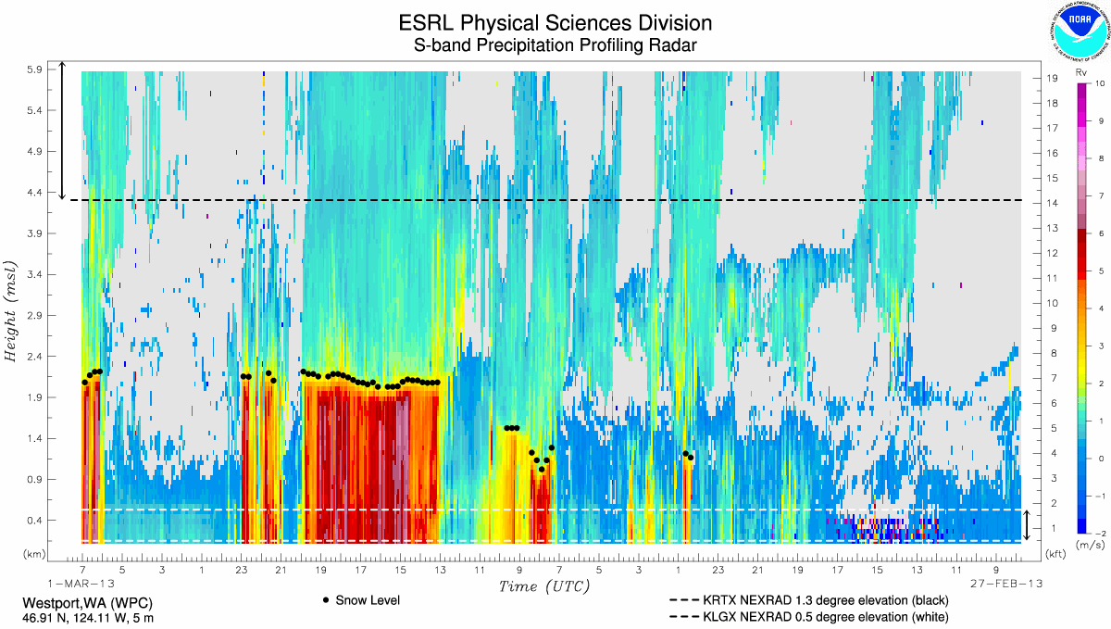
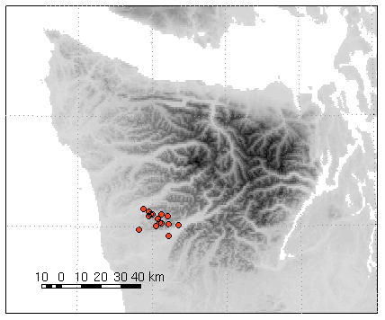
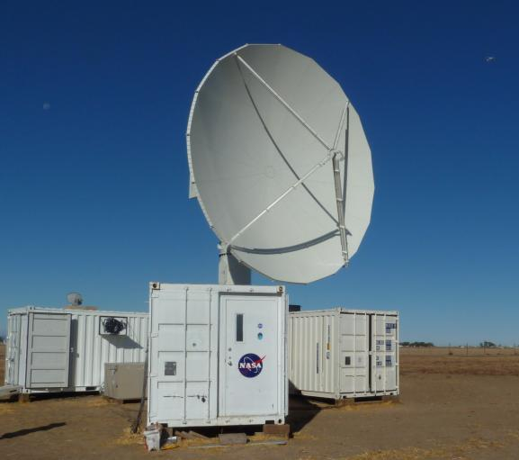
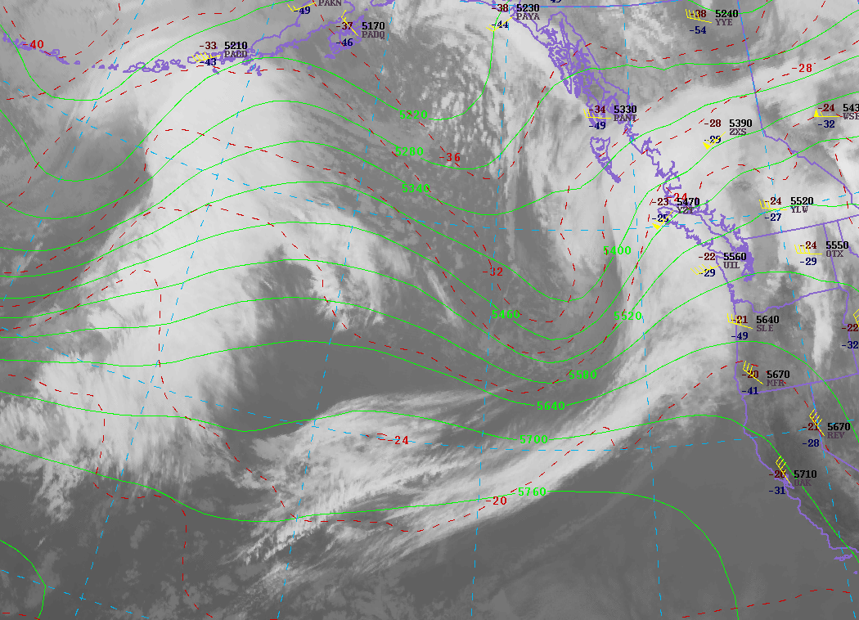
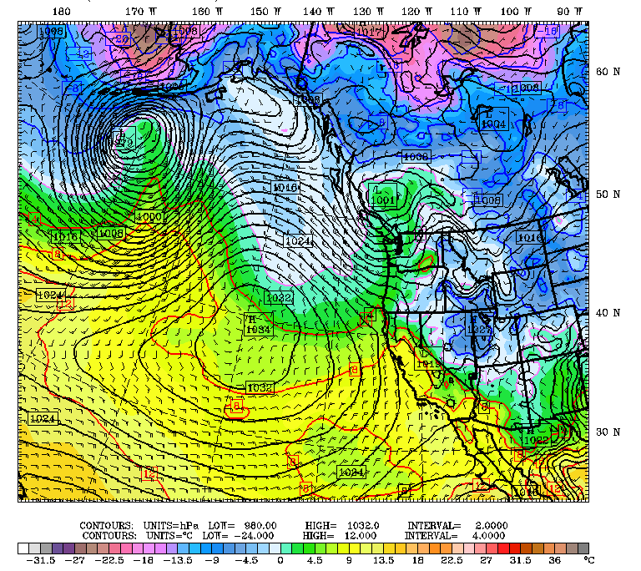
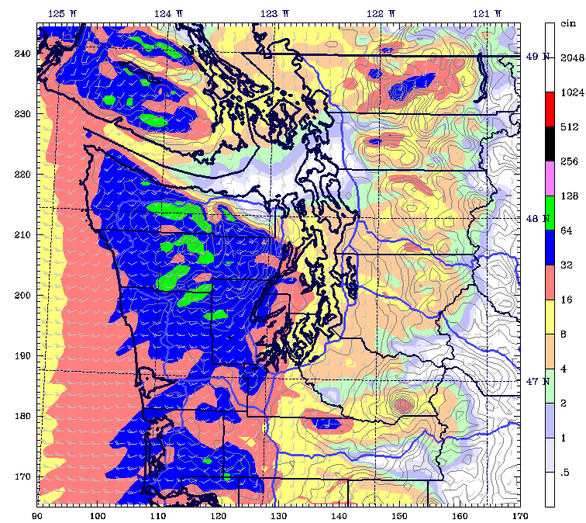
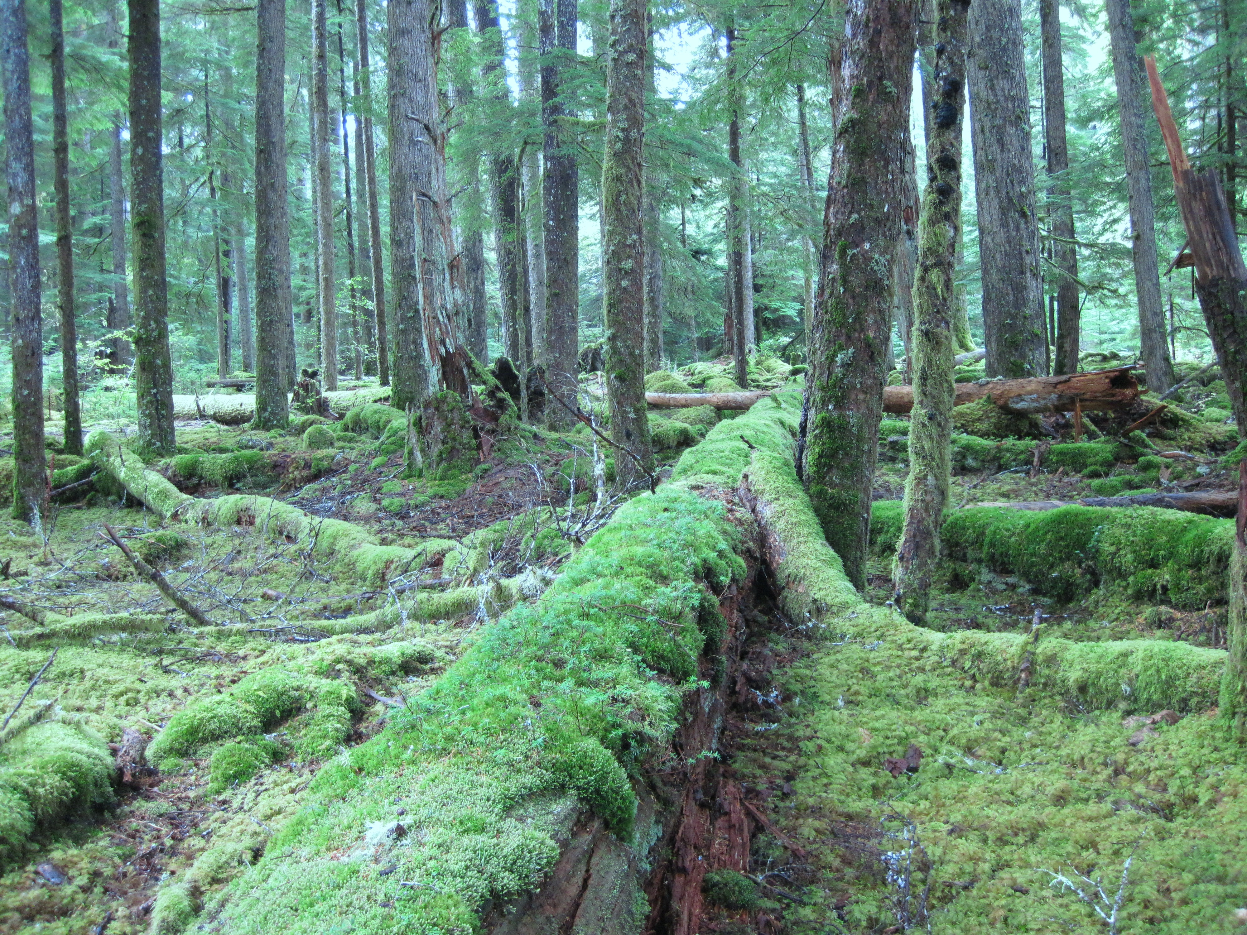
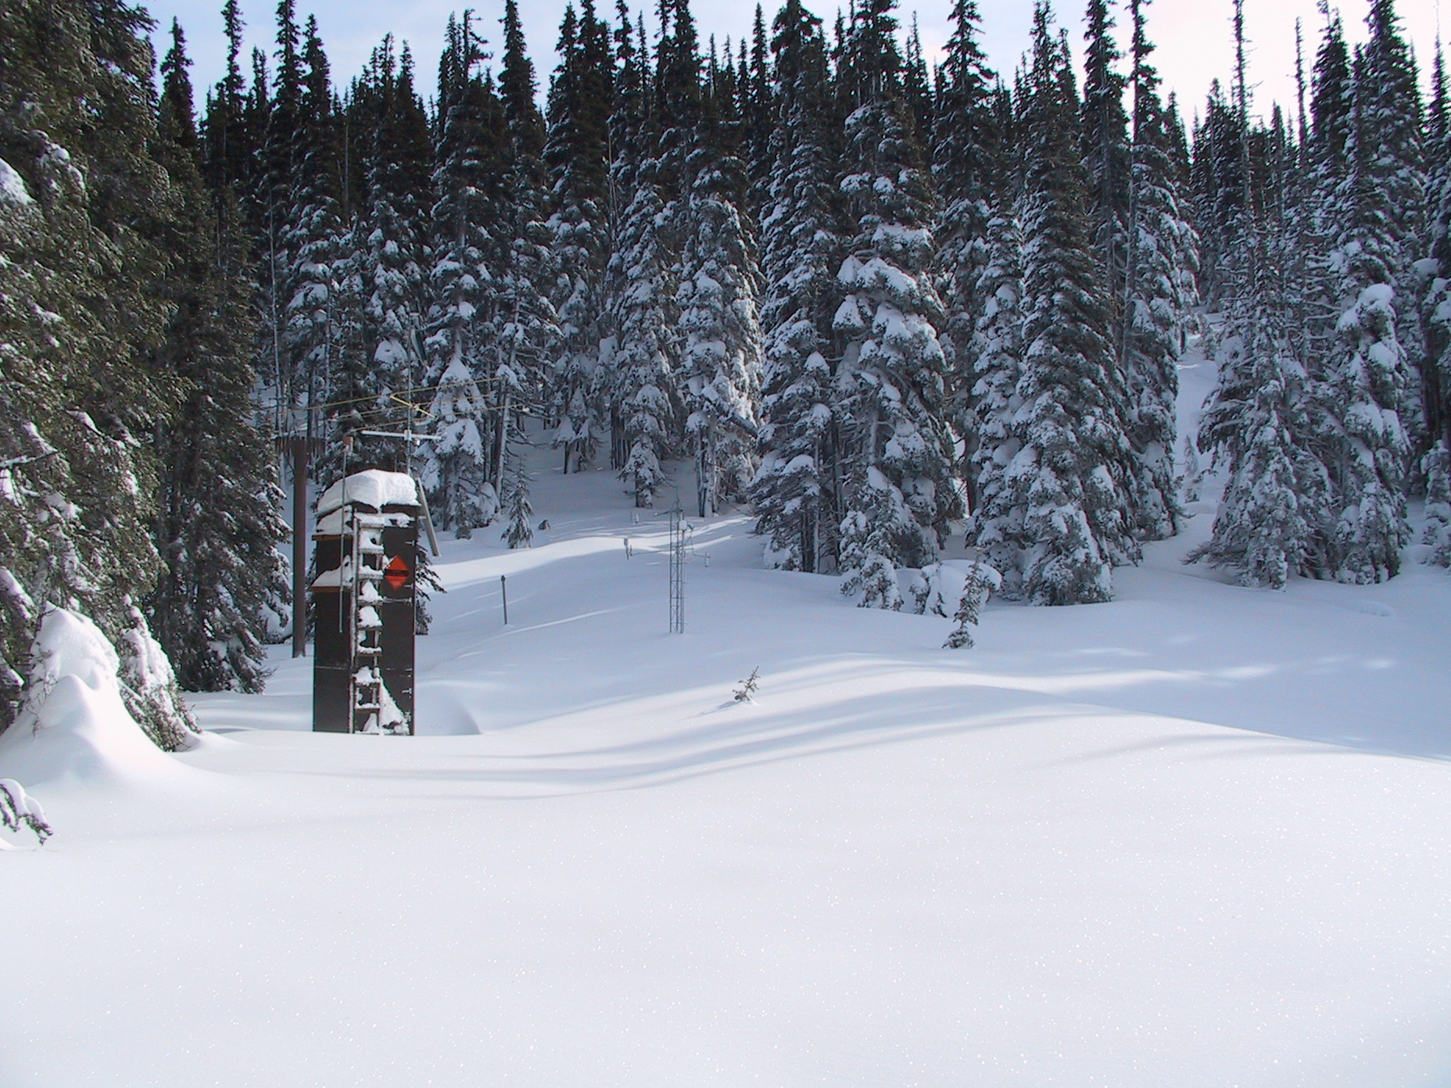
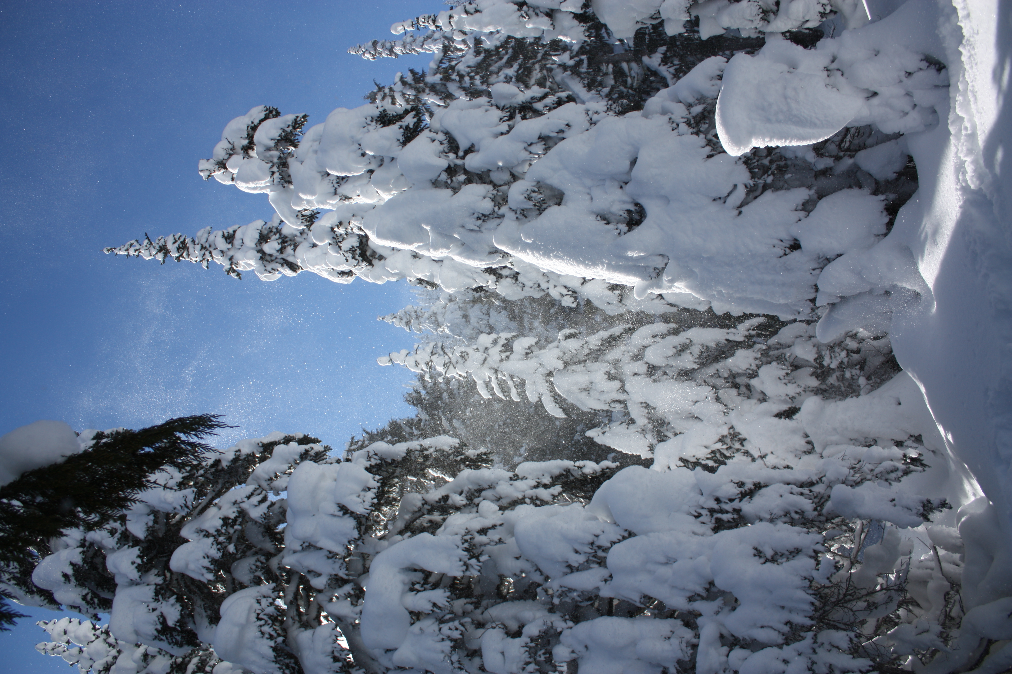

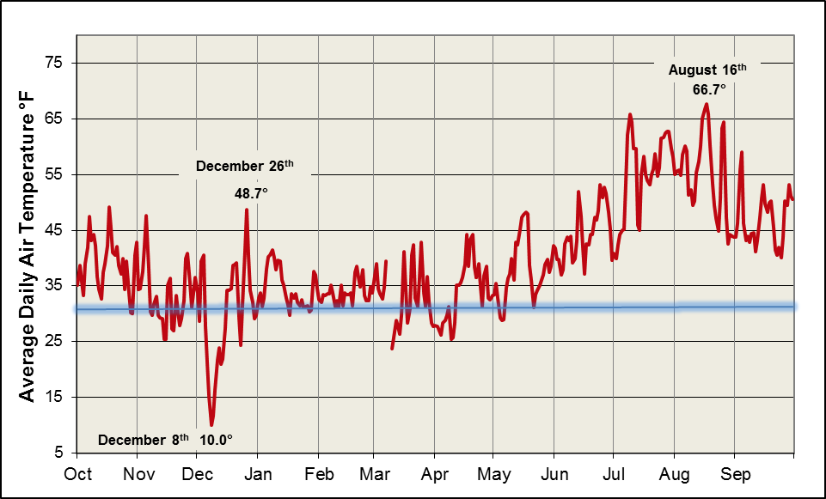
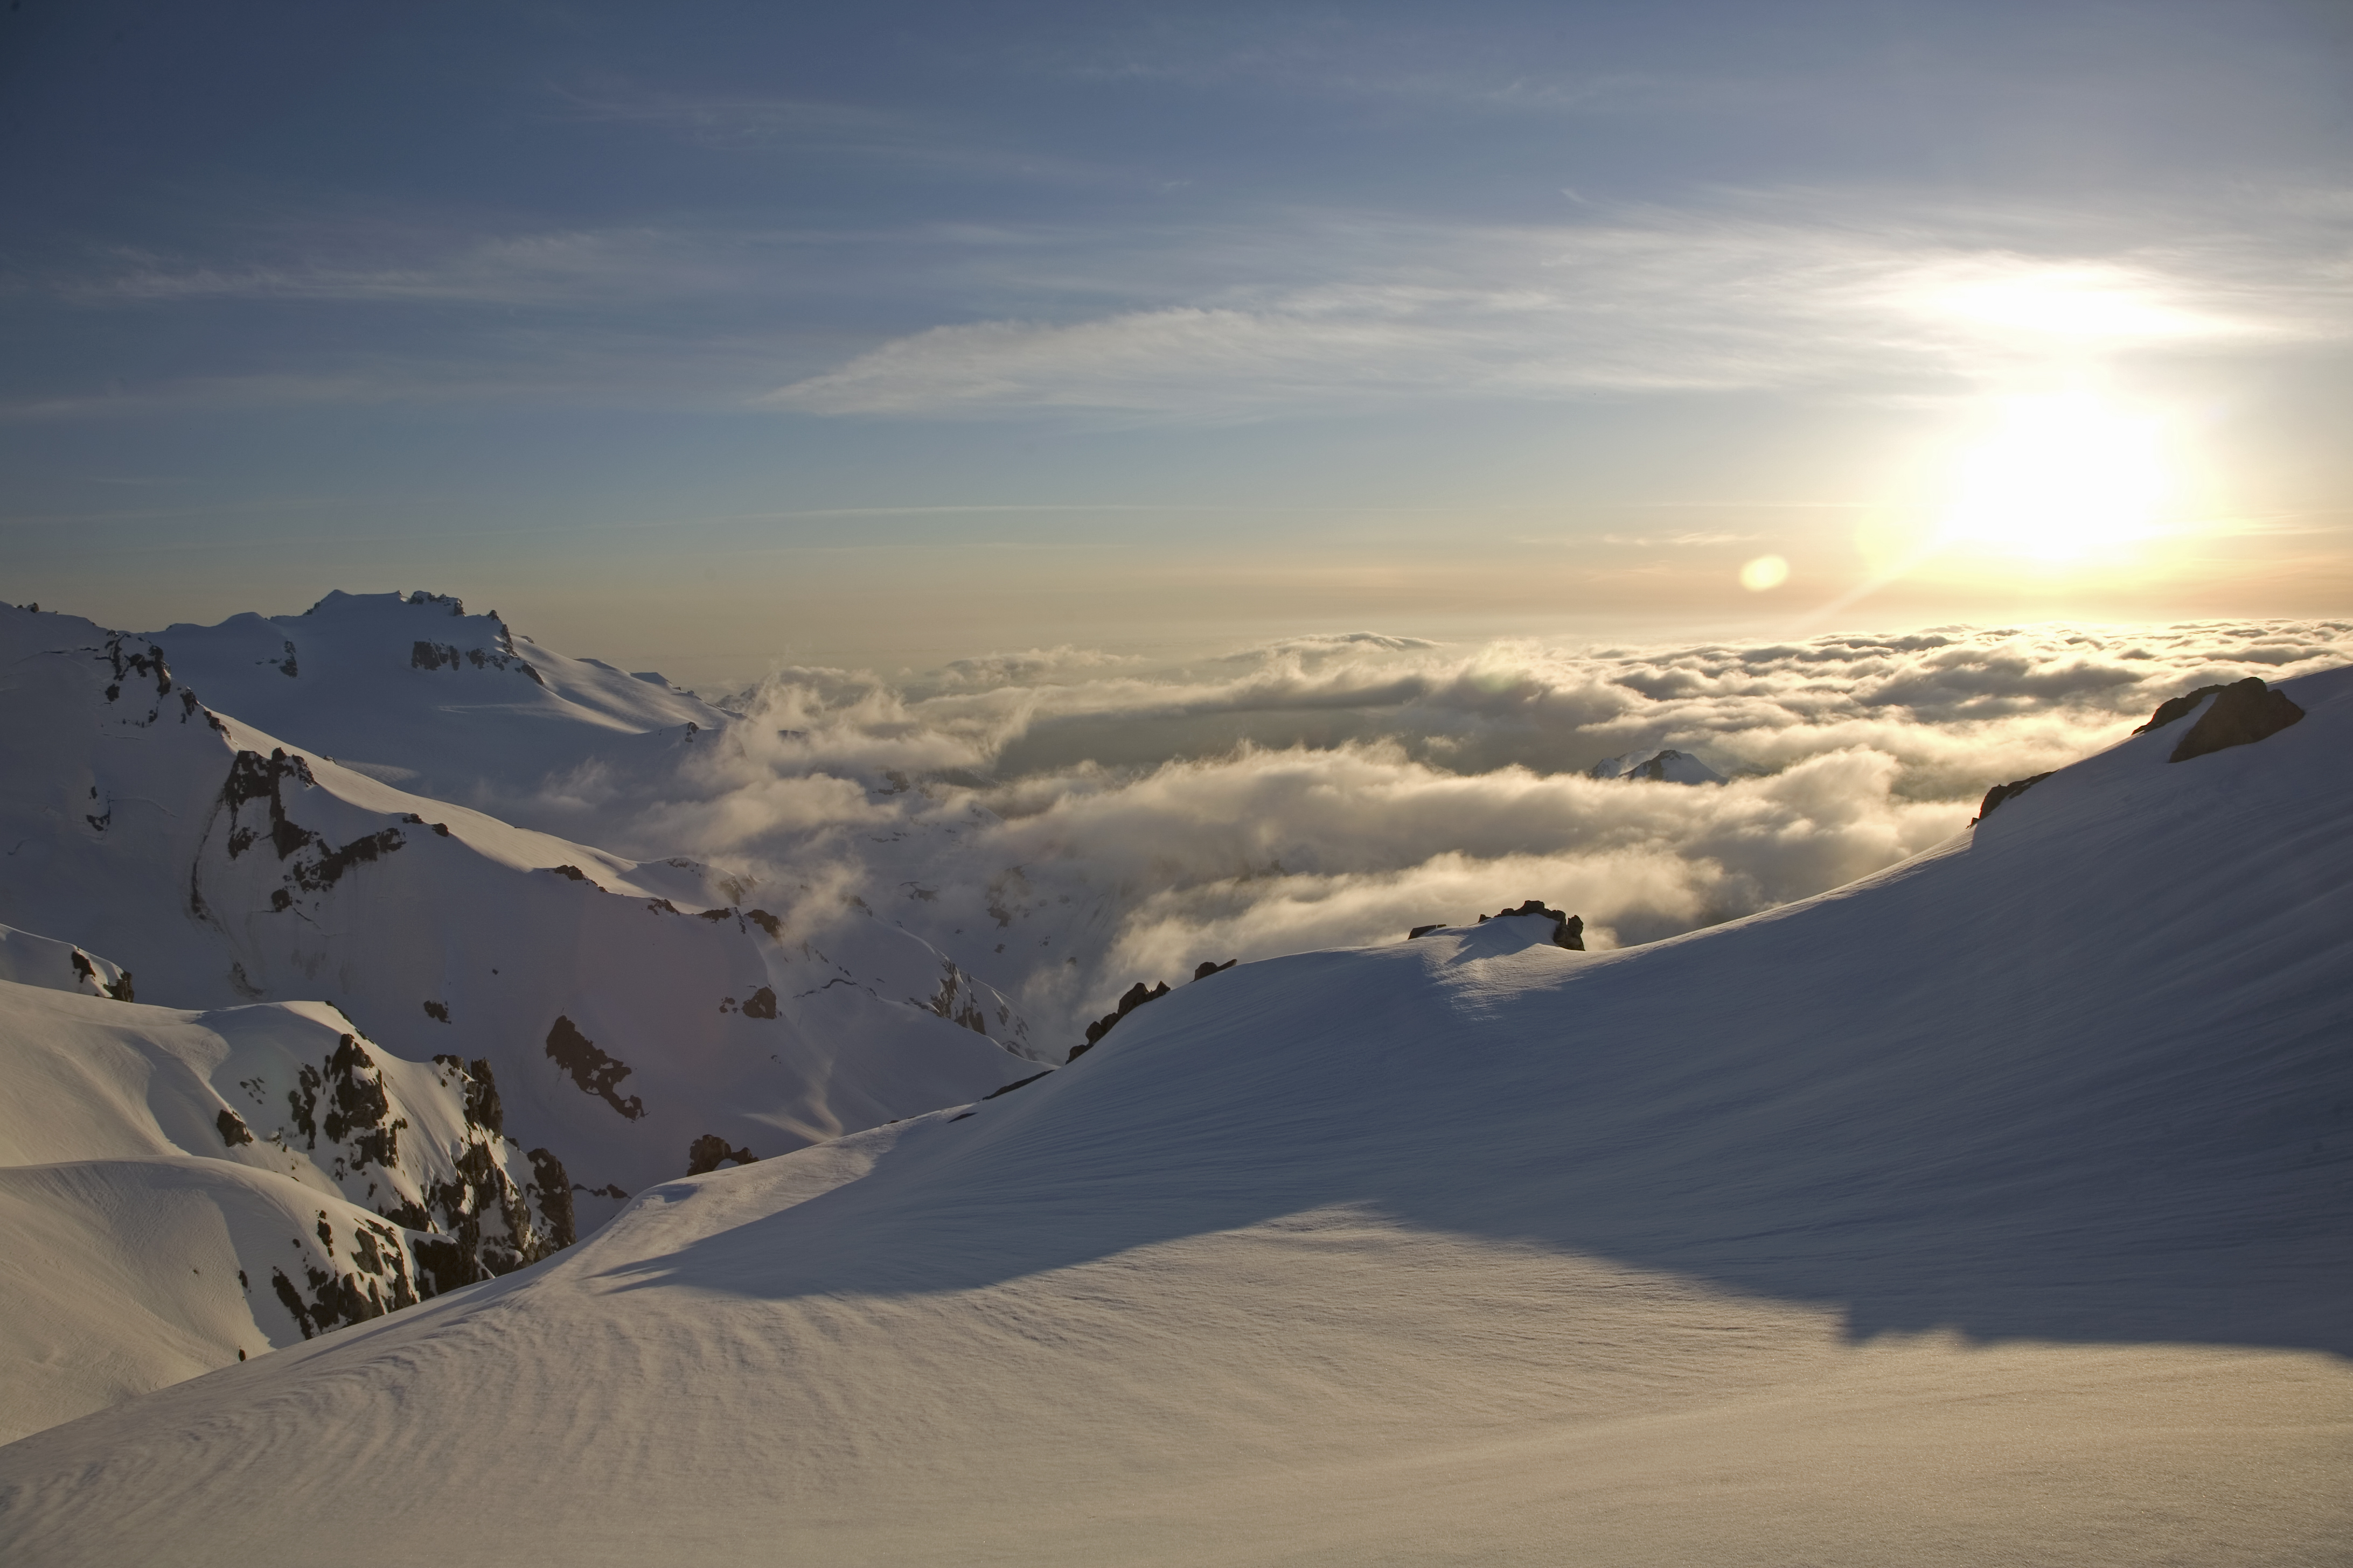
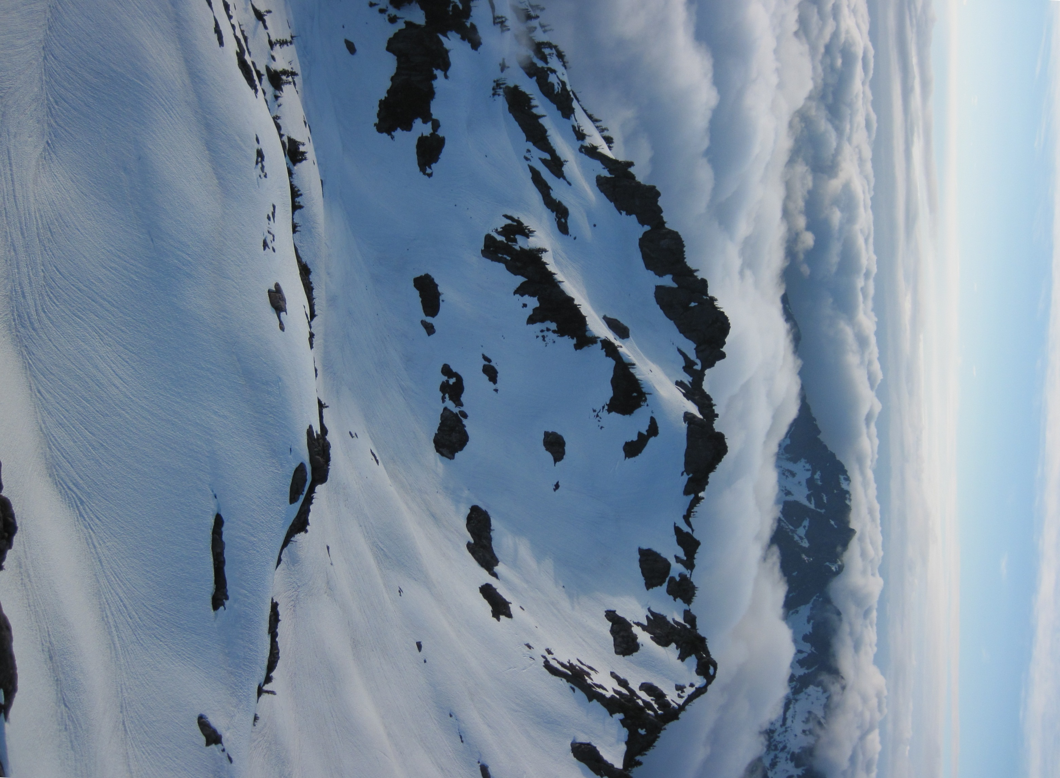
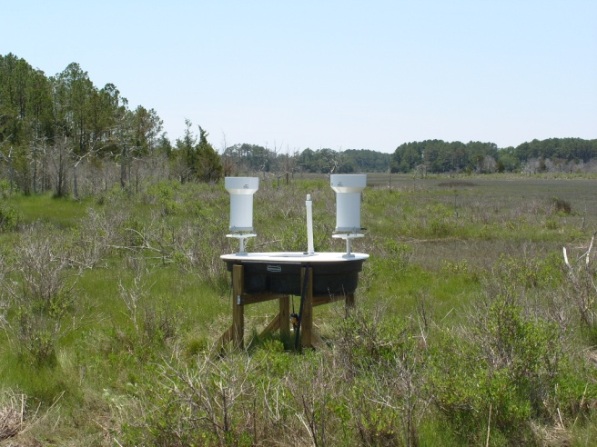
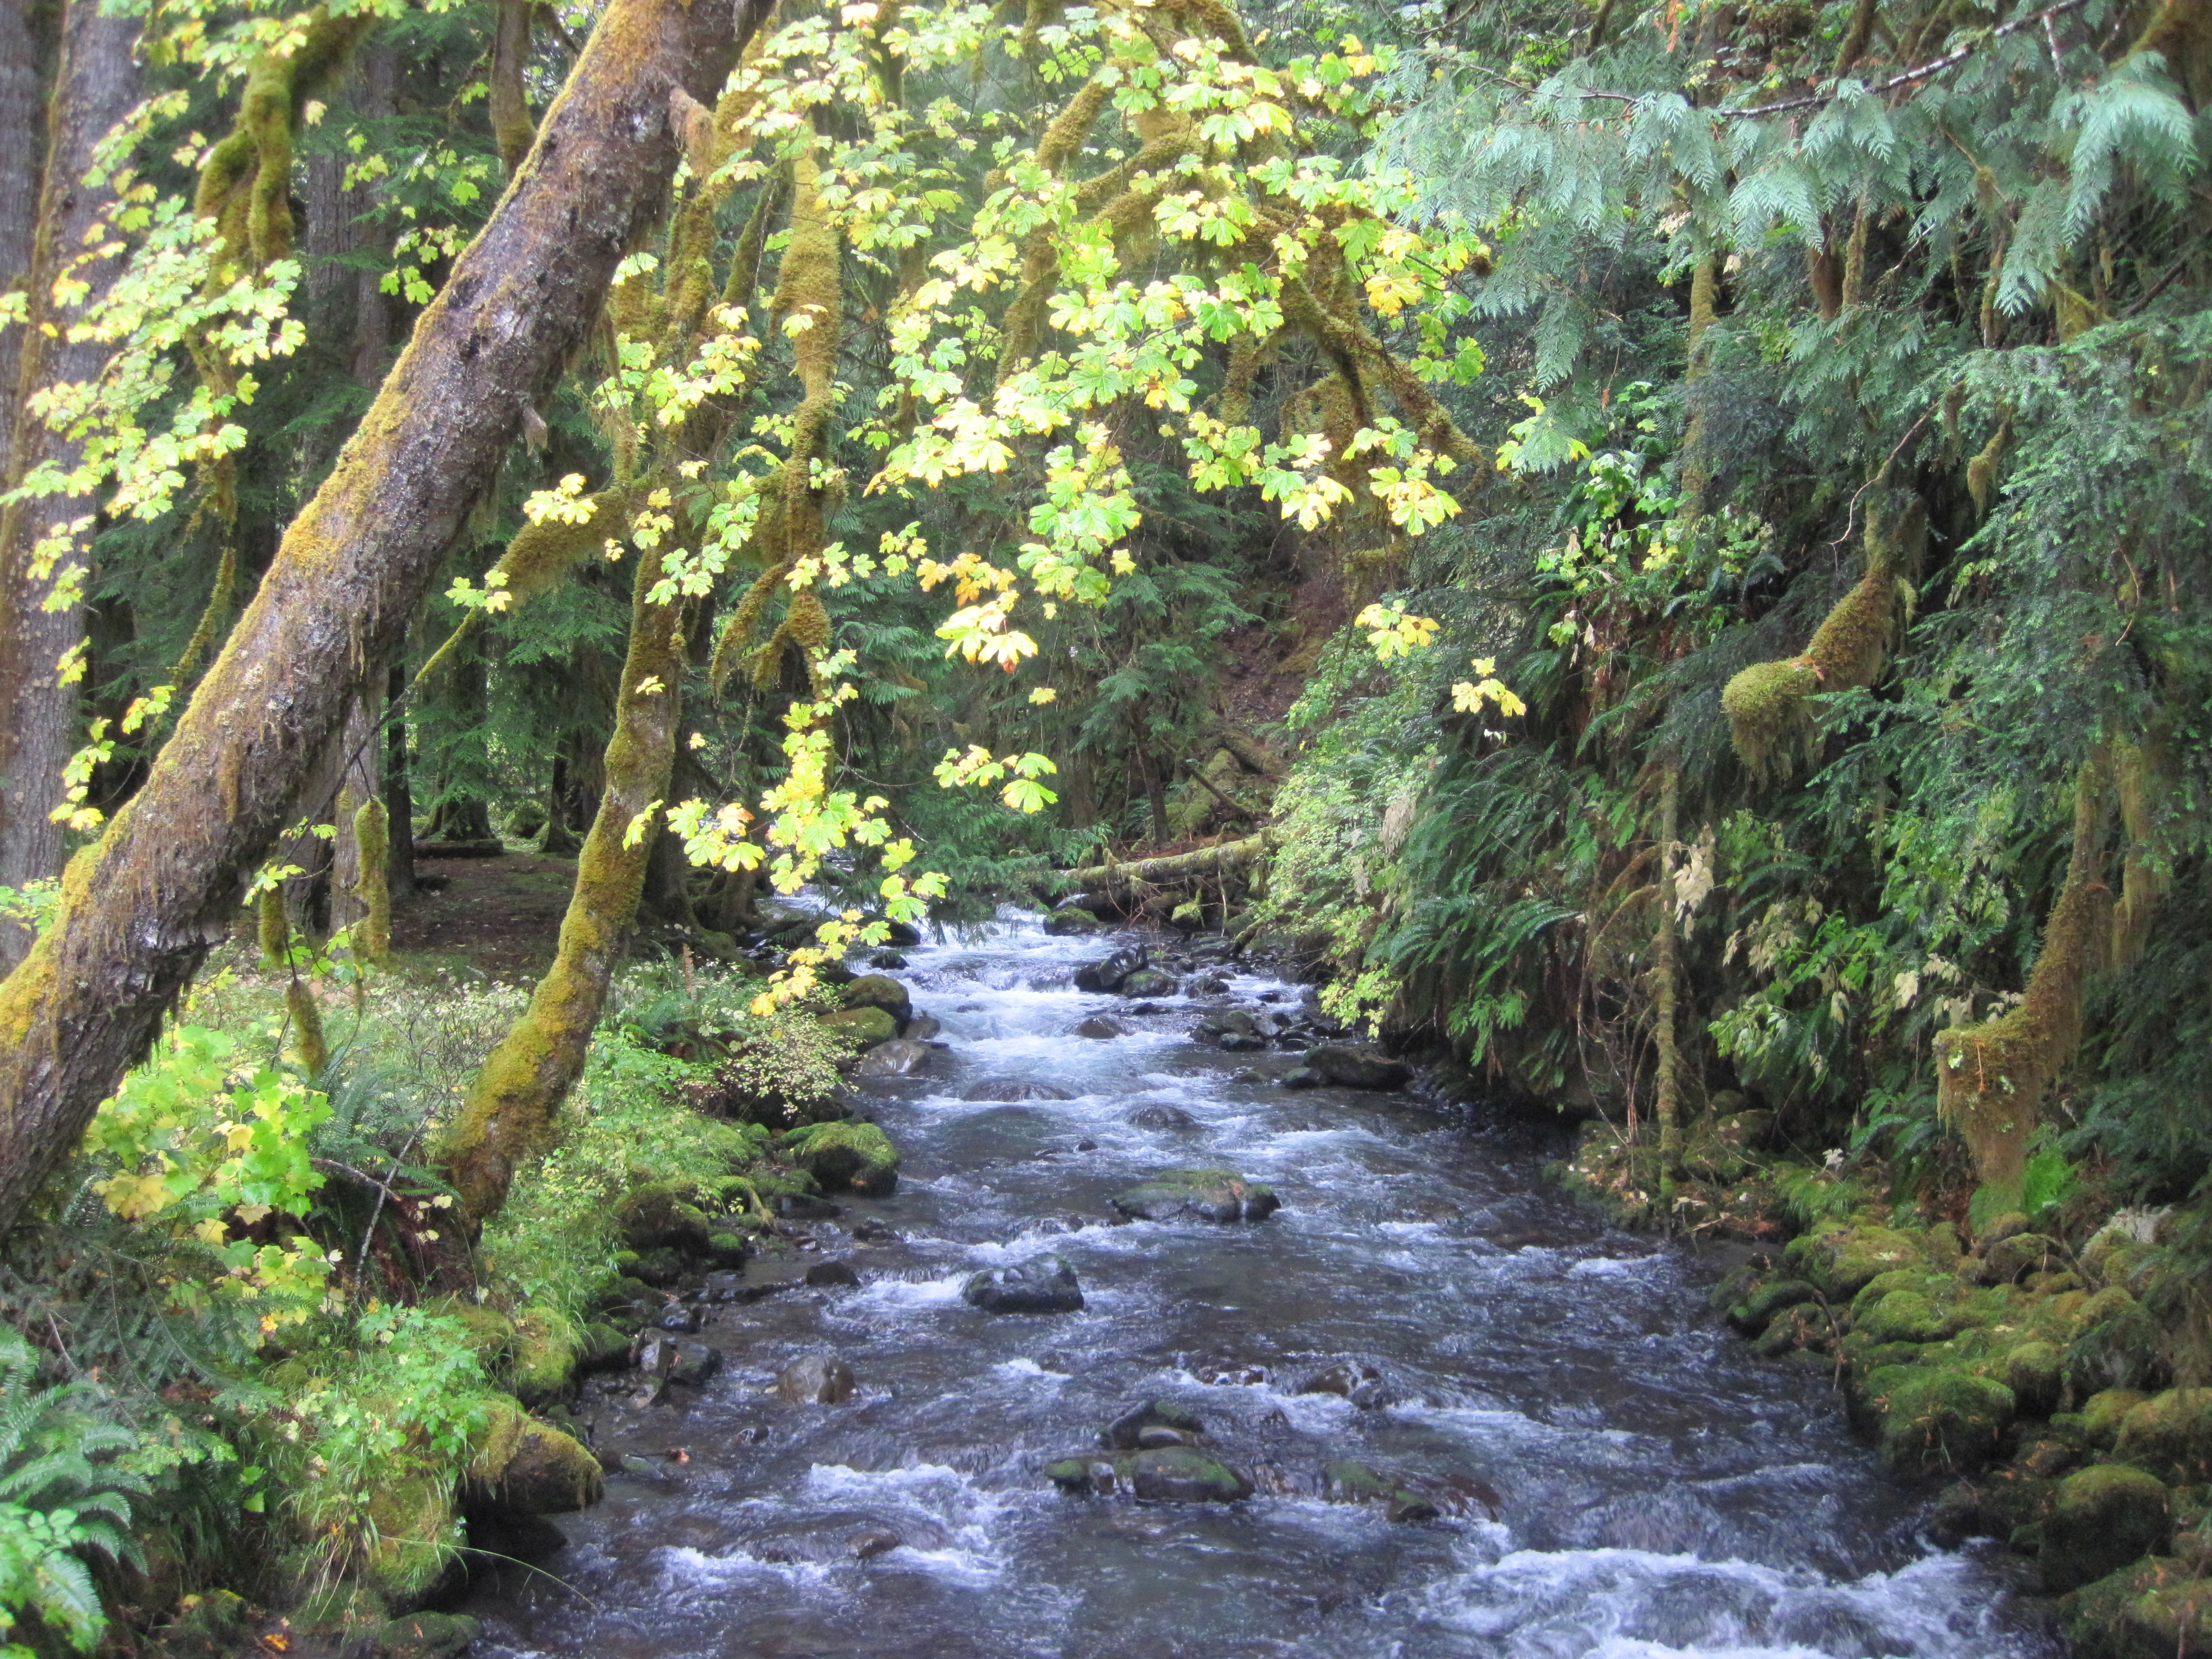
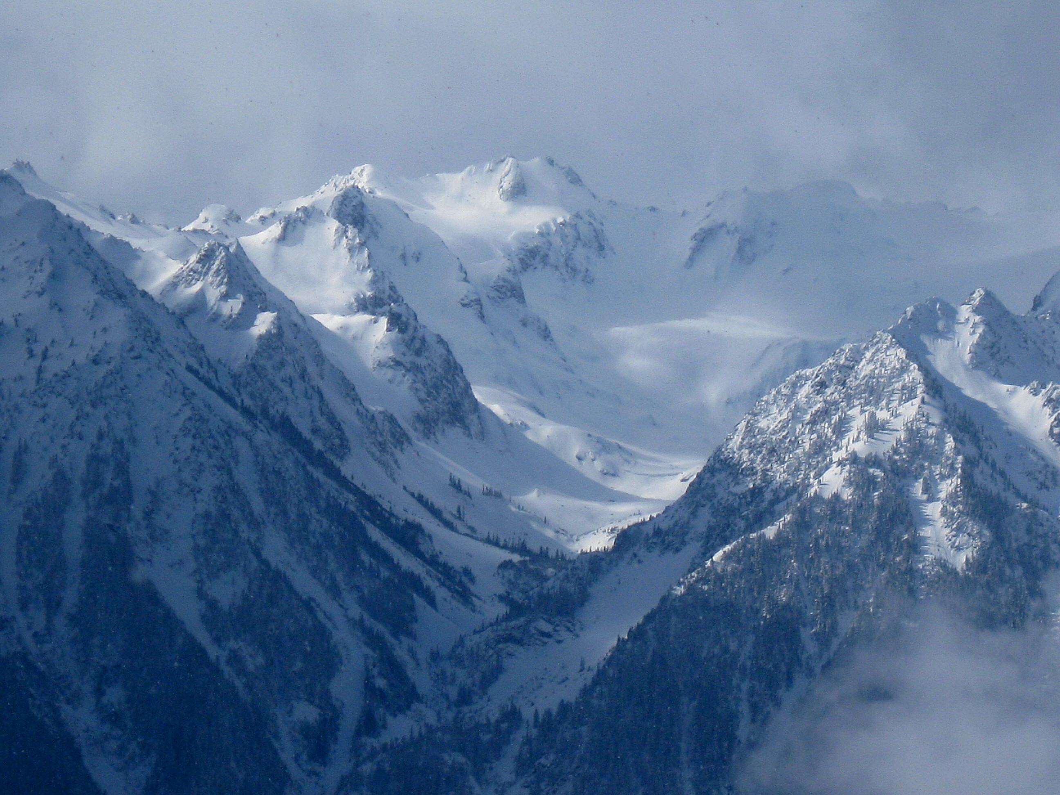
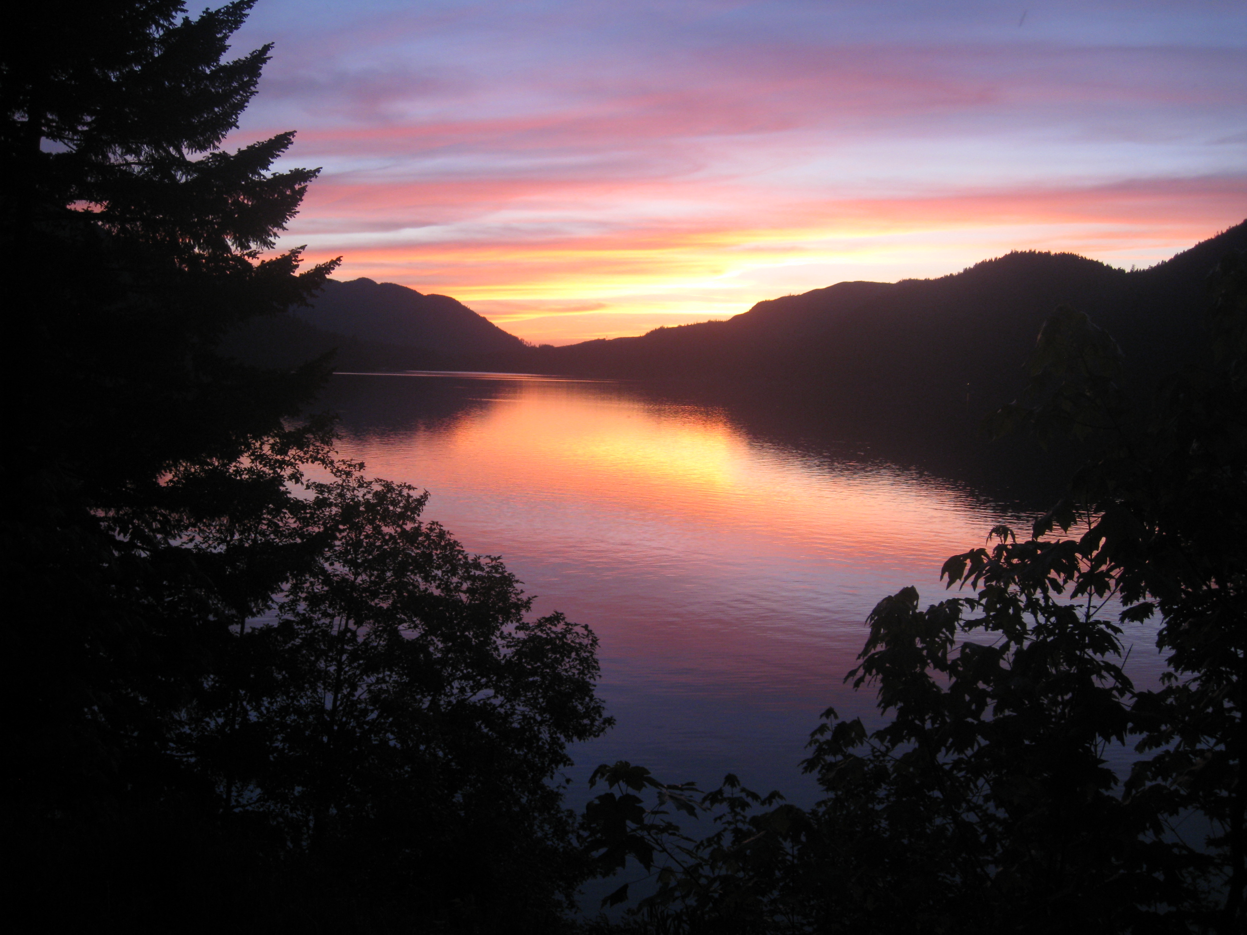
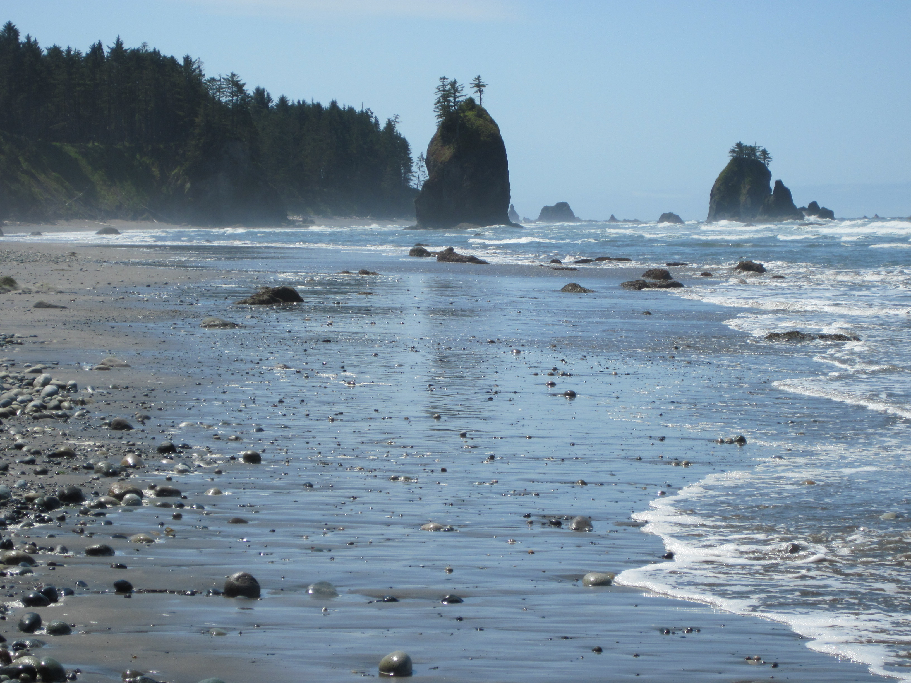
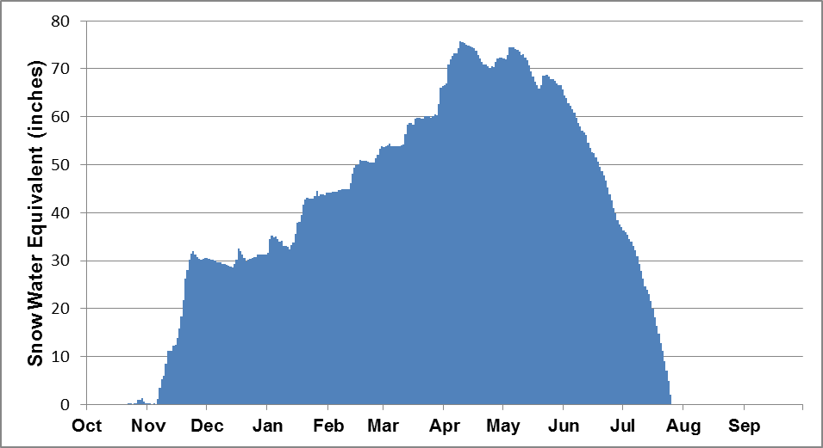
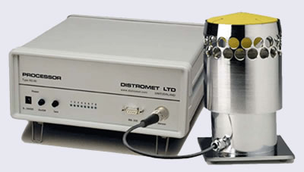
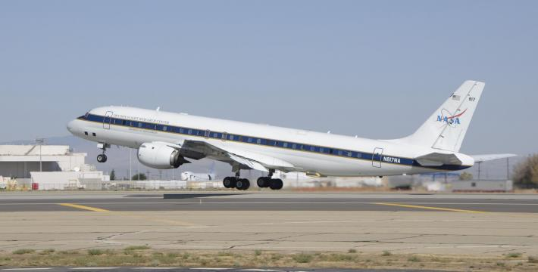
OLYMPEX – A Ground Validation Field Campaign on the Olympic Peninsula in the Pacific Northwest
Lynn McMurdie and Robert A. Houze, Jr., University of Washington, Walter Petersen, NASA/Wallops and William Baccus National Park Service, North Coast and Cascades Network
Climatology of the Olympic Peninsula
Hydrology
Persistent SW flow during winter provides a reliable source of moisture and high rainfall amounts
Overview
During the 2016 water year (Fall 2015 – Winter 2016), a Ground Validation Field Campaign for the Core satellite of the Global Precipitation Measurement (GPM) will occur on the Olympic Peninsula. The main purpose will be to validate the algorithms for the GPM Microwave Imager (GMI) and the Dual Frequency Precipitation Radar (DPR) for precipitation (both frozen and liquid) in the midlatitudes in a region of complex terrain, with transition from ocean to coast to land.
Science Focus
Several important scientific issues will be addressed with the measurements obtained during the field campaign. These include:
Physical validation of algorithms
Rain and snow mechanisms in complex terrain
Hydrological applications of the GPM measurements
Numerical modeling of precipitation processes and algorithm physics
The Elwha
One of the main goals of GPM is to provide precipitation estimates for input into hydrological applications such as forecasting flood events and water supply. OLYMPEX will focus on the Quinault and the Chehalis river basins.
The Hoh
NCEP mean sea level pressure (mb) for winter (November to February)
Total precipitation for 2009 – 2010 Water year at SNOTEL and NPS sites.
The Quinault
The Chehalis
Frequency
0°C level in KM at KUIL
Flooding on the Chehalis near Centralia
Mean 0°C level during moist onshore flow in winter is 1.5 km
Precipitation distribution as derived from 5-year climatology from a mesoscale numerical model and verified by rain gauges.
The Quinault River in winter showing a low rain/snow line.
GMI
The Hoh
Precipitation varies between ridges and valleys and exhibits enhancement on the mountain ridges.
Forecast (red and green) and observed (blue) streamflow for the Hoh river near Forks.
Small stream in the Elwha
North Fork of the Quinault
Rain Measurements in the Olympics
GPM Satellite
Olympic Peninsula
Modeling
(a)
(c)
(d)
The WRF mesoscale numerical model is run real time for 2 forecast cycles and at several resolutions everyday at the University of Washington (http://www.atmos.washington.edu/mm5rt/). The output will be crucial for operation support during the OLYMPEX field phase. In addition, the higher resolution runs (4km, 1.3 km) will be used to model precipitation processes in complex terrain and for developing algorithm physics.
SNOTEL
RAWS sites
COOP site
Gauge site
(b)
NPOL
Locations of SNOTEL, RAWS, COOP and Quillayute upper air station (a), and surface network of tipping bucket rain gauges (b)
Radar reflectivity at Langley (c) and vertically pointing S-Band Precipitation Radar at Westport (d) for 06 UTC 1 March, 2013 showing a warm advection rain event with a relatively high melting level (~2.1km or 7000+ ft.).
(a)
(b)
(c)
Currently there are SNOTEL, RAWS, a CRN station and rain gauges deployed. The Atmospheric River Observatory and the WSR-88D Coastal radar have been operating since 2007 and 2011, respectively. The NPOL S-band dual-pol radar is proposed for the campaign with additional rain and snow gauges, disdrometers and potentially other radars.
Field Campaign
The field campaign will focus on the extreme precipitation and its’ variation across the Olympic Peninsula with emphasis on two major river basins: the Quinault, which has its’ headwaters in high terrain and the Chehalis, which is a broader river draining from lower terrain.
Typical temperate rain forest
Observations and forecasts for a typical land-falling cyclone affecting the Olympic Peninsula. (a) IR satellite image with 500 hPa heights and observations overlaid for 00 UTC 25 February 2013, (b) 9-hr forecast of sea level pressure, 10-m winds and 925 hPa temperature by the 36-km WRF run valid 09 UTC 25 February 2013, and (c) 9-hr forecast of 3-hr precipitation ending 09 UTC 25 February 2013 by the high resolution 1.3 km WRF run. Note the forecast of strong westerly winds along the Washington and Oregon coasts and the strong enhanced precipitation forecast for the western and southwestern slopes of the Olympics and the maximum precipitation along the windward slopes of the highest terrain.
Snow Measurements in the Olympics
Challenges and Opportunities
There are 4 SNOTEL sites on the Olympic Peninsula, 3 of which are on the eastern side of the Peninsula. The 4th, Buckinghorse, is at the headwaters of the Elwha and is representative of the wetter side. For the field campaign, several instruments that can operate in snow environments are proposed including hot plates and video disdrometers.
The Olympics are a natural laboratory for midlatitude precipitation studies.
High rainfall amounts and relatively low melting level
Complex terrain leading to highly variable distribution of precipitation
Transition from ocean to coast to land in a relatively compact area
West coast flooding due to fronts crossing mountains
These same characteristics are also challenges for algorithm development and understanding orographic precipitation processes.
Measurements from OLYMPEX will bring GPM closer to the goal of monitoring snow and rain on all ranges of scales at all locations globally and applying these measurements to weather forecasting, flood monitoring and water supply.
Proposed Observations
Surface instruments could include:
SNOTEL, RAWS and Climate Reference Station
High density rain gauge network
Video disdrometer
Hot Plates and Pluvio weighing gauges
Radars:
Coastal WSR-88D
Atmospheric River Observatory
NASA NPOL S-band dual-pol radar
Possibly other Radars
Aircraft:
DC-8
Other aircraft could include Citation, P-3, ER-2
Waterhole SNOTEL Station
(a)
(b)
Dual-Gauge Net
Precipitation Video Imager (PVI)
DC-8
Average daily temperatures (a) and snow water equivalent (b) for water year 2010 measured at Buckinghorse SNOTEL Station
On the Blue Glacier, Mt. Olympus
SE Olympics
Acknowledgments
The authors thank Profs. Cliff Mass, Dennis Lettenmaier and Jessica Lundquist for their contributions to this project. All photos by Bill Baccus, except the Chehalis river flooding (AP Photo at KOMONews.com) and two pictures from the Blue Glacier (Ed Blanchard).
This work is supported by The National Aeronautics and Space Administration Grants NNX12AL54G and NNX13AG71G.

