Slide 1
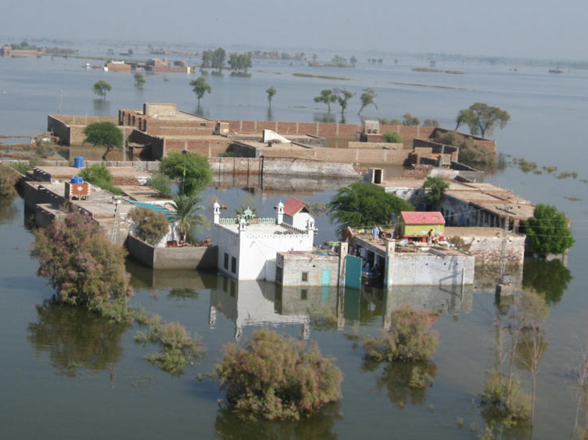
TRMM Insights into Recent Floods in Pakistan
R. A. Houze, Jr.
with
K. Rasmussen, and A. Hill
PMM Science Team Meeting, Annapolis, 18 March 2013

Slide 2
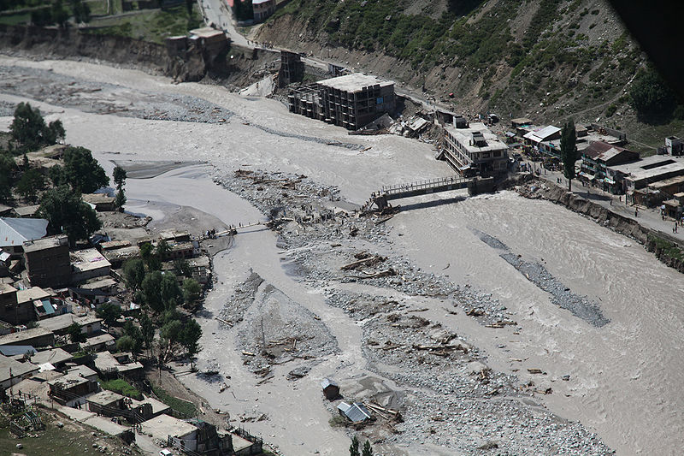
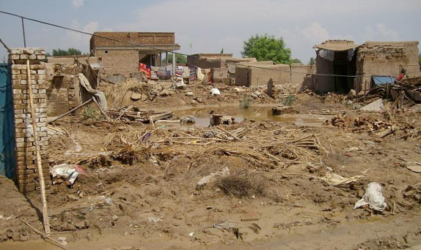
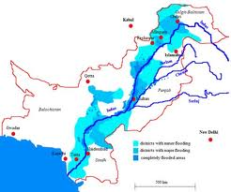
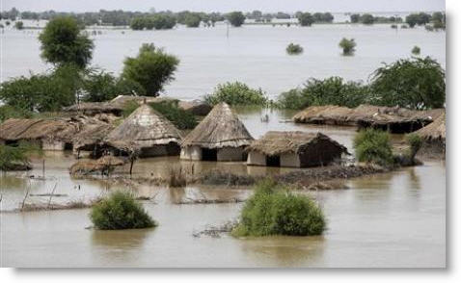
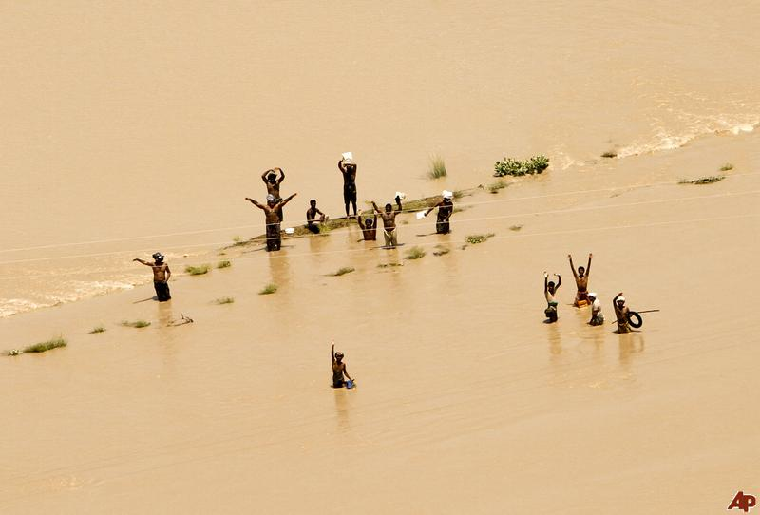
Pakistan 2010
2000 lives, extensive livestock, household, infrastructure & agricultural losses

Slide 3

Article on the 2010 Pakistan floods in BAMS
March 2011

Slide 4
Major floods in Pakistan in last 3 years
2010—Indus River, 2000+ dead, 20M+ affected
2011—Sindh region, lower Indus River, 400+ dead, 8M+ affected
2012—Sindh region, lower Indus River, 450+ dead, 5M+ affected
Notes:
Flash floods:
Doswell (1985)—”stationary synoptic environment produces storms that regenerate over a steep watershed
84 prone to flooding.”
Gruntfest and Handmer (2001)—define flash flooding events based on specific characteristics, such as their sudden occurrence, high risk to life and property, occurrence in unexpected locations, small local scale, and short duration

Slide 5
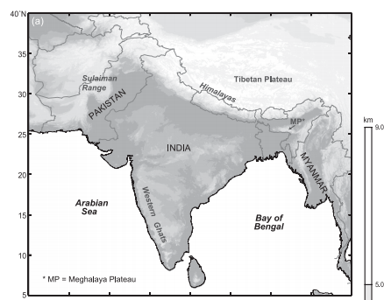
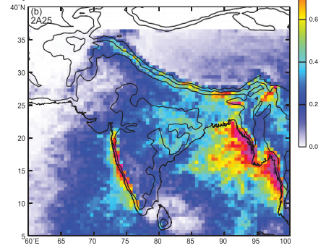
Geography &Rainfall Climatology

Slide 6
2010
(25-31 July)
2011
(25 Aug – 10 Sep)
Rainfall in flood episodes mm/h
2012
(4– 14 Sep)

Slide 7
Radar Identification of Extreme Rainstorms
Identify each contiguous 3D echo object seen on radar
Convective component
Stratiform component
Extreme characteristic
Contiguous 3D volume of convective echo > 40 dBZ
Extreme characteristic
Contiguous stratiform echo with horizontal area > 50 000 km²
“Broad stratiform region”
Top height > 10 km
“Deep convective core”
Horizontal area > 1 000 km²
“Wide convective core”

Slide 8
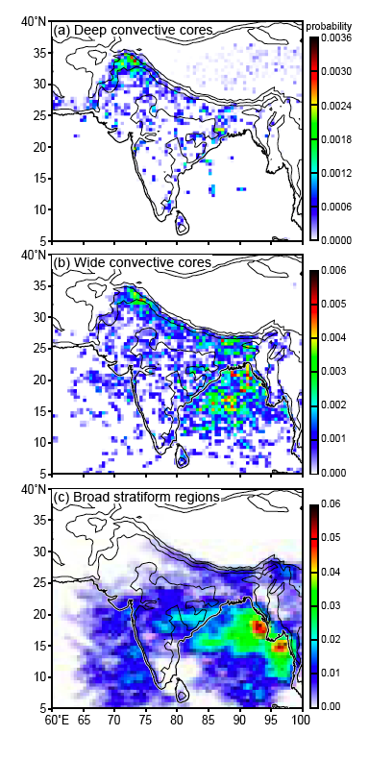
Probability of Broad Stratiform Echo based on multiyear climatolofy of TRMM PR data

Slide 9
Observations of Broad Stratiform Regions During 2010, 2011, & 2012 Flood Episodes
2010
2011
2012

Slide 10
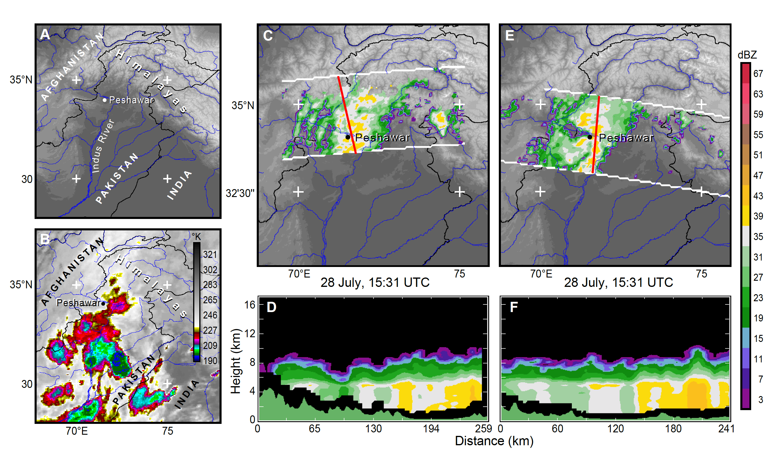
Broad stratiform precipitation over the mountains of Pakistan in 2012
15:31UTC
17:09 UTC
Broad stratiform
Houze et al., BAMS 2011

Slide 11
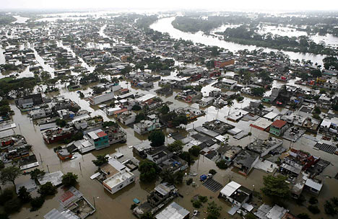
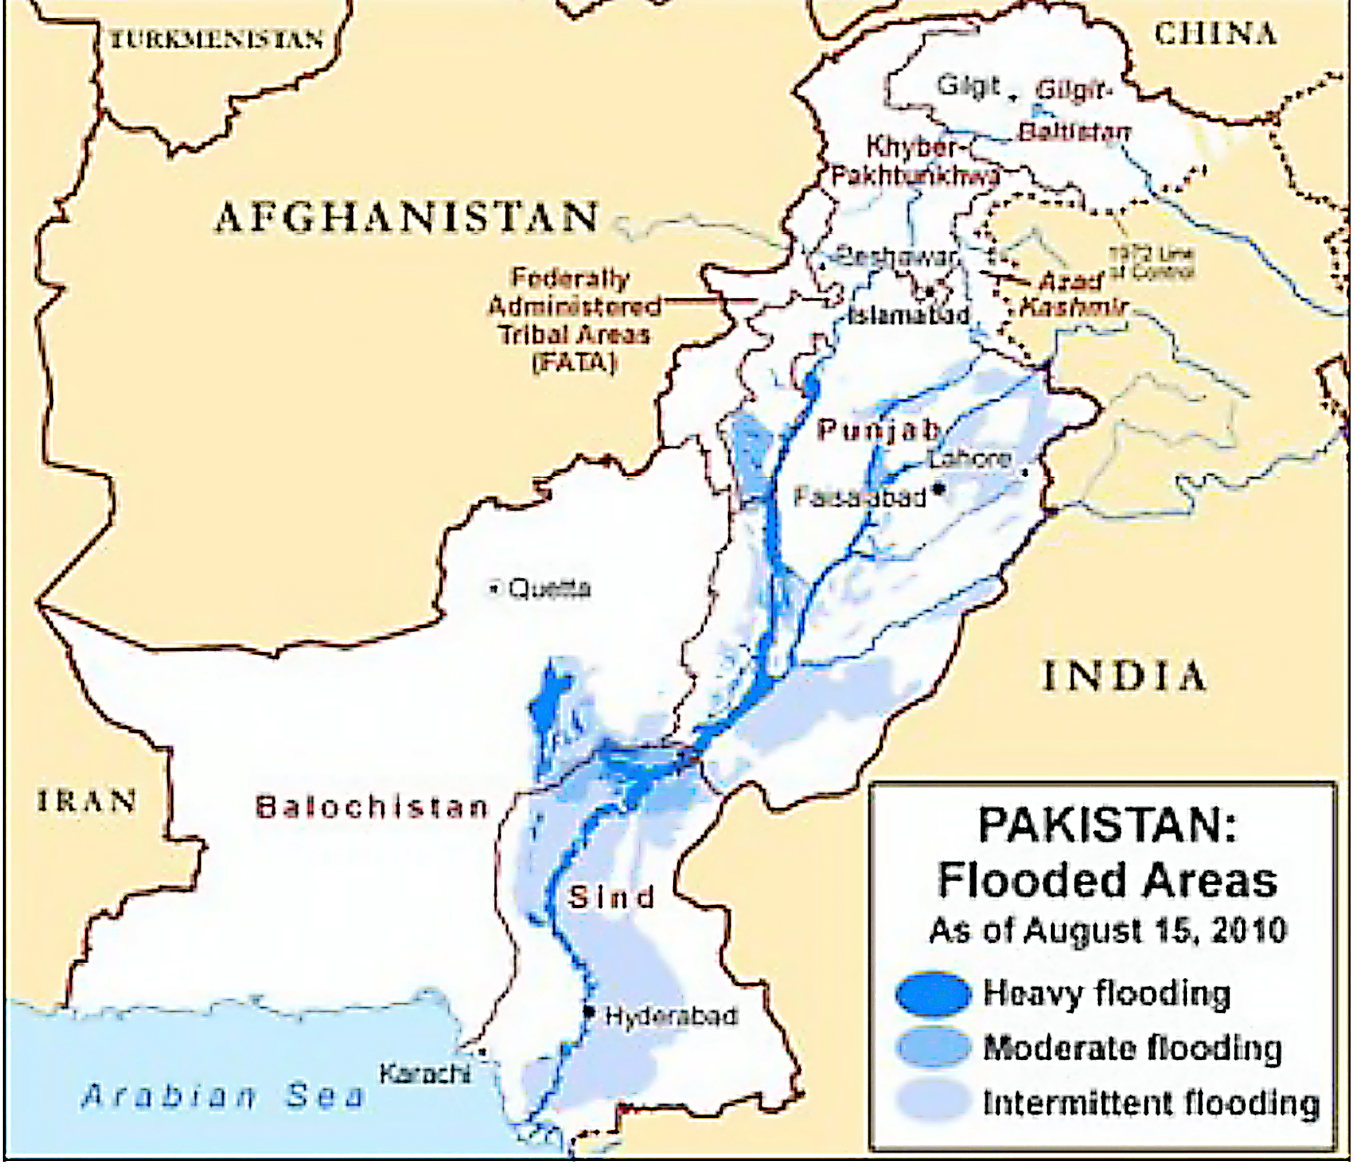
"Almost 20 million people need shelter, food and emergency care. That is more than the entire population hit by the Indian Ocean tsunami, the Kashmir earthquake, Cyclone Nargis, and the earthquake in Haiti—combined.”
Secretary-General Ban Ki-moon
August 2010
Peshawar
Leh

Slide 12
Multiyear TRMM PR Climatology of Wide Convective Echo Cores

Slide 13
Observations of Wide Convective Core Echoes During 2010, 2011, & 2012 Flood Episodes
2010
2011
2012

Slide 14
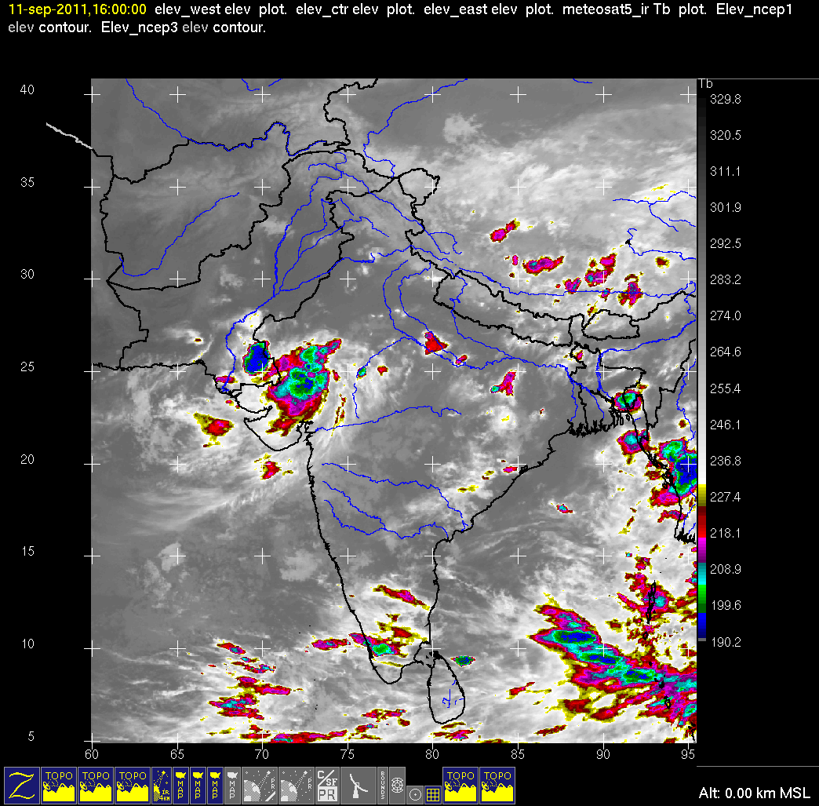

Slide 15
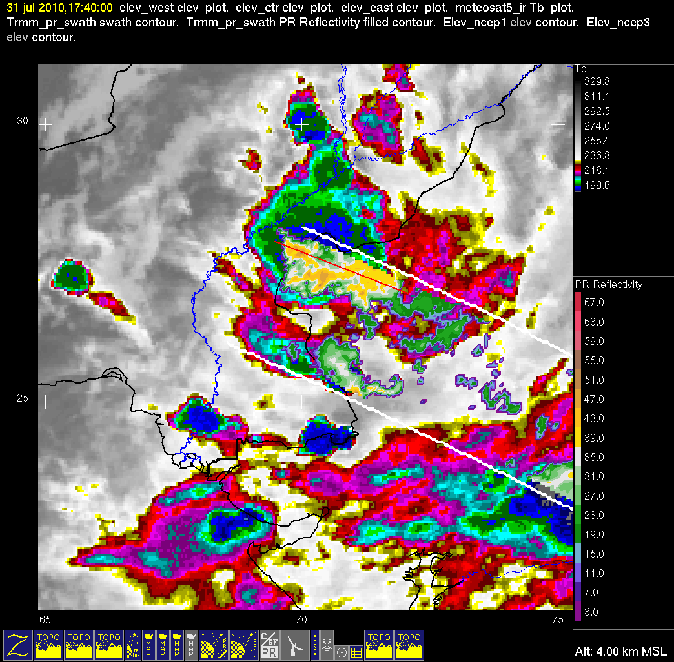
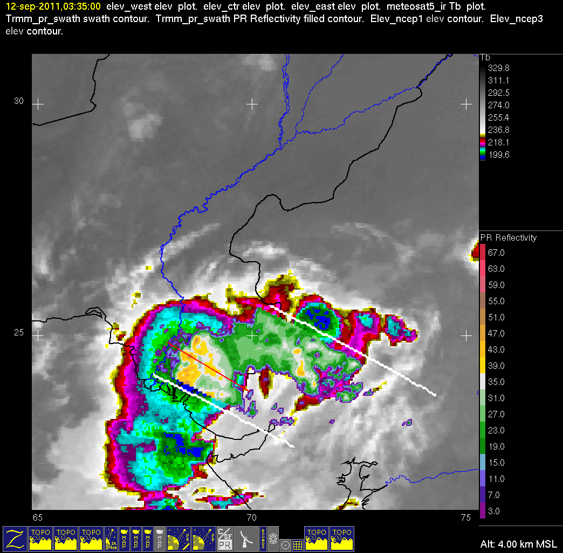
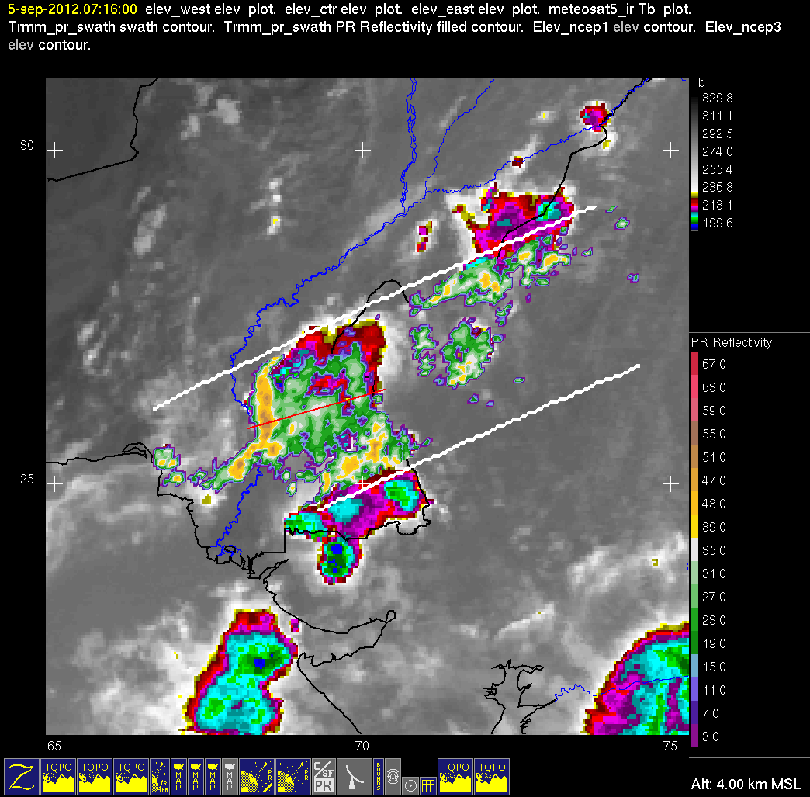
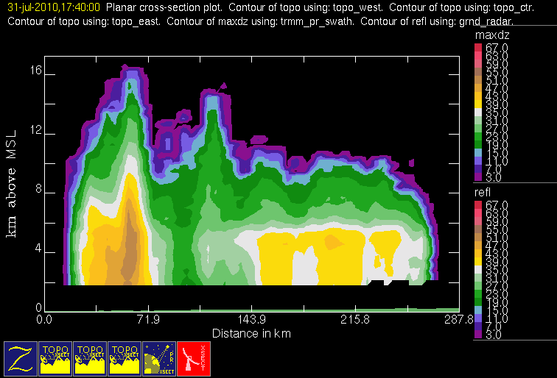
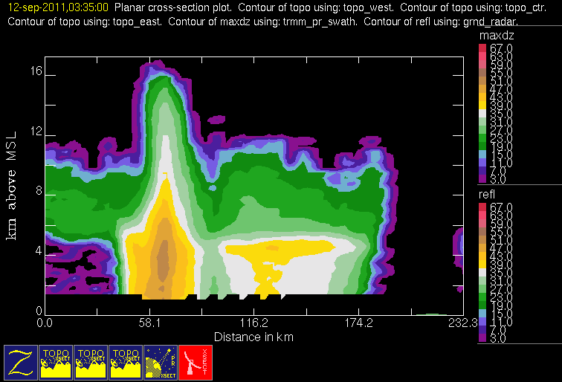
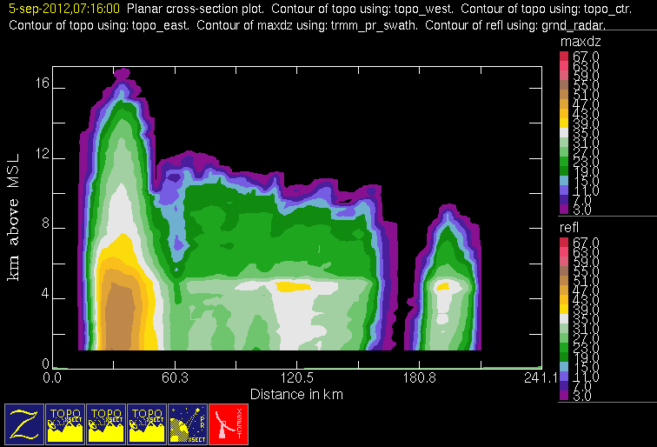
Examples of Storms Producing Floods
2010
2011
2012

Slide 16
Composites for Flood Periods
850 mb PW Anomaly
700 mb Hgt Anomaly
500 mb Hgt Anomaly
2010
2011
2012

Slide 17
JJAS Climatology 1981-2010
200 hPa
700 hPa
500 hPa
850 hPa

Slide 18
Conclusions: TRMM Insights into Recent Floods in Pakistan
Anomalous occurrence of mesoscale organized convection with stratiform
Associated with similar anomalous 700 and 500 hPa flow patterns in 3 consecutive years
PMM Science Team Meeting, 18 March 2013

Slide 19
End
Acknowledgements: NASA Grants NNX10AH70G, NNX11AL65H, and NNX13AG71G
PMM Science Team Meeting, 18 March 2013

Slide 20
Extra slides

Slide 21
Blocking Pattern
500 hgt anom
Surf. T anom
2010
Periods vary in length but all surpass the 5 day minimum length to classify as “blocking” pattern
Periods:
July 25th – Aug. 31st 2010
Aug. 8-16th 2011
Aug. 1-20th 2012
2011
2012

Slide 22
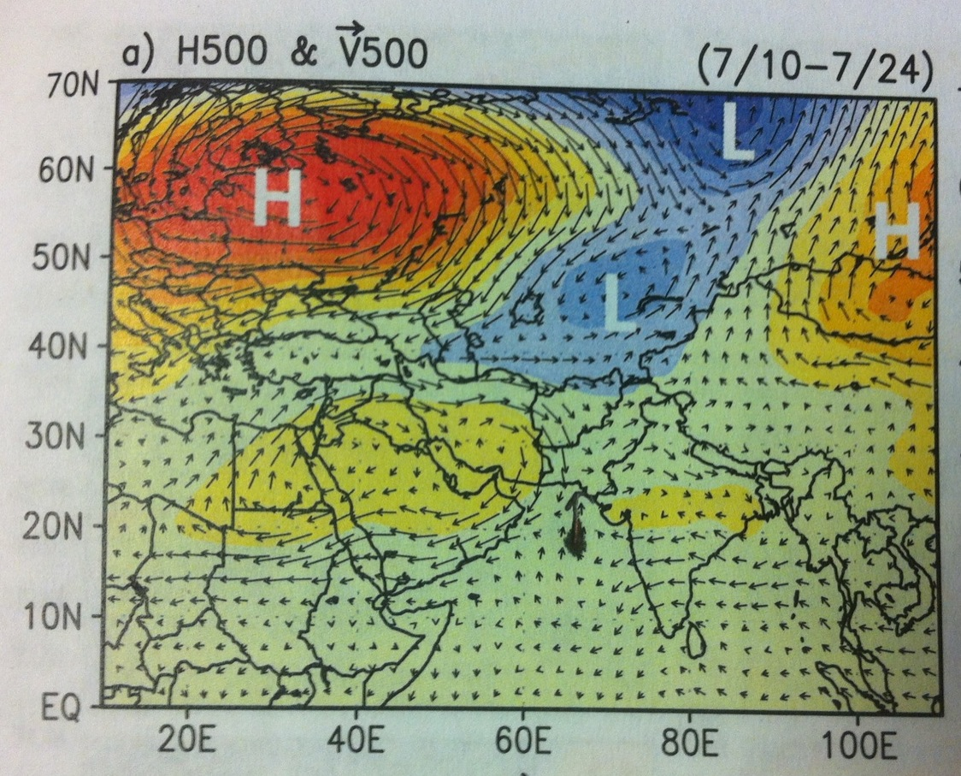
Rossby Wave Train
Onset periods of significiant flooding indicate this Rossby Wave Train (Lau and Kim 2012) that precede flooding events in ALL THREE YEARS
July 18-24th 2010
Aug 22-28th 2011
July 25-31st 2012
anomalies

Slide 23
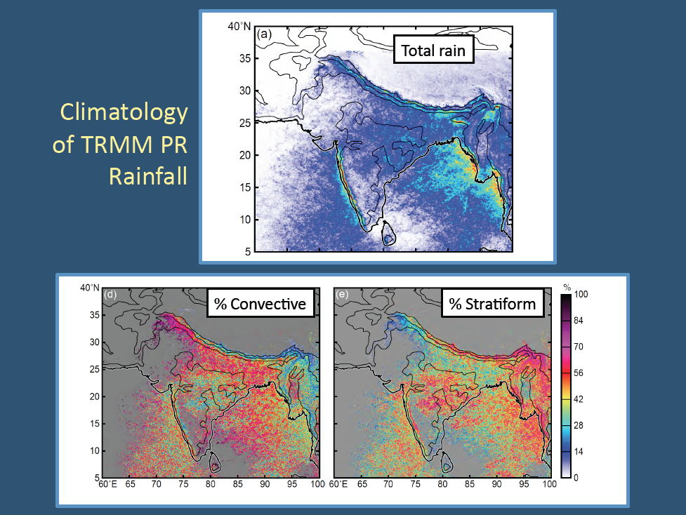

Slide 24
