Slide 1

Nonprecipitating Phenomena Seen by the S-PolKa Radar in DYNAMO
R. Houze
University of Washington
DYNAMO Workshop, Hapuna Beach, Hawaii, 5 March 2013

Slide 2
Summary
Low-level humidity and cumulus features seen by S-PolKa
Humidity
Cumulus organization

Slide 3
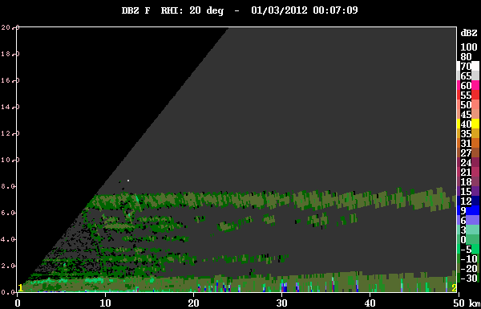
Humidity gradient layers and nonprecipitating clouds

Slide 4
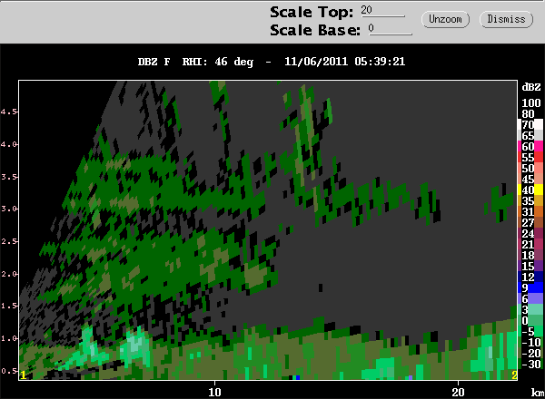
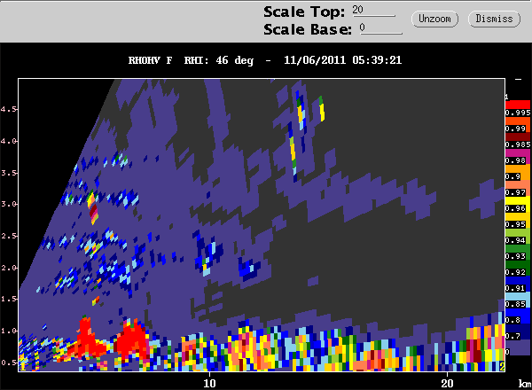

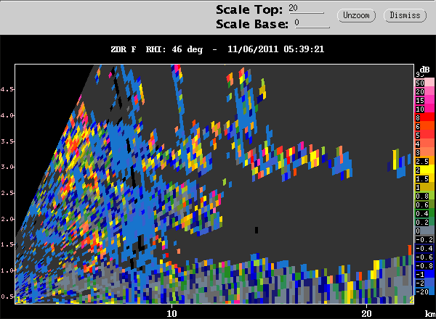

dBZ
“Mantle Echoes” Knight and Miller (1998)
Bragg scattering shows nonprecipitating cumulus in the moist layer
ρhv
ZDR

Slide 5
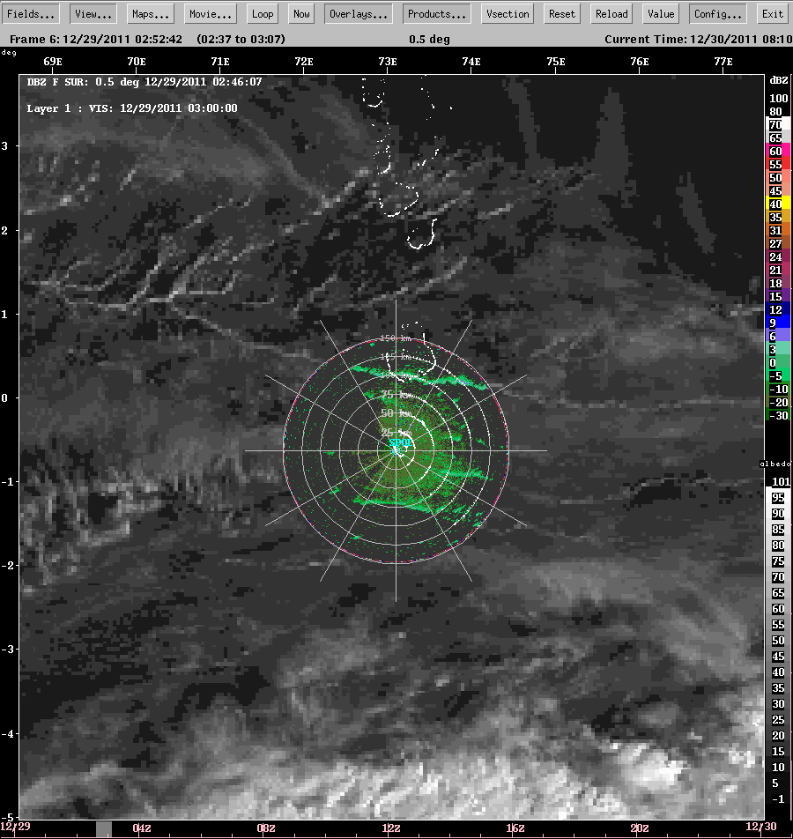
Long lines of cumulus

Slide 6
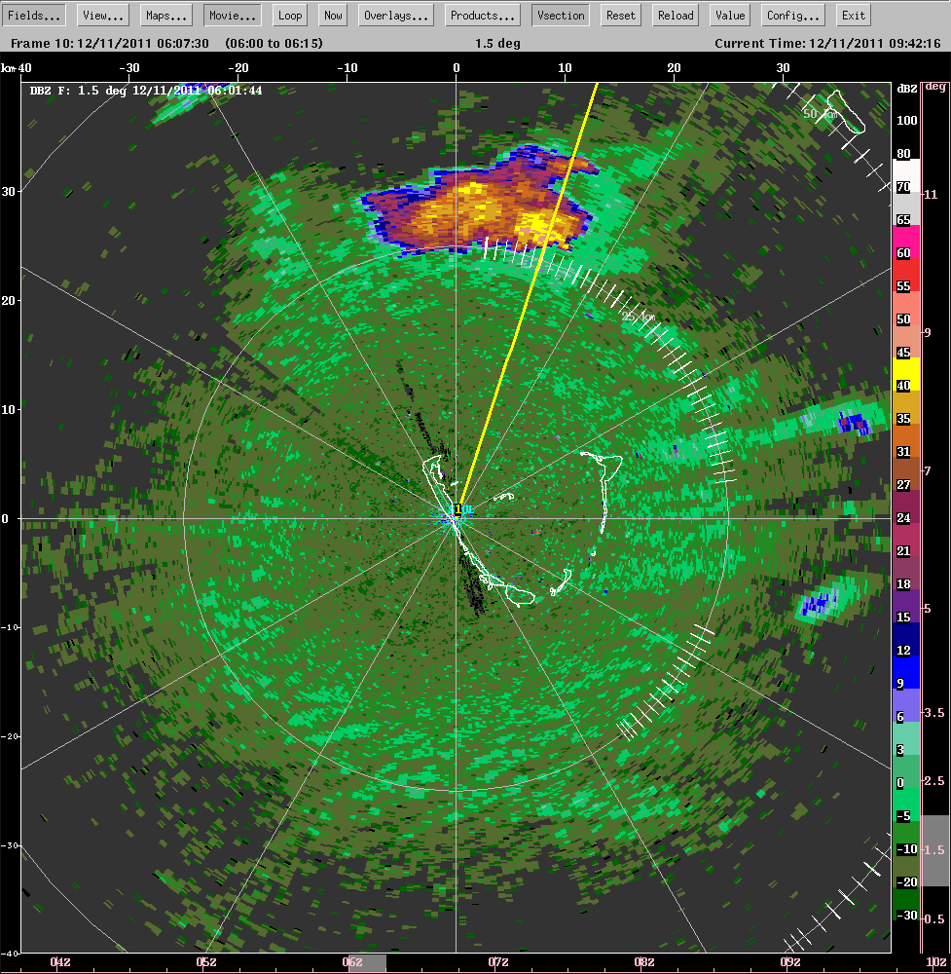
Lines of cumulus parallel to wind

Slide 7
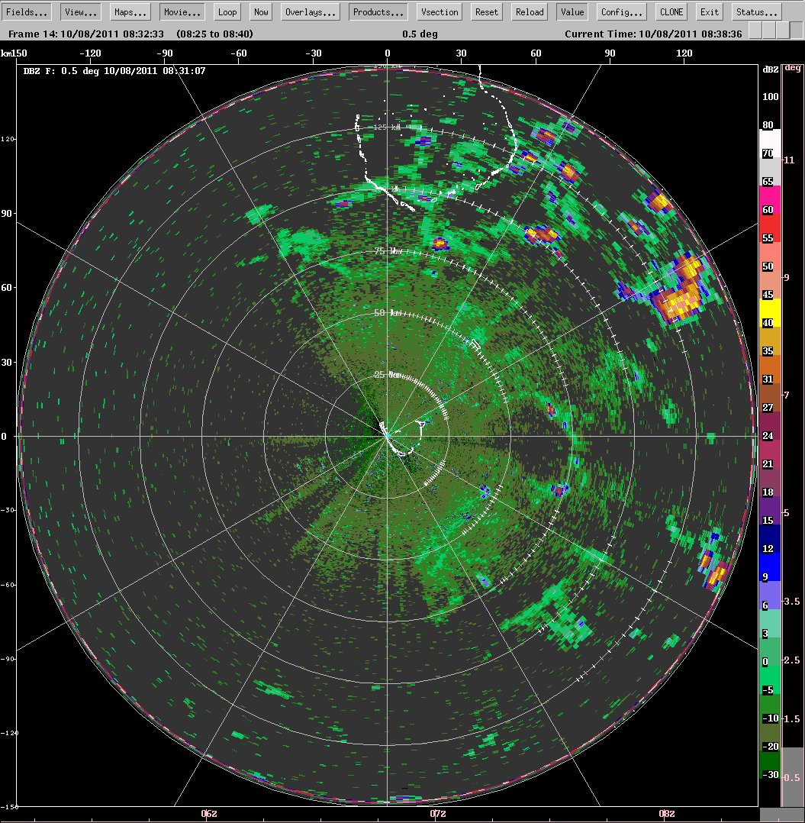
Slightly active moist layer
Clouds building at cold pool boundaries

Slide 8
End
This research was sponsored by DOE ARM grant #DE-SC0001164/ER-64752

