Slide 1

Microphysics of 2-Day Rain Events During the Active Stage
Hannah C. Barnes
Robert A. Houze, Jr.
University of Washington
MJO Field Data and Science Workshop
5 March 2013, Hapuna Beach Resort, Kohala Coast, Hawaii

Slide 2
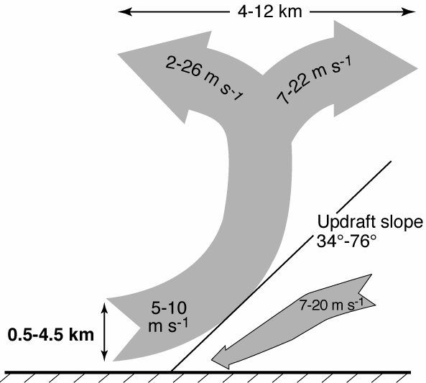
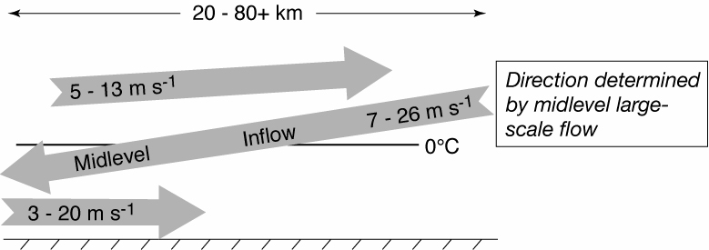
Conceptual Model of Kinematic Structure of MCS
3D, layer airflow
Convective
Stratiform
Kingsmill and Houze (1999a)

Slide 3
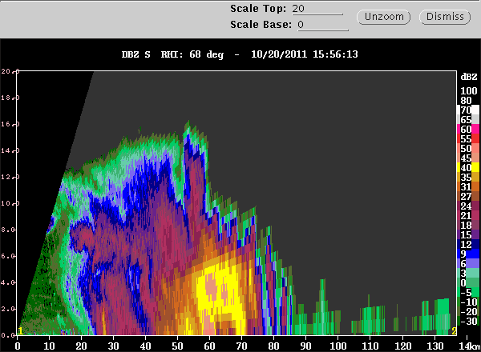
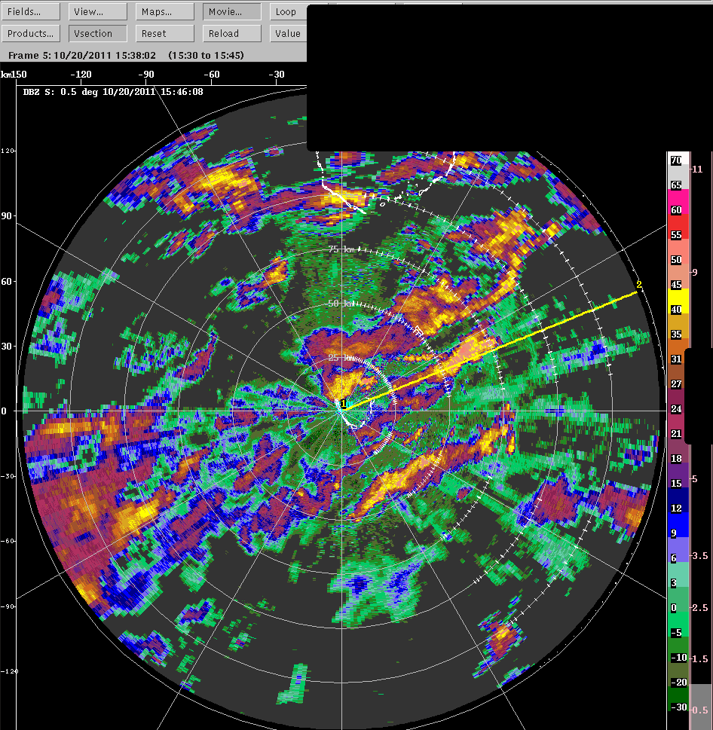
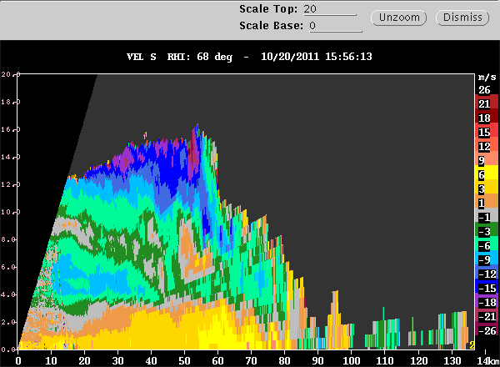
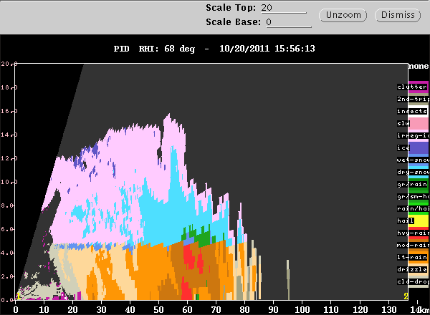
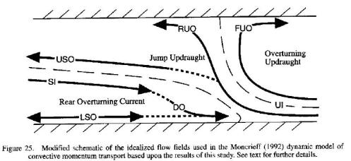
Leading Cell and Trailing Stratiform
1546 UTC 20 Oct 2011
Reflectivity
Radial Velocity
Particle Identification
Kingsmill and Houze 1999a
Notes:
This is a cell that develops along a convergent line that is rapidly moving towards the west. Cell develops and stratiform trails behind.

Slide 4
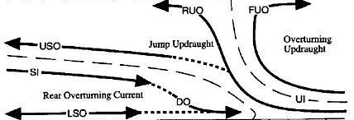
Conceptual Model of Microphysics
Anvil Stratiform Convective
Non-Oriented Ice
Oriented Ice
Dry Aggregates
Graupel
0˚C
Drizzle
Dry Aggregates
Light Rain
Heavy Rain
Graupel
Melting Aggregates
Rain / Graupel
Notes:
If convective cell alone will not have wet snow. If the cell develops in stratiform it may or may not. It is possible that the cell forms and then all the wet snow disappears.

Slide 6
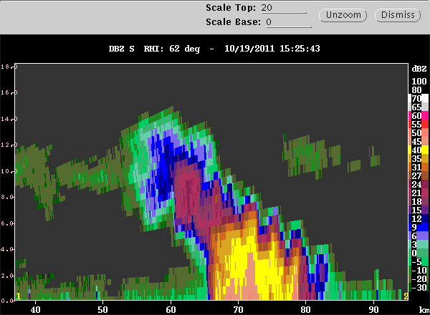
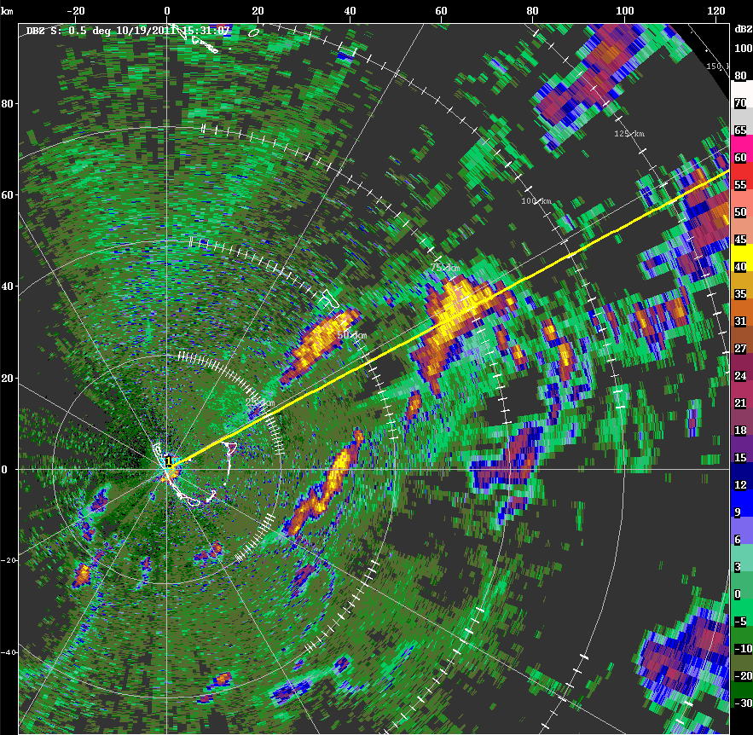
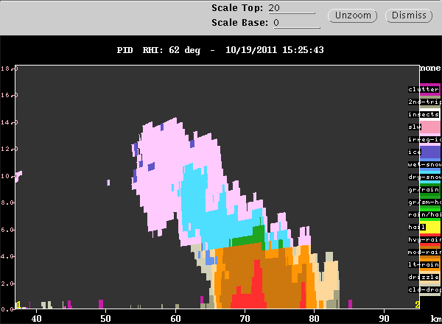
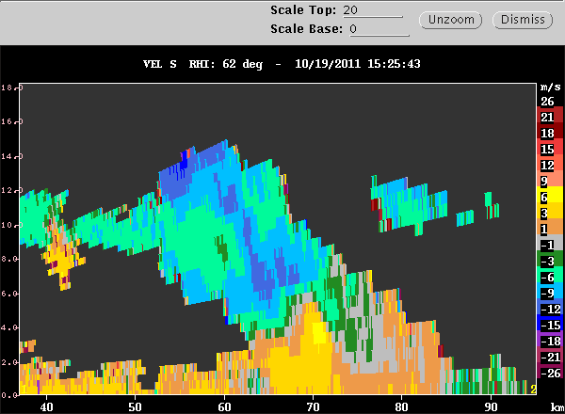
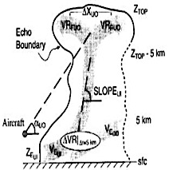
Convective Cell
Reflectivity
1531 UTC 18 Oct 2011
Radial Velocity
Particle Identification
Kingsmill and Houze (1999a)
Notes:
This cell appears to form on a coldpool as a number of cells merge. It dissipates by emitting its own coldpool, which generates two bands of convection on either side. You can see the coldpool “burst” from the convection.
Can see that this cell is developing in a region that has alto clouds.

Slide 7
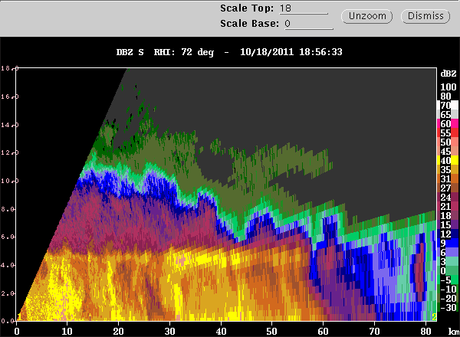
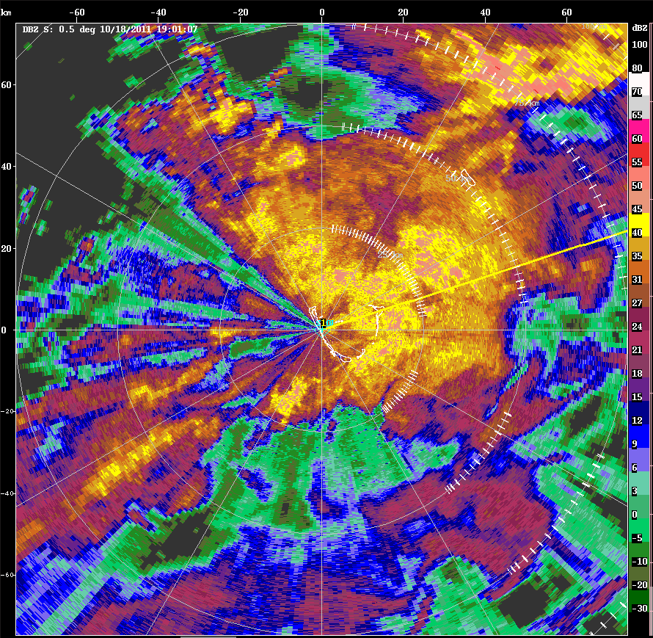
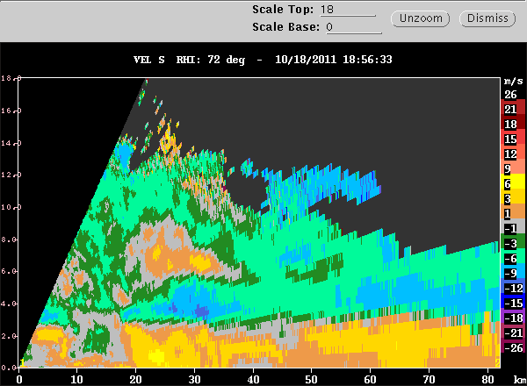
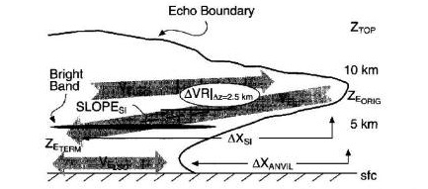
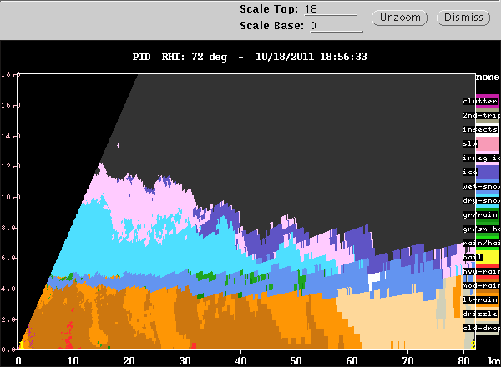
Stratiform Region
Reflectivity
1901 UTC 18 Oct 2011
Radial Velocity
Particle Identification
Kingsmill and Houze (1999a)

Slide 8
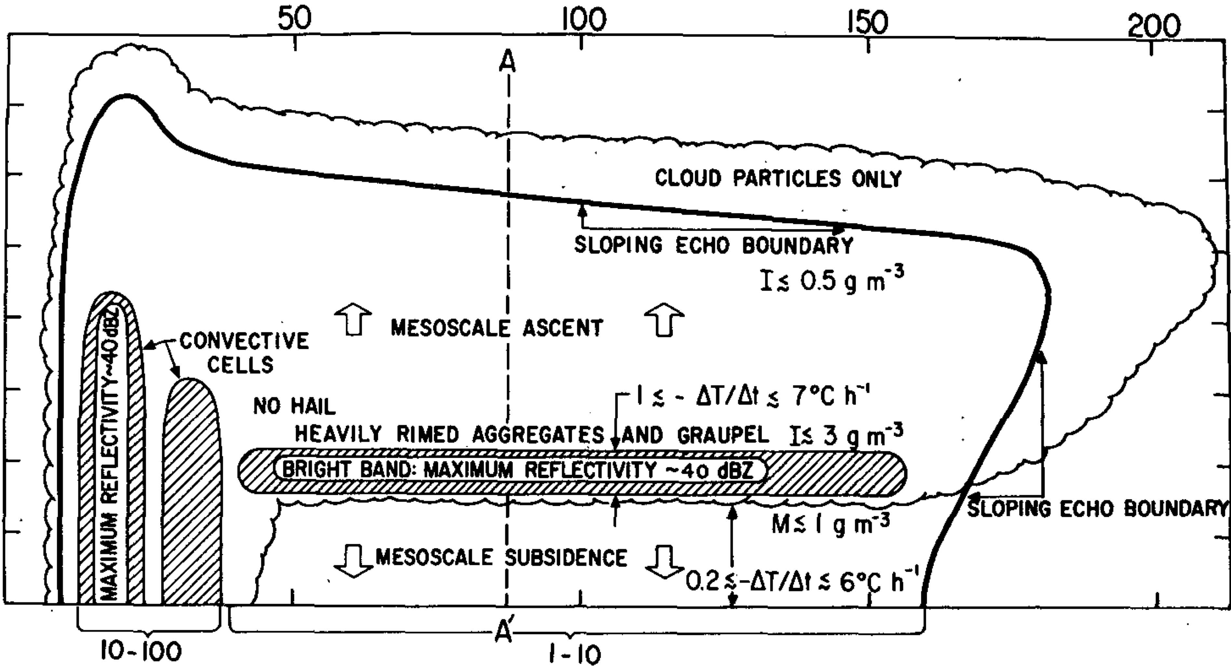
Theorized Hydrometeor Profile of MCS from GATE
Leary and Houze (1979b)

Slide 9
Acknowledgements
Funding
  DYNAMO – NSF AGS-1059611

