Slide 1
Hydrometeor characteristics from S-Pol
Angela Rowe
Radar Breakout Session
DYNAMO Workshop, Kona, Hawaii
5 March 2013

Slide 2
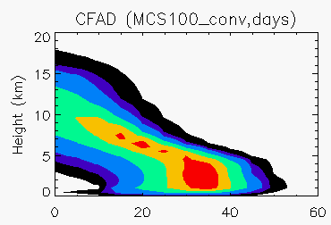
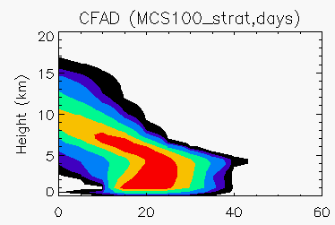
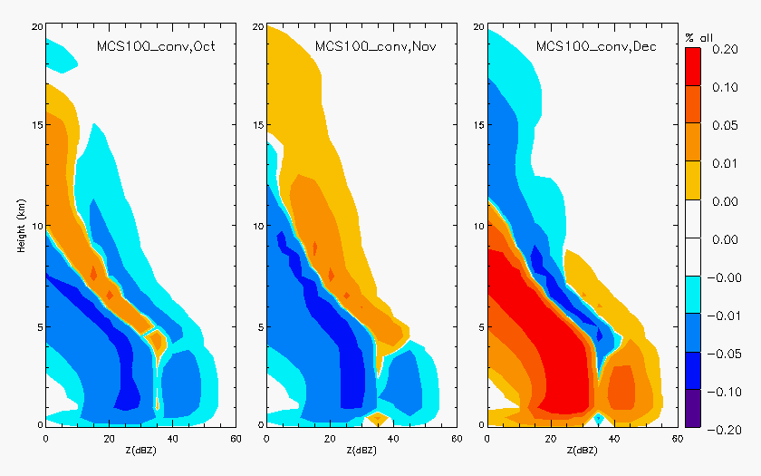
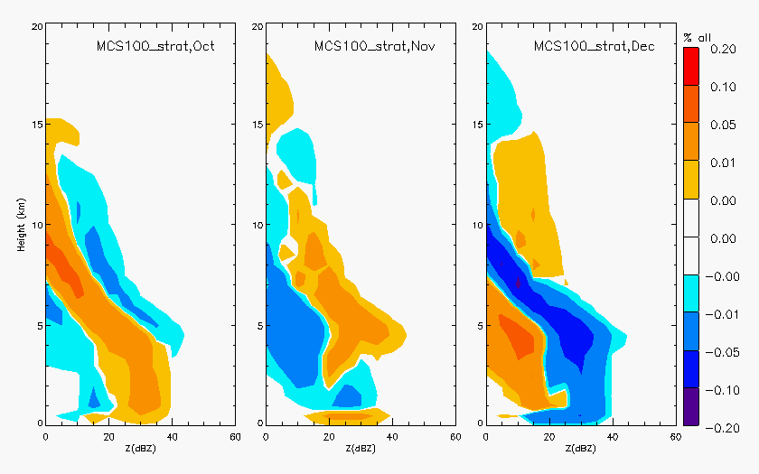
CFADs
Z (dBZ)
Z (dBZ)
Convection
Stratiform
Oct
Nov
Dec
Oct
Nov
Dec

Slide 3
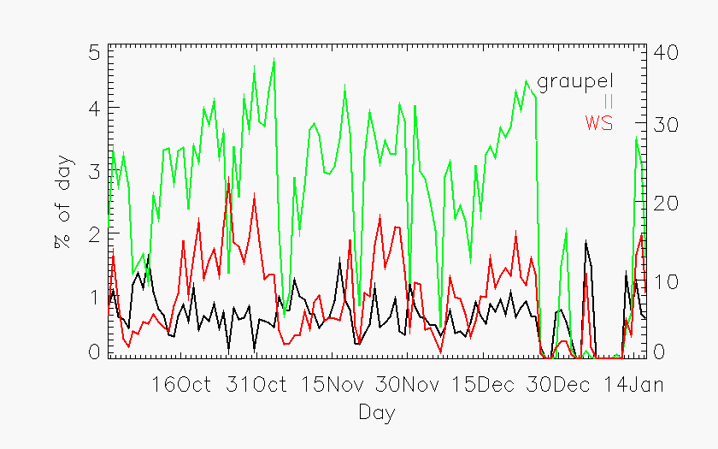
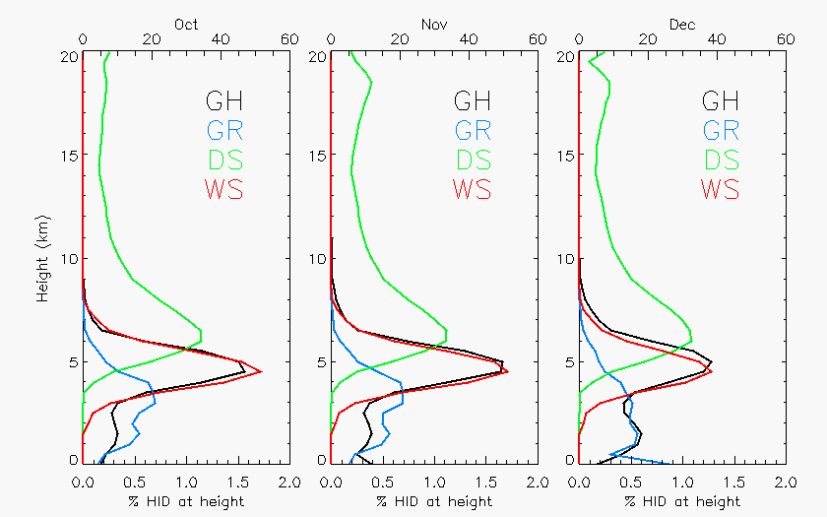
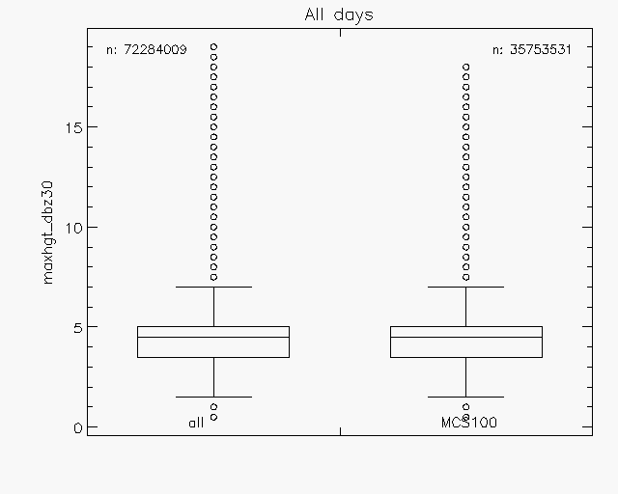
Hydrometeor Characteristics
Persistent ice
Wet snow peaks during active periods
Presence of graupel
Limited to within a few km of melting level
all
MCS

Slide 4
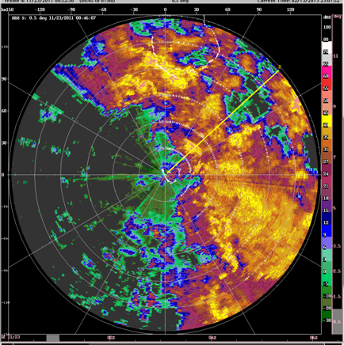
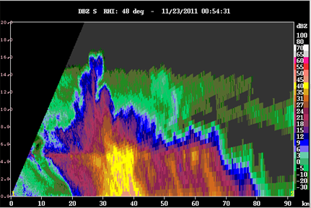
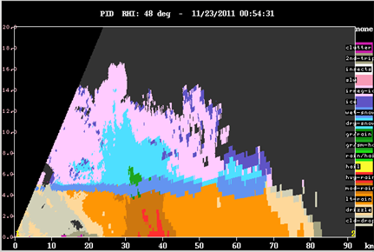
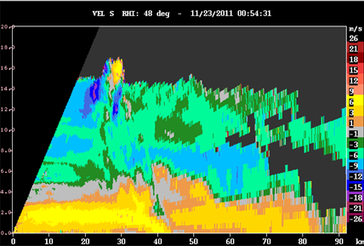
11/23/2011
Z
PID
V

Slide 5
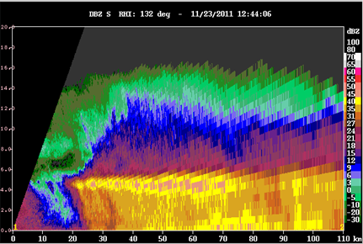
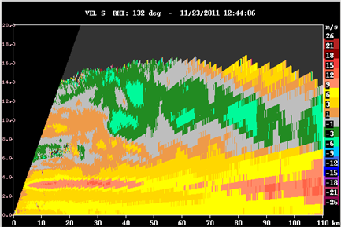
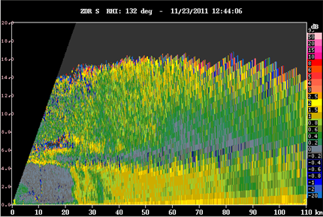
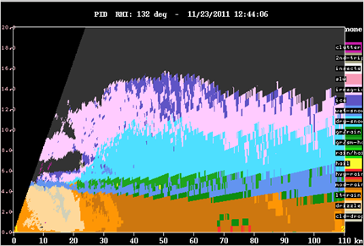
11/23/2011
Z
V
50 dBZ!
ZDR
PID

Slide 6
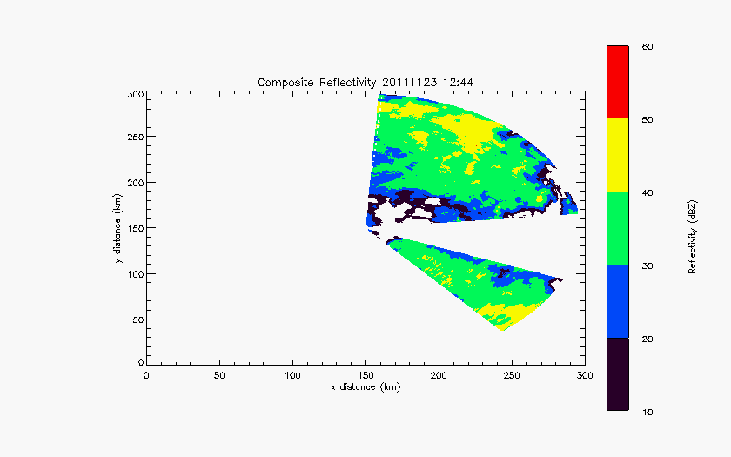
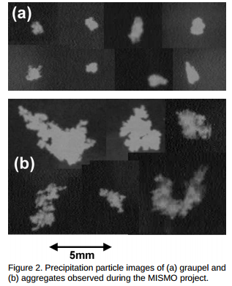
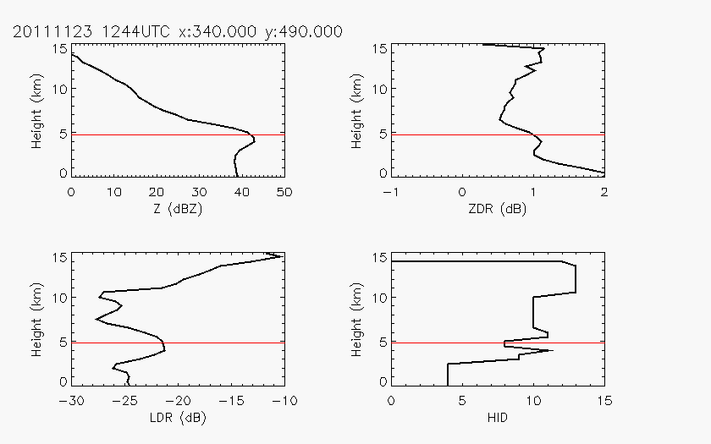
Suzuki et al. (2008)
Straka et al. (2000): wet aggregates (Z <45, ZDR 0.5-3, LDR -10 to -20)
Z ~30-40dBZ
ZDR ~0.5dB
Z ~42dBZ
ZDR ~1dB
Straka et al. (2000): graupel (Z 20-50, ZDR -0.5-2, LDR <-20)
LDR~-25dB
PID: Wet snow
LDR~-21dB
PID: Graupel
PID: Wet snow

Slide 7
Next steps
Continue improvement of PID
Comparison with aircraft data
Useful format for model comparison
Radar simulator?
Characteristics as transitions from shallow to deep to stratiform
E-mail: akrowe@atmos.uw.edu
Funded by NSF Grant # AGS-1059611 and DOE Grant # DE-SC0008452
MJO Field Data and Science Workshop, March 2013, Hawaii

