Slide 1
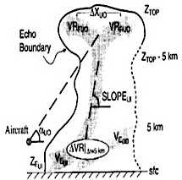
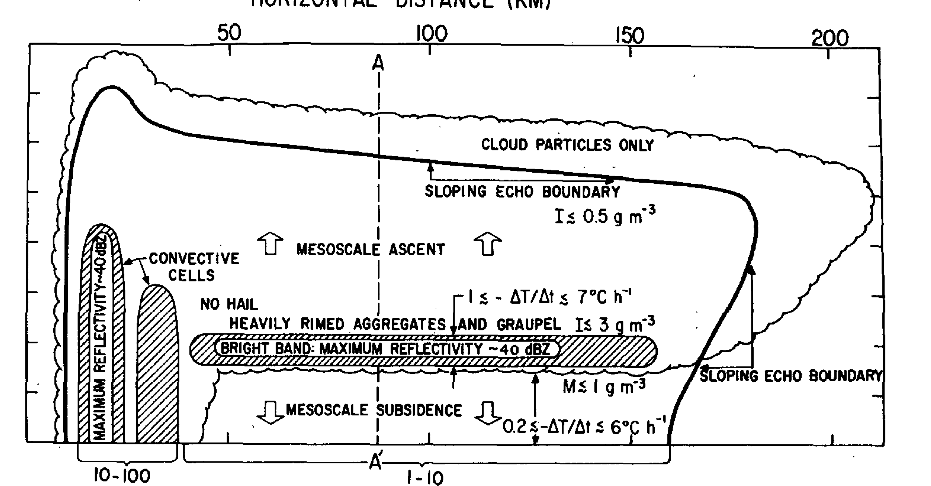
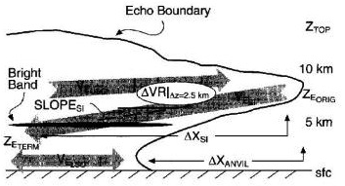
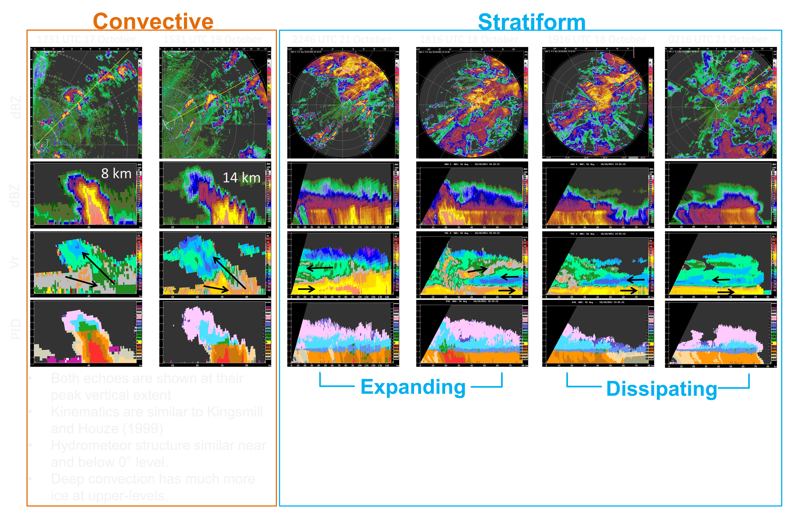
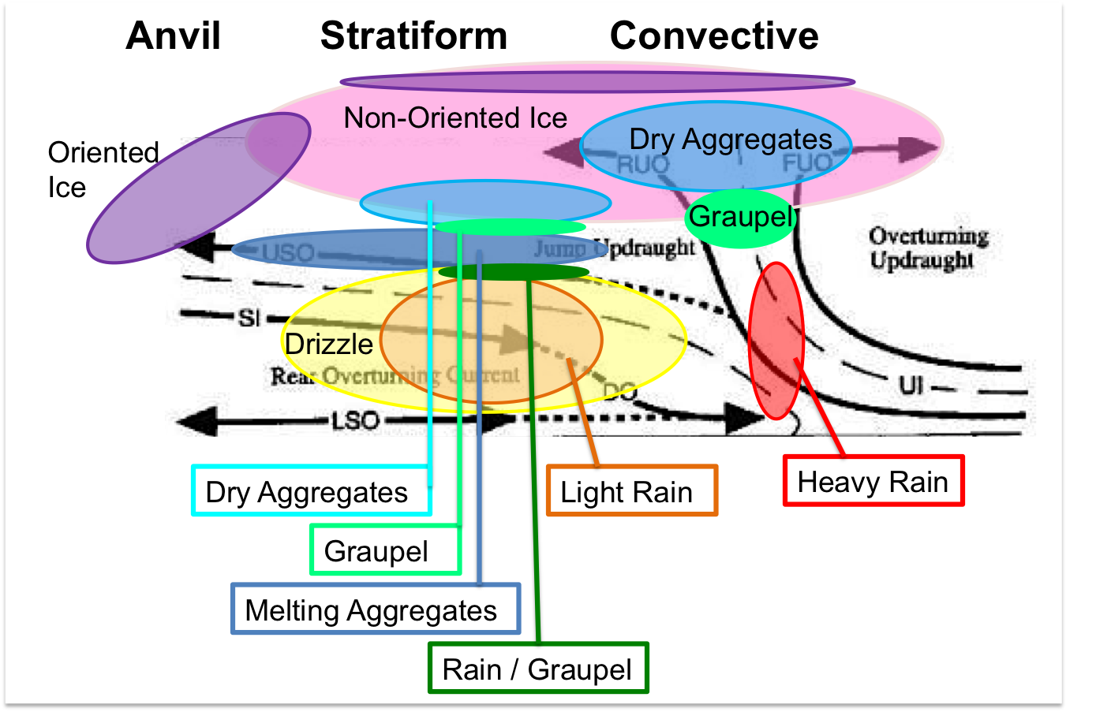
Kinematics and Microphysics of 2-Day Rain Events During the Active Stage
Hannah C. Barnes, Robert A. Houze, Jr., University of Washington
Introduction
Convective
Each large tropical field campaign has extended our understanding of the tropical cloud population and its structure. Mesoscale convective systems were recognized as members of the tropical oceanic cloud population in GATE (Houze and Betts 1980). Kingsmill and Houze (1999a) expanded the conceptual model of the MCS by using Doppler velocity data from TOGA-COARE to characterize the layered kinematic structure of convective and stratiform regions (shown on the left), largely verifying Moncrieff (1992). The polarimetric capabilities of the S-PolKa radar deployed during DYNAMO provides the opportunity to expand these conceptual models by characterizing the hydrometeor structure in these canonical structures. While Leary and Houze (1979b) utilized reflectivity data and drop size distributions from GATE to theorize the hydrometeor structure of an MCS (shown on the right), DYNAMO provides the first opportunity to investigate their hypothesized structure using dual-polarimetric radar. The purpose of this study is the compare the kinematic structure observed during DYNAMO to Kingsmill and Houze (1999a) and investigate how hydrometeors are distributed through these storms.
Stratiform
Leary and Houze (1979b)
Kingsmill and Houze (1999a)
Conclusions
All sizes of convective and stratiform echoes display layered flow consistent with Kingsmill and Houze (1999a).
Expanding stratiform regions are linked with surface convergence, dissipating stratiform regions are isolated from surface convergence.
Strong mid-level inflow develops under the anvil and progresses inwards as large, mature stratiform regions dissipate.
One of the largest differences between shallow and deep convection is greater ice content in deeper convection.
Hydrometeor Structure
Funded by the DYNAMO – National Science Foundation Grant AGS-1059611

