Slide 1

Convection in TOGA COARE—& other tropical field projects
Robert Houze
University of Washington
DYNAMO Workshop, Hapuna Beach, Hawaii, 4 March 2013
Notes:
The midlevel inflow to the sf region is an imp part of the MCS circulation.

Slide 2
40 years ago

Slide 3
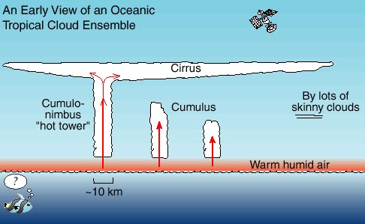
Prevailing view of tropical convection in the early 1970’s
Satellite view of the tropical cloud population

Slide 4
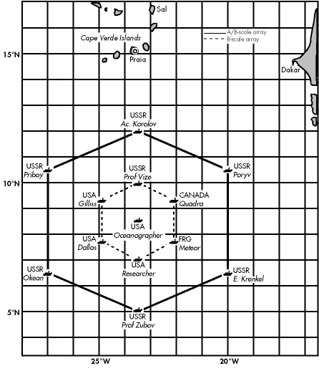

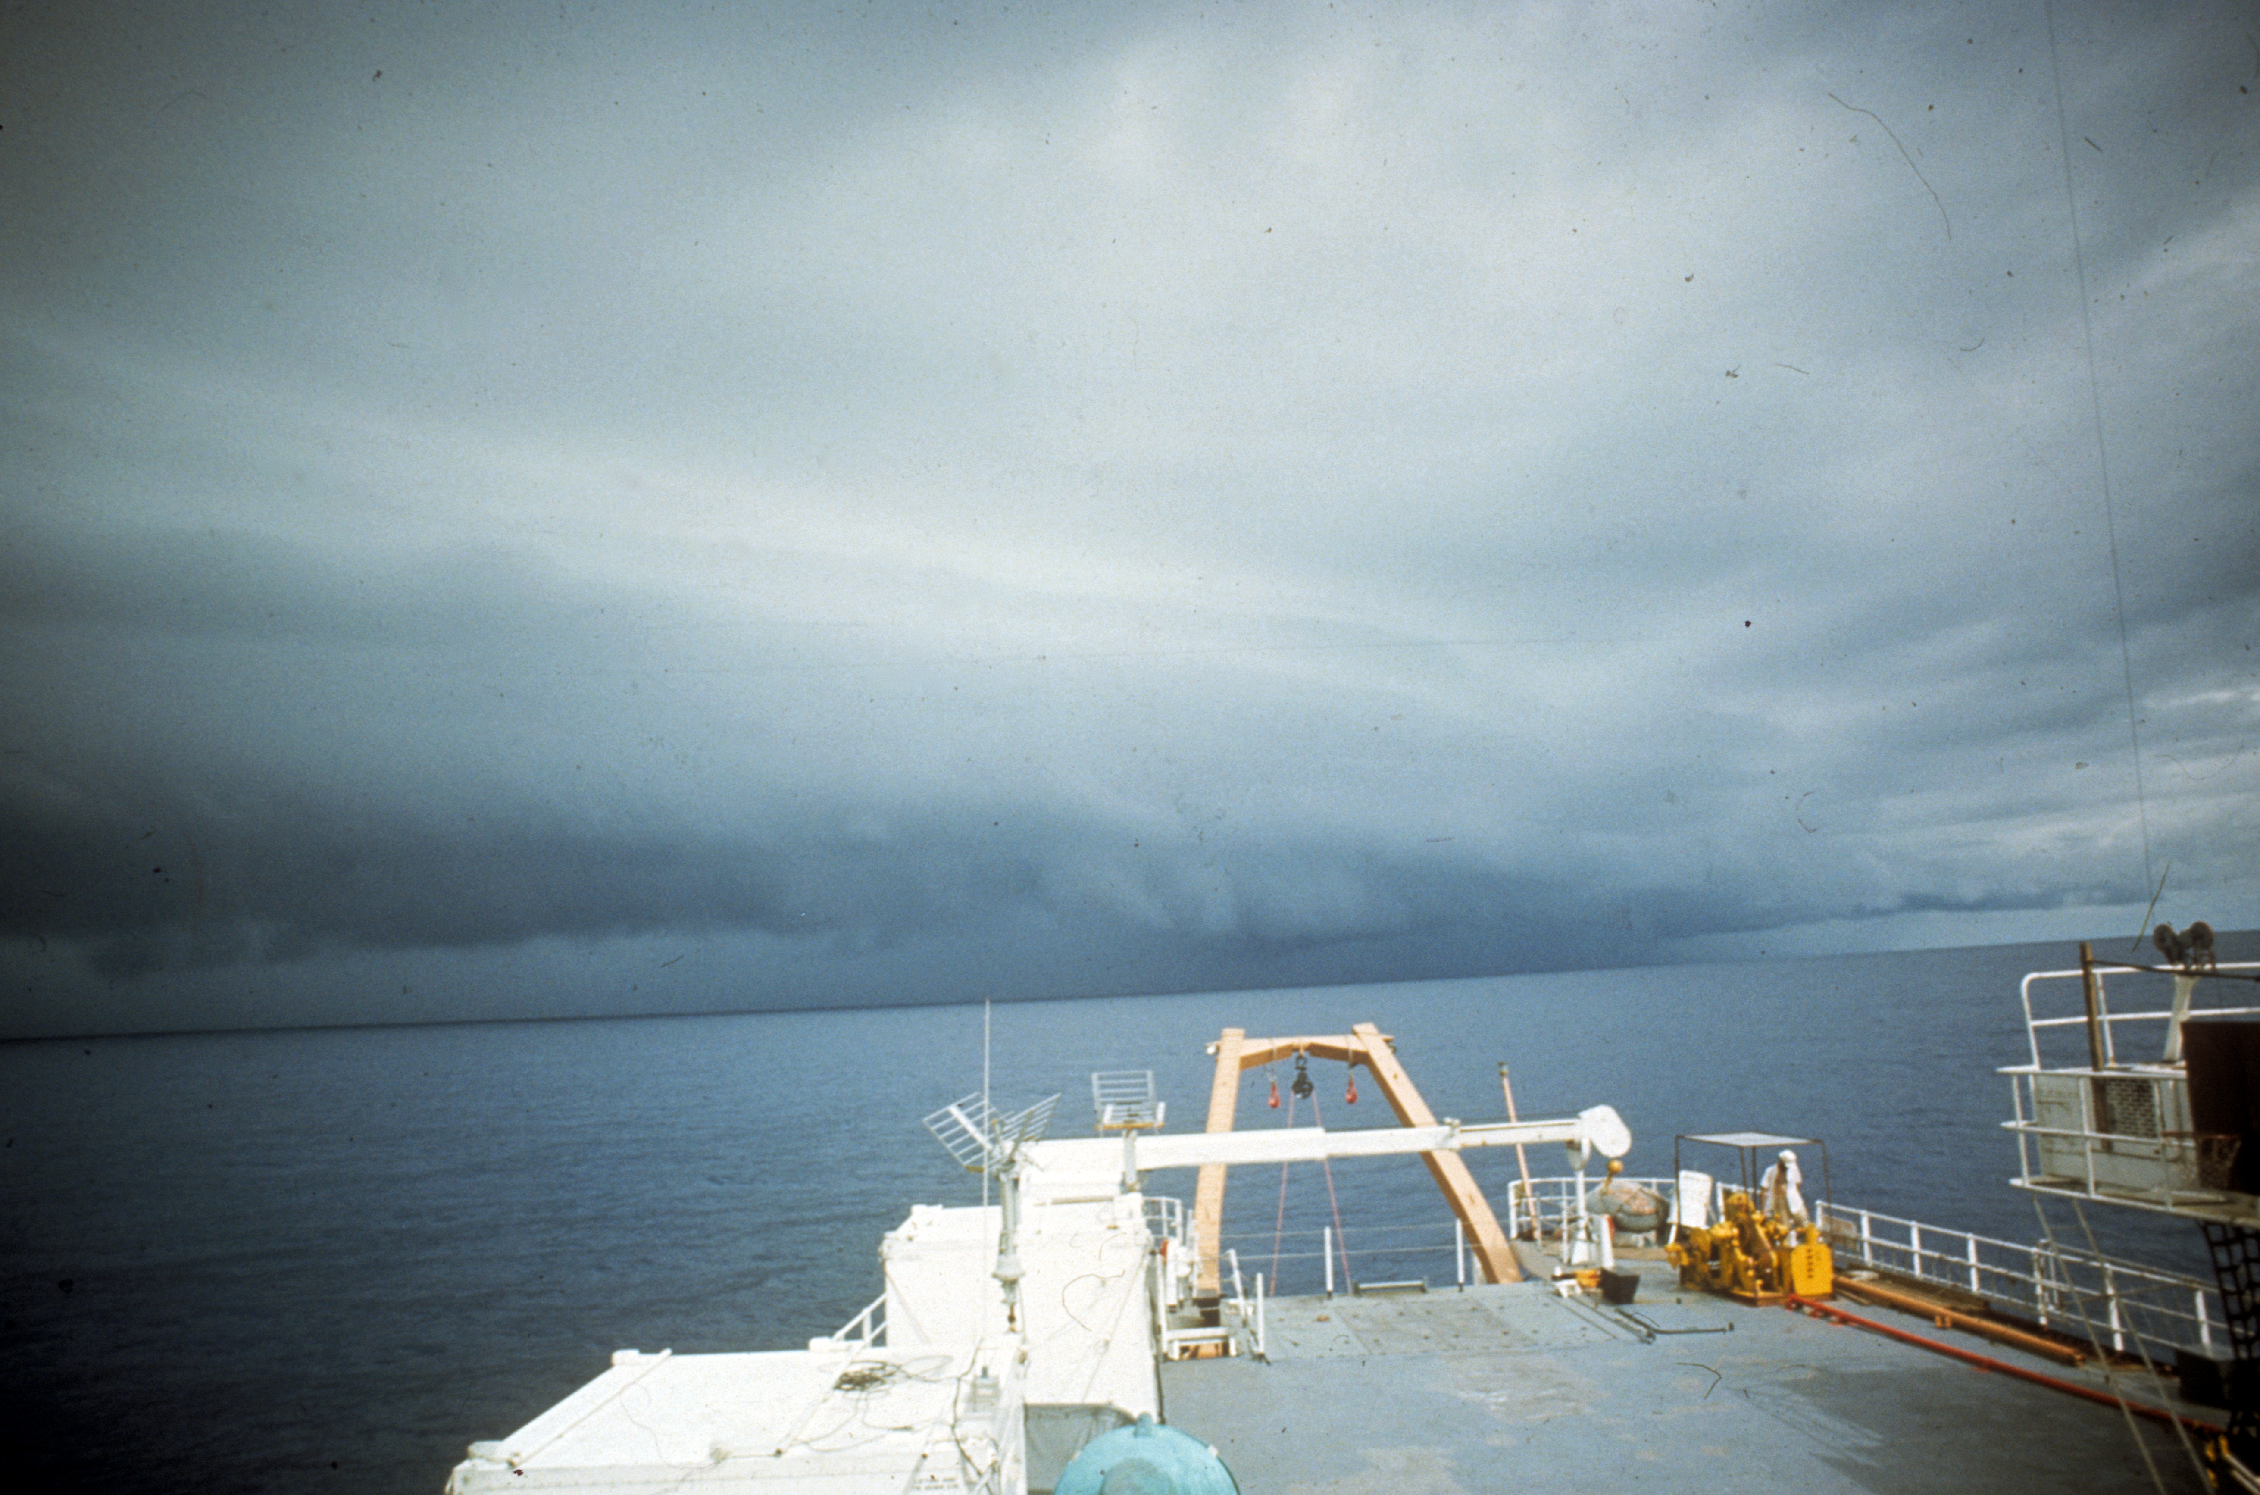
1974
40 ships!
12 aircraft!
16 sounding sites
4 shipborne scanning digital C-band radars
Notes:
40 ships. 12 a/c

Slide 5
Post-GATE view of the tropical cloud population
Houze et al. (1980)

Slide 6
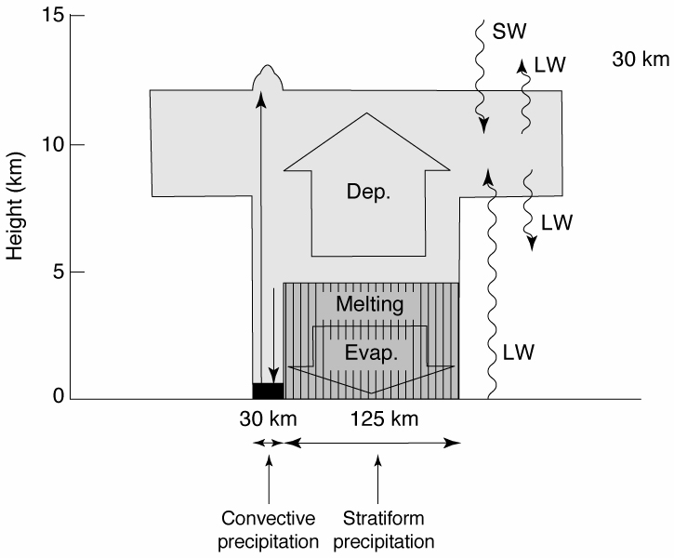
Heating and cooling processes in a mesoscale system
Houze 1982
Notes:
Top heavy

Slide 7
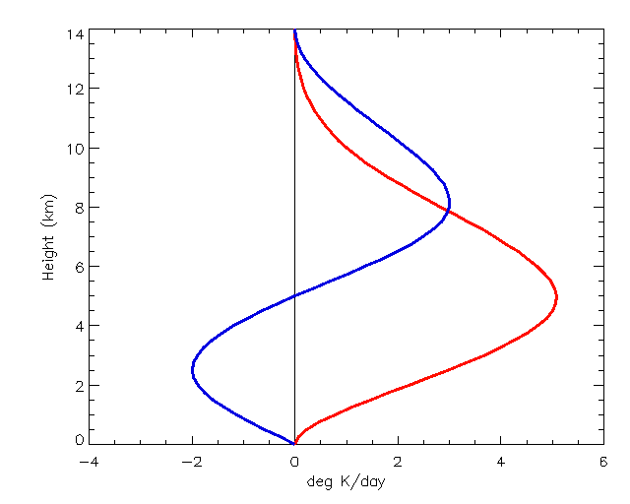
Mesoscale System Heating Profiles
Stratiform
Height (km)
Convective
Schumacher et al. 2004
Deg K/day
Notes:
The blue curve is applied to the stratiform fraction of the precipitation at the given pixel. Go to next slide.

Slide 8
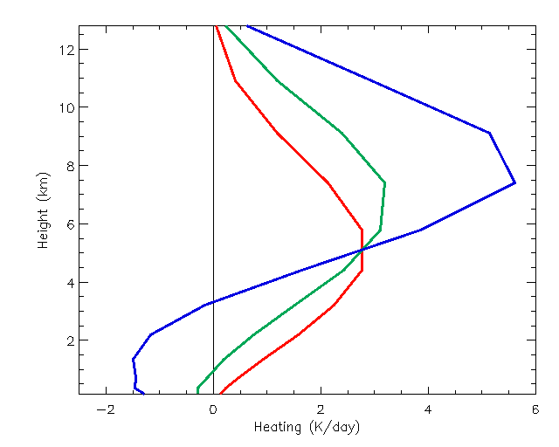
Mesoscale System Heating Profiles
70% stratiform
40% stratiform
Height (km)
0% stratiform
Deg K/day
Schumacher et al. 2004
Notes:
70% stratiform precipitation at a pixel yields the blue profile, which has a higher maximum than the 0% or 40 % stratiform profiles. Note also how the increased stratiform percentage yields a stronger vertical gradient of heating at upper levels and hence greater generation of potential vorticity. This shows how an increase in the stratiform rain fraction leads to a stronger circulation at upper levels.

Slide 9
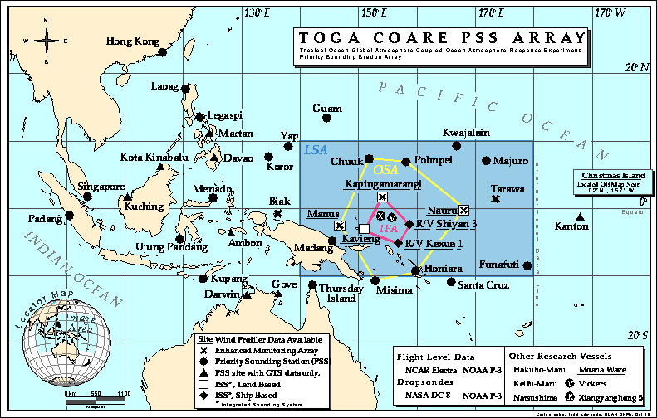
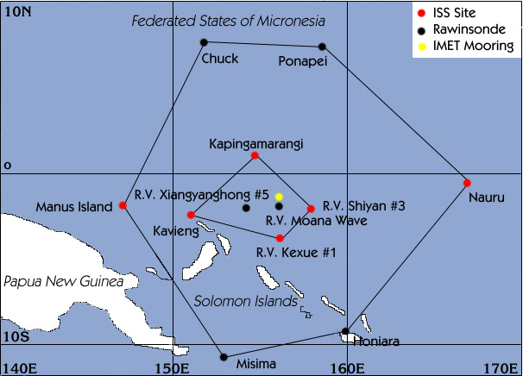
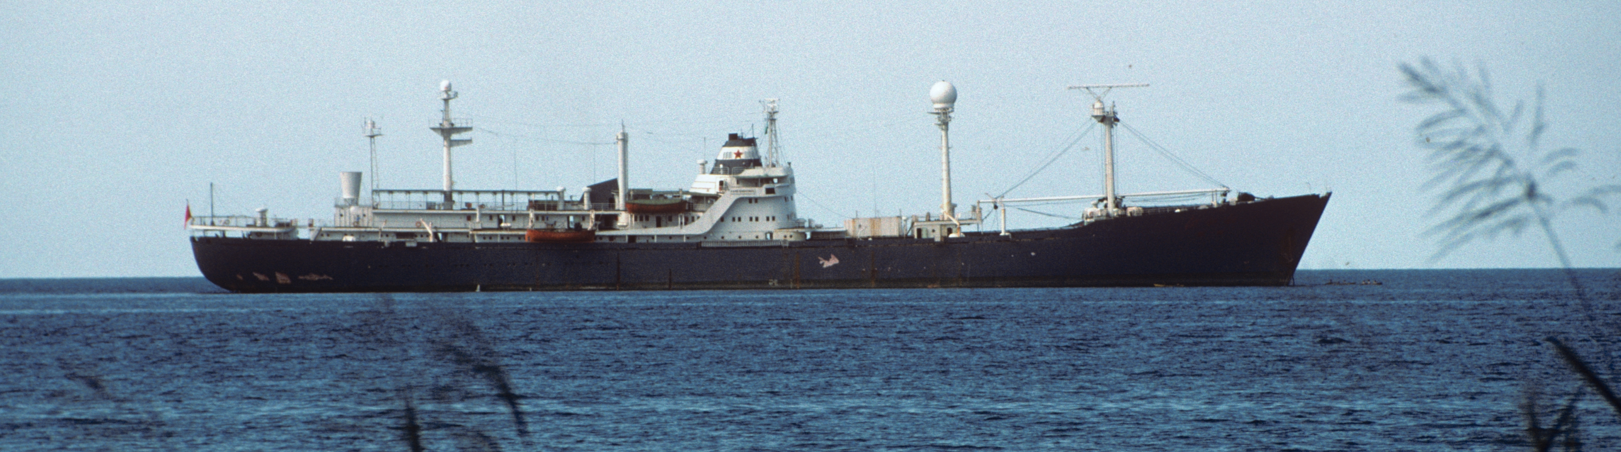
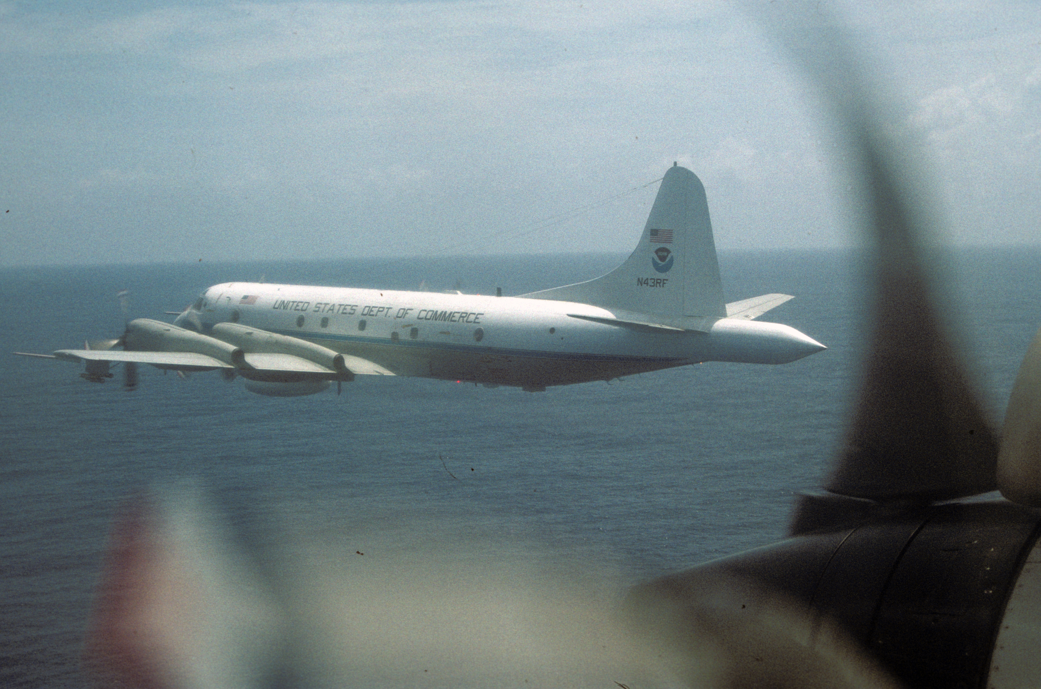
TOGA COARE
Shipborne and airborne Doppler radars
+ Rawinsondes

Slide 10
Congestus

Slide 11

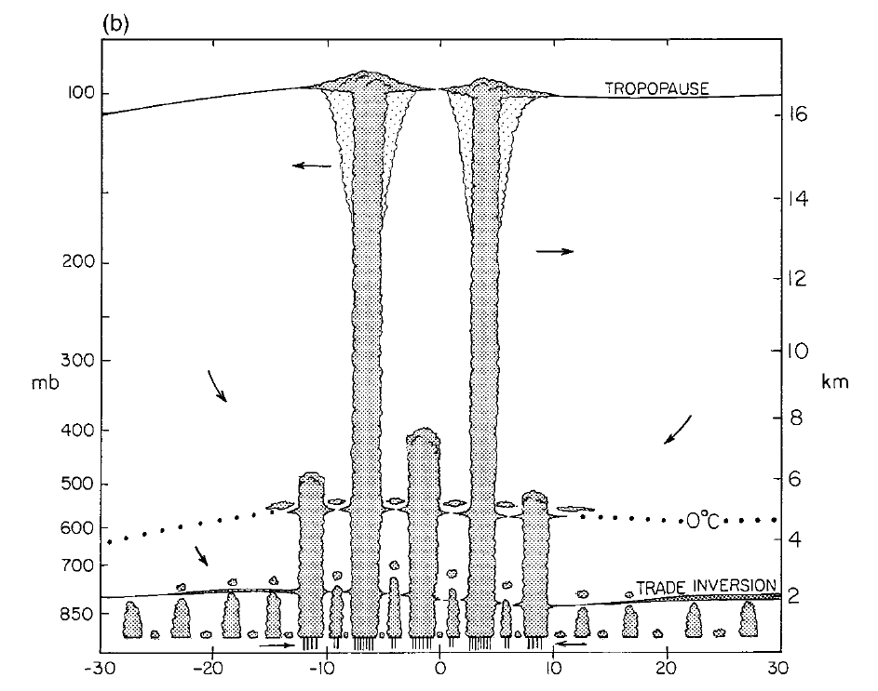
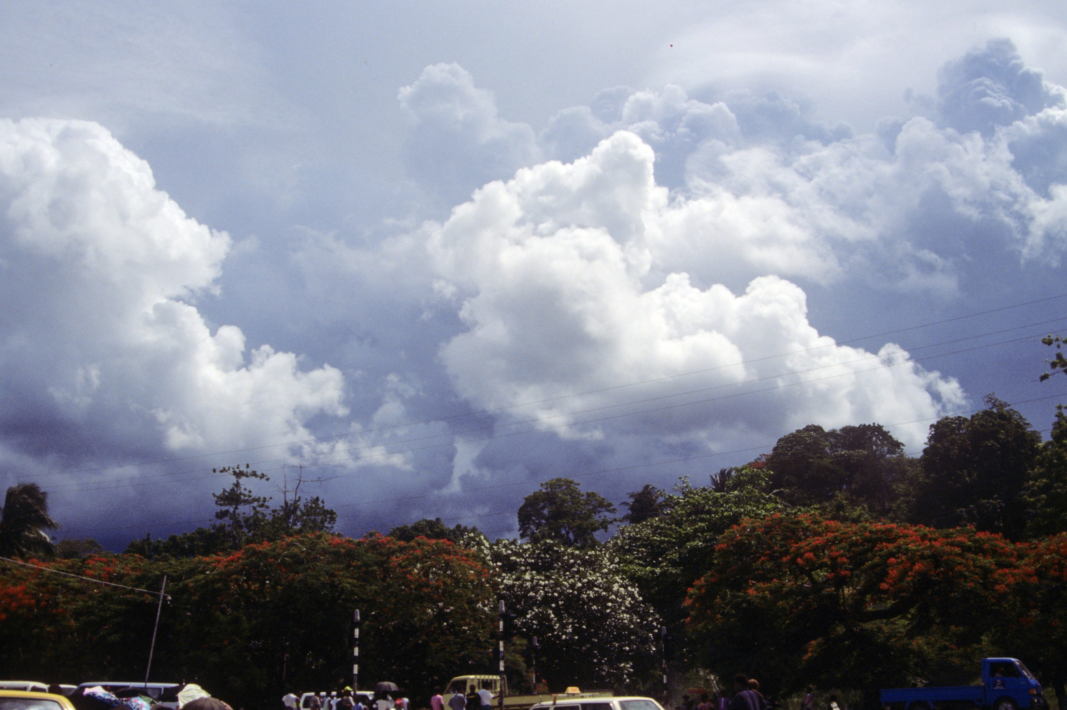
Dick Johnson’s sounding analysis…
“Trimodal distribution”
Cu congestus
Small Cb
Johnson et al. 1999

Slide 12
Mesoscale Systems

Slide 13
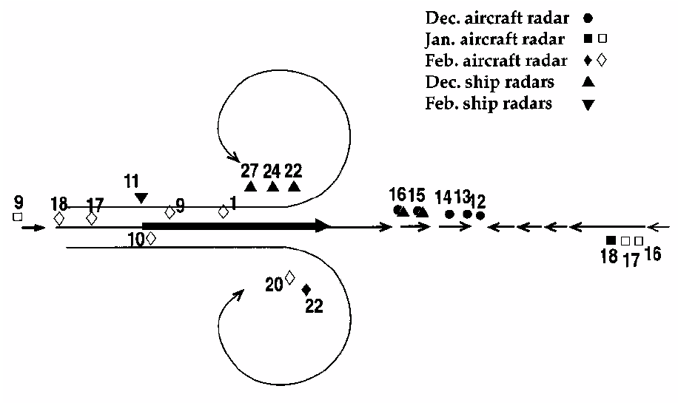
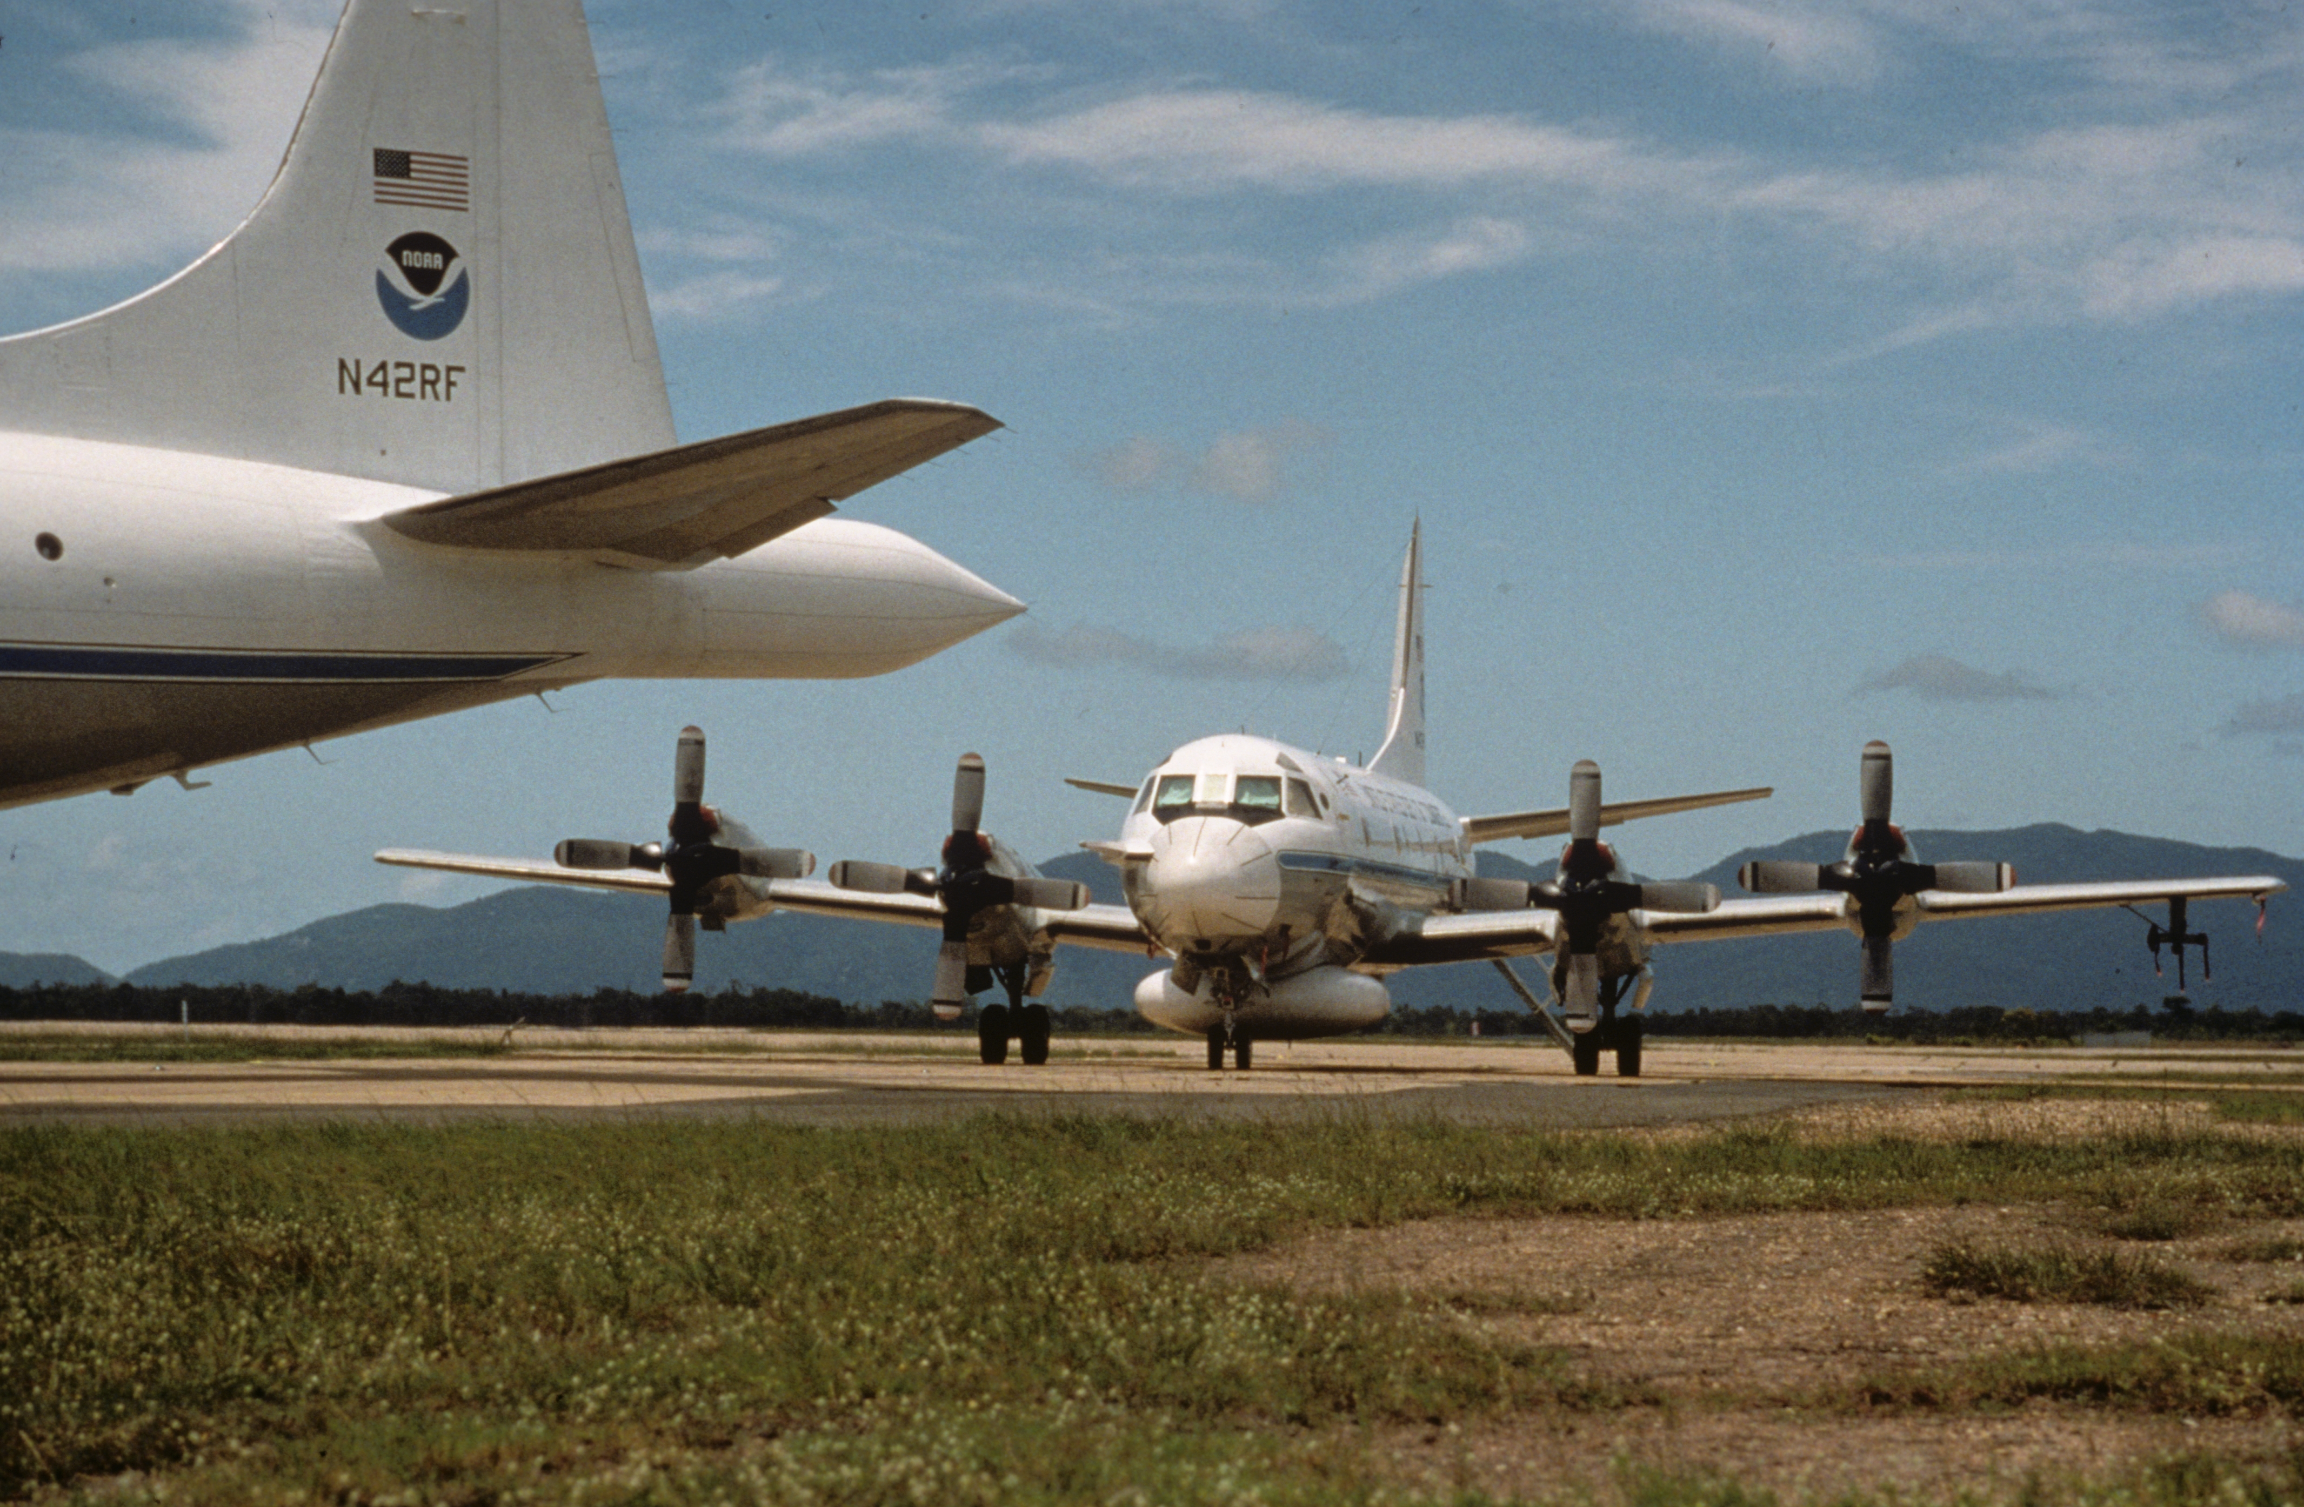
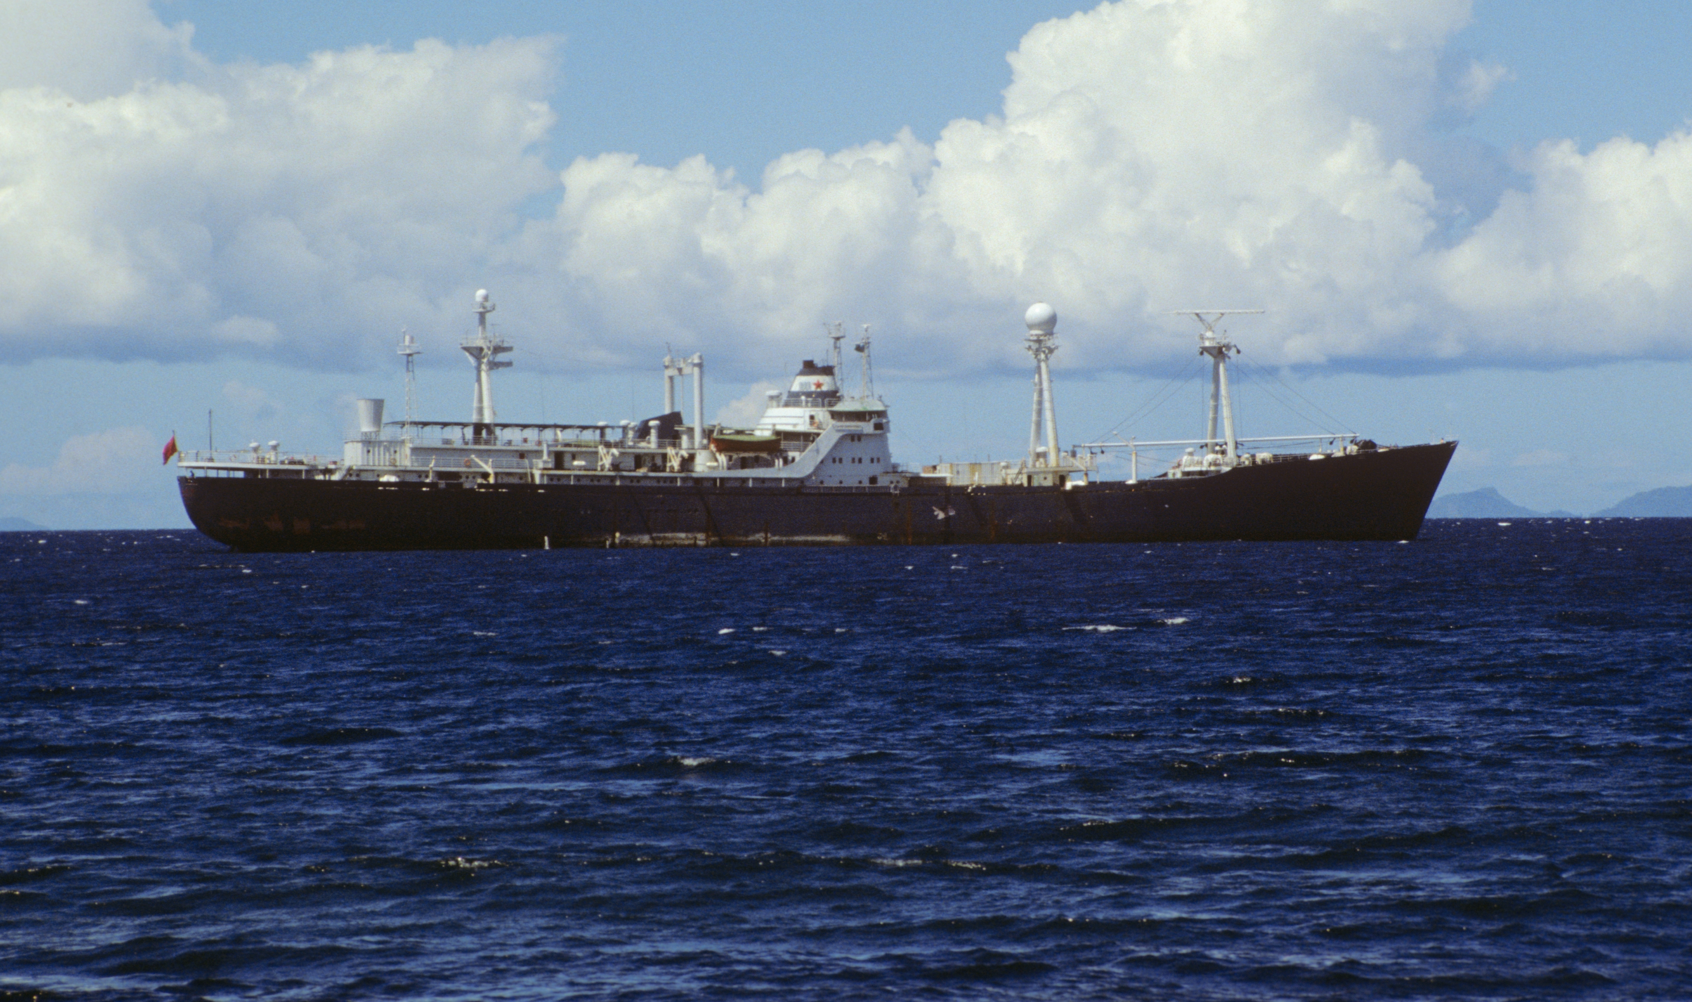
Doppler radar sampling relative to the MJO…
Rossby Gyres
Kelvin Wave Convergence
Houze et al. (2000)

Slide 14
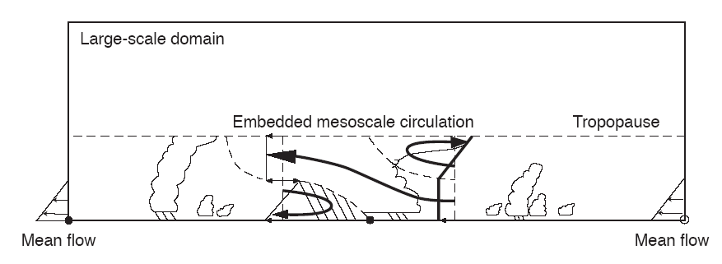
Moncrieff’s Mesoscale Layer Model of Tropical Convection…
Moncrieff 92

Slide 15
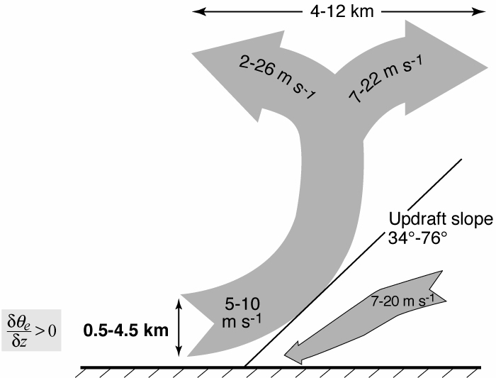
TOGA COARE Airborne Doppler Observations of MCSs…
25 convective region flights
<
Kingsmill & Houze 1999
Notes:
KH studied data from ___ flights around the conv regions of MCSs and found a deep layer of uplift. The layer lifting consisted of pot. Unstable air.

Slide 16
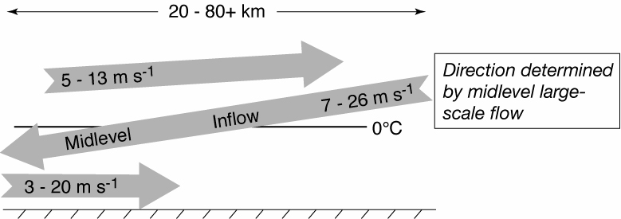
TOGA COARE Airborne Doppler Observations of MCSs…
25 stratiform region flights
Kingsmill & Houze 1999
Notes:
The midlevel inflow to the sf region is an imp part of the MCS circulation.

Slide 17
Now we can add the mesoscale circulation…
Midlevel inflow
Layer inflow
Houze 1982
Notes:
From the distributin of heating and cooling in the sf region we expect mid level convergence.

Slide 18
Momentum transport

Slide 19
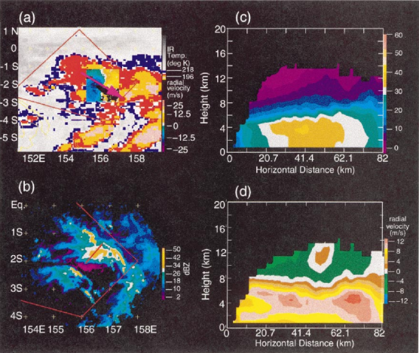
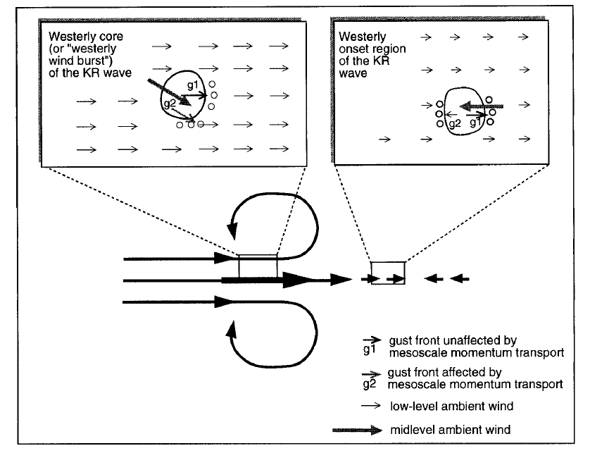
Momentum feedback…
+
−
…can be either positive or negative
Houze et al. (2000)

Slide 20
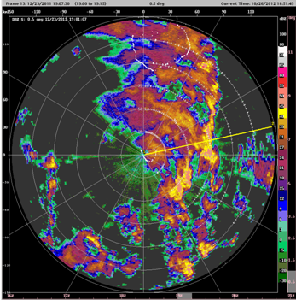
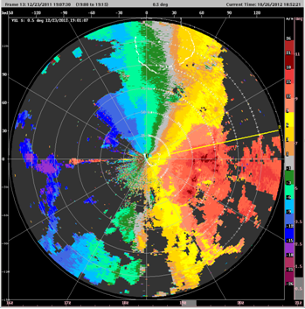
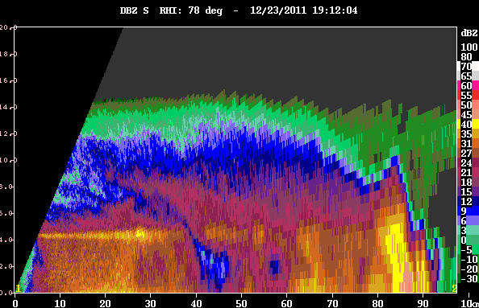
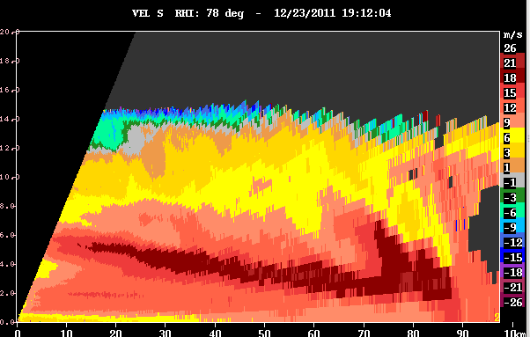
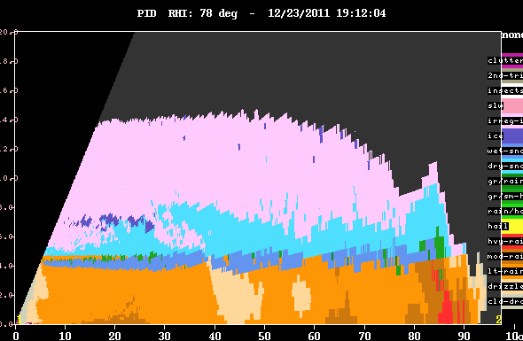
We are seeing this again in DYNAMO…
S-PolKa on 23 December 2011
Z
V
PID

Slide 21
Microphysics

Slide 22
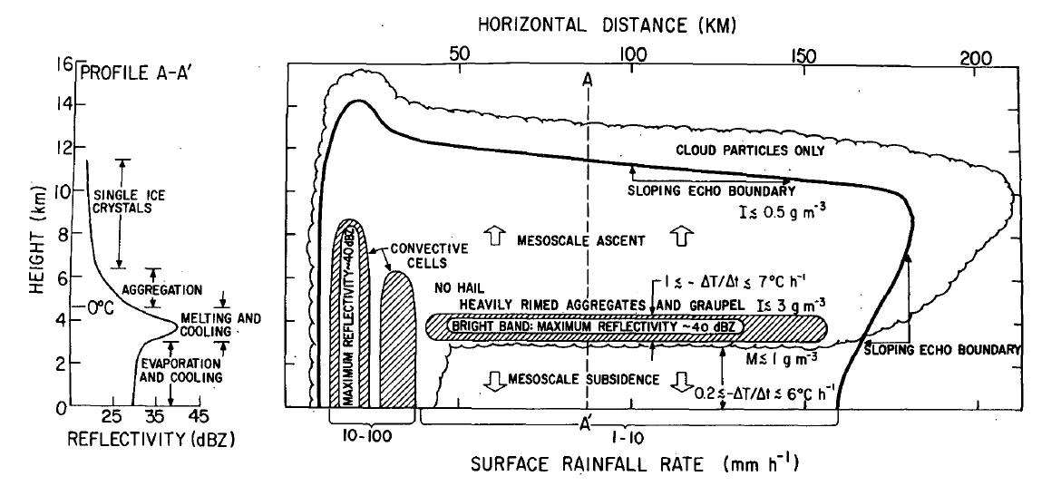
Leary and Houze’s (1979) GATE study
Inferred from measurements of raindrops!

Slide 23
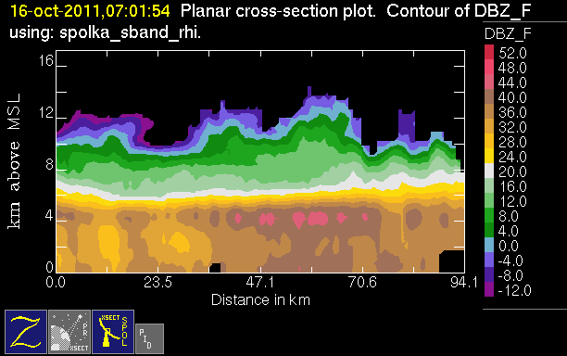
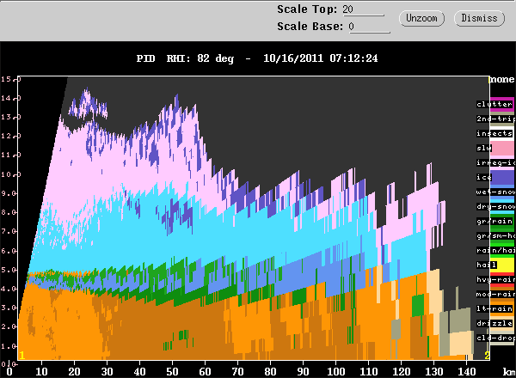
Now we see this in the DYNAMO polarimetric data!!
50 dBZ
graupel
10 km
melting snow
5 km

Slide 24
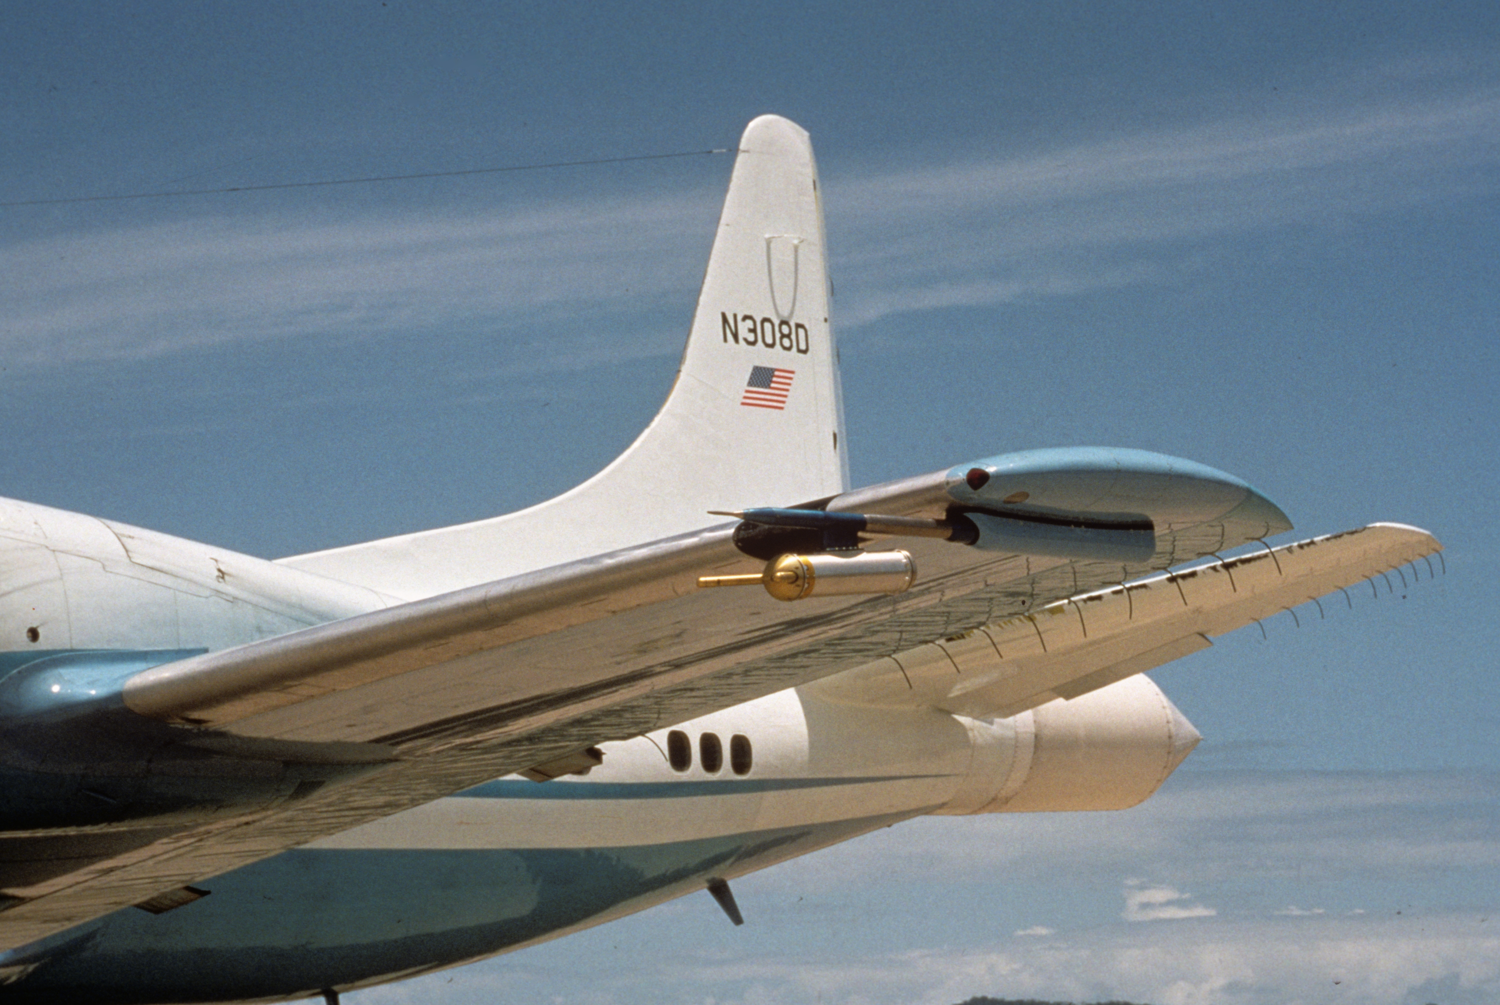
TOGA COARE dropped the ball!
Microphysics data collected but not analyzed!

Slide 25
Cloud population variation

Slide 26
What’s the PDF of the members of the population?
Houze et al. (1980)

Slide 27
TRMM say the PDF varies with phase of the MJO…
Active Phase
Suppressed Phase
Deep Convective Cores
Broad Stratiform Rain Areas
Phase 7
Barnes and Houze 2013

Slide 28
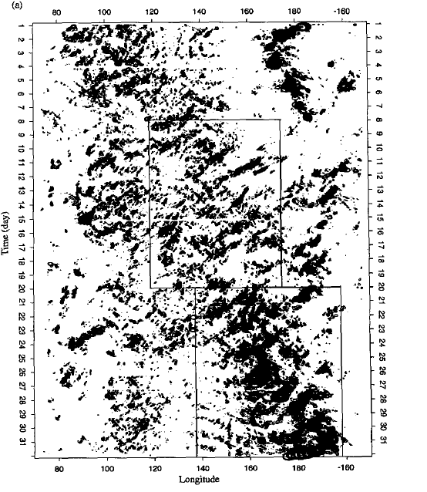
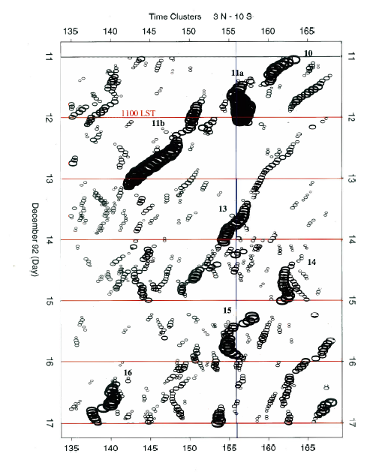
2-4 day waves
Chen, Houze, & Mapes 1996

Slide 29
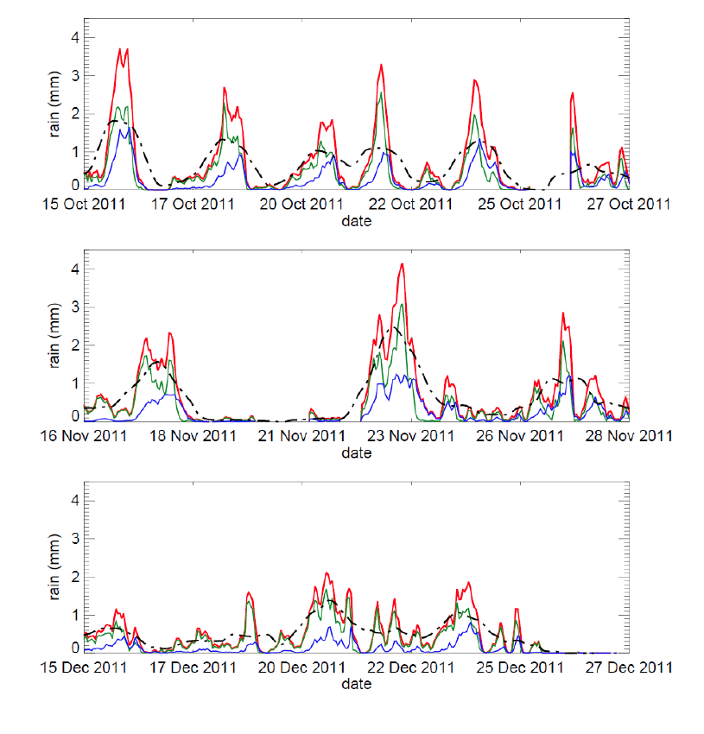
DYNAMO
Rain seen by the S-PolKa radar
October Active Period
November Active Period
December Active Period
Zuluaga and Houze 2013

Slide 30
Previous studies of tropical ocean convection…
Summary
GATE→
Mesoscale systems & stratiform heating
TOGA COARE→
Congestus
Mesoscale circulations
Momentum transports
2-4 day waves
Microphysics still need to be analyzed
Notes:
The midlevel inflow to the sf region is an imp part of the MCS circulation.

Slide 31


End
This research was supported by
NASA grants NNX10AH70G, NNX10AM28G,
NSF grants, AGS-1059611
DOE grant DE-SC0008452

