Slide 1
An Improved Algorithm for Radar-derived Classification of Convective and Stratiform Precipitation Echoes
Scott W. Powell and Stacy R. Brodzik
University of Washington, Seattle, WA
March 4, 2013
MJO Field Data and Science Workshop, Kohala Coast, HI
Breakout Session 1A
This work was supported by NSF grant AGS-1059611 and DOE grant DE-SC0008452.

Slide 2
Why we need a new/improved algorithm
Steiner et al (1995; SHY95) requires an interpolated dataset.
A standard 2 km interpolation, or even higher resolutions, “creates” data. This is bad.
Small, isolated convective echoes can be completely missed by SHY95.

Slide 3
Fixing the problem
Use the native resolution of the dataset, taking advantage of the high resolution typical along radials.
Easy gridding onto irregular Cartesian grid for determining distance between data points.
R (highest spatial resolution)
1. (R,Φ) -> (X,Y)
2. Determine distance between red box and all other data points. Yellow boxes represent those within specified distance.
Φ

Slide 4
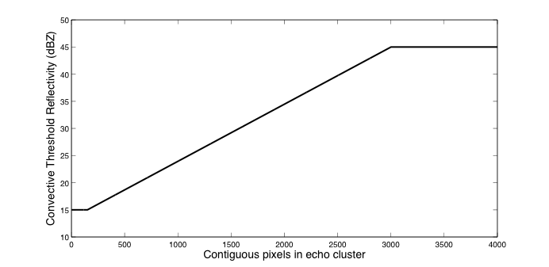
Fixing the problem
Use the native resolution of the dataset, taking advantage of the high resolution typical along radials.
Easy gridding onto irregular Cartesian grid for determining distance between data points.
Shallow convection scheme

Slide 5
Isolated Convective Echoes

Slide 6
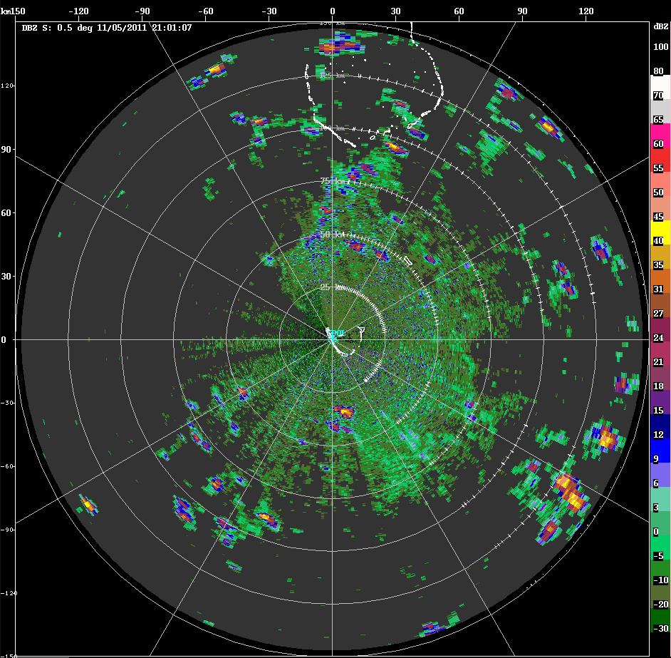

Slide 7
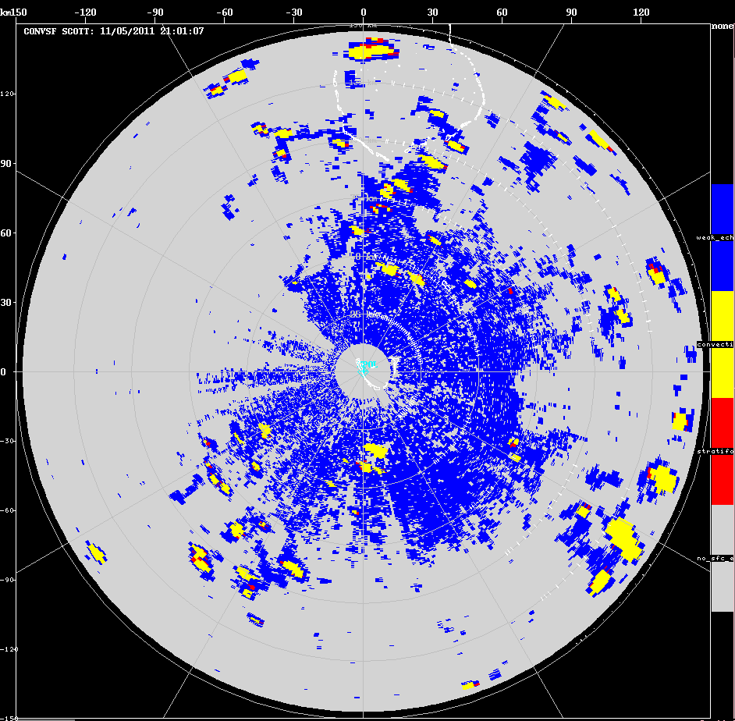

Slide 9
Large Echo Clusters

Slide 10
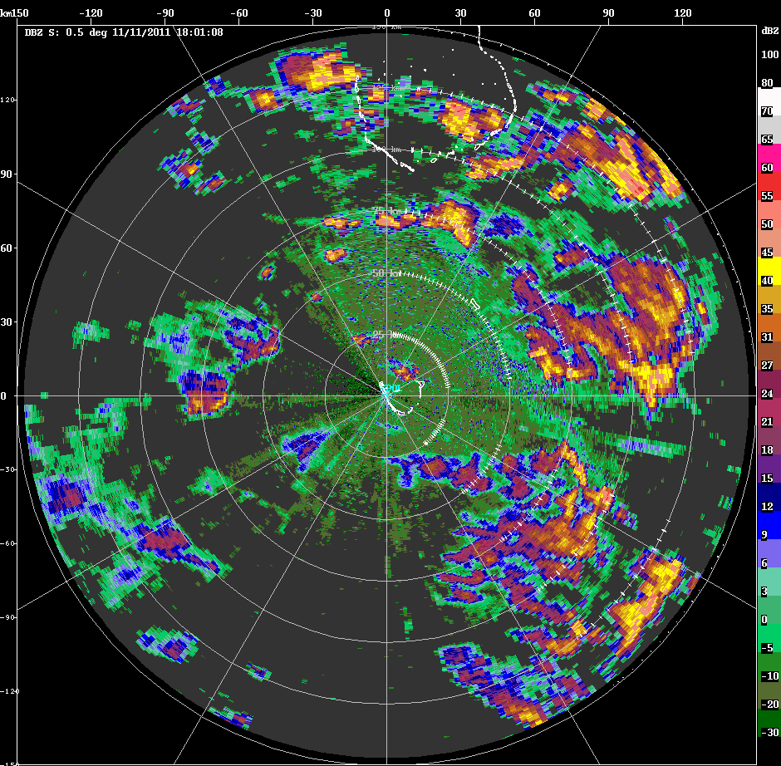

Slide 11
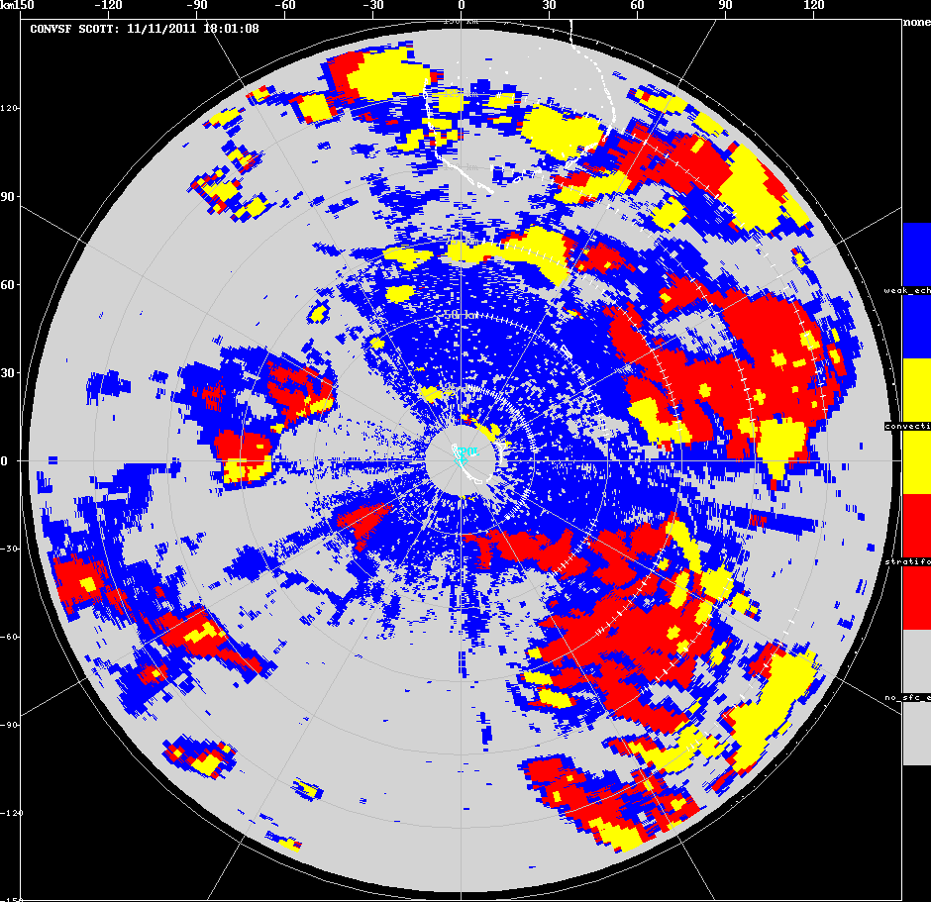

Slide 13
Squall Line

Slide 14
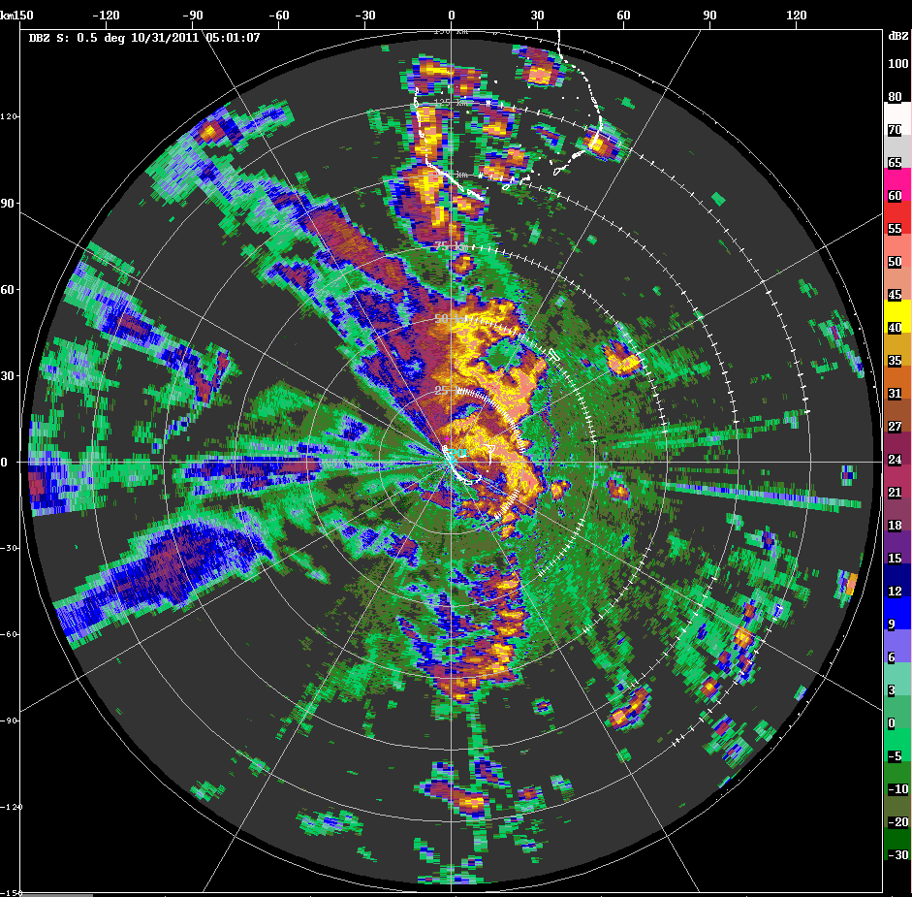

Slide 15
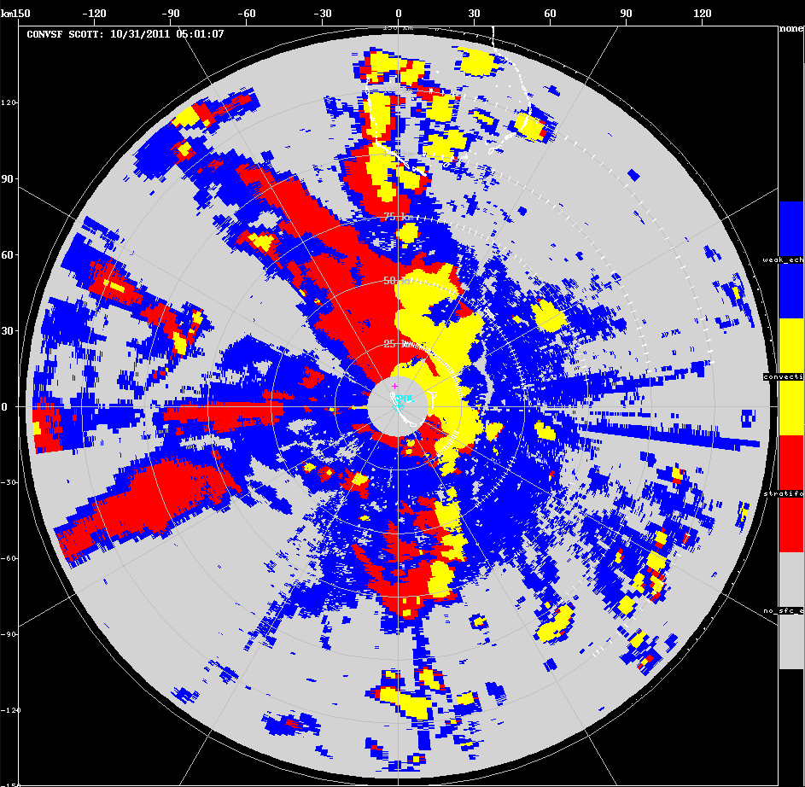

Slide 17
Widespread Stratiform with Embedded Convection

Slide 18
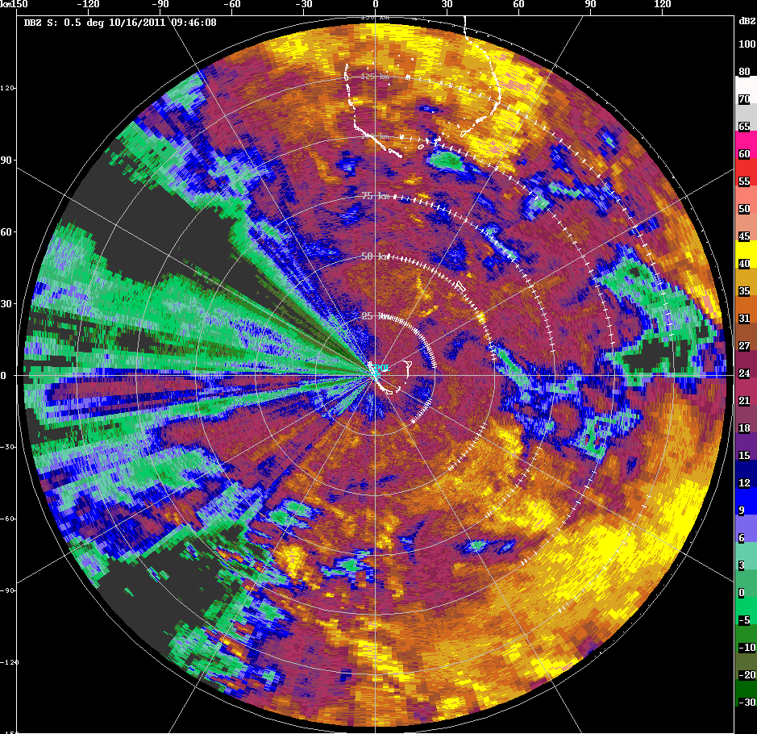

Slide 19
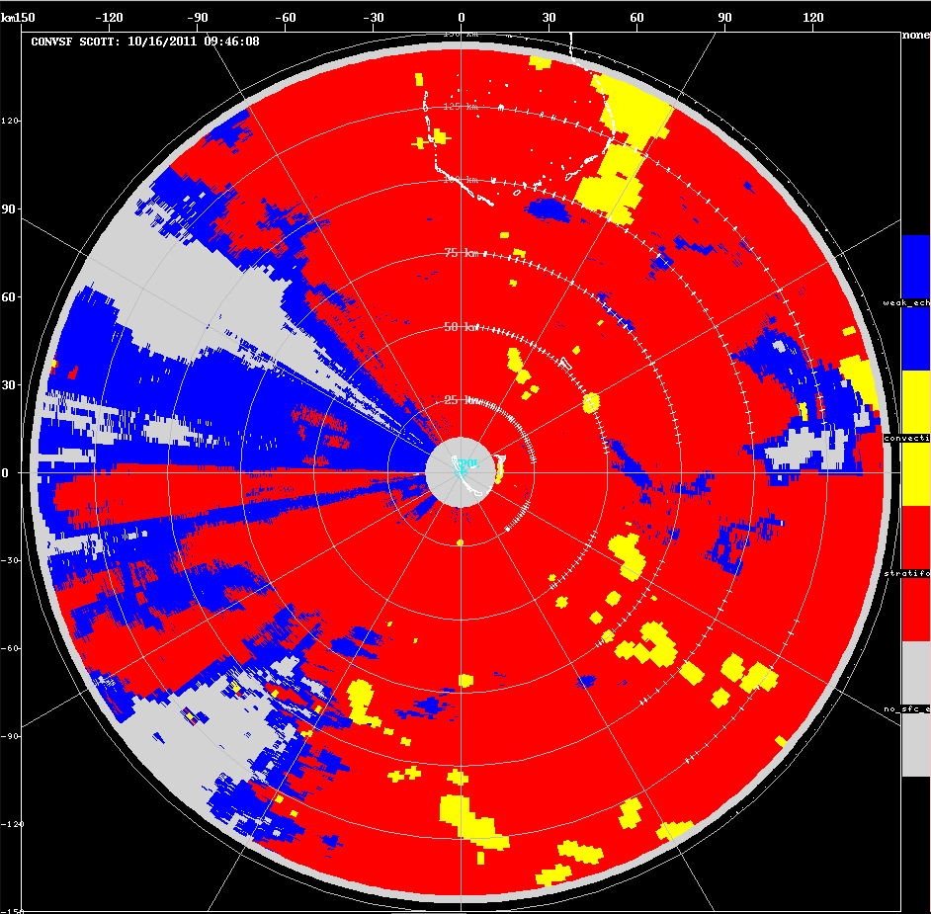

Slide 21
TOGA

Slide 22
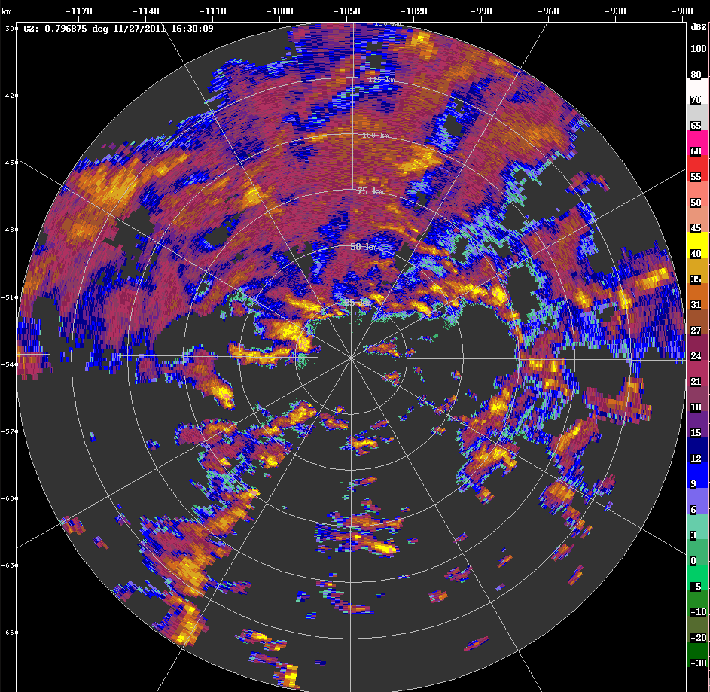

Slide 23
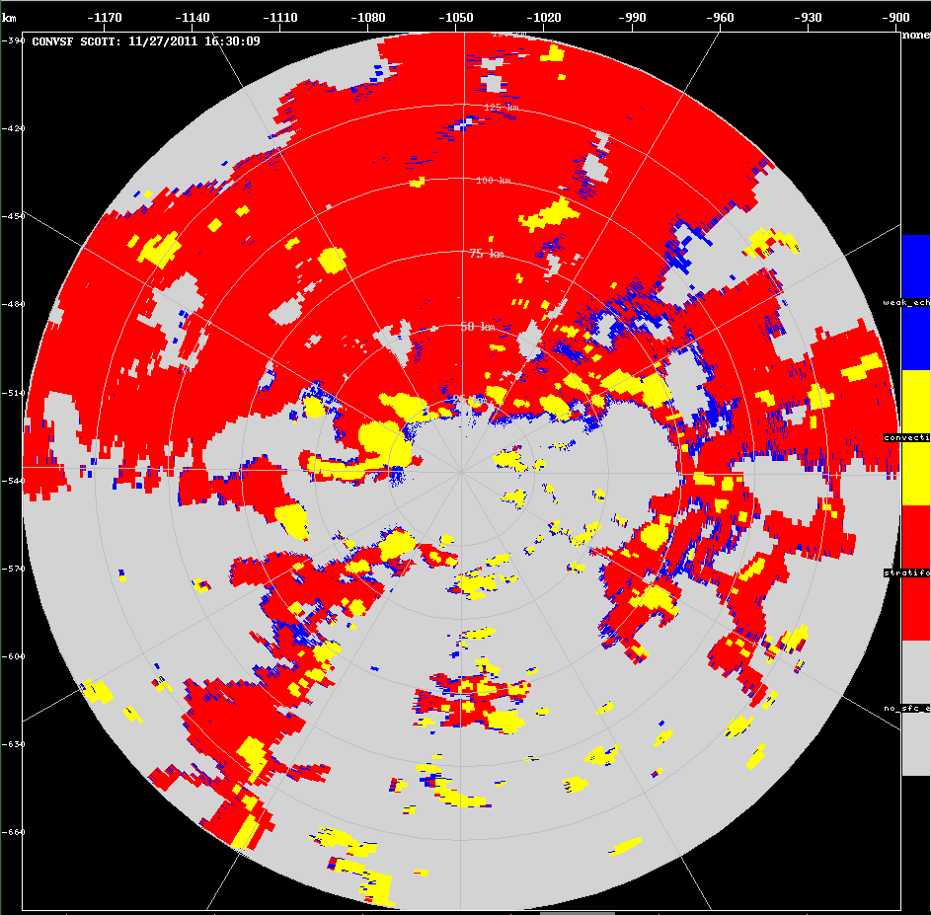

Slide 25
(Soon) Upcoming Improvements
Beam blockage (for Addu radars)
- Mask out Addu City completely
- Eliminate second-trip echo.
- Update shallow convection scheme.

Slide 26
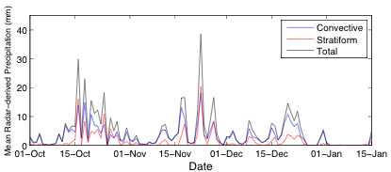
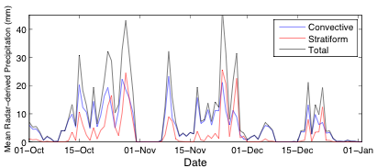
S-Pol
Hybrid rain rate
TOGA
Single Z-R (tentative)
Z = 129.56 R^{1.37}

Slide 27
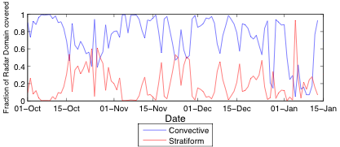
Improved stratiform
fraction during suppressed periods

Slide 28
Availability/Suggestions
Only input currently accepted is CFRadial.
Code currently only written for usage with MATLAB.
How to make easy-to-use for most users?
Other suggestions/concerns?

