Slide 1
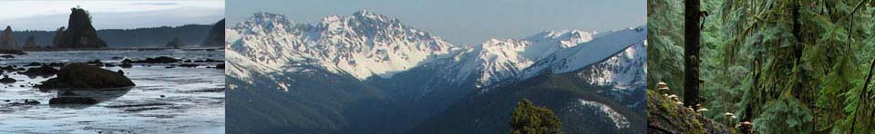
OLYMPEX: A Ground Validation Program on the Olympic Peninsula in the Pacific NW
Lynn McMurdie, Bob Houze (University of Washington)
Walt Petersen (NASA) and Bill Baccus (National Park Service)
1 March 2013 Pacific NW Weather Workshop

Slide 2
A future field program to validate a future satellite
In 2014 a new precipitation measuring satellite will be launched called the core satellite of the Global Precipitation Measurement (GPM) mission
NASA is conducting several field programs to validate and develop the algorithms used by the instruments on the GPM
One of these field programs will be on the Olympic Peninsula during water year 2015 – 2016. Most likely from Nov 2015 – Jan 2016

Slide 3
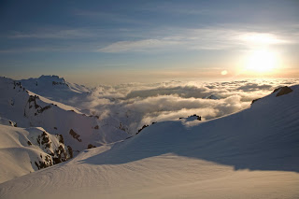
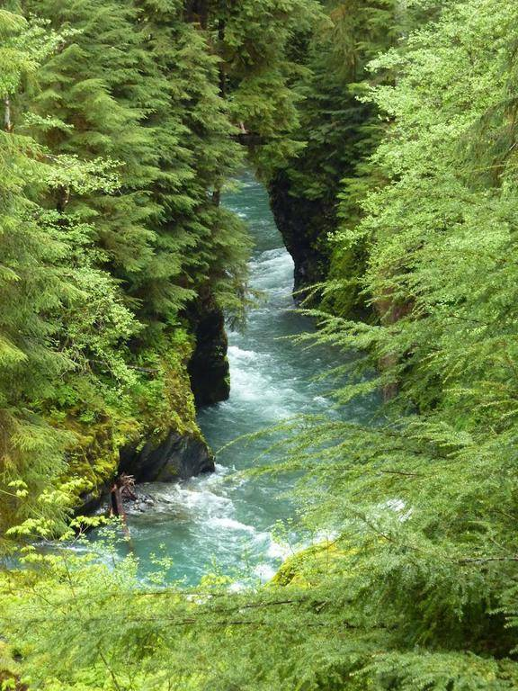
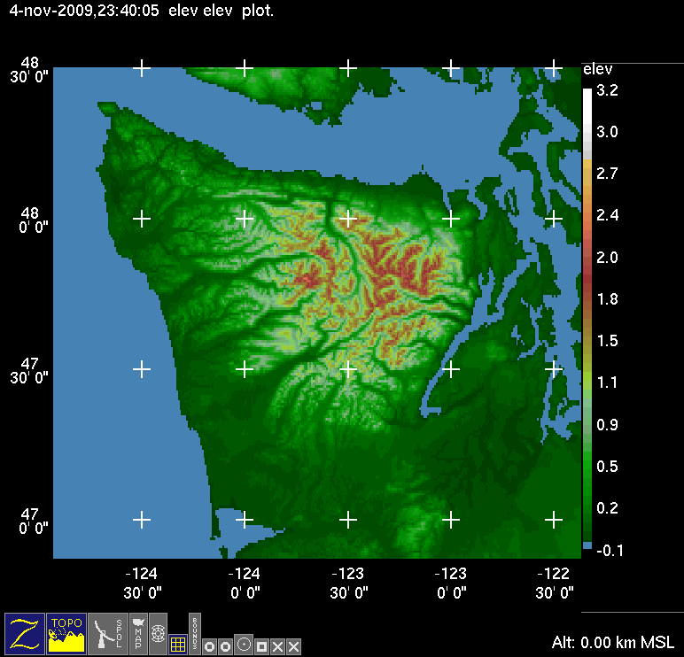
What environment is good for testing precipitation algorithms?
Lots of Rain
Lots of Snow
The Olympic Peninsula is the place for you!!!
Complex Terrain with transition from ocean to coast to land

Slide 4
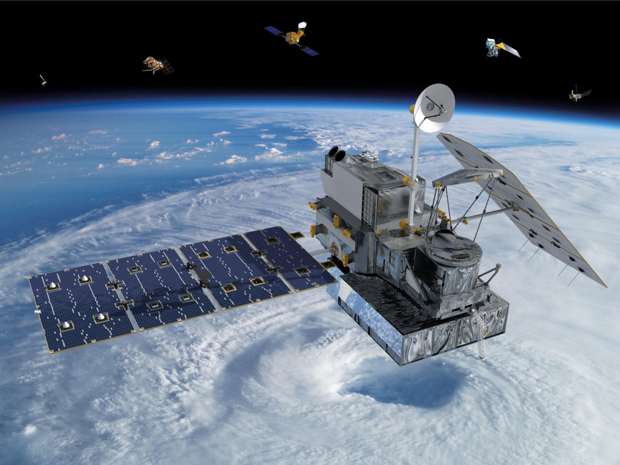
The GPM Satellite
A polar orbiting satellite with an altitude of 407 km, a 65° orbit inclination, and a non sun-synchronous circular orbit dedicated to measuring precipitation from space.
This means it will sample the earth from the Antarctic circle to the Arctic circle and will sample a particular spot on the earth at different times of the day.
Prior precipitation satellite TRMM only measured tropical regions

Slide 5
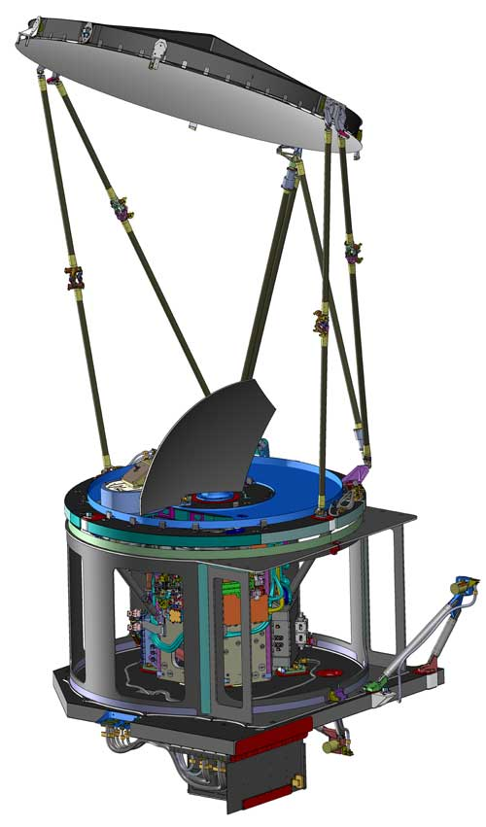
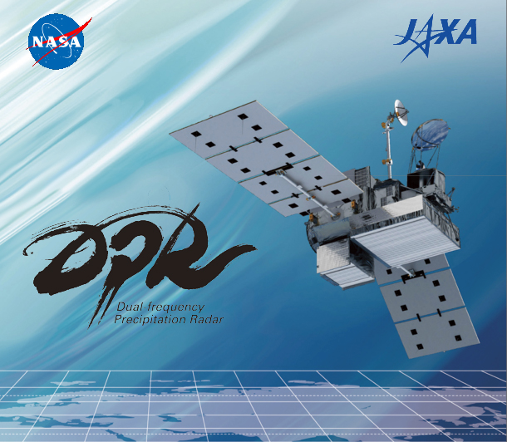
The GMI (and the) DPR Instruments
The GPM Microwave Imager
Passive microwave instrument with low frequencies to measure rain and high frequencies to measure snow
Prior instruments did not have the very high frequencies that will be on the GMI
Will have a swath width of 904 km
The Dual-Frequency Precipitation Radar (first time in space)
Will detect the 3-D distribution of precipitation
These frequencies will detect a range of precipitation regimes – tropical intense rain to midlatitude light rain and snow
Will have a swath width of 245 km (Ku band) and 120 km (Ka band)

Slide 6
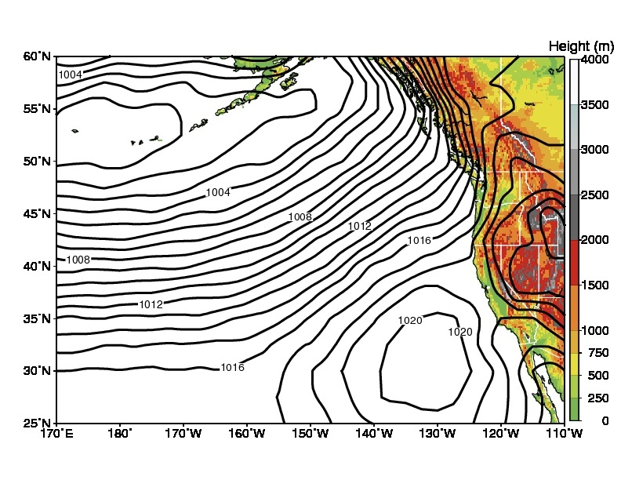
Climatology of Olympic Peninsula
Persistent southwesterly flow during the winter provides a reliable source of moisture
NCEP long-term mean sea level pressure (mb) for winter (November to February) and topography

Slide 7
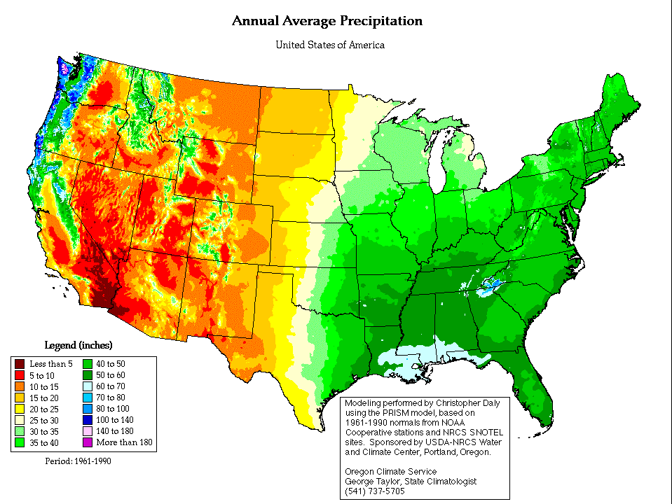
Climatology of Olympic Peninsula
Maximum
Annual average precipitation (PRISM)
Extremely large precipitation accumulation produced as the moist Southwesterly flow impinges on coastal terrain

Slide 8
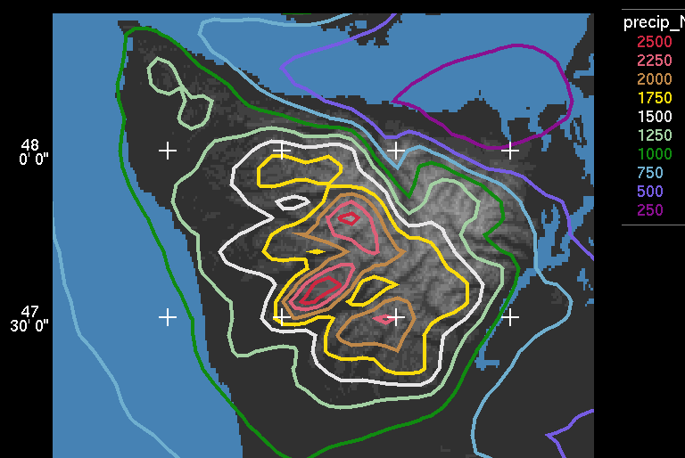
Climatology of Olympic Peninsula
Precipitation varies between ridges and valleys and exhibits enhancement on the mountain ridges.
Derived from a 5-year climatology of continuous mesoscale model results (MM5) and verified by precipitation gauges (Minder et al., 2008)

Slide 9
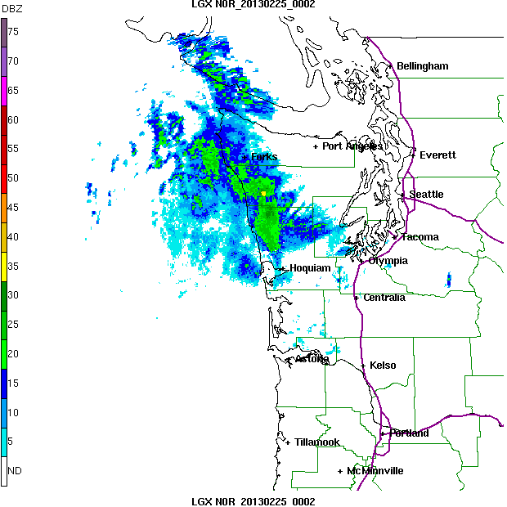
Typical Frontal Passage (from this past Sunday evening as seen by the coastal radar LGX)
SW side of Olympics gets rain well ahead of front
SW side gets rain during front
SW side gets post-frontal showers

Slide 10
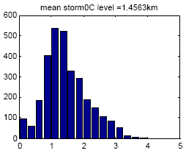

Climatology of Olympic Peninsula
Frequency of occurrence
0°C level
The mean 0°C level is low so that there is rain at low elevations and snow at high elevations
Distribution of Nov-Jan 0°C level for flow that is onshore and moist at low levels (KUIL sounding). Mean 0°C level during storms = 1.5 km See this full range in individual storms!
(plot provided by Justin Minder)

Slide 11
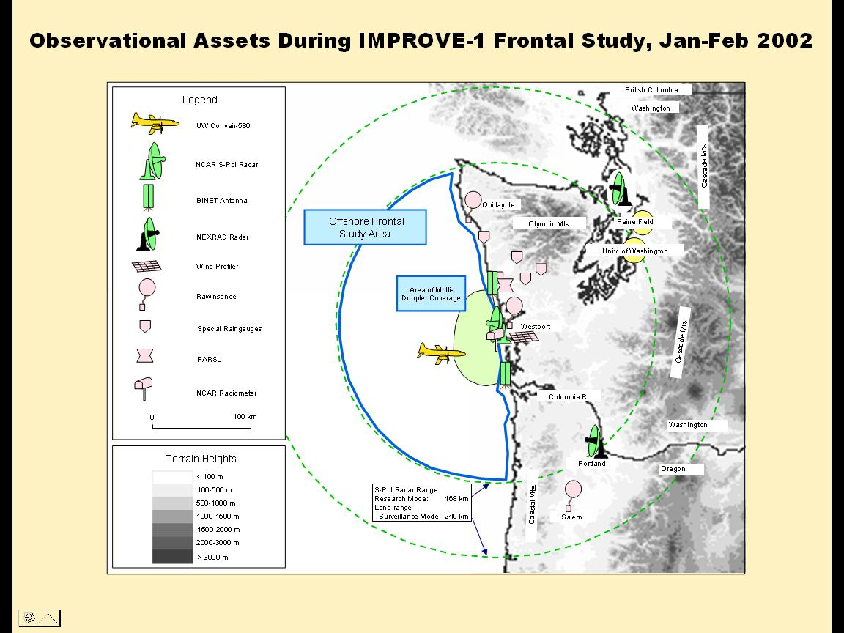
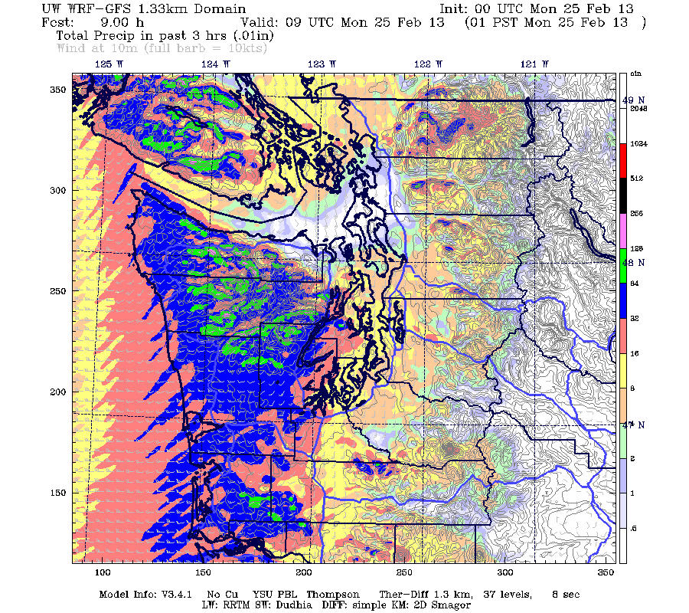
Resources and Experience in the Region
1965-2000: Cascade Project, CYCLES, COAST
2001: IMPROVE field experiment
Ongoing: Regional Environmental Prediction (MM5/WRF)

Slide 12
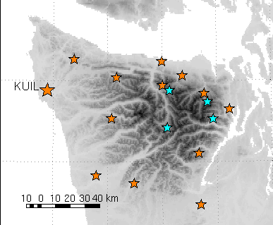
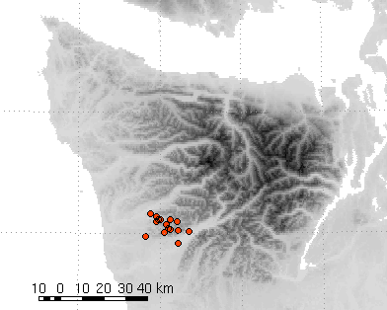
OLYMPEX: Current Instrumentation
Ground Measurements
Detailed gauge network
SNOTEL
RAWS sites
COOP site
  Current surface measurements of meteorological parameters at RAWS, COOP sites and at Quillayute (KUIL)
  Soundings at KUIL
  Snow measurements at SNOTEL sites (Buckinghorse closest to ‘wet’ side)
  Tipping bucket rain gauges deployed now along transect between the Quinault and Queets rivers and one at the coast (as in Minder et al. 2008). Network has been on site since ~2004

Slide 13
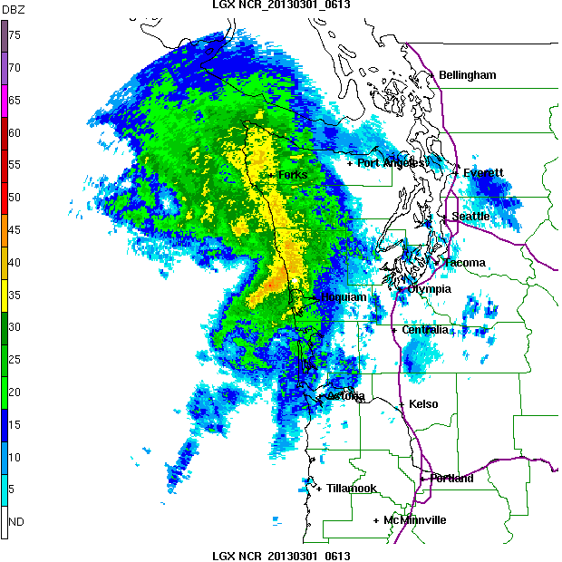
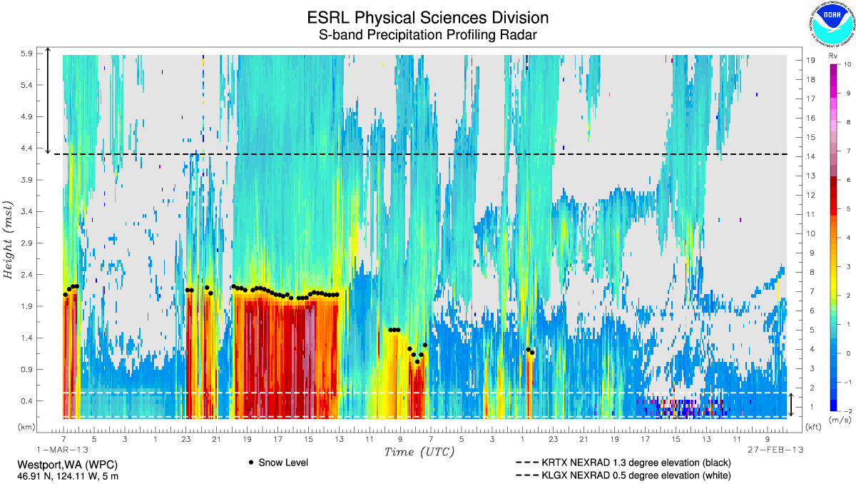
OLYMPEX: Current Instrumentation
Radar
  The celebrated and much beloved coastal radar – Langley, WA (LGX) – since 2011
  Atmospheric River Observatory at Westport, WA since 2009: 915 MHz Wind Profiling Radar
  Atmospheric River S-Band Precipitation Radar
Langley
Westport

Slide 14
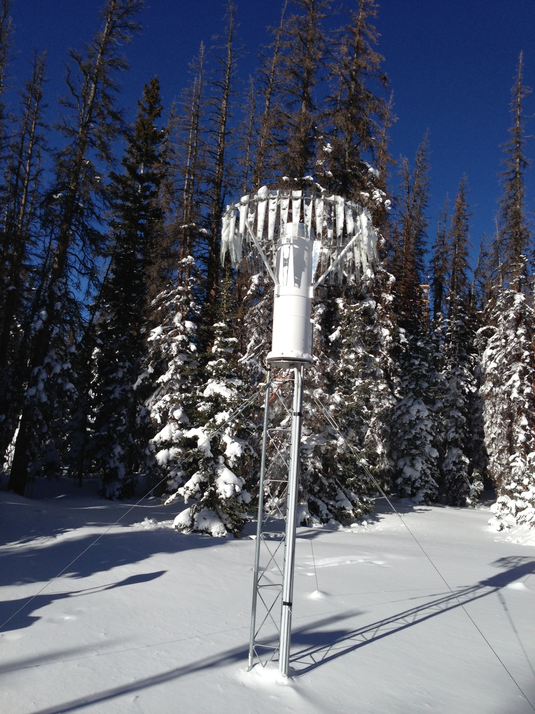
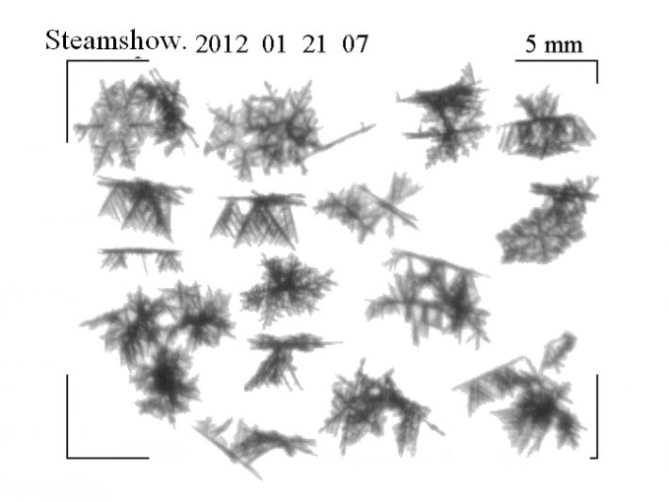
OLYMPEX: Proposed Instrumentation
Ground-based
  Additional Rain gauges, especially in Chehalis Basin
  Snow Measurements – hot plates, Pluvio precipitation gauge, snow video imager
  Video disdrometer
  River gauges?

Slide 15
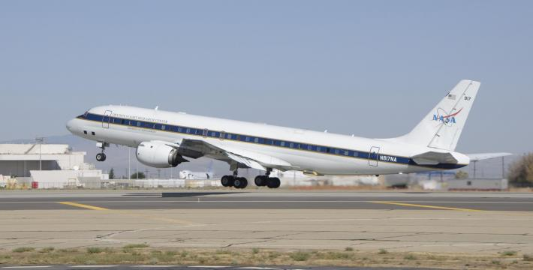
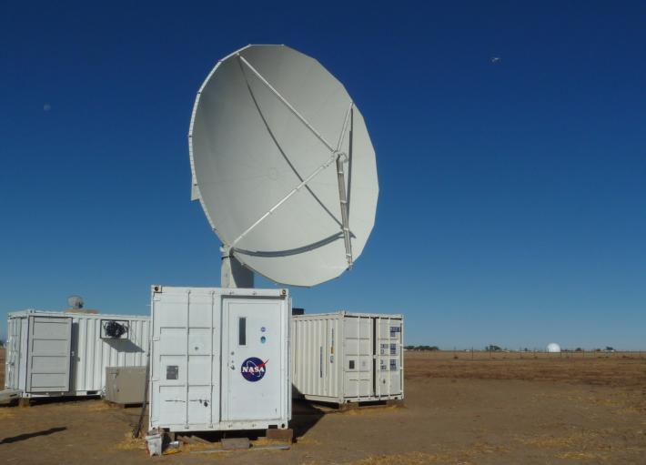
OLYMPEX: Proposed Instrumentation
Radar and Aircraft
DC-8
Global Hawk
  Npol in RHI Mode and maybe another radar?
  DC-8 and/or Global Hawk will fly instruments similar to those on the satellite
  DC-8 and/or other aircraft with microphysics instruments
Npol

Slide 16
OLYMPEX: Promises and Challenges
The Olympic Peninsula is a natural laboratory for precipitation studies
  Persistence of moist flow
  Huge precipitation amounts
  Complex terrain
  Low freezing level
Frequency of Occurrence
Freezing level in KM

Slide 17
OLYMPEX: Promises and Challenges
The Olympic Peninsula is a natural laboratory for precipitation studies
Builds on strong past experience in area and existing and planned resources
  Past field programs (CYCLES, COAST, IMPROVE, etc.)
  Coastal Radar, Atmospheric River Observatory, surface precip gauges
  NPOL, aircraft, additional snow/rain gauges
Npol

Slide 18
OLYMPEX: Promises and Challenges
The Olympic Peninsula is a natural laboratory for precipitation studies
Builds on strong past experience in area and existing and planned resources
Science Goals
  Physical validation of algorithms
  Rain and snow studies in complex terrain
  Hydrological applications of the GPM measurements
  Modeling studies: microphysics from models and data assimilation of GPM precipitation estimates

Slide 19
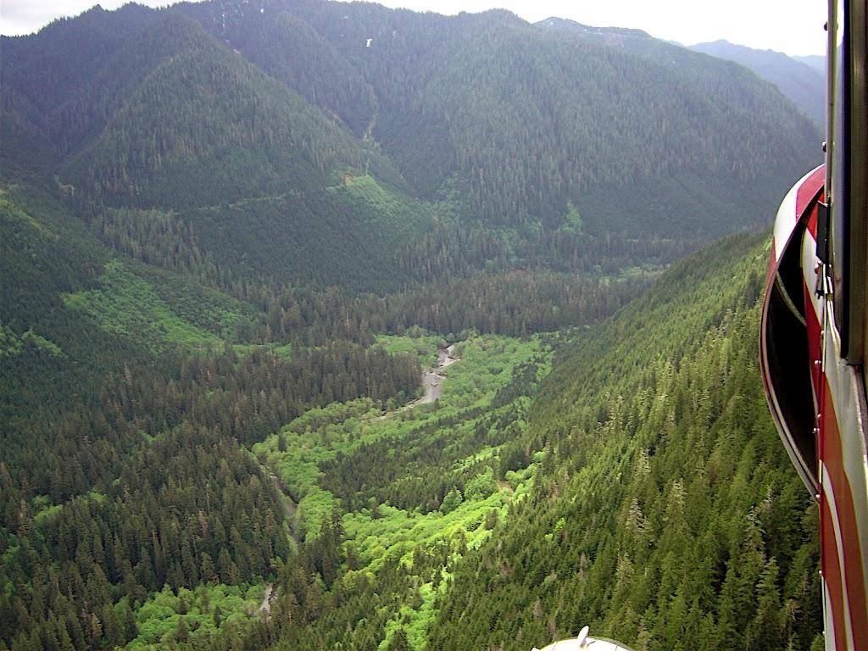
OLYMPEX: Promises and Challenges
The Olympic Peninsula is a remote area
  Much of region in Nat’l Park or Nat’l Forest land
  Difficult to install, get power and maintain instruments

Slide 20
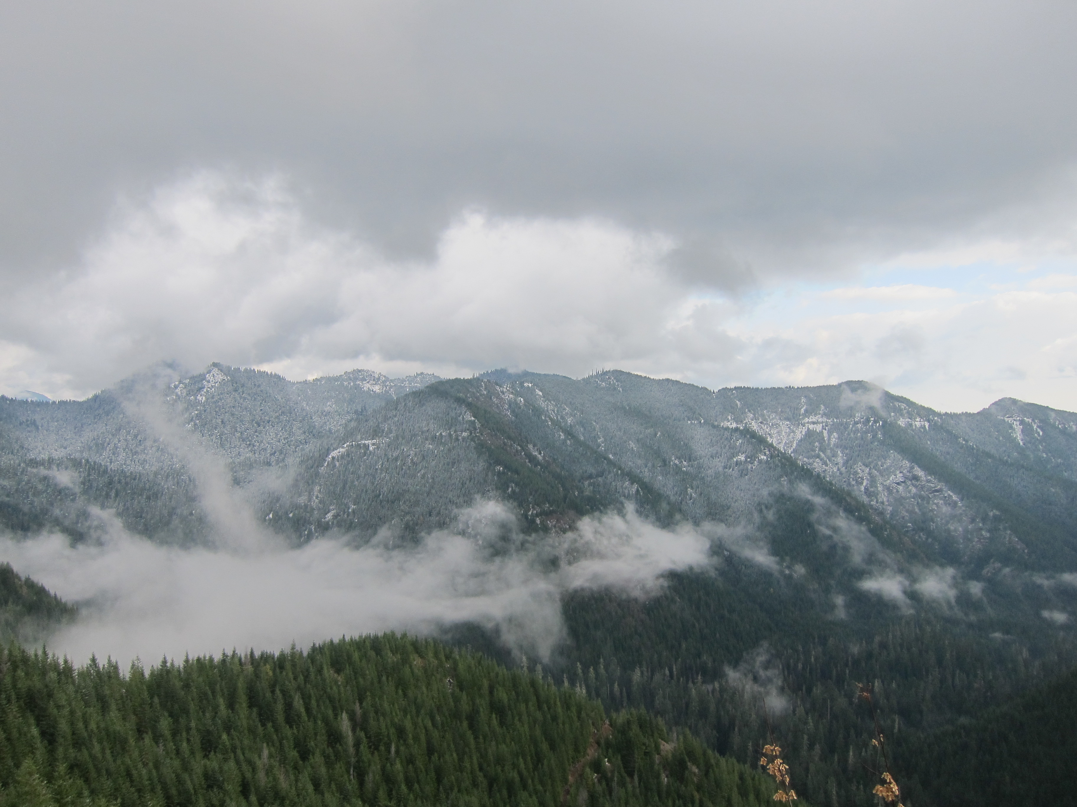
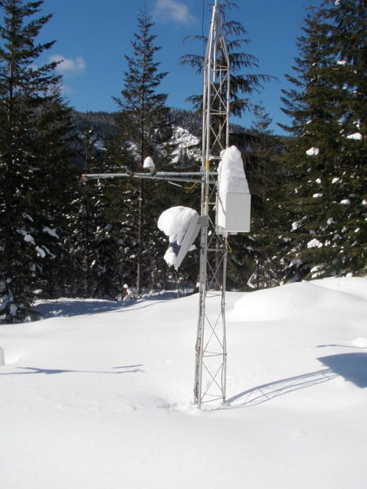
OLYMPEX: Promises and Challenges
The Olympic Peninsula is a remote area
Very challenging for satellite algorithms
  Mixed phase precipitation
  Transition ocean/coast/land
  Complex terrain
Challenging, but not impossible
  GPM and other ‘constellation’ satellites promises to be able to monitor all ranges of precipitation (light to intense) globally on many time scales (hours to daily to inter-annual)
  Results from OLYMPEX will help GPM fulfill that promise
Funding provided by NASA award: NNX12AL54G

