Slide 1
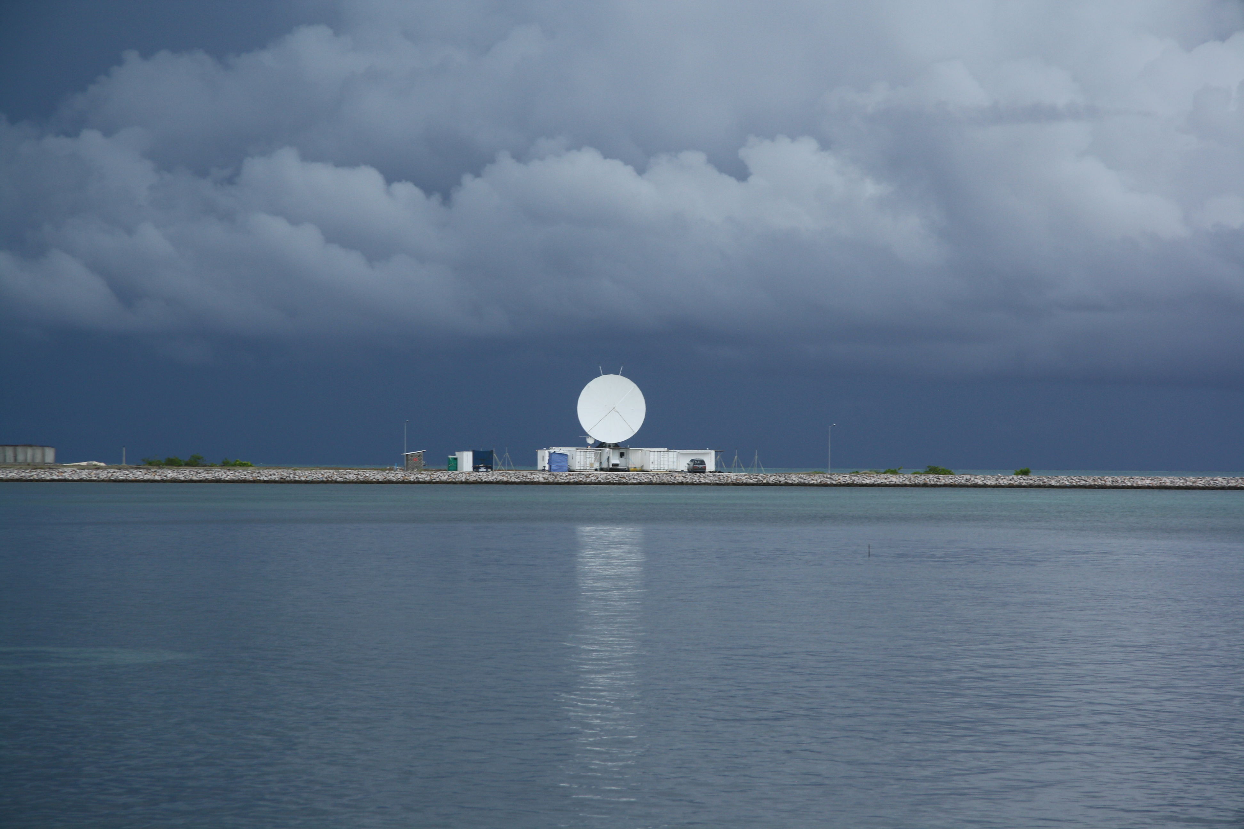
Radars and Adventures in Atmospheric Sciences
Atmospheric Sciences 220 Lecture
Professor R. A. Houze, Jr.
28 February 2013

Slide 2
How do we observe the atmosphere?

Slide 3
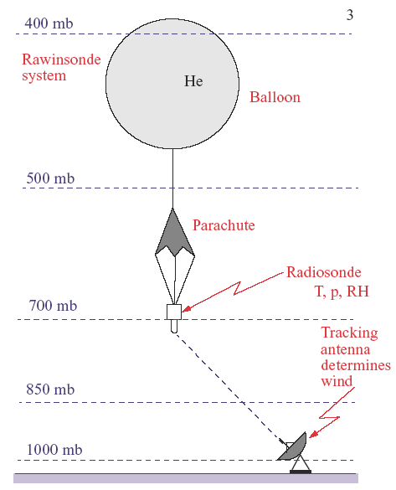
Balloon observations
Could also be tracked by GPS or other means

Slide 4
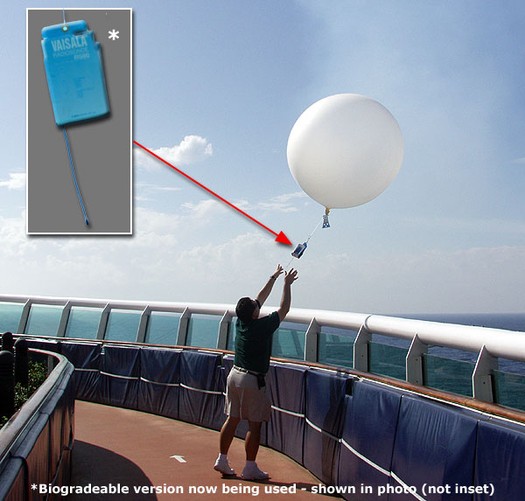
Radiosonde balloon being launched

Slide 5
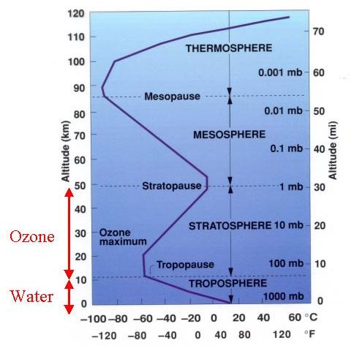
What does the balloon show?

Slide 6
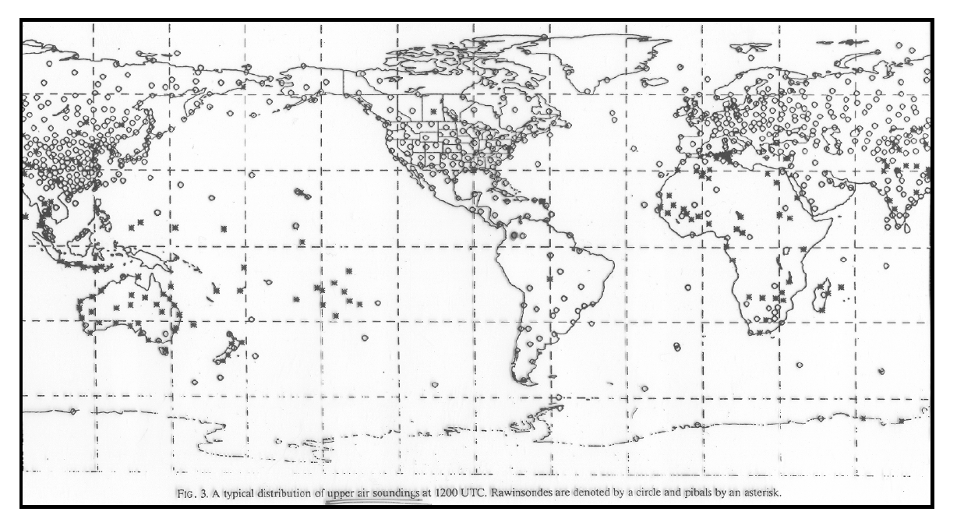
Locations of radiosonde stations around the world

Slide 7
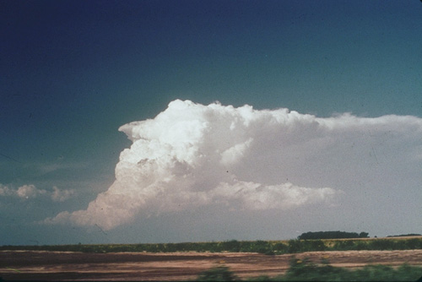
Cumulonimbus
Airflow

Slide 8
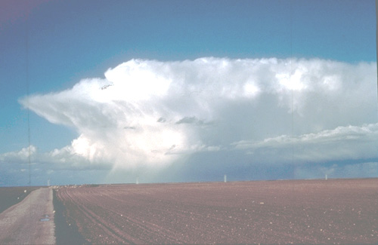
Cumulonimbus
Snow
Hail
Rain

Slide 9
Cloud Observations

Slide 10
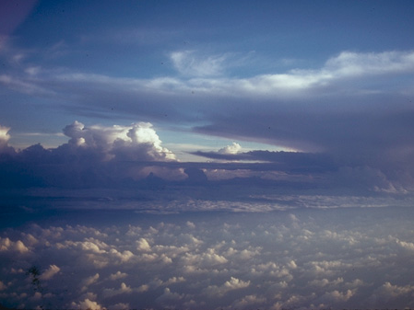
Visual Observation
Cumulonimbus
Towering cumulus (cumulus congestus)
Small cumulus (cumulus humilis)

Slide 11
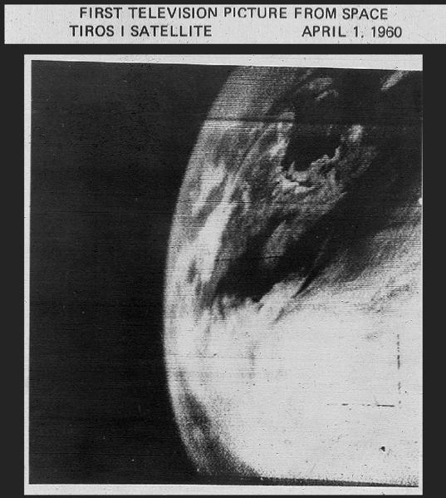

Slide 12
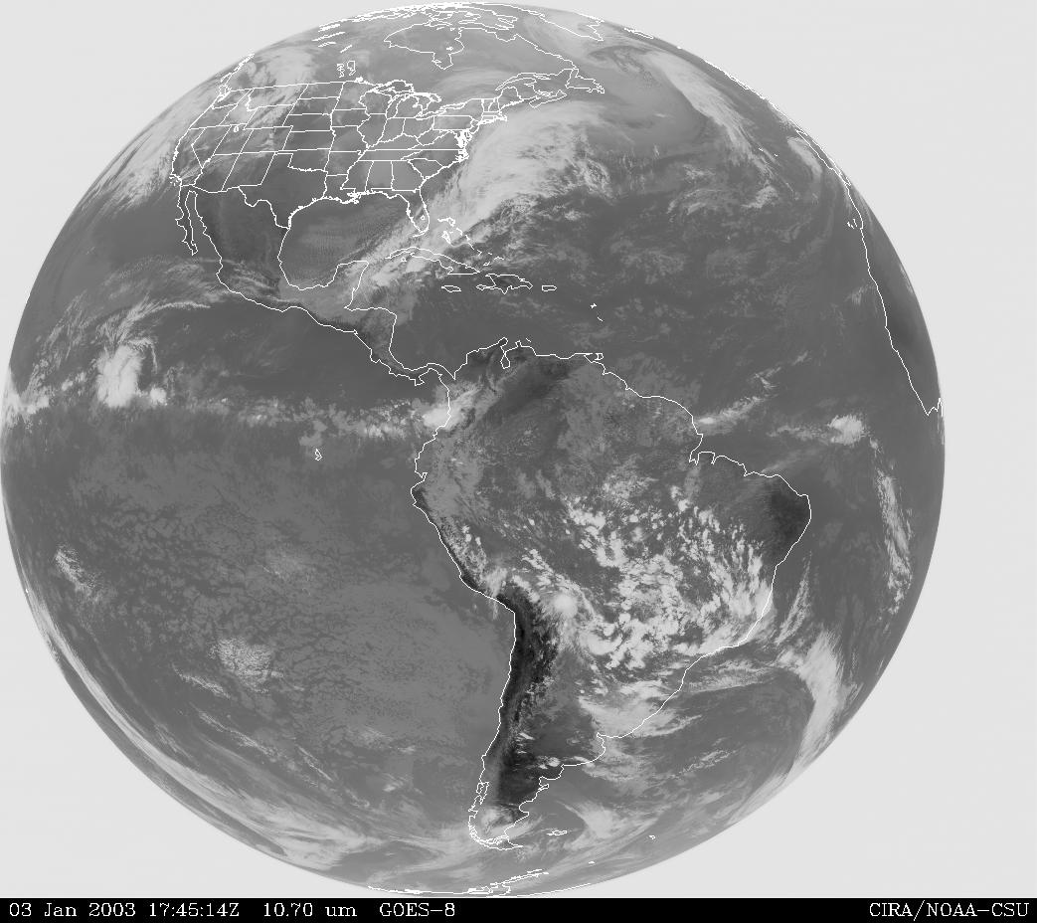
Notes:
The IR pattern emphasizes the higher cloud tops, which largely determine the global precipitation (and hence latent heating) pattern.

Slide 13
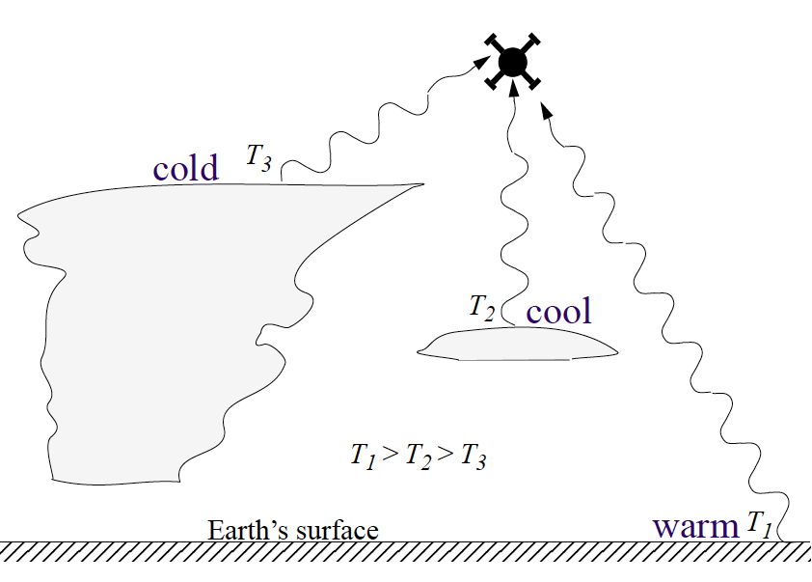
How satellites see clouds
Infrared
camera in space sees cloud top; observer on ground sees cloud base
Cloud top
Cloud base

Slide 14
Need to see inside the clouds

Slide 15
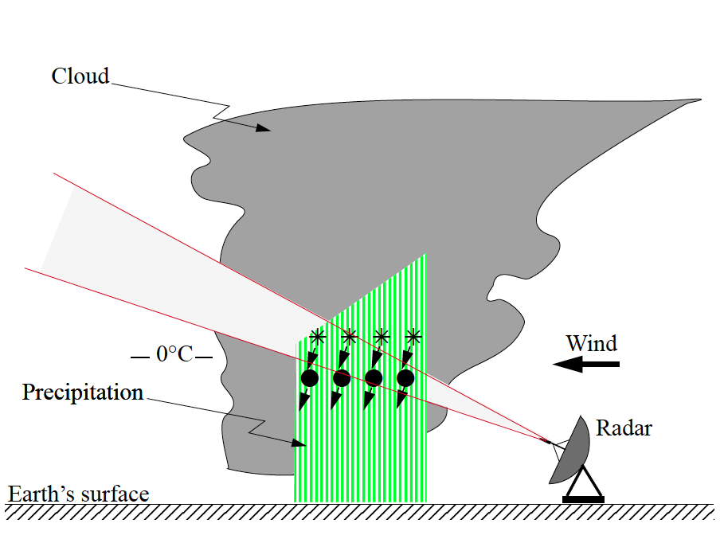


RADAR
Antenna
Microwave radiation
Target
Wavelength

Slide 16
DOPPLER RADAR
Antenna
Out
Back
Moving target
Wavelength

Slide 17
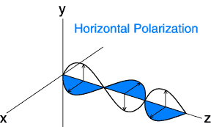
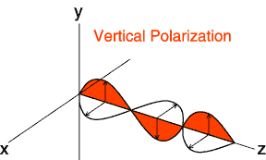

POLARIMETRIC RADAR
Big signal
Small signal
Comparison → The target is horizontally oriented

Slide 18
Meteorological Radar
..looks inside cloud like an MRI or CAT scan

Slide 19


What does a raindrop look like?
?
?

Slide 20
Meteorological Radar

Slide 21
Meteorological Radar
Speed
Snow
Rain
Polarimetric
Doppler

Slide 22
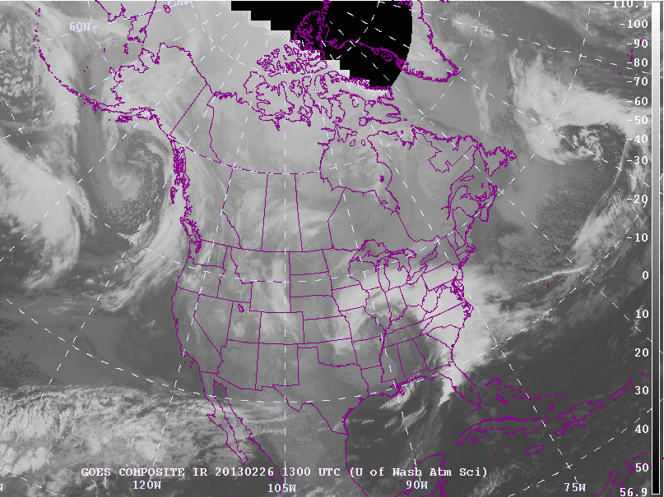

Slide 30
What drives the Earth’s atmosphere?

Slide 31
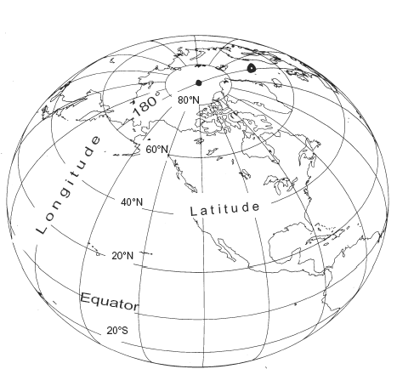
Geography Lesson
Earth loses heat
Seattle 47.5N/122.3W
Earth gains heat

Slide 32
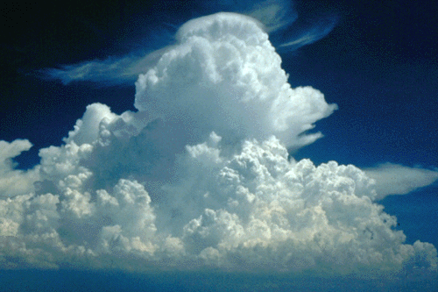

Clouds carry heat up
Sun heats Earth
Land or ocean

Slide 33
How can we learn about this heating process??
Not many observations

Slide 34
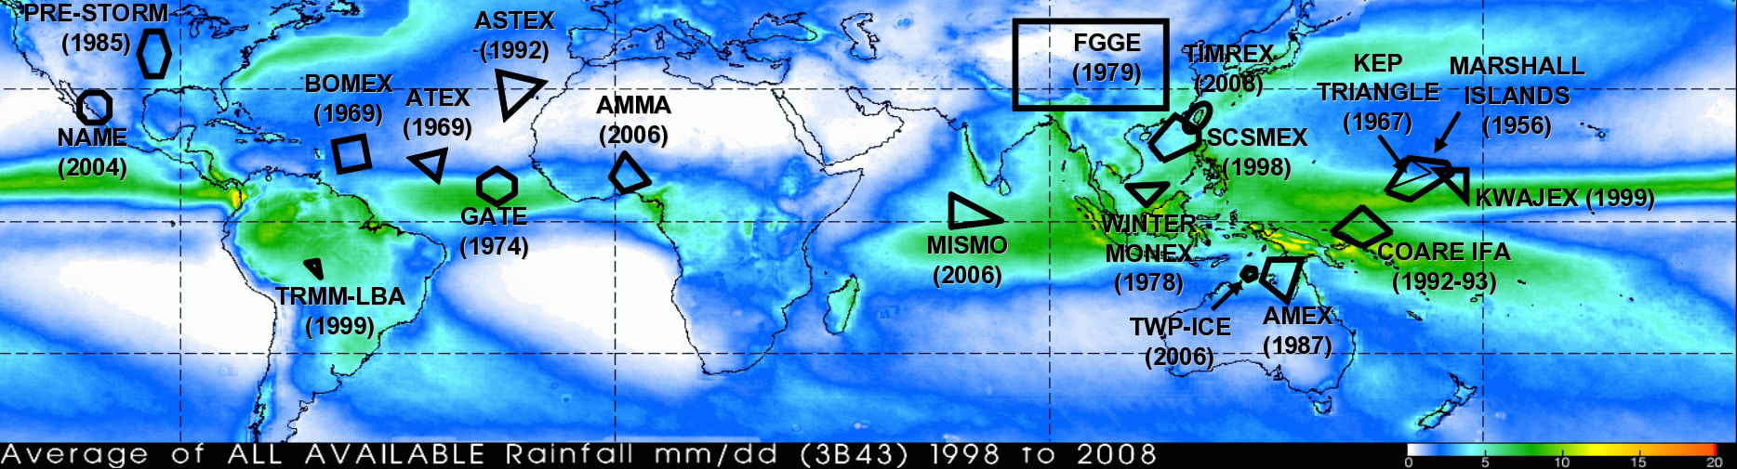
We have to do special “field campaigns”
BoB 1979
JASMINE
1999
TEPPS
1997
EPIC
2001
Tropical field campaigns over the last 40 years

Slide 35
Radiosondes and radars used to study clouds in these projects

Slide 36

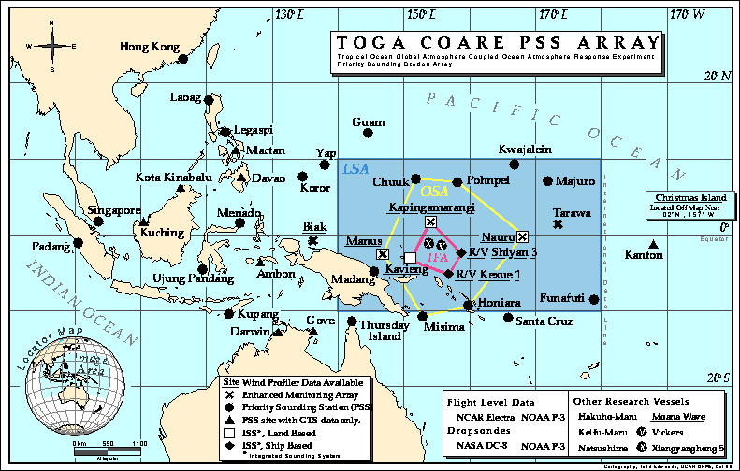
TOGA COARE 1992-3

Slide 37
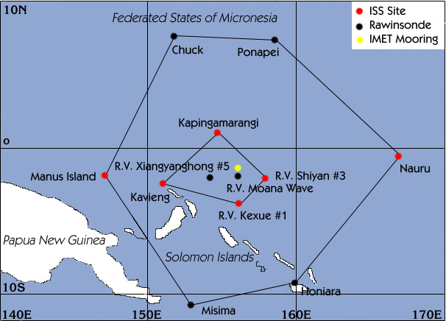
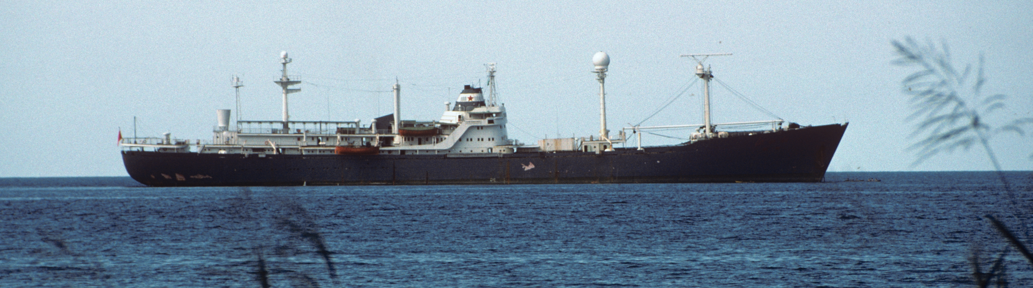
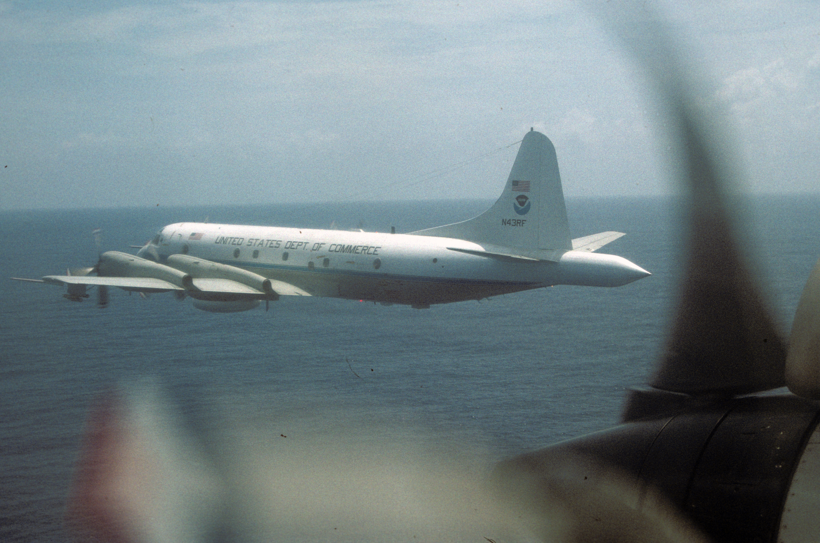
TOGA COARE 1992-3
Shipborne and airborne radars
+ Radiosondes

Slide 38
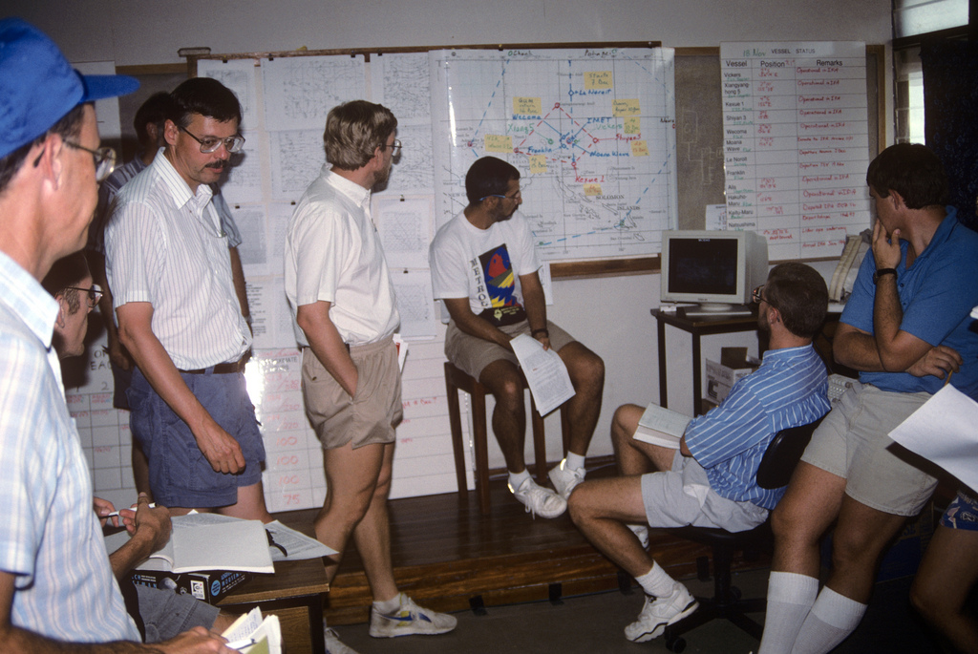

Slide 39
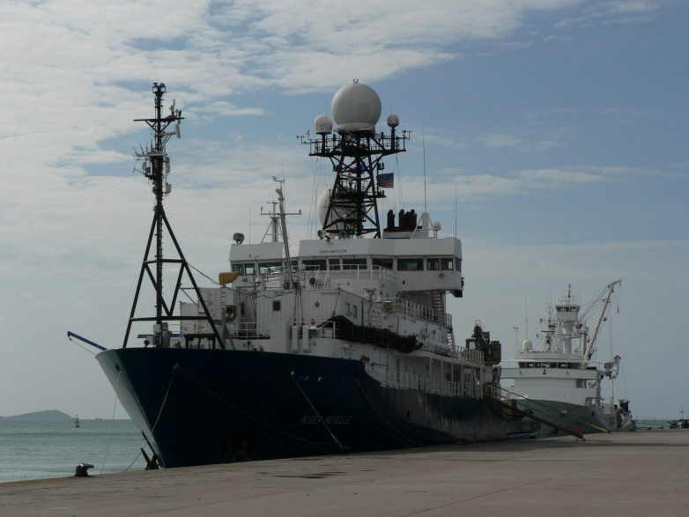
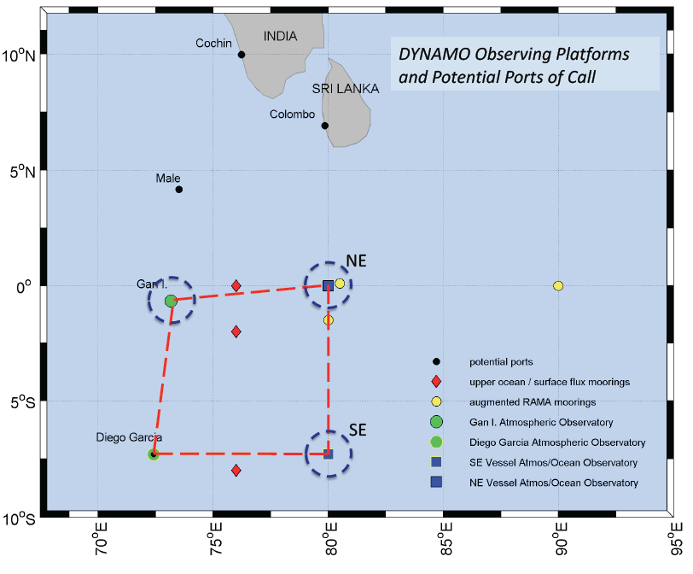
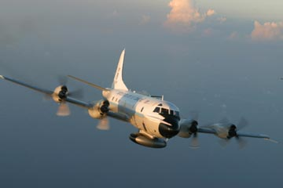
DYNAMO 2011

Slide 40
Hurricanes: the ultimate tropical clouds

Slide 41
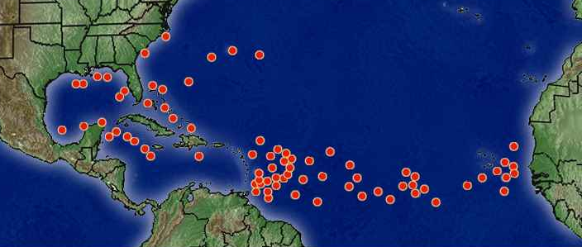
Atlantic Hurricanes
Mid-August Storms

Slide 42
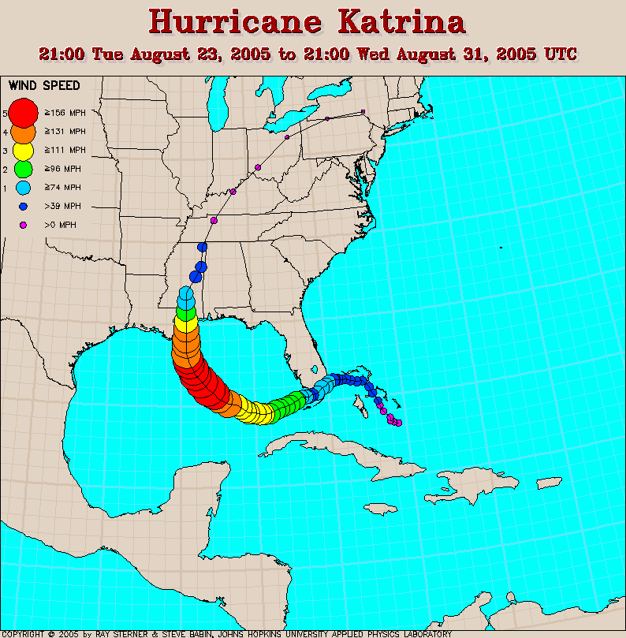

Slide 43
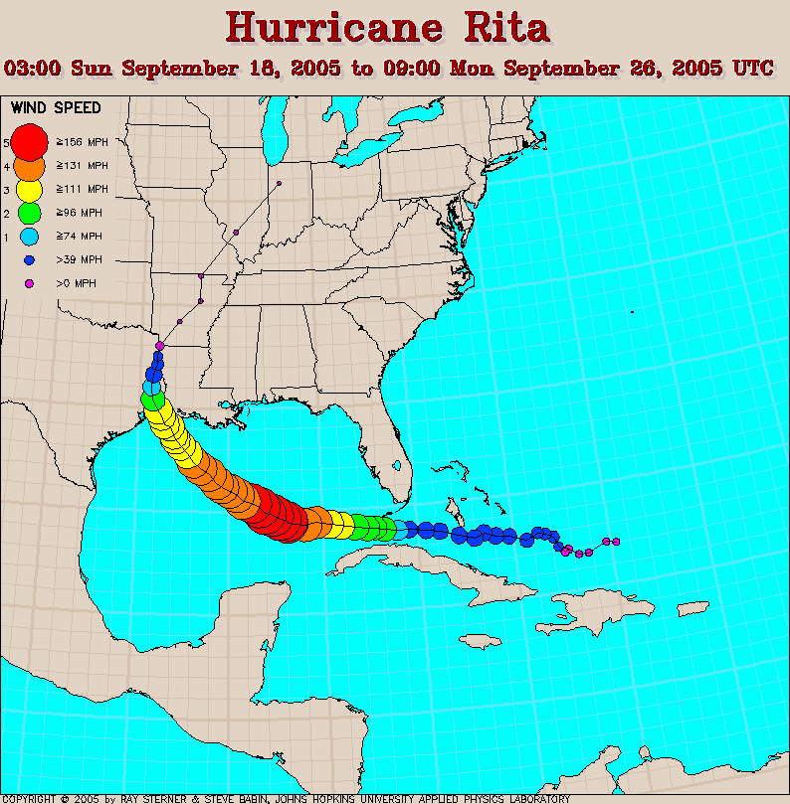

Slide 44
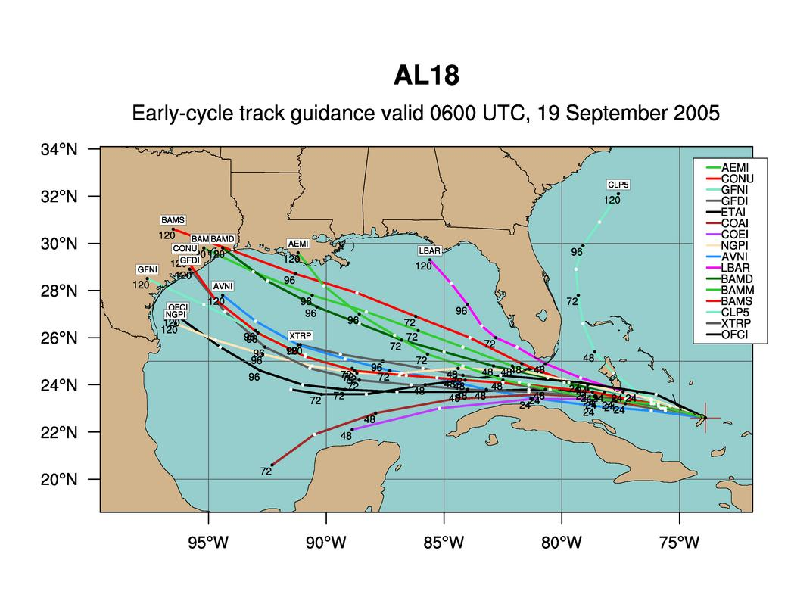
Model forecasts of Rita’s storm track

Slide 45
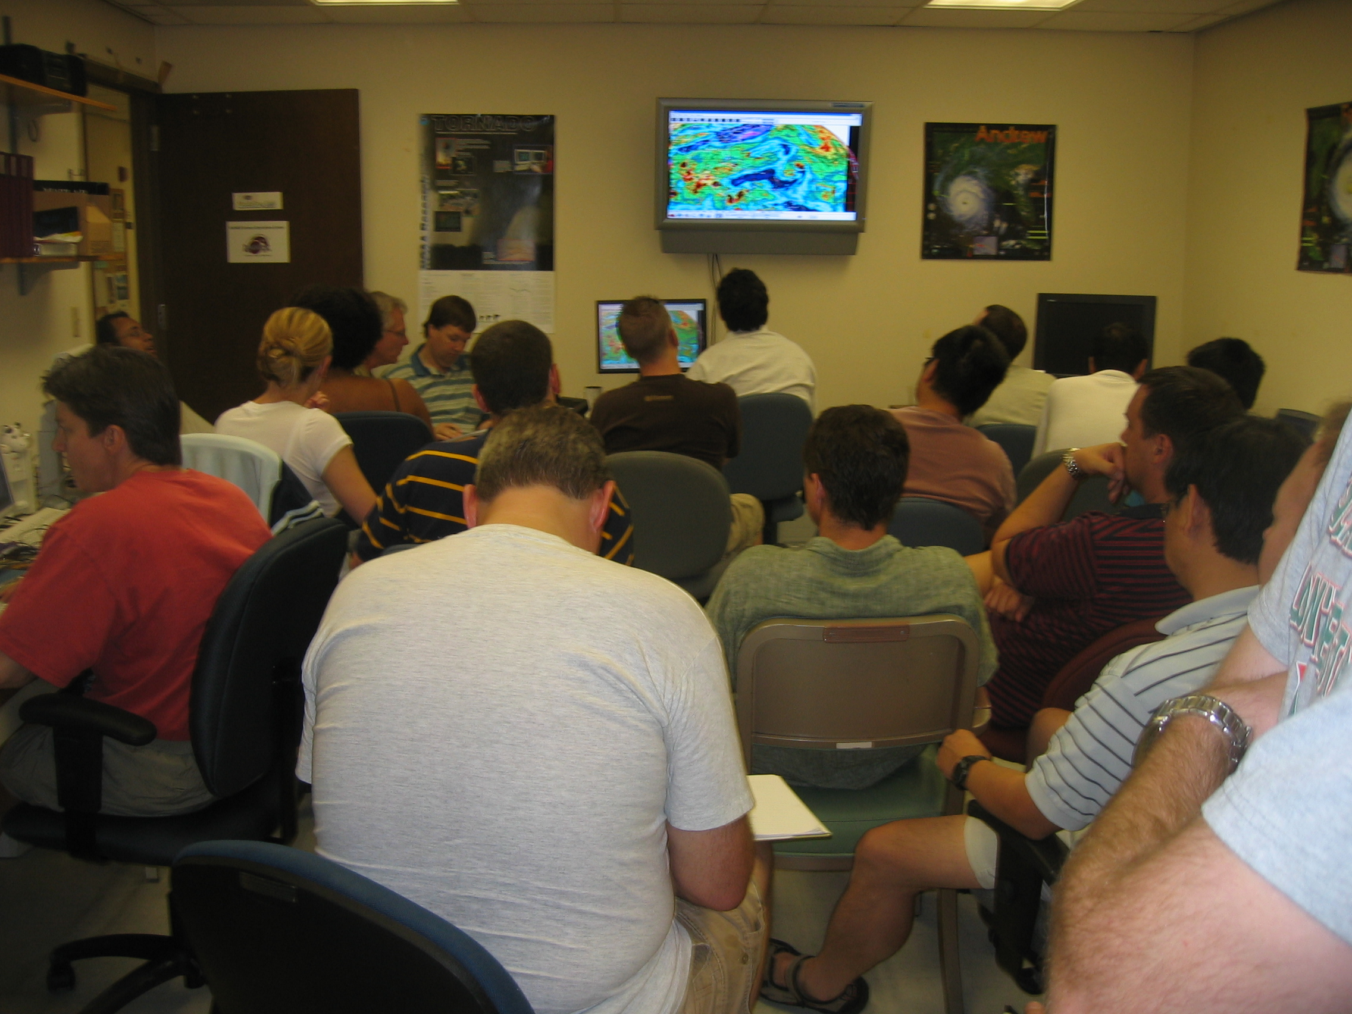

Slide 46
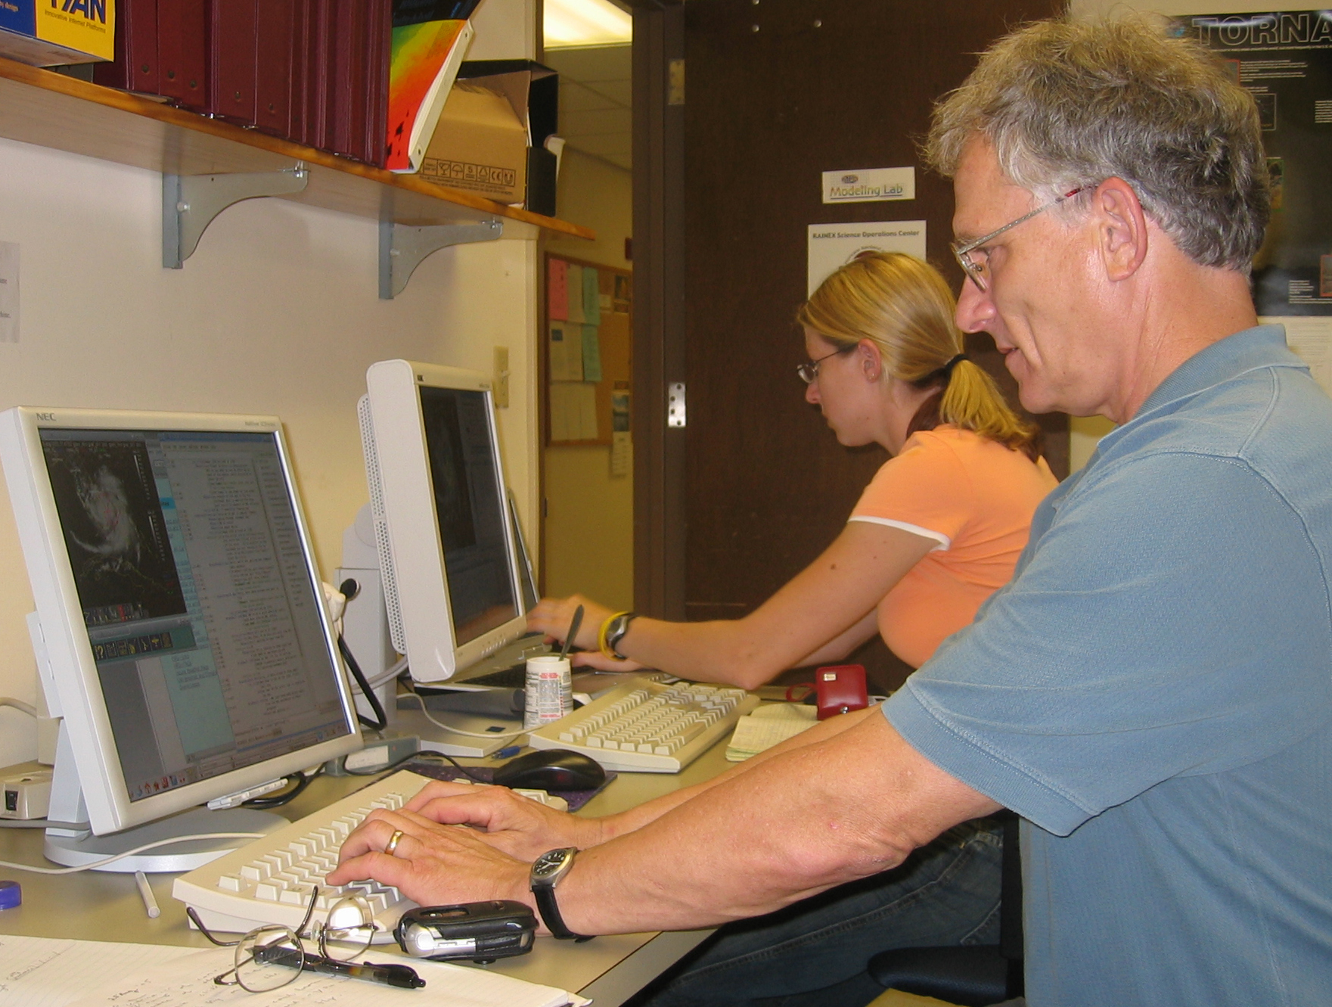

Slide 47
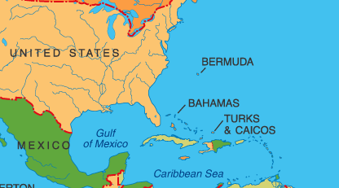

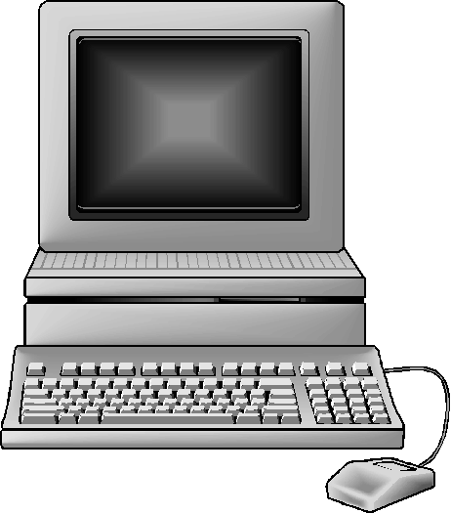
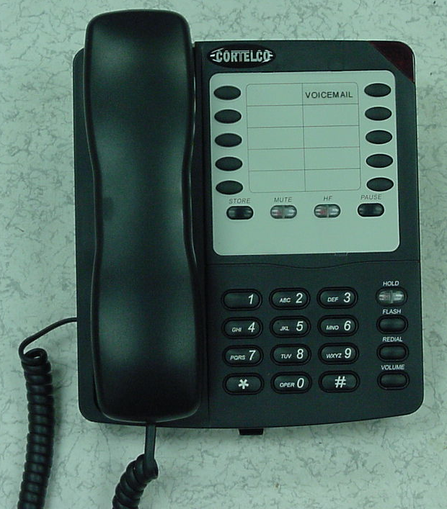
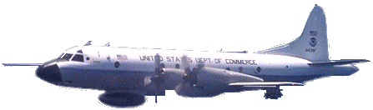
Communications--the key to success
CONFERENCE CALL
INTERNET CHAT
Boulder
Tampa
Miami

Slide 48
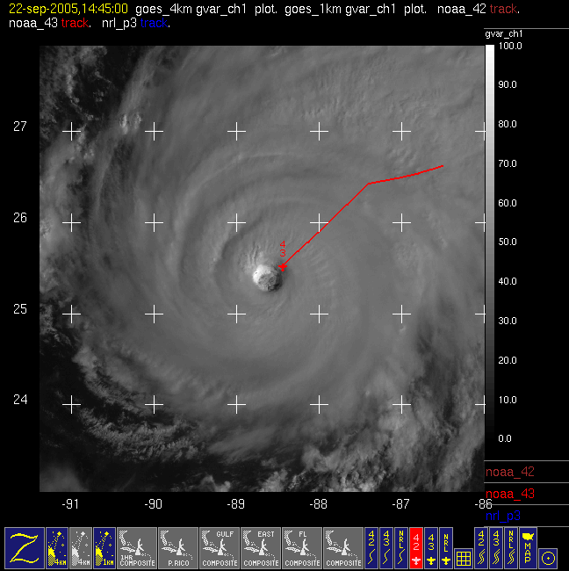
Rita-Day 2

Slide 49
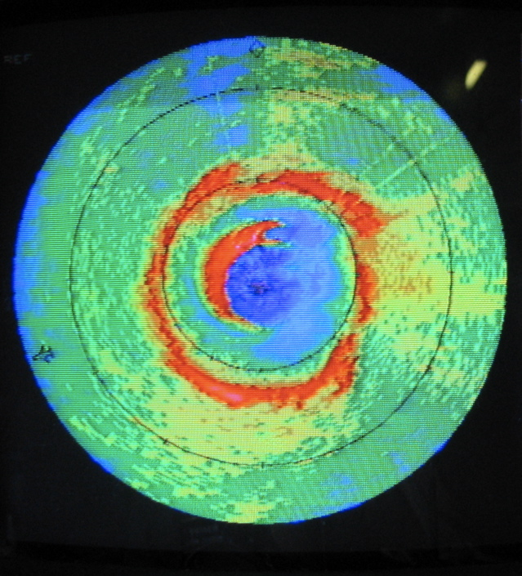
Rita-Day 2
Secondary eyewall on radar!

Slide 50
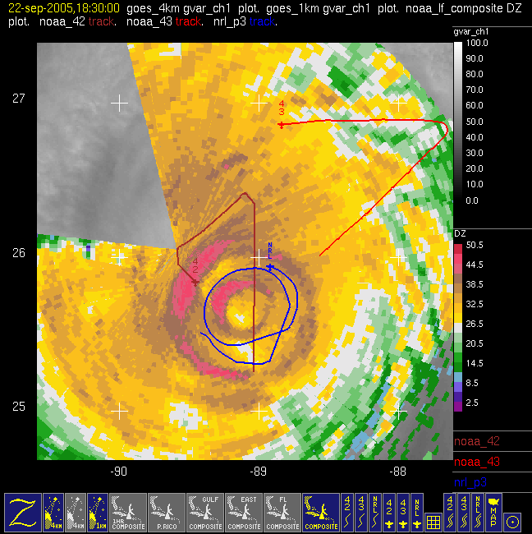
Rita-Day 2
Flying around between and through the primary and secondary eyewalls

Slide 51
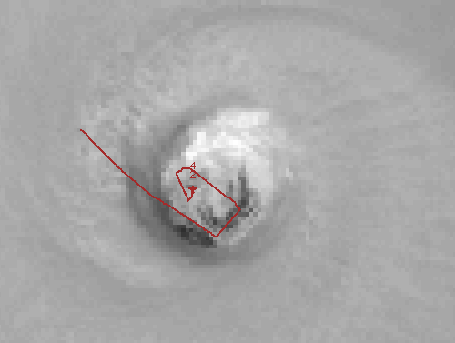
Inside the eye of Rita

Slide 52
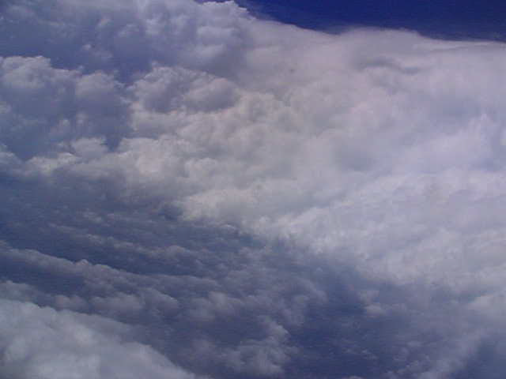

Slide 53
Cultural experience

Slide 54

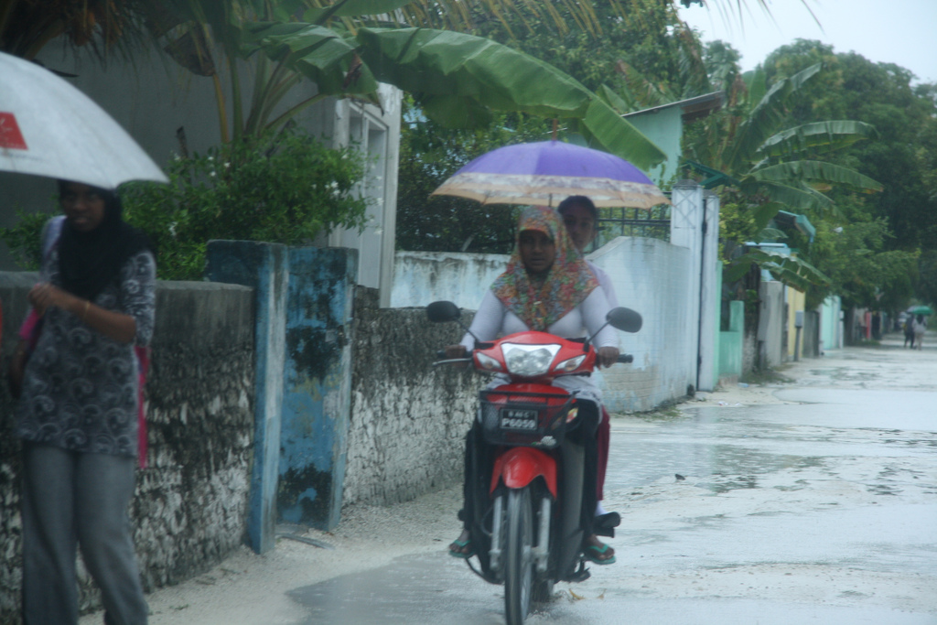
Life on Addu Atoll

Slide 55
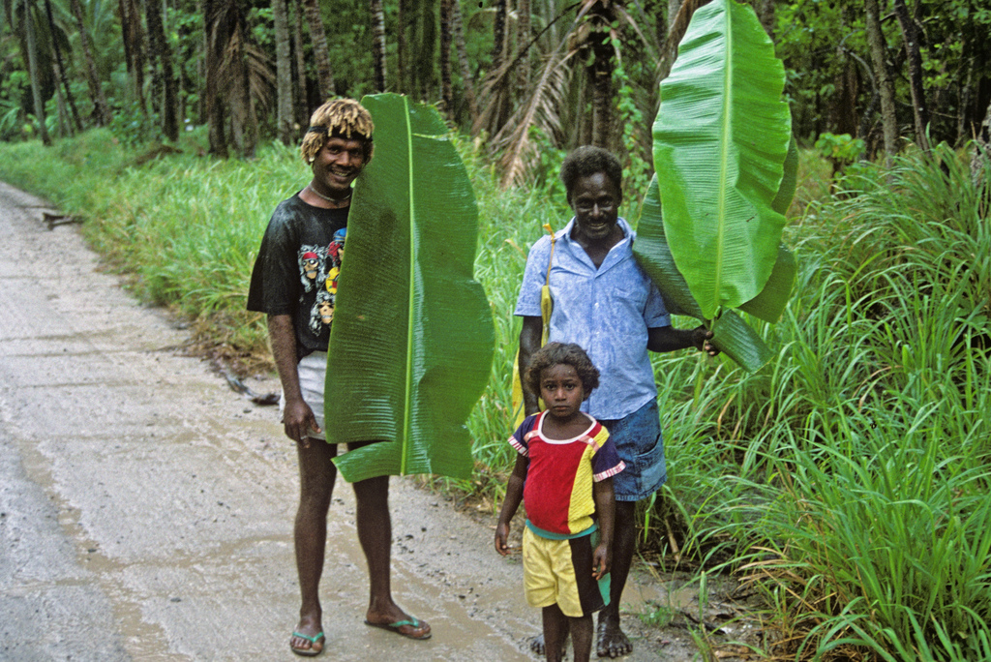


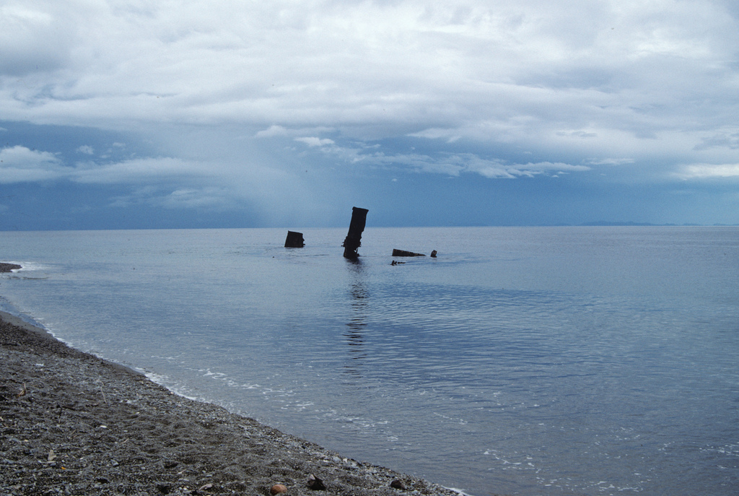

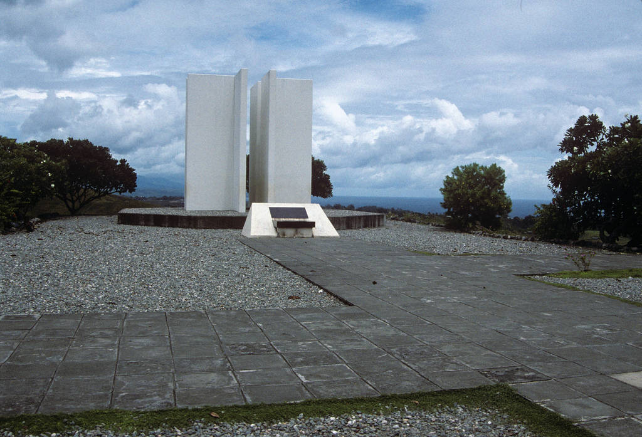
Life in the Solomons

Slide 56
Conclusion: Atmospheric science can be an adventure!

Slide 59
Meteorological Radar
..looks inside cloud like an MRI or CAT scan

Slide 60
Satellite Observation of Cloud Top Temperature
Infrared
camera in space sees cloud top; observer on ground sees cloud base
Cloud top
Cloud base

Slide 61
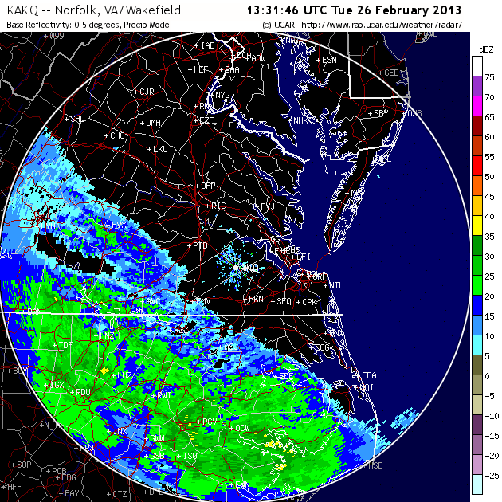

Slide 62
Aircraft
Island
Ship

Slide 63
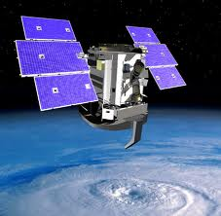
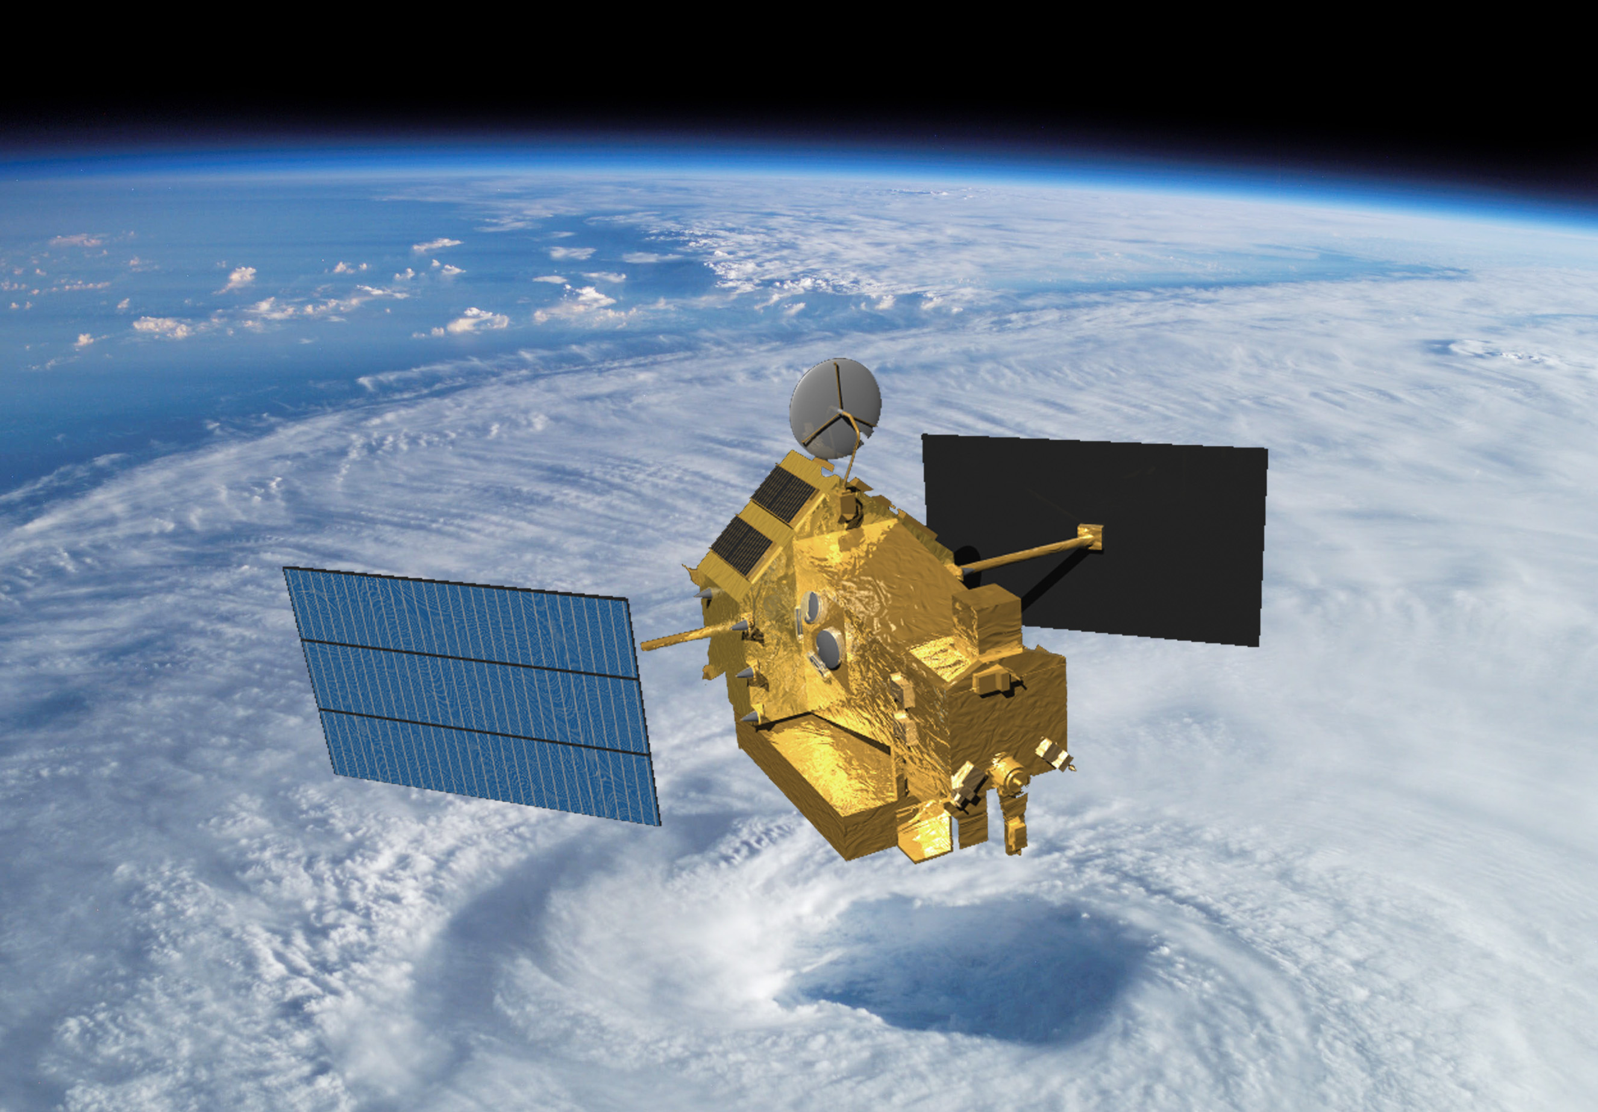
Radars in Space
CloudSat
2006-
TRMM
1997-

Slide 64
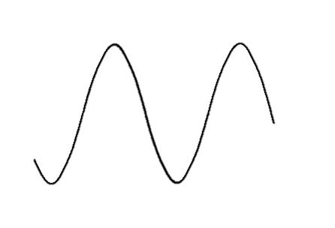
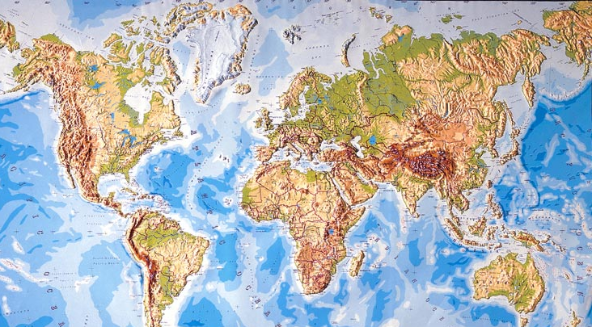
The future
GPM
CloudSat → EarthCare
Rockies
Himalayas
Next generation:
  Radars need to be in the same orbit!
TRMM
?
Andes
This research was supported by
NASA grants NNX10AH70G, NNX10AM28G,
and NSF grant AGS1144105
Notes:
Comment on GPM and the ability go to higher latitudes in the future—frontal systems, etc.

