Slide 1


Microphysical Characteristics of the MJO Cloud Population during DYNAMO
Angela Rowe
Atmospheric Sciences Dynamics Seminar
University of Washington, Seattle (JHN111)
21 February 2013

Slide 2
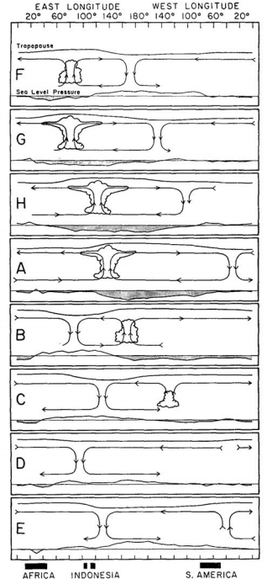
MJO
Madden and Julian (1972)
Eastward propagation
Overturning zonal circulations
Anomalous westerly (easterly) winds to the west (east) of convective center

Slide 3
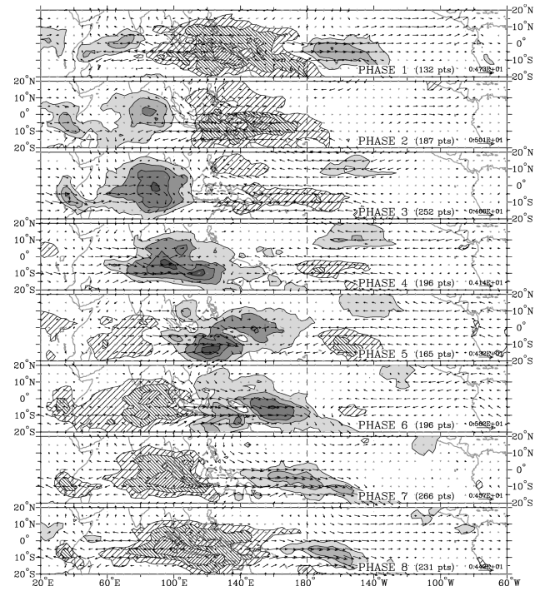
MJO
PHASE 2
Wheeler and Hendon (2004)
OLR anomalies
Phases 2 and 3 for Indian Ocean
PHASE 3

Slide 4
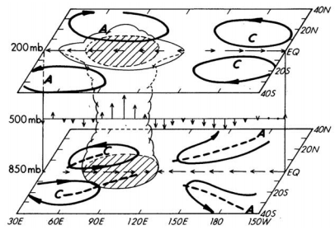
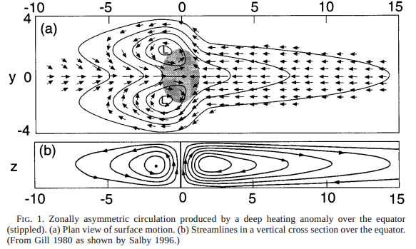
MJO
Equatorial waves coupled to deep convection (Rui and Wang 1990)
East of convective center resembles equatorial Kelvin wave
Gyres straddling equator characteristic of equatorial Rossby wave

Slide 5
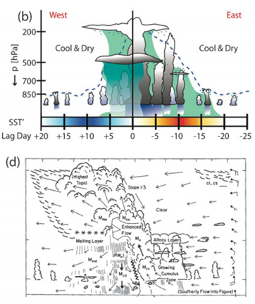
Cloud population
Benedict and Randall (2007)
Transition from shallow to deep
Zipser et al. (1981)

Slide 6
Broad stratiform (Barnes and Houze 2013)
%

Slide 7
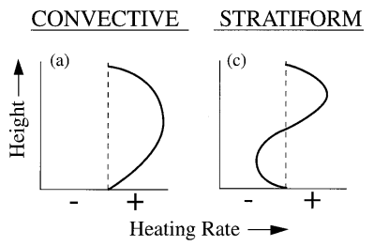
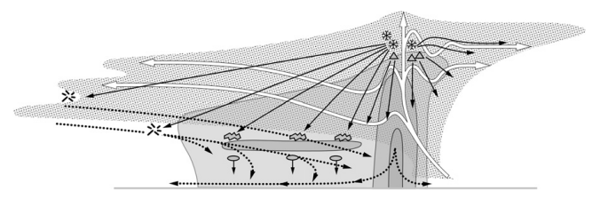
Microphysics
Heating in Tropics
  Variations impact larger-scale circulations
  Warm-rain vs ice processes in convective region
  Extent of stratiform
Radiative effects
  Anvils
Momentum transport
  Diabatic cooling in stratiform
Models require better representation of physical processes for understanding these feedbacks
Houze (1997)
Cetrone and Houze (2011)

Slide 8
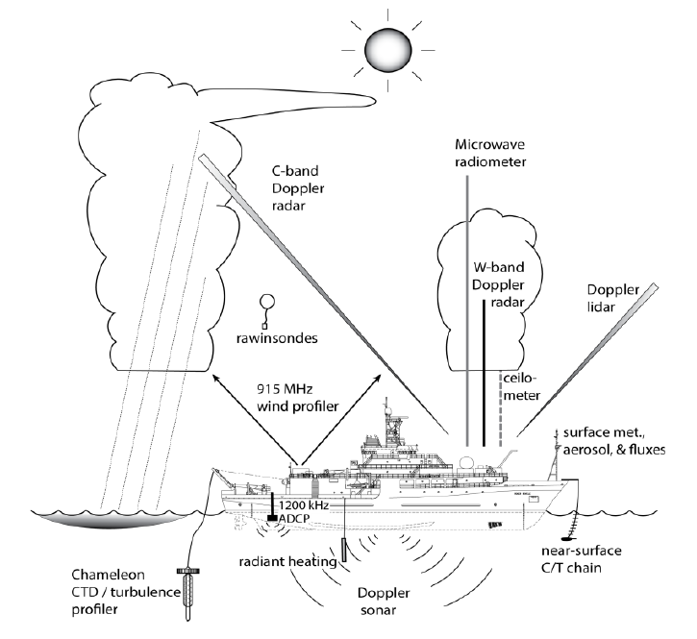
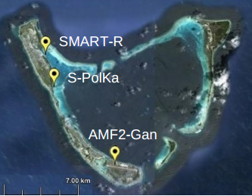
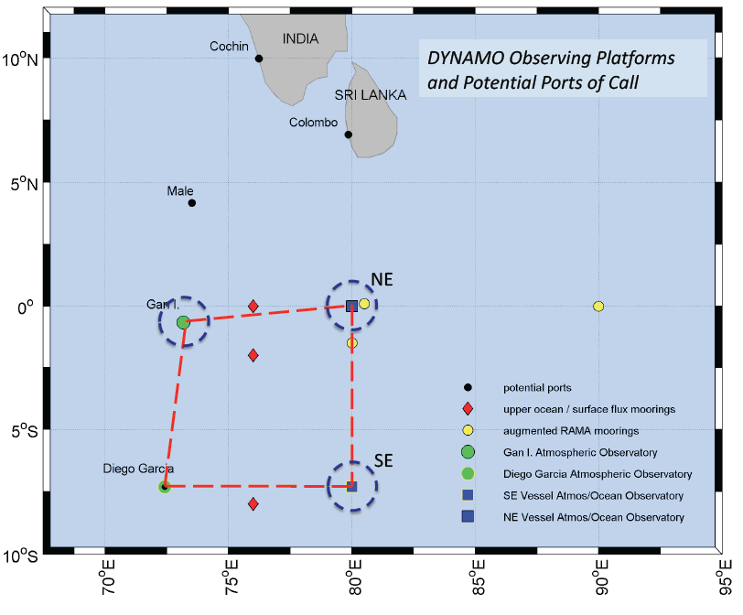
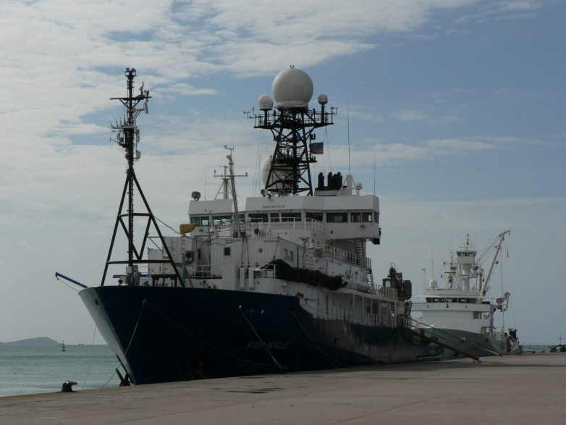
DYNAMO

Slide 9
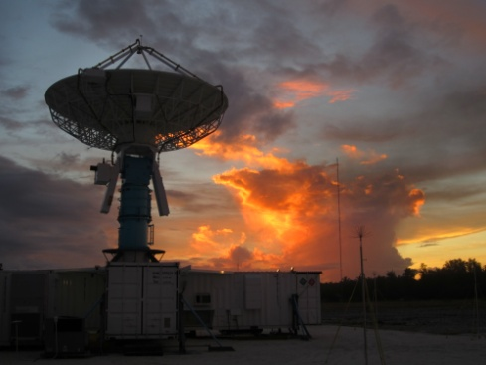
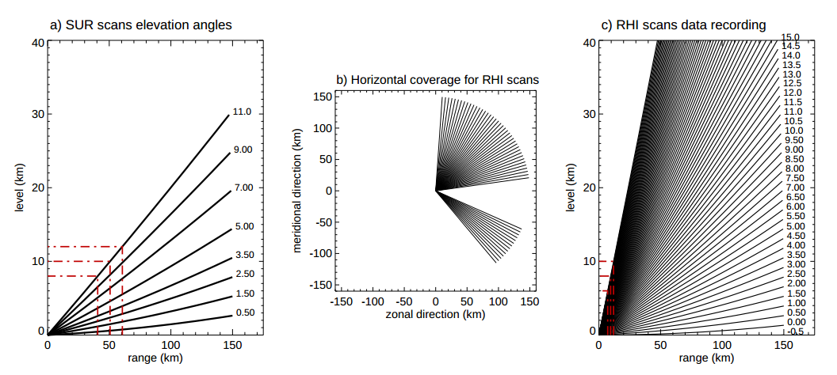
S-PolKa
Mike Dixon
Zuluaga and Houze (2013)

Slide 10
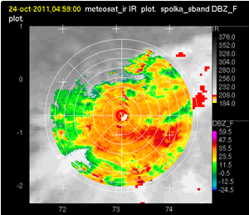
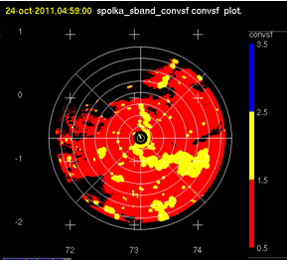
Convective/Stratiform Partitioning

Slide 11
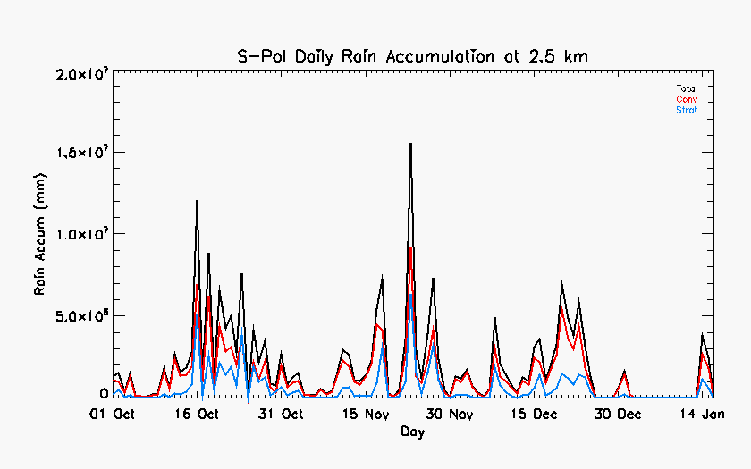
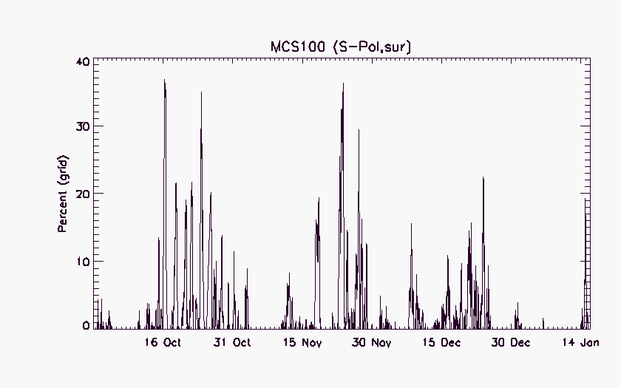
MCS
Frequency of MCSs coincide with peak rainfall
3 “active” periods

Slide 12
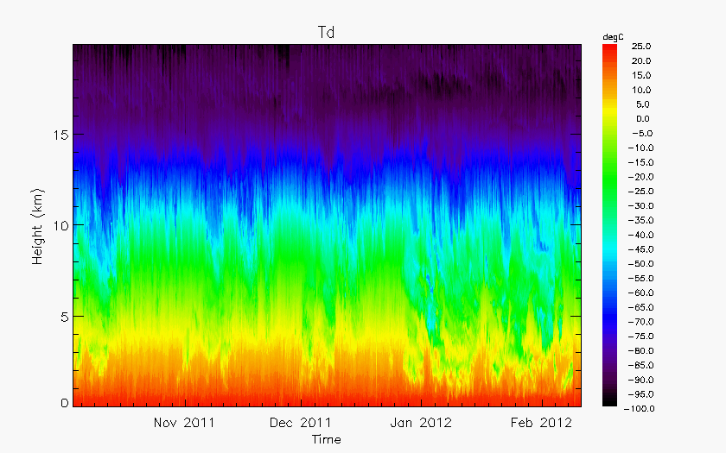
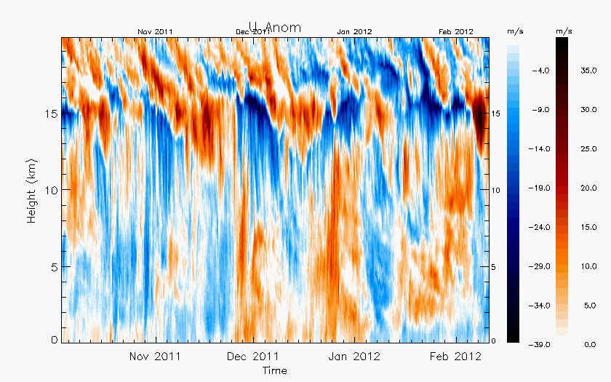
Environmental conditions
Td
Three “active” periods
  Increased mid-level moisture
  Upper-level anomalies (Kelvin waves)
Anomalous low-level westerlies in Dec
Suppressed conditions in Jan
U anom

Slide 13
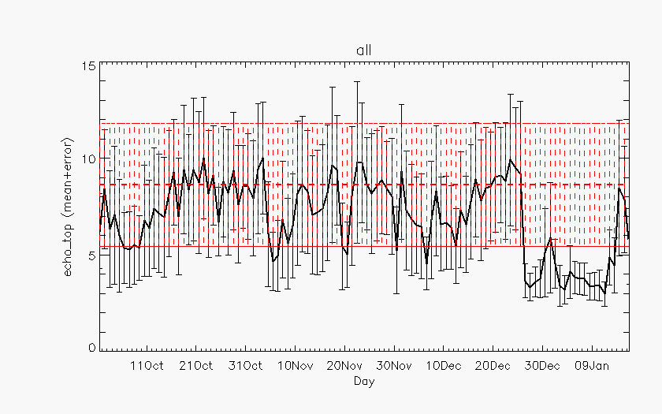
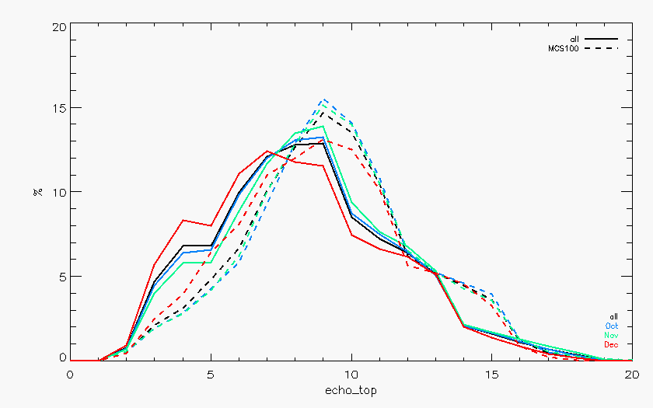
Echo-top heights
Transition from shallow to deep
Large spread
MCSs deeper
Shallower echo in Dec?
Oct
Nov
Dec
MCS
all

Slide 14
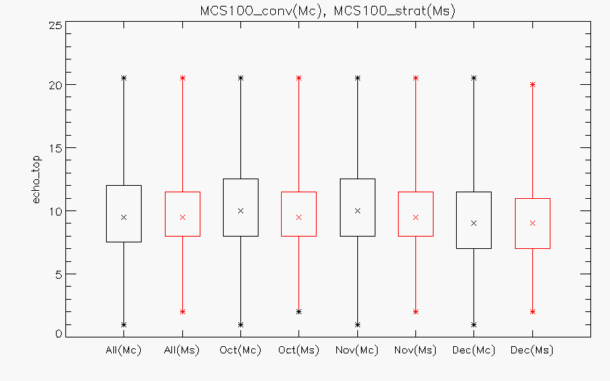
Echo-top heights
December convection

Slide 15
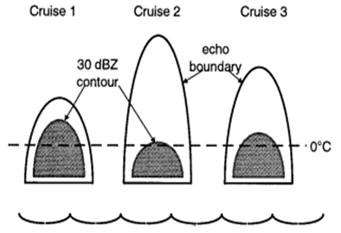
30-dBZ heights
Presence of > 30-dBZ above freezing level associated with lightning production (Zipser 1994; Petersen 1996)
Similar 30-dBZ heights despite deeper convection during active stages during TOGA COARE (DeMott and Rutledge 1998)
Inactive
Active
Active

Slide 16
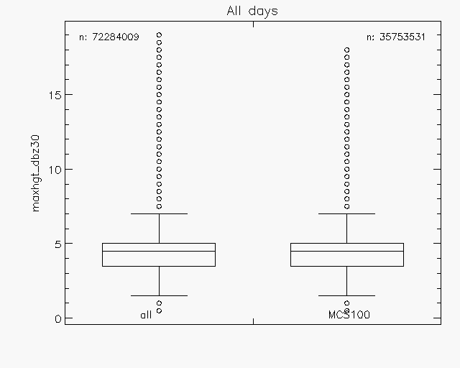
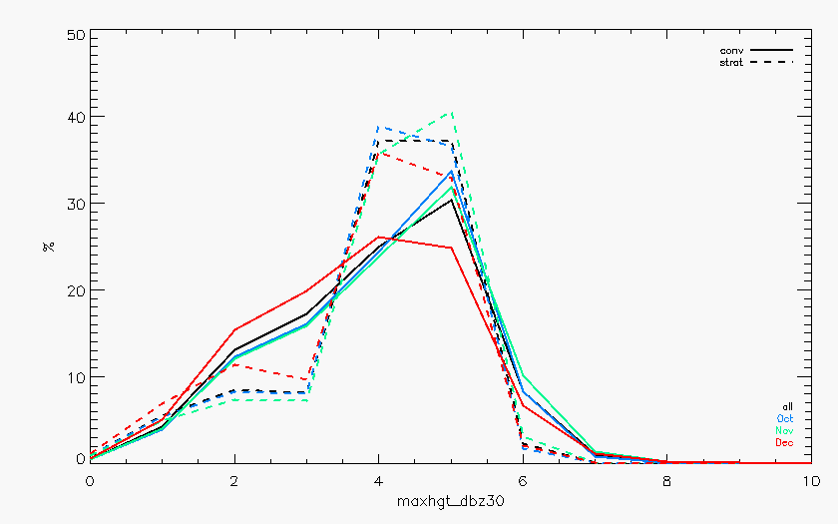
30-dBZ heights
Most at or below melting level
all
MCS
Oct
Nov
Dec
strat
Broader distribution for Dec convection
conv

Slide 17
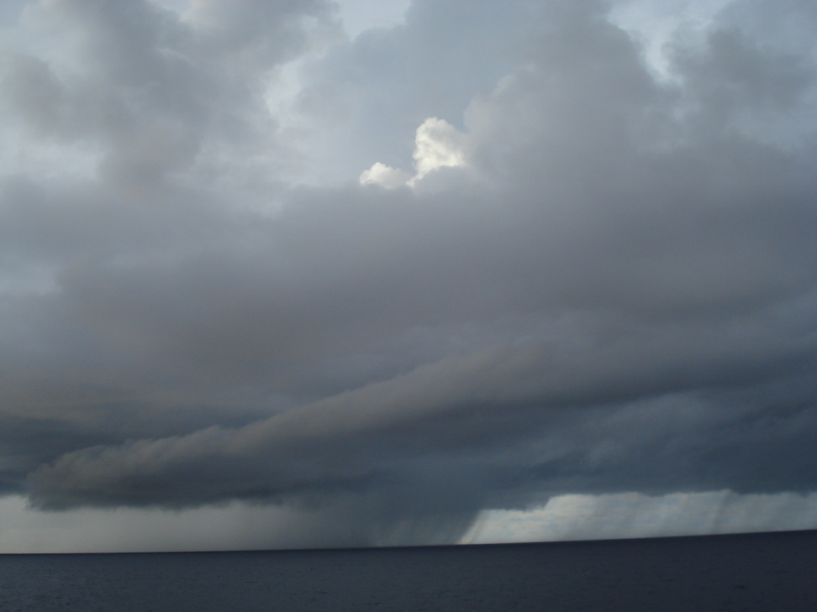
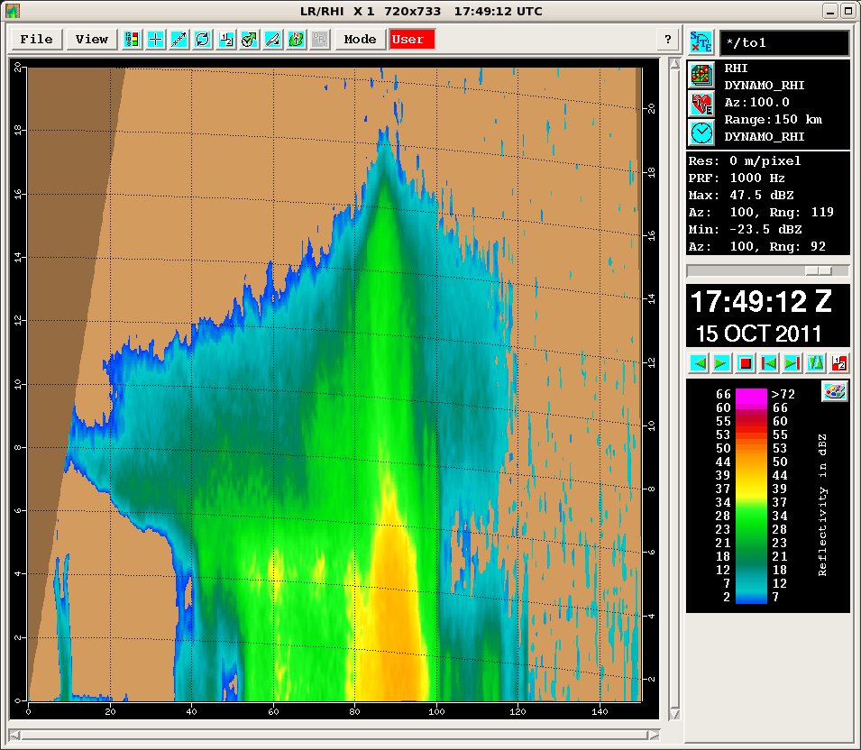
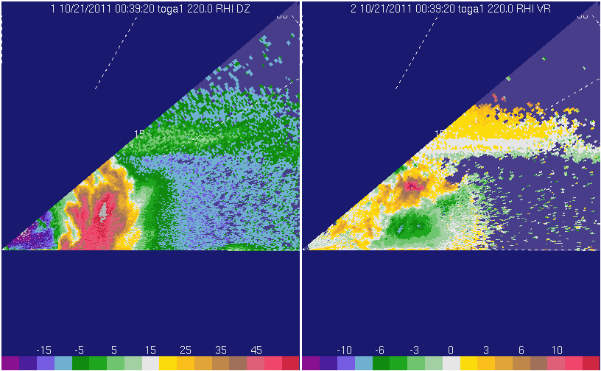
Revelle
8km
Z
V
>55 dBZ
LIGHTNING!!!

Slide 18
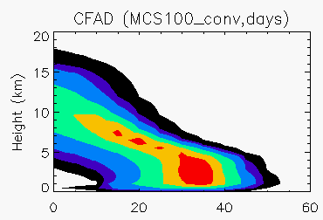
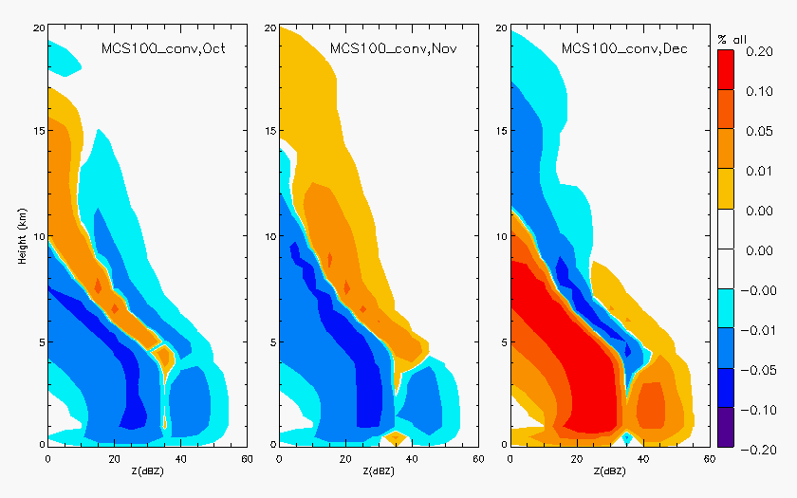
all
MCS convection
Z (dBZ)
Oct
Nov
Dec

Slide 19
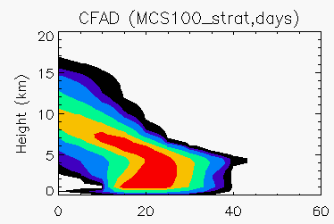
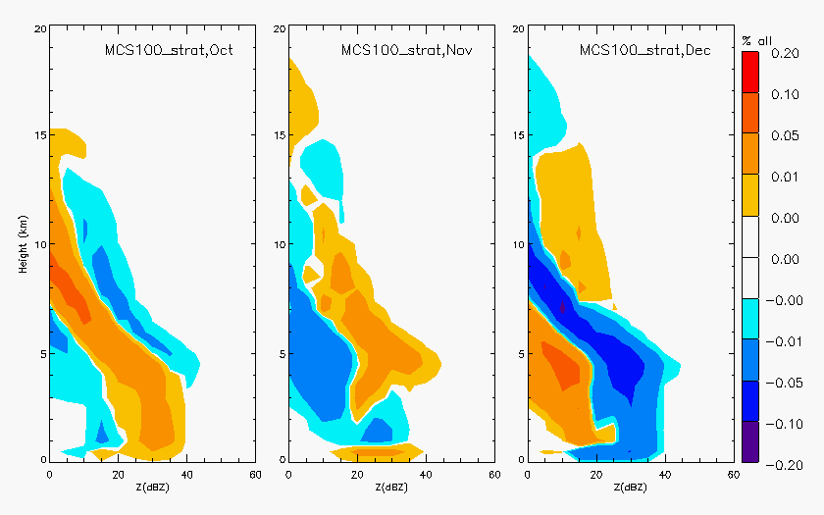
all
MCS stratiform
Z (dBZ)
Oct
Nov
Dec

Slide 20
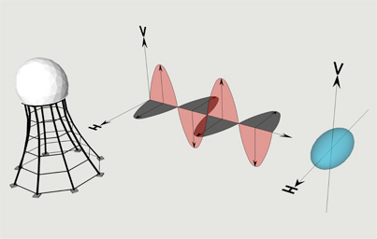





Dual-polarization
UCAR
Polarimetric variables
  Differential reflectivity (Z_{DR})
  Linear depolarization ratio (L_{DR})
  Correlation coefficient (ρ_{HV})
  Specific differential phase (K_{DP})
Particle identification
  Combination of variables (+T)
  Drizzle, rain (light, moderate, heavy), hail, rain/hail, graupel/small hail, graupel/rain, dry snow, wet snow, ice crystals (oriented, irregular)
CHILL

Slide 21
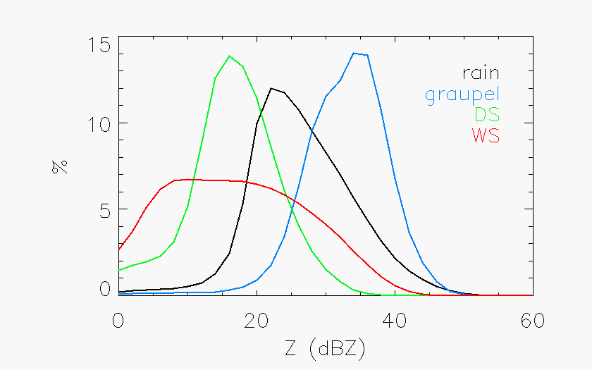
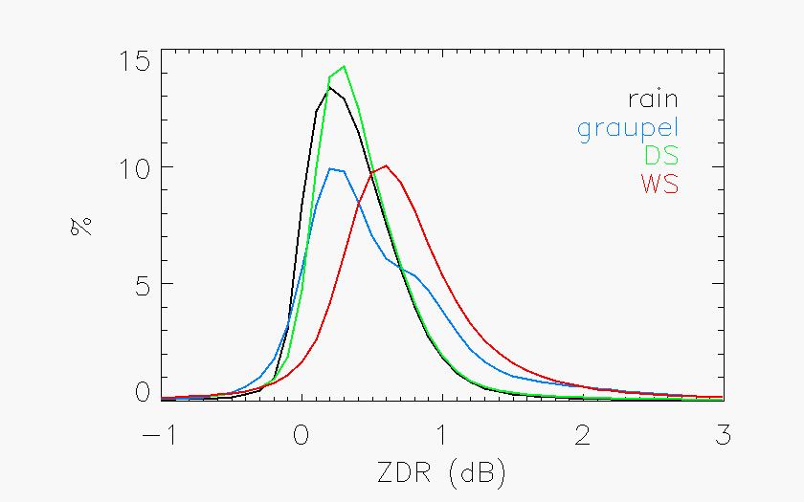
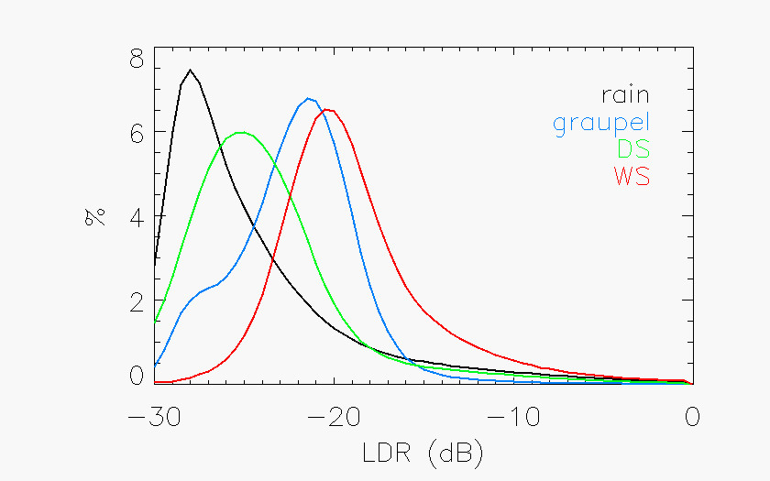
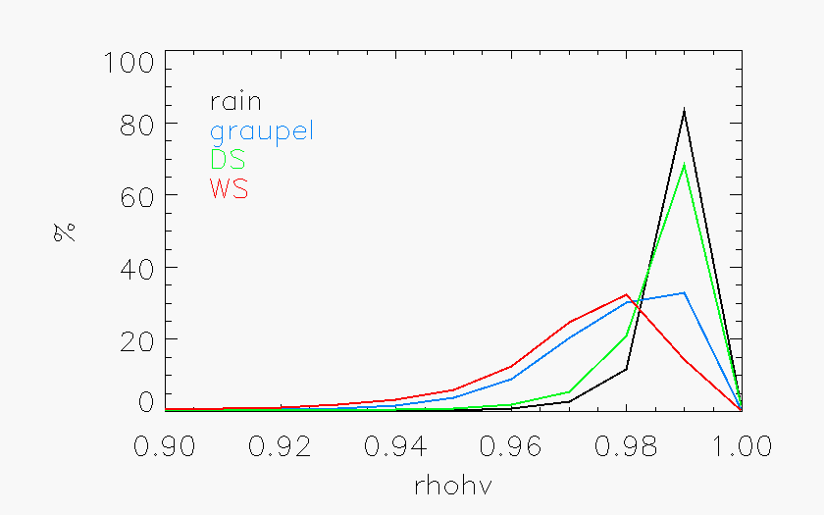

Slide 22
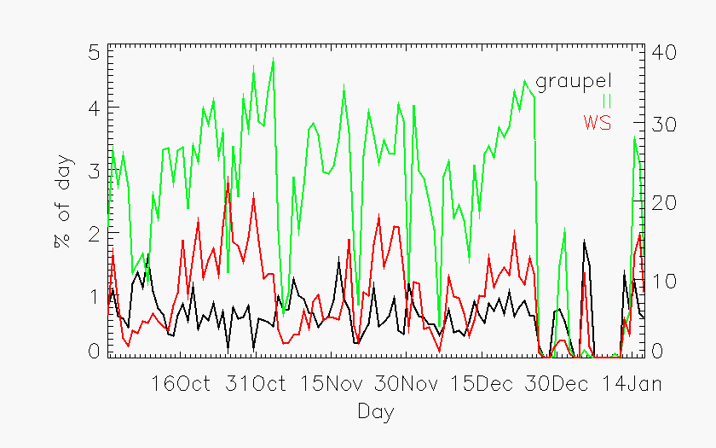
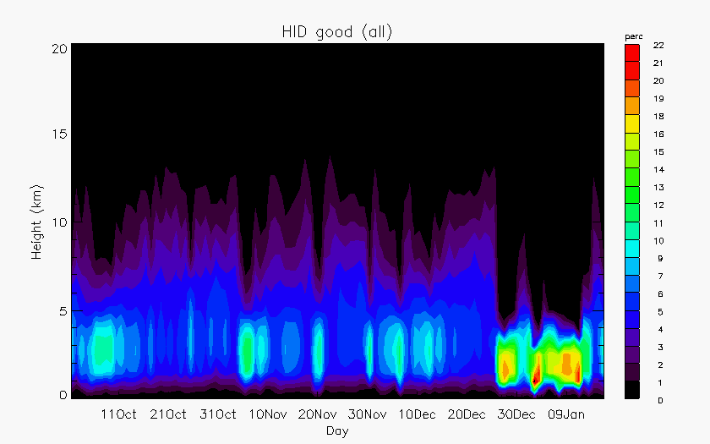
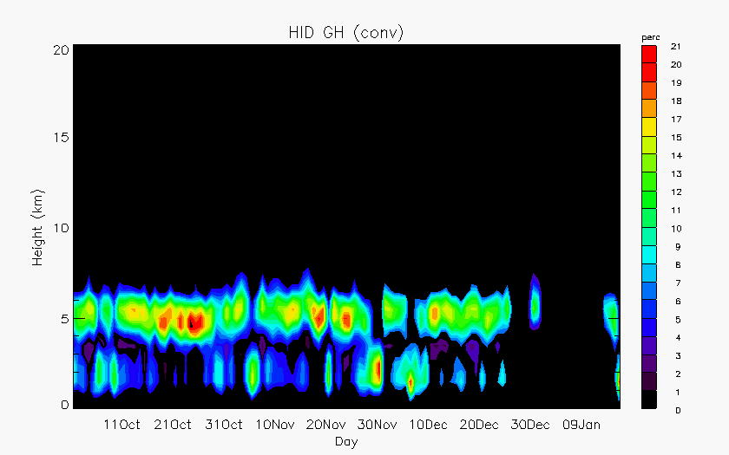
HID
Dominated by ice crystals
3 periods of peak wet snow
Persistent graupel (within a few km of the melting level)
Convection
All HID
Graupel/small hail

Slide 23
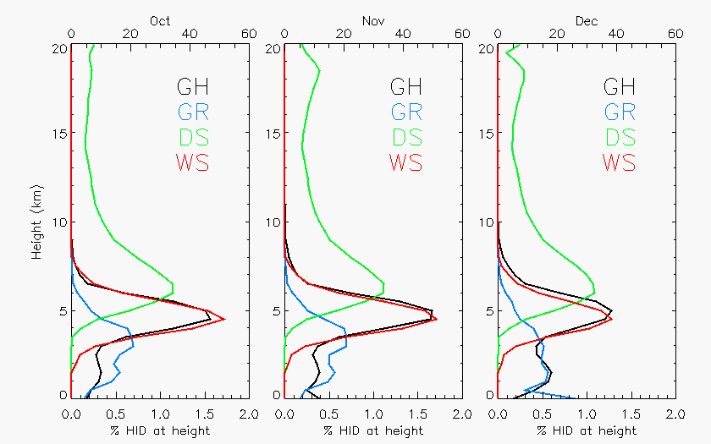

Slide 24
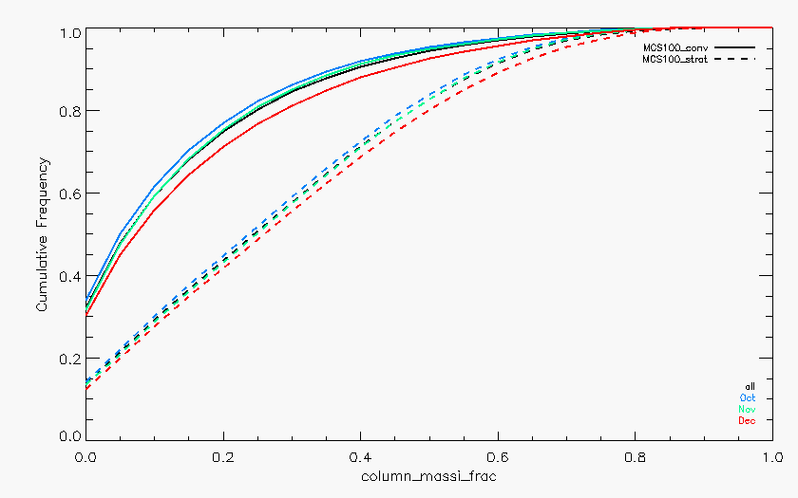
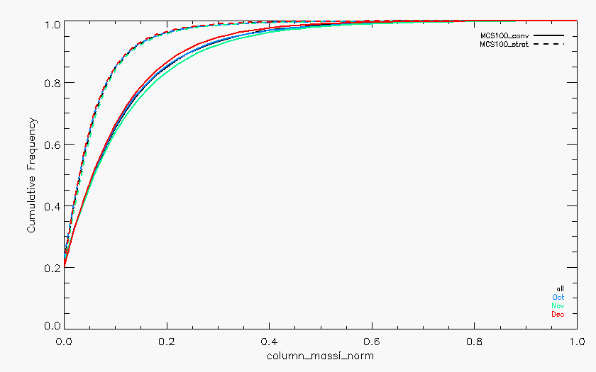
Vertically integrated ice mass
Difference reflectivity (Golestani et al. 1989): Zh-Zv
  Linearly proportional to horizontal reflectivity in rain
Z-M relationships via Carey and Rutledge (2000)
  Disdrometer data and scattering models
conv
strat
strat
conv
Ice mass (normalized by total points in vertical)
ice/(ice+liquid)
Oct
Nov
Dec
Fraction
g/kg

Slide 25
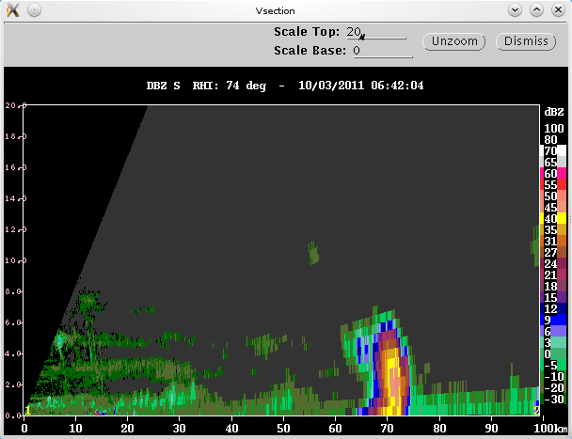
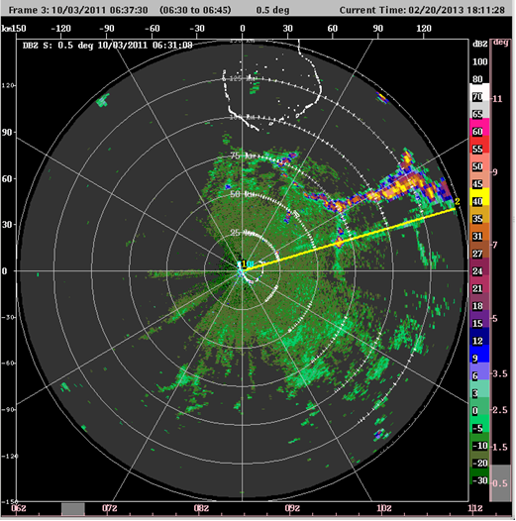
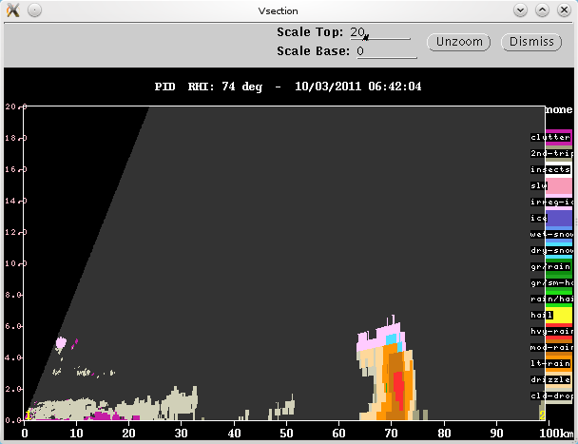
10/03/2011
10/03/2011
Z
50-55 dBZ
PID
red=Heavy Rain

Slide 26
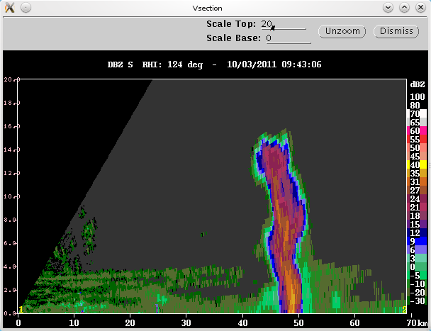
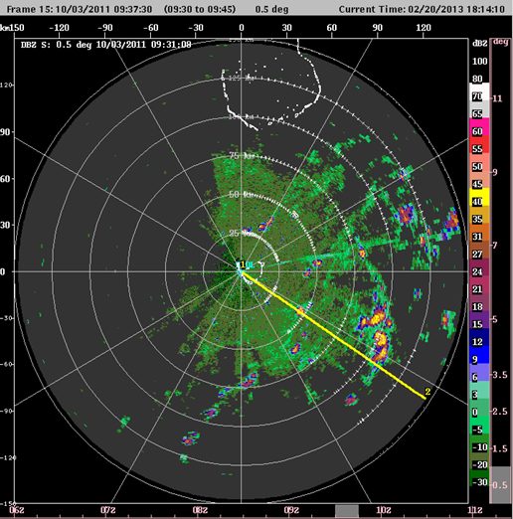
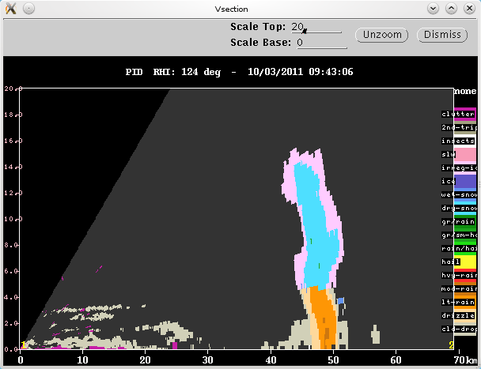
10/03/2011
Z
16 km!
PID
Dry snow

Slide 27
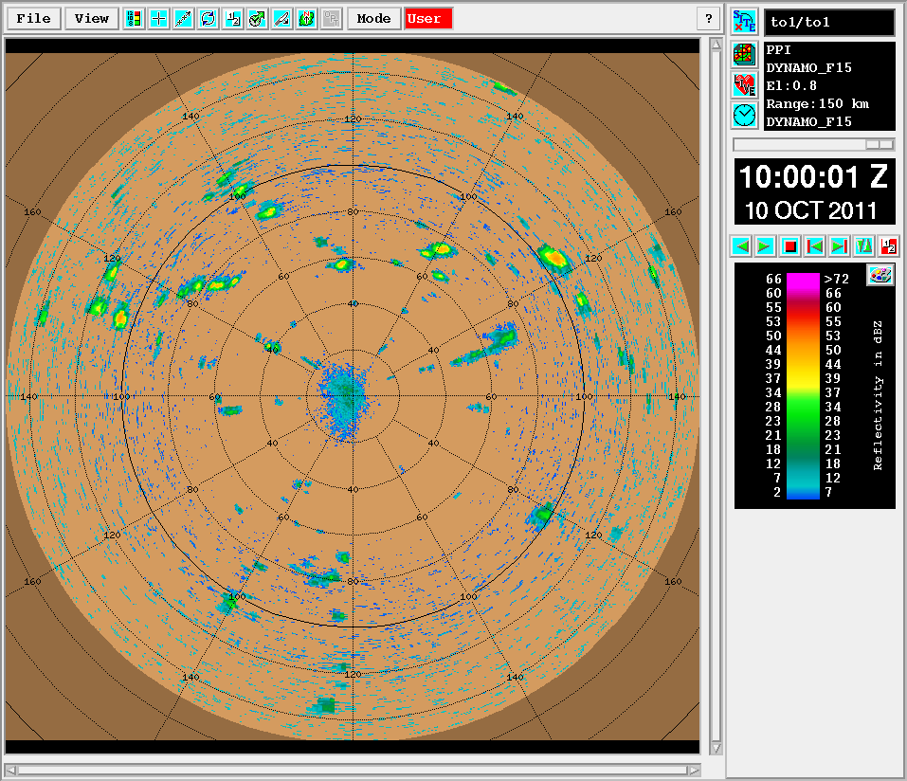



Revelle
10 km
50-55 dBZ

Slide 28

24 Oct – Revelle
Z
V

Slide 29




10/24/2011
Yamada et al. (2010)
Z
V

Slide 30







Z
V
10/16/2011
ZDR
ρHV
LDR
PID
Ice
Dry snow
Wet snow
Rain

Slide 31


KAZR

Slide 32




11/23/2011
Z
V
PID
Graupel

Slide 33




11/23/2011
Z
V
50 dBZ!
ZDR
PID

Slide 34



GATE: rimed aggregates and hexagonal graupel probable ice particle types just above melting level (Houze and Betts 1981)
MISMO: Videosonde showed ice crystals, graupel, and aggregates near and above freezing level (Suzuki et al. 2008)
1979
Ice Crystals
Graupel
Aggregates
Rain

Slide 35




10/16/2011
11/23/2011

Slide 36


10/16
Z
ZDR
Z ~20-30dBZ
ZDR ~0dB
Z ~37dBZ
ZDR~1dB
Z max higher than max ZDR
Straka et al. (2000): dry aggregates
(Z <35, ZDR 0-1, LDR <-25)
LDR
PID
LDR ~-27dB
PID: Dry snow
LDR ~-18dB
PID: Wet snow
11/23
Straka et al. (2000): wet aggregates (Z <45, ZDR 0.5-3, LDR -10 to -20)
Z
ZDR
Z ~30-40dBZ
ZDR ~0.5dB
Z ~42dBZ
ZDR ~1dB
Straka et al. (2000): graupel (Z 20-50, ZDR -0.5-2, LDR <-20)
LDR
PID
PID: Wet snow
LDR~-25dB
PID: Graupel
LDR~-21dB
PID: Wet snow

Slide 37

DECEMBER

Slide 38


October
December

Slide 39





12/23/2011
Z
PID
V

Slide 40



Houze et al. (2000)
TOGA COARE: Transport of westerly momentum downward in strong westerly region (Houze et al. 2000)
  Positive feedback
Braun and Houze (1997)
V

Slide 41
Summary
Cloud population
  Slightly shallower convection during Dec
  Higher stratiform fraction during Oct and Nov
Microphysical characteristics and implications
  Dry snow profile persistent
  “Active” periods characterized by increased wet snow (stratiform)
  Presence of graupel similar between periods (limited to a few km above melting level)
  Similar ice mass throughout all rainy periods
  Melting of graupel and wet aggregates in stratiform
  Momentum transport associated with melting

Slide 42


Slide 43

Thank you!
Funded by NSF Grant # AGS-1059611 and DOE Grant # DE-SC0008452

