Slide 1

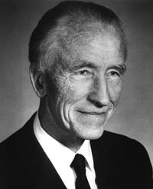
Tropical Convection: A Half Century Quest for Understanding
Robert Houze
University of Washington
Bjerknes Memorial Lecture, AGU, San Francisco, 4 December 2012
UW Atmospheric Sciences Colloquium, Seattle, 18 January 2013
Notes:
The midlevel inflow to the sf region is an imp part of the MCS circulation.

Slide 2
Tropical Convection: A Half Century Quest for Understanding
A personal story of three great field campaigns and the evolution of meteorological satellites
Notes:
The midlevel inflow to the sf region is an imp part of the MCS circulation.

Slide 3
Before Satellites

Slide 4
Visual Observation
Cumulonimbus
Cumulus congestus
Small cumulus

Slide 5
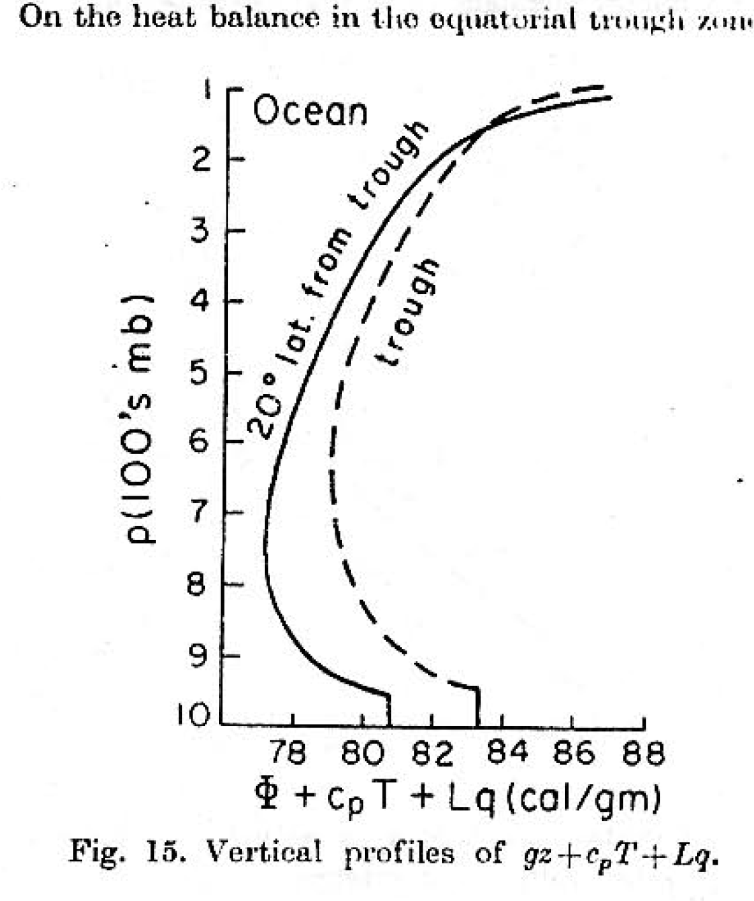
Radiosonde data in the tropics
“Hot tower hypothesis”
Riehl & Malkus 1958

Slide 6
TIROS I
1960

Slide 7
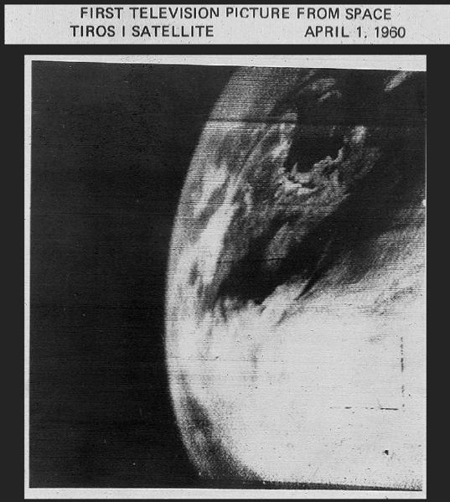

Slide 8
…the atmospheric sciences require worldwide observations and, hence, international cooperation…
John F. Kennedy, New York, 1961

Slide 9
“If we are genuinely interested in forecasting a few weeks in advance, we should give serious consideration to enlarging our network of observing stations, particularly over the oceans.”
Edward Lorenz, NYAS, 1963

Slide 10
The promise of global prediction
Satellites
Detente
Global Atmospheric Research Program
“ GATE ”

Slide 11
The era of field campaigns

Slide 12
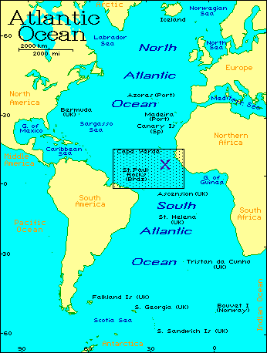

GATE 1974
Notes:
40 ships. 12 a/c

Slide 13
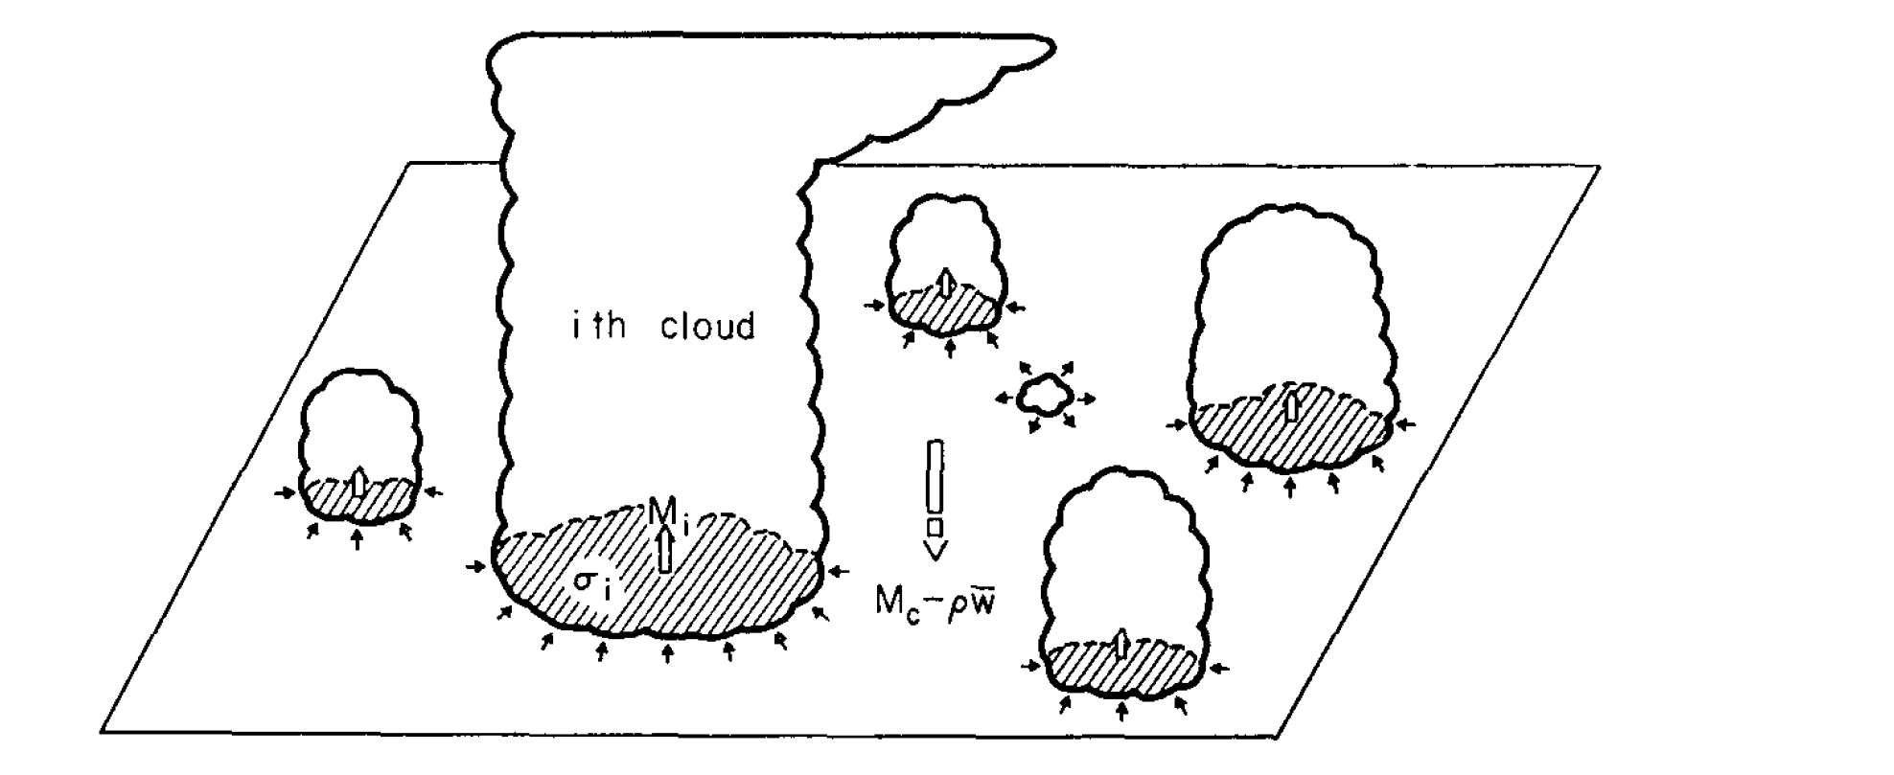
Problem: How to deal with tropical convection in a global model
Convective parameterization
Global model
grid
→ Small area assumption

Slide 14
Satellite Observations produced an
“inconvenient truth”

Slide 15
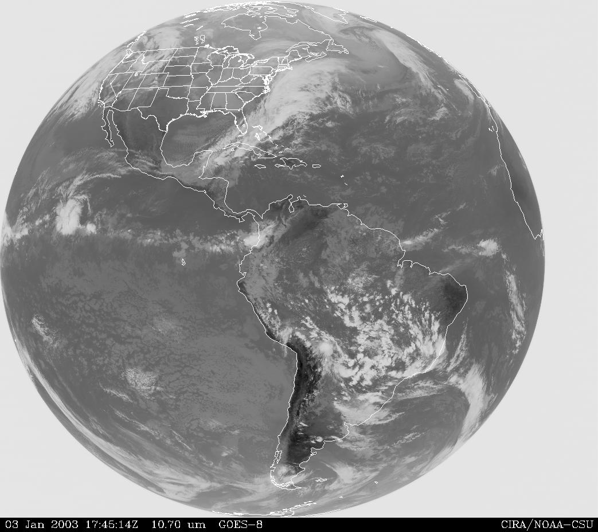
“No particular significance is attached to the interaction between the [mesoscale] and the other scales.”
…NAS Plan for U.S. Participation in GATE
Convective clouds
are actually large
…“mesoscale”
Notes:
The IR pattern emphasizes the higher cloud tops, which largely determine the global precipitation (and hence latent heating) pattern.

Slide 16
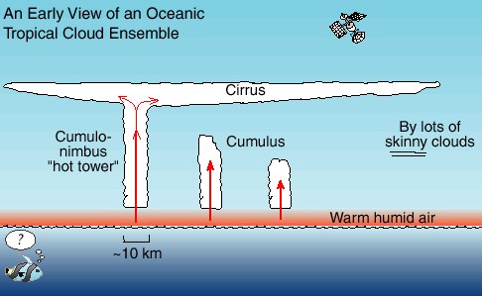
Prevailing view of tropical convection in the early 1970’s
Satellite view of the tropical cloud population
Explained satellite pictures
Retained the hot tower notion
Included smaller clouds

Slide 17
The grandest field campaign:
GATE 1974

Slide 18
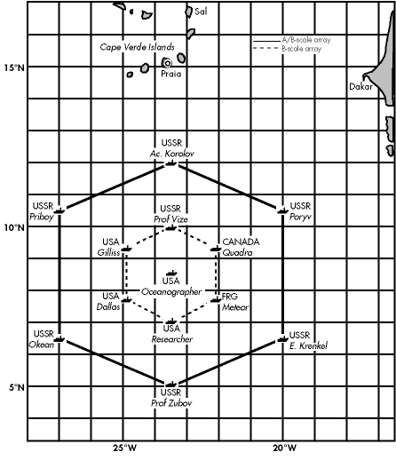
1974
40 ships!
12 aircraft!
16 sounding sites
4 shipborne scanning digital
C-band radars
Notes:
40 ships. 12 a/c

Slide 19
The GATE radars
led to a
second “inconvenient truth”

Slide 20
Post-GATE view of the tropical cloud population
Hot Tower
Global model grid
Houze et al. (1980)

Slide 21
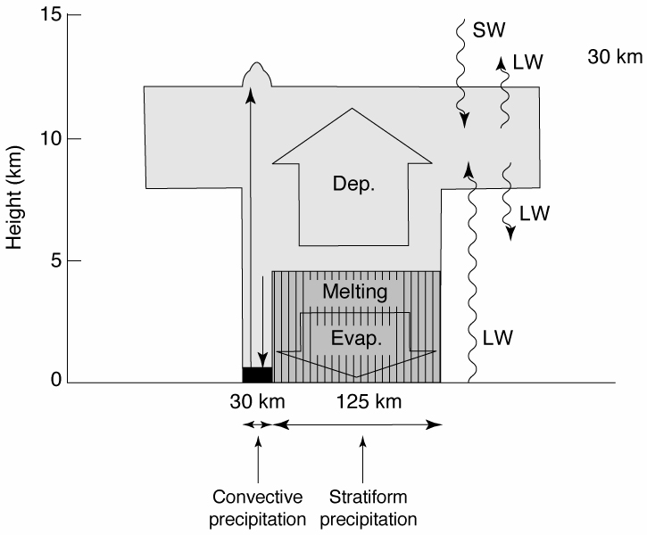
Heating and cooling processes in a mesoscale system
Houze 1982
Notes:
Top heavy

Slide 22
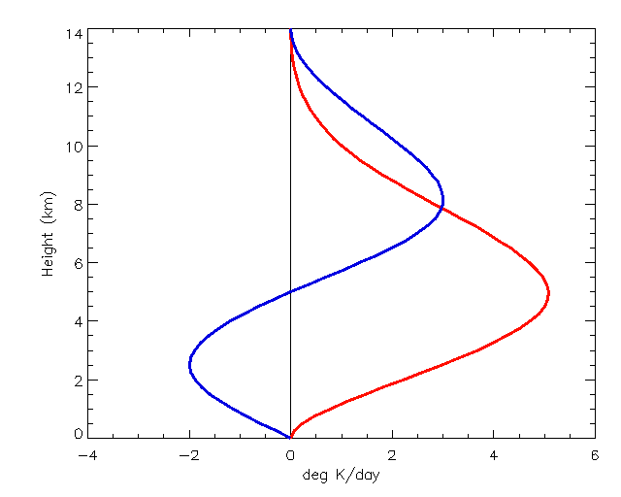
Simplified Mesoscale System Heating Profiles
Stratiform
Height (km)
Convective
Schumacher et al. 2004
Deg K/day
Notes:
The blue curve is applied to the stratiform fraction of the precipitation at the given pixel. Go to next slide.

Slide 23
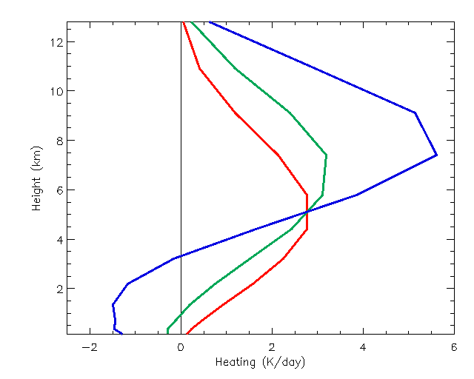
Mesoscale System Heating Profiles
70% stratiform
40% stratiform
Height (km)
0% stratiform
Does this matter?
Deg K/day
Schumacher et al. 2004
Notes:
70% stratiform precipitation at a pixel yields the blue profile, which has a higher maximum than the 0% or 40 % stratiform profiles. Note also how the increased stratiform percentage yields a stronger vertical gradient of heating at upper levels and hence greater generation of potential vorticity. This shows how an increase in the stratiform rain fraction leads to a stronger circulation at upper levels.

Slide 24
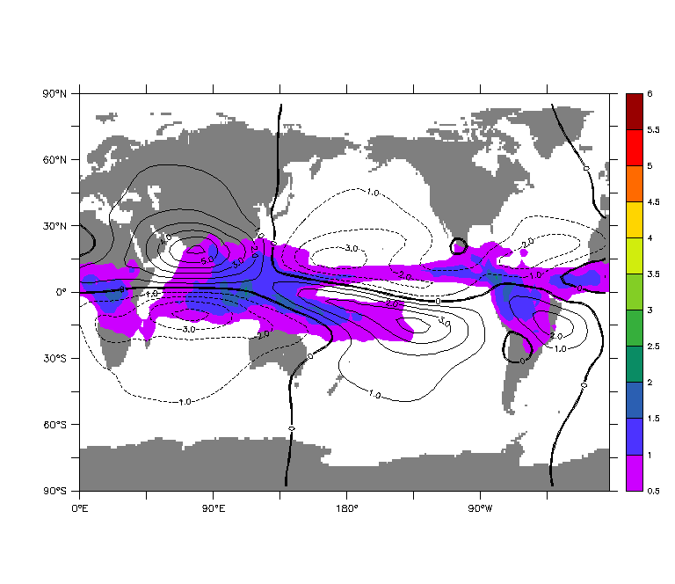
0% stratiform
K/day
250 mb stream function, 400 mb heating
Schumacher et al. 2004

Slide 25
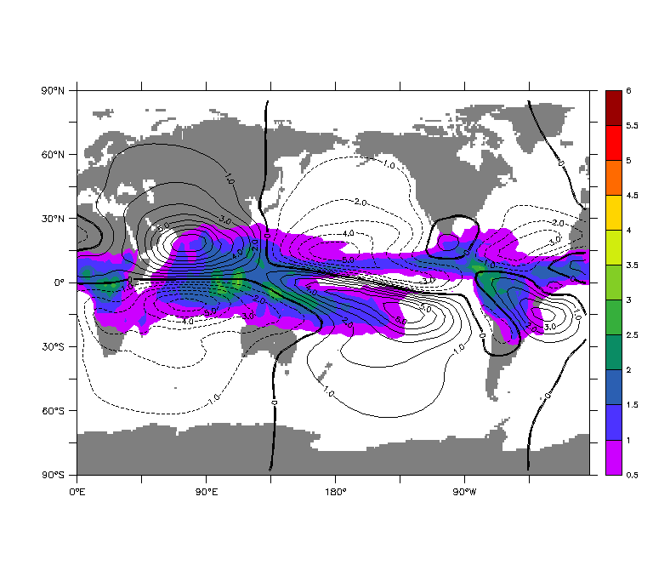
40% stratiform
K/day
250 mb stream function, 400 mb heating
Schumacher et al. 2004

Slide 26
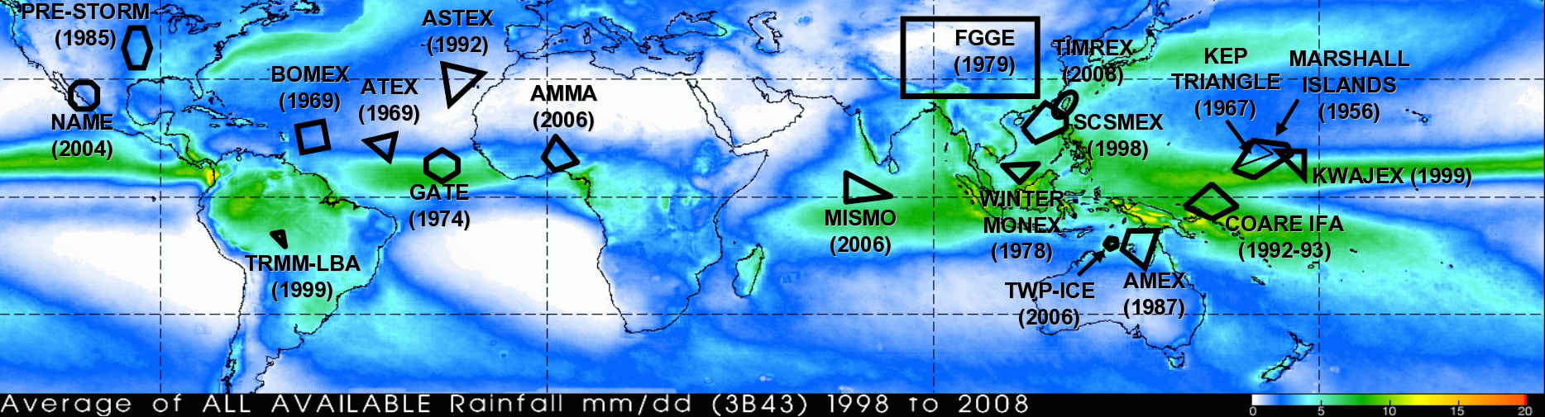
More Field Projects
BoB 1979
JASMINE
1999
TEPPS
1997
EPIC
2001
Atlantic
GATE
1974
W. Pacific
TOGA COARE
1992-3
Indian Ocean
DYNAMO
2011-12
(Dashed: No sounding network)
Soundings and radars on aircraft, ships, and islands

Slide 27
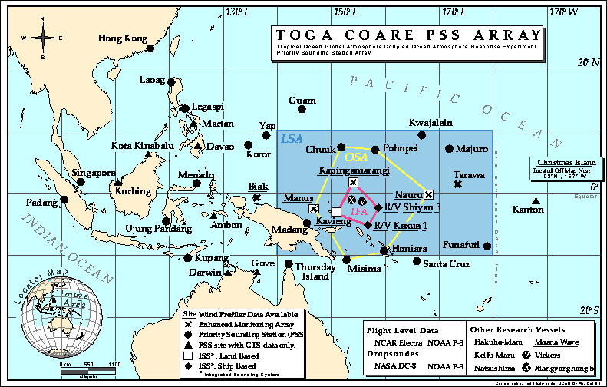
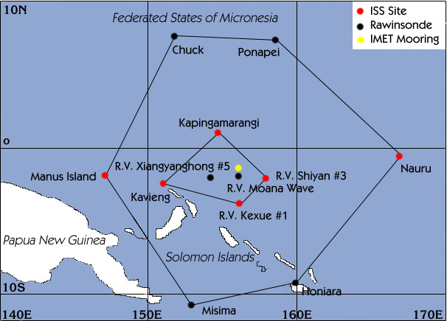
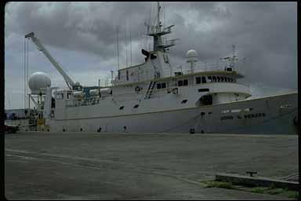


The West Pacific, 1992-93
TOGA COARE Array
Shipborne and airborne Doppler radars
+ Rawinsondes

Slide 28
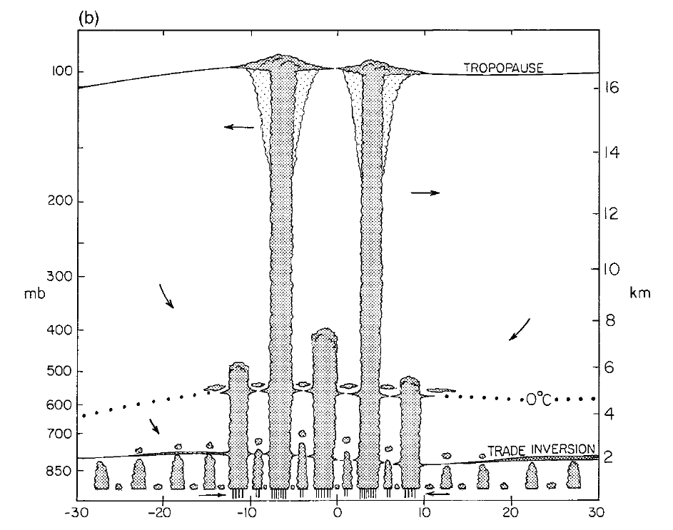
TOGA
COARE
Richard Johnson’s analysis of the
TOGA COARE rawinsonde data
Johnson et al. 1999
“Trimodal distribution”
Cu congestus
Small Cb

Slide 29
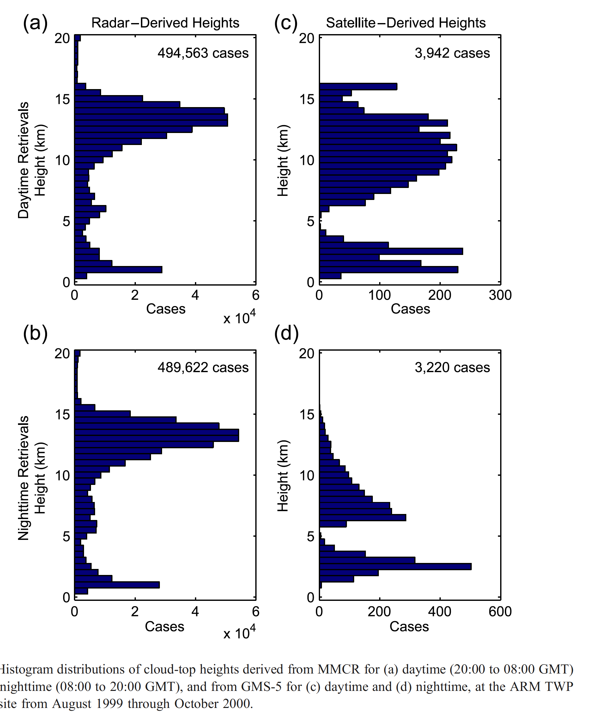
MANUS
X
ARM’s Manus Island cloud radar confirmed the “trimodal distribution”
Hollars, Fu, Comstock, & Ackerman 1999
Notes:
Histograms of cloud top height from MMCR for (a) day 20-08Z (b) night 8-20Z. Manus. Aug 1999-Oct 2000
35 GHZ, 9 mm wavelenght

Slide 30
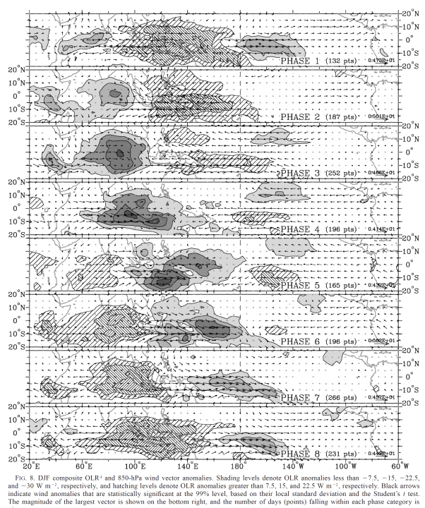
West Pacific
1
The “MJO”
2
3
Madden and Julian 1971, 1972
4
5
“Active Phase”
~1-2 weeks
6
7
8
TOGA COARE
Wheeler & Hendon 2004

Slide 31
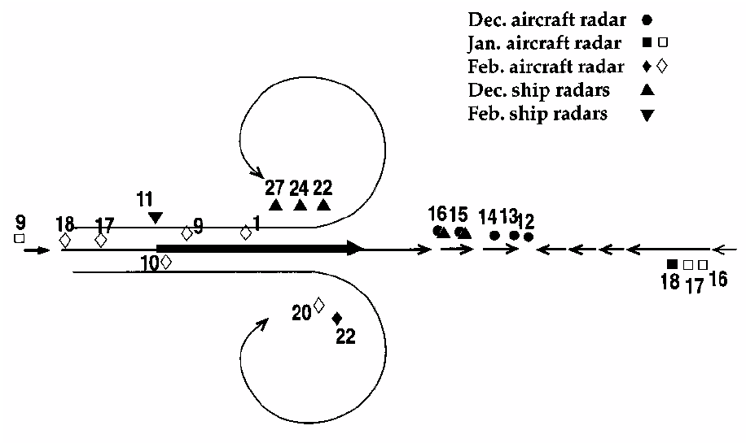
Doppler radar sampling relative to the MJO in TOGA COARE
Rossby
Gyres
Kelvin Wave
Convergence

Slide 32
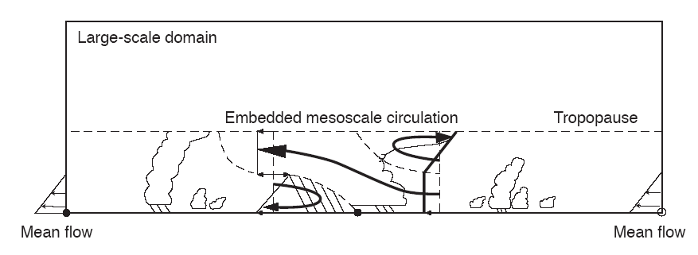
Moncrieff’s Mesoscale Layer Model of Tropical Convection
Moncrieff 92

Slide 33
Synthesis of TOGA COARE Doppler radar observations
confirms Moncrieff’s model

Slide 34
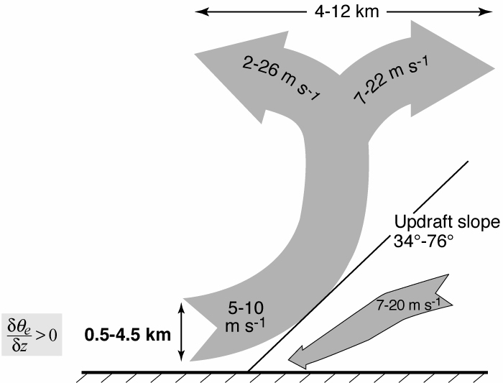
TOGA COARE
Airborne Doppler Observations of MCSs
25 convective region flights
Show deep layer of inflow to updrafts
<
Kingsmill & Houze 1999
Notes:
KH studied data from ___ flights around the conv regions of MCSs and found a deep layer of uplift. The layer lifting consisted of pot. Unstable air.

Slide 35
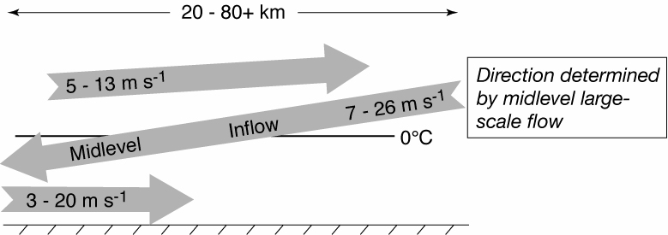
TOGA COARE
Airborne Doppler Observations of MCSs
25 stratiform region flights
Kingsmill & Houze 1999
Notes:
The midlevel inflow to the sf region is an imp part of the MCS circulation.

Slide 36
Empirical Model of an MCS
Midlevel inflow
Layer inflow
Houze 1982
Notes:
From the distributin of heating and cooling in the sf region we expect mid level convergence.

Slide 37
DYNAMO: The third of the 3 great field campaigns
BoB 1979
JASMINE
1999
TEPPS
1997
EPIC
2001
Atlantic
GATE
1974
W. Pacific
TOGA COARE
1992-3
Indian Ocean
DYNAMO
2011-12
(Dashed: No sounding network)

Slide 38

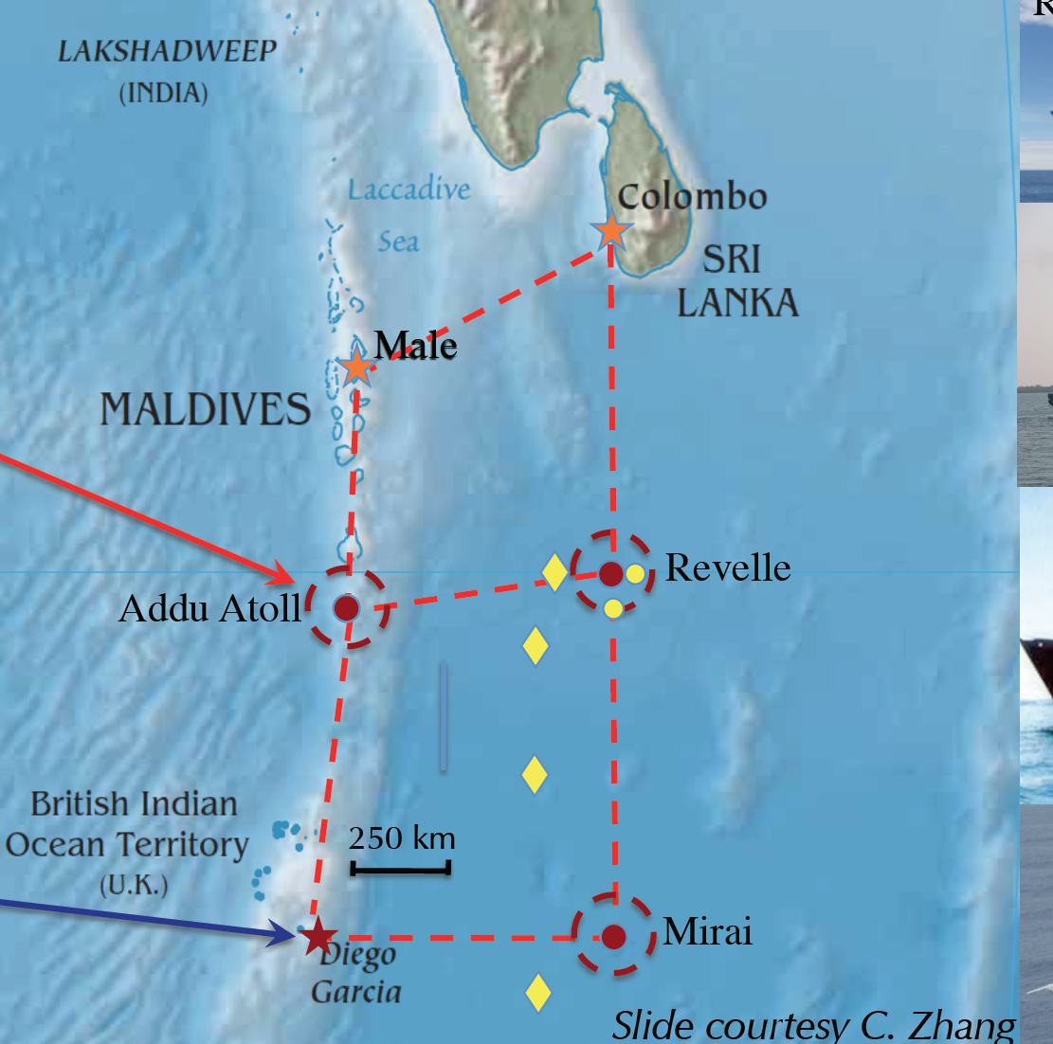
DYNAMO-AMIE-CINDY
Indian
Ocean
Two radars
Rawinsonde
Oceanography
Four radars
Rawinsonde
Falcon aircraft
Two radars
Rawinsonde
Oceanography
Rawinsonde
P3 aircraft

Slide 39
Focus of DYNAMO/AMIE:
Convective cloud
population

Slide 40
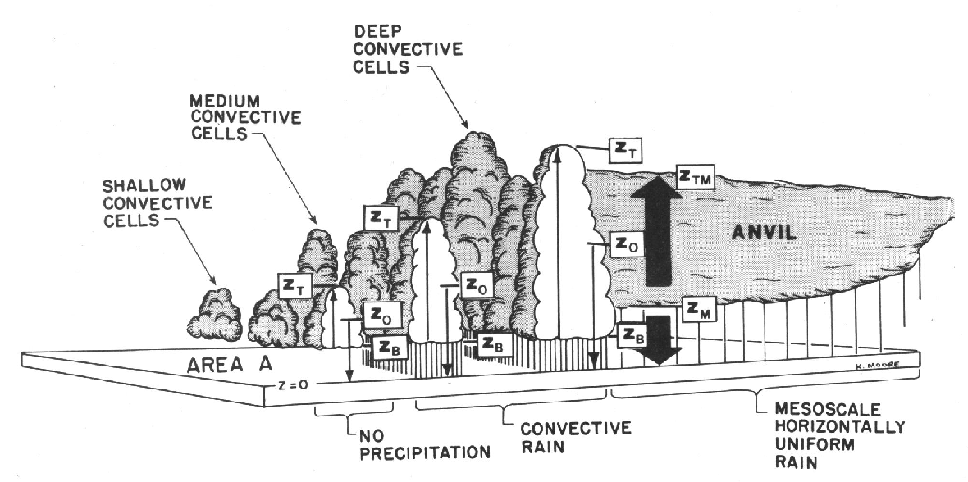

Multi-radar Approach
To document more aspects of the convective population
*
ANVIL
CUMULUS
HUMIDITY
DYNAMO/AMIE:
DUAL WAVELENGTH
Water vapor
DYNAMO/AMIE:
MM-WAVELENGTH
Non-precipitating Cumulus
GATE:
CM-WAVELENGTH
Precipitation
DYNAMO/AMIE:
MM-WAVELENGTH
Anvil cloud
TOGA COARE:
DOPPLER
Air motions
DYNAMO/AMIE:
POLARIMETRY
Microphysics

Slide 41
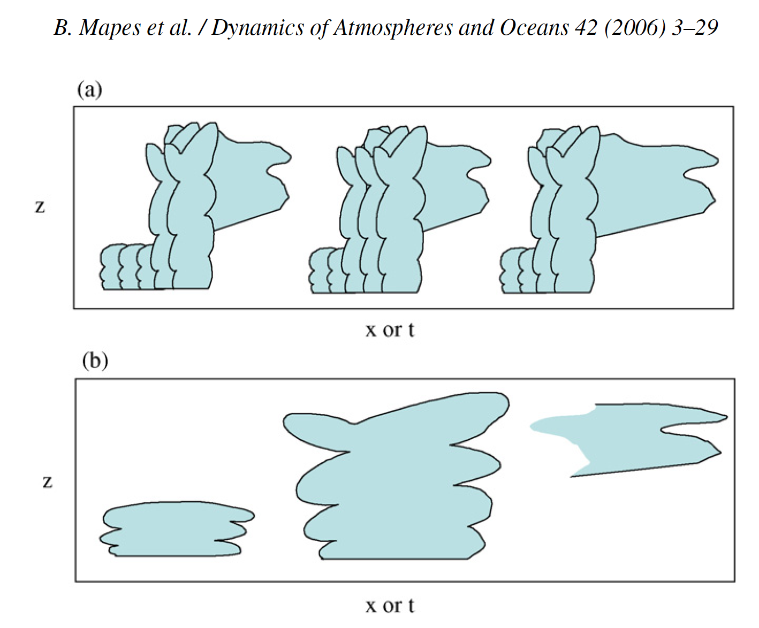
Stretched Building Block Hypothesis
Mapes et al. 2006
Cloud population at three different times
Large-scale wave structure at the same times

Slide 42
“We speculate that there is a natural selection in the atmosphere for wave packets whose phase structure produces a local, Eulerian sequence of cloud zone-supporting anomalies that aligns with the convective cloud system life cycle.”
Mapes et al. 2006

Slide 43
Indian Ocean
1
“Active Phase”
~1-2 weeks
2
The MJO
over the Indian Ocean
3
4
4
5
5
6
6
7
8
DYNAMO
Wheeler & Hendon 2004

Slide 44
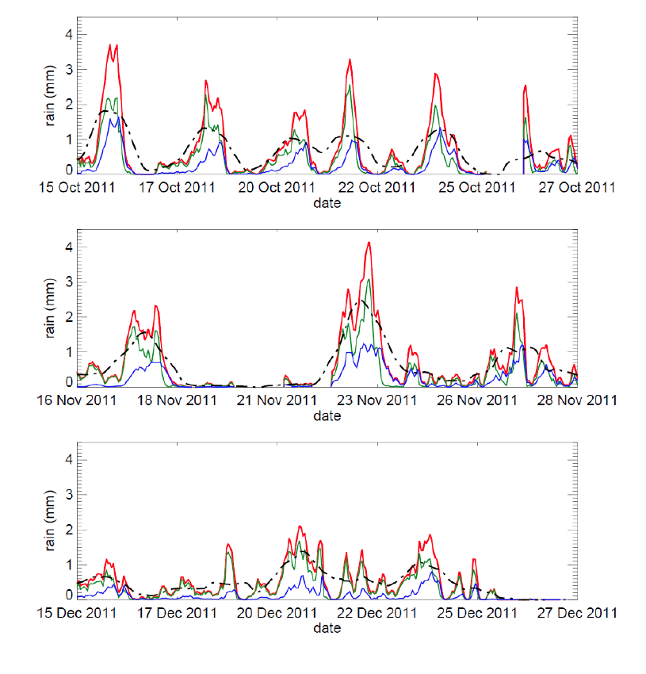
Rain seen by the S-PolKa radar
October Active Period
November Active Period
December Active Period
Zuluaga and Houze 2013

Slide 45
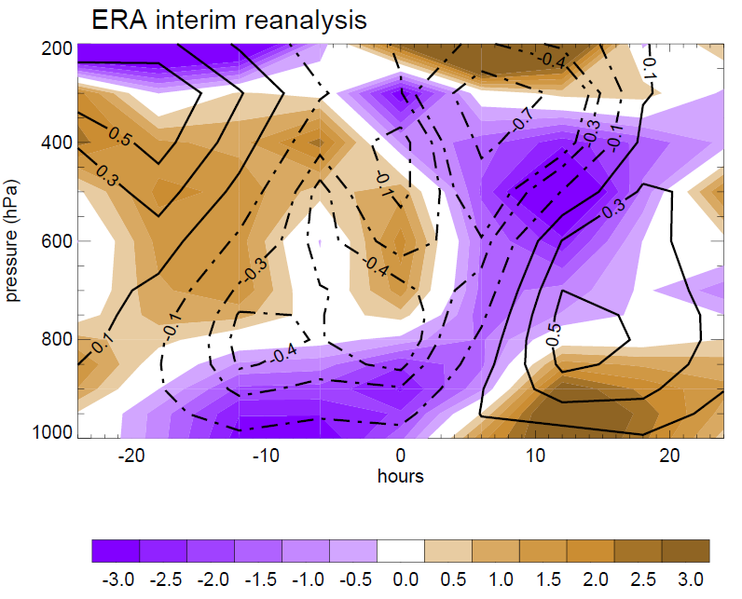
Composite large-scale divergence and vertical motion during 2-day rainfall episodes
Zuluaga and Houze 2013

Slide 46
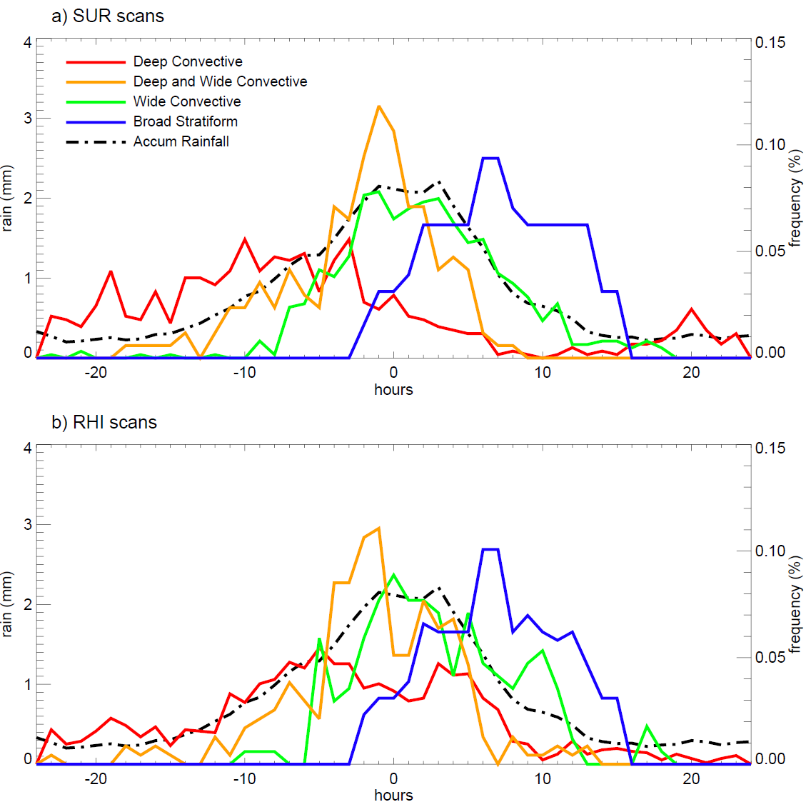
Variation of the DYNAMO radar echo population
Composite of all 2-day rainfall episodes

Slide 47
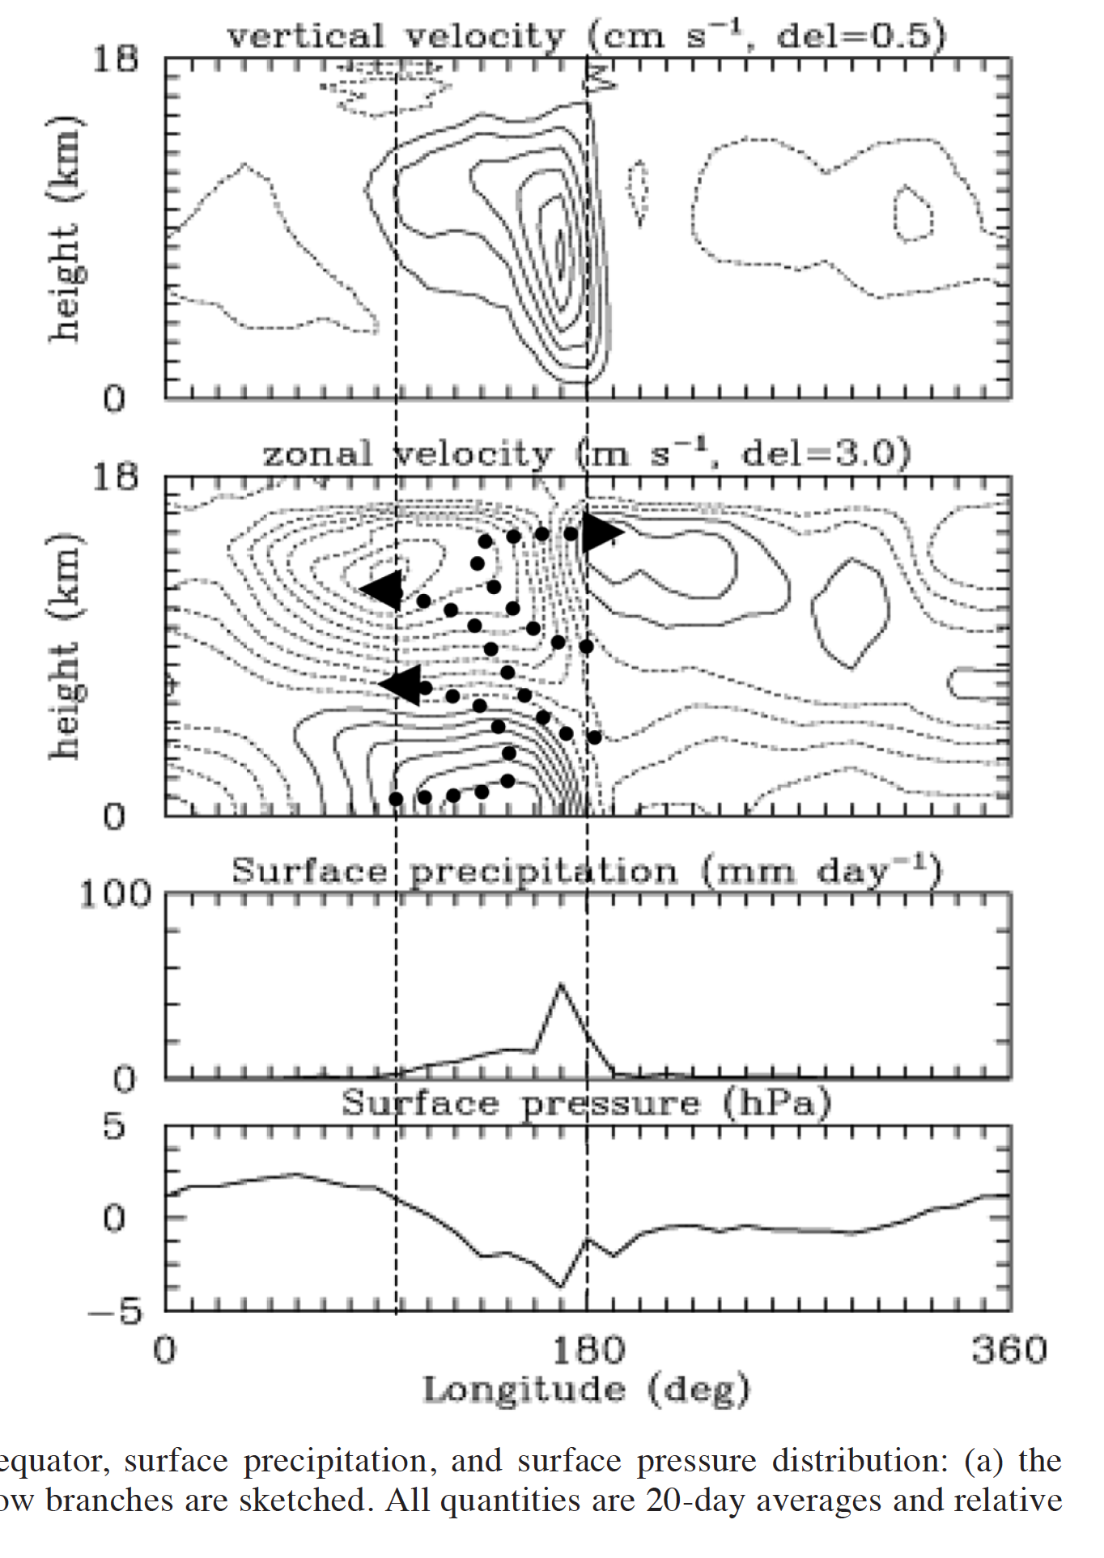
Vertical structure of the MJO
Moncrieff 2004

Slide 48
TRMM Radar Observations of the MJO over the Indian Ocean
Active Phase
Suppressed Phase
Deep Convective Cores
Broad Stratiform Rain Areas
Phase 7

Slide 49
Summary & Conclusions
The three great oceanic field campaigns
  GATE 1974
    Mesoscale systems
    Heating profiles
  TOGA COARE 1992-3
    Trimodality
    Mesoscale circulations
  DYNAMO/AMIE 2011-2
    Convective population
    Relation to large-scale waves
Notes:
The midlevel inflow to the sf region is an imp part of the MCS circulation.

Slide 50
Summary & Conclusions
Satellites (& reanalysis)
  TIROS 1960
    Global awareness
  TRMM 1997
    Precipitation radar in space
  A-Train 2000’s
    Cloud radar and lidar in space
  Next generation & beyond
    GPM, Earth Care, MeghaTropique, …
Notes:
The midlevel inflow to the sf region is an imp part of the MCS circulation.

Slide 51

End
This research was supported by
NASA grants NNX10AH70G, NNX10AM28G,
NSF grants, AGS-1059611
DOE grant DE-SC0008452

