Slide 1
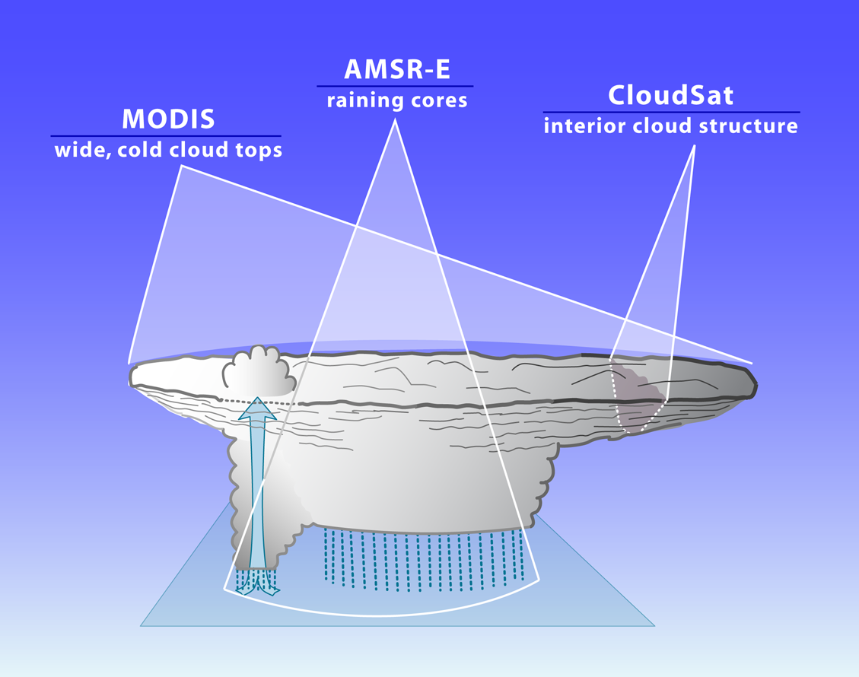
Multisensor Investigation of Deep Convection
Robert A. Houze, Jr., & Jian Yuan
University of Washington
AGU, San Francisco, 5 December 2012

Slide 2
  Mesoscale Convective Systems
  “MCSs”

Slide 3
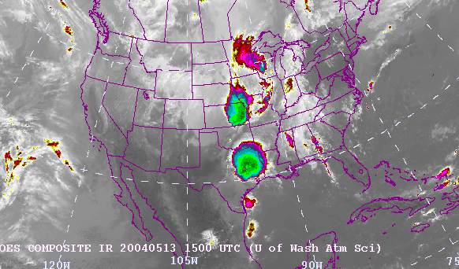
Example outbreak of MCSs
Large areas
of cold top

Slide 4
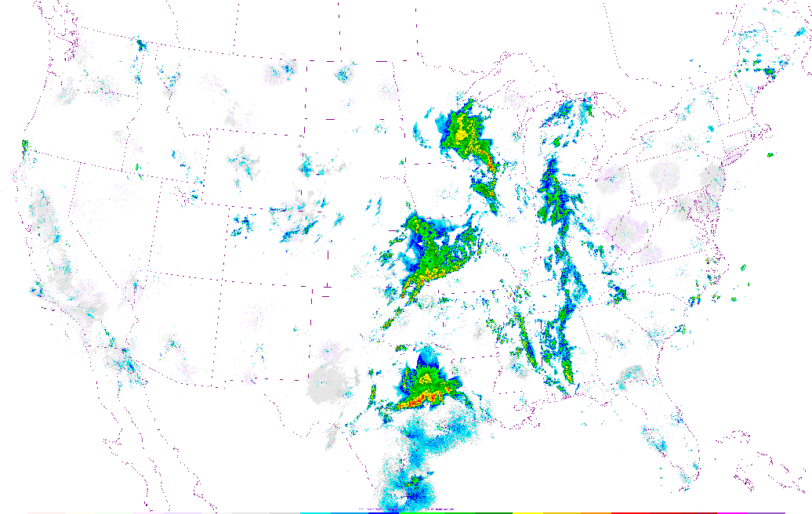
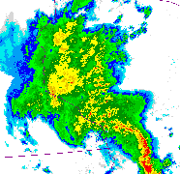
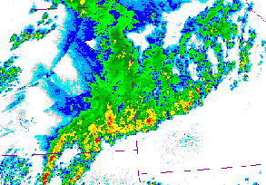
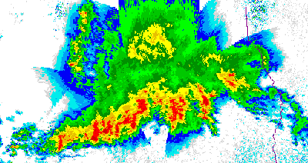
Radar echoes showing
the precipitation
in the 3 MCSs
Stratiform
Precipitation
Convective
Precipitation
1458GMT 13 May 2004

Slide 5
  How do MCS properties vary globally?
Notes:
Satellites provide the opportunity to determine how these properties vary over the globe and thus to determine their role in the climate system.

Slide 6
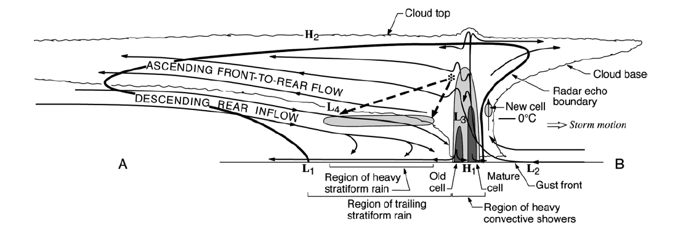
Details learned from field projects
Houze et al. 1989
Notes:
Many details of individual cases have been learned from field projects and other case studies. Little is known about how these details vary from one region to another and within different parts of larger scale phenomena like the MJO.

Slide 7
Basic components
Cold top
Anvil
Anvil
Raining core
Houze et al. 1989
Notes:
The basic components of an MCS can be simplified into 3 main features, which can be identified and MEASURED by satellite. The combination of these three properties can be used to identify an MCS if they satisfy certain criteria. Thus we can determine when and where MCSs occur around the globe. In addition we can determine how the properties of these three components vary from region to region. How big and wide is the cold top; how big and intense is the raining core; how thick are the anvils; and what are the characteristics of their internal structure. And how do these properties vary around the globe? One cannot holistically determine the properties of MCSs by identifying one of these properties alone. It’s important to see and evaluate all 3.

Slide 8
The 3 basic components can be determined from A-Train!
2
3
1
Notes:
A-Train offers the ability to see all 3 characteristics simultaneously. We take advantage of this ability.

Slide 9
  Combining cloud top and raining core properties to determine MCS existence
Notes:
We now look briefly at how we combine 2 of these properties to first identify MCSs

Slide 10
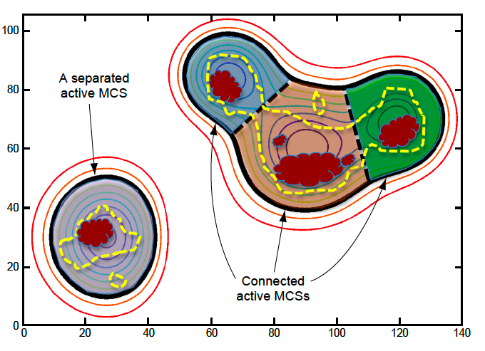
Identify High Cloud Systems (HCSs)
260K
Closed
contour
Heavy rain
Rain
Separated
MCS
Connected
MCSs

Slide 11
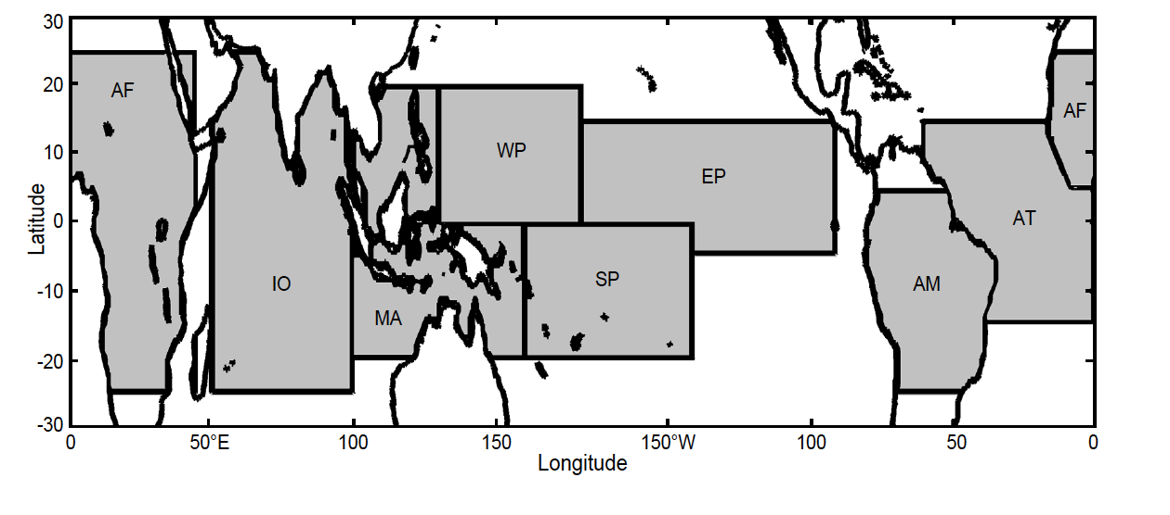
Which HCSs are MCSs?
Yuan and Houze 2010

Slide 12
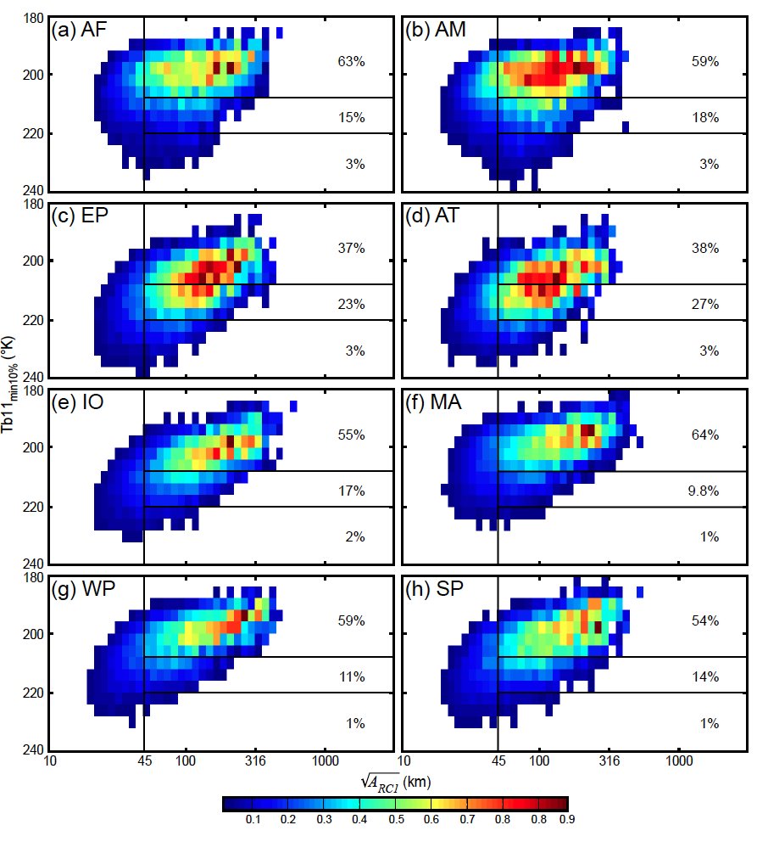
PDF of rain amount as a function of raining core properties
Min TB11 over raining core
220
°K
Using these values for “MCS” criteria
→56% all tropical rain
2000 km²
Size of raining core
Yuan and Houze 2010
Notes:
Must have one dominant core
with intense cells, and
accounting for >70% rain area

Slide 13
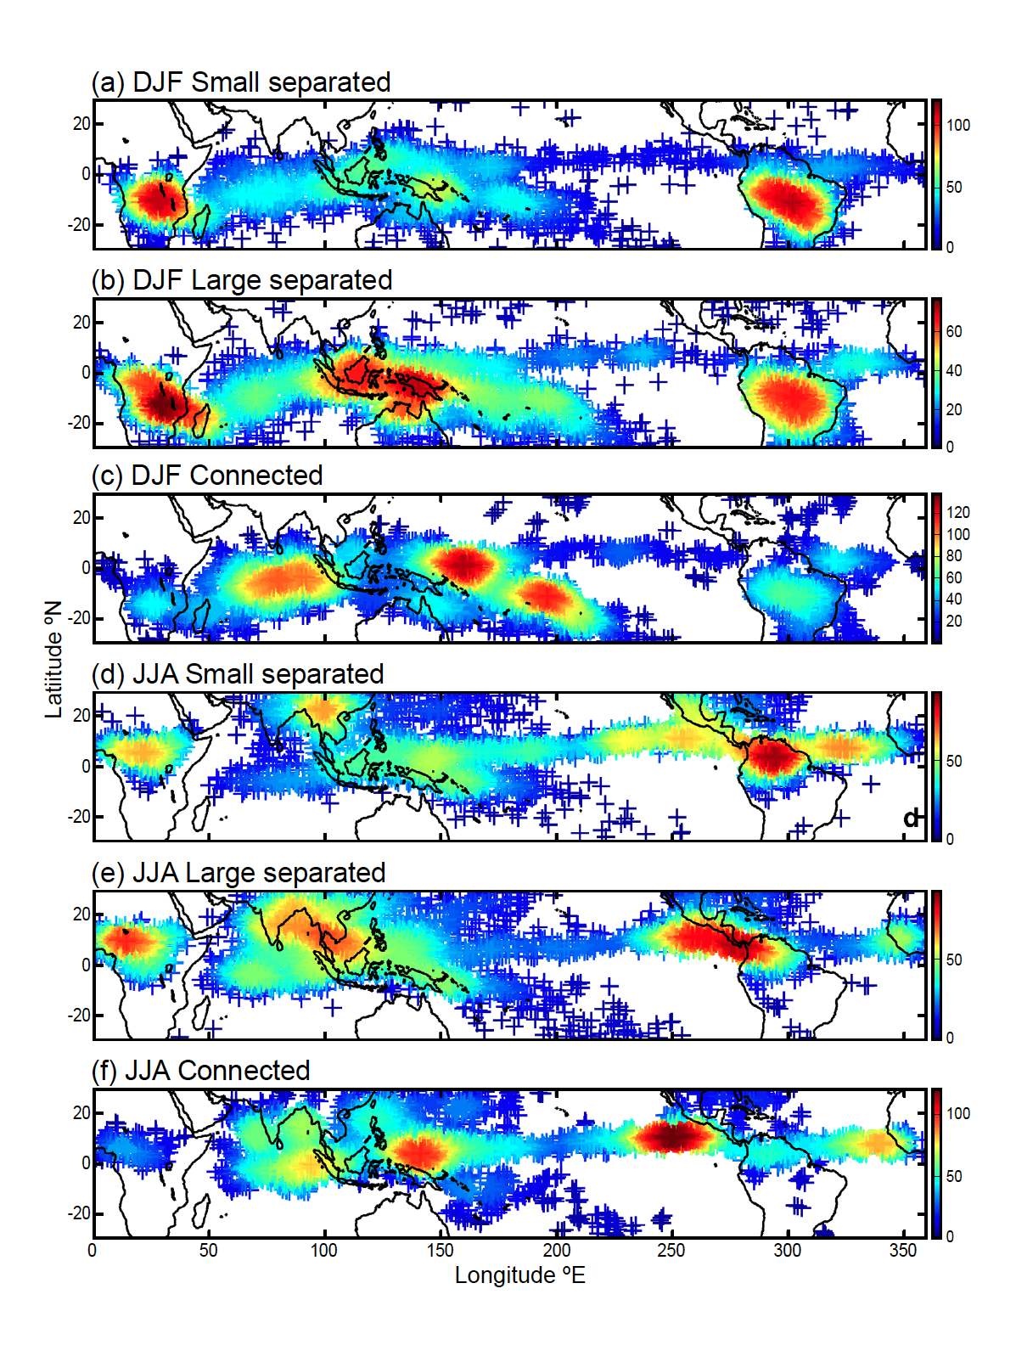
MCSs Over the Whole Tropics
Smallest 25% (<12,000 km²)
Largest 25% (>40,000 km²)
“Superclusters”
Yuan and Houze 2010
Notes:
Size of MCS is size of cold cloud top. To qualify as MCS, must have large cold cloud top, large rain area, and some heavy rain. This figure shows spatial distribution of active MCSs. Color of each point shows the number of active MCSs found within a circular area with radius of five degrees centered on that point. (a) Small separated MCSs (<12,000km2; i.e., the smallest 25%) in DJF, (b) large separated MCS (>40,000km2; i.e., the largest 25%) in DJF, (c) connected MCS in DJF, (d)-(f) same as (a)-(c) except for JJA.

Slide 14
Cold top
Anvil
Anvil
Raining core
MODIS/AMSR-E
→identifies cold top
→locates the raining core
→remainder is anvil

Slide 15
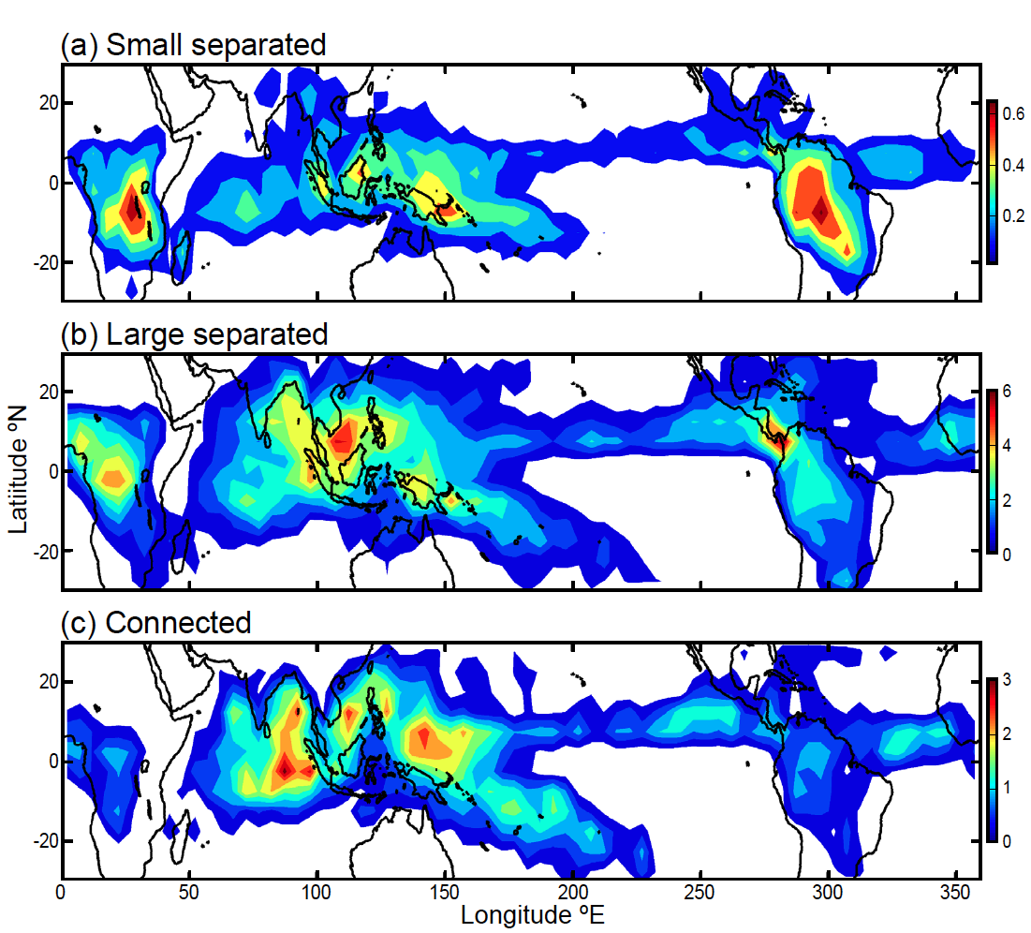
Frequency of MCS anvils over tropics
Yuan and Houze 2010

Slide 16
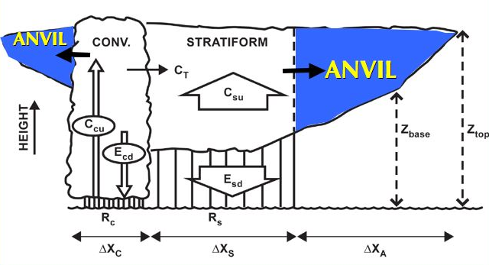
The Anvil Problem
Mesoscale Convective System
Need to understand how anvil is related to the raining region
Extensively studied

Slide 17
CloudSat applied to MCS anvils

Slide 18
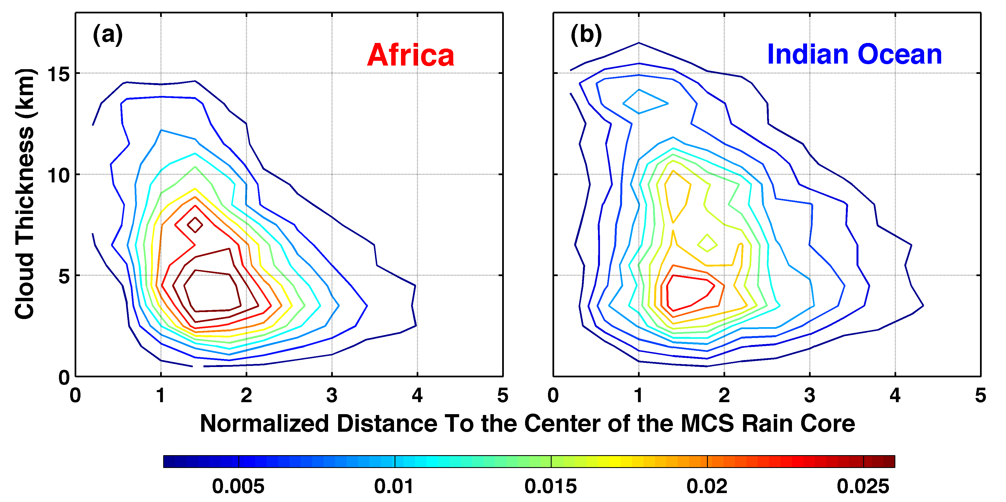
Statistics of anvil width & thickness seen by CloudSat
Africa
Indian Ocean
Yuan and Houze 2010
Notes:
Normalized by dimension of the MCS rain area

Slide 19
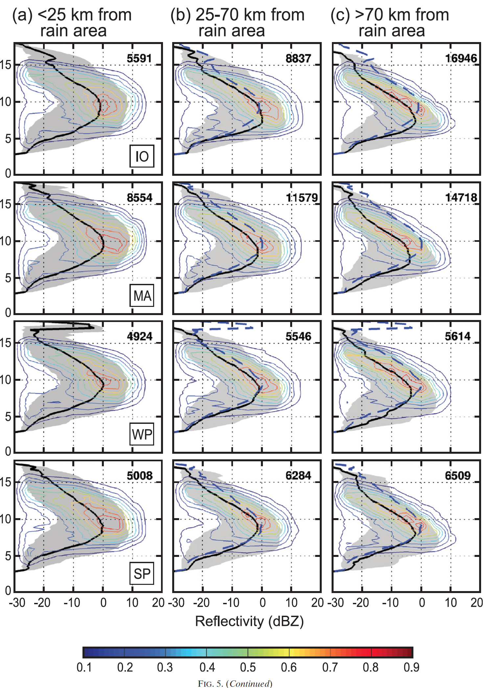
Internal structure of MCS anvils
Indian Ocean Anvils
CVCV
CVCV

Slide 20
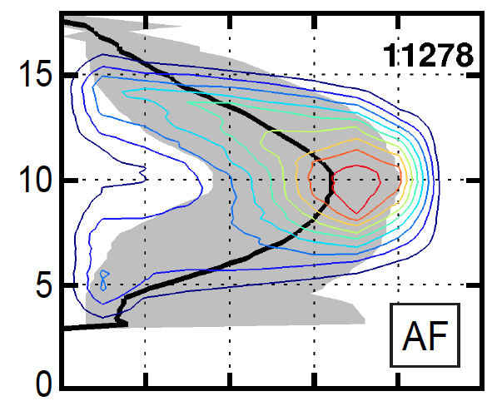
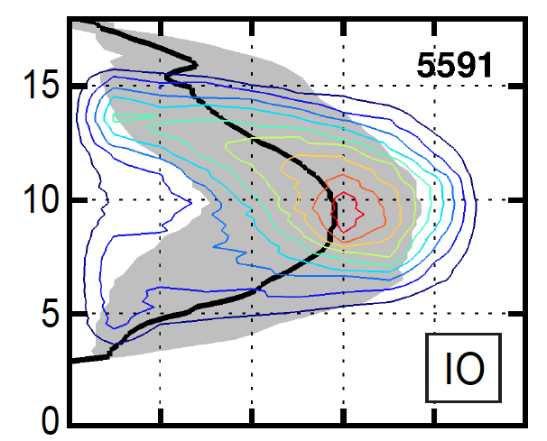

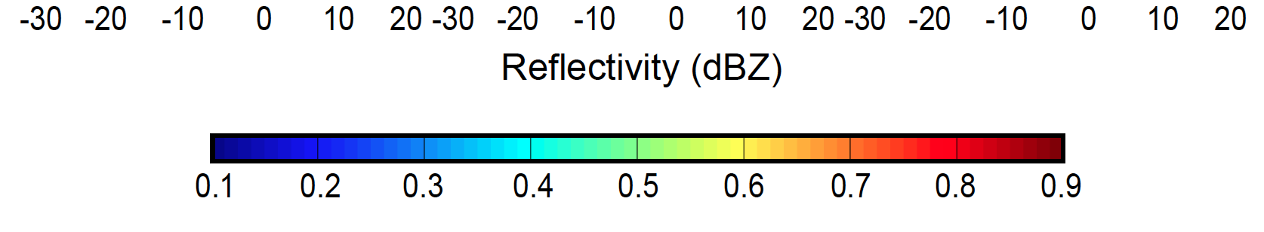
Internal structure of MCS anvils
Africa
Indian Ocean
Yuan, Houze, and Heymsfield 2011

Slide 21
Future Work

Slide 22
Multisensor identification of MCSs makes it possible to answer important questions about the global variability of MCSs
Thin-cloud extent of the MCS anvils?
    CALIPSO
Environments of MCSs?
    Reanalysis, AIRS
Aerosol environments?
    CALIPSO, MODIS
Electrical properties?
    WWLLN, other networks

Slide 23
Summary
MODIS Tb11, AMSR-E, & CloudSat →
mapping of Mesoscale Convective Systems and their anvil clouds
Future studies →
CALIPSO—thin cloud extent of MCS anvils
MODIS & CALIPSO—aerosol environment of MCSs
WWLLN—electrification of MCSs
Notes:
Comment on future satellites, GPM, EarthCARE, and beyond. Need to have satellites in same orbit like A-Train. This would improve relation between raining core and anvil components.

Slide 24
End
This research was supported by
NASA grants NNX10AH70G, NNX10AM28G,
and NSF grant AGS1144105
Notes:
Comment on GPM and the ability go to higher latitudes in the future—frontal systems, etc.

Slide 25
End
This research was supported by
NASA grants NNX10AH70G, NNX10AM28G,
and NSF grant AGS1144105
Notes:
Comment on GPM and the ability go to higher latitudes in the future—frontal systems, etc.

Slide 26
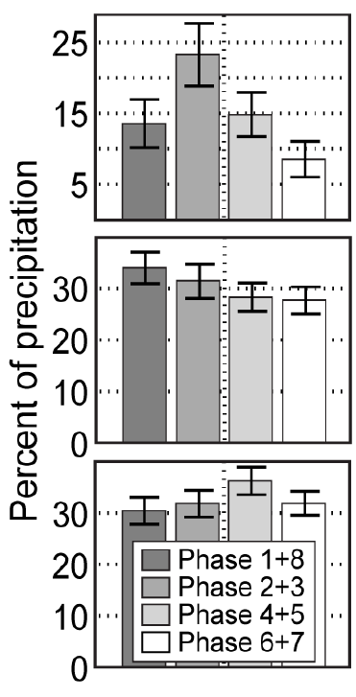
Indian Ocean MCSs Contribution to Rainfall by phase of the Madden-Julian Oscillation
Connected MCSs
Connected MCSs
Other high cloud systems
Yuan and Houze 2012

Slide 27
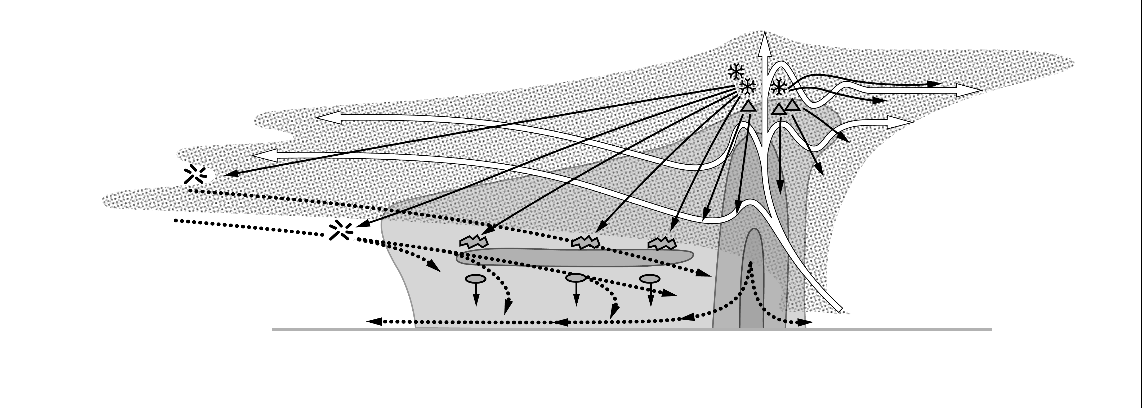

Conceptual model of anvil microphysics
graupel
snow
convective rain
stratiform rain
Cetrone and Houze 2011
Notes:
WAVELENGTH: W-band, 3 mm wavelength
THIN ANVILS:
1) LEADING—higher -- comes directly from convective updraft
2) TRAILING—occur at more levels -- moisten a deeper layer
THICK ANVILS:
3) LEADING—stronger-larger particles -- graupel

