Slide 1


Extreme Convection in Subtropical South
America: TRMM Observations and
High-Resolution Modeling
Kristen Lani Rasmussen
Robert A. Houze, Jr. and Anil Kumar
Mountain Meteorology Conference
    Steamboat Springs, CO
23 August 2012

Slide 2
Most Extreme Topographic Features on Earth
Rocky
Mountains
Himalayas
Andes

Slide 3
Most Intense Thunderstorms on Earth
Flash rate (#/min)
0-2.9
2.9-32.9
32.9-126.7
126.7-314.7
314.7-1389
Convective “hot spots” occur near major mountain ranges
Zipser et al. (2006)
Notes:
Get rid of top tier

Slide 4
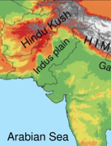
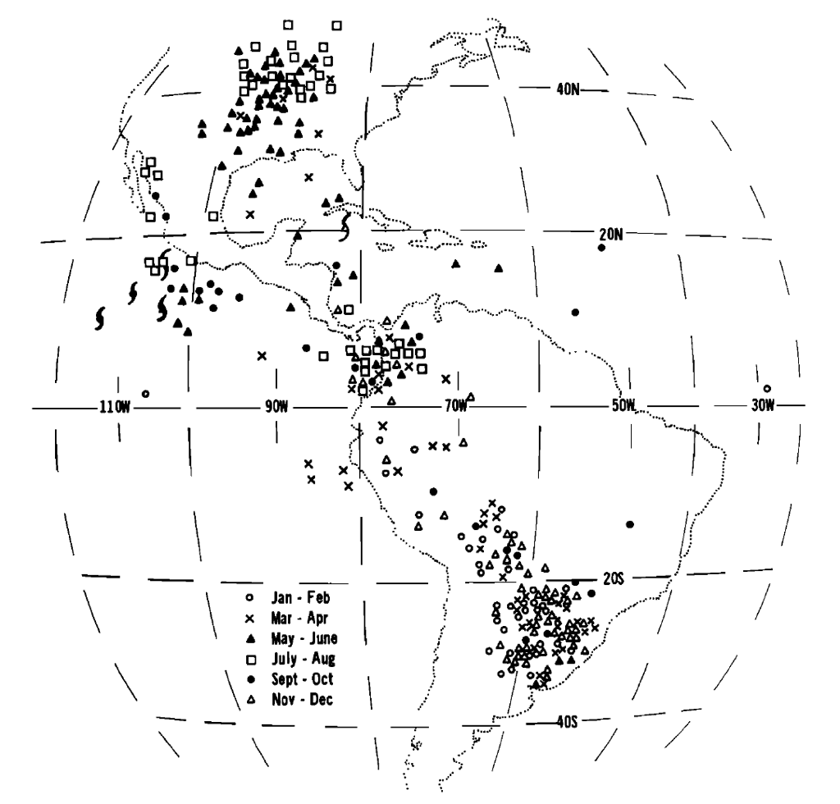
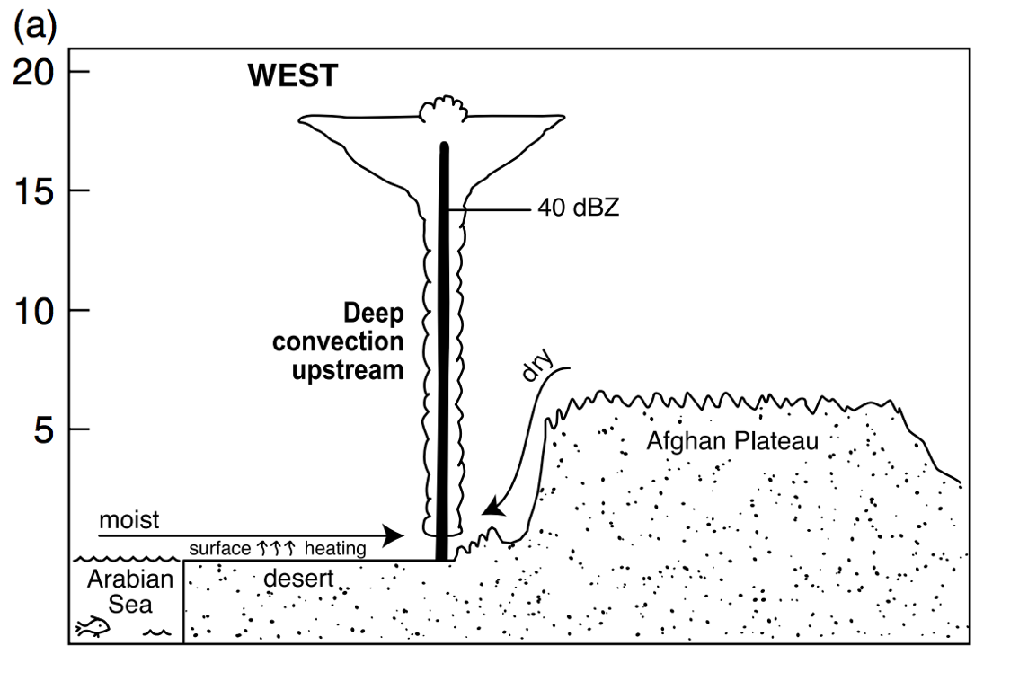
Convective storms around the world
MCSs in the Americas
Deep convection
near the Himalayas
Orographic initiation
Sawyer (1947), Houze et al. (2007)
Velasco and Fritsch (1987)

Slide 5
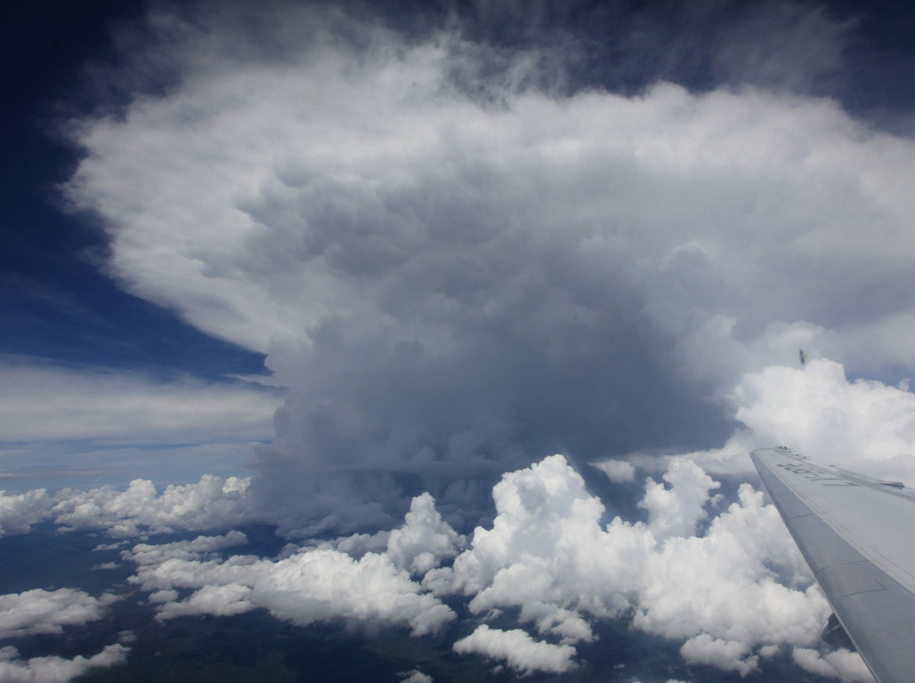
Radar observations from the TRMM satellite
Notes:
Radar is 3D

Slide 6
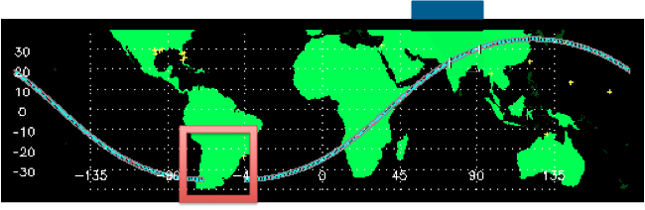
Radar identification of extreme events
TRMM Precipitation Radar
Houze et al. (2007)

Slide 8
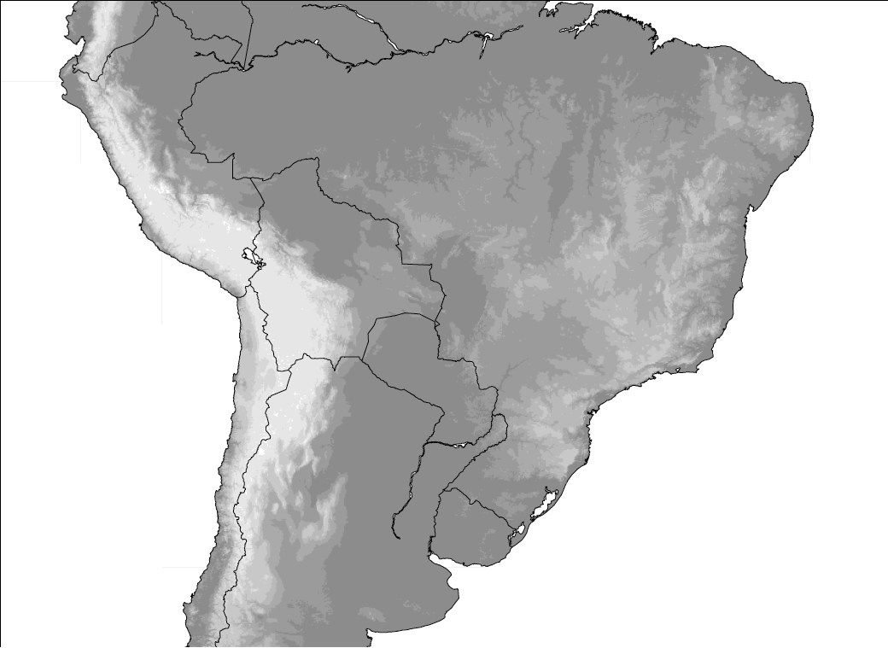
Hypothesis of Storm Life-Cycle
Broad
Stratiform
Regions
Wide
Convective
Cores
Deep
Convective
Cores
Romatschke and Houze (2010)
Suggested by Rasmussen and Houze (2011), Matsudo and Salio (2011)

Slide 9
Capping and triggering
700 mb vertical motion
Composite climatology for days when a wide convective core was identified in subtropical South America
Subsidence on leeward side of Andes helps suppress convective outbreaks prior to reaching the Sierra Cordoba Mountains
Moist air from the Amazon
Upper-level Flow over the Andes; Dry, subsiding air

Slide 10
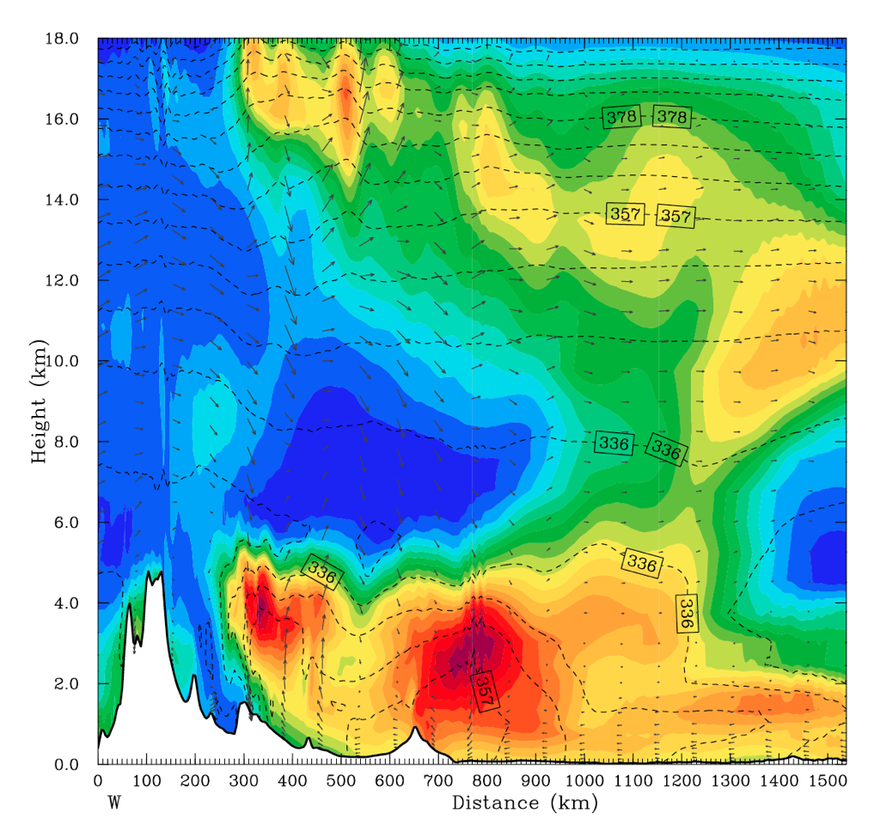
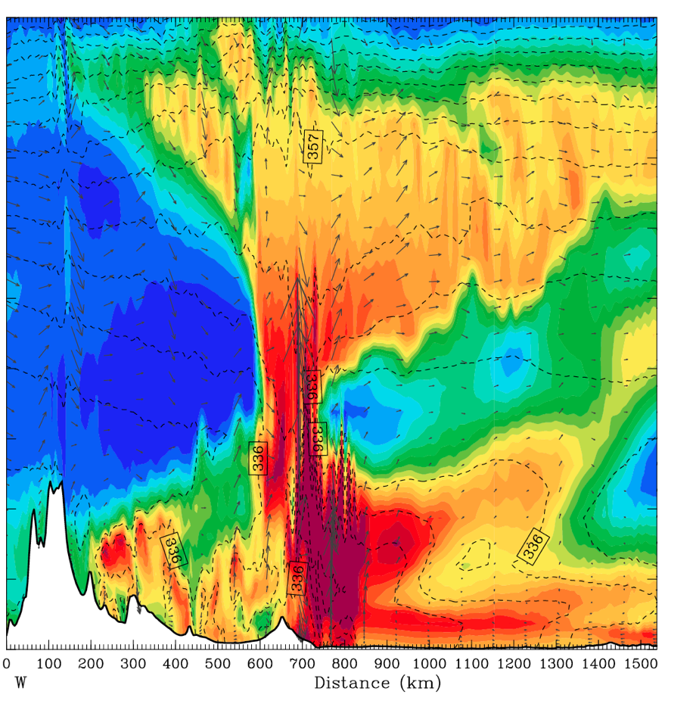

Lee subsidence and capping inversion
Dashed lines - equivalent potential temperature, shading - relative humidity
T = 2 hrs
Lee subsidence capping low-level
moist air
➔ Highly unstable!
T = 8 hrs
Convective initiation on
the eastern foothills of
the Sierras de Córdoba
Mountains
Air with high equivalent
potential temperatures
near the Andes foothills
RH
Strong evidence confirming the hypothesis of lee subsidence and a capping inversion from Rasmussen and Houze (2011)

Slide 11
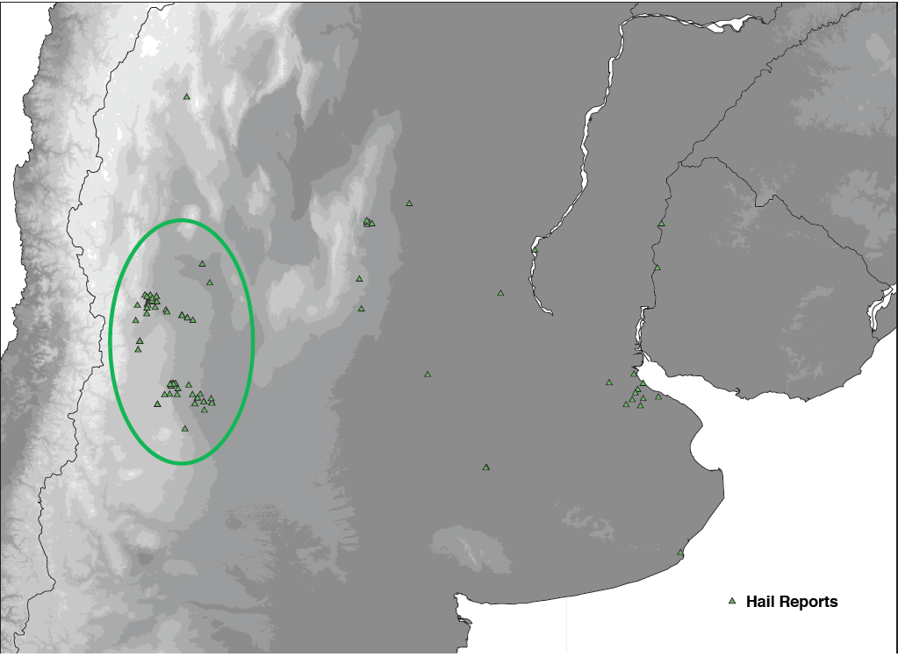
Hail reports from local media

Slide 12
Lightning Imaging
Sensor (LIS)
aboard the
TRMM satellite
January
(1998-2009)

Slide 13
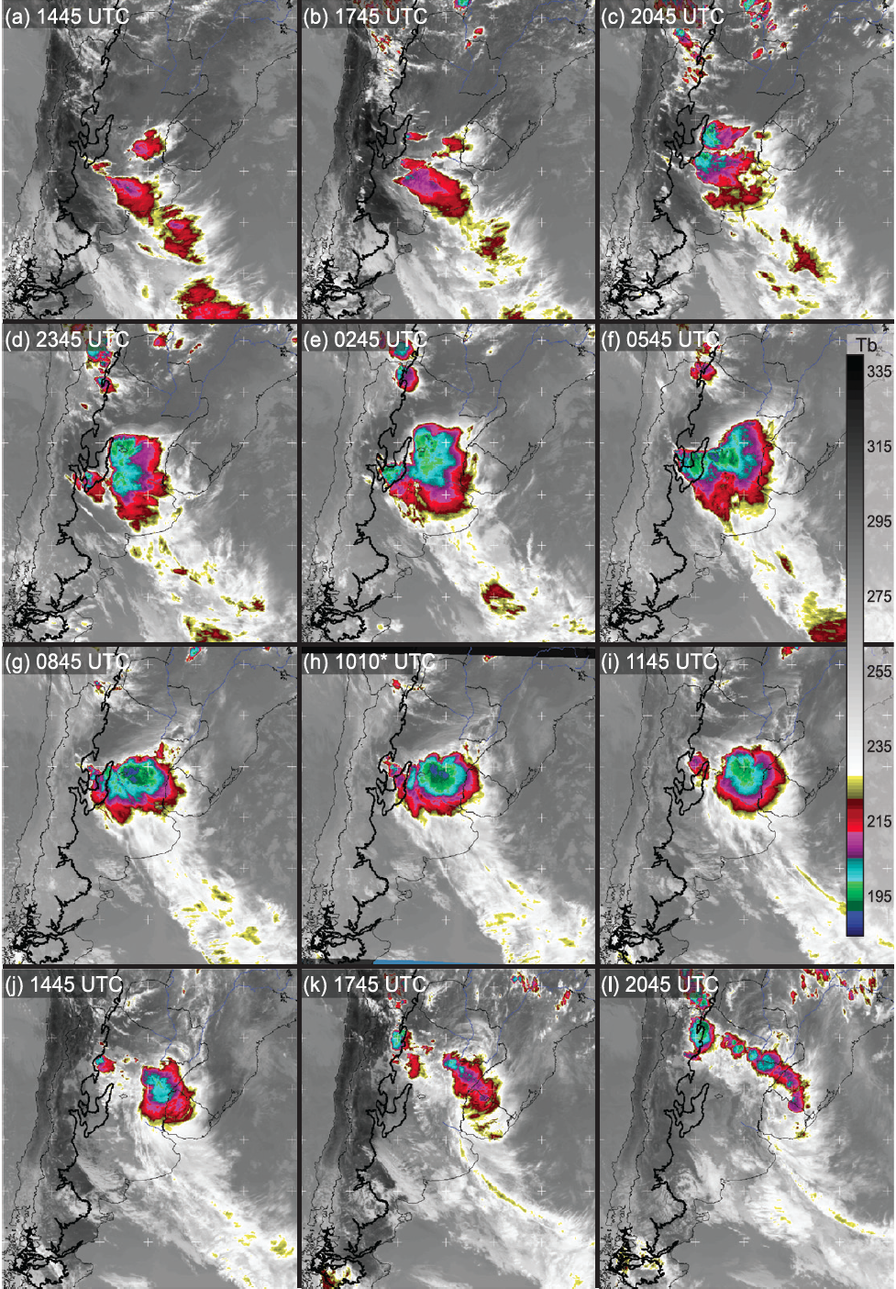
27 December 2003
GOES IR Loop
0.5 km topography outlined in black

Slide 14
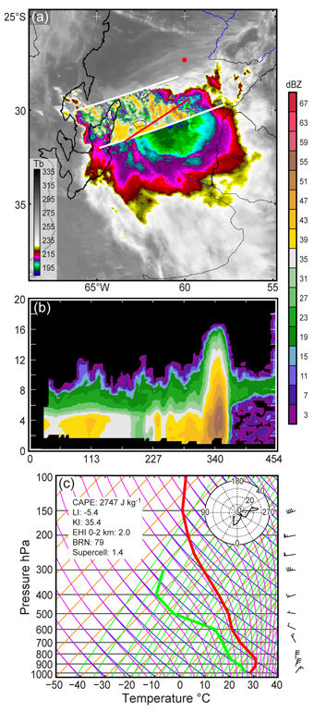
TRMM PR Data
Deep and wide convective core identified by TRMM PR algorithm
Feature tied to the Sierras de Córdoba Mountains
Convective line in front with trailing stratiform precipitation
Cross-section shows a clear brightband signature that indicates stratiform echo
dBZ
TRMM PR
swath indicated
by white lines
67
51
35
19
Cross-section
along red line
3
1002 UTC 27 December 2003

Slide 15
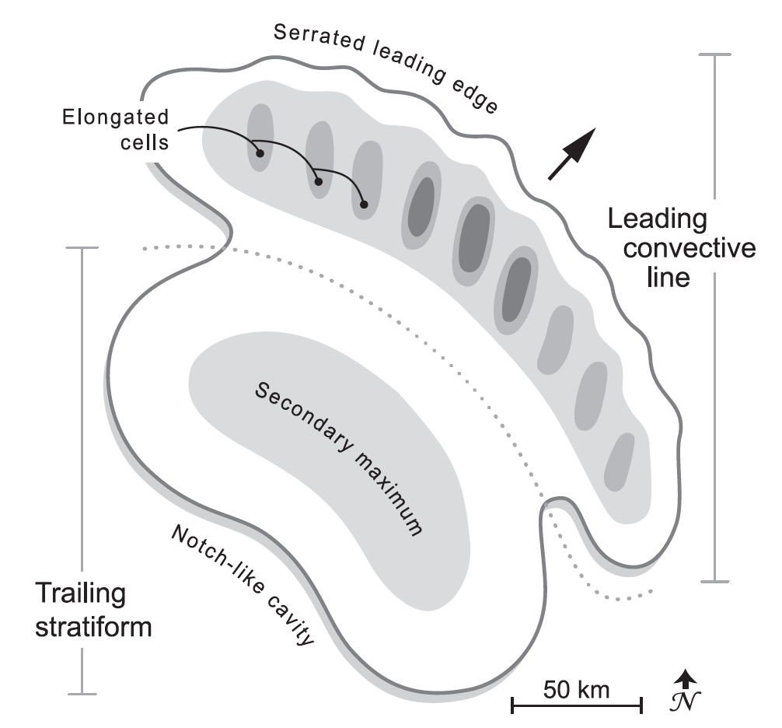
Oklahoma Archetype
Houze et al. (1990), modified by Rasmussen and Houze (2011)

Slide 16
Mesoscale Organization
Degree of Organization | Range of Scores | South America | Oklahoma (Houze et al. 1990) | Switzerland (Schiesser et al. 1995)
Strongly Classifiable | C > 5 | 11 (20%) | 14 (22.2%) | 0 (0%)
Moderately Classifiable | 0 ≤ C ≥ 5 | 30 (54.5%) | 18 (28.6%) | 12 (21.4%)
Weakly Classifiable | C < 0 | 7 (12.7%) | 10 (15.9%) | 18 (32.1%)
All Classifiable Systems | All C | 48 (87.3%) | 42 (66.7%) | 30 (53.6%)
All Unclassifiable Systems | --- | 7 (12.7%) | 21 (33.3%) | 26 (46.4%)
Total Number of Storms Analyzed | --- | 55 | 63 | 56

Slide 17
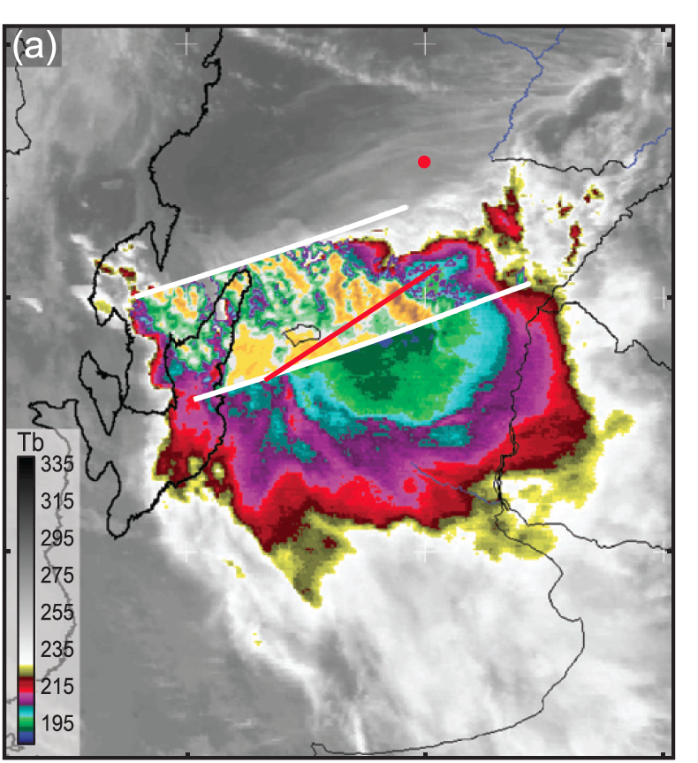
Model/data comparisons
WRF Simulation: Thompson Scheme
Height (km)
Distance (km)
TRMM PR Data
Height (km)
Distance (km)

Slide 18
Summary
Deep convection triggers near the Sierras de Córdoba Mountains and Andes foothills, grows upscale into eastward propagating MCSs, and decays into stratiform regions
Lee subsidence capping low-level moisture is observed in the model results
Storms with wide convective cores in S. America tend to be line-organized and are similar in organization to squall lines in Oklahoma
Choice of microphysics scheme can greatly impact the storm structure and is important for deep convective simulations

Slide 19
Acknowledgments
This research was supported by NASA Grants NNX10AH70G and NNX11AL65H, and NSF Grant AGS-1144105,

Slide 20
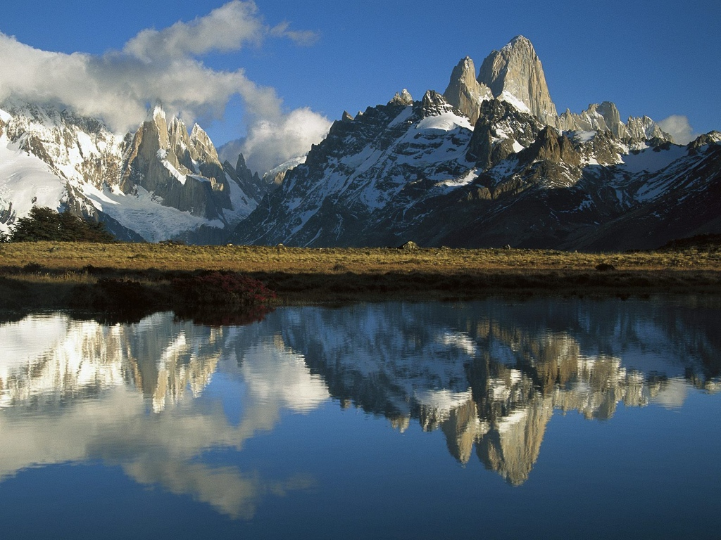
Thank you!
Questions?

