Slide 1



Tropospheric Humidification by Anvil Clouds over the Indian Ocean
Scott W. Powell
University of Washington
Dept. of Atmos. Sci.
April 19, 2012
30th Conference on Hurricanes and Tropical Meteorology, Ponte Vedra Beach, FL

Slide 2


Slide 3


Slide 7
Maxima/Minima in humidity are
observed at lower levels first.

Slide 8
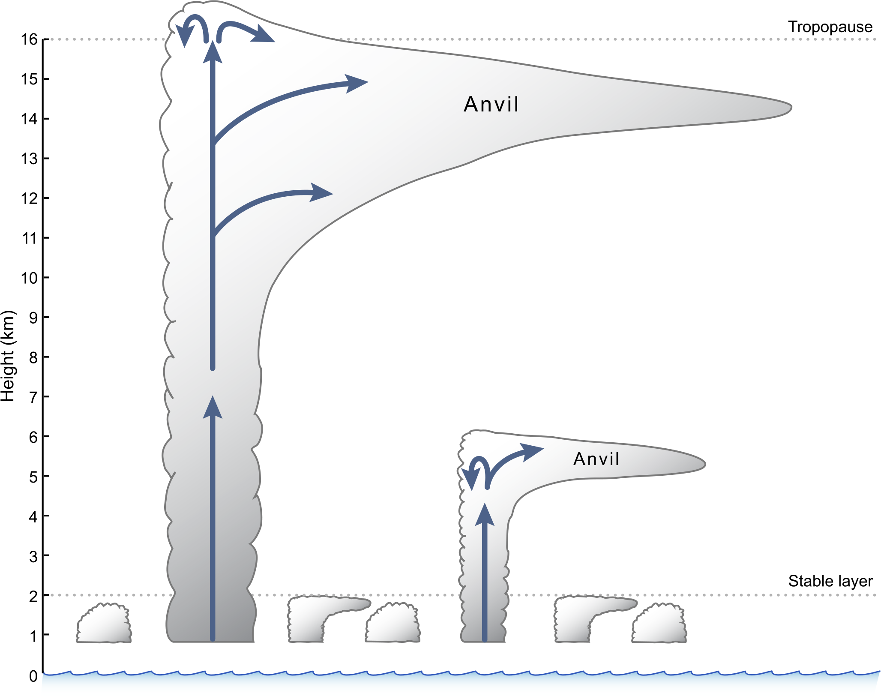

Slide 9
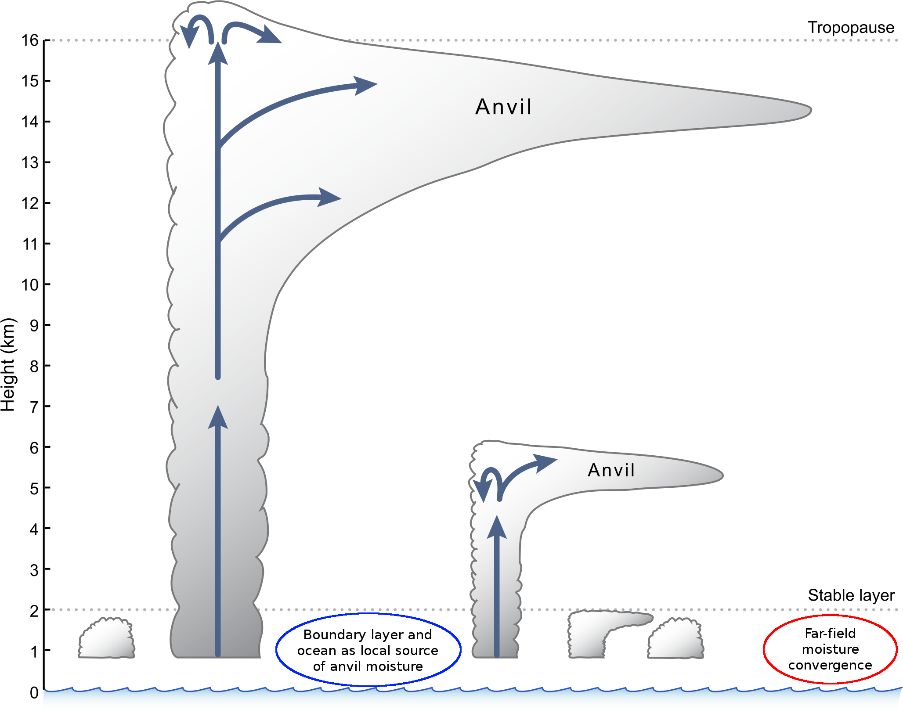

Slide 10
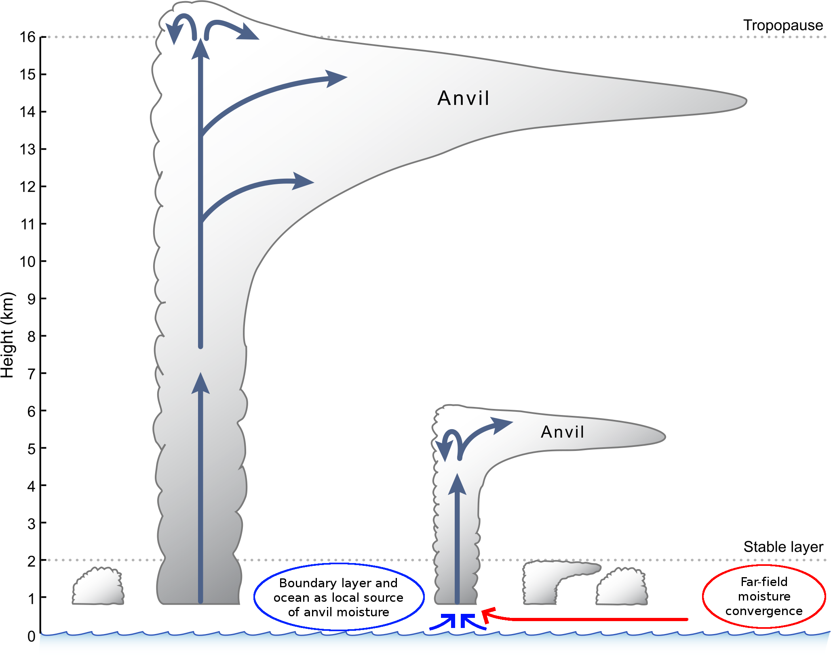

Slide 11
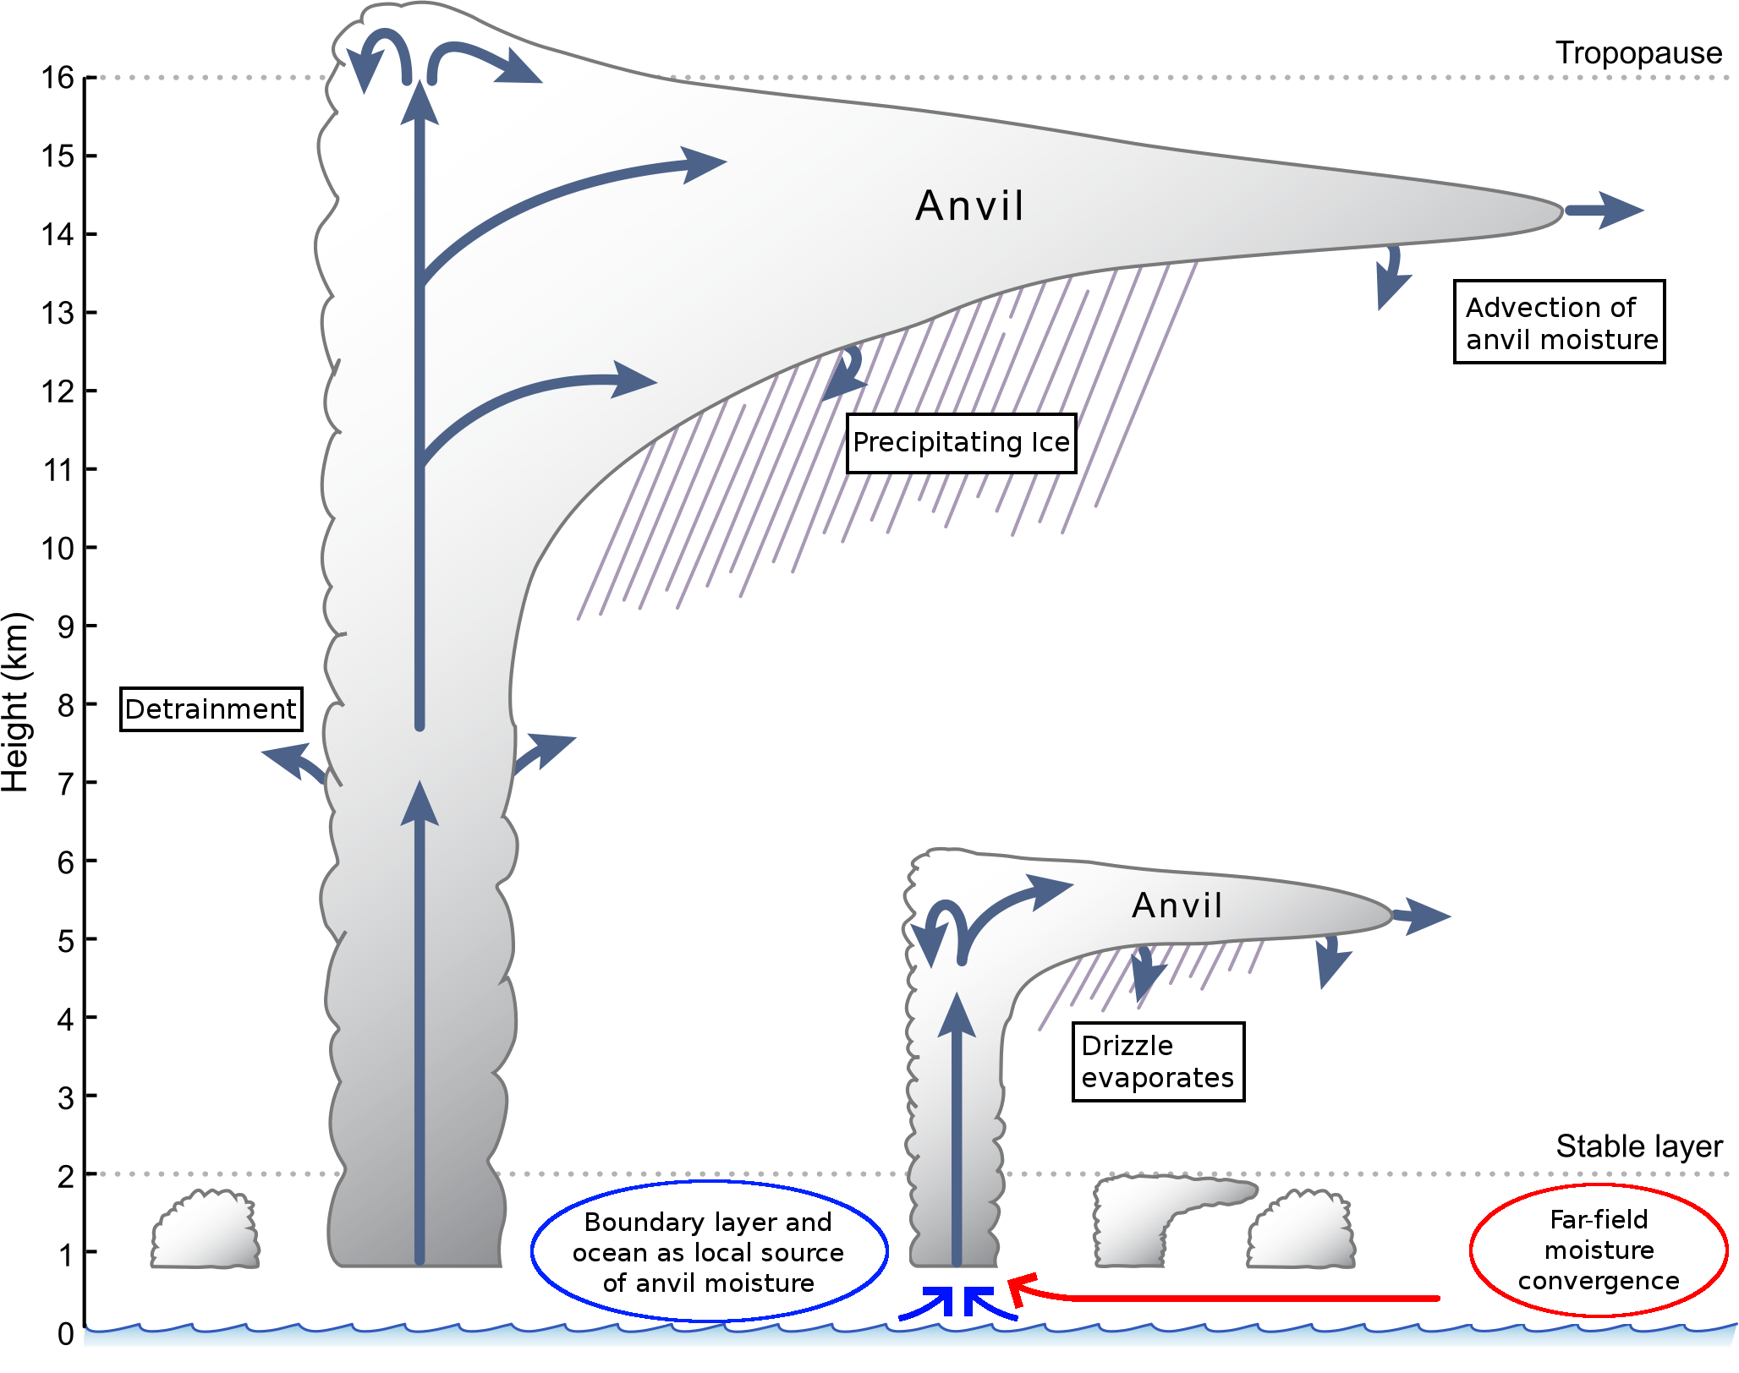

Slide 12
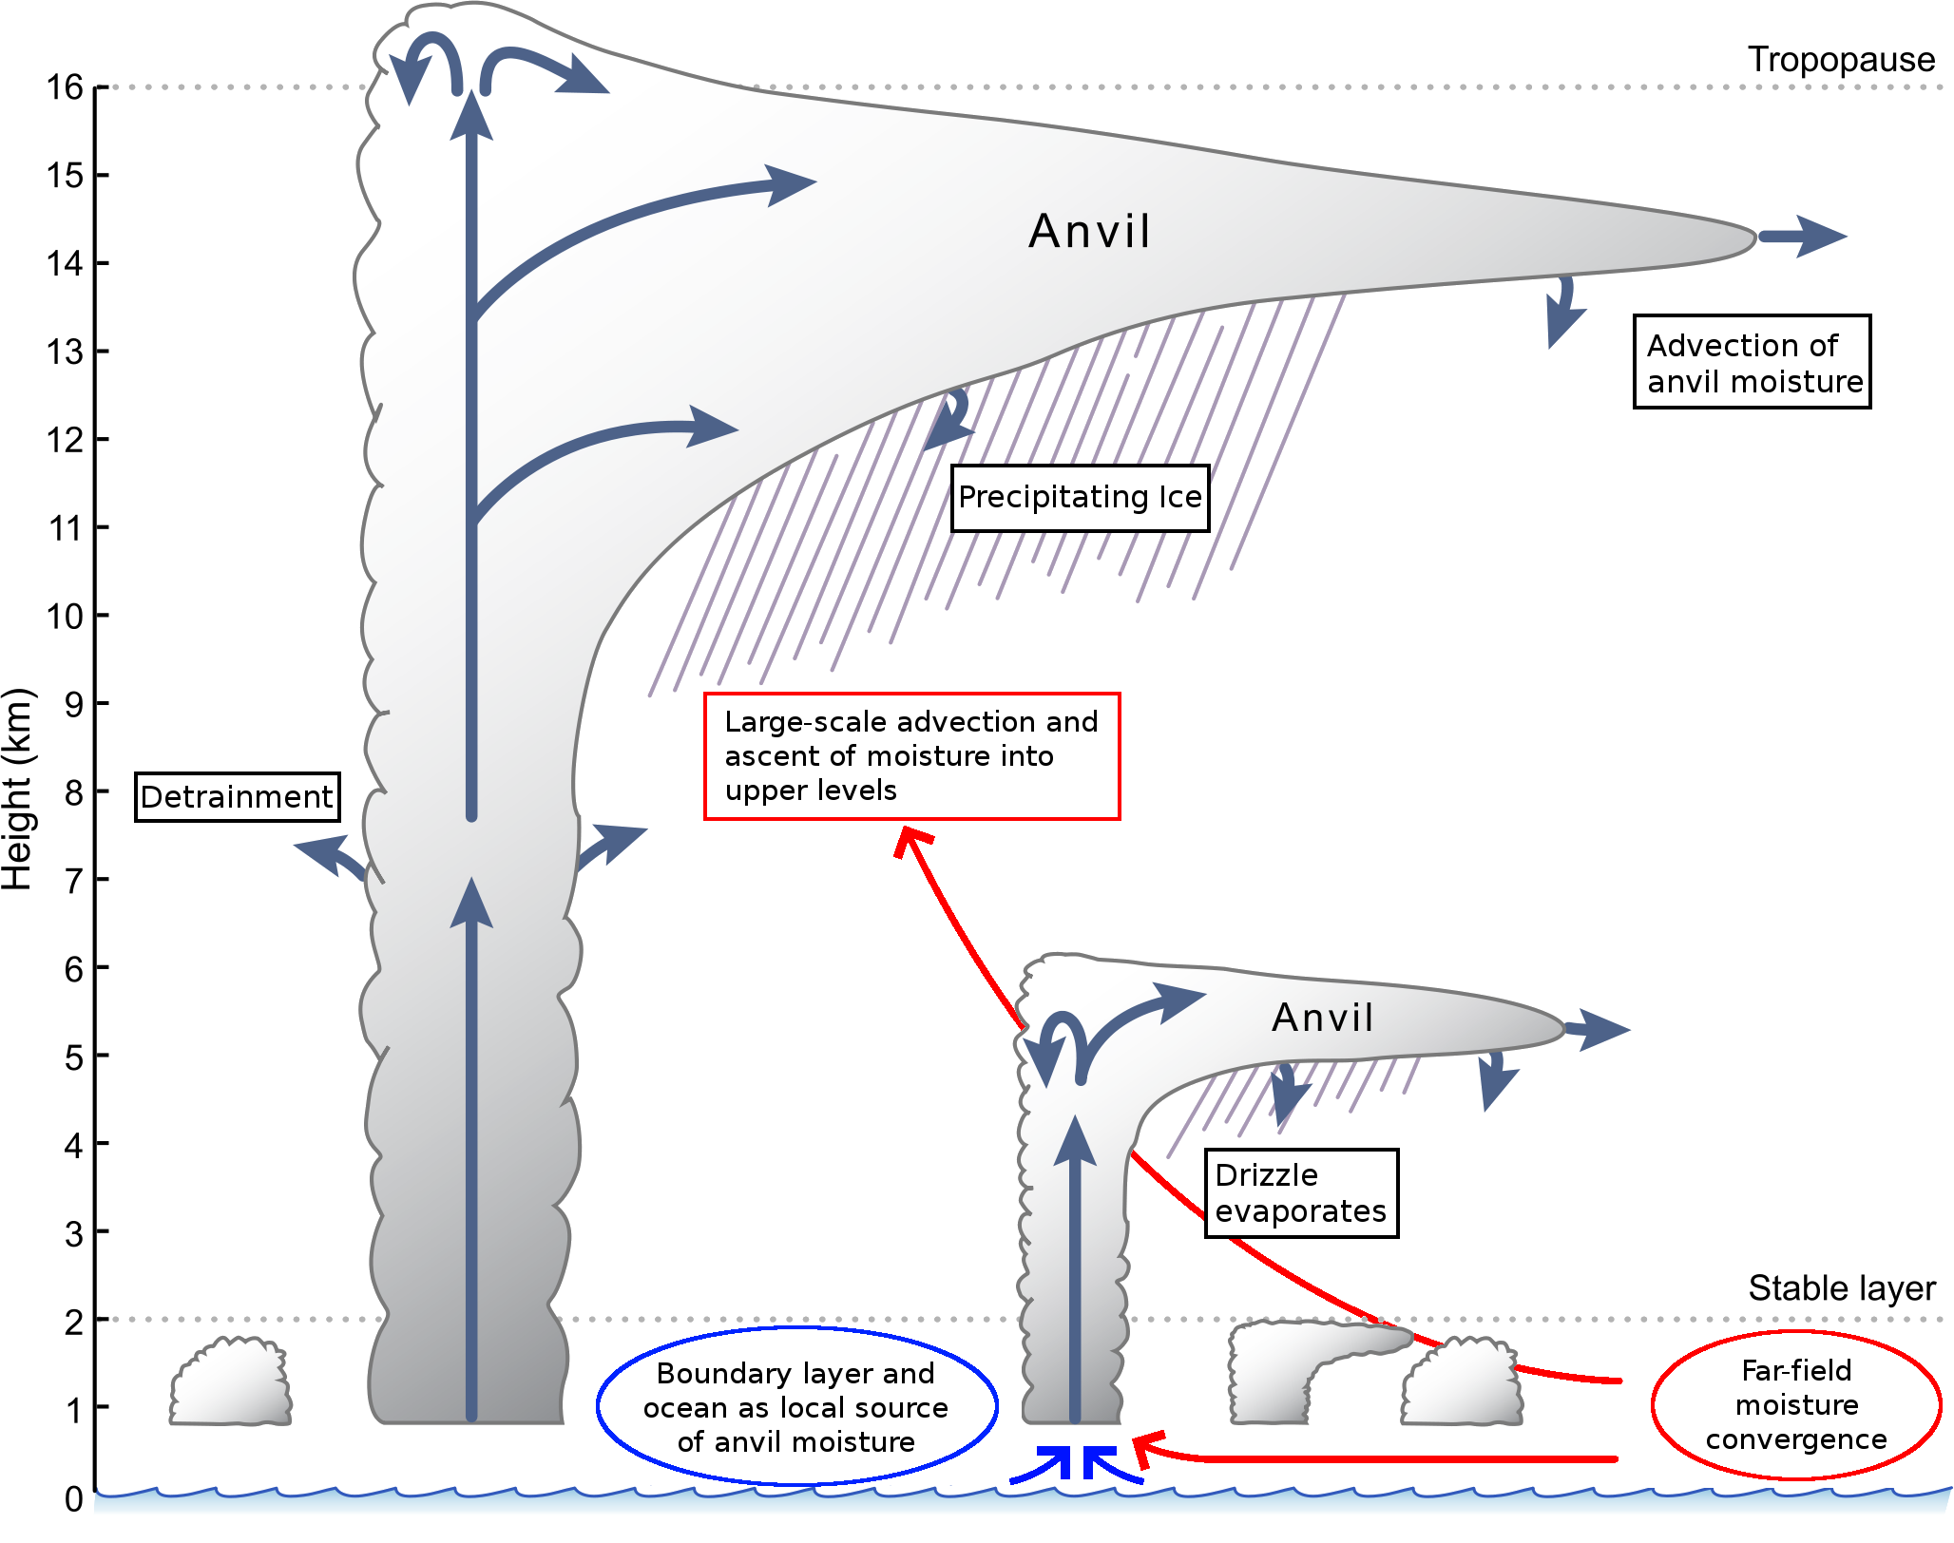

Slide 13

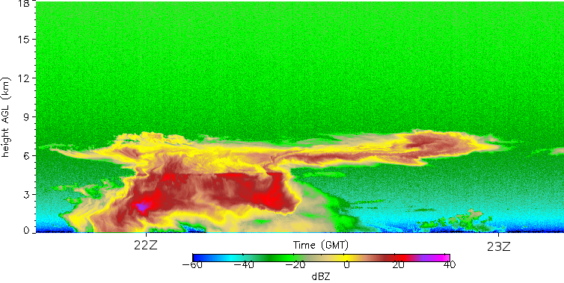
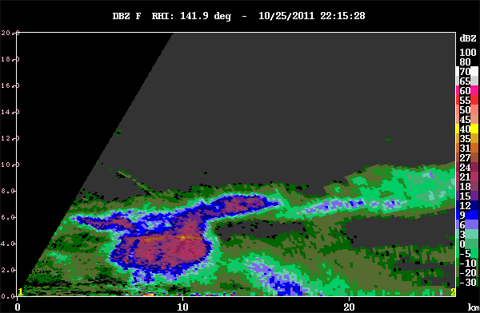
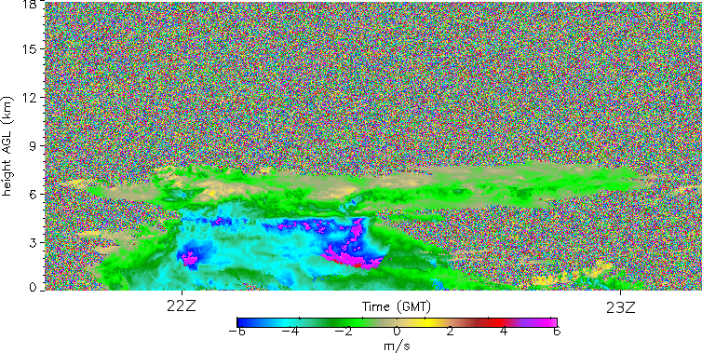
Radar observations of anvils
KAZR
S-Pol

Slide 14
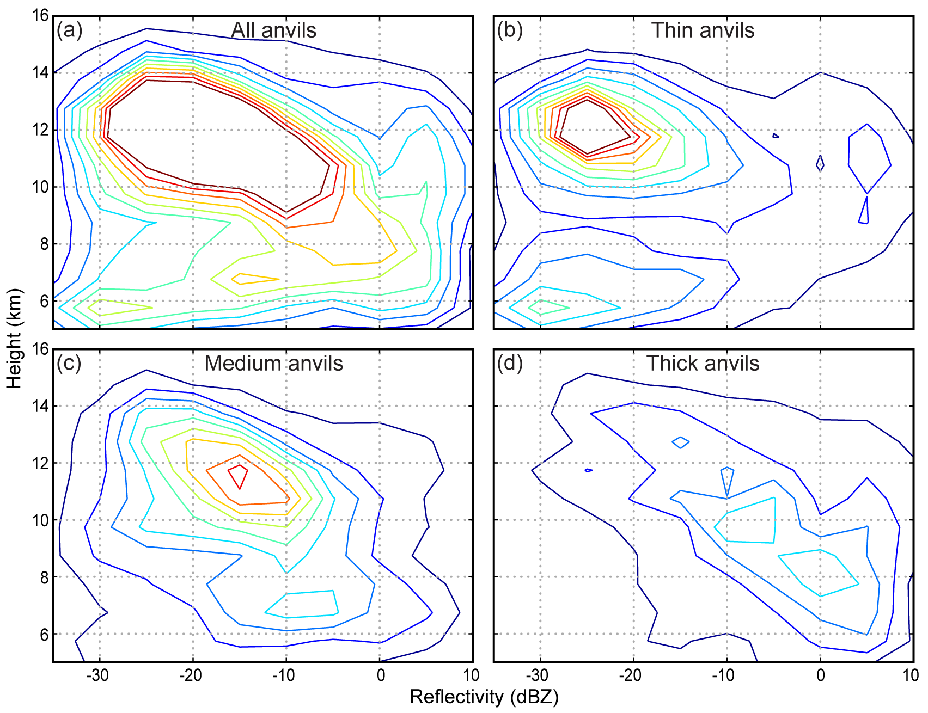
West African Anvils (Powell et al 2012)
66%
26%
8%

Slide 15
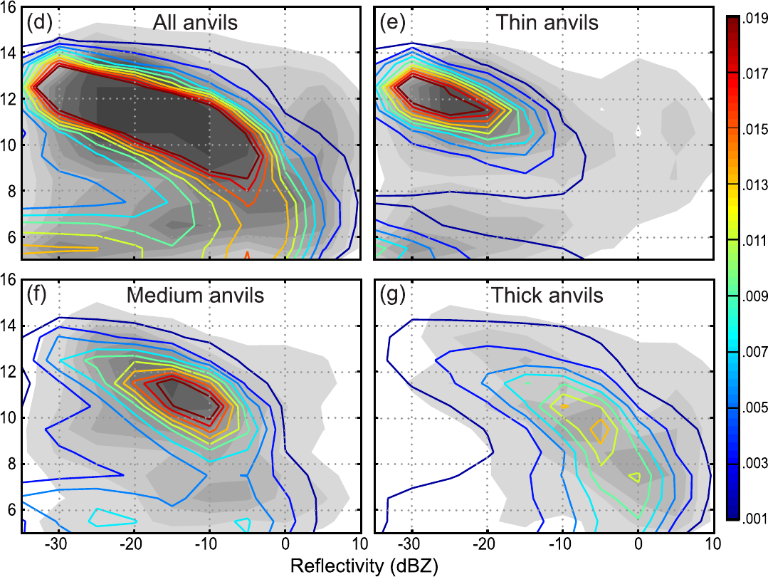
Modeling West African Anvils
61%
30%
9%

Slide 16
Indian Ocean Anvils
83%
15%
3%

Slide 17
Precipitating Clouds

Slide 19
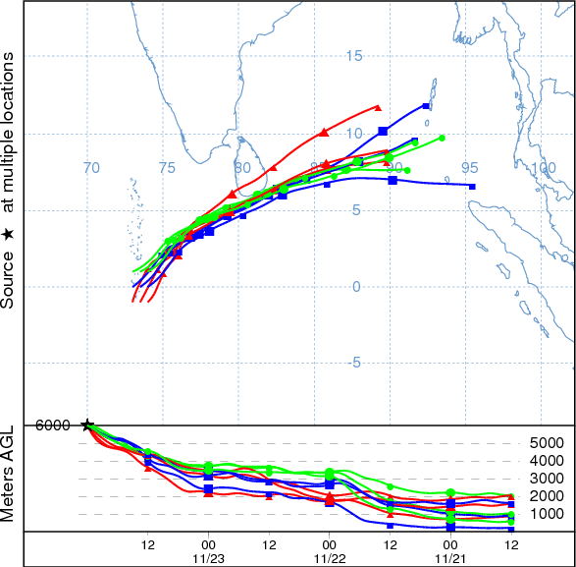
Large-scale ascent of moisture?
Far-field moist BL air

Slide 20

Summary
Role of anvil clouds in moistening of troposphere
Local and far-field sources of moisture
Advection and ascent of far-field moist boundary layer air
Radar observations detail cloud structures used to validate mesoscale model.

Slide 21
End
This research was supported by DOE grant DE-SC0001164 / ER-64752 and NSF grant AGS-1059611

