Slide 1
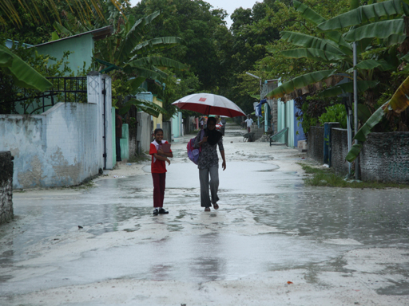
Indian Ocean Convection Seen by the S-PolKa Radar in DYNAMO
R. Houze
and
D. Hence, S. Brodzik, K. Rasmussen, S.Powell, H. Barnes,
B. Dolan, K. Chakravarty, C. Burleyson, Z. Li,
S. Ellis, T. Weckwerth, J. Vivekanandan, J. Hubbert, W.-C. Lee
AMS Conf. on Hurricanes and Tropical Meteorology, Ponte Vedra, FL, 19 April 2012

Slide 2
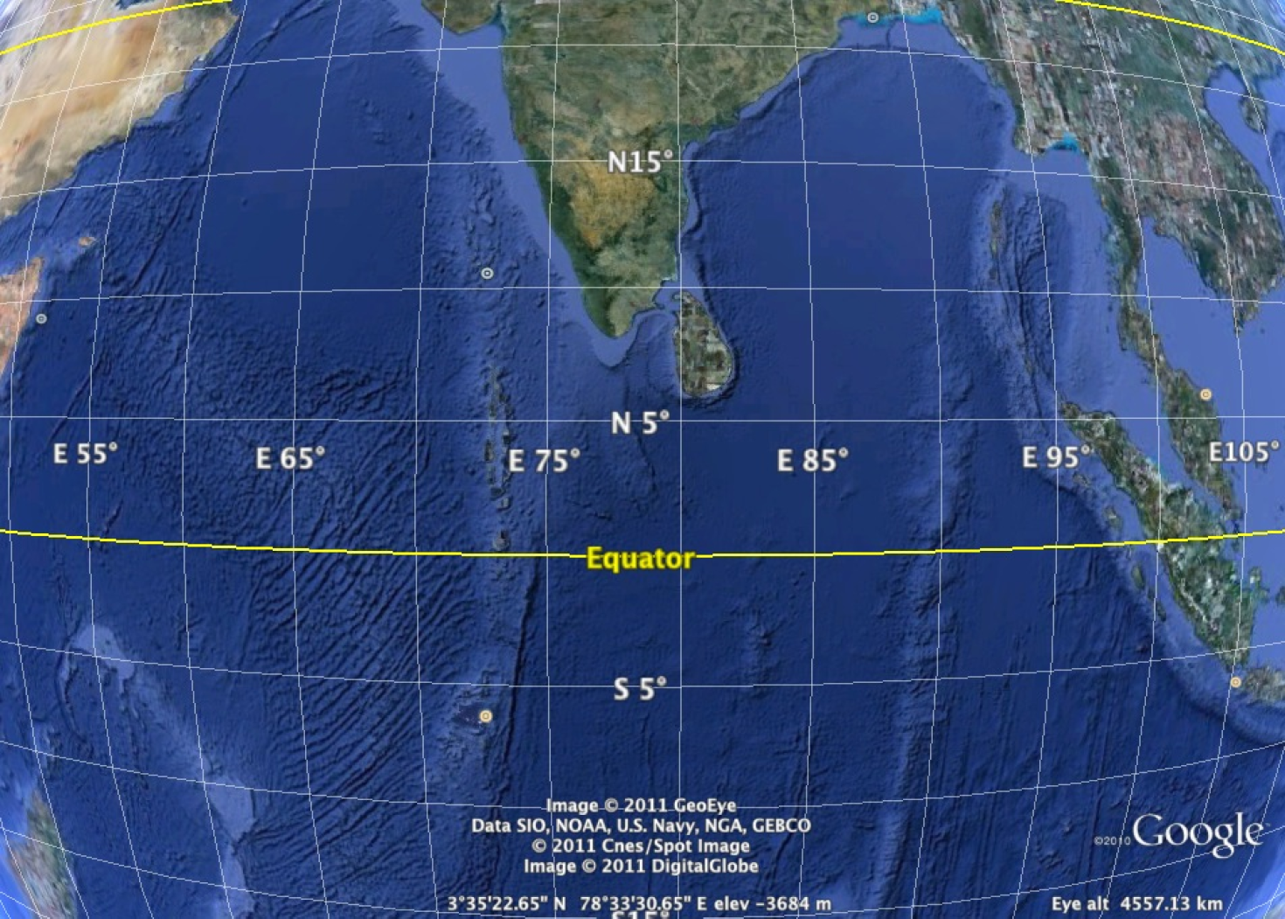
DYNAMO Radar experiment goal
→ Characteristics and evolution of the MJO cloud population in the region where the disturbance builds up
Addu Atoll

Slide 3
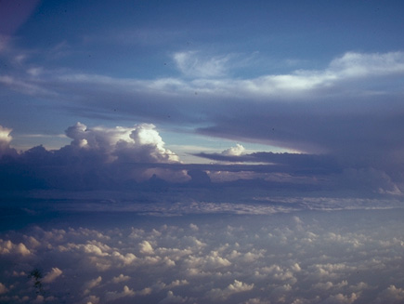
Clouds in the moist layer

Slide 4
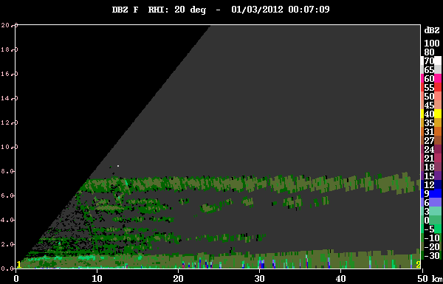
Humidity gradient layers and nonprecipitating clouds

Slide 5
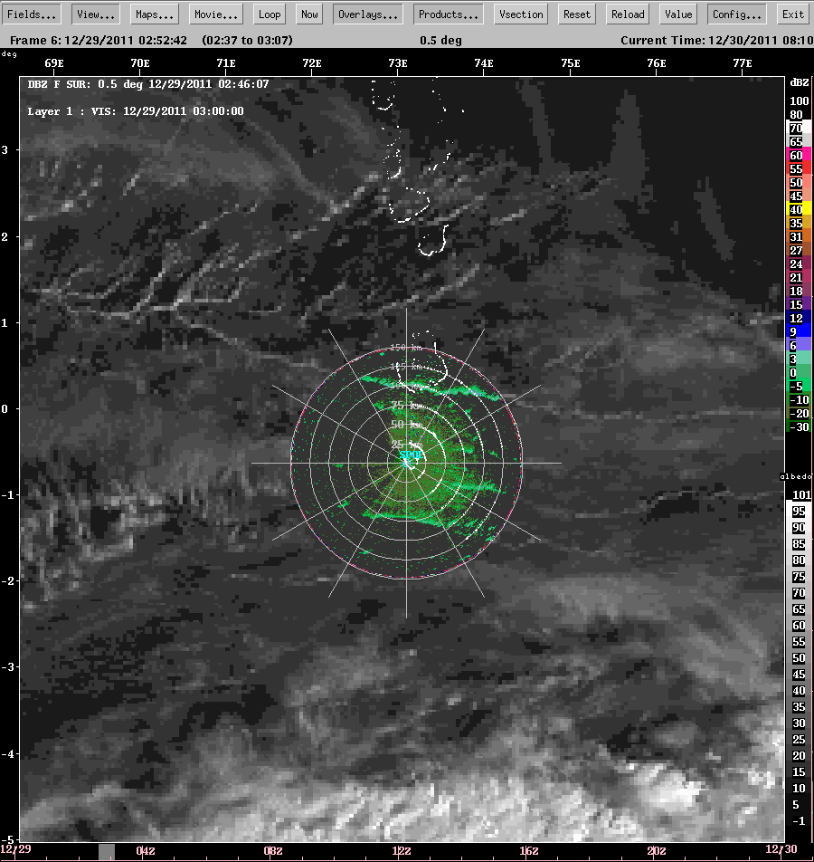
Long lines of cumulus

Slide 6
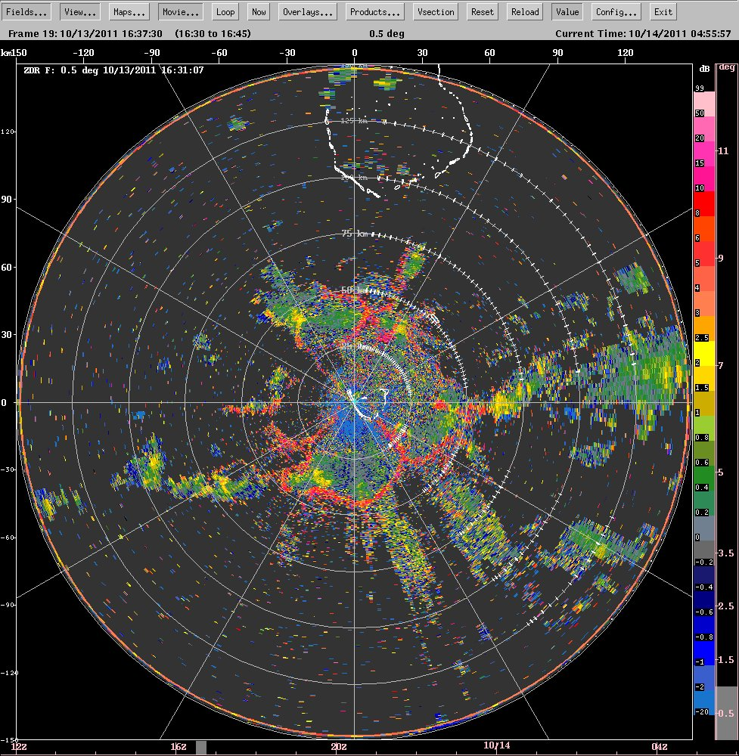
Cold pool examples seen in differential reflectivity (ZDR)

Slide 7
Deep precipitating convection

Slide 8
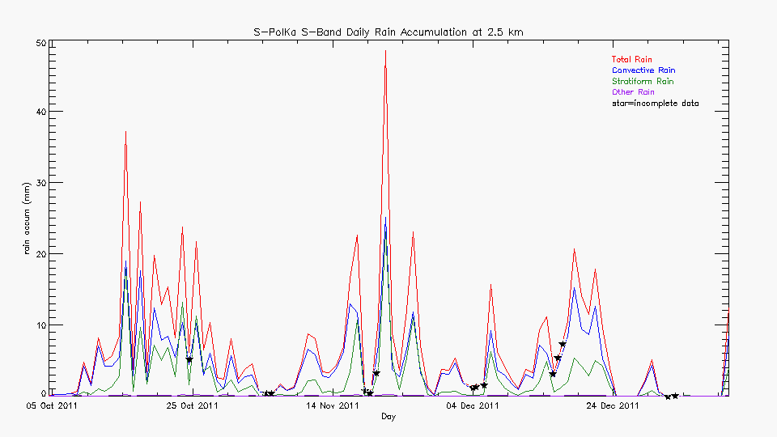
Rain over area scanned by S-PolKa

Slide 9
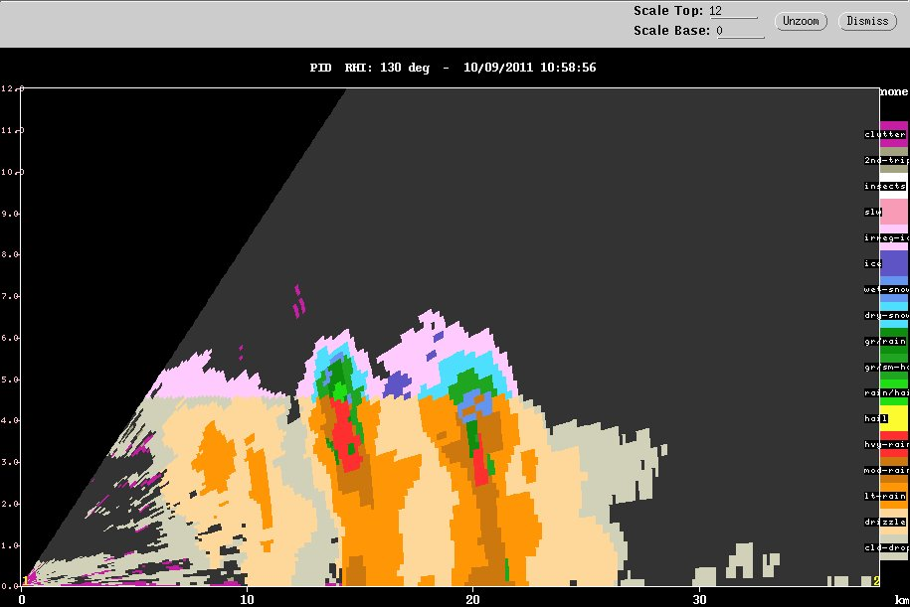
Small cumulonimbus
small ice
graupel
large non-melting ice
8 km
melting snow
4 km
heavy rain

Slide 10
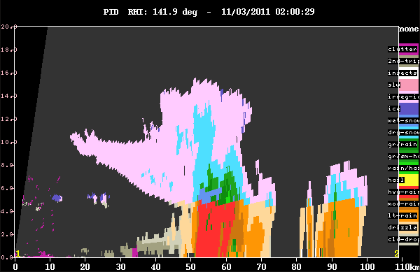
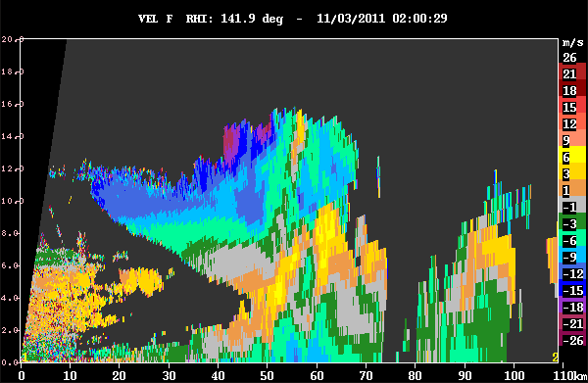
Moderate cumulonimbus
Large
non-melting
ice
small ice
Hydrometeor type
graupel
heavy rain
melting ice
Doppler velocity

Slide 11
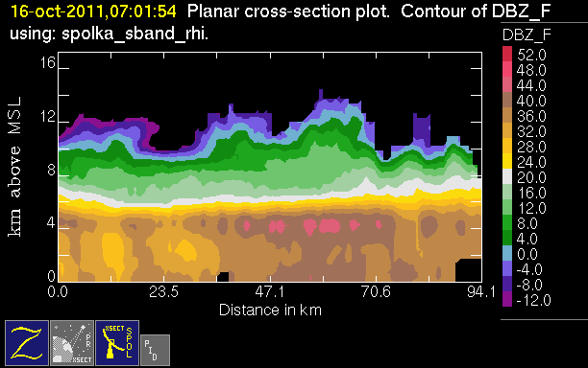
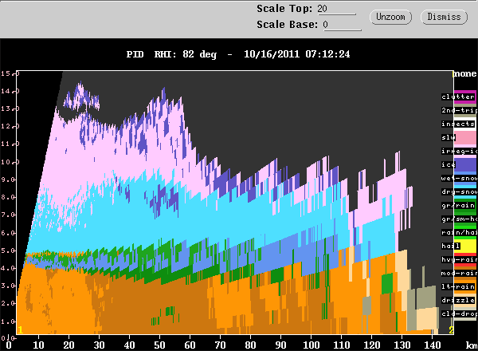
Broad stratiform region of a mesoscale system
50 dBZ!
graupel
10 km
melting snow
5 km

Slide 12
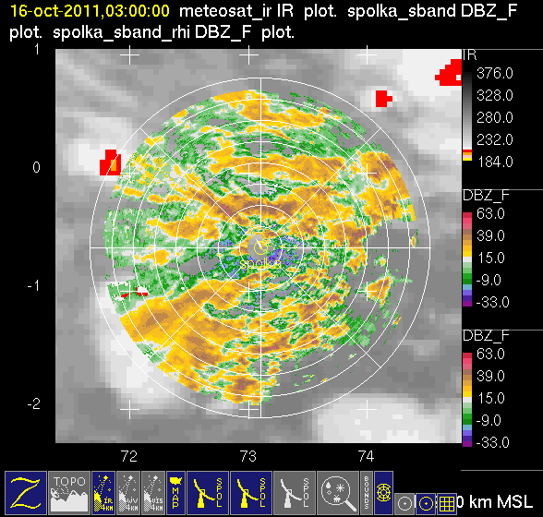
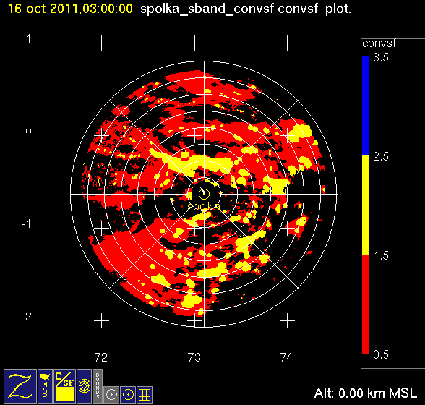
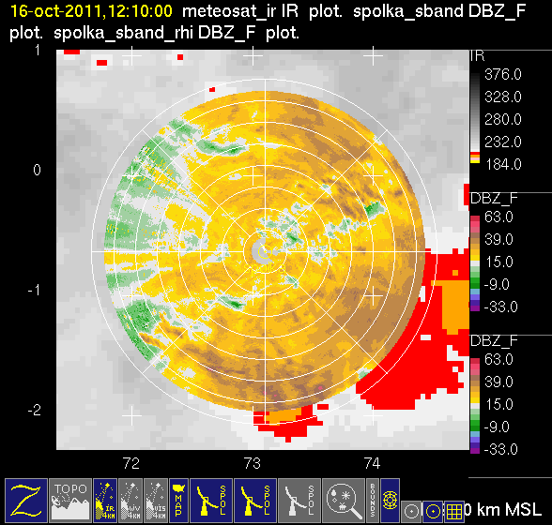
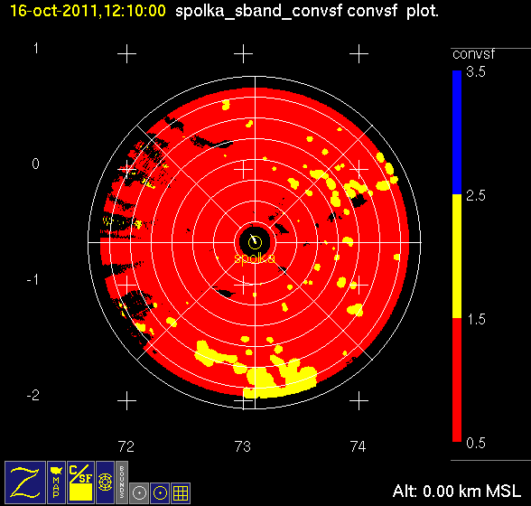
Stratiform
Large mesoscale system
Convective

Slide 13
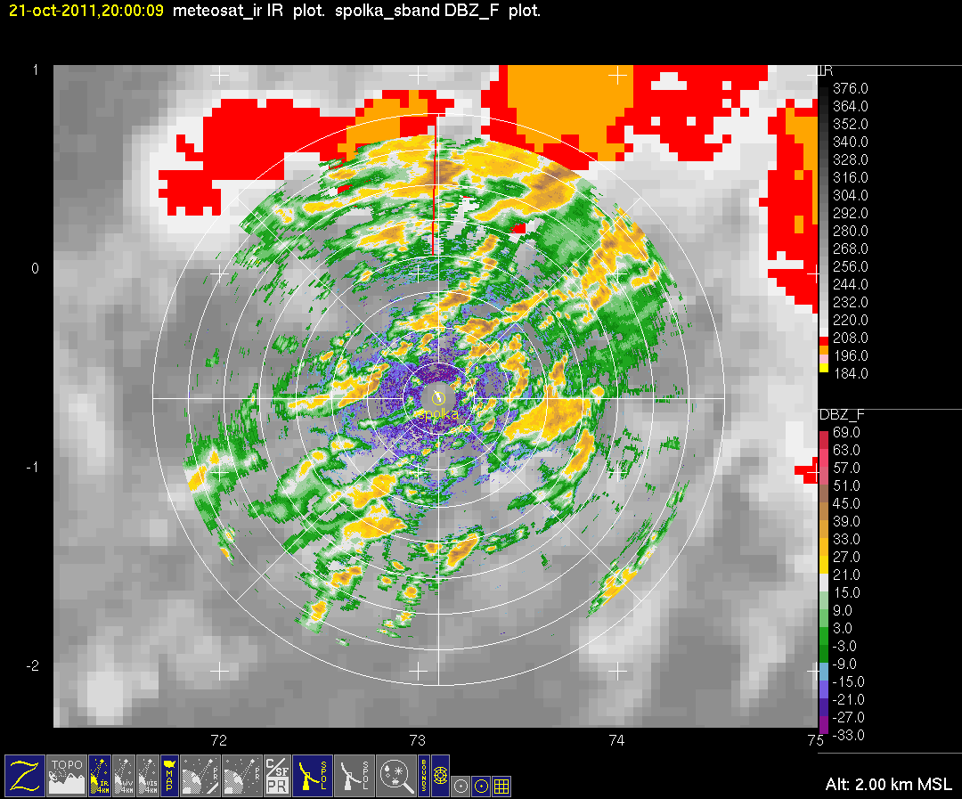
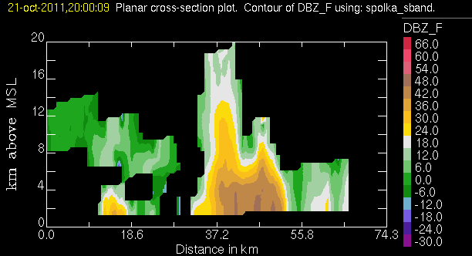
Convection feeding into a large MCS
in sheared environment

Slide 14
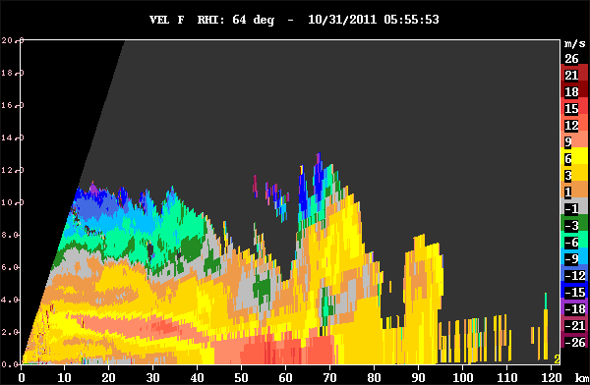
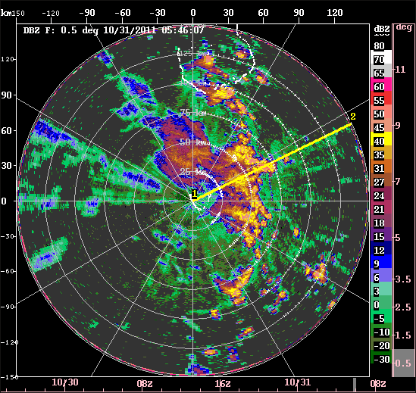
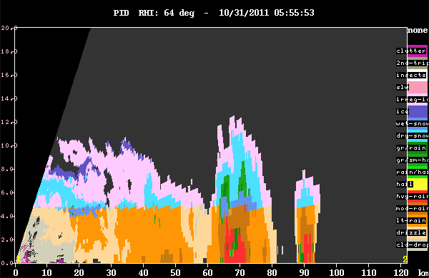
Momentum transport

Slide 15
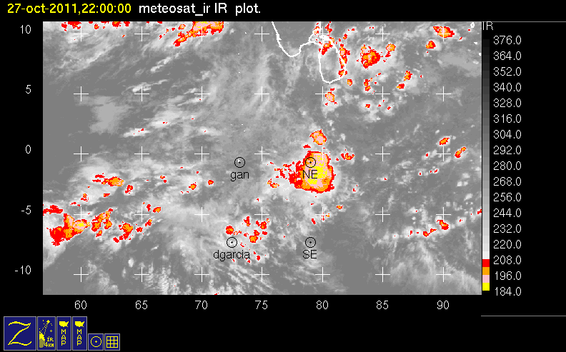
Biggest MCS of first active phase:
weak unidirectional shear

Slide 16
Larger than mesoscale organization

Slide 17
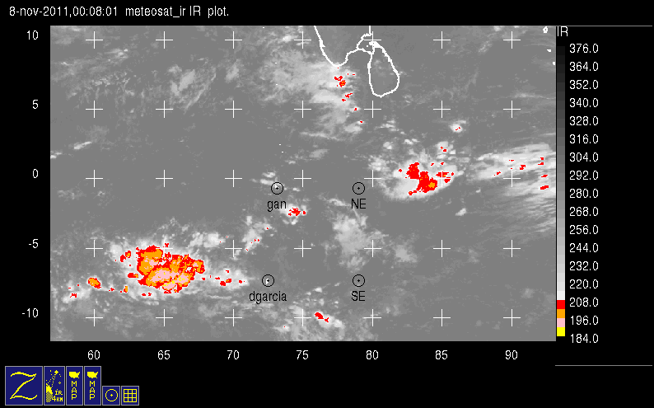
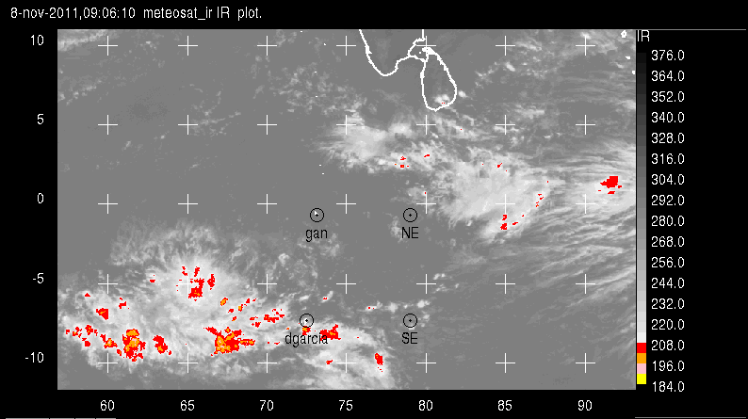
Giant Rings of Convection

Slide 18
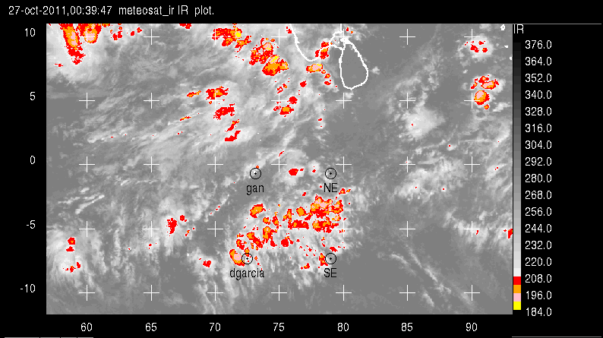
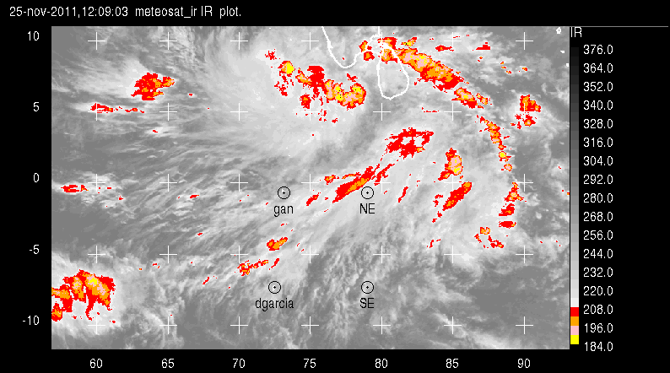
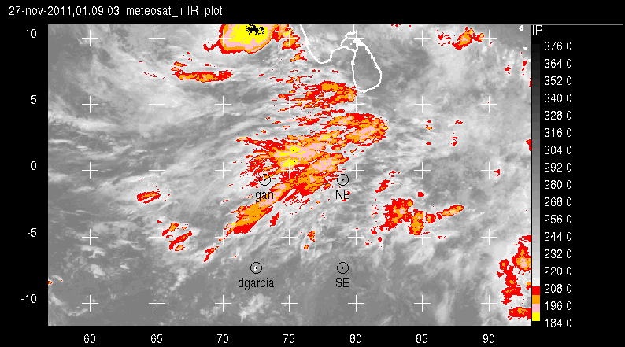
Westerly Surges

Slide 19
SUMMARY
Moist layer
Humidity layers
Cumulus lines and cold pools
Deep convection
Microphysics
Anvil clouds of deep convection
Mesoscale systems
Effects of shear
Larger than mesoscale organization

Slide 20
End
This research was sponsored by NSF grants AGS-1059611 and DOE grant DE-sc0001164/er-64752.

