Slide 1
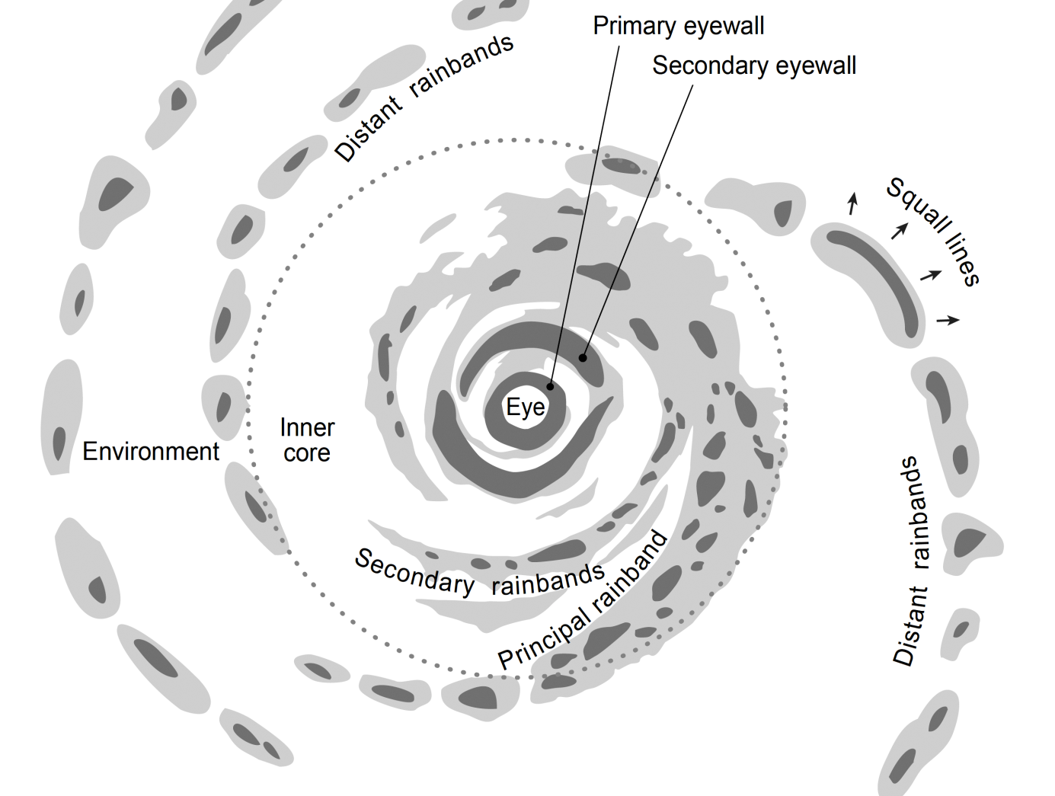


Convective-scale variations in the inner-core rainbands of tropical cyclones
Houze 2010
Anthony C. Didlake, Jr. and Robert A. Houze, Jr.
30th Conference on Hurricanes and Tropical Meteorology
April 17, 2012

Slide 2
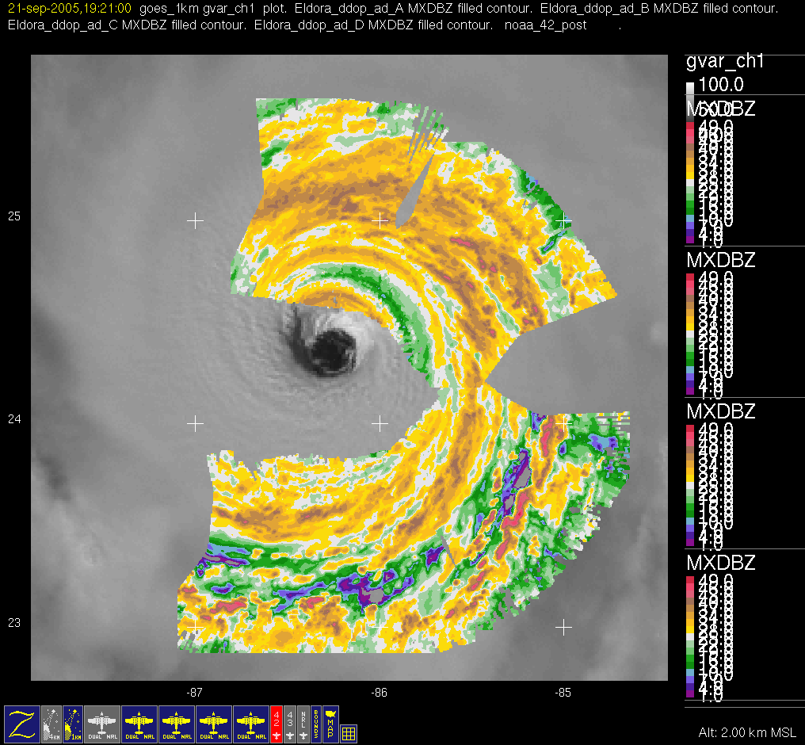
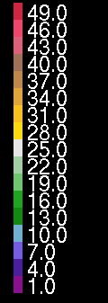
NCAR ELDORA radar
Hurricane Rita
S t r a t i f o r m
9/21/2005 1845-1927 Z
2 km reflectivity
dBZ
C o n v e c t i v e

Slide 3
Method of analysis
Divide into “inner” and “outer” regions
Classify pixels as “convective” or “stratiform”
Take radial cross sections across convective regions
Inner
Outer

Slide 4
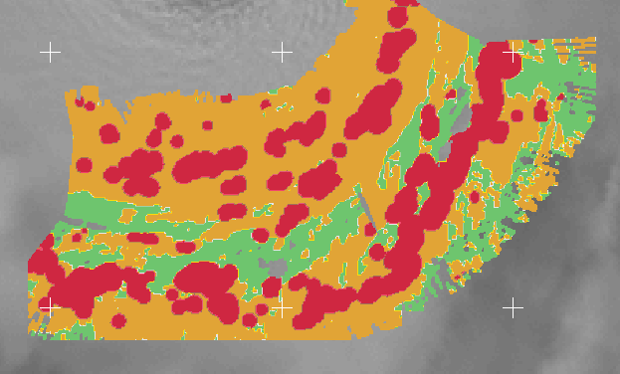
Method of analysis
Divide into “inner” and “outer” regions
Classify pixels as “convective” or “stratiform”
Take radial cross sections across convective regions
Inner
Outer

Slide 5
Composite cross sections
Tangential wind (m/s) – Shaded contours
Reflectivity (dBZ) – Contour lines
Secondary circulation – Vectors
inner region outer region
v (m/s)
eye

Slide 6
Tangential wind
inner region outer region
v (m/s)
Hence and Houze 2008
u (m/s)
Radial wind

Slide 7
Tangential wind
inner region outer region
v (m/s)
u (m/s)
Radial wind

Slide 8
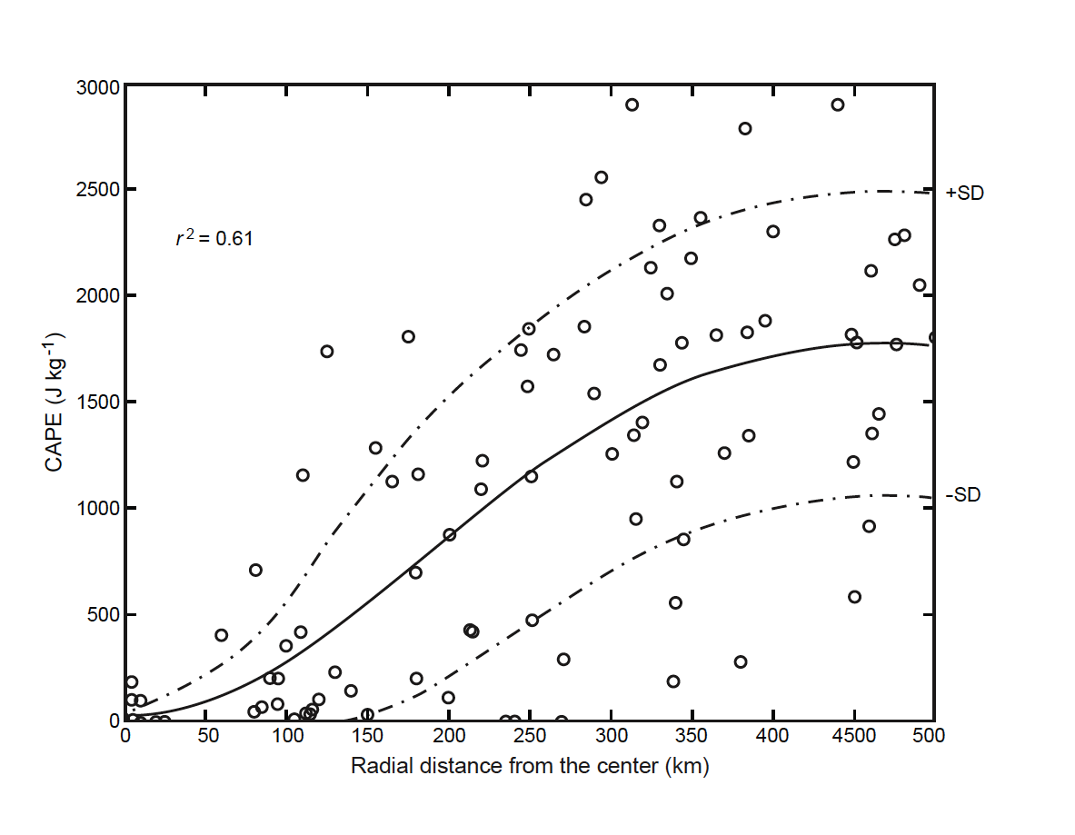
Vertical velocity (m/s)
CAPE as a function of radius
down
total
up
Bogner et al. 2000
solid – inner
dashed – outer

Slide 9
Tangential momentum tendency
inner region outer region
blue – radial advection
red – vertical advection
green – Coriolis term
Altitude (km)
acceleration (m s⁻²)
acceleration (m s⁻²)

Slide 10
Tangential momentum tendency
Total tendency
D red – inner black – outer
Altitude (km)
Altitude (km)
acceleration (m s⁻²)
acceleration (m s⁻²)

Slide 11
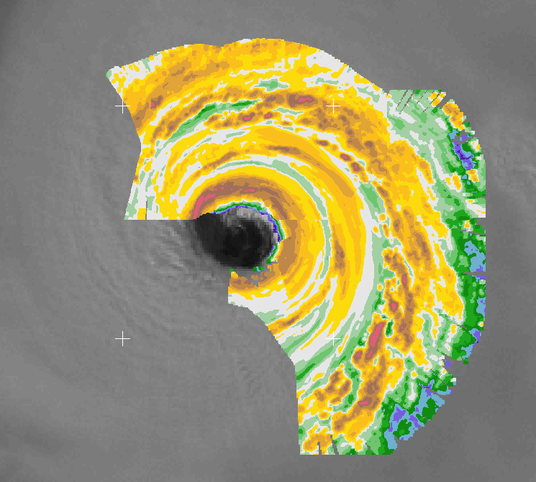
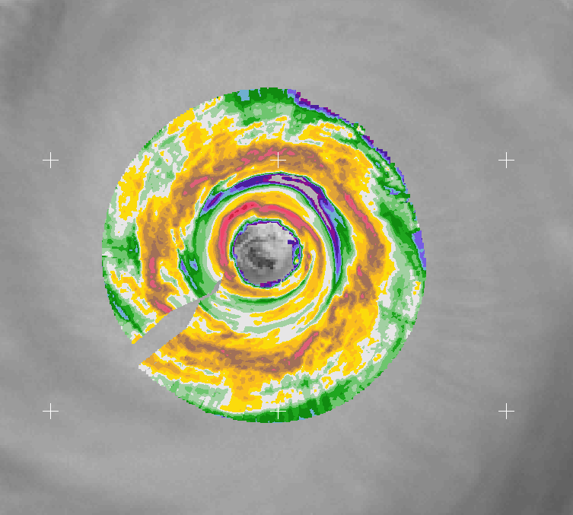
9/21/2005 2010 Z
Rainband convective cells
Didlake and Houze 2012
9/22/2005 1800 Z
Secondary eyewall
Didlake and Houze 2011

Slide 12
Critical zone for secondary eyewall formation
Rainband convective cells
Strong winds and low CAPE
Confinement of jet
Amplification via WISHE feedback
Inner edge subsidence
Didlake and Houze 2012
Secondary eyewall
Didlake and Houze 2011

Slide 13
Conclusions
Kinematic structure varies with radius
Tangential jet depends on radial and vertical advection
  Inner cell jets constrained to low levels
  Outer cell jets occur within large range of altitudes
Convective cells can reach critical zone of secondary eyewall formation

Slide 14
Acknowledgments
Michael Bell
Wen-Chau Lee
Stacy Brodzik
NDSEG Fellowship Program
NSF grant ATM-0743180

