Slide 1
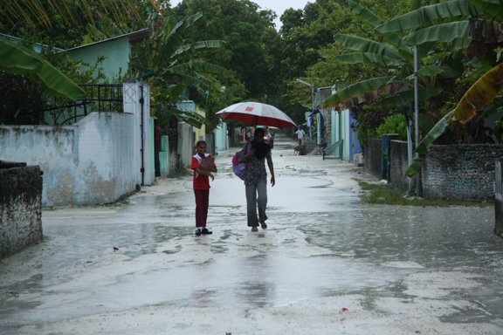
The Cloud Population of the Madden-Julian Oscillation
Early Results
from DYNAMO
R. Houze
and
D. Hence, S. Brodzik, K. Rasmussen, S. Powell, H. Barnes,
B. Dolan, K. Chakravarty, C. Burleyson, Z. Li,
S. Ellis, T. Weckwerth, J. Vivekanandan, J. Hubbert, W.-C. Lee
Atmos. Sci. Colloquium, Seattle, 6 April 2012

Slide 2
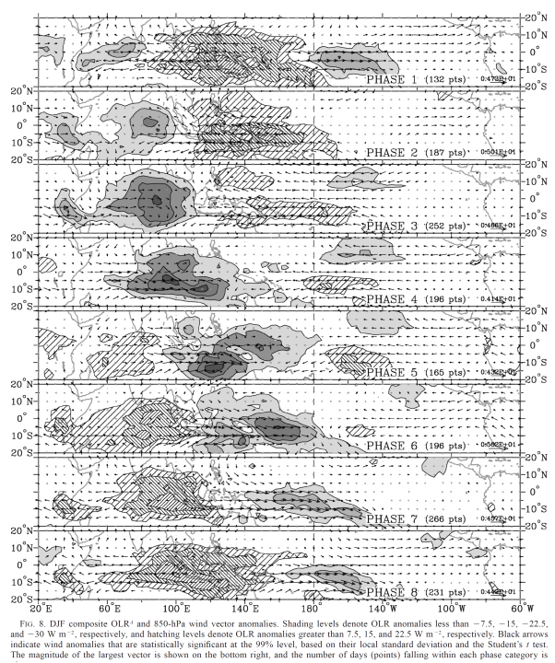
Indian
Ocean
1
2
3
The MJO
4
5
Wheeler and Hendon 2004
6
7
8
DYNAMO

Slide 3
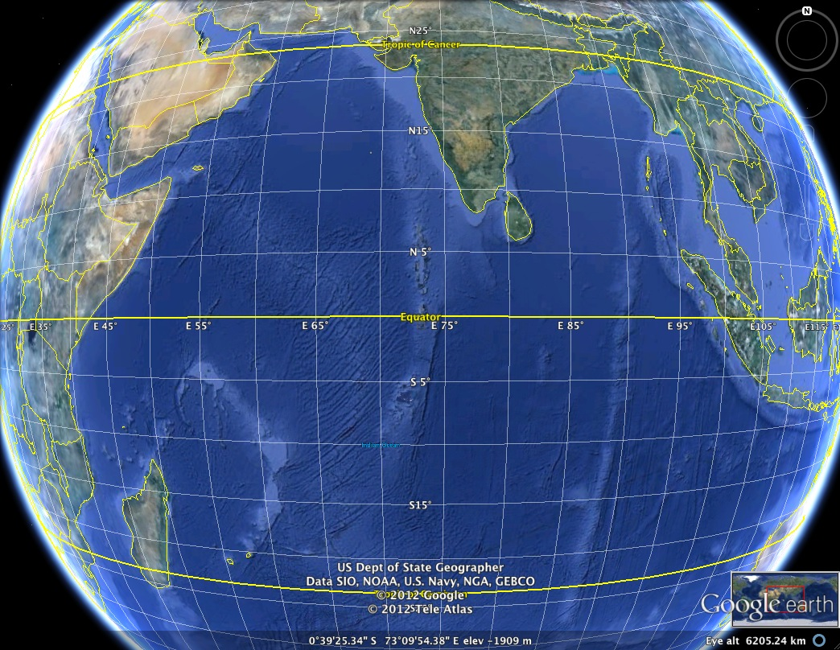

Slide 4
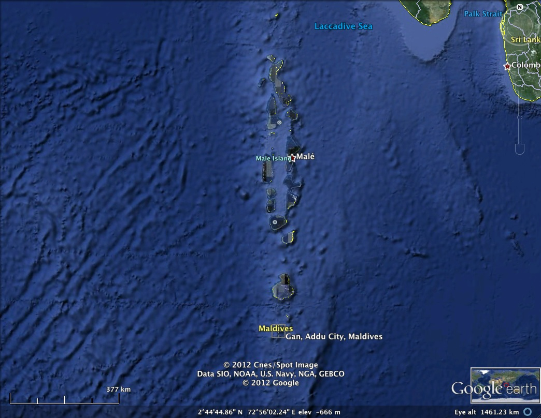
7N
Equator

Slide 5
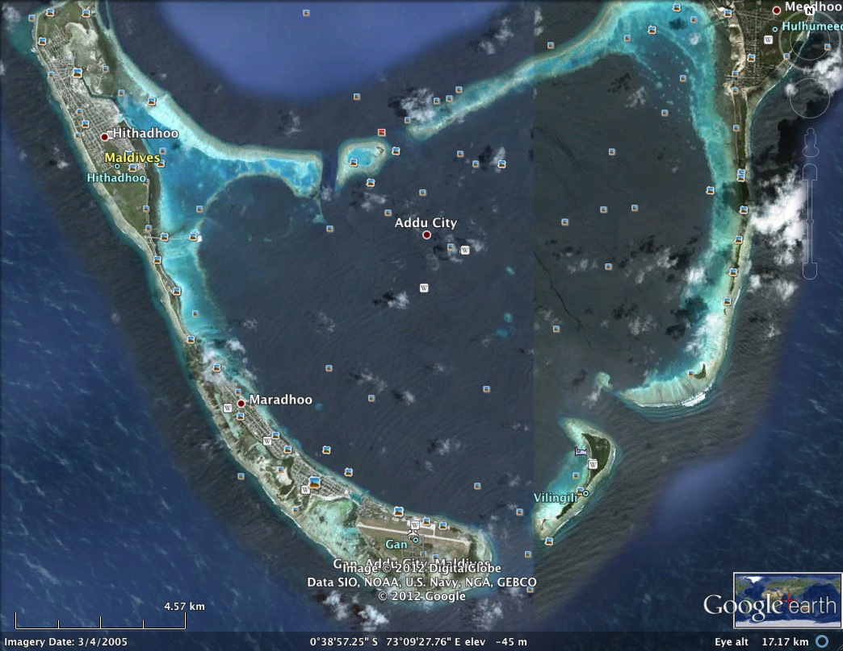

Slide 6
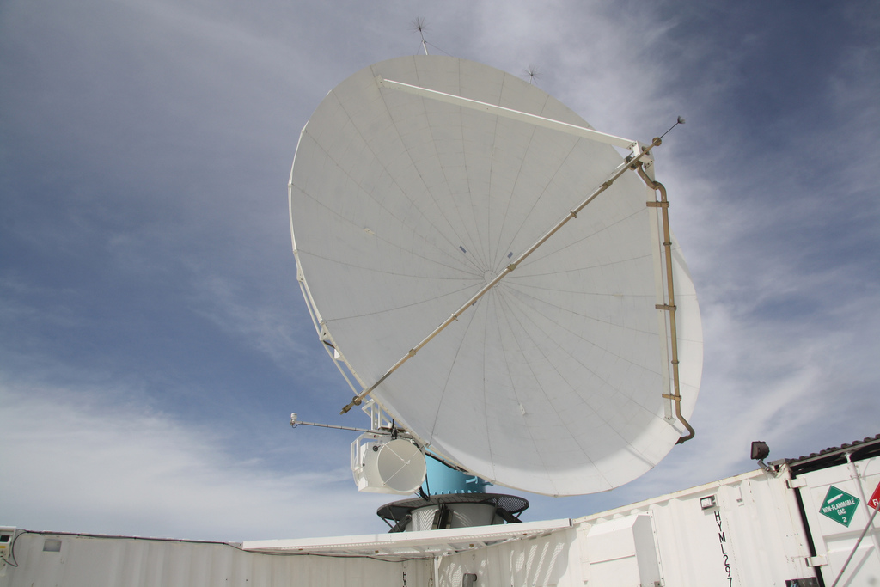
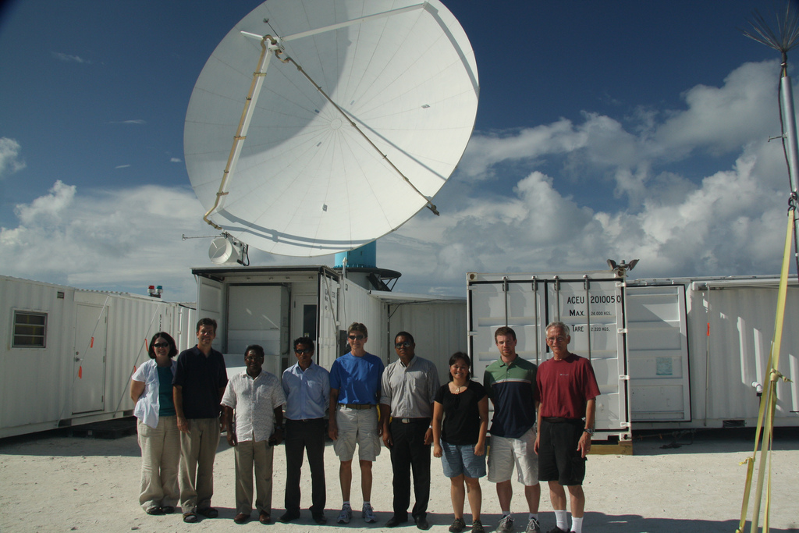
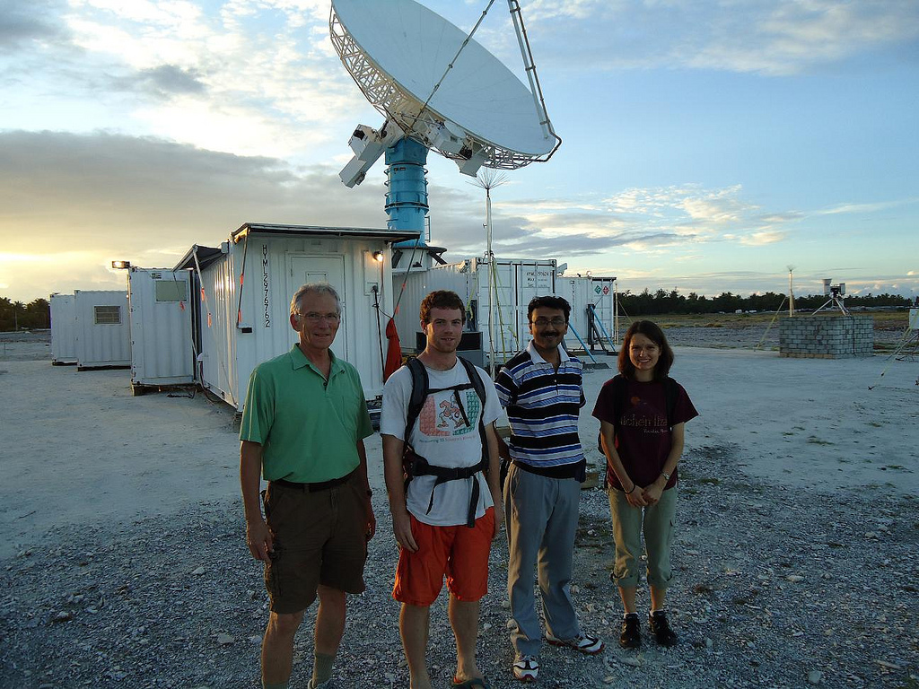
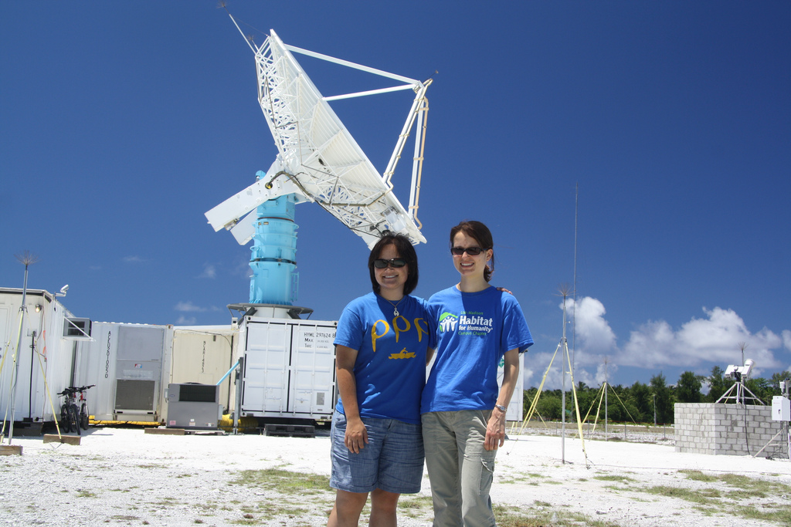
NCAR S-PolKa
Radar
S
Ka

Slide 7
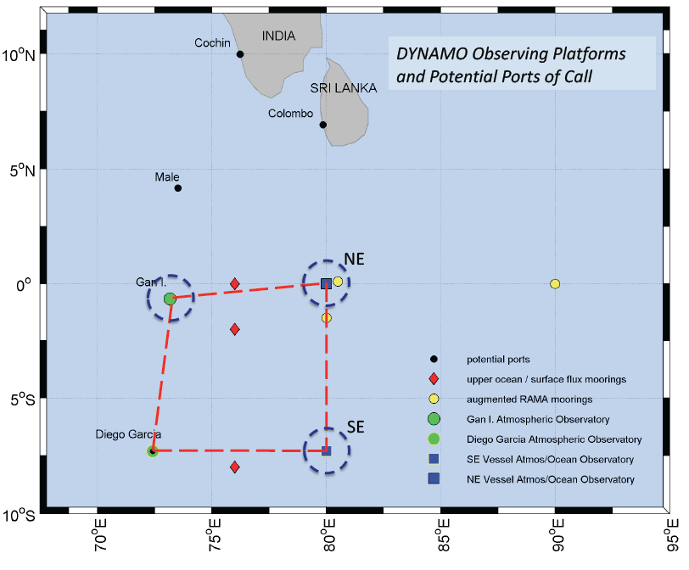

Slide 8
Satellite
Project Data Flow
Global models
Soundings
Other island radars
Ship data
NCAR field catalog
Aircraft data
Ship radars
LIghtning
NCAR
radar
processor
S-PolKa
radar
UW server
UW workstations
Daily Science
Summaries

Slide 9
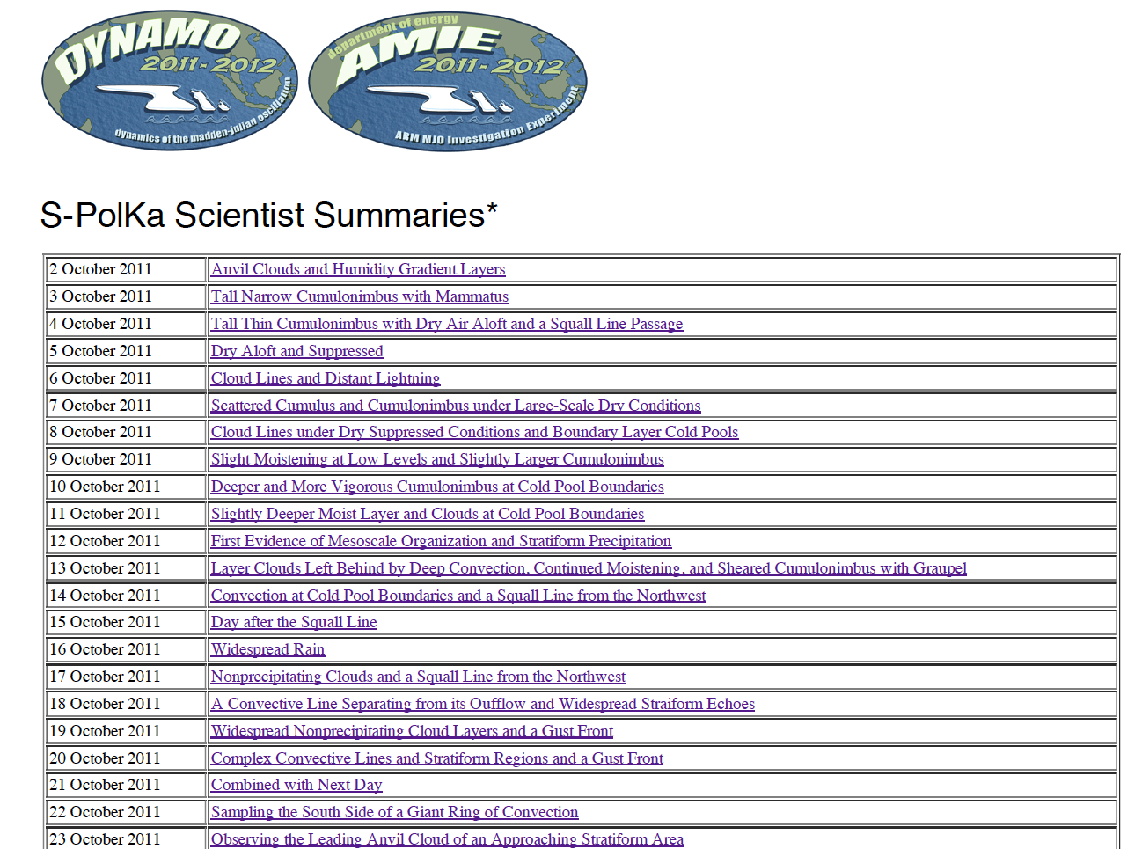

Slide 10
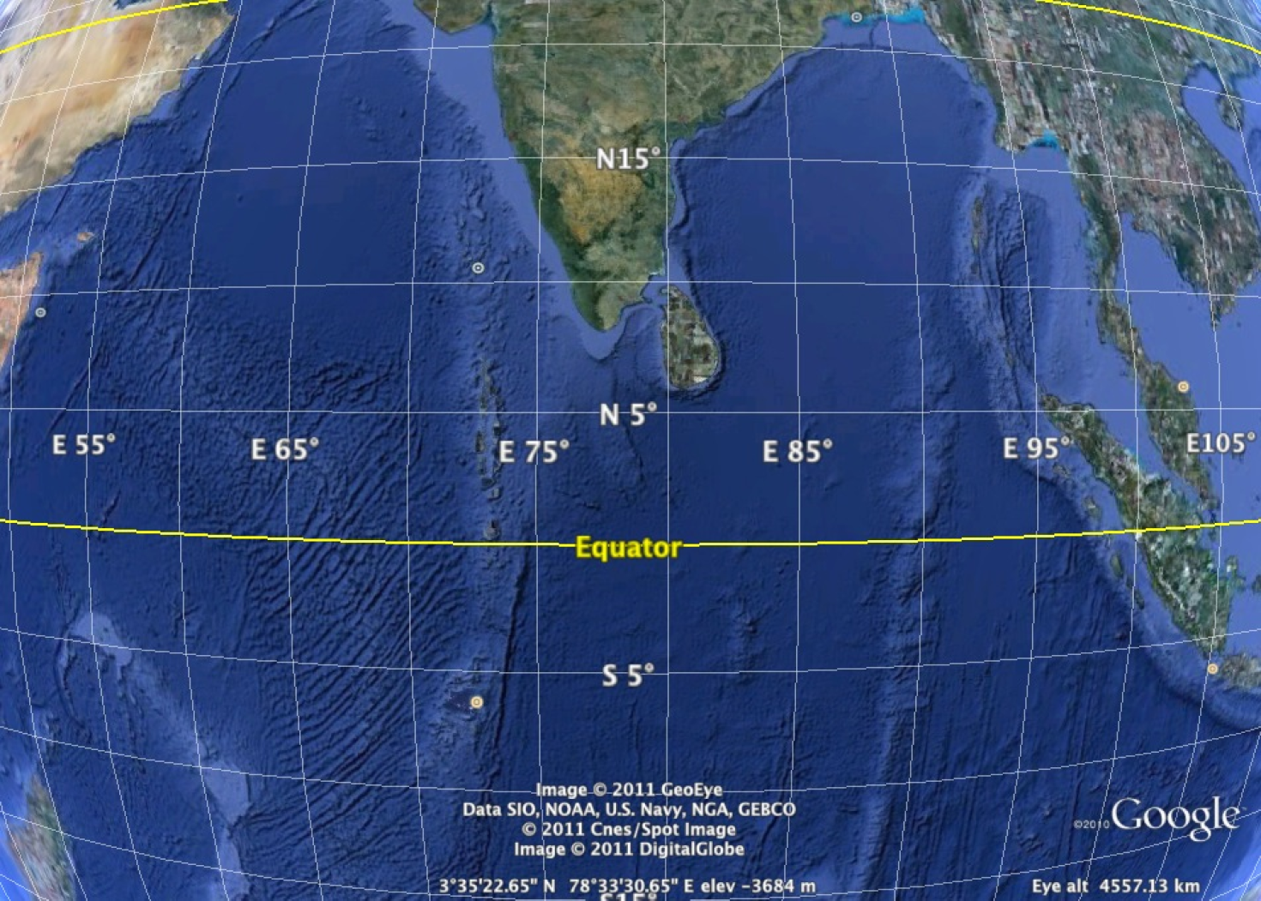
Radar experiment goal
→ Characteristics and evolution of the MJO cloud population in the region where the disturbance builds up
Addu Atoll

Slide 11
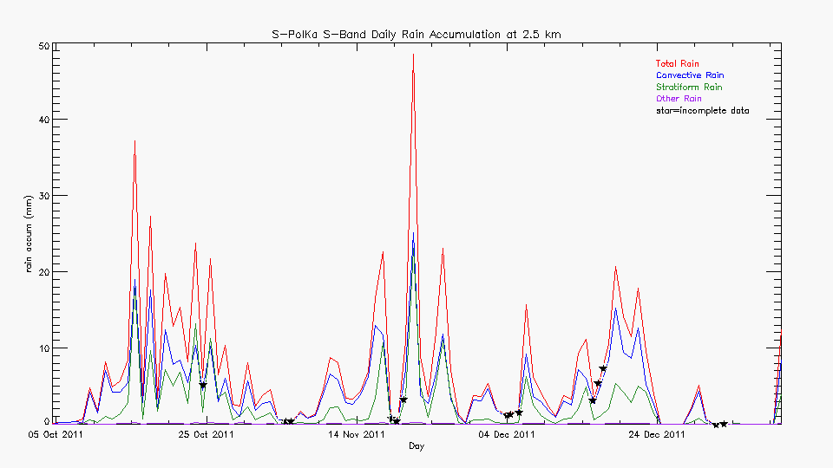
Rain over area scanned by S-PolKa
Supp.
Active
Supp.
Active
Lull
Active
Supp.

Slide 12
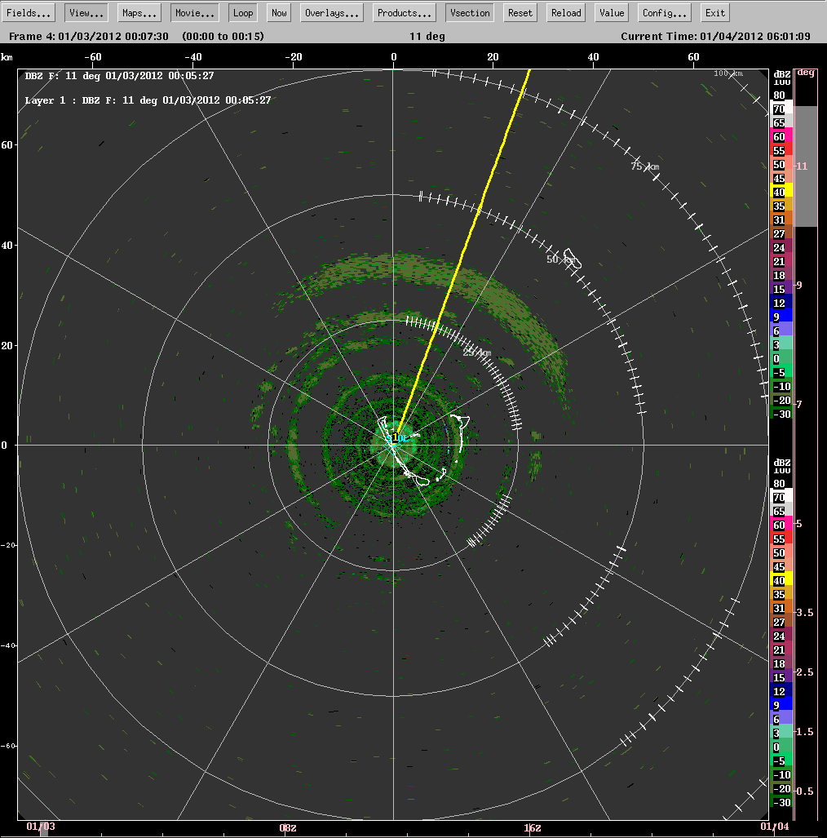
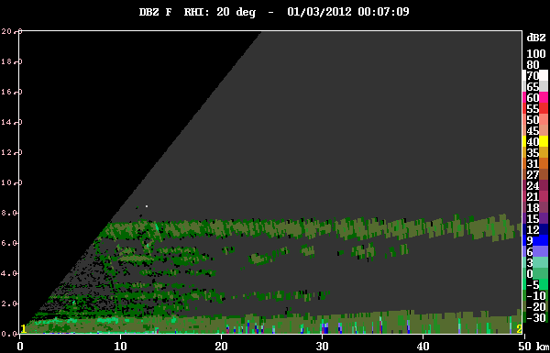
Suppressed condition
echoes

Slide 13
Supp.
Active
Supp.
Active
Lull
Active
Supp.

Slide 14
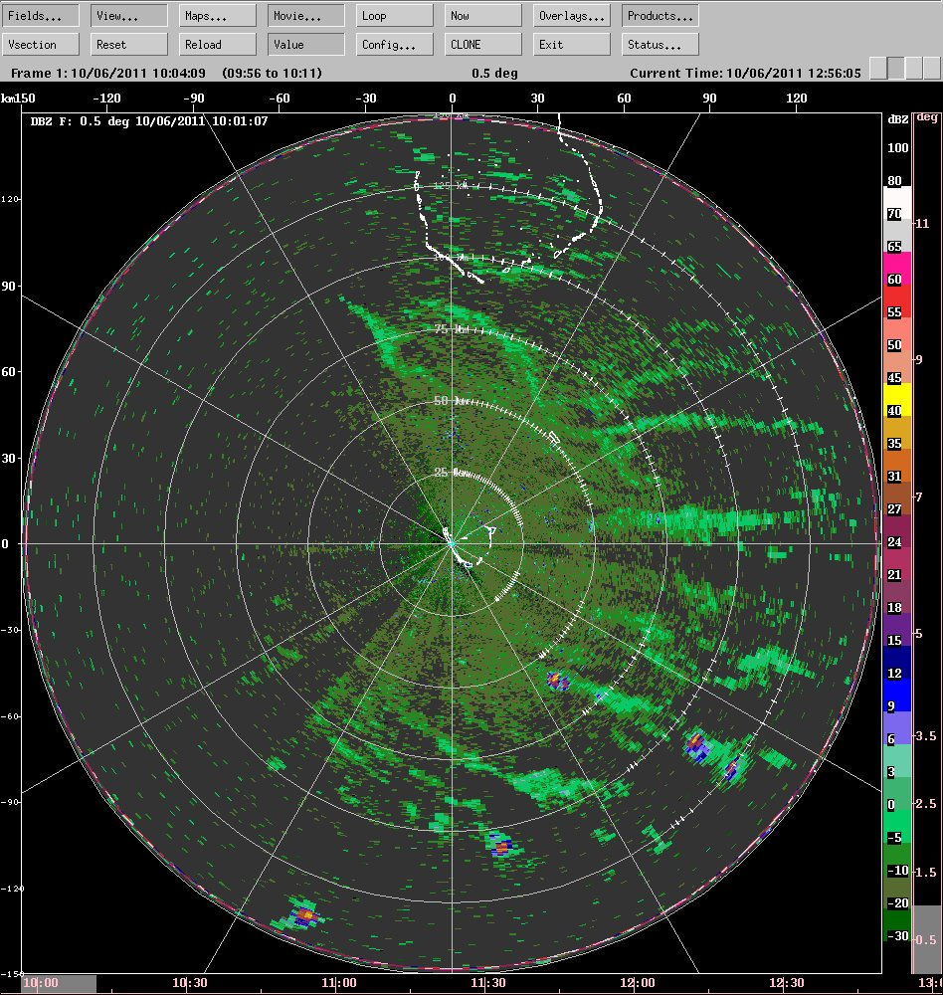
Suppressed phases:
Lines of non-precipitating clouds

Slide 15
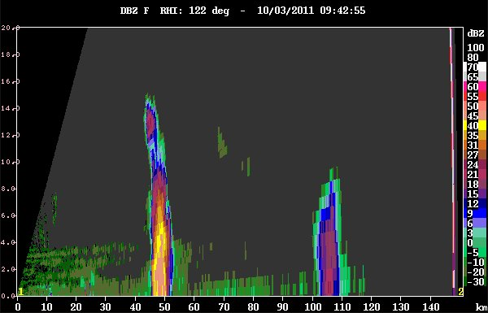
Suppressed phases: The “worm echo”

Slide 16
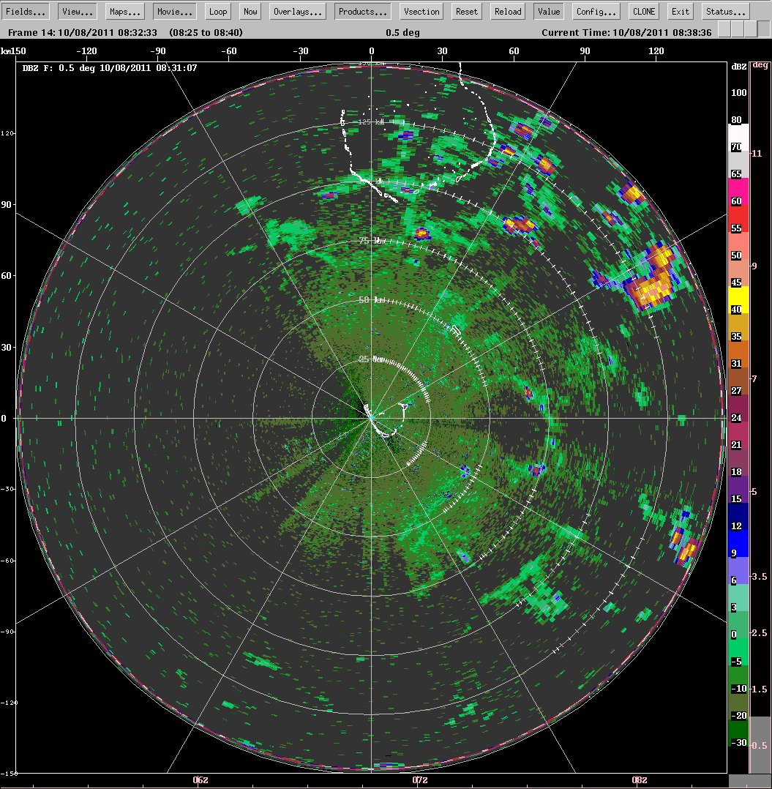
Slightly active moist layer
Clouds building at cold pool boundaries

Slide 17
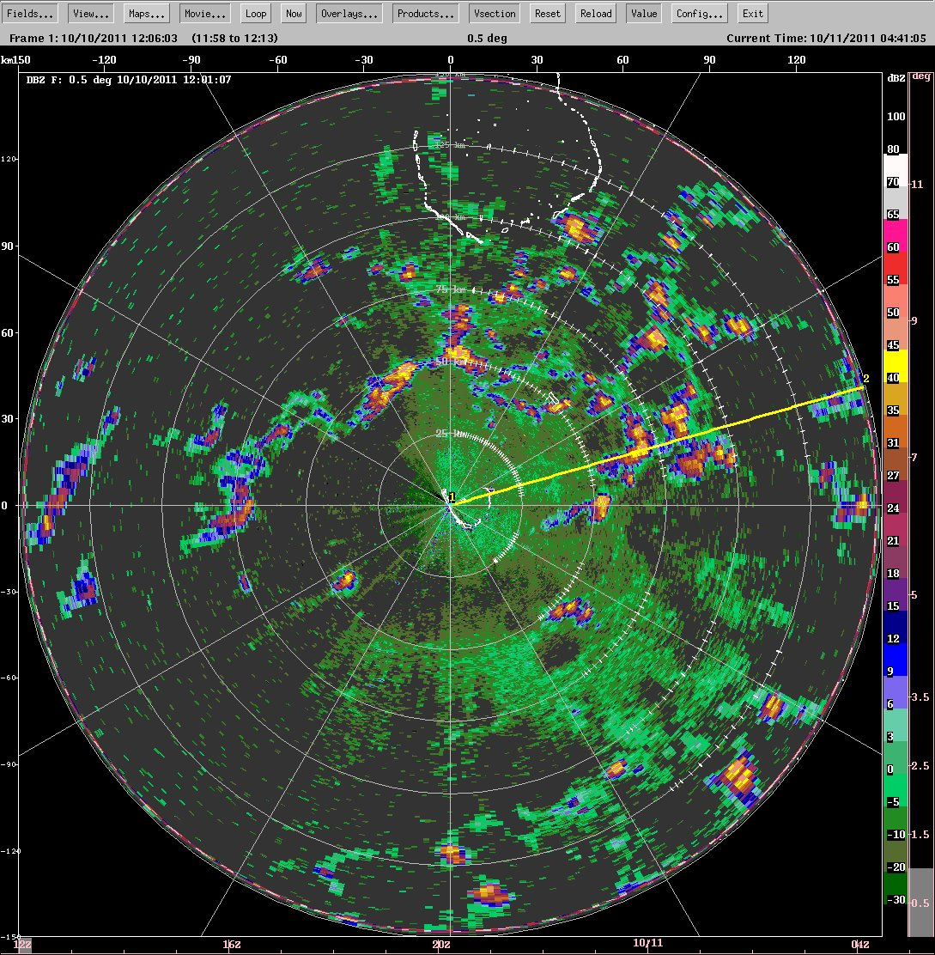
Slightly active moist layer
Clouds building at cold pool boundaries

Slide 18
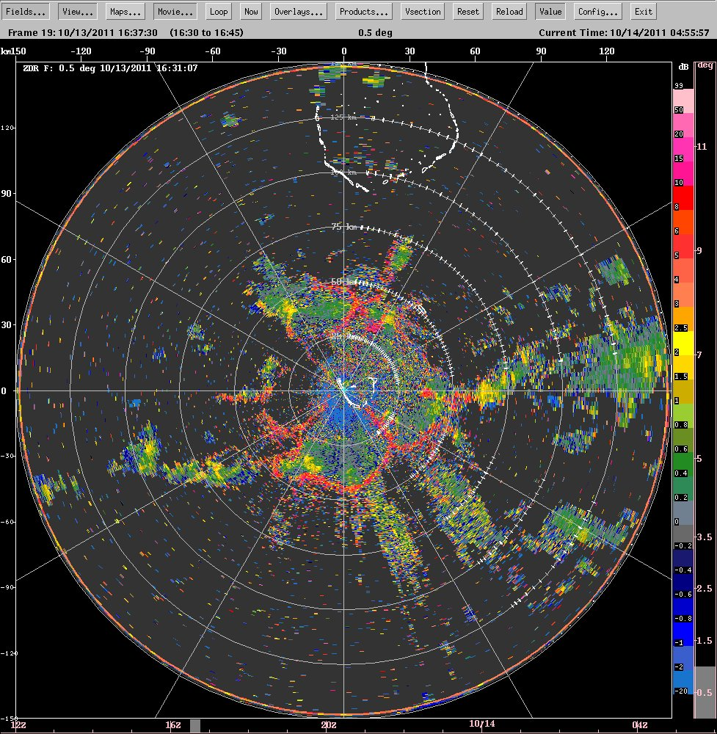
Cold pool boundaries seen in differential reflectivity (ZDR)
Birds?
Dragonflies?
???

Slide 19
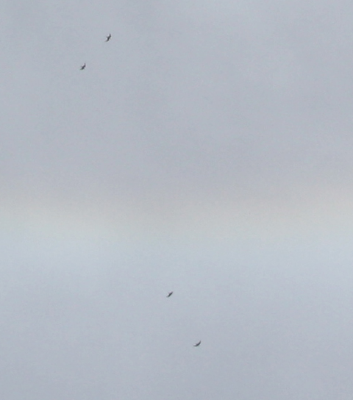
Birds caught on camera

Slide 20
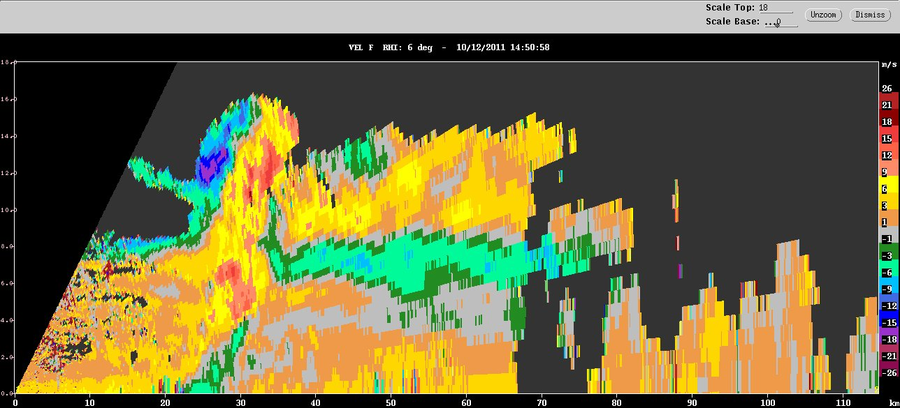
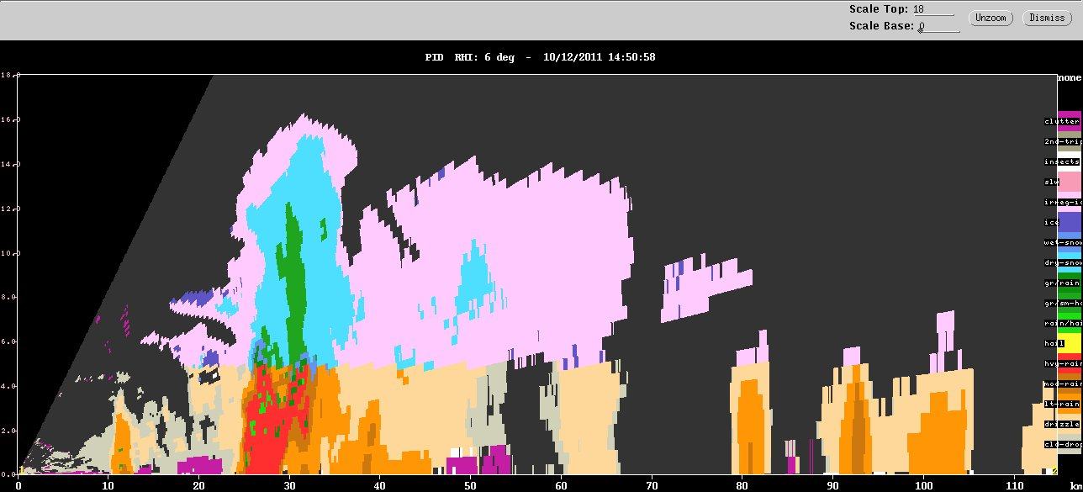
Moderate cumulonimbus begin to grow upscale
Doppler velocity
small ice
large non-melting ice
Hydrometeor type
graupel
melting
ice
heavy
rain

Slide 21
Supp.
Active
Supp.
Active
Lull
Active
Supp.

Slide 22
October 16

Slide 23
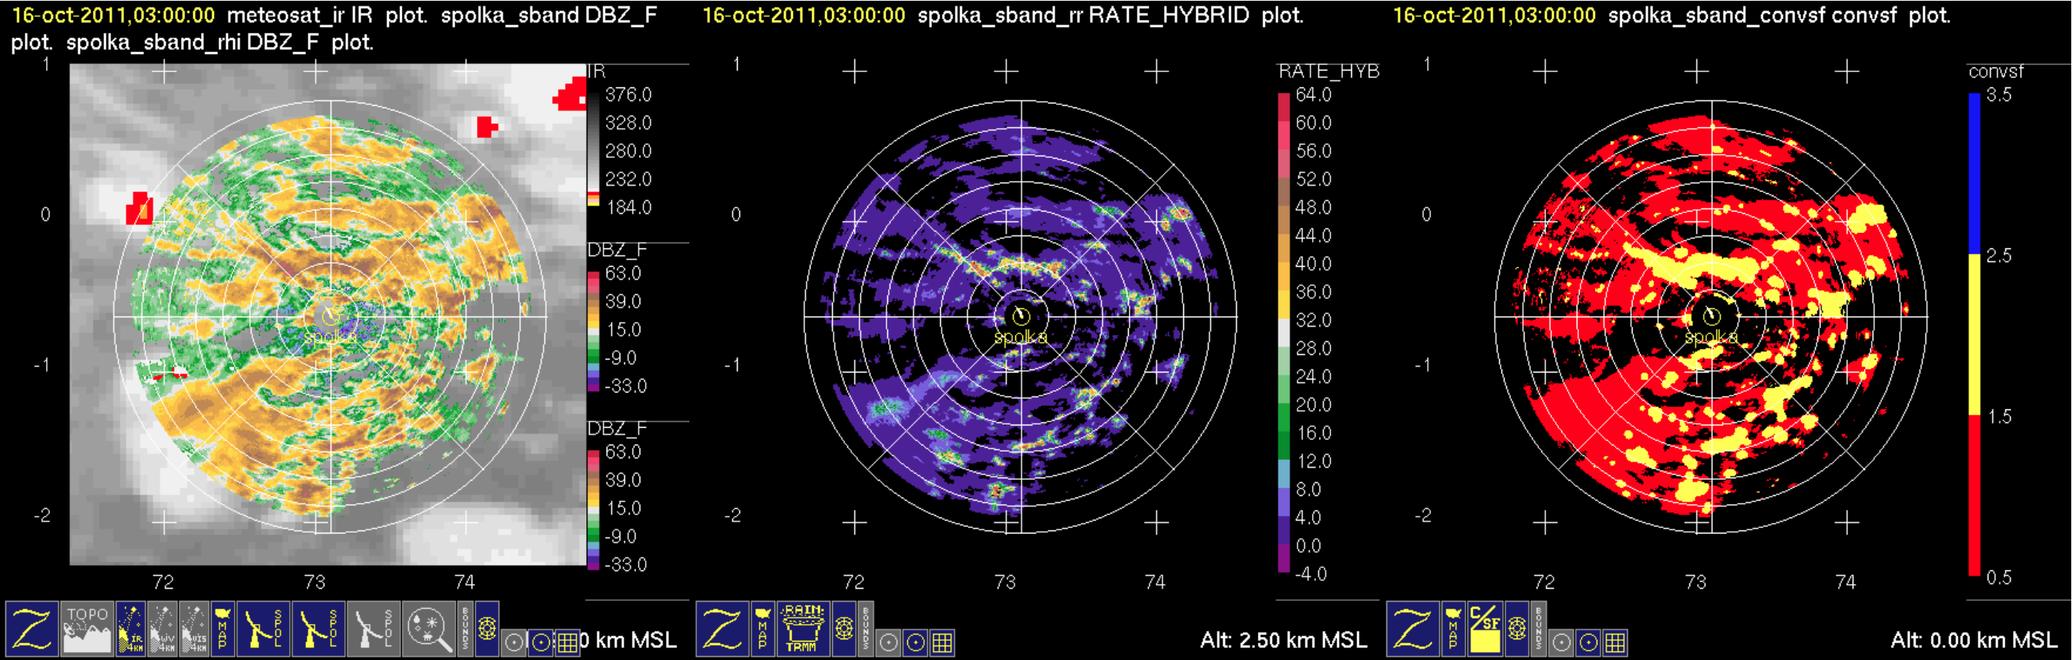
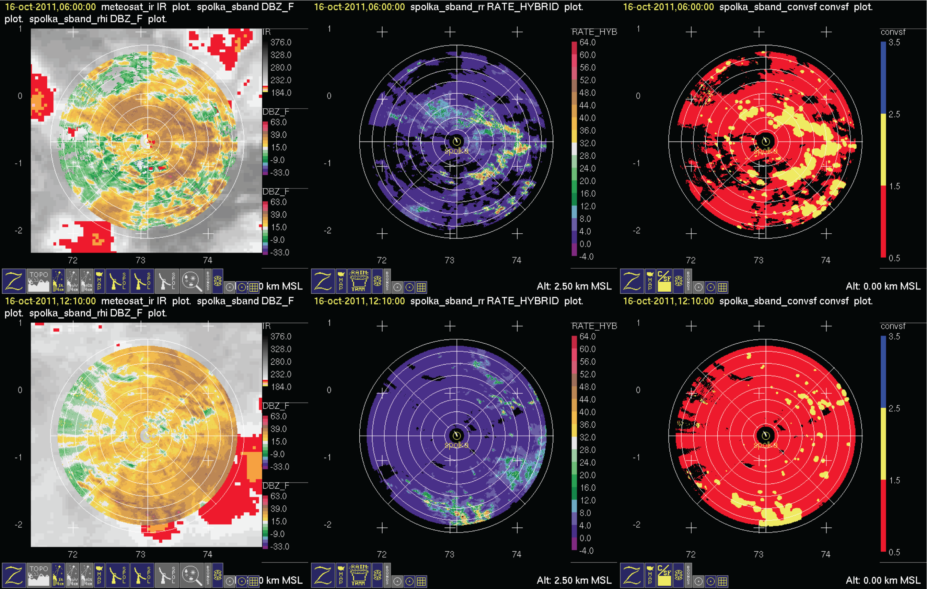
Conv.
Refl.
Rain
Strat.
October 16

Slide 24
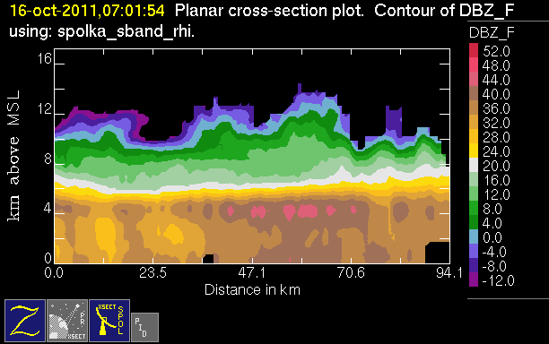
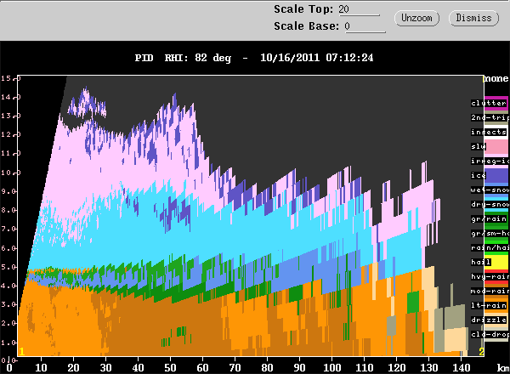
Intense melting layer
50 dBZ!
graupel
10 km
melting snow
5 km

Slide 25
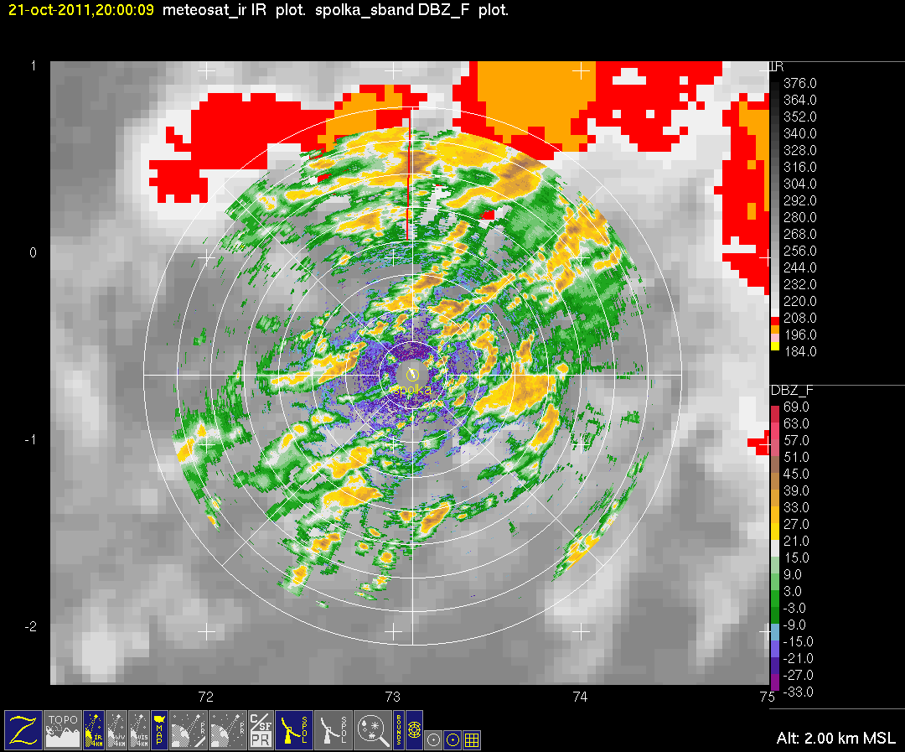
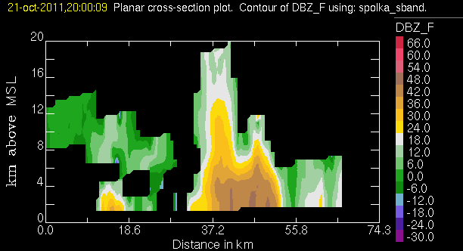
Active phase few days later
Convection feeding into a large MCS

Slide 26
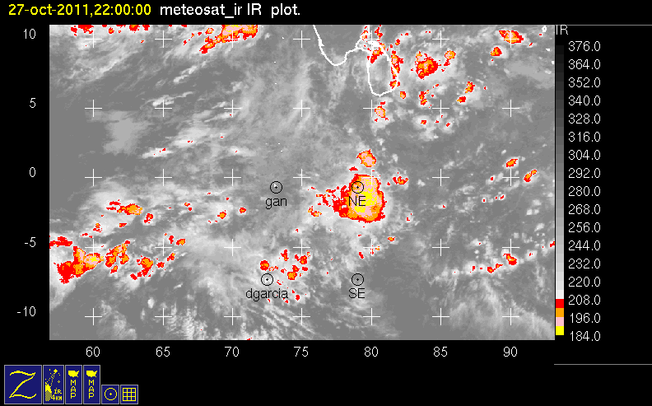
Biggest MCS of first active phase:
weak unidirectional shear

Slide 27
Supp.
Active
Supp.
Active
Lull
Active
Supp.

Slide 28
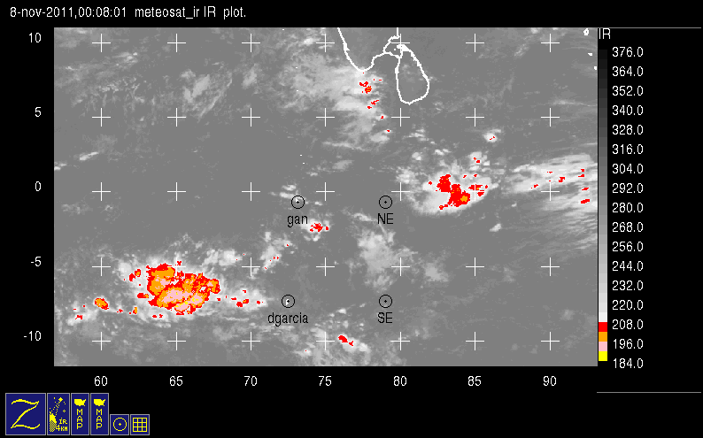
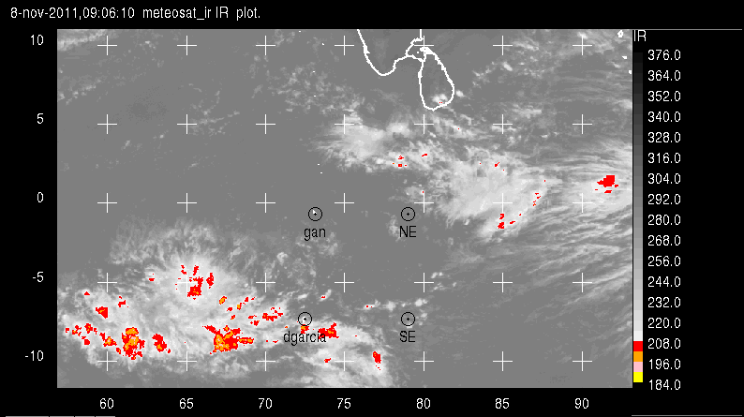
Giant Rings of Convection
Larger than mesoscale organization of deep convection

Slide 29
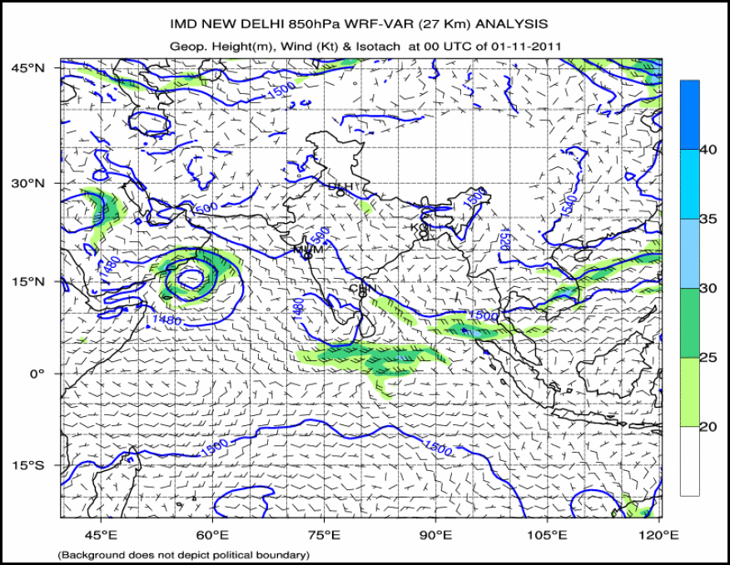

Slide 30
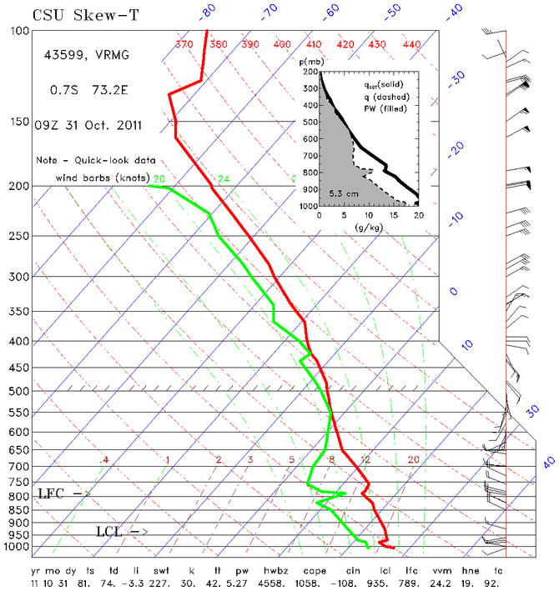

Slide 31
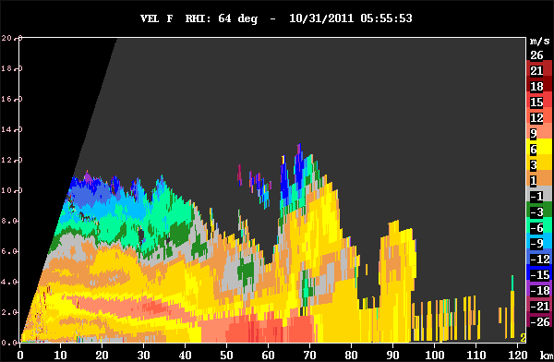
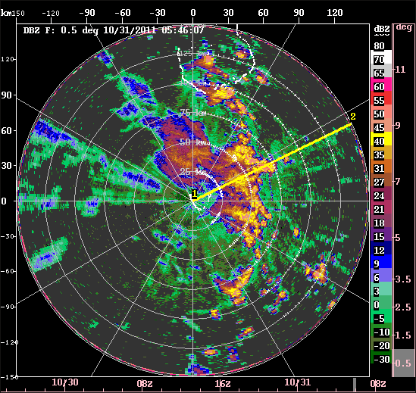
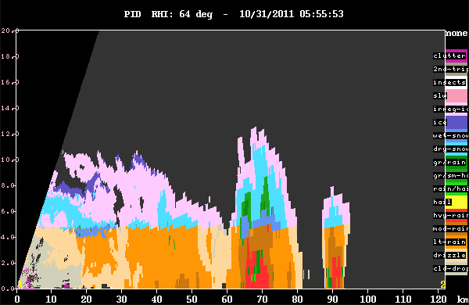
Squall line in late active phase westerlies
Doppler velocity
Hydrometeor type

Slide 32
Supp.
Active
Supp.
Active
Lull
Active
Supp.

Slide 33
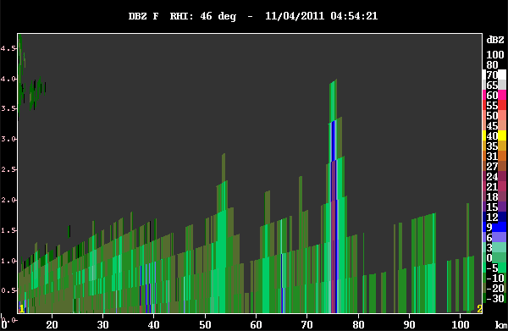
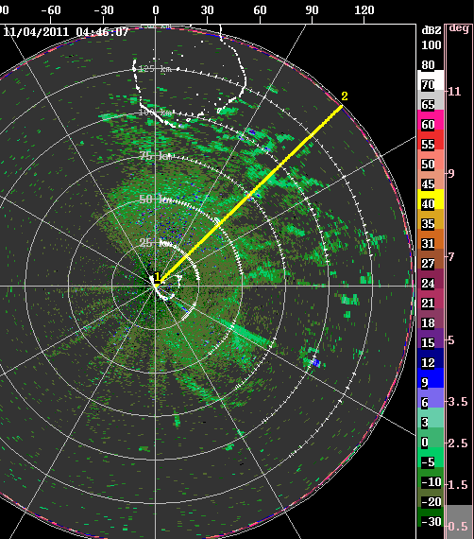

Suppressed condition clouds

Slide 34
Supp.
Active
Supp.
Active
Lull
Active
Supp.

Slide 35
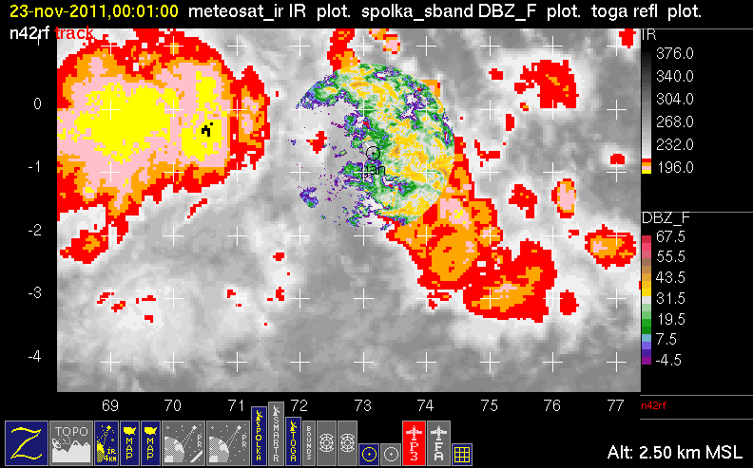

Slide 36
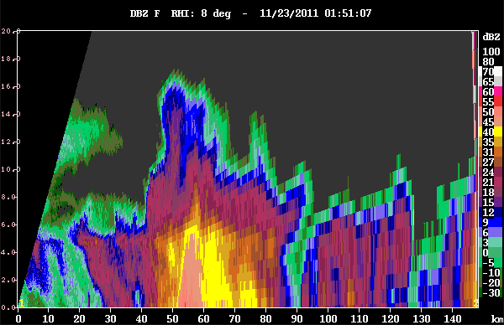
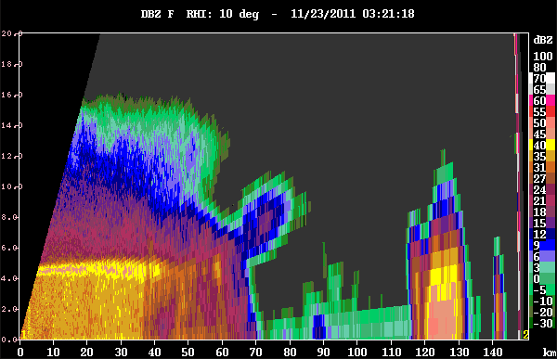
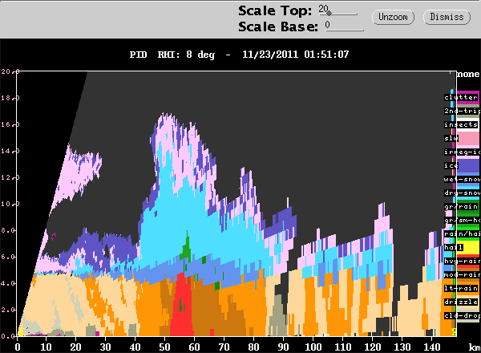
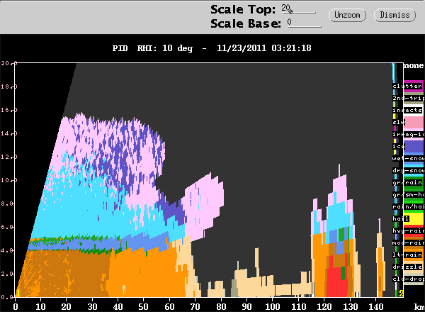

Slide 37
Supp.
Active
Supp.
Active
Lull
Active
Supp.

Slide 38
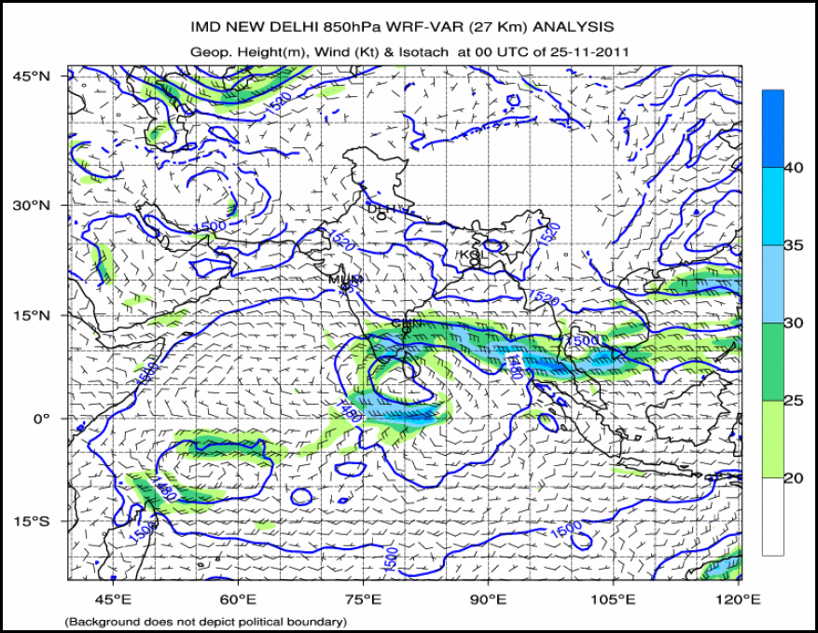

Slide 39
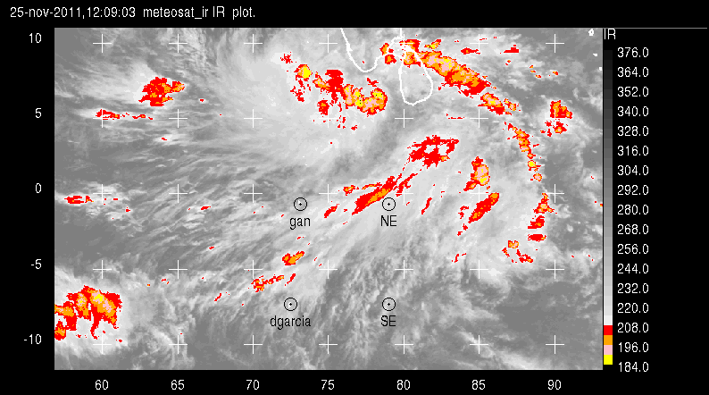
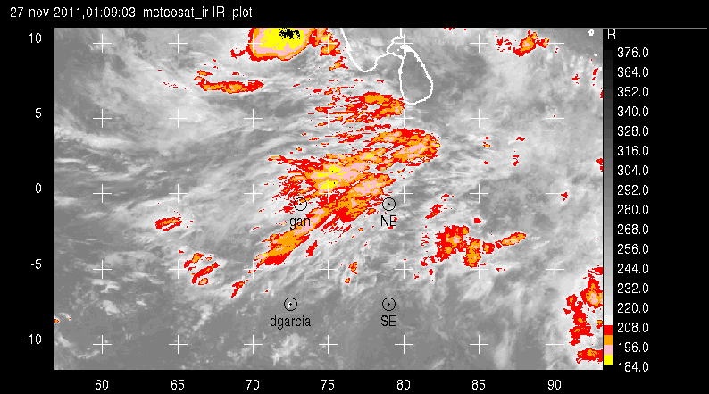
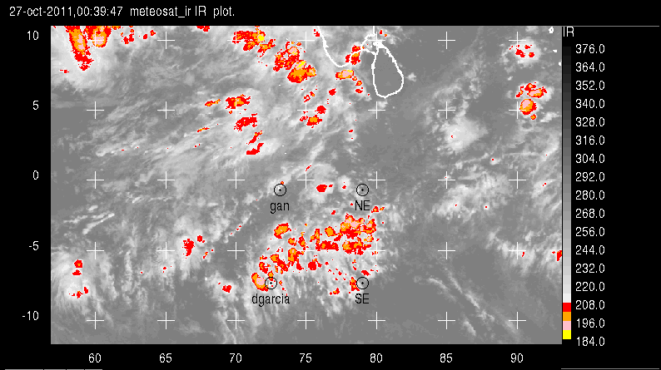
Westerly Surges
November
Larger than mesoscale organization of deep convection
October

Slide 40
Supp.
Active
Supp.
Active
Lull
Active
Supp.

Slide 41
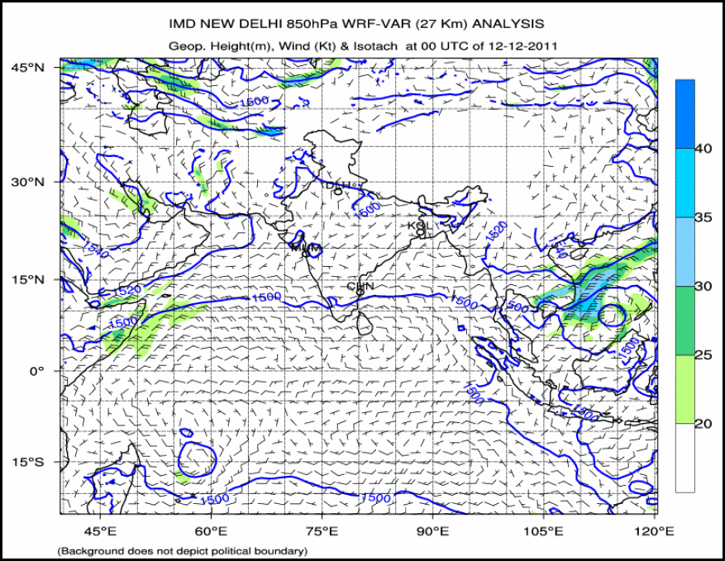

Slide 42
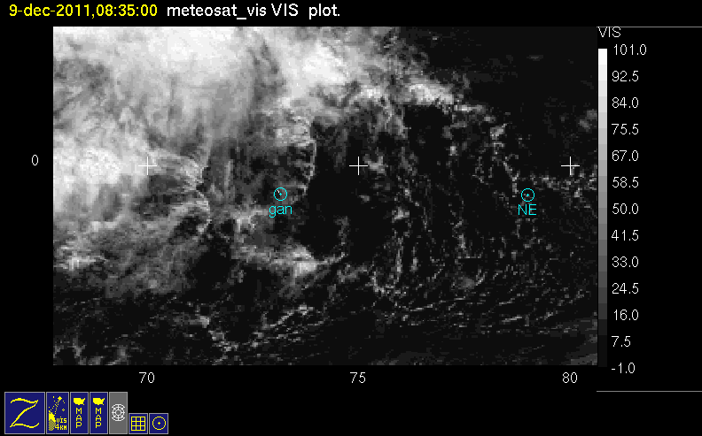
Long arc line
Notes:
Westerlies moist up to 500 mb, dry aboe

Slide 43

Long arc line
segment on radar

Slide 44

Squall line
in the strong westerlies

Slide 45


Weak stratiform in the strong westerlies

Slide 46

S-PolKa S-band Stratiform Rain Fraction
Stratiform Rain Fraction

Slide 47
Supp.
Active
Supp.
Active
Lull
Active
Supp.

Slide 48


Slide 49



The most robust squall line in the strong westerlies…
…robust momentum transport
…only moderate stratiform

Slide 50
Supp.
Active
Supp.
Active
Lull
Active
Supp.

Slide 51


Slide 52


Slide 53
Summary of MJO cloud population characteristics & evolution seen by the S-PolKa radar
Humidity gradient layers monitored & measured
Cloud lines dominate in highly suppressed period
Cold pools are first stage of convective population
Graupel & other ice lofted & input into stratiform regions
Convection enhanced inside stratiform regions
MCS development strongest in weak shear
Shear inhibits stratiform region formation
Westerlies organize convection on larger than mesoscale
Squall lines form in westerlies at back of active zone
Squall lines transport momemtum downward

Slide 54
End
This research is supported by NSF grant ATM AGS-1059611, DOE grant DE-SC0001164/ER-64752, and NASA grants NNX10AM28G and NNX10AH70G

