Slide 1
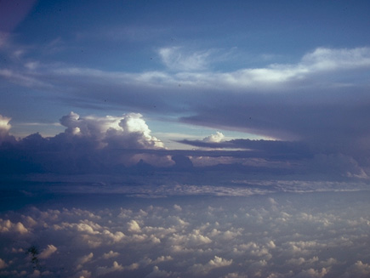
Nonprecipitating Phenomena Seen by the S-PolKa Radar
In AMIE
R. Houze
University of Washington
ARM Science Team Meeting, Washington DC, 14 March 2012

Slide 2
Summary
Non-precipitation features seen by S-PolKa in AMIE
Humidity
Cumulus organization
Cirrostratus & altocumulus layers
Anvils of deep convection

Slide 3
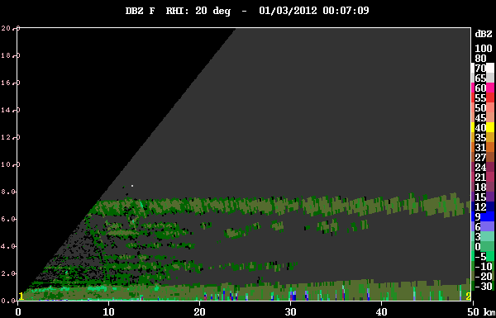
Humidity gradient layers and nonprecipitating clouds

Slide 4
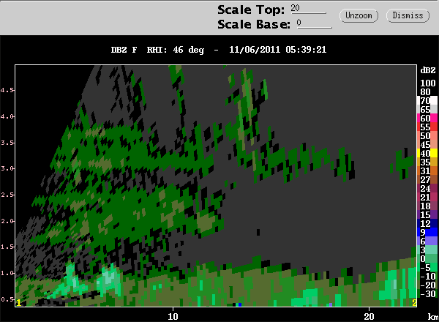
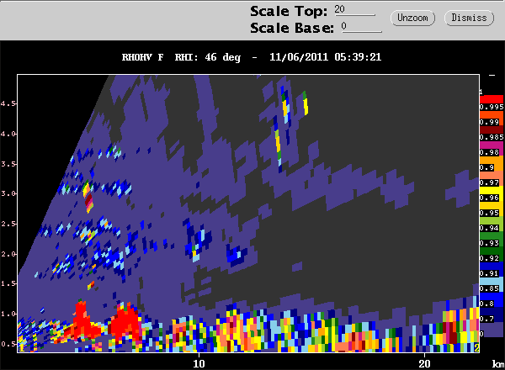

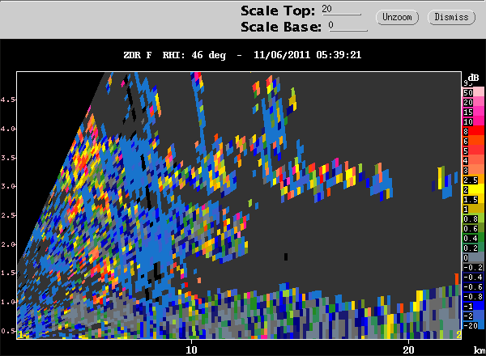

dBZ
“Mantle Echoes” Knight and Miller (1998)
Bragg scattering shows nonprecipitating cumulus in the moist layer
ρhv
ZDR

Slide 5
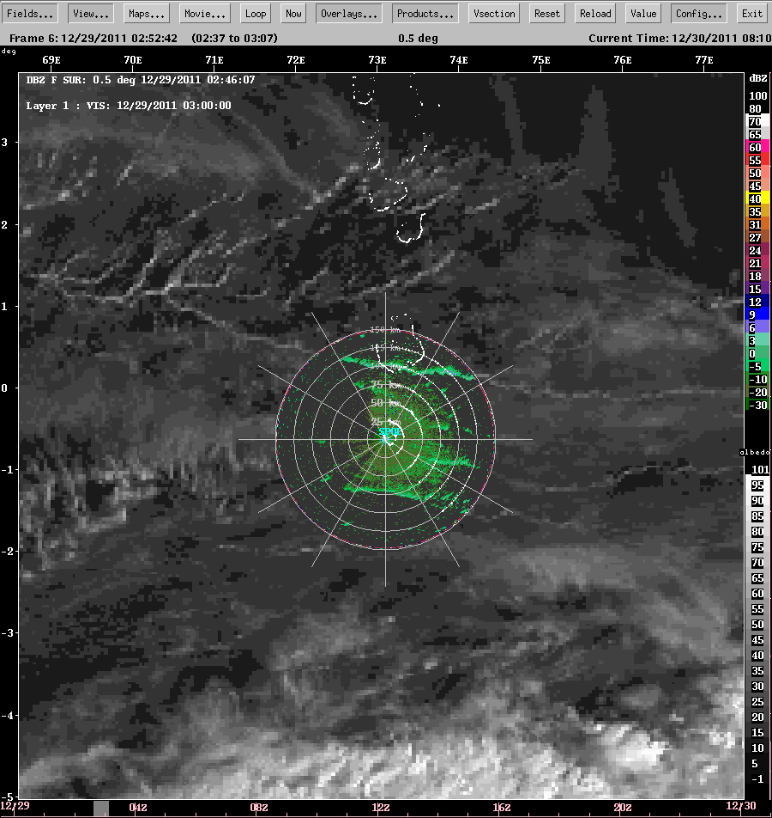
Long lines of cumulus

Slide 6
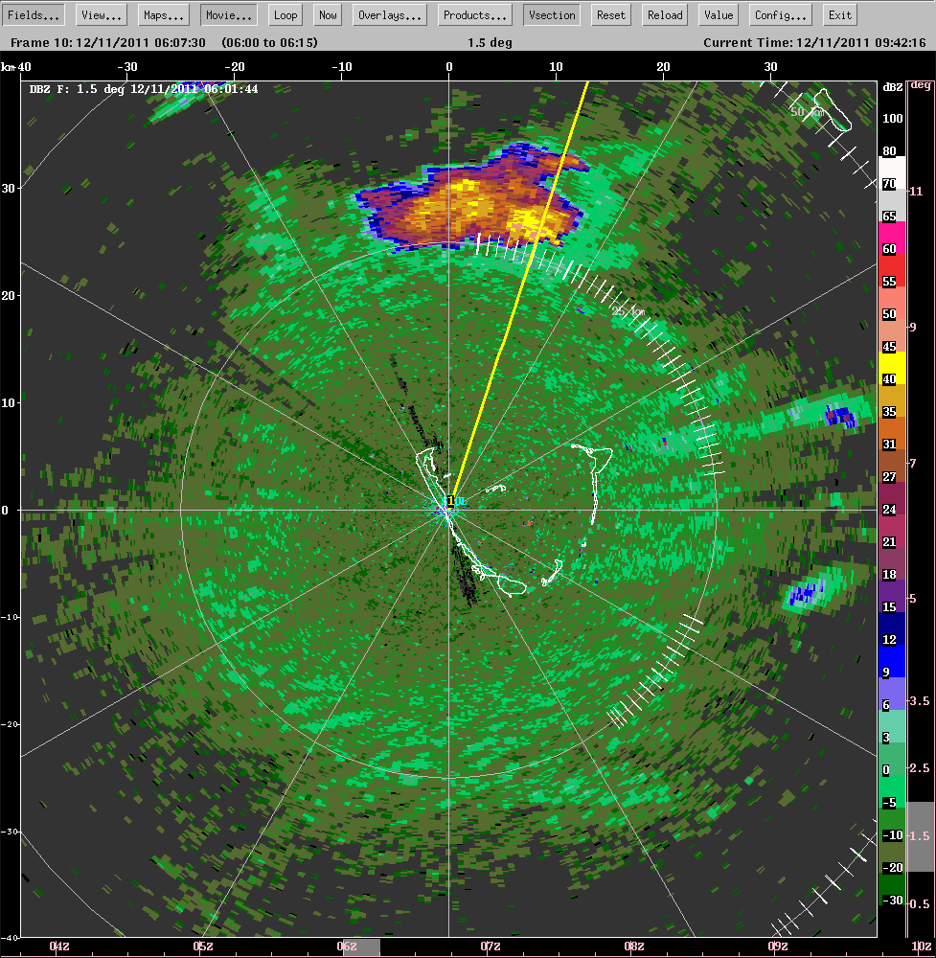
Lines of cumulus parallel to wind

Slide 7
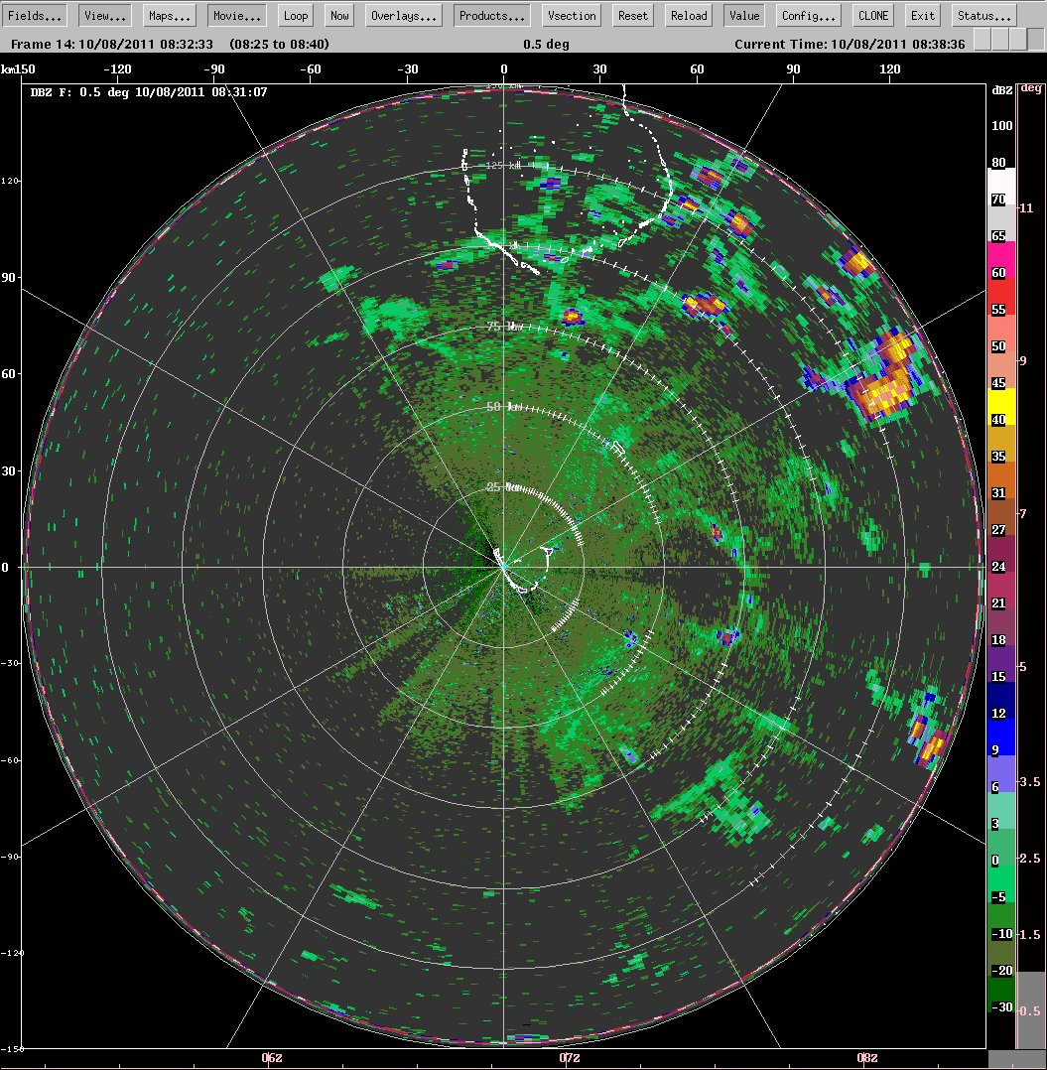
Slightly active moist layer
Clouds building at cold pool boundaries

Slide 8
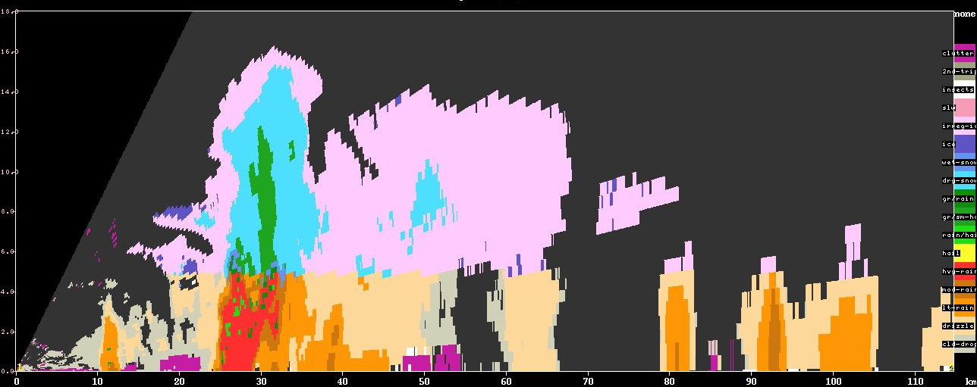
Hydrometeor identification
small ice
large non-melting ice
graupel
melting
ice
heavy
rain

Slide 9
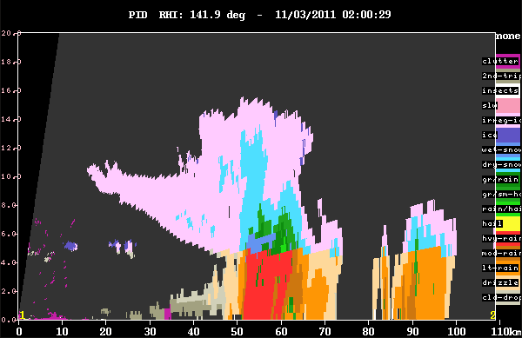
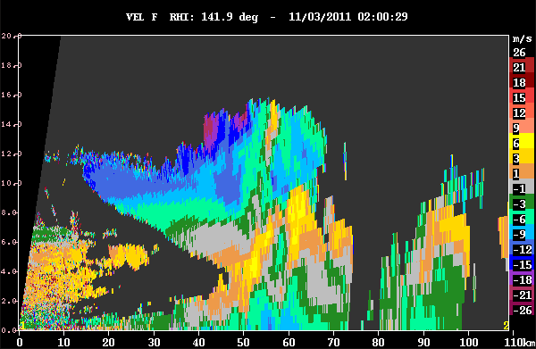
An anvil example
Hydrometeor type
Doppler velocity

Slide 10
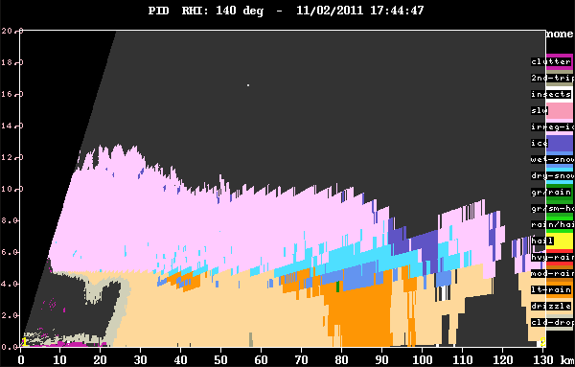
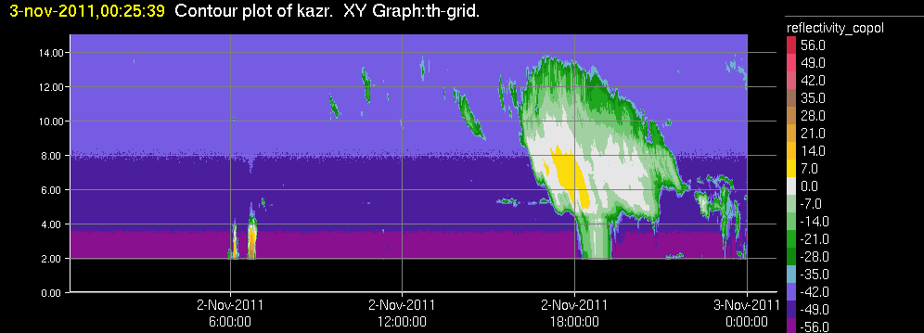
A stratiform region anvil seen by
both
S-PolKa and KAZR

Slide 11
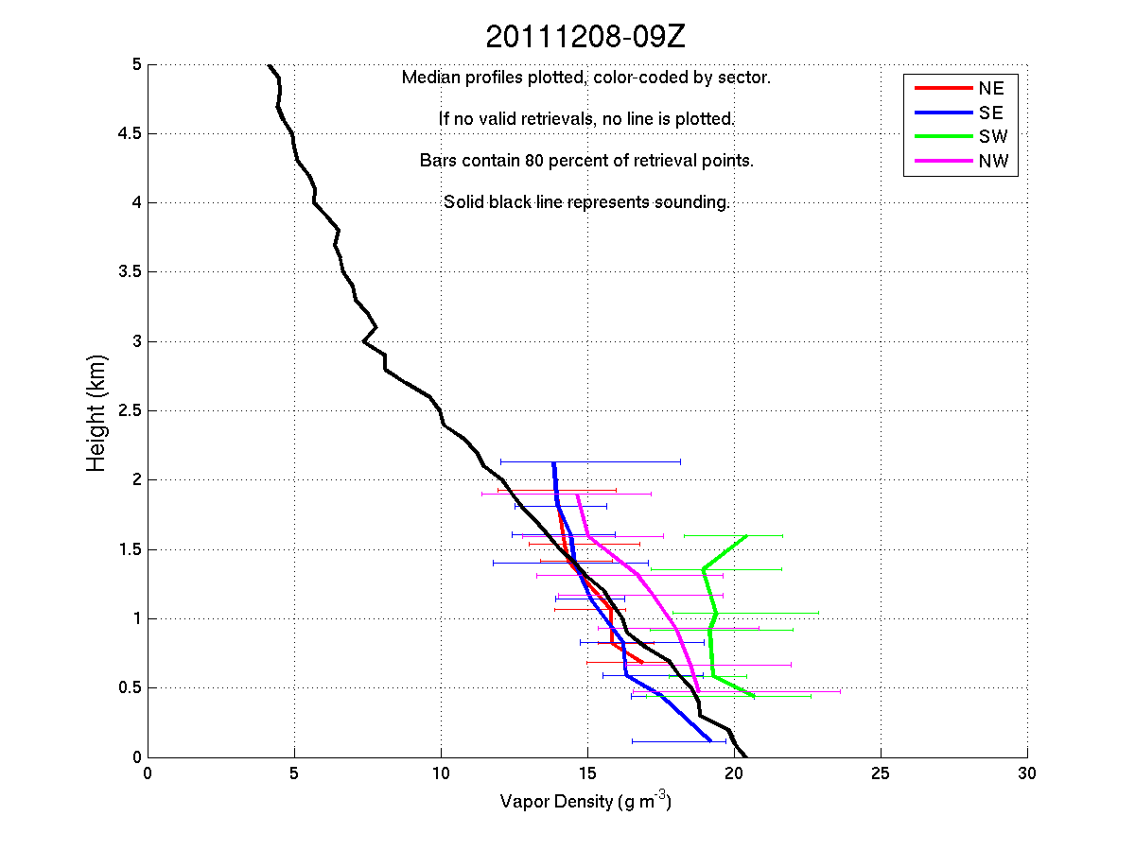
Dual-wavelength humidity profiles

Slide 12
End
This research was sponsored by DOE ARM grant #DE-SC0001164/ER-64752

Slide 13
Extras

Slide 14
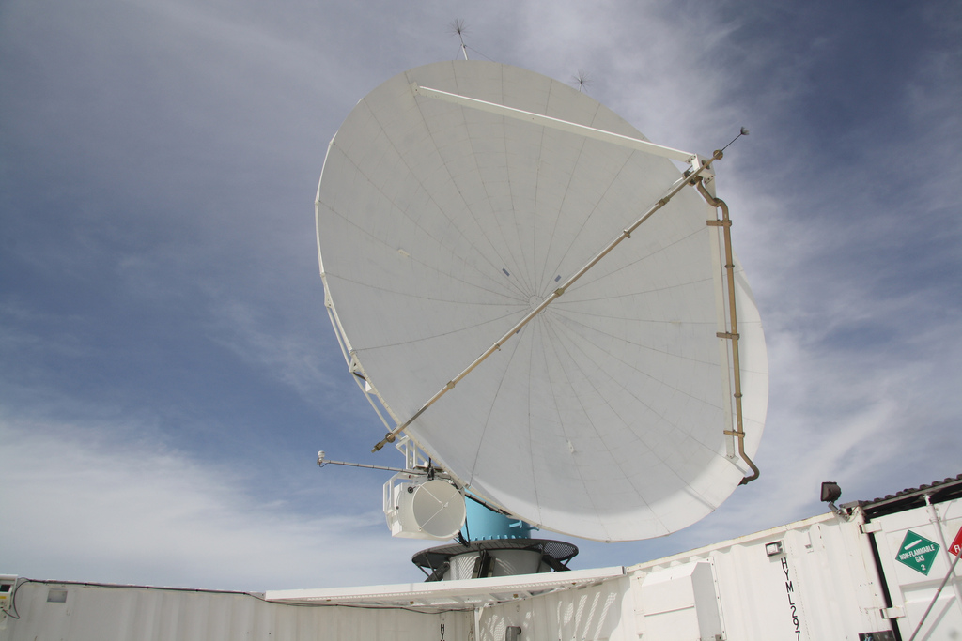
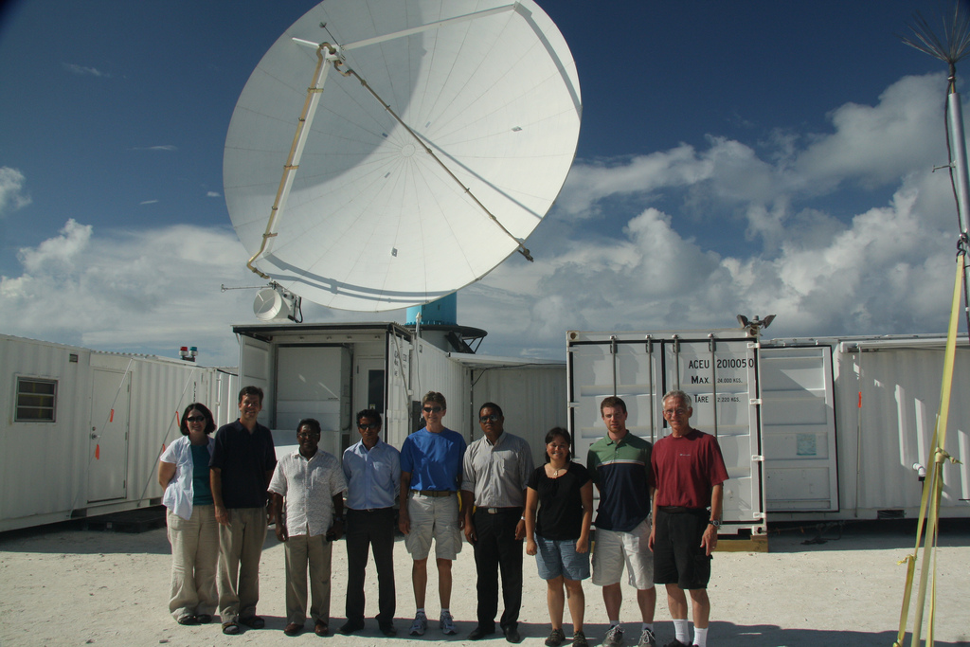
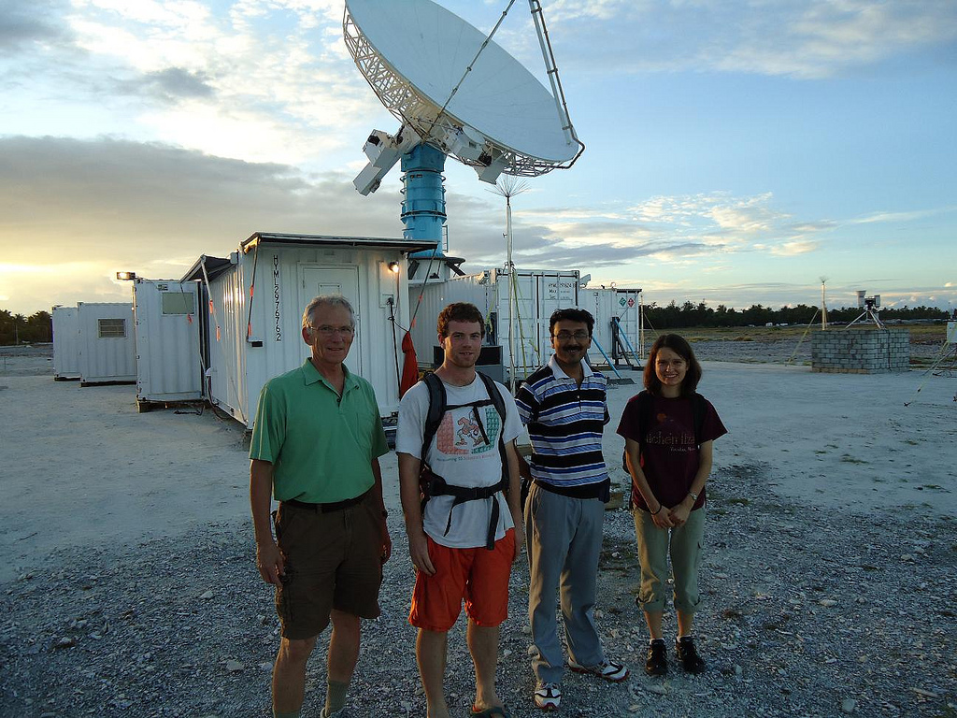
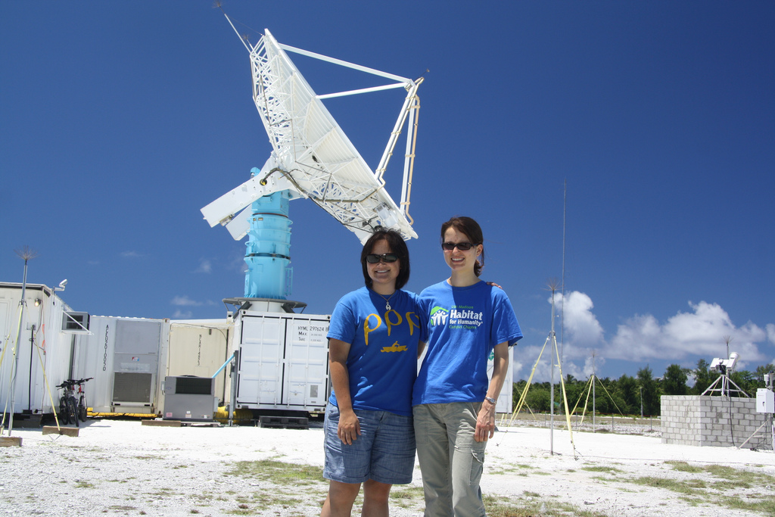
NCAR S-PolKa
Radar
S
Ka

Slide 15
Examples of Humidity Features and Nonprecipitating Clouds Seen by S-PolKa

Slide 16
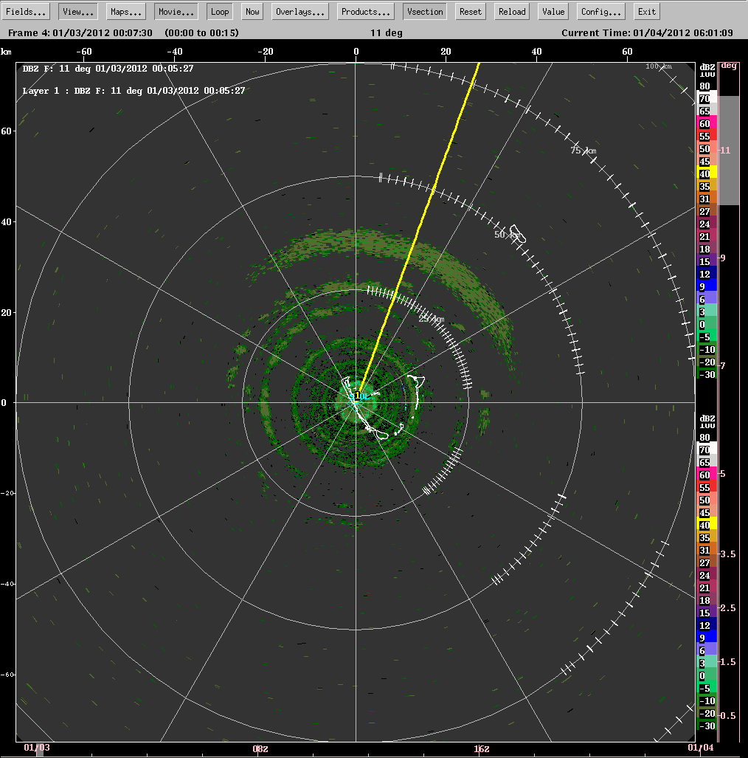
Humidity gradient rings and nonprecipitating clouds

Slide 17
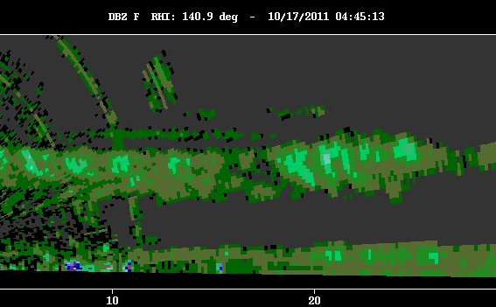
Nonprecipitating clouds and virga

Slide 18
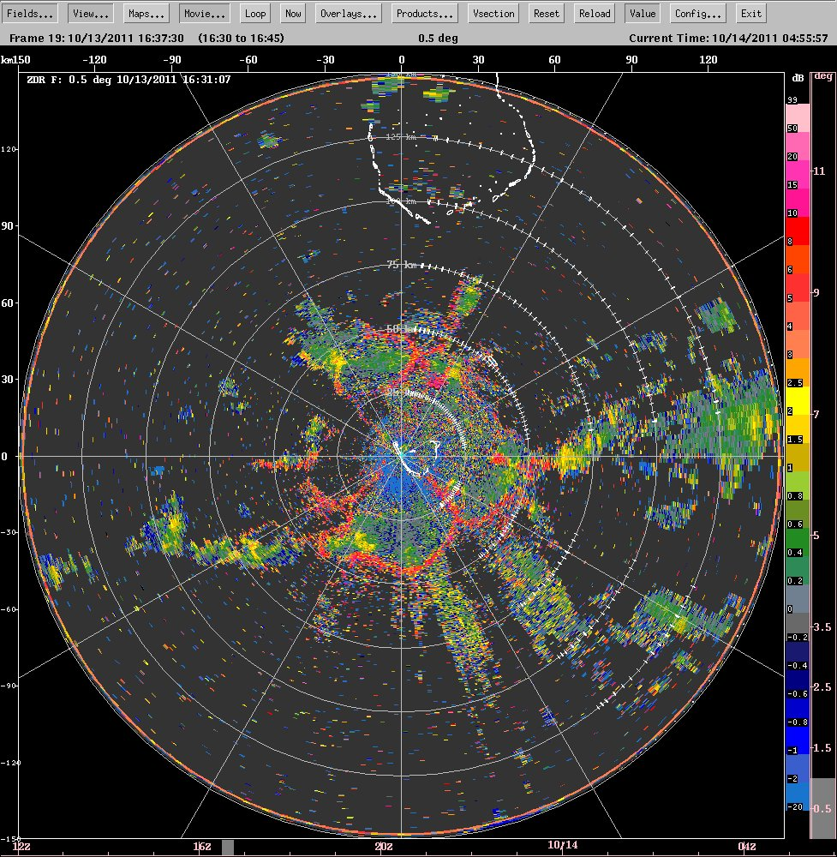
Cold pool examples seen in differential reflectivity (ZDR)

Slide 19
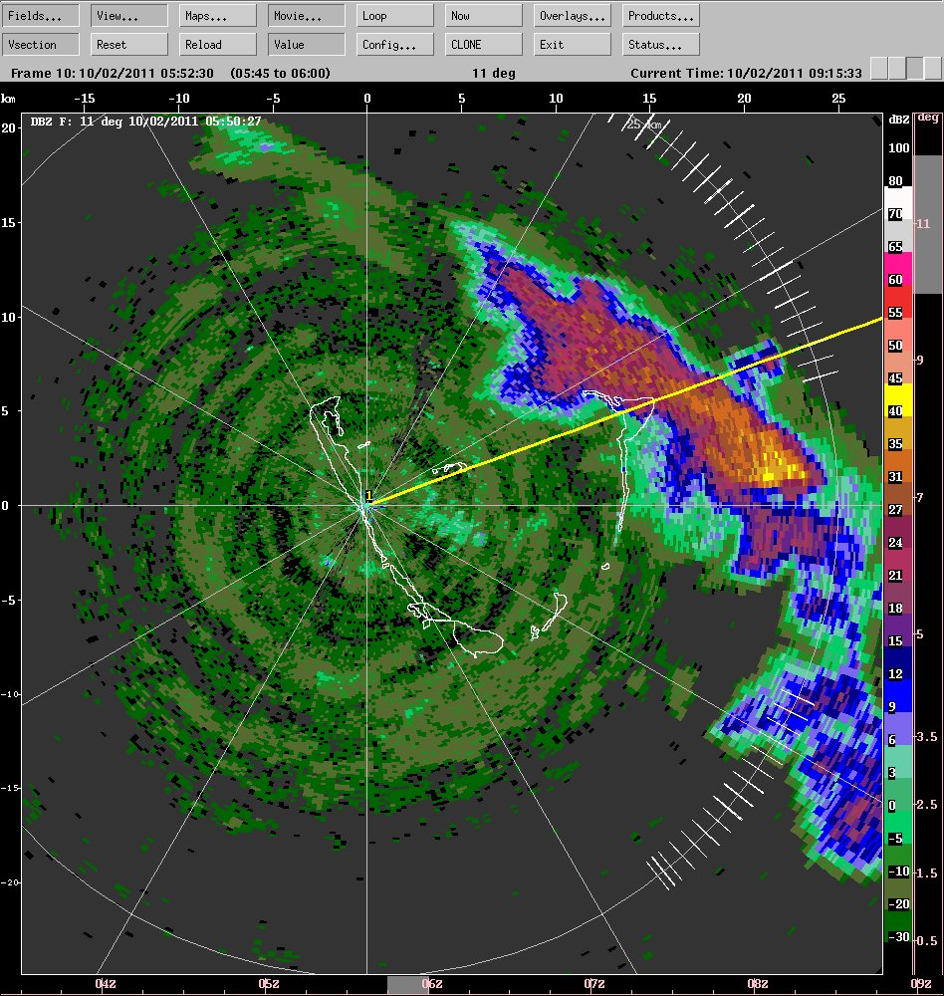
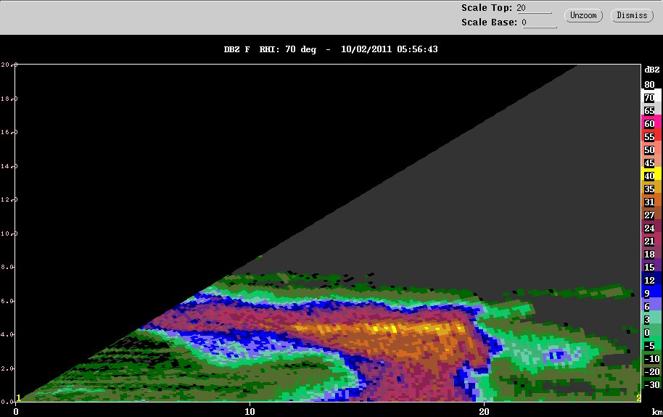
Humidity rings and anvil cloud

Slide 20
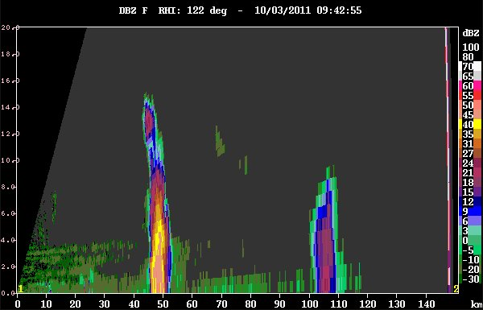
The “worm echo”

Slide 21
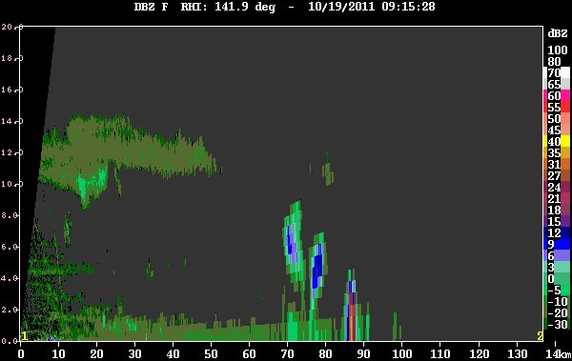
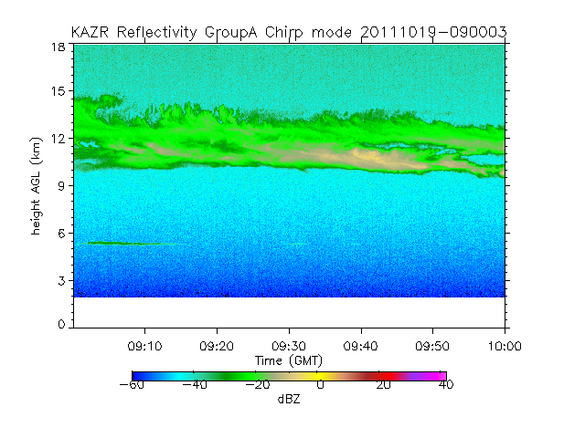
Upper-level cloud over KAZR

Slide 22
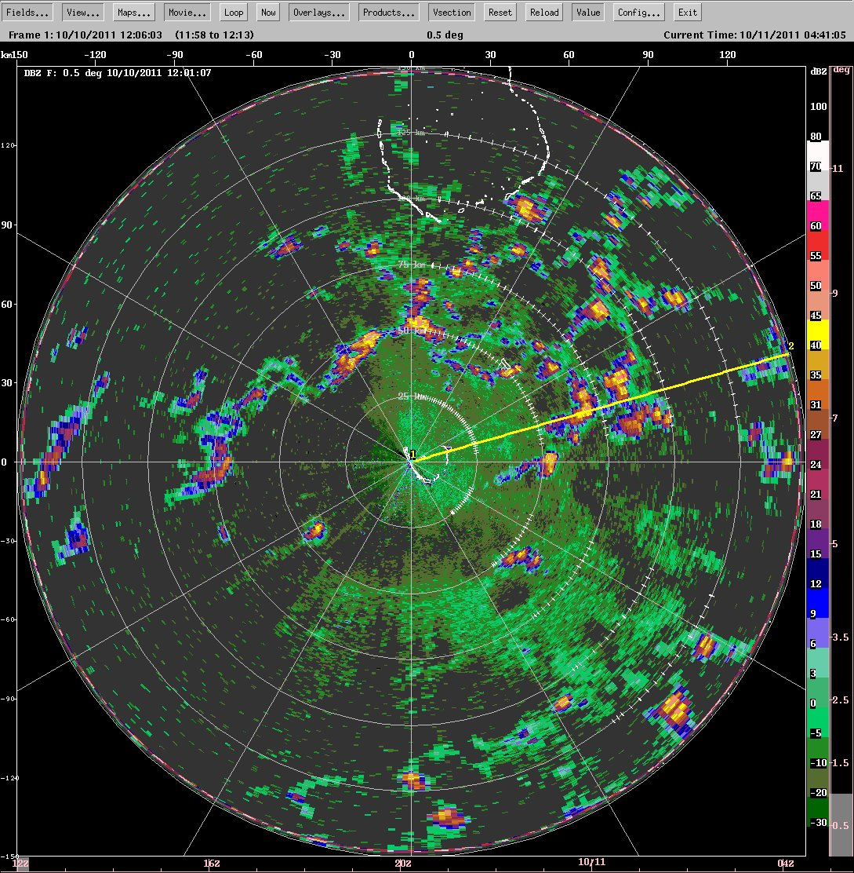
Slightly active moist layer
Clouds building at cold pool boundaries

Slide 23
More Extras

Slide 24
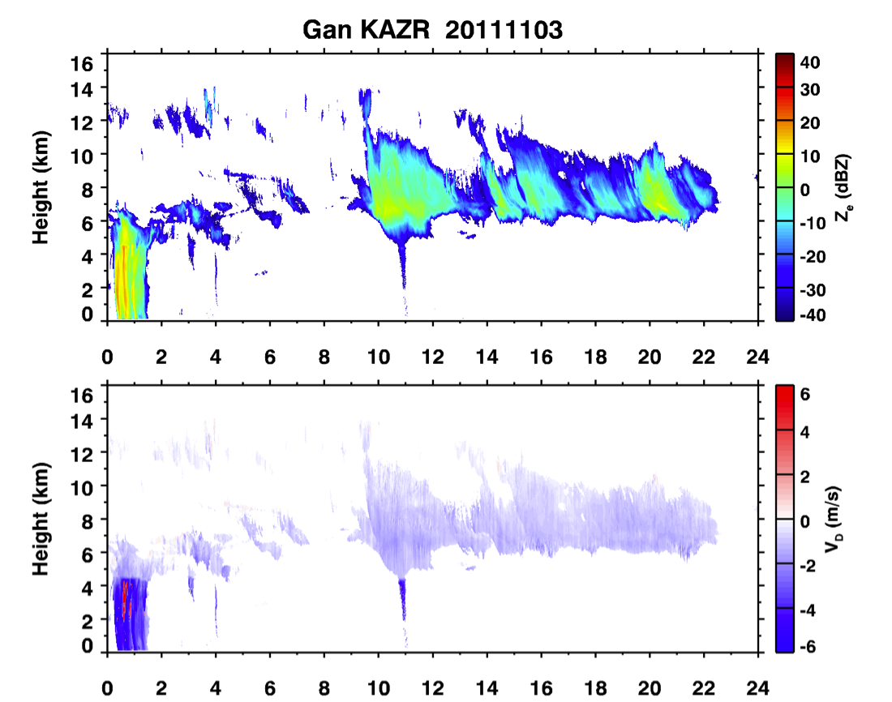
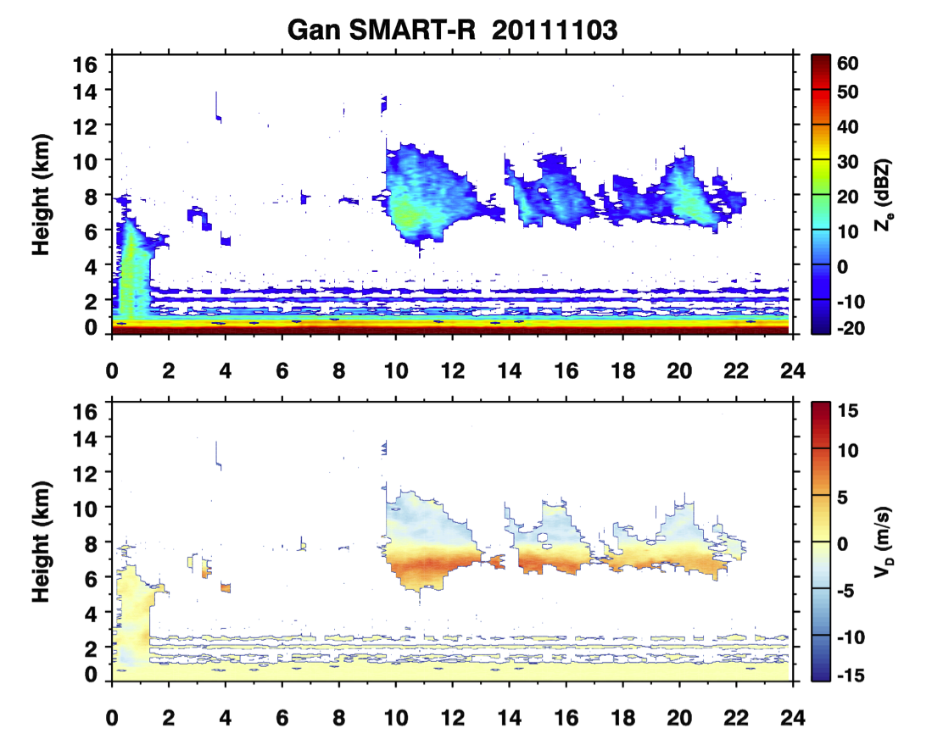
Gan KAZR and SMART-R
KAZR
SMART-R
Generally agree well above 3-km height
SMART-R low level (1-3km) AP
Below 1-km SMART-R ground clutter?

Slide 25
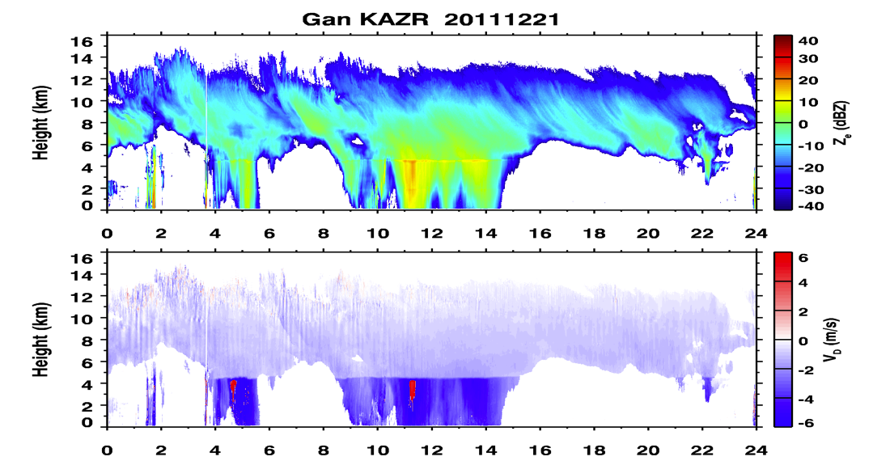
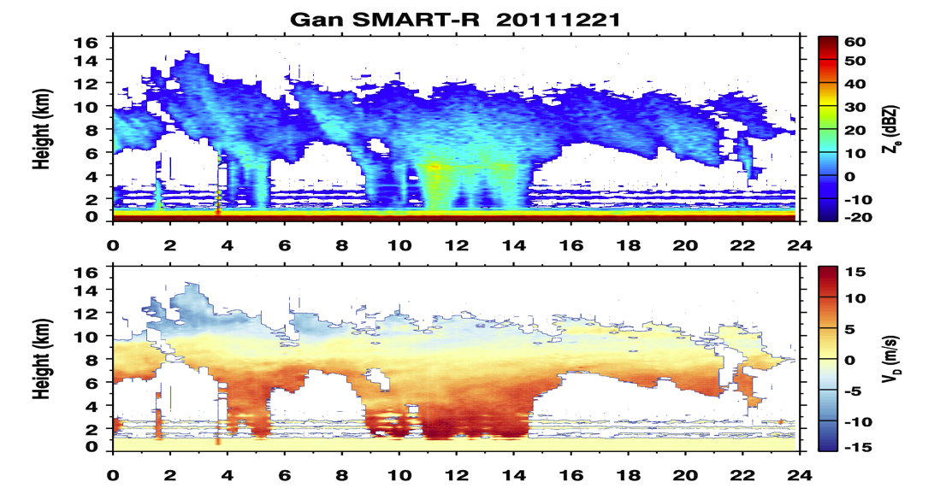
Gan KAZR and SMART-R
KAZR
SMART-R
Note: color scale is different between two radars
Z_{top} difference is about 1~2 km
SMART-R Z_{e} is about 8 dB too high (Courtney), this has not been corrected yet

Slide 26
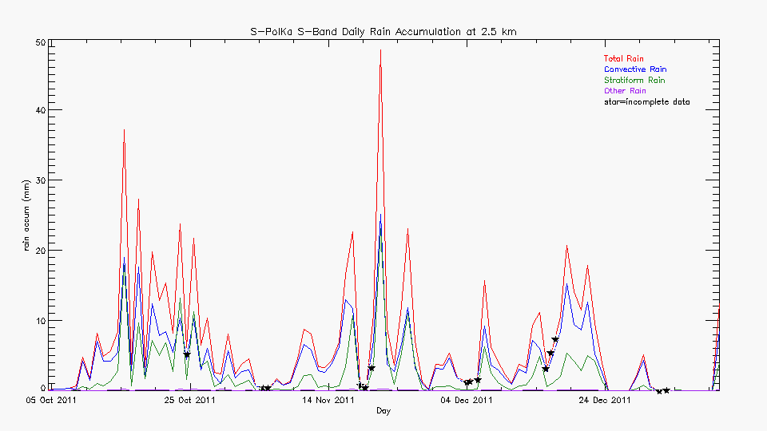
Rain over area scanned by S-PolKa

