Slide 1

The Convective Cloud Population of the Madden-Julian Oscillation:
Early Results from DYNAMO
R. Houze
D. Hence, S. Brodzik, K. Rasmussen, S.Powell,
H. Barnes, B. Dolan, K. Chakravarty, C. Burleyson, Z. Li,
S. Ellis, T. Weckwerth, J. Vivekanandan, J. Hubbert, W.-C. Lee
Int. Conf. on Opportunities and Challenges in Monsoon Prediction in a Changing Climate
Golden Jubilee of the Indian Institute of Tropical Meteorology, Pune, India, 23 February, 2012

Slide 2
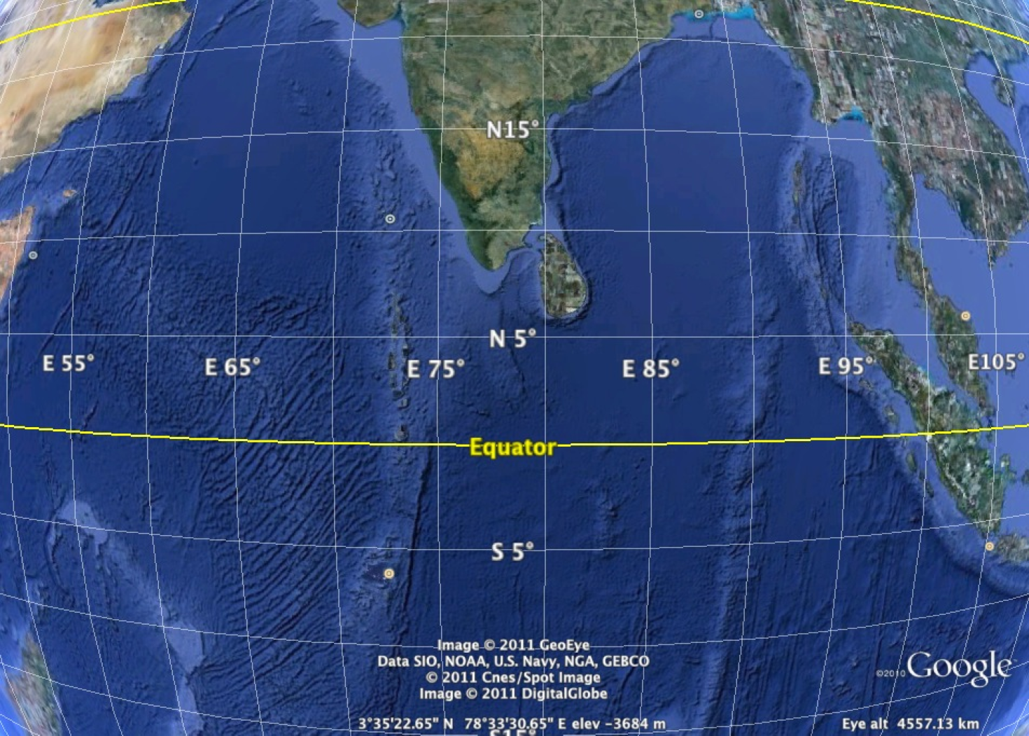
MJO Initiation area

Slide 3



Slide 4
Five radars on Addu Atoll
Addu Atoll

Slide 5
Radar experiment goal
→ Characteristics and evolution of the MJO cloud population in the region where the disturbance builds up
Addu Atoll

Slide 6
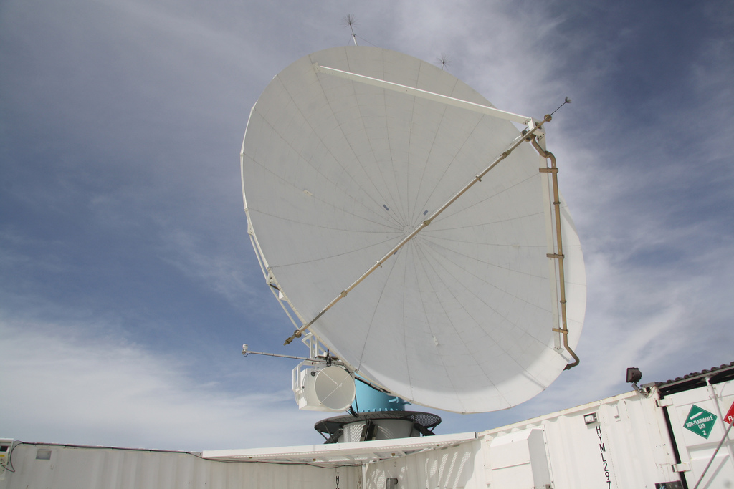
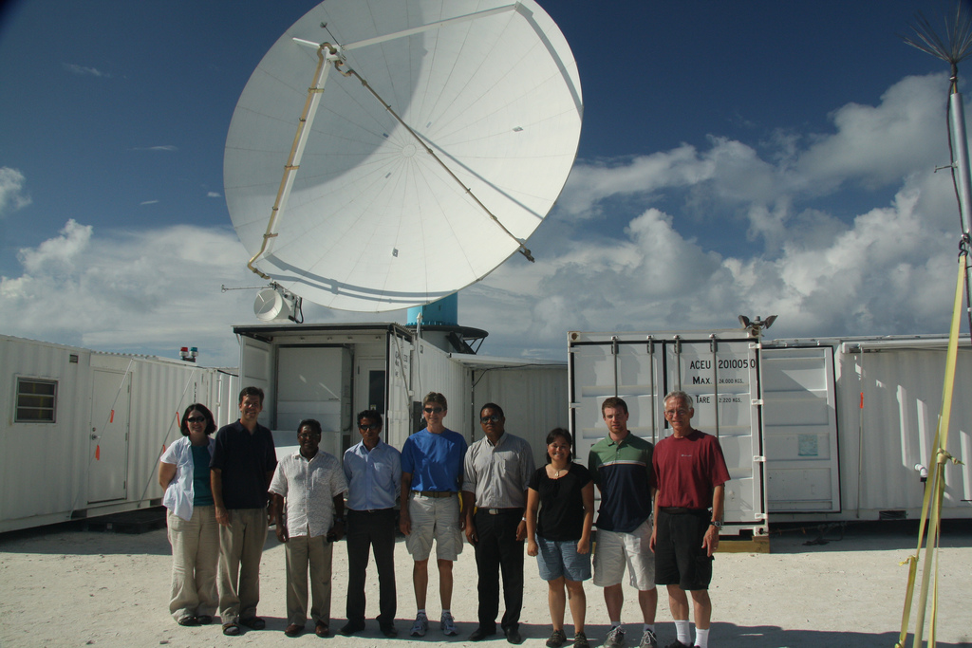
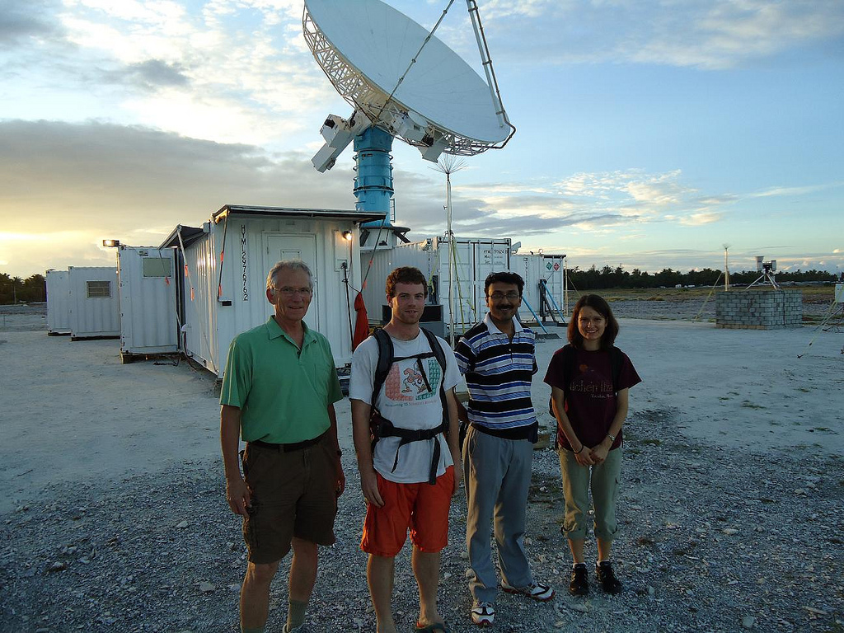
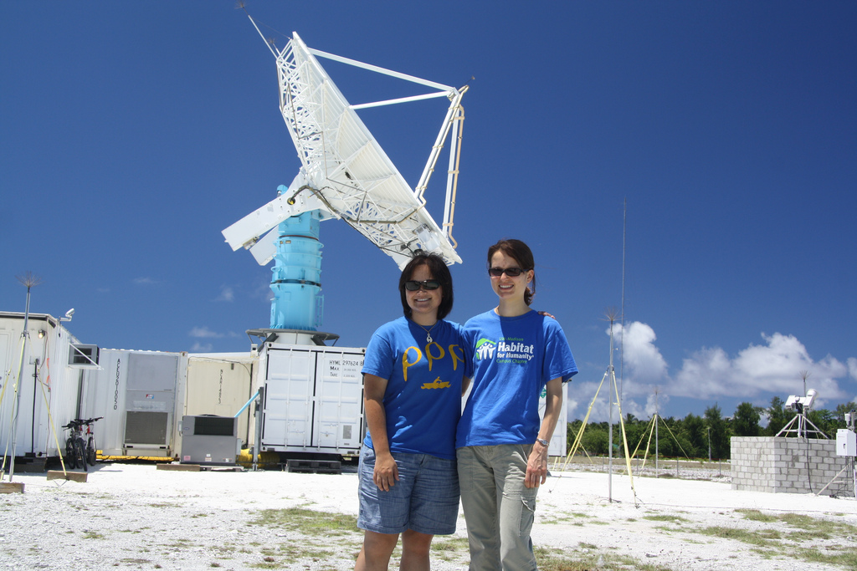
NCAR S-PolKa
Radar
S
Ka

Slide 7
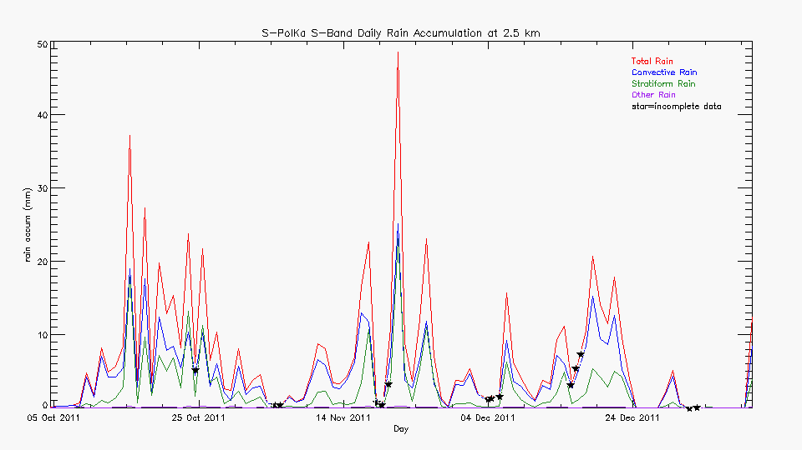
Rain over area scanned by S-PolKa
Supp.
Active
Supp.
Active
Lull
Active
Supp.

Slide 8
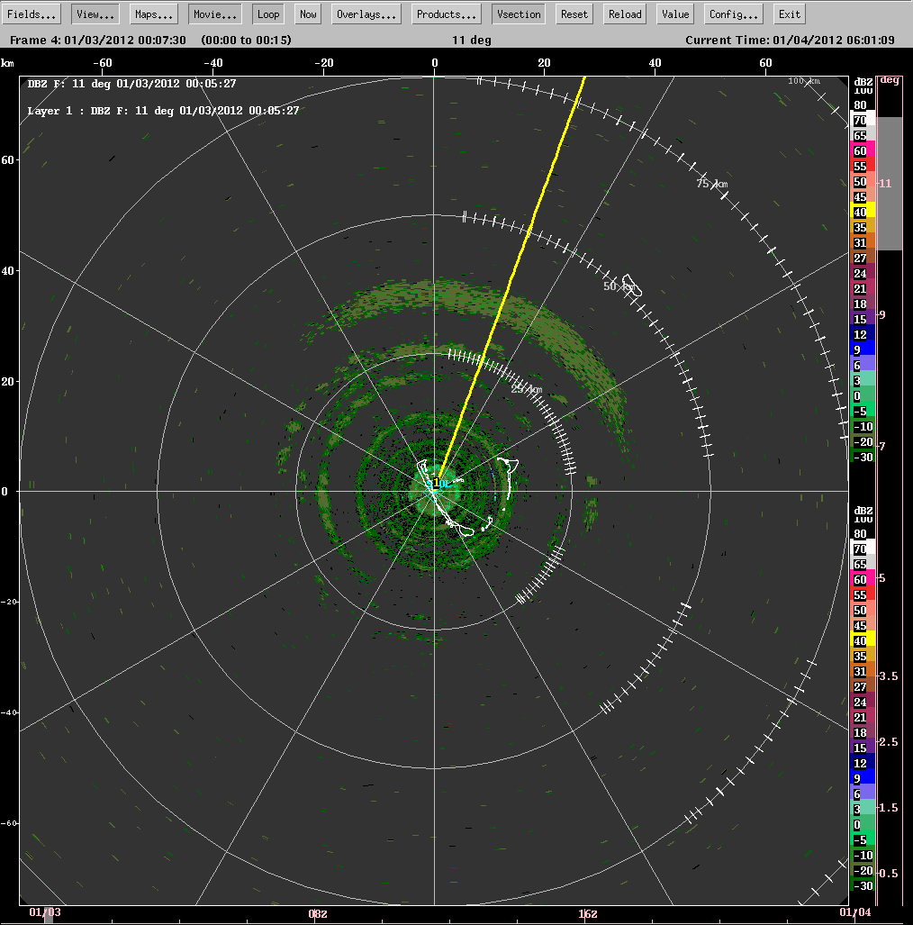
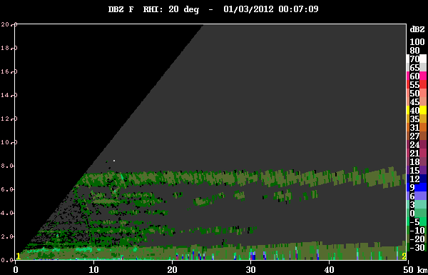
Suppressed condition
echoes

Slide 9
Supp.
Active
Supp.
Active
Lull
Active
Supp.

Slide 10
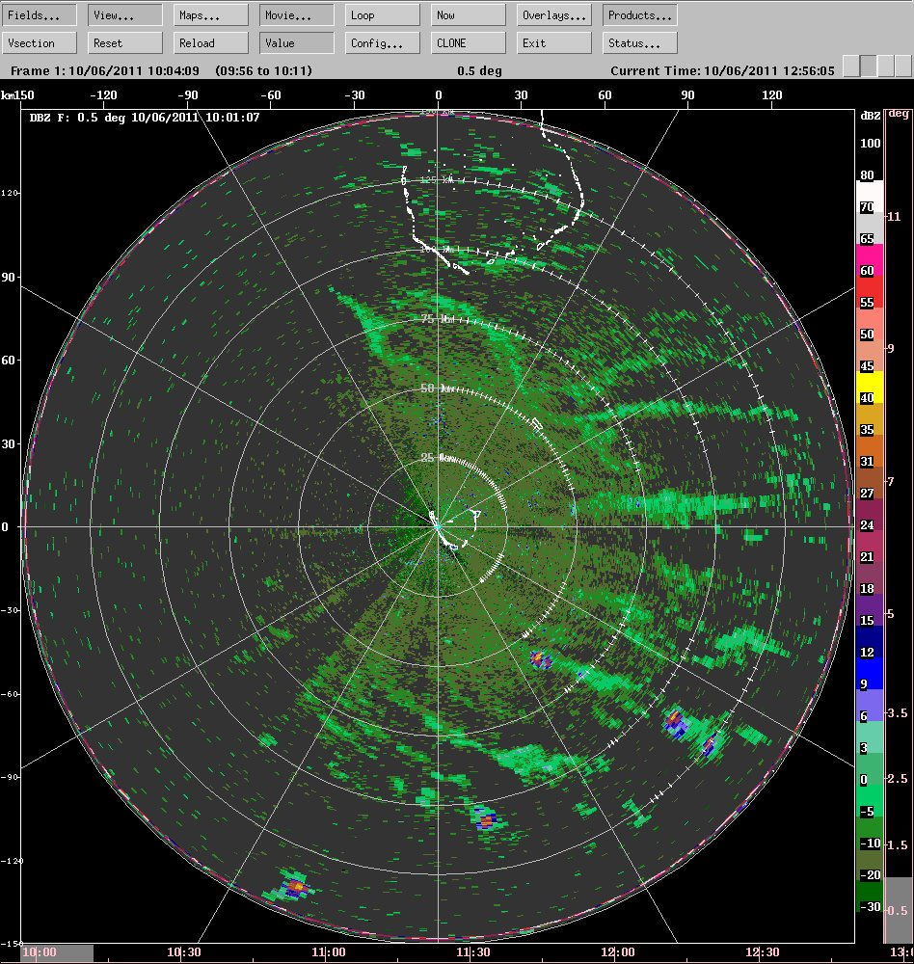
Suppressed phases:
Lines of non-precipitating clouds

Slide 11
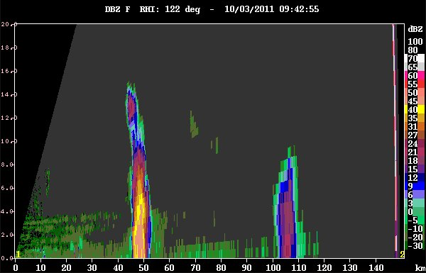
Suppressed phases: The “worm echo”

Slide 12
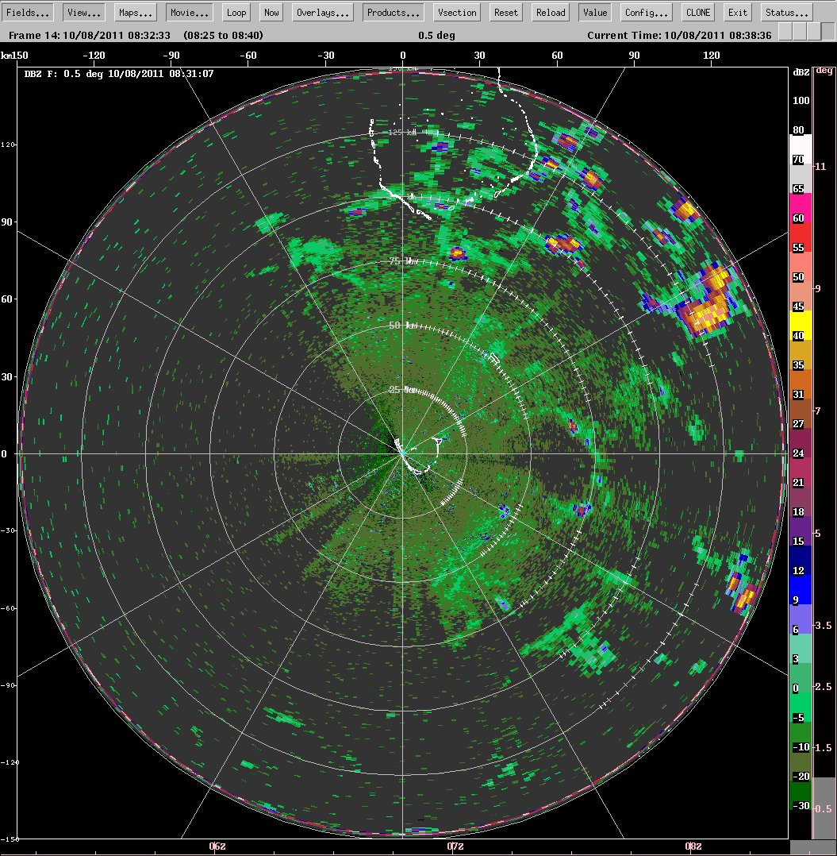
Slightly active moist layer
Clouds building at cold pool boundaries

Slide 13
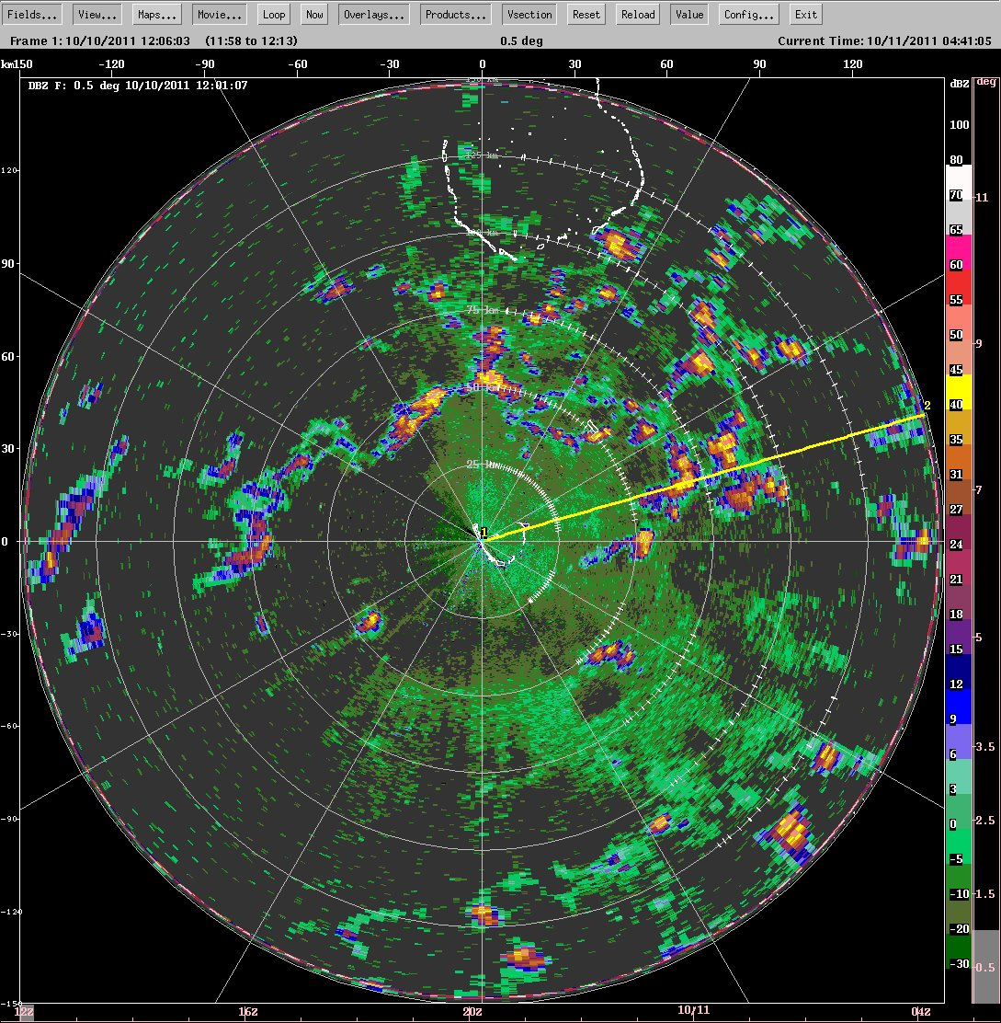
Slightly active moist layer
Clouds building at cold pool boundaries

Slide 14
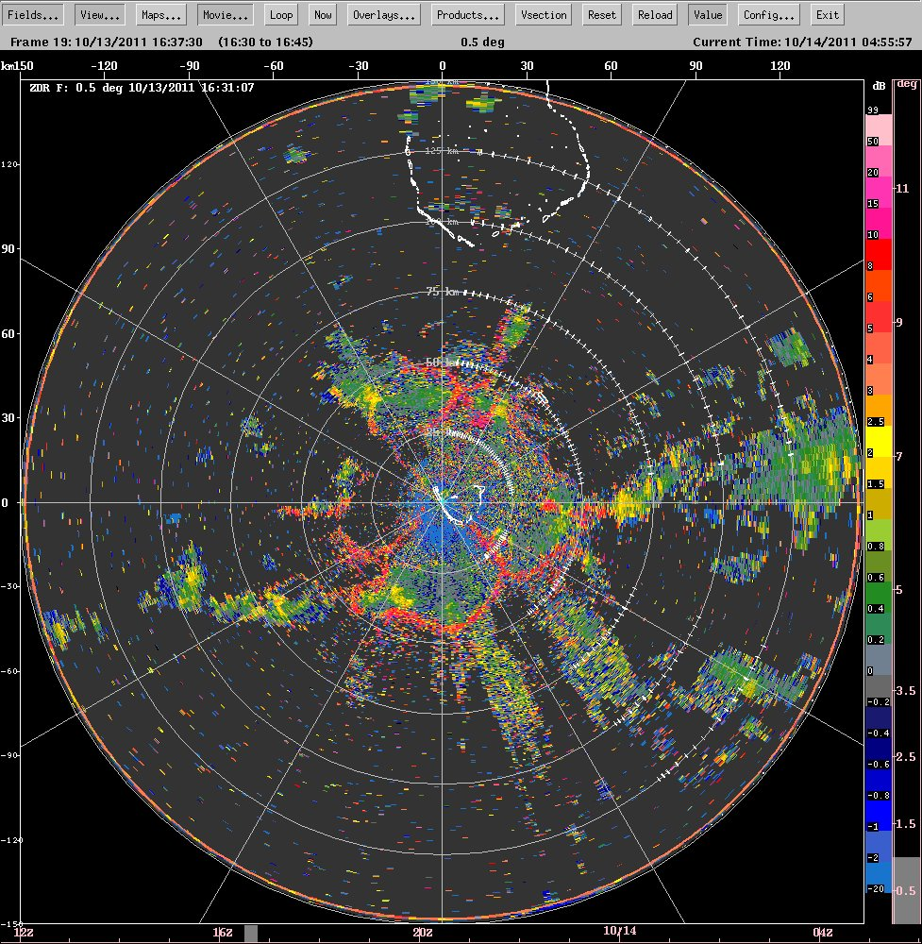
Cold pool boundaries seen in differential reflectivity (ZDR)
Birds?
Dragonflies?
???

Slide 15
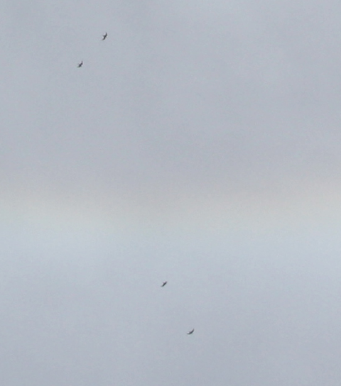
Birds caught on camera

Slide 16
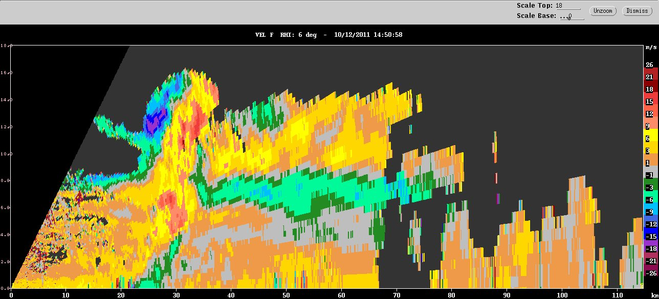
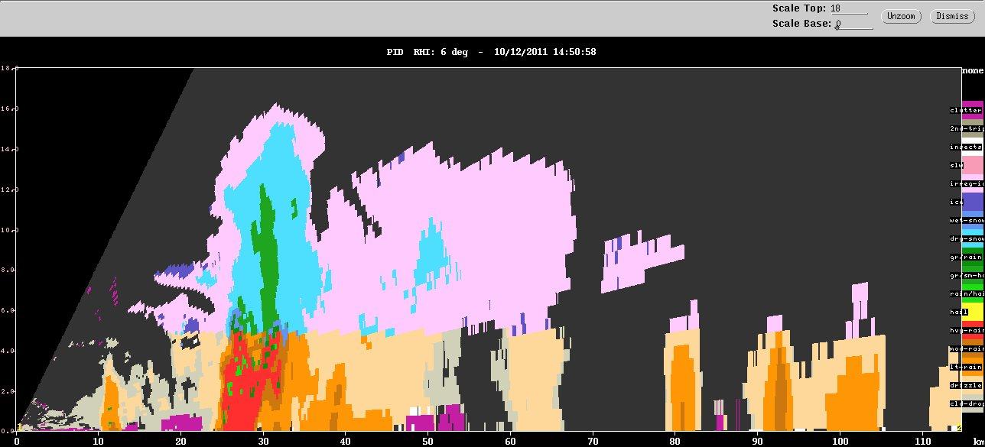
Moderate cumulonimbus begin to grow upscale
Doppler velocity
small ice
large non-melting ice
Hydrometeor type
graupel
melting
ice
heavy
rain

Slide 17
Supp.
Active
Supp.
Active
Lull
Active
Supp.

Slide 18

October 16

Slide 19
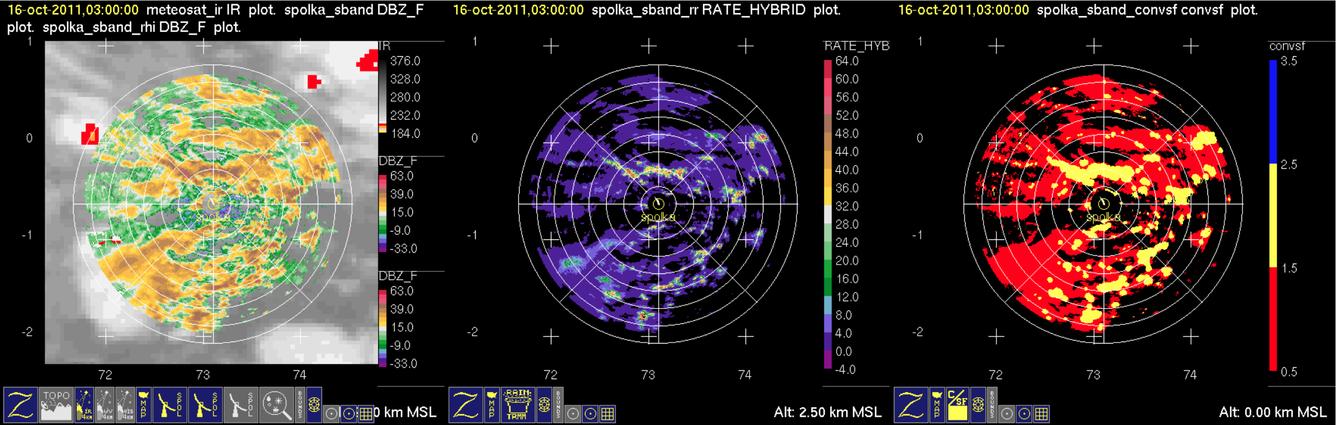
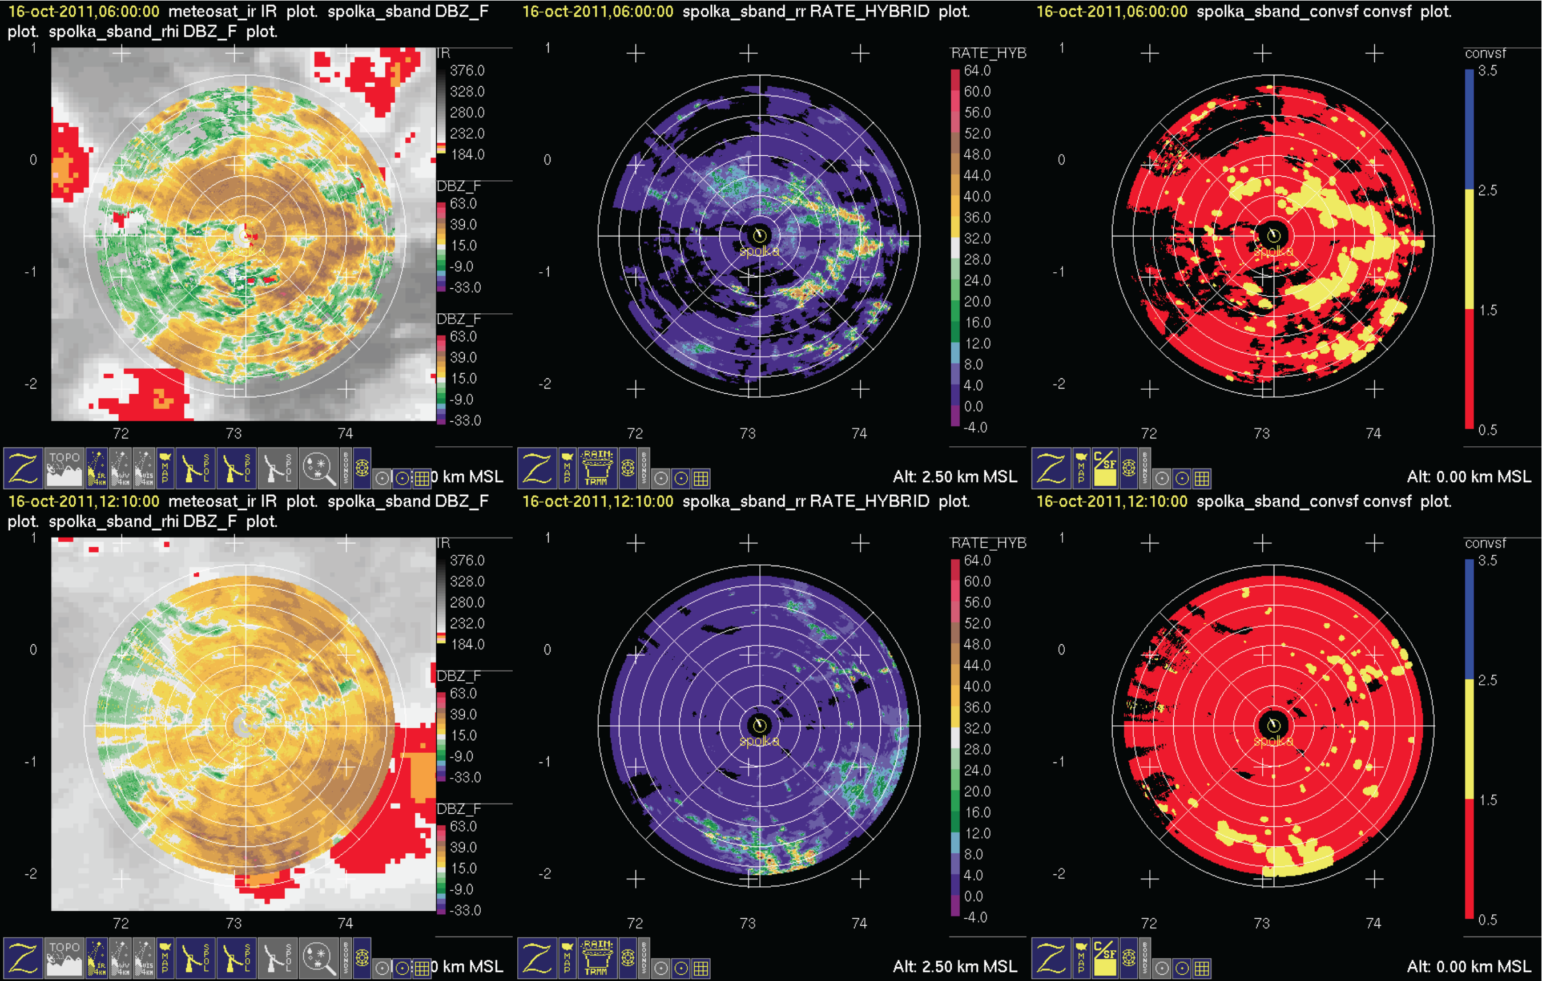
Conv.
Refl.
Rain
Strat.
October 16

Slide 20
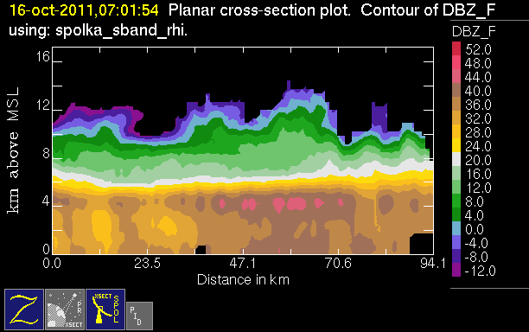
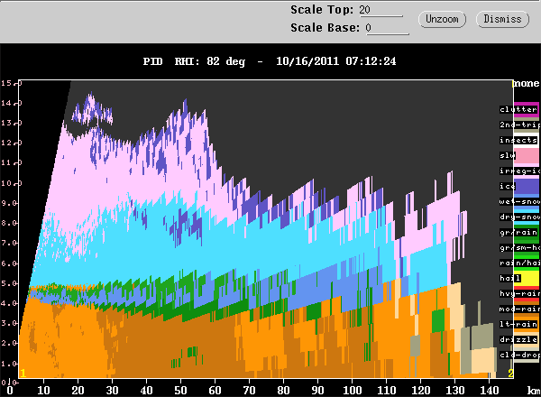
Intense melting layer
50 dBZ!
graupel
10 km
melting snow
5 km

Slide 21
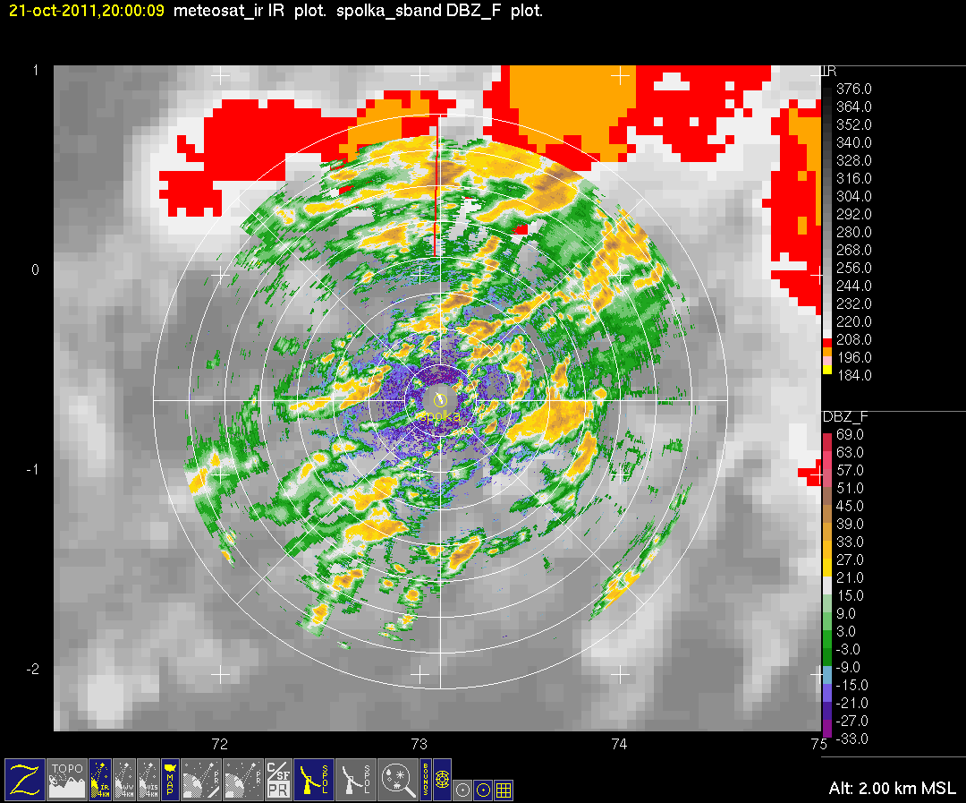
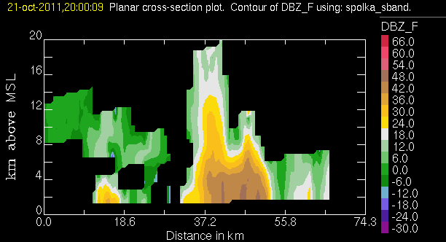
Active phase few days later
Convection feeding into a large MCS

Slide 22
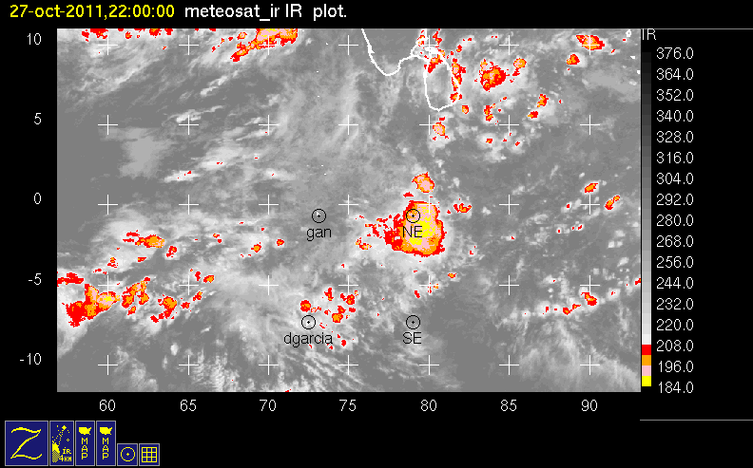
Biggest MCS of first active phase:
weak unidirectional shear

Slide 23
Supp.
Active
Supp.
Active
Lull
Active
Supp.

Slide 24
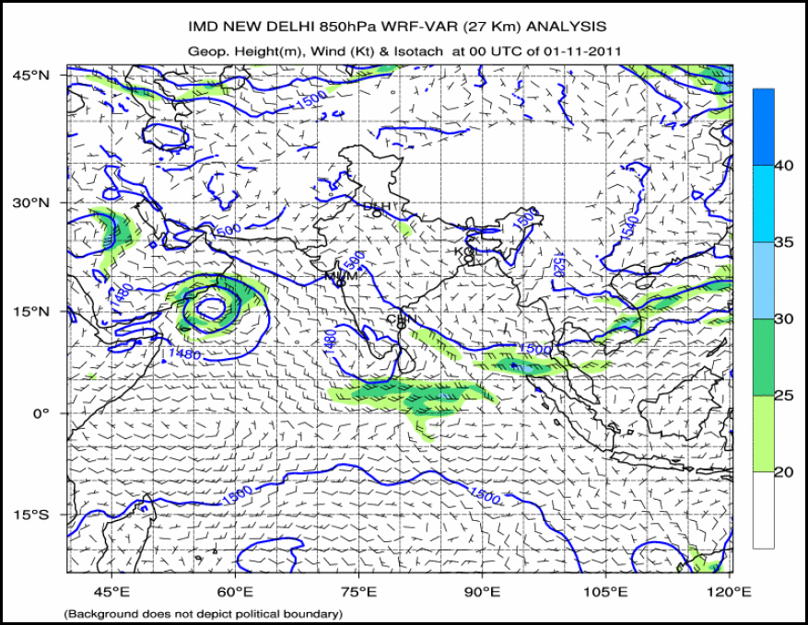

Slide 25
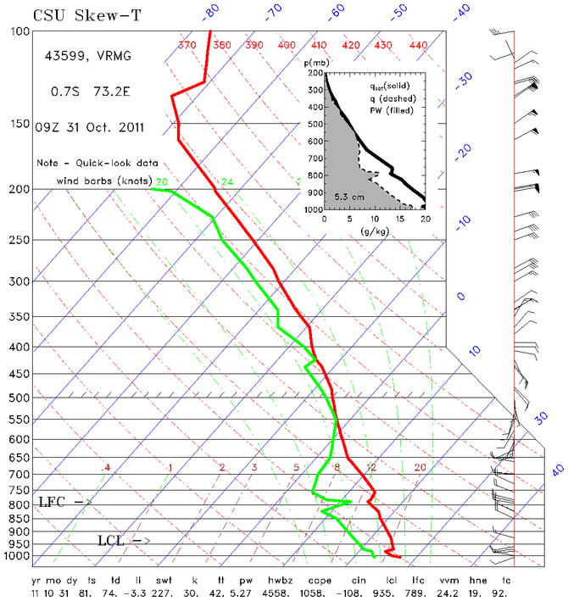

Slide 26
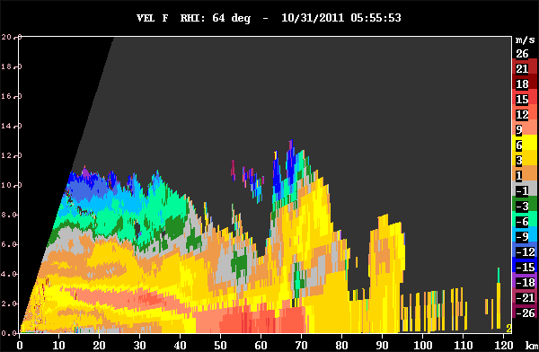
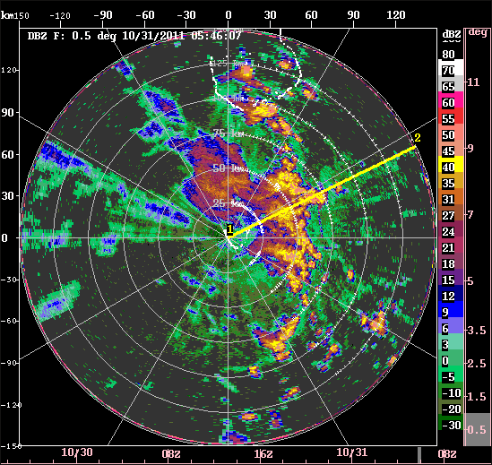
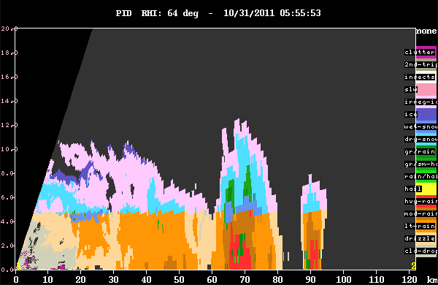
Squall line in late active phase westerlies

Slide 27
Supp.
Active
Supp.
Active
Lull
Active
Supp.

Slide 28
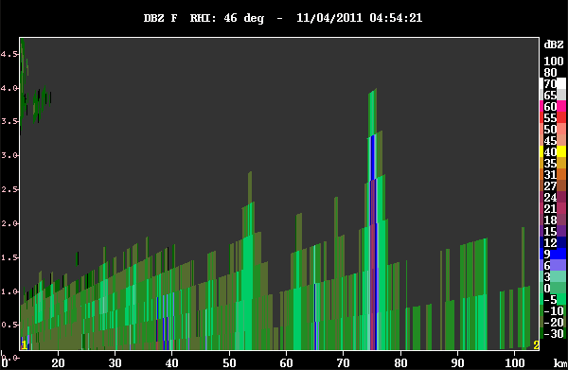
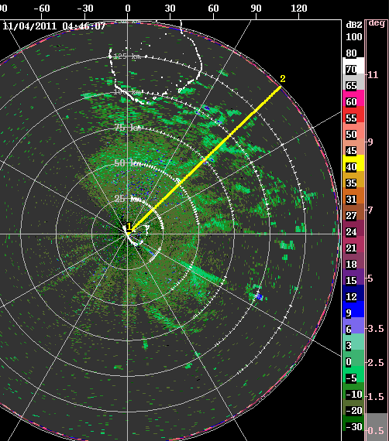

Suppressed condition clouds

Slide 29
Supp.
Active
Supp.
Active
Lull
Active
Supp.

Slide 30
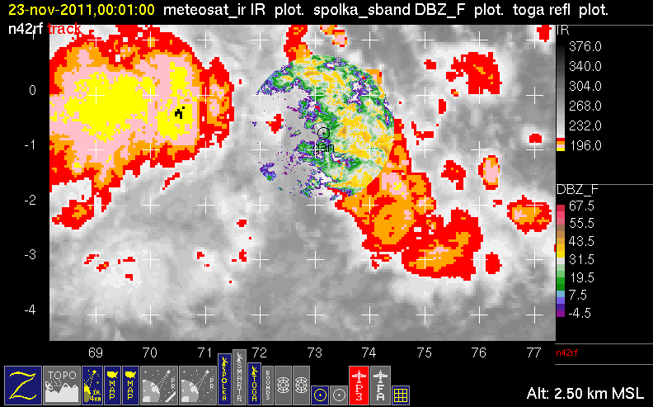

Slide 31
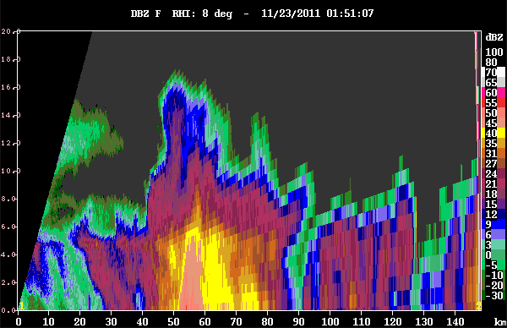
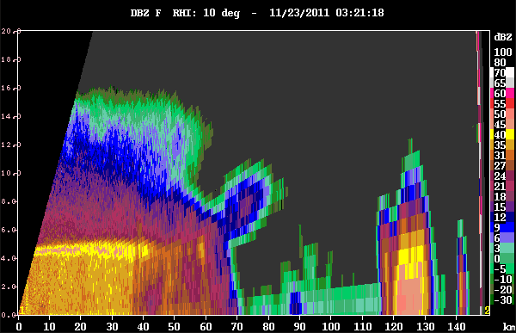
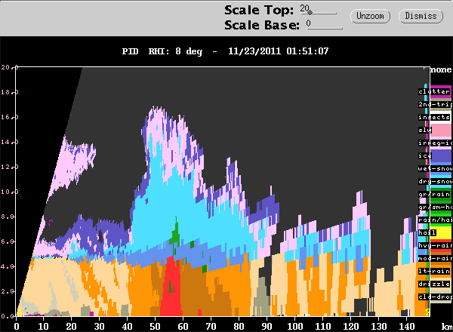
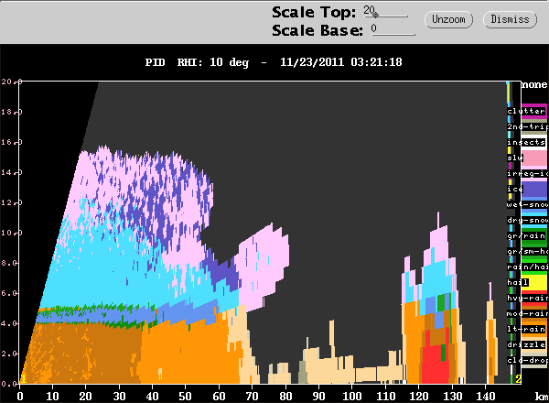

Slide 32
Supp.
Active
Supp.
Active
Lull
Active
Supp.

Slide 33
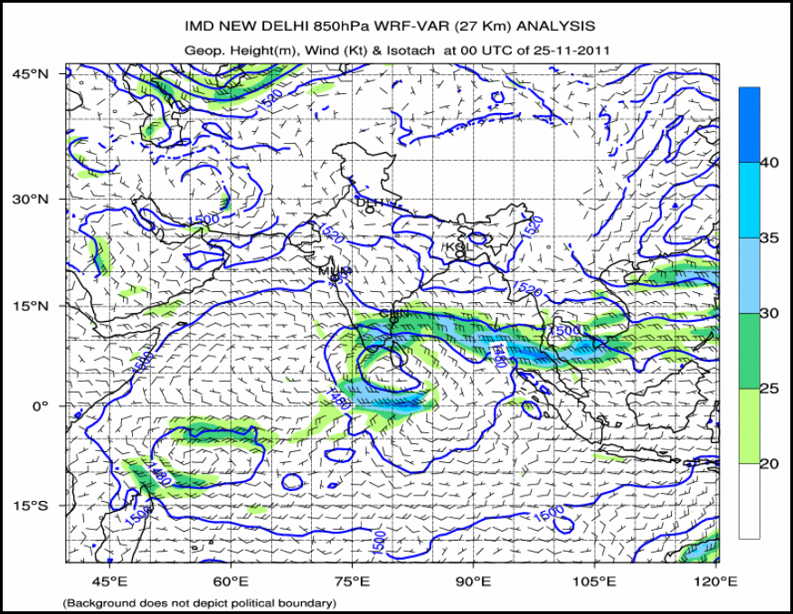

Slide 34
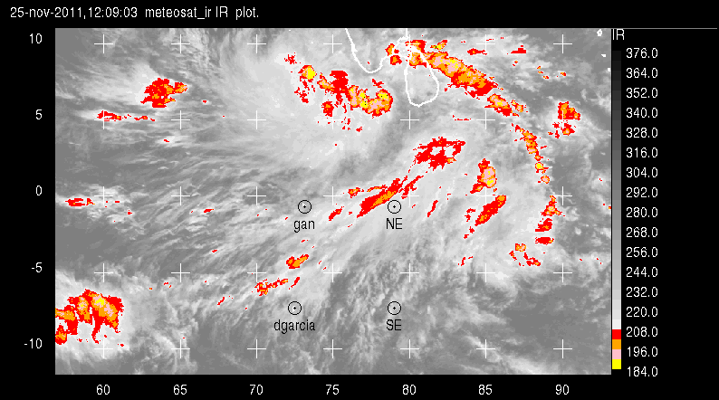
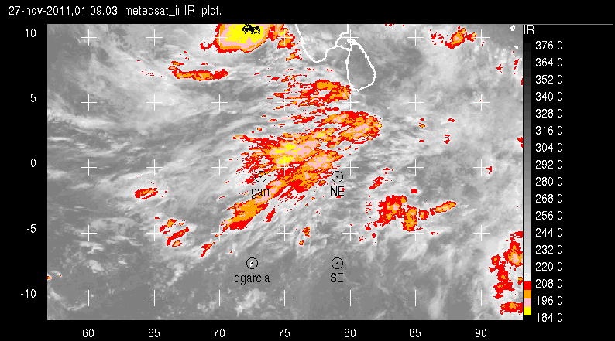
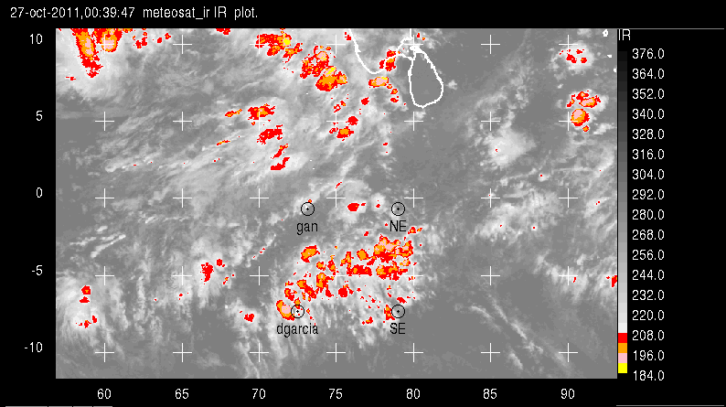
Westerly Surges
November
Larger than mesoscale organization of deep convection
October

Slide 35
Supp.
Active
Supp.
Active
Lull
Active
Supp.

Slide 36
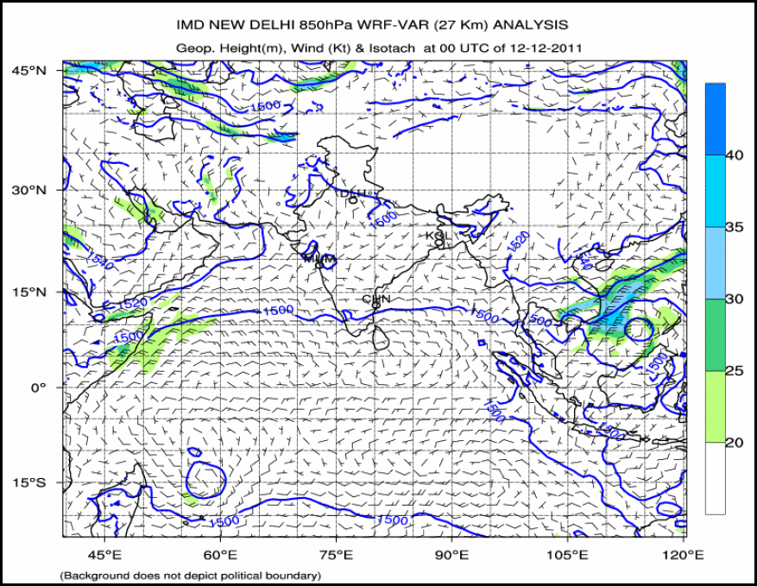

Slide 37
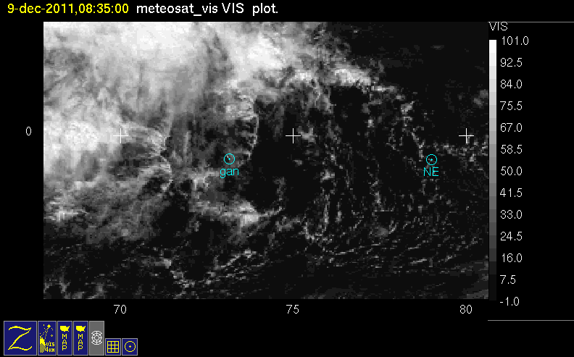
Long arc line
Notes:
Westerlies moist up to 500 mb, dry aboe

Slide 38
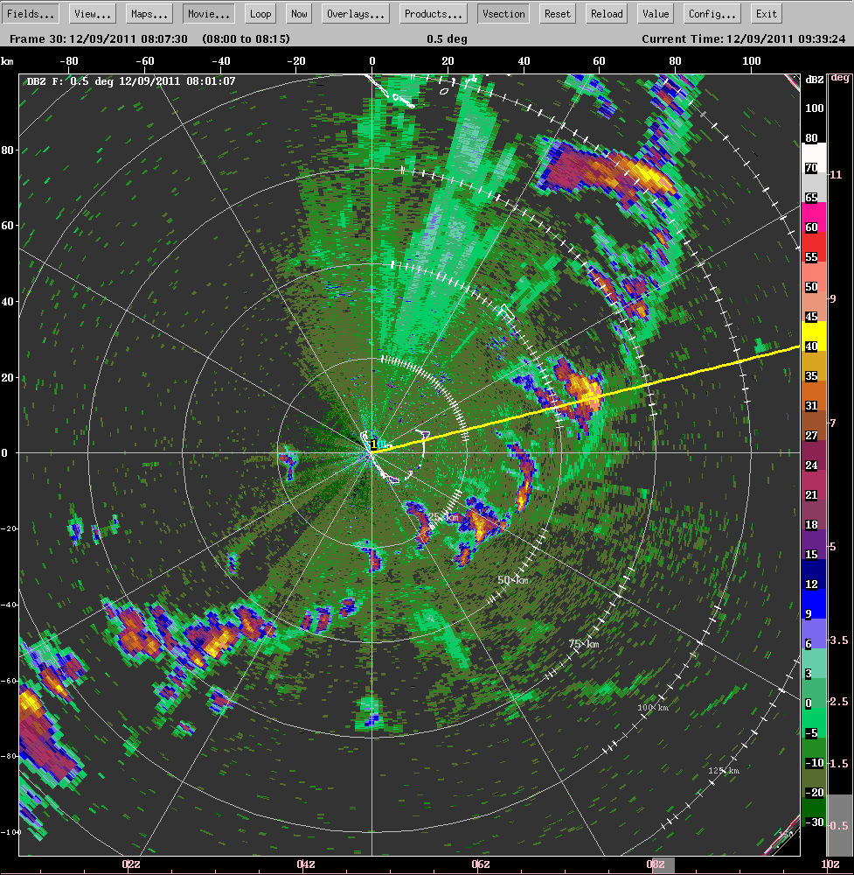
Long arc line
segment on radar

Slide 39
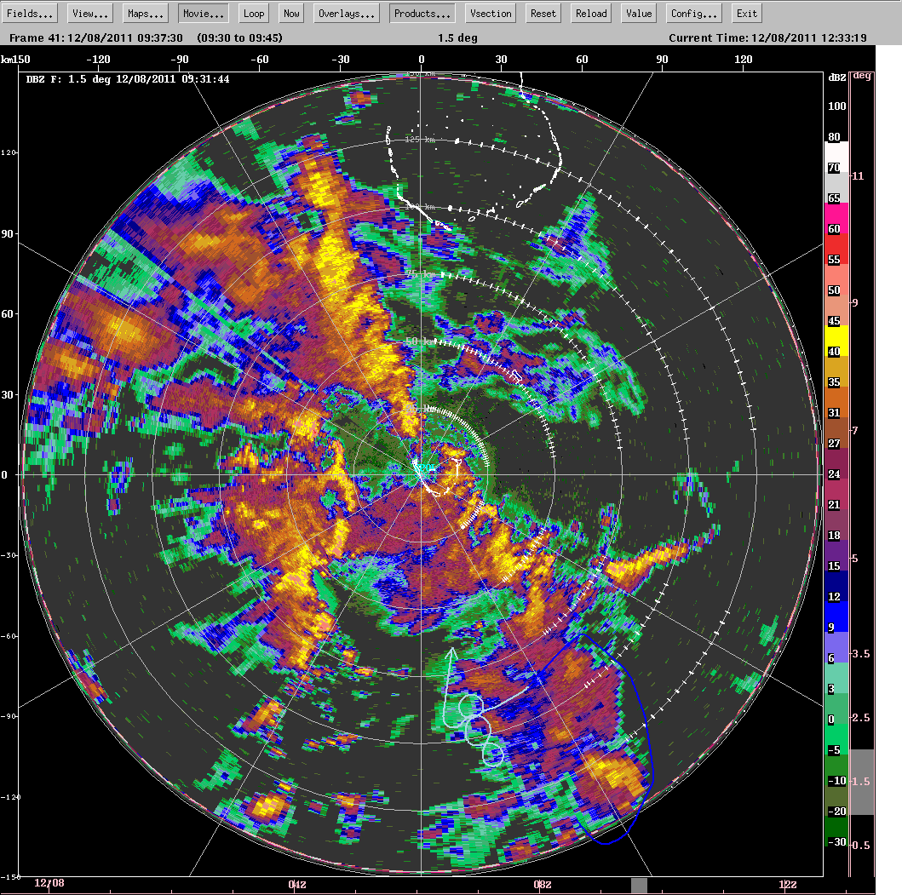
Squall line
in the strong westerlies

Slide 40
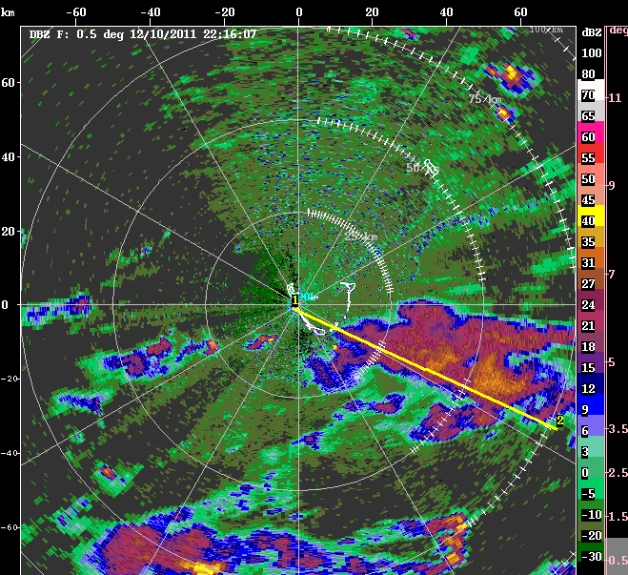
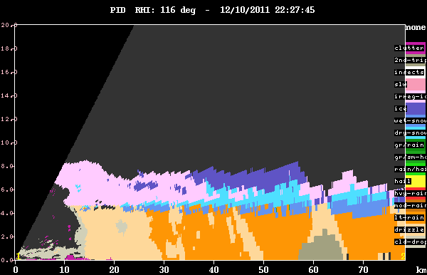
Weak stratiform in the strong westerlies

Slide 41
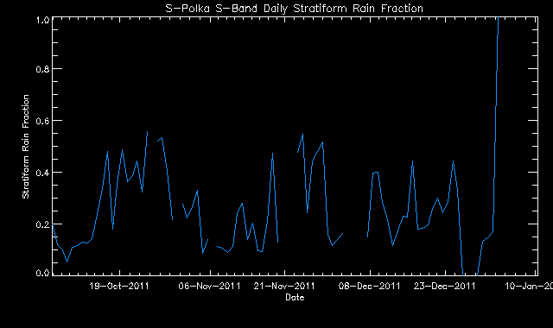
S-PolKa S-band Stratiform Rain Fraction
Stratiform Rain Fraction

Slide 42
Supp.
Active
Supp.
Active
Lull
Active
Supp.

Slide 43
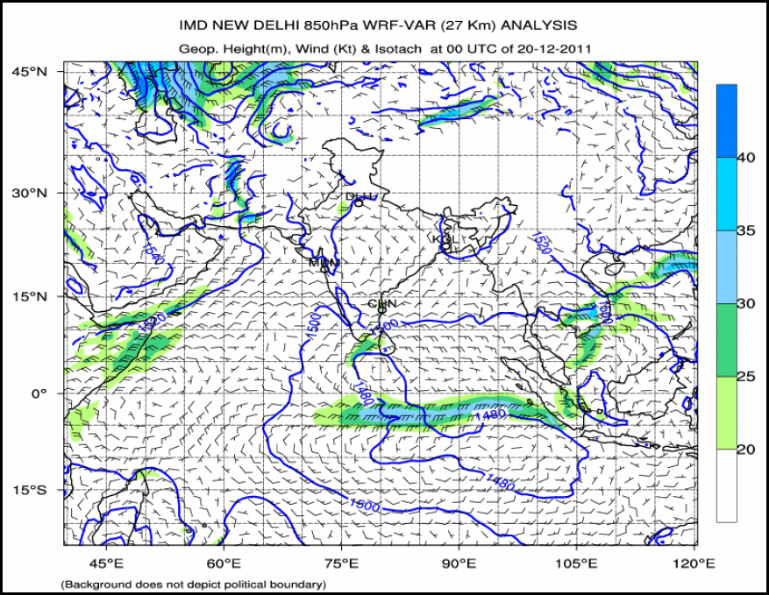

Slide 44
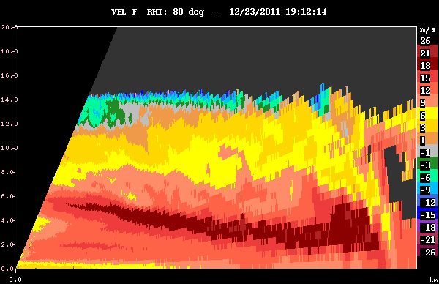
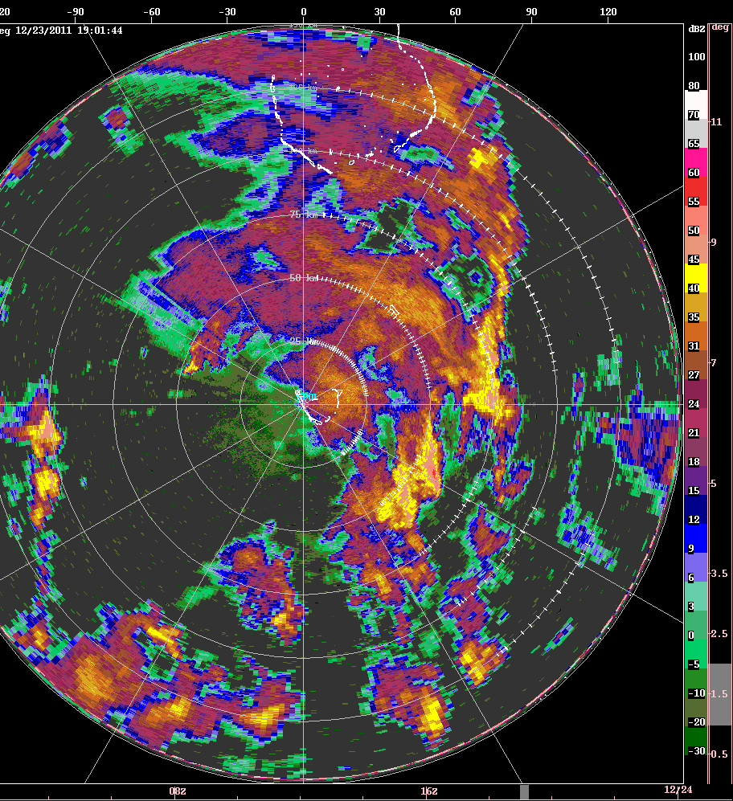
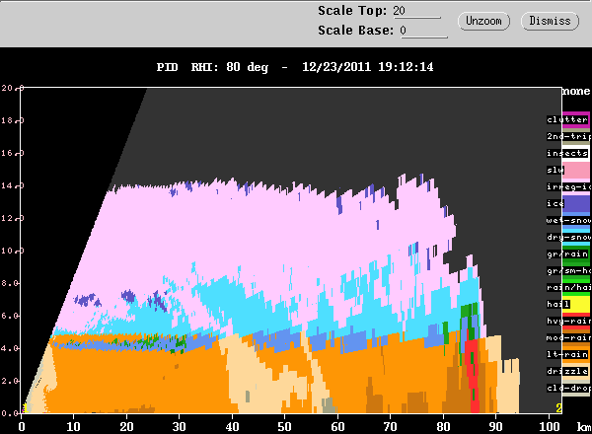
The most robust squall line in the strong westerlies…
Momentum transport
…has only moderate stratiform

Slide 45
Supp.
Active
Supp.
Active
Lull
Active
Supp.

Slide 46


Slide 47


Slide 48
Summary of MJO cloud population characteristics & evolution seen by the S-PolKa radar
Humidity gradient layers monitored & measured
Cloud lines dominate in highly suppressed period
Cold pools are first stage of convective population
Graupel & other ice lofted & input into stratiform regions
Convection enhanced inside stratiform regions
MCS development strongest in weak shear
Shear inhibits stratiform region formation
Westerlies organize convection on larger than mesoscale
Squall lines form in westerlies at back of active zone
Squall lines transport momemtum downward

Slide 49
End
This research is supported by NSF grant ATM AGS-1059611, DOE grant DE-SC0001164/ER-64752, and NASA grants NNX10AM28G and NNX10AH70G

Slide 50
End
This research is supported by NSF grant ATM AGS-1059611, DOE grant DE-SC0001164/ER-64752, and NASA grants NNX10AM28G and NNX10AH70G

