Slide 1
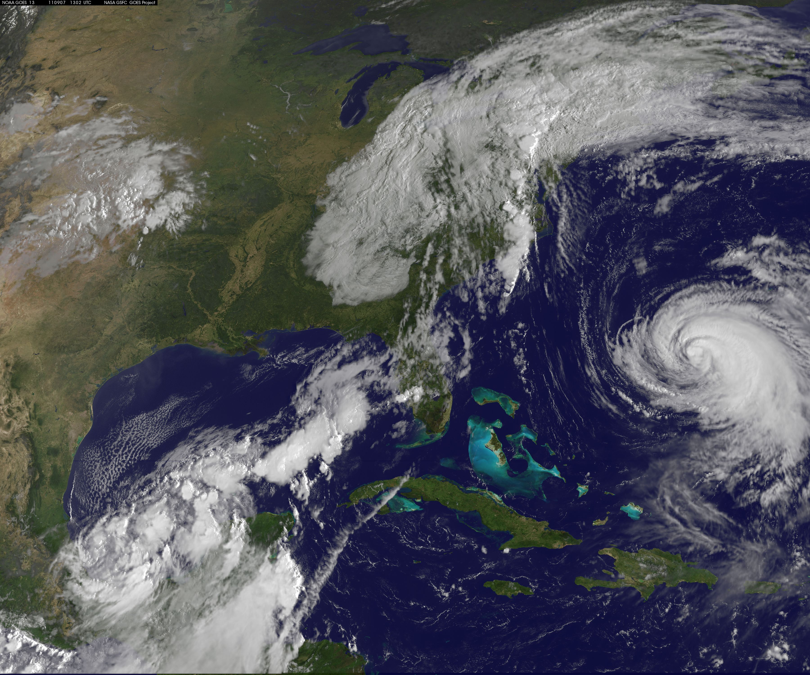
The Vertical Structure of Tropical Cyclone Precipitation as seen by the TRMM Precipitation Radar
Deanna A. Hence and Robert A. Houze, Jr.
University of Washington
Presented at AMS Annual Meeting, 24 January 2012
Supported by NASA grant NNX12AJ82G and NSF grant ATM0743180
Image: NASA
Notes:
Katia far right
Remnants of Lee over east coast
Now TS Nate in Gulf, new TS Maria off screen

Slide 2
The current conceptual model
Eye
Houze (2010)
Notes:
Learned from radar studies the basic components of a hurricane
Idealized schematic of tropical cyclone radar echo

Slide 3
Objectives of this study…
Identify the typical vertical precipitation structures of tropical cyclone eyewalls and rainbands
Examine how these structures differ with radial distance and around the storm

Slide 4
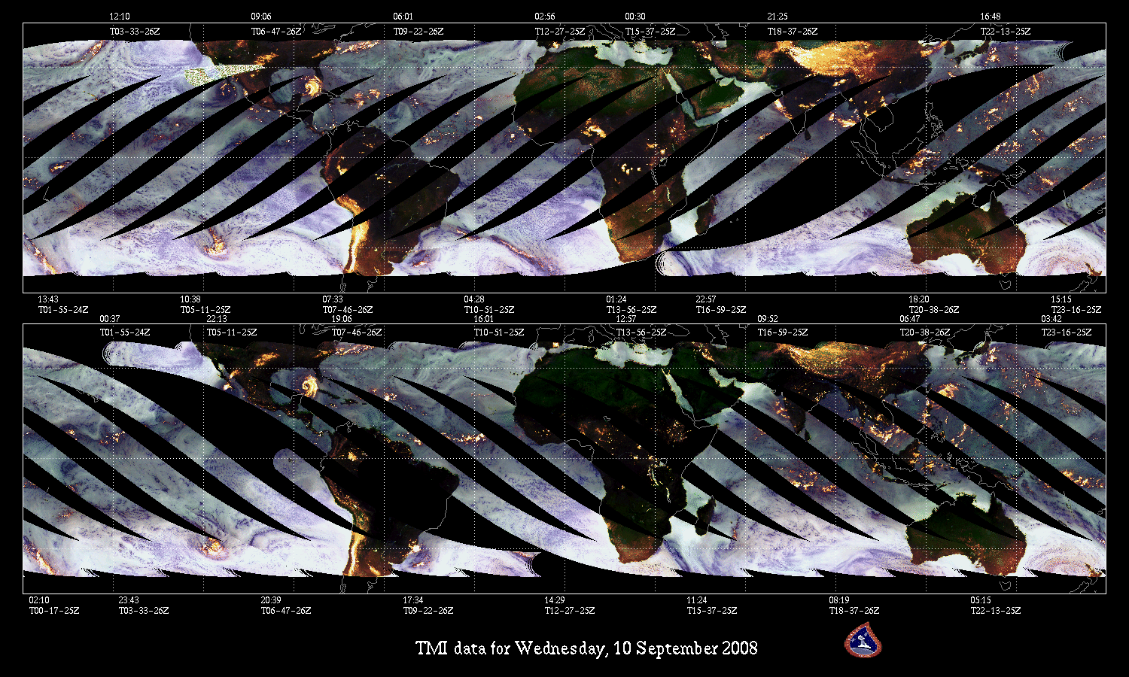
TRMM: Scanning 40°N to 40°S since 1997
From NASA TRMM website (http://trmm.gsfc.nasa.gov/)
Notes:
TRMM = Tropical Rainfall Measurement Mission
Polar orbiter, inclination level at 35 degrees so focuses on the tropics
Carries Microwave Imager, Lightning Sensor and First Ever Spaceborne Precipitation Radar
Advantages: daily high detail obs over the oceans with instruments that can penetrate cloud shield
Disadvantages (of all polar orbiters): still snap-shot, only gets obs 1-3x per day

Slide 5
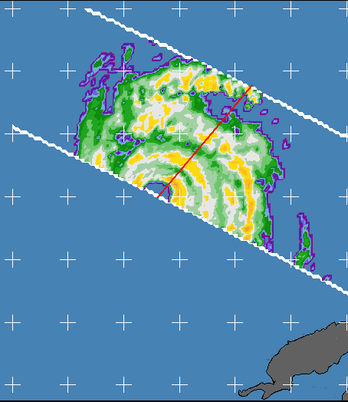
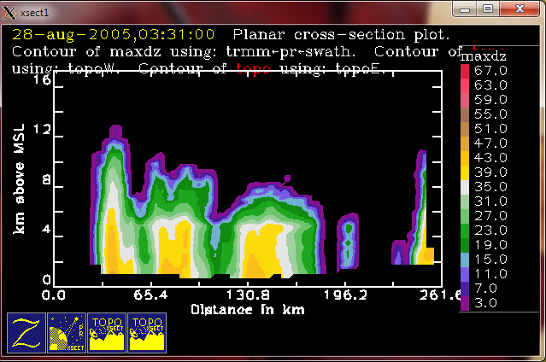
TRMM Precipitation Radar: 3-D View
TRMM PR Reflectivity at 03:26 on 28 August 2005
dBZ
67
35
25N
Reflectivity Crosssection
dBZ
67
Eyewall
12
3
Rainbands
8
km
35
4
22N
89W
86W
83W
3
Notes:
First Ever Spaceborne Radar buys us 3-dimensional view of hurricanes
TRMM PR reflectivity of Hurricane Katrina
Swath width usually too narrow to cover full storm
Can see:
part of high reflectivity ring of eyewall
big inner rainbands
rain cells of outer rainbands
Take cross-section along red arrow
Can see:
intense eyewall echo reaching high altitudes
shallower rainbands
Bit of rain cell
Combine many overpasses of many storms because of narrow swath width.
Use statistics to analyze “typical” structure.

Slide 6
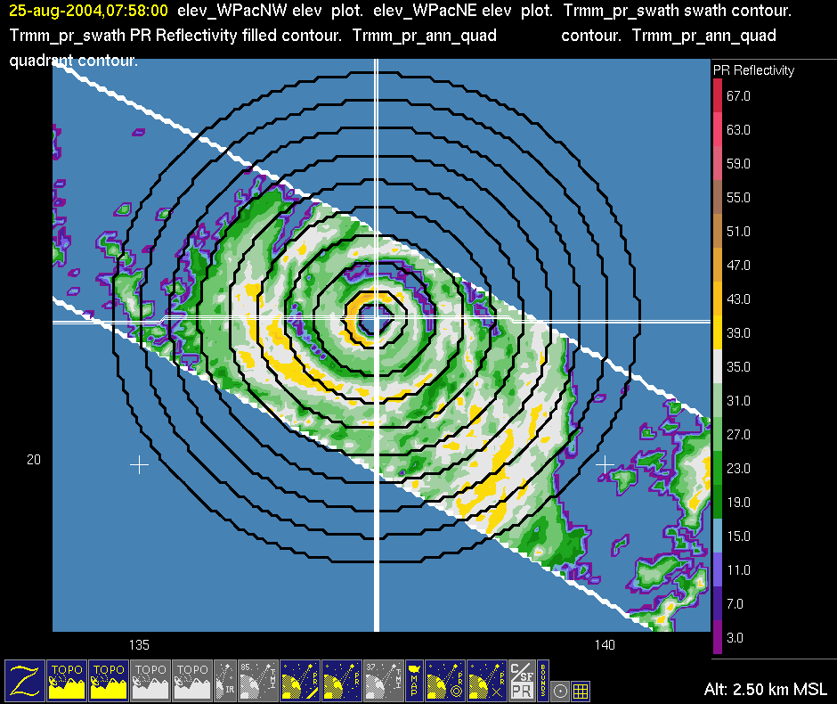
Database Preparation: Center Details
Super Typhoon Chaba
TRMM PR Reflectivity on 24 August 2004
dBZ
67
From the NHC and IBTRACS best track data
Center location
Eye diameter
35
20
3
135
140
Notes:
First must prepare database
NHC and International Best Track Archive for Climate Stewardship Best Track
Center and eye diameter establish rings
Usually evenly spaced

Slide 7
Eyewall: Intense, Deep, Unique
Eyewall
Distant Rainbands
Other Oceanic Convection
Sharp Peak
Rapid change
8
Height (km)
5
30
40
30
40
Reflectivity (dBZ)
Hence and Houze (2010a)
Notes:
Going to be referring to what the yellow region and the blue outer lines are doing a lot
Modal structure==high frequencies: intense, deep
Outlier structure==low frequencies: even deeper, more intense
Sharp peak, rapid change at melting level—upper-level ice and melting signature
Compared to ordinary tropical oceanic convection: way deeper, way more intense, less connected through melting layer

Slide 8
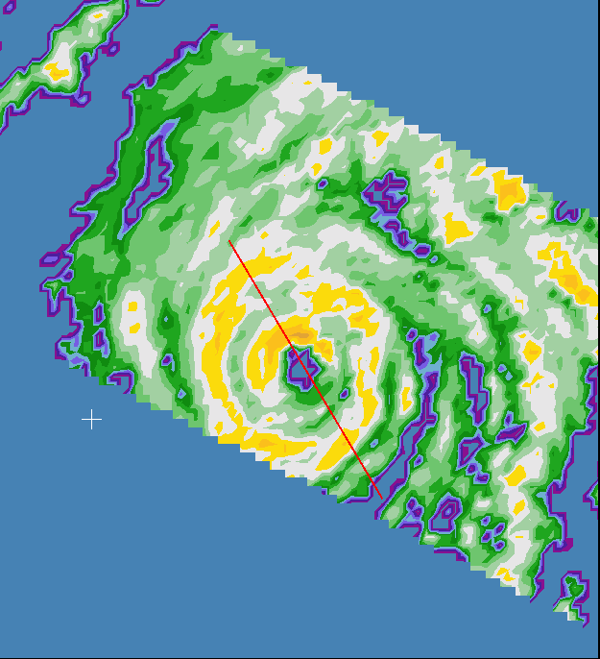
One is not like the other
Inner Eyewall
TRMM PR Reflectivity at 14:43 on 23 Sep 2005
8
5
dBZ
67
25
35
35
Outer Eyewall
8
25N
pinched
Height (km)
3
5
25
35
90W
Reflectivity (dBZ
Notes:
Had to space rings subjectively because of varying moat widths.
Inner eyewall looks like usual eyewall, a little shorter
Outer eyewall low levels squeezed together and scooted over
Dramatic pinching in distribution of melting layer is rainband-like signature
Think it signals disconnection between upper and lower levels

Slide 9
Quadrant Analysis by Wind Shear
Super Typhoon Chaba
TRMM PR Reflectivity on 24 August 2004
UR
UL
dBZ
67
From the NCEP Reanalysis winds
200-800 hPA shear
35
Reflectivity (dBZ)
20
3
DR
DL
Shear
135
140
Notes:
To look at asymmetric structure, divide rings into quadrants
Tried track first, but signal inconsistent..then tried shear and the signal was huge
divide data into quadrants based on mean shear vector
Wind shear is difference in the winds between two layers
Use NCEP Reanalysis u, v winds to calculate 200 and 800 hPa wind vectors 500-750 km from storm center

Slide 10
Single Eyewall
Inner Eyewall
Outer Eyewall
Hence and Houze (2010b)
Notes:
In general, outer eyewall more symmetric than inner eyewall
Single eyewall has slightly greater coverage in left of shear quadrants, low-level mean reflectivity similar
Inner eyewall big disparity in echo coverage and mean reflectivity, especially in upper levels
Outer eyewall, some disparity in echo coverage but very little in mean reflectivity

Slide 11
A New Conceptual Model
Hence and Houze (2010b)
Notes:
Idealized radar schematic that is consistent with statistics shown
Convective progression in inner eyewall exaggerated version of single eyewall
Convective cells in outer eyewall live and die locally, but DL convection amped up
Because of high wind speeds, small ice particles can circumnavigate inner eyewall…distances involved and lower wind speeds in outer eyewall don’t allow ice to get very far

Slide 12
A New Spiral Rainband Model
Inner
Outer
Notes:
Idealized schematic drawn to be consistent with statistics
Noticed a regime change between regions 5 and 6….
change in rate of change of fraction of coverage
convective fraction
change from more homogeneous stratiform precipitation to cellular convection with radial distance
Also asymmetric…rainband convection organizes into coherent lines in UR, mature and develop in DR, collapse in DL into stratiform with some blowover to UL

Slide 13
Two Layers
Inner
Outer
Notes:
Inner region rainbands more intense in low levels but less above
Excess Kurtosis—measure of peakedness or flatness of distribution
Positive = peaked
Negative = flat
Inner regions less flat in low levels, stay peaked in upper levels = high uniformity and homogeneity
Outer regions more flat in low levels, peaks in upper levels but then becomes negative again = more heterogeneity in structure
Major dip in kurtosis between 5-6 km = melting layer
Biggest dip in inner regions
Smaller in outer regions
Sign of seperation between upper and lower microphysical regimes

Slide 14
Conclusions
The vertical precipitation structure of eyewalls:
Single eyewalls: deep, intense, with deeper and more intense outliers
Inner eyewalls: similar to single eyewalls but less deep
Outer eyewalls: intense, uniform, constrained by inner eyewall

Slide 15
Conclusions
The vertical precipitation structure of rainbands:
Inner region rainbands: uniform, stratiform, vertically constrained convection, upper separate from lower
Outer region rainbands: sparse, convective, upper more connected to lower

