Slide 1
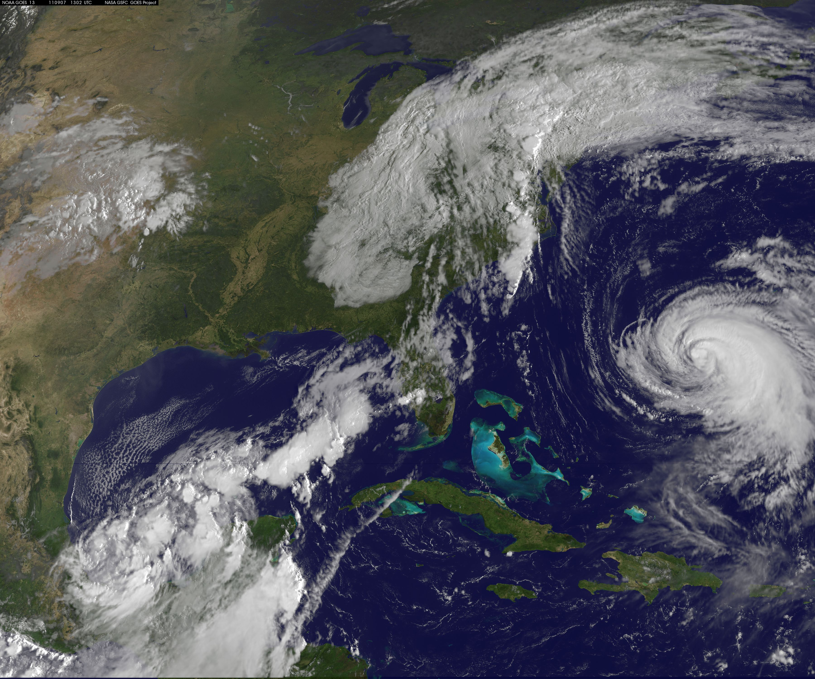
The Vertical Structure of Tropical Cyclone Precipitation as seen by the TRMM Precipitation Radar
Deanna A. Hence
PhD Final Exam
September 8, 2011
Image: NASA
Notes:
Katia far right
Remnants of Lee over east coast
Now TS Nate in Gulf, new TS Maria off screen

Slide 2
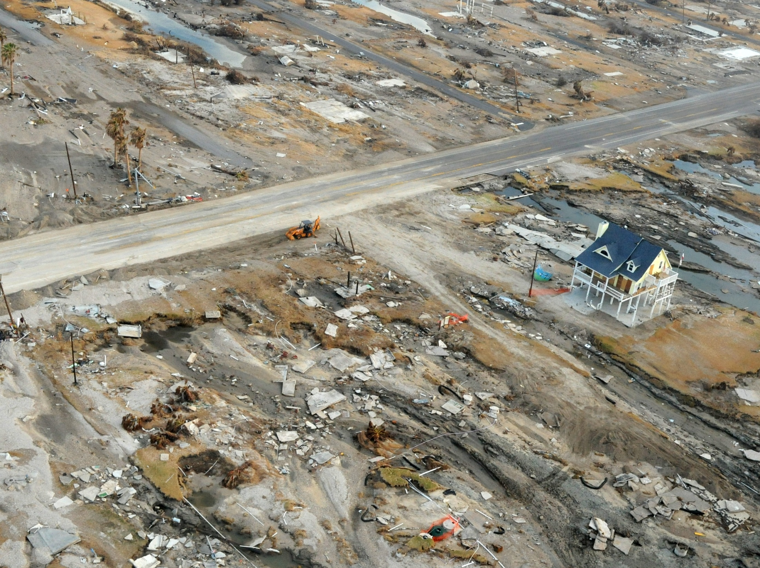
Ike 2008: $30.2 billion damage
195 deaths between US, Cuba, Haiti
Katrina 2005: 1836 deaths
Most expensive hurricane in US
Cyclone Nargis 2008: 138,366 deaths
Jocelyn Augusitno/FEMA
http://www.photolibrary.fema.gov/photolibrary/photo_details.do?id=38895
Notes:
Gilchrist, Texas after Ike.
Katrina $91.1 billion.
1836 deaths in Katrina confirmed in US.
Cyclone Nargis 2008, Myanmar: 138,366 fatalities
Still counting Irene damage despite not being a very intense storm.
Continuing buildup of infrastructure on the coasts, combined with poor human ability to evaluate risk of rare catastrophic events, increases need for understanding.

Slide 3
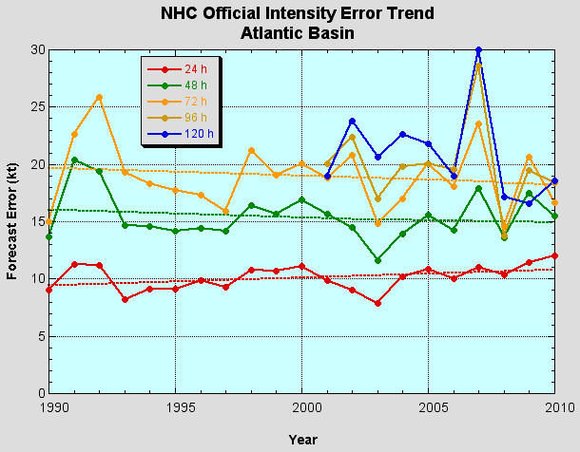
Forecasting intensity still a challenge
From the National Hurricane Center http://www.nhc.noaa.gov/verification/verify5.shtml
Notes:
Over 20 years intensity forecasts haven’t improved much.
Think better understanding of internal tropical cyclone dynamics are needed to get at this problem

Slide 4
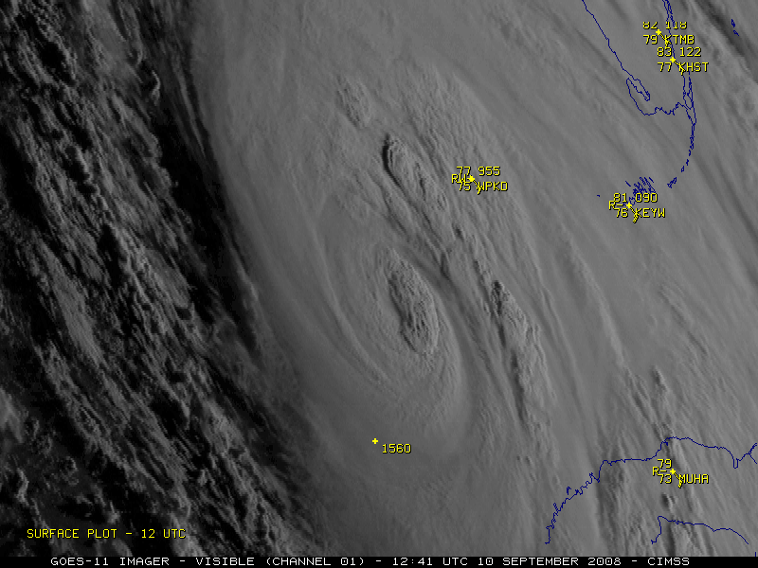
Notes:
4
Hurricane Ike 2008
Satellite advantages: constant coverage over the oceans, especially by geostationary satellites like this one
Pretty but hides what’s underneath

Slide 5
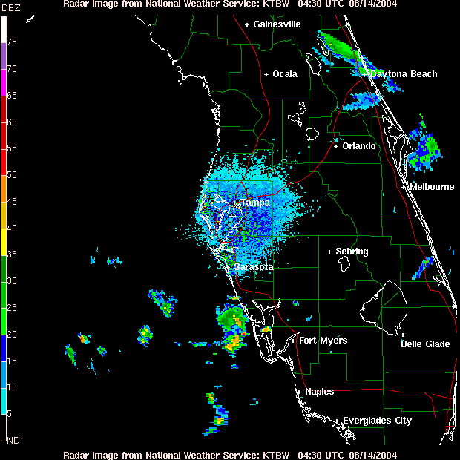
Benefits of Radar
Notes:
Personal favorite method: radars
Radar like CAT Scan of hurricane, tells us where the precipitation (rain, snow, ice) and sometimes winds
Radar reflectivity: sends out radiation, bounces off rain or ice particles
how much comes back related to whether liquid or ice, number, size
High reflectivity = heavy precipitation AND/OR large particles like hail….in this case heavy rain
Hurricane Charley 2004

Slide 6
The current conceptual model
Eye
Houze (2010)
Notes:
Learned from radar studies the basic components of a hurricane
Idealized schematic of tropical cyclone radar echo

Slide 7

August-
September
NSF NOAA NRL NCAR UW UM
Notes:
Collected detailed data from case studies
Wanted to step back and look at what these known features look like statistically.

Slide 8
Objectives of my research…
Identify the typical vertical precipitation structures of tropical cyclone eyewalls and rainbands
Examine how these structures differ with radial distance and around the storm
See how the storm and its environment change these structures

Slide 9
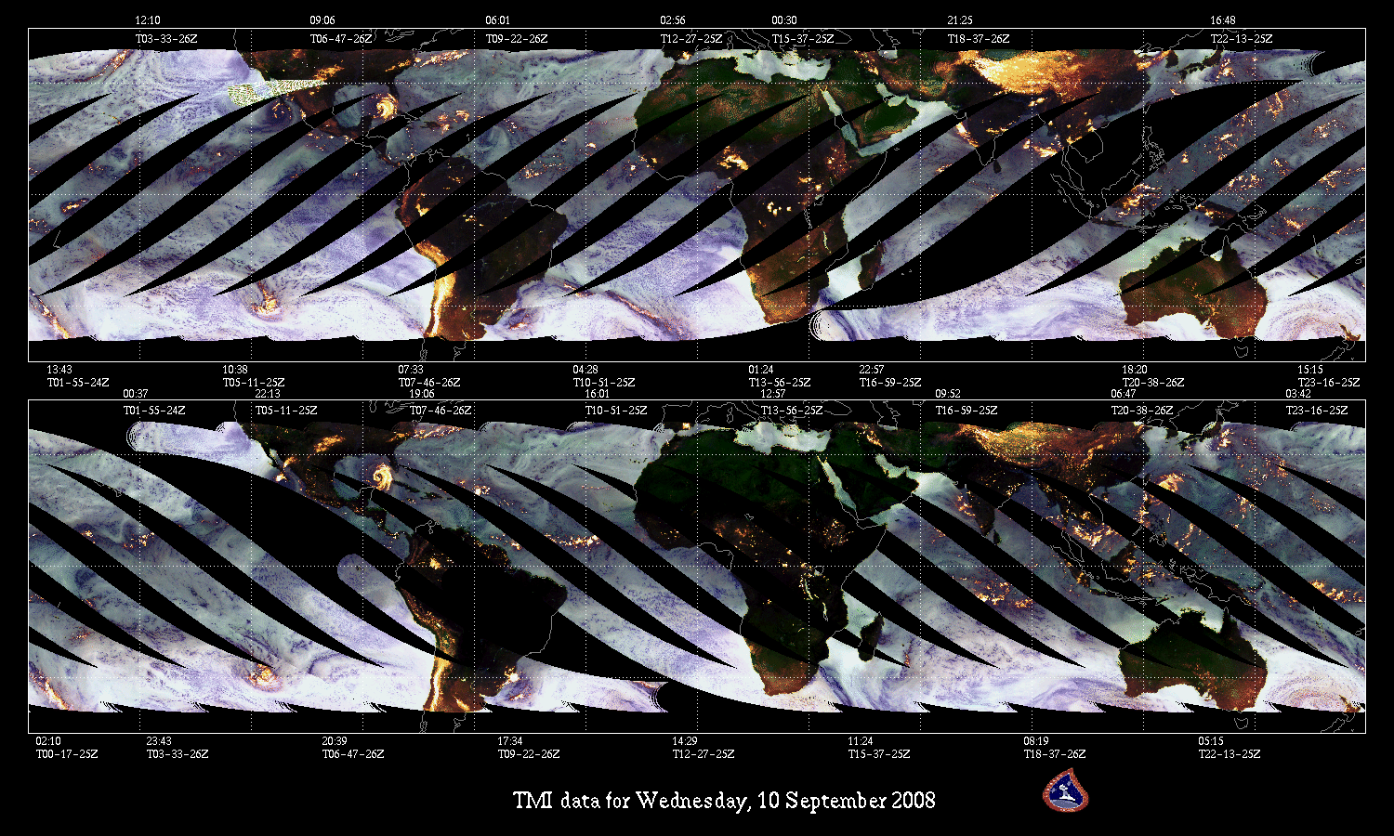
TRMM: Scanning 40°N to 40°S since 1997
From NASA TRMM website (http://trmm.gsfc.nasa.gov/)
Notes:
TRMM = Tropical Rainfall Measurement Mission
Polar orbiter, inclination level at 35 degrees so focuses on the tropics
Carries Microwave Imager, Lightning Sensor and First Ever Spaceborne Precipitation Radar
Advantages: daily high detail obs over the oceans with instruments that can penetrate cloud shield
Disadvantages (of all polar orbiters): still snap-shot, only gets obs 1-3x per day

Slide 10
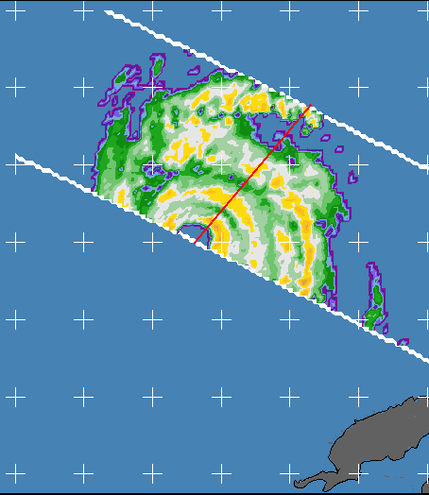
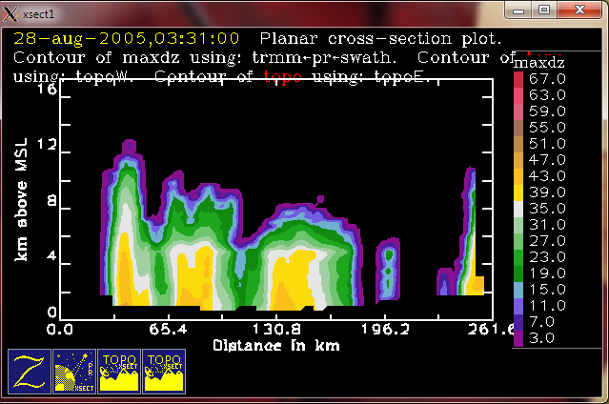
TRMM Precipitation Radar: 3-D View
TRMM PR Reflectivity at 03:26 on 28 August 2005
dBZ
67
35
25N
Reflectivity Crosssection
dBZ
67
Eyewall
12
3
Rainbands
8
km
35
4
22N
89W
86W
83W
3
Notes:
First Ever Spaceborne Radar buys us 3-dimensional view of hurricanes
TRMM PR reflectivity of Hurricane Katrina
Swath width usually too narrow to cover full storm
Can see:
part of high reflectivity ring of eyewall
big inner rainbands
rain cells of outer rainbands
Take cross-section along red arrow
Can see:
intense eyewall echo reaching high altitudes
shallower rainbands
Bit of rain cell
Combine many overpasses of many storms because of narrow swath width.
Use statistics to analyze “typical” structure.

Slide 11
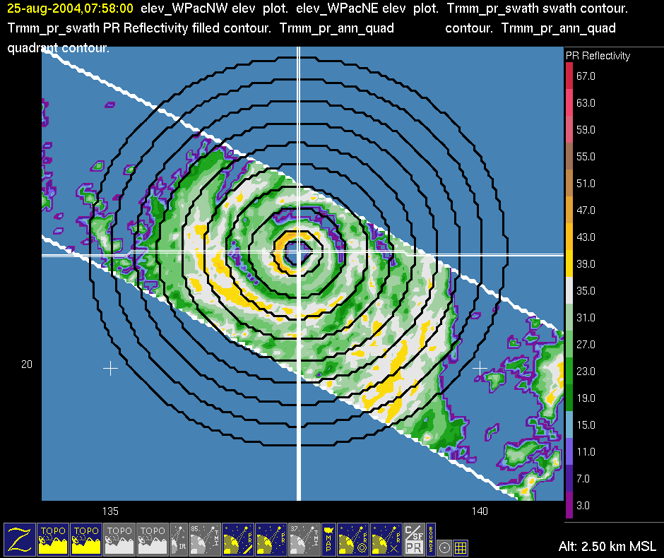
Database Preparation: Center Details
Super Typhoon Chaba
TRMM PR Reflectivity on 24 August 2004
dBZ
67
From the NHC and IBTRACS best track data
Center location
Eye diameter
35
20
3
135
140
Notes:
First must prepare database
NHC and International Best Track Archive for Climate Stewardship Best Track
Center and eye diameter establish rings
Usually evenly spaced

Slide 12
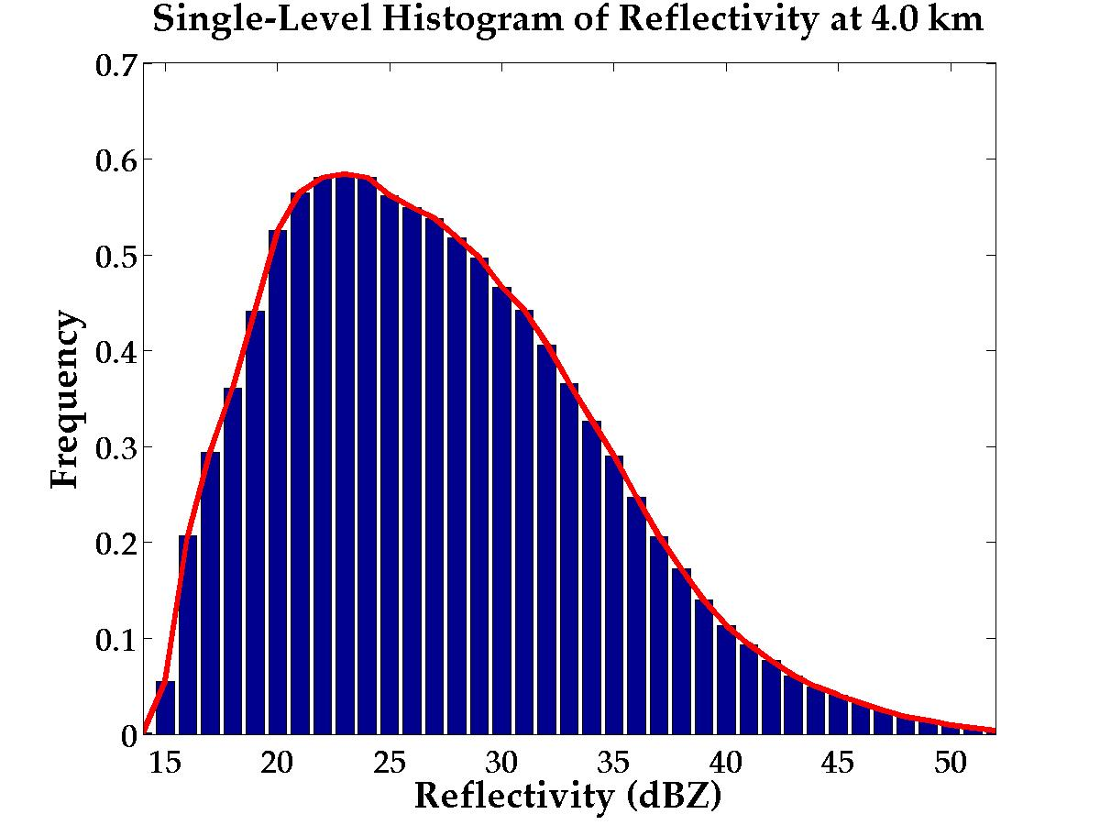
From radars to statistics: histograms
Super Typhoon Chaba
TRMM PR Reflectivity on 24 August 2004
dBZ
67
35
3
135
140
Notes:
12
Zoom in on the Region 6
Count the reflectivity of every pixel at one level
Create histogram of reflectivity pixels at that level
More common = high frequency, rare = low frequency
Intense rain = more high reflectivity pixels counted

Slide 13
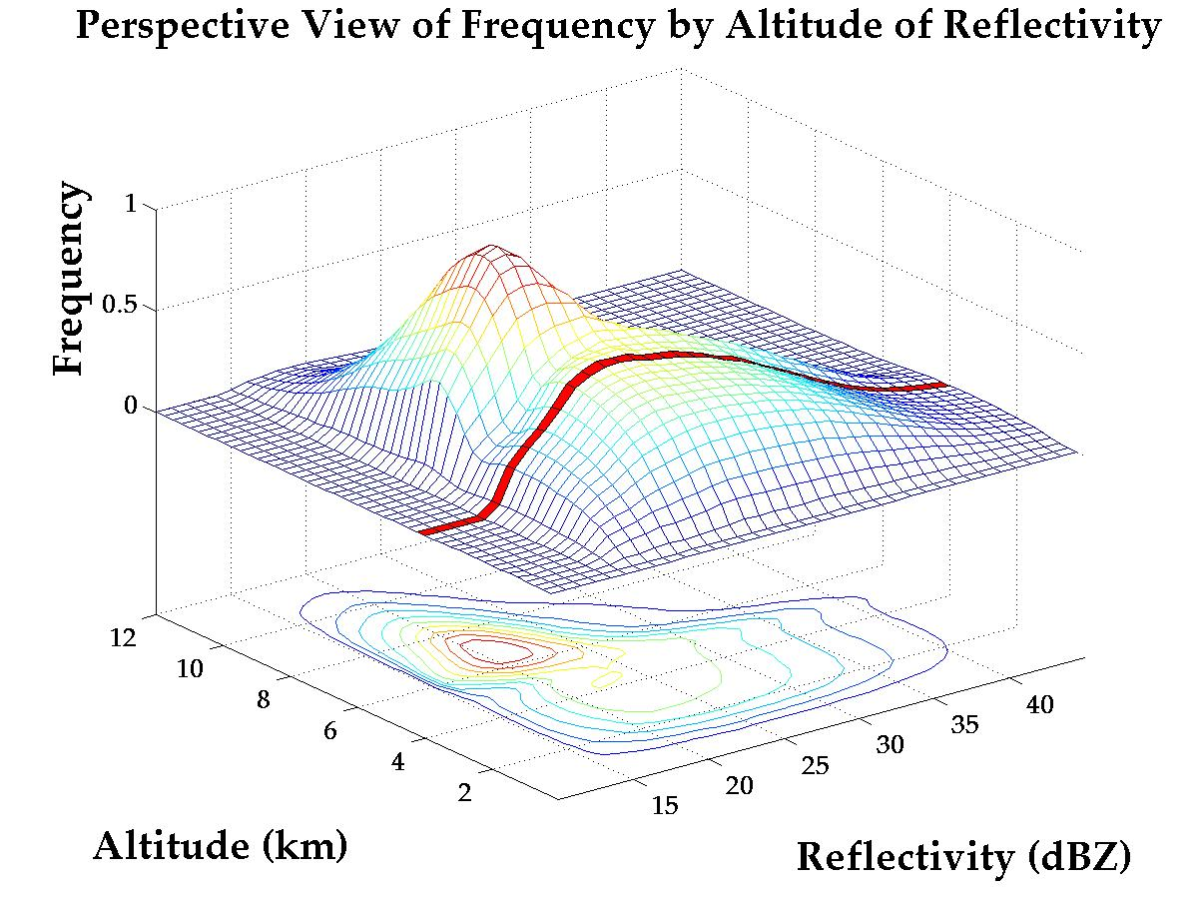
Histograms to Contoured Frequency by Altitude Diagrams (CFADs)
(Yuter and Houze 1995, Houze et al. 2007)
Notes:
Create histograms for every level in atmosphere that you have data
X-axis is reflectivity
Altitude is Y-axis, so this 4 km histogram is red line
Z-axis is frequency
Creates something like a topographic map, where your elevation is frequency of reflectivity values
Do this for every overpass, then combine them together to get sample frequency for all storms.
Can break out in sections to study small parts of storm

Slide 14

Part I: Cases with Single Eyewalls

Slide 15
Notes:
Focusing on when storms only have one of these rings

Slide 16
Notes:
Eyewall of Katrina on 28 August
Beautiful clear eye, sloping eyewall = “stadium effect”
Why do eyewalls look this way?

Slide 17
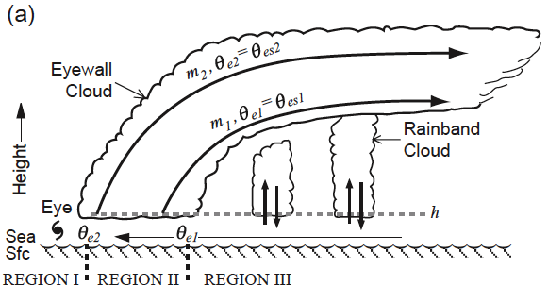
The eyewall at its most basic
Emanuel (1986)
Notes:
Because tropical cyclones have a unique force balance that occurs at particularly high wind speeds
When storm circulation balanced, eyewall main uplift conditionally neutral along sloping lines of momentum and equivalent potential temperature
This is eyewall circulation at its most basic.
Advantage: lots of water moved upward very efficiently, although not very quickly
Unstable perturbations embedded in eyewall inflow manifest as convective towers superimposed on main eyewall cloud
This model does not account for asymmetric uplift in eyewall

Slide 18
Eyewall: Intense, Deep, Unique
Eyewall
Distant Rainbands
Ordinary Oceanic Convection
Sharp Peak
Rapid change
8
Height (km)
5
30
40
30
40
Reflectivity (dBZ)
Notes:
Going to be referring to what the yellow region and the blue outer lines are doing a lot
Modal structure==high frequencies: intense, deep
Outlier structure==low frequencies: even deeper, more intense
Sharp peak, rapid change at melting level—upper-level ice and melting signature
Compared to ordinary tropical oceanic convection: way deeper, way more intense, less connected through melting layer

Slide 19
Eyewalls get stronger with higher intensity
Eyewall
Distant Rainbands
Environment
Category 1 and 2
Category 4 and 5
8
Height (km)
5
30
40
30
40
Reflectivity (dBZ)
Notes:
CAT 12 eyewall: weaker, shallower
CAT 45 eyewall: very intense, deep, very intense outliers, everything more robust

Slide 20
Quadrant Analysis by Wind Shear
Super Typhoon Chaba
TRMM PR Reflectivity on 24 August 2004
UR
UL
dBZ
67
From the NCEP Reanalysis winds
200-800 hPA shear
35
Reflectivity (dBZ)
20
3
DR
DL
Shear
135
140
Notes:
To look at asymmetric structure, divide rings into quadrants
Tried track first, but signal inconsistent..then tried shear and the signal was huge
divide data into quadrants based on mean shear vector
Wind shear is difference in the winds between two layers
Use NCEP Reanalysis u, v winds to calculate 200 and 800 hPa wind vectors 500-750 km from storm center

Slide 21
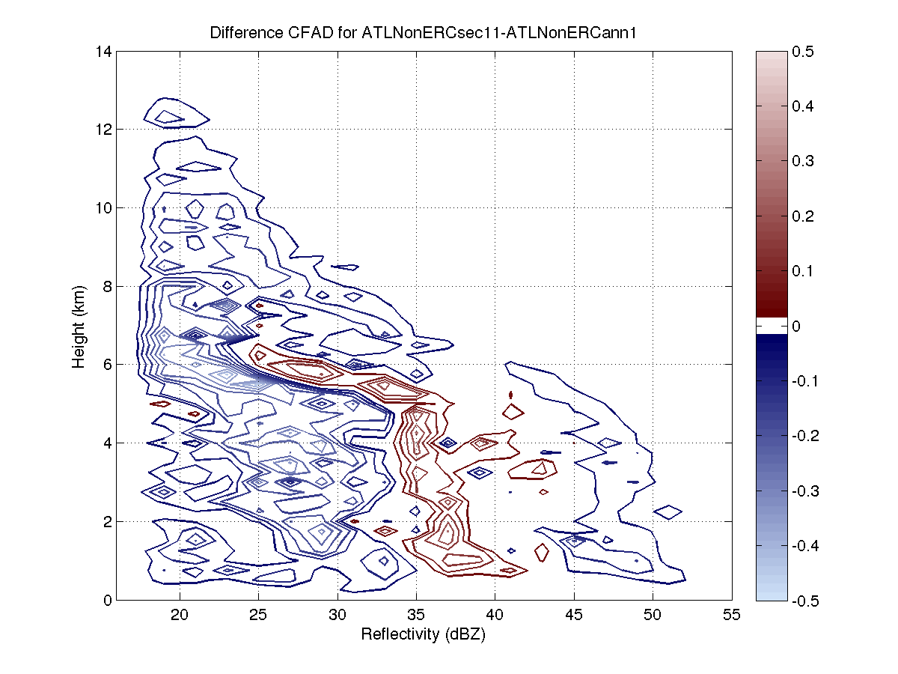
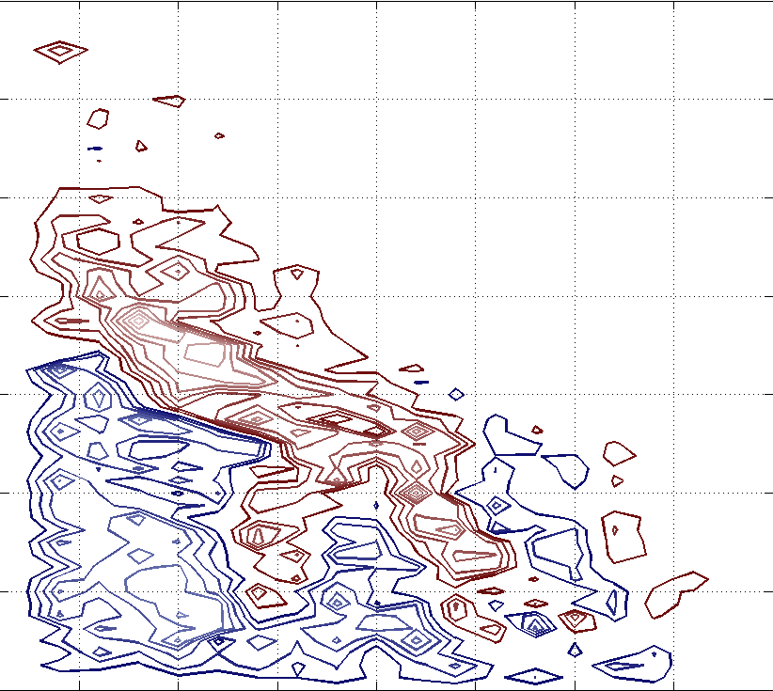
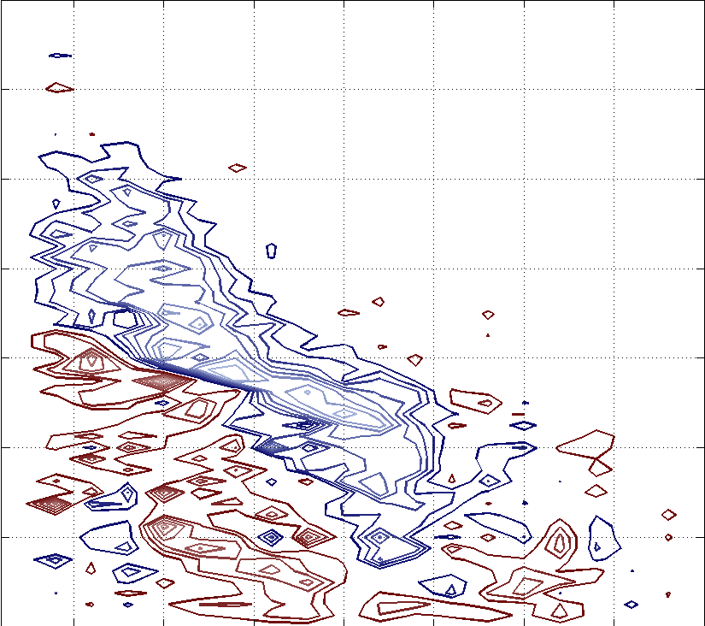
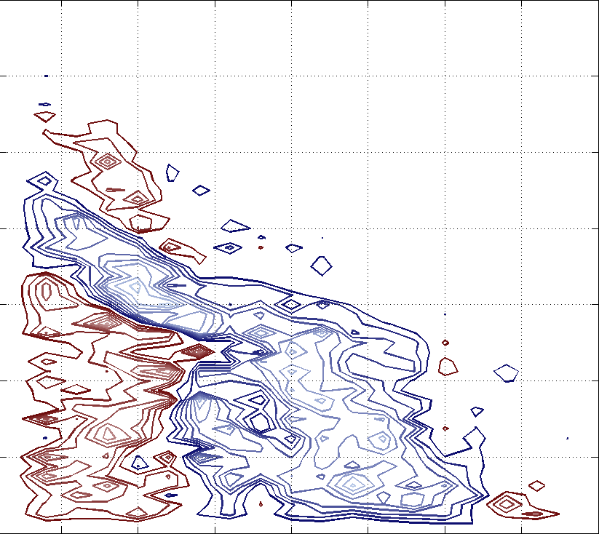
Eyewall asymmetries and wind shear
DL
DR
Shear
Eyewall
8
5
UL
UR
30
40
Reflectivity (dBZ)
30
40
Reflectivity (dBZ)
30
40
Notes:
Took quadrant CFADs and subtracted out total eyewall region CFAD
Red is where there are more points than the mean, blue is where there is less
Buildup of reflectivities in upper levels of DR
Intensifying of low-level reflectivities in DL
Shrinking and weaking of reflectivities in upshear quadrants
Progression of convective cells: initiate in DR, mature in DL, weaken in UL, die in UR

Slide 22
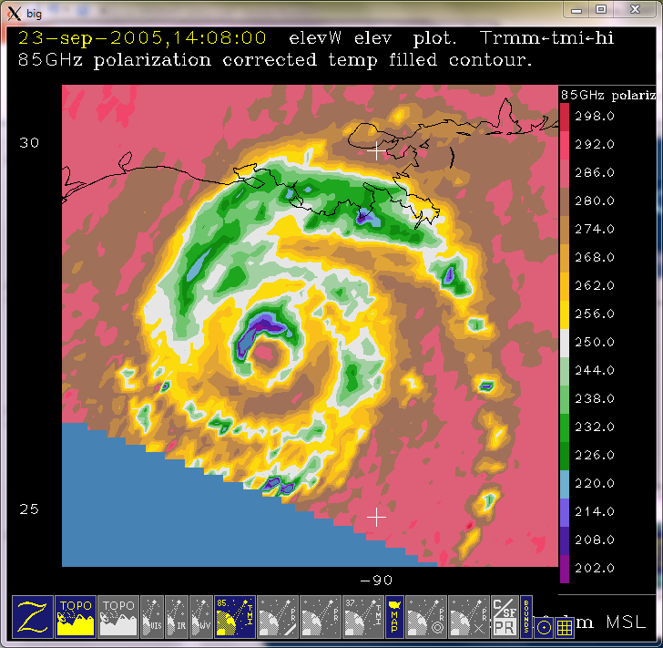
Rita: weaker, but holding on
TRMM TMI Brightness Temperature at 13:47 on 23 Sept 2005
More Ice
Shear direction
Notes:
TRMM Microwave Imager, sensitive to precipitation-sized ice
Blue is more ice, which means more convection
Can see pattern seen in quadrant CFADs…initiation in DR, maturation in DL, weakening in UL, nothing in UR.
Pattern itensifies with increasing wind shear, pushing convection and rain more and more into DL

Slide 23
Summary of Eyewall Structure
Eyewall precipitation is intense and deep
Deeper and more intense perturbations on mean eyewall structure
The mean structure deepens and intensifies with greater storm intensity
The mean circulation becomes more asymmetric with greater wind shear

Slide 24
Part II: Concentric Eyewalls
Notes:
Focusing now on when there are more then one eyewalls

Slide 25
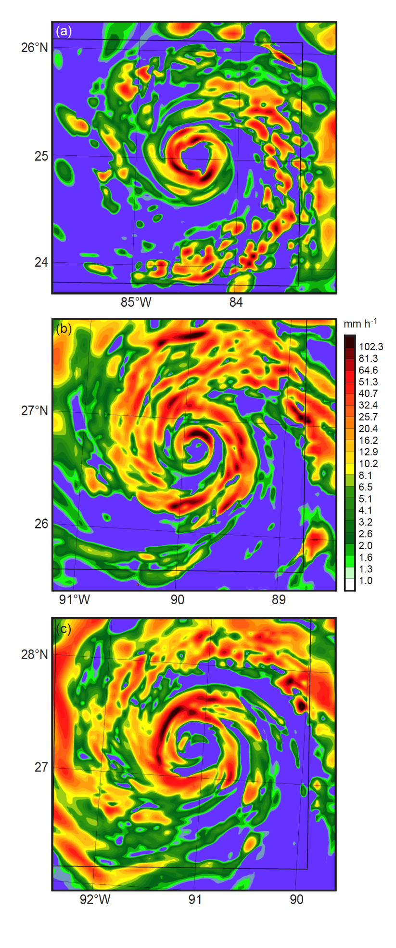

What is an Eyewall Replacement Cycle?
MM5 simulation done in the field
Courtesy Shuyi Chen
Notes:
It is what it sounds like

Slide 26
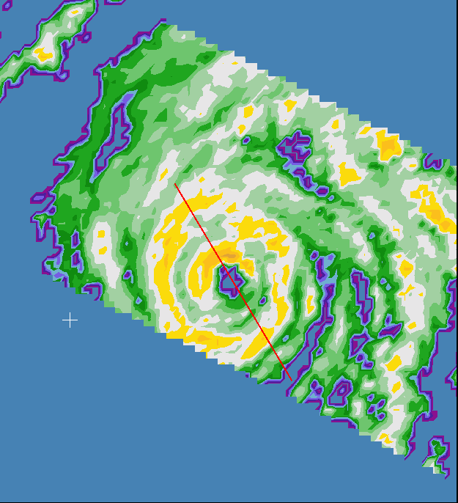
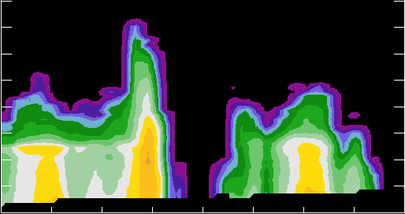
Two eyewalls seen by TRMM
TRMM PR Reflectivity at 14:43 on 22 Sep 2005
Reflectivity Crosssection
dBZ
Inner Eyewall
67
12
Outer Eyewall
Outer Eyewall
8
Inner Eyewall
35
km
4
25N
moat
moat
3
90W
Notes:
Inner eyewall highly asymmetric
Outer eyewall almost as intense, fully circular, much shorter
Light precipitation region between two eyewalls is called the moat…sometimes fully precipitation free

Slide 27
Concentric eyewall conceptual model
**
*
**
*
Houze et al. (2007)
Notes:
Warm inflow over ocean surface
Some diverted by newly formed eyewall
Rest lifts in older eyewal, outflow lying over new eyewall
Compensating subsidence in eye and regions between two eyewalls

Slide 28
One is not like the other
Inner Eyewall
TRMM PR Reflectivity at 14:43 on 23 Sep 2005
8
5
dBZ
67
3
25
35
35
Outer Eyewall
8
25N
pinched
Height (km)
3
5
25
35
90W
Reflectivity (dBZ
Notes:
Had to space rings subjectively because of varying moat widths.
Inner eyewall looks like usual eyewall, a little shorter
Outer eyewall low levels squeezed together and scooted over
Dramatic pinching in distribution of melting layer is rainband-like signature
Think it signals disconnection between upper and lower levels

Slide 29
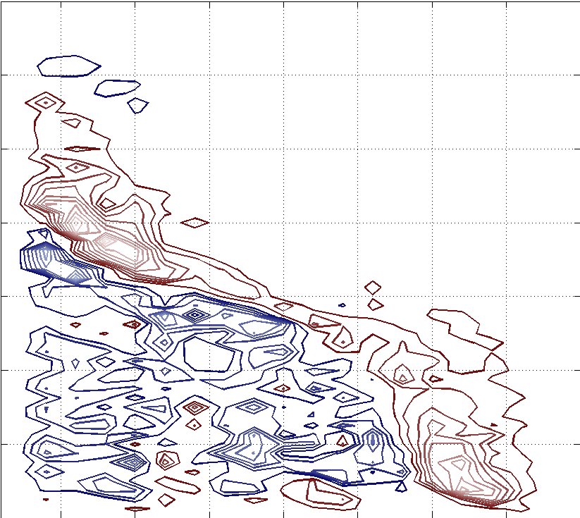
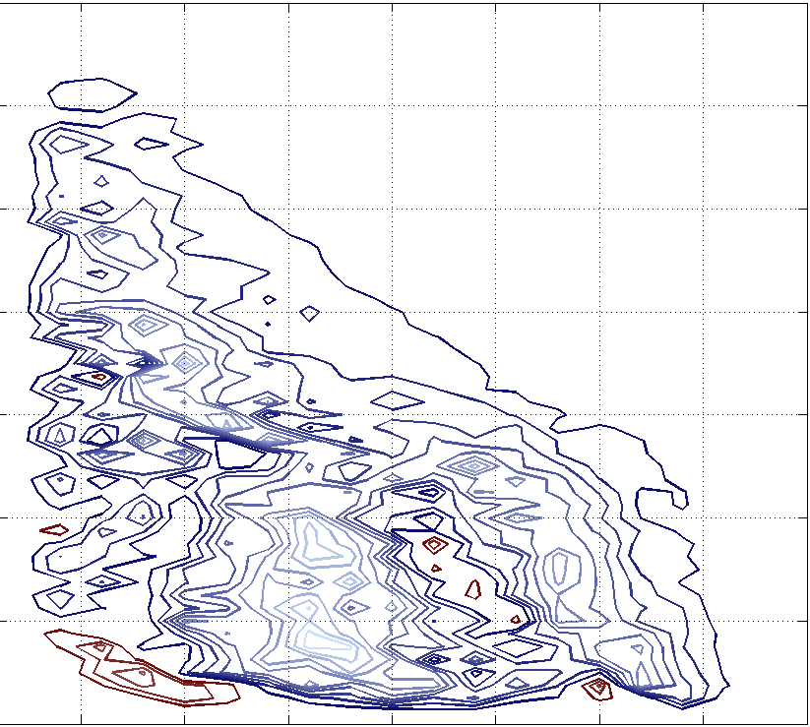
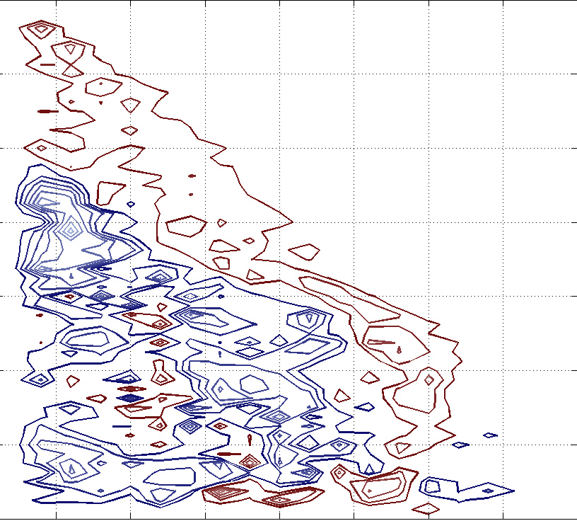
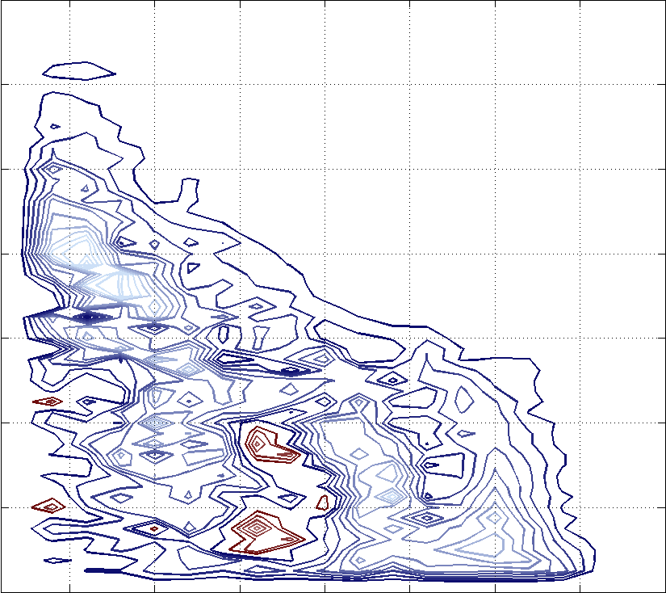
The inner eyewall quadrants
DL
DR
Shear
8
Height (km)
5
UL
UR
25
35
Reflectivity (dBZ)
25
35
Reflectivity (dBZ)
25
35
Notes:
Same differencing, but now with inner eyewall
Looks like a high shear case…high reflectivities very concentrated to left-of-shear side, especially DL
Right-of-shear side suppressed

Slide 30
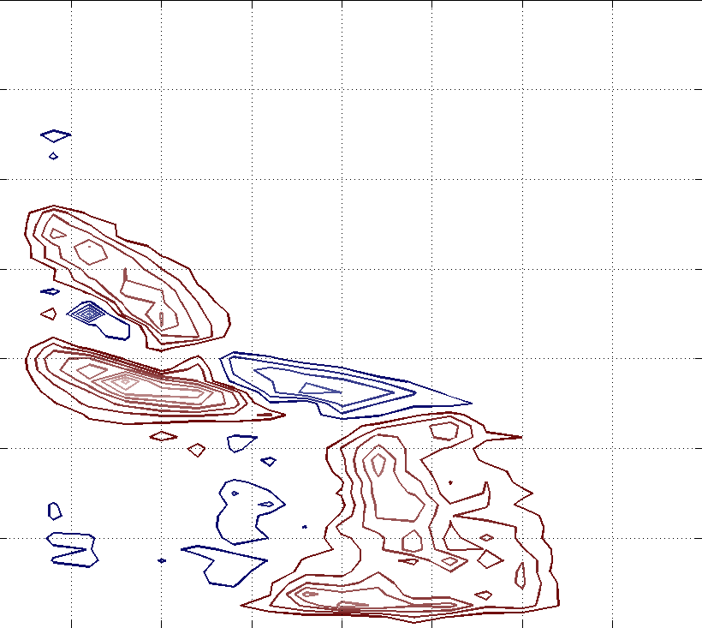
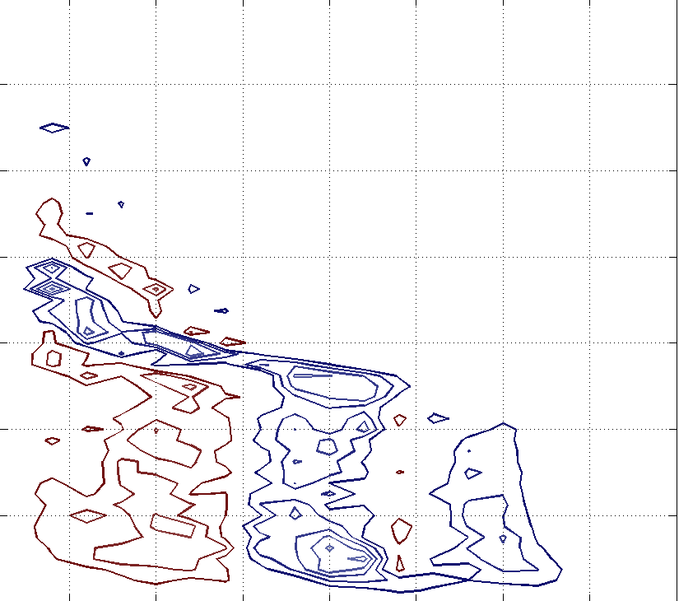
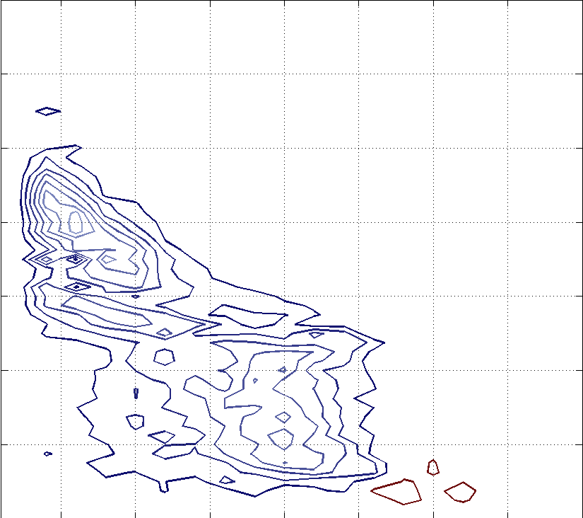
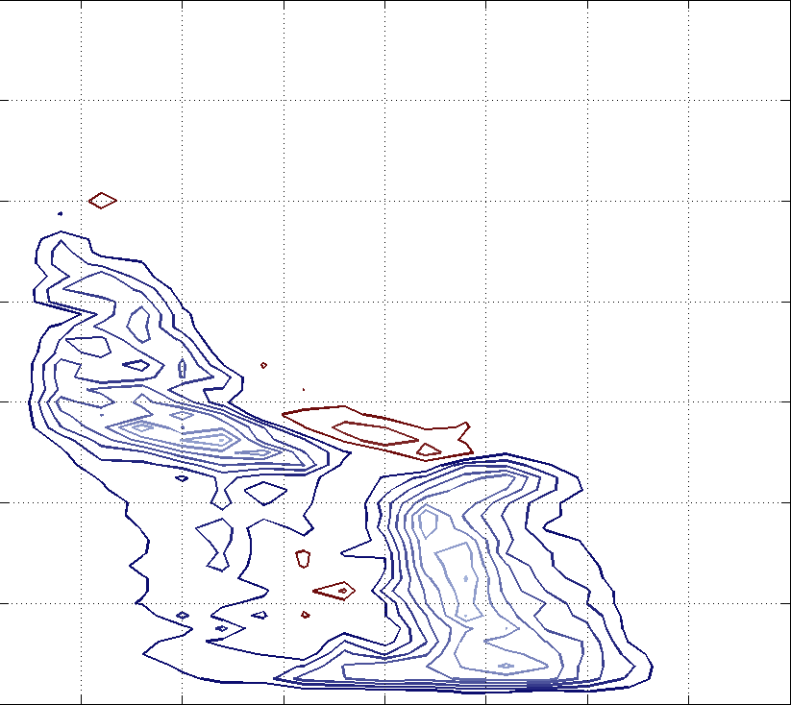
The outer eyewall quadrants
DL
DR
Shear
8
Height (km)
5
UL
UR
25
35
Reflectivity (dBZ)
25
35
25
35
Reflectivity (dBZ)
Notes:
DL has some intensification and higher echo
UR some weakening
Similar pattern, but all happening at lower levels
Think convection and resulting echo locally generated

Slide 31
Single Eyewall
Inner Eyewall
Outer Eyewall
Notes:
In general, outer eyewall more symmetric than inner eyewall
Single eyewall has slightly greater coverage in left of shear quadrants, low-level mean reflectivity similar
Inner eyewall big disparity in echo coverage and mean reflectivity, especially in upper levels
Outer eyewall, some disparity in echo coverage but very little in mean reflectivity

Slide 32
The New Conceptual Model
Notes:
Idealized radar schematic that is consistent with statistics shown
Convective progression in inner eyewall exaggerated version of single eyewall
Convective cells in outer eyewall live and die locally, but DL convection amped up
Because of high wind speeds, small ice particles can circumnavigate inner eyewall…distances involved and lower wind speeds in outer eyewall don’t allow ice to get very far

Slide 33
In addition: Vertical Information
Notes:
Cross section DL to UR, cutting through most and least intense portions of eyewalls
Left of shear side more intense
Right of shear side less so
Seeing bottom portion of convection on left of shear side of inner eyewall
Seeing ice exhaust (top portion) of DL convection on the right of shear side of inner eyewall

Slide 34
Summary of Concentric Eyewall Structure
While active, the inner eyewall maintains many of its original characteristics
The outer eyewall is intense, but uniform and constrained by the eyewall
The outer eyewall is rainband-like above, building eyewall-like convection from below

Slide 35
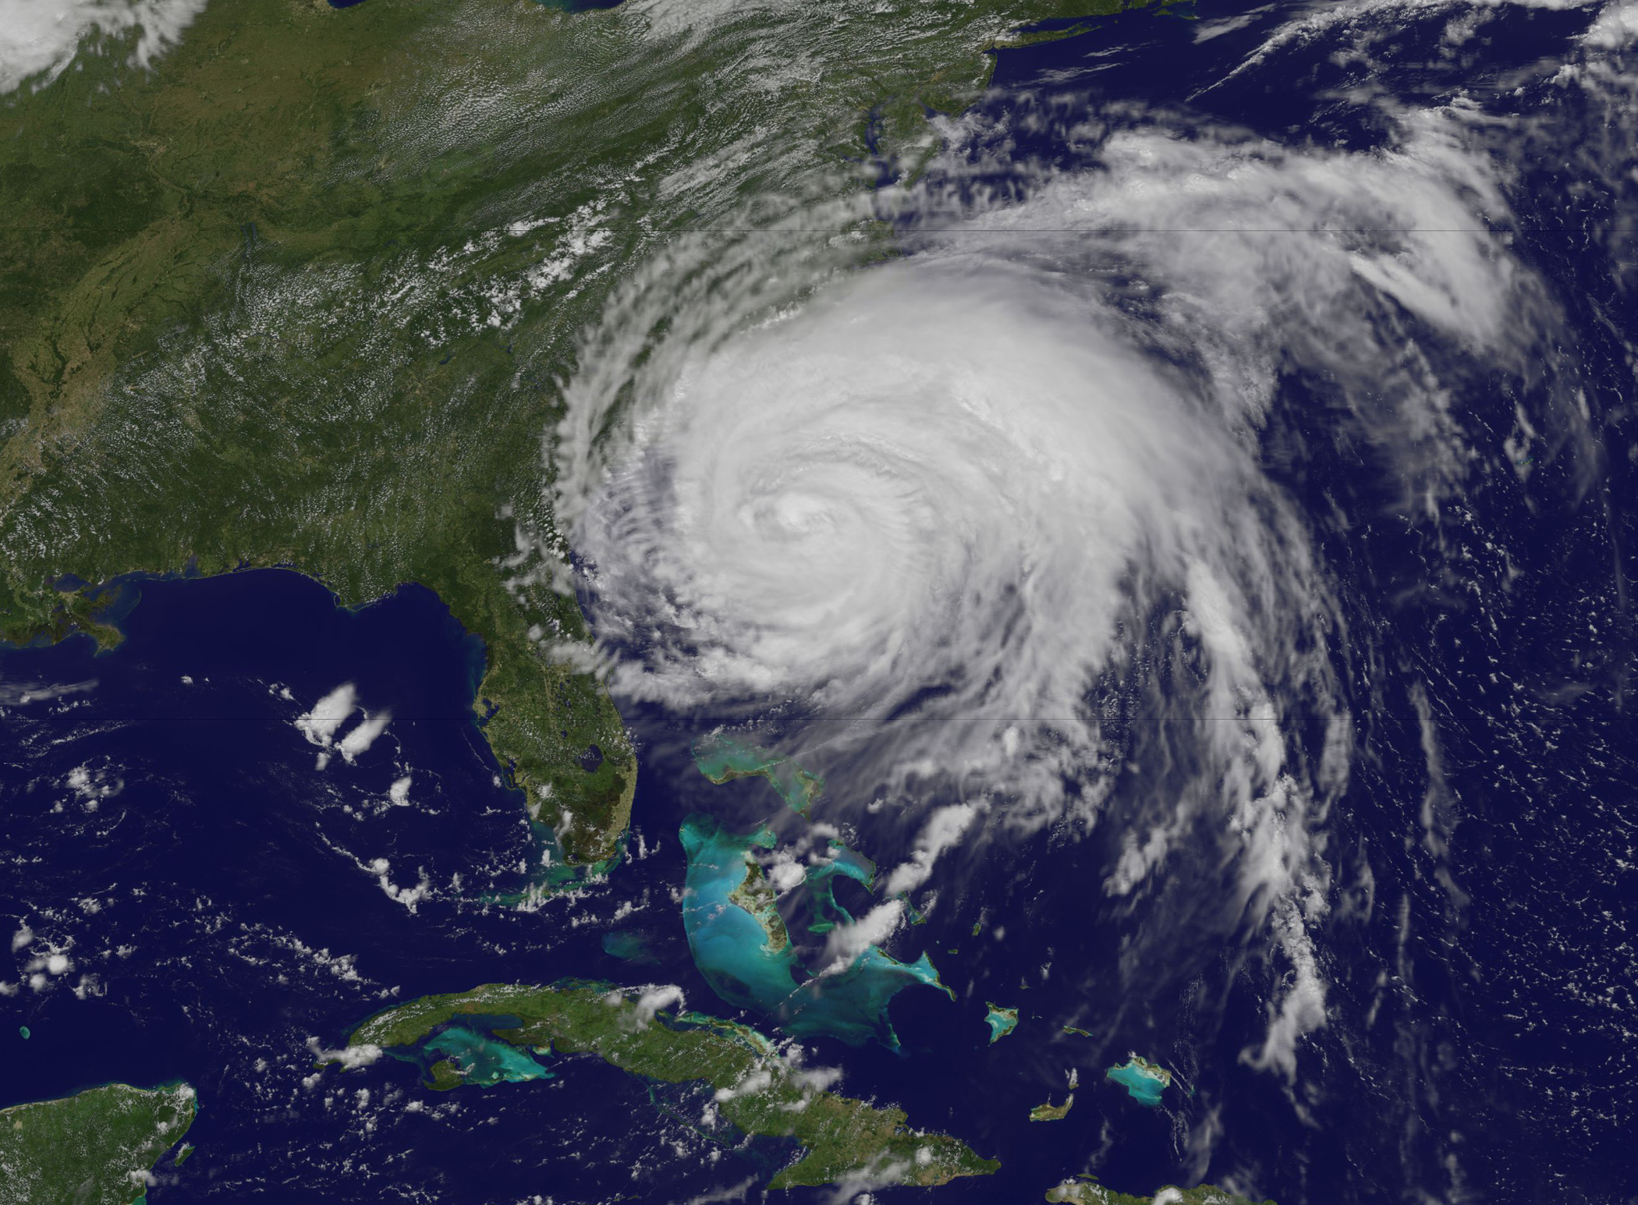
Part III: The Rainbands
Notes:
Showing how rainbands extend impacts of tropical cyclones way beyond storm center

Slide 36
Notes:
Covering everything outside of the eyewall regions now

Slide 37
A New Spiral Rainband Model
Inner
Outer
Notes:
Idealized schematic drawn to be consistent with statistics
Noticed a regime change between regions 5 and 6….
change in rate of change of fraction of coverage
convective fraction
change from more homogeneous stratiform precipitation to cellular convection with radial distance
Also asymmetric…rainband convection organizes into coherent lines in UR, mature and develop in DR, collapse in DL into stratiform with some blowover to UL

Slide 38
Two Layers
Inner
Outer
Notes:
Inner region rainbands more intense in low levels but less above
Excess Kurtosis—measure of peakedness or flatness of distribution
Positive = peaked
Negative = flat
Inner regions less flat in low levels, stay peaked in upper levels = high uniformity and homogeneity
Outer regions more flat in low levels, peaks in upper levels but then becomes negative again = more heterogeneity in structure
Major dip in kurtosis between 5-6 km = melting layer
Biggest dip in inner regions
Smaller in outer regions
Sign of seperation between upper and lower microphysical regimes

Slide 39
Vertical Structure of Rainbands
Notes:
Now looking UL to DR to maximize seeing convection in rainbands
Eyewall outflow above inner regions, asymmetric as shown before….now seeing more of the upper-level structure on the left side
Left-of-shear side mostly stratiform that is most robust closer to center
Right-of-shear side highly convective, inner rainband convection constrained to surface, gains some height away from eyewall outflow

Slide 40
Stronger storms have dissimilar inner and outer rainbands
Notes:
Weaker storms, rainbands more similar in intensity and characteristics
Stronger storms, vertical constraint on inner rainbands more intense
Suggests as vortex gets stronger, its influence upon rainbands also stronger

Slide 41
Higher shear makes inner rainband convection more asymmetric
Notes:
In low shear cases, distribution of convection and rainband intensity fairly even…more downshear/upshear asymmetry
As shear intensifies, convection becomes more and more downshear left, disparity between quadrants widens significantly
Outer rainbands unaffected, may get DL ice blowoff in really high shear

Slide 42
Conclusions
The vertical precipitation structure of eyewalls:
Single eyewalls: deep, intense, with deeper and more intense outliers
Inner eyewalls: similar to single eyewalls but less deep
Outer eyewalls: intense, uniform, constrained by inner eyewall

Slide 43
Conclusions
The vertical precipitation structure of rainbands:
Inner region rainbands: uniform, stratiform, vertically constrained convection, upper separate from lower
Outer region rainbands: sparse, convective, upper more connected to lower

Slide 44
Conclusions
Impacts of higher storm intensity:
Eyewall precipitation structure intensifies
Vertical constraint on inner rainbands strengthens
Impacts of higher shear:
Uneven convection in eyewall and inner rainbands
Rainfall pushed to left-of-shear quadrants
Notes:
Acknowledgements:
Bob
Brad, Mike, Shuyi, Eve (GSR), Cliff
Beth and Stacy == lifesavers
Mesoscale Group
Various colleagues in department, in and outside of university
Paul, family
Many friends
Don’t want to drag on, hope to thank everyone individually

