Slide 1
Modeling the General Circulation of the Atmosphere.
Topic 1: A Hierarchy of Models
Dargan M. W. Frierson
University of Washington, Department of Atmospheric Sciences
TopiC 1, Day 1: 1-7-12

Slide 2
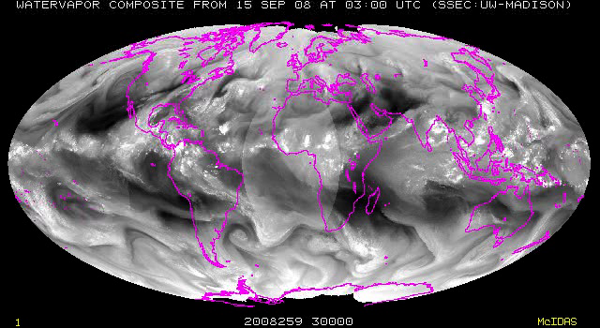
Modeling the General Circulation

Slide 3
In this class…
We’ll study:
  The “general circulation” of the atmosphere
  Large scale features of the climate

Slide 4
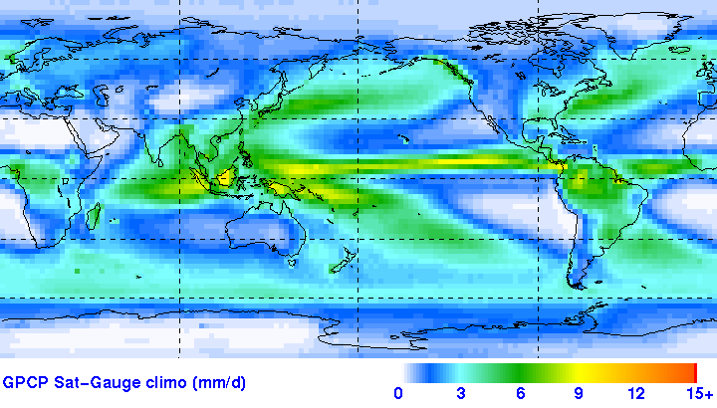
Questions like…
What determines the precipitation distribution on Earth?
GPCP Climatology (1979-2006)

Slide 5
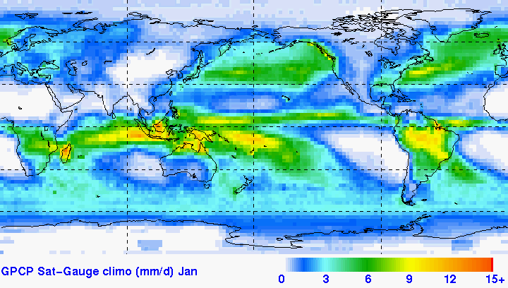
Questions like…
What determines the precipitation distribution on Earth?
GPCP (1979-2006)

Slide 6
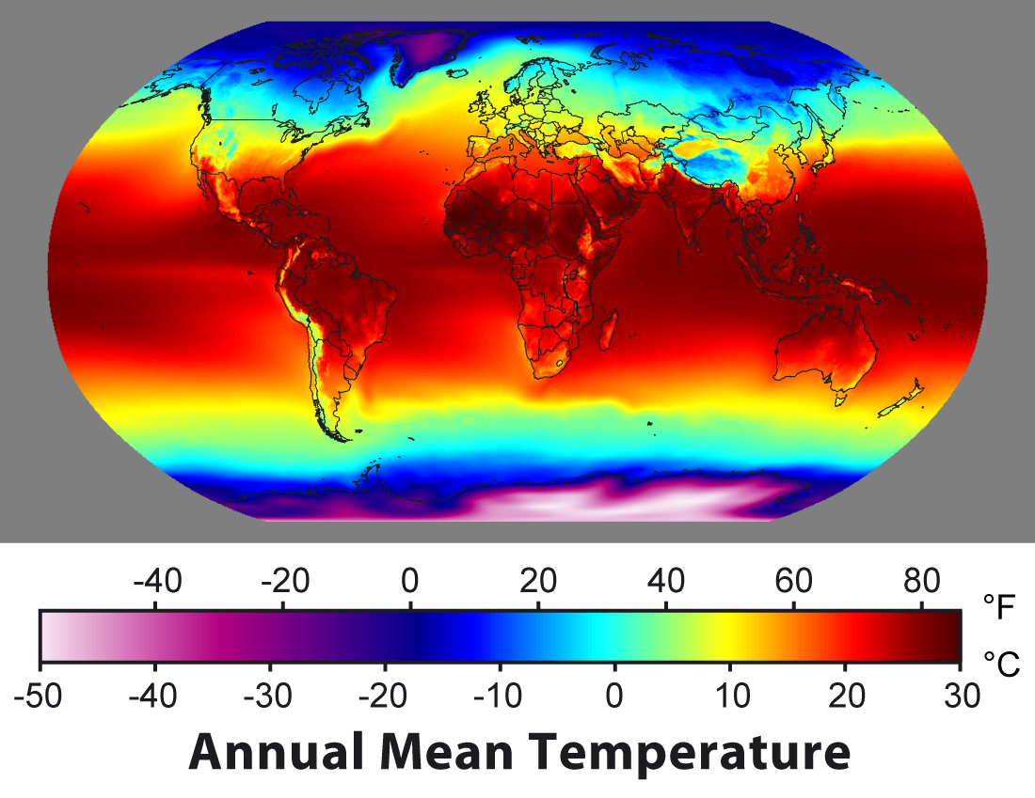
Questions like…
What determines the north-south temperature distribution on Earth?

Slide 7
Questions like…
What determines the vertical temperature structure on Earth?
Dry static energy from NCEP reanalysis

Slide 8
Questions like…
What determines the vertical temperature structure on Earth?
Moist static energy from NCEP reanalysis

Slide 9
Questions like…
What determines the location/intensity of the jet streams?
Zonally averaged zonal winds from NCEP reanalysis

Slide 10
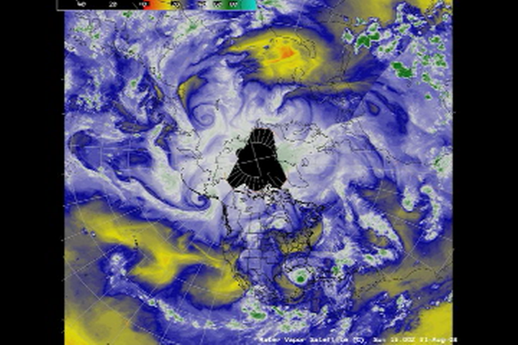
Questions like…
What determines the intensity of eddies?

Slide 11
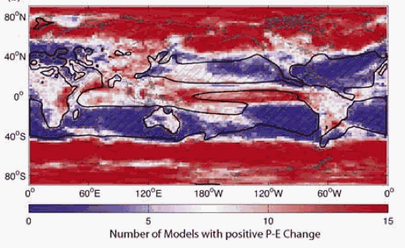
Questions like…
How will these change with global warming?
Rainy regions get rainier, dry regions get drier
From Lu et al 2006

Slide 12
First: General Circulation Models (GCMs)
What are the components of these models?
What are the essential physical processes that are being modeled?
What are the simplest mathematical models that can capture the basic physics?
How have the parameterizations evolved over the history of climate modeling?

Slide 13
AGCM Components
AGCM: Atmospheric General Circulation Model
“Dynamics”:
  Fluid equations on a rotating sphere
“Physics”:
  Radiative transfer
  Surface fluxes/boundary layer scheme
  Clouds
  Moist convection

Slide 14
Dynamical Cores of AGCMs
Fluid motion on the sphere!

Slide 15
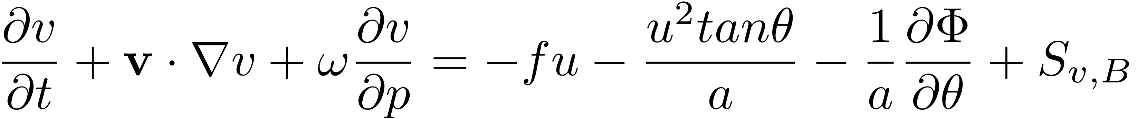
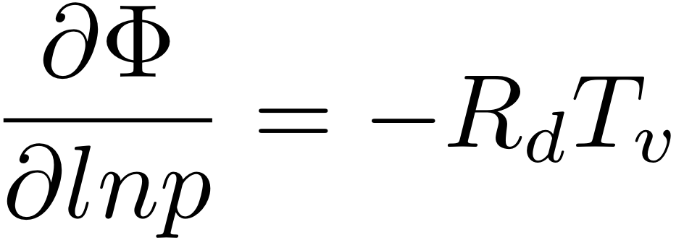
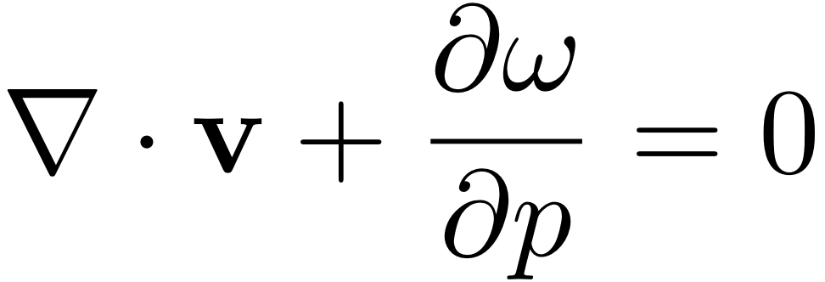
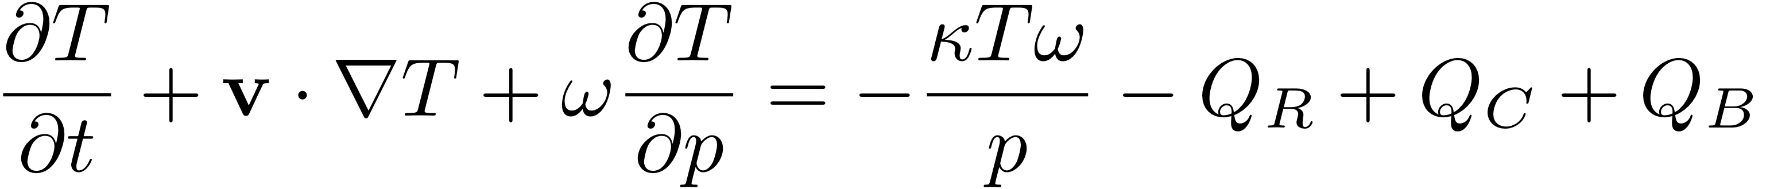
Dynamical Cores of AGCMs
The primitive equations:
Coordinates: = (longitude, latitude, pressure)

Slide 16
Dynamical Cores of AGCMs
Horizontal momentum equations:

Slide 17
Dynamical Cores of AGCMs
Horizontal momentum equations:
Metric terms

Slide 18
Dynamical Cores of AGCMs
Horizontal momentum equations:
Pressure gradient term
= geopotential

Slide 19
Primitive equations
Vertical momentum eqn. is hydrostatic balance

Slide 20

Hydrostatic balance
Vertical momentum equation:
In z-coordinates, written as:
Key assumption: atmosphere is a very thin film
  Small aspect ratio (100 km horizontal grid size)
Cloud resolving models are nonhydrostatic

Slide 21
Hydrostaticity
2x2.5 deg GCMs are reeeeally hydrostatic
Garner Frierson Held Pauluis and Vallis (2007, JAS):
  Ran a nonhydrostatic model at GCM resolution (2x2.5 degrees)
  Multiplied nonhydrostatic terms by a constant
    Makes convection occur at larger scales and have slower growth rates
    Same as “DARE” method of Kuang, Bretherton & Blossey
  We had to multiply nonhydrostatic terms by 10000 before we started to see effects!

Slide 22
Dynamical Cores of AGCMs
Mass conservation:
Mass conservation equation
Looks incompressible, but it isn’t. Pressure coordinates makes this form possible
(requires hydrostatic balance too).

Slide 23
Dynamical Cores of AGCMs
Thermodynamic equation:
Temperature changes
due to compression and
expansion

Slide 24
Dynamical Cores of AGCMs
Source terms: where much of the complexity comes in
“Physics”

Slide 25
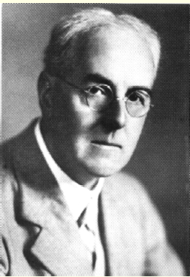
The First Numerical Model of the Atmosphere
Lewis Fry Richardson: British
mathematician, physicist,
atmospheric scientist
  Scientific career very influenced
  by his Quaker beliefs (pacifism)
Made the first numerical weather
prediction in 1922
  Did the calculations completely by
  hand! Took over 1000 hours!
Also had a dream of the future of
weather prediction…
All info on this topic is from Peter Lynch: Check out his book “The Emergence of NWP”!

Slide 26
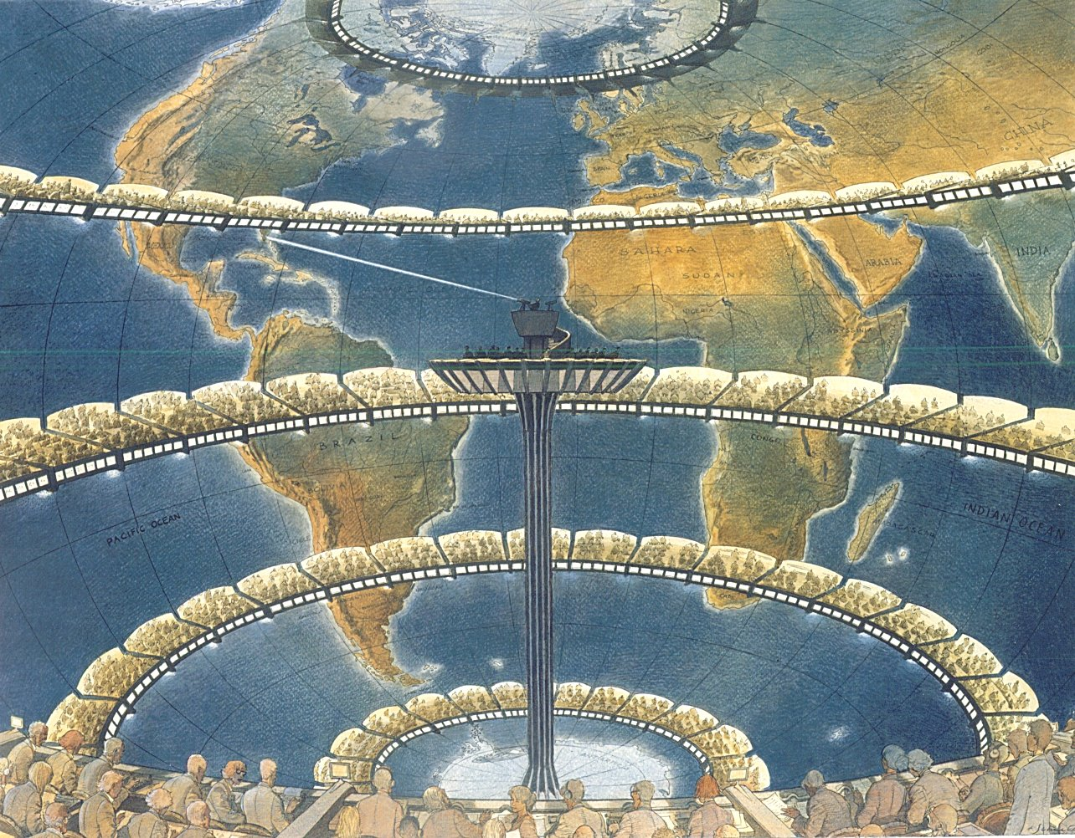
Richardson’s Dream: The Forecast Factory
Filled with employees (“computers”) doing calculations
Richardson’s dream in
1922 of a global
forecasting system
He estimated 64,000
“computers” (people)
would be necessary to
forecast over the globe

Slide 27
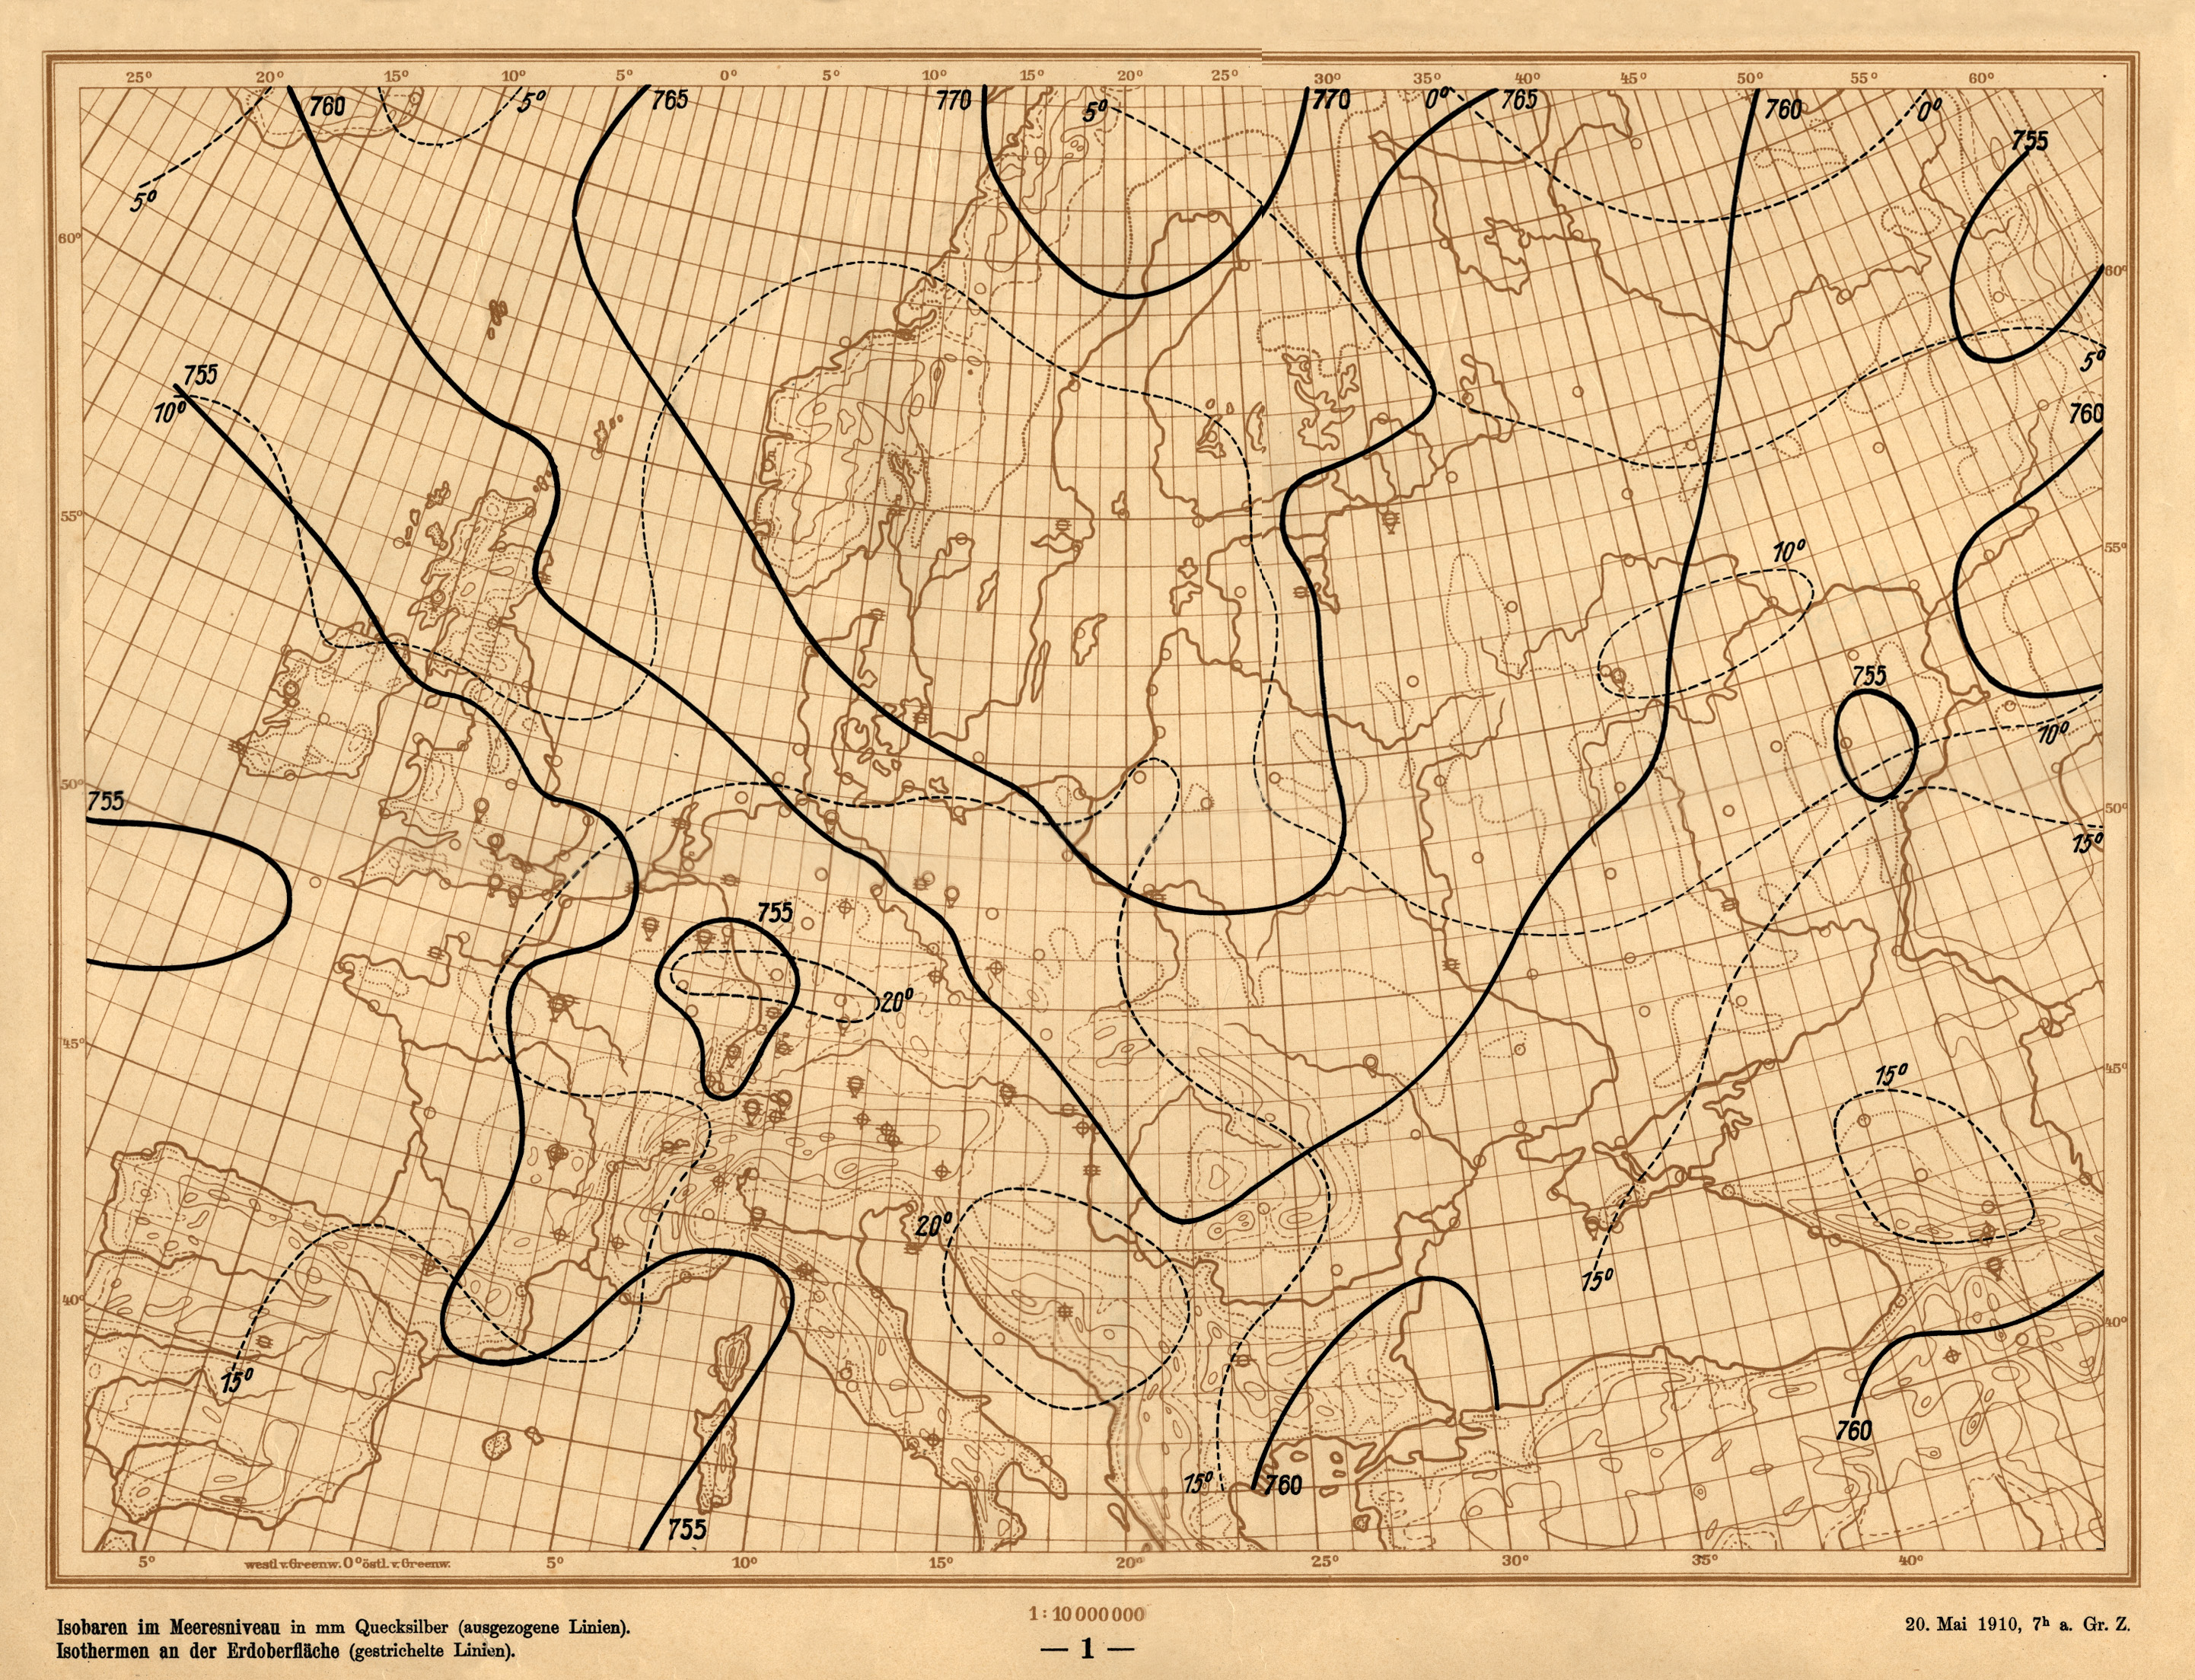
Richardson’s Experiment
Used data from
May 20, 1910
Halley’s comet was passing, and there was a large hot air balloon observational campaign to study effect of comets on weather.
SLP and surface
temperature

Slide 28
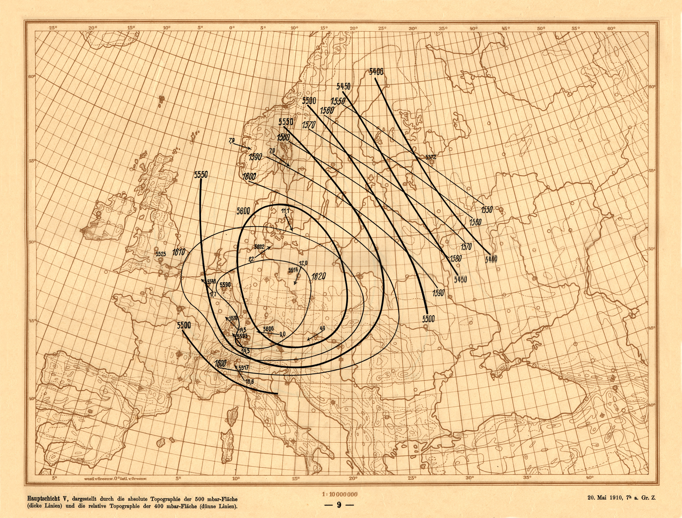
Richardson’s Experiment
Tabulated values
from these charts
by hand!
500 mbar heights
and 500-400 mbar
thickness

Slide 29
Richardson’s Calculations
Served as ambulance driver with the Friends’ Ambulance Unit in France during WWI
  Transported injured soldiers, often under heavy fire
Took six weeks to perform the calculations
  “My office was a heap of hay in a cold rest billet”
  Peter Lynch thinks he meant 6 weeks*7 days*24 hours = 1000 hours of computation!
    I.e., it took him the whole time he was in France, 2 years
Calculation book was lost during the battle of Champagne
  But recovered months later under a heap of coal
Eventually published in 1922

Slide 30
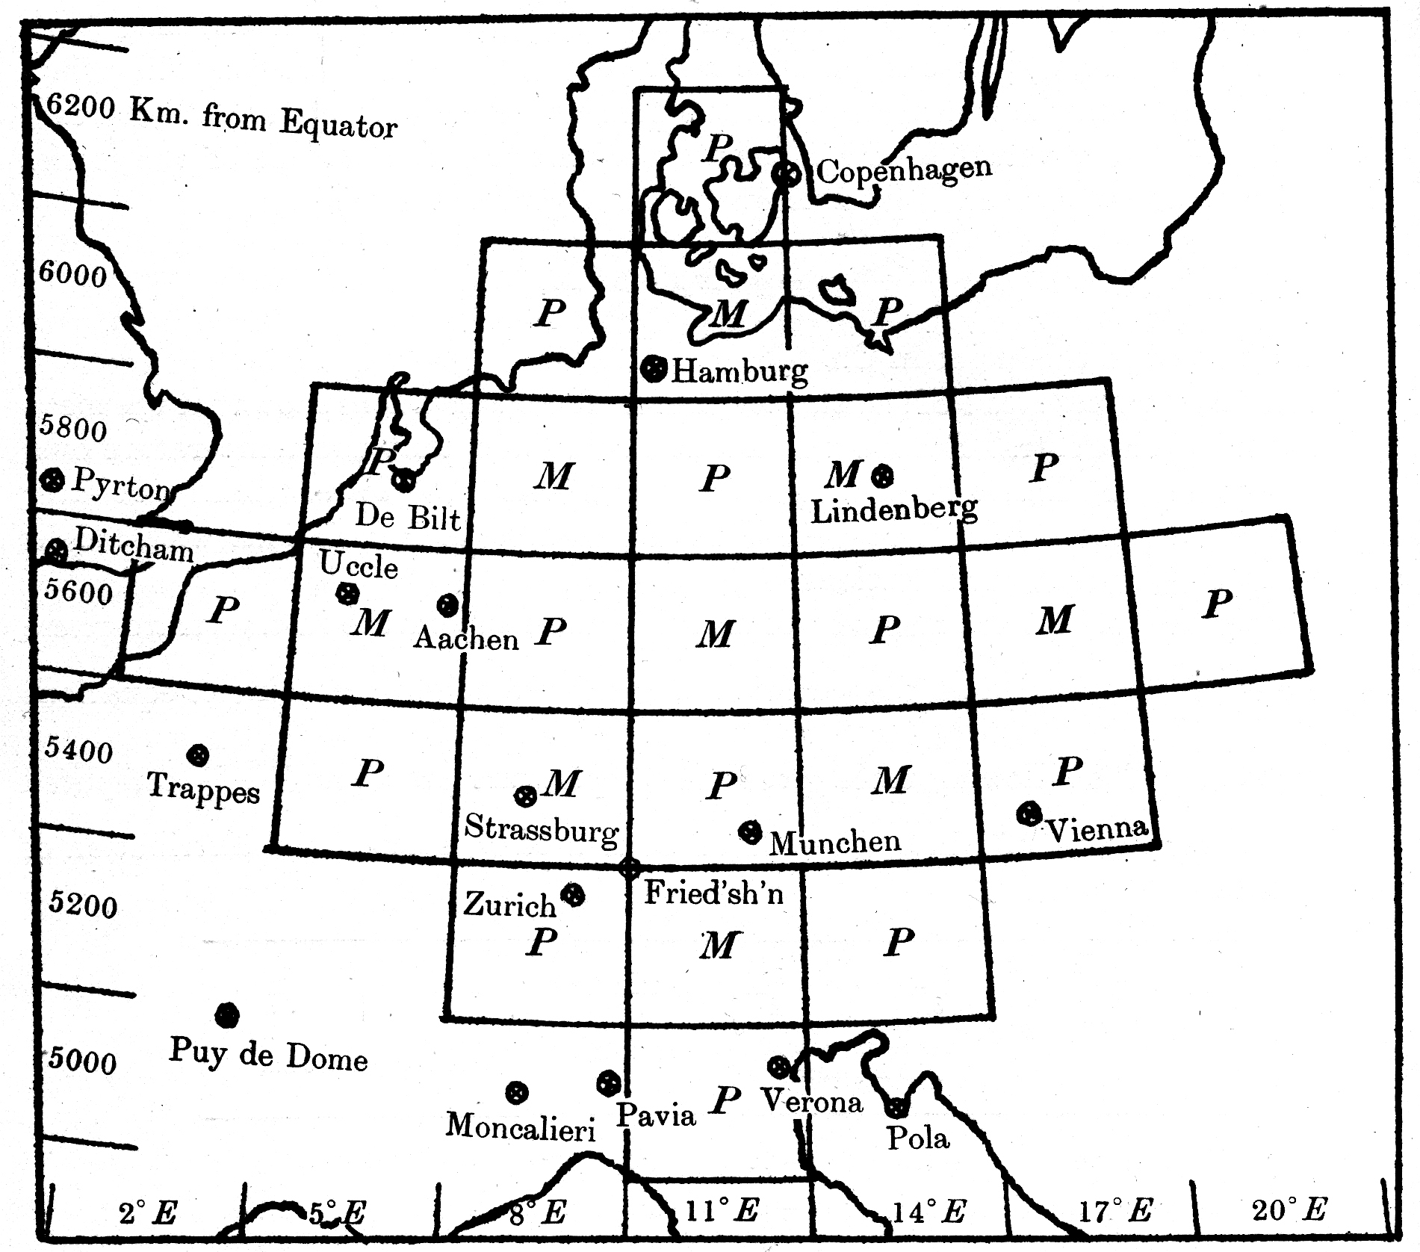
Richardson’s Calculations
Goal: calculate the surface pressure tendency at one point (in Bavaria), 6 hours in the future
Discretized into five layers in the vertical
Used primitive equations
  Assuming hydrostatic balance
Used finite differences to
calculate changes in
momentum, temperature,
and pressure

Slide 31
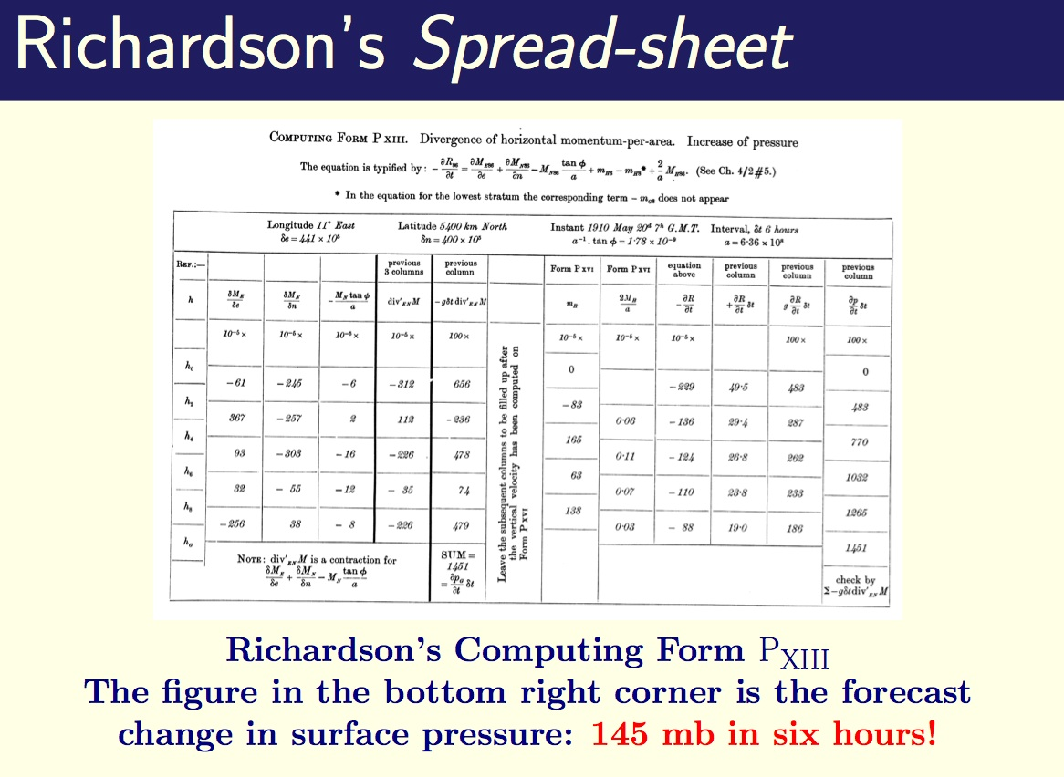
Richardson’s results

Slide 32
Richardson’s Forecast Bust
Why such a failure?
Not due to bad numerics, as many claim
  He only took one time step, so numerical instabilities can’t develop
Rather it has to do with fast & slow manifolds

Slide 33
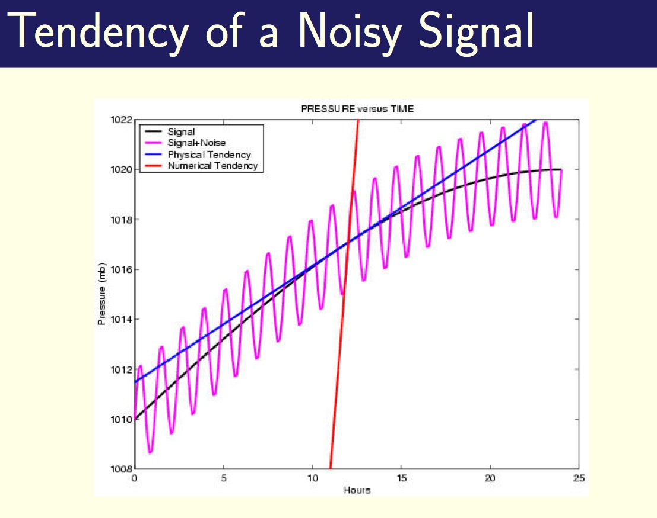
Extrapolating noisy rates of change
A simple schematic illustrating how extrapolating a noisy signal is dangerous…

Slide 34
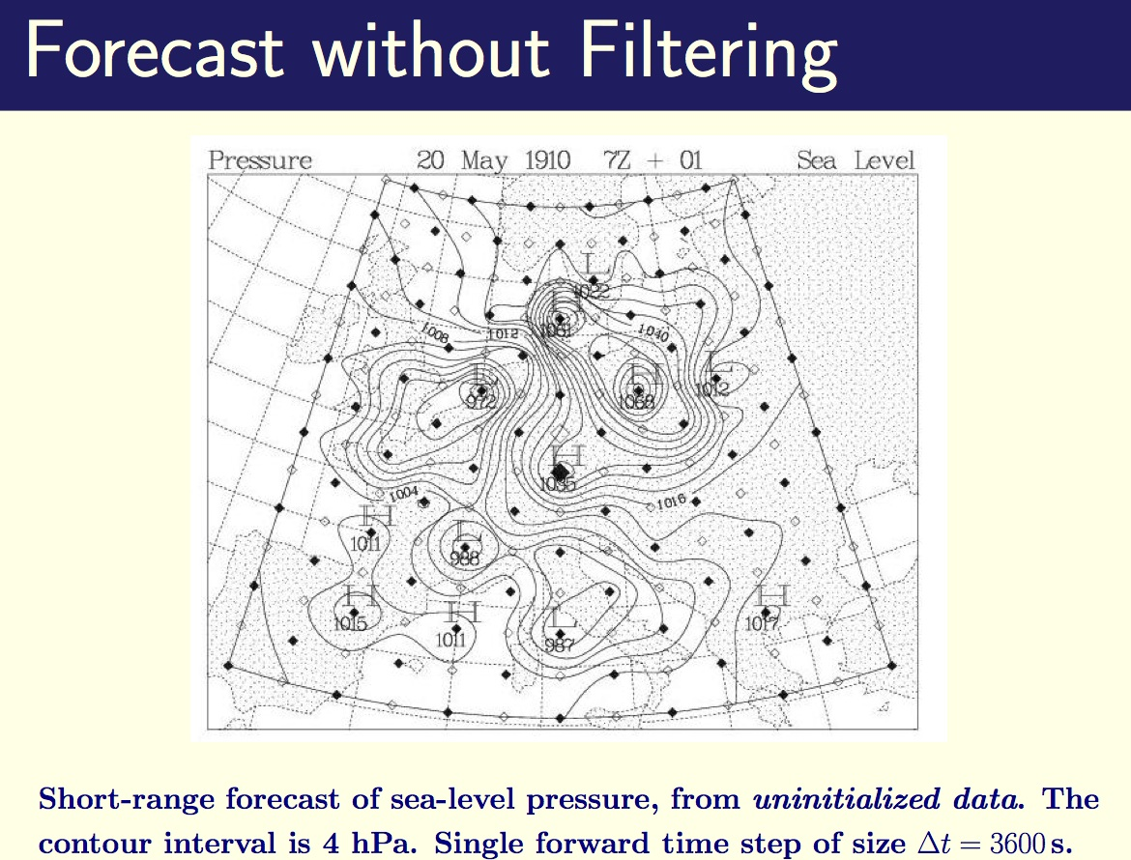
Richardson’s forecast

Slide 35
Richardson’s Forecast
Richardson himself realized that gravity waves were the problem.
He suggested smoothing of initial conditions
  And proposed 5 different methods for this
Unfortunately he couldn’t implement them due to computational expense
  But we can reproduce the results using today’s computers…

Slide 36
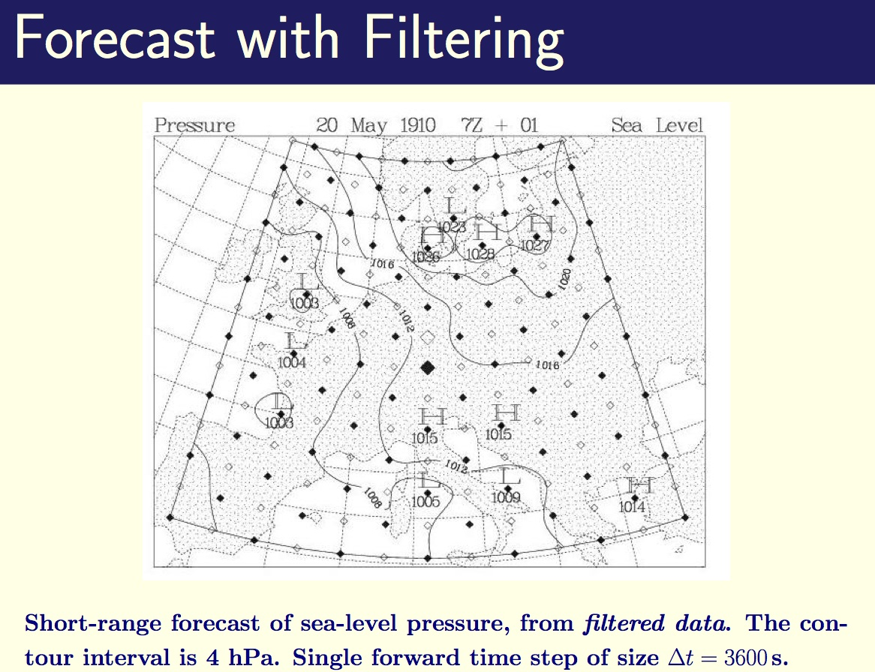
“Balancing” the initial conditions

Slide 37
The First Successful NWP Experiment
Fast gravity waves were the problem:
  Why not try predicting with a model that has no gravity waves?
John von Neumann, Jule Charney, Ragnar Fjortoft
Research proposal proposed three uses for NWP:
  Weather prediction (duh)
  Planning where to take observations
  Weather modification!

Slide 38
ENIAC Forecast Grid
Used barotropic model
(no gravity waves, no
problems with imbalanced
initial conditions)
Same model we’ll use in
class to study Rossby waves
We’ll also use the barotropic
model in lab to make some
weather forecasts with
modern data!

Slide 39
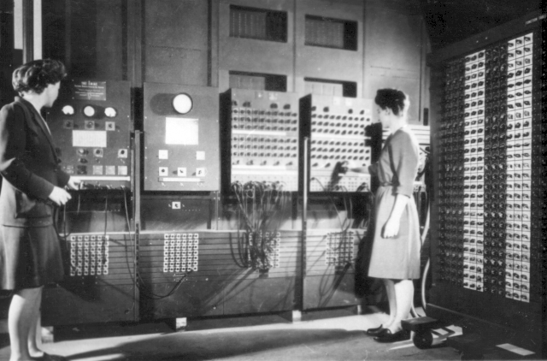
The First Computer!
ENIAC: The Electronic Numerical Integrator and Computer

Slide 40
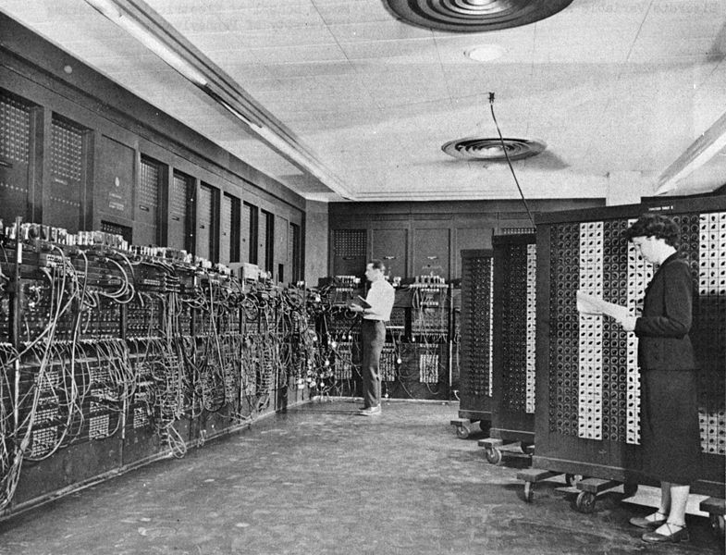
You know, in 60 years our phones will be able do to these calculations…

Slide 41
First Forecast
Initial
conditions
Observed
height 24
hrs later
Observed and
computed
change in
height
Forecast
height 24
hrs later

Slide 42
Second Forecast
Initial
conditions
Observed
height 24
hrs later
Observed and
computed
change in
height
Forecast
height 24
hrs later

Slide 43
Third Forecast
Initial
conditions
Observed
height 24
hrs later
Observed and
computed
change in
height
Forecast
height 24
hrs later

Slide 44
Fourth Forecast
Initial
conditions
Observed
height 24
hrs later
Observed and
computed
change in
height
Forecast
height 24
hrs later
Results are not
that impressive
for first
“successful” NWP
forecast!

Slide 45
First Operational NWP Systems
NWP really took off though & quickly improved!
December 1954: Royal Swedish Air Force Weather Service in Stockholm
  Model developed at the Institute of Meteorology at the University of Stockholm (Rossby, etc)
  Barotropic model, 3 forecasts per week of North Atlantic
May 1955: Joint Numerical Weather Prediction Unit, Maryland
  3 level QG model
1966: US uses 3-level primitive equation model
Global coverage since 1973

Slide 46
Numerical Methods
Gridpoint methods:
  Fields specified at points
  Often staggered to support ease of taking derivatives
  “B-grid”: velocity is on different grid as geopotential, temperature and tracers
  Common resolutions: 2x2.5 deg (90x144 points)

Slide 47

Numerical Methods
Spectral methods:
  Uses spherical harmonics to represent fields
  Different ways to truncate (triangular or rhomboidal)
    Triangular has uniform resolution around the sphere, rhomboidal focuses resolution in midlatitudes more
    Triangular is the preferred choice now, rhomboidal is only used in very low res GCMs
  Common resolutions: T42 (64x128; 2.8 deg),
  T85 (128x256; 1.4 deg)
  Highest resolution model in AR4:
  T106 (1.1 deg resolution)

Slide 48
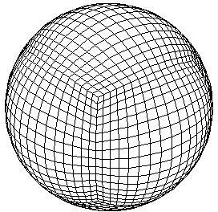
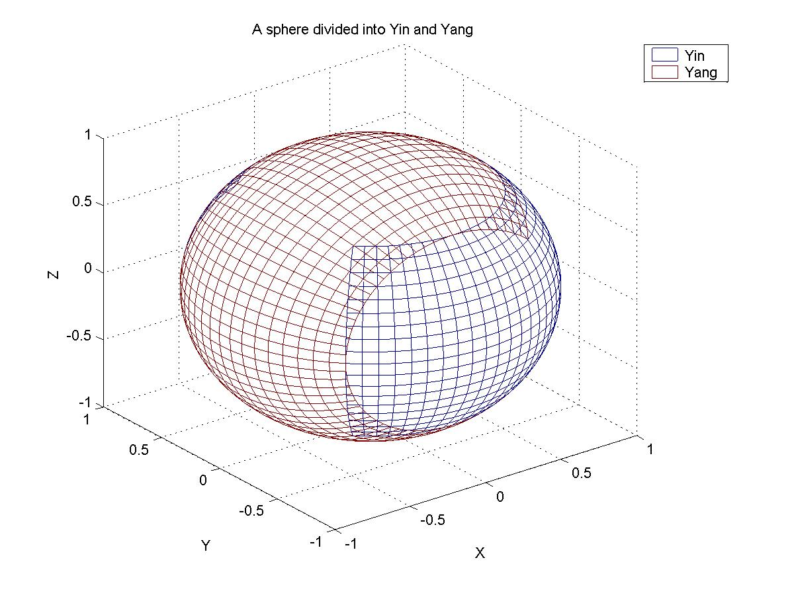
Numerical Methods
Many modeling centers are developing more sophisticated numerical methods
New GFDL dynamical core: finite volume
  Better conservation properties
Different meshes:
  “Cubed sphere”
  “Yin-yang”

Slide 49
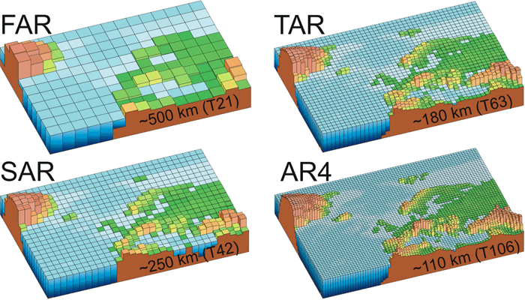
Model Resolution Evolution
Changes in resolution over time:
AR = “assessment
report”
FAR = “first” AR, etc
FAR: 1990
SAR: 1995
TAR: 2001
AR4: 2007
AR5: 2014

Slide 50
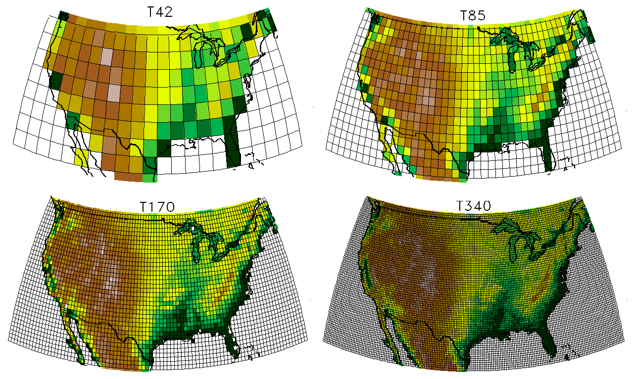
Model Resolutions

Slide 51
Numerical Methods
Vertical coordinates:
  Topography introduces significant complication (pressure levels can disappear)
  “Sigma coordinates”: p/ps
    Makes the surface a coordinate (not true in pressure coords)
Models are trending towards higher vertical resolution
  CMIP3: Most around 25 vertical levels
  New GFDL model: 48 levels

Slide 52
Numerical Methods
Since not all aspects of the numerical methods conserve energy, a correction is usually applied
  Energy calculated before and after dynamics is called
  Temperature multiplied by a constant everywhere to assure energy stays the same

Slide 53
Dynamical Core Key Points
Hydrostatic fluid equations on sphere
  The future will be nonhydrostatic: more expensive though and not necessary at the moment
Numerics
  Wouldn’t it be nice if we lived on Flatland…
    Poles and topography lead to difficulties
  No clear winner for numerical schemes
    Spectral methods
    Gridpoint methods (e.g., B-grid)
    Finite volume
Resolution
  Much better local effects near topography in higher res models
  Also can begin to resolve tropical storms at high res
  Climate sensitivity doesn’t change much with resolution
  Large scale fidelity with obs isn’t all that dependent on resolution (as long as the model isn’t really low res)

Slide 54
Next: Physics of AGCMs
Climate models have some very complex parameterizations of physical processes
We’ll describe general ideas of how these are parameterized
The history of some of the parameterizations
And talk about simple ways to parameterize these effects as well

Slide 55
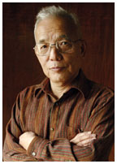

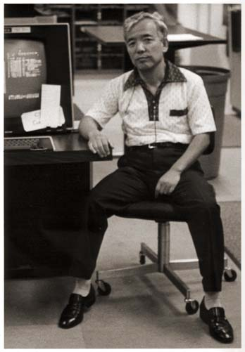
Suki Manabe: Father of Climate Modeling
Syukuro Manabe (born 1931):
  Worked at GFDL from 1958-1997
  1997-2001: Director of Earth Simulator, Japan

Slide 56
Early Manabe Modeling Studies
Radiative model: M. and Moller (1961)
Radiative-convective model: M. and Strickler (1964)
Atmosphere only model: Smagorinsky, M. and Holloway (1965)

Slide 57
First Coupled Climate Model
Manabe and Bryan (1969):
  First coupled climate model

Slide 58
First Global Warming Forecast
Manabe and Wetherald (1975):
Polar amplification
Wet areas get wetter & subtropical drying

Slide 59
Other Early Manabe Studies
I find these early modeling papers still really fascinating…
Effect of ocean circulation on climate:
  Turn off ocean model
Effect of moisture:
  Turn off latent heating
Effect of mountains:
  Bulldoze all topography
Effect of changing solar radiation, doubling CO2, ice sheets, clouds, soil moisture, etc…

Slide 60
Present Day GCMs
Next we’ll discuss state-of-the-art GCMs
  CMIP = coupled model intercomparison project
    CMIP3: for IPCC 4th assessment report
    CMIP5: for IPCC 5th assessment report
But first, a list of things the CMIP3 models didn’t even try to do:
  Carbon cycle
  Dynamic vegetation

Slide 61
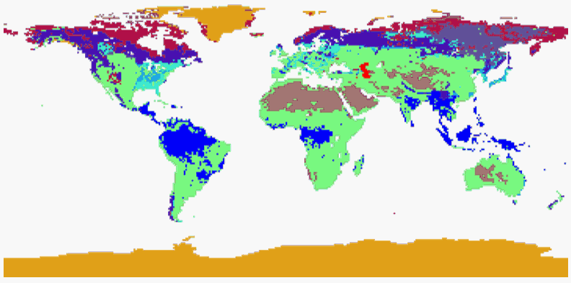
Vegetation Types
Land types:
1: (BE) broadleaf evergreen trees
2: (BD) broadleaf deciduous trees
3: (BN) broadleaf/needleleaf trees
4: (NE) needleleaf evergreen trees
5: (ND) needleleaf deciduous trees
6: (G) grassland
7: (D) desert
8: (T) tundra
9: (A) agriculture
10: (I) ice
11: (L) lake

Slide 62
What Models Don’t Parameterize (yet)
But first, a list of things the CMIP3 GCMs didn’t even try to do:
  Carbon cycle
    They used prescribed CO2 distributions
  Dynamic vegetation
    Prescribed to be current climate values
  Dynamic ice sheet models
    Prescribed to current size
  Interactive chemistry (e.g., ozone chemistry)
    Prescribed ozone hole
  Aerosol effects on cloud formation
    Not often considered
“Earth system models” are trying to parameterize many of these

Slide 63
Physical Parameterizations
We’ll discuss the following physical parameterizations:
  Radiative transfer
  Convection
  Clouds
  Surface fluxes/boundary layer schemes

Slide 64
Radiative transfer models
Clear sky radiative transfer is essentially a solved problem
Divide electromagnetic spectrum into bands
Solar absorption and scattering by H2O, CO2, O3, O2, clouds, aerosols
  GFDL AM2 model uses 18 bands of solar radiation
  Aerosols are sea salt, dust, black & organic carbon, and sulfate aerosols
    Aerosol and chemical concentrations are prescribed as monthly mean climatologies

Slide 65
Radiative transfer models
Longwave absorption and emission by H2O, CO2, O3, N2O, CH4, CFC-11, CFC-12, CFC-113, HCFC-22, aerosols, clouds
  8 longwave bands
Very computationally expensive!
  Often ~50% of the total CPU usage is running the radiation code
  Often not called every time step
  Faster implementations such as neural networks are being developed

Slide 66
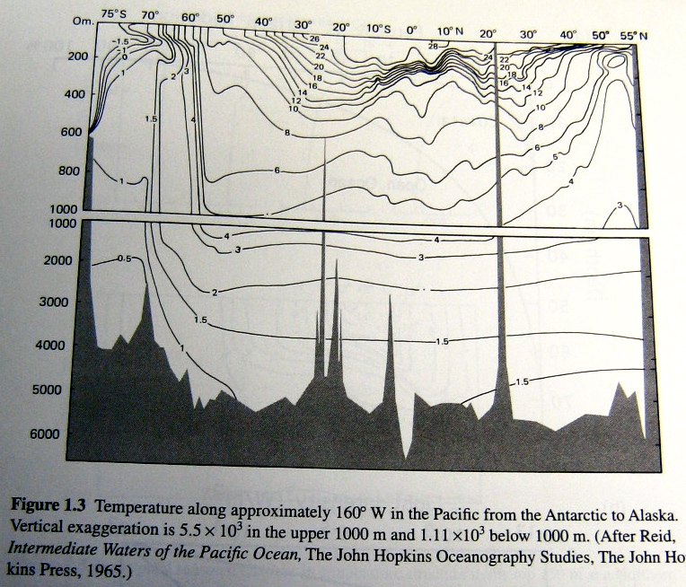
Moist convection schemes
Convection: vertical overturning due to density differences
Atmosphere is strongly heated from below, leading to large amounts of convection
Moisture complicates this
significantly (huge heat source)
  Ocean is heated from above:
  key difference between
  atmosphere and ocean!
Ocean temps across Pacific
Depth
Warm ocean water is confined within a few 100
meters of the surface
Latitude

Slide 67
Moist convection schemes
Classical goals of cumulus parameterization (Cu param):
  Precipitation
  Vertical distribution of heating and drying/moistening
Non-classical goals of Cu param:
  Mass fluxes (for tracer advection)
  Generation of liquid and ice phases of water
  Interactions with PBL, radiation, and flow (momentum transport)
Goals from review by Arakawa (2004)

Slide 68
Moist convection schemes
Simplest convection scheme:
  Condense whenever a gridbox hits 100% saturation
Earliest convection scheme:
  Moist convective adjustment (Manabe et al 1965)
  Above plus neutralizing convective instability
  Derivation (on board):
    First dry convective adjustment, then conditional instability & moist convective adjustment

Slide 69
Moist convection schemes
Simplified Betts-Miller convection scheme:
  Relax temperature to moist adiabat
  Relax humidity to some profile
  This won’t conserve energy though (heating must equal drying): adjust so it does
  But then negative precipitation can occur: “shallow (nonprecipitating) convection”

Slide 70
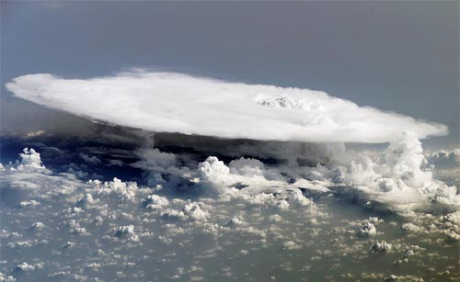
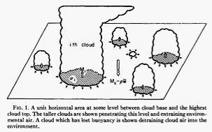
Moist convection schemes
Most CMIP3/5 convection schemes are “mass flux” schemes
  Based on models of sub-grid scale entraining plumes
  Entrainment adds to vertical mass flux, dilutes plume
  Humidity, etc advected by updrafts and compensating subsidence

Slide 71
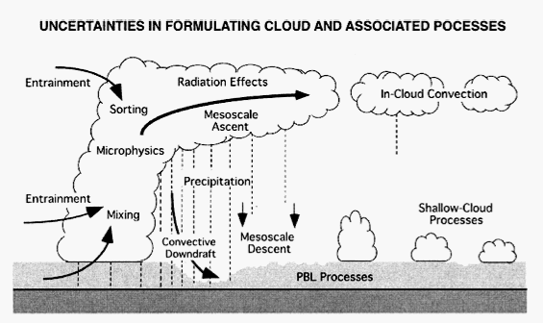
Moist convection schemes
“Mass flux” schemes:
  Convective intensity determined by “quasi-equilibrium” of CAPE (closure)
  Easy to trigger convection in these schemes (get weak, steady convection)

Slide 72
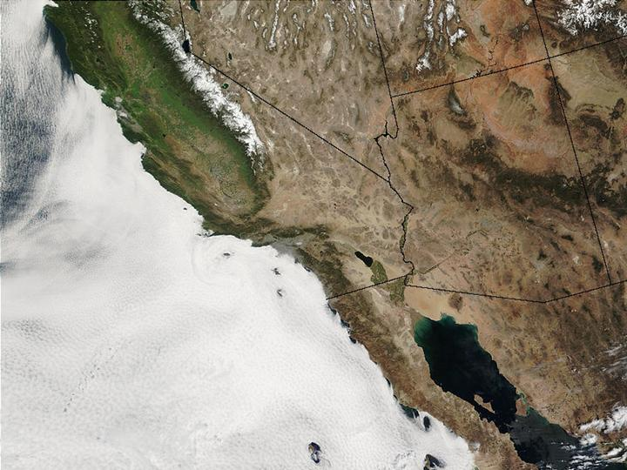

Cloud schemes
Cloud interactions are the most uncertain process in GCMs
  Lead to the largest differences among models

Slide 73
Cloud schemes
Historical implementations of cloud parameterizations:
  First, climatological cloud distributions were used (e.g., Holloway and Manabe 1971)
  After that, diagnostic cloud parameterizations were used
    Based on properties such as relative humidity, vertical velocity, and static stability
    E.g., Wetherald and Manabe 1988: clouds when relative humidity exceeds 99%
    Slingo 1987: Diagnostic scheme based on convective precipitation, humidity, vertical velocity, and stability

Slide 74
Cloud schemes
Now schemes are prognostic:
  Cloud water and cloud ice are tracked as separate variables
    Stratiform anvils & cirrus clouds can be quite long lived
  Cloud fraction is prognostic too in many models
  A certain percentage of condensation from the convection scheme goes into cloud water instead of precipitation
    “Precipitation efficiency”

Slide 75
Cloud schemes
Prognostic cloud schemes (continued):
  Bulk microphysics parameterizations:
    Transferring among phases (e.g., autoconversion and accretion of cloud liquid into rain)
  Erosion of clouds
    If there’s dry air in the gridbox
  Rain inside and outside of clouds is tracked: determines whether reevaporation is important
  Cloud overlap is also a key part of the parameterization:
    Important for radiation, falling precip

Slide 76
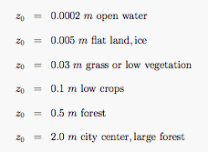
Surface Flux Parameterization
Surface flux schemes
  How much evaporation & heat flux comes off the ocean/land
  SH = sensible heat flux = C |v| (T – Ts)
  Surface drag coefficient C is a function of stability and shear
    “Monin-Obukhov” similarity theory
    Neutral drag coefficient: just a function of “surface roughness” & von Karman coefficient
Surface roughness
values for different
surfaces

Slide 77
Surface Flux Parameterization (continued)
Monin-Obukhov theory for drag coefficient C
  SH = C |v| (T – Ts)
  Neutral drag coefficient: just a function of surface roughness & von Karman coefficient
  Under stable or unstable conditions: function of Richardson number
    C is larger under unstable conditions
    C gets smaller (and approaches zero) under stable conditions
  Stable side drag coefficients are currently pretty uncertain

Slide 78
Surface Flux Parameterization (continued)
Monin-Obukhov theory for drag coefficient C
  GCMs have their lowest layers very close to the surface (typically within 20 m)
    So Monin-Obukhov theory can be used to calculate drag coeffs

Slide 79
Boundary Layer Parameterizations
Boundary layer scheme
  How heat, moisture and momentum are distributed in the turbulent boundary layer
  Typically based on turbulent closures with empirical data
  Matched to Monin-Obukhov surface layer
  Some have an additional prognostic variable, the turbulent kinetic energy
    Gives memory to the mixing

Slide 80
Additional GCM Parameterizations
Shallow convection
  UW shallow convection scheme is implemented in GFDL’s AM3 model (for CMIP5)
  This scheme is a single-plume mass flux scheme
  Other ways:
    Diffusive schemes
    Adjustment schemes
Cumulus momentum transport
Gravity wave drag
  Momentum fluxes due to gravity waves near topography

Slide 81
Flux Adjustment
What if your climate model drifts to an unrealistic state?
Early climate models had to use “flux adjustment”:
  Putting in fluxes of heat and moisture at different locations to make climate more realistic
For the 2nd assessment report, most models had to use flux adjustment, or had poor mean state
By the TAR (third assessment report), most models didn’t need flux adjustment
In CMIP3, only 4 of 24 models have flux adjustment

Slide 82
CMIP3 GCM Summary
Of 24 models in the CMIP3 archive:
  1 is non-hydrostatic (Had-GEM)
  4 have aerosol indirect effect (on clouds)
  4 have some kind of chemistry
    3 of these are sulfate aerosol production from SO2
    1 has simplified ozone chemistry (CNRM)
    1 has GHG (methane, nitrous, CFC-11 and CFC-12) concentration modifications from chemistry (NCAR CCSM3)
  0 have dynamic vegetation, carbon cycle, or dynamic ice sheets
Whew!

Slide 83
Simplified physics GCMs
There is value in developing GCMs with simplified physics:
  Easier to understand
  Easier to reproduce results
  Results more robust (less sensitive to parameters)
  Less computational expense
  Test ground for theories of the general circulation

Slide 84

Simplified GCM Experiments
Nature has only provided us with one planet
Computer models allow us to explore a range of imaginary planetary climates:
  Ocean-covered planets
  Planets with different rotation rates,
  radius, solar heating
  Certain physical effects suppressed or
  enhanced

Slide 85
Simplified GCM Experiments
See Held (2005, BAMS) for biological analogy:
  In biology, hierarchy occurs naturally: bacteria, fruit flies, mice, etc
  This has allowed rapid progress in understanding molecular biology, the genome, etc
In atmospheric science, we have to create our own hierarchies
  Have to additionally argue that the simplified models are worth studying though

Slide 86

An Idealized GCM
Held-Suarez model (1994, BAMS)
Radiation and convection parameterized as
Warmer than Teq => cooling
Cooler than Teq => warming
That’s it

Slide 87
How to parameterize equilibrium temp?
Equilibrium temperature = what would happen if dynamics didn’t act
Radiation and convection

Slide 88
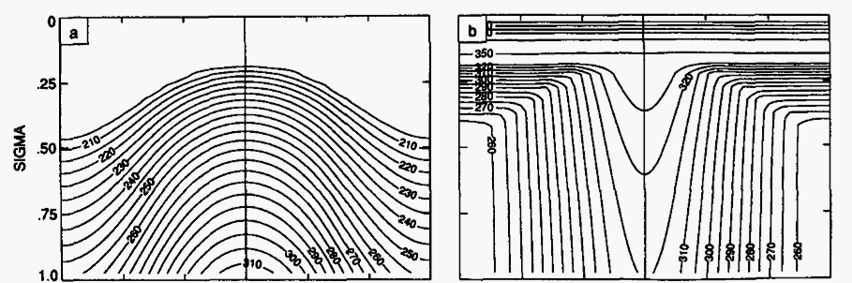
The Held-Suarez Dry GCM
Equilibrium distribution is what radiation and convection would produce without dynamics
Temperature
Potential Temperature
Latitude
Latitude
Equator is hotter than observed
Pole is colder than observed
Constant stratospheric temperature
Roughly moist adiabatic vertical
structure

Slide 89
The Held-Suarez Dry GCM
Radiation parameters:
  Horizontal gradient of radiative equilibrium: 60 K
  Vertical gradient of potential temperature at the equator: 10 K
  Free tropospheric relaxation time: 40 days
  Boundary layer relaxation time: 4 days at surface
Temperature
Potential Temperature
Latitude
Latitude

Slide 90
The Held-Suarez Dry GCM
Strong damping in the boundary layer is required to prevent a strong inversion from occurring
Also friction within boundary layer:
  Frictional damping time: 1 day at surface
  Boundary layer depth: up to 700 hPa
Other physical parameters:
  Mean surface pressure = 1000 hPa, g = 9.8 m/s2
  Dry air constants: R = 287.04 J/kg, cp = 1004 J/kg
  a = 6.371 x 10^6 m
  Omega = 7.292 x 10^-5 (s^-1)

Slide 91
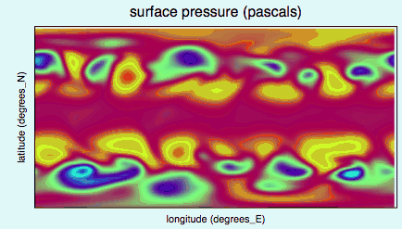
The Held-Suarez Dry GCM
Instantaneous surface pressure:

Slide 92
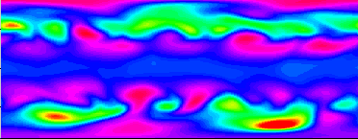
The Held-Suarez Dry GCM
Instantaneous surface pressure:
Latitude
Longitude

Slide 93

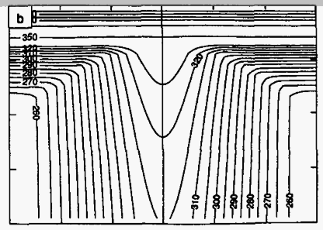
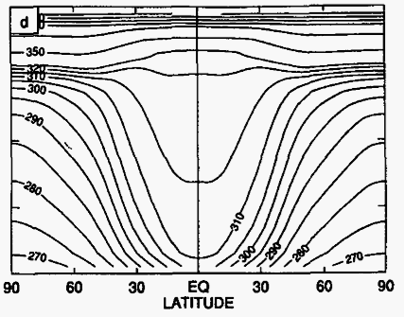
The Held-Suarez Dry GCM
Potential temperature climatology
Circulation transports heat poleward and upward
From Held and Suarez (1994)

Slide 94
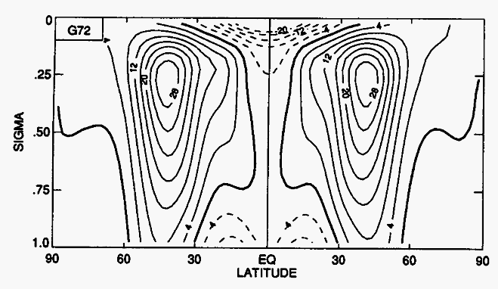
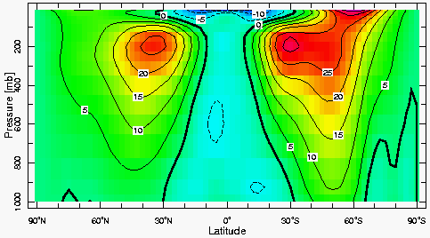
The Held-Suarez Dry GCM
Zonal winds
versus observations:

Slide 95
The Held-Suarez Dry GCM
Held-Suarez model has been used to study:
  Annular modes of extratropical variability (Gerber and Vallis)
  Sensitivity of extratropical circulation to tropopause height (Williams; Lorenz and DeWeaver)
  Winds in equatorial troposphere (Kraucunas and Hartmann)
  Stratosphere-troposphere coupling (Reichler, Kushner and Polvani)

Slide 96
Held-Suarez Extensions
More realistic stratospheric winds (Polvani and Kushner)
Statically unstable reference profile + convection scheme (Schneider)
Perpetual austral winter (Ring and Plumb)

Slide 97
Held-Suarez Model
Strengths:
  Remarkably simple formulation
  Gives realistic circulation in many aspects
Weaknesses:
  No surface fluxes, no possibility of land-sea contrast
  Says nothing about precipitation, clouds, ice, etc
  Not heated from below like real atmosphere
  Tropics are very quiet
  Diabatic processes are weak
  Baroclinic eddies tend to do everything

Slide 98

Introduction to Moisture in the Atmosphere
Saturation vapor pressure is a function of temperature in the Clausius-Clapeyron equation:
Roughly exponential for temperatures on Earth
  Warmer air can hold much more moisture
  7% per K increase in temperature
Condensation of water vapor can be huge heat source on Earth
  Typical tropical lower tropospheric moisture content: 45 K

Slide 99
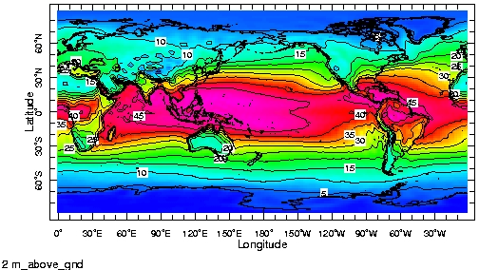
Introduction to Moisture in the Atmosphere
Surface specific humidity, measured in Kelvin:
Source: NCEP Reanalysis

Slide 100
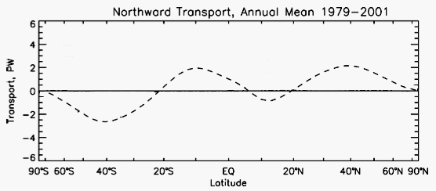
Introduction to Moisture in the Atmosphere
Moisture flux in the atmosphere:
  Equatorward moisture flux in tropics
  Poleward moisture flux in midlatitudes
Source: Trenberth and Stepaniak (2003)

Slide 101
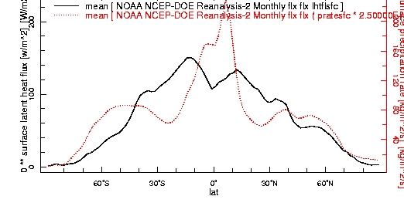
Introduction to Moisture in the Atmosphere
Precipitation and evaporation:

Slide 102
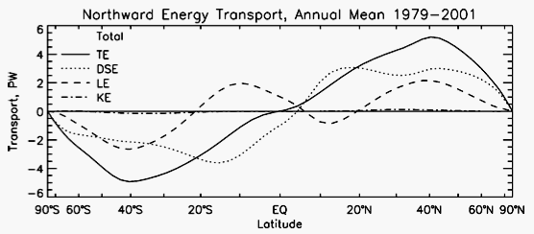
Introduction to Moisture in the Atmosphere
Effect of moisture on energy transports:
  Comparison with dry flux:
Dry static energy transport
Total transport

Slide 103
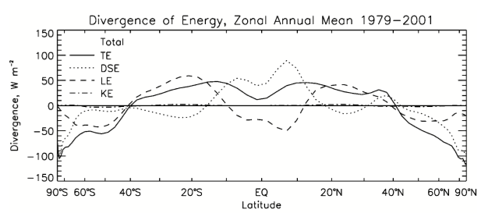
Introduction to Moisture in the Atmosphere
Components of divergence of energy transport:
  Moisture divergence dominates dry throughout the midlatitudes
Latent dominates eq’ward of 60º N
Latent dominates eq’ward of 65º S
Source: Trenberth and Stepaniak (2003)

Slide 104
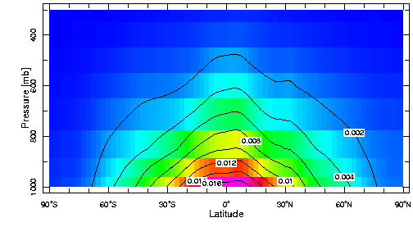
Introduction to Moisture in the Atmosphere
Moisture is concentrated in the lower levels of the atmosphere
  Upper atmosphere is too cold to hold much water vapor
Freezing is also associated with latent heat release
  It’s a significantly smaller heat source though:
    Latent heat of vaporization: 2.5 x 10^6 J/kg
    Latent heat of fusion: 3.3 x 10^5 J/kg
Zonal mean moisture
content

Slide 105
Water Vapor and Global Warming
With global warming, atmospheric moisture content will increase
  20% increase with 3 K global temperature increase
What effects will the increased moisture content have on the general circulation of the atmosphere?
  Motivation for developing a simplified moist GCM

Slide 106
GRaM: An Idealized Moist GCM
Gray Radiation Moist GCM
  Most GCMs have a metric ton of physics, but you can get a long way with just a GRaM!
Primitive equations
Gray radiative transfer
  Water vapor, cloud, & other radiative feedbacks suppressed
  Radiative fluxes only a function of temperature
Aquaplanet surface (ocean-covered Earth)
  Slab mixed layer
  Zonally symmetric
Simplified Monin-Obukhov surface fluxes
K-profile boundary layer scheme
Simple convection schemes
  Grid-scale condensation or simplified Betts-Miller scheme
See Frierson, Held & Zurita-Gotor 2006 for details

Slide 107
Gray radiation
Upward and downward streams
Prescribed optical depths for longwave radiation
  Designed to look roughly like water vapor
Idealized shortwave radiation profile
  Based on idealized profile (Legendre polynomial)
  All SW goes into the surface (in simplest version of set-up)

Slide 108
Slab mixed layer ocean
Specify a heat capacity and solve energy equation
  Heat capacity is always equivalent to a depth of water (e.g., 2.5e7 J/m2/K is equivalent to 60 m)
A nice alternative to fixed SST
  Fixed SST doesn’t respect energy conservation
    E.g., faster surface winds cause more evaporation, but surface doesn’t cool in response
SST biases can develop though (obviously)
  Q-flux: a prescribed surface heat flux designed to simulate ocean heat transport divergence
    Also used to correct model biases in practice though

Slide 109
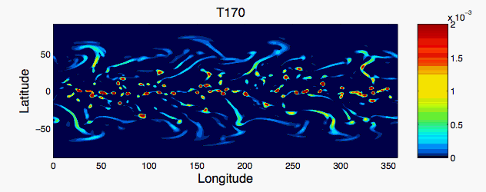
Model Climatology
Instantaneous precipitation

Slide 110
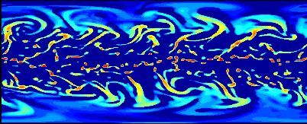
Model Climatology
Instantaneous precipitation

Slide 111
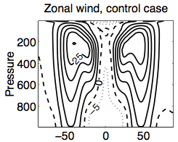

Model climatology
Zonal wind and temperature

Slide 112

Model Climatology
Precipitation and evaporation

Slide 113


Effect of convection scheme
Instantaneous precipitation
Simplified Betts-Miller
convection scheme
Grid scale condensation only

Slide 114

GRaM GCM
Model is very adaptable to different physical regimes
  Nothing is tuned to current climate parameters
  Allows large parameter variations
  Applicable to other climates as well
Simulation of seasonal cycle
of convection on Titan
(Mitchell et al 2006)

Slide 115

General Circulation Changes with Moisture
Vary moisture content over wide range
  Goal: to understand the effect of moisture on the general circulation
Strategy:
  Vary Clausius-Clapeyron constant :

Slide 116
Varying Moisture Content
Dry limit: similar to very cold climates on Earth
High moisture case: similar to post-snowball hothouse climates?
We are using just as an understanding tool though
  Direct comparisons should be made using more comprehensive models

Slide 117


Static Stability Changes
Dry static energy, idealized GCM simulations:
Static stability ( ) increases in tropics (as expected)
Latitude
~Zero stability
High stability
From Frierson, Held and Zurita-Gotor (2006)

Slide 118
Static Stability Changes
Static stability also increases in midlatitudes:
Further investigated in Frierson (2008), Frierson and Davis (2011)
Seen in IPCC simulations as well (Frierson 2006)
Latitude
~Zero stability
High stability
From Frierson, Held and Zurita-Gotor (2006)

Slide 119

Midlatitude Jet Changes
Zonal winds:
Poleward and upward shift with increased moisture
  Similar to global warming simulations (Yin 2005)
Related to static stability changes?
  Static stability increases preferentially on equatorward side of storm tracks (work with Jian Lu & Gang Chen: LCF08, CLF08)
From Frierson, Held and Zurita-Gotor (2006)

Slide 120


Energy Fluxes in Simplified Moist GCM
Moisture flux in idealized simulations:
Significant increase in
moisture flux in midlatitudes
From Frierson, Held and Zurita-Gotor (2007)

Slide 121

Energy Fluxes in Simplified Moist GCM
Moist static energy flux in idealized simulations:
MSE flux increases by
less than 10%
From Frierson, Held and Zurita-Gotor (2007)

Slide 122

Energy Fluxes in Simplified Moist GCM
Fluxes in idealized simulations:
Decrease in dry static energy flux to almost
perfectly compensate the increase in moisture flux!
From Frierson, Held and Zurita-Gotor (2007)

Slide 123
Strengths/Weaknesses of GRaM GCM
Strengths:
  Simple consideration of condensation
  Closed energy budget, active surface
  Not tuned to current climate parameters
  Allows large parameter variations
  Expandable into a full GCM
Weaknesses:
  Too awesome?
  Much more complex than Held-Suarez
  Stratosphere
  Lack of water vapor/clouds in radiative transfer

Slide 124
End of Topic 1: Model Hierarchies
We have running on pynchon:
  Held-Suarez dry dynamical core model
    With spectral, finite volume, or B-grid dynamical core
  Idealized moist GCM (GRaM)
  GFDL’s AM2 model
    Full GCM over realistic geography
  Aquaplanet version of AM2
  Models with simplified vertical structure:
    Barotropic vorticity equation model on the sphere
    Shallow water model on the sphere

