Slide 1
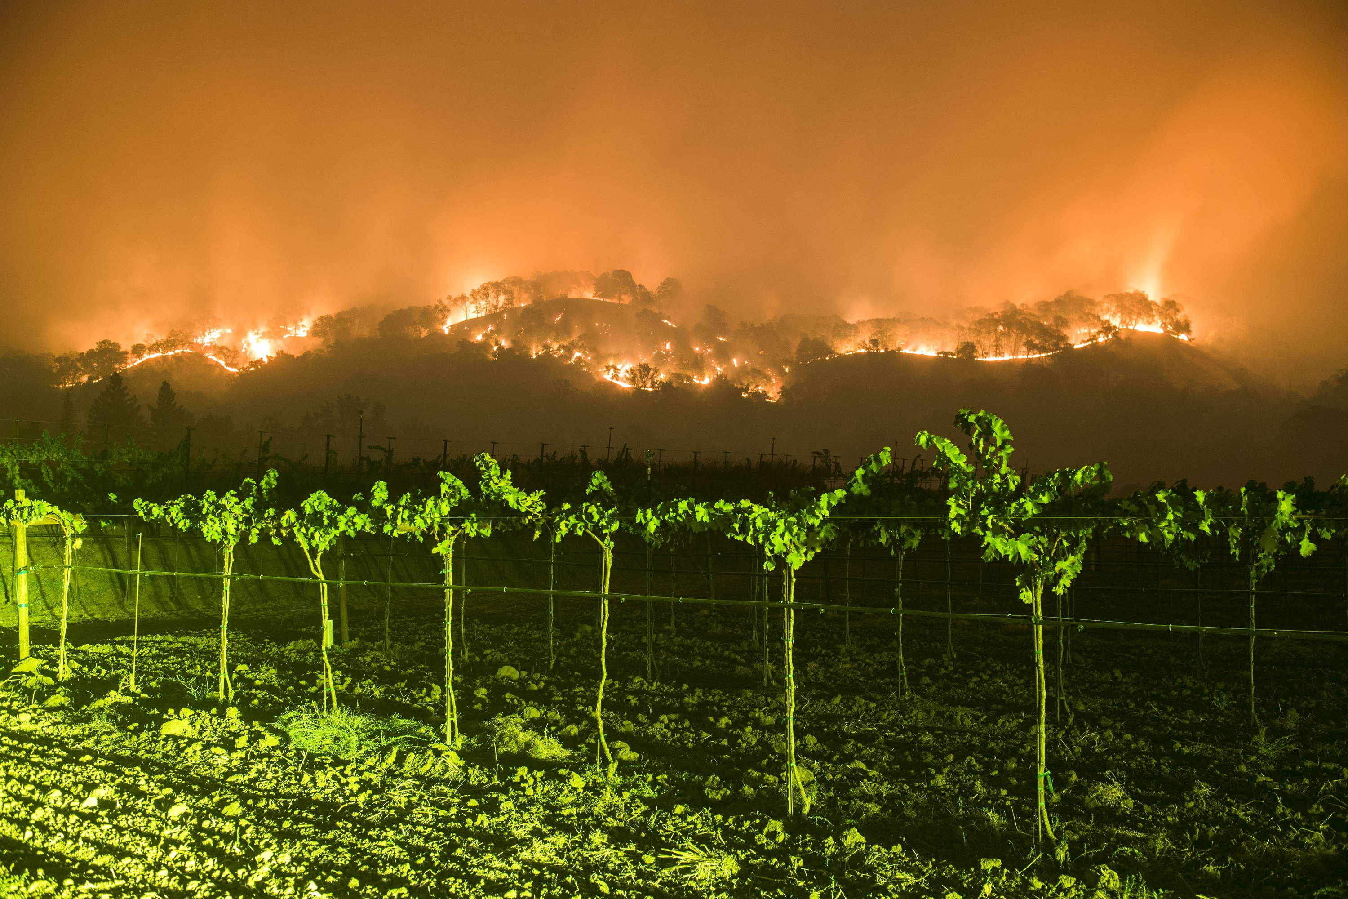
The Wine Country Fires of October 2017: A Highly Predictable, Severe Weather Event
Cliff Mass and David Ovens

Slide 2
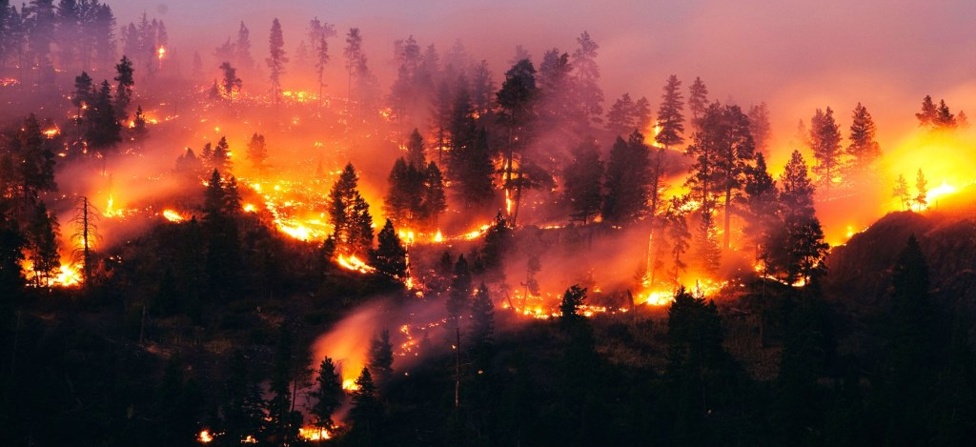
During the evening of Sunday, October 8, 2017, wildfires began in the hills above Santa Rosa, Napa, and other towns of the ”wine country” north of San Francisco

Slide 3
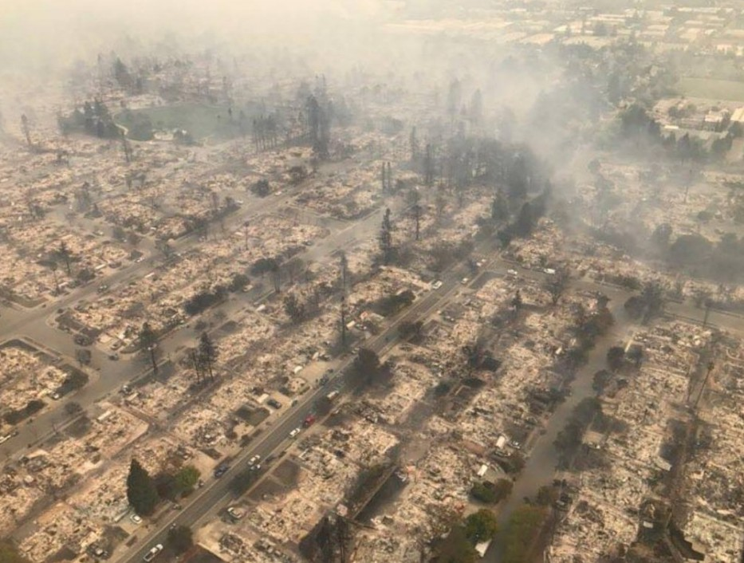
And then, pushed by strong winds, rapidly descended into populated areas

Slide 4
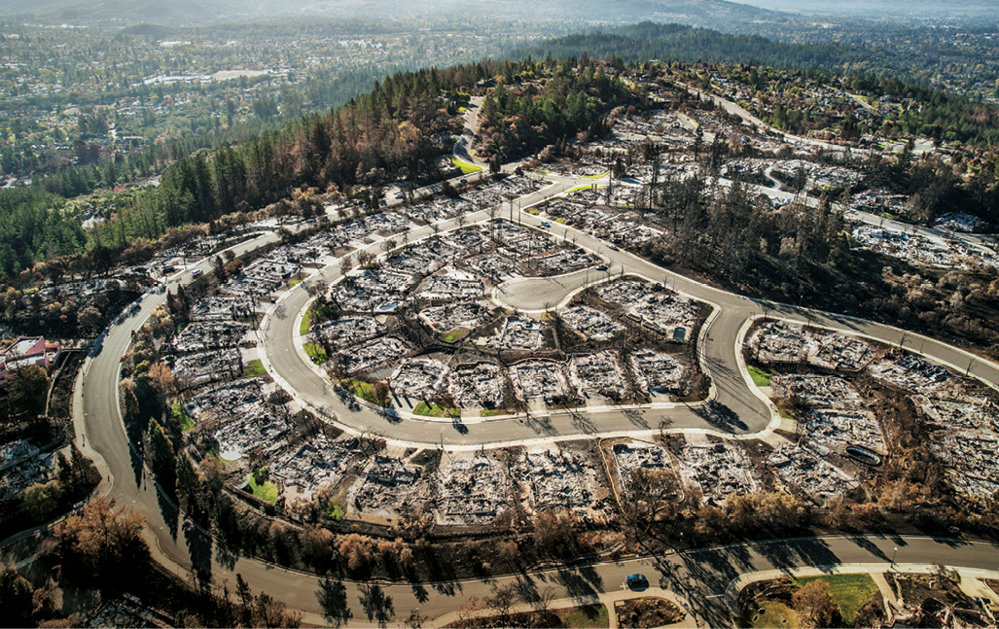
Before it was over, the “Wine Country” wildfires became the most devastating in CA history
44 died and hundreds were hospitalized
More than 9,000 structures were destroyed
Burned 245,000 acres of land
More than 9 billion in insured property loss
Total damage/loss much more.
Serious air quality degradation over the region for over a week.

Slide 5
Video of the Fire

Slide 6
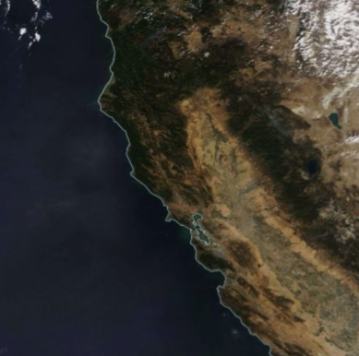
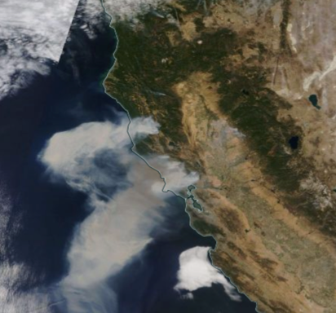
Modis Imagery: October 8 versus October 9, 2017

Slide 7

Some questions to be considered in this talk
What meteorological conditions accompanied the fires?
Were these conditions predictable?
What started the fires?
Could this disaster have been prevented?
Did anthropogenic global warming play a significant role in this event?

Slide 8

Immediate answers for those needing a nap
What were the meteorological conditions accompanied the fires?
Upper level short-wave passage resulting in a mesoscale downslope wind event.
Were these conditions predictable?
Yes
What started the fires?
Power lines and wind
Could this disaster have been prevented?
Yes
Did anthropogenic global warming play a significant role in this event?
No

Slide 9
The Geography of the Region

Slide 10
Major Wine Country Fires

Slide 11
Climatological Lead Up

Slide 12
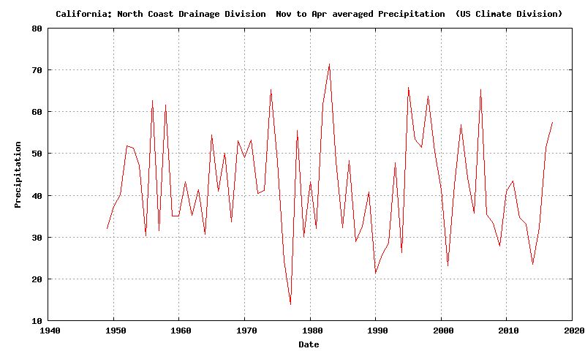
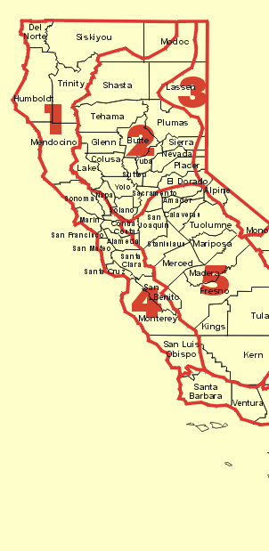
A Wet Winter Before the Fires
NOAA CA North Coast Drainage Climate Division

Slide 13
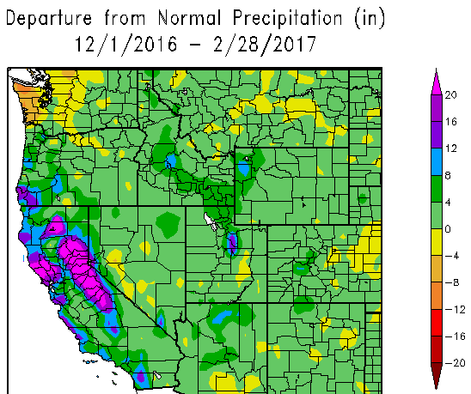

Slide 14
The Wet Winter Led to Luxuriant Grass Growth

Slide 15
Excessive Grass Growth is a Wildfire Hazard
“Precipitation tends to be above normal in the winter or early spring …Wet
winters enhance the growth of grasses and other fine fuels.”
Westerling, A. L., D. R. Cayan, T. J. Brown, B. L. Hall, and L. G. Riddle (2004), Climate, Santa Ana Winds and autumn wildfires in southern California, Eos Trans. AGU, 85(31), 289–296.

Slide 16
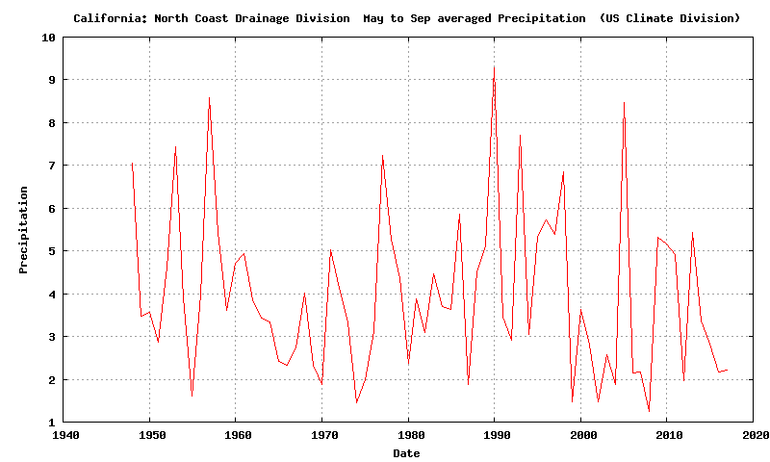
The Preceding Summer Was Typically Dry

Slide 17
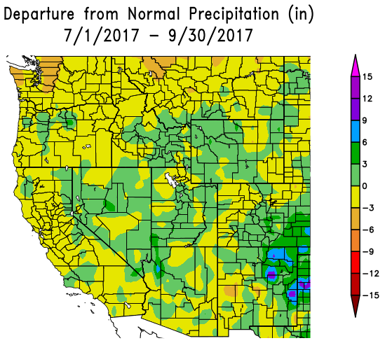

Slide 18
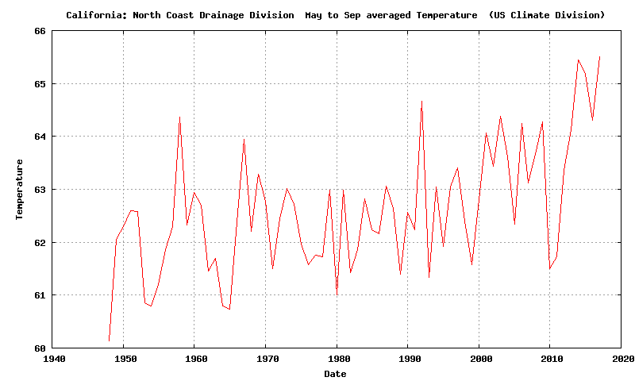
But it was warmer than normal by ~3F.

Slide 19
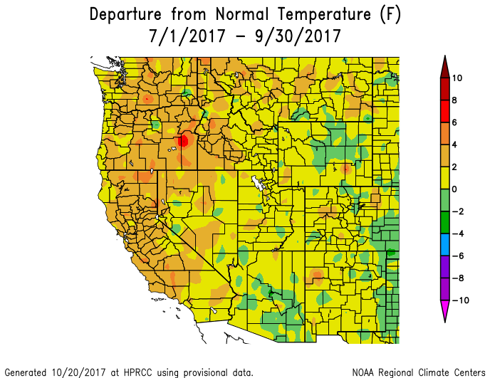

Slide 20
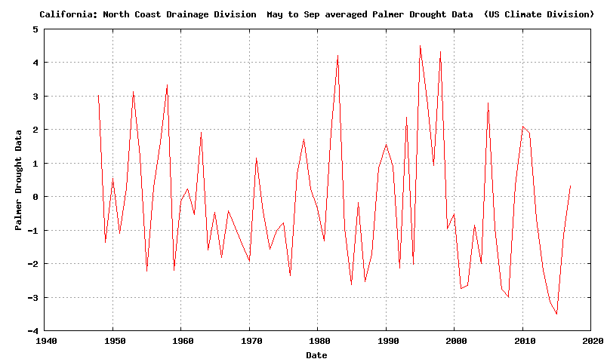
With a wet winter/spring, and a normally dry, but warmer than normal summer, the Palmer Drought Severity Index was near normal

Slide 21
Palmer Drought Severity Index
The Palmer drought severity index is a measurement of dryness based on past precipitation and temperature
The Palmer Drought Index is based on a supply-and-demand model of soil moisture.
Good measure of long-term drought (over several months)
May September

Slide 22
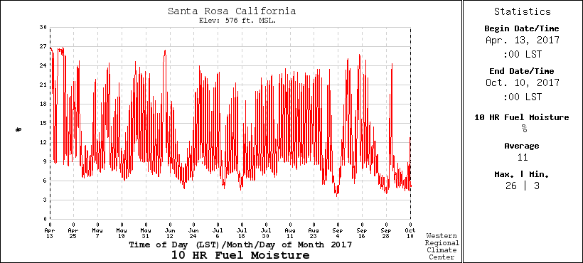
10-hour Fuel Moisture (.25 to 1 inch diameter)
Varies rapidly, drops with offshore flow. Below 10% is dangerous

Slide 23
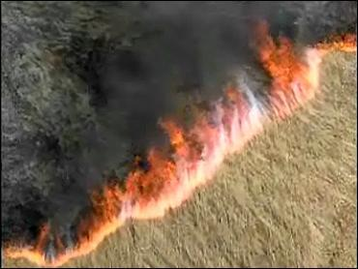
1-hr or Fine Fuels (less than 1/4 inch in diameter) Respond More Quickly to Changes in Atmospheric Moisture Content
Examples include grass, leaves, and mulch
Would be even drier than 10-hr fuels under offshore flow
Would act as “tinder” for new fires.

Slide 24
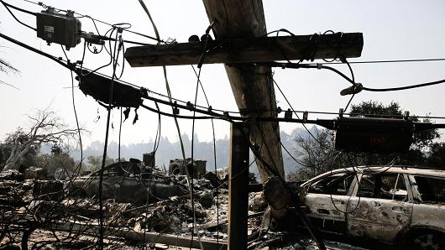
Fire Initiation
172 fire starts leading to 18 major fires
911 calls about power outages and small fires started around 9 PM October 8, just when winds accelerated
Initial investigation traced most fires to failing electrical infrastructure (downed lines, exploded transformers) resulting from strong winds

Slide 25
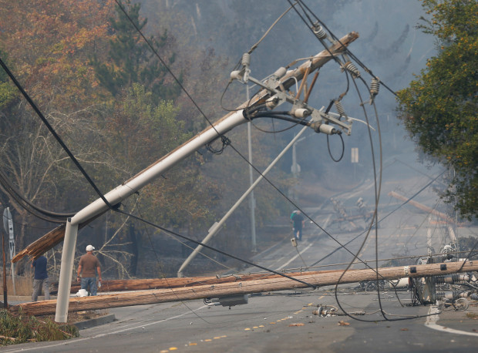
Fire Initiation: Trees Not Cleared Around Powerlines, Falling Powerlines, Poorly Programmed Reclosers

Slide 27
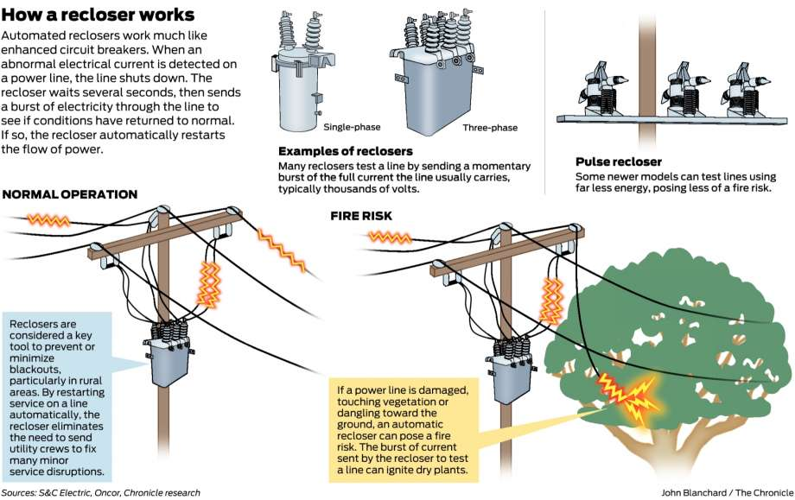
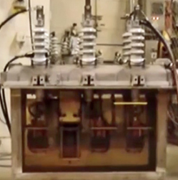
PG&E Reclosers Kept on Trying to Restore Power—Up to 3 Times.

Slide 28
The Winds

Slide 29
Max Gusts During the Event (knots):
Big spatial variation with strongest winds (60-95 knots) on lee (SW) slopes of terrain

Slide 30
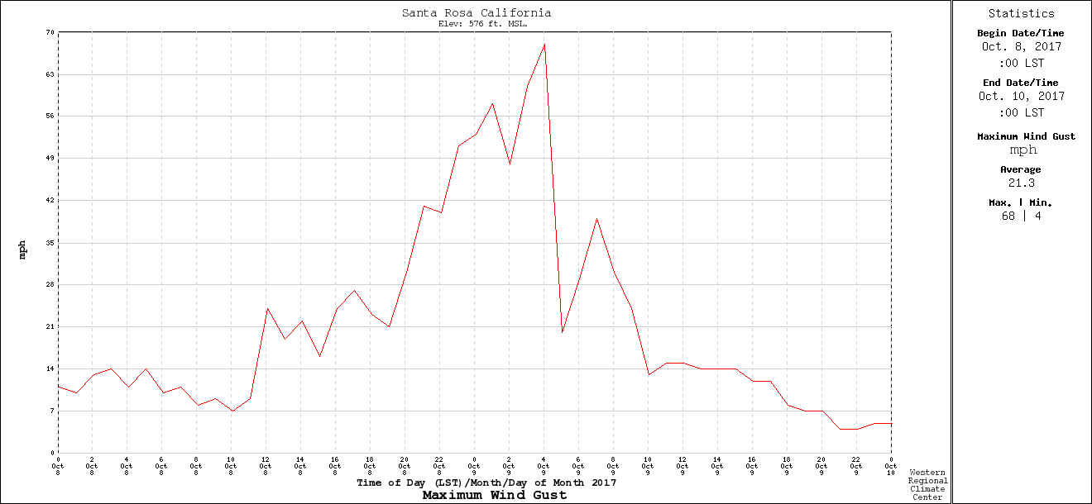
Temporal Variation: Rapid Increase and Decline
Santa Rosa RAWS
9 PM
PDT
midnite
6AM

Slide 31
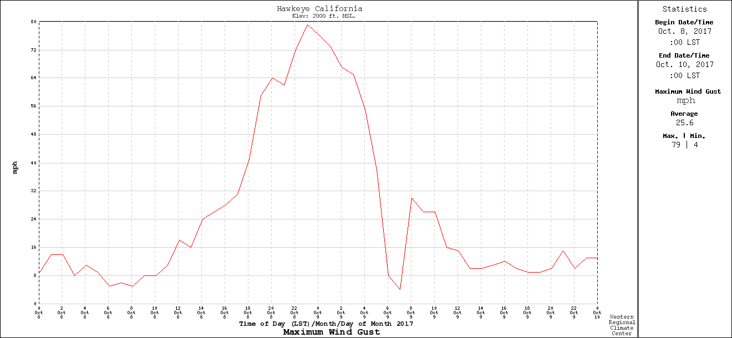
Hawkeye RAWS

Slide 32
Wind Bottom Line
Strongest winds in favored areas just to the lee of terrain gusted to 60-95 knots
The wind at Hawkeye RAWS was the strongest ever observed there.
Far lesser winds in lower areas downstream
Winds came up very rapidly starting around 9 PM and were over by 6 AM the next morning (Monday).

Slide 33
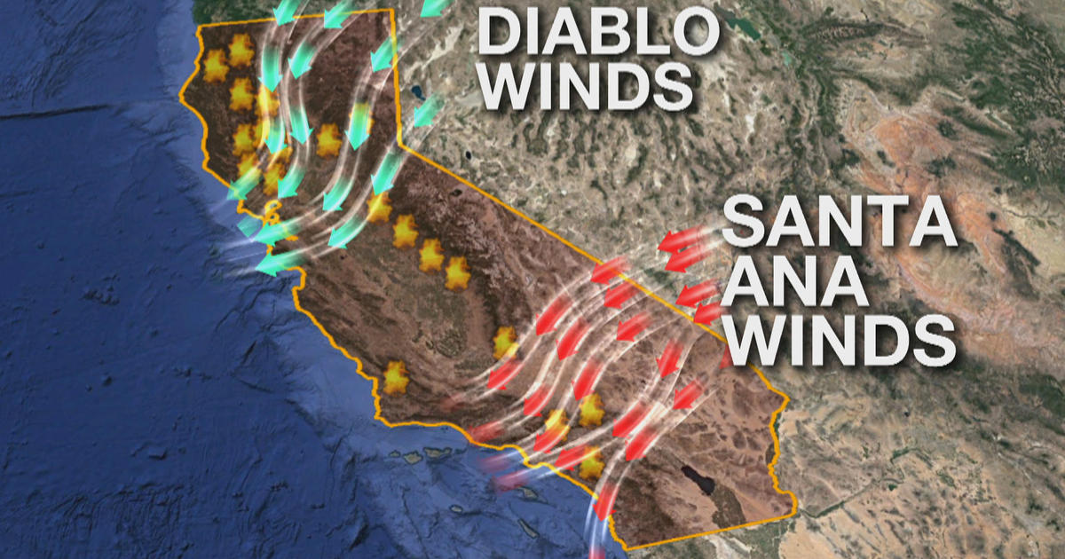
Side Note: Such Strong Winds, Which Typically Occur in the Fall, Are Known as Diablo Winds
Definition: hot, dry offshore wind from the northeast that typically occurs in the San Francisco Bay Area of Northern California during the spring and fall.

Slide 34
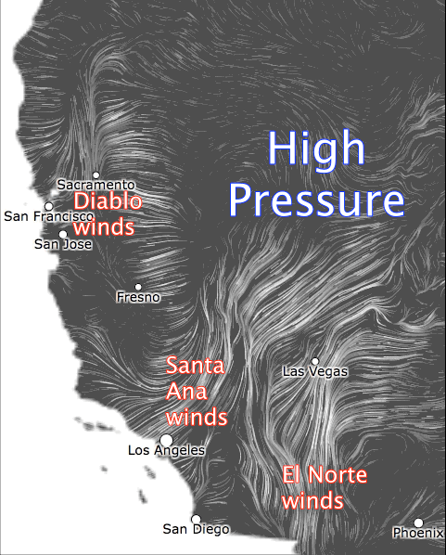
Such warm, dry offshore winds are associated with high pressure over the intermountain west
High Pressure

Slide 35
The Synoptic and Mesoscale Origins of the Strong Winds

Slide 36
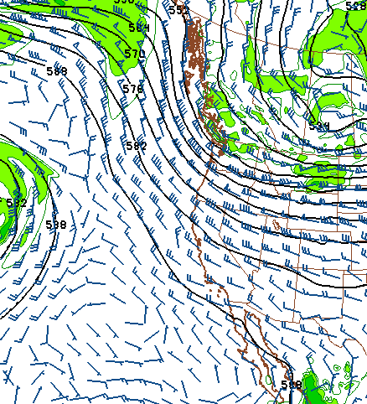
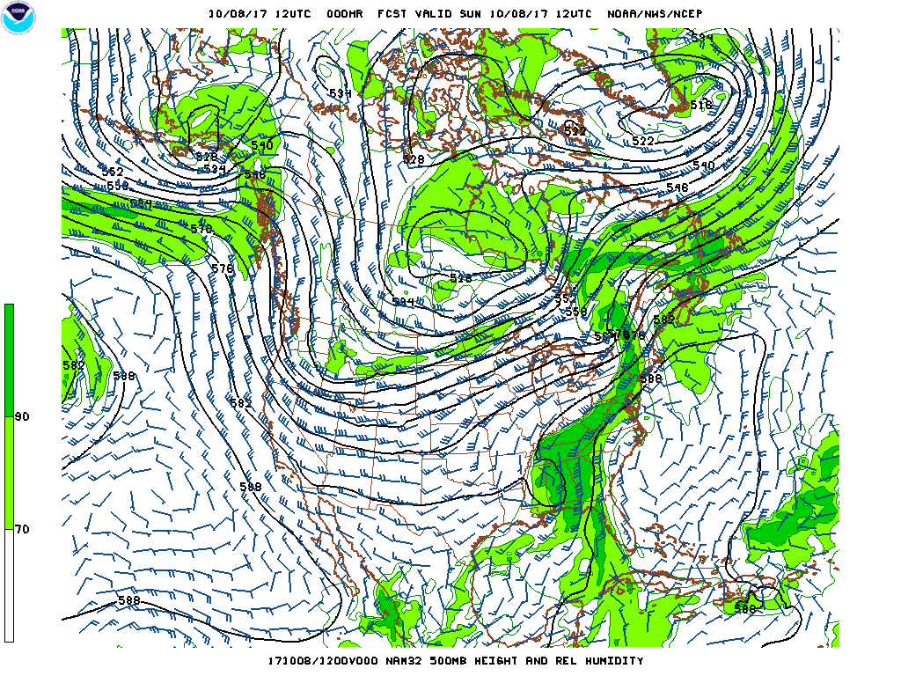
Upper Level Trough Passage
0000 UTC 8 October
1200 UTC 8 October

Slide 37
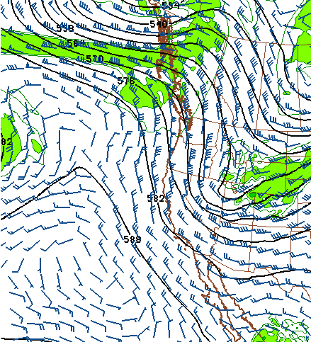
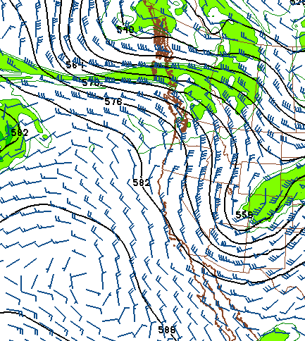
0000 UTC 9 October
1200 UTC 9 October

Slide 38
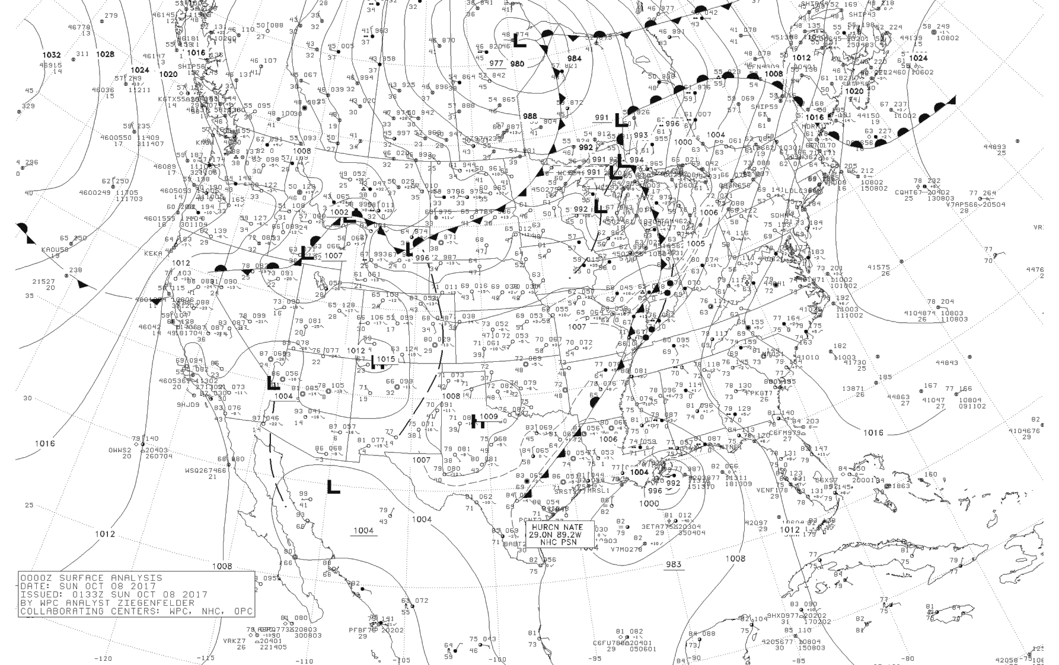
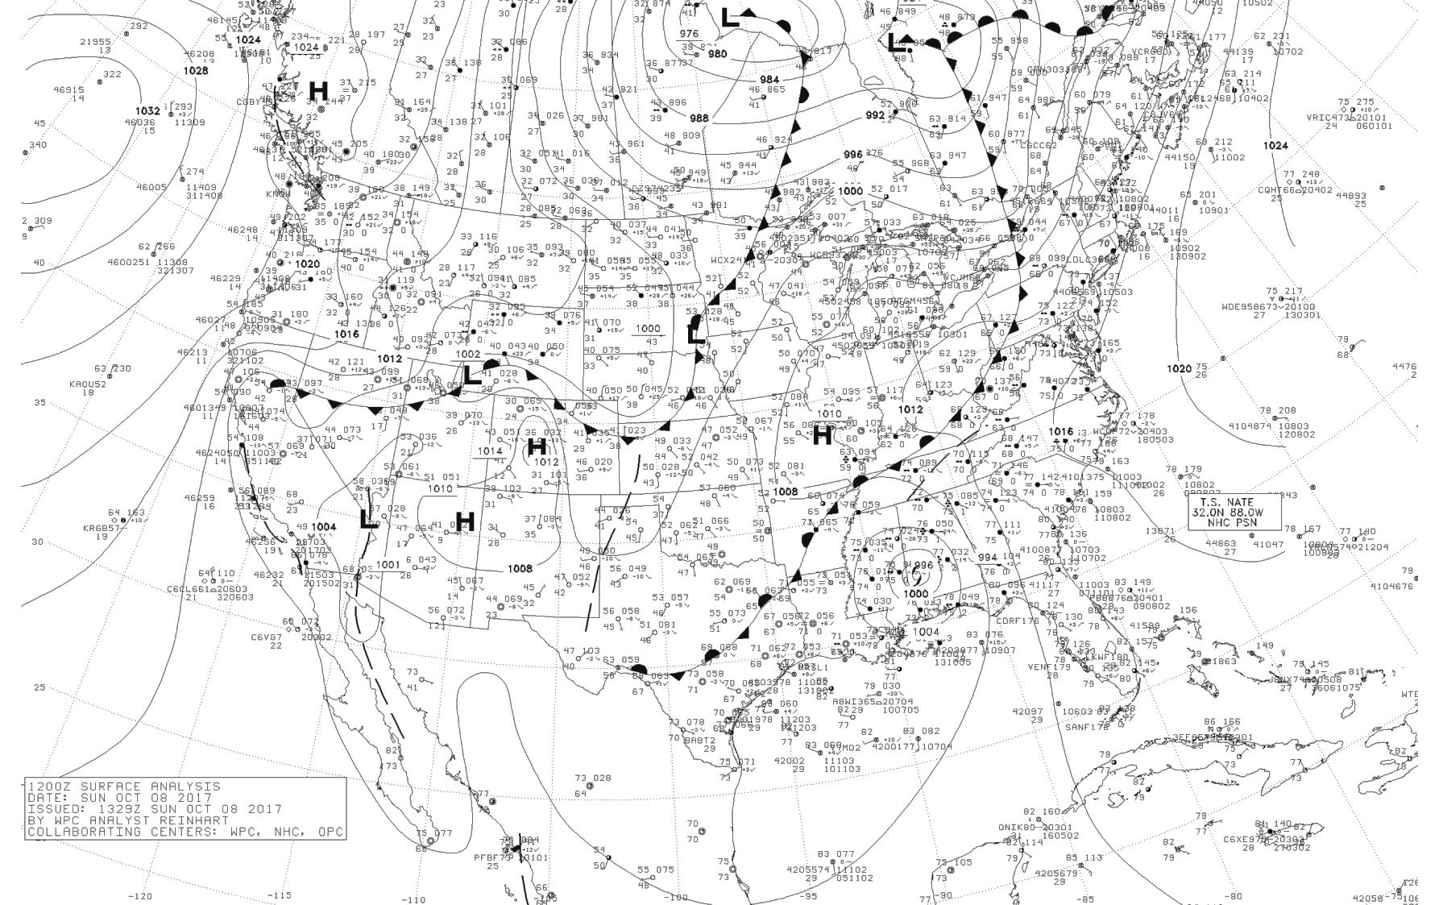
High Pressure
Built into the
Northwest and then the Intermountain West
0000 UTC 8 October
1200 UTC 8 October

Slide 39
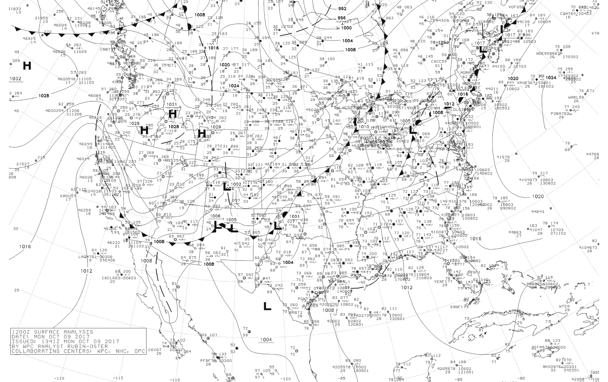
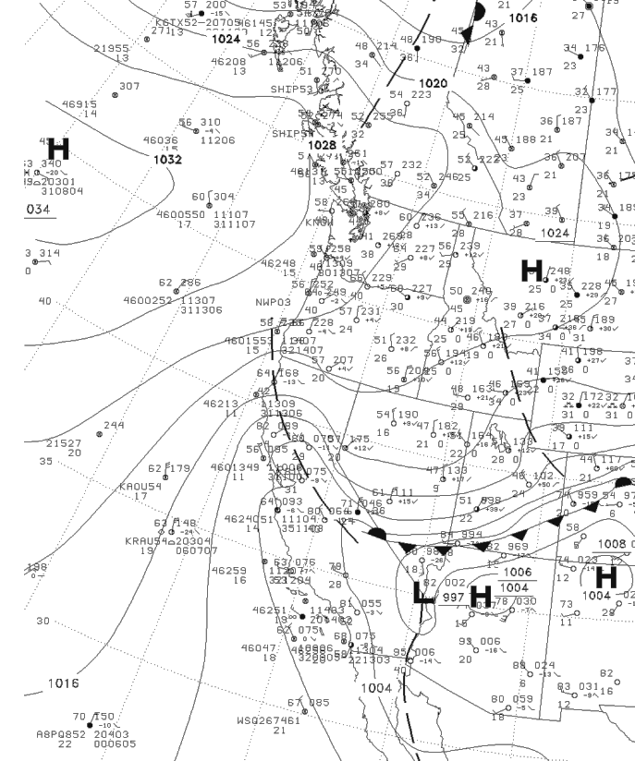
0000 UTC 9 October
1200 UTC 9 October

Slide 40
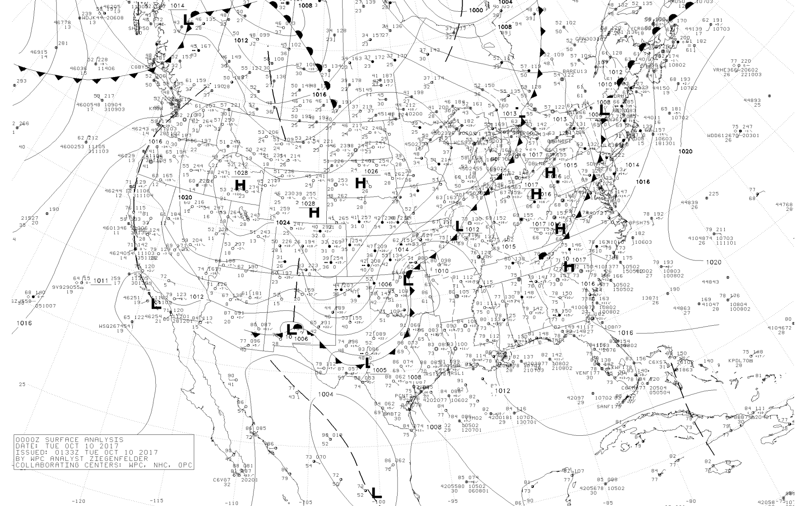
0000 UTC 10 October

Slide 41
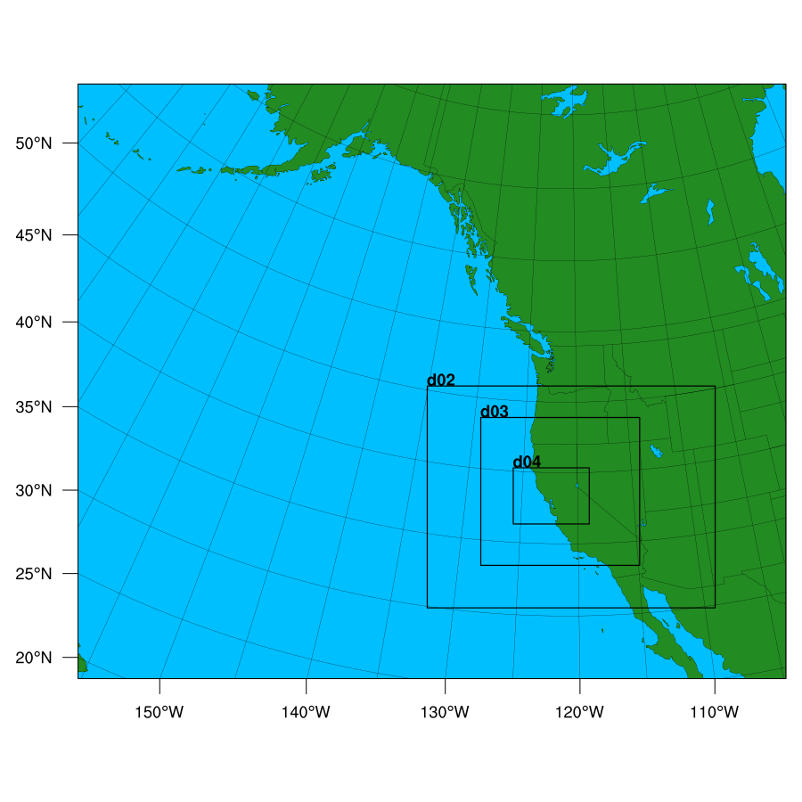
High-Resolution WRF Simulation of the Event
36-12-4-1.3 km domains
Initialized at 1200 UTC Oct. 8

Slide 42
12-km domain
9
1200 UTC 8 October

Slide 45
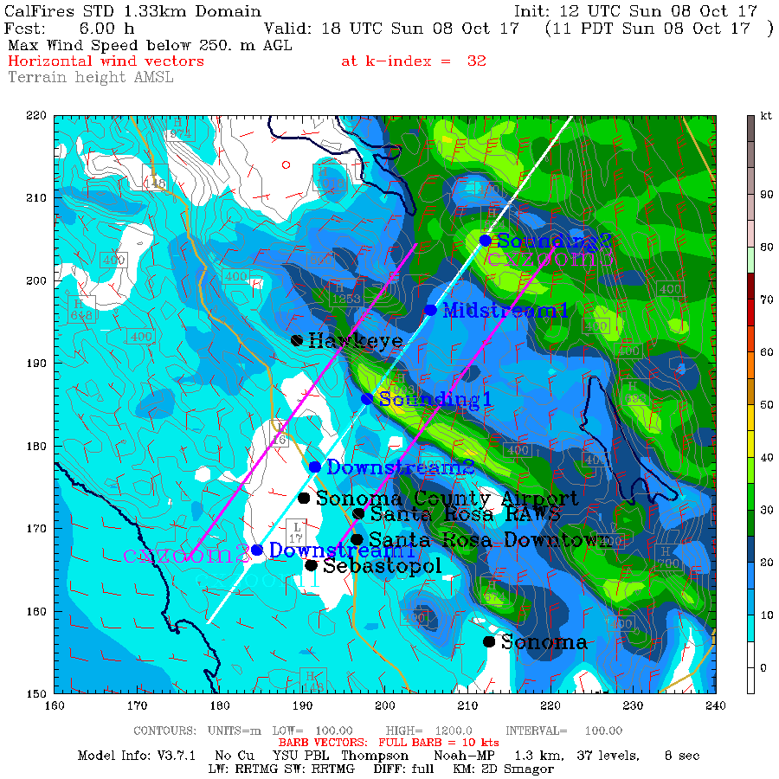
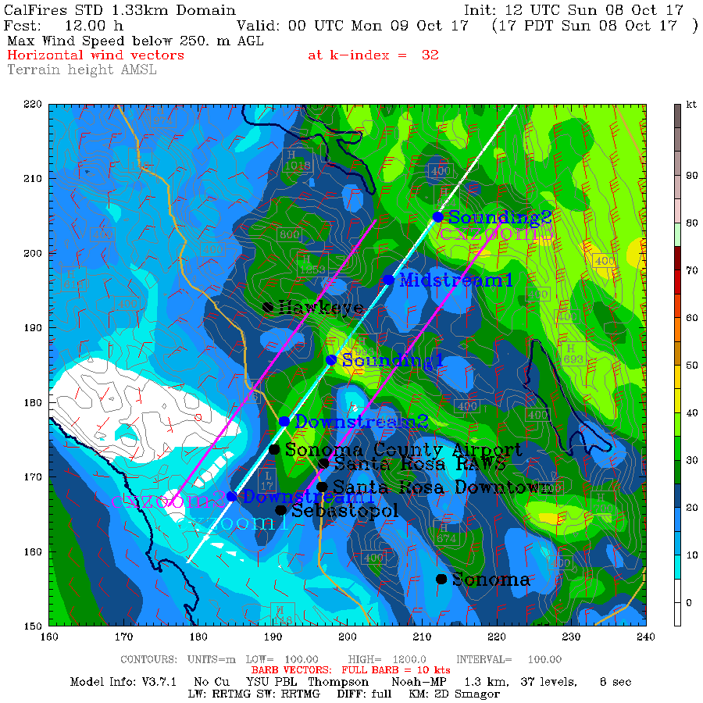
11 AM October 8
5 AM October 9
1.33 km domain: Strongest winds in the lowest 250 m (kt)

Slide 46
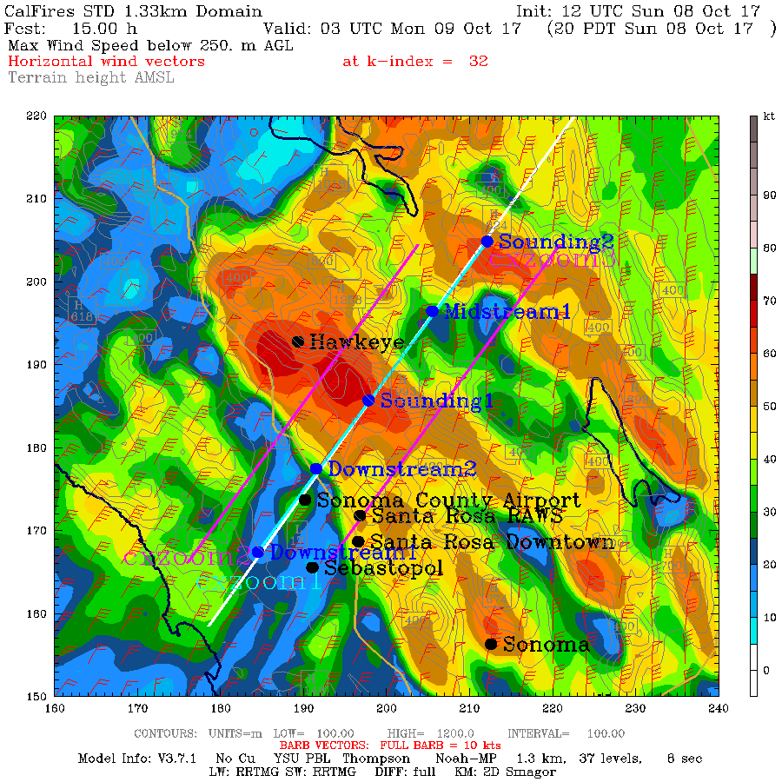
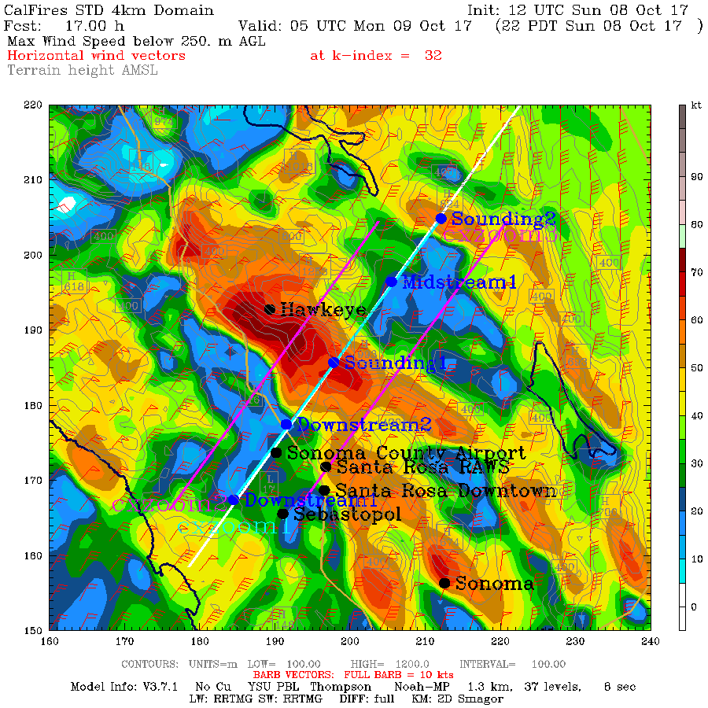
8 PM October 8
10 PM October 9

Slide 47
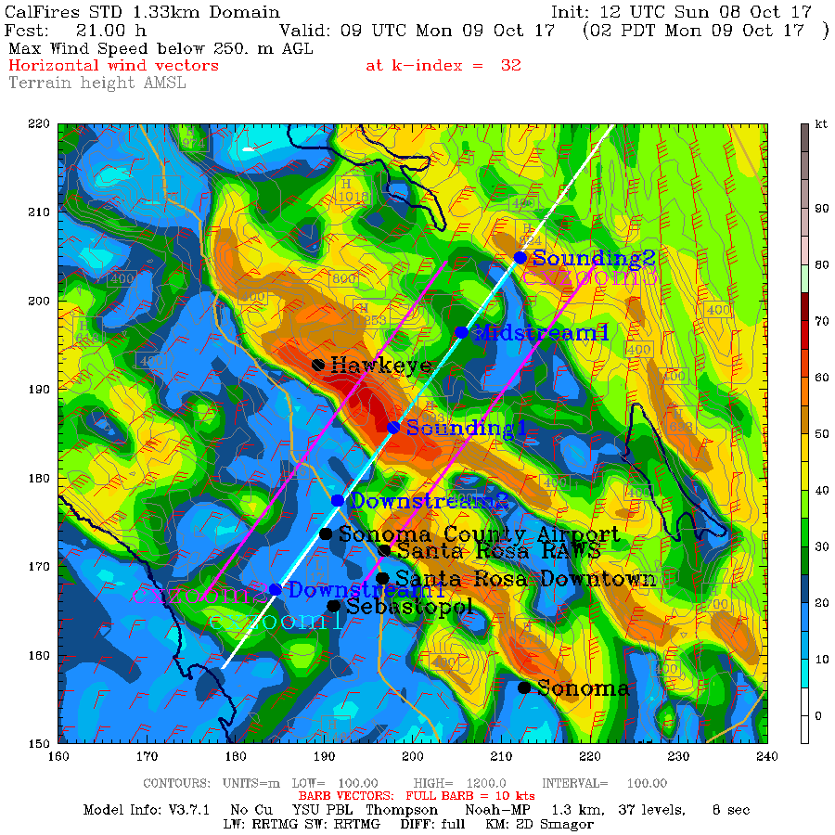
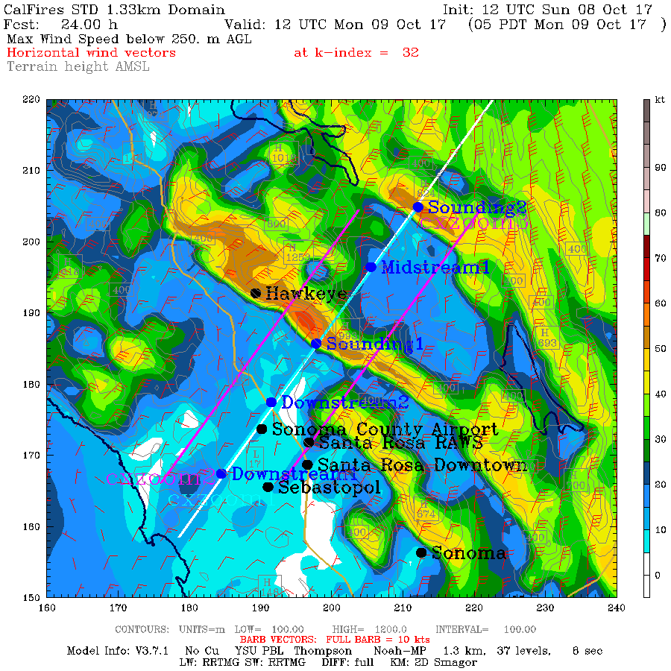
2 AM October 9
5 AM October 9

Slide 48
Vertical Cross Sections

Slide 49
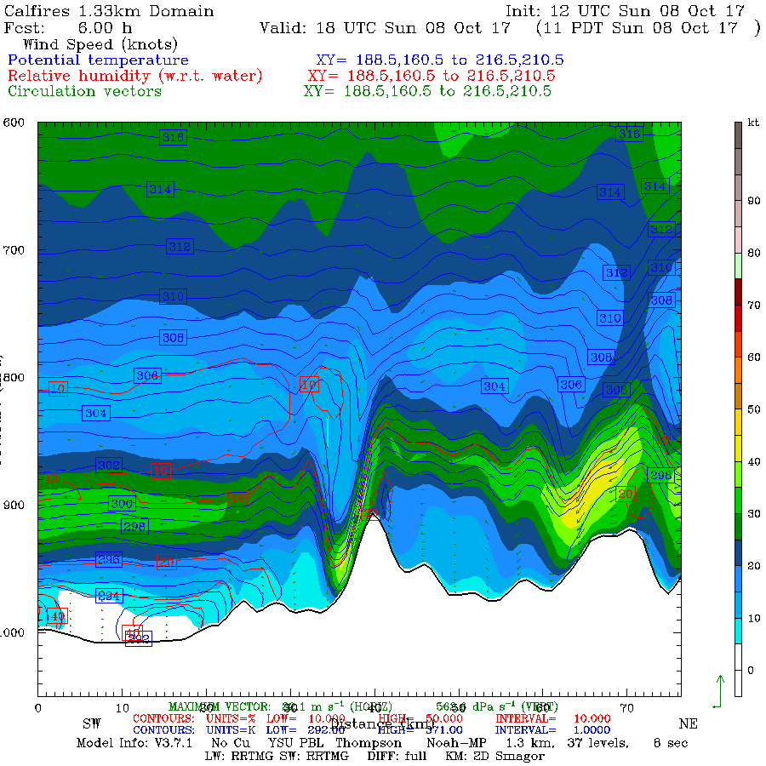

Slide 50
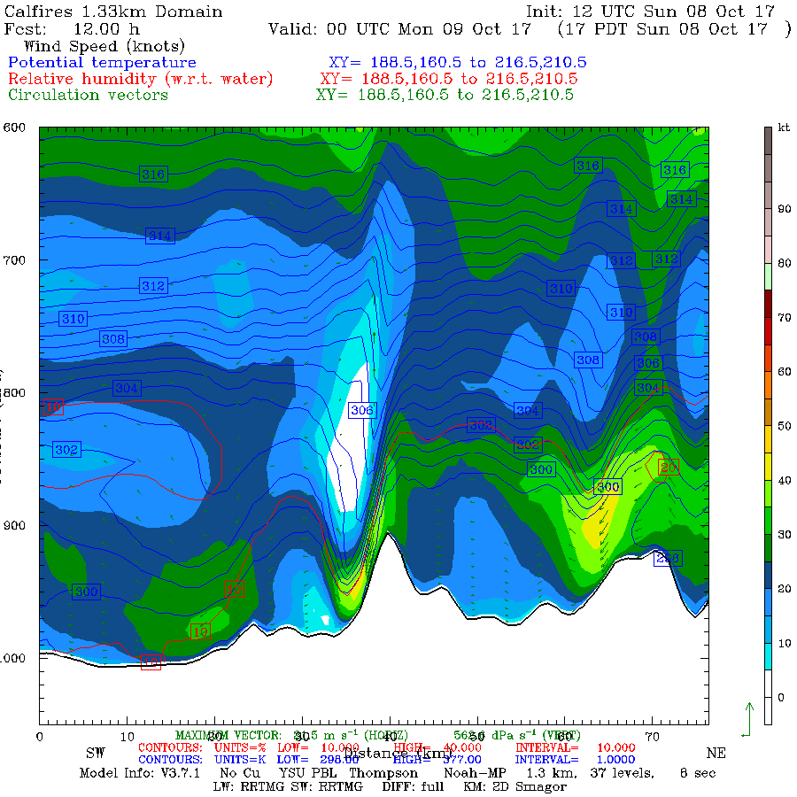

Slide 51
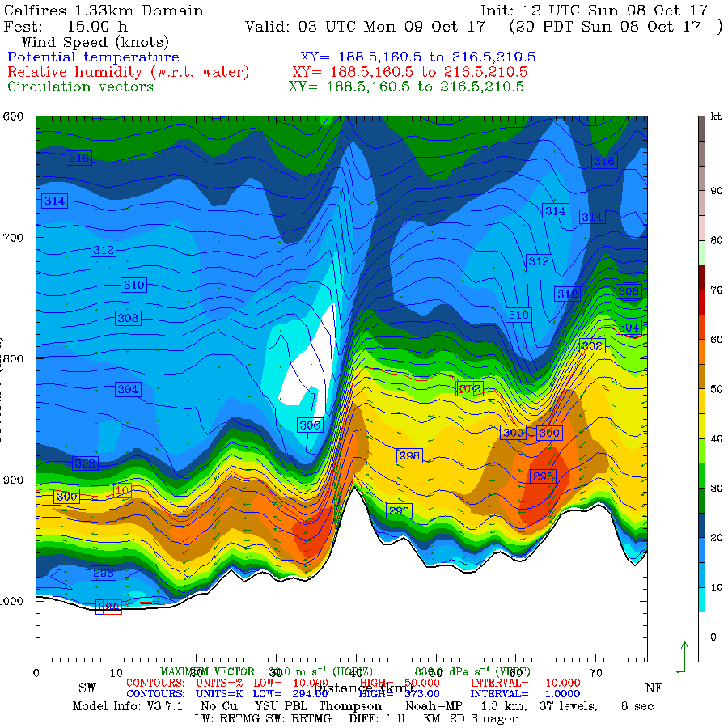

Slide 52
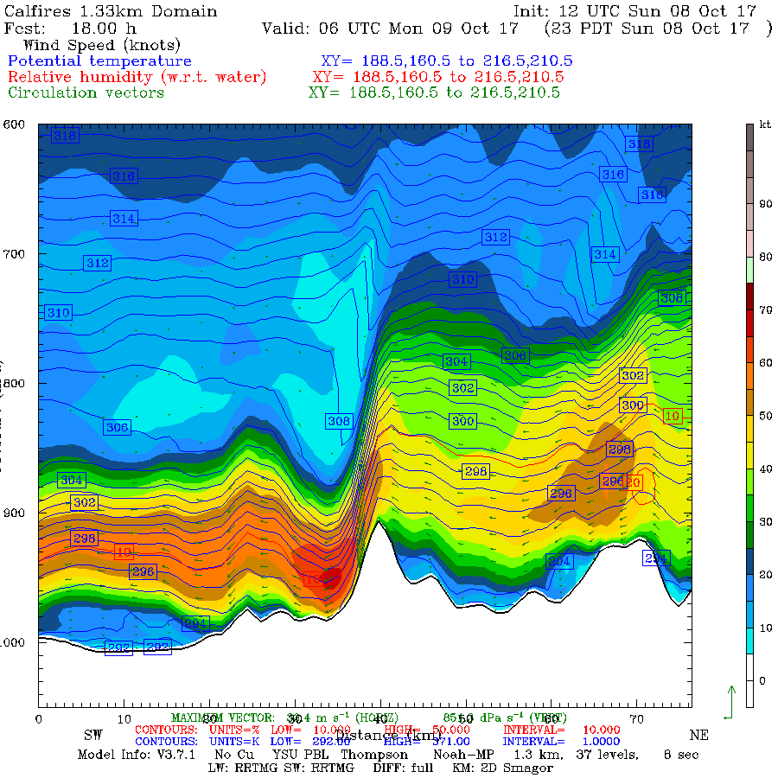
Terrain-Related
Downslope
Windstorm

Slide 53
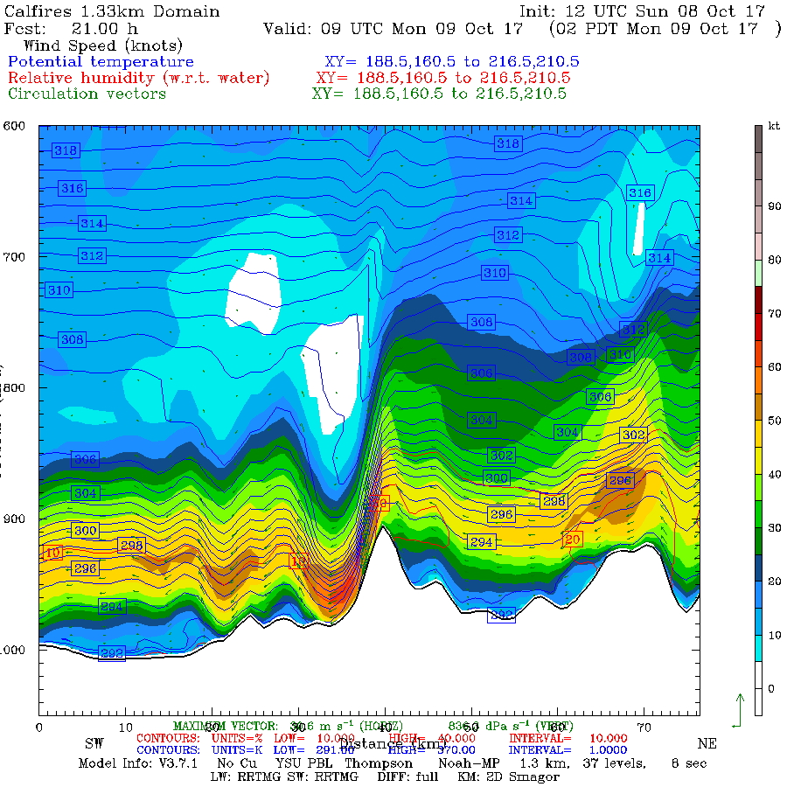

Slide 54
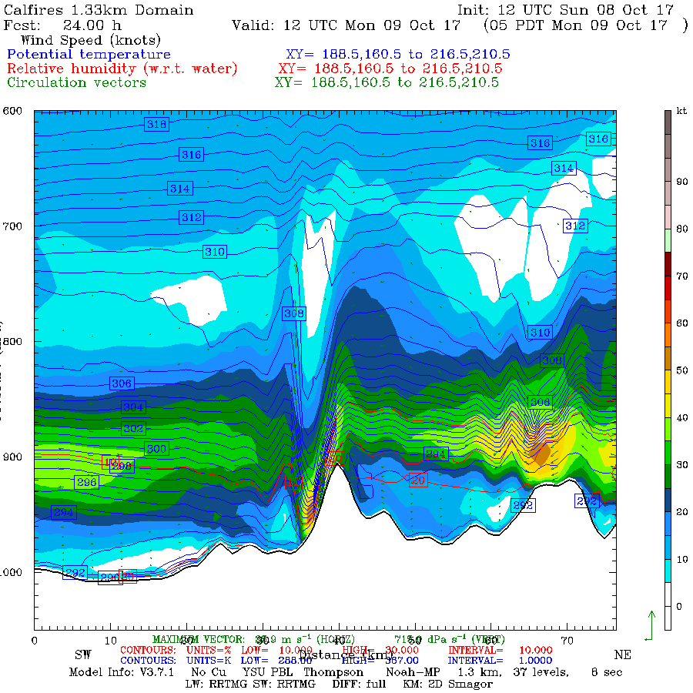

Slide 55
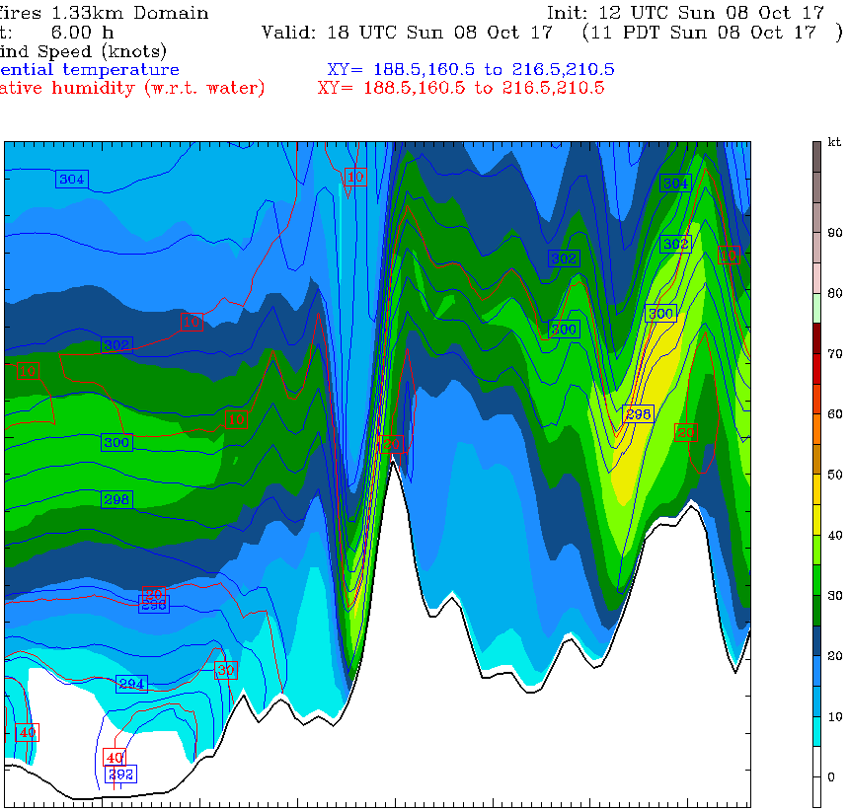

Slide 56
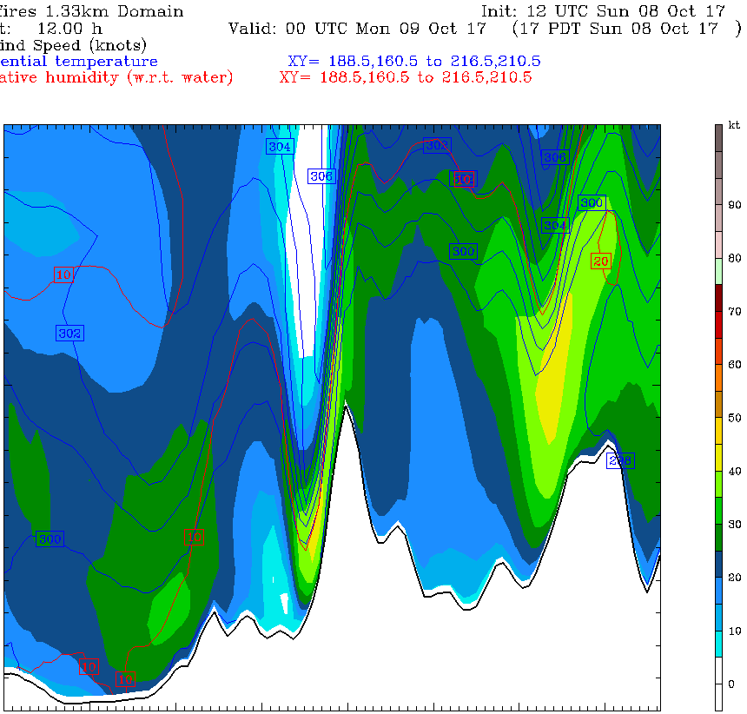

Slide 57
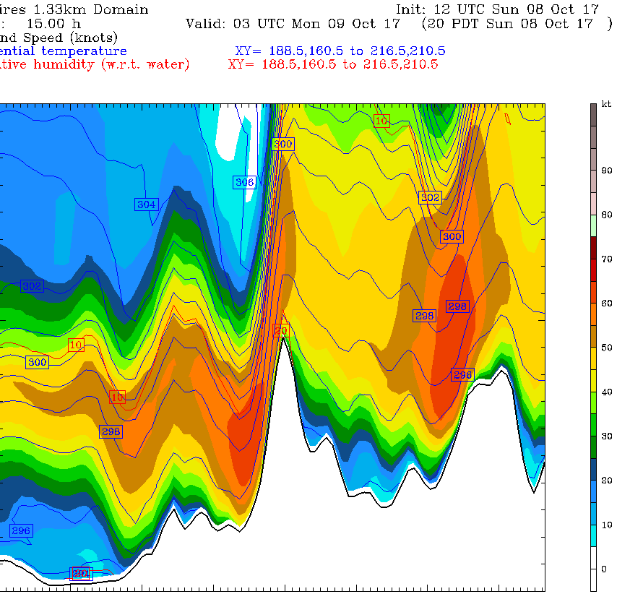

Slide 58
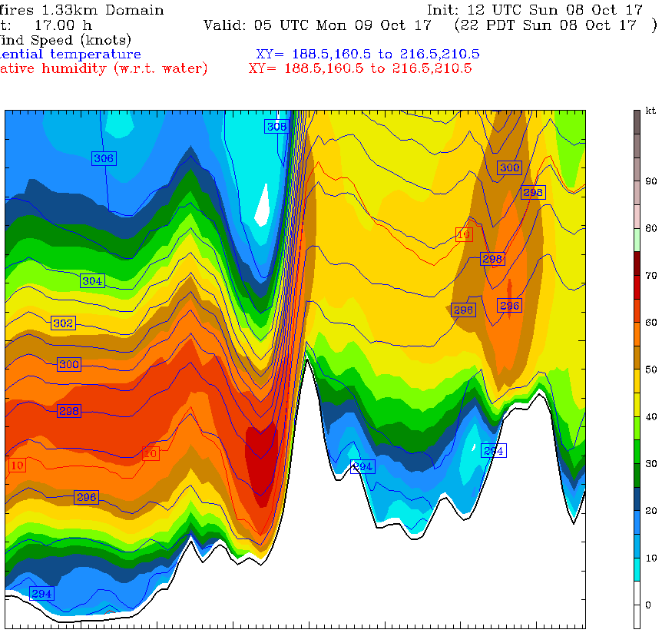
10 PM October 8

Slide 59
To Better Understand the Mesoscale Dynamics of this High-Amplitude Wave, Let’s Examine an Upstream Model Sounding

Slide 60


Slide 61


Slide 62

Increased flow normal to the barrier
Increased stability at and above crest level
Critical level around 550 hPa

Slide 63


Slide 64

A Closer Look at the Diablo Winds

Slide 65



1800 UTC 8 October: 4km domain
700
SLP
850

Slide 66



0000 UTC 9 October 2017
SLP
850
700

Slide 67



0300 UTC 9 October
SLP
850
700

Slide 68



0600 UTC October 9
SLP
850
700

Slide 69
Conclusions Based On the Model Simulation
WRF did an excellent job in duplicating the pattern and temporal evolution of the winds.
Strong winds were associated with a downslope wind event.
The downslope event revved up as winds normal to the terrain increased with upper level short wave passage, the development of a more stable layer at and above crest level, and the establishment of a marginal critical level.
Gaps in the Sierra Nevada allowed cool air into the Central Valley, that produced an enhance gradient over Wine Country.

Slide 70

Serious Air Quality Impacts
Many Bay area AQ sites had their worst air quality on record
Air quality declined to extremely unhealthy levels for millions of people
Remained unhealthy for days.
Sickened thousands of people.
Hundreds of people ended up in Bay Area hospitals from the effects of smoke

Slide 71

October 10

Slide 72
October 13

Slide 73
Daily View
Bad air quality last days

Slide 75
Were the Wine Country Wildfires Associated with Anthropogenic Global Warming?

Slide 76


There has been a lot of claims to that effect:

Slide 77

“He said a warming climate has contributed to catastrophic wildfires. “That’s the way it is with a warming climate: dry weather and reducing moisture.” said Brown.

Slide 78
An Irony

Slide 79
Little Evidence That Anthropogenic Global Warming Contributed to the Wildfires
The fire was initiated and supported by very strong winds.
No reason to believe that Diablo Winds are associated with global warming, in fact the opposite is probably true.

Slide 80
Little Evidence for an Anthropogenic Global Warming Contribution
Ignition was associated with the failure of a human technology (electrical lines, poles, and reclosers)

Slide 81
There is Little Evidence for the Importance of Anthropogenic Global Warming for the Wildfires
A key element in the severity was excessive grass growth resulting from unusually large winter precipitation.
No reason to expect more central CA precipitation under global warming
Deser et al., 2012. Precipitation trends for 2010–60 [mm]. (Stippling indicates values not significant at the 95% confidence level.

Slide 82

The Role of Invasive Grasses
Invasive, non-native grasses played an important role
Cheatgrass, “Bromus tectorum”
a.k.a. grassoline

Slide 84
If the temperatures were a few degrees warmer, or the summers a bit drier, it would not make a difference for coastal CA wildfires
A normal summer is warm and dry enough to allow fires.
And 1-hr and 10-hr fuels are always dry enough to burn in summer under offshore flow.
There is a deep literature, based on observed conditions and fires, that supports these points. (Keeley and Fotheringham 2003;Keeley 2004 Abatzoglou and Kolden 2013, Keely and Syphard 2016).
“The extent of preceding drought is largely irrelevant to the size of these autumn fires because of the severity of weather during the fire event”

Slide 85
No long-term trends in wildfires
No long-term upward trend in fires for coastal California
The region has a long history of fire.

Slide 86
Fire is No Stranger to the Region

Slide 87

Hanly Fire of 1964: Nearly Identical to the Tubbs Fire

Slide 88

1917-1928 Wildfire Map for Marin County

Slide 89


Urbanization Makes Fires More Frequent and Destructive
Sonoma County Population

Slide 90
Too many people living in the hills

Slide 91
Bottom Line
There is no reason to believe that anthropogenic global warming in any way contributed to the Wine Country fires or will enhance them in the future.

Slide 92

Operational Forecast Guidance Was Excellent, Even Days Out
10-h surface (10-m) wind gust forecast (kt) valid at 0700 UTC 9 October 2017. The model was initialized at 1200 UTC 8 October 2017. Wind gusts are derived by determining the highest wind speed in the lowest km.
NOAA/NWS Operational
HRRR Model
NOAA/NWS Operational
HRRR Model

Slide 93

Operational CANSAC Model
30-h surface wind forecast (mph) for 0600 UTC 9 October 2017 for a run initialized at 0000 UTC 8 October 2017 from the nested 2-km domain

Slide 94


Based on these and other modeling systems, the NWS released high wind and red flag warnings—days before.
Two Days Before

Slide 95


Slide 96
Inadequate Warning to the Population by Civil Authorities
Although a general threat was communicated days before, there was a breakdown in communication when the fires started to explode
Lack of a general broadcast of an acute danger over cellular networks.

Slide 97
Lack of Firefighting Equipment During the First Day
A lack of resources during the critical first day, resulted in many buildings burning unnecessarily, especially in urban areas.
Most requests for “mutual aid” were not heeded.

Slide 98

Could we have prevented the fires with better use of weather forecasts?

Slide 99
Quite possibly, yes, with pre-emptive power outages
The winds caused the fires and allowed them to explode that night.
The winds were skillfully forecast the previous day.
With such strong predicted winds, power failures were inevitable.
Why not de-energize the powerlines in the hills and vulnerable areas a few hours before the winds were going to hit?
Might doing so have saved 44 lives and billions of dollars of damage?

Slide 101

Take Home Messages

Slide 102
Initiation
The Wine Country wildfires resulted from strong downslope winds and a vulnerable electric system.
Heavy precipitation the previous winter contributed additional fuels that probably enhanced fire potential.

Slide 103
Mesoscale Modeling
The forecast skill of mesoscale modeling has improved enormously during the past decade so that it is now a potent tool for preparation and warning for wildfires.

Slide 104
Inadequate Application of Scientific Progress
Society is not taking full advantage of improved warning capabilities from improved observations and numerical weather prediction.
Poor communication and lack of understanding by the governmental sector and others of the quality of the information we can provide.
A great deal of unnecessary loss of life and economic damage is occurring.

Slide 105
Miscommunication about climate change
Some politicians, climate activists, and media are making unsupportable claims that the coastal California wildfires resulted, in part or total, from anthropogenic global warming.
Such false claims are inconsistent with the peer-reviewed literature and being used as cynical tools to encourage “proper” actions.
Furthermore, such miscommunication works against dealing with the real problems, such as land use, urbanization, and poorly maintained power grids.
“California's hellish fires: a visit from the Ghost of Christmas Future
…This was predicted by climate scientists”
Posted in Skeptical Science, 11 December 2017

Slide 106
Dealing With the Real Problems
Homes and buildings must be moved out of areas that are prone to wildfire.
Regular fire must return to natural areas.
The electrical distribution system must be updated to be less prone to starting fires (e.g., underground lines, fix the recloser problem)
Societal decision makers must learn how to use improved predictions.
Better warnings and coordinated fire fighting capabilities are needed

Slide 107

The End

