Slide 1
Atmospheric Sciences 101
Humidity

Slide 2
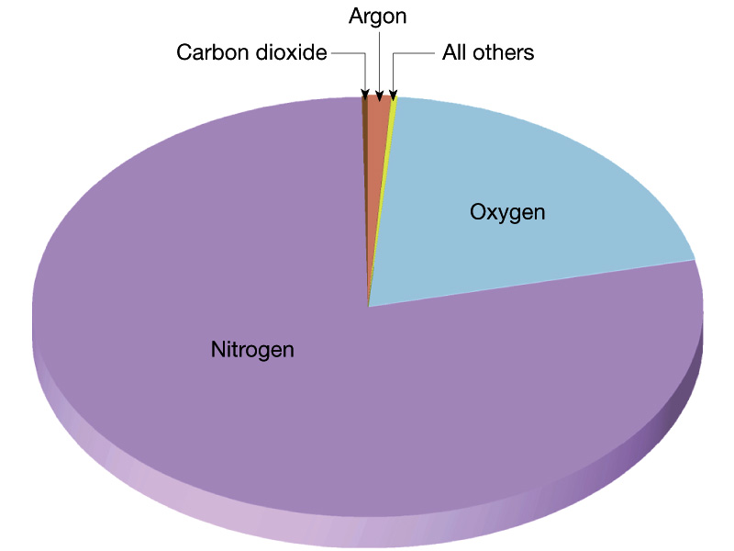
Air is mostly composed of Nitrogen (N₂, 78%) and Oxygen (O₂, 21%), with the next largest component being water vapor (H₂0, ~0-4%)

Slide 3
Humidity
Humidity is a measure of the water vapor content of the air
Water vapor plays a critical role in the atmosphere
Associated with clouds and precipitation
Very important way of moving energy in the atmosphere
E.g., energy going into evaporating water vapor in the tropics, which condenses and release energy in the midlatitudes
Has a big influence on our comfort and how we cool when warm

Slide 4

Some basic water vapor concepts
H2o vapor is a DRY gas, just like O2 and N2. It is not ”wet”
Warm air can “hold” more water vapor than dry air.
The amount of water vapor air can “hold” increases rapidly with temperature

Slide 5
An Experiment
Start with a sample of air with some water vapor
Start cooling it down. It will progressively be able to hold less and less water vapor
Eventually it will only be able to hold the water vapor it started with.
This is called saturation.
If one cools the air down further, some of the moisture will begin condensing out.

Slide 6

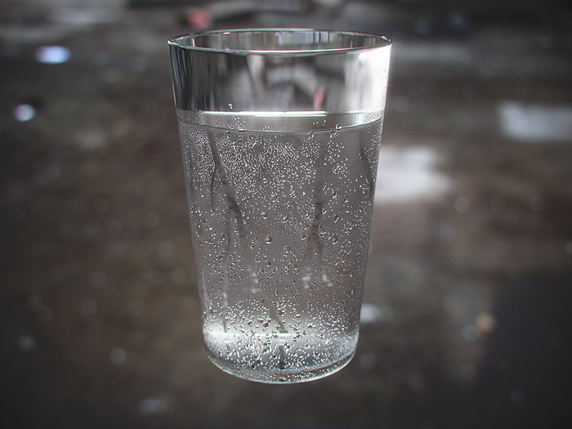
You See This Process Happening All the Time

Slide 7
Dew Point (T_{d})
The temperature to which must be cooled (at constant pressure) in order for it to become saturated.
Measured in °C or °F
A measure of water vapor in the air. Why?
The more water vapor there is in the air, the less you have to cool it down!
So more water vapor means higher dew point.

Slide 8
Dew Point
Typical dew point in Seattle during summer is ~ 50F
In humid, Washington DC in summer: 65-75F
Reported at most airport stations around the world.

Slide 9
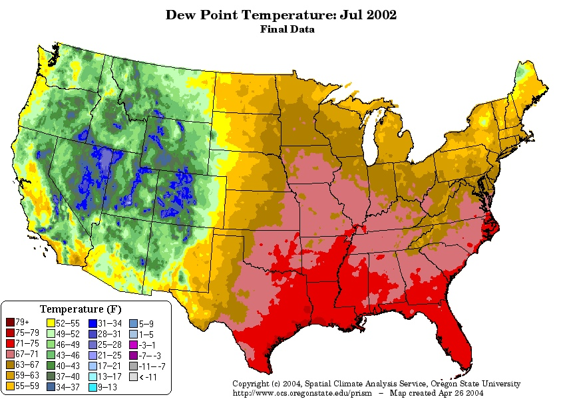

Slide 11
Relative Humidity Varies During the Day/Night
Lower during the day when temperatures are warm
Higher at night when temperatures are cool

Slide 12
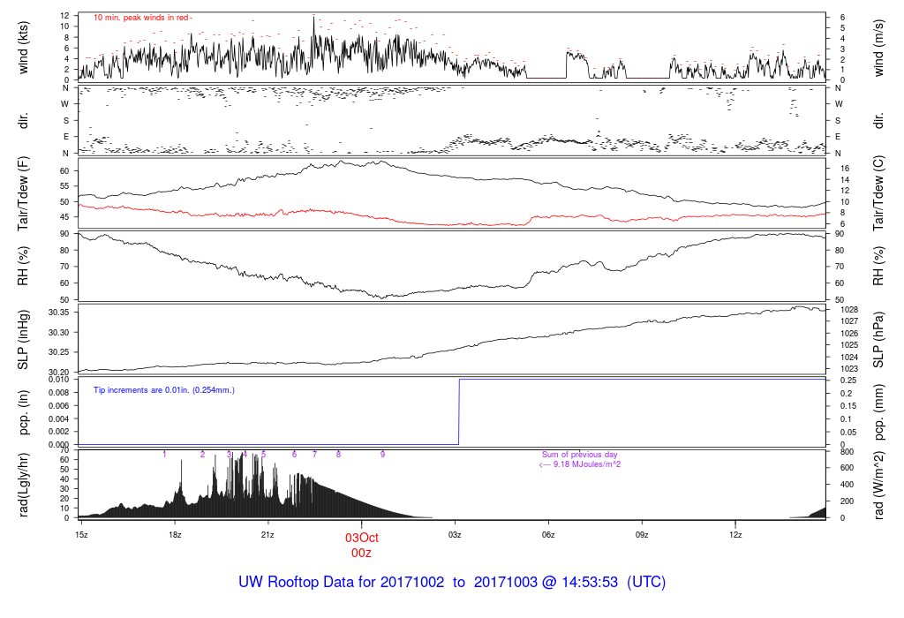

Slide 13
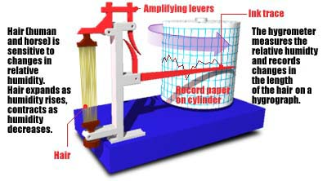
How do we measure humidity? Use devices called hygrometers.
In the old days, hair hygrometers

Slide 15
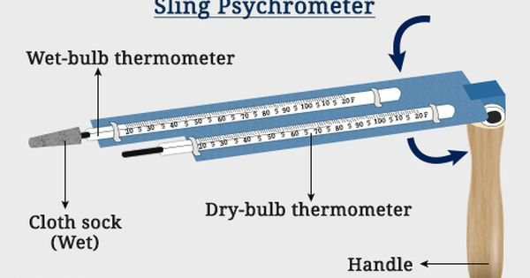
Then moved to psychrometers, with two thermometers, one with a “wet bulb”

Slide 16
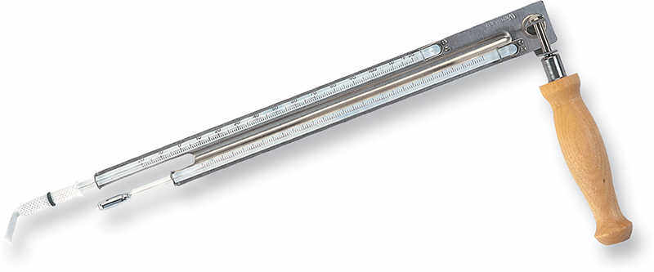
Psychrometer
Measures both a ”dry bulb” and “wet bulb” temperature
The difference between the two can be used to calculate humidity, either relative humidity or dew point

Slide 17
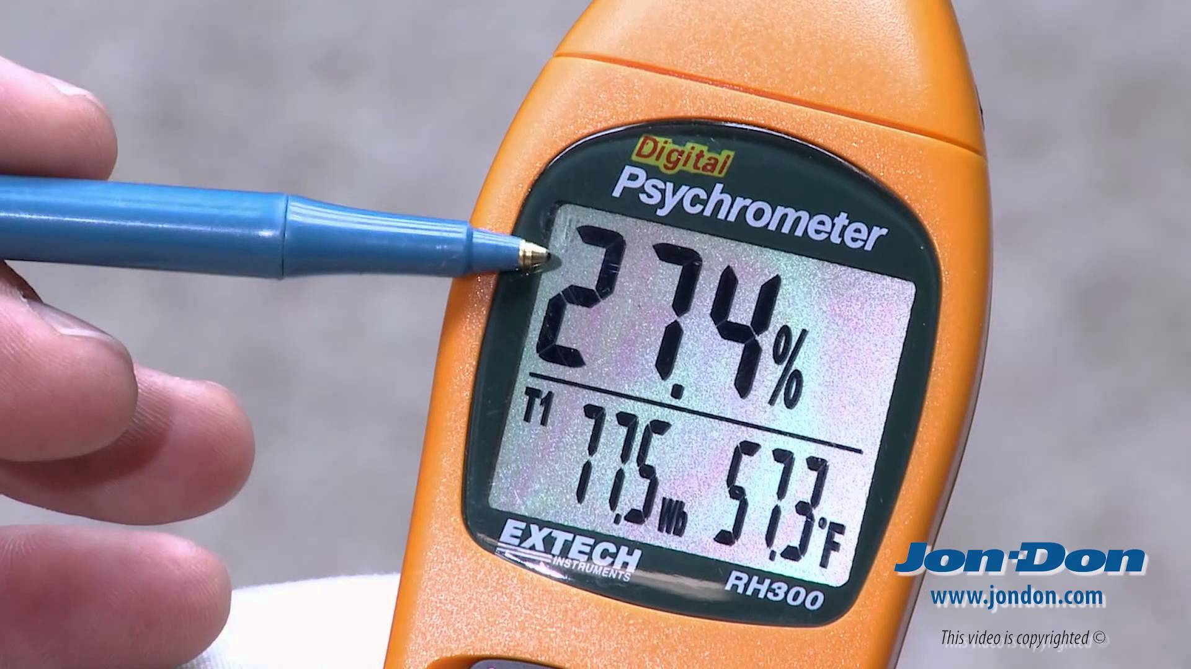
More Recently Electronic Psychrometers/Hygrometers Available
Some use solid state devices
Others chilled mirrors

