Slide 1
Saildrone Pacific Sentinel Project

Slide 2
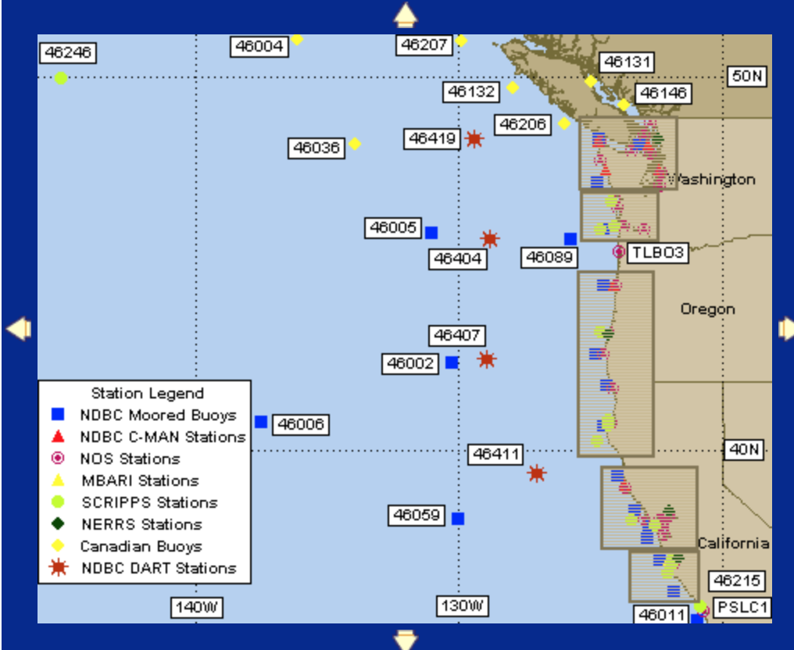
X

Slide 3
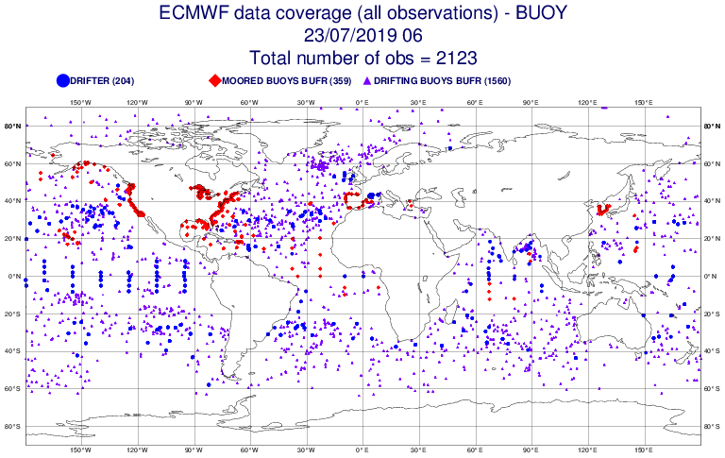
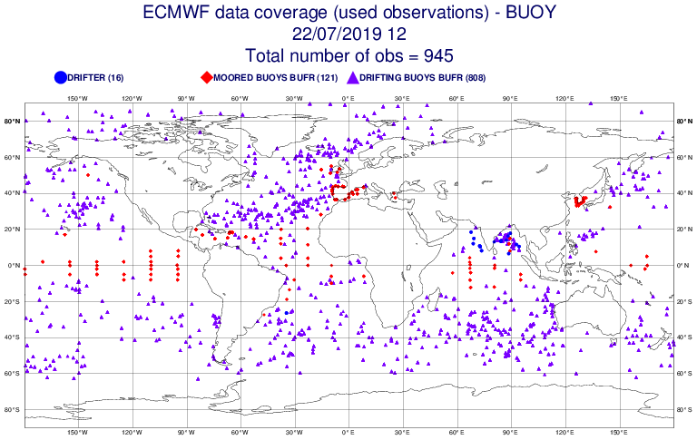

Slide 4
ALL Buoys Used

Slide 5
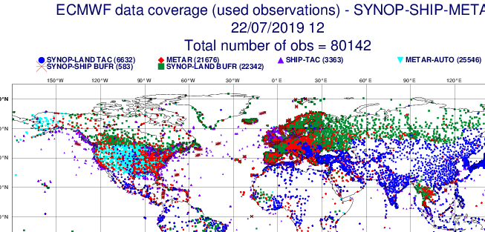

Slide 6
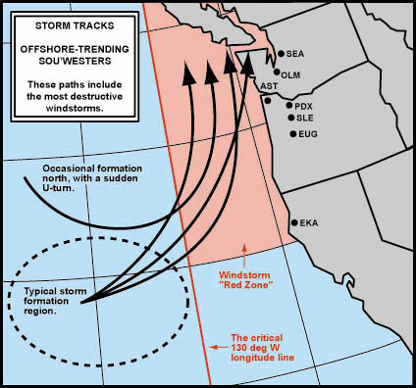
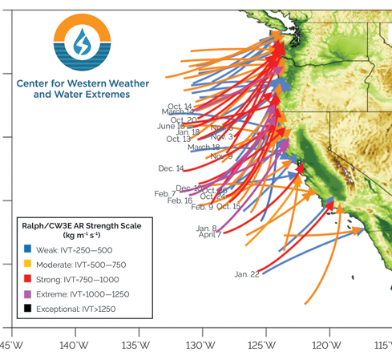

Slide 7
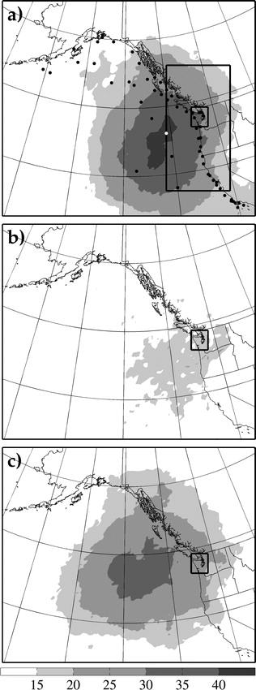
Torn and Hakim (2008)-24h Sensitivity

Slide 8
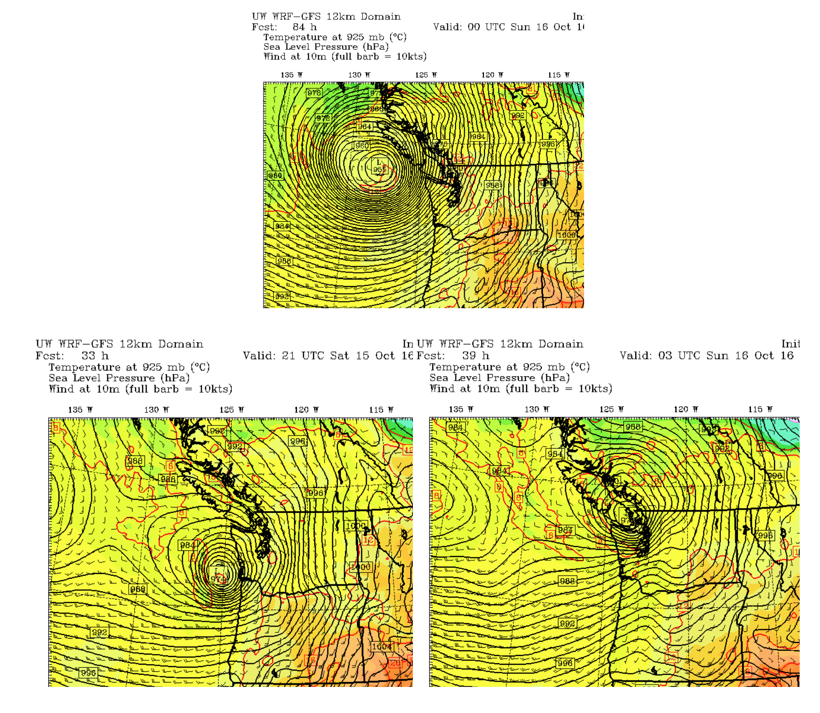
West Coast Issues
Intensity and position of landfalling storms
Intensity of positions of atmospheric rivers, including waves on them
Describing the offshore winds/waves during summer

Slide 9
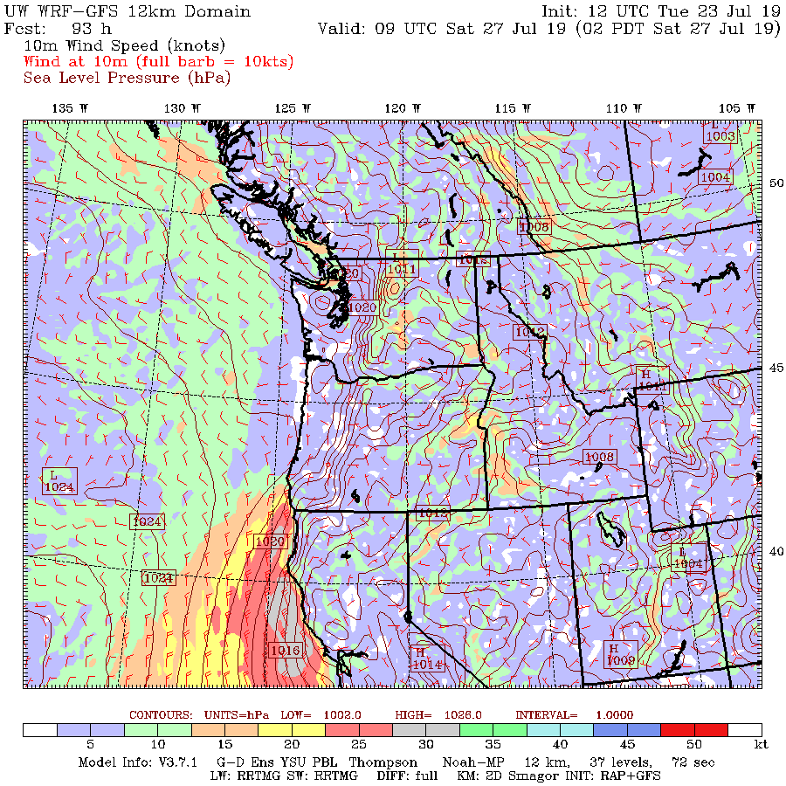

Slide 10
Surface Pressure is the Key Observation
Surface parameter that contains 3D information
Substantial correlations at distance over water

Slide 11
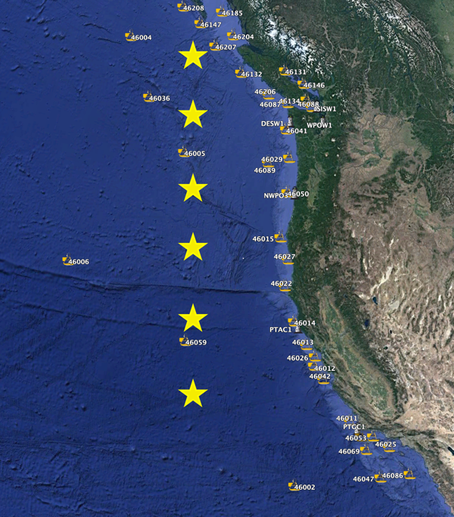
How to deploy?
Possibility one: Static Picket Fence

Slide 12
How to deploy?
Possibility two: picket fence with adjustments in prior days based on ensemble guidance (sensitivity, storm locations)
L

Slide 13
How to deploy?
Possibility three: cluster in most probably storm/AR locations and move into position during prior 5 days.

Slide 14
Year 1: Conservative Approach
Used static picket fence
Simplifies first year operation
Will catch all events for most of west coast

Slide 15
Initial activities
Zero order: use saildrones to determine pressure differences with model initializations.
Work with NCEP or ESRL to rerun situations in which there are major differences between saildrone and initializations
Rerun UW WRF system for interesting cases using the saildrone data. Easiest thing would be observation nudging.
If time, run UW EnKF assimilation system for a few cases using Saildrone data.

