Slide 1
Saildrone Pacific Sentinel Project

Slide 2
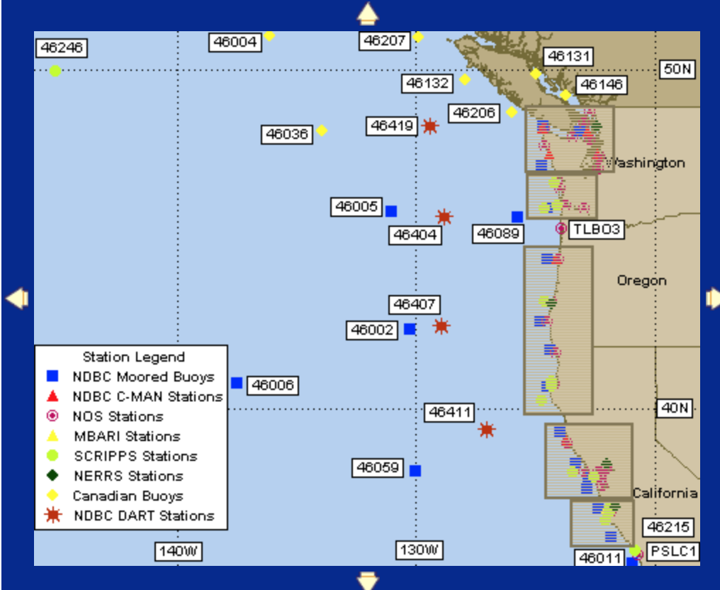
X

Slide 3
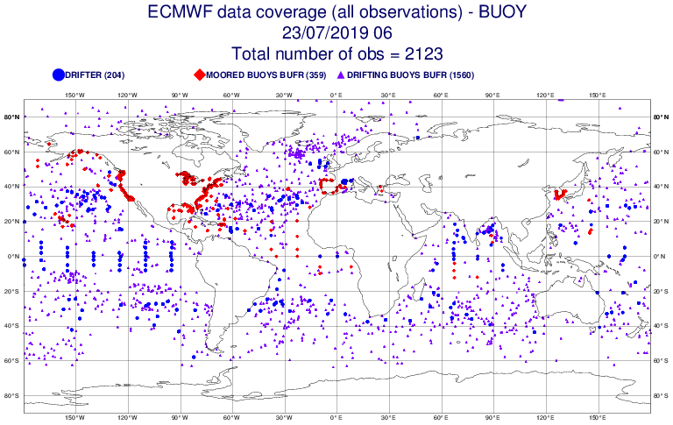
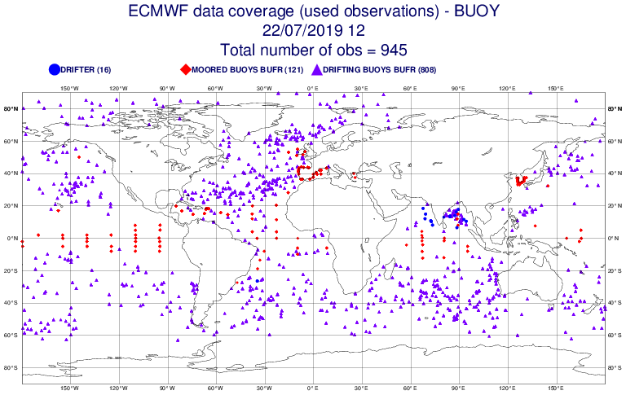

Slide 4
ALL Buoys Used

Slide 5
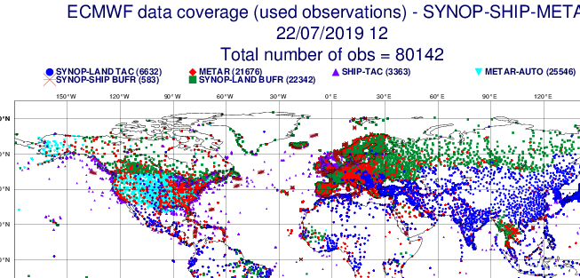

Slide 6
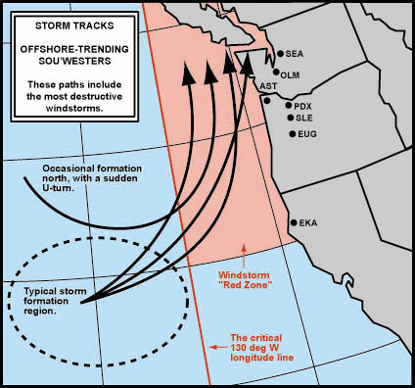
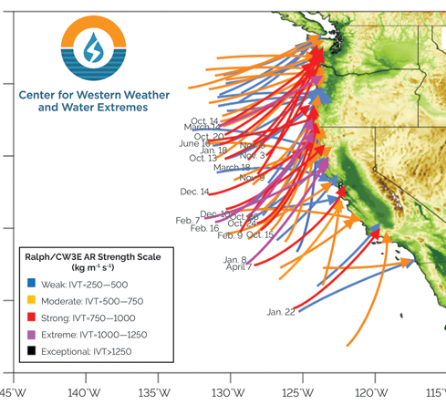

Slide 7
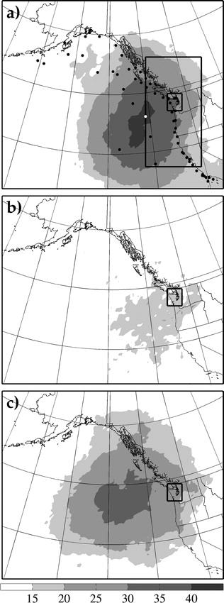
Torn and Hakim (2008)-24h Sensitivity

Slide 8
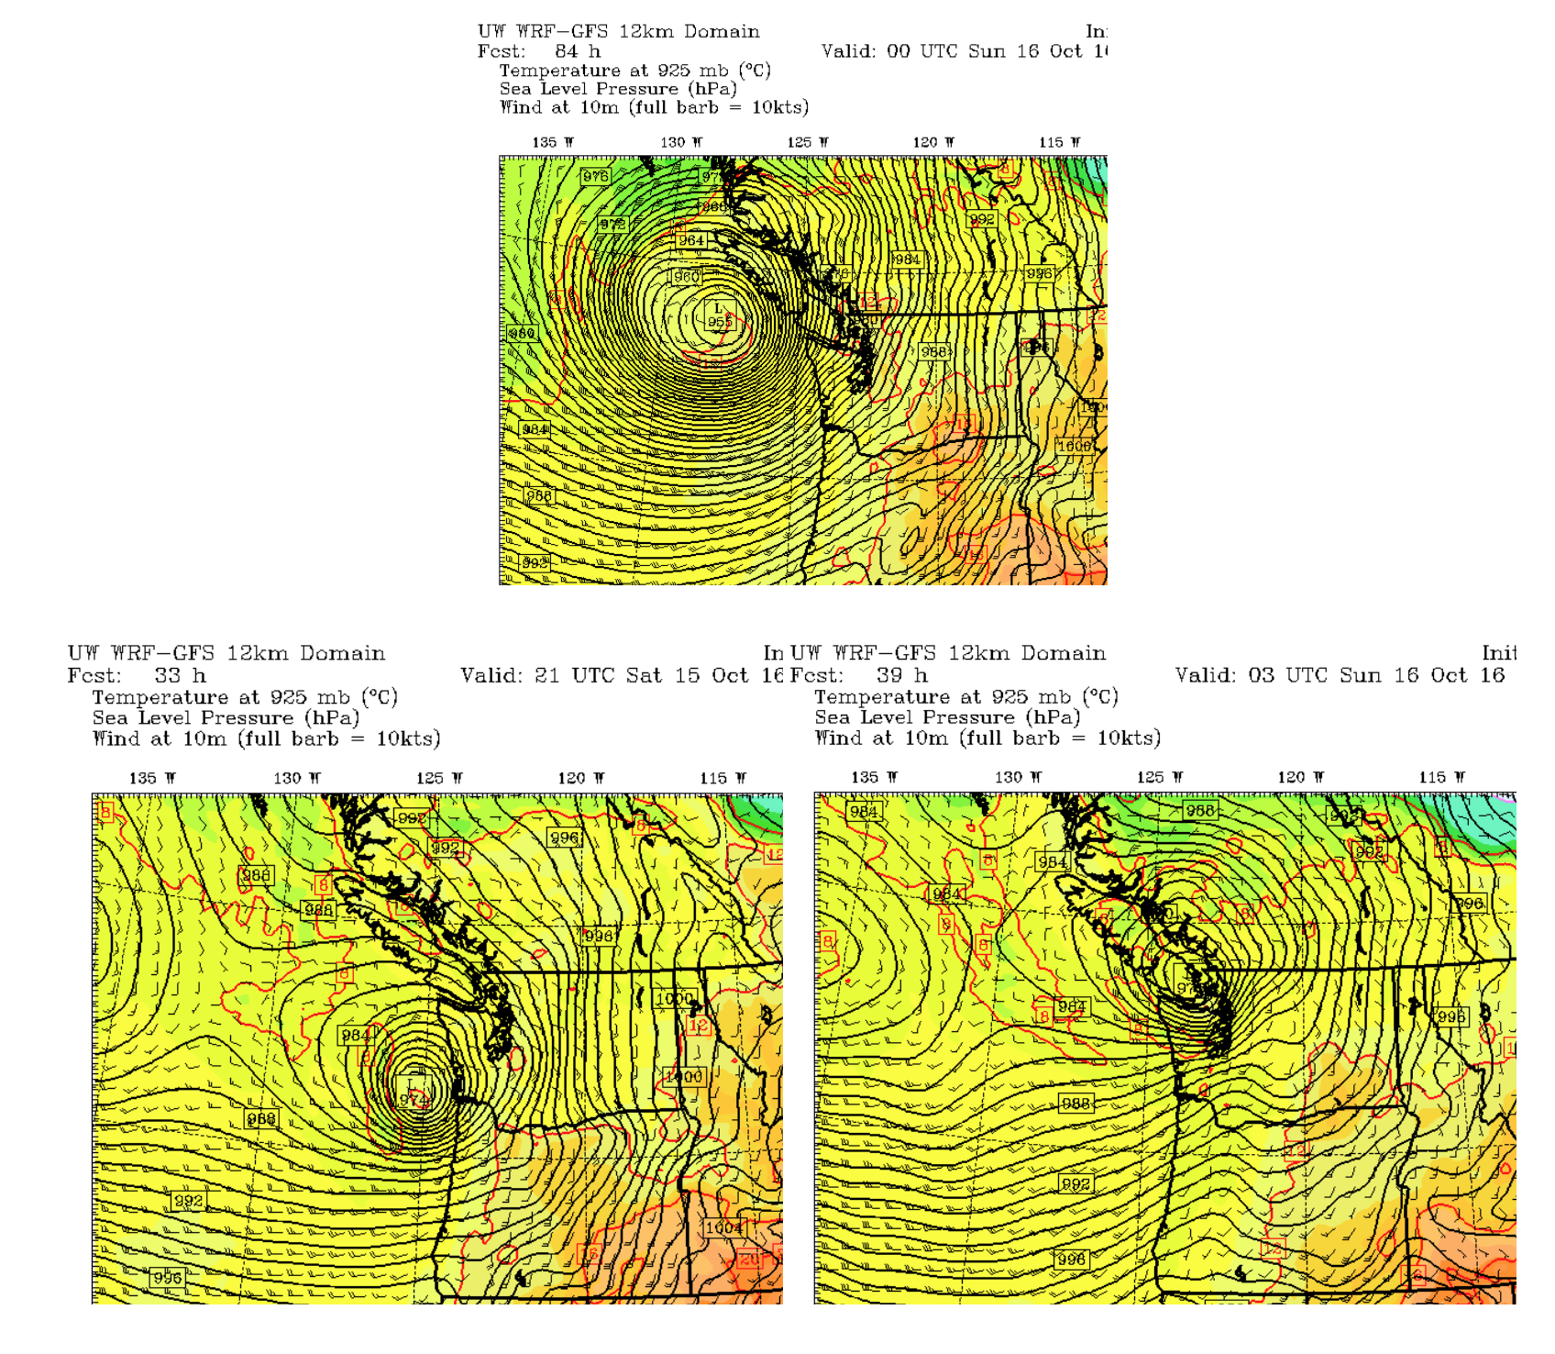
West Coast Issues
Intensity and position of landfalling storms
Intensity of positions of atmospheric rivers, including waves on them
Describing the offshore winds/waves during summer

Slide 9
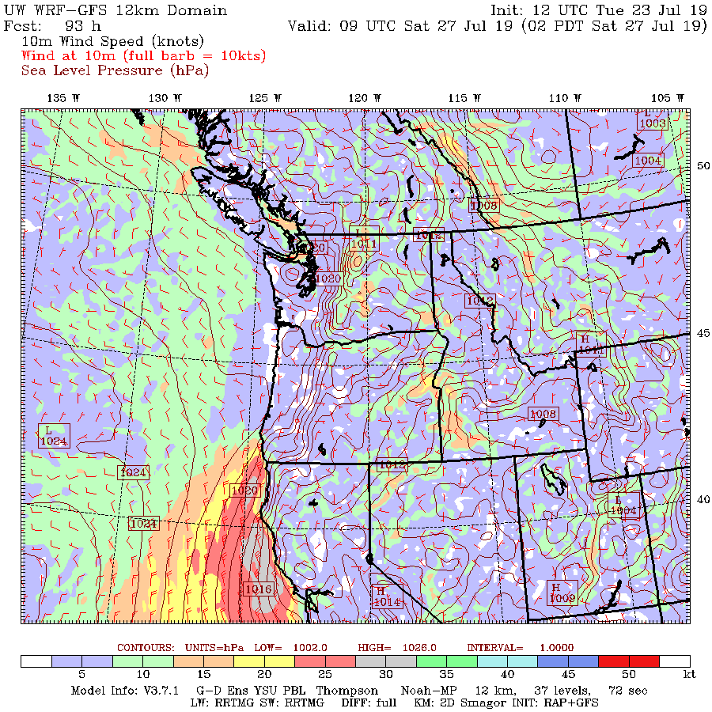

Slide 10
Surface Pressure is the Key Observation
Surface parameter that contains 3D information
Substantial correlations at distance over water

Slide 11
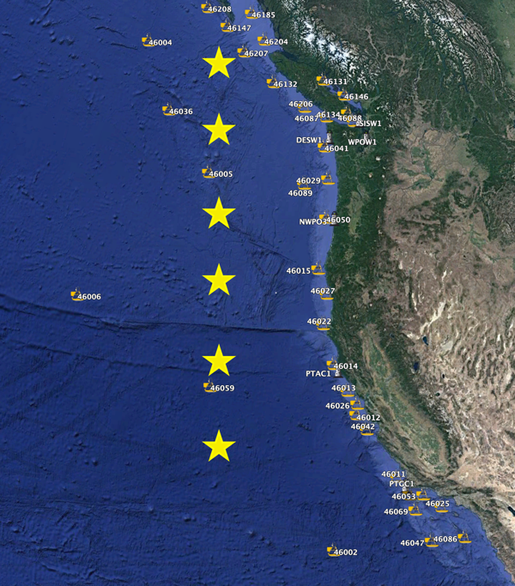
How to deploy?
Possibility one: Static Picket Fence

Slide 12
How to deploy?
Possibility two: picket fence with adjustments in prior days based on ensemble guidance (sensitivity, storm locations)
L

Slide 13
How to deploy?
Possibility three: cluster in most probably storm/AR locations and move into position during prior 5 days.

Slide 14
Year 1: Conservative Approach
Used static picket fence
Simplifies first year operation
Will catch all events for most of west coast

