Slide 1
Saildrone Pacific Sentinel Project

Slide 2
Goals
To evaluate whether Saildrone observations off the West Coast can improve downstream weather prediction, particularly short term.
To evaluate whether such Saildrone observations can better define the meteorology and upper ocean off the coast.

Slide 3
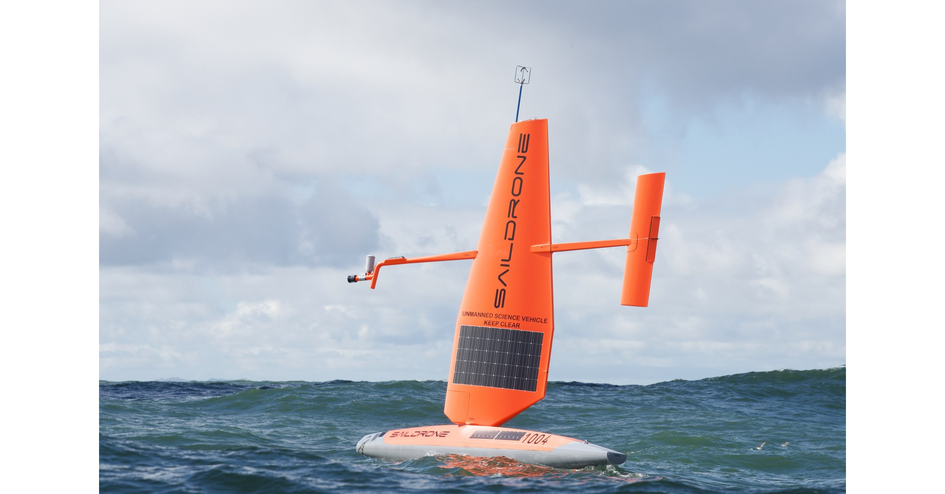
Saildrone

Slide 4
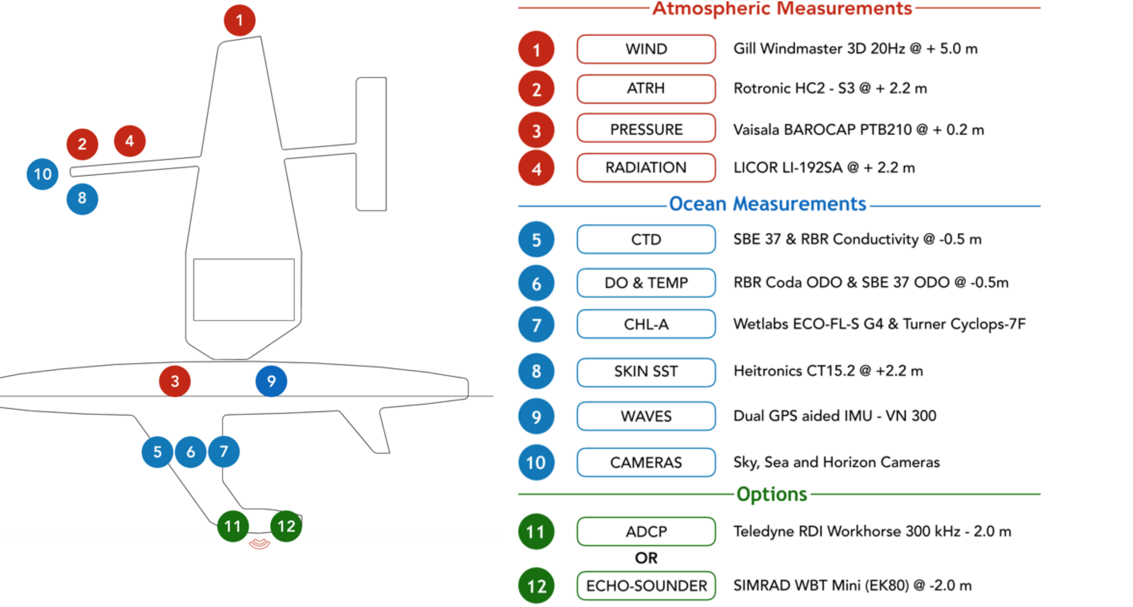
Sensors

Slide 5
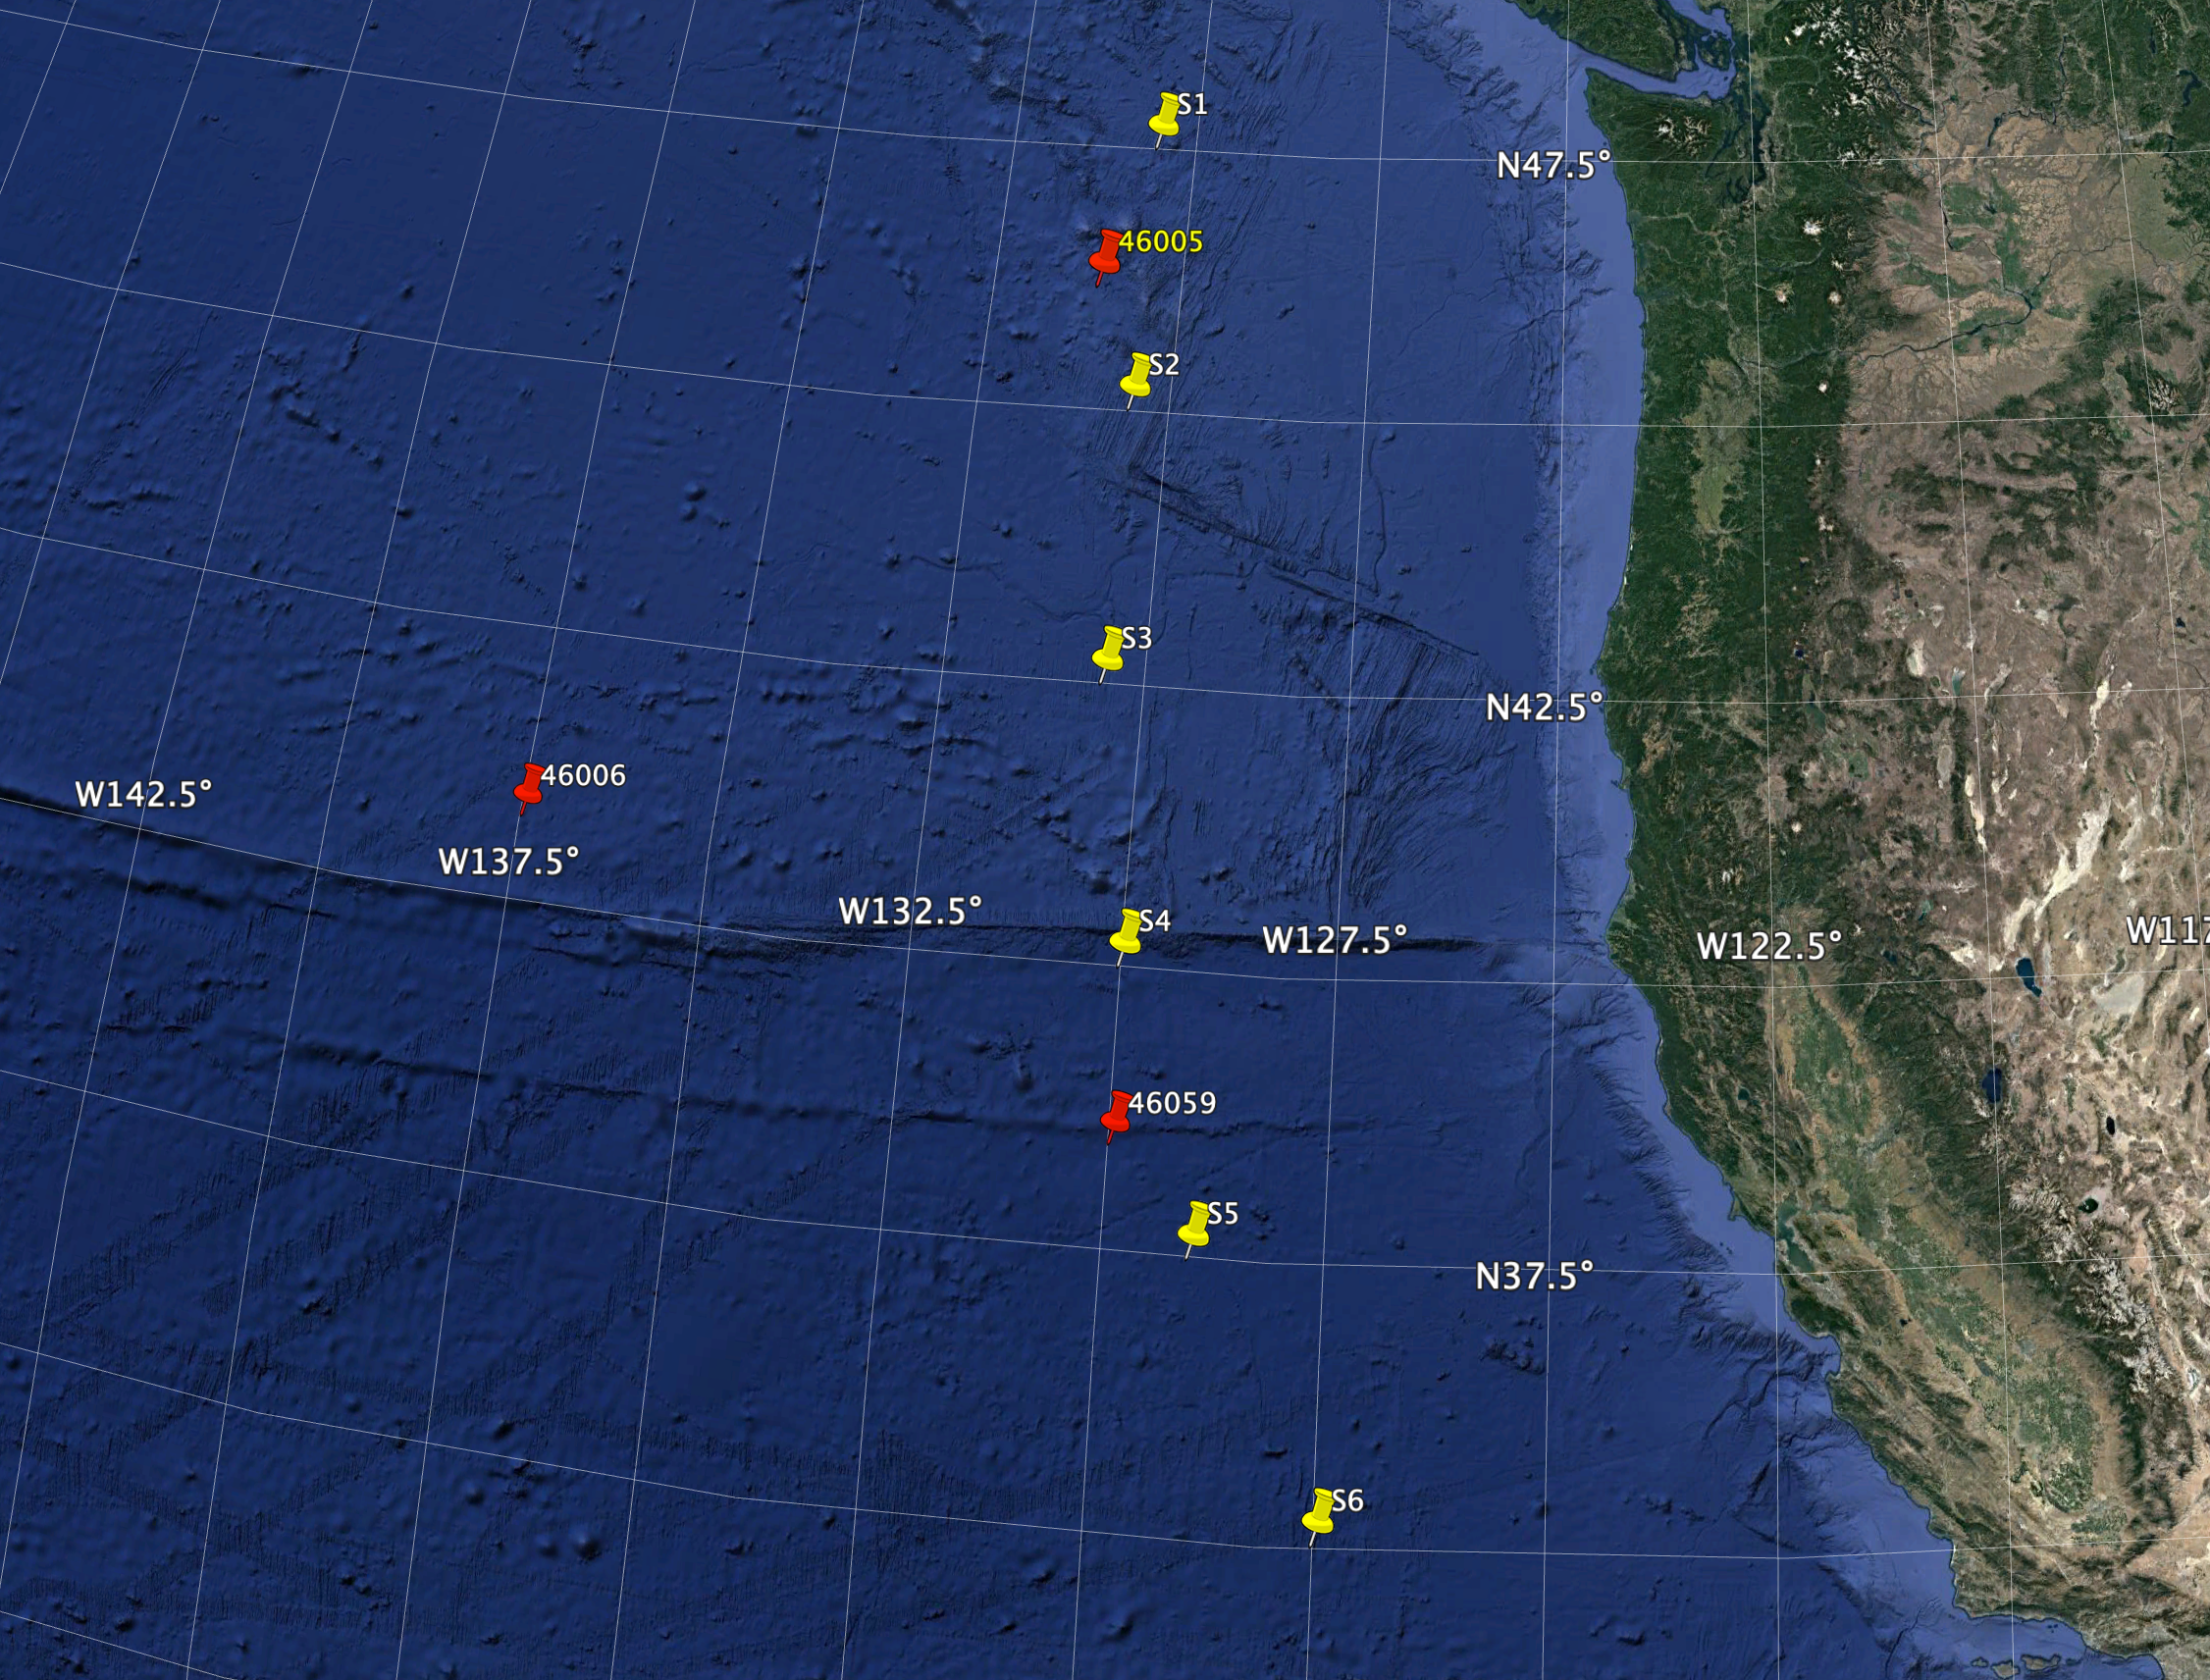
There are providing six Saildrones
They can stay on station and can handle big waves
Can move roughly 40-60 km a day.

Slide 6
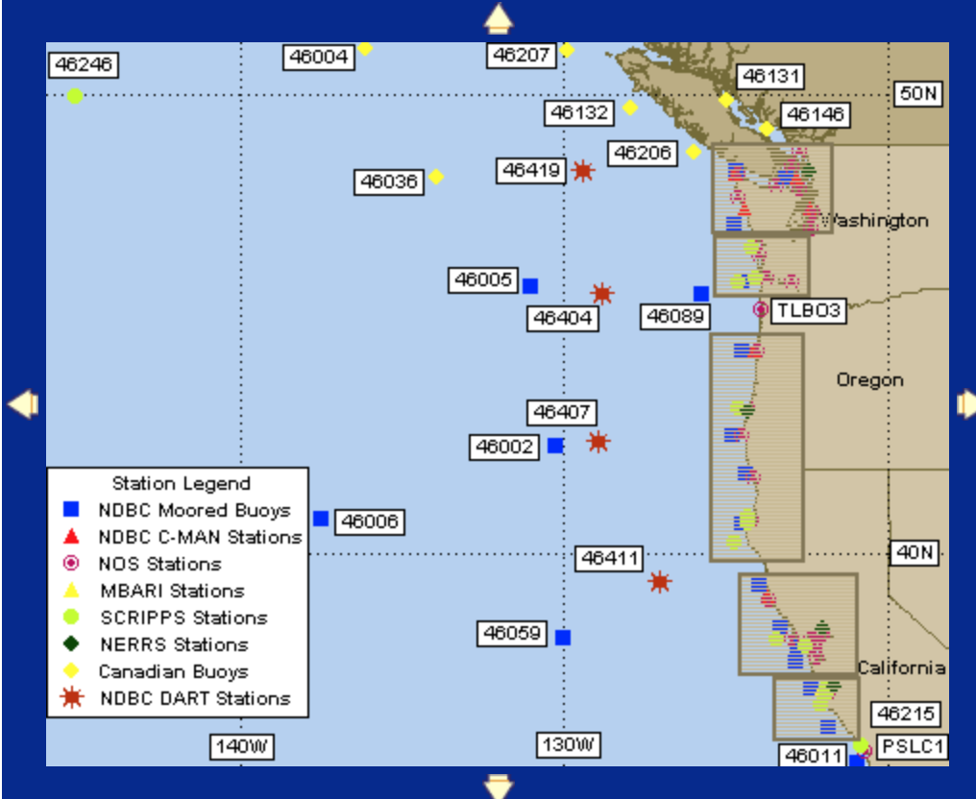
Where to put them?
Two major possibilities
Static picket fence
Adaptive

Slide 7
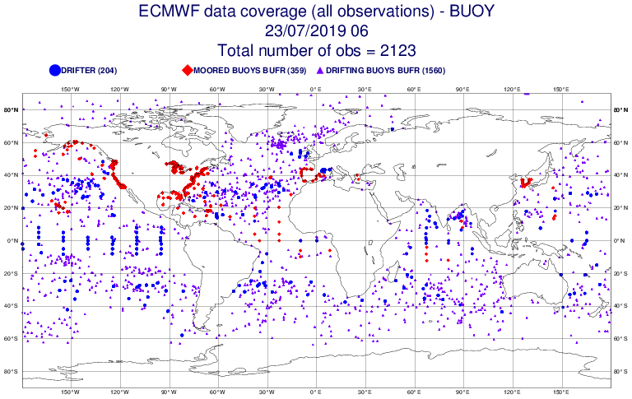
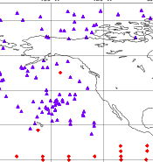
ALL Buoys Used
ECMWF

Slide 8
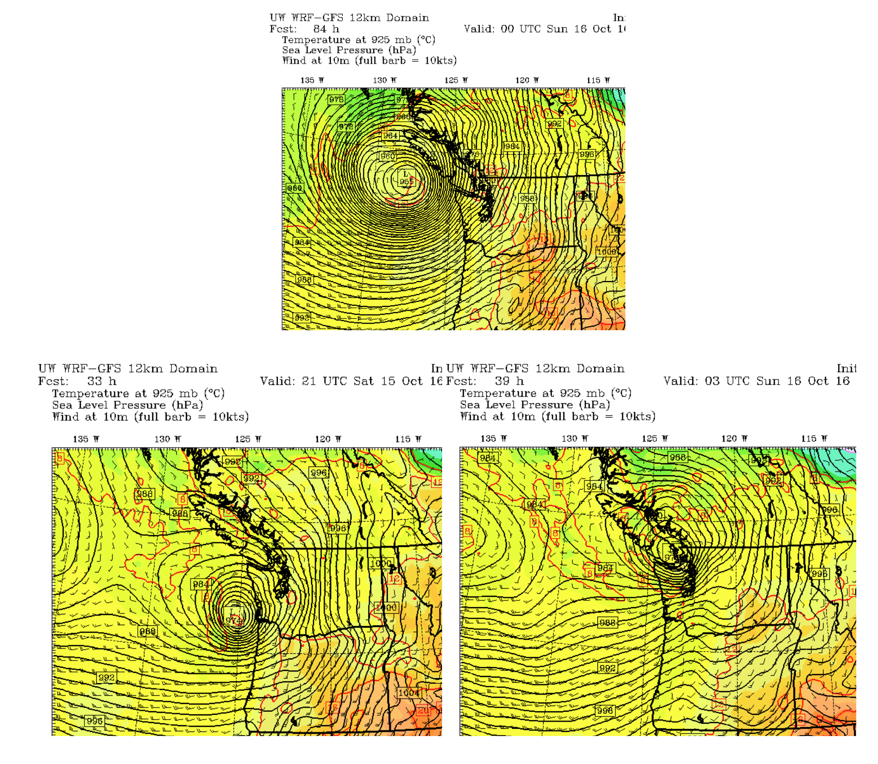
Some West Coast Issues
Intensity and position of landfalling storms
Intensity of positions of atmospheric rivers, including waves on them
Describing the offshore winds/waves during summer

Slide 9
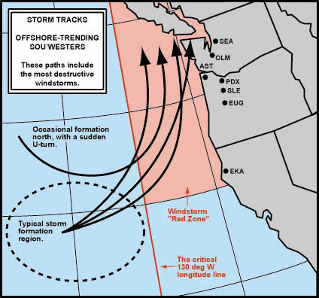
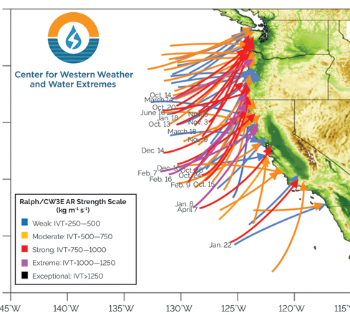

Slide 10
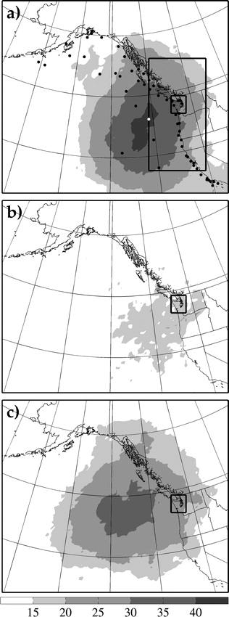
Torn and Hakim (2008)-24h Sensitivity

Slide 11
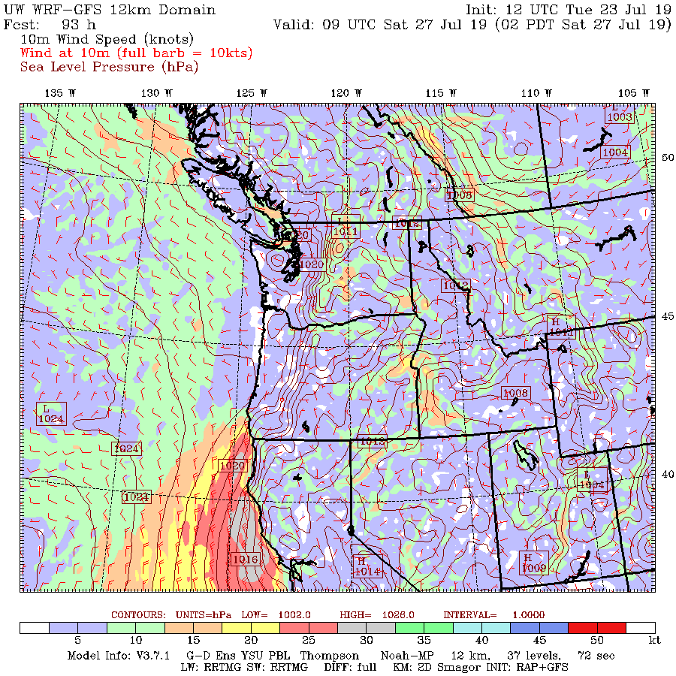

Slide 12
Surface Pressure is the Key Observation
Surface parameter that contains 3D information
Substantial correlations at distance over water

Slide 13
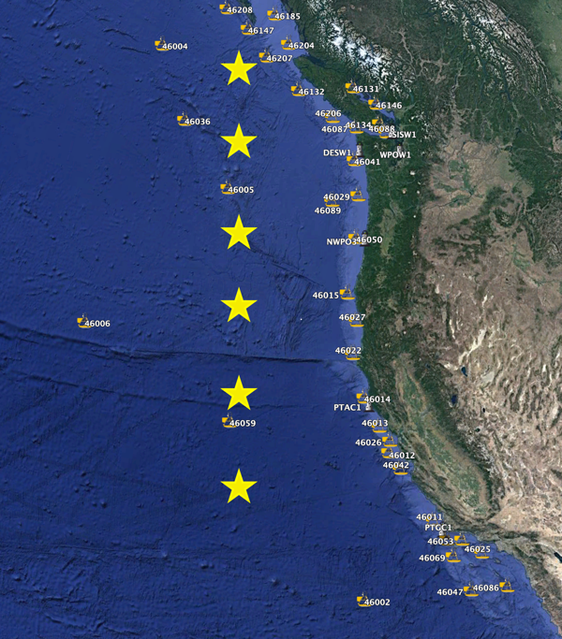
How to deploy?
Possibility one: Static Picket Fence

Slide 14
How to deploy?
Possibility two: picket fence with adjustments in prior days based on ensemble guidance (sensitivity, storm locations)
L

Slide 15
How to deploy?
Possibility three: cluster in most probably storm/AR locations and move into position during prior 5 days.

Slide 16
Year 1: Conservative Approach
Used static picket fence
Simplifies first year operation
Will catch all events for most of west coast

Slide 17
Proposed Positions

Slide 18
Initial activities
Get a web page up showing the current location of saildrones and their observations.
Get in ships and buoys as well, and perhaps coastal observations.
Create maps of differences between initial model state (GFS-FV3, UKMET, or others) and Saildrone at initialization times.
Create maps of differences between saildrone obs and forecasts.
Time scale: one month or less.
Query: they want to set up FTP server access, updated every hour…ok?

Slide 19
Phase 2:
Work with NCEP to get some test runs with Saildrone after we find interesting cases.
Run WRF with obs nudging to see impact of Saildrone obs.
Question: Feasible to run EnKF, doing our own assimilation?

Slide 20
Phase 3: Adaptive Observations
Calculate sensitivities from ensembles
Move ships to maximize coverage for storms/ARs.
Move to coast during summer to define coastal mesoscale meteorolgy

