Slide 1
The Impacts of Convection-Permitting Resolution on Tropical Convection and Extended Global Prediction Skill:
Preliminary Results with MPAS
Nicholas Weber¹
Clifford Mass¹
Daehyun Kim¹
Bill Skamarock²
Roy Rasmussen²
¹University of Washington – Department of Atmospheric Sciences, Seattle, WA
²National Center for Atmospheric Research (NCAR), Boulder, CO
January 9, 2018
American Meteorological Society 98th Annual Meeting
Austin, TX
31st Conference on Climate Variability and Change
Session 4A: Convection-Resolving/Eddy-Permitting Climate Modeling

Slide 2
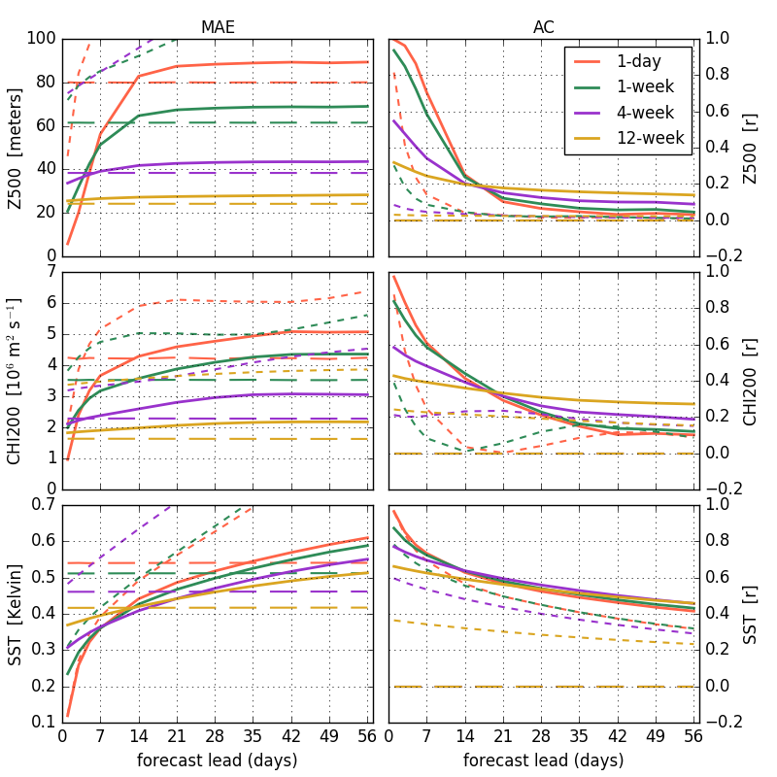
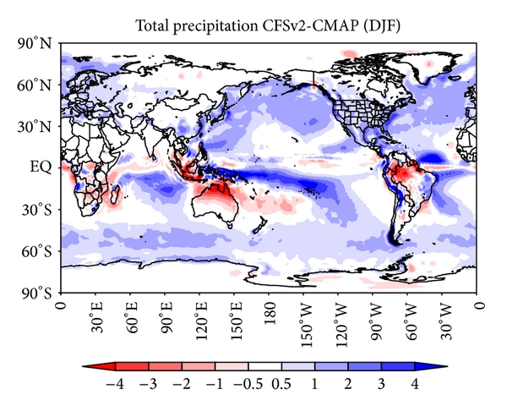
The current state of extended/subseasonal forecasting
Subseasonal predictability is limited to just the first 2-4 weeks (depending on the time scale)^{1,2,3,4}
Tropical convection, an important driver of extratropical circulation, is poorly simulated in global models^{4,5}
Biases in convection, moisture, and circulation may poorly impact other aspects of the forecast (e.g., the MJO)^{4,6,7,8}
¹Kumar et al. 2011; ²Yuan et al. 2011; ³Li and Robertson 2015; ⁴Weber and Mass 2017; ⁵Lin 2007, ⁶Silva et al. 2014;
⁷Gonzalez and Jiang 2017; ⁸Kim 2017

Slide 3
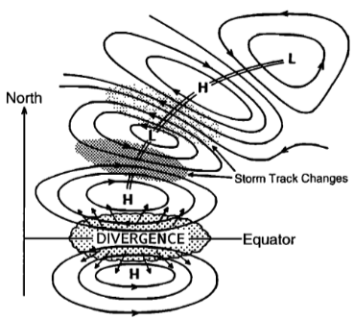
Why convection-permitting resolution?
Explicit convection can improve:
  Precipitation distribution^{1,2}
  Diurnal cycle³
  Propagating convection/MJO⁴⁻⁸
  Mean state?⁹
Thus, we expect improved extratropical prediction
¹Holloway et al. 2012; ²Inoue et al. 2008; ³Sato et al. 2009; ⁴Davis et al. 2003; ⁵Miura et al. 2007; ⁶Miyakawa et al. 2014; ⁷Wang et al. 2015; ⁸Pilon et al. 2016; ⁹Prein et al. 2015
Notes:
Convection is the bridge between predictable SSTs and global circulation

Slide 4
Questions for today:
By going to convection-permitting resolution can we…
Improve large-scale tropical convection?
Increase subseasonal extratropical forecast skill?

Slide 5
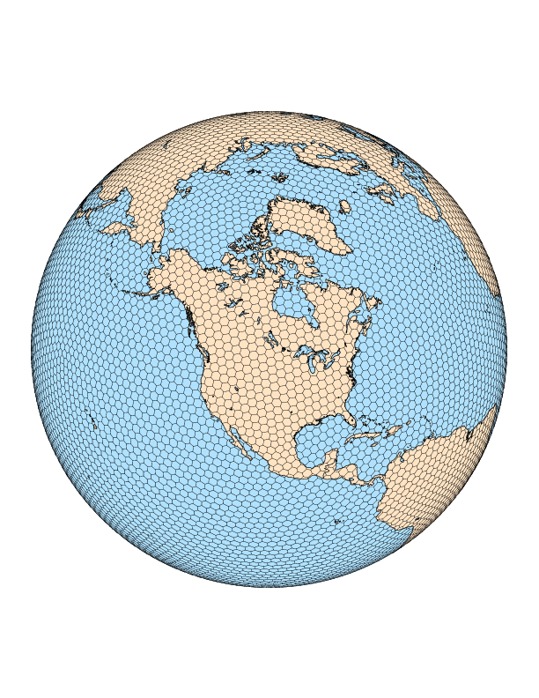

Our tool: MPAS
Version: MPAS v5.1 – “out of the box”
Domain:
Resolution:
Physics: ‘convection_permitting’ suite – no Cu scheme
3-km
65+ million cells
120-km

Slide 6
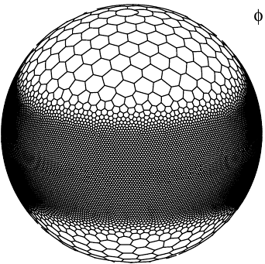
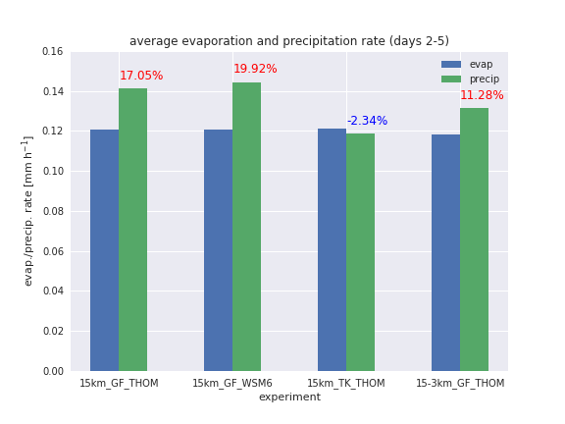
Why not use a “tropical channel” mesh?
Would conserve resources!
But Grell-Frietas is the only packaged scale-aware scheme
  Produces too much precipitation

Slide 7
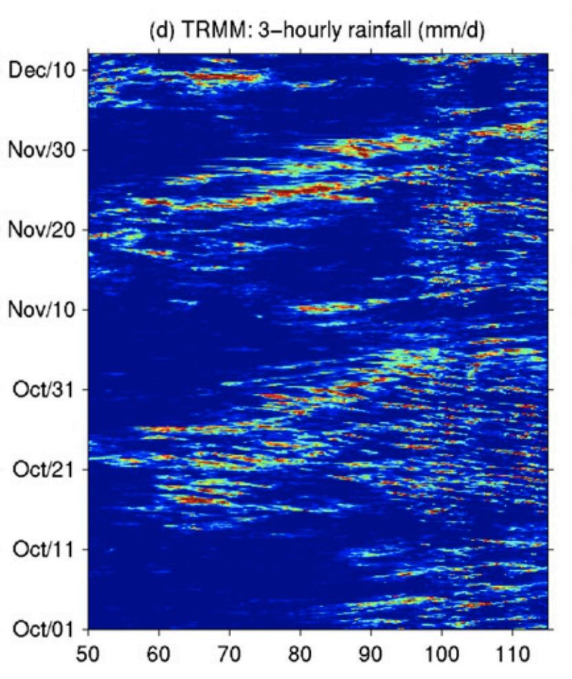
Our case: November DYNAMO MJO
Integrated for 28 days: Nov 22 2011 → Dec 20 2011
Integrate
Initialize
FNL analyses for ICs and BCs (SSTs fixed at initial value)
Figure from Wang et al. 2015

Slide 8
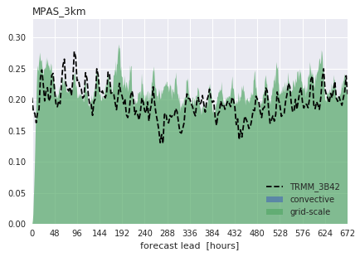
Results: precipitation characteristics
Stable integration
  Volumetric precipitation is stable and unbiased
Too much (little) heavy (light) precipitation
  Opposite problem in models with parameterized convection

Slide 9
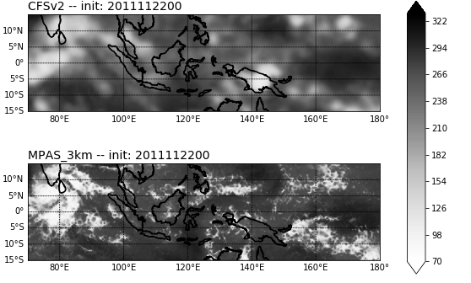
3-km simulation OLR
Valid: Nov 25 00:00Z (3-day lead)
W m⁻²

Slide 10
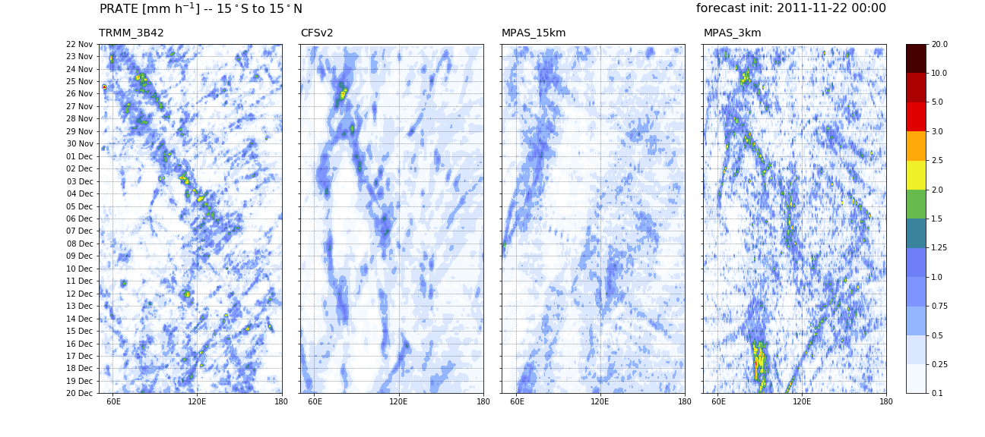
Improved large-scale tropical convection?
precipitation rate
Notes:
MJO event: Nov 22 through Dec 5 – two separate Kelvin waves
CFSv2 and MPAS_3km both get the waves, but MPAS is *much* better (e.g., phase speed)
MPAS_15km produces *westward* propagating convection – understanding why will be key
Stunning result how much better MPAS_3km is!
Still a MC barrier effect – need to understand this as well
Kelvin waves: ~8.6m/s phase speed

Slide 11
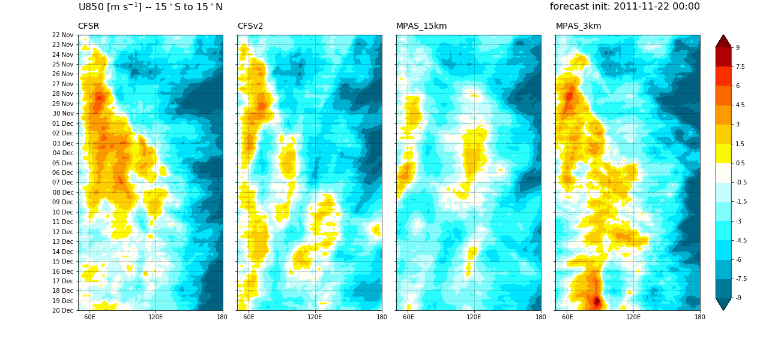
Improved large-scale tropical convection?
Improved large-scale tropical convection?
zonal wind – 850 hPa
Notes:
MPAS_3km does a great job with the low-level winds!
MPAS_15km didn’t even start with a good low-level wind signal

Slide 12
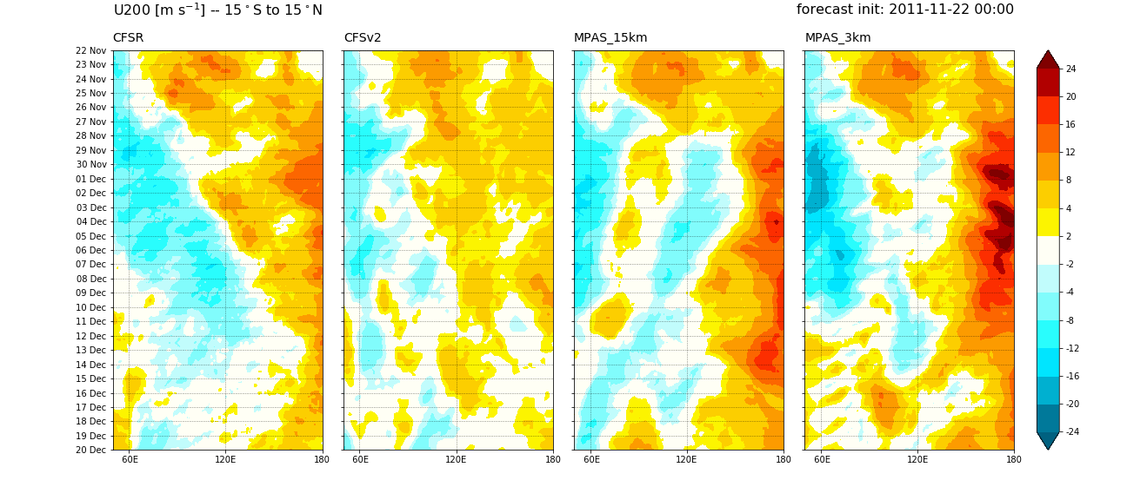
Tropical Hovmöllers
Improved large-scale tropical convection?
zonal wind – 200 hPa

Slide 13
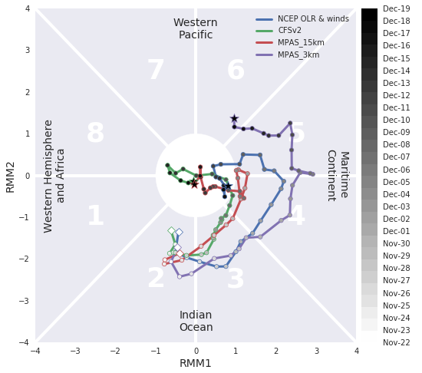
MJO RMM indices
Improved large-scale tropical convection?
MJO RMM
indices:

Slide 14
Questions for today:
By going to convection-permitting resolution can we…
Improve large-scale tropical convection?
Increase subseasonal extratropical forecast skill?

Slide 15
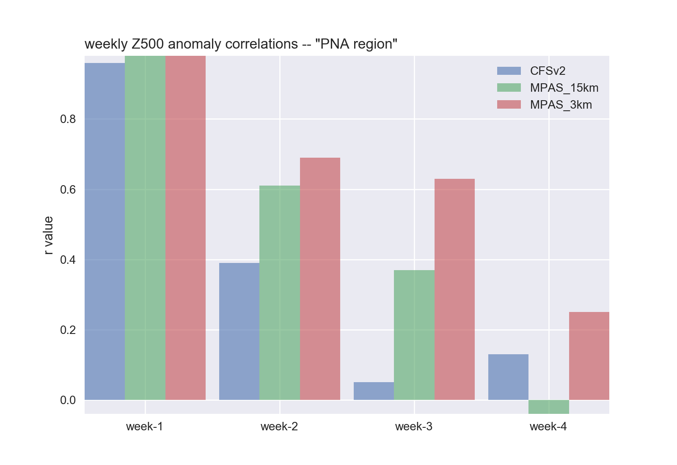
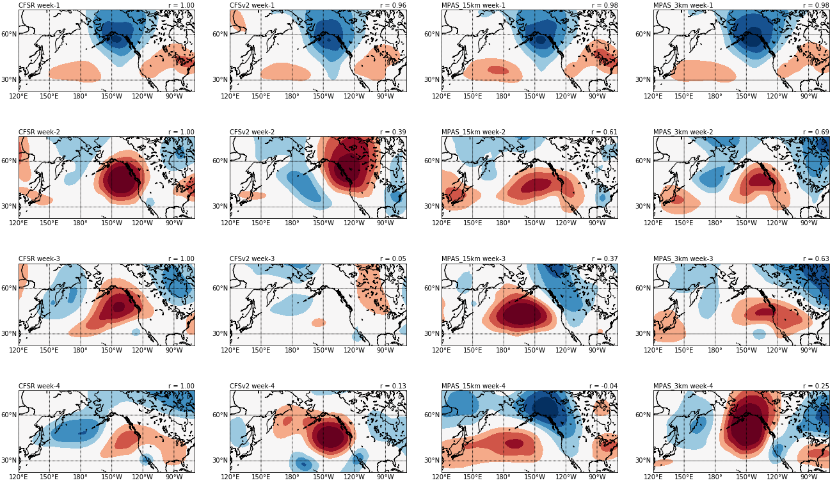
Increased subseasonal extratropical forecast skill?
CFSR
CFSv2
MPAS_15km
MPAS_3km
Week-2
Week-1
Week-3
Week-4

Slide 16
Questions for today:
By going to convection-permitting resolution can we…
Improve large-scale tropical convection?
Increase subseasonal extratropical forecast skill?
Is the 3-km MJO perfect?

Slide 17
M.C. barrier in MPAS_3km
precipitation rate
Propagation halts over M.C. – Why?
Theory #1: Preceding convection over M.C./W. Pacific

Slide 18
M.C. barrier in MPAS_3km
zonal wind – 200 hPa
Theory #1: Preceding convection over M.C./W. Pacfic
M.C. divergence disrupts MJO outflow

Slide 19
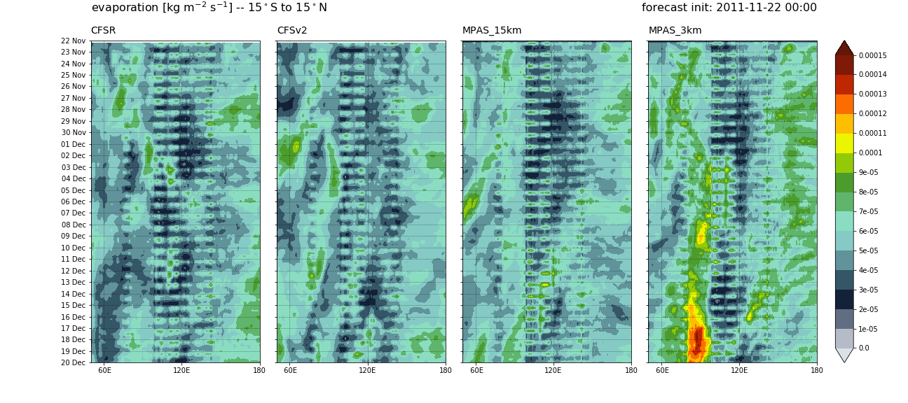
M.C. barrier in MPAS_3km
evaporation rate
Theory #2: Stronger evap. W. of convection → more low-level moisture

Slide 20
M.C. barrier in MPAS_3km
zonal wind – 850 hPa
Theory #2: Stronger evap. W. of convection → more low-level moisture
Low-level winds are not stronger. Fixed SSTs maybe be removing
the negative moisture (cooling) feedback of the winds.

Slide 21
Conclusions
Convection-permitting resolution significantly improves the simulation of the MJO
Subseasonal extratropical circulation is improved by convection-permitting resolution.
    Yet to be proven that improved MJO is the cause.
Many fundamental questions need to be answered. e.g.:
    Why does the MJO stall in MPAS_3km?
    Why westward propagation in MPAS_15km?

Slide 22
Questions?

Slide 23
References
Davis, C. A., K. W. Manning, R. E. Carbone, S. B. Trier, and J. D. Tuttle, 2003: Coherence of warm-season continental rainfall in numerical weather prediction models. Mon. Wea. Rev., 131, 2667–2679.
Gonzalez, A. O., and X. Jiang, 2017: Winter mean lower tropospheric moisture over the Maritime Continent as a climate model diagnostic metric for the propagation of the Madden-Julian oscillation. Geophys. Res. Lett., 44, 2588–2596.
Holloway, C. E., S. J. Woolnough, and G. M. S. Lister, 2012: Precipitation distributions for explicit versus parametrized convection in a large-domain high-resolution tropical case study. Quart. J. Roy. Meteor. Soc., 138, 1692–1708.
Inoue, T., M. Satoh, H. Miura, and B. Mapes, 2008: Characteristics of cloud size of deep convection simulated by a global cloud resolving model over the western tropical Pacific. J. Meteor. Soc. Japan, 86A, 1–15.
Kim, H.-M., 2017: The impact of the mean moisture bias on the key physics of MJO propagation in the ECMWF reforecast. J. Geophys. Res. Atmos., 122, 7772-7784.
Kumar, A., M. Chen, and W. Wang, 2011: An analysis of prediction skill of monthly mean climate variability. Climate Dyn., 37, 1119-1131.
Li, S. and A. W. Robertson, 2015: Evaluation of Submonthly Precipitation Forecast Skill from Global Ensemble Prediction Systems. Mon. Wea. Rev., 143, 2871-2889.
Lin, J. L., 2007: The double-ITCZ problem in IPCC AR4 coupled GCMs: Ocean-atmosphere feedback analysis. J. Clim., 20, 4497-4525.
Miura, H., M. Satoh, T. Nasuno, A. Noda, and K. Oouchi, 2007:A Madden-Julian Oscillation event realistically simulated by a global cloud-resolving model. Science, 318, 1763–1765.
Miyakawa, T., and Coauthors, 2014: Madden–Julian Oscillation prediction skill of a new-generation global model demon- strated using a supercomputer. Nature Commun., 5, 3769.
Pilon, R., C. Zhang, and J. Dudhia, 2016: Roles of deep and shallow convection and microphysics in the MJO simu- lated by the Model for Prediction Across Scales. J. Geophys. Res. Atmos., 121, 10 575–10 600.
Prein, A. and Coauthors, 2015: A review on regional convection-permitting climate modeling: Demonstrations, prospects, and challenges. Rev. Geophys., 53, 323-361.
Sato, T., H. Miura, M. Satoh, Y. N. Takayabu, and Y. Wang, 2009: Diurnal cycle of precipitation in the tropics simulated in a global cloud-resolving model. J. Climate, 22, 4809–4826.
Silva, G., L. Dutra, R. Rocha, T. Ambrizzi, and E. Leiva, 2014: Preliminary Analysis on the Global Features of NCEP CFSv2 Seasonal Hindcasts. Advances in Meteorology, 2014, Article ID 695067.
Wang, S.,A.H. Sobel, F. Zhang, Y.Q. Sun, Y. Yue, and L. Zhou, 2015: Regional simulation of the October and November MJO events observed during the CINDY/DYNAMO field campaign at gray zone resolution. J. Climate, 28, 2097–2119.
Weber, N. J. and C. F. Mass, 2017: Evaluating CFSv2 Subseasonal Forecast Skill with an Emphasis on Tropical Convection. Mon. Wea. Rev., 145, 3795-3815.
Yuan, X., E. F. Wood, L. Luo, and M. Pan, 2011: A first look at Climate Forecast System version 2 (CFSv2) for hydrological seasonal prediction. Geophys. Res. Lett., 38, L13402.

Slide 24
Extra
Slides

Slide 25
Project outline
Goal: Investigate the impact of convection-permitting resolution on subseasonal global forecast skill…
  … and other forecast features (e.g., MJO, mean state)
First steps: using MPAS
  Run at 3-km global resolution with fixed and prescribed SSTs
  Examine impacts of shallow convection and mixing schemes
Down the road: coupled ocean, FV3…

Slide 26
Physics parameterizations
No convection scheme
Thompson* microphysics
RRTMG radiation
MYNN* surface layer & PBL schemes
Noah land surface
2D-Smagorinsky subgrid mixing scheme
*Sensitivity tests were done to compare with other schemes
Notes:
MPAS default “convection_permitting” physics suite

Slide 27
Computer resources
Supercomputer: Cheyenne (5.34 petaflops)
Run on 1024 nodes → 36,864 cores
Core hours: 2.7 million
Wall clock: 74 hours
Output: ~80TB
Notes:
“Unadjusted” core hours: 1.2M on economy queue
Had to be very selective of output variables to save space
Disk space is the primary limiting factor!

Slide 28
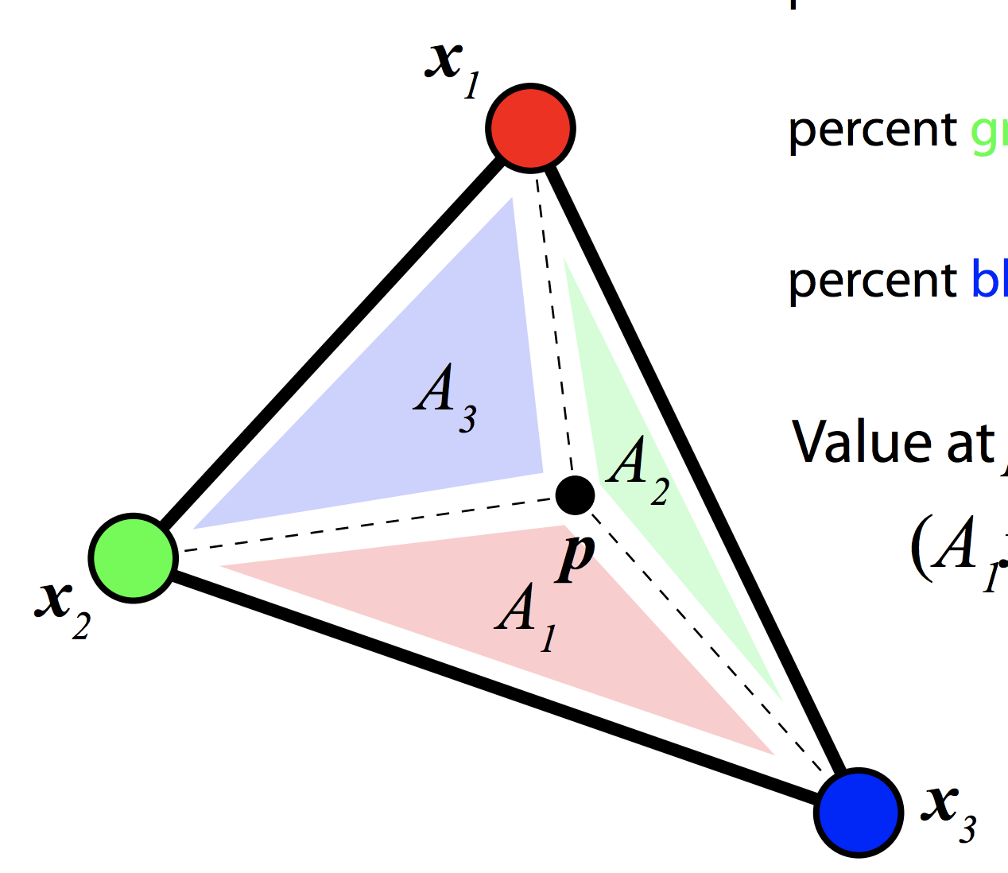
Working with MPAS’s Voronoi mesh
Limited software for reading, manipulating, and displaying data on massive unstructured meshes
  Used barycentric interpolation software for most of this preliminary analysis**
**Not conservative! Important for fields like precipitation.

Slide 29
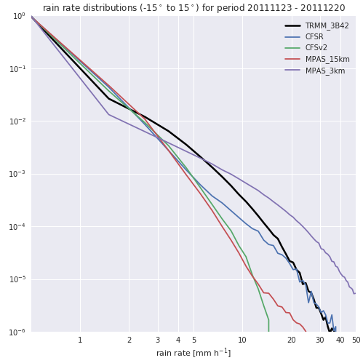
Precipitation rate distributions
Light precip:
Too much (little) for parameterized (explicit) convection
Heavy precip:
Too little (much) for explicit (parameterized) convection
3-km distribution will improve with conservative interpolation
Notes:
Parameterized convection: too much light precip, too little heavy
Explicit convection: opposite!

Slide 30
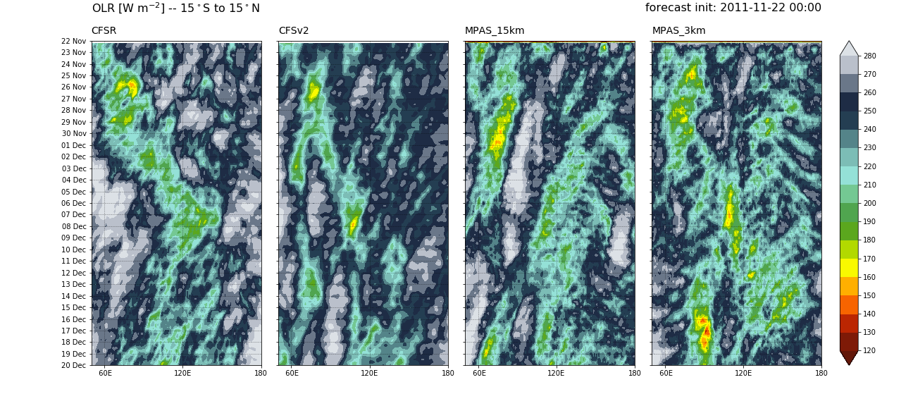
Tropical Hovmöllers
outgoing longwave radiation
Notes:
OLR signals match the precipitation
For eastward-moving convection/MJO (in CFSR, CFSv2, MPAS_3km), OLR “trails” precipitation maximum
For the westward-moving packet in MPAS_15km, OLR/precip extrema are superimposed – why is this? (physical process?)

Slide 31
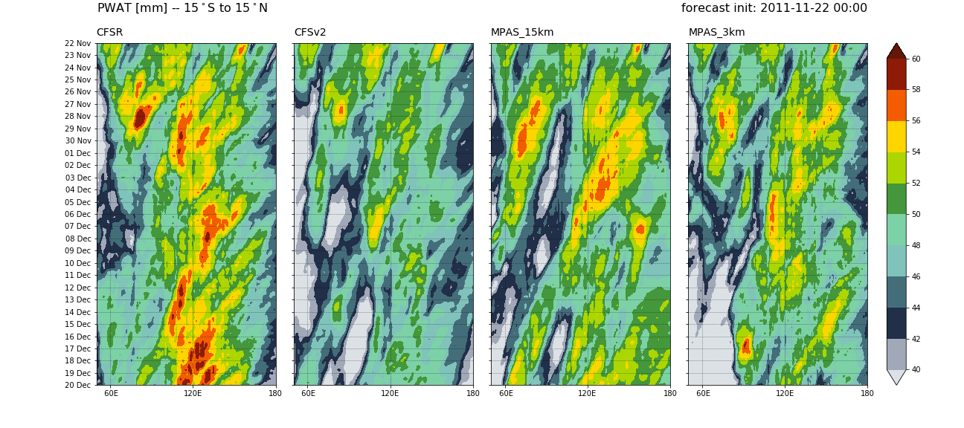
Tropical Hovmöllers
precipitable water
Notes:
Both the observed and modeled MJOs propagate through regions of low PWAT
More preceding moisture in observations

Slide 32
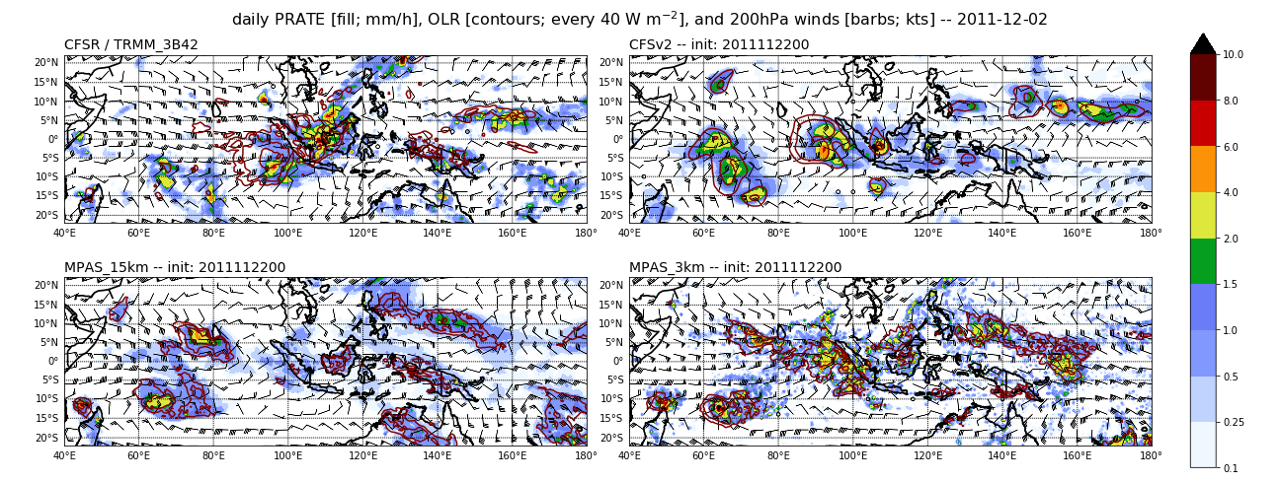
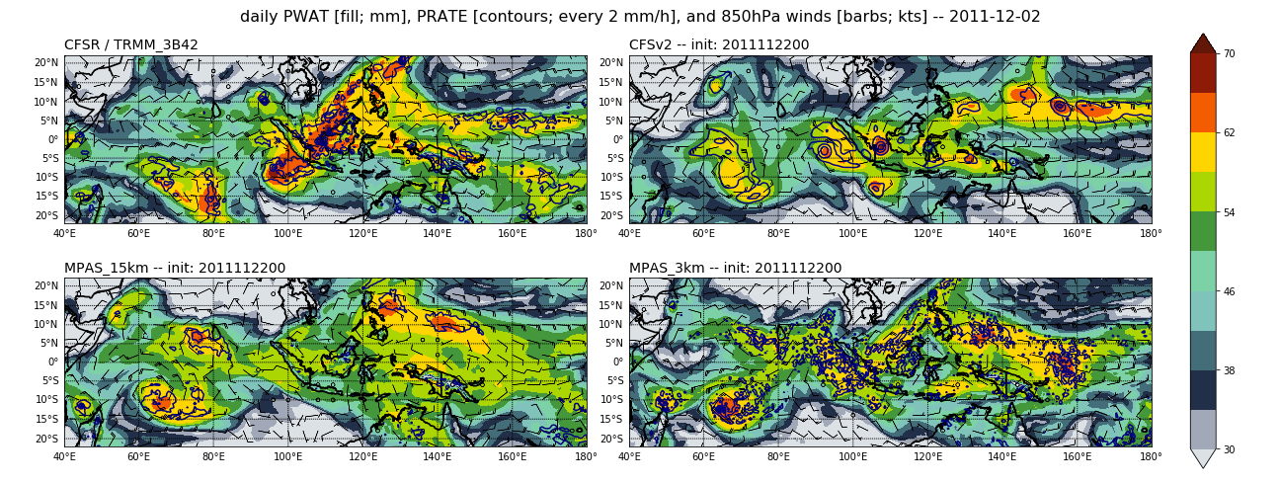

Slide 33
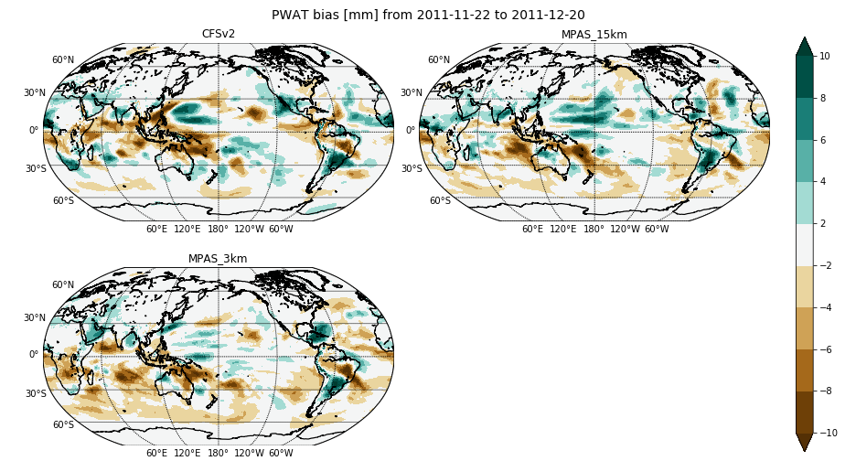
Moisture bias (Nov 22 – Dec 20)

Slide 34
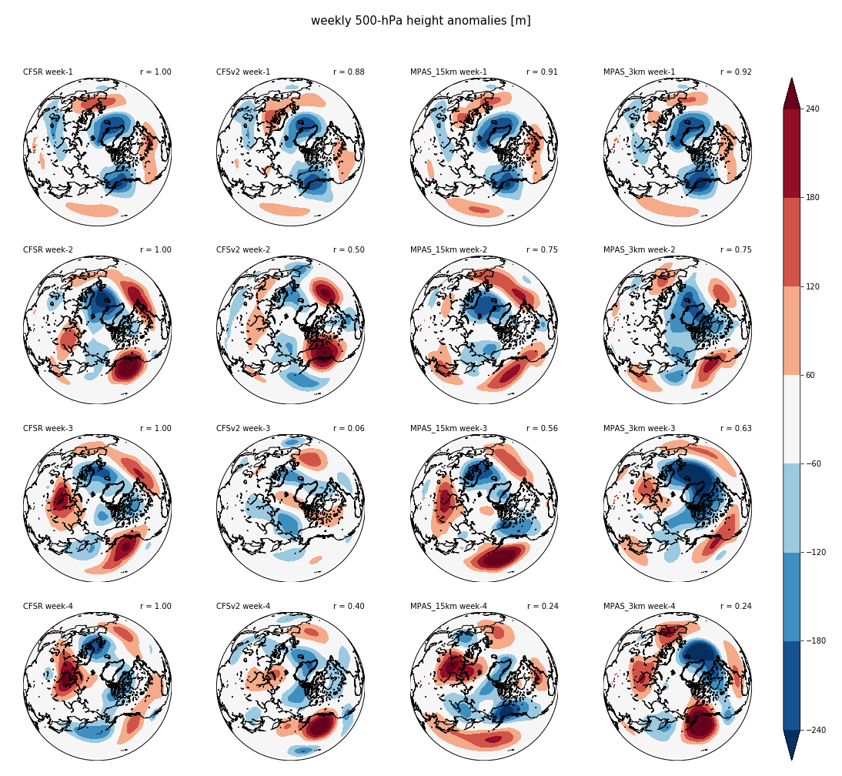
Extratropical circulation -- NH
weekly 500hPa height anomalies [m]
MPAS runs perform equally well, outperform CFSv2 for weeks 1-3

Slide 35
Currently being investigated:
“Why does the 15-km simulation fail to produce the eastward-propagating Kelvin waves (and thus an MJO)?”
“Why does the 3-km MJO stall over the M.C.?”
“What component(s) of the overall moisture tendency is/are captured better in the 3-km simulation?”
“Will prescribed SSTs improve surface fluxes and thus MJO propagation?”
“Is the improved PNA circulation tied to the MJO?” – Look at Rossby Wave Source
Tropical diurnal cycle (land vs. ocean)
Vertical latent heating/vertical motion profiles
Moisture/convection coupling
Precipitation distributions using conservative grid remapping

