Slide 1
Low level Jet

Slide 2
Not rare

Slide 5
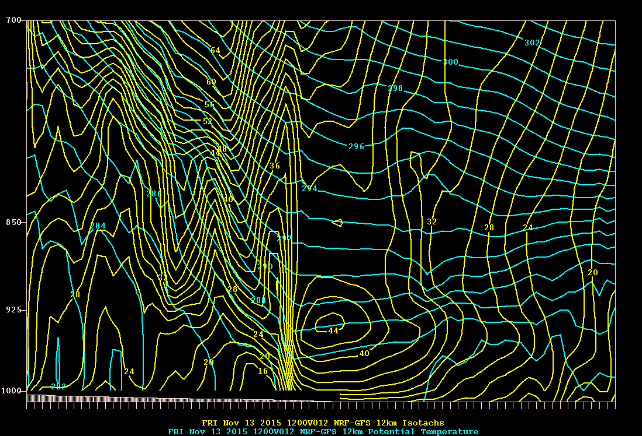

Slide 6
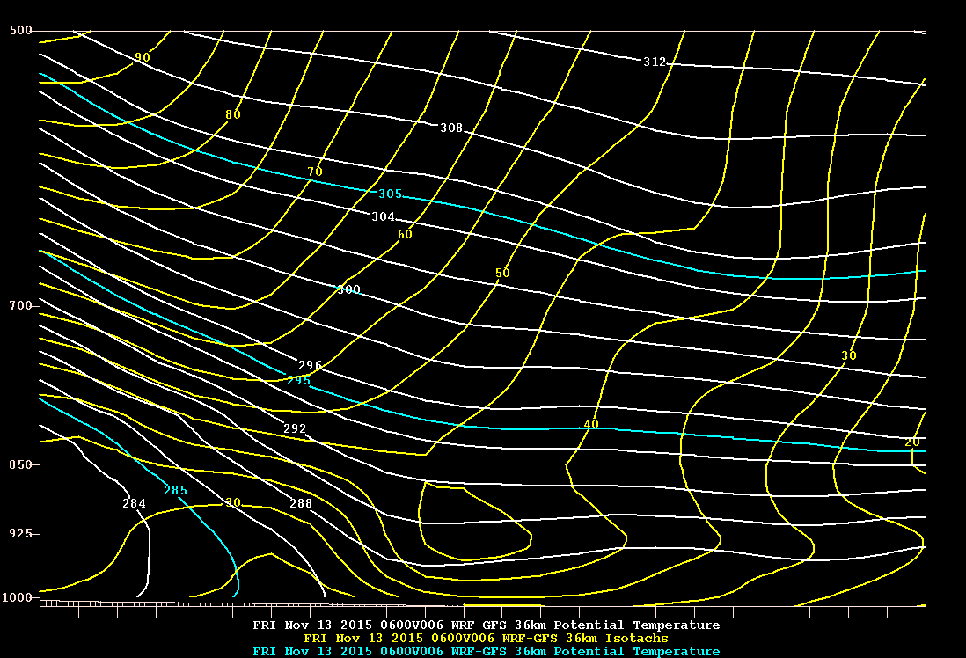

Slide 7
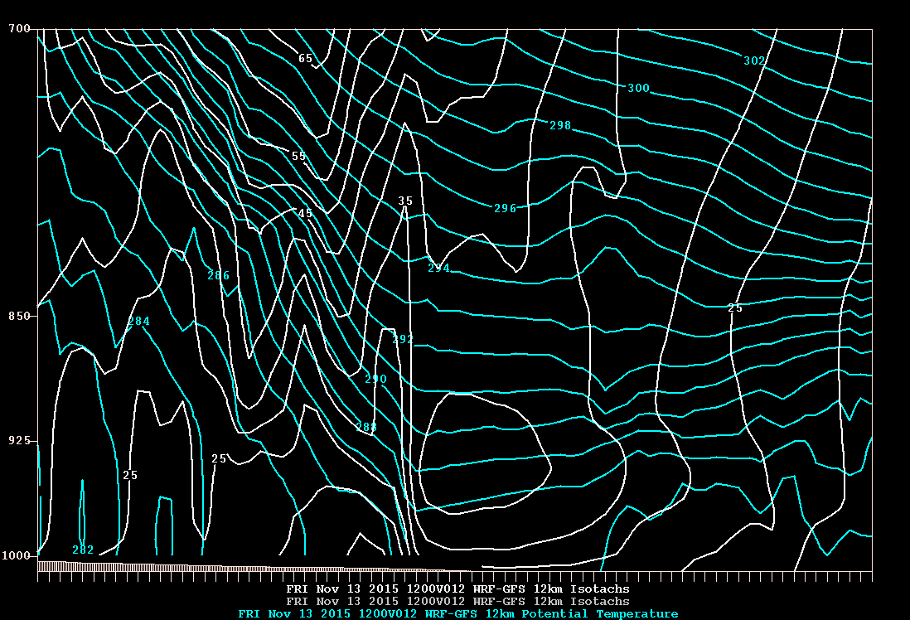

Slide 8
Nov 13, 2015 06 UTC

Slide 11
Alternative: Low-level diabatic PV on front

Slide 12
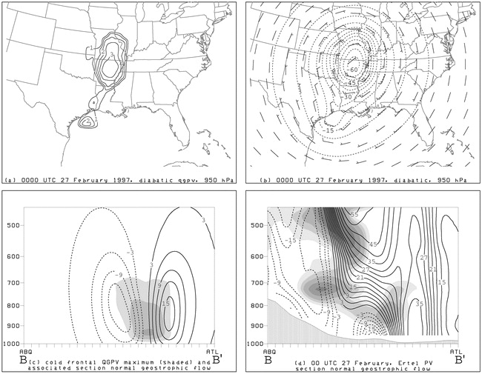
Inversion summary for the cold-frontal PV anomaly at 0000 UTC 27 Feb 1997: (a) cold-frontal QGPV anomaly at 950 hPa (solid, contour interval 0.5 × 10⁻⁵ s⁻¹), (b) geopotential height (dashed, contour interval 5 m) and geostrophic wind (standard plotting convention) recovered from inversion of cold-frontal QGPV anomaly, (c) cross section of QGPV and section-normal geostrophic wind component (m s⁻¹, solid, positive for flow into section; dashed, negative for flow out of section). Section orientation shown in Fig. 4c. (d) As in (c), except Ertel potential vorticity and observed section-normal geostrophic wind speed

