Slide 1

Why has U.S. Numerical Weather Prediction Fallen Behind and What Can Be Done About It?
Cliff Mass
University of Washington

Slide 2
“Mediocrity is self-inflicted” Walter Russell

Slide 3
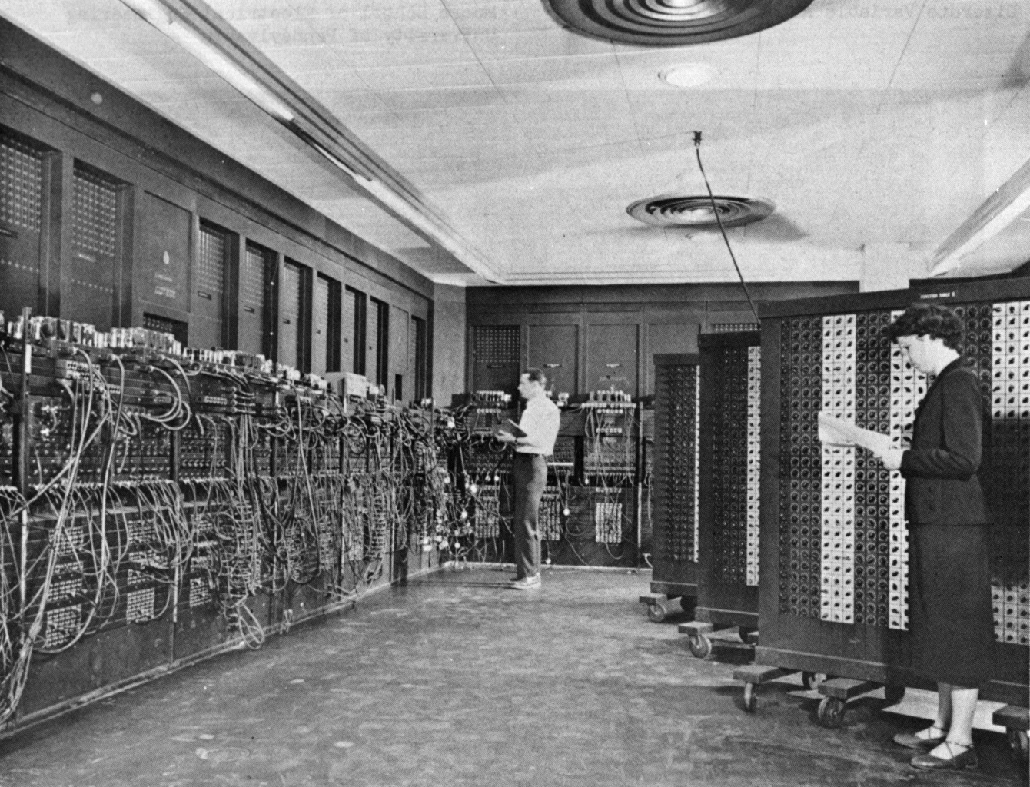
Numerical weather prediction began in the U.S. (1950)
ENIAC Computer

Slide 4
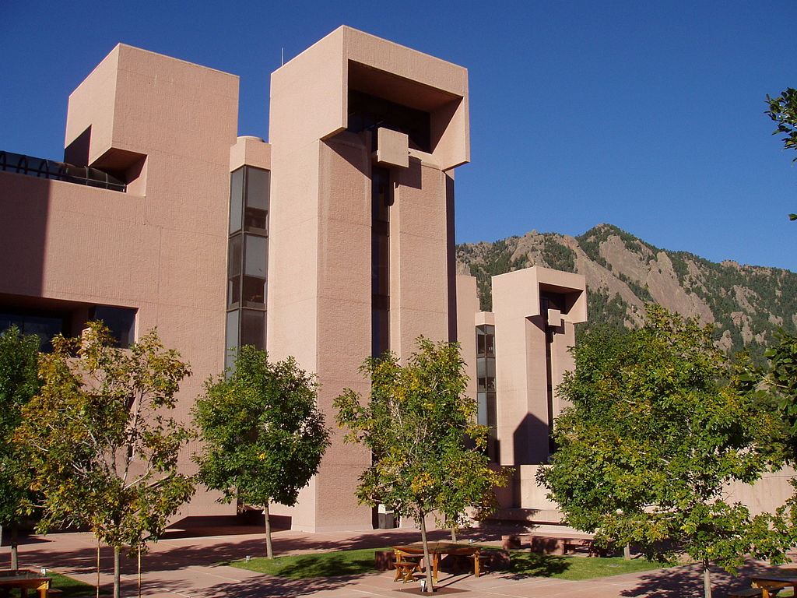
The U.S. has had the largest weather research community in the world

Slide 5
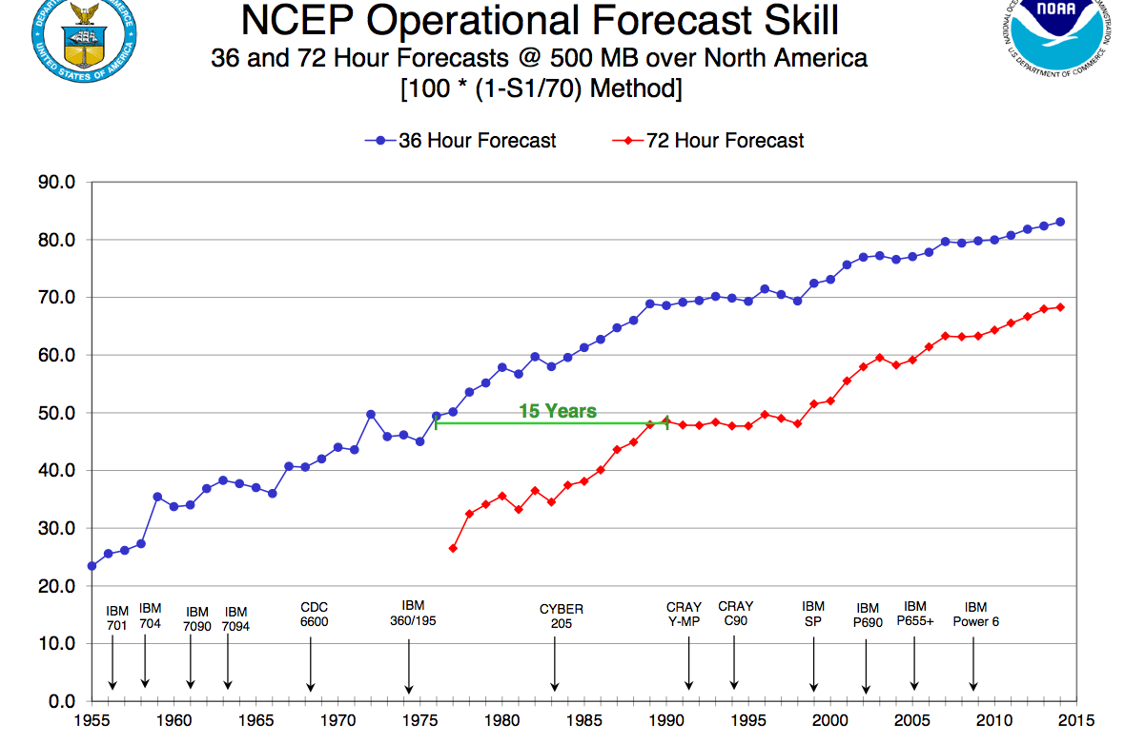
National Weather Service NWP has shown substantial improvements in forecast skill

Slide 6
A Huge Accomplishment
Complex and expensive observing systems (satellite, radar, and more)
Use of very large computers
Complex data assimilation and modeling systems of millions of lines of code
Cooperation across nations
Modeling from the molecular to the planetary scales.

Slide 7

It’s a miracle …

Slide 8
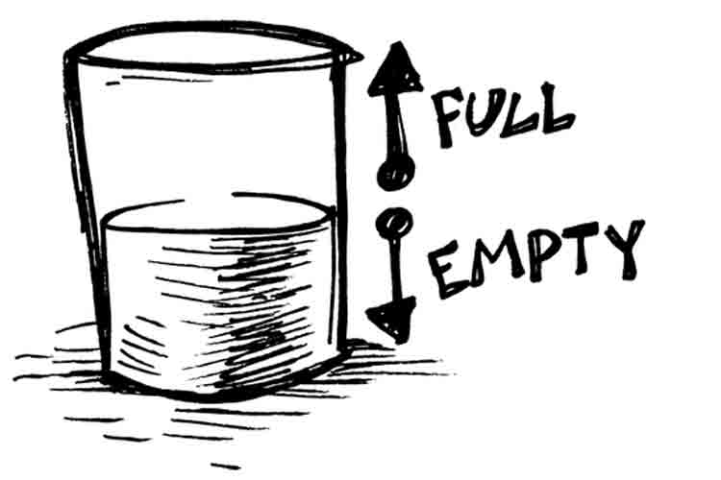
But something is wrong… the U.S. (NOAA/NWS NCEP EMC) is now in 3rd place in global prediction

Slide 9
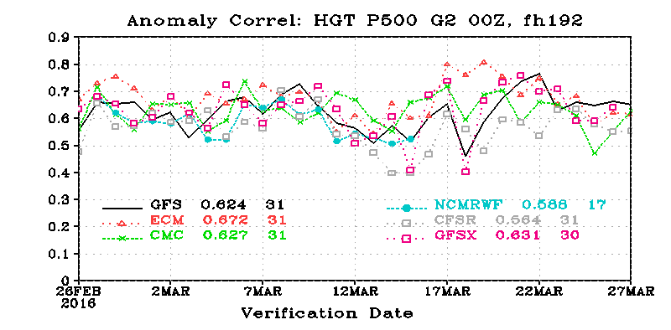
The Order: ECMWF, UKMET, NCEP/CMC
8 Days, Global, 500 hPa

Slide 10
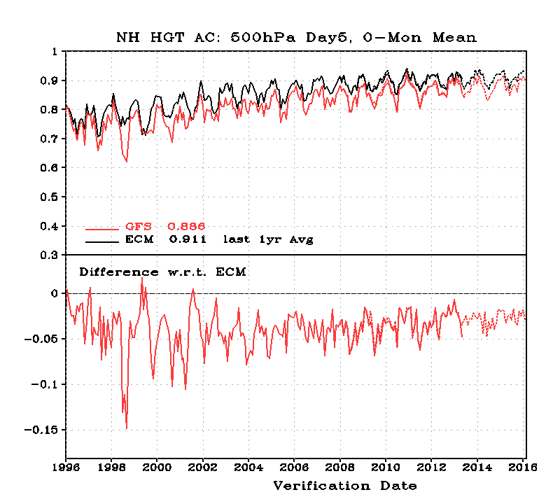
20-year Trend in NH Skill (500 hPa, Day 5)
Black-EC
Red-NCEP
NCEP
Worse
NCEP-ECMWF

Slide 11
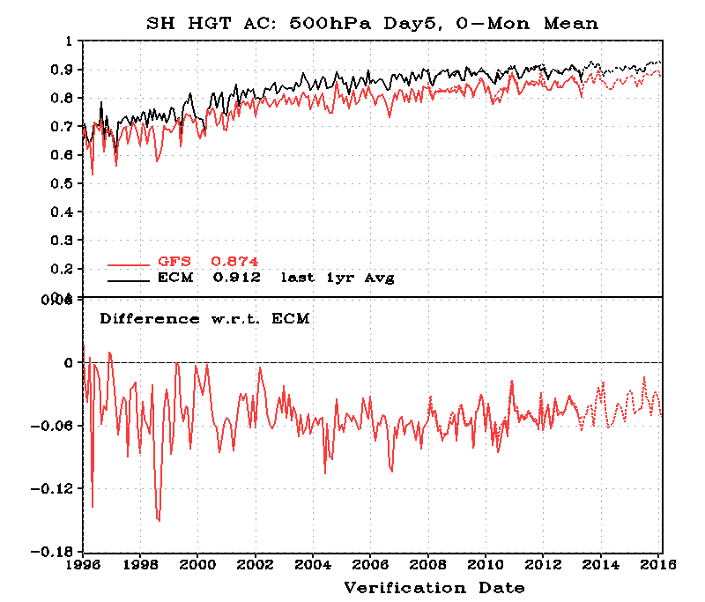
Southern Hemisphere Worse

Slide 12
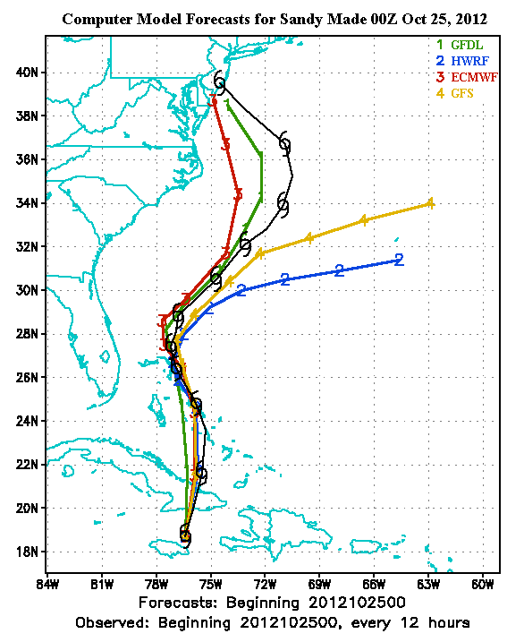
Hurricane Sandy Was a Watershed Event
A week before, the ECMWF took the storm into the NE U.S, while GFS directed it out to sea.
ECMWF was right.

Slide 13
The Public and Media Noticed

Slide 14
And they kept on noticing…

Slide 15
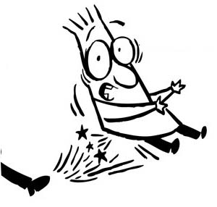

Slide 16
NBC Nightly News
http://www.nbcnews.com/video/nightly-news/51108647#51108647

Slide 17
But the problems extend beyond global modeling…

Slide 18
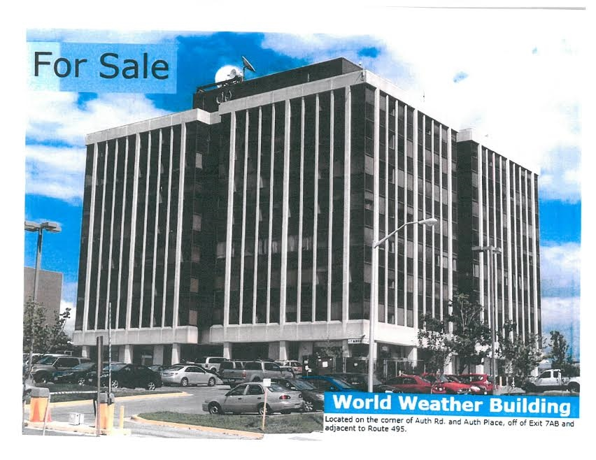
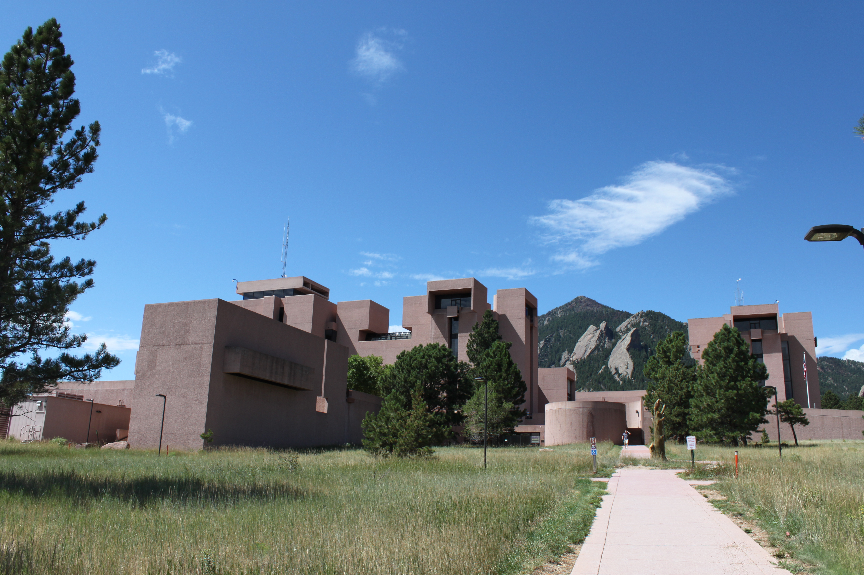
The research community and the operational communities are not working together effectively

Slide 19
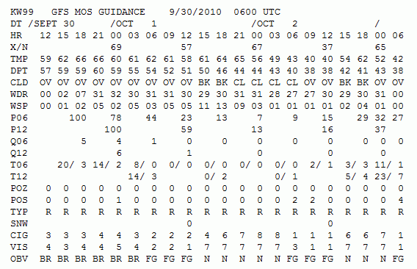
Model Postprocessing Uses a Technique of the late 1960s: Model Output Statistics (MOS)

Slide 20
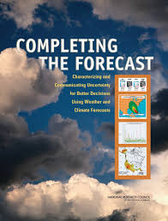
The National Weather Service Has Delayed Moving Towards High Resolution Ensembles
Over a dozen workshops and NRC reports have called for a more aggressive move towards ensembles and probabilistic prediction

Slide 21
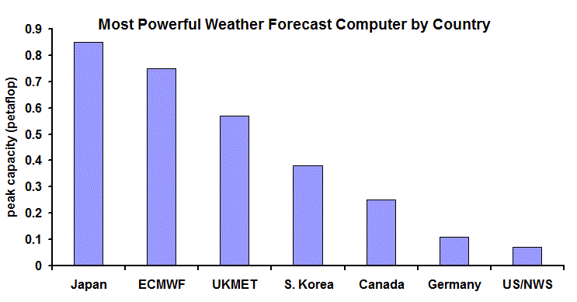
And NWS Computer Resources Have Been Under-Resourced For Years
2013

Slide 22
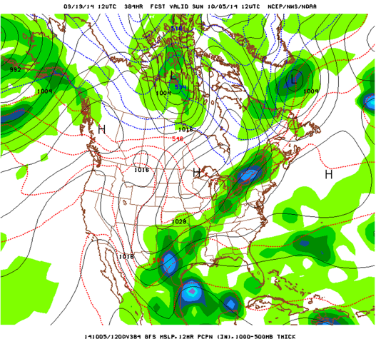
This Talk
The history of U.S. NWP
Why have we fallen behind in global prediction
Deficiencies in regional and local prediction
What can be done to fix the situation.

Slide 23
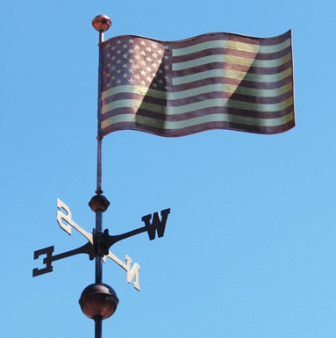
Numerical Weather Prediction (NWP) Began in the U.S.

Slide 24
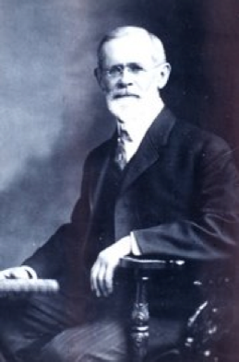
American Cleveland Abbe (1901): forecasting is a matter of solving equations that we know
Ol’ Probs

Slide 25
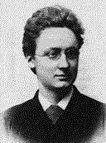
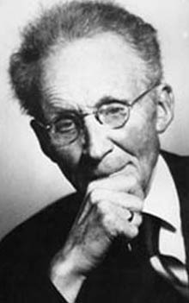
Norwegians Agree
In 1904, Vilhelm Bjerknes suggested that the primitive equations could be used to numerically predict the future atmosphere.
NWP wasn’t practical because there was no way to do the computations quickly and 3D data not available.

Slide 26
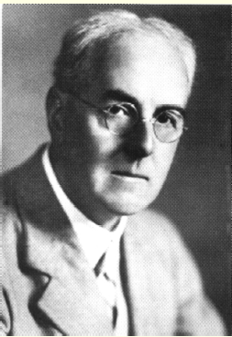
L. F. Richardson: An Insightful But Unsuccessful Attempt at Numerical Prediction
In 1922 Richardson published a book Weather Prediction by Numerical Process that described an approach to using the primitive equations: solving the equations on a grid using finite differences.

Slide 27
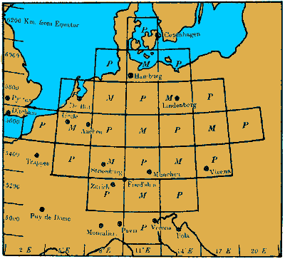
L. F. Richardson
He attempted to make a numerical forecast using a mechanical calculator
Unfortunately, the results were not good, probably because of problems with his initial conditions.

Slide 28
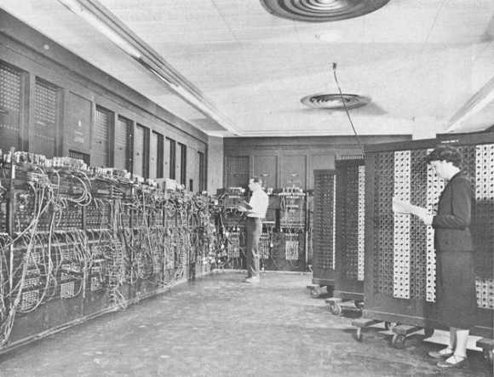
The Dream Becomes Possible (in the U.S.)
By the late 1940s there was an extensive upper air radiosonde network.
Digital programmable computers became available …the first being the ENIAC
ENIAC

Slide 29
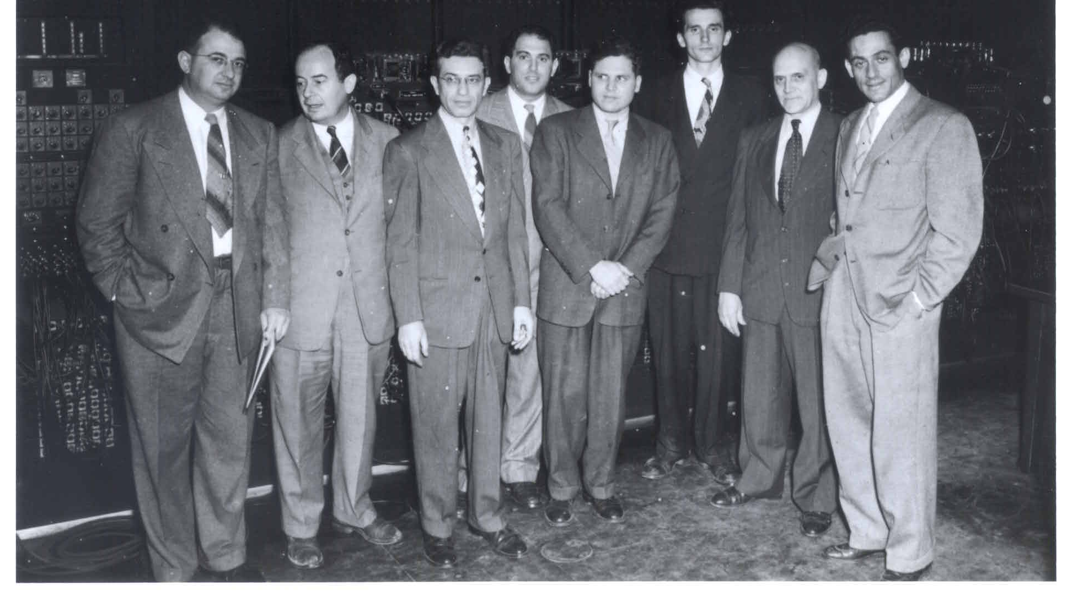
Harry Wexler, John von Neumann, M. H. Frankel, Jerome Namias, John Freeman, Ragnar Fjörtoft, Francis Reichelderfer and Jule Charney
In 1948, John von Neumann, the developer of the ENIAC, assembled a group of meteorologists at the Institute of Advanced Study in Princeton to attempt the first NWP. Headed by Jule Charney.

Slide 30
The First Successful Numerical Weather Prediction
Took place in April 1950, using the ENIAC
The prediction was for 500-mb height over North America, using a two-dimensional grid with 270 points about 700 km apart.
One-level barotropic model.
The NWP era had begun.

Slide 31
First Numerical Weather Forecast

Slide 32
The Exciting Early Days of U.S. NWP: Global Leadership and Close Cooperation

Slide 33
The First Decades (Limited Area Models)
1954: The Joint Numerical Weather Prediction Unit (JNWPU)- Weather Bureau, AF, and Navy—was created.
1956: First operational forecasts with barotropic model (IBM 701, 381 km)
1962: three-layer quasi-geostrophic baroclinic model (cyclogenesis!).

Slide 34
The First Decades
1966: six layer primitive equation model -381 km.
1971: Limited-area Fine Mesh model (LFM)-190 km
1978: Seven-layer primitive equation model (hemispheric)
1985: Nested Grid Model (NGM). 16 levels, 90km

Slide 35
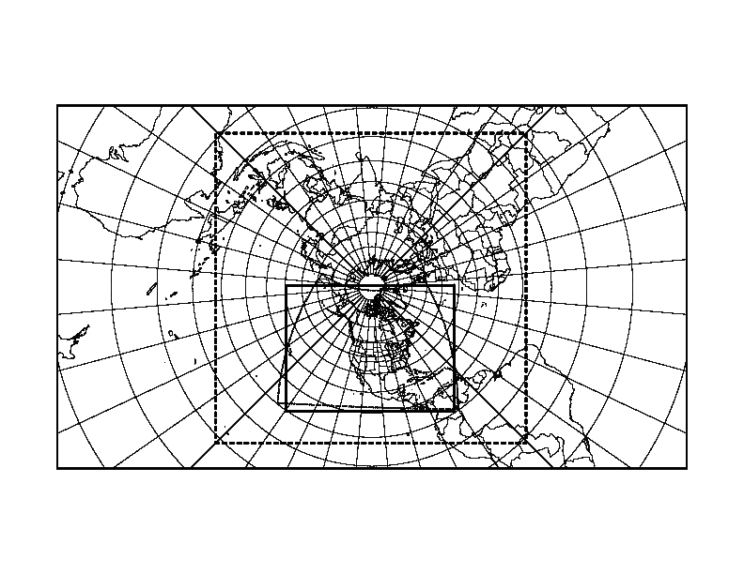
NGM Grid Structure

Slide 36
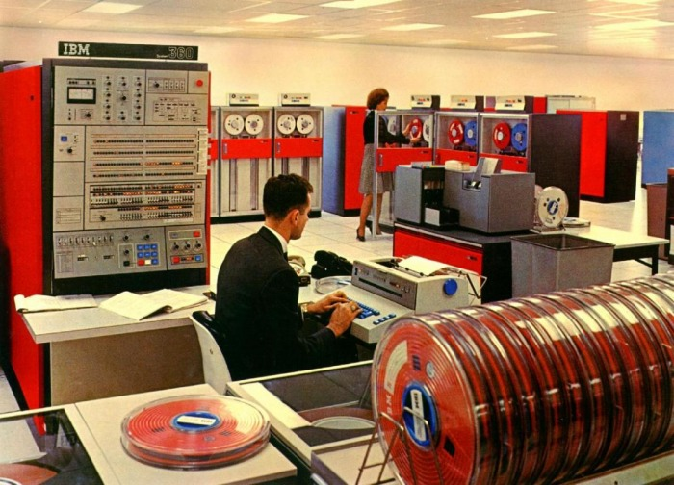
Early U.S. Global NWP
1974: Nine-layer, grid-point PE model.
1980: Global spectral model, 12 layers. R30 (~ 400km)

Slide 37
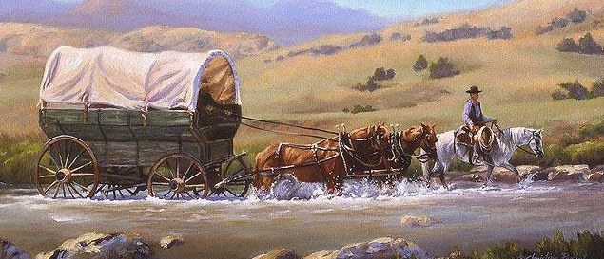
First Decades
U.S. NWP was dominated by the pioneers:
Shuman, Cressman, Charney, Phillips, and others
Creative, innovative individuals, often with close academic ties
National NWP was the only act in town (limited access to computer resources), so folks were compelled to work together.
Government agencies worked closely together

Slide 38
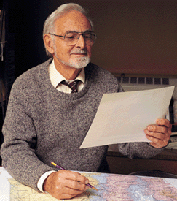
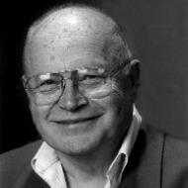
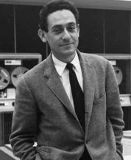
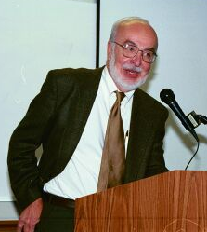
A Characteristic of the Early Decades: Close Relationship Between Gov. Agencies/Academia
Richard Reed
Norm Phillips, MIT
Bill Bonner
Jule Charney

Slide 39

And then a major competitor appears
Created in 1975, to pool European resources for producing medium range and seasonal forecasts
1979: Start of operational global prediction
Aggressive approach, entraining the best talent and advice from around the world, including the U.S.

Slide 40
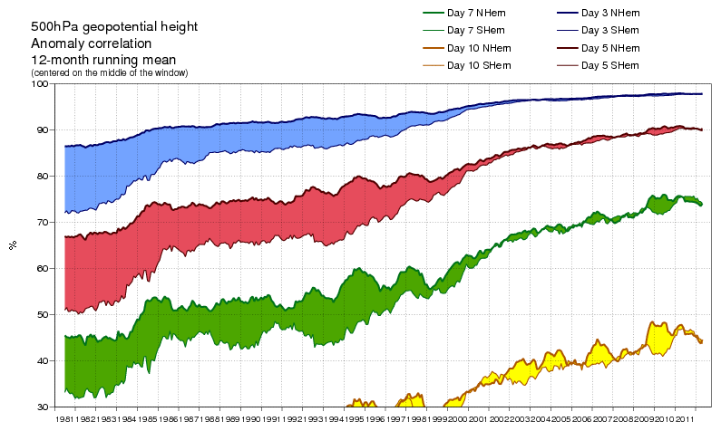
ECMWF: Strategic, Cooperative, Innovative
Able to secure state-of-the-art computers.
In 1997 moved to a more advanced data assimilation approach, 4DVAR

Slide 41
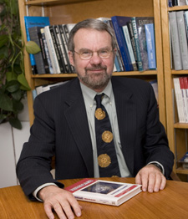
In the 1980s and early 1990s, a change of culture occurred in U.S. NWP
Computer resources became available to the academic community and model development spread outside of NWS.
1980s: Rick Anthes and NCAR developed the MM4 mesoscale model, starting with Anthes’ hurricane model
1992: MM5: nonhydrostatic, multi-nesting, FDDA, improved physics and numerics

Slide 42
A Huge Modeling Community Develops
A large MM5 community grew, including thousands of users around the world.
Tutorials, workshops, help desks, and more

Slide 43
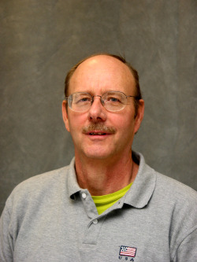
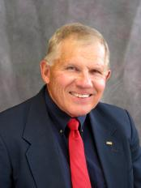
Spread of NWP: RAMS Model
RAMS, the Regional Atmospheric Modeling System, developed by Roger Pielke and Bill Cotton of Colorado State.
Similar to MM5 in many ways, but more limited in distribution.
Favorite of the air quality community

Slide 44

In 1989 NSF Sponsored the Development of ANOTHER Mesoscale Modeling System: ARPS
Directed towards storm scale modeling
The ARPS model is similar to MM5 and WRF
The model has been supplanted by WRF
Valuable work on data assimilation for convective storms.
Very large investment: was it worth it?

Slide 45
The Navy Develops a Redundant Capability
The U.S. Navy began running low-end NWP models in the 1960s (barotropic)
By the 1980s, they developed a model suite that paralleled what was run by the National Weather Service:
NOGAPS: a global model, like the NWS Spectral
NORAPS: an NGM regional model clone.
By the mid-1990s, COAMPS, a non-hydrostatic model similar to MM5

Slide 46

Bottom Line
U.S. NWP efforts became split over many modeling systems and efforts:
National Weather Service
Navy
Air Force
NCAR/Penn State
Oklahoma
Colorado State
And others: e.g., Wisconsin, Drexel, …
U.S. research and operational communities disengaged

Slide 47

The US NWP Became an Uncoordinated Giant
Slow in progress
Inefficient with resources
USA

Slide 49
And the impacts of this lack of coordination were felt….

Slide 50

National Weather Service NWP Becomes More Bureaucratic and Isolated
By the mid-1980s most of the pioneers of NWP had left leadership roles.
The National Weather Service NWP bureaucracy had grown large and inward looking
The university community, with its own capabilities, increasingly disengaged from NWS NWP model development.

Slide 51
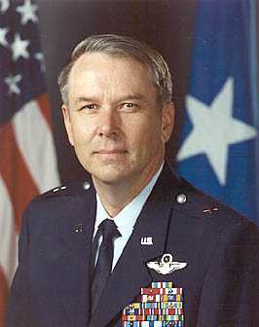
National Weather Service Turns to Military Leadership: Allowed the Ship to Drift
Colonel Elbert Friday 1988-1997
General Jack Kelley 1998-2004
General David Johnson 2004-2007
Colonel Jack Hayes 2007-2012
General David Johnson
NOT a meteorologist

Slide 52
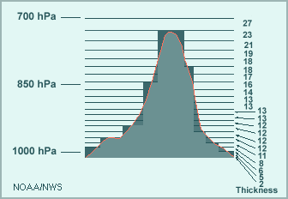
The Landmark Decision in 1993: Which Regional Model for the U.S. ETA or MM5?
A replacement for the hydrostatic NGM was needed.
Instead of picking the popular MM5, the NWS acquired an experimental model brought to the U.S by some Yugoslavian émigrés…the Eta model

Slide 53
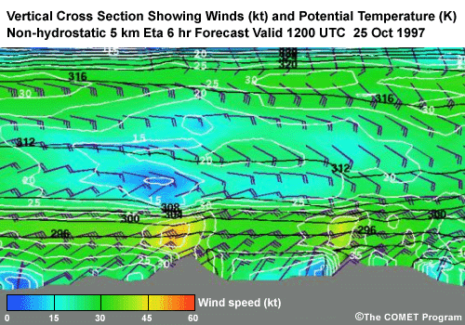
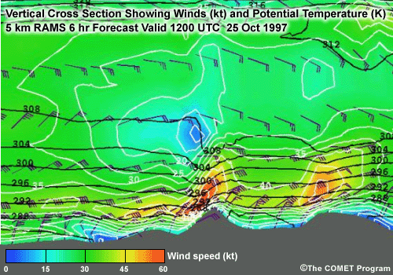
Eta: A Disaster for U.S. NWP
Problematic vertical coordinate system
Eta was unable to do mountain waves
Required excessive vertical resolution
Rejected by the academic community.

Slide 54
A Second Chance Lost: NMM Versus WRF
By 2000, it was clear that the Eta model was a failure and needed to be replaced.
NCAR has developed a replacement for MM5 called WRF.
After substantial talks with NCAR about WRF, the National Weather Service rejected WRF in favor of a cleaned up version of Eta (changed vertical coordinate system): NMM.

Slide 55
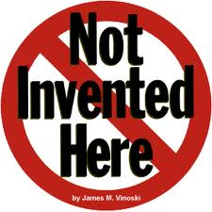

Slide 56
NMM Becomes the NWS Mesoscale Modeling System
Physics lagged WRF.
Far more diffusive than WRF
Academic community avoided it.
In a desperate move, NCEP rebranded NMM as WRF-NMM

Slide 57
ECMWF Surges Ahead
By the mid-1990s ECMWF pulled even with NCEP.
With more computer resources, ECMWF moved to superior data assimilation (4DVAR), higher resolution, better model physics, assimilating more observation types, and better quality control.
Their forecasts became increasingly superior.

Slide 58

NCEP Loses Customers
Many U.S. private sector firms abandon NCEP global model (GFS) for ECMWF
$ 100-200K a year charge by ECMWF
In 2015, the US Air Force announces it is abandoning GFS for UKMET office model.

Slide 59
National Weather Service NWP Infrastructure Problems
The World Weather Building (home until 2014)
Decaying, cramped, no large meeting rooms
Mold/Fungus in vents
Dangerous area.

Slide 60
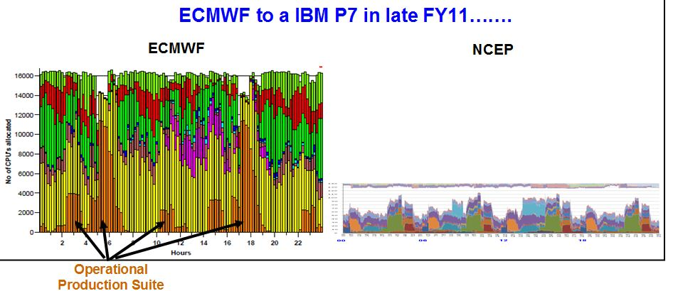
Inadequate Computing
Until recently NCEP had roughly 10% of the computer power of ECMWF for doing far more

Slide 61
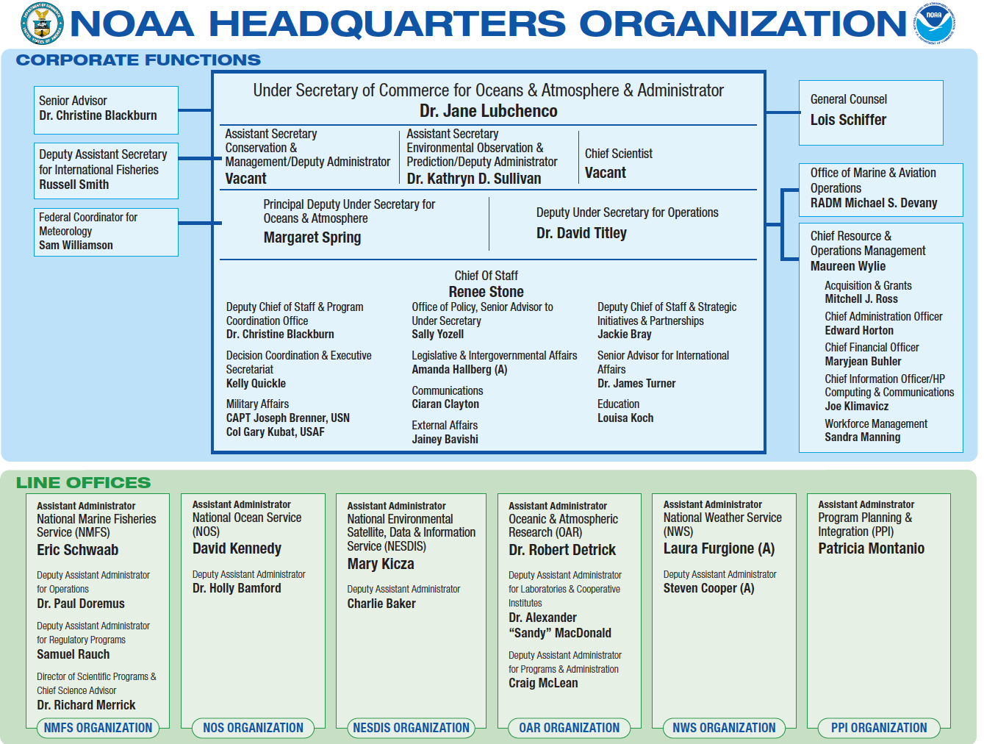
Research and Operations for NWP Separated in NOAA
NWP Research
Operational NWP

Slide 62
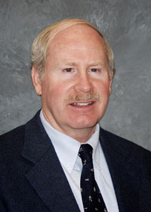
Research and Development of NWS NWP Models Done Outside NWS in NOAA Labs (ESRL, GFDL)
Individuals responsible for operation NWP did not control the individuals developing the models.
This has led to major problems and inefficiencies.
Past Head of ESRL

Slide 63

ESRL Developed Two Global Models That Will Never Be Used: FIM And NIM
NIM
FIM

Slide 64
NOAA and the U.S. Government Has No Detailed Strategic Plan for U.S. NWP
Our competitors do! ECMWF, UKMET, CMC, and others.

Slide 65
US Strategic Plan

Slide 66

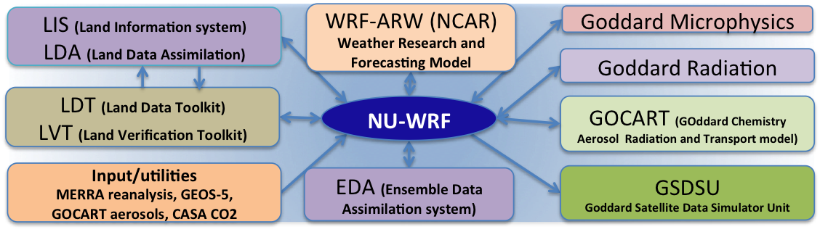
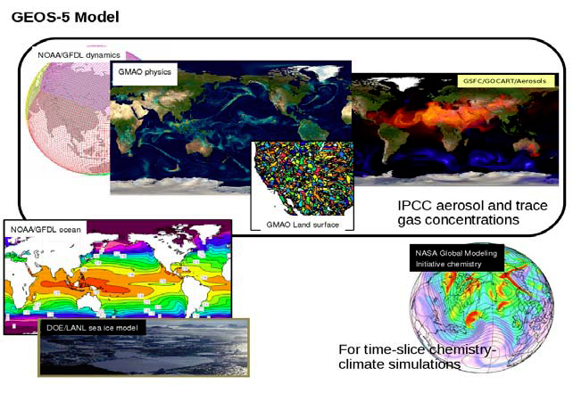
And NASA is Off Doing Its Own Thing
NU-WRF
GEOS-5

Slide 67
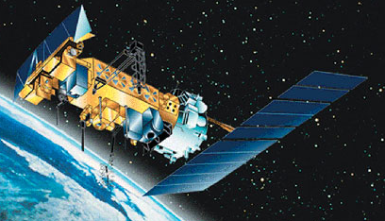
No rational observing system planning
There were concerns about the expected gap in polar-orbiter weather satellite coverage, suggesting weather forecasting skill would decline.
But no one really knew the impacts, considering changes in data assimilation and the potential for cheaper additions to other platforms such as COSMIC.

Slide 68
Rational observing system design
NOAA needs to determine the optimal collection of observations, including dropping old data sources that are no longer needed.
Rational way: Observing System Simulation Experiments (OSSEs) and Observing System Experiments (OSEs).
NOAA/NWS has done very little of this and billions of dollars of hardware have been purchased without a clear understanding of the impacts of new sensors and satellites.

Slide 69

Recent Positive Developments
New Building for US NWP and NCEP, College Park

Slide 70
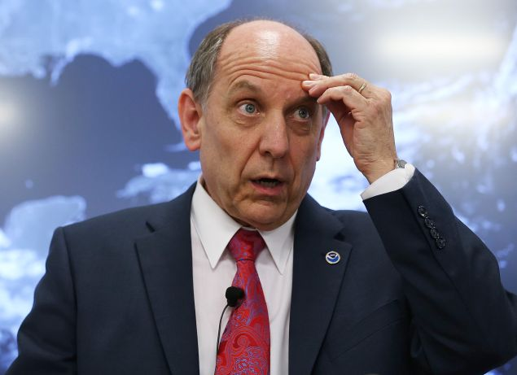
More Funds for Extramural Research
Dr. Louis Uccellini, Director, NWS
Pushed for the new building and more research funding

Slide 71
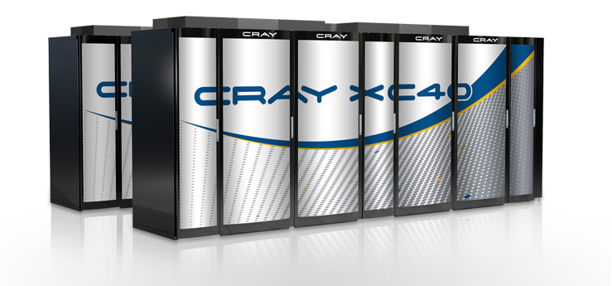
After Sandy, Congress Provided Money for a Big Computer Upgrade
Two CRAY XC-40s. Each about 2 petaflops. US and ECMWF nearly equal.

Slide 72
Next Generation Global Prediction System Evaluation (NGGPS)

Slide 73
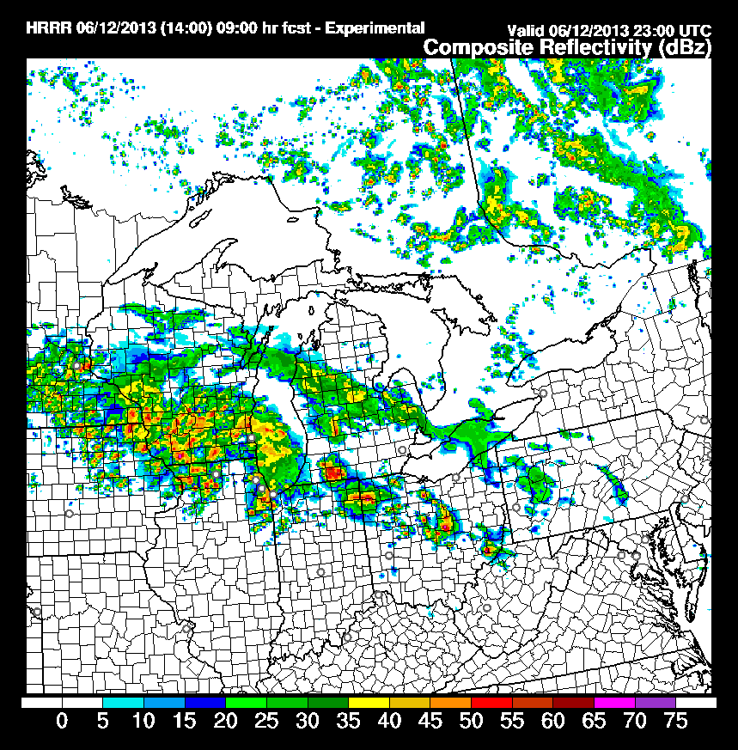
The High Resolution Rapid Refresh (HRRR, 3-km): A Major Advance

Slide 74
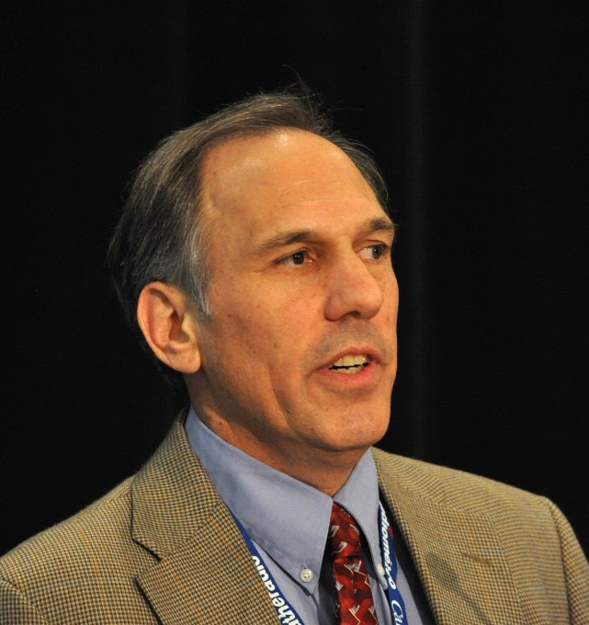
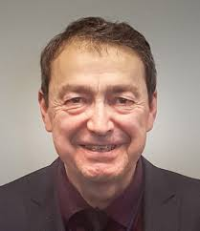
More Open NCEP Leadership
Bill Lapenta, Director of NCEP
Fred Toepfer, NWS HQ

Slide 75
Creation of New NCEP Advisory Groups, such as UMAC

Slide 76

How to fix U.S. NWP

Slide 77
The Community Needs to Focus Its Efforts and Work In a More Coordinated Manner
Less modeling systems. Unified modeling systems
Organize the research community to concentrate on key problems (PHYSICS, e.g., stable boundary layer, convection)
National coordination of research and development

Slide 78


The NWS Should Select NCAR’s MPAS over GFDL FV3
Select MPAS and the operational and research communities will be brought together.
Choose FV3 and the same divisions will occur as in the past.

Slide 79

Reduce the Number of Modeling Systems
The National Weather Service should drop NMM in lieu of WRF or regional MPAS.
The Air Force should drop UKMET and use MPAS.
The National Weather Service should drop NAM-RR (the NMM version of HRRR)
NASA , NCAR, NOAA should work together

Slide 80
NCEP Should Run a Convection-Resolving Ensemble over the U.S. (2-4 km)
NCAR is doing this on 5000 cores. NCEP has 140,000 cores

Slide 81

NCEP Computer Resources Need to Be at Least 10x Larger
State of science global and region modeling for the U.S. requires far more resources than ECMWF.
New CRAY machines and GPU technology can make 50 petaflop machines available now.

Slide 82


$
ONE
THREE
=
F18

Slide 83
Unify and Rationalize Large-Scale, Hydrostatic Ensembles
Currently, the NWS runs a global ensemble system (GEFS) at 33 km (21 members).
Also an SREF at 16 km (26 members). Excessive clustering.
Should drop SREF and replace by GEFS with 50 members and ~18 km resolution, with both initial condition and stochastic physics uncertainty. One hydrostatic ensemble.

Slide 84
SREF
GEFS

Slide 85

Extended Range Forecasting
Currently, the NWS runs the CFS model (low resolution GFS model with coupled ocean) out to 9 months. 24 runs a day!
Little indication of skill past about 3 weeks.
Stop doing something that doesn’t work and explore convection-allowing resolution (ensembles) over the tropics.

Slide 86
NICAM, .87 km grid spacing

Slide 87
Optimistic
Today there is reason to be more optimistic about the future of US NWP
But major cultural change is necessary both inside and outside of the National Weather Service.
Consolidation and more large-scale organization is need.
ECMWF is not the ceiling of what is possible: the large U.S. community can do better.

Slide 88
The End

