Slide 1
Consortium Meeting June 6, 2019
Cliff Mass and David Ovens
UW

Slide 2
Testing of New Version of the System
Evaluated WRF V4.0.3 versus our current system (3.7.1)
Compared with and without hybrid vertical coordinate system
Ran over three seasons.
Slightly slower.
Basic conclusion: No significant improvement and less stable
Recommendation: Wait

Slide 3
Testing and evaluation of WRF version 4.0.3
Ran our full test suite of summer, winter, and spring cases for several configurations of WRF version 4.0.3 at 36/12/4-km resolution:
WRFV403: all of the new defaults: hybrid vertical coordinate, theta-m, microphysical effective radii in RRTMG
WRFV403NHC: just version 4.0.3, all other settings like current WRFRT.
WRFV403NOAH: same as WRFV403 but with Noah LSM instead of Noah-MP.
WRFV403HYB: just adding hybrid vertical coordinate

Slide 4
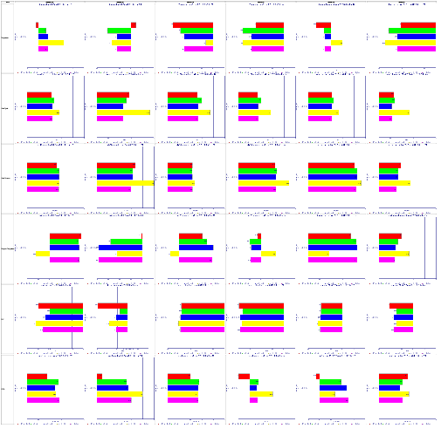
WRF 4.0.3 vs 3.7.1 12-km Suface Bias
(Red is current, others 4.0.3 options)
Summer Winter Spring
AM PM AM PM AM PM
Temp 2m
WSP 10m
Wind Dir 10m
Dewpoint 2m
SLP
6-hr Pcpn

Slide 5
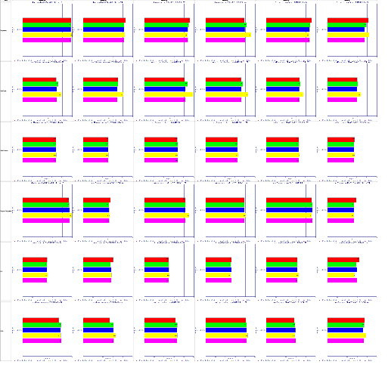
WRF 4.0.3 vs 3.7.1 12-km MAE
(Red is current, others 4.0.3 options)
Summer Winter Spring
AM PM AM PM AM PM
Temp 2m
WSP 10m
Wind Dir 10m
Dewpoint 2m
SLP
6-hr Pcpn

Slide 6
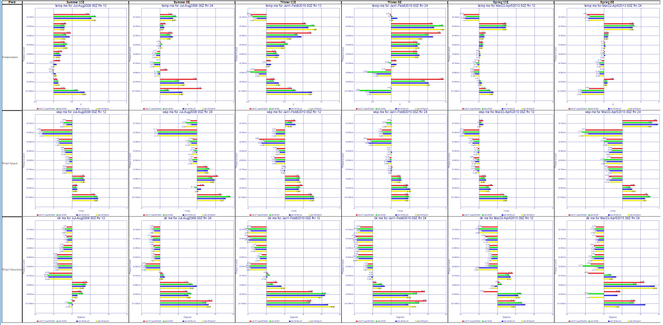
WRF 4.0.3 vs 3.7.1 4-km Vertical Biases
(Red is current, others 4.0.3 options)
Summer Winter Spring
AM PM AM PM AM PM
Temp
WSP
Wind Dir

Slide 7
WRF 4.0.3 vs 3.7.1 4-km Vertical Biases
(Red is current, others 4.0.3 options)
Summer Winter Spring
AM PM AM PM AM PM
Temp
WSP
Wind Dir
Inconsistent results. At some levels and some times WRF 3.7.1 may be best or worst. Same is true for WRF 4.0.3

Slide 8
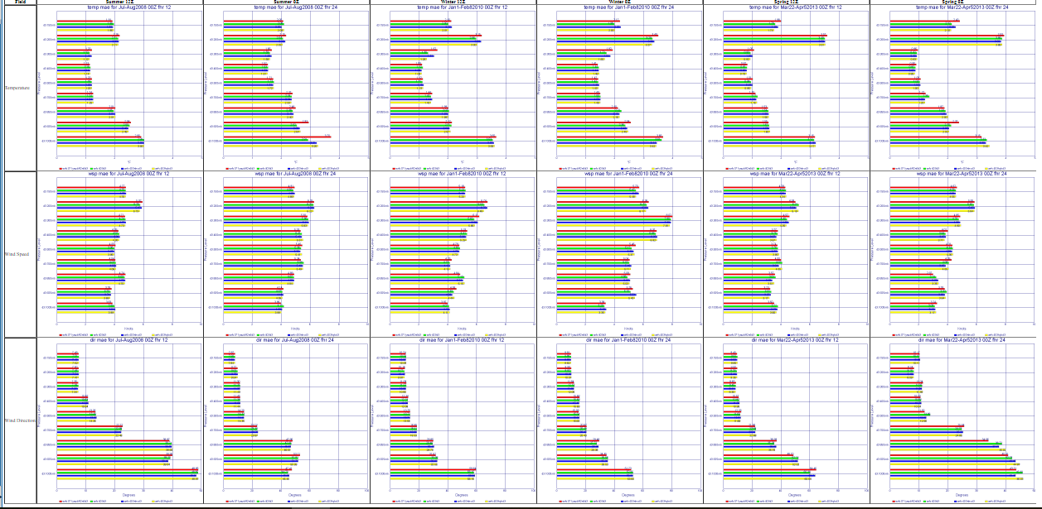
WRF 4.0.3 vs 3.7.1 4-km Vertical MAE
(Red is current, others 4.0.3 options)
Summer Winter Spring
AM PM AM PM AM PM
Temp
WSP
Wind Dir

Slide 9
WRF 4.0.3 vs 3.7.1 4-km Vertical MAE
(Red is current, others 4.0.3 options)
Summer Winter Spring
AM PM AM PM AM PM
Temp
WSP
Wind Dir
Same as the bias, results are inconclusive. At some levels and some times WRF 3.7.1 may be best or worst. Same is true for WRF 4.0.3

Slide 10
WRF 4.0.3 vs 3.7.1 4-km Vertical Biases
(Red is current, others 4.0.3 options)
Summer Winter Spring
AM PM AM PM AM PM
Temp
WSP
Wind Dir
Inconsistent results. At some levels and some times WRF 3.7.1 may be best or worst. Same is true for WRF 4.0.3

Slide 11
Testing of New Version of the System
Evaluated WRF V4.0.3 versus our current system (3.7.1)
Compared with and without hybrid vertical coordinate system
Ran over three seasons.
Slightly slower.
Basic conclusion: No significant improvement and less stable
Recommendation: Wait
Evaluate 4.1 this fall.

Slide 12
Enhancement of Ensemble System
Addition of French modeling system (Arpege)
Four additional physics members
Additional graphics, some requested by consortium members

Slide 13
New physics ensemble members added
GFSWRF4: same physics and initialization as real-time WRF-GFS, but using WRF version 4.0.3 including its new defaults: hybrid vertical coordinate system, moist potential temperature (use_theta_m=1 option) and microphysical effective radii in RRTMG radiation scheme. (added 2019050100)
HRRR: uses MYNN PBL and Noah LSM (the RUC LSM was too moist). WRF version 4.0.3 with hybrid vertical, moist theta, and effective radii. (added 2019050100)
WRFV75: same physics and initialization as real-time, but using 75 vertical levels instead of 37. (added 2019050100)
WRF4DRAG: identical to GFSWRF4 except that our terrain-variance drag parameterization is activated in the YSU PBL. (added 2019051700)

Slide 14
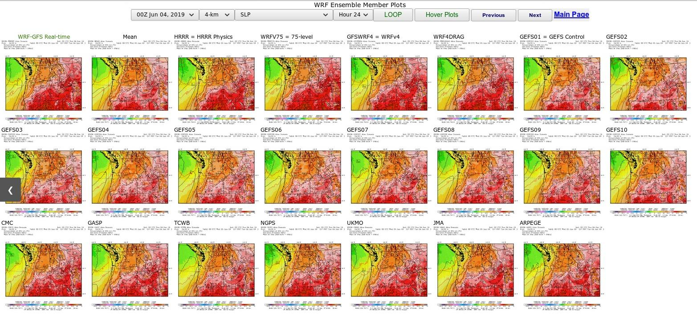
Full Suite of Ensemble Members

Slide 15
Full Suite of Ensemble Members
Physics Members

Slide 16
Full Suite of Ensemble Members
Modeling centers

Slide 17
Full Suite of Ensemble Members
Real-time now has consistent plots

Slide 18
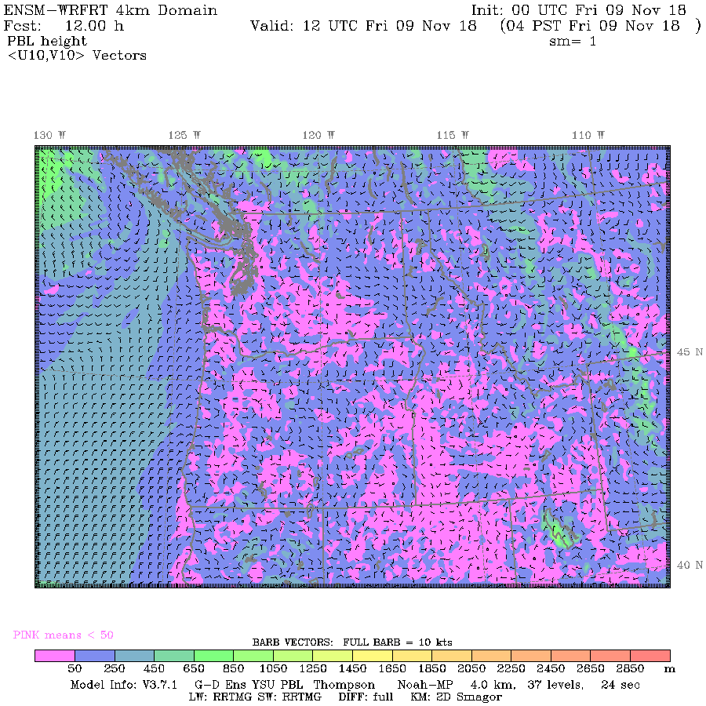
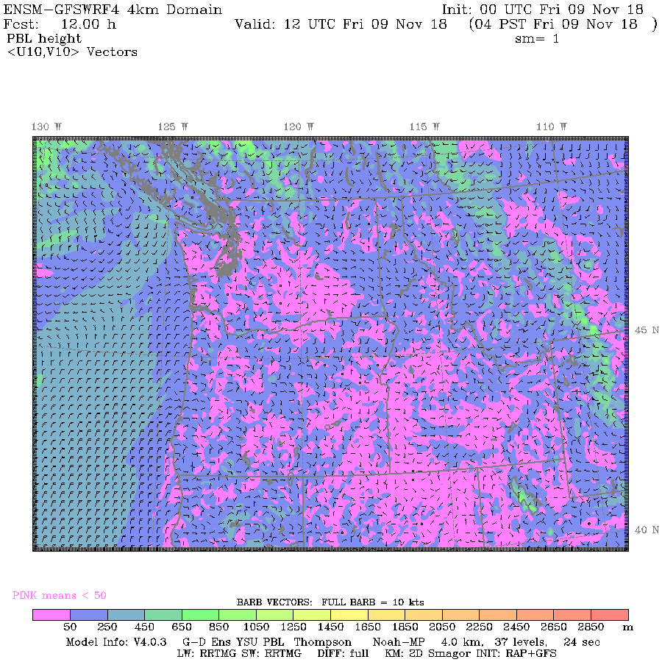
Performance of Physics Members during November 9, 2018 Stagnation Event
WRFRT
GFSWRF4

Slide 19
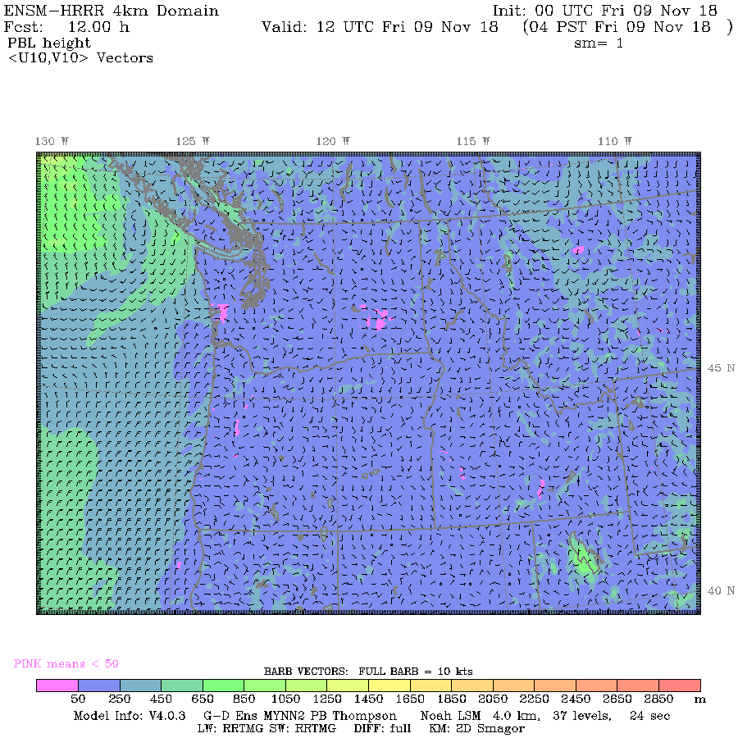
Performance of Physics Members during November 9, 2018 Stagnation Event
WRFRT
HRRR

Slide 20
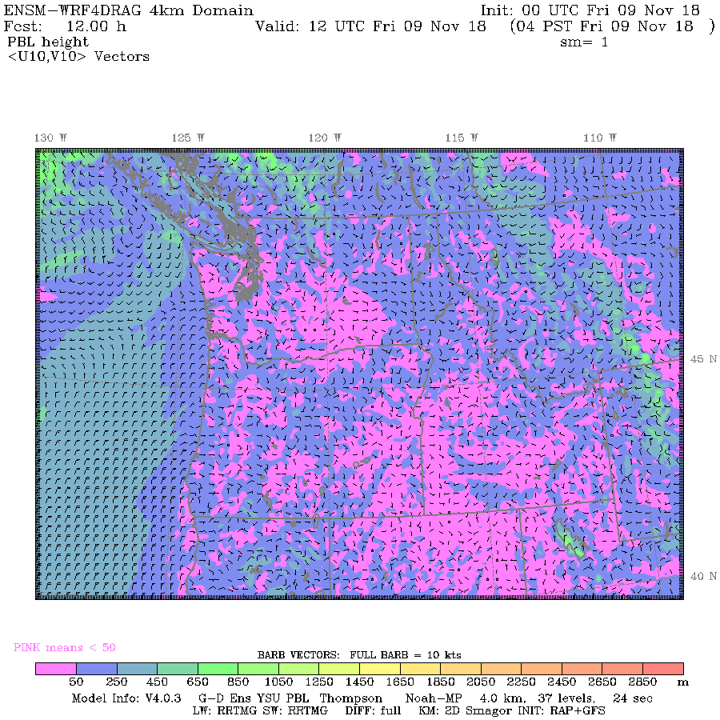
Performance of Physics Members during November 9, 2018 Stagnation Event
WRFRT
WRF4DRAG

Slide 21

Performance of Physics Members during November 9, 2018 Stagnation Event
WRFRT
WRFV75

Slide 22
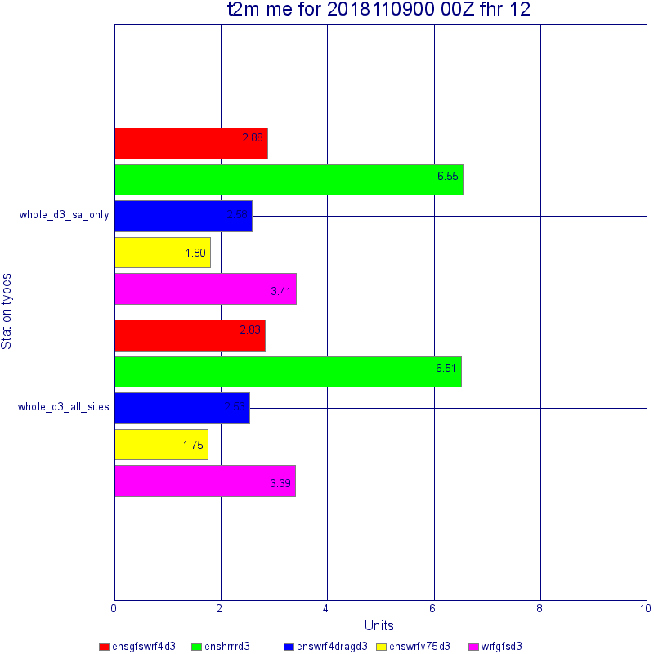
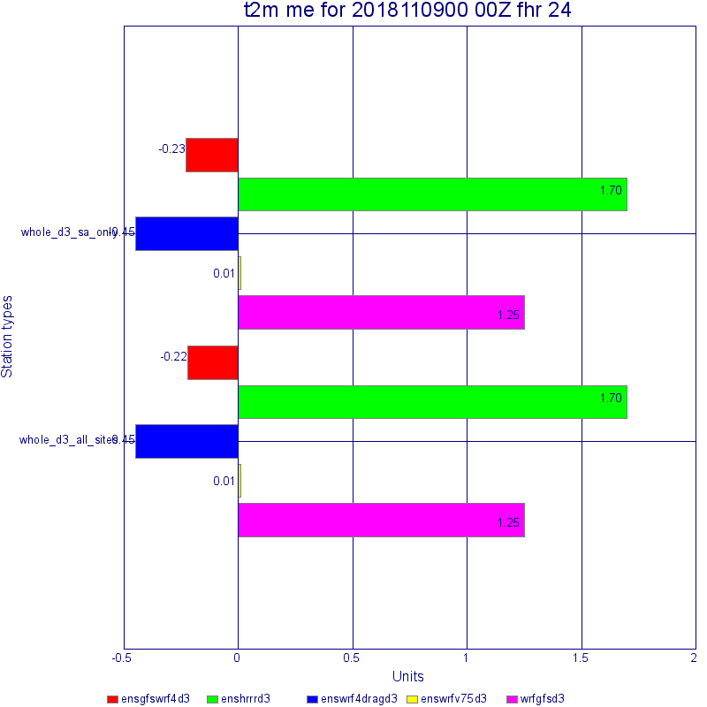
Performance of Physics Members during November 9, 2018 Stagnation Event
2m Temperature Bias 12Z
2m Temperature Bias 0Z
WRFV75 has
Lowest biases

Slide 23
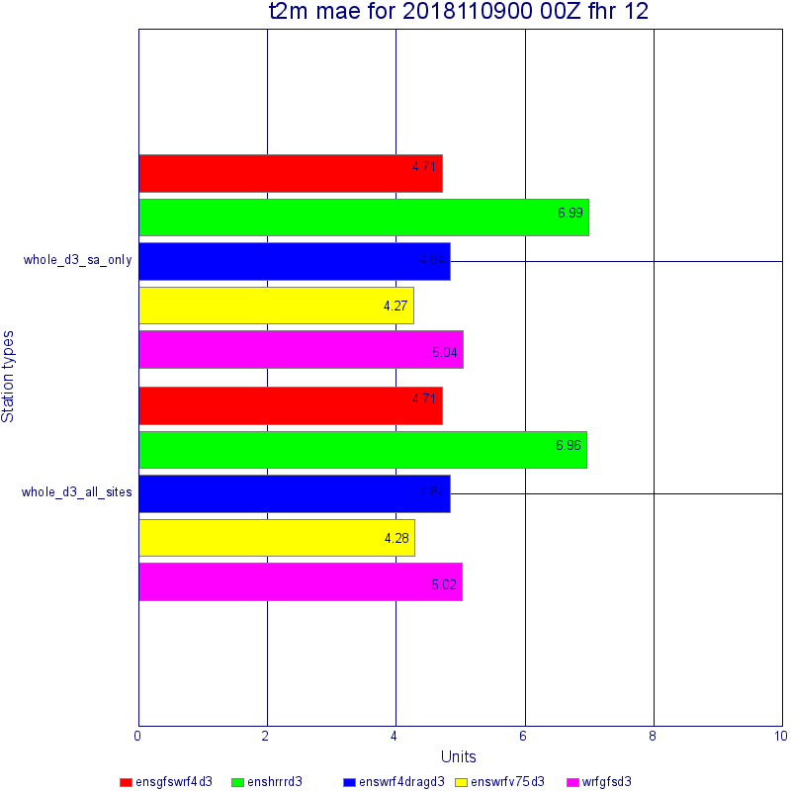
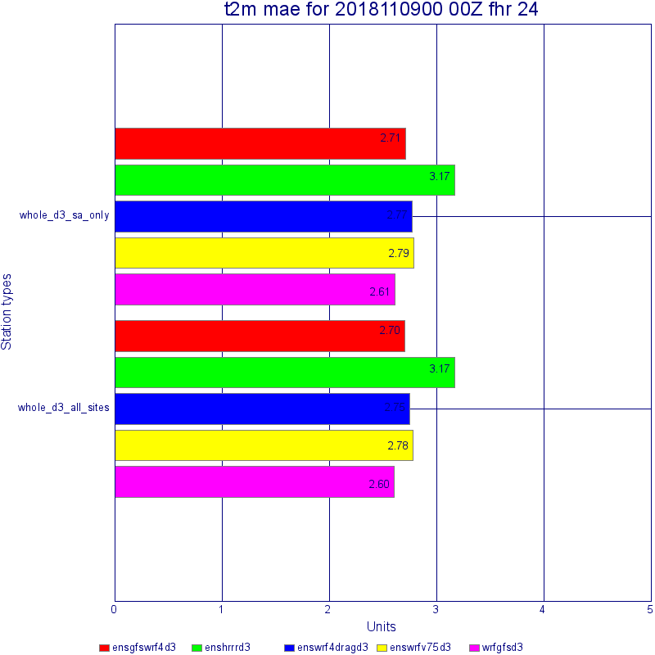
Performance of Physics Members during November 9, 2018 Stagnation Event
2m Temperature MAE 12Z
2m Temperature MAE 0Z
WRFV75 has
Lowest MAE in AM
but not PM

Slide 24
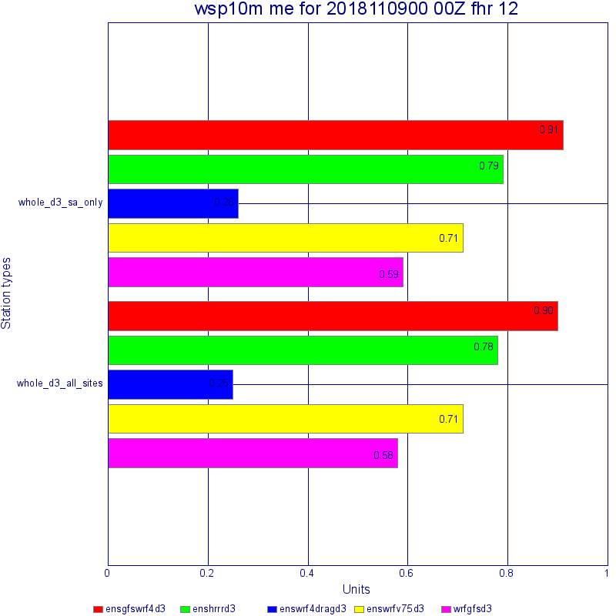
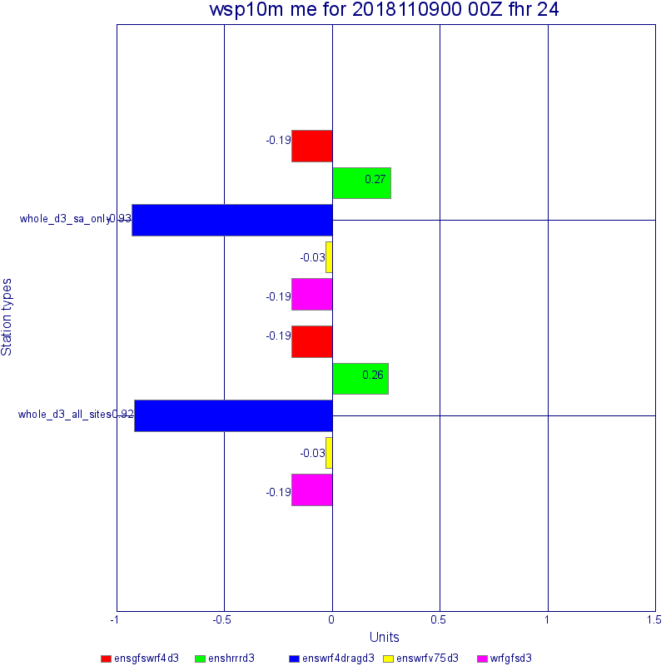
Performance of Physics Members during November 9, 2018 Stagnation Event
10m Wind Speed Bias 12Z
10m Wind Speed Bias 0Z
WRFV75 and WRF4DRAG have high and low speed biases depending on time of day.

Slide 25
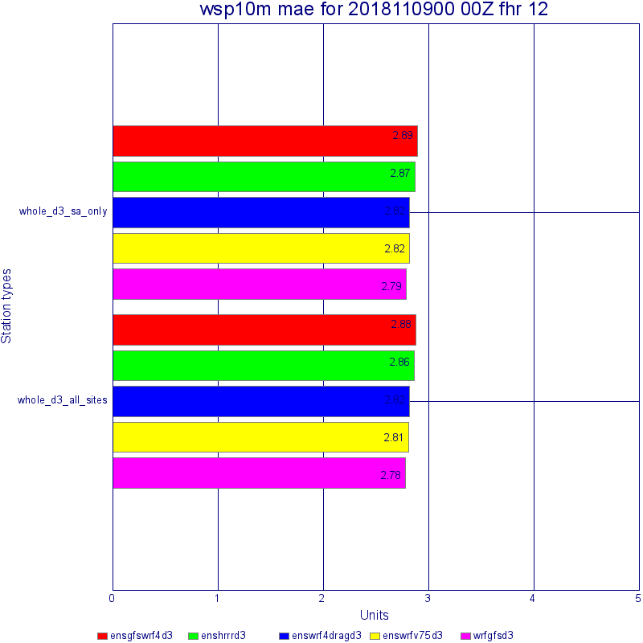
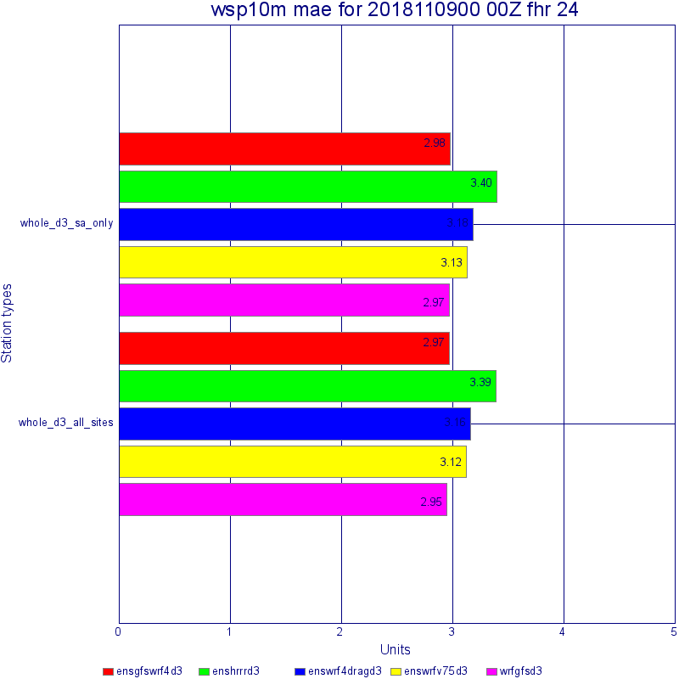
Performance of Physics Members during November 9, 2018 Stagnation Event
10m Wind Speed MAE 12Z
10m Wind Speed MAE 0Z
Overall, current real-time
has lowest MAE

Slide 26
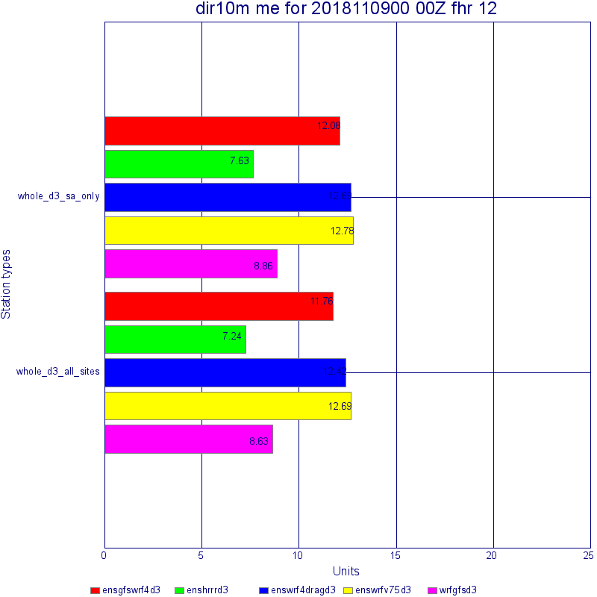
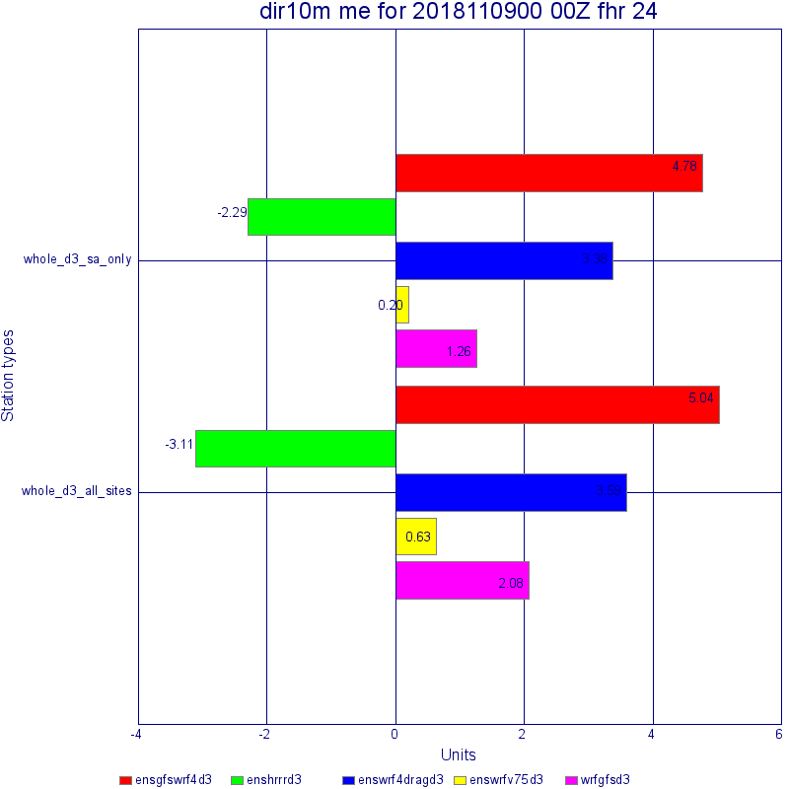
Performance of Physics Members during November 9, 2018 Stagnation Event
10m Wind Direction Bias 12Z
10m Wind Direction Bias 0Z

Slide 27
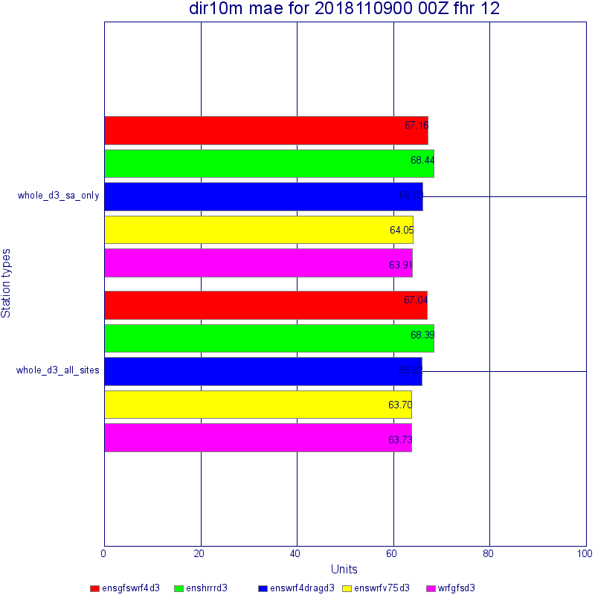
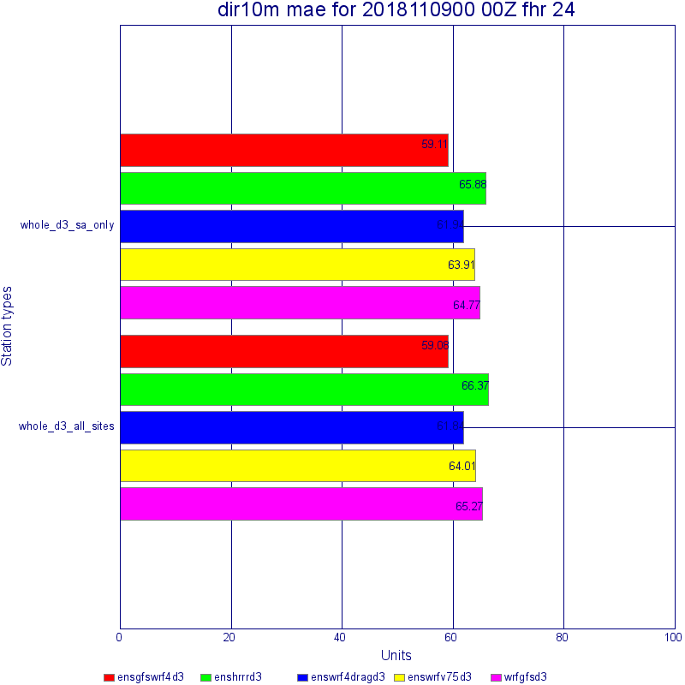
Performance of Physics Members during November 9, 2018 Stagnation Event
10m Wind Direction MAE 12Z
10m Wind Direction MAE 0Z
No clear winner
for wind direction

Slide 28
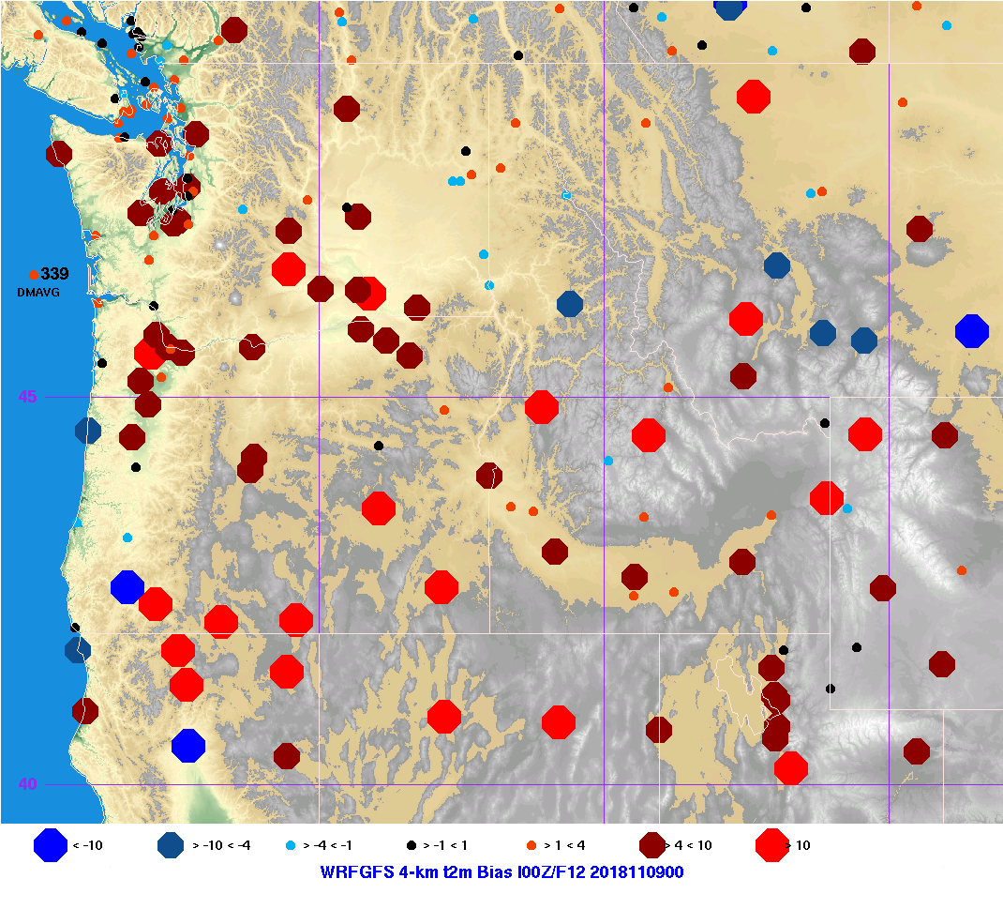
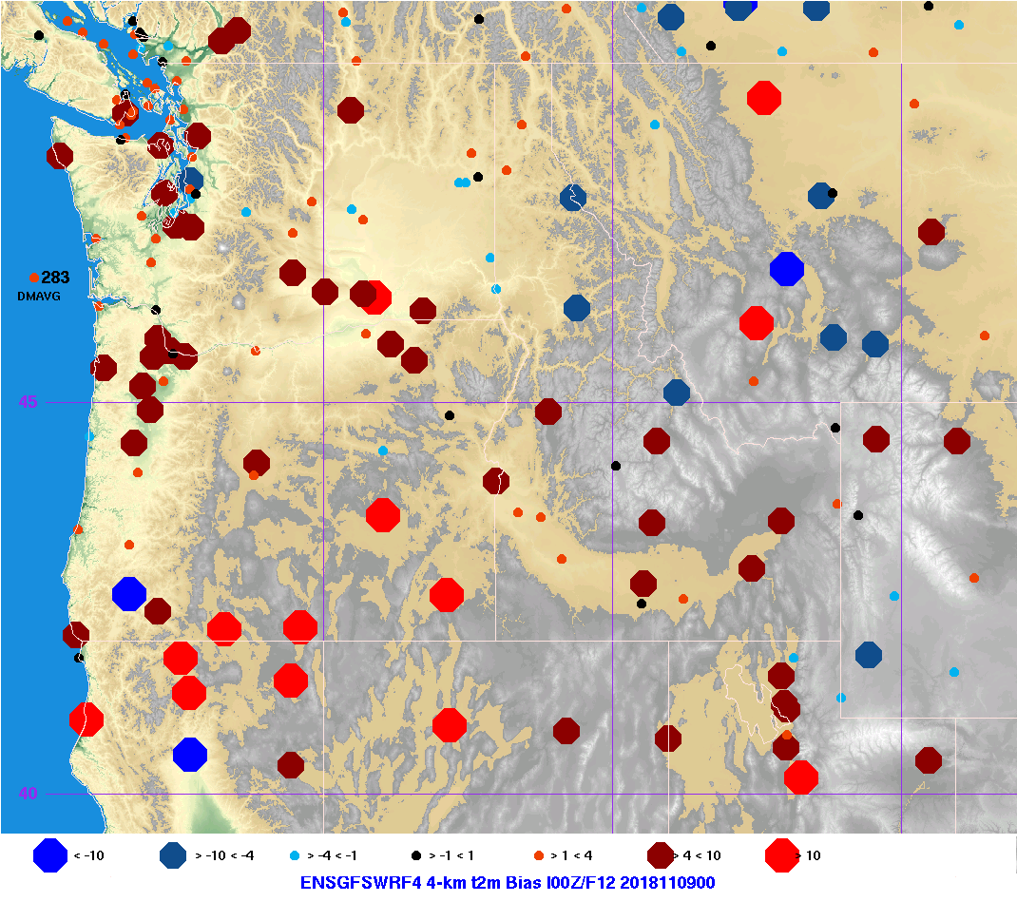
Performance of 4-km Physics Members during November 9, 2018 Stagnation Event
WRFRT 2m Temperature Bias
GFSWRF4 2m Temperature Bias

Slide 29
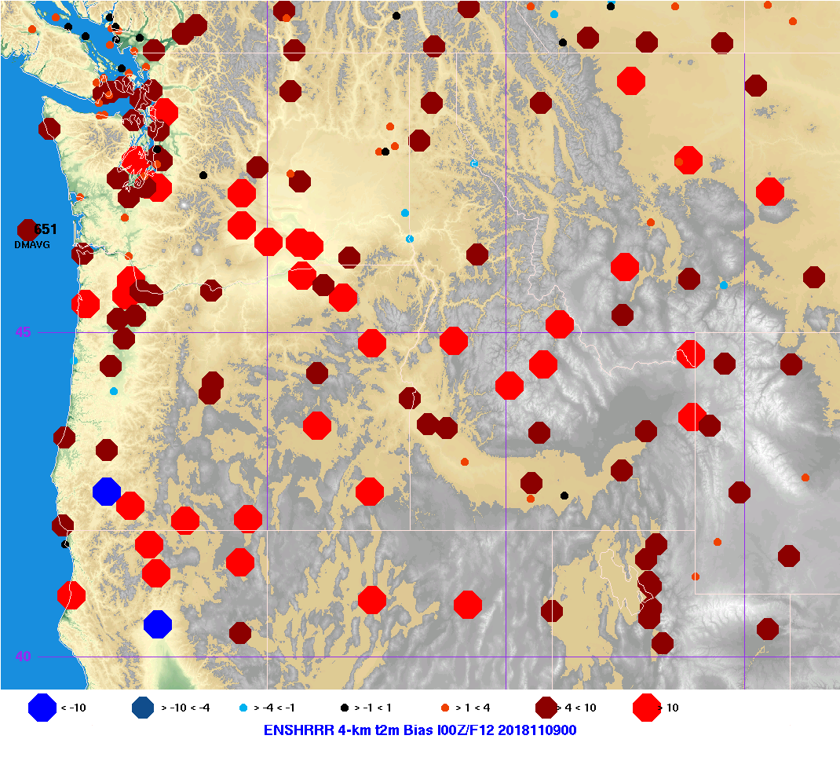
Performance of 4-km Physics Members during November 9, 2018 Stagnation Event
WRFRT 2m Temperature Bias
HRRR 2m Temperature Bias

Slide 30
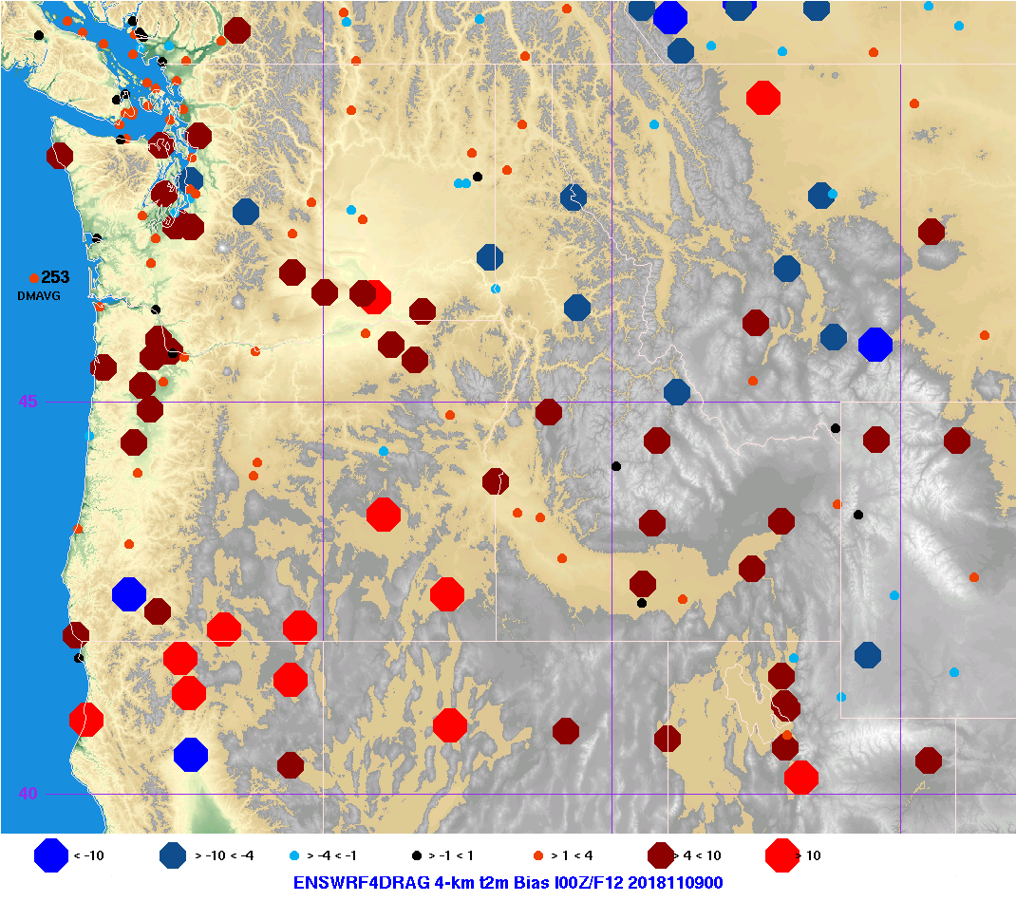
Performance of 4-km Physics Members during November 9, 2018 Stagnation Event
WRFRT 2m Temperature Bias
WRF4DRAG 2m Temperature Bias

Slide 31
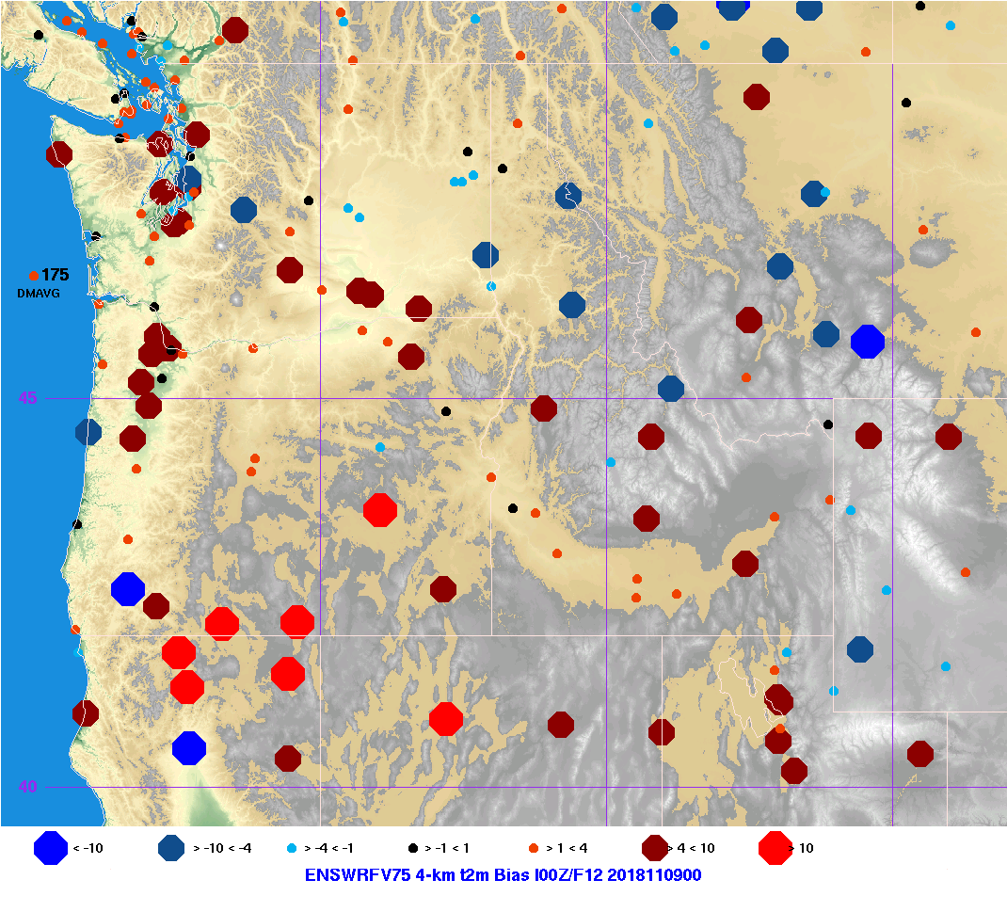
Performance of 4-km Physics Members during November 9, 2018 Stagnation Event
WRFRT 2m Temperature Bias
WRFV75 2m Temperature Bias

Slide 32
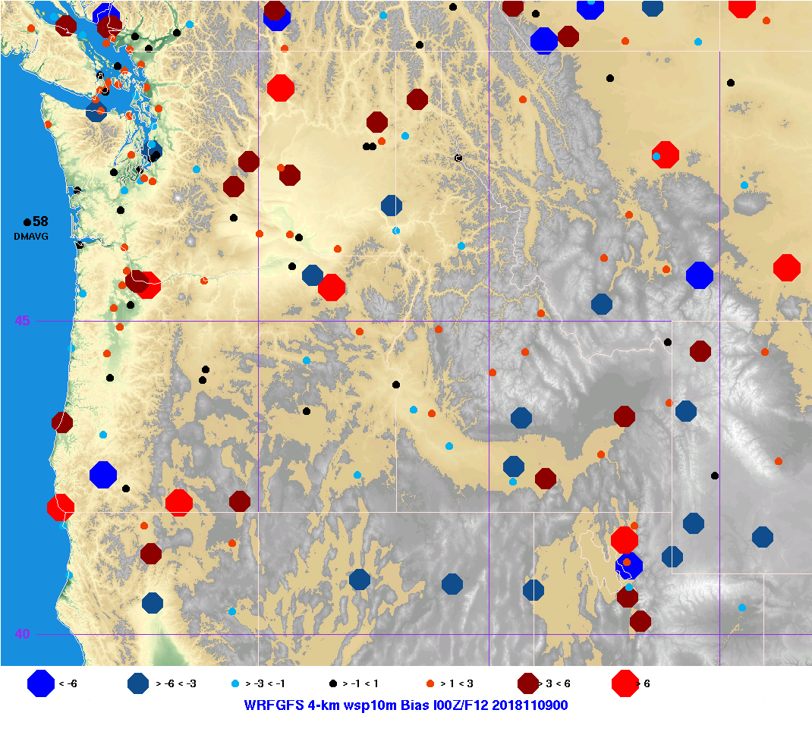
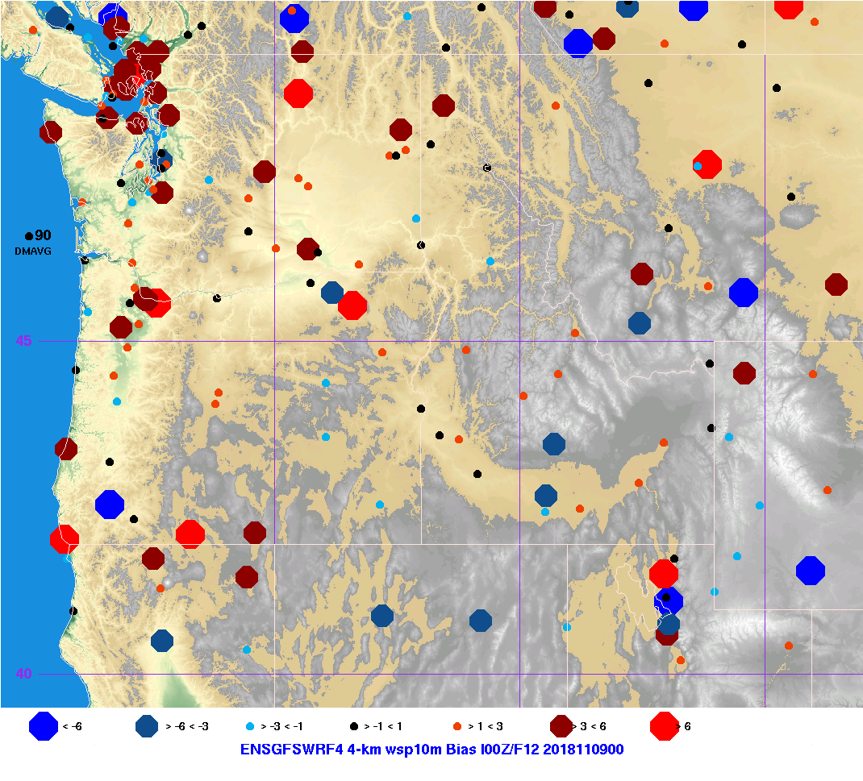
Performance of 4-km Physics Members during November 9, 2018 Stagnation Event
WRFRT 10m Wind Speed Bias
GFSWRF4 10m Wind Speed Bias

Slide 33
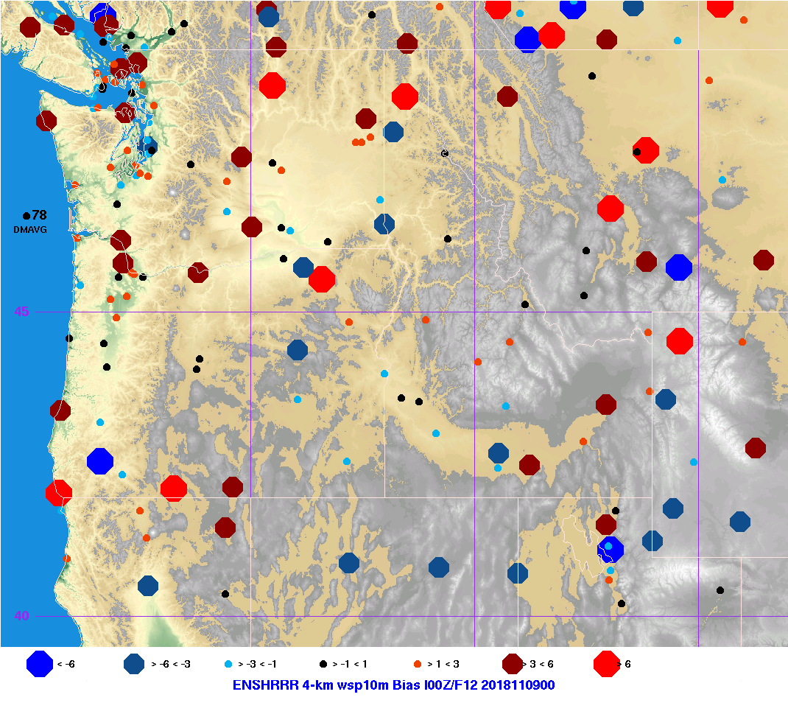
Performance of 4-km Physics Members during November 9, 2018 Stagnation Event
WRFRT 10m Wind Speed Bias
HRRR 10m Wind Speed Bias

Slide 34
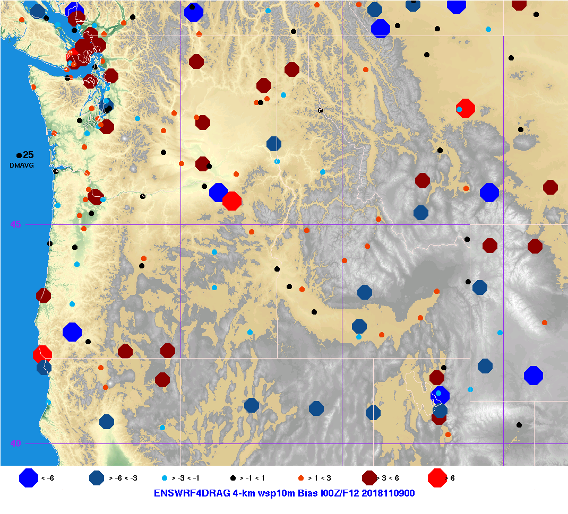
Performance of 4-km Physics Members during November 9, 2018 Stagnation Event
WRFRT 10m Wind Speed Bias
WRF4DRAG 10m Wind Speed Bias

Slide 35
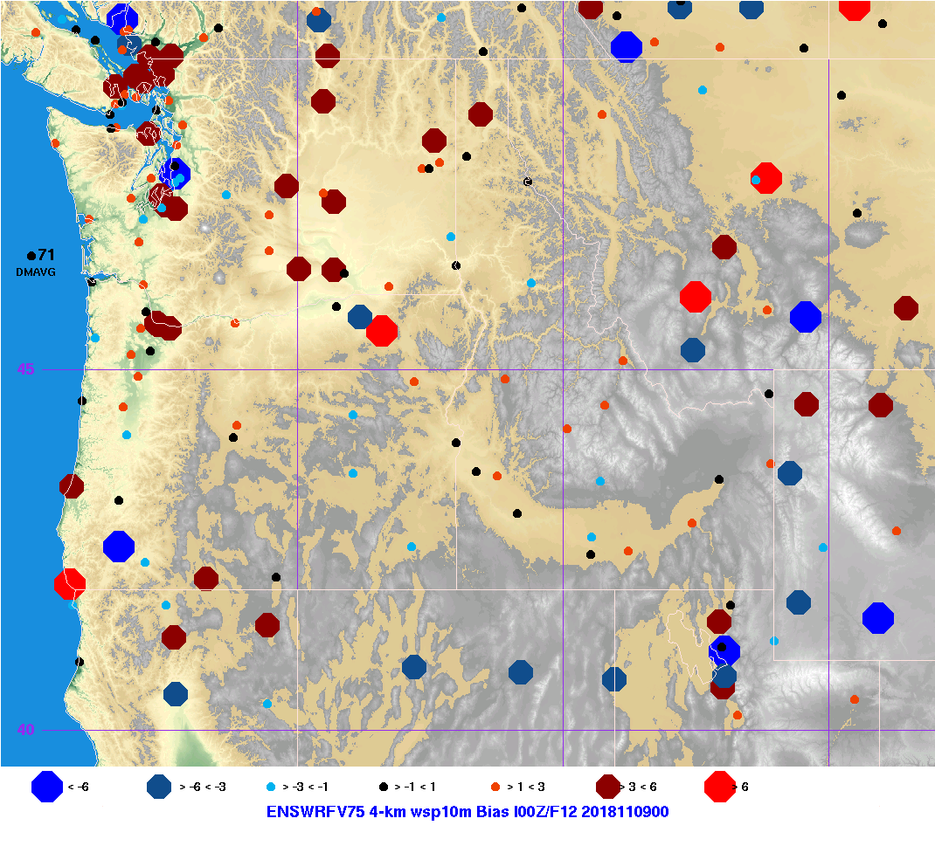
Performance of 4-km Physics Members during November 9, 2018 Stagnation Event
WRFRT 10m Wind Speed Bias
WRFV75 10m Wind Speed Bias

Slide 36
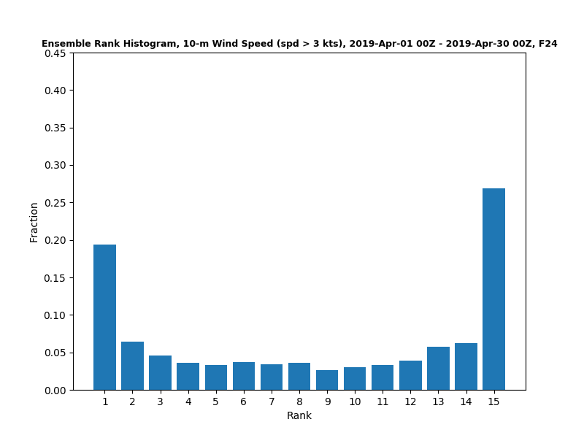
Creating Ensemble Diagnostics

Slide 37
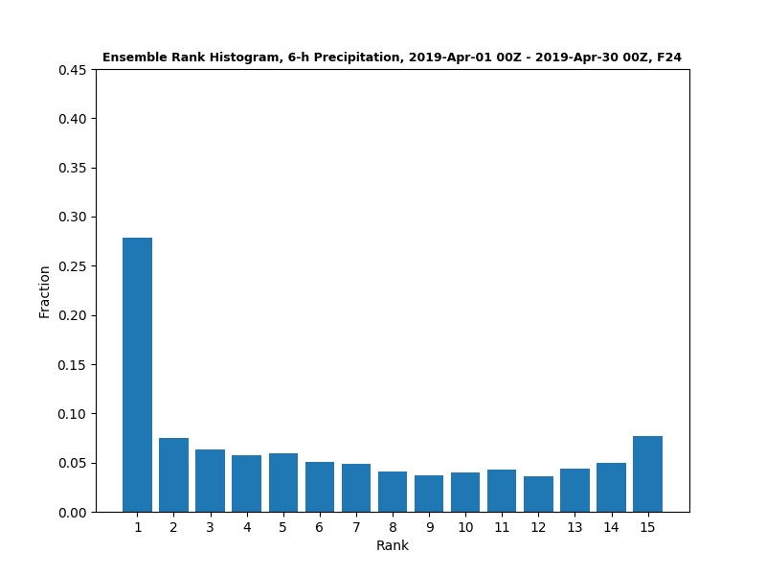

Slide 38
New parameter for Fire Community
Hot-Dry-Windy
Product of the maximum vapor pressure deficit (in hPa) and the maximum wind speed in the layer at or below 500 m AGL.
Added for the Forest Service, Brian Potter.
Works well for some cases (Wine Country Fires 2017) but not for others (Camp Fire 2018).

Slide 39
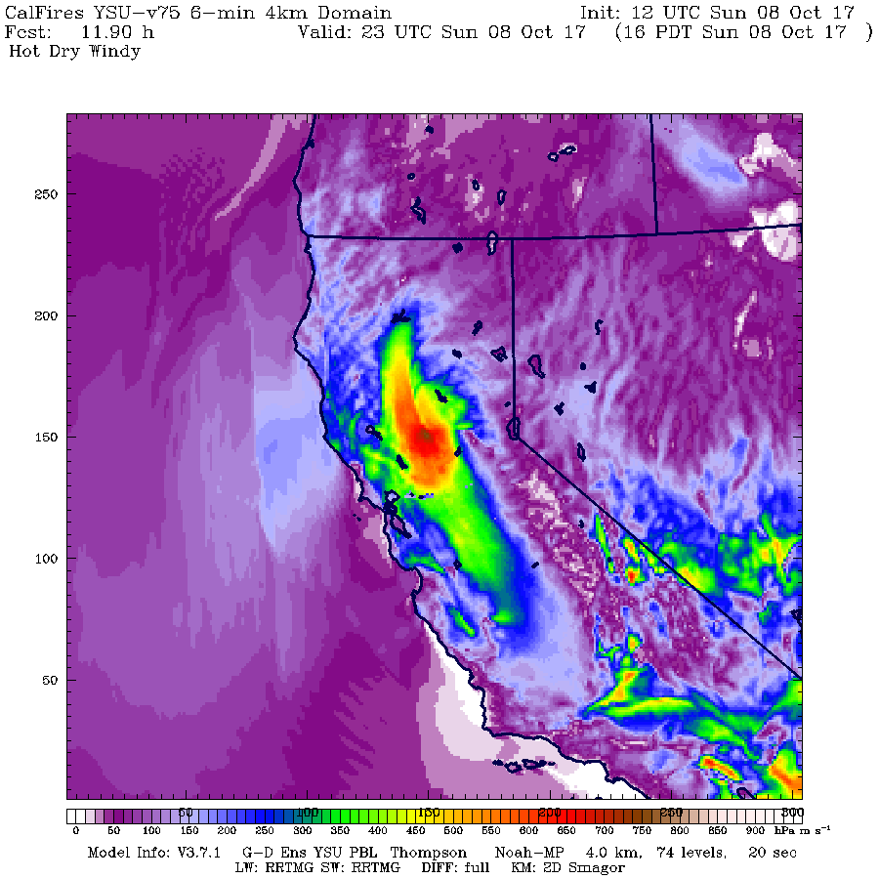
Hot-Dry-Windy for Wine Country Fires, 2017

Slide 40
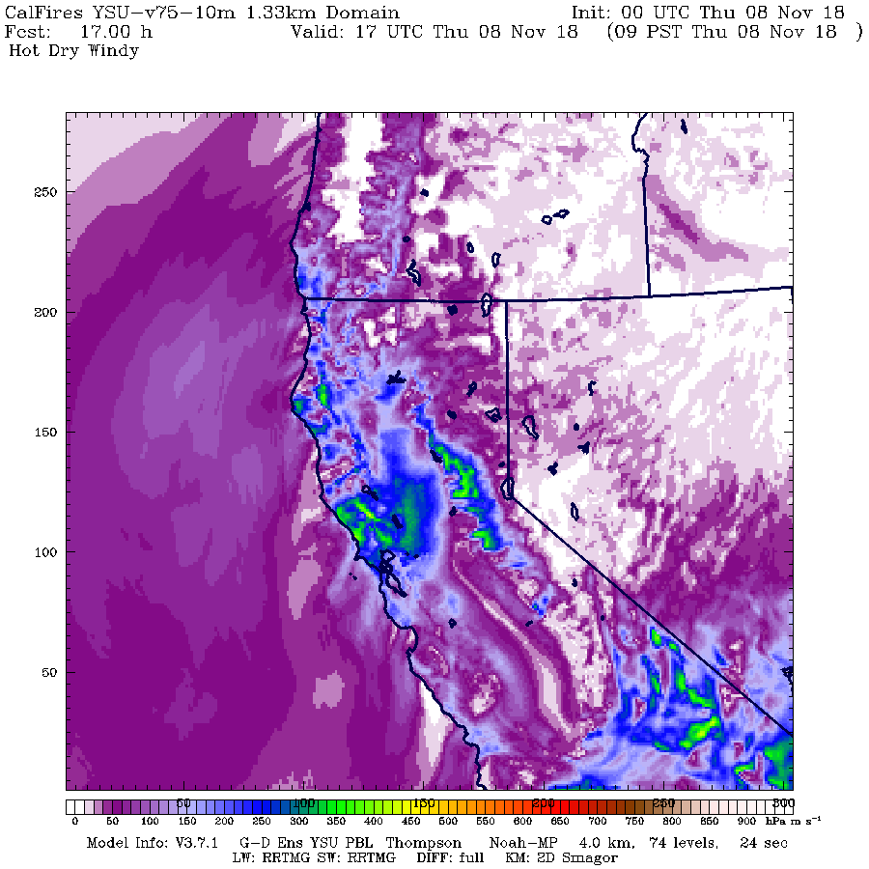
Hot-Dry-Windy for Camp Fire Case, 2018

Slide 41
Consortium Meeting, June 6, 2019
New ensemble physics members added:
GFSWRF4: same physics and initialization as real-time WRF-GFS, but using WRF version 4.0.3 including its new defaults: hybrid vertical coordinate system, moist potential temperature (use_theta_m=1 option) and microphysical effective radii in RRTMG radiation scheme. (added 2019050100)
HRRR: uses MYNN PBL and Noah LSM (the RUC LSM was too moist). WRF version 4.0.3 with hybrid vertical, moist theta, and effective radii. (added 2019050100)
WRFV75: same physics and initialization as real-time, but using 75 vertical levels instead of 37. (added 2019050100)
WRF4DRAG: identical to GFSWRF4 except that our terrain-variance drag parameterization is activated in the YSU PBL. (added 2019051700)

Slide 42
Consortium Meeting, June 6, 2019
New national center model added:
Météo-France, 0.5°: Action de Recherche Petite Échelle Grande Échelle (ARPEGE) Modèle Atmosphérique (labelled as ARPG, added 2019052400).
Thanks to Roland Stull at UBC for pointing out this model and provided guidance in acquiring it.

Slide 43
Full Suite of Ensemble Members

Slide 44
Full Suite of Ensemble Members
Physics Members

Slide 45
Full Suite of Ensemble Members
Modeling centers

Slide 46
Full Suite of Ensemble Members
Real-time now has consistent plots

Slide 47
Performance of Physics Members during November 9, 2018 Stagnation Event
WRFRT
GFSWRF4

Slide 48
Performance of Physics Members during November 9, 2018 Stagnation Event
WRFRT
HRRR

Slide 49
Performance of Physics Members during November 9, 2018 Stagnation Event
WRFRT
WRF4DRAG

Slide 50
Performance of Physics Members during November 9, 2018 Stagnation Event
WRFRT
WRFV75

Slide 51
Performance of Physics Members during November 9, 2018 Stagnation Event
2m Temperature Bias 12Z
2m Temperature Bias 0Z
WRFV75 has
Lowest biases

Slide 52
Performance of Physics Members during November 9, 2018 Stagnation Event
2m Temperature MAE 12Z
2m Temperature MAE 0Z
WRFV75 has
Lowest MAE in AM
but not PM

Slide 53
Performance of Physics Members during November 9, 2018 Stagnation Event
10m Wind Speed Bias 12Z
10m Wind Speed Bias 0Z
WRFV75 and WRF4DRAG have high and low speed biases depending on time of day.

Slide 54
Performance of Physics Members during November 9, 2018 Stagnation Event
10m Wind Speed MAE 12Z
10m Wind Speed MAE 0Z
Overall, current real-time
has lowest MAE

Slide 55
Performance of Physics Members during November 9, 2018 Stagnation Event
10m Wind Speed MAE 12Z
10m Wind Speed MAE 0Z
Overall, current real-time
has lowest MAE

Slide 56
Performance of Physics Members during November 9, 2018 Stagnation Event
10m Wind Direction Bias 12Z
10m Wind Direction Bias 0Z

Slide 57
Performance of Physics Members during November 9, 2018 Stagnation Event
10m Wind Direction MAE 12Z
10m Wind Direction MAE 0Z
No clear winner
for wind direction

Slide 58
Performance of 4-km Physics Members during November 9, 2018 Stagnation Event
WRFRT 2m Temperature Bias
GFSWRF4 2m Temperature Bias

Slide 59
Performance of 4-km Physics Members during November 9, 2018 Stagnation Event
WRFRT 2m Temperature Bias
HRRR 2m Temperature Bias

Slide 60
Performance of 4-km Physics Members during November 9, 2018 Stagnation Event
WRFRT 2m Temperature Bias
WRF4DRAG 2m Temperature Bias

Slide 61
Performance of 4-km Physics Members during November 9, 2018 Stagnation Event
WRFRT 2m Temperature Bias
WRFV75 2m Temperature Bias

Slide 62
Performance of 4-km Physics Members during November 9, 2018 Stagnation Event
WRFRT 10m Wind Speed Bias
GFSWRF4 10m Wind Speed Bias

Slide 63
Performance of 4-km Physics Members during November 9, 2018 Stagnation Event
WRFRT 10m Wind Speed Bias
HRRR 10m Wind Speed Bias

Slide 64
Performance of 4-km Physics Members during November 9, 2018 Stagnation Event
WRFRT 10m Wind Speed Bias
WRF4DRAG 10m Wind Speed Bias

Slide 65
Performance of 4-km Physics Members during November 9, 2018 Stagnation Event
WRFRT 10m Wind Speed Bias
WRFV75 10m Wind Speed Bias

Slide 66
New parameter for Fire Community
Hot-Dry-Windy
Product of the maximum vapor pressure deficit (in hPa) and the maximum wind speed in the layer at or below 500 m AGL.
Added for the Forest Service, Brian Potter.
Works well for some cases (Wine Country Fires 2017) but not for others (Camp Fire 2018).

Slide 67
Hot-Dry-Windy for Wine Country Fires, 2017

Slide 68
Hot-Dry-Windy for Camp Fire Case, 2018

Slide 69
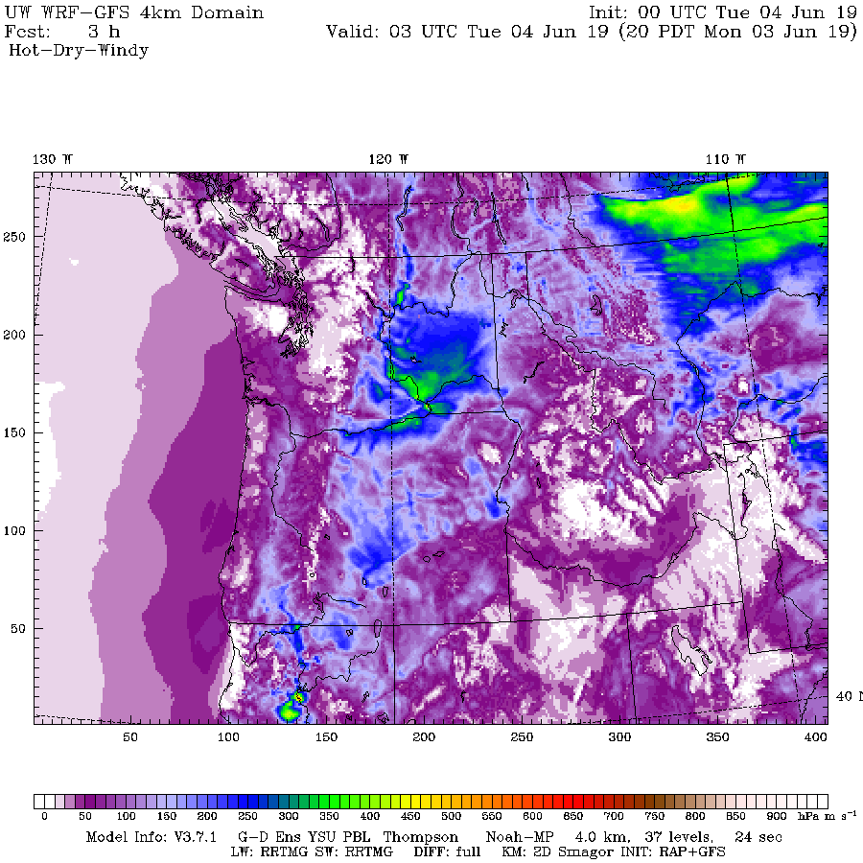

Slide 70
Problems with NOAH-MP
Got crazy cold in parts of western WA in February when there was snow on the ground
The old NOAH LSM is better.
This is a national problem—talked to the folks in Boulder about it.
NOAH MP is better when no snow…so fine now
May have to switch to NOAH this fall if not fixed.

Slide 71
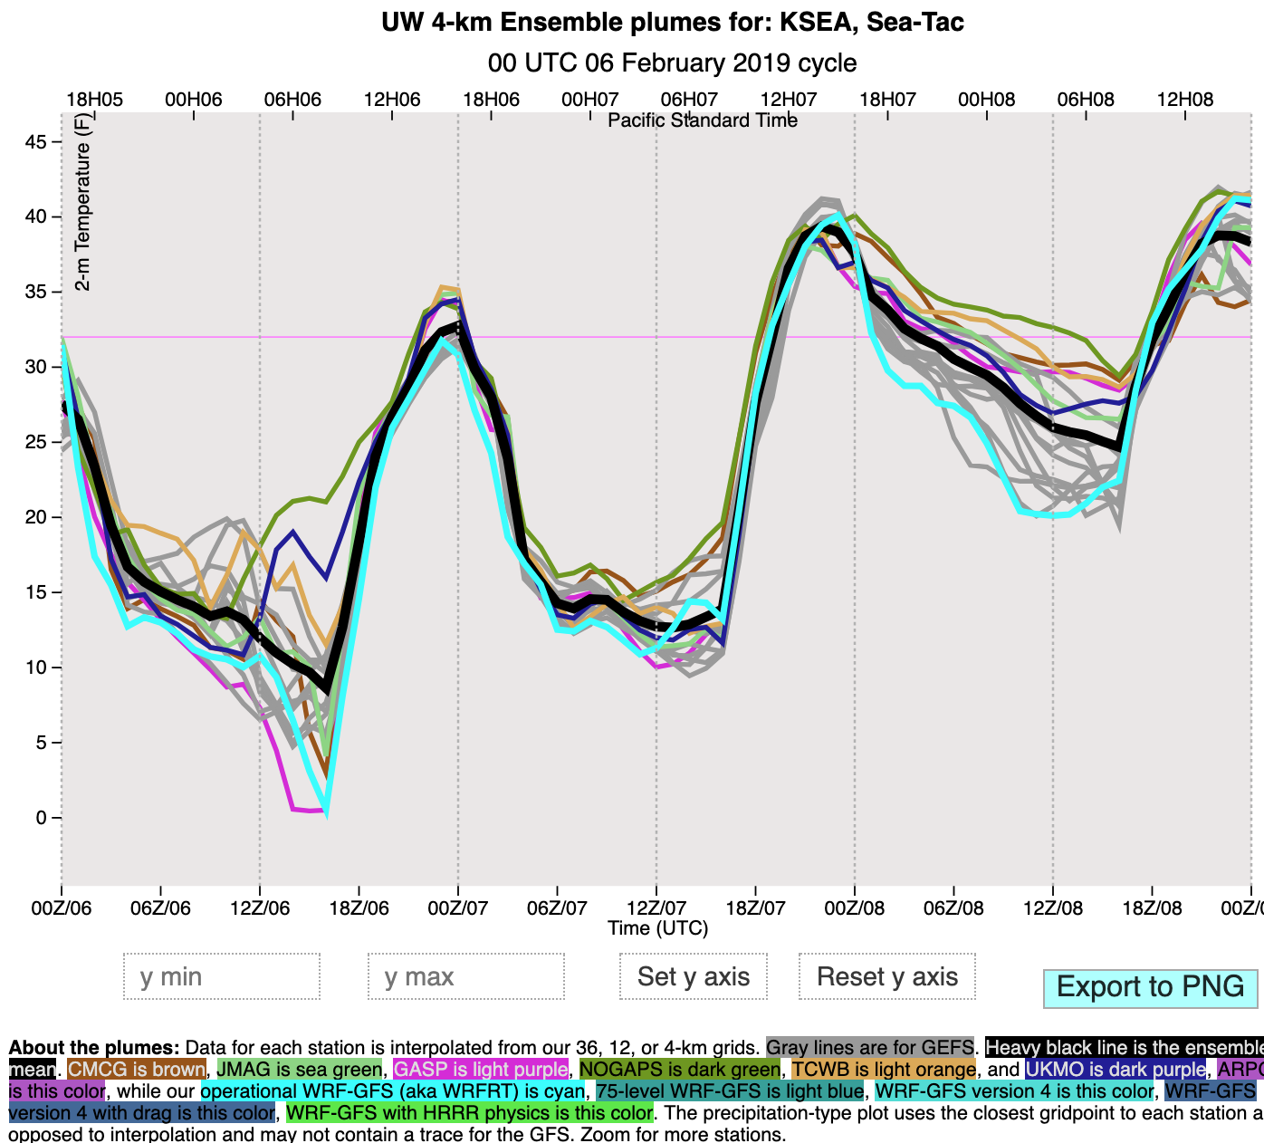

Slide 72
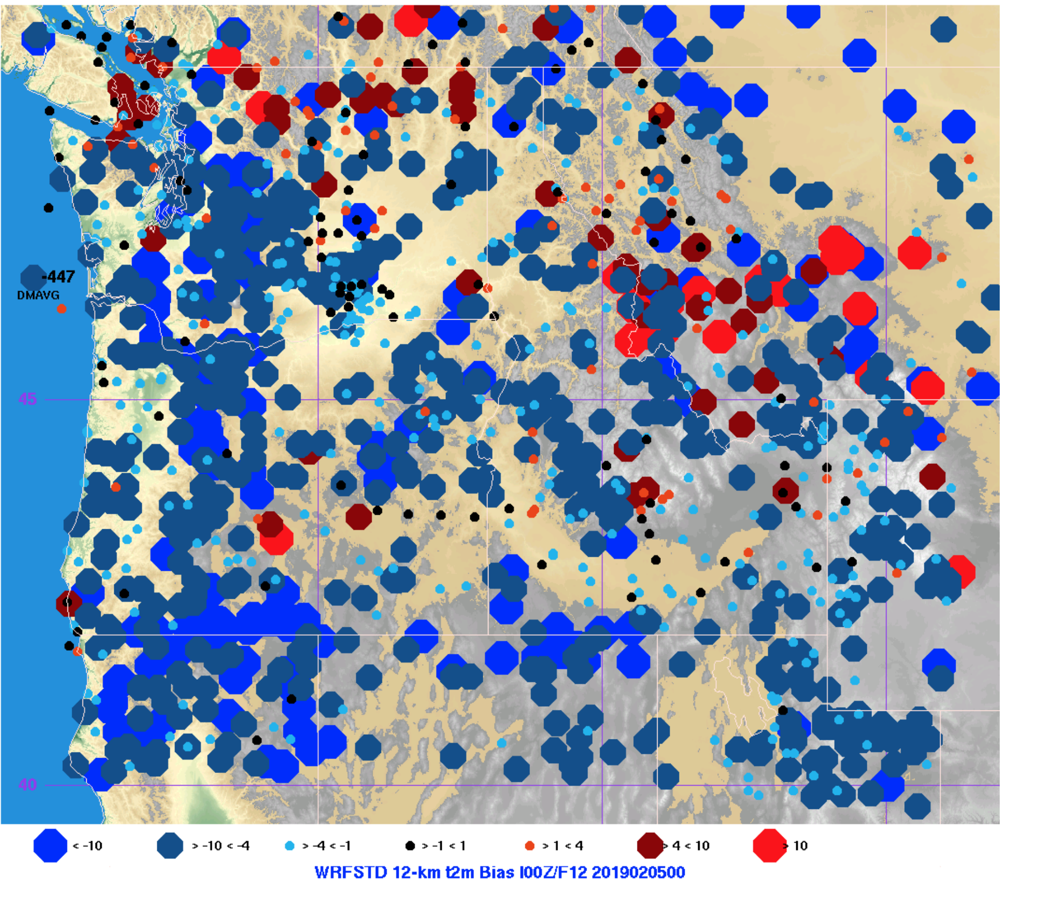

Slide 73
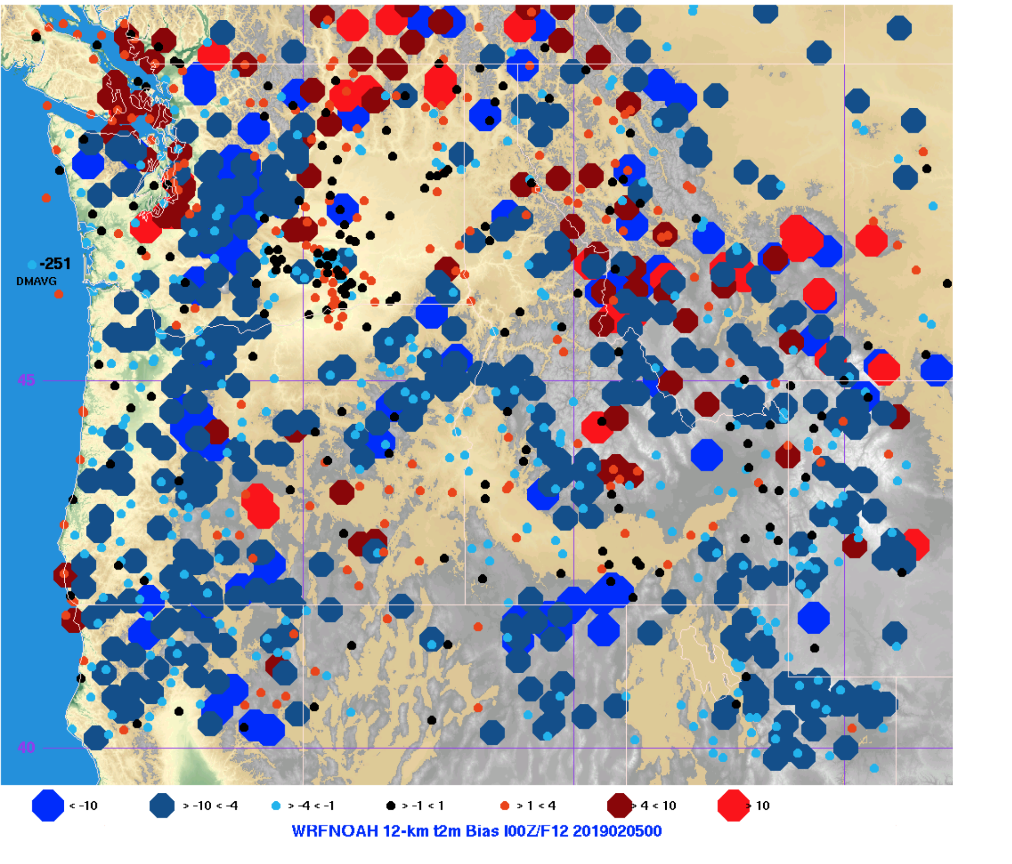

Slide 74
Additional Work
Dave Ovens reran 162 WRF 4-km Cases (hours 0-36) for Robert Solomon’s AirFire work.
Cases spanned dates from July 2009 to November 2018 and filled holes in his archive.

Slide 75
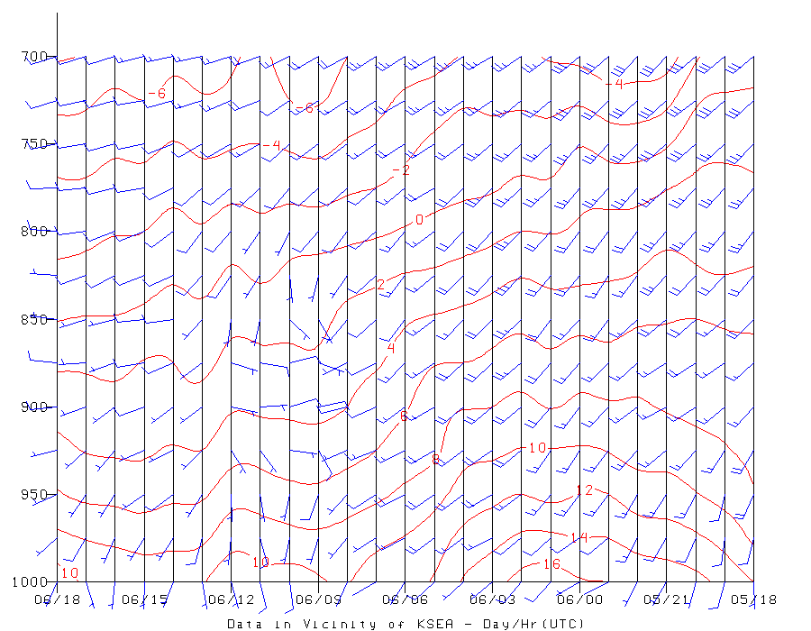
ACARs Graphics: Should expand now that the sounder is toast?

Slide 76
Consortium Meeting, June 6, 2019
Additional work:
Began using 3-hour boundary files for ensemble members that have them with 2019052500 forecast:
Navy NAVGEM (aka NGPS)
Meteo France ARPEGE (aka ARPG)
Canadian CMCG.
All physics members already use them.

