Slide 1
Consortium Meeting
6/4/2015

Slide 2
Usage is Up

Slide 3
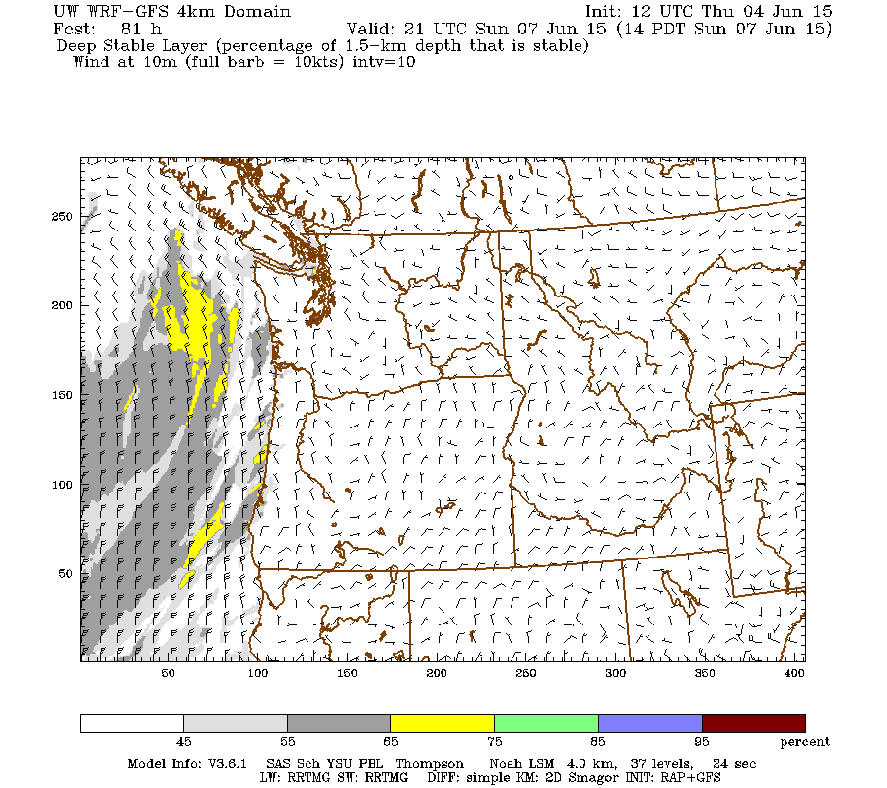
Some Additions
BUFKIT files available for consortium users
New ventilation graphics (deep stable layer graphics)

Slide 4
BUFKIT FORMAT

Slide 5
Model Problems
We made major enhancements on late January:
WRF 3.6.1
NOAH MP Land Surface Model (LSM)
RAP model initialization
This produced better verifications, but this spring we started to have problems (model stopping)
…and we traced it back to the NOAH-MP
On May 8th, we switched back to the NOAH LSM (not MP)
NOAH MP was much better with snow…not a factor now.

Slide 6
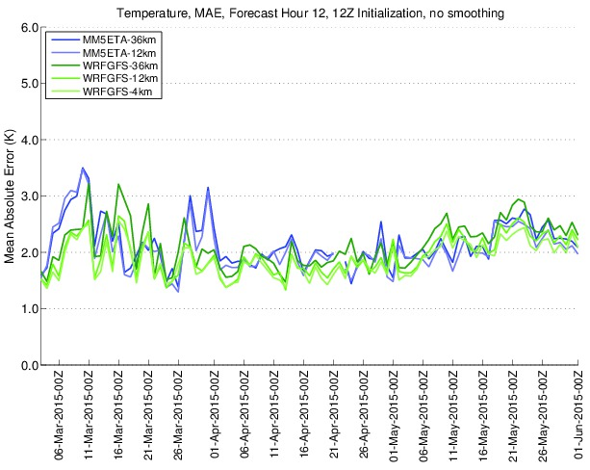
Mixed bag impact

Slide 7
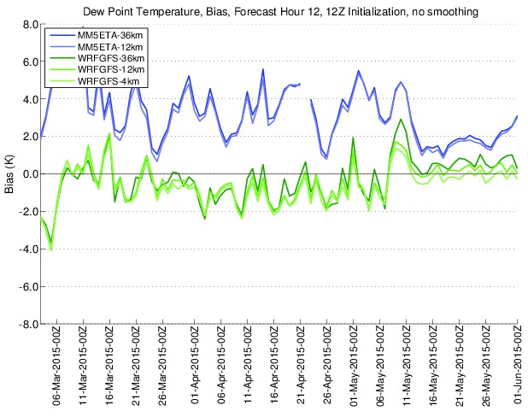

Slide 8
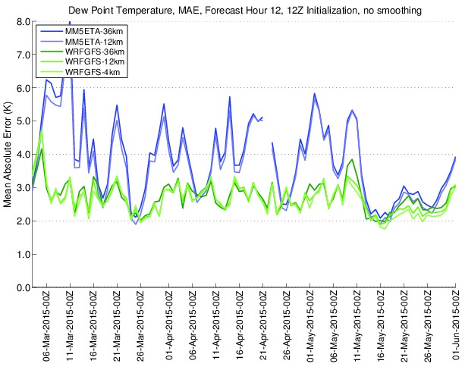

Slide 9
NOAH-MP
The NOAH-MP version in WRF 3.7 seems much more stable.
Will wait until 3.7.1 comes out this summer and if good, can switch to 3.7.1 with NOAH-MP
Good news: NOAH LSM is faster than NOAH MP

Slide 11
Other Problem
Crazy lines in unstable ocean air.
Doesn’t seem to have a big impact
The problem is with a parallelization problem in our cumulus scheme (SAS, Simple Arakawa Schubert).
Working with NCAR on this…may switch to other scheme this fall if no fix or if other scheme verifies better.

Slide 12
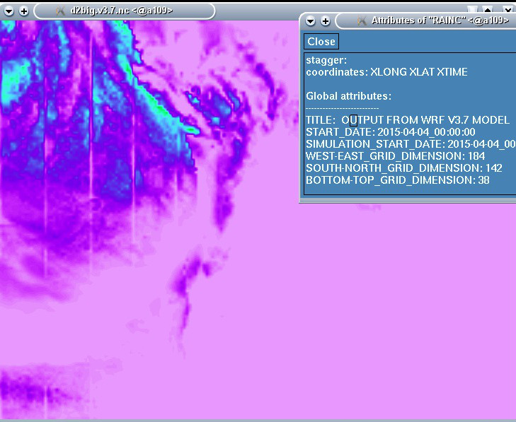

Slide 13
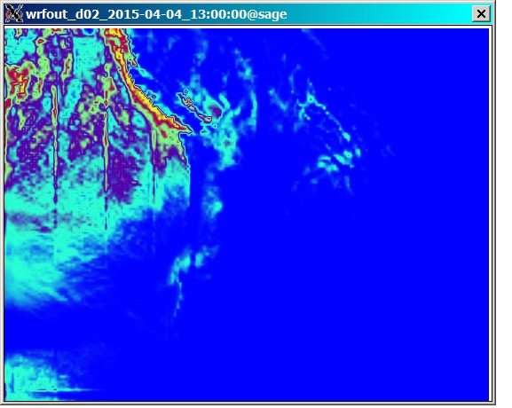

Slide 14
New Domain
The key issue is to expand 4/3 km coverage to include all of Oregon.
I am also highly recommending we move the northern boundary a bit farther north to do a better job regarding the Fraser valley and get the boundary away from an area of major interest.
The Forest Service will be paying for a doubling of her computer resources

Slide 15
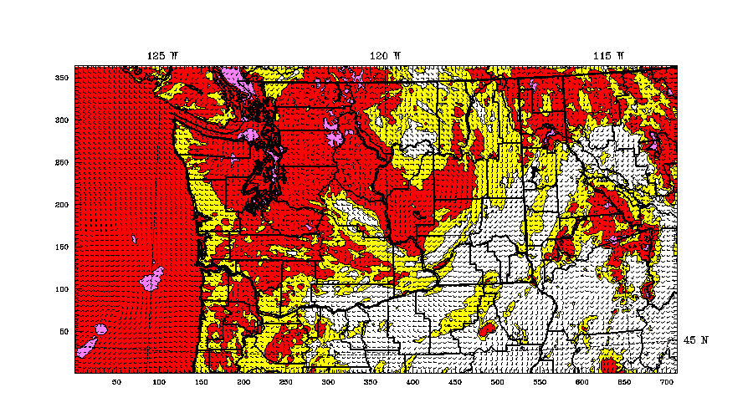
Now

Slide 16
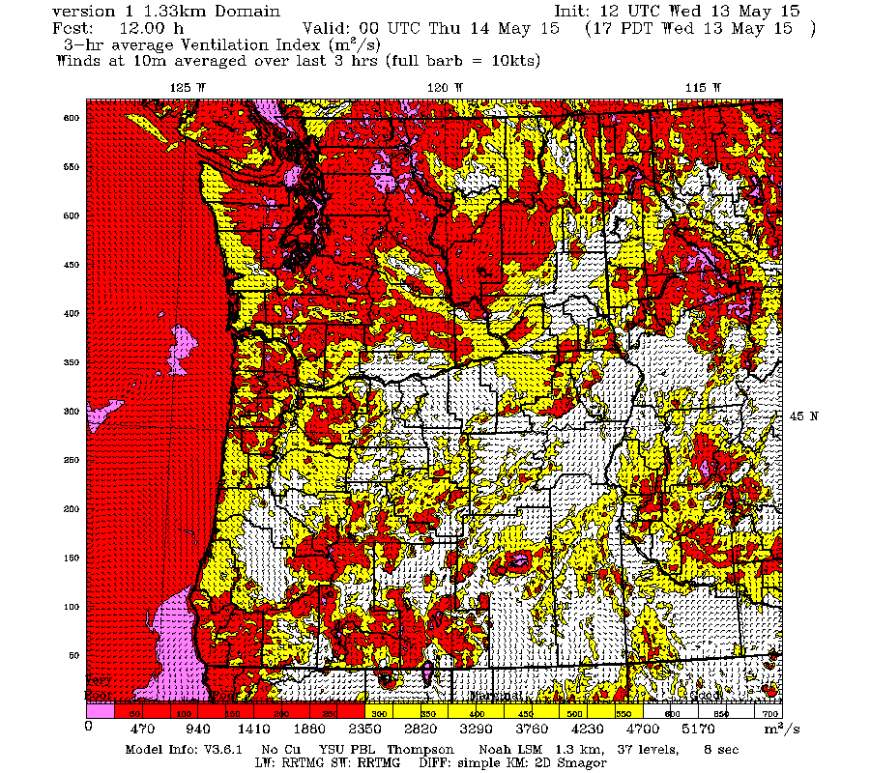
Just South

Slide 17
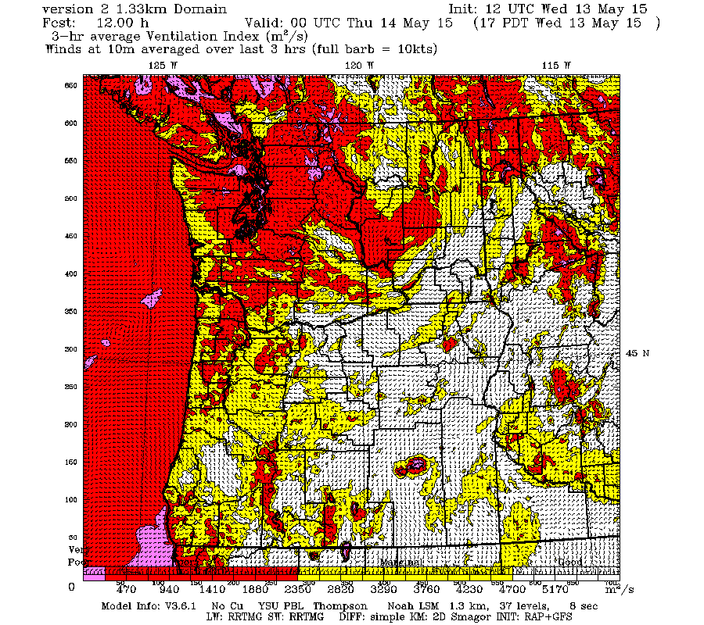

Slide 18
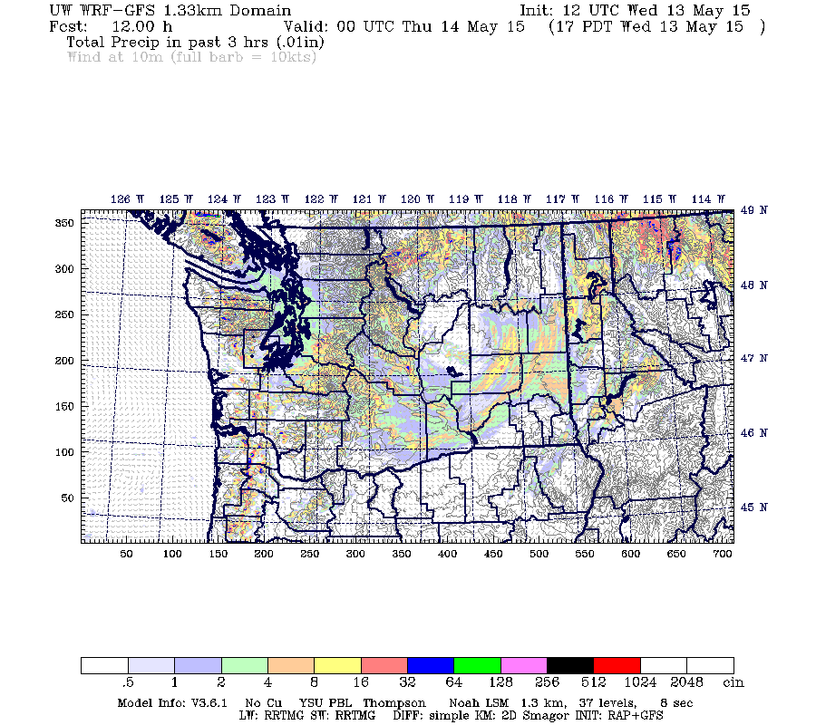

Slide 19
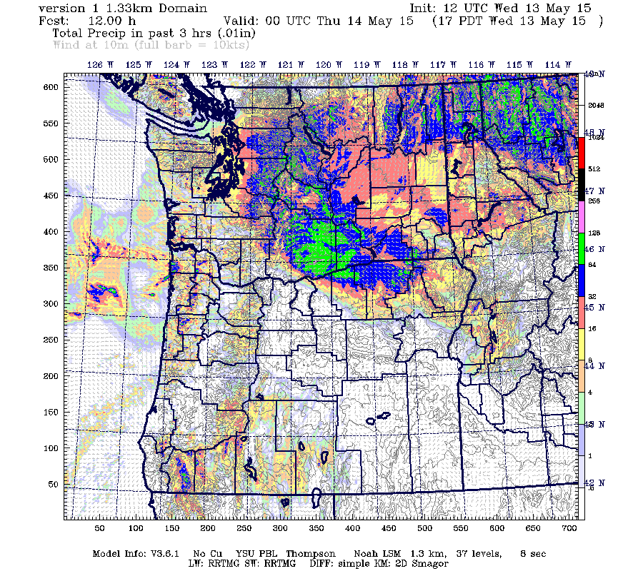

Slide 20
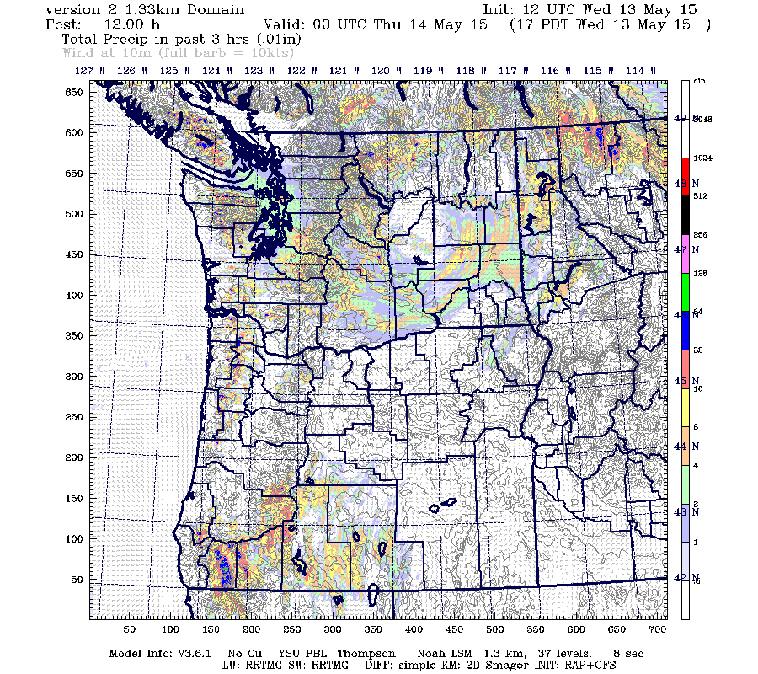

Slide 21
Advantages to Everyone of New Domain
Push boundaries away from areas of interest
Much larger domain for convective development (no cumulus scheme in 4/3!)
Most systems come from south and southwest…so more time over our inner domain.

Slide 22
Resources and Timing
Domain and file size increase for 4/3-km domain:
1) from 712x364 to 712x619 = 1.70 factor
2) from 712x364 to 712x664 = 1.82 factor
Runtime increase for 4/3-km domain, 12-hour simulation:
1) from 3510 seconds to 5554 seconds = 1.58 factor [getting a more efficient break-up of the domain]
2) from 3510 seconds to 6006 seconds = 1.71 factor

Slide 23
What will doubling our CPUs do for us?
Will not get double, since there resources never scale 100% with cpu addition
From previous experience, suspect will get around 1.8x (also just acquired a faster switch)
So we should be able to keep the time the same.
Boise and SW Idaho now covered by high-resolution.

Slide 24
New graphic interface
The key problem is how to view all the detail we are producing.
For some folks, we can ship them the grids and they have the ability to view as they like (NWS, KING).
We can add more close up domains
Use a viewer (e.g., google maps) to zoom in

Slide 25
WSU Has Worked with Google Maps Interface…but there is an issue

Slide 26
The issue is that you don’t get more detail as you zoom in

Slide 27
Dave has tested a similar approach

Slide 31
So what are the alternatives?
Load full resolution and zoom it (long load times, big memory demand)
Divide into sectors
Or tile in a way to load more detail in a sector as one zooms in
No one has done the latter for WRF, but Dave things with a lot of work it might be possible.

Slide 32
What should we do?
Perhaps subsection first and allow Dave to put the effort in to get the google interface approach working with tiling.

Slide 33
Change from 12z to 06z?
Advantage…full run (with 4/3 km) will be waiting for use by 7:30 AM
Dave has made several runs at 06Z—no problem.

Slide 34
Difference in skill at 06Z
The GFS model has similar skill at all initialization times (00, 06, 12, 18)
06 is very slightly less skill full…most apparent for the long-term forecast…very small the first 48h

Slide 35
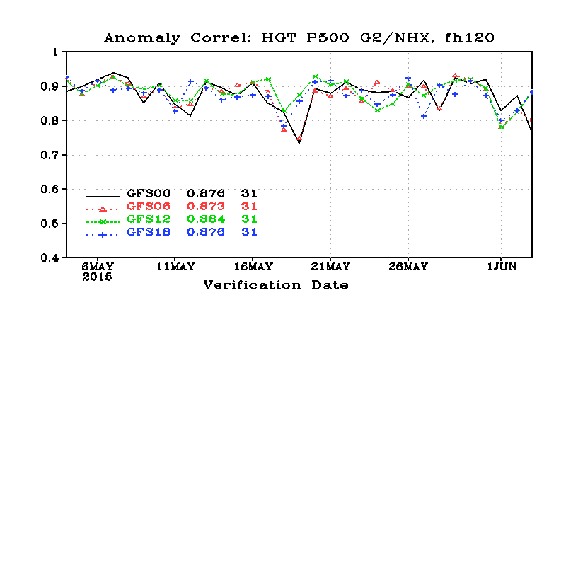
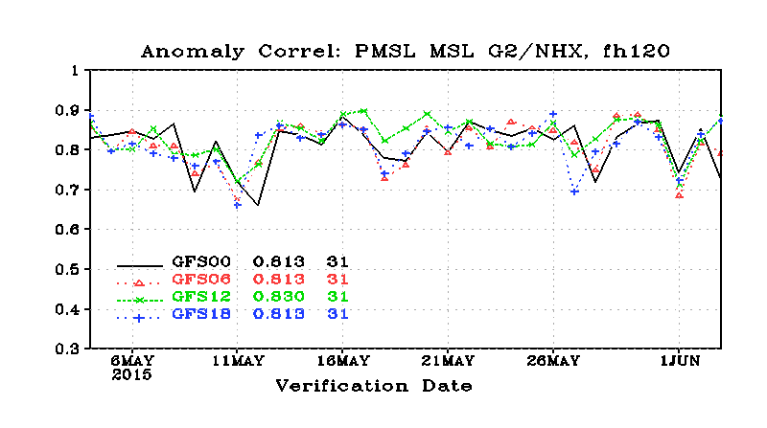
5 days

Slide 36
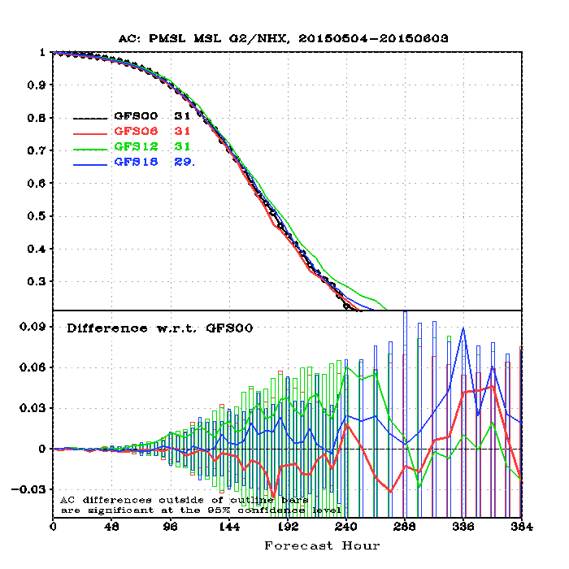

Slide 37
Another reason for little difference, we do mesoscale initialization with RAP, which uses all data sources EVERY HOUR
Of course, since 06Z run starts six hours earlier, it will have slightly less skill at the same time in the future.

Slide 38
We have run and verified several 06 starts

Slide 40
06 skill
Generally between 00 and 12 UTC initialization
Looks like 12 UTC does slightly better with low clouds (subjective)

Slide 41
Proposal?
Run full model system at 06 and 18 UTC
Add non-4/3 km runs at 00 and 12 UTC?
Would be a lot of graphics and more files to store.

Slide 42
The End

