Slide 1
Consortium Meeting
Cliff Mass, University of Washington
Feb 1, 2018

Slide 2
High-Resolution (4-km) Ensemble is Operational
16 members
10 members are randomly selected by the GFS ensemble (GEFS)
6 members are from major national systems
UKMET (UK)
CMC (Canada)
JMA (Japan)
GASP (Australian)
TCWD (Taiwan)
NGPS (Navy)

Slide 3
High-Resolution Ensemble
Just for 0000 UTC cycle
Runs after high-resolution WRF is done.
Is done before high-resolution WRF begins.
Runs for 72 hr.
A variety of graphics have been created.
Very open to new graphics or changes.

Slide 11
Suggestion
It is very useful to compare the high-resolution run with the ensembles to see if it is an outlier.

Slide 12
Caution: More Resolution Can Make the Real-time an outlier, when its synoptic evolution is the same

Slide 13
Comments or Suggestions? New products/graphics?

Slide 14
Hit Stats

Slide 15
When do folks look at our graphics?

Slide 16
Big Improvement in March
New server room in department
Upgrade of bandwidth: 10 times more (from 1 to 10 GBs⁻¹)
Occasionally we bog down when there are too many requests (e.g., snowstorm, windstorm)

Slide 17
Some other activities for Dave
Diagnosing more problems with n60 (a node on the sage cluster, ongoing)
Running some past cases for Ranil at Ecology
Fixing the on_the_fly plots

Slide 18
High Resolution Modeling and Wildfires
The last summer wildfires have been widespread and have had huge impacts on air quality throughout the West Coast.
Mesoscale model forecasts have been stunningly good.
It is apparent that there is a new world of enhanced AQ and wildfire forecasting possible.

Slide 19
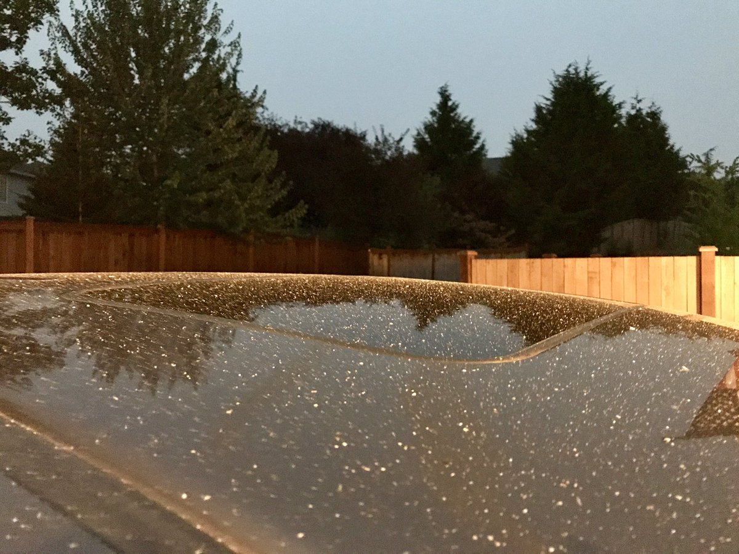
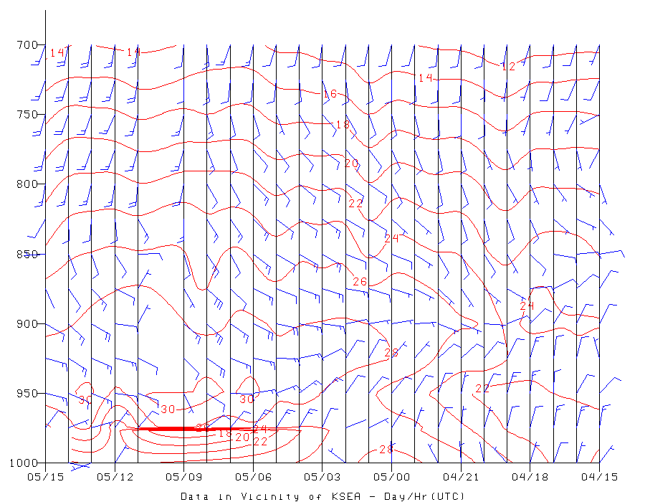
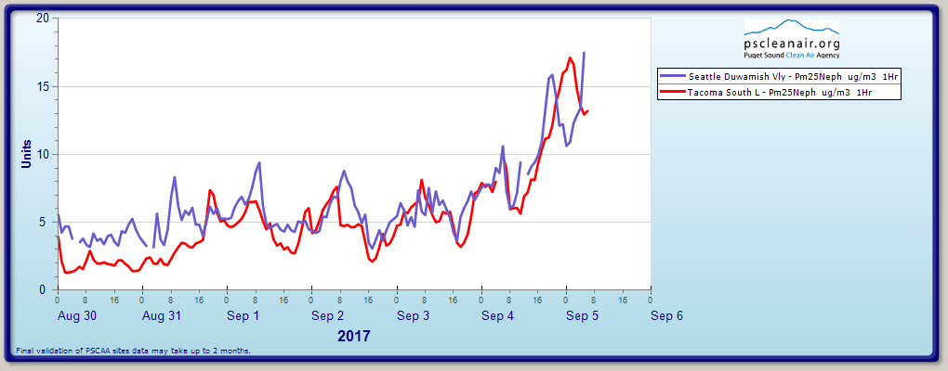
WRF run of Sept. 4 showed the potential for ash and AQ degradation

Slide 20
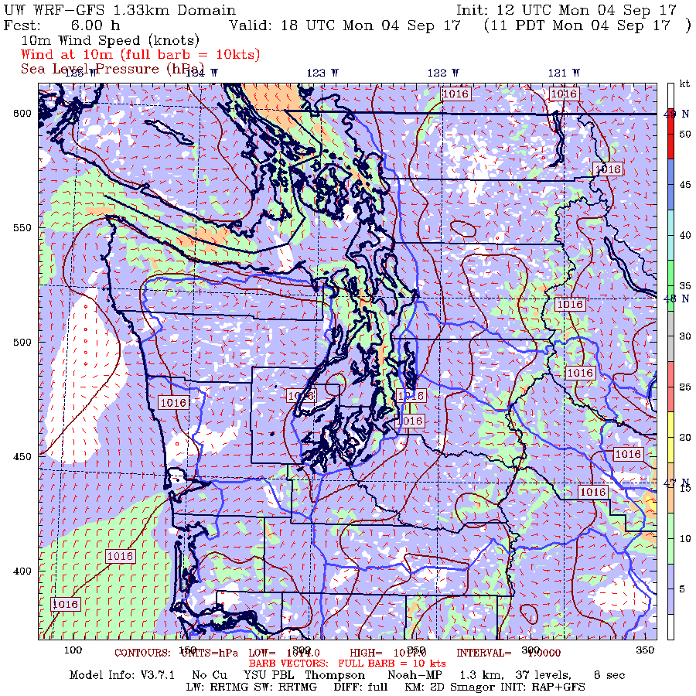

Slide 21
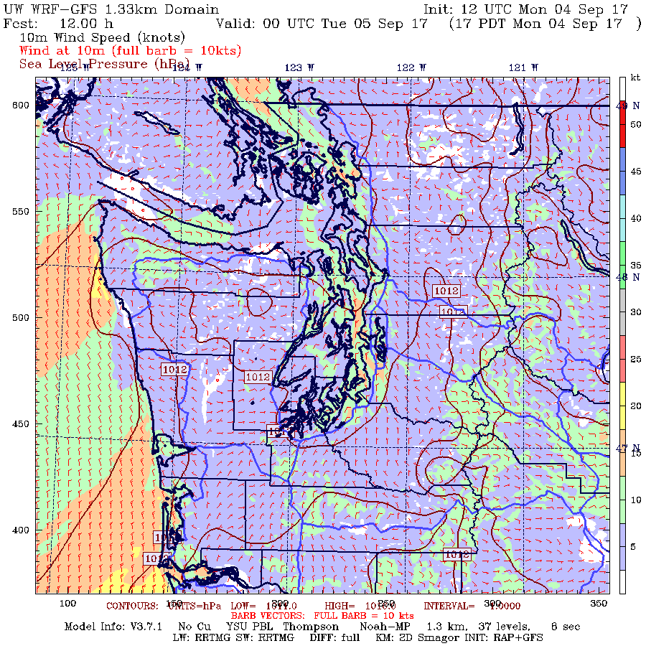

Slide 22
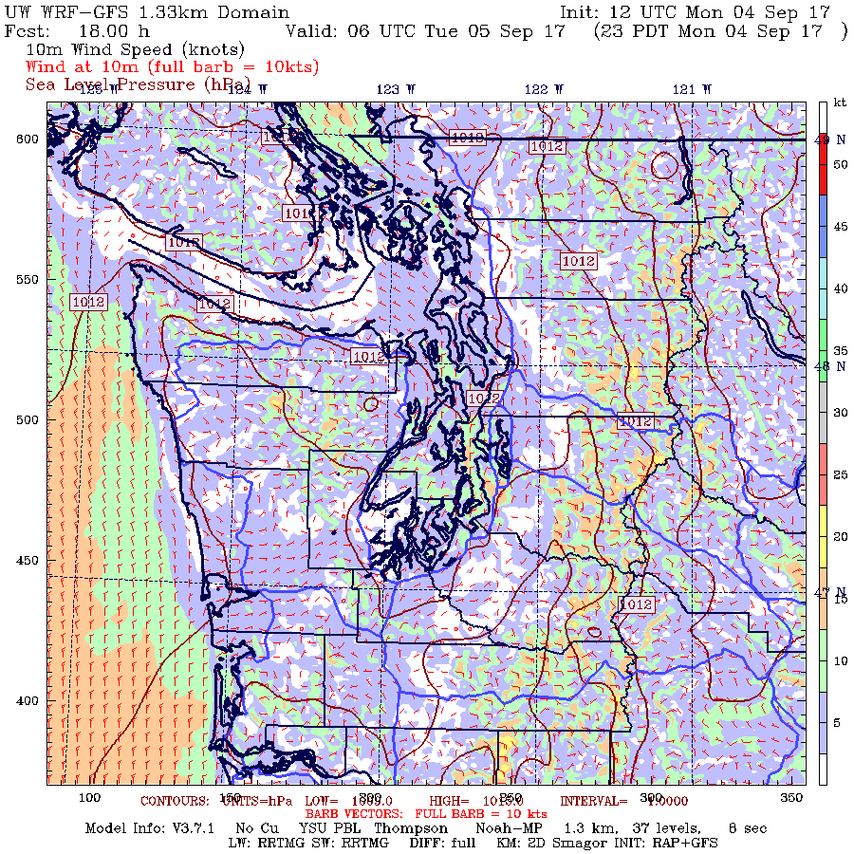

Slide 23
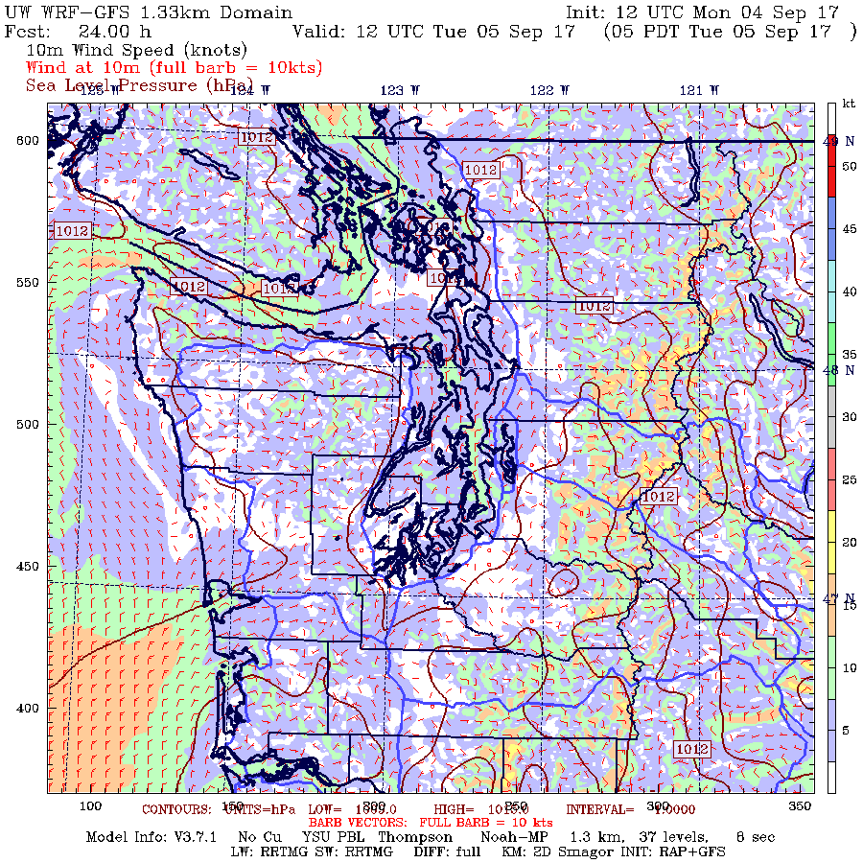

Slide 24
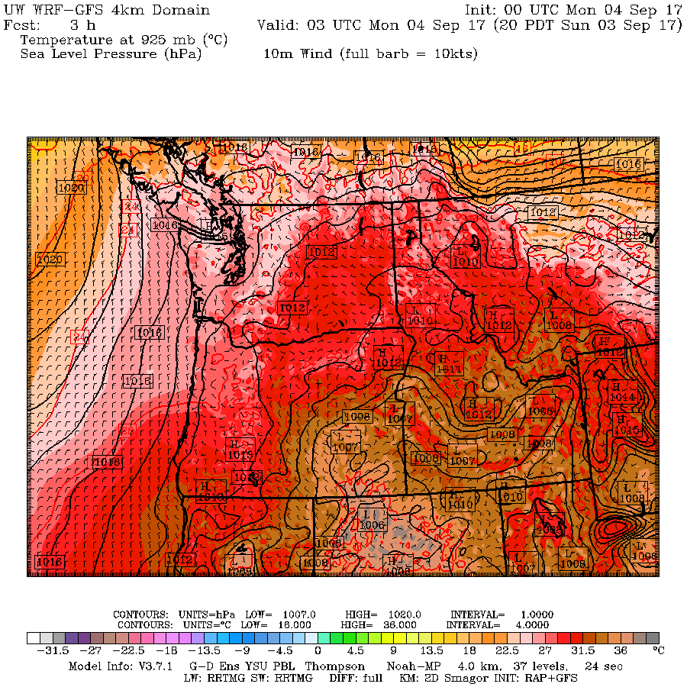

Slide 25
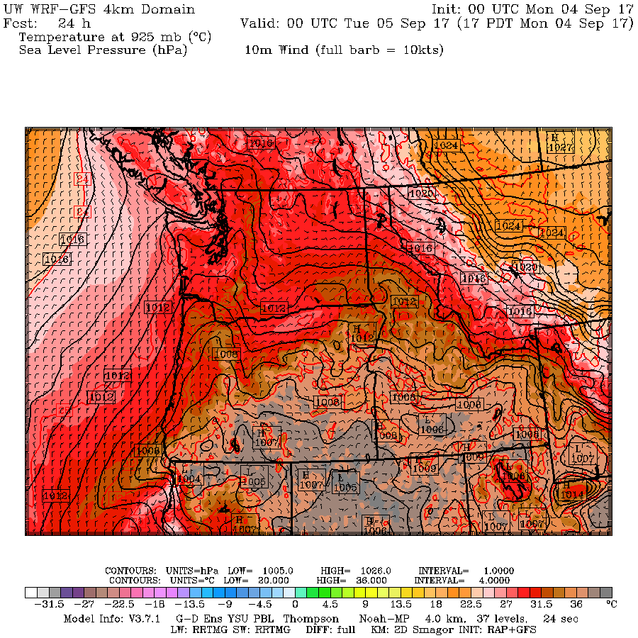

Slide 26
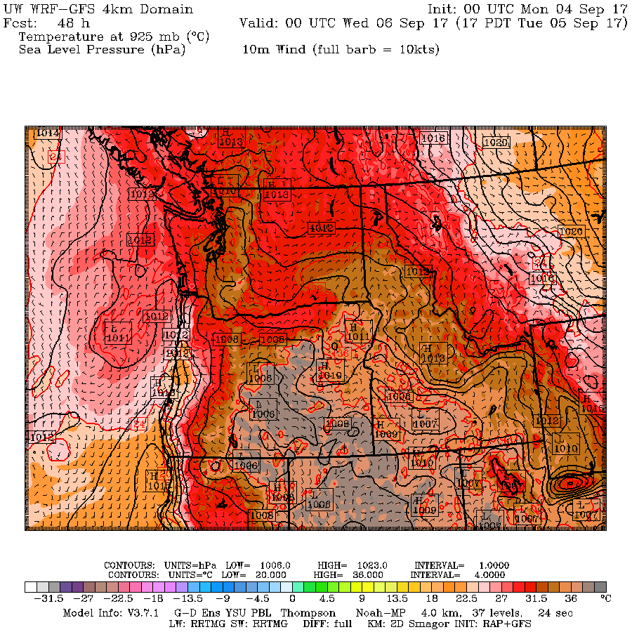

Slide 27
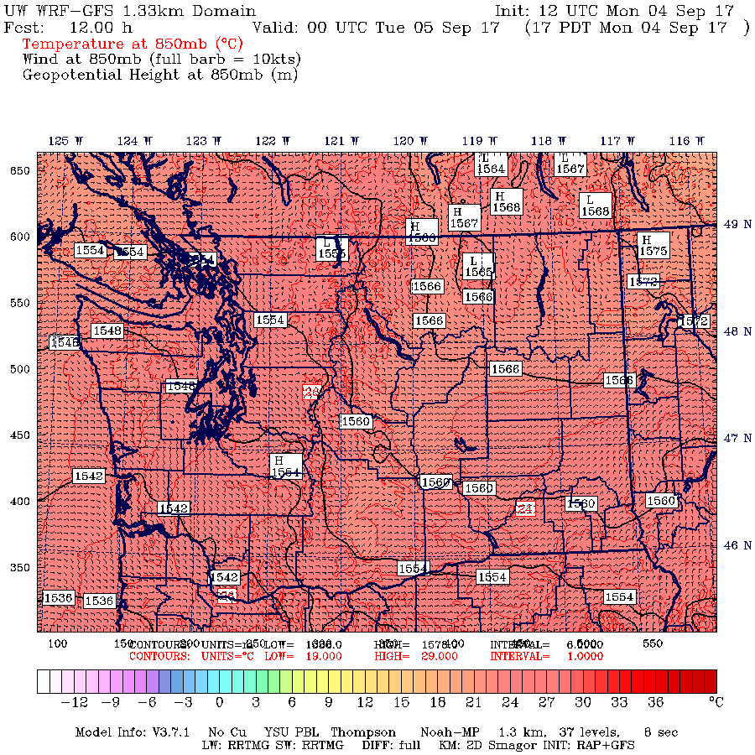

Slide 28
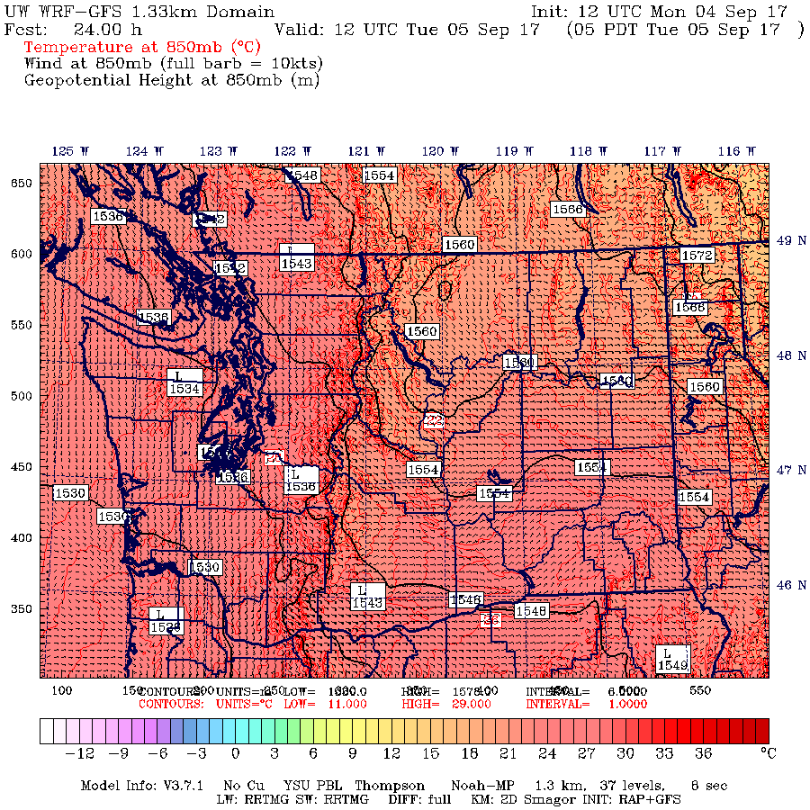

Slide 29
An Example of Great Success: the Northern California Wildfire on Oct 8/9 2017

Slide 30
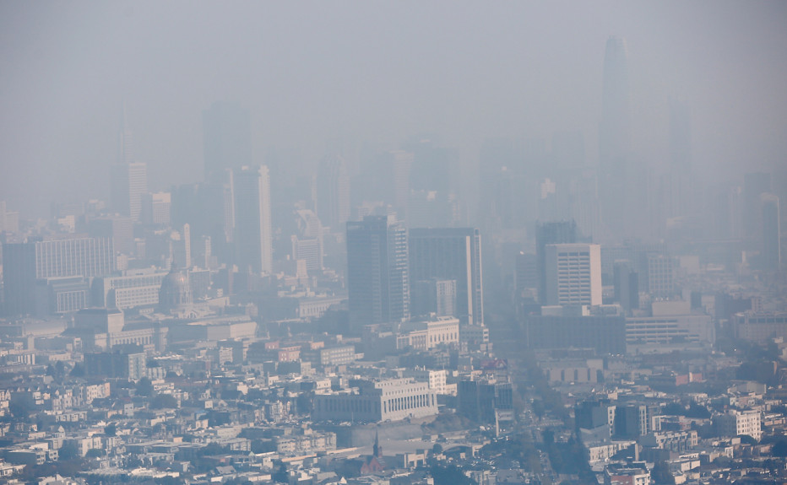
Serious Air Quality Impacts
Many Bay Area AQ sites had their worst air quality on record
Air quality declined to extremely unhealthy levels for millions of people
Remained unhealthy for days.
Sickened thousands of people.
Hundreds of people ended up in Bay Area hospitals from the effects of smoke

Slide 31
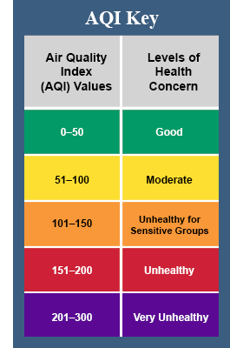
October 10

Slide 32
October 13

Slide 33
Daily View Bad air quality last days

Slide 34
Max Gusts During the Event (knots): Big spatial variation with strongest winds (60-95 knots) on lee (SW) slopes of terrain

Slide 35
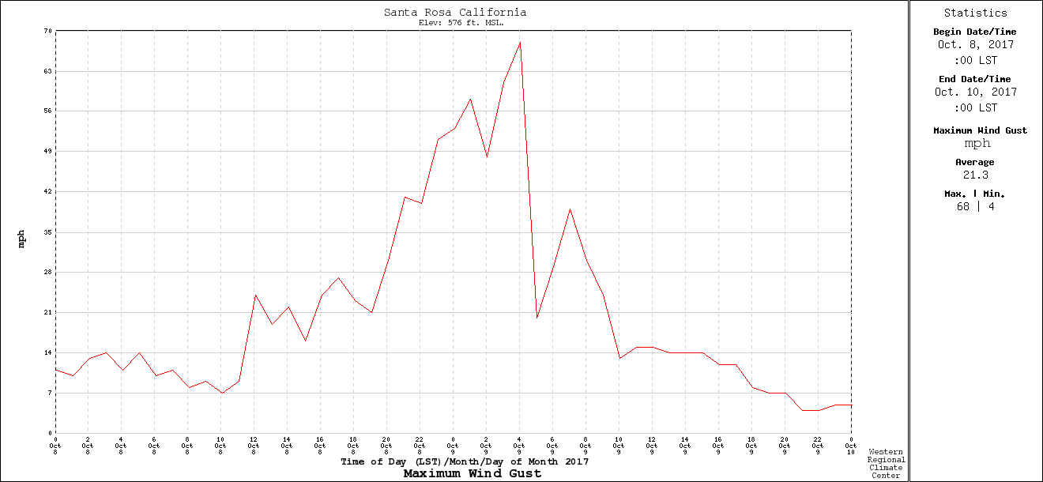
Temporal Variation: Rapid Increase and Decline
Santa Rosa RAWS
9 PM
PDT
midnite
6AM

Slide 36
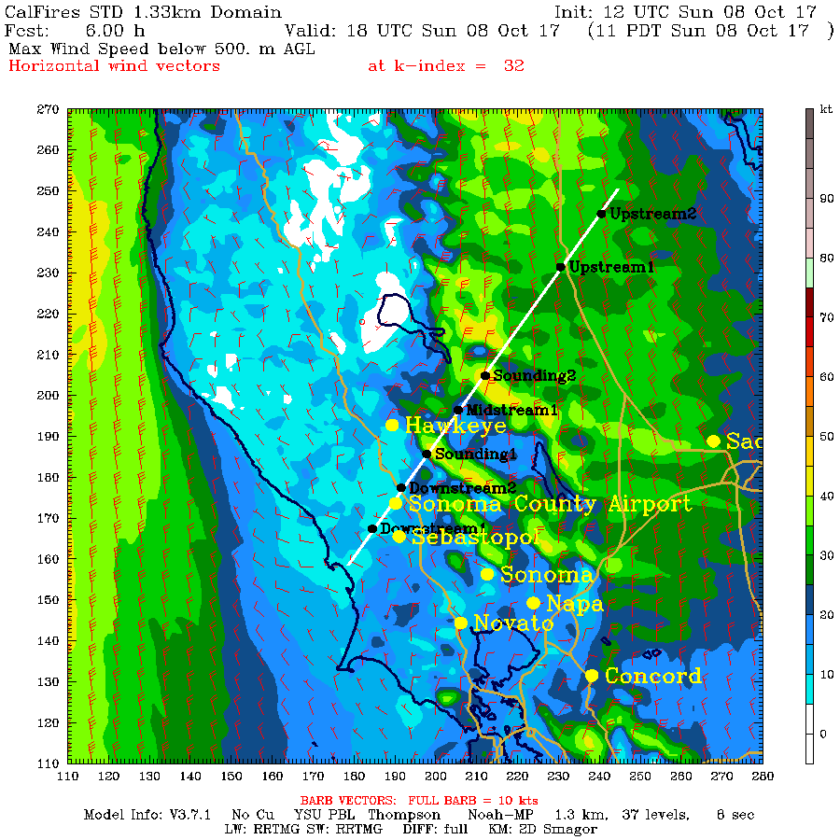

Slide 37
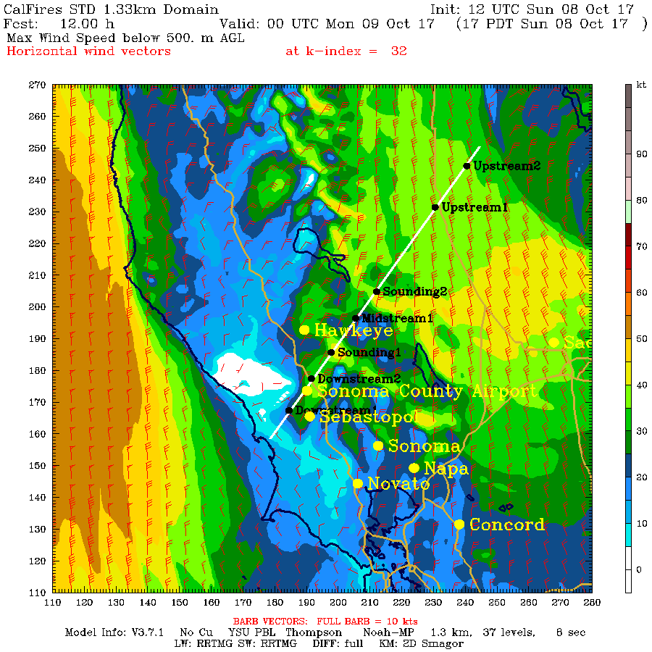

Slide 38
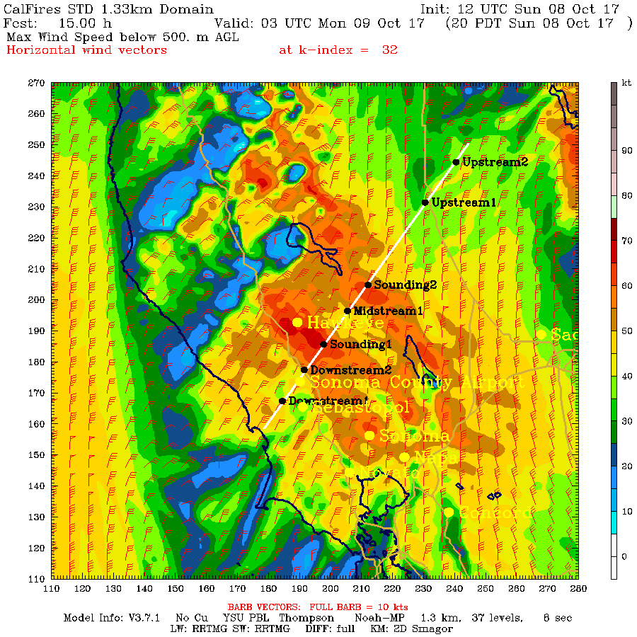

Slide 39
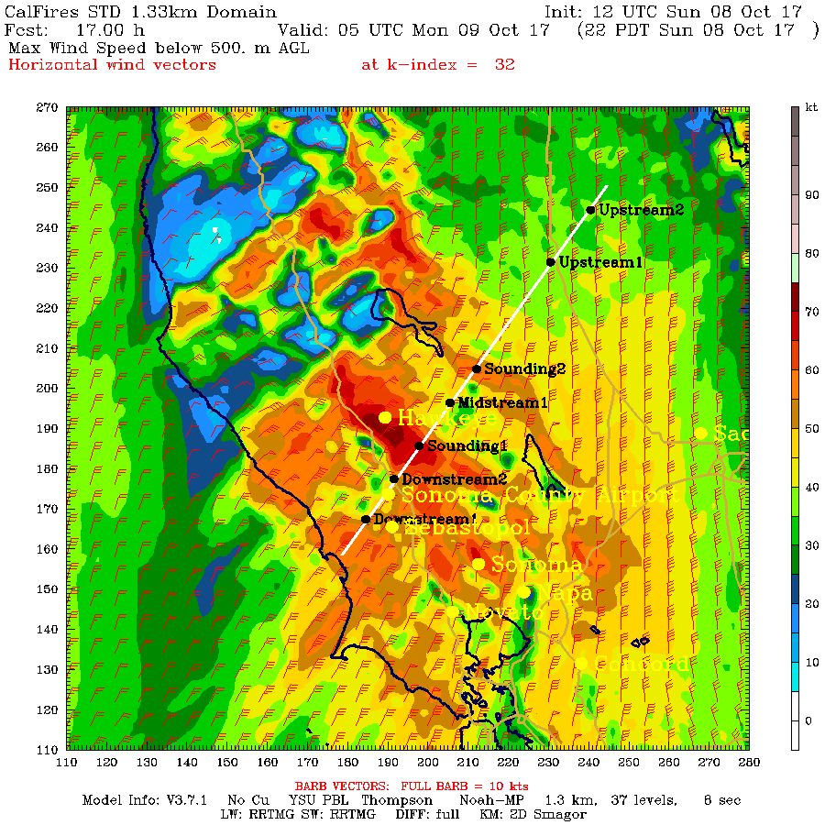

Slide 40
The end

